Slide 1

Functions

Slide 2
http://www2.warwick.ac.uk/fac/sci/moac/degrees/modules/tutorial/matlab

Slide 3
Review
Script files
  Run a list of commands
Flow Control
  If, for, while, etc

Slide 4
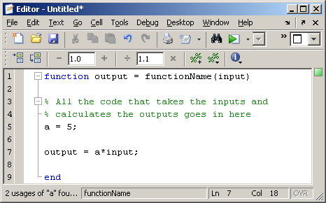
Functions
  All variables are local variables

Slide 5
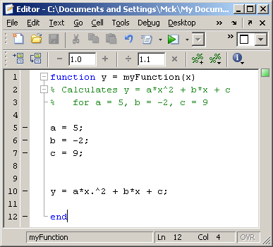
Example

Slide 6
Fibonacci Sequence
Write a function that calculates the n^{th} number in the Fibonacci Sequence

Slide 7
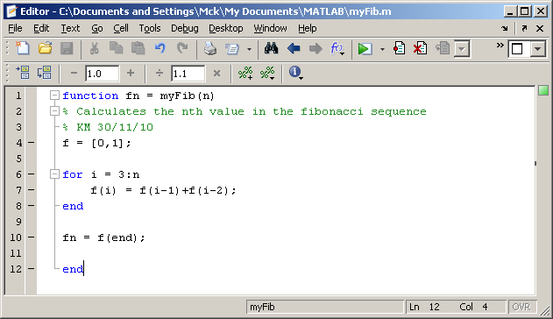
My solution

Slide 8
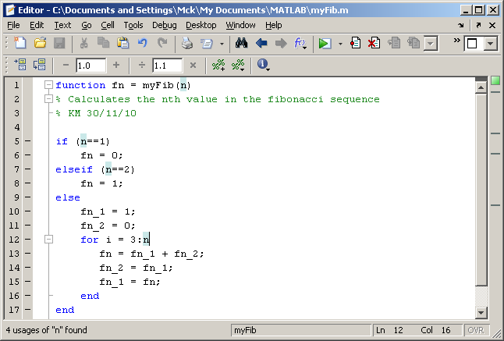
or

Slide 9
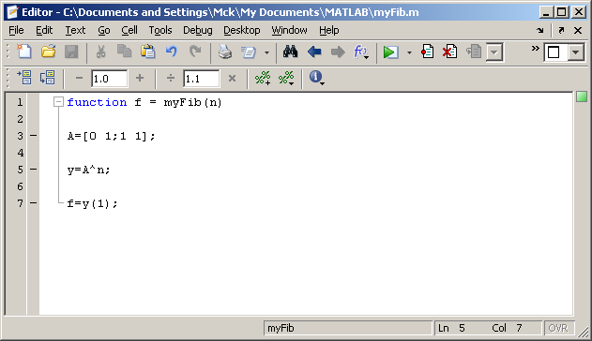
or

Slide 10
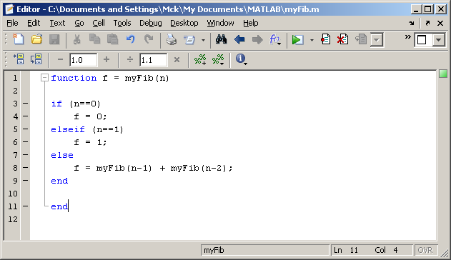
or

Slide 11
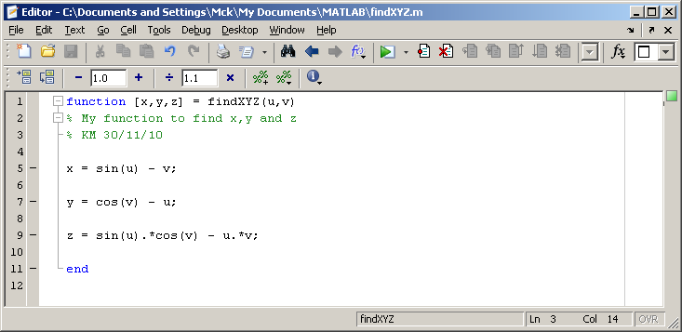
Multiple inputs and outputs
Comments + good layout make things easier to read, correct, use and re-use.

Slide 12
Rooting finding
Write a function that solves
For real roots, otherwise displays an error.
Also creates a plot of this function.
And displays the real roots.

Slide 13
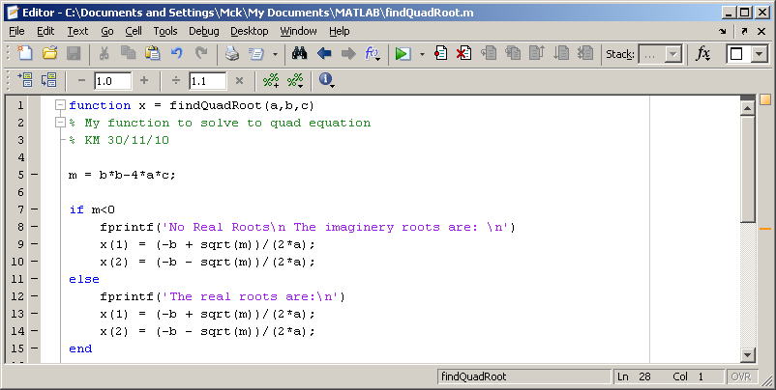
My Solution

Slide 14
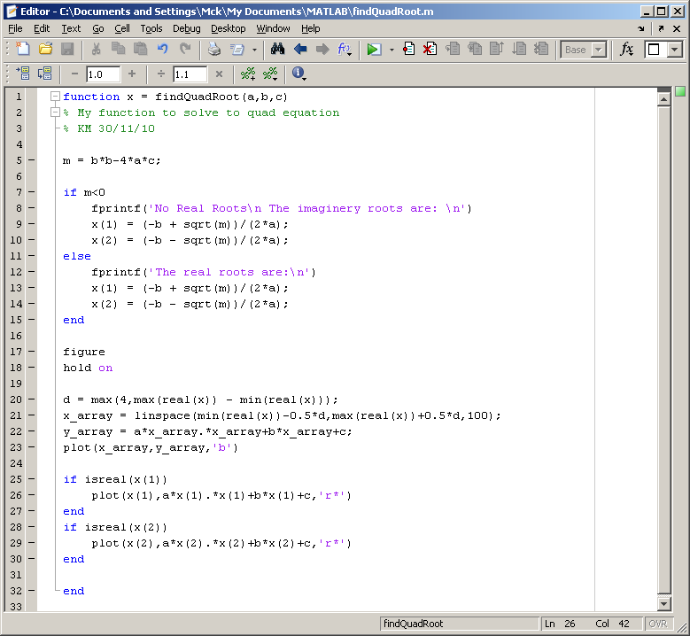

Slide 15
What is the difference between a script and a m-file?

Slide 16
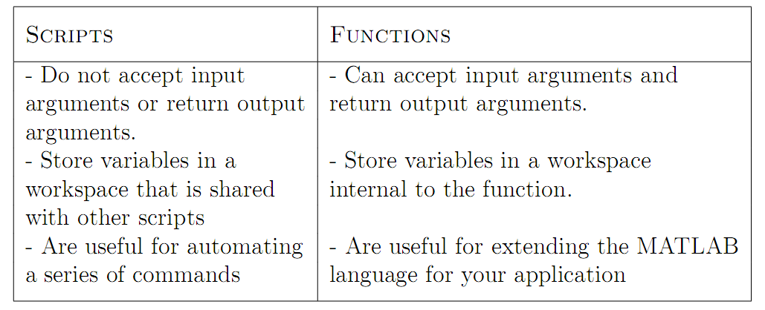

Slide 17
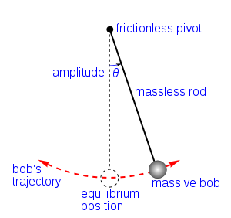
Pendulum Simulation

Slide 18
Inputs:
  Length of pendulum
  Starting pendulum angle
Hints:
  To start just draw the pendulum in its starting position
  Use Euler rule

Slide 19
