Slide 1
Scientific Computing RTP
warwick.ac.uk/scrtp
We provide expert advice, professional support and state of the art facilities for researchers solving science and engineering problems with computational methods.
Dr Philip Grylls
Senior Research Software Engineer,
SC RTP

Slide 2

Who are we?
Academic Director: Prof. David Quigley
Facilities Manager: Dr Miguel Oliveira
Senior Linux Systems Administrators: Magnus Lewis-Smith (desktop), Jaroslaw Zachwieja (storage)
HPC Systems Administrator: Phill Harvey-Smith (taskfarm)
Senior HPC Infrastructure Engineers: Abhishek Kamble
Chris Hall
Research Software Specialist: Dr Tanmoy Chakraborty
Senior Research Software Engineers: Dr Chris Brady,
Dr Heather Ratcliffe
Dr Pip Grylls
New RSE starting Nov…

Slide 3
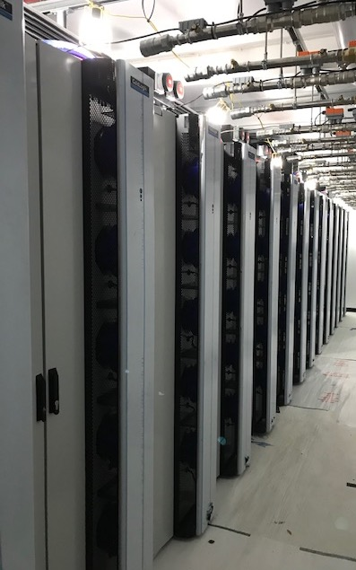
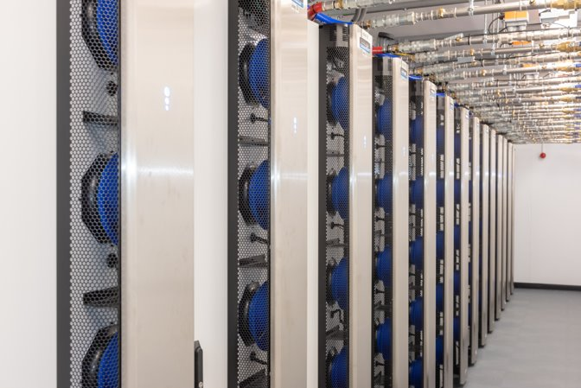
SCRTP Facilities
Desktop Linux, taskfarm and storage
High Performance Computing – Avon & Blythe
Sulis tier 2 HPC service
- For problems bigger than your laptop/workstation
warwick.ac.uk/scrtp/desktop/
- For the most computationally intensive problems
warwick.ac.uk/scrtp/hpc/
- For high throughput and ensemble compute
sulis.ac.uk

Slide 4
Research Software Engineering
Research Software Engineering (RSE) is about acknowledging the link between software and research.
Research Software Engineers (RSEs) are specialists in software engineering but have a research background.
The SCRTP have 4 research software engineers:
  Dr Christopher Brady
  Dr Heather Ratcliffe
  Dr Philip Grylls
  Starting November
We can be contacted at resource.rse@warwick.ac.uk
more info at warwick.ac.uk/rse.

Slide 5
General Support
On an ad-hoc basis we have the following support mechanisms
  Research Computing Drop In
  SCRTP Facility support
  Software Engineering Training
  Advice on Software Design/Language Selection/ Hardware Spec
Academic Collaboration
We can work with you over a longer period, to provide the following and more:
  Optimisation
  Workflow Development
  Code Review
  Specialist software development
If you want a % of a seconded RSE then get in touch before applying for a grant so we can help with the application and ensure we have the necessary resources.

Slide 6

Support
Access
  warwick.ac.uk/scrtp/desktop/gettingstarted/
Documentation:
  Wiki, FAQs, user guides and online video tutorials:
    docs.scrtp.warwick.ac.uk/
    warwick.ac.uk/research/rtp/sc
Direct access to technical staff, via Bugzilla or Slack:
  bugzilla.csc.warwick.ac.uk
  scrtp-uow.slack.com
Drop-in sessions:
  SCRTP staff on hand to help with issues, answer questions etc.
  warwick.ac.uk/research/rtp/sc/user_support/research-computing-drop-in/
warwick.ac.uk/scrtp

