Slide 1
Final Year Projects
Safety Information
John Horsler

Slide 2
Laboratory work
Office work
Risk Assessment process
Risk assessment – worked example
Advice and Guidance
Notes:
Increased awareness of how to manage interaction with high hazard equipment, situation, processes
Ergonomics – back complaints, arm problems, headaches
Significant part of H&A is risk assessment, basic documentation
Explain the RA process
Point in the direction of where to find help

Slide 3
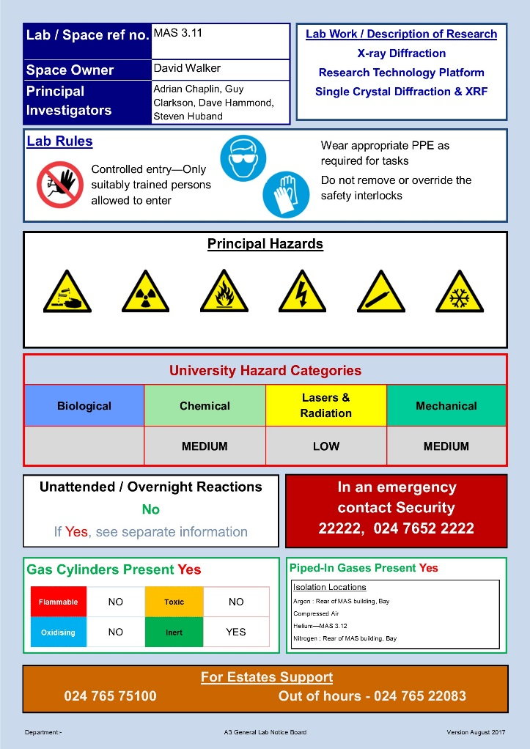
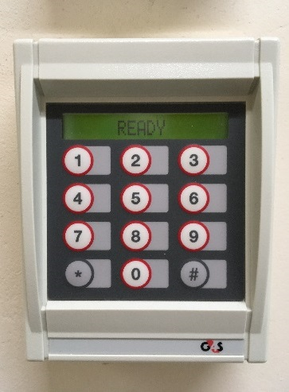
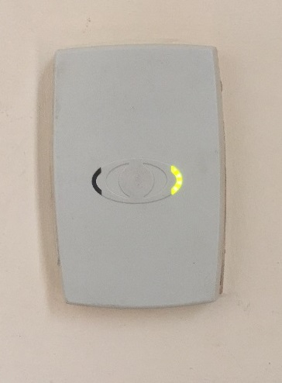
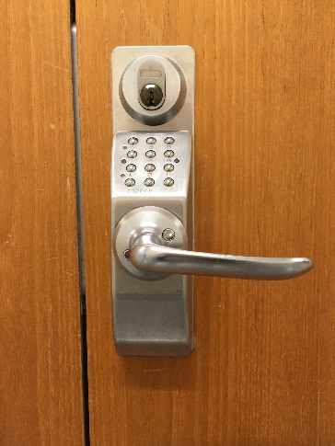
Lab Noticeboards
Laboratory Work
Restricted Access
Notes:
Hazards of a particular laboratory?
Lab Rules PPE requirements
Main hazards
Contact numbers for responsible persons
Mention secure labs – card access or numerical code. Only given access after induction training
(Xray, EM labs)

Slide 4





Laboratory Work
Electricity
Ionising Radiation
Lasers
Compressed gases
Cryogenic liquids
Notes:
TRAINING, TRAINING, TRAINING
Encounter more high hazard equipment, research spaces not teaching spaces
90% of all issues identified by visual inspection, damaged cables or casing
Ionising radiation – X-rays or Electron Microscopy, use as characterization tools
Lasers – ultrasound, spectroscopy, cutting tools, evaporating metals for deposition, different powers, access controls
Cylinder hazards, leaks, manual handling, fires
Cryogens – competent to use, Mr Woodward, Dr Howes, issues of asphyxiation

Slide 5





Laboratory Work
Chemicals
Understand the hazards and precautions
Safety data sheets
Labelling (name, identity, permanent)
Add to risk assessment
Notes:
Personal crusade – background as a chemist
Curious pricing :£10 for 10 g, £15 for 1 kg
Only order minimum quantities
Think lifetime costs – disposal expensive

Slide 6

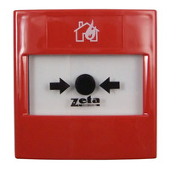

Laboratory Work
Familiarise yourself with your laboratory and its environment (“What do I do if…..)
Find out about safety devices and procedures
Ask staff to explain anything which is unfamiliar or unusual.
Notes:
Ask yourself a few questions…
What do I do if I spill chemicals?
Where is the nearest emergency shower?
Where are the fire extinguishers?
Who is the nearest first aider and where do I find them?
Do not rely on others to know these things.
You have a responsibility for your own safety.

Slide 7
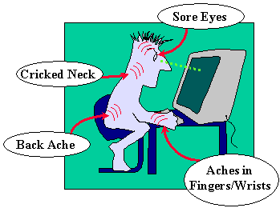
Office Work
Long periods in front of a display screen.
Stress on your body
H&S web pages
Contact me!
Notes:
Repetitive strain injury
Carpal tunnel syndrome - wrists
Shoulder pain
Back pain Alternating mouse use
Trackball Penguins (vertical mouse)
Take regular breaks (45 minutes)

Slide 8

The most important piece of advice for any aspect of Health & Safety…
Notes:
Don’t just struggle on
“Go home healthy” HSE campaign
Don’t be proud be safe

Slide 9
Risk Assessment process
Definitions
Hazard
The harm which might be caused by a task or event
Risk
The combination of the likelihood of the occurrence of a hazard and its severity
Risk Assessment
A formal evaluation of the risks associated with a process and their reduction
Notes:
Superficial to extreme
Paper cut
Broken Arm
Eye injury by chemical spill or laser strike (potentially life-changing)
From Unlikely to highly likely

Slide 10
Risk Assessment process
Five Steps to Risk Assessment
1. Identify the hazards
2. Identify who might be harmed
3. Assess the risk and decide upon controls
4. Record the findings
5. Review and update
To reduce the risk to As Low As Reasonably Practicable (ALARP)
Notes:
Not zero risk
Practicalities to be considered
Written down

Slide 11
Risk Assessment process
Hierarchy of Controls
1. Elimination
2. Substitution
3. Engineering controls
4. Administrative controls
5. Personal Protective Equipment
Notes:
Engineering
Interlocks for rooms with class 3B or 4 lasers
Administrative
Safe systems of work, monitoring software, access controls
PPE
Gloves, goggles, safety boots

Slide 12
Risk Assessment Spreadsheet
Project risk assessment form 2018.xlsx
Moodle courses
PX402 : Due Friday week 2 (12/10/18), 6 p.m.
PX319 : Due Thursday week 3 (18/10/18), 6 p.m.
Notes:
The same spreadsheet for both courses
Different requirements about when they need to be submitted
Download from the course pages
Upload once completed
Fix up to date RA in your lab workbook

Slide 13
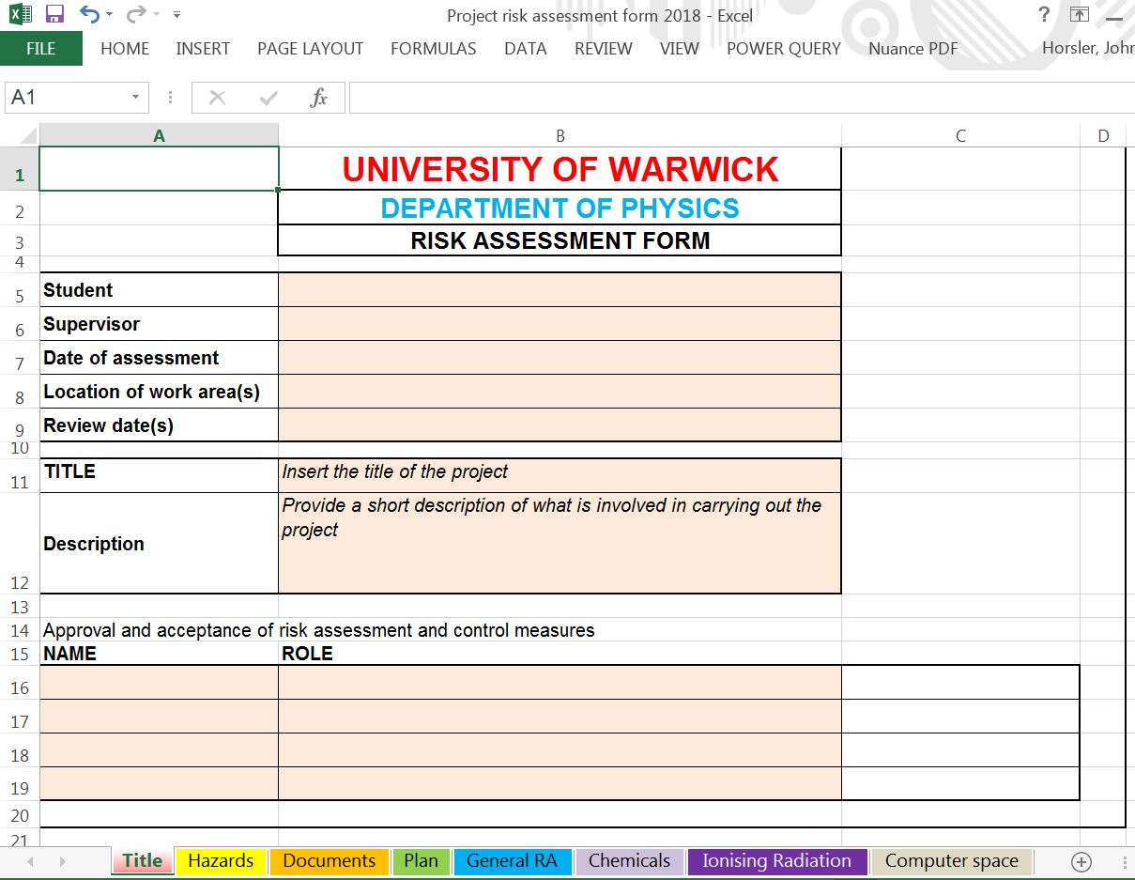
Title
Notes:
Basic information about your project

Slide 14
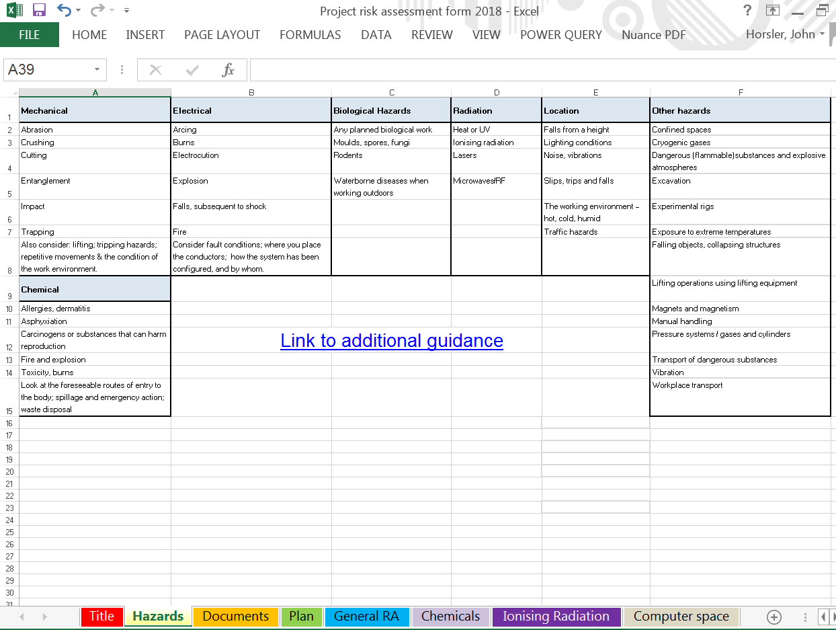
List of hazards
Notes:
Information pages – ideas, guidance
A range of hazards – not exhaustive, but useful to refer to when preparing your assessment
The link takes you to the H&S web pages on inSite

Slide 15
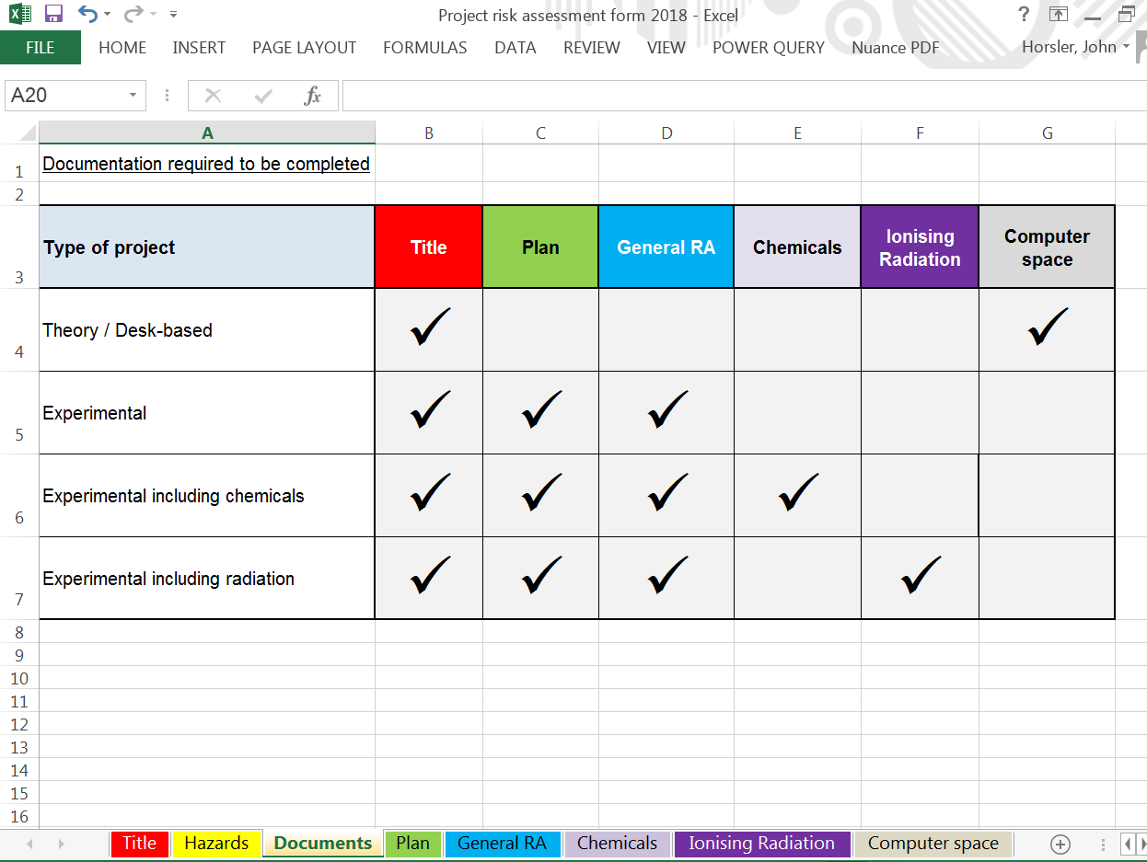
Documents
Notes:
Information showing which parts of the spreadsheet you need to complete:
Theory / Desk-based (2)
Ionising radiation (5)
When completed and reviewed, upload to Moodle

Slide 16
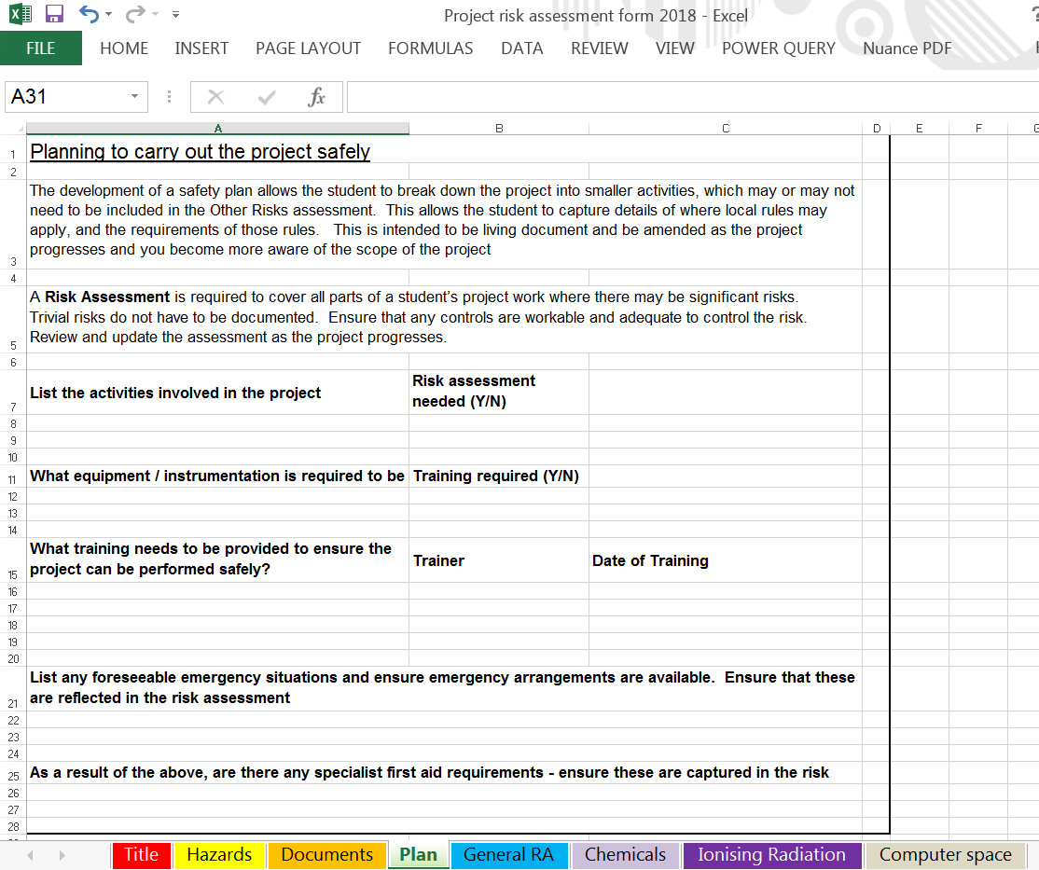
Plan
Notes:
Identifies things you need
By breaking it down you see needs more clearly
Chemicals - may need some protective equipment – Stores
Training needs
Use of a piece of research equipment
Handling cryogenic fluids
Specialist help

Slide 17
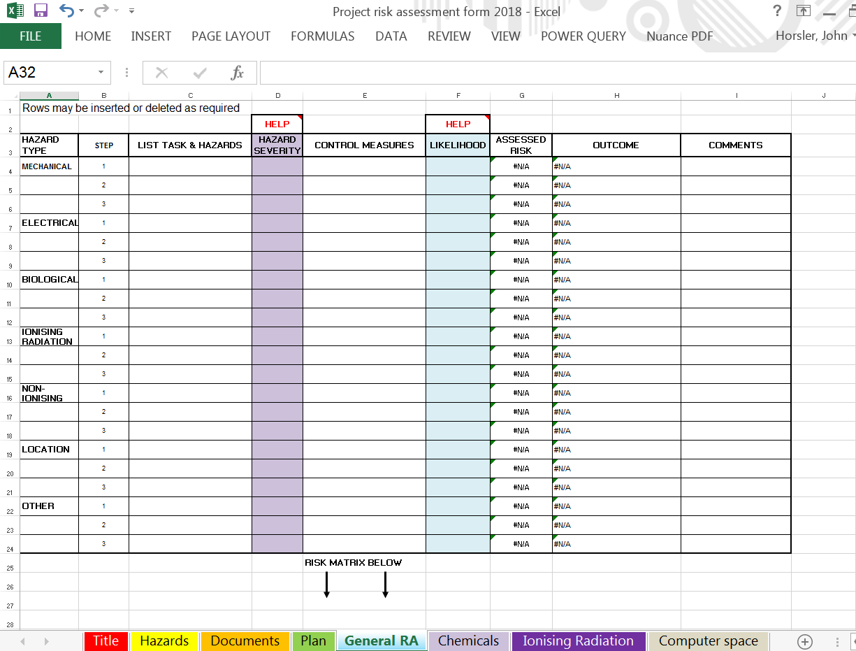
General RA (1 of 2)
Notes:
Risk Assessment except chemicals
Mechanical, Electrical, Personal, Biological, Radiation
More information in the worked example later

Slide 18
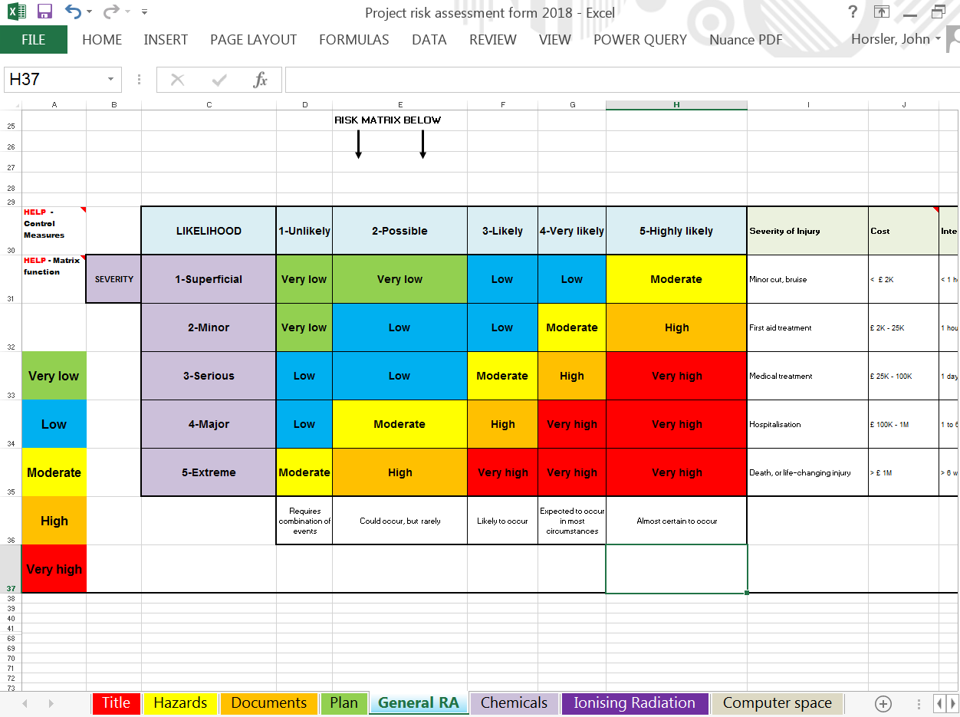
General RA (2 of 2)
Notes:
Scroll down to see Risk Matrix
Not an exact science, an assessment, not a measurement
Unlikely to Highly Likely
Superficial to Extreme

Slide 19
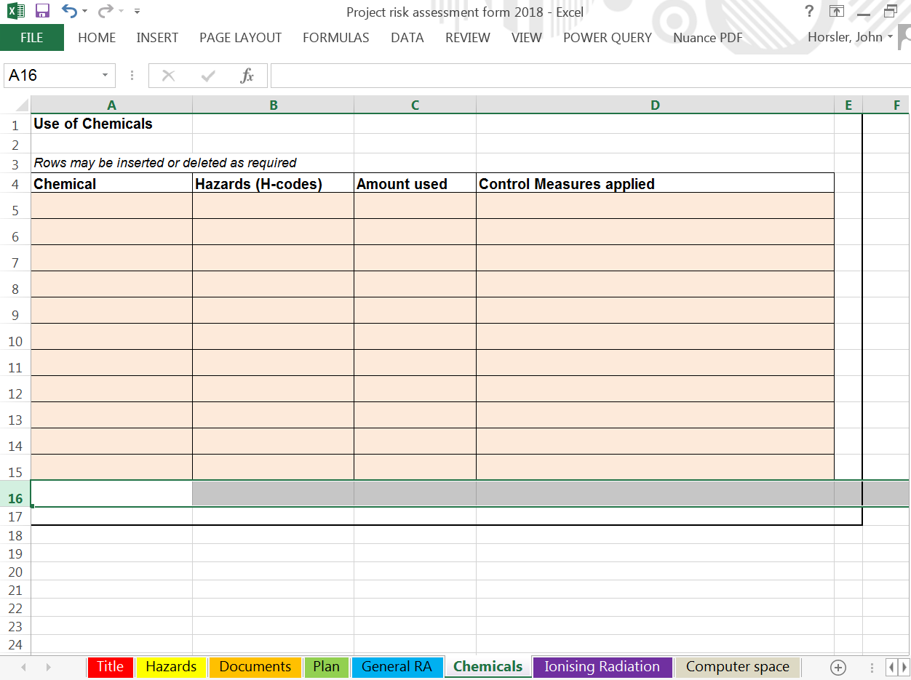
Chemicals
Notes:
Information from Safety Data Sheets
Manufacturer
Hazard statement
Precautionary statements
PPE required ?

Slide 20
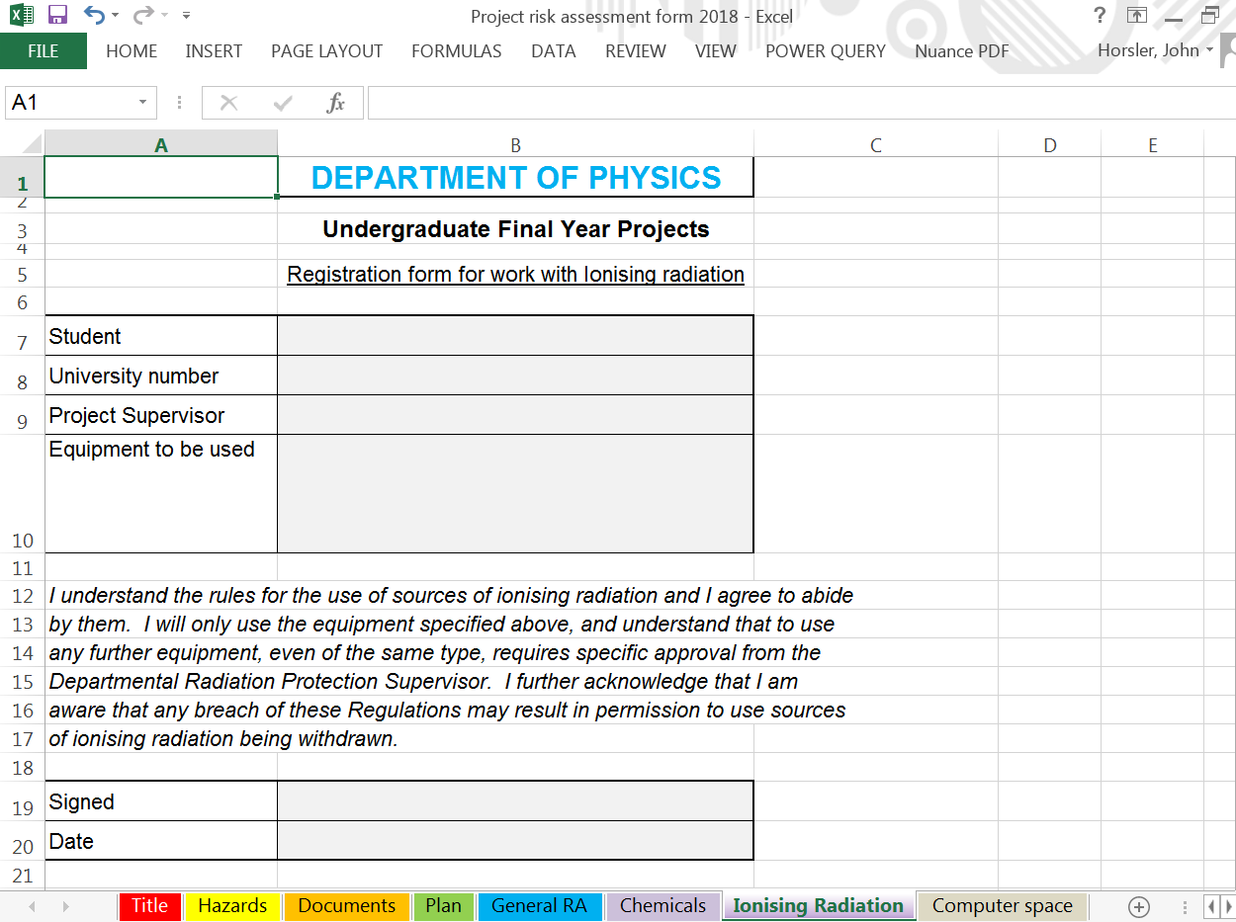
Ionising Radiation
Notes:
Needs to be printed out, completed and handed in to Dr Jon Duffy MAS room 4.03
If using X-rays or Electron Microscopy, either as the major part of project or as characterisation tools

Slide 21
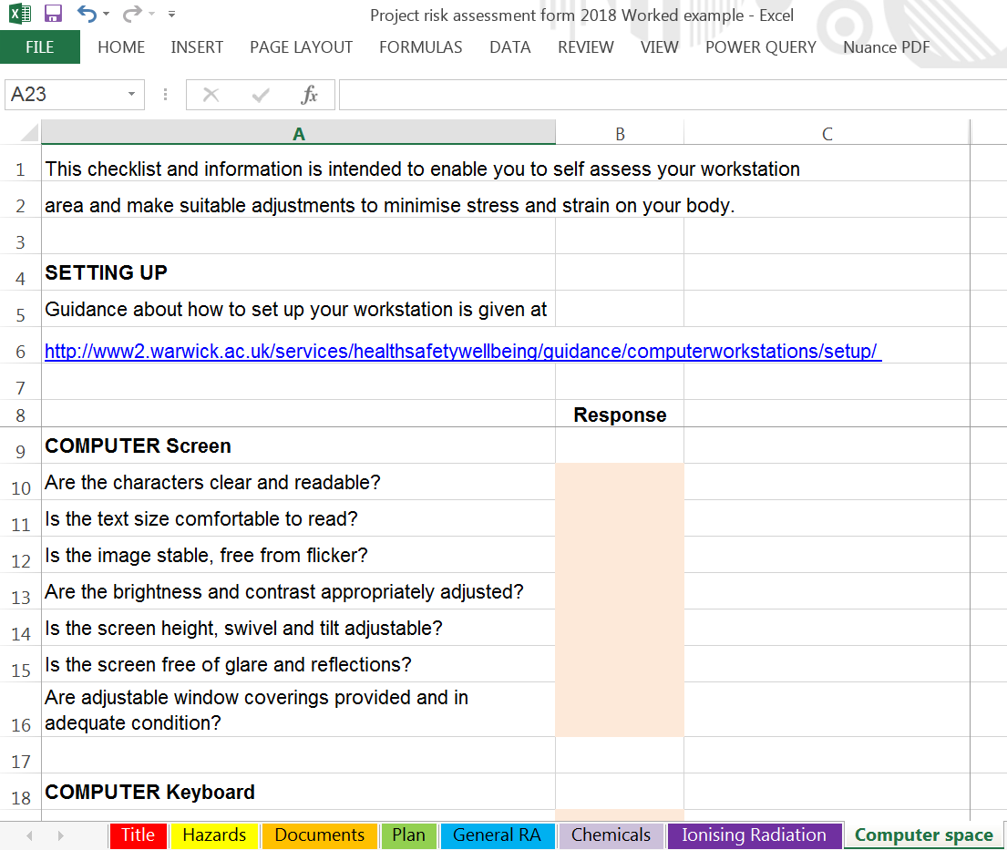
Computer Space
Notes:
Set of issues to do with your desk, chair, computer set up
Link to advice on H&S web pages

Slide 22
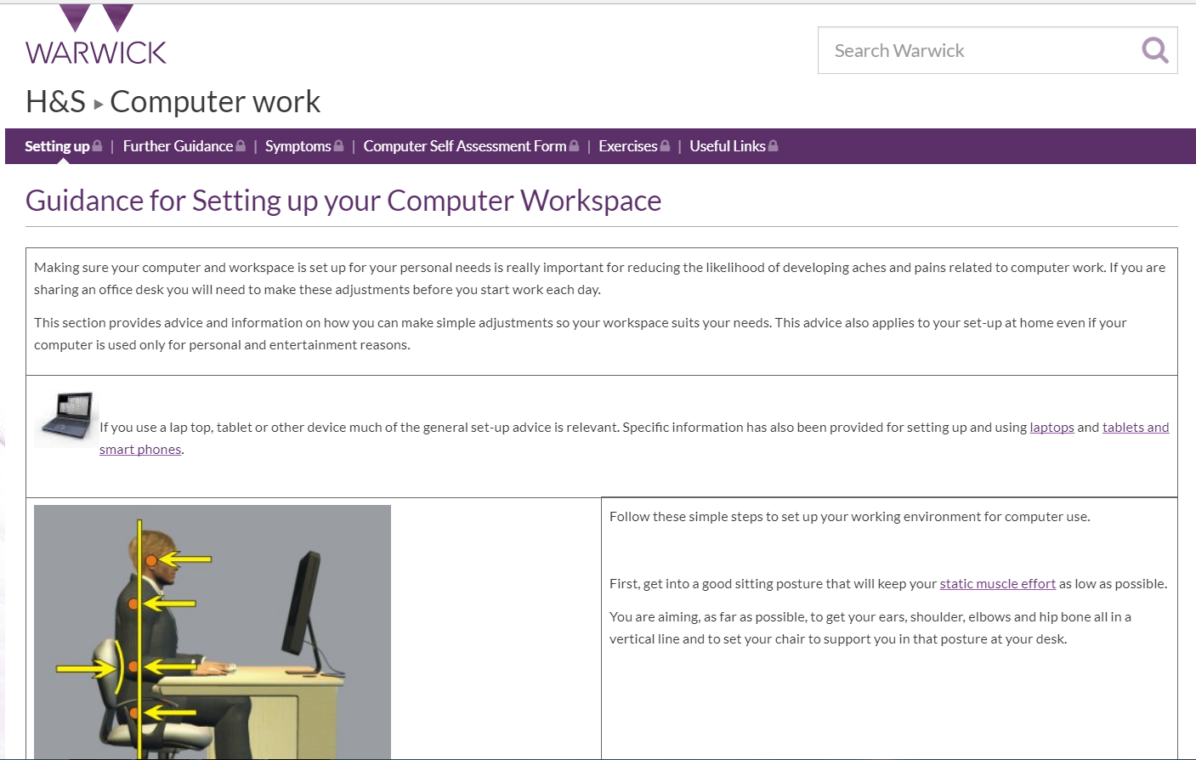
Computer Space - Link

Slide 23

Worked Example
Notes:
RA is something we all do every day
often without even being aware
Crossing a road
Bicycle versus heavy goods vehicle
Designers have done – saucepan handle

Slide 24
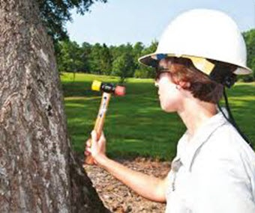
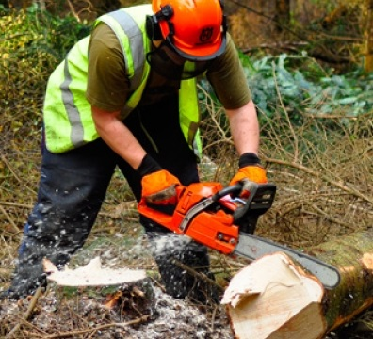
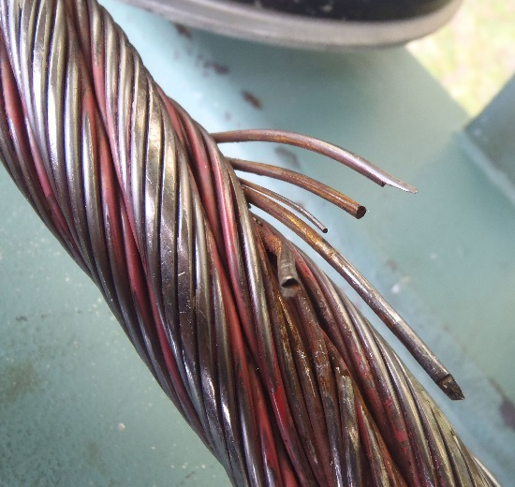
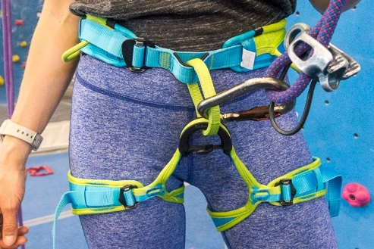




Control Measures
Notes:
Design
Building
Inspection
Harnesses
Training
Gloves
Access protection
Supervisor as whistle blower (observed competence)

Slide 25
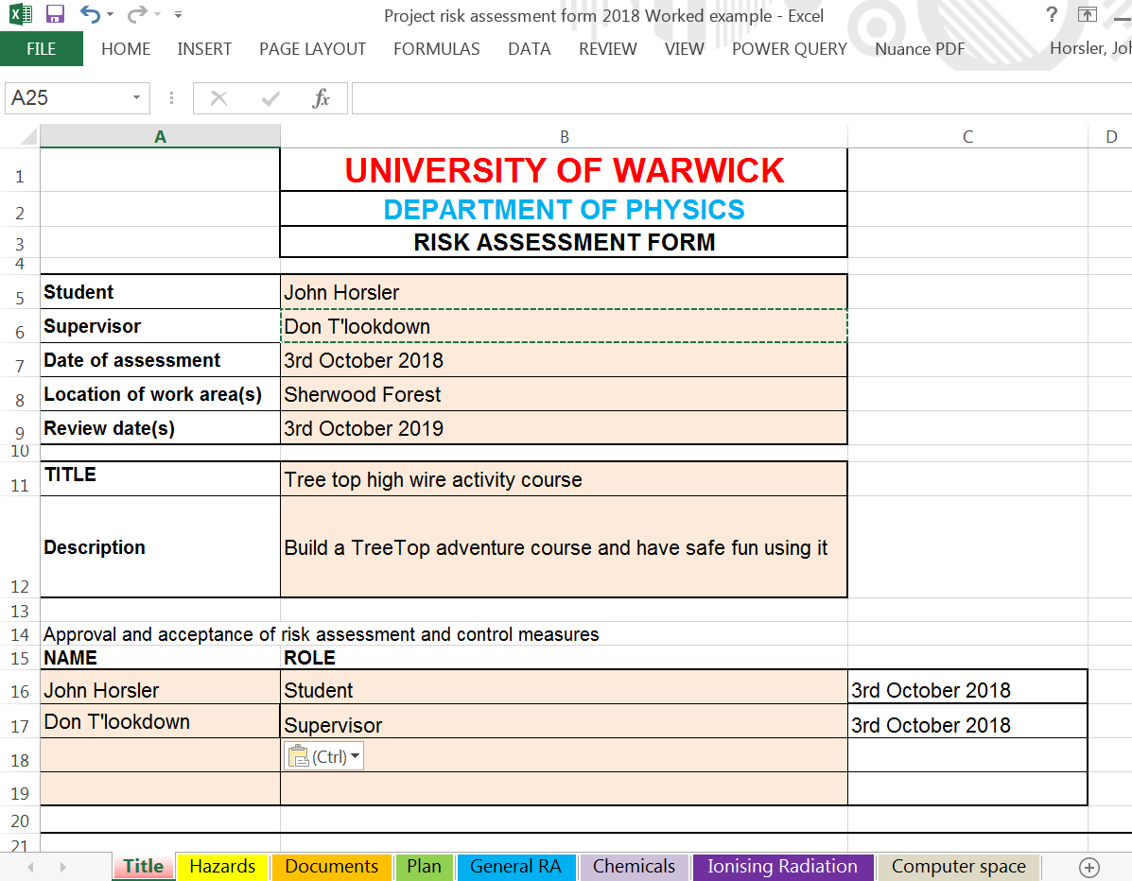
Worked Example - Title
Notes:
Reviewed and approved by your supervisor
I’ll also be looking at them

Slide 26
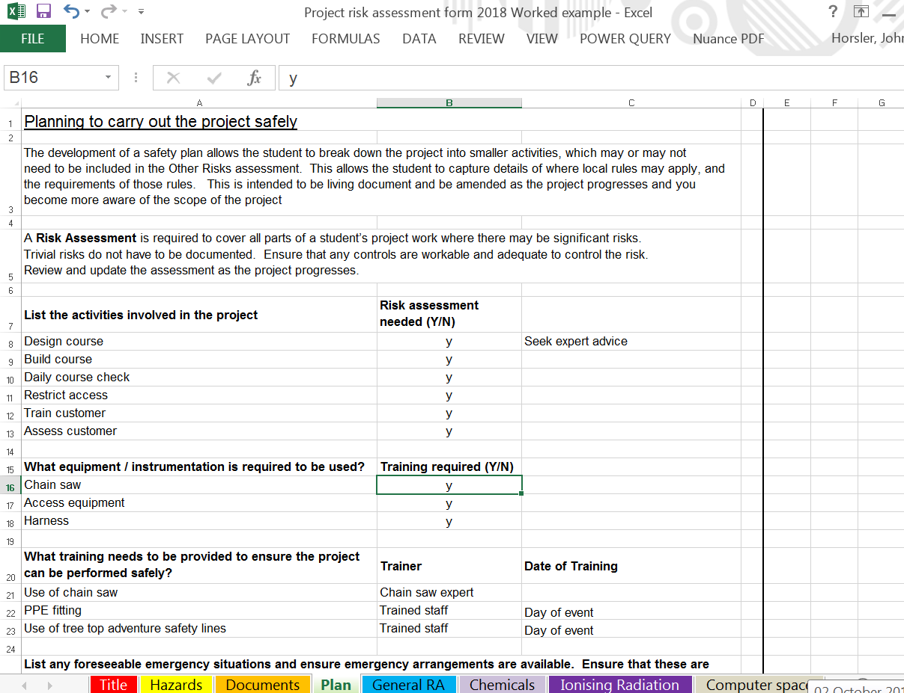
Plan
Notes:
Start with the plan, break it down into small pieces
Just list all of the steps, can always decide no hazard at later stage.
Training needed, where from (ask supervisor)
One-off task, might ask expert, repeat get trained
First aid – what might you need, where can I source it

Slide 27
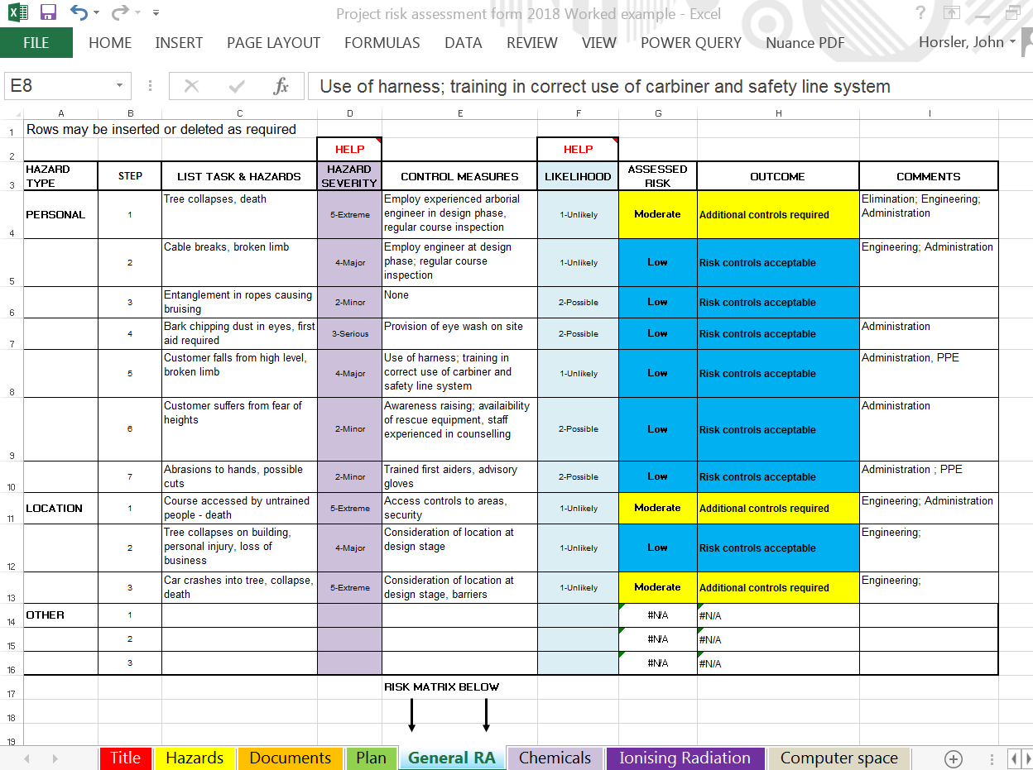
General RA
Notes:
Input data in Hazard Severity and Likelihood, get result in Assessed risk
Changes colour to reflect the matrix
Aiming for green or blue, sometimes yellow is OK (usually when Extreme)

Slide 28
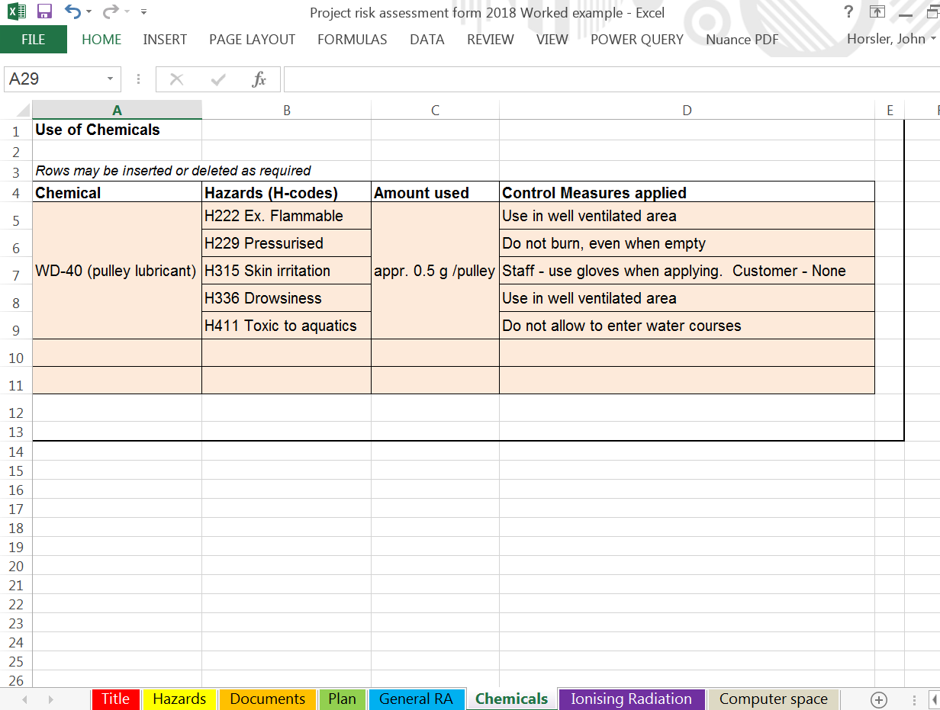
Chemicals
Notes:
Lubricating the pulleys, not an issue for customers but staff only

Slide 29
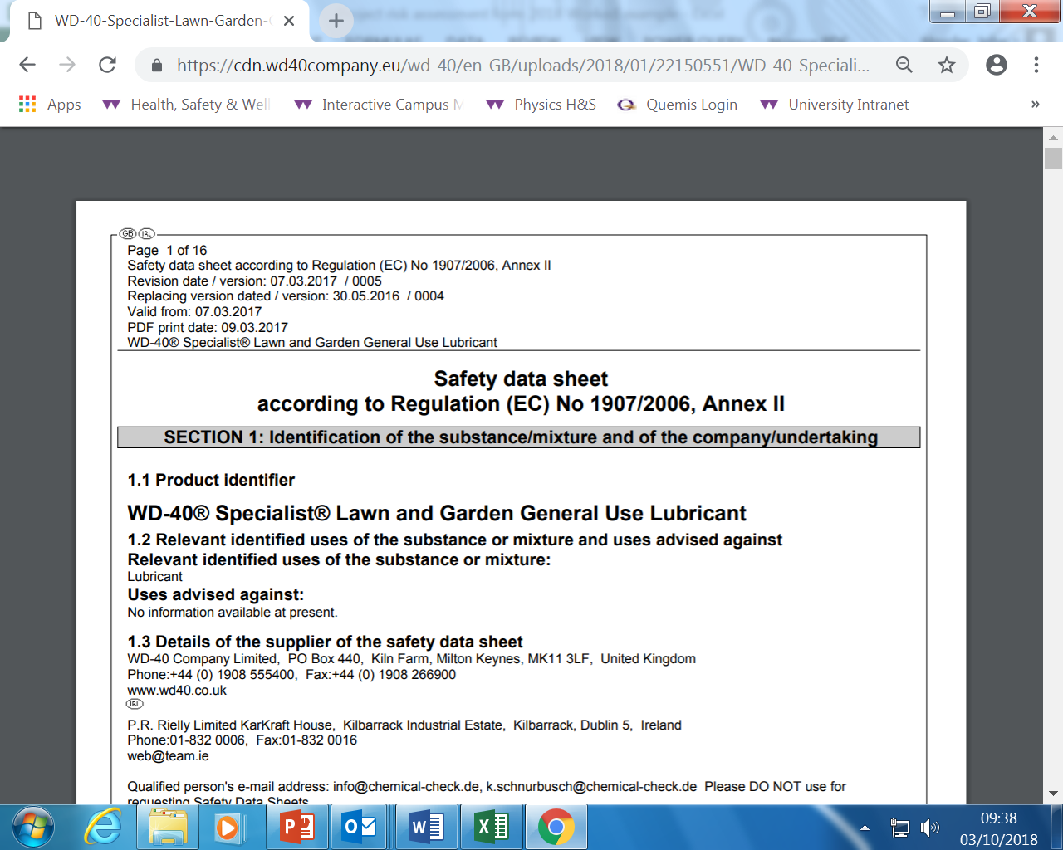
Chemicals – MSDS
Notes:
European regulations if possible
Other countries still provide information but may not be as obvious

Slide 30
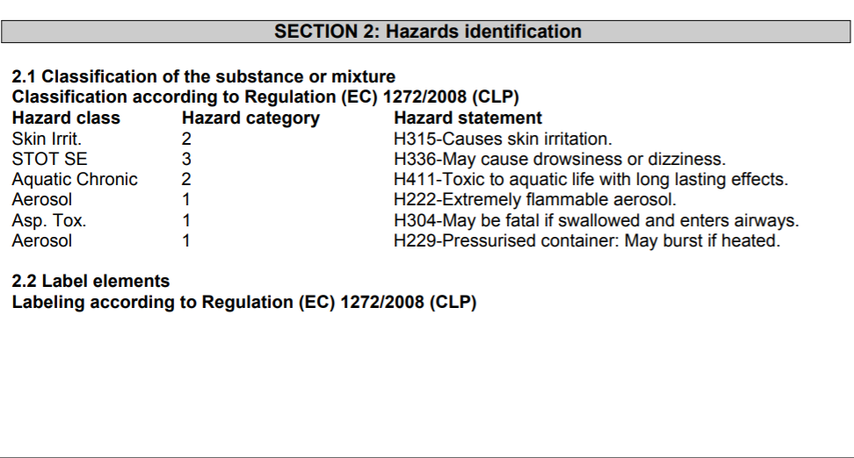
Chemicals MSDS
Notes:
European Design : Section 2
Hazard information, H-codes
People in Physics ordering chemicals, you have to input this information to Opera
Means of managing the safety before having the hazard on site

Slide 31
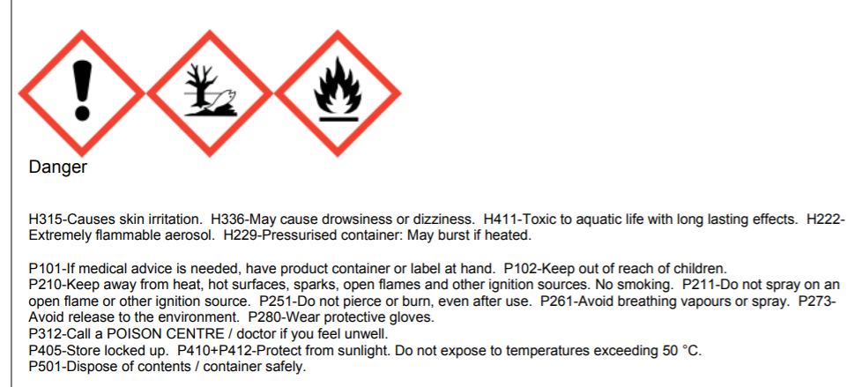
Chemicals MSDS
Notes:
Also in Section 2, P-statements or Precautionary codes, advise about how to deal with the hazards shown
Search “Safety Data Sheets” on inSite, the University web pages for more information about how to interpret.

Slide 32

Computer Space
Notes:
Link is in the H&S Information document, and on the Computer space page of the Project Risk assessment spreadsheet
Lots of information, car seat adjust, so with computer.
Leads you through the process of adjusting your chair, monitor, layout of your desk.
Desktops and laptops, Trackballs and Penguin Mouse

Slide 33
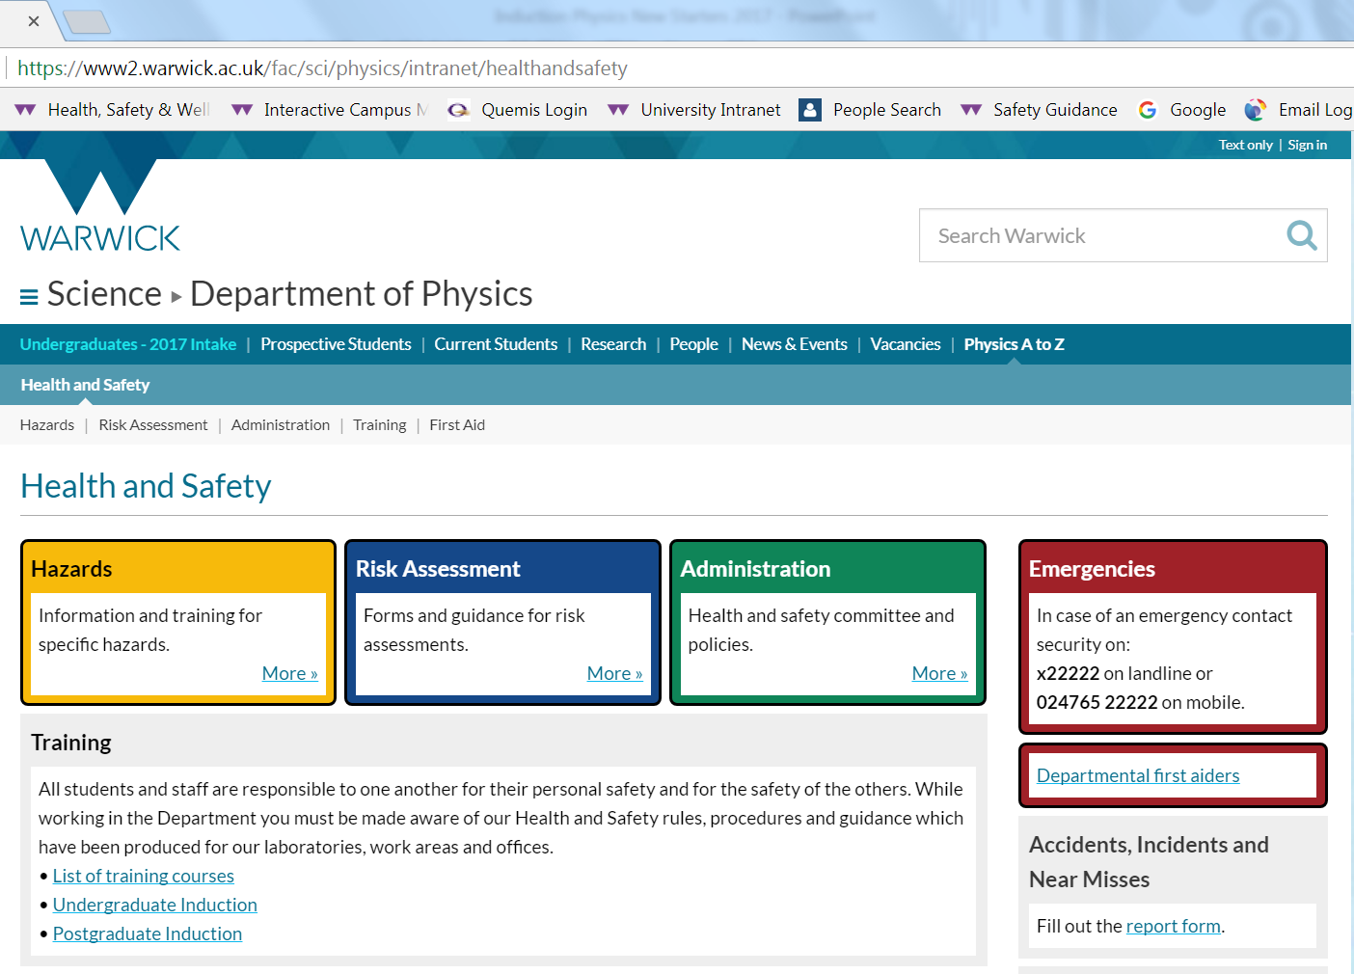
Physics H&S Web Pages inSite
Advice and Guidance
Notes:
Links within the department
Information specific to Physics
Lasers
Magnetic fields
Ionising radiation

Slide 34
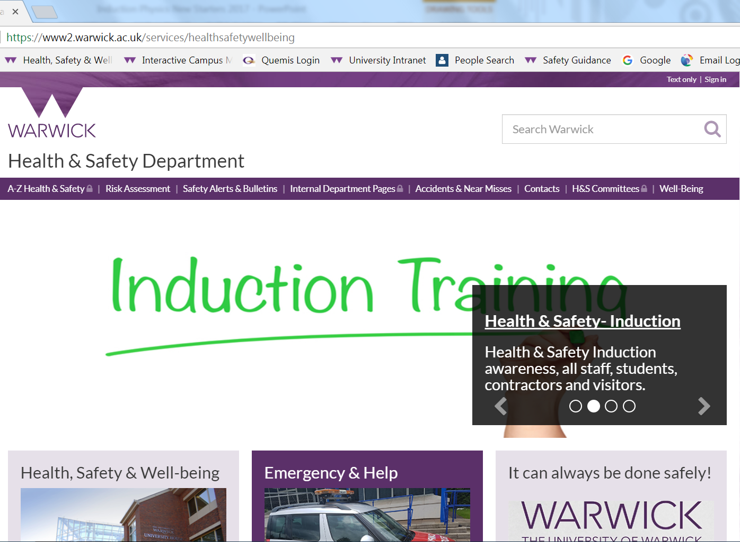
Health & Safety Web Pages inSite
Advice and Guidance
Notes:
Wide range of information
University policy on H&S
H&S Induction
Fire Safety Awareness training packages on Moodle
Physics objective for 2019

Slide 35
Project supervisor
John Horsler
Health & Safety Officer (Room P 5.68) j.horsler@warwick.ac.uk
Advice and Guidance
Notes:
Project supervisor will understand the task, advise on how to use equipment, access arrangements
I can advice on the risk assessment process, control measures, chemicals

