Slide 1

Emergency Response Plan
Space/s:
Author:
Date:

Slide 2
Contents
Emergency Response | Page Number
Response to fire
Response to a gas alarm (oxygen depletion)
Response to a chemical spill
Response to laser exposure to eye from a Class 3B or Class 4 Laser
Response to flooding
Emergency contacts
Revisions and changes

Slide 3
Response to fire
Assess the situation
Assess the emergency, be prepared to evacuate the space.
If the nature of the emergency puts anyone in the space at risk of harm, evacuate the space immediately and call Community Safety.
If the emergency can be controlled without personal risk, deal with the incident following guidance below.
Emergency | Assessment of Emergency | Response
Fire | If the fire can be controlled without personal risk | Immediate response if the fire cannot be extinguished or anyone is at risk of harm: Evacuate the space Sound the fire alarm and leave the building immediately by the most direct route. Once outside, everyone should proceed to a safe place away from the building, keeping all roads and access ways clear for emergency responders. Staff should encourage and help others out and away from the building. No one must re-enter the building until Community Safety have confirmed it is safe to do so (see NOTE below). NOTE: Community Safety respond to all fire alarms on University premises to aid evacuation and to investigate the cause of the alarm at the location it has been activated. Officers will silence the alarm and reset the fire control panel only when safe to do so. Once the fire alarm is silenced, DO NOT assume it is safe to re-enter the building until you have been told to so by Community Safety. To inform occupants the building is safe, Community Safety will walk the perimeter of the building and communicate with people, once the alarm has been reset. If you are unsure if the building is safe to re-enter, call the Community Safety Control Room on 024 7652 2083 for further guidance. IF the fire can be extinguished then: Use the correct fire extinguisher, or fire blanket, or sand to attempt to extinguish fire. Call Community Safety on ext. 22222 (024 765 22222)

Slide 4
Response to a gas alarm (version A – Analox Alarms)
Assess the situation
Assess the emergency, be prepared to evacuate the space.
If the nature of the emergency puts anyone in the space at risk of harm, evacuate the space immediately and call Community Safety.
If the emergency can be controlled without personal risk, deal with the incident following guidance below.
Emergency | Assessment of Emergency | Response
Gas alarm from a leak detected in the space | Listen for the room or building alarm and take immediate action if safe to do safe. This will be most audible in the labs where the O2 depletion sensors are located. Oxygen depletion sensors are located in XXX These alarms are Analox O2NE+ TM which are fitted to spaces where activities with asphyxiating gases pose a risk. Alarm repeaters (control panels) are located outside of spaces so the alarm level can be read without entering. | On hearing a continuous alarm in the room/building: If the oxygen depletion alarm detects O2 concentrations below 19.5% Alarm 1 indicator will begin to flash, and the buzzer will sound at a slow speed. Ventilate the area until alarm light goes out. If competent to do so, source the leak and shut off. Otherwise contact the Space Owner and Technical Services Manager for assistance. If the oxygen depletion alarm detects O2 concentrations below 18% Alarm 1 & 2 will flash and a horn will sound quickly. It is vital that the room is evacuated IMMEDIATELY and that NO ONE ENTERS the room. Whilst evacuating try to increase ventilation where possible (including opening doors between the affected room and the outside) Alarms are self-cancelling when O2 level rises above the alarm limits (above 19.5%). ONLY allow access to the room once this has been confirmed. Only upon confirming point 4 can the O2 depletion sensor panel be checked to see if there are any faults or false alarms. A yellow flashing light means there is an internal fault with the system. Contact the Space Owner who will escalate as needed and communicate with Technical Services to establish the next steps. Do not enter a room if the oxygen % is below 18% or if you see a person laying unconscious

Slide 5
Response to a gas alarm (version B – Building control alarms)
Assess the situation
Assess the emergency, be prepared to evacuate the space.
If the nature of the emergency puts anyone in the space at risk of harm, evacuate the space immediately and call Community Safety.
If the emergency can be controlled without personal risk, deal with the incident following guidance below.
Emergency | Assessment of Emergency | Response
Gas alarm from a leak detected in the space | Listen for the room or building alarm and take immediate action if safe to do safe. Oxygen depletion sensors are located in XXX Building control panels are located outside of spaces so the alarm level can be read without entering. | On hearing a continuous alarm in the room/building: It is vital that the room is evacuated IMMEDIATELY and that NO ONE ENTERS the room. Whilst evacuating try to increase ventilation where possible (including opening doors between the affected room and the outside. ONLY allow access to the room when O2 level rises above the alarm limits (above 19.5%). Only upon confirming point 3 from the control panel can the O2 depletion sensor panel be checked to see if there are any faults or false alarms. Notify the Space Owner who will communicate and escalate with Technical Services if alarm panel/sensors are identified or suspected of being faulty. Do not enter a room if the oxygen % is below 18% or if you see a person laying unconscious

Slide 6
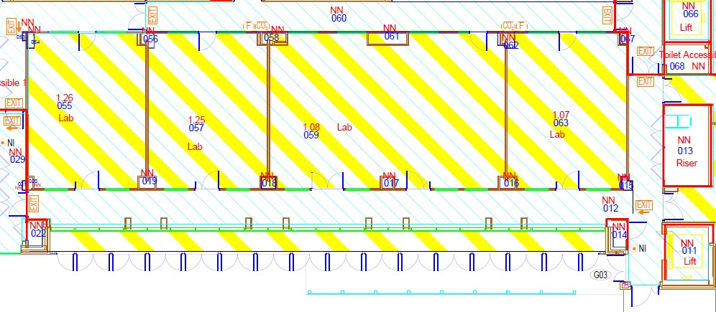
Response to a gas alarm
The below map identifies the locations of gas alarms and related systems within the space
Key
Control Panel
Oxygen Depletion Sensors
Gas Regulators
Route to Gas Cage
CP
O2
R

Slide 7
Response to a chemical spill
Assess the situation
Assess the emergency, be prepared to evacuate the space.
If the nature of the emergency puts anyone in the space at risk of harm, evacuate the space immediately and call Community Safety.
If the emergency can be controlled without personal risk, deal with the incident following guidance below.
Emergency | Assessment of Emergency | Response
Chemical spillage (liquid and powder) | Stop all activity and evacuate non-essential personnel from the area. Do not deal with a spill unless trained and you are confident in what you and doing. Consult the COSHH Assessment and SDS for specific hazard and control information regarding the spilt substance. | Spillage (liquid) In the event of spillage outside a fume cupboard or local exhaust enclosure: If the substance is flammable, eliminate sources of ignition; Instruct others to keep at a safe distance; Open windows where appropriate; For spillage of volatile materials, evacuate the room and shut the door unless the substance has been determined to be safe to use in the open. Unless the spillage is one which may be left to clear by evaporation and ventilation, call Community Safety who will call the Emergency Services. For spillage of material which has been determined safe to use in the open, absorb it onto sand or proprietary absorbent, and transfer it into a container which is put into a well-ventilated space for ultimate disposal. If external to the premises, prevent spills from entering drains or watercourses by creating a bund and using absorbent materials, then transfer to a container for ultimate disposal. If trained to deal with a spill locally, identify relevant materials from a local spillage kit, don relevant personal protective safety equipment and mitigate the spill from entering any drain. Spill kits are available in Technical Services Managers Office (P1.62). Contact the Principal Investigator, Space Owner and Technical Services Manager of the incident. Spillage (powder) Chemicals in a powder form may pose additional hazards and therefore further control measures (RPE) may be required. Consult the SDS for specific information. Powder spills should never be swept up using a dustpan and brush, standard vacuum etc. The powder must be covered with wet absorbent material to absorb/dissolve the powder. Continue to “damp-down” until there is no visible powder left and the spill can be dealt with as for wet spills.

Slide 8
Response to a chemical spill (continued)
Assess the situation
Assess the emergency, be prepared to evacuate the space.
If the nature of the emergency puts anyone in the space at risk of harm, evacuate the space immediately and call Community Safety.
If the emergency can be controlled without personal risk, deal with the incident following guidance below.
Emergency | Assessment of Emergency | Response
Contact with hazardous chemical on a person | Stop all activity and evacuate non-essential personnel from the area. Consult the COSHH Assessment and SDS for specific hazard and control information regarding the hazard substance | Contact a Fire Aider or Community Safety immediately. Workers should know what help to give before qualified help arrives on the scene. Below is basic first aid response to chemical spill/contact. The SDS must be referred to for specific first aid requirements. Eyes Flood thoroughly with water for at least 10 minutes. Use sterile eyewash or tap water from a clean container or run gently from a hose. Gently, but if necessary firmly, prise eyelids open. SEEK IMMEDIATE MEDICAL ATTENTION. Skin Drench with plenty of water. Remove contaminated clothing. Continue with running water for 10 minutes. Do not scrub or break the skin surface. Unless contact has been slight SEEK IMMEDIATE MEDICAL ATTENTION. Lungs Remove affected personnel from area of exposure, without putting yourself in danger (i.e. do not enter a room where the general atmosphere appears to be dangerous - call the Fire Brigade). Rest them and keep them warm. Unless exposure has been slight and the patient feels quite well, SEEK IMMEDIATE MEDICAL ATTENTION. Mouth DO NOT INDUCE VOMITING OR GIVE ANYTHING TO DRINK. If the chemical has been confined to the mouth give large amounts of water as mouth wash - ensure mouth wash is not swallowed. SEEK IMMEDIATE MEDICAL ATTENTION

Slide 9




Response to a chemical spill
The below map identifies the locations of first aid measures within and surrounding the space
Key
Chemical Spill Kit
Emergency Shower
Eyewash Basin/Bottle
First Aid

Slide 10
Response to a flood
Assess the situation
Assess the emergency, be prepared to evacuate the space.
If the nature of the emergency puts anyone in the space at risk of harm, evacuate the space immediately and call Community Safety.
If the emergency can be controlled without personal risk, deal with the incident following guidance below.
Emergency | Assessment of Emergency | Response
Flooding in space | Do not enter a flooded area if water levels are high or if electrical hazards are suspected. | In the event of a flood, evacuate the lab safely and shut off electricity to equipment in the affected area if safe to do so. If the cause of the flood is accessible and safe to reach please isolate Notify the Space Owner who will communicate and escalate with Technical Services.

Slide 11
Response to laser exposure to eye from a Class 3B or Class 4 Laser
Assess the situation
Assess the emergency, be prepared to evacuate the space.
If the nature of the emergency puts anyone in the space at risk of harm, evacuate the space immediately and call Community Safety.
If the emergency can be controlled without personal risk, deal with the incident following guidance below.
Emergency | Assessment of Emergency | Response
Laser exposure to eye from a Class 3B or 4 Laser | Stop all laser activity immediately. | Secure the area to prevent further exposure. All beams must be safely isolated or the power to the laser switched off. In addition, all other potential hazards must be made safe e.g. electrical, biohazard, trip hazards. Seek first aid assistance and call Community Safety. Inform the Space Owner or Principal Investigator, a department Laser Safety Officer (LSO) and University Radiation Protection Officer (RPO). Inform Health & Safety Services. Provide initial first aid whilst waiting for assistance: Do not allow the injured person to rub their eyes. Keep the person calm and seated. Do not apply pressure or attempt to treat the eye. The Emergency Procedure Card (AOR005) that is displayed in the laboratory must be taken to the hospital with the injured person.

Slide 12
Emergency contacts
The following is correct as of XX/XX/XX
Name | Role | Contact Details | Spaces
First Aiders | First Aiders | As per QR Poster | All
Community Safety | Community Safety | 02476 522222 (mobile) 22 222 (landline) | All
Kevin Murphy | Technical and Building Services Manager |  | All
 | Space Owner
 | Principal Investigator

Slide 13
Revisions and changes
Name | Revisions | Date Revised

