Slide 1
A note on the scale of the universe - answers
Astronomers use light years since the distances in space are so large that, if expressed in km or m, the numbers would be mind boggling.
Light travels 7.5times around the earth in one second.
1light-year = 9.461×10¹²km
1light-year = 9.461×10¹⁵m
It takes light 0.001years=8.8hours to travel from one side to the other.
It takes light 0.001years=32,000s to travel from one side to the other
Looking at the stars is like looking into the past as the light takes so long to travel to us, due to the large distances between objects, that we see what it looked like when the light was initially emitted, which is in the past.
In 5s, light travels 1.5×10⁹m.
In 0.2s, light travels 6×10⁷m

Slide 2
Scale of the universe
https://scaleofuniverse.com/

Slide 3
Objects in the universe

Slide 4
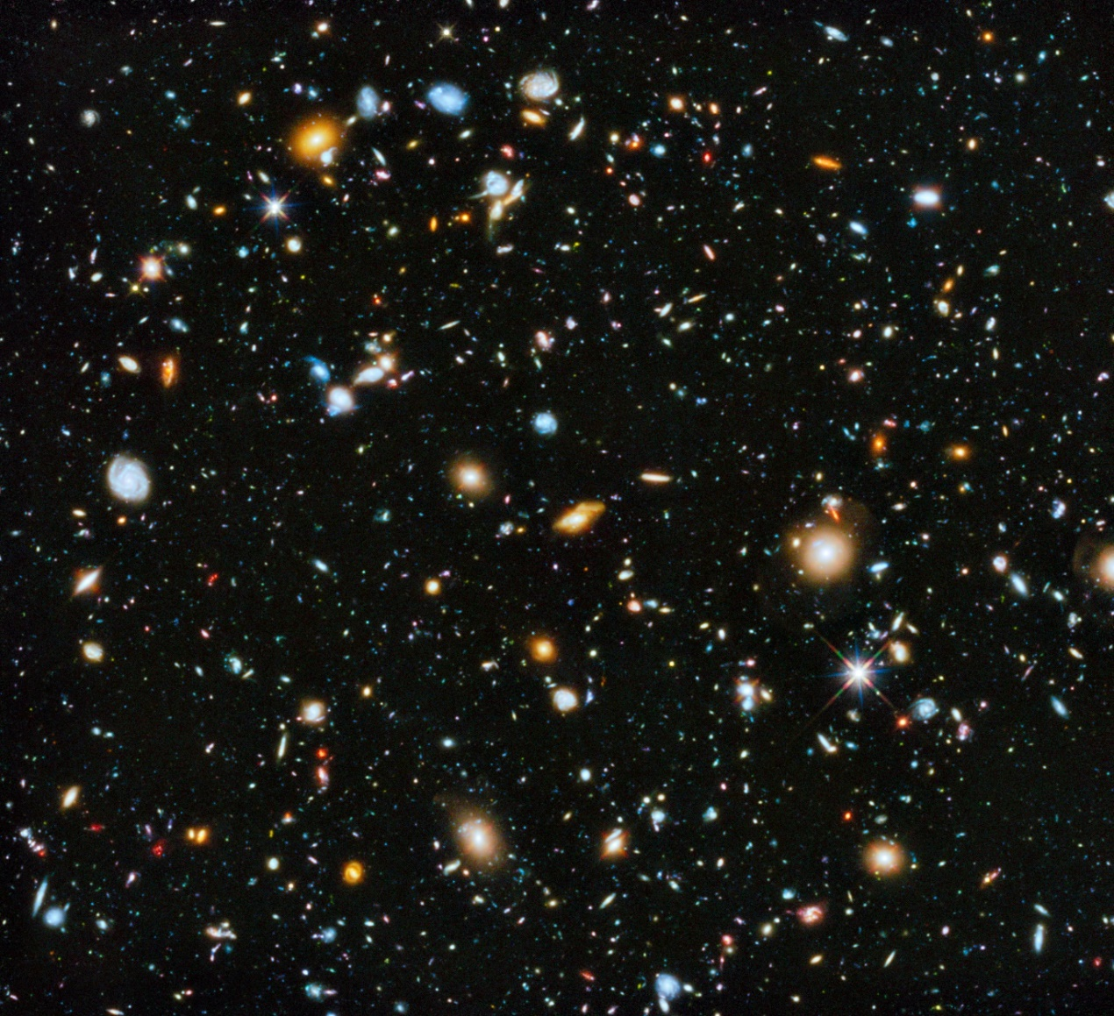
The Universe – the Hubble Ultra-Deep field image
Notes:
This image is the Hubble Ultra-Deep Field, each point of light being a galaxy or galaxy cluster. This image shows the most distant galaxies known to humankind. This image is of an area of the sky roughly 1/80th the size of the full moon. In this tiny region, it is reckoned there are around 10,000 galaxies. In the furthest reaches, it looks back around 13billion years to the light that was emitted around 500million years after the big bang.

Slide 5
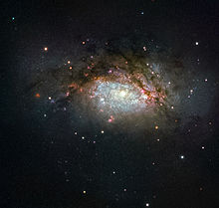

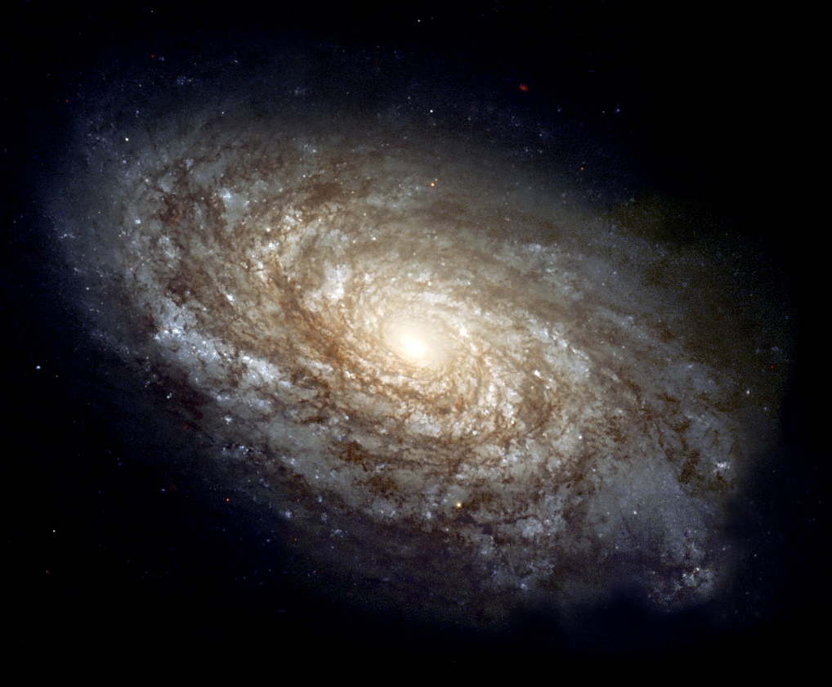
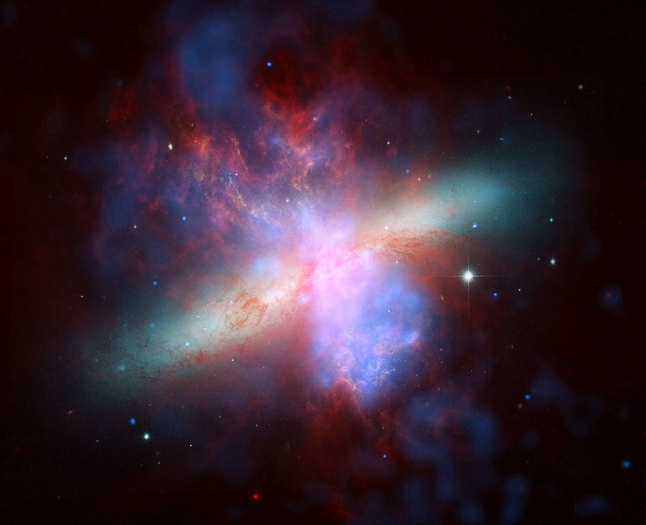
Galaxy
An elliptical galaxy
A spiral galaxy – our galaxy, the Milky Way, is of this type.
An irregular galaxy
Notes:
Galaxies are collections of stars (and their orbiting planets), dust and gas (as well as dark matter) that are bound into a single entity by gravity. Galaxies come in three families of shapes and many are thought to have supermassive black holes at their centre.

Slide 6
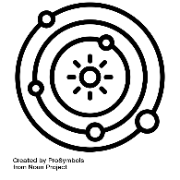
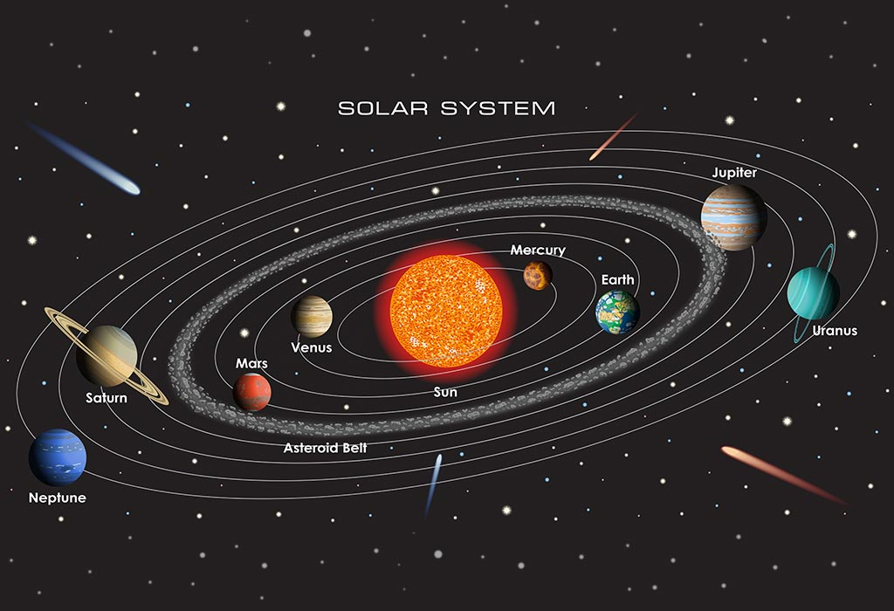
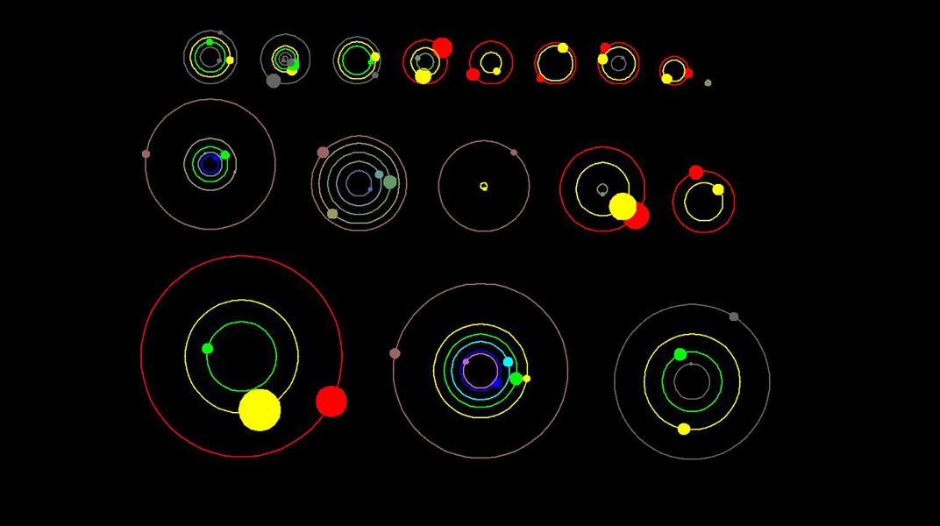
Planetary system
Our solar system is a planetary system, with the planets orbiting our star – the sun.
There is a huge variety of planetary systems (in terms of size and orbital period) found by the Kepler space telescope.
Notes:
Galaxies are filled with planetary systems: planets, dwarf planets, asteroids and all other objects that are gravitationally bound to orbit their star. Current research looks into the wide variety of planetary systems out in the Universe, noting the massive variation there is between one system and the next. Our planetary system consists of eight planets, five dwarf planets and two belts of debris – the asteroid belt and the Kuiper belt.

Slide 7
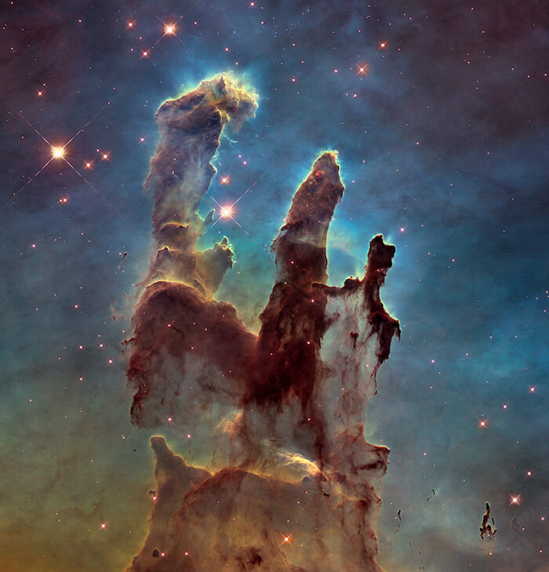
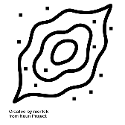
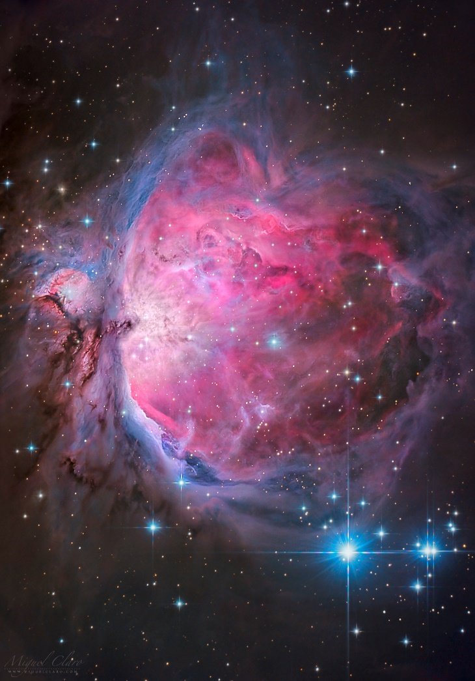
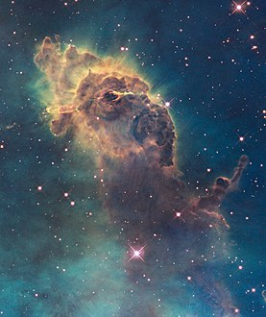
Nebula
The pillars of creation from the Eagle nebula
A portion of the Carina nebula
The Orion nebula
Notes:
Nebulae are clouds of dust and gas that are bound by gravity. They are truly vast, being light years across. They host star-forming regions such as the pillars of creation in the Eagle nebula where the dust and gas becomes denser, attracting more dust and gas due to the additional gravitational field until a star is formed (more on that later).

Slide 8
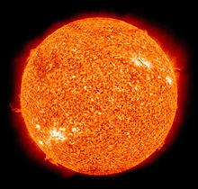

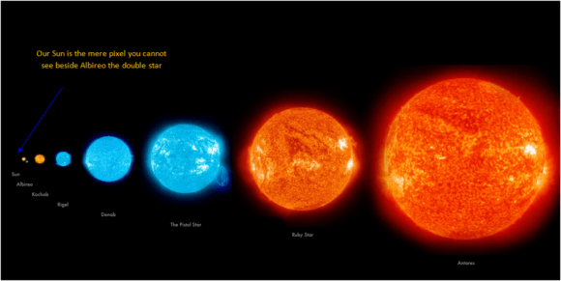
Star
Our sun is an example of a star, experiencing the main-sequence portion of its life.
Notes:
A star is a hot sphere of plasma – ionised gas – that is emitting electromagnetic radiation due to a process of nuclear fusion at its core. This is what makes stars luminous (they emit light). Not all stars are the same. Whilst in the night sky, we see them as tiny specks of light, there is a huge variation in the size, mass and colour of stars as they form, grow and die. This is a topic for later.

Slide 9
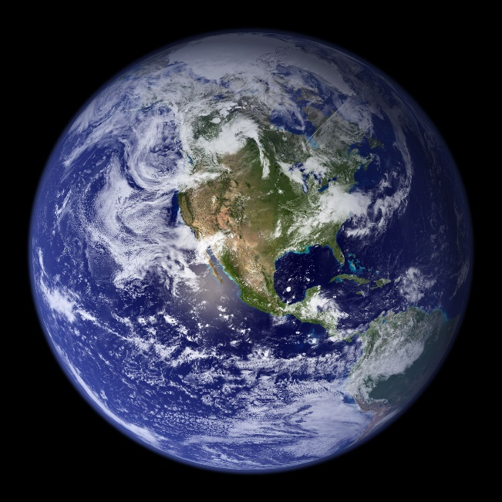

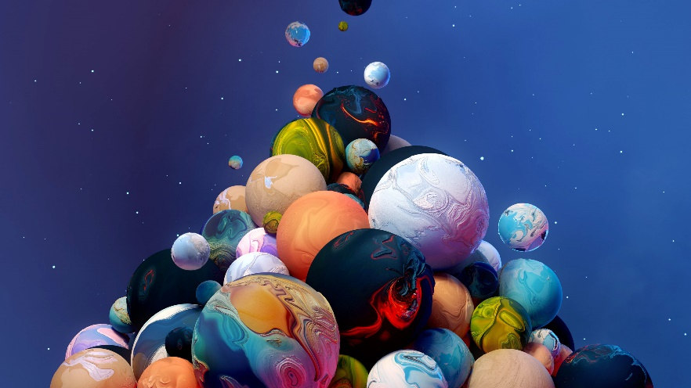
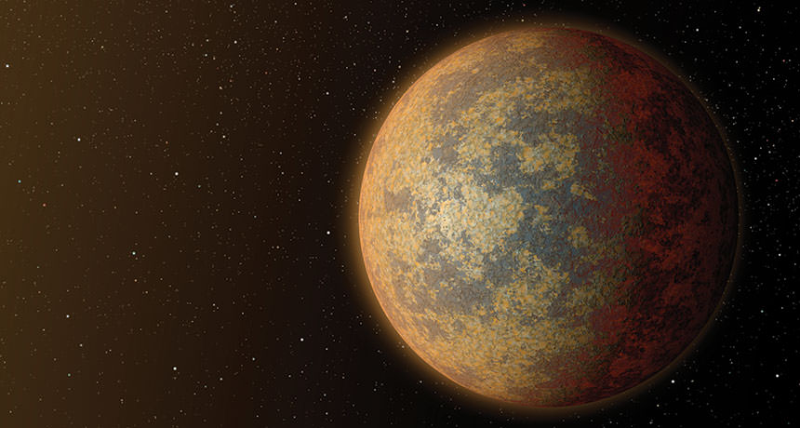
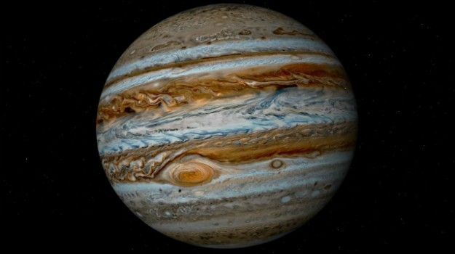
Planet
Earth is a rocky planet
Rocky planets such as BD+20594b, the largest rocky planet yet discovered. It’s half the size of Venus.
Gas giant planets such as Jupiter and Saturn
Notes:
Just like there is a huge variety of galaxies and stars, there is a huge variety of planets. These are non-luminous objects (they don’t emit light) that orbit a star. There are conditions that must be fulfilled to be considered a planet – you need to independently orbit your star, you need to have a large enough mass to be roughly spherical, you need to be the dominant object on your orbital path

Slide 10
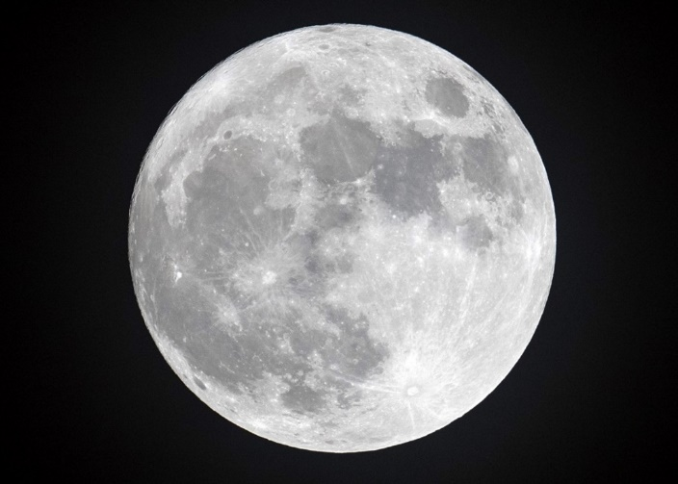
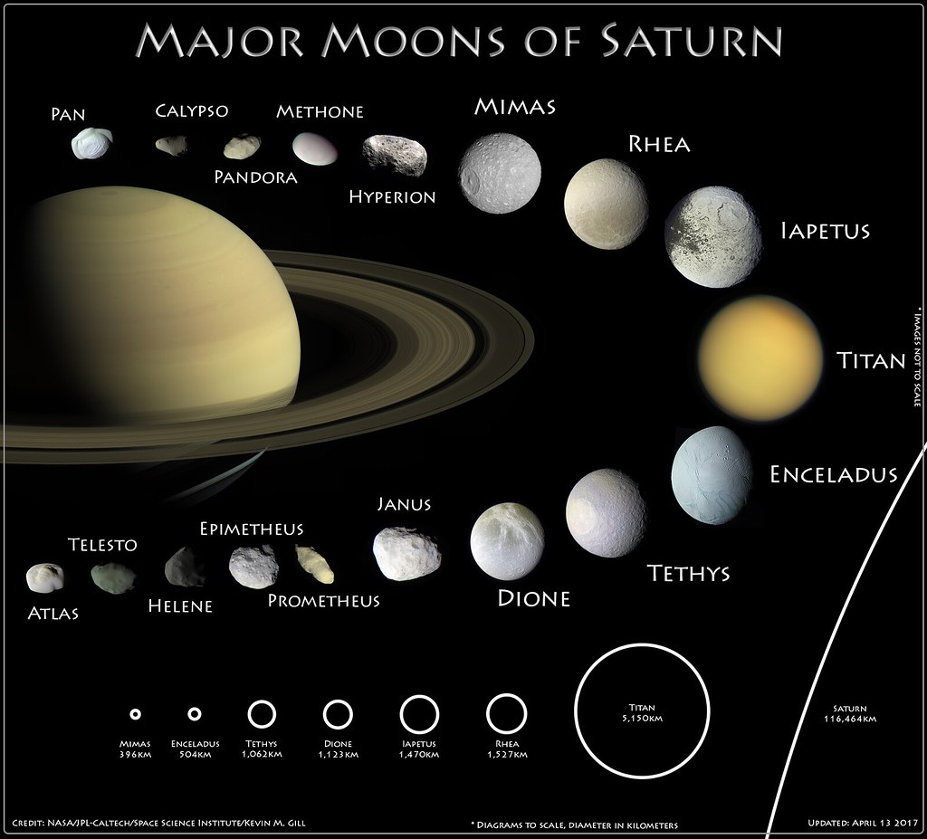
Moons
The earth has one moon, but other planets have many, such as Saturn
Notes:
A moon is any natural object that orbits a planet due to gravitational pull of the planet. They come in a wide range of shapes and sizes.

Slide 11

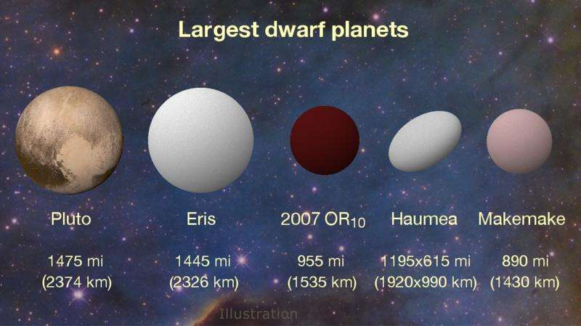
Dwarf planet
These are the five largest dwarf planets in our solar system. They don’t fulfil all three of the planet criteria. Ceres is a further named dwarf planet in our solar system, the only one located in the asteroid belt, but is smaller than these 5.

Slide 12
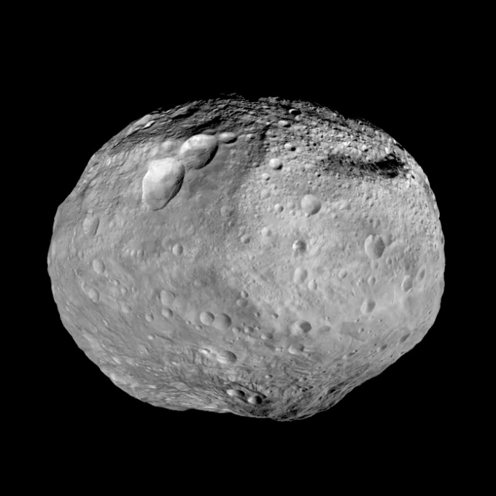

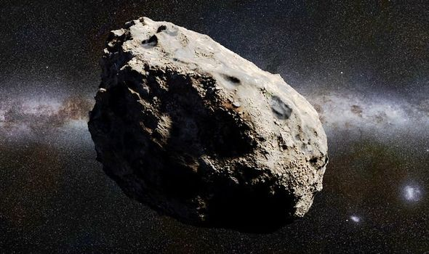
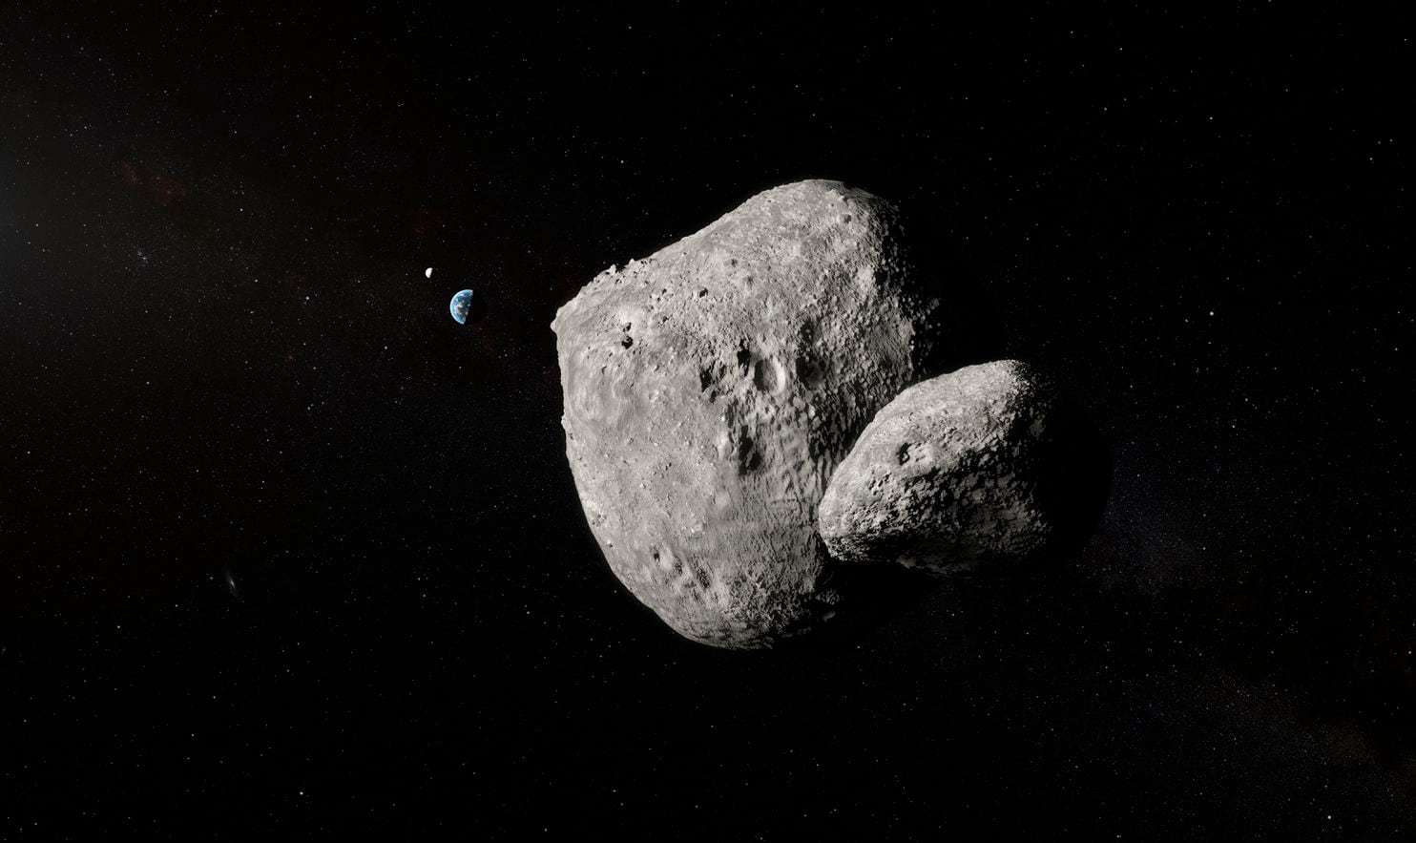
Asteroid
Notes:
Asteroids are lumps of rock and metal. The asteroid belt, between Mars and Jupiter contains millions of asteroids of varying sizes, all in a collective orbit. The dwarf planet Ceres lives in the Asteroid belt, and is designated a dwarf planet as its orbit is blocked by many other large asteroids so it doesn’t dominate its orbit.

Slide 13

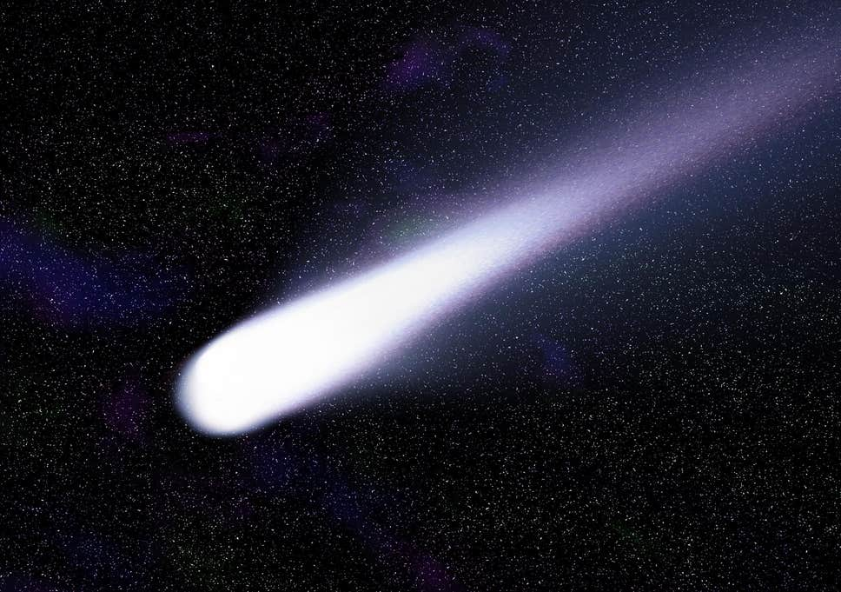
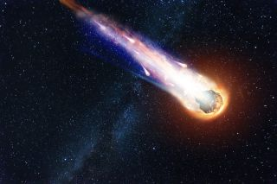
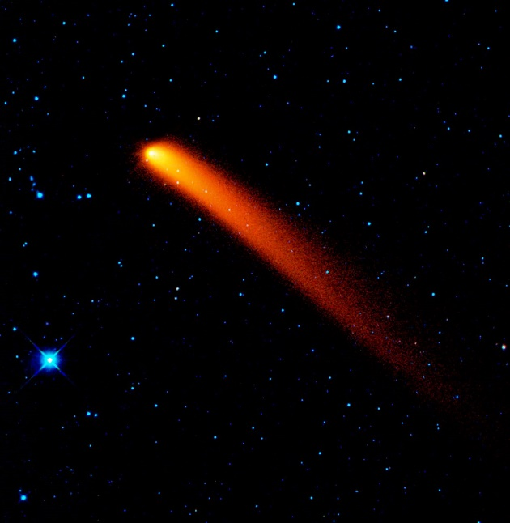
Comet
Notes:
Comets are generally lumps of ice and rock. The tail of gas and dust forms when it gets closer to the sun.

Slide 14
Objects in the universe – answers
Luminous means to give out or to emit visible light.
The earth is non-luminous because it doesn’t emit visible light (but it does emit light in the infrared part of the spectrum – black body radiation).
A galaxy is larger than a planetary system, as a galaxy contains billions of stars, each with the possibility of being its own planetary system.
We call our planetary system ‘the solar system’.
We call our galaxy ‘the Milky Way’.
A planet is a non-luminous object that orbits a star directly (whilst dominating its orbit and having a large enough mass) whereas a moon orbits a planet (and hence indirectly orbits a star).

Slide 15
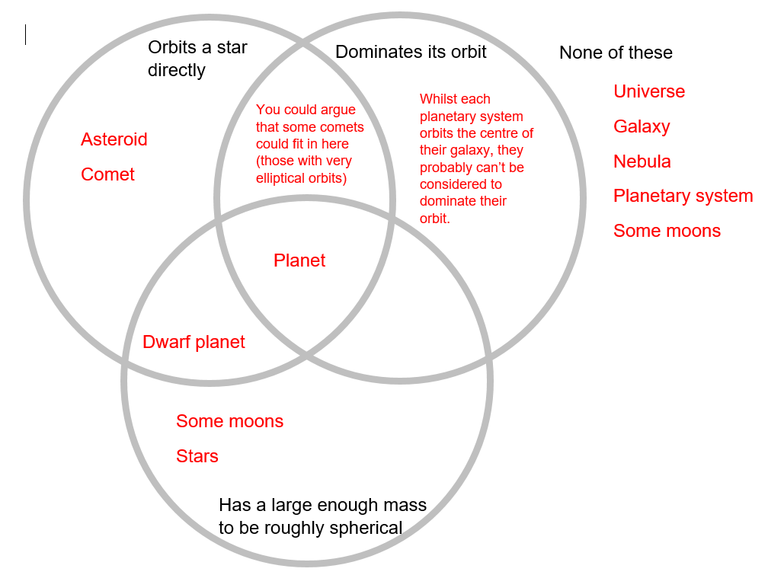
Objects in the universe – answers
16

Slide 16
Objects in the universe – answers
Pluto is no longer considered a planet as it doesn’t dominate its orbit. There are objects that orbit along a similar path that aren’t significantly smaller than it.
An asteroid can be bigger than a moon. An asteroid orbits a star directly whereas a moon orbits a planet. Some planets have very small moons, and some asteroids can exceed this without being considered a planet or dwarf planet.
Planets can have multiple moons, the earth just happens to have one. Mercury and Venus have none. Jupiter has 79 that we currently know about.

Slide 17
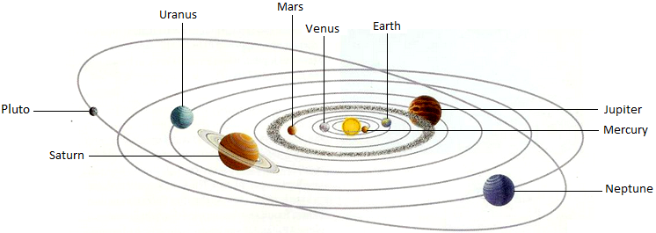
What is an orbit?

Slide 18
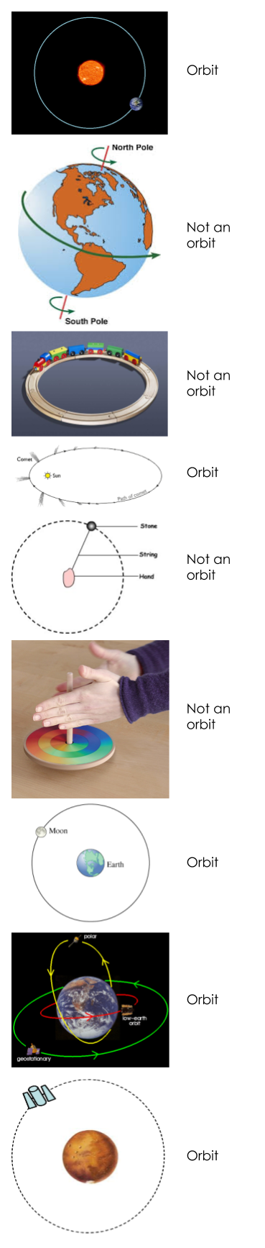
What is an orbit?

Slide 19
What is an orbit? - answers
An orbit is the elliptical path that one object in space takes to travel around another object. It is caused by the gravitational attraction between the two objects.
The shape of an orbit is an ellipse – a squashed/elongated circle.
Astronomers struggled to notice the elliptical shape since orbits only tend to be slightly elliptical. They are very close to being circles.
Orbits are often drawn as circles as their elliptical shapes are so close to being circles in many cases. And circles are simpler.
b) As it is spinning on its own axis, not moving around another object
c) As it is not moving around another object and its path is circular
e) As it is moving in a definite circle (the string doesn’t change length) and it is not caused by a gravitational force.
f) As it is spinning on its own axis, not moving around another object

Slide 20
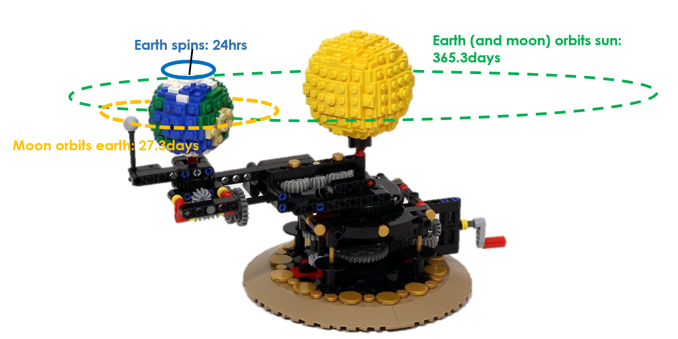
What is an orbit? - answers
25. The LEGO version:

Slide 21
What is an orbit? - answers
The force of gravity from the object that is at the centre of the orbit.
2×10²⁰N. The forces are equal in size but opposite in direction.
The sun’s pull on the earth is much greater than the force from the moon. In fact, the ratio of the moon’s pull to the sun’s pull is 1:200

Slide 22
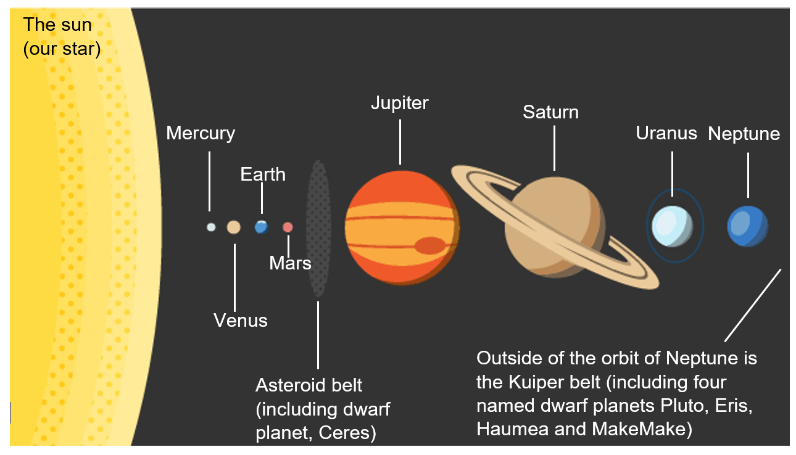
Our solar system
Note: not to scale

Slide 23
https://vimeo.com/139407849 This video shows the difficulty in creating both the planets to scale and their orbits to scale.

Slide 24
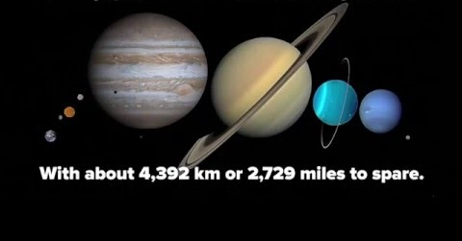
Aside:
Inside the distance between the earth and moon, we could fit all of the other planets. Space is named very aptly – it contains a lot of empty space

Slide 25
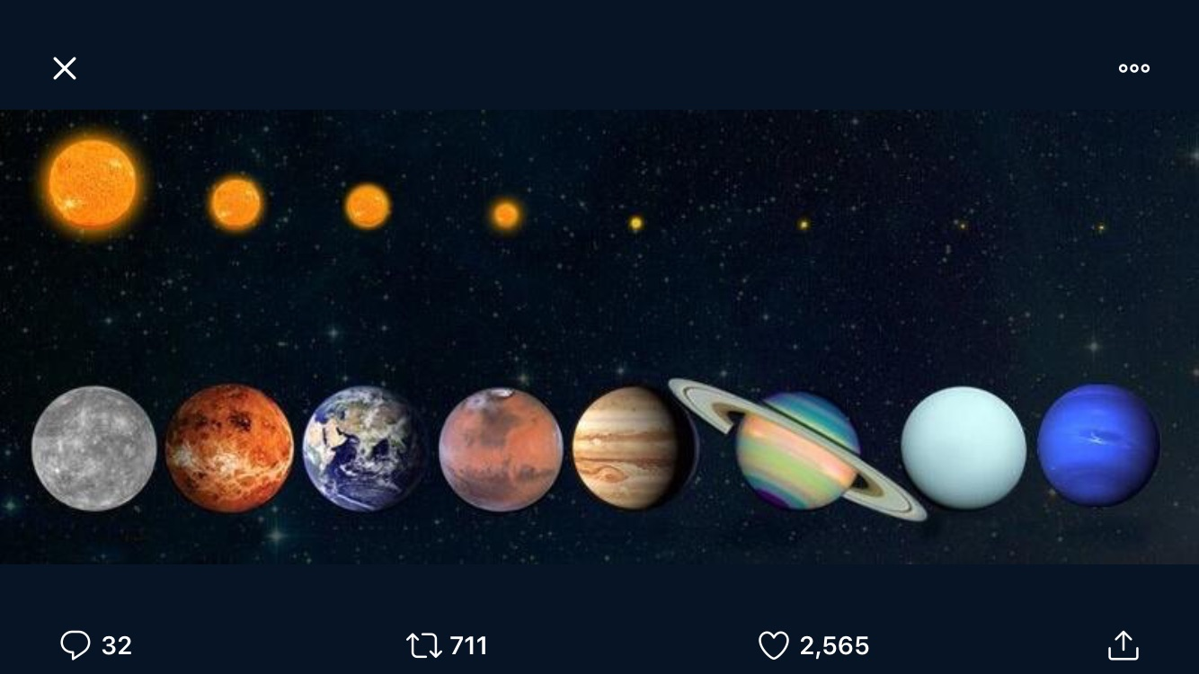
Aside: To scale: what the sun looks like from different planets (note: the planets are not to scale)

Slide 26
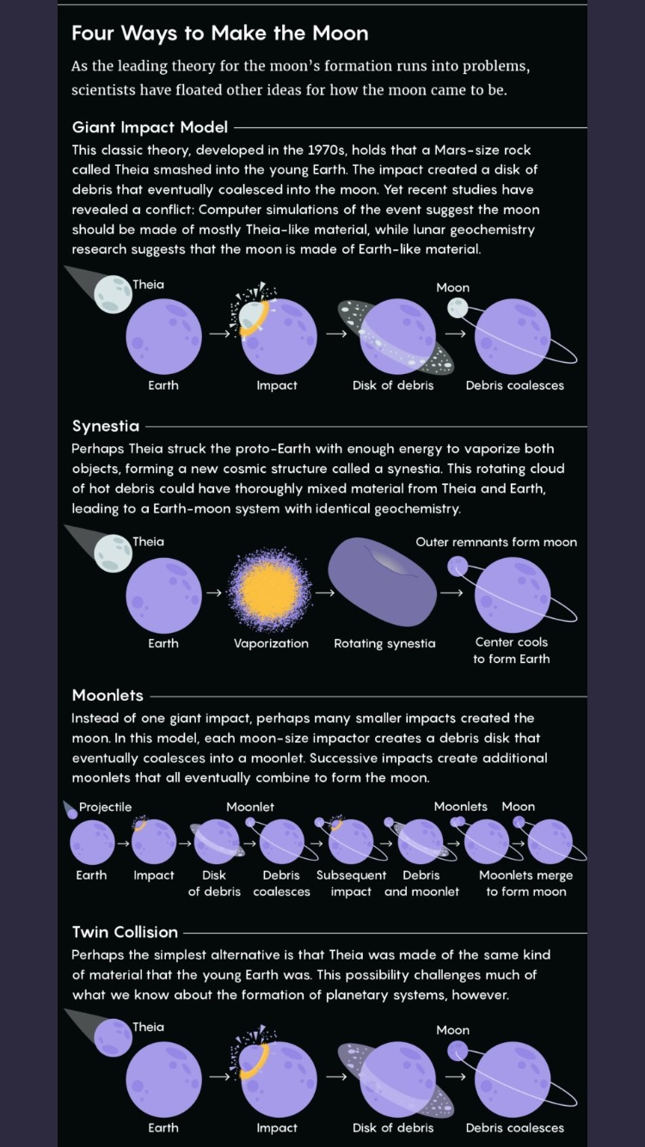
Aside: Theories of moon formation

Slide 27
Our solar system
Mercury, Venus, Earth, Mars
A dwarf planet and a planet both orbit a star. They are both roughly spherical in shape.
365.25days.
It is the time it takes the earth to orbit the sun.
Jupiter.
The gases Hydrogen and Helium.
Hydrogen is found as a liquid on the gas giants as it is colder there than on earth. Condensation is when a gas turns into a liquid.
Neptune.
Water, ammonia and methane.
Because water, ammonia and methane are most typically found as liquids on earth, but due to the temperature of Uranus and Neptune, they are frozen there.
Mercury, Venus, Earth, Mars, Jupiter, Saturn, Uranus, Neptune.

Slide 28
Our solar system
The mass per unit volume is larger for the terrestrial planets than the gas giants or the ice giants.
Because orbits in these regions contain so many other objects that block one another’s orbits, preventing them from ‘dominating their orbit’ which is one of the planetary criteria.
1375kg
325kg
496.7s = 8.3mins
a) 4500000000km = 4.5 × 10⁹km = 4.5 × 10¹²m
b) 15000s = 250mins = 4.2hrs

Slide 29
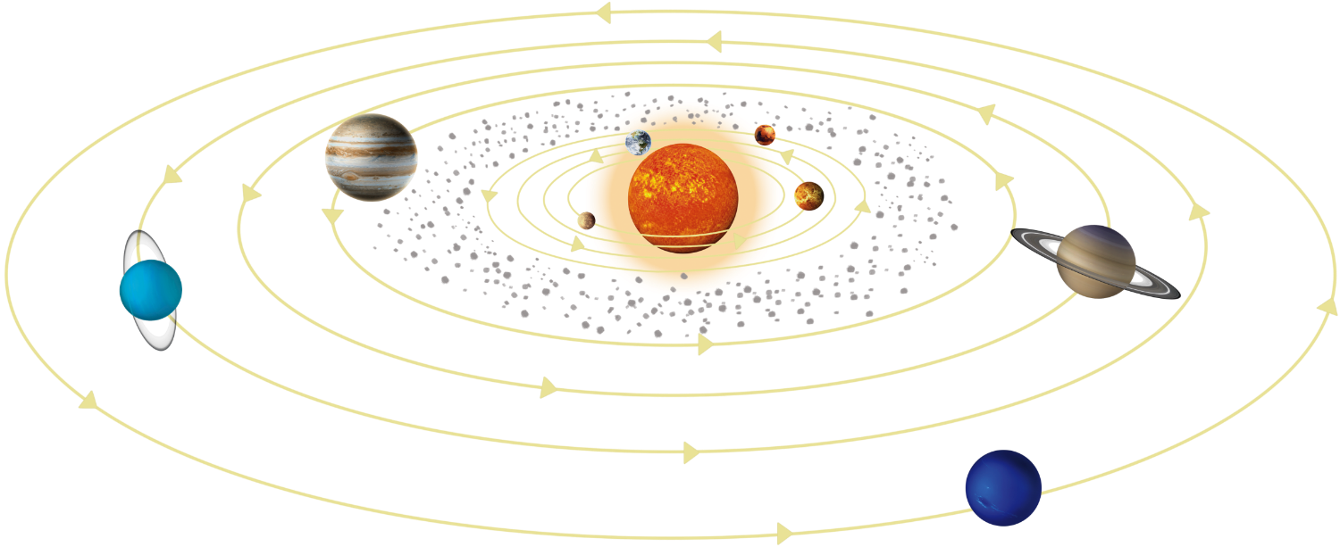
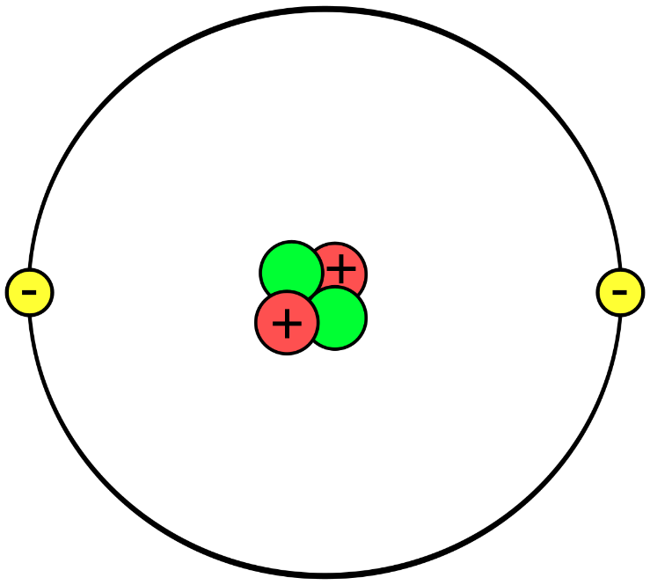
Our solar system
46.
47.

Slide 30
Our solar system
48. Similarities: largest part at centre. Objects orbit centre. Lots of empty space.
Differences: orbits causes by different processes, orbiting objects are all unique in solar system but all the same (electrons) in the atom. Electrons can be drawn on same shell, planets must dominate their orbits.
49. It is so difficult to create a true scale model of the solar system as the planets are so small in comparison with the size of the orbits. This means if we draw the orbits to scale on a piece of paper, the planets are microscopic. If we get the planets to scale with physical, small objects, the orbits are gigantic.

Slide 31
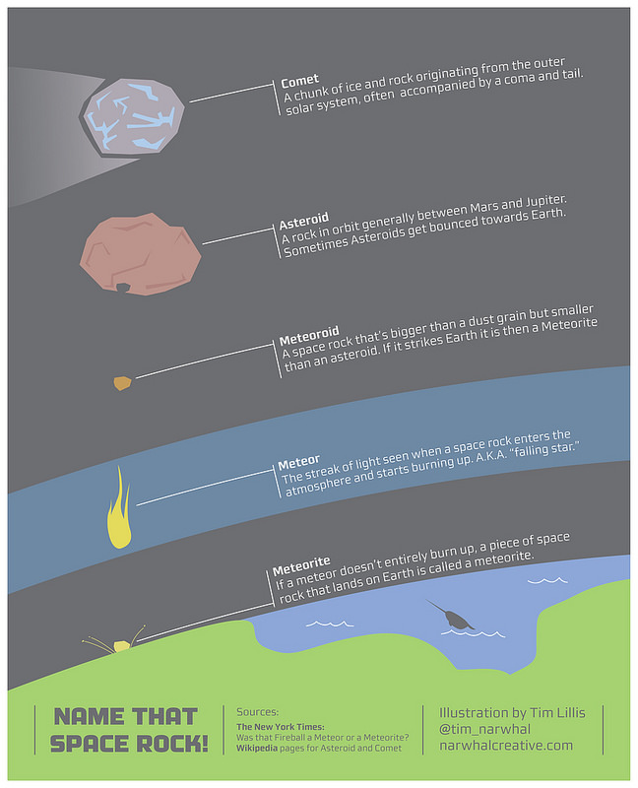

Slide 32
Aside: Asteroids, Comets and Meteoroids
Asteroid
Comet
Meteoroid

Slide 33
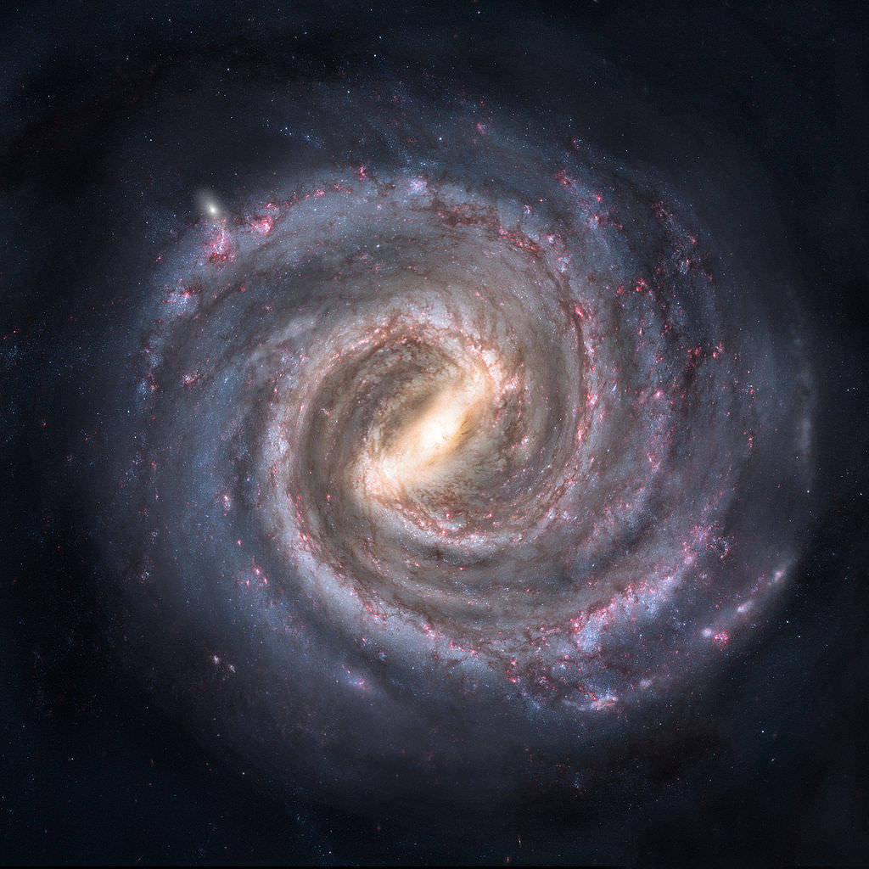
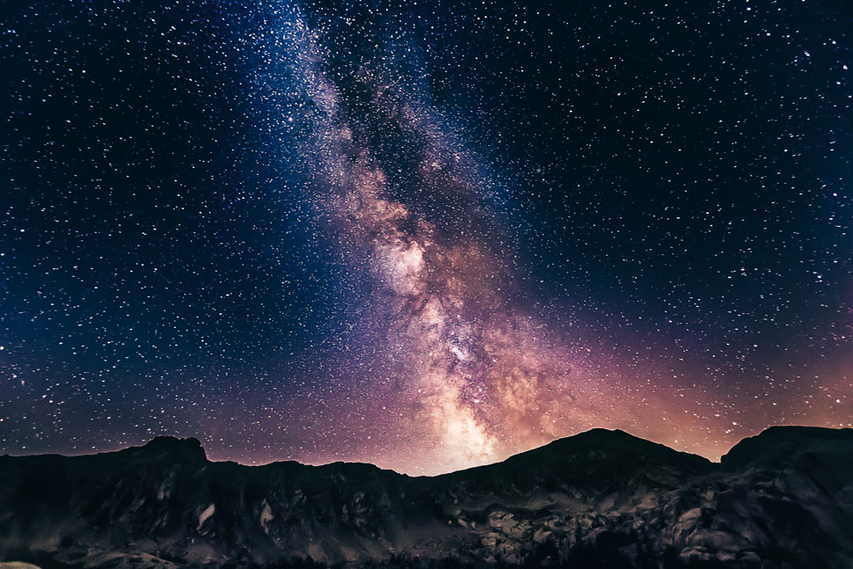
Our galaxy
The Milky Way as seen from earth.
The Milky Way as it probably looks from distance – a spiral galaxy.

Slide 34
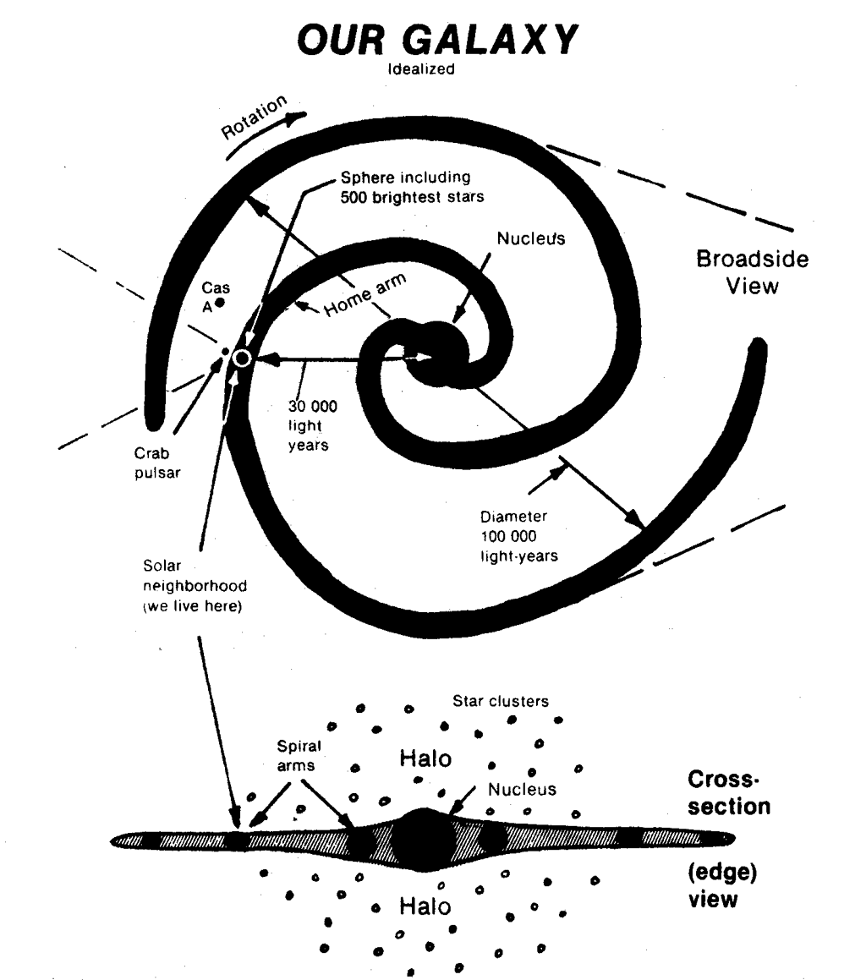
Our galaxy

Slide 35
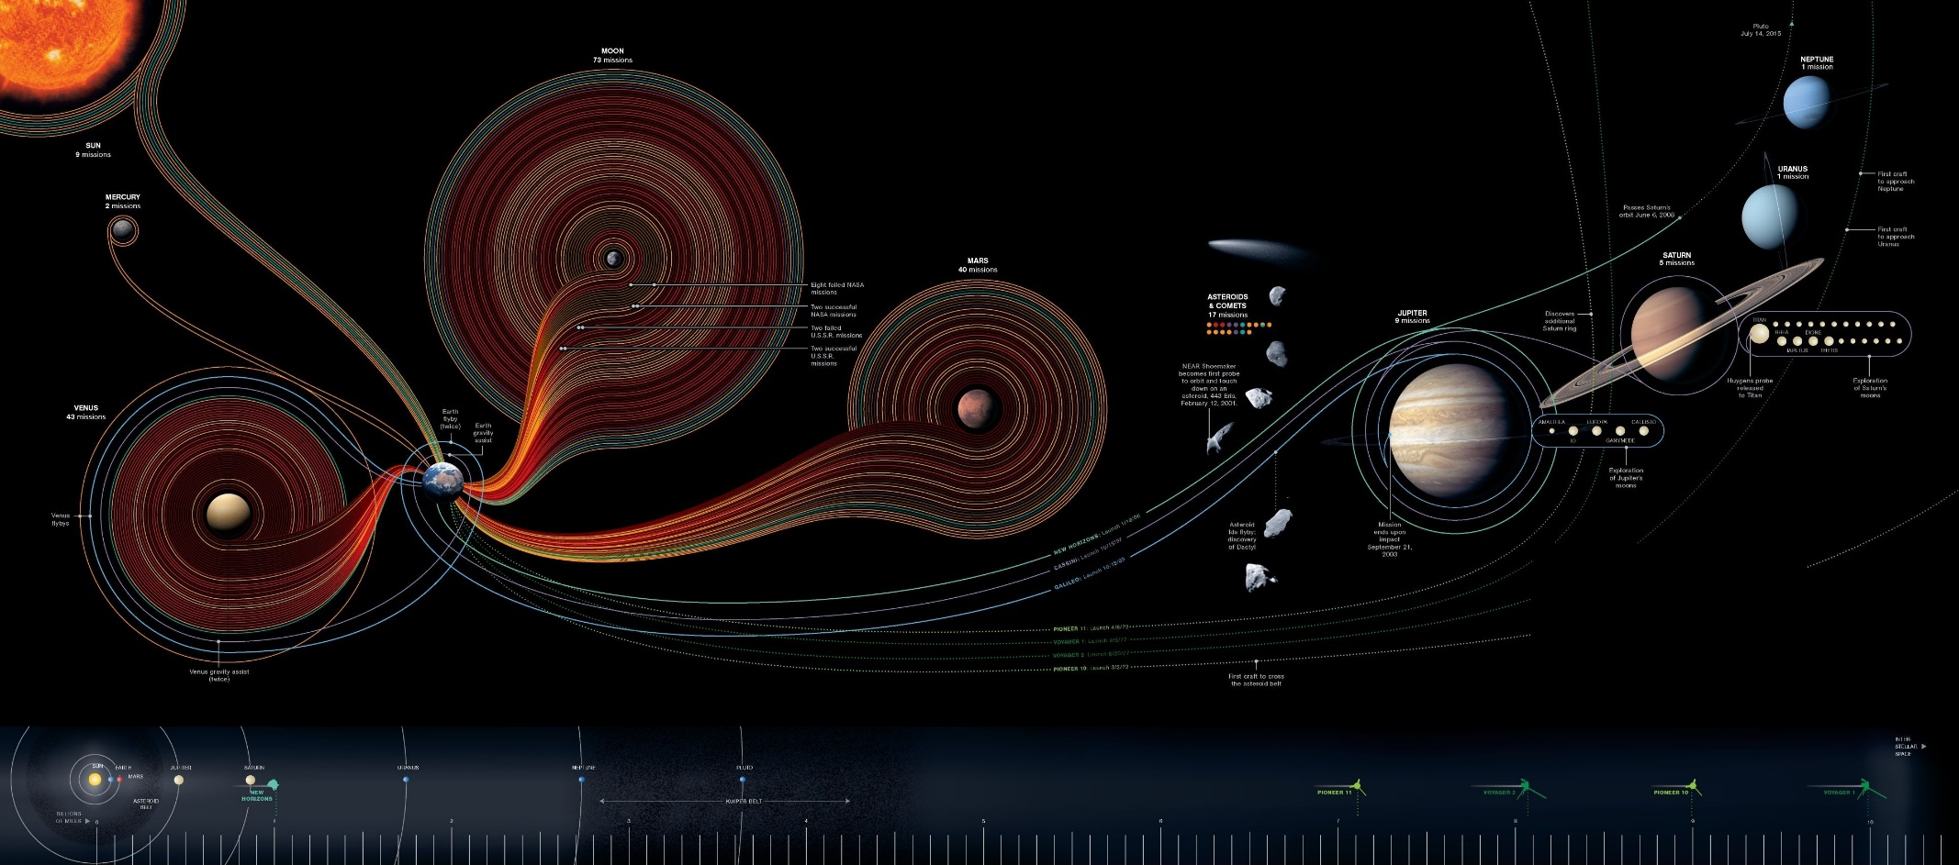
Space travel in our galaxy Link: https://tfetimes.com/wp-content/uploads/2015/05/fifty-years-of-exploration_50290a6d94ffe.jpg

Slide 36
Our galaxy: answers
The Milky Way
Spiral
On one of the arms of the spiral
Interstellar means ‘between stars’. It is the huge empty space in between planetary systems.
We’ve never got a camera out of the galaxy to photograph it.
High above the dark side of the moon, 400,000km from earth.
No.
Yes, the two Voyager probes are believed to have left our solar system.
1.3s
100,000light years=100,000 x Speed of light x seconds in a year = 100,000 x 3x10⁸ x (365.25x24x60x60) = 9.5x10²⁰m

Slide 37
Artificial satellites and stable orbits
Lightest satellite:
https://www.bbc.co.uk/news/world-asia-india-46956595
How many people are on the ISS right now?
https://www.howmanypeopleareinspacerightnow.com/
Sputnik I facts:
https://www.youtube.com/watch?v=hQ90kQKwYSg

Slide 38
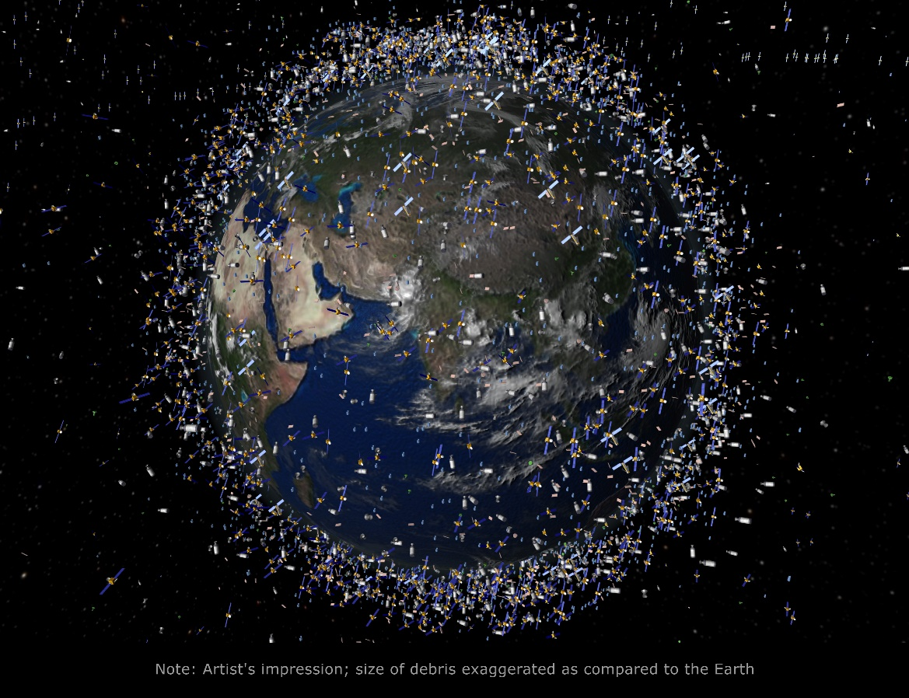
Artificial Satellites
This is an artist’s impression of the artificial satellites around earth.
The scale of the satellites themselves has been exaggerated, but not the number of them.

Slide 39
Artificial satellites and stable orbits: answers
An object, such as the moon, that orbits another astronomical object, such as the earth, without being put there by humans.
An object, such as the international space station, that orbits an astronomical object, such as the earth, but has been put there by humans.
No, artificial satellites can orbit anything.
Space debris includes artificial satellites that are no longer working as well as tiny bit of asteroids that have been brought into an orbit around the earth.
Sputnik I, KalamSat, The International Space Station (ISS).
The moon.

Slide 40
How do objects stay in orbit?
How do satellites stay in orbit?
https://www.youtube.com/watch?v=IC1JQu9xGHQ
https://www.youtube.com/watch?v=OmFHwQkCYlQ
How do we get satellites there?
https://www.youtube.com/watch?v=lGoVy44C3cA

Slide 41
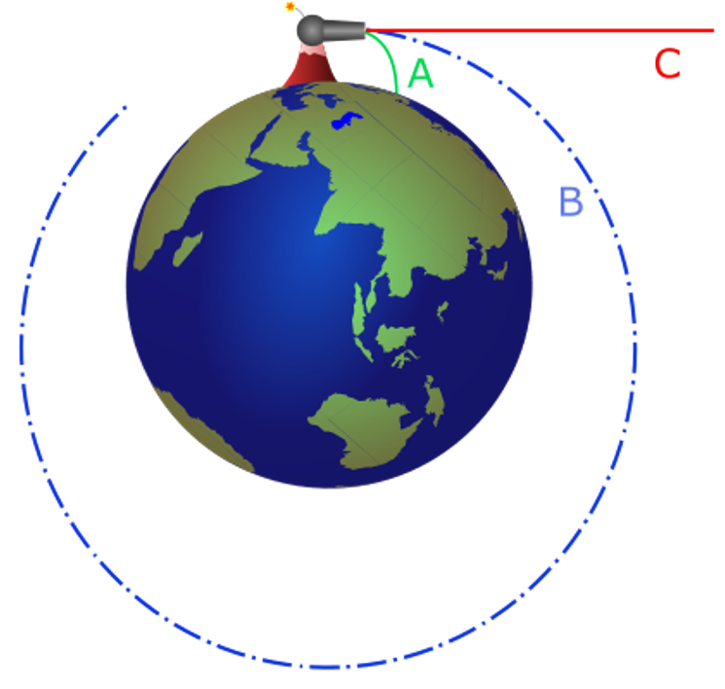
How do objects stay in orbit? Answers
Image:
Because the moon has essentially no atmosphere so there is no air resistance to worry about. To orbit the earth, we need to avoid the atmosphere and hence be a lot further up.
We use a rocket to get them into space and then carefully use boosters to alter their location and speed.
F=ma
0.0002m/s²
Velocity is a vector, speed is a scalar
Velocity is the speed of an object in a given direction
If the velocity is changing, but not the speed, then it is the direction of the object that is changing.

Slide 42
How do objects stay in orbit? Answers
The velocity changes because the direction changes, but the speed remains constant. Imagine an arrow for the velocity – the length of the arrow doesn’t change (this is the speed), but the direction does, so the velocity is changing.
Suggested answers
A satellite is accelerating because it experiences a force (gravity) from the object that it is orbiting.
A satellite is accelerating but it is not changing its speed, only its direction.
A satellite is accelerating so that is can change direction to complete an entire orbit around an object.

Slide 43
Stable orbits
Stable orbit demo on a ice hockey table
https://www.youtube.com/watch?v=ALdcbZYlOs4
Do this demo:
https://www.youtube.com/watch?v=t3ZkGpgqADk

Slide 44
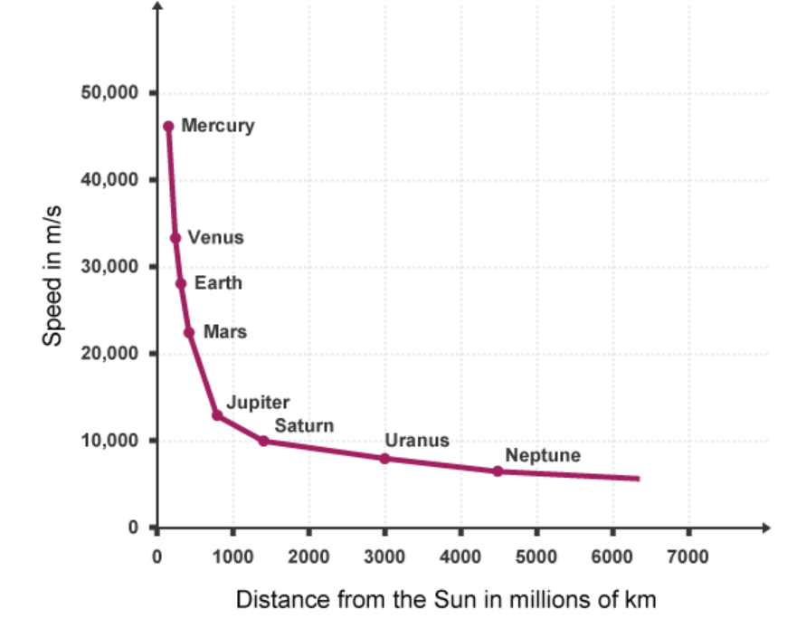
Stable orbits

Slide 45
Stable orbits: answers
Low earth, medium earth, high earth
As the orbital speed increases, the orbital radius decreases (or vice versa).
The rubber bung demo is not an orbit as the central force is not gravity but tension.
A geostationary orbit is one where the speed of the orbiting object matches the speed at which the Earth spins so the orbiting object stays above the same location on earth.
0.017N (remember km to m)
3055m/s (remember km to m)

Slide 46
Stable orbits: answers
Venus
Answers should be around 32km/s for a linear interpolation (actual answer around 30km/s)
Answers should be around 16km/s for a linear interpolation (actual answer around 13km/s)
Saturn
Answers should be around 7km/s
Neptune
As the orbital radius increases, the orbital speed decreases. It is not a linear relationship.

Slide 47
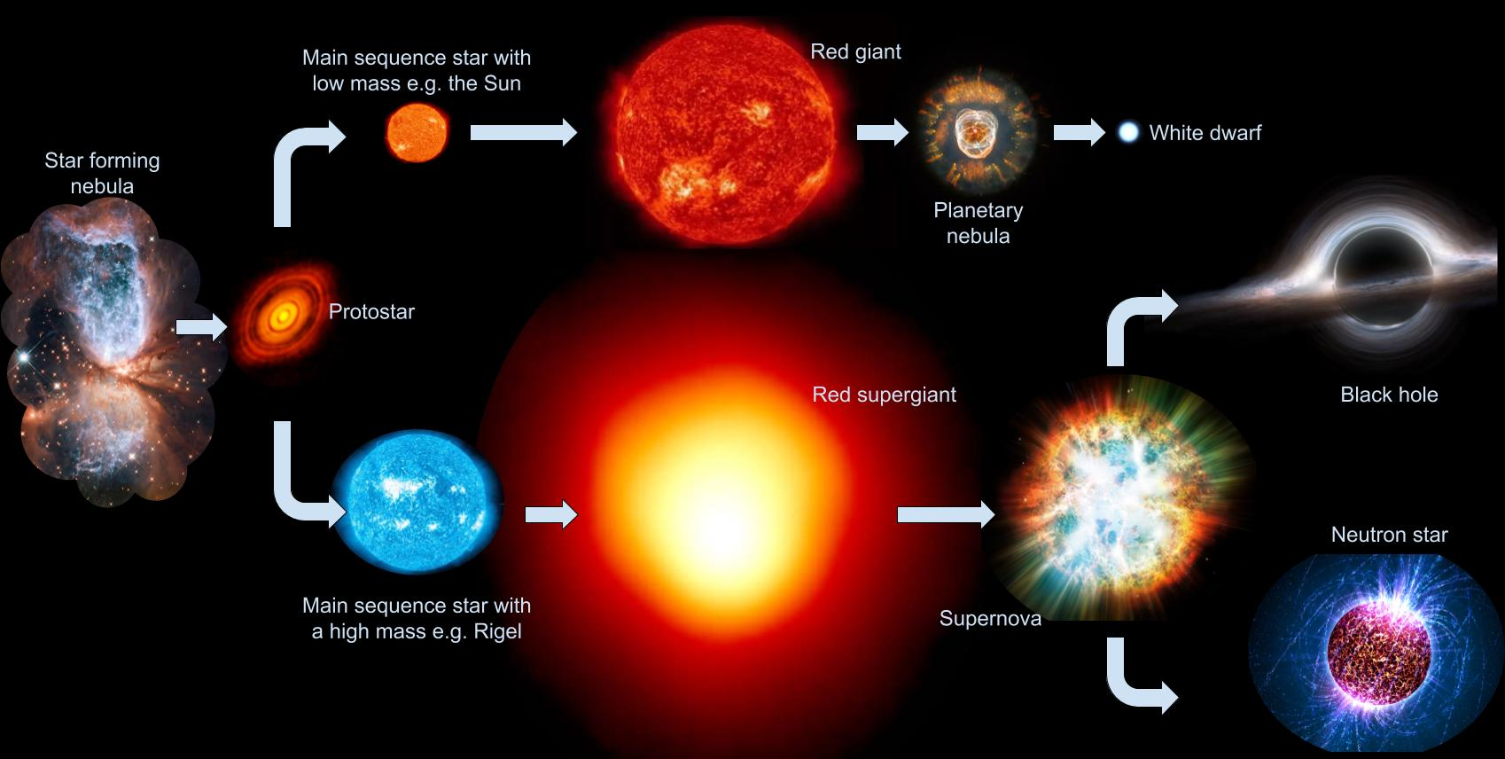
Lifecycle of a star
https://www.youtube.com/watch?v=TfkZ_GtS5wk
https://www.youtube.com/watch?v=9EnBBIx6XkM

Slide 48
Nebula
The pillars of creation from the Eagle nebula
A portion of the Carina nebula
The Orion nebula
Notes:
Nebulae are clouds of dust and gas that are bound by gravity. They are truly vast, being light years across. They host star-forming regions such as the pillars of creation in the Eagle nebula where the dust and gas becomes denser, attracting more dust and gas due to the additional gravitational field until a star is formed (more on that later).

Slide 49
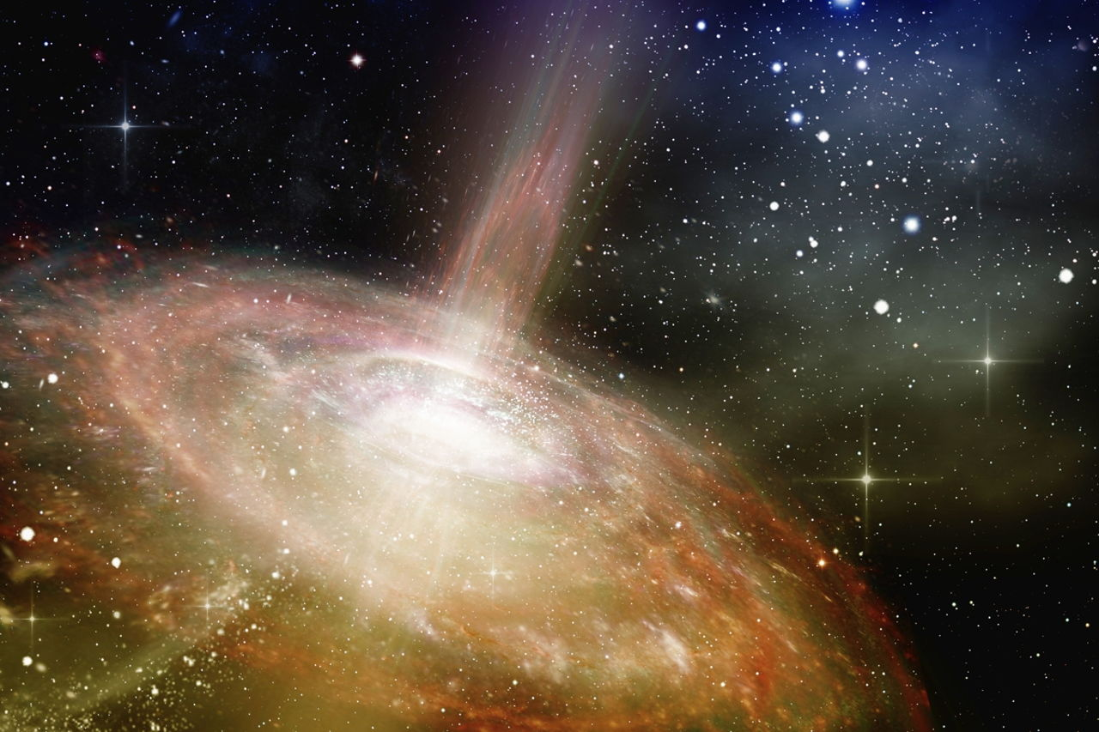
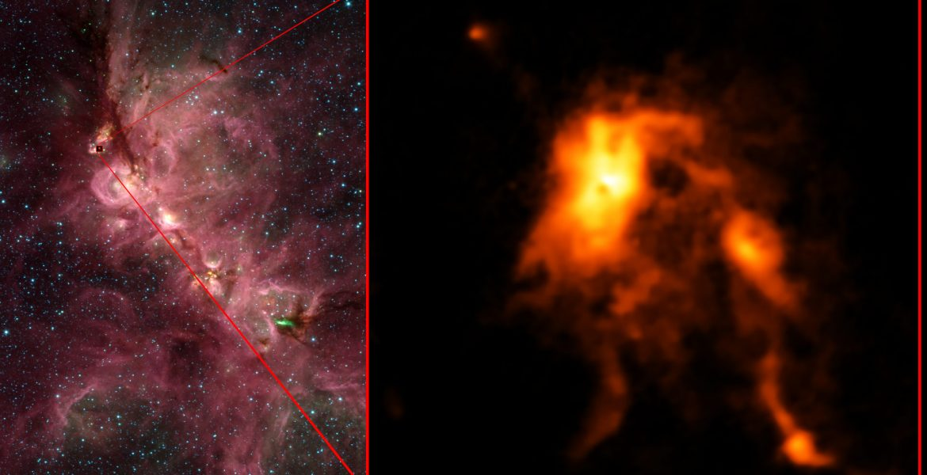
Protostar
Artist’s impression
Real image

Slide 50
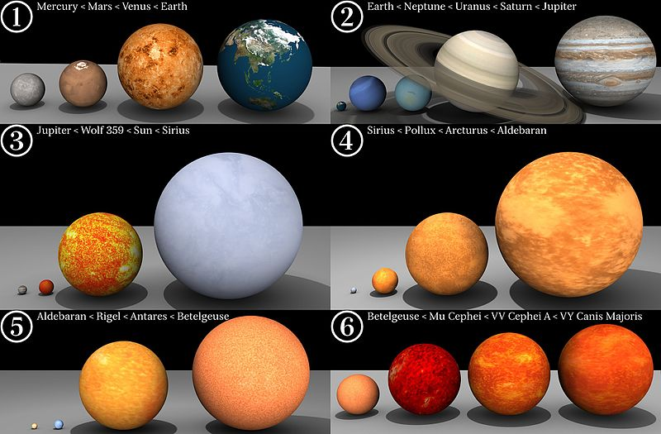
Main Sequence Stars

Slide 51
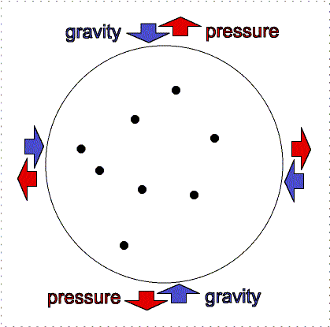
Main sequence stars

Slide 52
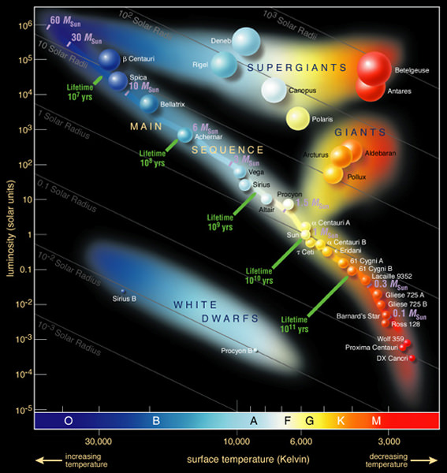
Aside: The Herzsprung Russell diagram

Slide 53

Aside: The Herzsprung Russell diagram

Slide 54
Birth of a star: answers
A cloud of dust and gas
Due to the force of gravity between them.
Density. The density of the dust and gas cloud increases.
Temperature is a measure of the average kinetic energy of particles.
Protostar
A single proton (a proton and a neutron if we consider deuterium – heavy hydrogen)
They have a positive charge and like charges repel.
Nuclear fusion – hydrogen nuclei being fused together to make helium
It doesn’t collapse due to the great amounts of energy that are released by nuclear fusion.
It doesn’t expand due to the gravitational force that pulls it together
Balanced/equilibrium
Main sequence

Slide 55
The fate of the stars
The fate of our sun
https://www.youtube.com/watch?v=iauIP8swfBY
Scale of the Universe:
https://scaleofuniverse.com/

Slide 56
The fate of the stars
https://www.youtube.com/watch?v=TfkZ_GtS5wk
https://www.youtube.com/watch?v=9EnBBIx6XkM

Slide 57
The fate of stars: answers
The nuclear store of the elements within the star itself – mainly Hydrogen.
Because the mass is being converted into energy (which we see as light).
The force of gravity weakens.
Unbalanced forces – we have a resultant force acting
The star expands
Red giant
Red supergiant
It decreases
Because the force from nuclear fusion reduces due to the lack of fuel and reduced temperature, meaning that gravity can once again compress it.
Because there is no Hydrogen for fusion.
Diagrams that show
Force from fusion larger than force from gravity
Force from gravity larger than force from fusion

Slide 58


Small stars form white dwarfs whist emitting a planetary nebula
White dwarfs at the centre of the emitted planetary nebula

Slide 59

White dwarfs will eventually (theoretically) form black dwarfs
Artist’s impression (for a whole bunch of reasons. Think of these yourself)

Slide 60



Large stars explode as supernovae

Slide 61

Neutron stars and black holes
Artist’s impression of a neutron star (left) and a black hole (right).
Scientists think they have seen a black hole swallow a neutron star: https://interestingengineering.com/like-pac-man-scientists-believe-they-detected-a-black-hole-swallowing-a-neutron-star

Slide 62
The end of a stars life: answers
A cloud of ionised gas released from the outer layers of a red giant when it collapses.
It has nothing at all to do with planets other than it’s roughly spherical in shape.
1.4x10²⁷m³
1.8x10⁹kg/m³
Because it emits no light and its small
Because white dwarfs haven’t had long enough to cool so far
An explosion that occurs towards the end of the life of a massive star
They are both emitted from dying stars. They both contain heavier elements than Hydrogen.
Supernovae are bigger. They contain the heaviest elements.
A neutron star and a black hole
Density. A black hole is more dense than a neutron star.
A white dwarf (then a black dwarf) as it is a low mass star.

Slide 63

The fate of stars: answers

Slide 64

Creating New Elements

Slide 65

Creating New Elements Beyond Helium

Slide 66

Creating New Elements Beyond Helium

Slide 67

Creating new elements
What can be made by fusion within stars

Slide 68

Creating New Elements

Slide 69

Creating New Elements: answers
In stars
An atom with a different number of neutrons
${}_{1}^{2}H+{}_{1}^{1}{H→{}_{2}^{3}{He}}$
${}_{2}^{3}{He}+{}_{2}^{3}{He→{}_{2}^{4}{He}+2{}_{1}^{1}H}$
Only up to Iron is more energy released by fusion than is required to bring the initial nuclei together.
By nuclear fusion in stars.
By supernovae (the deaths of the largest stars
They need a lot of energy to overcome the electrostatic repulsion between them.
Stars can only fuse elements up to Iron. Further than Iron requires more energy than is released. This energy is achieved only during a supernova when a star dies.
26 protons and 30 neutrons.
The supernova also spreads out the newly created elements in the explosion.

Slide 70

Aside: how did our solar system form? https://www.jpl.nasa.gov/edu/learn/video/space-place-in-a-snap-the-solar-systems-formation/

Slide 71


A source of waves

Slide 72

Red Shift

Slide 73

Blue Shift

Slide 74

Aside: Doppler shift and emission spectra from atmospheres of distant exoplanets

Slide 75

Red Shift and the Doppler Effect: answers
Source of waves, an observer, and motion between the two
The frequency increases
The frequency decreases
The wavelength decreases
The wavelength increases
$v=fλ$ so if the speed of the wave is constant (which it is if we don’t change the medium that the wave is in), then to keep a constant speed the frequency must decrease if the wavelength increases (and vice versa).
Because electromagnetic radiation would move towards the redder end of the spectrum

Slide 76
Red Shift and the Doppler Effect: answers
Lower pitch
Higher pitch
As it moves towards, the pitch is higher – frequency is larger, wavelength is smaller - blue shift. As it moves away, the pitch is lower -frequency is smaller, wavelength is longer - red shift).
As it moves towards, the light gets bluer - frequency is larger, wavelength is smaller - blue shift. As it moves away, the light gets redder - frequency is smaller, wavelength is longer - red shift.

Slide 77

Red Shift and the Doppler Effect: answers
$v=fλ$; 330=260x λ; λ=330/260=1.27m
The sound is a lower pitch (red shifted).$v=fλ$; 330=250x λ; λ=330/270=1.32m
$c=fλ$; 3×10⁸=f x 0.45×10⁻⁶; f=3×10⁸/0.45×10⁻⁶=6.7×10¹⁴Hz
$c=fλ$; 3×10⁸=f x 0.42×10⁻⁶; f=3×10⁸/0.42×10⁻⁶=7.1×10¹⁴Hz

Slide 78

Red Shift and the Big Bang Theory

Slide 79

Red Shift and the Big Bang Theory

Slide 80

Red Shift and the Big Bang Theory

Slide 81

Red Shift and the big bang theory

Slide 82

Red Shift and the Big Bang Theory

Slide 83
Red Shift and the Big Bang Theory: answers
Because the galaxies are moving away from us
Because all galaxies are demonstrated red-shifted light so it seems they’re all moving away. This is only possible if space itself is expanding.
We look at the emission spectra of the galaxy. As all stars are doing the same fusion process, the emission spectra should be identical if galaxies remain stationary. The emission lines are red shifted, showing the galaxies ae moving away.
The light from galaxies that are further away is more red-shifted than those that are closer. They must be moving away faster.
They extrapolated backwards. If everything is moving away from each other now, in the distant past it must have been closer together. The start of the Universe would have been when it was all at one point.

Slide 84
Red Shift and the Big Bang Theory: answers
The density of the Universe is decreasing as the volume is increasing.
The mass of the Universe is staying constant, just becoming more spread out.
Because it allows us to see how all galaxies can simultaneously move apart.
We have to focus on the rubber sheet. The gas inside the balloon has no meaning in our analogy.
The whole Universe was in a hot, dense state….

Slide 85
Aside: The Big Bang Theory
Hubble’s discovery
https://www.youtube.com/watch?v=A-vHAxc6djs
Discovery of the cosmic microwave background
https://www.scientificamerican.com/video/the-pigeon-the-antenna-and-me-robert-wilson/
The Big Bang Theory explained
https://www.youtube.com/watch?v=wNDGgL73ihY

