Slide 1



RSO recovery through blind stacking – Current results and future goals
Ben Cooke
University of Warwick

Slide 2
Contents
Motivation
Blind stacking introduction
Original simulation
INT dataset
Orbit refinement
Conclusions
Next steps/Future work

Slide 3
Motivation
The number of RSOs in Earth orbit has been increasing for years – Due to both scheduled launches and fragmentation events
Planned end of life and debris removal techniques are becoming important, but are still limited in scope
To ensure future safety and useability of earth orbit we need to measure and track the current and future RSO population
However, the smallest/faintest targets are hard to observe, especially if they are unknown
How do we detect faint RSOs, without requiring prior information on their locations/orbits?

Slide 4
Introduction – What is blind stacking?
A method for recovery of faint, moving targets with unknown or imprecise speed, direction and location
Relies on testing and comparing many orbits/paths on a pixel-by-pixel basis
Begins with a dataset of n frames
Procedure:
Choose a path to test (i.e. rate and direction of motion between frames)
Shift each image by the appropriate amount and combine the corresponding pixels
Compare stacked/integrated image with a master, replacing only the brighter pixels
Repeat steps 1-3 for each potential path
Notes:
Result is a single image in which moving targets are brightness spikes
Pros: Can detect multiple orbits in a single dataset
Cons: Computationally expensive – relies on GPU acceleration
Runtime dependent on number of paths – dependent on rate of motion

Slide 5
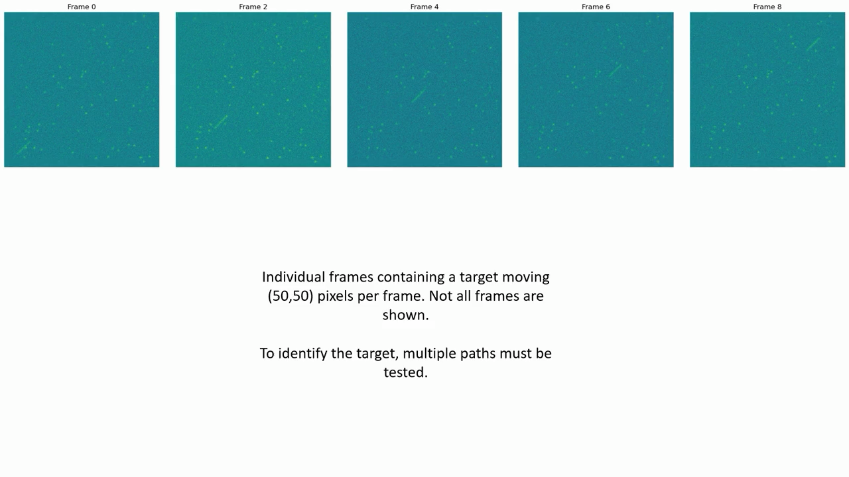
Introduction – Blind stacking visually

Slide 6
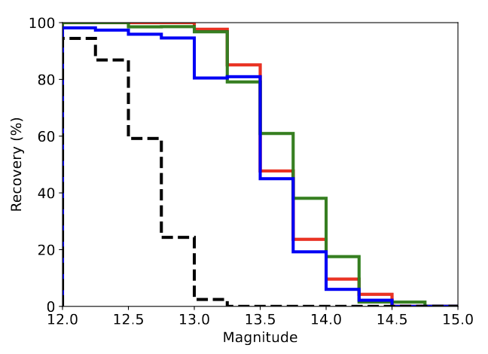
Original simulation
Simulation to determine the feasibility of using blind stacking to improve recovery of faint LEO targets
Based on a real CMOS dataset with injected targets
Tested a range of parameters including exposure time, frames per stack and binning factor
Showed an improvement of 1-1.5 mags depending on optimisation
Simulated recovery of LEO objects using sCMOS blind stacking – Cooke et al. 2023 (ASR)
Notes:
Results of our original blind stacking simulation are shown here

Slide 7
INT dataset – Introduction
Blind stacking works in a simulated environment – We want to confirm on a real-world dataset
Have access to a 2018 INT GEO satellite observing campaign
The data had been searched for GEO objects using individual frames – Could blind stacking recover missed targets?
Blind stacking code required some adaptations to run on INT dataset
Adaptations:
Mask out stellar streaks
Account for deadtime between exposures
Notes:
1. Observing campaign used stationary telescope – stellar streaks look like satellites – used mathematical morphology
2. Stacking and integration steps use different ‘exposure times’

Slide 8
INT dataset – Example detections
Notes:
Individual raw frames
Individual frames with binning
Median stack of raw frames, median stack of binned frames, blind stacking output/detection

Slide 9
INT dataset – Example detections
Notes:
Individual raw frames
Individual frames with binning
Median stack of raw frames, median stack of binned frames, blind stacking output/detection

Slide 10
INT dataset – Example detections
Notes:
Individual raw frames
Individual frames with binning
Median stack of raw frames, median stack of binned frames, blind stacking output/detection

Slide 11
INT dataset – Magnitude histogram
DebrisWatch I: A survey of faint geosynchronous debris – Blake et al. 2021 (ASR)
Notes:
Combination of original single-frame detections, and extra blind stack detections – 15 new detections
Majority of original detections recovered in blind stacking as well

Slide 12
INT dataset – Limitations
INT dataset is not ideally suited for blind stacking
Each pointing has only ~5 frames – Limits the amount of stacking possible
Exposures are long, leading to long streaks and thus many paths to test
Deadtime is significant – Increases motion between frames without increasing usable data accordingly
Want to employ blind stacking on a better suited dataset
Have a 36cm astrograph (RASA) dataset taken in parallel with INT
Better suited for blind stacking:
More frames per pointing
Shorter exposures
Reduced deadtime
Notes:
INT telescope: 2.54m
RASA telescope: 36cm

Slide 13
INT dataset – Conclusions/Next steps
Have shown that blind stacking works in a real-world scenario
Improvement in number and magnitude of recovered targets
Even on a limited dataset
Next step is to run algorithm on RASA data and compare results to INT – How does a small telescope with better suited data compare to a large telescope?
Hope to publish results, alongside open access full blind stacking code
Applicable to any dataset looking for faint moving targets
Blind stacking code for RSO recovery: Three case studies – Cooke et al. (in prep.)

Slide 14
Orbital refinement – Introduction
Blind stacking detections provide a single location and direction/magnitude of motion
Good for population studies but even small uncertainties result in a large range of orbits
Observing a second detection of the same target can improve the precision on the extrapolated orbit
Original detection can be used to inform/target the second
An informed second detection can be much less computationally expensive
Begin with a simulation – Attempt to target and recover the same RSO and thus refine its orbit
Notes:
We can use blind stacking to identify targets, but how do we go further than that?

Slide 15
Orbital refinement – Original detection
Notes:
Original blind stacking detection of a simulated RSO
Detected through a full blind stacking search – no prior knowledge so tested over 200 paths

Slide 16
Orbital refinement – Extrapolated values
Notes:
Based on original detection location and motion, we can predict a second location and motion a short time later
Precision depends on original detection precision and elapsed time

Slide 17
Orbital refinement – Targeted stacking
Based on the extrapolated values and targeted paths we can attempt a targeted recovery of the same target
Target recovery requires significantly less resources than a full blind stacking approach
Result is two detections of the same target
We can now use this second detection to compare the inferred orbital precision using 1 or 2 detections
Notes:
Based on these extrapolated values, we can refine the blind stacking search area for a second detection
4/216 paths
~2% - factor of 54 decrease
No loss in recovery accuracy/precision

Slide 18
Orbital refinement – P4 distribution
Notes:
Plot showing position precision of a target later in its orbit
Red: using the original blind stacking detection
Blue: combining the original blind stacking and second targeted stacking detections

Slide 19
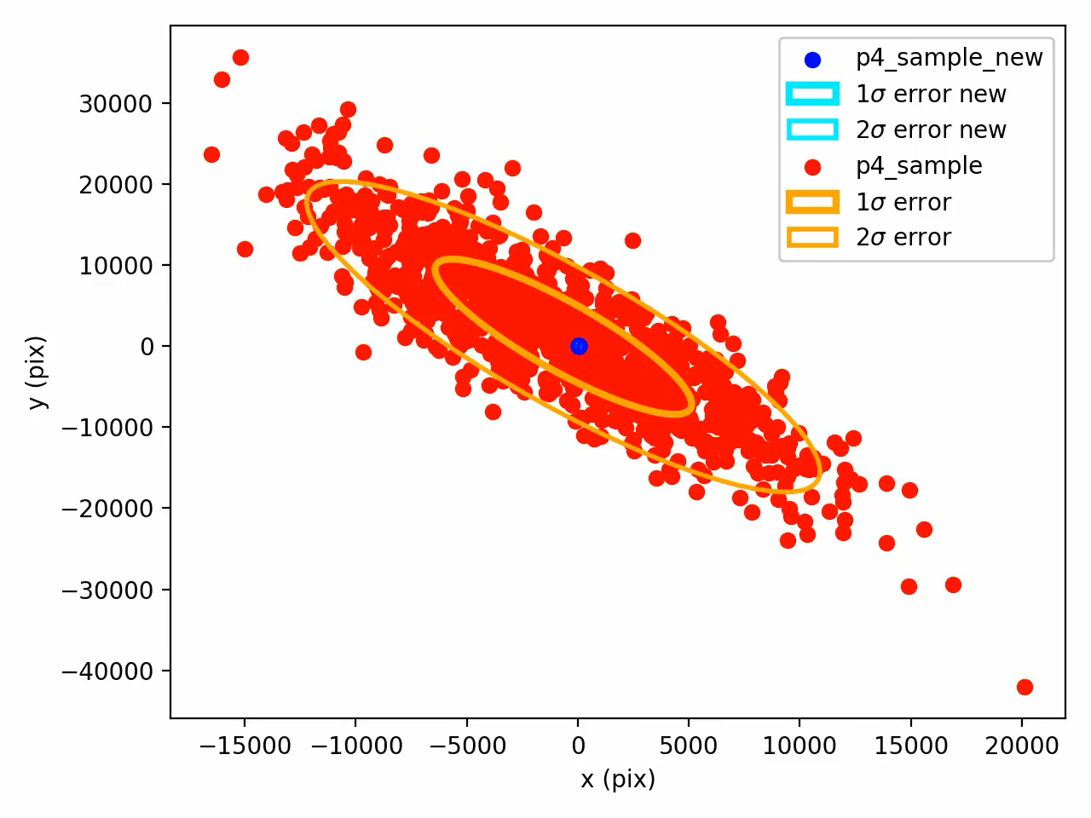
Orbital refinement – P4 distribution
Notes:
Orders of magnitude improvement in extrapolated location

Slide 20
Orbital refinement – P4 orbits
Notes:
Plot showing range of allowed orbits
Red: using the original blind stacking detection
Blue: combining the original blind stacking and second targeted stacking detections

Slide 21
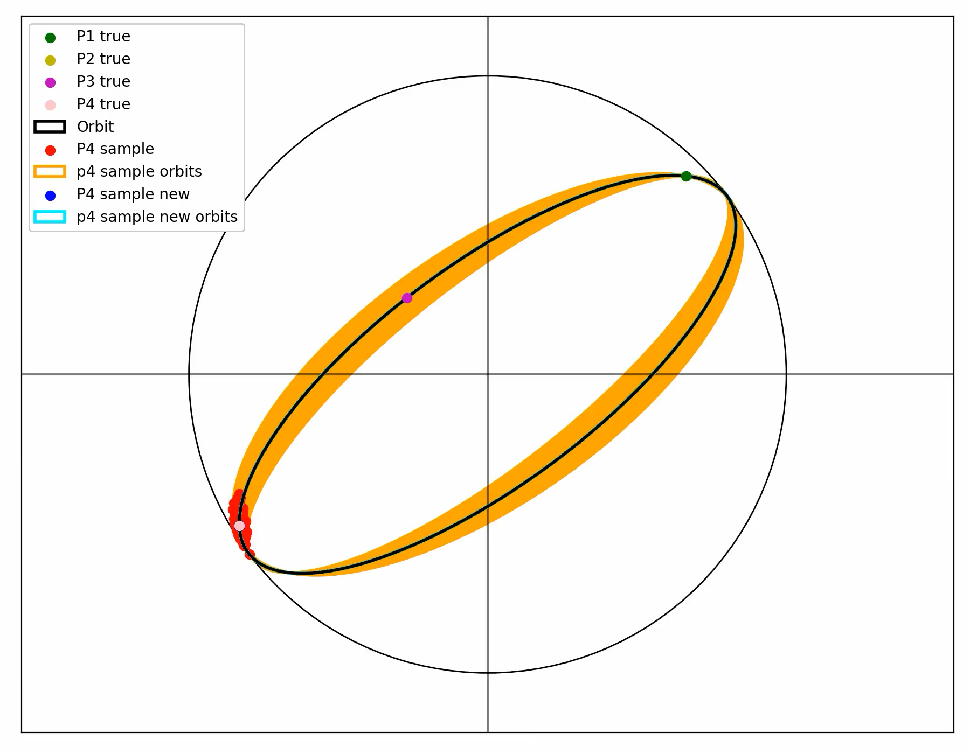
Orbital refinement – P4 orbits
Notes:
Orders of magnitude improvement in inferred orbit precision

Slide 22
Orbital refinement – Conclusions/Next steps
Shown that an initial blind stacking detection can be used to aid in a targeted recovery at a later time
Significantly reduces computational time required
Have also shown that a second detection of the same target significantly improves the orbital parameters of a target and thus the ability to catalogue it effectively
Simulation requires further development
What is the optimal time for a second detection to ensure positive identification, while limiting search space and maximising orbital classification?
Need to account for physical and temporal limitations
Orbital refinement of blind stacking detections – Cooke et al. (in prep.)

Slide 23
Conclusions
Blind stacking has been proved to be successful on real-world data
Multiple new, faint RSO recoveries, even in a non-ideal dataset
Blind stacking detections can be leveraged to target further detections of the same target and thus refine orbital parameters
Extrapolating a blind stacking detection can allow for a re-detection using a fraction of the computational resources
Orbital precision is enhanced significantly using even a single further detection

Slide 24
Next steps/Future work
Test blind stacking algorithm on a more appropriate dataset
How does the magnitude improvement differ
How does a small telescope using blind stacking compare to a much bigger telescope
Publish an open-source version of blind stacking algorithm
Applicable to any dataset searching for moving targets
Further development of orbit refinement simulation
How best to optimise set-up to minimise computational requirements and maximise orbit refinement

Slide 25
Thank you!
benjamin.cooke@warwick.ac.uk

