Slide 1
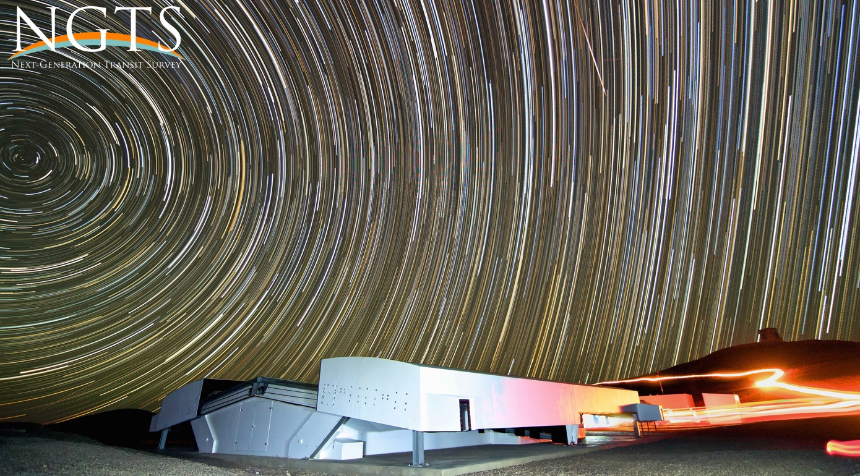
What is a sCMOS camera?
Ioannis Apergis

Slide 2
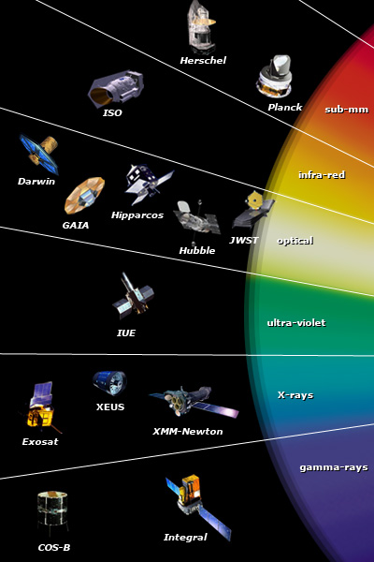
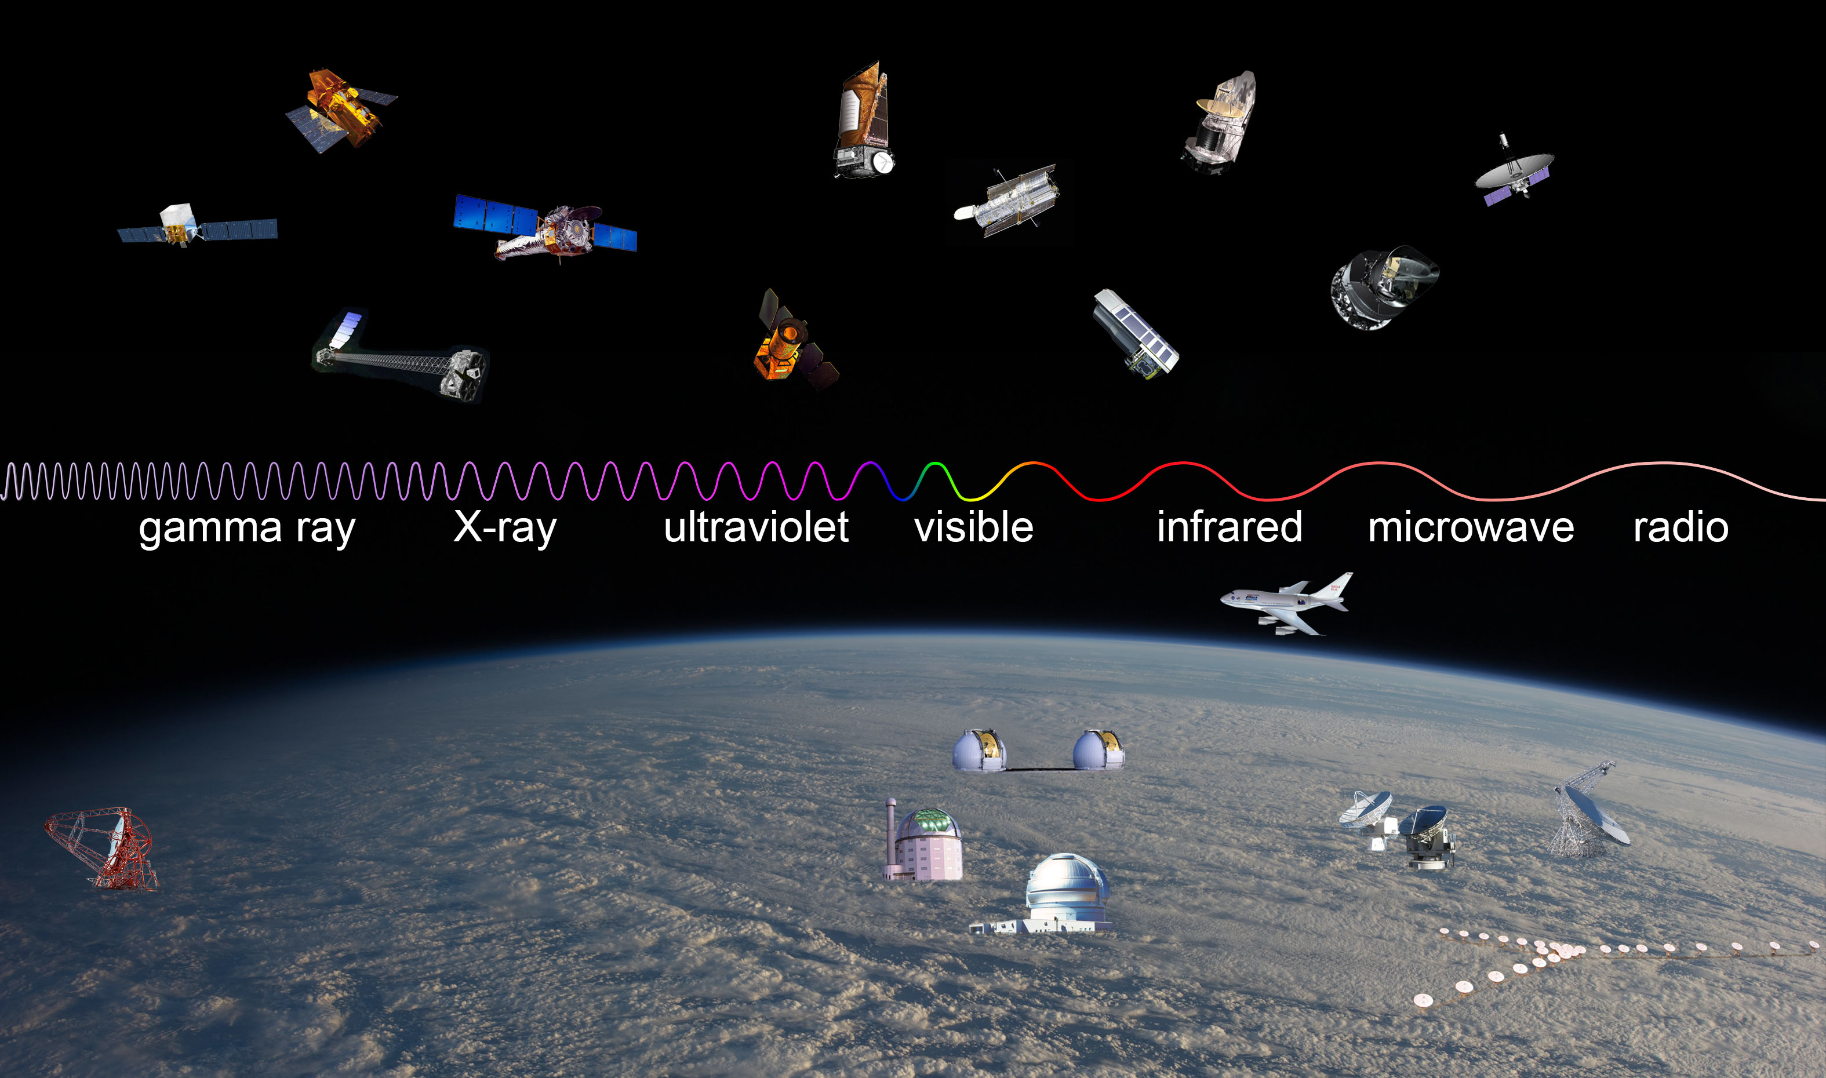
How do we observe the sky?
We use telescopes to observe in different wavelengths
Some of them on Space some others on Earth
Detectors sensitive at different wavelengths

Slide 3
What are calibration images?
Apart from the science data we also record some images during the night of observations.
This images are usually measuring the behavior of our instrument, artefacts of our instrument and the telescope itself.
To correct the science images.
Calibration images are:
Bias images
Dark images
Flat images

Slide 4

Bias images
We record these type of images before or after the observations take place.
These images are taken with 0 exposure and without light (shutter on)
They measure the signal that comes from the electronics of the sensor.

Slide 5
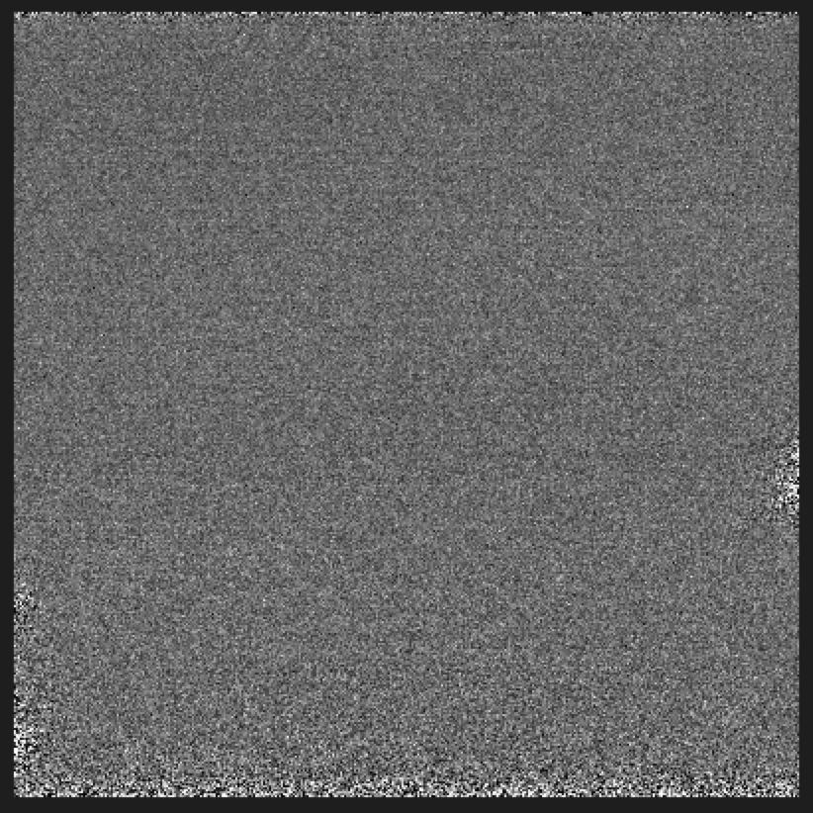
Dark Images
Heat is generated inside the sensors
During an exposure, incident photons, heat from the electronics and the environment, all will sum up to increase the dark current
Linear with exposure
Exponential dependency with temperature
Solution = cool the sensor!

Slide 6
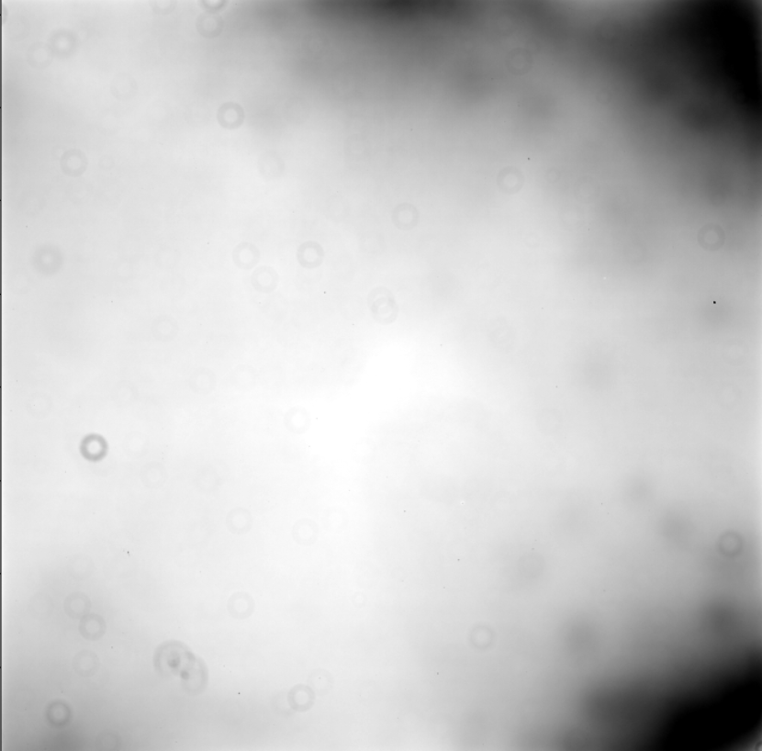
Flat images
Record a uniform area of sky at half the saturation
Usually on after sunset (dusk flats)
Before the sun rising (dawn flats)
Used to remove variations in illumination
To remove pixel variations
To remove artefacts from the lenses (vignetting)
To remove dust in on the lenses

Slide 7
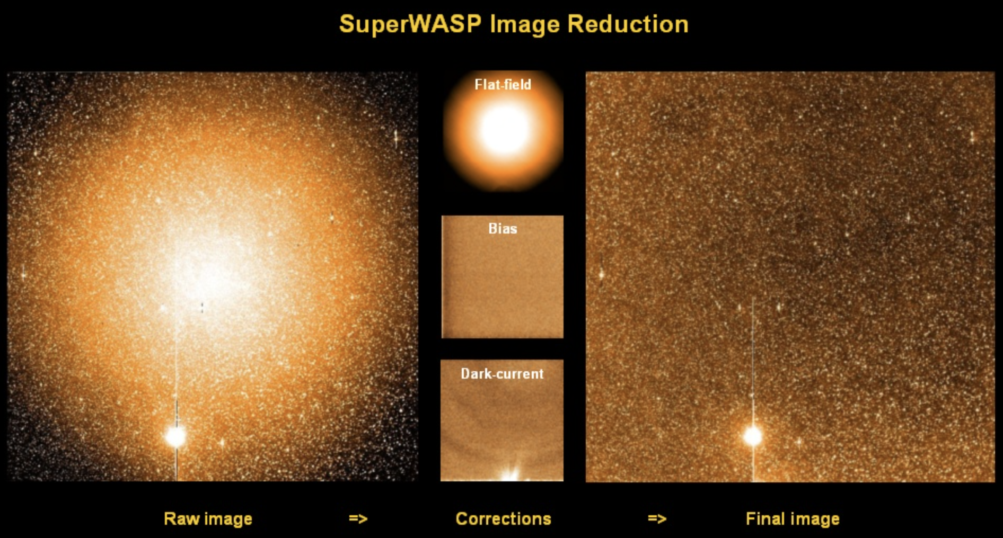
Image reduction process
We used these calibration images to correct them from our science frames
image from https://www.superwasp.org/about/

Slide 8
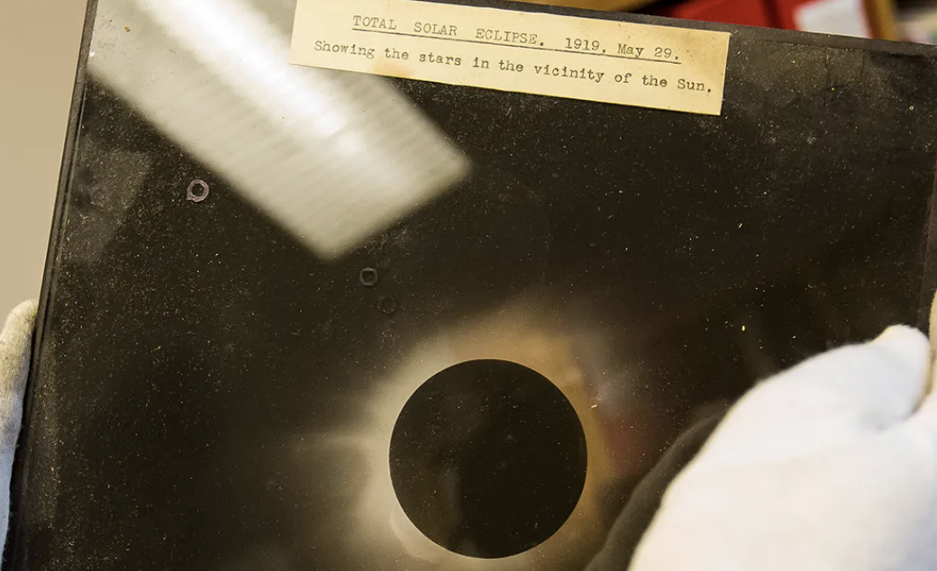
Astronomical Detectors: Photographic Plates
Made of gelatin and/or silver halide crystals
Adjust the plate on the telescope
Acquire long exposures
Post process in dark room with specific chemicals
QE peak at 10% in Blue and UV
Used for at least 150 years

Slide 9
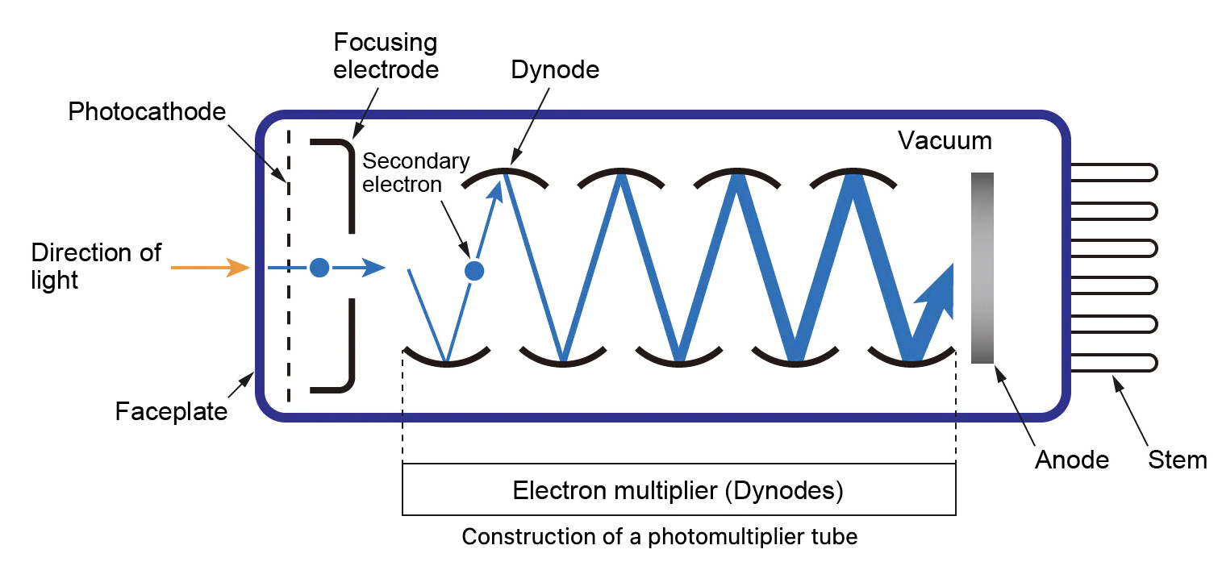
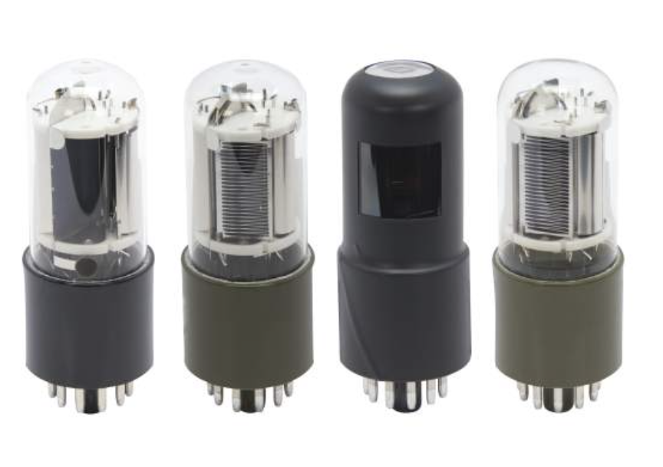
Astronomical Detectors: Photomultiplier Tubes (PMTs)
Works with the photoelectric effect
Photons react with the photocathode
Faster response time that a CCD
QE peaks at 35%
Stop being used in observatories since 80s

Slide 10
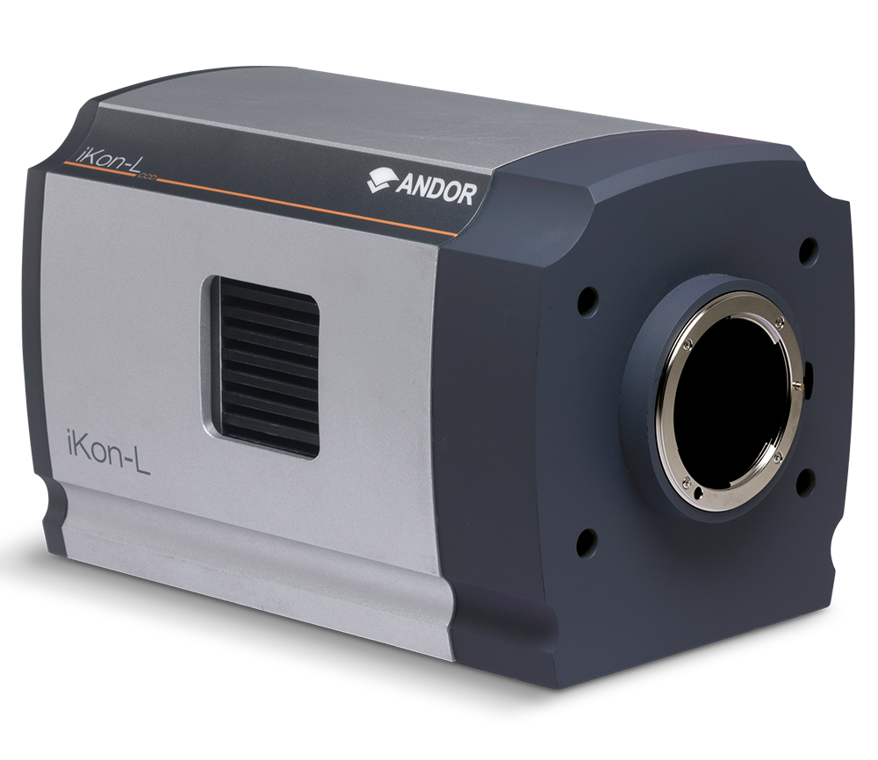
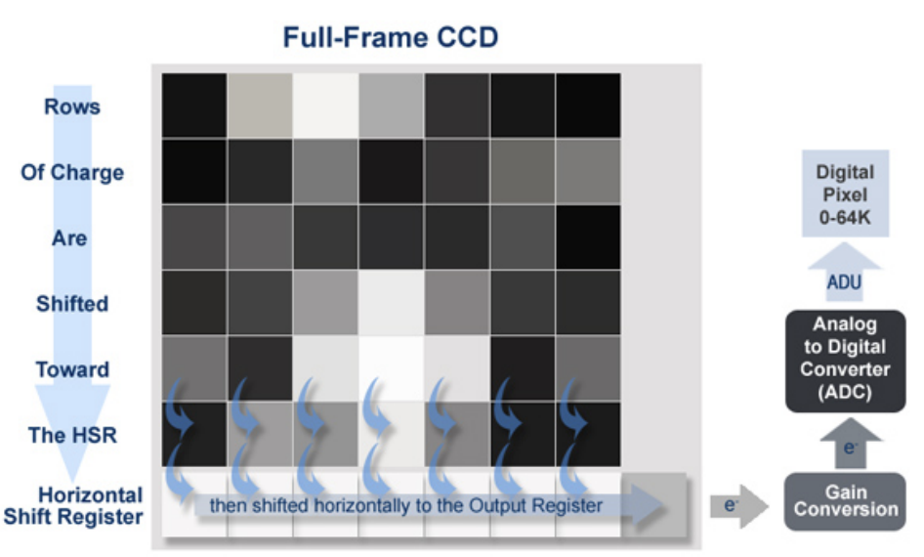
Astronomical Detectors: CCD
Known as Charged-Coupled Device
Made by silicon material
It is an integrated circuit
Captures light and produce electrons
Using the photoelectric effect

Slide 11
CCD: Advantages – Disadvantages
Good dynamic Range
Have been in Astronomy more than 40 years
Deep depletion technology, QE’s peak at various wavelengths
Slow scan camera (low speeds)
High read noise
Operates with mechanical shutter for reading out
Large power consumption

Slide 12
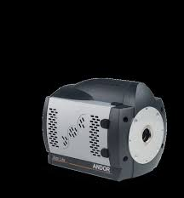
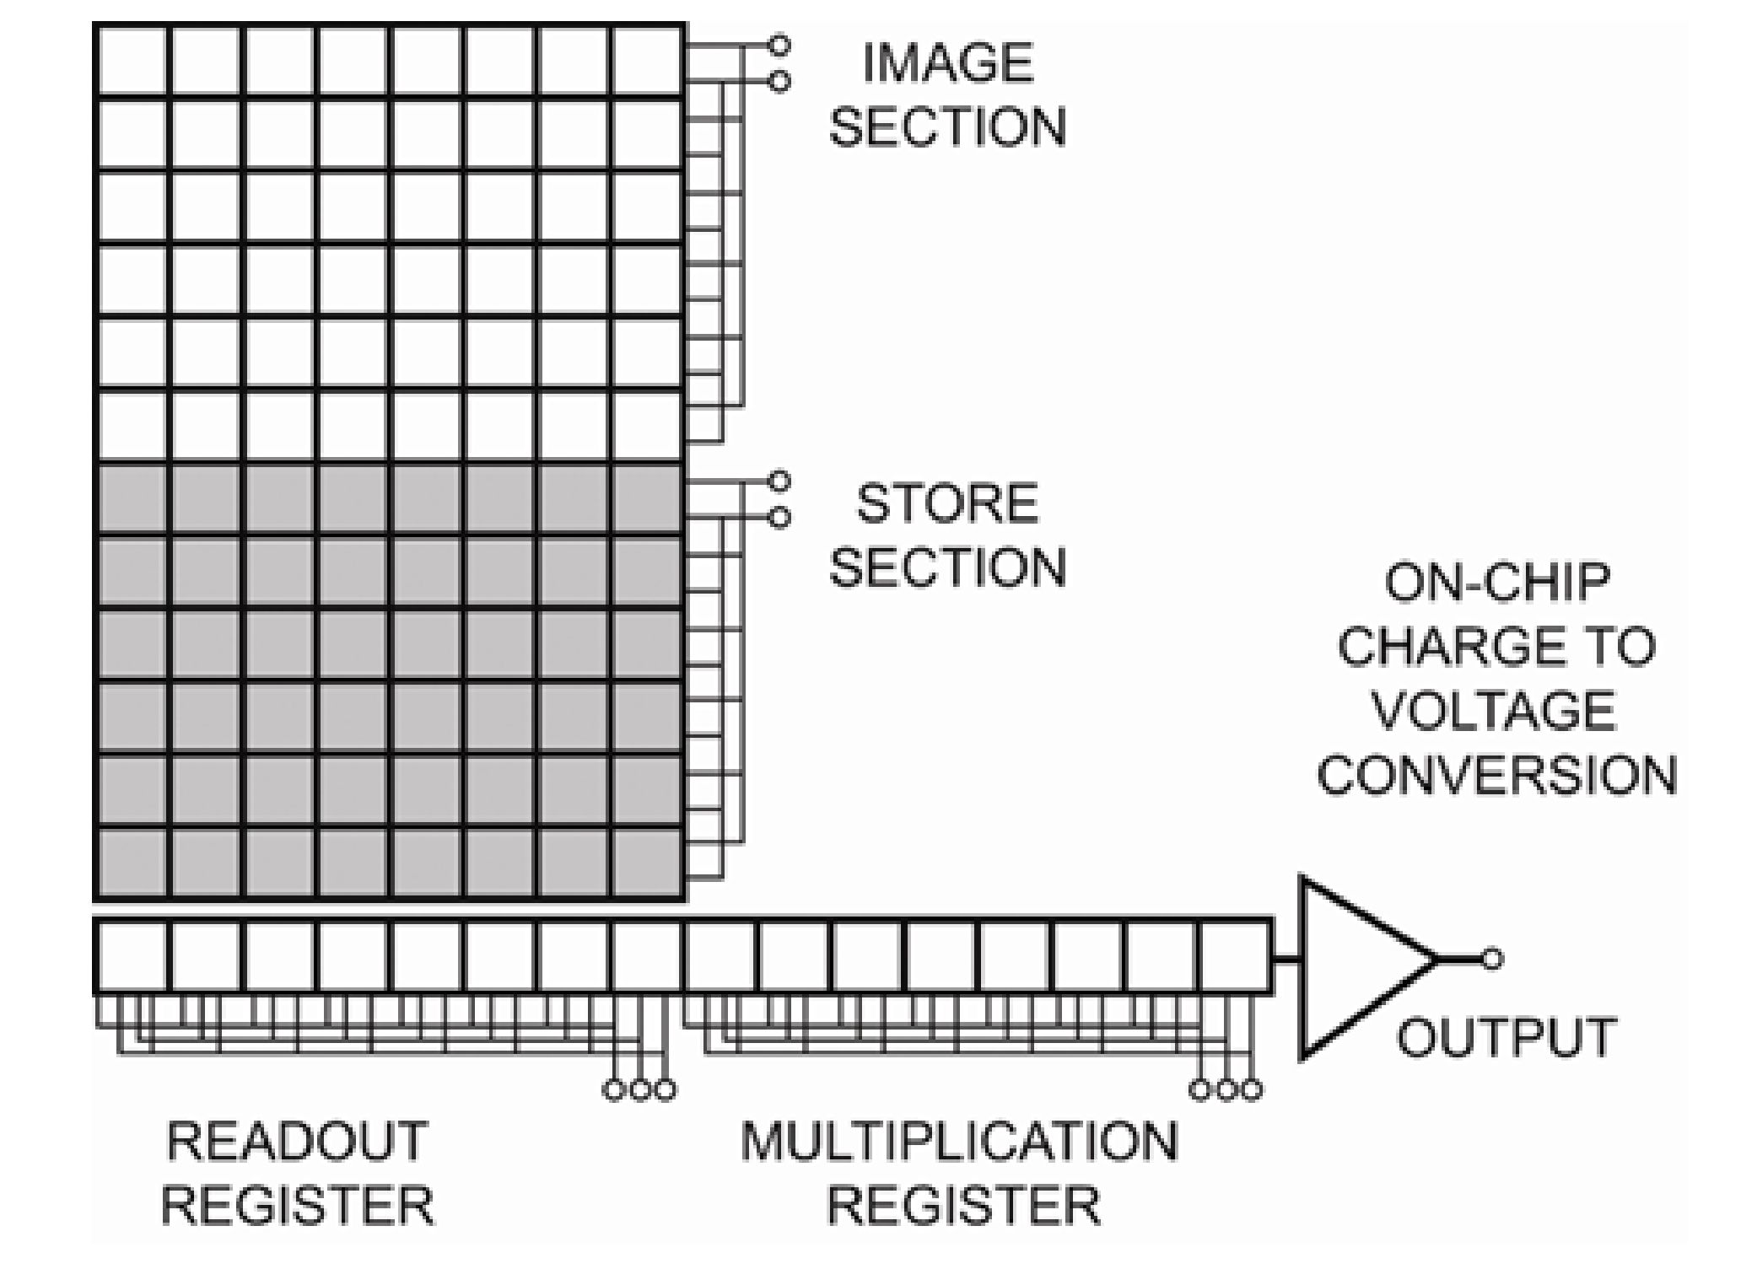
Astronomical Detectors: EMCCD
Electron Multiplying CCD Camera
Made by silicon
Frame transfer to the storage area
It is an integrated circuit
Capture light and produces electrons
Amplifying the charge signal prior to the readout

Slide 13
EMCCD: Advantages – Disadvantages
Produces very high speeds modes
Extended dynamic range
Suffers from gain aging effects (parasitic effects)
Charge Induced Charge (CIC) problems – impact ionization

Slide 14
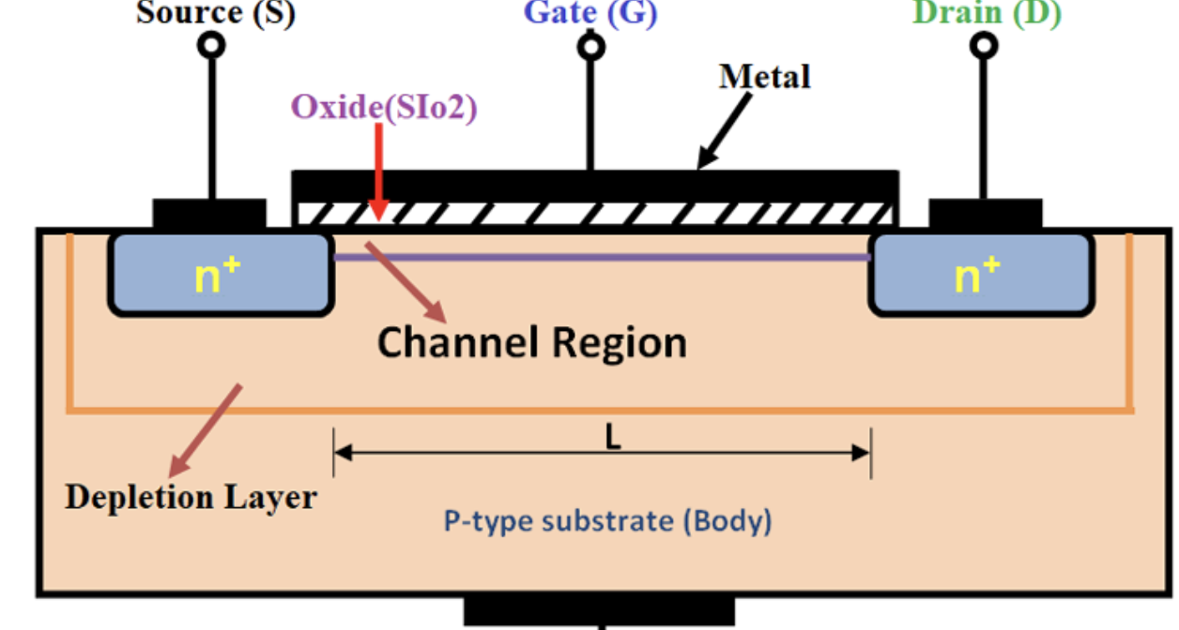
sCMOS? What is a sCMOS
Scientific Complementary Metal Oxide Semiconductor (sCMOS)
Metal = Controls the flow
Oxide = Insulator
Semiconductor = Charge is generated via photoelectron effect

Slide 15
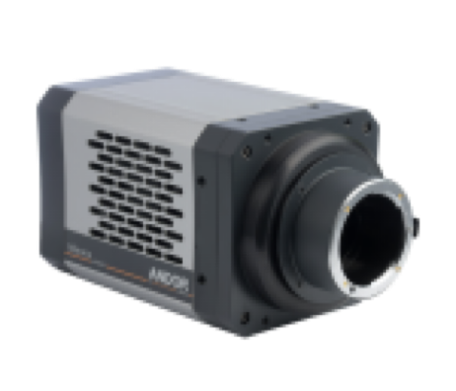
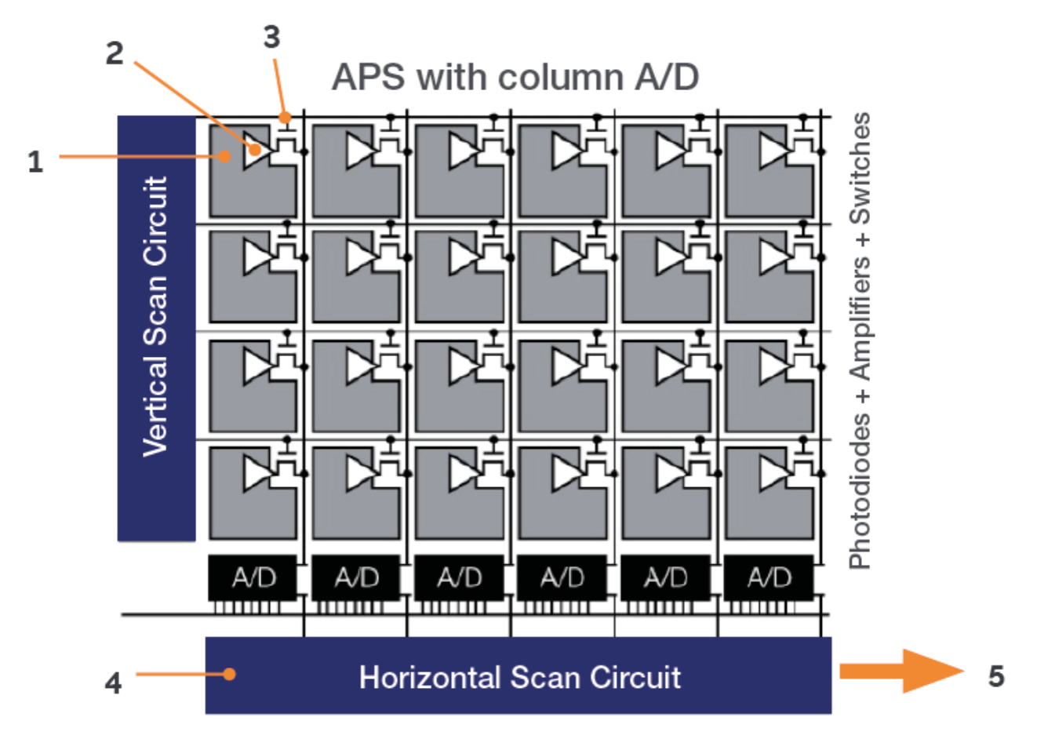
Astronomical Detectors: sCMOS
Photosensitive area / photodiode
On pixel amplifier to convert to voltage
Analog to digital signal conversion takes place
Final digitized signal is then readout

Slide 16
Astronomical Detectors: sCMOS
Offer low read noise
Extended dynamic range
Fast frame rate and high speeds
Global shutter = shutterless operation
Low power consumption
Large dark current / glow
Only comes with Front / Back sided thinned illuminated sensor architecture (at least for now)

Slide 17
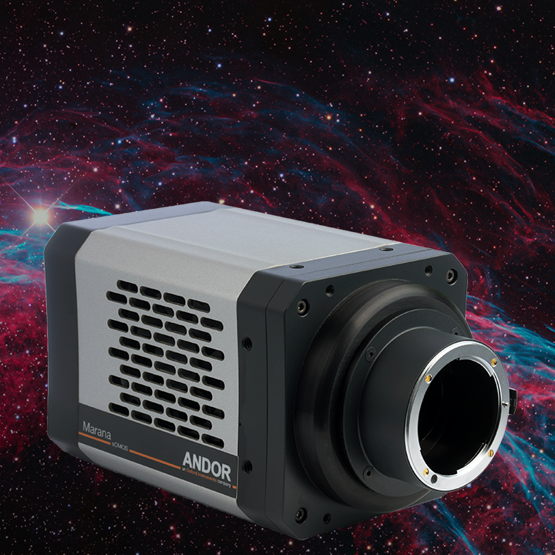
The case of Andor Marana sCMOS
Back-side illuminated sensor
Pixel size / sensor size: 11 x 11 um / 22.5 x 22.5 mm
Readout Rate: 100 / 200 MHz in HDR/FFR
Read noise: 1.6 e-
Full Well Capacity: 70000 e-
Dark current: 0.7 e-/pix/sec @ -25

Slide 18
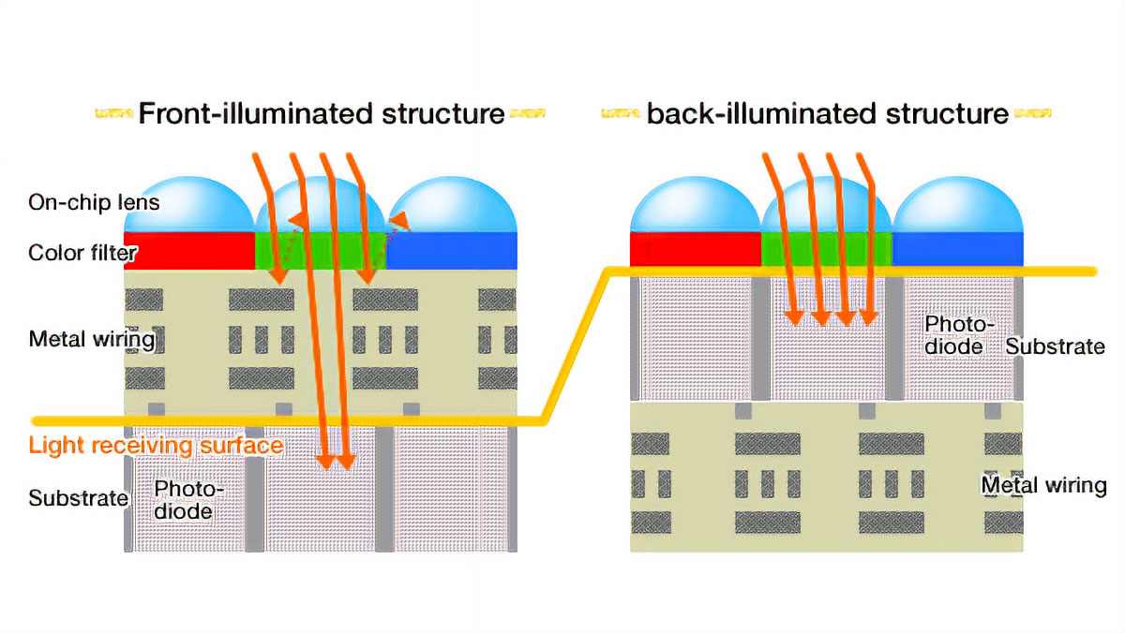
Back side illumination?
New generation CCDs and sCMOS feature a back-side illuminated pixel architecture.
This enlarges the QE of the cameras, without the need of micro-lenses in front of the silicon

Slide 19
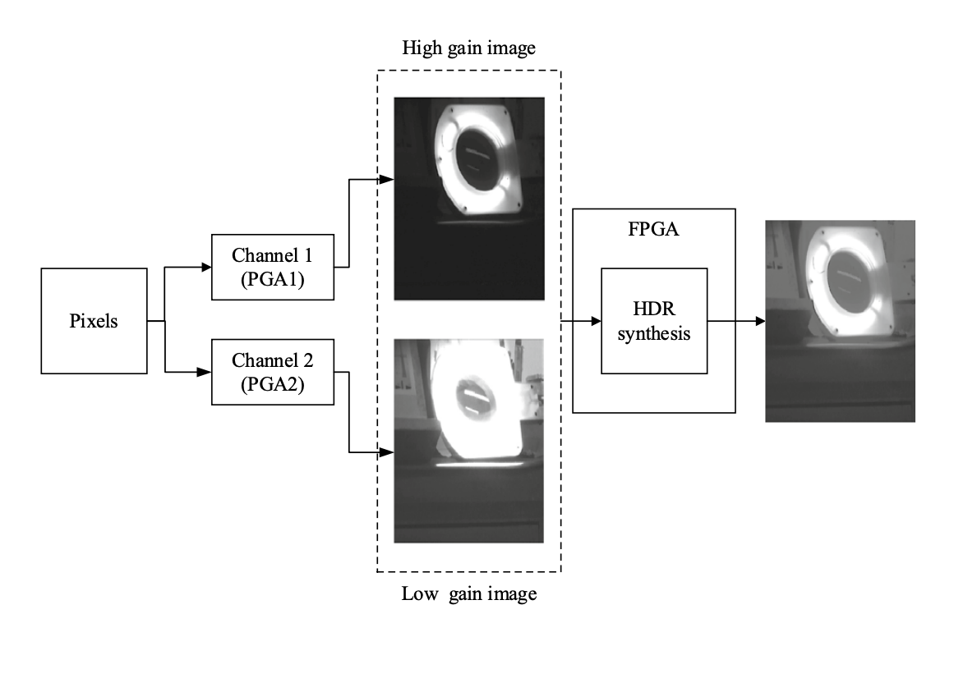
Marana Features HDR
The camera reconstructs a High Dynamic Range image from two channels
One with High Gain (sensitive to low light conditions)
One with Low Gain (sensitive to large light conditions)

Slide 20
How to characterize a camera?
Measure the Read Noise = ?
Measure the Dark current = ?
Measure spatial non-uniformities (PRNU, DSNU) = ?
Measure photon transfer curves = ?

Slide 21
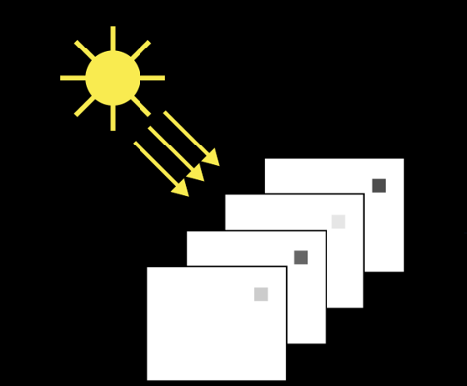
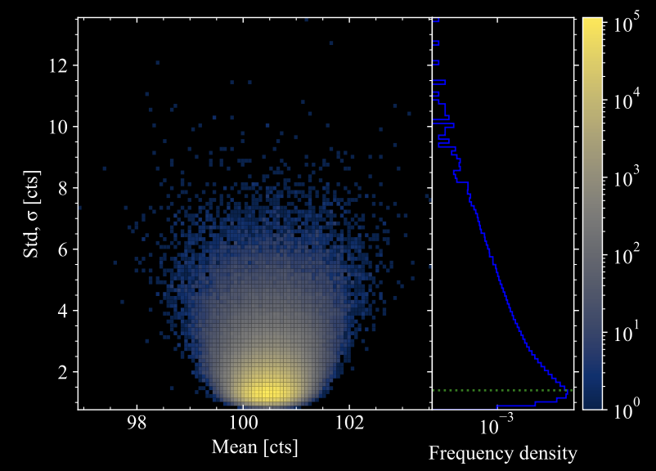
Temporal noise without light
The variations per pixel basis between the images is the temporal noise of the camera.
Without considering light and at 0 exposure this is the read noise of the camera.

Slide 22
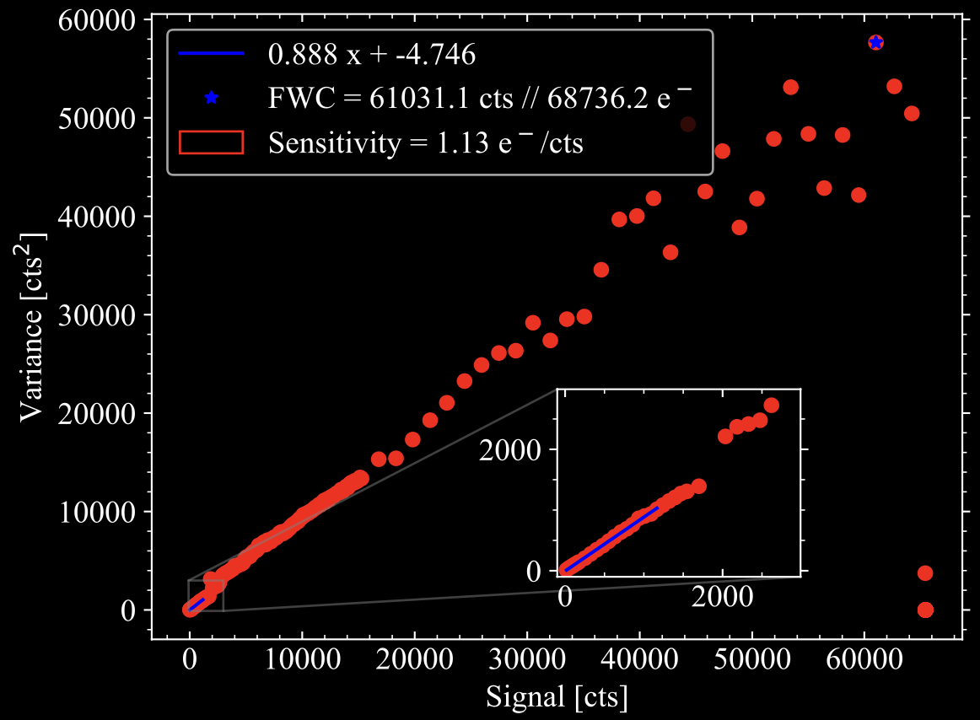
Temporal noise with light
It is the photon shot noise when images are illuminated
discrete light = incident photons following the Poisson statistics
Poisson statistics = probability distribution that describes the number of events that occur within a fixed interval of time

Slide 23
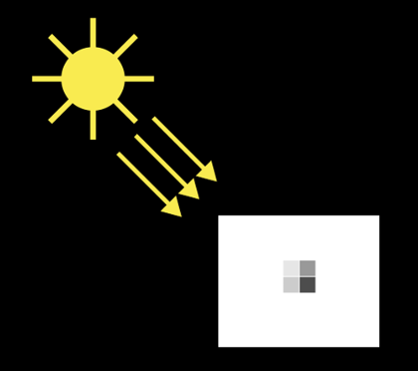
Spatial noise without light
With the spatial noise we measure the variations between the pixels on the same frame
On dark conditions and at 0 exposures
This known as Fixed Pattern Noise in dark
We measure the dark signal non-uniformities (DSNU)

Slide 24
Spatial noise with light
Again, we measure the pixel variations but with light on the same image
This is very similar to a flat image as we mentioned earlier
This is known as Fixed Pattern Noise in light
We measure the Photon Response Non-Uniformity (PRNU)

Slide 25
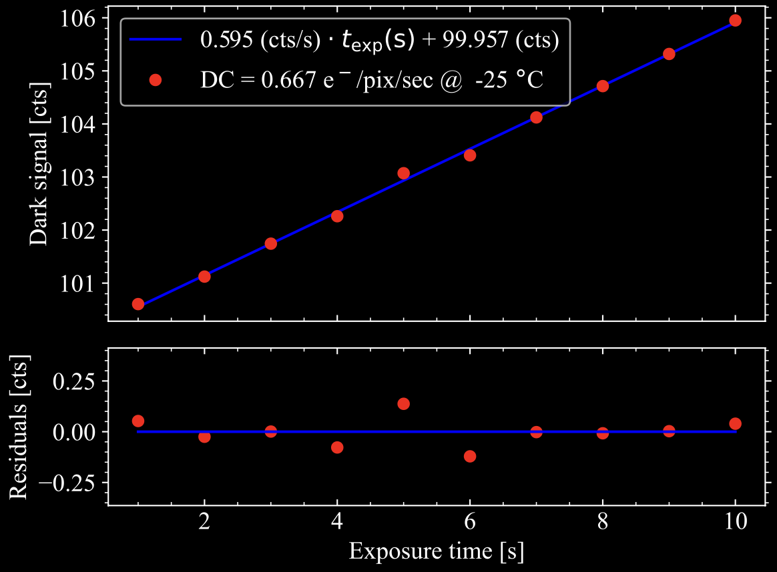
Dark current measurement
We measure the linear response of the dark signal with respect the exposure
By modeling it with a linear fit we can extract the slope which measures the dark current
The intercept indicates the bias level

Slide 26
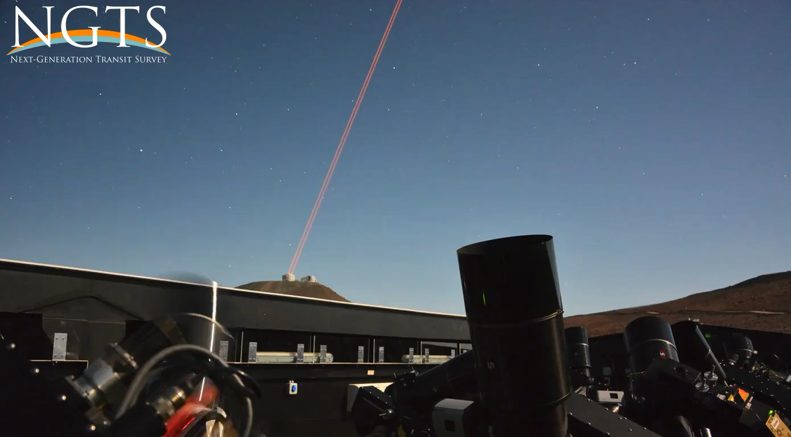
The NGTS survey
Located at Paranal Observatory
Compose of 12 robotic fully automatic 20 cm aperture telescopes.
Made to detect exoplanets via the transiting method
Equipped with 12 deep depleted CCD, sensitive to red wavelengths – perfect for red stars

Slide 27
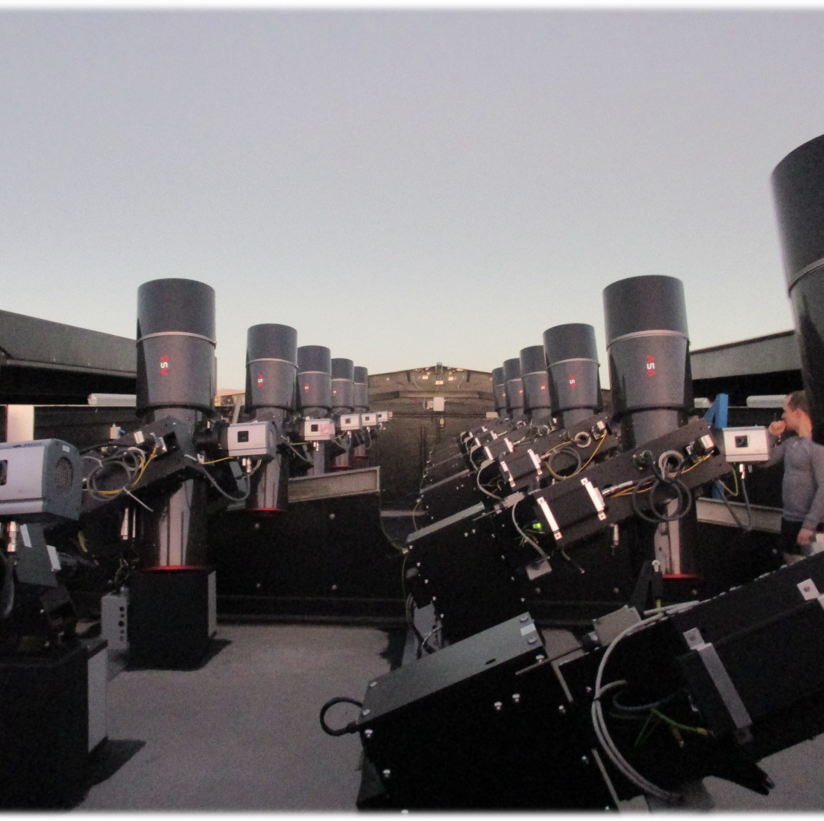
Our Plans
To use the sCMOS Marana by replacing it with one of the CCDs
Directly compare their photometric performance and the precision on a transiting exoplanets
sCMOS will provide higher temporal resolution?
sCMOS operate shutterless
sCMOS is sensitive to blue rather than red

