Slide 1
Conor Byrne, Marcelo Aron Fetzner Keniger
(+ Lauren Doyle, Ben Davies, Tafadzwa Zivave)
UK National Astronomy Meeting
Birmingham, July 22nd, 2026
Notes:
Hello, everyone. My name is Marcelo, and I’m here with Conor on behalf of the University of Warwick planetarium team to tell you a bit about our activities and how outreach with a mobile planetarium works. First, I would like to thank the organising committee for giving us the opportunity to talk in this session.

Slide 2
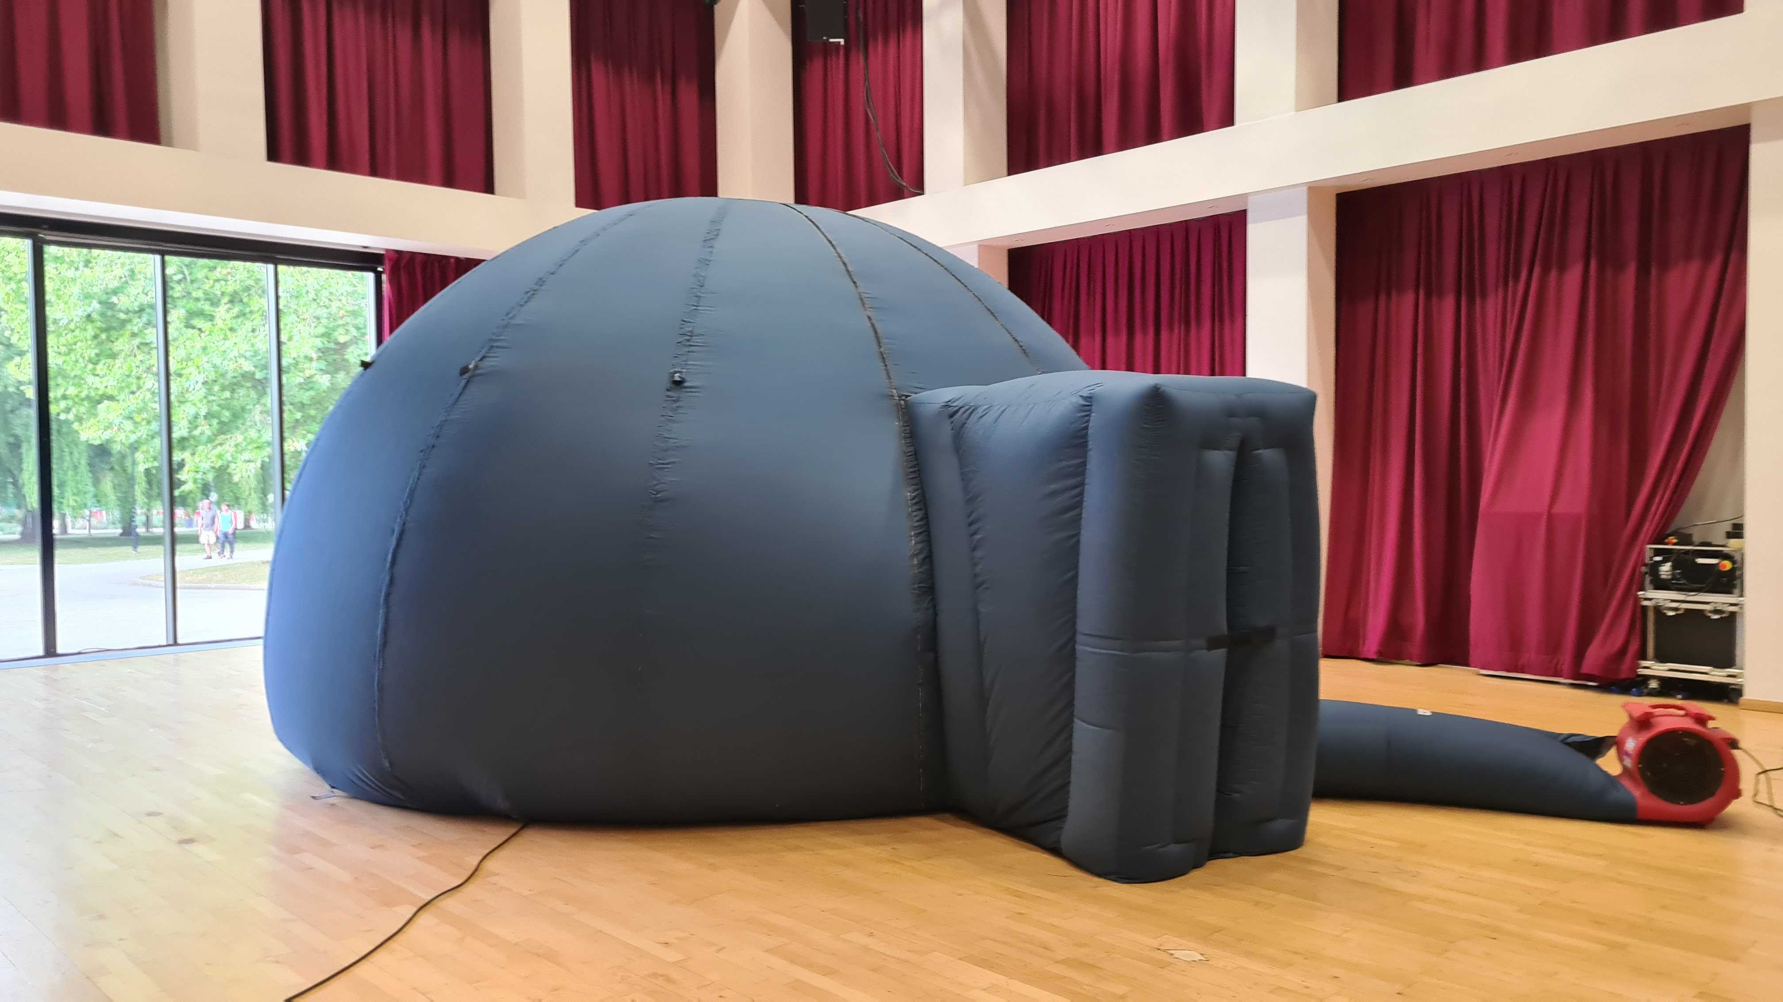
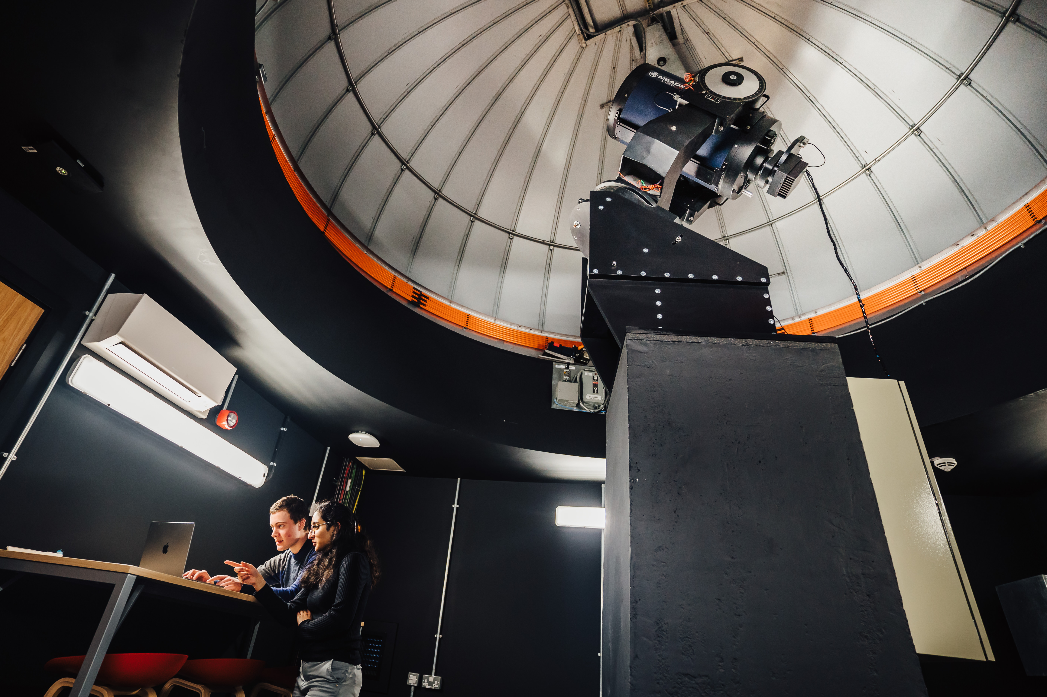
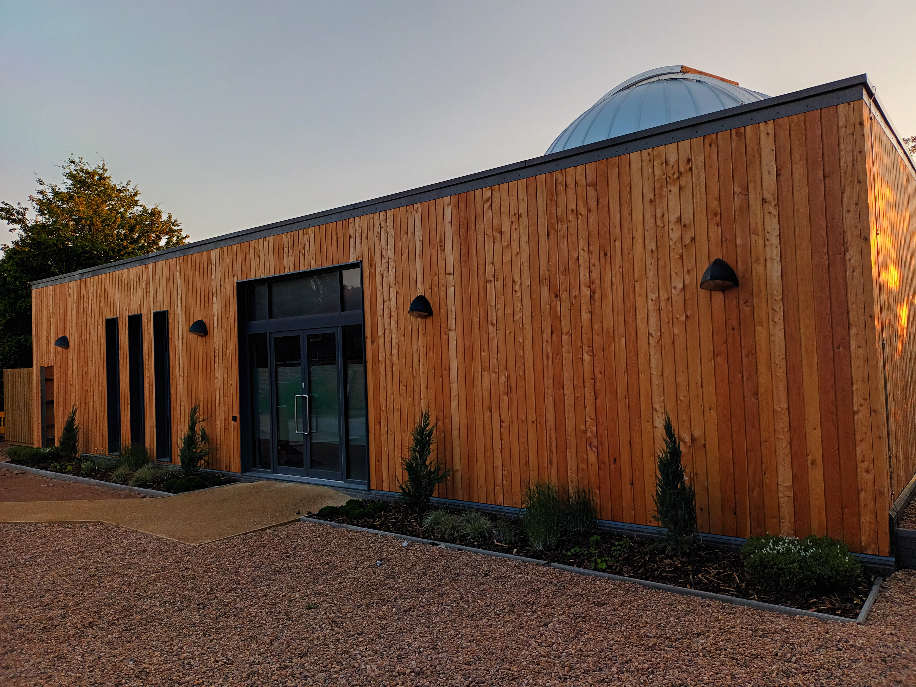
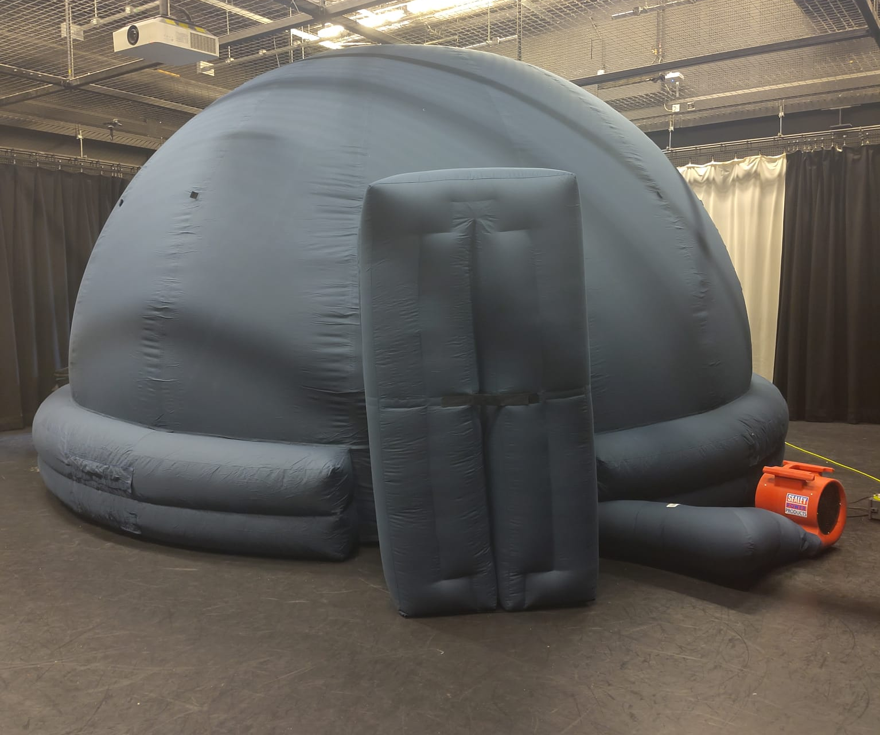
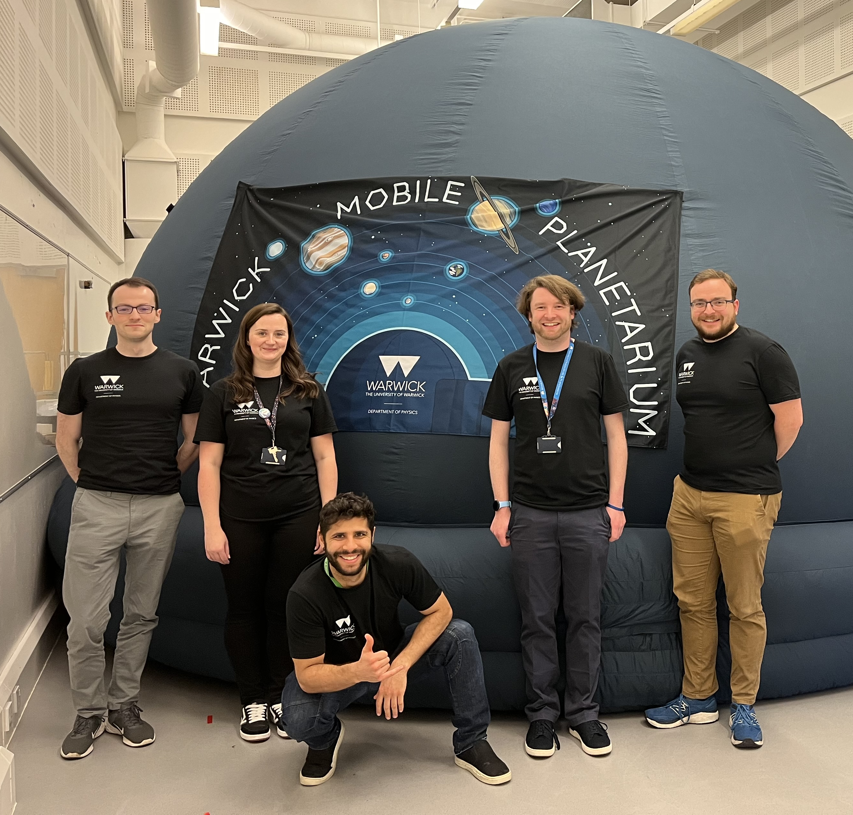
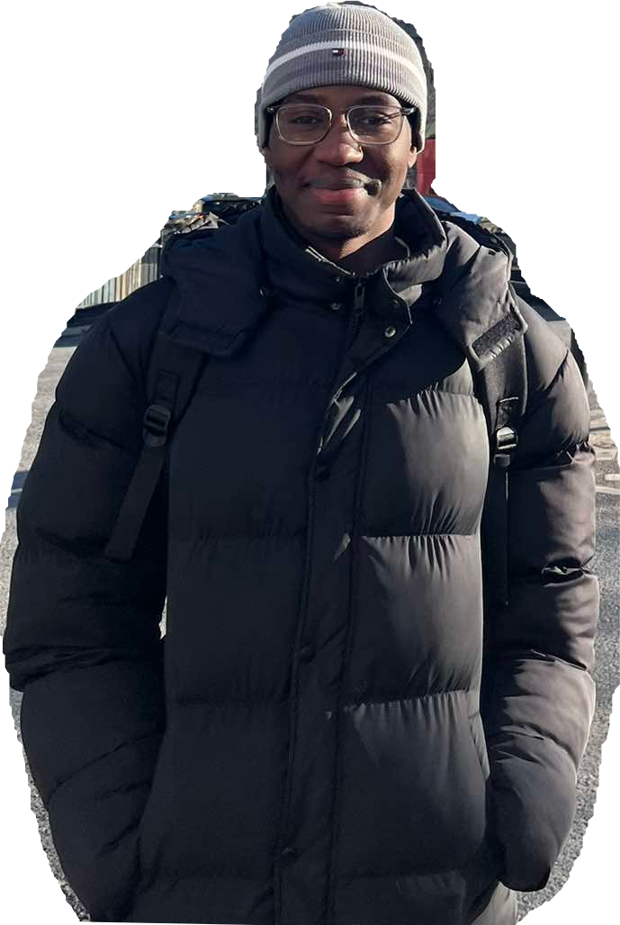
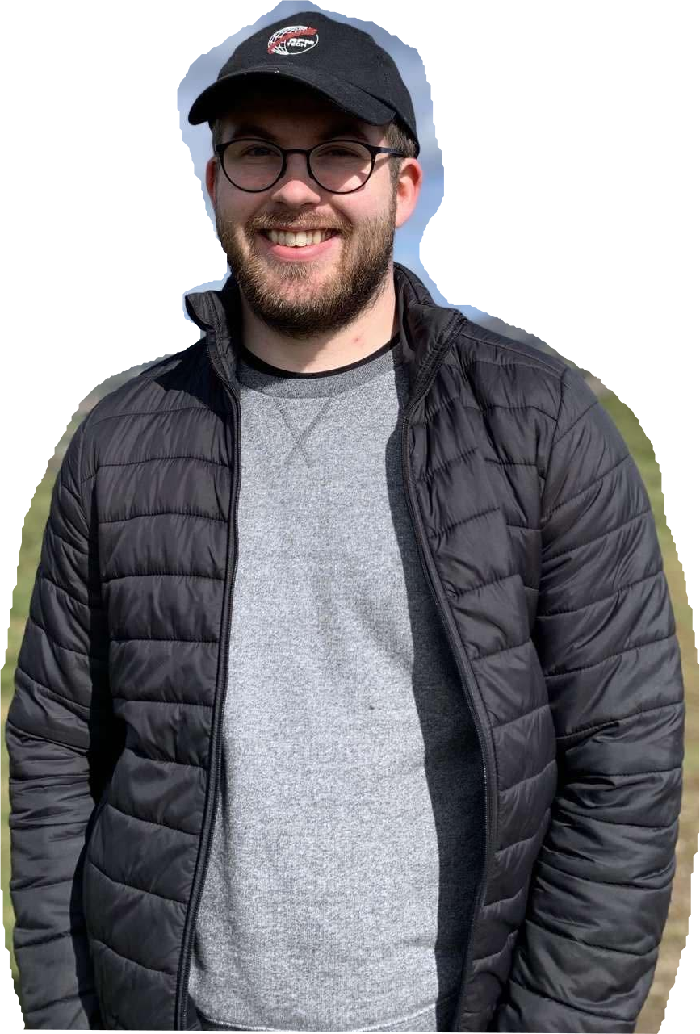
Who are we?
2 planetarium coordinators, 2-3 planetarium managers
~30 active planetarium volunteers (staff, postdocs, PhDs, undergrads)
What do we do?
Teach children about space
  Visit schools, host scout groups on campus, attend STEM fairs/events
  Predominantly Year 5 groups to align with the science curriculum
  For on-campus events, include a tour of our teaching observatory
Night sky tours using Stellarium, pre-recorded shows from NSC Creative (narrated by celebrities such as Rupert Grint and David Tennant)
Notes:
Now, who are we? The planetarium team is currently composed of 2 planetarium coordinators, that’s Conor and Lauren, and 3 planetarium managers, that’s me, Ben and Taf. They are not in this picture, the two people at the edges are David and Gareth, two of our esteemed volunteers who sadly are no longer at Warwick, but we didn’t have a picture with the current planetarium team all together. There you go, fixed. Apart from the managing team, we have a group of around 30 volunteers (including us 5), and they are the ones who carry out the events.
And what do we do? Basically, we teach children about space. We do so by using inflatable domes, such as our older, smaller dome, and our newer, bigger, better big dome. We take these domes to schools, host events on campus for scout groups, for example, as well as attend school’s STEM fairs or other big STEM events such as the Resonate Festival. Our events are mostly tailored to Year 5 children, as that's when they learn about space. For on-campus events, we often include a tour of our campus observatory, called The Marsh Observatory, so that children can see what an actual telescope looks like. When it comes to the planetarium shows, with the domes I mentioned, plus a spherical mirror and a projector, we can provide an immersive experience to the children by giving them a night sky tour using the Stellarium software or by showing them pre-recorded videos made specifically for planetarium shows, which are narrated by beloved British celebrities such as David Tennant and Rupert Grint.

Slide 3
Some statistics
Term time | Visitors | Shows | Events
2023-2024 | 1246 | 76 | 23
2024-2025 | 2110 | 105 | 35
2025-2026 | 1621 | 90 | 29
All time | 4977 | 271 | 87
Numbers as of July 20th, 2026
Notes:
Now, I wanted to share with you some numbers that we have gathered since we resumed activities back in November 2023. Since then, we have had almost 5000 visitors in 87 different events. And you can see that from the academic year of 2023-2024 to the next one, we had a significant increase in visitors and events. These numbers are a bit lower for the current academic year as it is not over yet, but it does seem like for this year the numbers went down a bit, and I’ll tell you why I think that is in a moment.

Slide 4
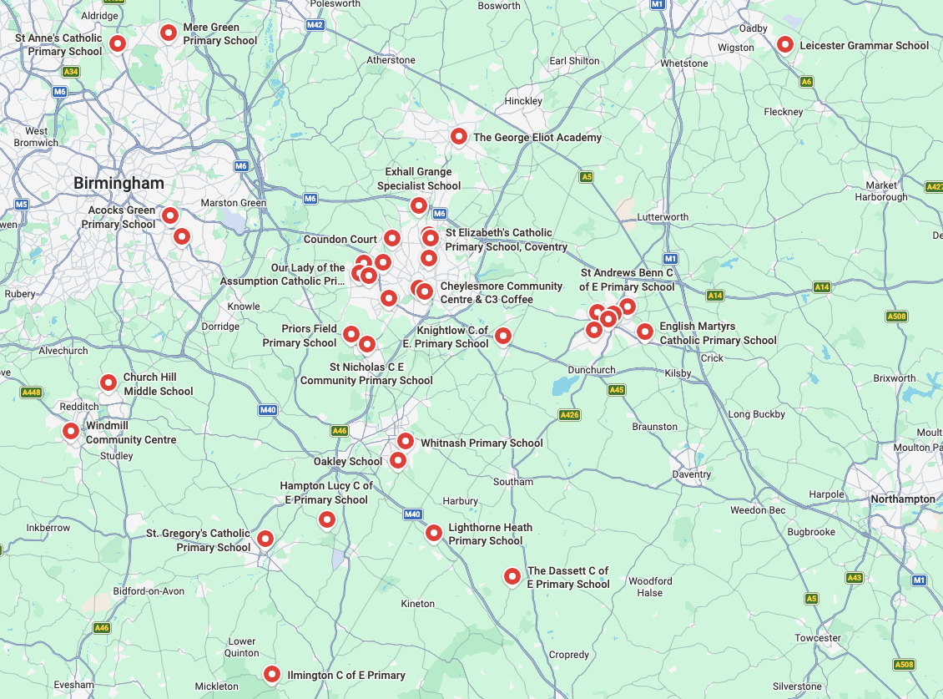
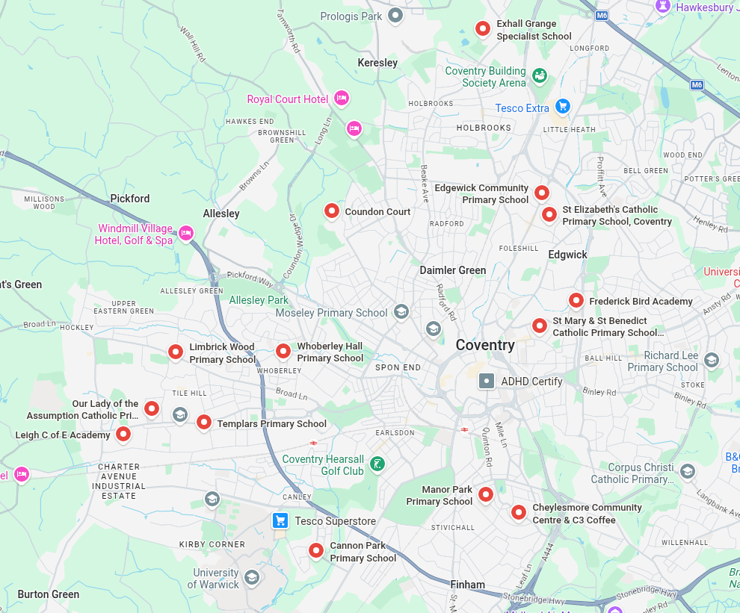
Our area of reach
14 schools in Coventry
38 schools within ~40 km radius
Notes:
Now, when it comes to which schools we visit, we try to prioritise local schools. The University of Warwick is located in the outskirts of Coventry, so that is our local region. We have worked with 14 different schools in Coventry,. We also often go to other nearby towns, and in this plot I show the full extent of our reach, where we have been to 38 different schools within a 40 km radius. I should point out that this includes some schools that have come to us, but it doesn't include any schools we might have worked with in bigger events such as STEM fairs, neither does it include scout groups or any other different type of events (for example, we have in the past organised an event for home-educated children).

Slide 5
Booking specifics
Events are free of charge (costs covered by the Department of Physics)
High demand from local schools, limited by volunteer availability
Prioritise schools with high Widening Participation (WP) benchmark:
  Categorised by the Warwick Institute for Engagement (WIE)
  Proxies for socio-economic disadvantage (Index of Multiple Deprivation, Free School Meal Eligibility)
  School attainment/performance
WP Benchmark | 0 | 1 | 2 | 3+
2023-2024 | 2 | 3 | 5 | 4
2024-2025 | 4 | 6 | 5 | 3
2025-2026 | 5 | 3 | 4 | 2
All time | 11 | 12 | 14 | 9
Notes:
We try to make our events as accessible as possible. We offer them free of charge, compared to private planetarium events that can cost several hundred pounds, ​a budget which not all schools may have. To do that, we rely on support from our department but most of all, we rely on our volunteers' availabilities. We have a lot of demand, and our limiting factor in accommodating all the requests we get is, without a doubt, volunteer availability.
As such, when deciding which events to carry out, we try to prioritise schools with a high Widening Participation (or WP) benchmark. There is a team at Warwick that provides us with a list of all the schools in the country and their WP benchmark, which is based on socio-economic indicators such as the Index of Multiple Deprivation and the Free School Meal Eligibility, as well as indicators for school attainment/performance. Basically, the higher the WP benchmark, the more disadvantaged the school and the pupils there may be, so they might not have the resources to have these sort of events, which is why we try to prioritise these schools.
In this table I show you the distribution of WP benchmarks between the schools that we have worked with in the past few years. The distribution remains roughly the same throughout the years, and it seems like we are not reaching as many high WP schools as we hoped. I should point out that in the latest version of the WP benchmarks, the maximum is 3, so there are no WP 4 schools anymore, at least in the metric that we use.

Slide 6
WP = 0 | WP = 1 | WP = 2 | WP = 3
11 | 12 | 14 | 9
Notes:
With this plot you can better visualise the distribution, and now I have grouped together the WP 3 and previous WP 4 schools. This is the WP distribution of all the schools we worked with.

Slide 7
WP = 0 | WP = 1 | WP = 2 | WP = 3
16 | 23 | 22 | 28
Notes:
And this is the WP distribution of schools in Coventry. Our distribution does not reflect the reality of our local schools, despite our best efforts. Why is that? They just reach out less, simple as that. Every time we get a request from a high WP school, we do our best to make it happen, and the few times we could not accommodate their requests were due to things outside of out control. The truth of the matter is that high WP schools just don't reach out to us as much as low WP schools. Why? I don't know, I can only speculate. Maybe because they don't have resources for these sorts of activities, they don't look for them, so they might have not heard of us. Since we resumed activities, we have been quite busy, and because we are always in demand, we haven't reached out to any schools ourselves. I can say that we have established connections with local high WP schools and we typically carry out events with them once a year, but maybe moving forward we can start actively reaching out to other high WP schools to bridge the gap between our current WP distribution and that of the local schools.

Slide 8
Funding
STFC Spark Award (April 2024-March 2027)
  £15,000, with matched funding from the Department of Physics
    New equipment purchase (Dome, projector, mirror cleaning)
    Purchase of new show (Great Solar System Adventure)
    Printed materials (stickers, leaflets)
Additional support from the Department of Physics
  Contracted hours for PhD students to serve as admins
  Reimbursement for travel to schools
  Support from the University Portering team to transport the equipment to and from schools free of charge
  Insurance cover for equipment (damages)
Equipment is secured and department will support ongoing operation
Thanks to all of our tireless volunteers giving up their time for free

Slide 9
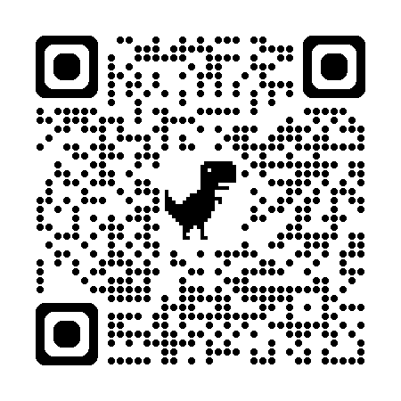
Thank you!
Planetarium@warwick.ac.uk
Notes:
That is all we had to say for today. If you scan this QR code, it will take you to our webpage, where you can find more details about the shows we offer and how to book. Feel free to also reach out by sending us an e-mail. Thank you very much for listening, and we are happy to take any questions.

