Slide 1


Telluric lines: the bane of ground-based observations
Marcelo Aron Fetzner Keniger
UK National Astronomy Meeting
Birmingham, July 23rd, 2026
Notes:
Hello, everyone. My name is Marcelo, I'm a final year PhD student at the University of Warwick, and first I would like to thank the organising committee for giving me the opportunity to speak at this conference. Now, I realised that the title of my abstract was too long to put in a presentation, so I changed it to "Telluric lines: the bane of ground-based observations".

Slide 2
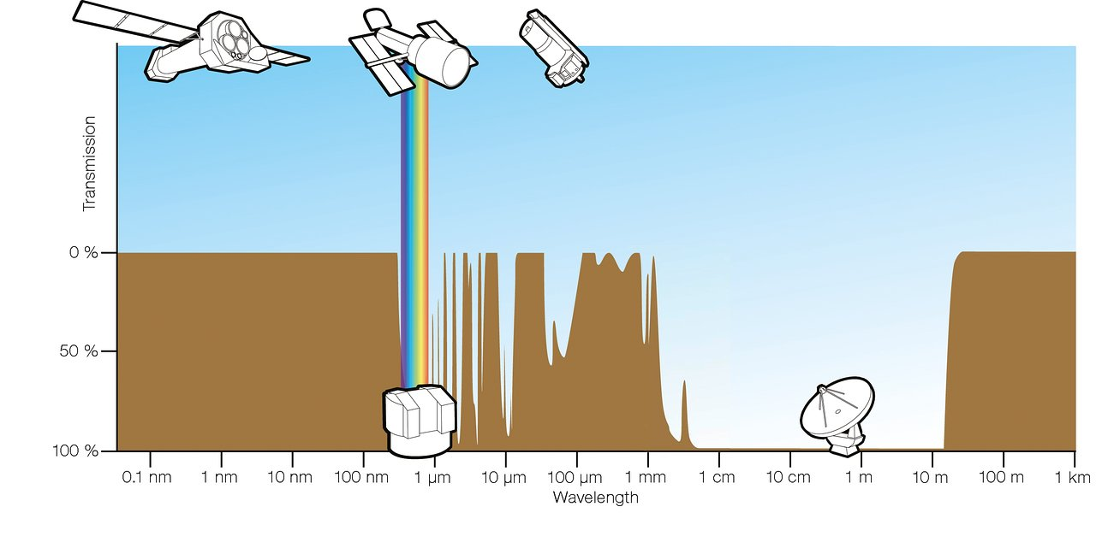
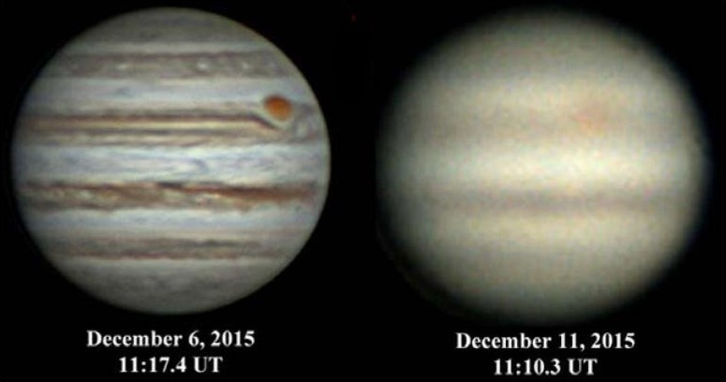
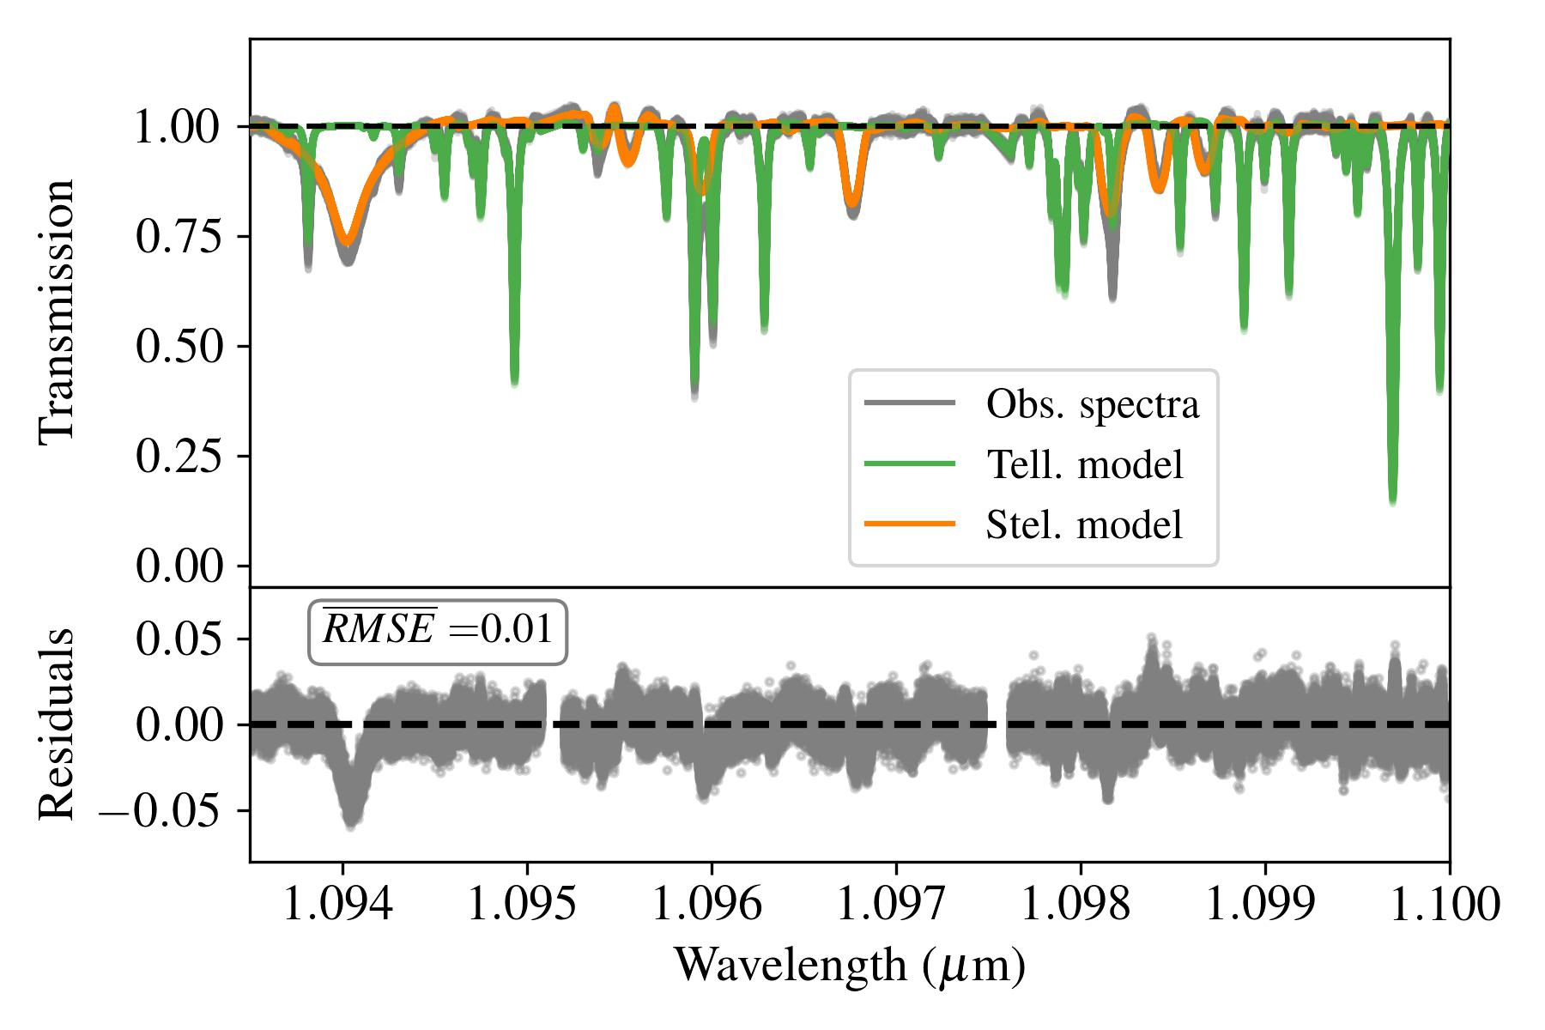
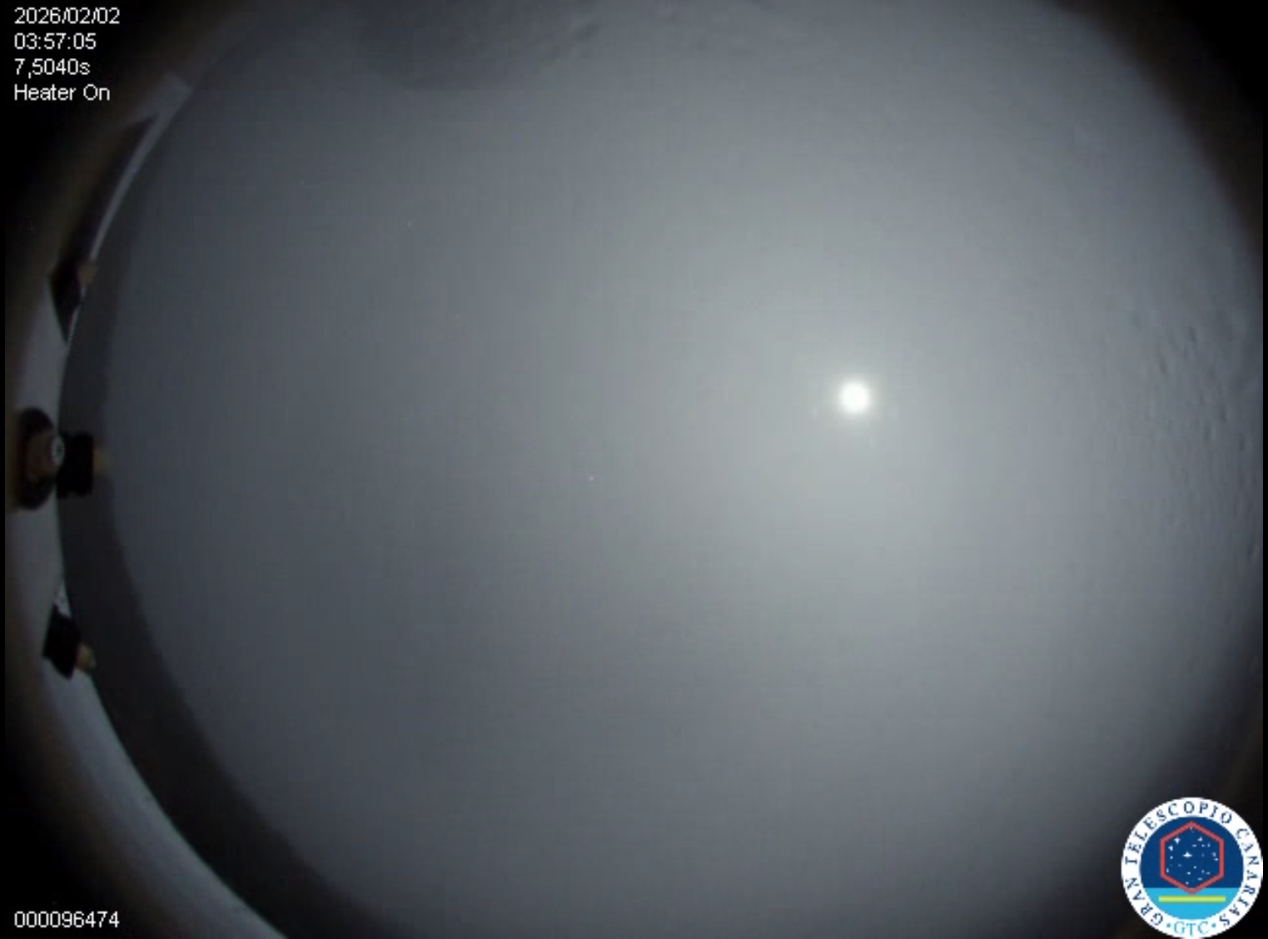
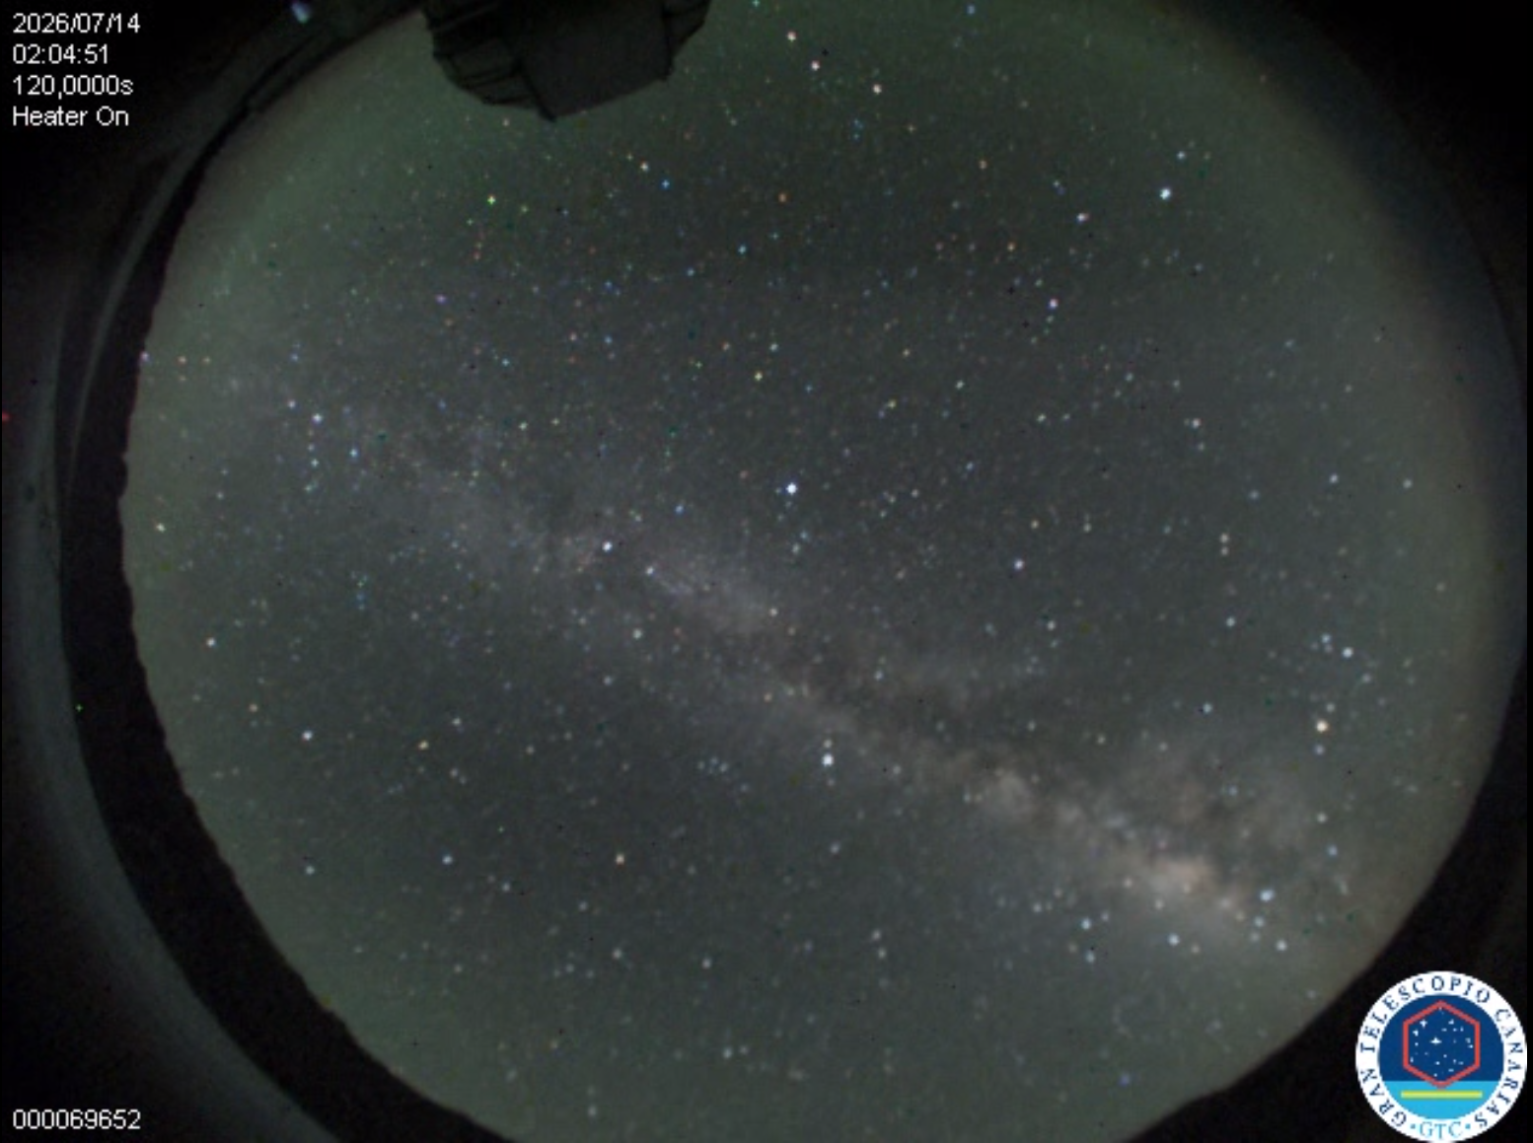
Earth's atmosphere is great, but…
Blocks light
Air turbulence (astronomical seeing)
Bad weather (clouds, rains)
Telluric lines
Credit: ESA/Hubble (F. Granato)
Credit: Clif Ashcraft
Fetzner Keniger et al. (2026)
Notes:
The atmosphere of the Earth is great; I personally love it. As humans, we should be thankful for it, for we could not exist without it. However, if you are an astronomer trying to observe things in space from the ground, the atmosphere of the Earth is oftentimes a nuisance. For starters, it blocks a lot of the light coming from space, so we have a much more limited wavelength range to observe, as we can see from this figure here. Not only that, but air turbulence makes images blurry, the dreaded astronomical seeing, though bad seeing is not even the worst-case scenario, because it can be cloudy or rainy and then you just can't observe at all, as you can see from these pictures where I show two snapshots taken from the All Sky Camera at the Grantecan in La Palma. For those doing spectroscopy, specifically in the high-resolution regime, such as myself, the contamination of the atmosphere is also present in the form of the telluric lines. These are simply the absorption (or sometimes emission) lines that result from the interaction of light with chemical species in the Earth's atmosphere. You can see here from this plot that we have the observational spectra, in grey, which contain the stellar lines (model in orange) and the telluric lines (model in green). The only way around them is, well, to put our telescopes in space, which is already something we do.

Slide 3
Exoplanet atmospheres
Over 300 exoplanets for which we have information on their atmospheres (IAC ExoAtmospheres database, July 2026), obtained with both space- and ground-based observations
Ground-based observations will get a major upgrade with ELTs, but the reduction and analysis methods need to advance accordingly
Biggest challenge: telluric correction!
(Statement backed by Cubillos et al. 2025 and Jayne Birkby's talk at HORS3S)
Notes:
Space-based observations have some limitations of their own, and both space-based and ground-based observations have worked side-by-side to improve our knowledge on exoplanet atmospheres, and today we have over 300 exoplanets for which something about their atmosphere is known, and this was achieved with roughly equal contributions from both ground-based and space-based observations. For ground-based observations, there will be a major upgrade with the upcoming ELTs, but to fully exploit their instrumental capabilities, we must refine our data reduction techniques. In particular, the biggest challenge facing ground-based HRS observations today is correcting for the telluric contamination. Now, these are not just my words, this recent review which has several experts in the field said so, and so did Jayne Birkby, perhaps one of the top experts in the field, in her recent talk at the HORS3S conference which happened in Granada just two weeks ago (and if you don't believe me, the talks were recorded and will be uploaded online soon, so you can check it out for yourselves).

Slide 4
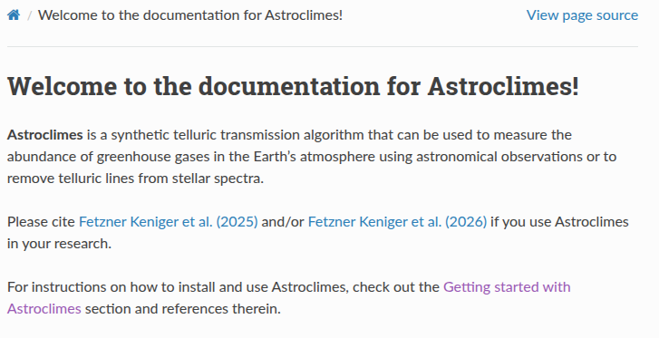

Goal
Assess different methods for removing telluric and stellar lines ("detrending")
Comparison of three detrending methods: Astroclimes, Molecfit, PCA
Try Astroclimes for yourself!
Notes:
With that, I hope I have convinced you about the importance of ground-based high-resolution observations and the necessity for good correction of the telluric contamination. The process of removing telluric and stellar lines from spectra is often called "detrending", which I will use throughout this talk. In the work that I will be presenting here today, my collaborators and I assessed three different detrending methods in their capabilities to remove the telluric and stellar lines and determined how they potentially affect the signal of an exoplanet's atmosphere. The three methods studied are Astroclimes, Molecfit and Principal Component Analysis, or PCA. Before I talk a bit more about how each method works, I want to highlight Astroclimes, because that is an algorithm that I developed. It is publicly available, you can just scan this QR code and it will take you to the GitHub page, and from there you can also find the link to the ReadtheDocs page. I am trying to get people to use it so I can get community feedback and claim once and for all that my algorithm is at least easier to use than Molecfit. Astroclimes is currently tailored for the CARMENES spectrograph, but I am in the process of expanding it to other instruments. If you want me to do that for a specific instrument, or you would like help in doing so yourself, please reach out to me (I'll leave my contact information at the end of the talk).

Slide 5
What is different about the detrending methods?
Astroclimes/Molecfit
PCA
Direct modelling
Combines atmospheric profiles, molecular line lists/cross-sections and radiative transfer equation
Only models telluric lines, stellar lines removed using master stellar template
Blind detrending
Based on linear algebra, decomposes spectra in components describing its features
Telluric and stellar lines removed simultaneously (along with everything else, hence “blind”)
  Level of “cleanliness” determined by number of PCA components (N_{C})
Notes:
In the interest of time, I won't go into detail about explaining how each method works, so if you'd like to know more, feel free to ask me later. Nonetheless, there are a few points I want to outline about the differences between the methods. Both Astroclimes and Molecfit are what we call direct modelling approaches, in which the telluric lines are modelled and removed directly.
PCA, on the other hand, is what we could call a "blind detrending approach". Both Astroclimes and Molecfit work similarly, where they combine an atmospheric profile with molecular cross-sections (based on line lists) through a radiative transfer equation to generate the telluric models.
PCA is based on linear algebra, where you decompose the spectra in components that describe its features, starting with the most striking ones, which in this case would be the stellar and the telluric lines.
One caveat of the direct modelling approach is that only the telluric lines are removed, so the stellar lines must be removed still. One common approach in the literature, and the one I employ here, is to calculate the mean of the spectra throughout one night after you have removed the telluric lines, thus creating a master stellar template that can be used to remove the stellar lines. This works because we don't expect the stellar lines to change much throughout a single night.
With PCA, we don't have to worry about that, because it removes the telluric and stellar lines simultaneously. However, it may remove everything else with it, because you don't really know what exactly you are removing, as it cleans the spectra indiscriminately, hence the name "blind detrending approach". The level of "cleanliness" is determined by the number of PCA components that you choose for your PCA model. The tricky part of employing PCA is precisely determining the optimal number of PCA components, because if you choose too few, your correction might not be very good, but if you choose to many, you end up removing things you didn't want to from your spectra, such as the very planetary signal you want to analyse.

Slide 6
This work
Injection and recovery tests
After detrending, residuals are cross-correlated with injected signal
MCMC run to determine effect of detrending on signal
  3 free parameters: scaling factor δ, K_{p} and V_{sys}​
Data from CARMENES instrument, day-side observations of τ Bootis b, a non-transiting HJ orbiting an F-type star
  5 nights of observation available
2 nights used for injection and recovery tests (nights 1 and 4)
  Night 1 also explored with different K_{p} values: 110, 80 and 50 km/s
Notes:
To assess the capabilities of the three detrending methods studied, I carried out a series of injection and recovery tests. So, I would inject a synthetic signal into the observational spectra, detrend the spectra, then cross-correlate the residuals with the very same planet model that I injected to see if we could recover this signal. I did this for several different injected signal strengths. Additionally, I also ran an MCMC comparing the residuals with the injected signal to determine how much the signal had changed. I had three free parameters: a scaling factor δ, which basically quantified the change in the magnitude of the signal; plus Kp and Vsys, which tell us whether the signal changed location in velocity space. I should mention that the data used here are CARMENES observations of the day-side of the non-transiting planet tau Bootis b, which is a hot Jupiter orbiting an F-type star. There are a total of 5 nights of observation of CARMENES data for this target. For the injection and recovery tests, two of these nights were used (nights 1 and 4), to have scenarios with different levels of telluric contamination, and for one of the nights (night 1) three different Kp values were used for the injected signal: 110, 80 and 50 km/s. 110 km/s is the literature value for Kp for tau Bootis b, and the other two values I chose to the detrending methods to their limits as we expected them to struggle more to clean the spectra with planetary signals with lower orbital velocities. Sadly, I am a certified yapper and there was no way in hell I could condense all of this into a 10-minute talk, so here I will only show the results for one scenario, but I will mention the results for the other scenarios in my conclusions, and the eager minds can come catch me later during the break.

Slide 7
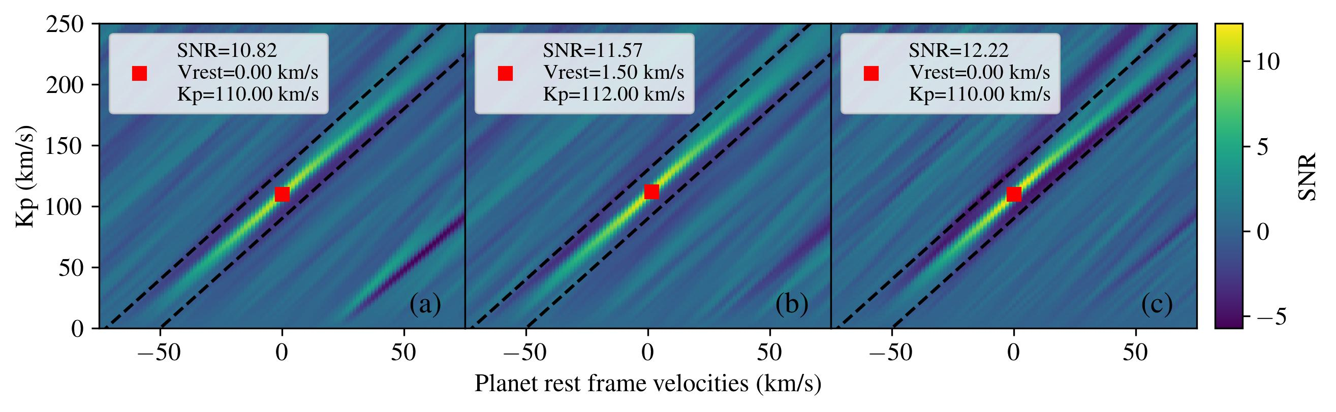
Night 1 (2018/03/26) - K_{p} = 110 km/s
Astroclimes
Molecfit
PCA, N_{c} = 3
Fetzner Keniger et al. (2026)
Notes:
To start, I just want to show you one example of how the velocity map plots look. Here, the x axis corresponds to the rest frame velocity of the planet, which is a proxy for the systemic velocity, and the y axis corresponds to the RV semi-amplitude Kp. The colour coding is based on the SNR, which I calculate based on the area delimited by the dashed lines. What I want to show here is just that Astroclimes seems to have some leftover telluric residuals, seen on the bottom right of the first panel, which is less prominent for Molecfit and even less prominent for PCA.

Slide 8
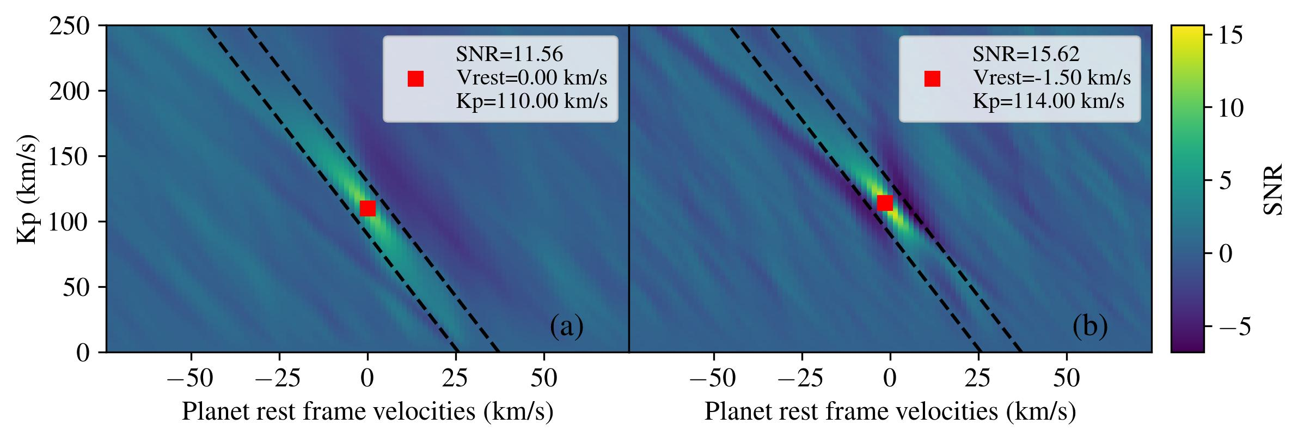
Night 4 (2019/03/15) - K_{p} = 110 km/s
Astroclimes
PCA, N_{c} = 3
Fetzner Keniger et al. (2026)
Notes:
However, if you look at the same plot for night 4, which had better observing conditions (i.e. lower humidity), this artifact is no longer seen, as instead the most prominent feature leftover from the detrending process are these anti-correlation areas around the signal introduced by PCA. And if you’re wondering why there is no Molecfit in this plot, it is because I only ran Molecfit for one night due to time constraints.

Slide 9
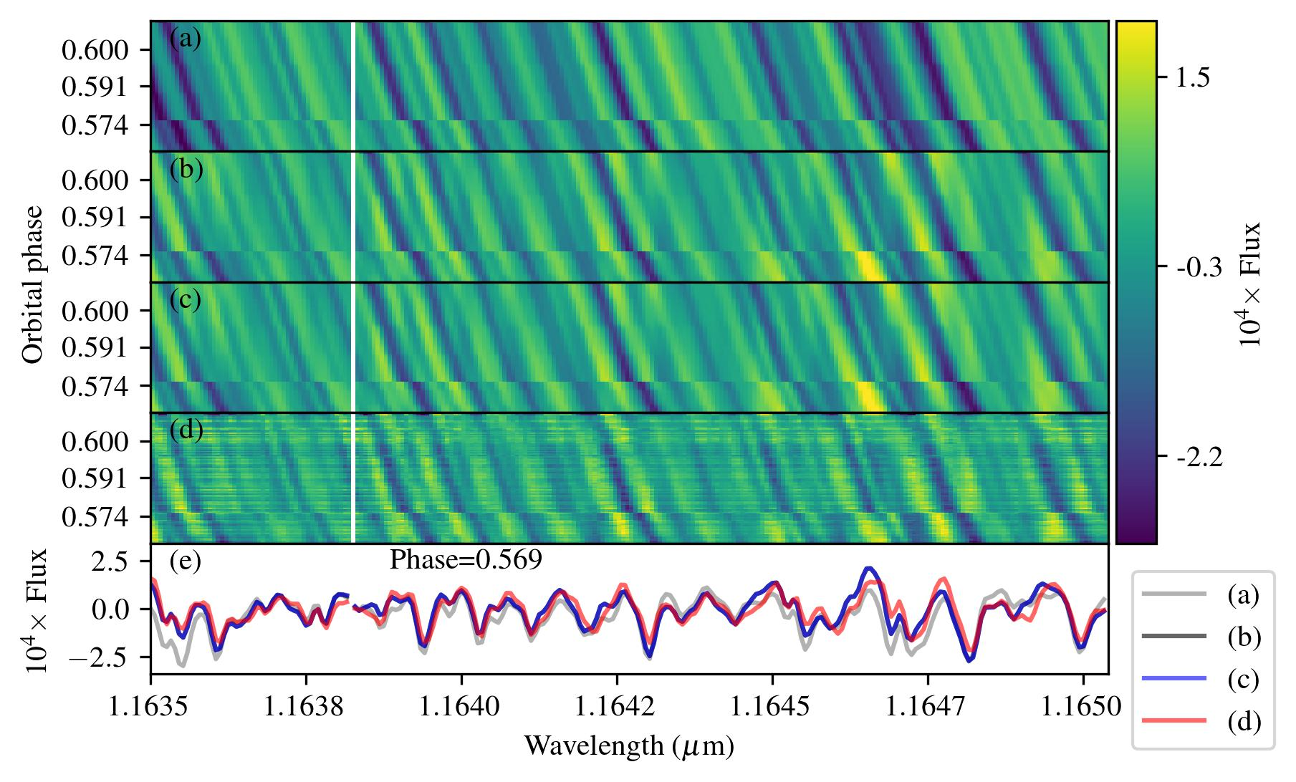
Night 1 (2018/03/26) - K_{p} = 110 km/s
The residuals difference should yield precisely the injected planetary signal!
Injected planetary signal
Astroclimes residuals difference
Molecfit residuals difference
PCA residuals difference
One individual exposure (one row in the panels above)
Fetzner Keniger et al. (2026)
Notes:
Coming back to the results from night 1, I want to show you visually what the effect of each detrending process is on the injected planetary signal. In this plot, the top panel shows the injected planetary signal. The next three panels show what I call the "residuals difference" for Astroclimes, Molecfit and PCA. What are they? So, I carried out the detrending process on the observational spectra WITH and WITHOUT the injected planetary signal. When taking the DIFFERENCE between the residuals from either case, we'd expect to get precisely the injected signal, so we were hoping that panels (b), (c) and (d) were as close to panel (a) as possible. For Astroclimes and Molecfit, we can see that they are quite similar, not just to panel (a) but amongst each other, however you can still see some signal degradation, more prominent on the left edge of the panel. When you look at the PCA panel, however, it becomes evident that it is a lot more aggressive on the injected signal than the other two methods.

Slide 10
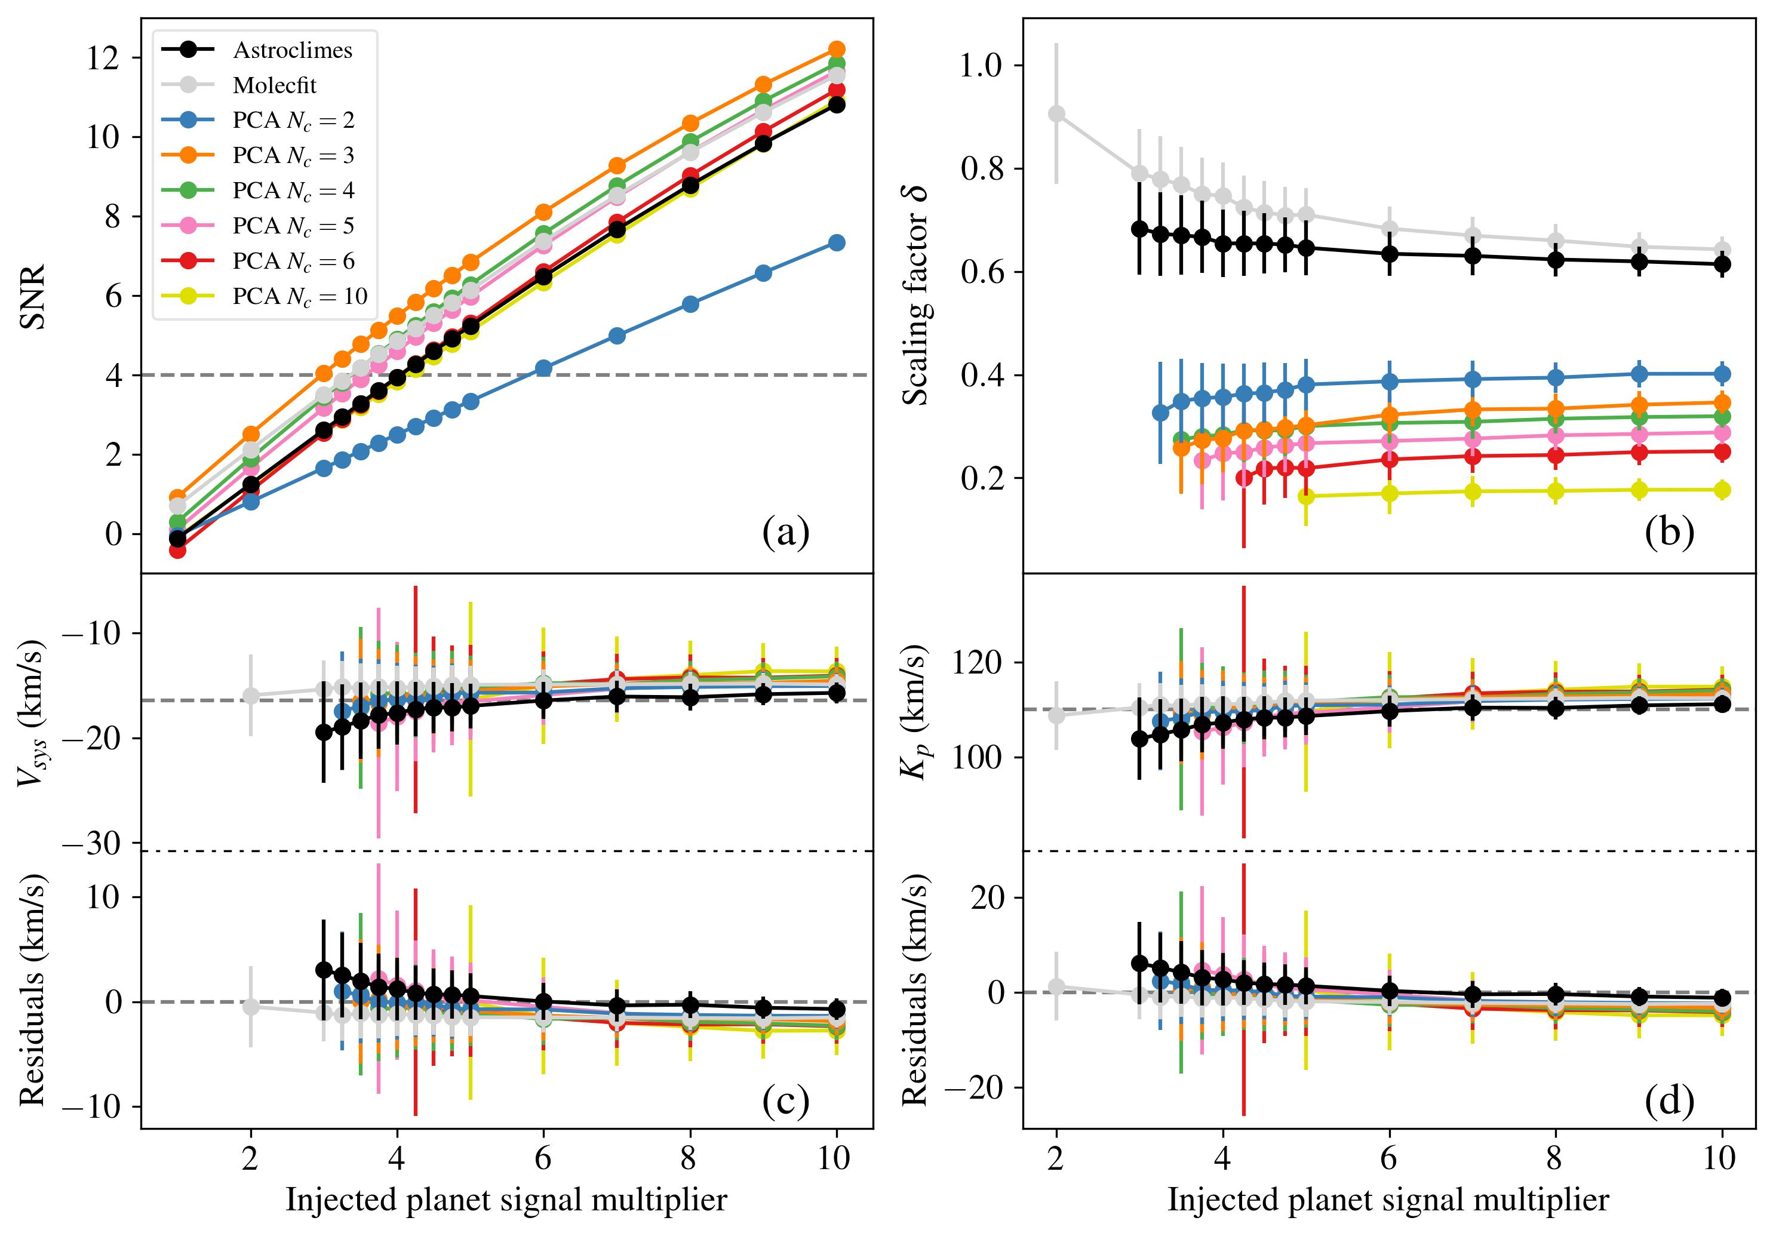
Night 1 2018/03/26
K_{p} = 110 km/s
Fetzner Keniger et al. (2026)
Notes:
This is also clear from this plot, where I compiled the results from all the injection and recovery tests for a single night, so for all the different injected signal strengths. The top left panel shows the SNR, top right shows the scaling factor δ, and the bottom plots show Vsys and Kp respectively. For this night and this value of Kp in particular, certain PCA options managed to achieve higher SNR than Astroclimes and Molecfit with 3 PCA components getting the top spot, however this comes at the expense of much higher signal degradation, with an average of just around 30% of the signal remaining, versus close to 70% for Astroclimes and Molecfit. In this case, the retrieved Vsys and Kp values never deviated too much from the original values.

Slide 11
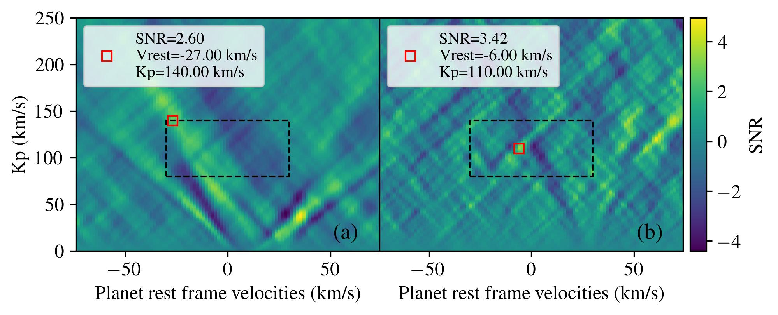
Trying to detect water in 𝜏 Bootis b
Found water!
Presence of water in τ Bootis b is heavily debated in the literature
5 nights of CARMENES observations, same data as Webb et al. (2022)
Detrending with PCA or Astroclimes
Different VMRs of H₂O tested, different ephemerides used (Brogi et al. 2012 and Justesen et al. 2019)
No H₂O detected!
Astroclimes
PCA
Fetzner Keniger et al. (2026)
Notes:
Finally, I also tried to detect water in tau Bootis myself. This has been a hot topic in the literature, with some references saying they found water, and others saying there is little to no evidence of water. Here, I used the 5 nights of CARMENES observations, which is the same dataset as Webb et al. (2022), who claimed a detection of H2O. I detrended the data using both Astroclimes and PCA, which mind you is a different approach than the one used in Webb et al. (2022). I looked for detections using models with different levels of water abundance, as well as different ephemerides, but no matter what configuration I used, I could not find any significant detection of water.

Slide 12

Conclusions
Read (and cite 😉) the paper
PCA heavily erodes planetary signal, Astroclimes/Molecfit retain the signal better, at the expense of slightly poorer telluric correction
Reanalysis of CARMENES data for τ Bootis b resulted in non-detection of H₂O, at odds with Webb et al. (2022)
Find out the results for lower K_{p} and different night on the paper!
✉️
marcelo.keni2@hotmail.com
Thank you for listening!
Notes:
With that, I leave you with my summaries, plus QR codes for you to read (and cite, hopefully) the paper and try out Astroclimes and my contact information.

Slide 13
Additional slides

Slide 14
Open questions
Why does Astroclimes have that leftover telluric artifact and Molecfit doesn’t?
Is the reason why we don’t find H₂O in τ Bootis b because our detrending has wrecked the signal?
I’d like to know that myself
I hope not
Notes:
To start, I just want to show you one example of how the velocity map plots look. Here, the x axis corresponds to the rest frame velocity of the planet, which is a proxy for the systemic velocity, and the y axis corresponds to the RV semi-amplitude Kp. The colour coding is based on the SNR, which I calculate based on the area delimited by the dashed lines. What I want to show here is just that Astroclimes seems to have some leftover telluric residuals, seen on the bottom right of the first panel, which is less prominent for Molecfit and even less prominent for PCA.

Slide 15
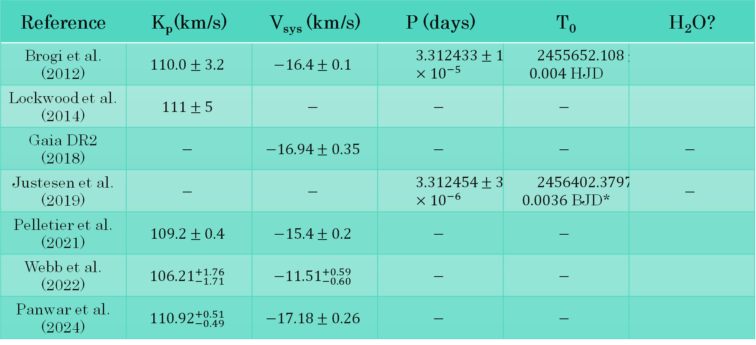

𝜏 Bootis b throughout the literature
Reference | K_{p}(km/s) | V_{sys} (km/s) | P (days) | T₀ | H₂O?
Brogi et al. (2012) | $$110.0±3.2$$ | $$−\text{16.4}±\text{0.1}$$ | $$3.312433±1.9×{10}^{−5}$$ | $2455652.108±\text{0.004}$ HJD | No
Reference | K_{p}(km/s) | V_{sys} (km/s) | P (days) | T₀ | H₂O?
Brogi et al. (2012) | $$110.0±3.2$$ | $$−\text{16.4}±\text{0.1}$$ | $$3.312433±1.9×{10}^{−5}$$ | $2455652.108±\text{0.004}$ HJD
Lockwood et al. (2014) | $$111±\text{5}$$ | $$−$$ | $$−$$ | $$−$$
Gaia DR2 (2018) | $$−$$ | $$−16.94±\text{0.35}$$ | $$−$$ | $$−$$ | $$−$$
Justesen et al. (2019) | $$−$$ | $$−$$ | $$3.312454±3.3×{10}^{−6}$$ | $2456402.3797±\text{0.0036}$ BJD* | $$−$$
Pelletier et al. (2021) | $$109.2±\text{0.4}$$ | $$−15.4±0.2$$ | $$−$$ | $$−$$
Webb et al. (2022) | $${106.21}_{−1.71}^{+1.76}$$ | $${−11.51}_{−0.60}^{+0.59}$$ | $$−$$ | $$−$$
Panwar et al. (2024) | $${110.92}_{−0.49}^{+0.51}$$ | $$−17.18±0.26$$ | $$−$$ | $$−$$
No
Yes
No
Webb et al. (2022) | $${106.21}_{−1.71}^{+1.76}$$ | $${−11.51}_{−0.60}^{+0.59}$$ | $$−$$ | $$−$$ | Yes
Yes
No
Bae et al., in prep | $$?$$ | $$?$$ | $$?$$ | $$?$$ | Yes
15
Notes:
And you might be wondering, why these values? I didn’t make them up out of nowhere (well, two of them I did), but 110 km/s is the literature value for Kp for tau Bootis b, and there seems to be good agreement in the literature about that, with maybe one case that deviates a little bit. When we look at Vsys, however, there are some significant differences, and one possible explanation proposed for that is due to the companion star that could potentially be inducing this RV shift, but I am in no position to confirm nor refute that. I’ve also added columns with periods and T0s from the literature, which will be important later, but the column I want you to focus is the last one, where it is said whether or not these references detected water in the atmosphere of tau Bootis b. First one, no. Second one, a couple of years later, yes. Then, a lot of time passed, and the next study of tau Boo’s atmosphere resulted in no water detected, only very low upper limits. Then a year later there was a detection claim, but a couple of years after that, again, no significant detection, only very low upper limits. I should point out that all of these studies used different data sets, except the last, which reanalysed the dataset used in the first one. And, I have some inside information for you. Just two weeks ago someone presented a poster at the HORS3S conference where they also claimed a detection of water in tau Boo, using yet another dataset. So, safe to say, there is a lot of discourse around the presence of water in this planet.

Slide 16
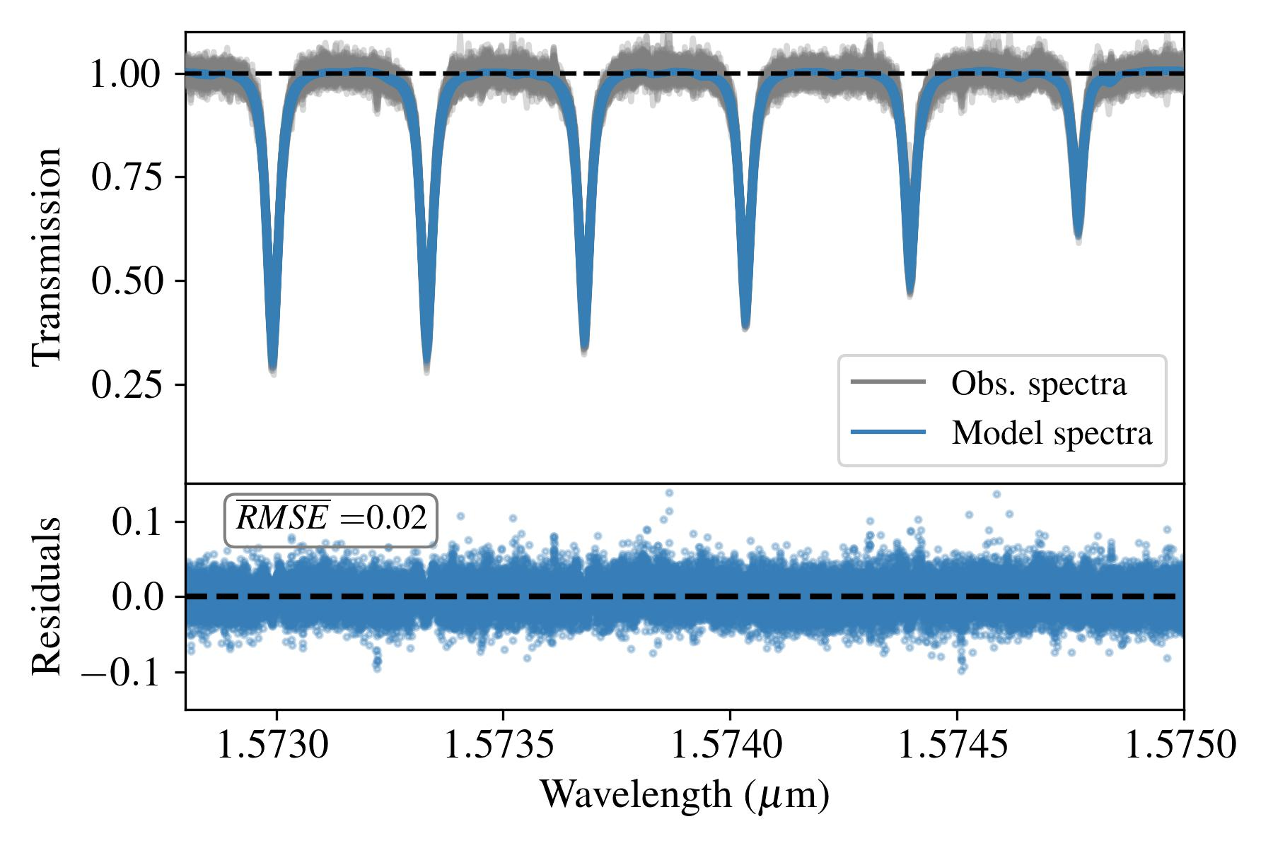
Astroclimes and Molecfit – Direct modelling
Telluric lines are modelled and removed directly
Notes:
Astroclimes and Molecfit are both direct modelling approaches, in which a synthetic telluric transmission model is computed and fit to the data, as shown in this plot (in the interest of time, I won't explain how these models are computed, but feel free to ask me afterwards). The best-fit models for each observation are then used to remove the telluric lines.

Slide 17
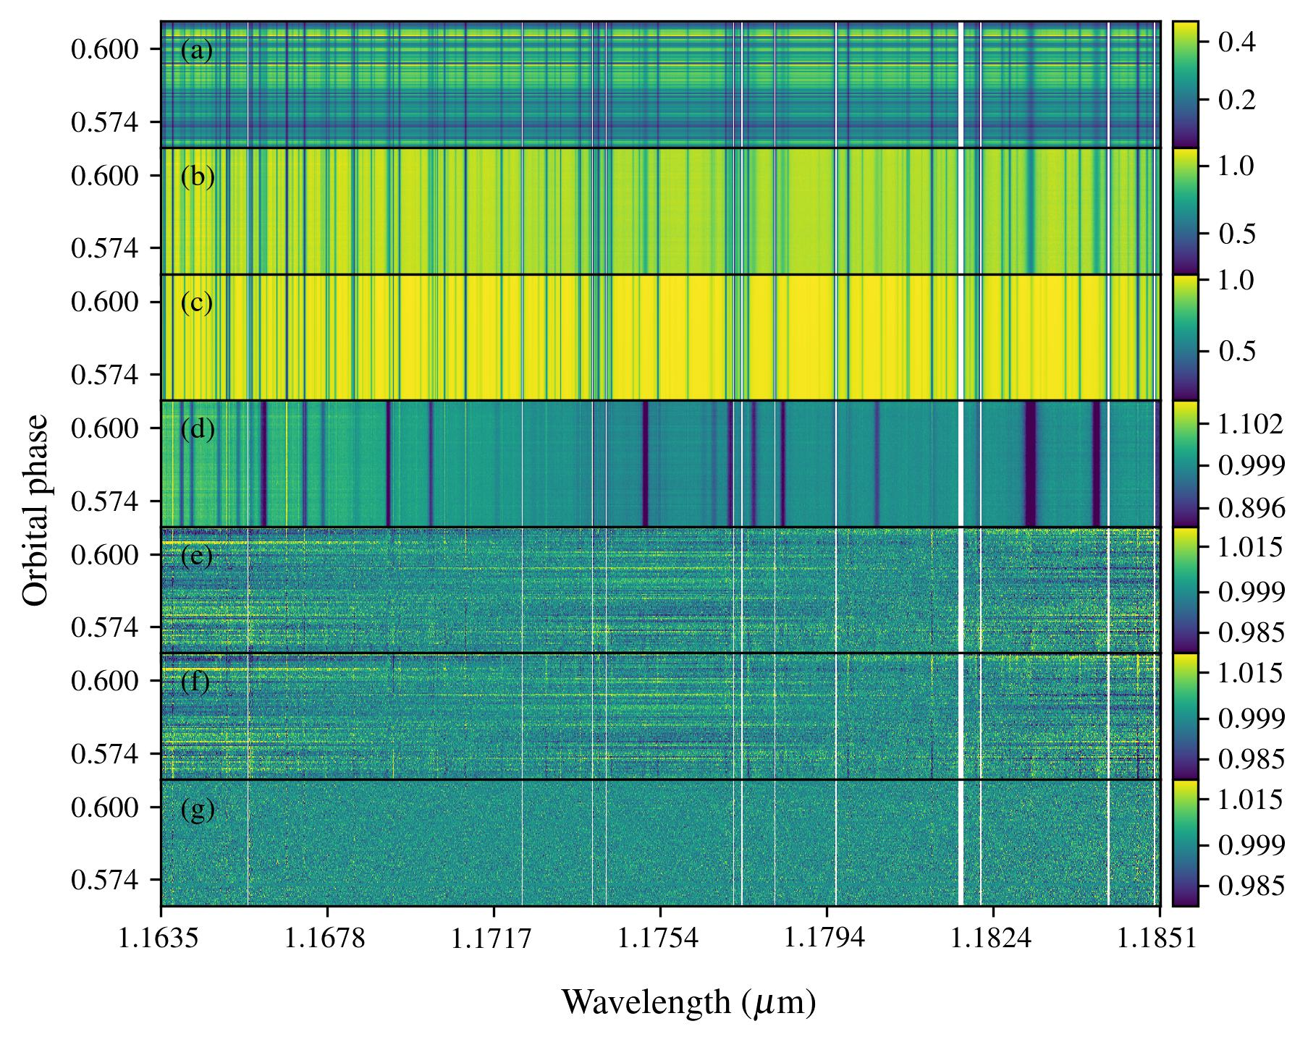
Step-by-step detrending process with Astroclimes
Stacked spectra of same target over one night
Median divided spectra
Astroclimes best-fit telluric models
Division of (b) by (c) - its nightly mean is the master stellar template used to remove the stellar lines
Astroclimes residuals
Molecfit residuals
PCA residuals
Target is τ Bootis b, data is day-side observations with CARMENES (NIR), 99 spectra
Notes:
Here I show the step-by-step of the detrending process. Starting with the stacked observational spectra of the same target over one night, I divide them by their median just so that every spectra is roughly on the same level. Then, I divide the observational spectra by the Astroclimes best-fit models, shown in panel (c) here, and I get panel (d) as a result. Now, we still have the stellar lines. To remove them, I take the mean of all observations in one night to create a master stellar template, and divide the spectra by it to remove the stellar lines. We are left with our residuals, which are shown in panel (e) here for Astroclimes. The process for Molecfit is exactly the same, the only difference is in the model on panel (c), and we can see that their residuals look very much alike. The PCA residuals, on the other hand, look a lot smoother, so you might think that this is the superior method, but hold on, I think I can at least cast some doubt on your minds.

Slide 18
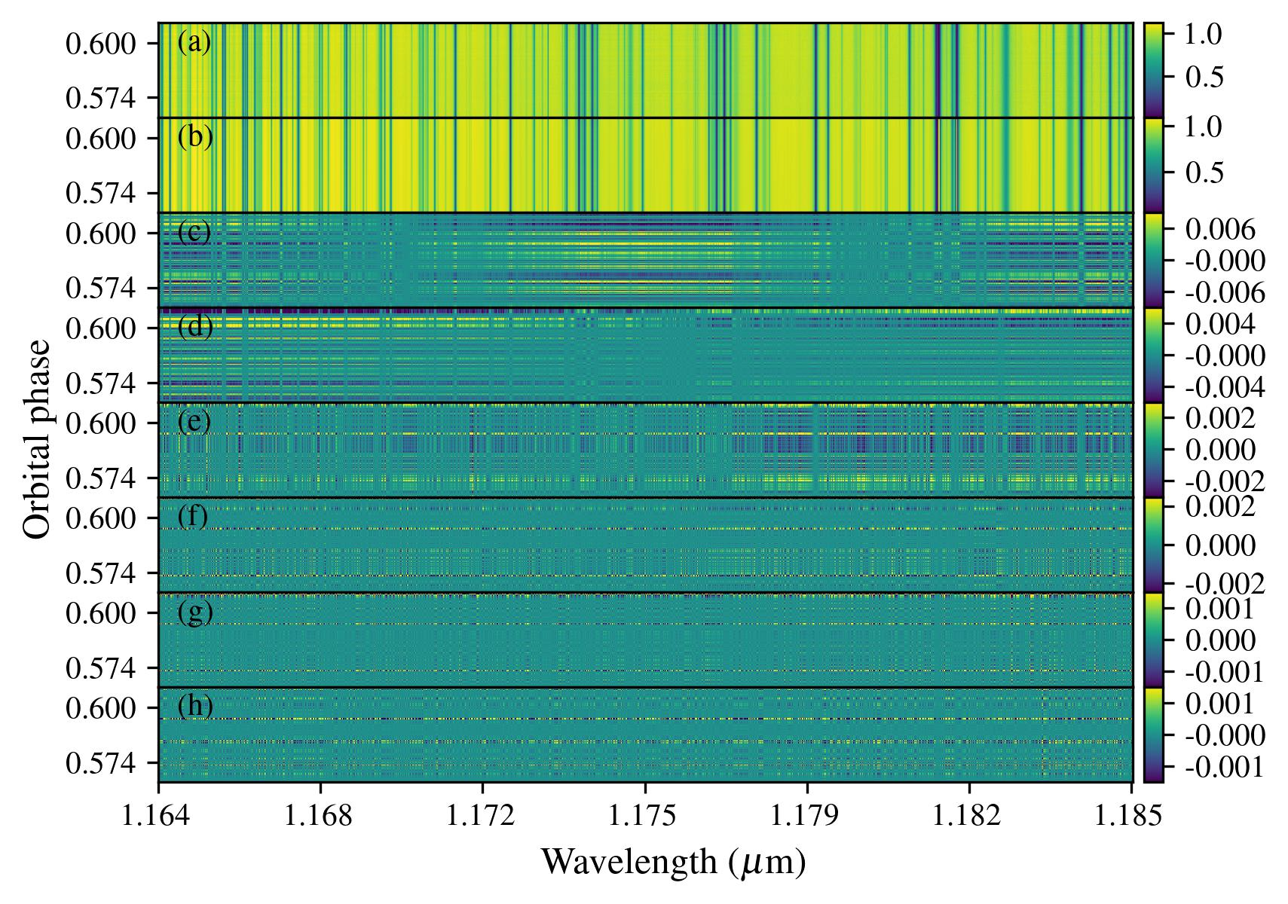
PCA – Blind approach
Decompose spectra in components that describe the features in the spectra, starting with the most striking ones
Which features are removed is governed by the number of PCA components chosen
Notes:
You see, PCA is based on a blind approach to remove the telluric and stellar lines, so you don't really know what you are removing. Basically, it works by decomposing the observational spectra in components that describe the features in the spectra, starting with the most striking ones, which in this case are the telluric and stellar lines. Which features are removed are determined by the number of PCA components chosen. In this plot, the top panel shows the (median divided) observational spectra, while the subsequent panels show the individual PCA components from 1 to 6 and then 10 on the last panel. The tricky part of employing PCA is choosing the optimal number of components, because if you choose to few components, then your correction might not be good enough. Conversely, if you choose too many components, you might end up removing a significant portion of the planetary signal you wish to detect.

Slide 19
Night 1 (2018/03/26) - K_{p} = 110 km/s
Astroclimes
Molecfit
PCA, N_{c} = 3
Fetzner Keniger et al. (2026)

Slide 20
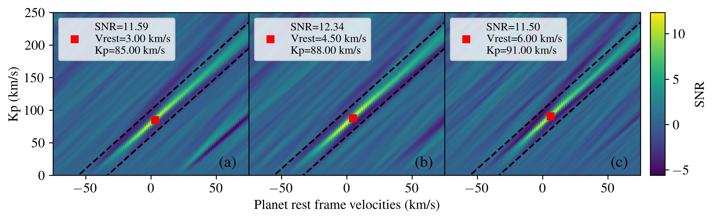
Night 1 (2018/03/26) - K_{p} = 80 km/s
Astroclimes
Molecfit
PCA, N_{c} = 3
Fetzner Keniger et al. (2026)

Slide 21
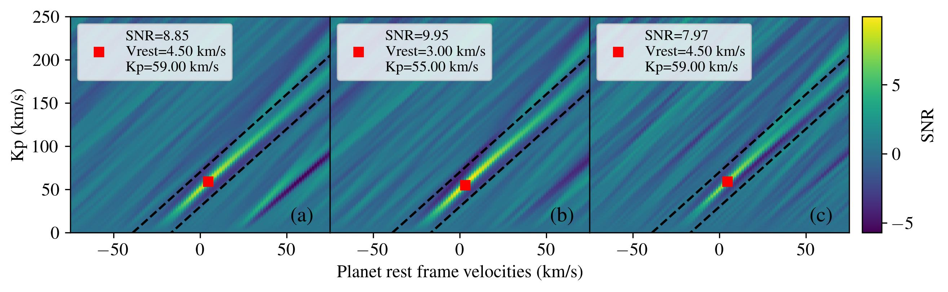
Night 1 (2018/03/26) - K_{p} = 50 km/s
Astroclimes
Molecfit
PCA, N_{c} = 3
Fetzner Keniger et al. (2026)

Slide 22
Night 4 (2019/03/15) - K_{p} = 110 km/s
Astroclimes
PCA, N_{c} = 3
Fetzner Keniger et al. (2026)

Slide 23
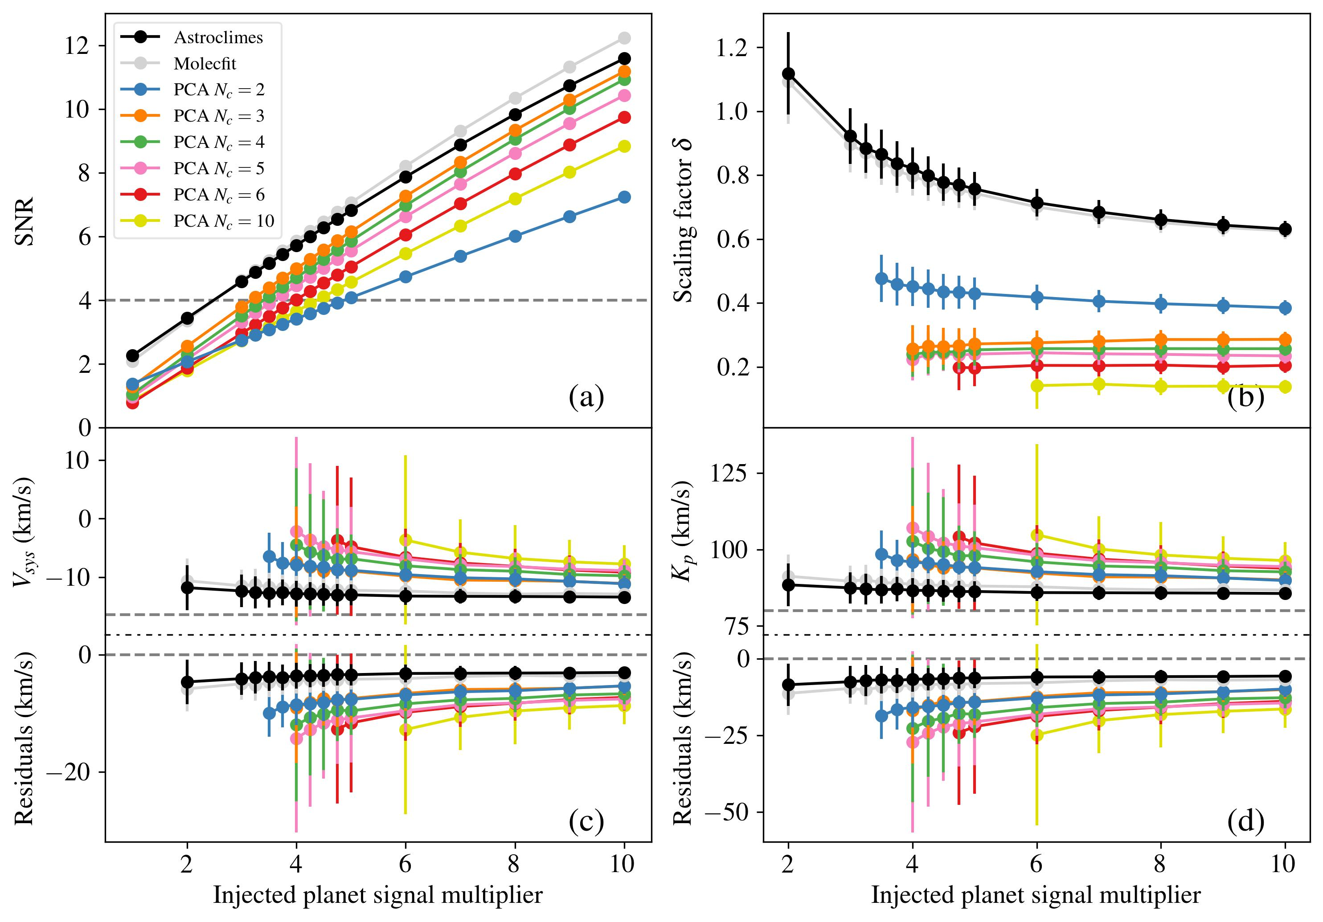
Night 1 2018/03/26
K_{p} = 80 km/s
Fetzner Keniger et al. (2026)
Notes:
As we move towards the lower orbital velocity cases, again we see that the direct modelling approaches retain the signal a lot better, and this time they also achieve higher SNR, with Molecfit performing slightly better than Astroclimes. The drop in SNR and rise in signal degradation from PCA is to be expected. PCA relies on the planet's signal having different velocities throughout the night so that it is picked up by different pixels in the detector. For planets with lower orbital periods, that is not necessarily the case, so PCA struggles more to disentangle the planet's signal from the stellar and telluric signals. As a result, we see more degradation in the magnitude of the planet's signal, but also in the position, evidenced by the shift in the retrieved Vsys and Kp, which I should point out is also true for Astroclimes and Molecfit. Not only that, but Astroclimes and Molecfit seem to bias weak signals, making them seem more inflated, but I can also tell you that part of this is due to the fact that the noise structure coincidentally exhibited a relatively strong positive correlation right where the signal was injected.

Slide 24
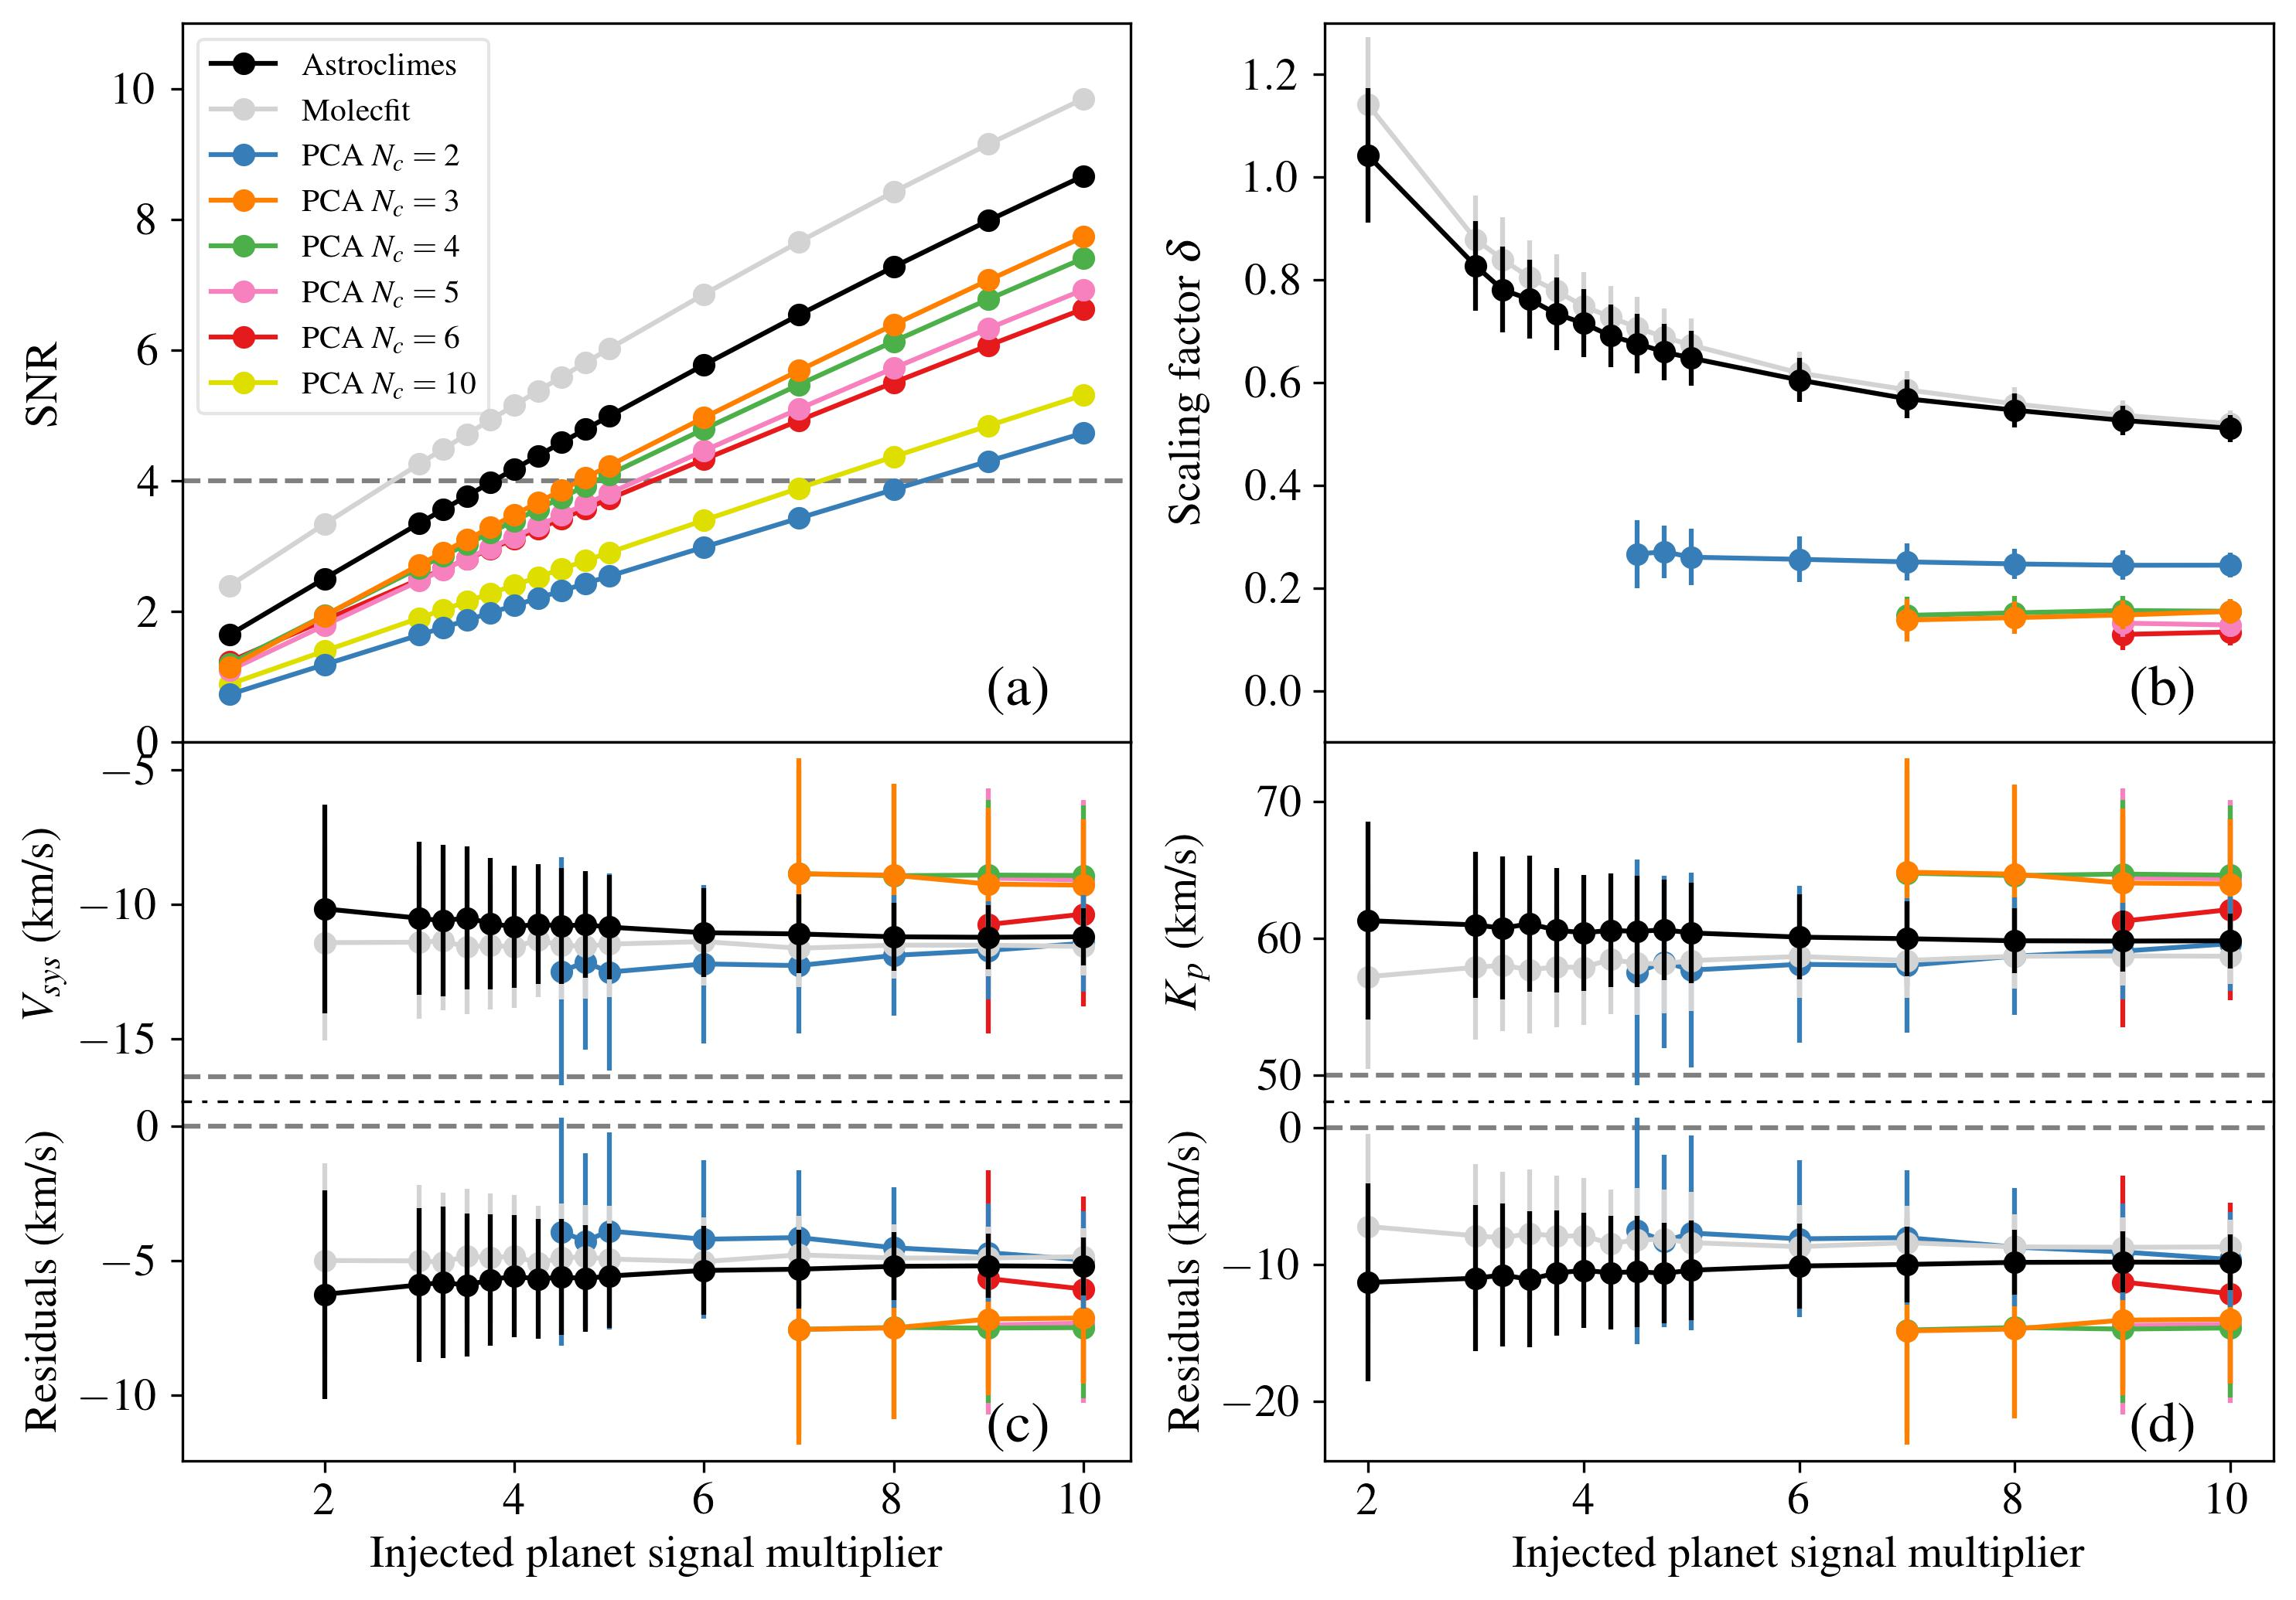
Night 1 2018/03/26
K_{p} = 50 km/s
Fetzner Keniger et al. (2026)
Notes:
For the case with the lowest Kp studied, the effects just described become even more apparent, and you'll notice that there are way less PCA points in panels (a), (b) and (c), that is because I am only plotting the results from the MCMC runs that converged.

Slide 25
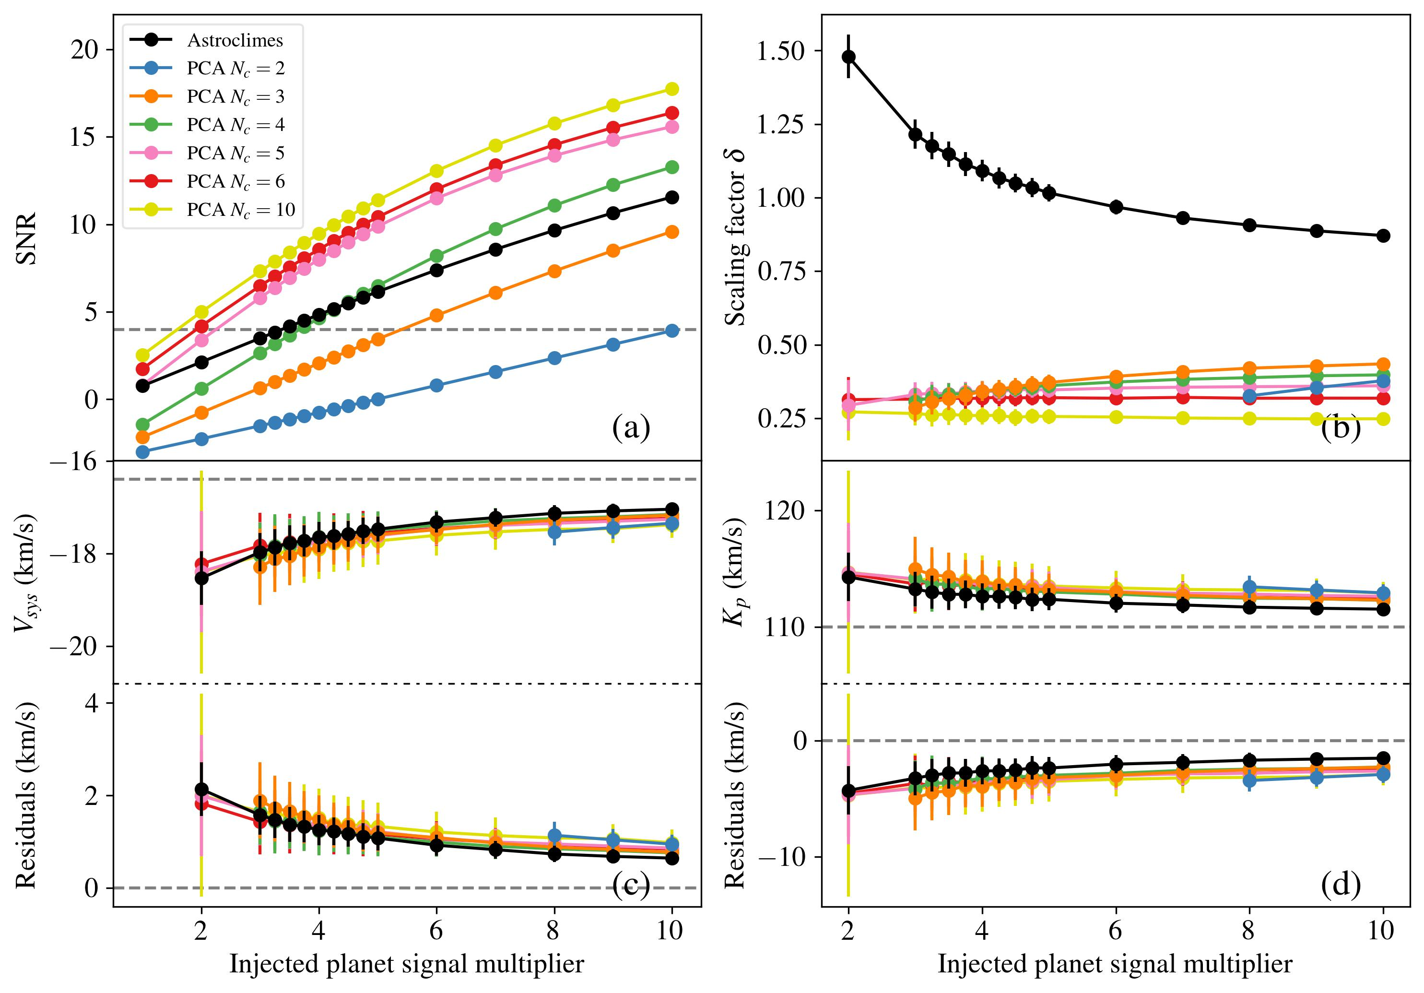
Night 4 2018/03/26
K_{p} = 110 km/s
Fetzner Keniger et al. (2026)
Notes:
When we look at the injection and recovery test results for the other night, there are a couple of interesting differences from the same Kp scenario for night 1. Now, the highest SNR has been achieved with 10 PCA components, despite it having the highest level of signal degradation. That is likely because PCA is not only good at removing stellar and telluric lines, but it removes noise as well, so high SNR can be achieved even though most of the signal has been removed as well. You'll also notice that the magnitude of the signal recovered by Astroclimes seems drastically amplified, and besides the reasons I already mentioned, I believe there are two other factors at play here: the first is that according to Webb et al. (2022), this night had the strongest H2O signal out of all the nights, so that could be acting to make the signal seem amplified; second, the planetary signal crosses the point of RV = 0 km/s, i.e. it crosses where the telluric signal is, so any leftover telluric signal could also act to make the signal seem amplified. In this case, the retrieved Vsys and Kp also seem quite biased, but if I'm being completely honest, I'm not too sure what is the reason behind that.

Slide 26
What is different about the detrending methods?
Astroclimes and Molecfit: direct modelling
  Telluric lines are modelled and removed directly
  Roughly similar modelling process, but with key differences (e.g. atmospheric profiles, line lists, normalisation/optimisation process)
  Only model telluric lines, stellar lines are removed using a master stellar template
PCA: blind detrending approach
  Decomposes spectra in components describing its features, starting with most striking ones (telluric/stellar lines)
  Removes features indiscriminately
  Level of "cleanliness" is determined by number of PCA components (N_{C})
Notes:
In the interest of time, I won't go into detail about explaining how each method works, so if you'd like to know more, feel free to ask me later. Nonetheless, there are a few points I want to outline about the differences between the methods. Both Astroclimes and Molecfit are what we call direct modelling approaches, in which the telluric lines are modelled and removed directly. Both algorithms works very similarly, but there are a few key differences, such as in the choice of atmospheric profiles and line lists, and how we deal with the normalisation and optimisation of the spectra (by optimisation here I mean how we find the best-fit models). One issue here, however, is that only the telluric lines are modelled, so we still need to remove the stellar lines somehow. A common approach, and the one I do here, is to take the mean of all the spectra for a single night after I have removed the telluric lines, thus creating a master stellar template, which can be used to then remove the stellar lines. This works because we don't expect the stellar lines to change much throughout a single night.
PCA, on the other hand, is what we call a blind detrending approach. It uses linear algebra to decompose the spectra into components that describe its features, starting with the most striking ones, which in this case would be the stellar and telluric lines. However, you don't know exactly what it is that you are removing, as it cleans the spectra indiscriminately. You can choose how many components your PCA model will have, and that will determine the level of "cleanliness", so to speak, of your residuals. The tricky part of employing PCA is precisely determining the optimal number of PCA components, because if you choose too few, your correction might not be very good, but if you choose to many, you end up removing things you didn't want to from your spectra, such as the very planetary signal you want to analyse.

