Slide 1

Constraining the Attitudes of RSOs from Photometric measurements
Robert J.S Airey
Robert.Airey@warwick.ac.uk
OFEME SYMPOSIUM 2025
20/11/2025

Slide 2
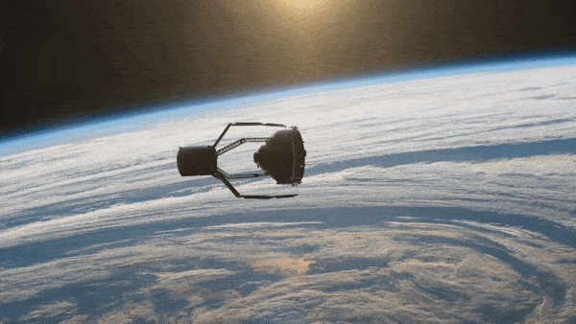
Why is this important?
Population of non-cooperative objects in near-Earth orbit continues to grow
Active Debris Removal (ADR) techniques proposed to:
Improve space sustainability
Reduce collision risk
Most ADR approaches require a service vehicle to attach to a target vehicle (see right)
Knowing the rotational state of the target is critical for successful ADR

Slide 3
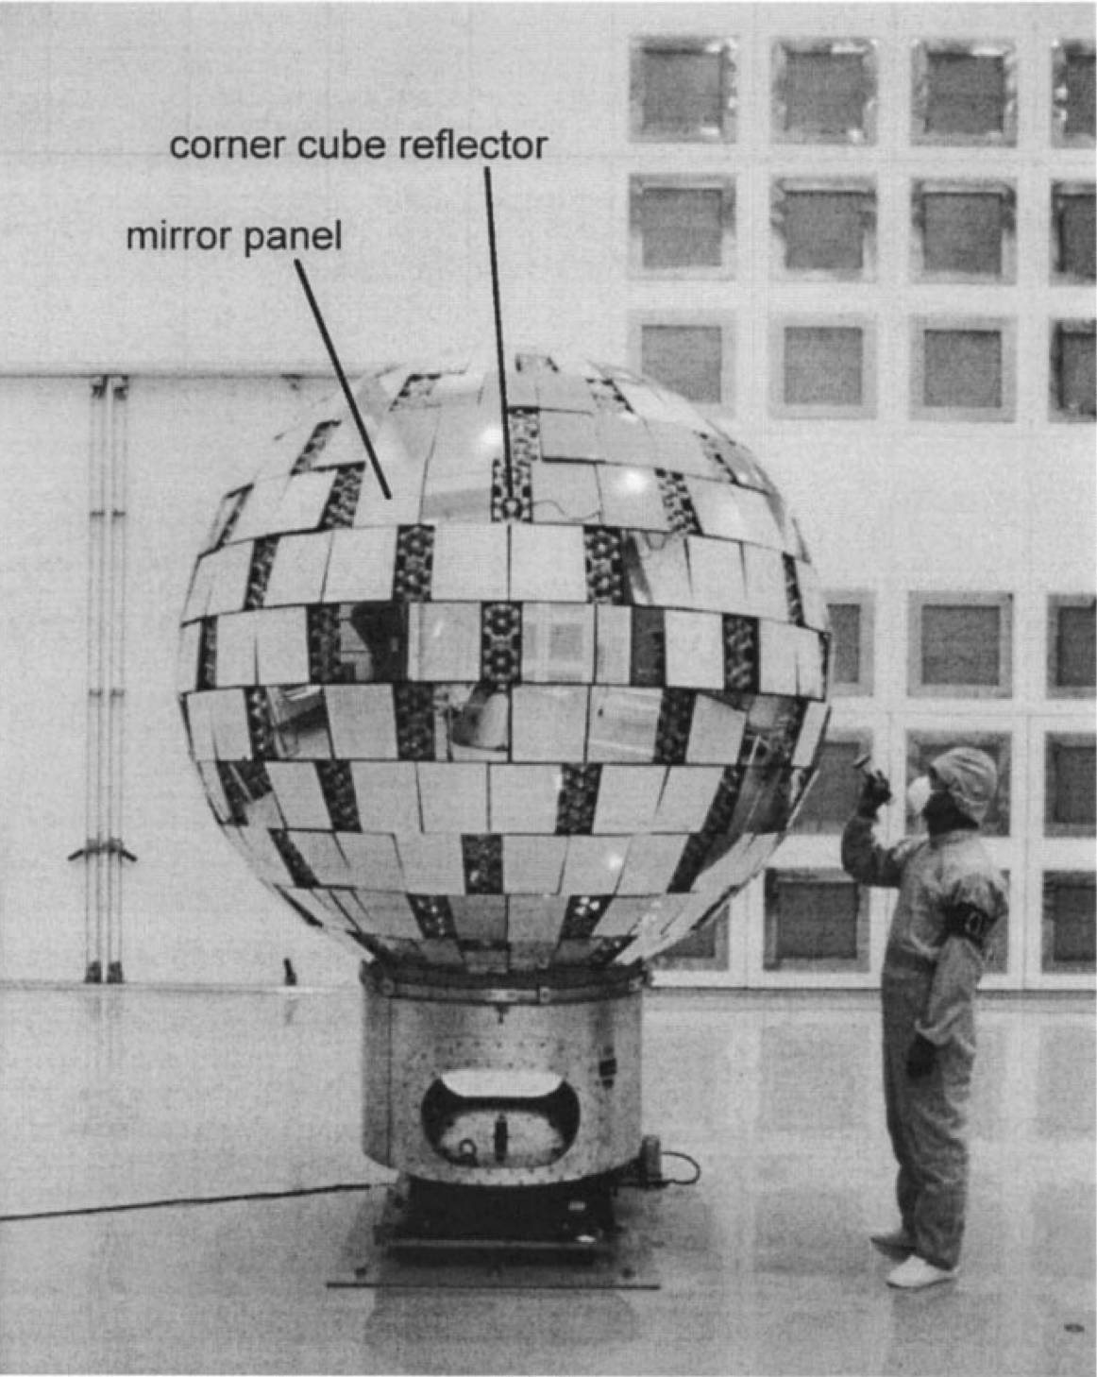
Case Study 1 : Ajisai
Background:
Launched 1986 by NASDA (Japan) for geodetic measurements
Low Earth Orbit (LEO): ~1500 km altitude, ~50° inclination
Spin-stabilised, initial spin aligned with Earth’s rotation axis, 1.5 s period (Sasaki & Hashimoto 1987)
Mirror Layout & Reflection Geometry:
Otsubo et al (2000)
12 primary latitudinal rings + 2 polar caps
Sub-rings contain 3 mirrors
Each sub-ring ensures reflection towards observer during rotation
Empirical Models from Literature :
Spin-axis & period can be approximated using empirical models (Kucharski et al 2016)
Models describe: Precession and nutation cones and spin period
Koshkin et al (2017) modelled the mirror positions in the body frame of the satellite

Slide 4
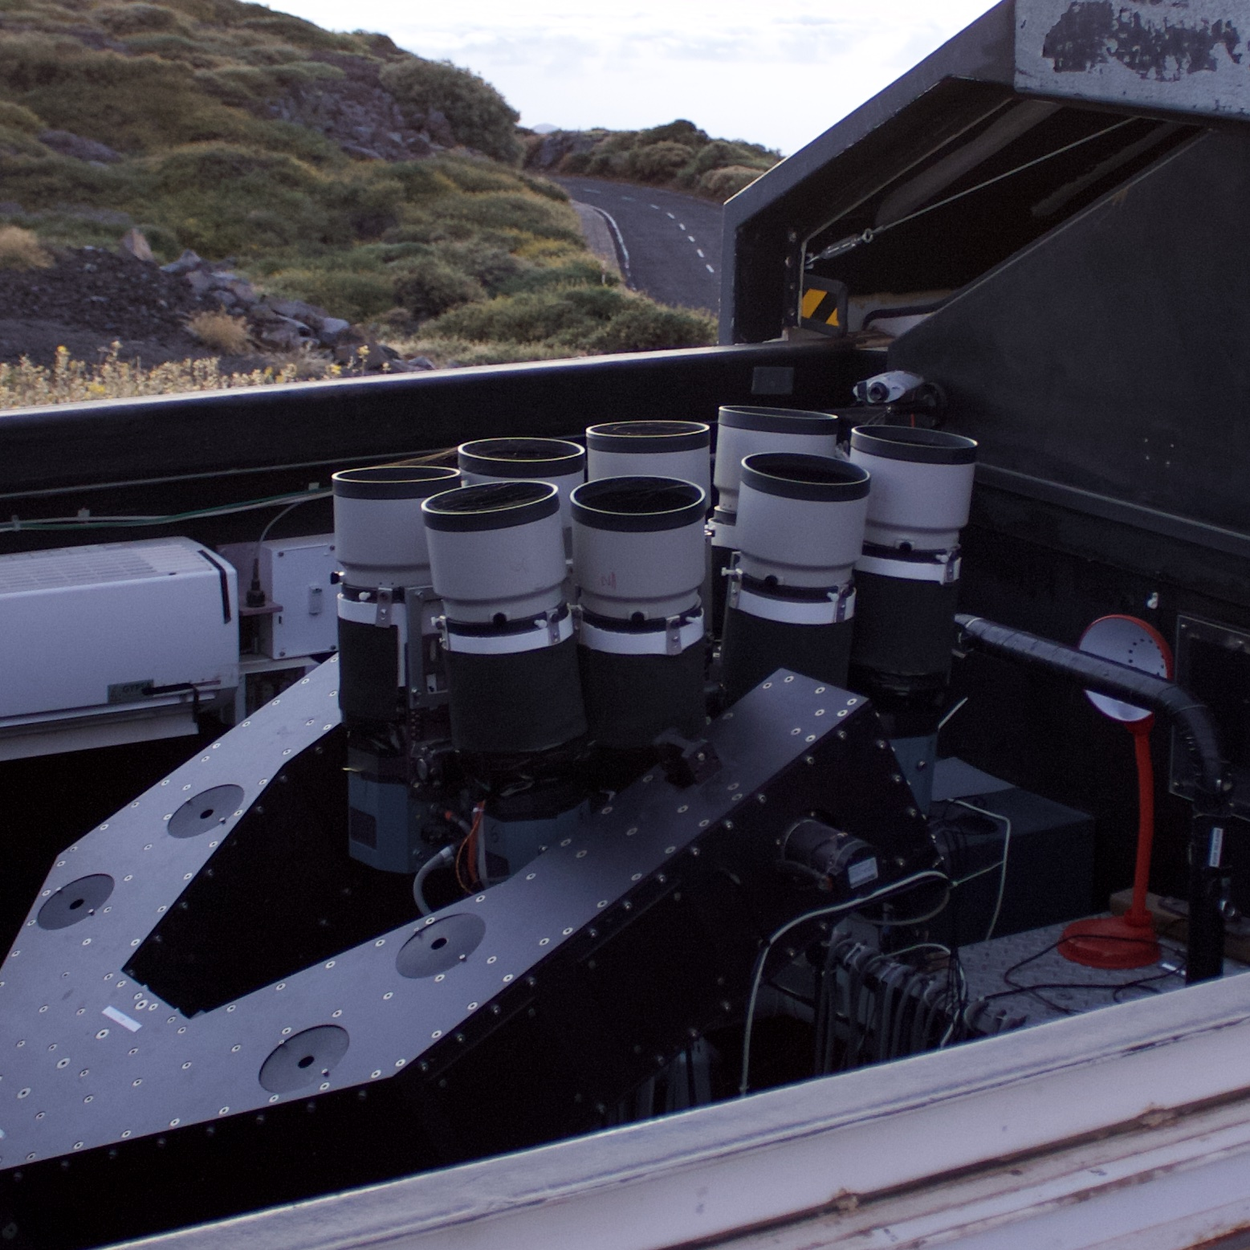
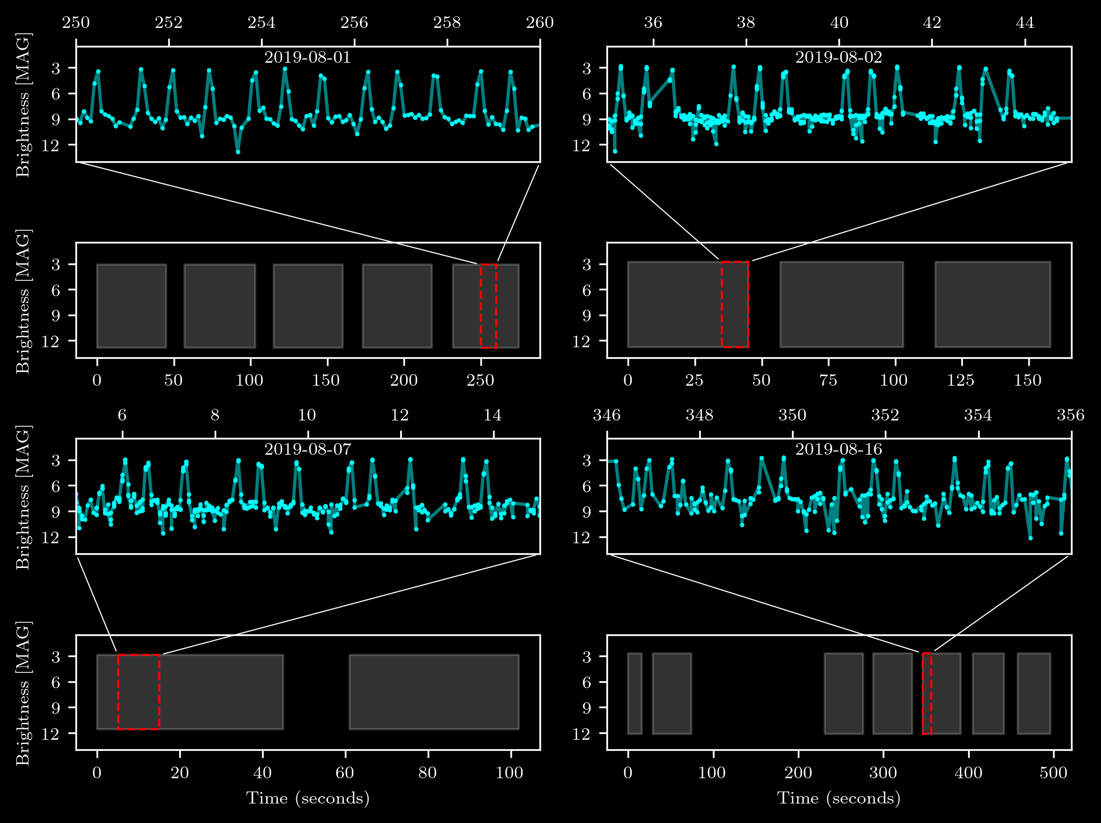
Observational Summary
Ajisai was observed 4 times in August of 2019 with SuperWASP as part of a larger LEO survey (Chote et al, 2019)
Triplets of mirrors are easily identifiable in the light curves

Slide 5
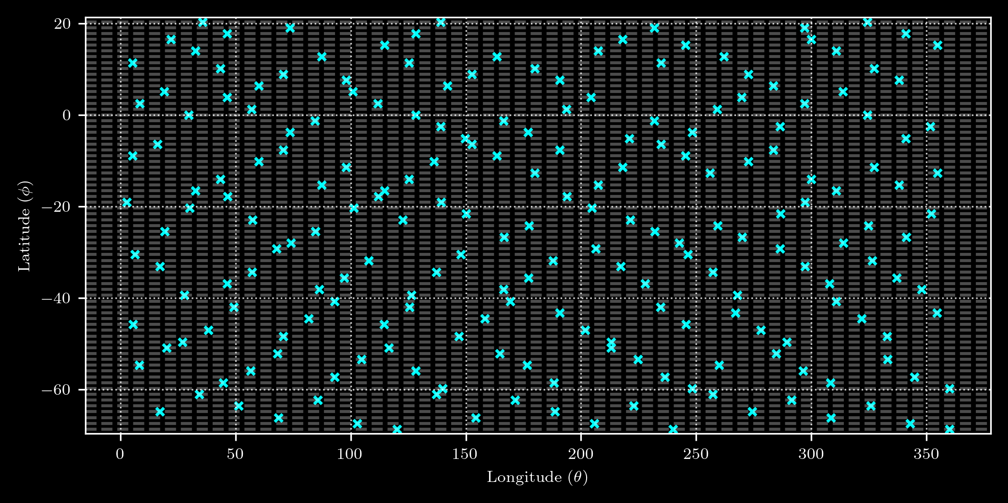

$$+$$
?
How do we make use of observer frame data with body frame data?

Slide 6
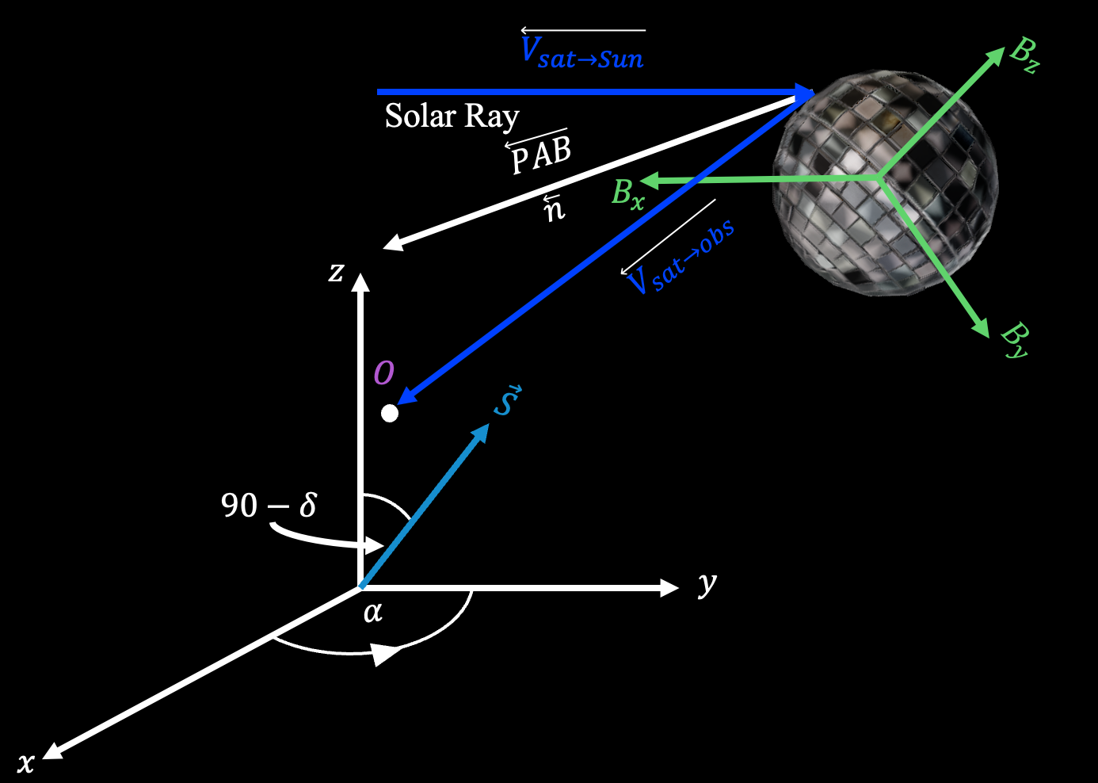
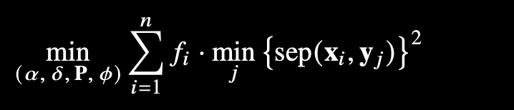
Methodology Outline
We assume a perfect reflection occurs when the Phase Angle Bisector (PAB) aligns with a mirror normal
We can use the spin-state parameters (spin-pole + period + initial rotational offset) to transform this vector into the body frame
Use Markov Chain Monte Carlo (MCMC) to sample the parameter space
Better spin state fits correspond to better alignment of bright measurements with the modelled mirror positions

Slide 7
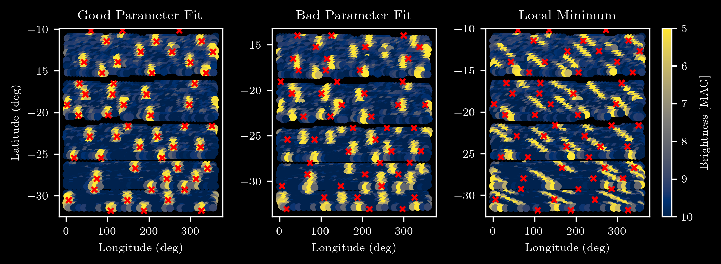
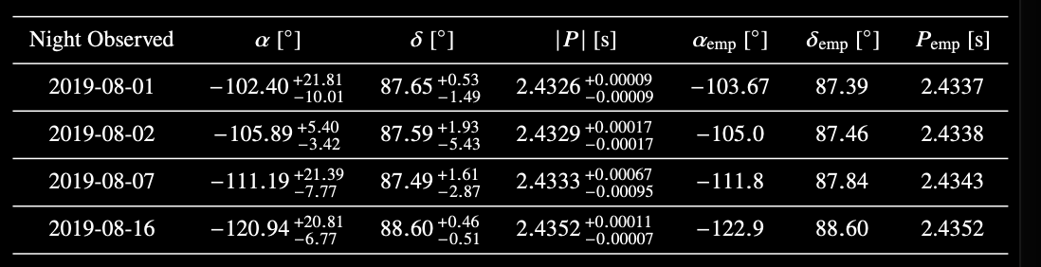
The Good, The Bad and The Ugly
Best-fit parameters: Transform all bright glints onto the expected mirror positions.
Offsetting the best-fit solution’s δ by 5° produces a noticeably poor fit.
Some parameter-space combinations create local minima by mapping only part of the bright glints onto expected mirror positions.

Slide 8
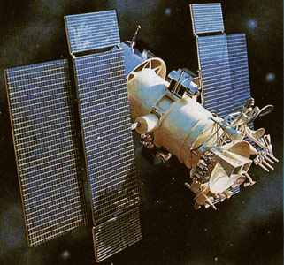
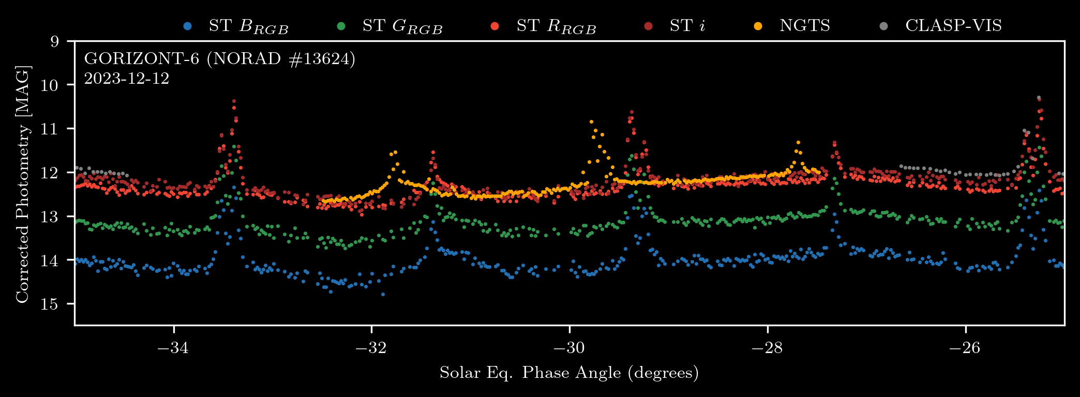
Case Study 2 : Gorizont-6
Gorizont-6 is a retired rotating Russian communications satellite in graveyard orbit
We acquired simultaneous observations over a large baseline with STING (La Palma) and NGTS (Chile)
Glints from the spacecraft arrive at Chile before La Palma, if we can pair these like features together then we can make a cost function to find the best spin-pole to explain what we see from the two sites
Artist’s impression of a Gorizont satellite (source: Gunter’s Space Page, “Gorizont 1-33 (11F662)

Slide 9
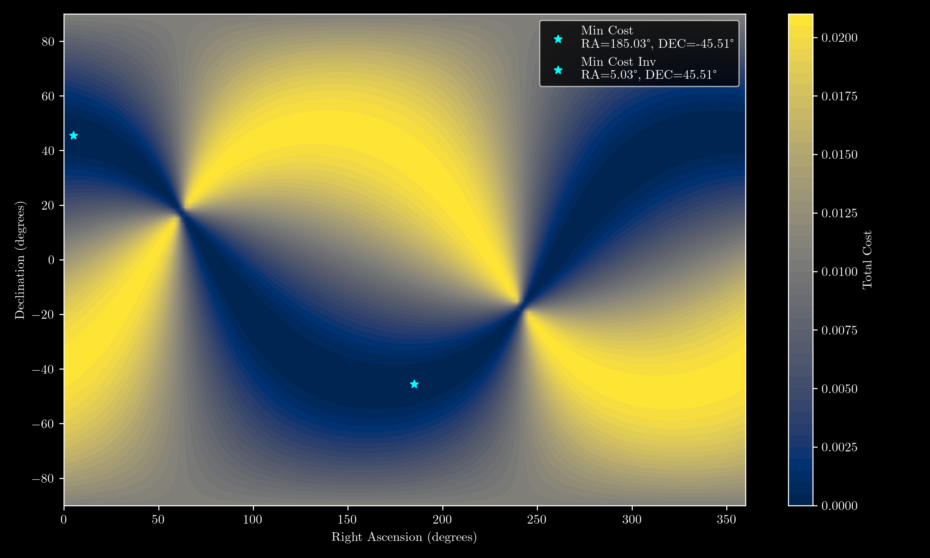
A glint seen from two sites gives two sightlines that define a plane in space.
The object’s spin axis lies along the intersection of these planes.
We want the spin axis direction that best fits all glint timings and angles.

Slide 10
Summary
Outlined viable methods for making inferences on the spin-state of two very geometrically different objects from photometric measurements
Our results show that we can recover the spin-axis and rotation period of fast-spinning objects such as Ajisai using modest ground-based instrumentation, making it readily scalable to a wider range of targets and observatories.
Thank You!

