Slide 1
Fine structure of kink modes in coronal loops
Ding Yuan^{1,2}, Tom Van Doorsselaere²
dyuan2@uclan.ac.uk
Jeremiah Horrocks Institute,
University of Central Lancashire, Preston, UK
2. Centre for mathematical Plasma & Astrophysics
Department of Mathematics
KU Leuven, Belgium

Slide 2
Contents
Forward Modelling
Synthetic studies
Applications

Slide 3
$1.Forward Modelling code
FoMo (C++)
FoMo code is used to synthesize the (E)UV, X-ray, radio and optically thick line emission of 3D plasma structures.
Van Doorsselaere et al. Frontiers, submitted

Slide 4
FoMo code to synthesize EUV, Radio emissions of optically thin and thick plasmas
1. Spectrographic observation
->The emissivity of each plasma fluid element is spread the intensity to a Gaussian spectrum with a thermal width and modified by Doppler shift.
2. Imaging observation

Slide 5
Purpose: plasma parameters to observables
Damping measured in emission intensity do not necessarily reflect real MHD wave damping, De Moortel & Bradshaw (2008), Kumar et al 2015, Fang et al 2015
Emission intensity enhancement does not always means temperature increase; it could be an opposite case if the plasma is heated to the hot wing of the contribution function, Yuan et al 2015

Slide 6
Slow modes of loops at various temperature
Yuan et al ApJ 2015

Slide 7
Empirical trend

Slide 8
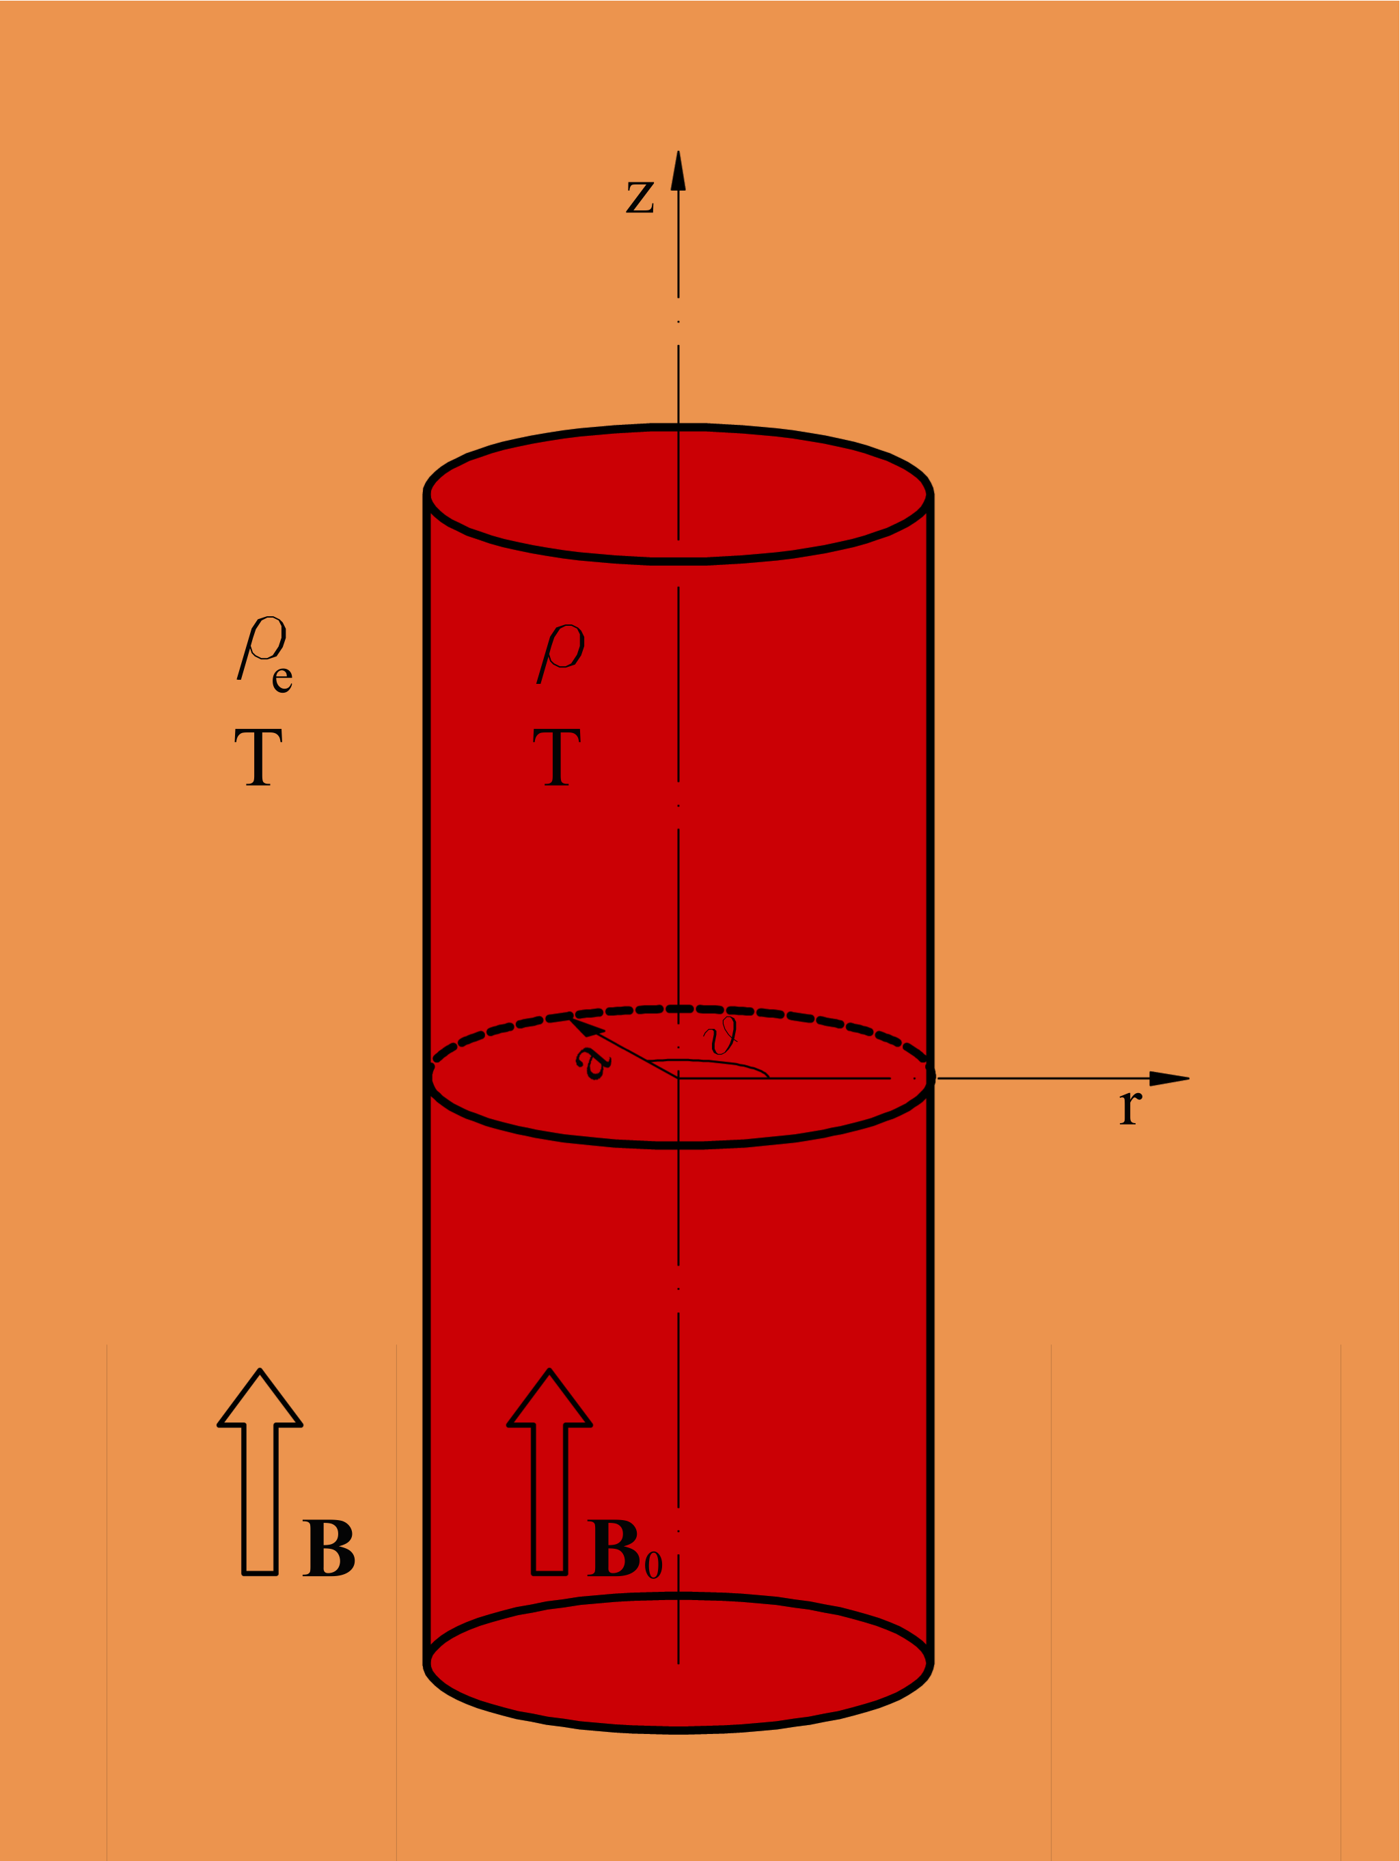

$2. Kink mode in a plasma cylinder
Edwin & Robert Sol. Phys.(1983) 88, 179

Slide 9
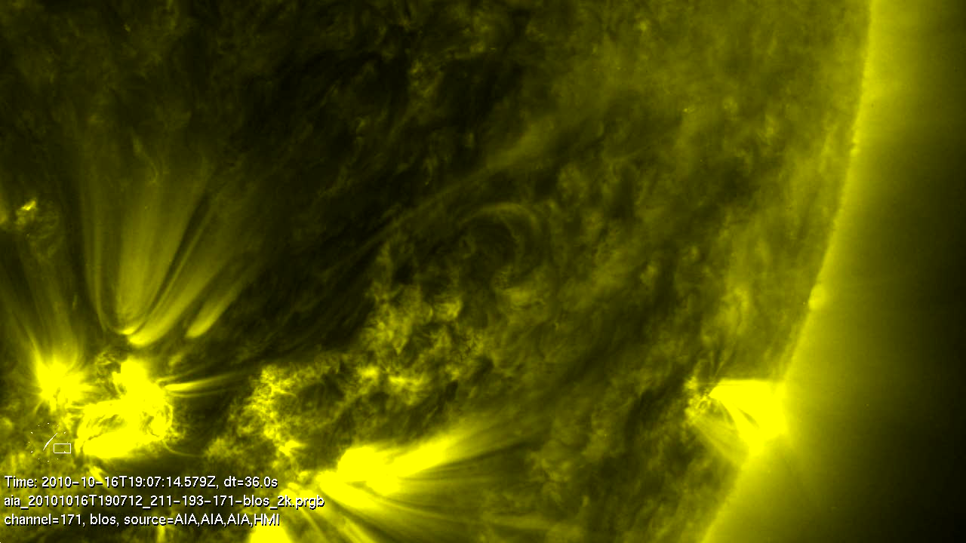
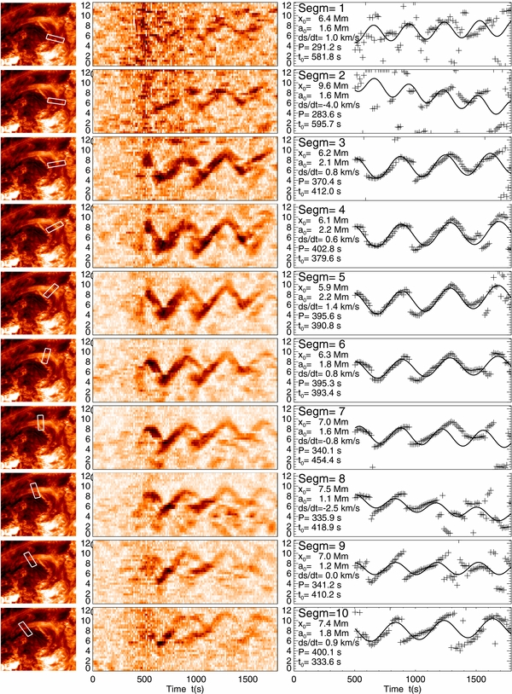
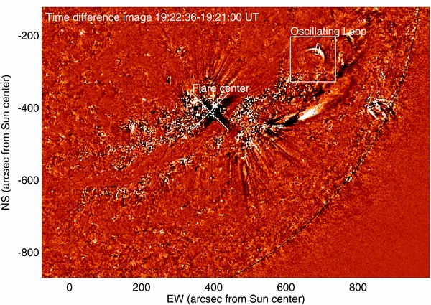
SDO/AIA observations
Aschwanden & Schrijver 2011

Slide 10
Low-amplitude and non-damping kink waves
Unresolved transverse motion under detection capability of modern instruments?
Nistico et al 2013
Anfinogetntov et al 2013

Slide 11
Kink mode soluion:
“Rigid” motion + quadrupole terms
Goossens et al 2014
Notes:
Elena.pilishvili.1@iliauni.edu.ge

Slide 12
Loop shell deformation
Yuan & Van Doorselaere ApJS, subm

Slide 13
Mapping into a semi-torus

Slide 14
Active region loop model
Inside the loop
Outside the loop

Slide 15
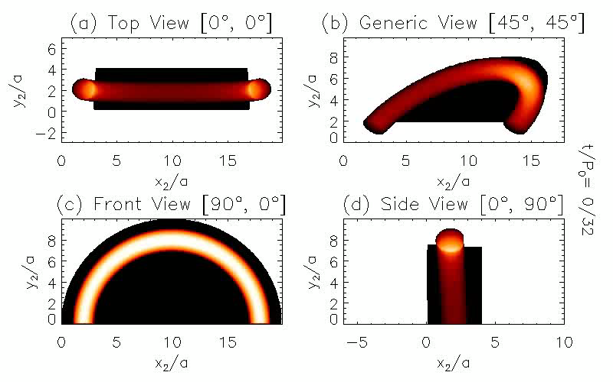
Fe IX 171.073 A

Slide 16
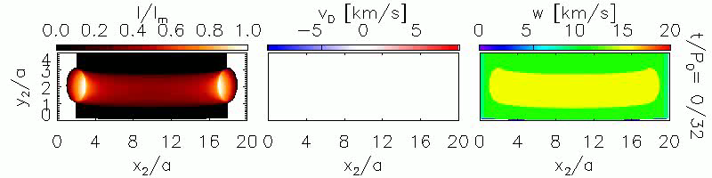
Top view
Kink motion of the loop
Line width broadening at loop edges

Slide 17
A slice at loop apex

Slide 18
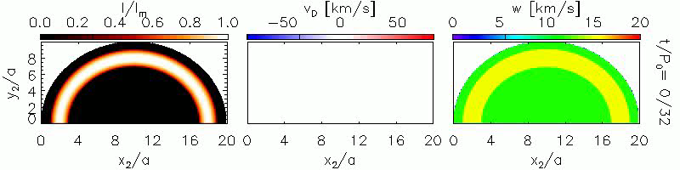
Front view
Loop kink motion in Doppler shift
Line width broadening
Loop width variation

Slide 19
Time distance plot
1. Pendular motion
2. Loop width variation

Slide 20
Broadening and intensity suppression

Slide 21
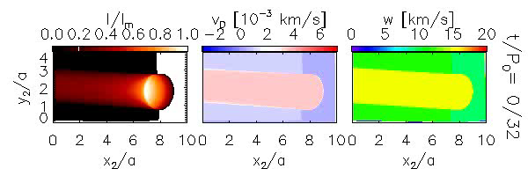
Side view

Slide 22
Time distance plot

Slide 23
Summary
Kink MHD mode is an almost incompressible mode; the geometric effect determines the observational features, while the contribution function plays a trivial role.
A quadrupole term in the kink mode solution leads to the detection of a pendular motion at front view, nonthermal broadening at the loop edge and “apparent” loop width modulation.

Slide 24
$3. Applications
Oscillation phase and amplitude distribution
Fine structures in a kink wave
Mode identification

Slide 25
Phase and amplitude distributions

Slide 26
Loop width variation
Observation
Model

Slide 27
Polarization: horizontal or vertical
Maximum intensity at axis or extremes?

Slide 28
Mode identification
1. Overtone identification
2. Phase jump at anti-nodes

Slide 29
Summary
Vertical and horizontal mode are distinctive in where the intensity emission reaches maximum.
Observation could be effectively supported by forward modelling in determining the wave properties.

