Slide 1

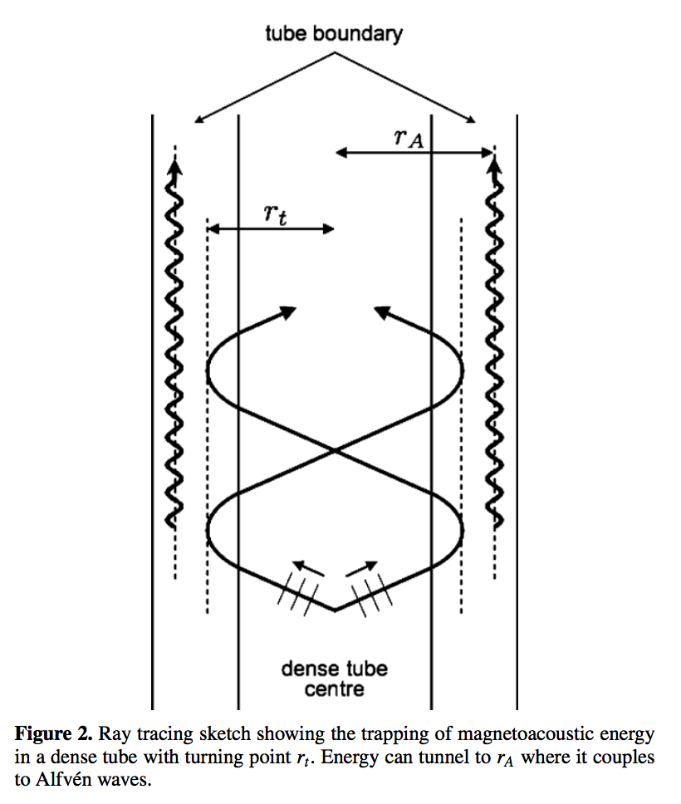
Musings on the Relation between Fast and Alfvén Waves in a Structured Low 𝛽 Plasma
Paul Cally
School of Mathematical Sciences

Slide 2
Abstract
I will discuss how fast and Alfvén waves are coupled by magnetic field geometry in a non-uniform (particularly gravitationally stratified) MHD atmosphere, with implications for wave energy penetrating the transition region and entering the corona. I will also show how coupling can also be produced by Hall current, though only at much higher frequencies than are commonly considered in coronal seismology. Finally, I will report on some incomplete work on fast/Alfvén coupling in a 2D periodic nest of flux tubes.

Slide 3
Contents
MHD Wave Types
Fast/Alfvén mode coupling in linear ideal MHD
  Geometry + stratification
  Hall current
Nest of flux tubes and separating mode types
Conclusions

Slide 4
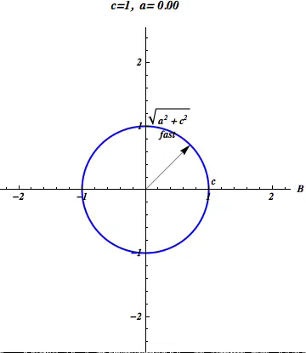
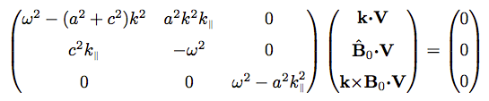
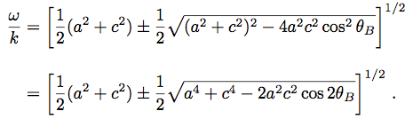
MHD wave types
Phase velocity polar diagram
Uniform plasma
Determinant
Three wave types: Alfvén, fast, slow
Coupling at a=c?

Slide 5
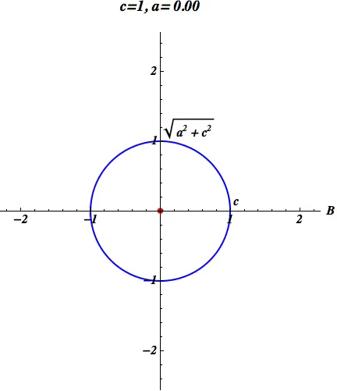
MHD wave types
Group velocity polar diagram
Uniform plasma
Determinant
Three wave types: Alfvén, fast, slow
Coupling at a=c?

Slide 6
Conversion
Depending on circumstances, an upcoming acoustic-gravity wave can
  Reflect
  Convert to other MAG mode
  Convert to Alfvén
  Combination of all
Cases: low frequency (1 mHz) gravity waves, k_{x}= 2 rad/Mm, B=10 G (Newington & Cally 2010)
  Just the Eikonal/ray theory results

Slide 8
However …
… in reality, not all energy flux follows one path. For example
Conversion region
magnetic
Partial conversion/transmission/reflection
acoustic
Acoustic (full) and magnetic (dashed) wave-energy fluxes as functions of height z (Mm) for B = 10 G, 𝜃 = 83◦, 𝜙= 30◦. Once again, the frequency is 1 mHz and the horizontal wavenumber is 2 rad/Mm. The vertical line indicates the position of the Alfvén/acoustic equipartition level a = c.

Slide 9
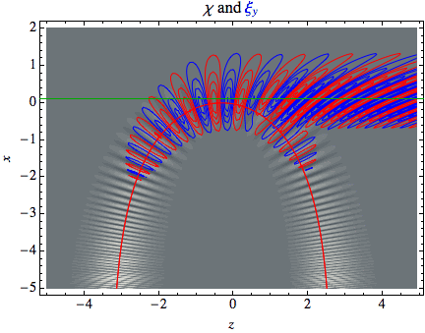
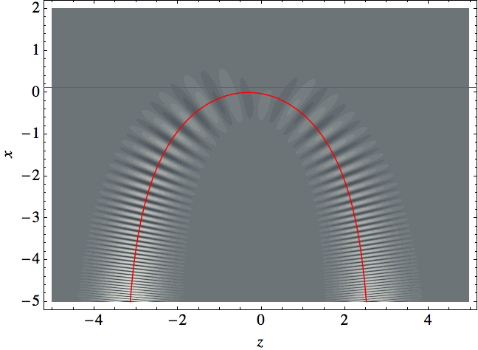

Fast to Alfvén, horizontal field
Alfvén Continuum Resonance
Cally & Andries (2010)
Reflecting fast wave couples to Alfvén wave
Alfvén speed increasing exponentially with height
B in z direction (horizontal)
Fast wave ray bundle injected from bottom
Red curve – classical ray path of centre of bundle
Green line – Alfvén resonance corresponding to centre of bundle
Must contain y component of wavevector or else no coupling
Note phase mixing as Alfvén wave propagates⇒ thermalization
Mode conversion or resonant absorption?

Slide 10
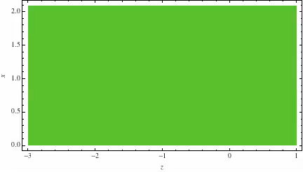
Type II: Fast to Alfvén, horizontal field
Temporal ray bundle (Hanson & Cally 2011)
Alfvén speed increasing exponentially with height; B horizontal
Note phase mixing as t increases

Slide 12
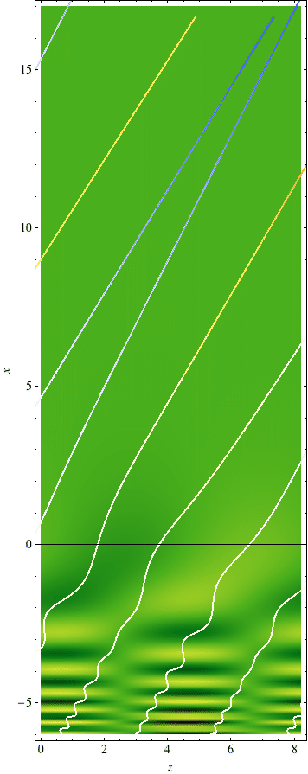
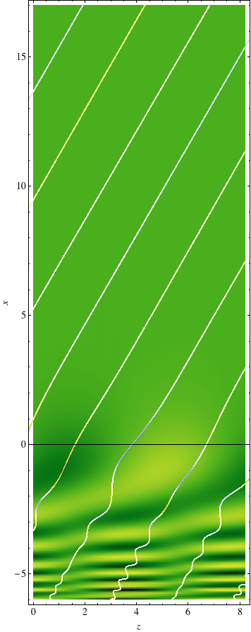
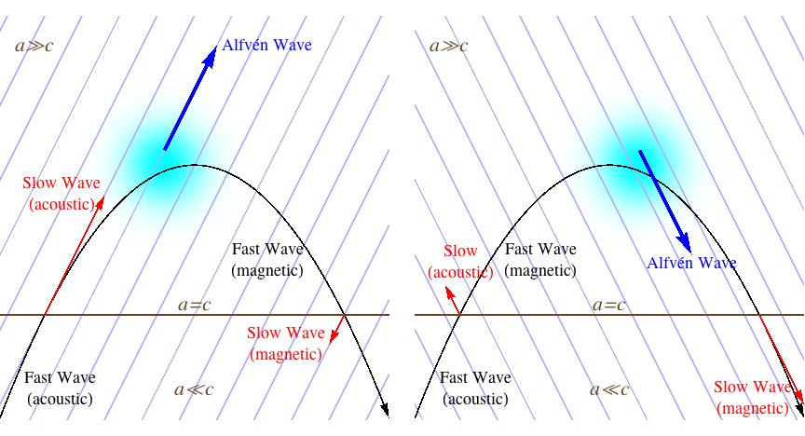


Type II: Fast-to-Alfvén Conversion, inclined field
Cally and Hansen 2011 (ApJ)

Slide 13
Survey of Wave Directions
Cally & Goossens (2008)
Uniform inclined B
Model S with isothermal “chromosphere”
5 mHz, k_{x}=1.37 rad/Mm
Driver at z=-5 Mm
Acoustic and magnetic (i.e. Alfvén) flux at top of box
A combination of acoustic (slow) and Alfvén wave leaves at the top.
Reflected at bottom (not shown)
Wave vector relative to field geometry crucial!

Slide 14
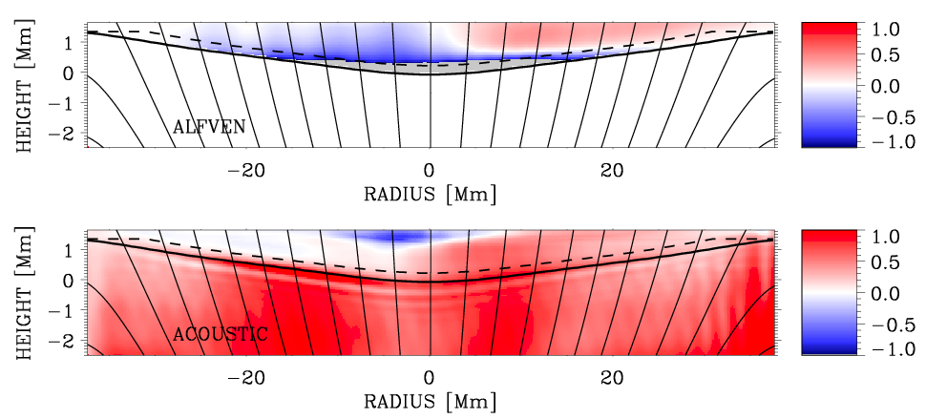
Sunspot model
5 mHz 𝑘_{𝑥}=1.37 rad Mm⁻¹ seismic wave
Converts to fast at 𝑎=𝑐 (full line)
Reflects beyond ω/𝑘_{𝑥}=𝑎
Alfvén wave flux shows expected directionality dependent on field inclination
Application to “realistic” sunspot models confirms Alfvén conversion
  Khomenko & Cally (2012) – 2.5D
  Felipe (2012) – 3D
K & C (2012): 5 mHz
Note distorted aspect ratio

Slide 15
Concentrate on Cold Plasma
Fast and Alfvén waves only
Uniform field with vertically stratified density
Alfvén operator
𝞷 = displacement vector
𝜒=∇∙𝞷 dilatation (rep fast wave)
Alfvén wave driven by fast wave!
Transition region?

Slide 16
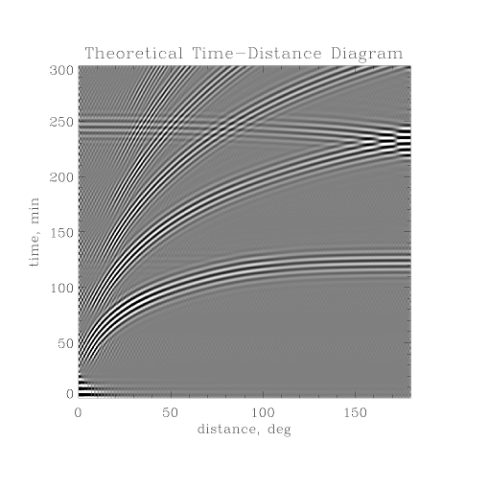
Time-Distance Helioseismology
Duvall et al (1993)
A major local helioseismolgy method
Measures “travel times” (usually phase but possibly group) between separated surface points to infer subsurface wave speeds (temperature, flow, etc)

Slide 17
Boundary Value Problem (BVP) calculation in uniform inclined magnetic field
Variation with field inclination 𝛳 and orientation 𝜙
Computational Setup
“Travel time” perturbation 𝛿𝜏 (as measured by phase; Time-Distance Helioseismology [TD)
Total fractional energy loss 𝓛 from injected fast wave
Acoustic losses (fraction) F_{ac} at top of box
Magnetic (Alfvén) losses F_{mag} at top of box

Slide 18
Travel Time and Energy Losses
Fast-Alfvén conversion causes positive shift that partially cancels f-s
Fast-slow conversion causes negative travel time shift
Total losses essentially symmetric about 𝜙=90º; causes symmetry in 𝛿𝜏
↑ Alfvén
↓ Alfvén
↑ slow
↓ slow
No shift when ω < ω_{c} cos 𝛳
Upward acoustic transmission T greatest at small attack angle α
Upward Alfvén losses enhanced for 𝜙<90º
Moradi & Cally, Seismology of the wounded sun, MNRAS 2013

Slide 19
BVP cf Simulations + TD
BVP
SPARC+TD (with Hamed Moradi)

Slide 20
Travel Time Perturbations
Relative to quiet Sun: With and without Transition Region
No TR
With TR
Hansen & Cally, Time-Distance Seismology and the Solar Transition Region, Solar Phys 2014

Slide 21
Alfvén Fluxes at the Top
Effect of Transition Region
Leaky resonance shows clearly in upward Alfvén flux

Slide 22
Cut at 𝜙=60º: with and without TR
Jump in branch near acoustic ramp threshold! Robust.
Peaks caused by leaky TR “lid”
Full: no TR; Dashed: with TR

Slide 23
Stratification across flux tubes
Same process, but with fast wave trapped, so iterated conversion
Pascoe, Wright & De Moortel, 2010

Slide 24
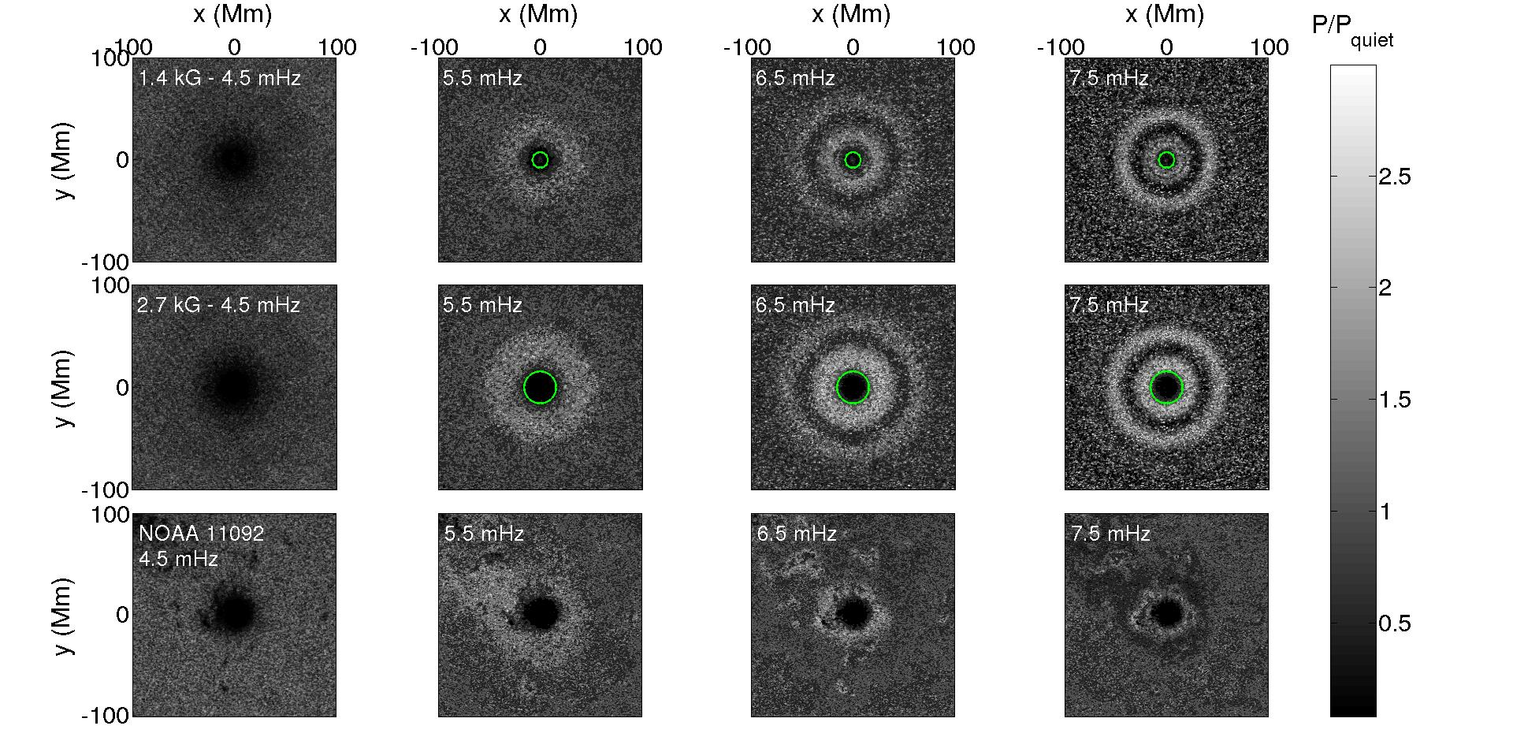
Acoustic Halos around Sunspots at High Frequencies
Simulation (Carlos Rijs) and Observation (Paul Rajaguru)
– v_{z} Doppler power
Rijs, Rajaguru, Przybylski, Moradi, Cally, & Shelyag (ApJ in press)

Slide 25
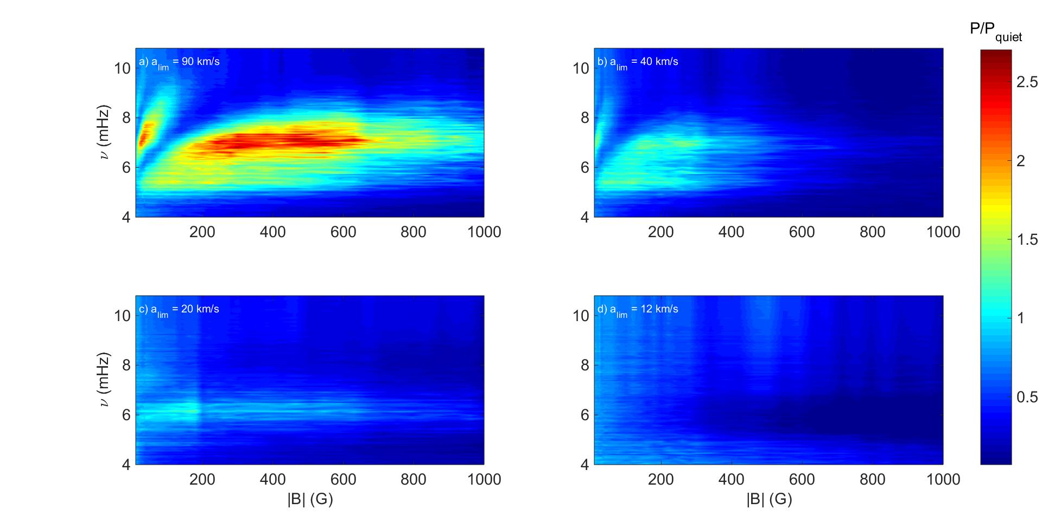
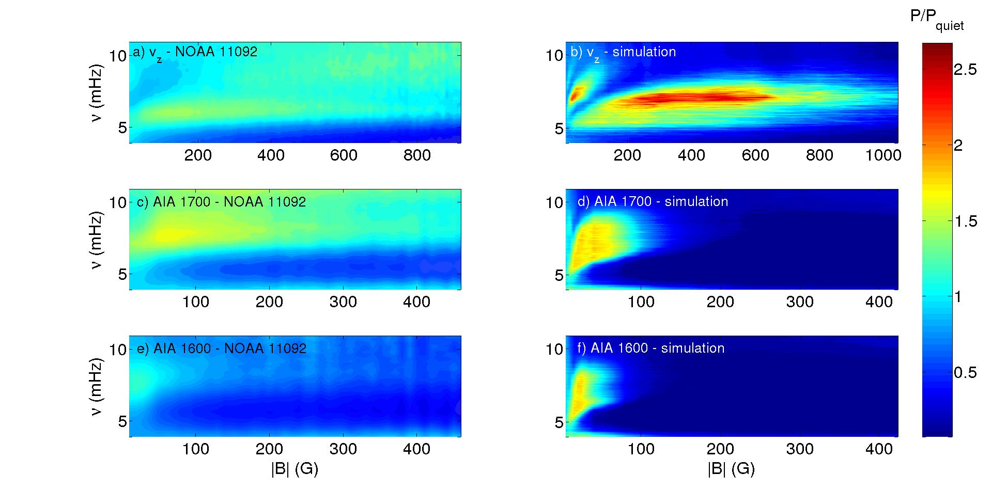
Hypothesis: Halos are returning fast waves
Suggested by Khomenko & Collados (2009)
Supported by simulations of Rijs et al (2015a,b)
Powerful test: impose small Alfvén speed limiter in simulations so that fast waves don’t reflect
  Halos disappear!
Suggestion of gap in observed (real) halos at high frequency; clear in simulations
  Related to fast/Alfvén conversion?
Line | Height
Fe I 6173 Å (Doppler) | ~140 km
AIA 1600 Å | ~430 km
AIA 1700 Å | ~360 km

Slide 26
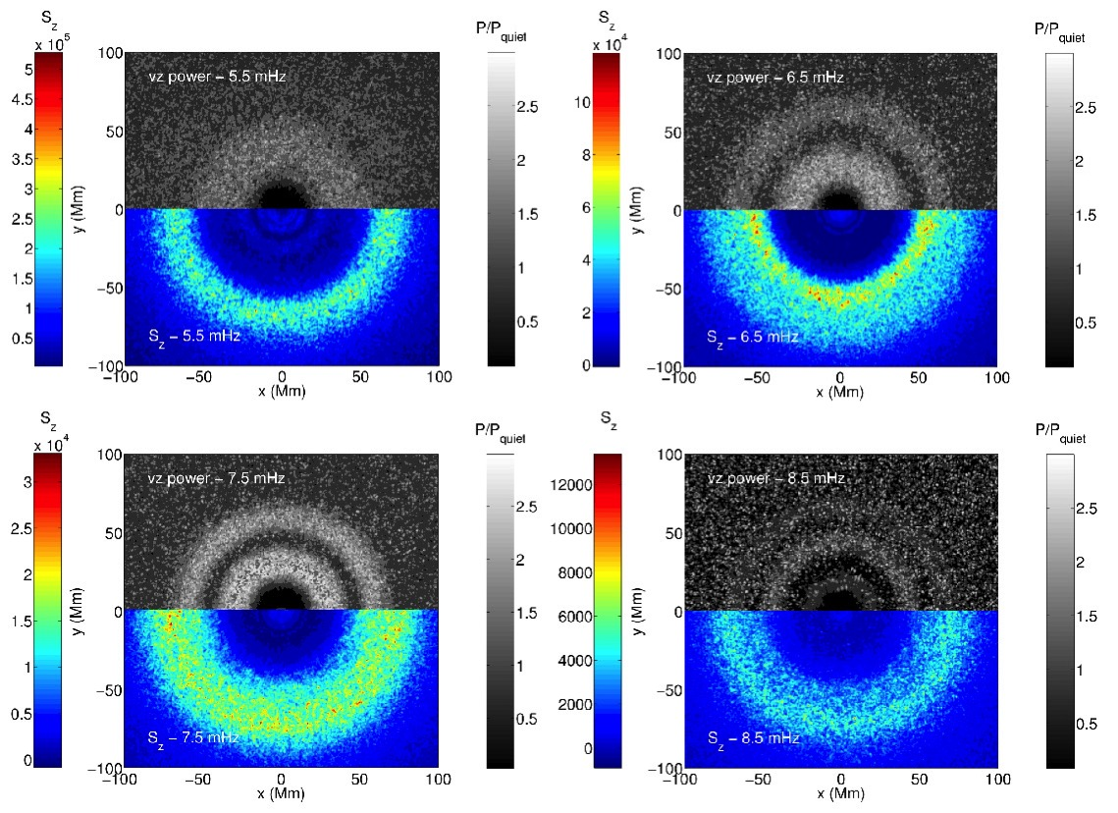
Simulated Halos and fast/Alfvén Mode Conversion –
Gap due to Alfvén conversion loss?

Slide 27
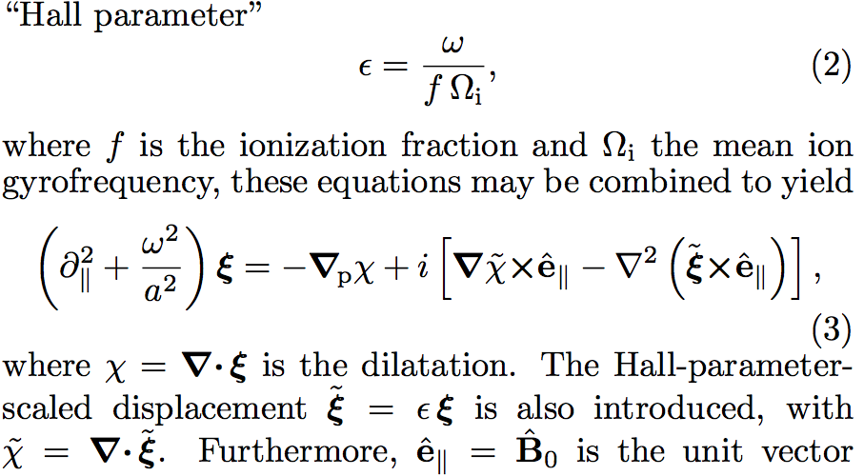
Fast/Alfvén Conversion caused by Hall Effect
Cold plasma
Green: Alfvén operator
Blue: fast wave coupling
Red: Hall term
Hall term produces continual oscillation between fast and Alfvén states
Extremely weak at active region field strengths and mHz frequencies
Effective for weak fields (few G), low ionization fraction (~10⁻³), high frequency (Hz), near parallel propagation [need all!]
Expected to be effective in galactic star forming regions
N_{osc} = number of fast-Alfvén-fast oscillations in passing from 0 to L
  Increases quadratically with frequency
  Decreases quadratically with field strength
Cally & Khomenko, ApJ 2015 (in press)

Slide 28
Hall-MHD Fast/Alfvén Conversion Coefficient
Conversion coefficient (upward) as a function of Hall coefficient 𝜖₀ for two different “Hall window” thicknesses.
Upper: nearly parallel propagation (θ=5°)
Lower: θ=30°

Slide 29
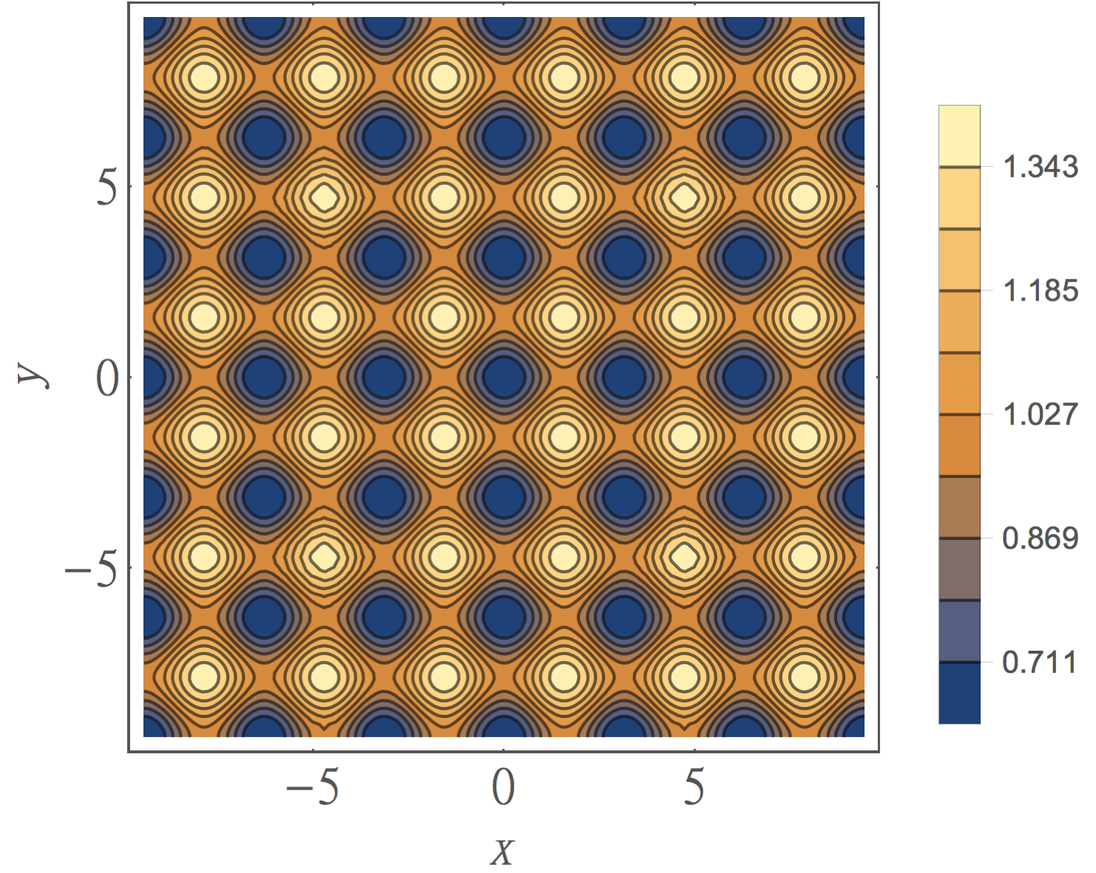
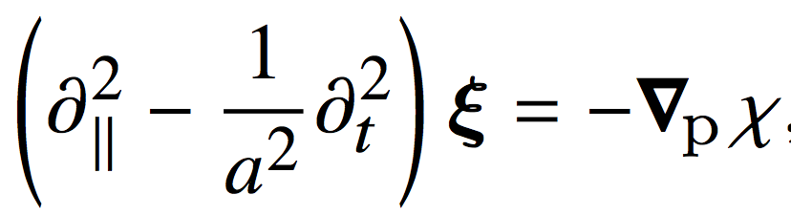
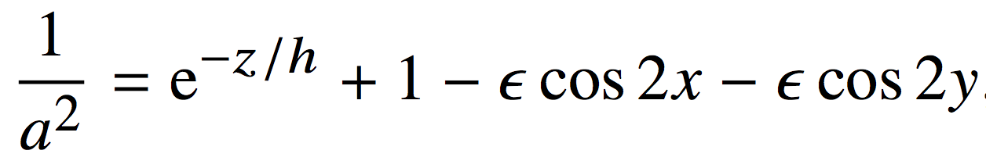
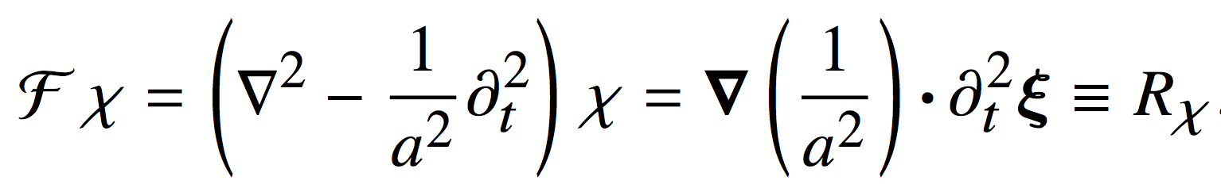
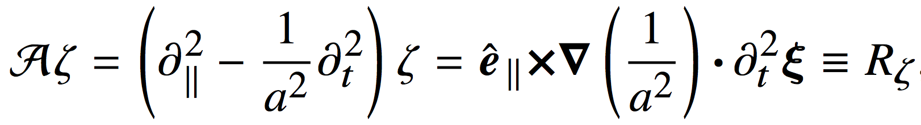
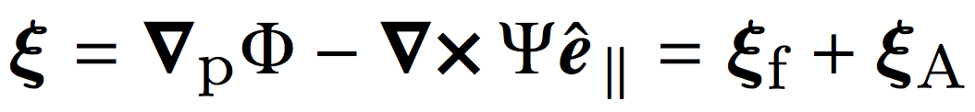
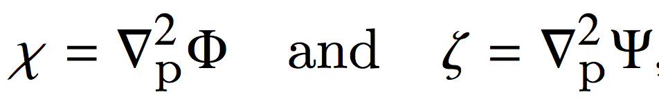
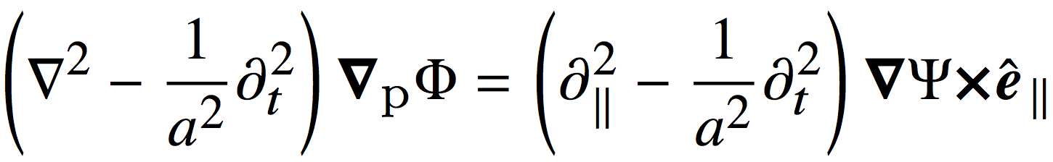
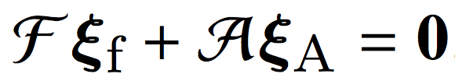
Periodic Flux Tube Array: Cold Plasma
Wave equation
Take divergence: 𝜒=∇∙𝞷
Take curl: 𝜁=e||∙∇×𝞷
Expand in irrotational (fast) and solenoidal (Alfvén) parts.
Hence
Convenient separation of fast and Alfvén
Example planform of periodic flux tubes.
Solve semi-analytically (Mathieu functions)

Slide 30
The End
结束

