Slide 1
Solar Physics at Monash
A glimpse at 2016
Paul Cally

Slide 2
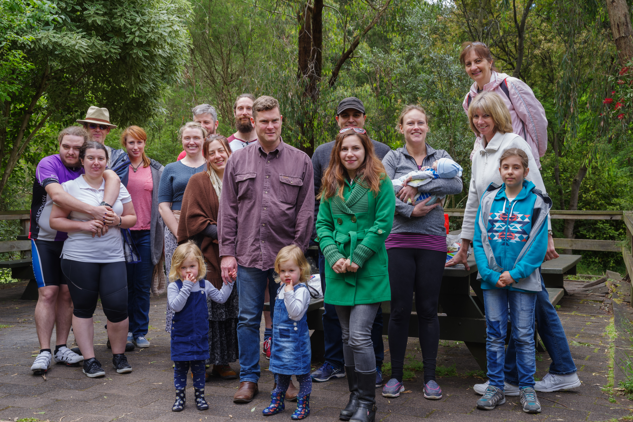
Clique du Soleil
Past and Present
Paul Cally (Prof)
Alina Donea (Snr lecturer)
Sarah Jabbari (postdoc)
Carlos Rijs (PhD student, just completed)
Damien Przybylski (PhD student, nearly completed)
Dana Lacatus (PhD student)
Alin Paraschev (PhD student)
Jamon Pennicott (PhD student)
Sergiy Shelyag (Affiliate)

Slide 3
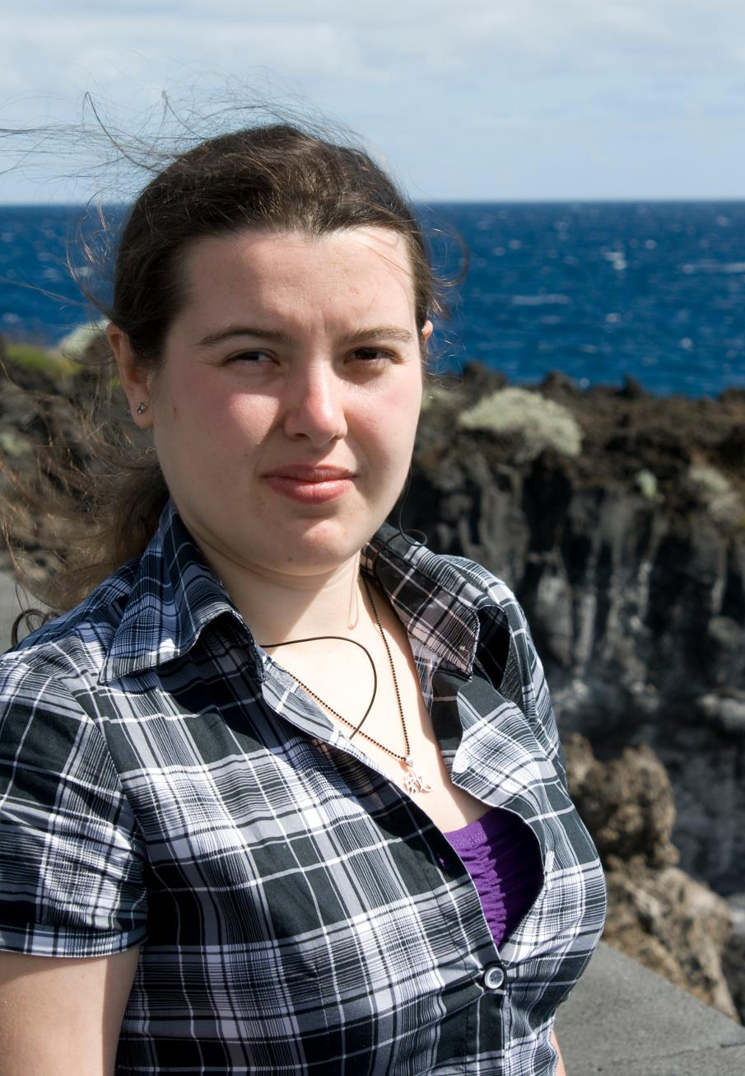
The March 11, 2015 X2.1 flare: Peculiar post-flare spectral signatures
D. A. Lacatus¹, A. Donea¹, P. Judge²
¹ School of Mathematical Sciences, Monash University, Australia
² High Altitude Observatory, National Center for Atmospheric Research, USA
E-mail: daniela.lacatus@monash.edu
The only X-class flare of 2015 observed by IRIS occurred at 16:22 UT on 11 March 2015, in AR 12297. The impulsive phase of the flare was followed by a broad red-shifted emission that appears to correspond to a form of highly turbulent post-flare coronal rain. We use analytical methods to understand the unusual profiles and constrain the local conditions.
Post flare emission properties:
Starts abruptly 6 min after flare and lasts more than an hour
Region 20 pixels across (6") ⇒ 45 Mm.
Smooth profile across multiple Doppler shifts ⇒ unresolved motion.
Broad components are not obviously self-reversed
Total broad post flare profile intensity higher than core ⇒ not scattering of photons from core, different emitting plasma pocket.
Ratio of k/h ≈1.15 (far from thin 2:1 value) ⇒optically thick plasma. The C II 1334/1335 Å lines ratio also close to 1:1 (thin value 1:2).
Profile width of 150 km/s and ∼70 km/s redshift ⇒ 4X more energy in unresolved motions than in resolved ones ⇒ Magnetic fields play important role.
Origin of peculiar profile:
Redshift: macroscopic plasma flow corresponding to coronal rain.
Width: microturbulent/unresolved motions produced by waves originating in the impulsive phase
Duration: slow damping of waves or decay to radiative processes
Evolution of the emission in the Mg II k&h lines during flare. Peculiar long lasting, broad and highly redshifted emission after the impulsive phase. (Cubic square root scaling)

Slide 4
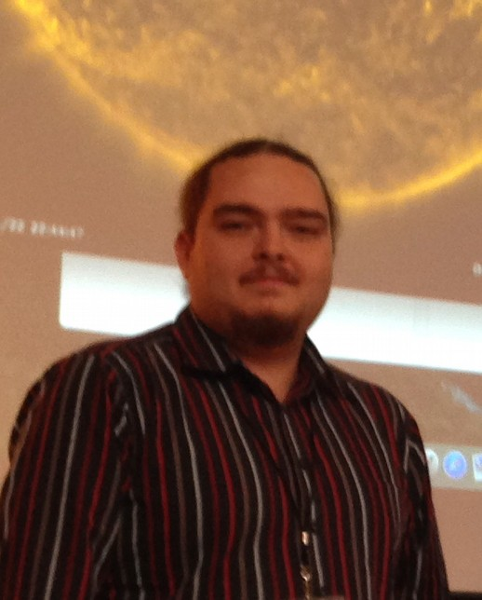
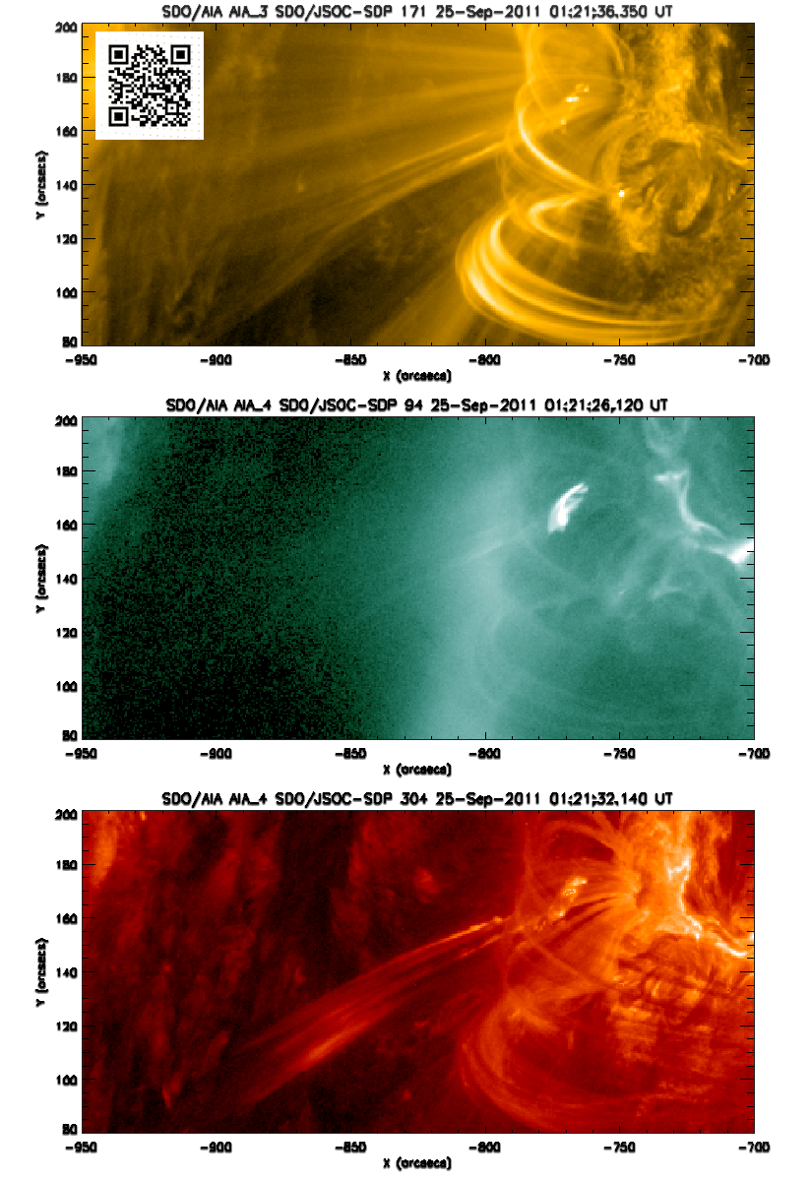
Long timescale recurrent coronal jet emission: Coronal Geyser structure
Alin Razvan Paraschiv and Alina Donea School of Mathematical Sciences, Monash University, Australia
We report the existence of a dynamical recurrent jet emission structure (Coronal Geyser) rooted in a penumbral moat region.
The photospheric B_{LOS} configuration can be explained by an anchored (micro)filament topology.
Upward propagating Type-III radio bursts are associated to the EUV flaring corresponding to all detected jet events. Radio burst morphology suggests that jet inducing reconnection is occurring at coronal heights.
Correlated RHESSI and GOES X-ray enhancements suggest beam heating of the site's footpoints. Bright H_{α} signatures indicate lower height (transition region) erupting plasma. These surges are apparently time delayed versus the main EUV flaring!

Slide 5
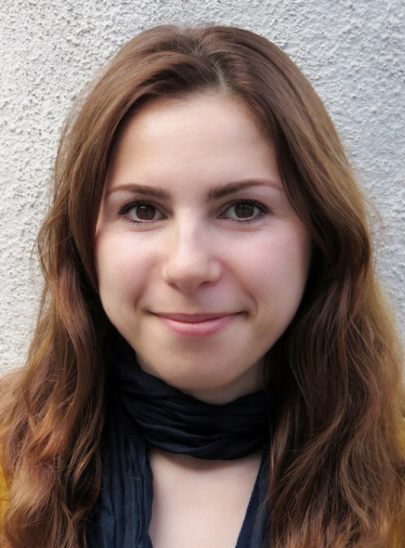
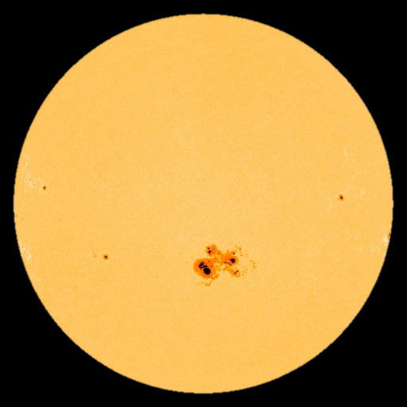
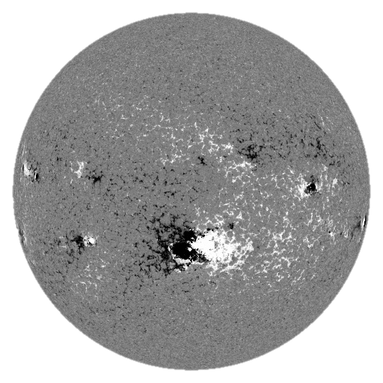
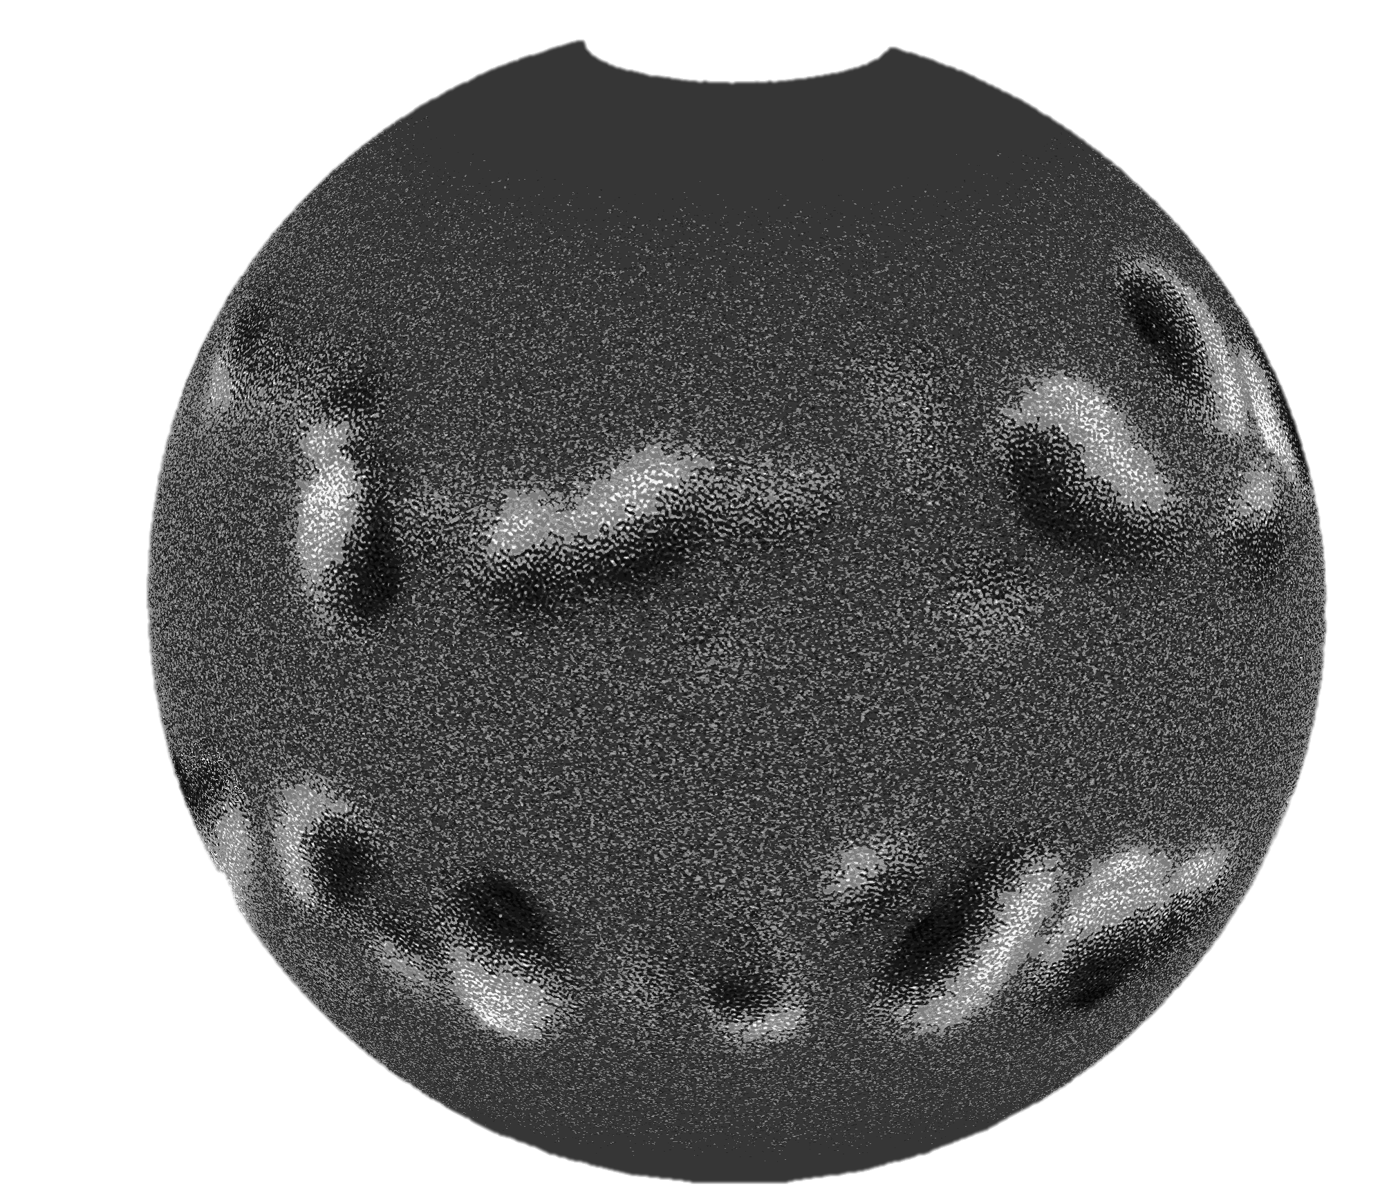
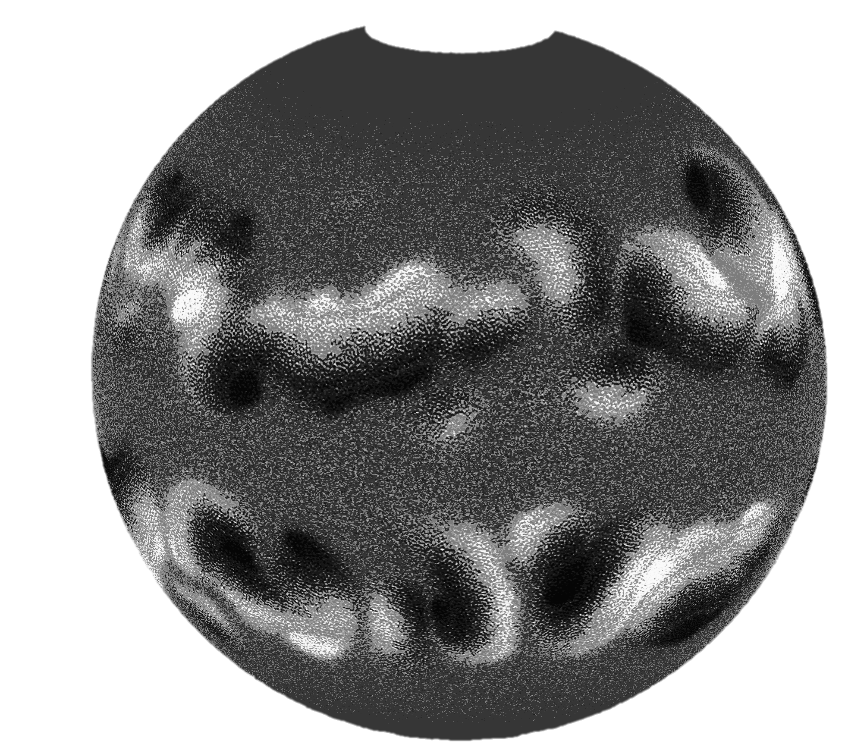
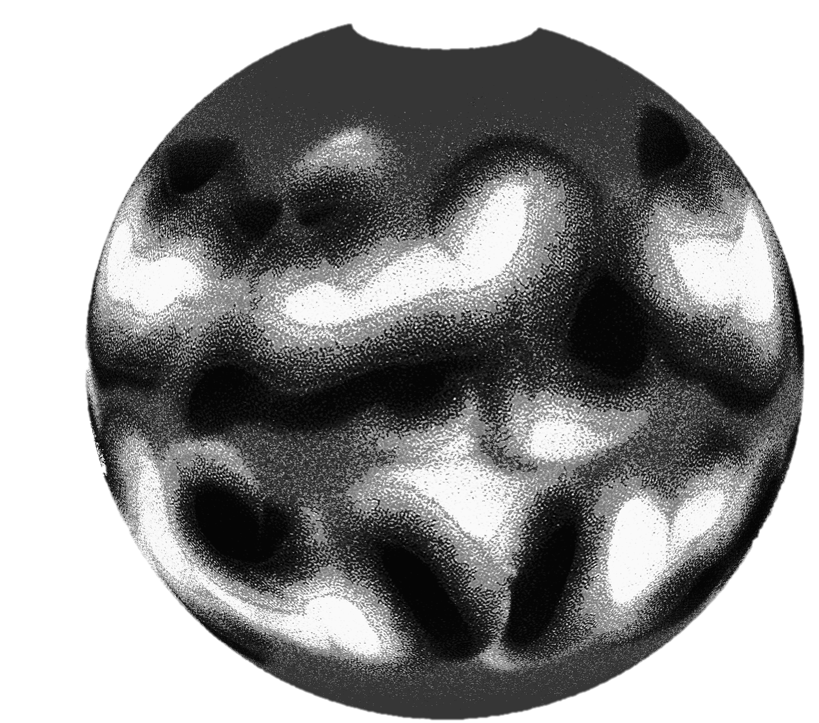
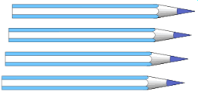
Sarah Jabbari
Research fellow
Advanced MHD simulations to study the wave propagation in the Solar interior and atmosphere
We use numerical simulations to model linear and non-linear MHD waves from interior to corona in the presence of strong Stratification, Large-scale background Magnetic field, and active regions and Sunspots.
Applications:
to compare our founding of the mode properties at the photospheric levels with helioseismic observations to study mode conversion.
to model solar active regions and their effect on solar wave properties (far-side helioseismic imaging)
Magnetic flux concentration in stratified turbulent plasma with dynamo effect:
Both Direct Numerical Simulation and Mean field simulations of a forced turbulence plasma in the presence of gravity and a background magnetic field (generated by dynamo effect).
Pencil-code
Notes:
1/16/17
5
5

Slide 6

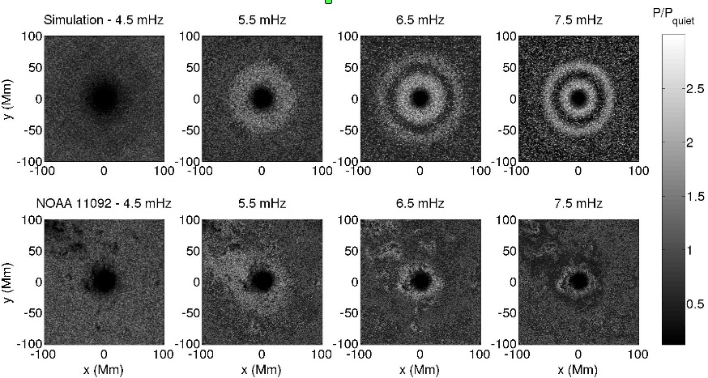
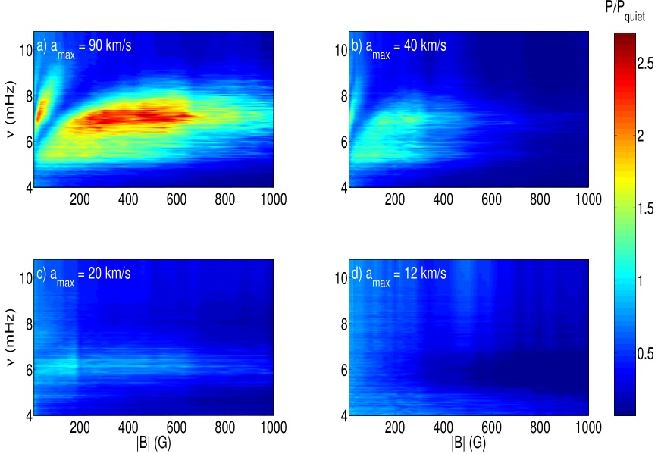
Simulated halos (Rijs et al. 2015, 2016)
The acoustic halo was simulated and compared to observations
The halo is shown to be entirely dependent on the overlying atmosphere
Fast-slow conversion is the likely halo mechanism

Slide 7
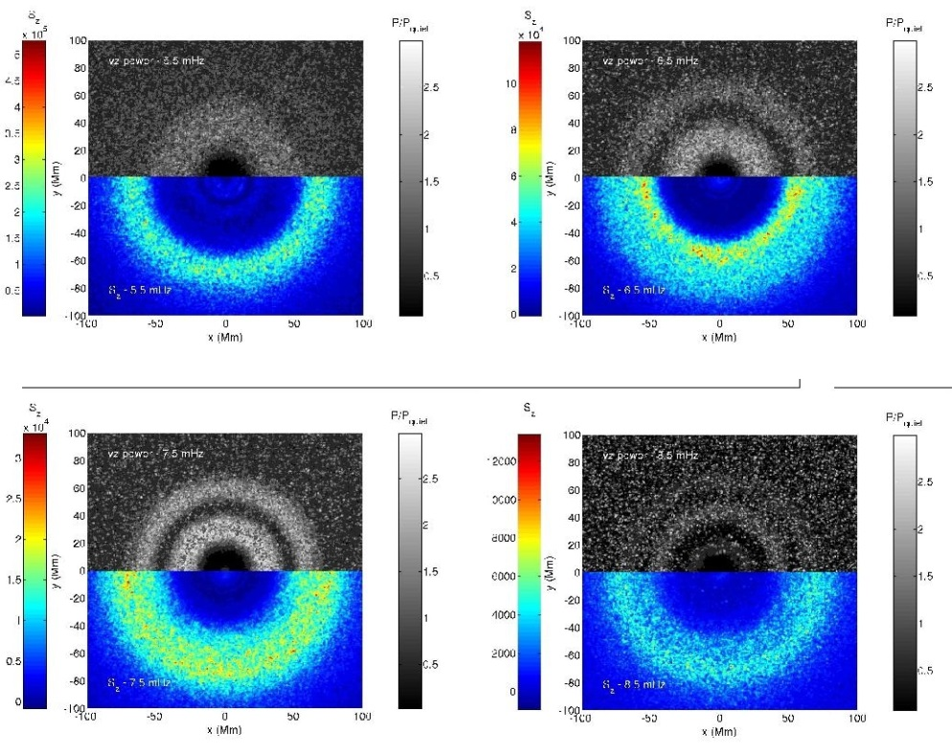
Simulated halos (Rijs et al. 2015, 2016)
Upwards-travelling Alfven signature corresponds to a lack of enhancement.
Suggests that fast-toAlfven conversion is preventing energy from returning to the photosphere

Slide 8
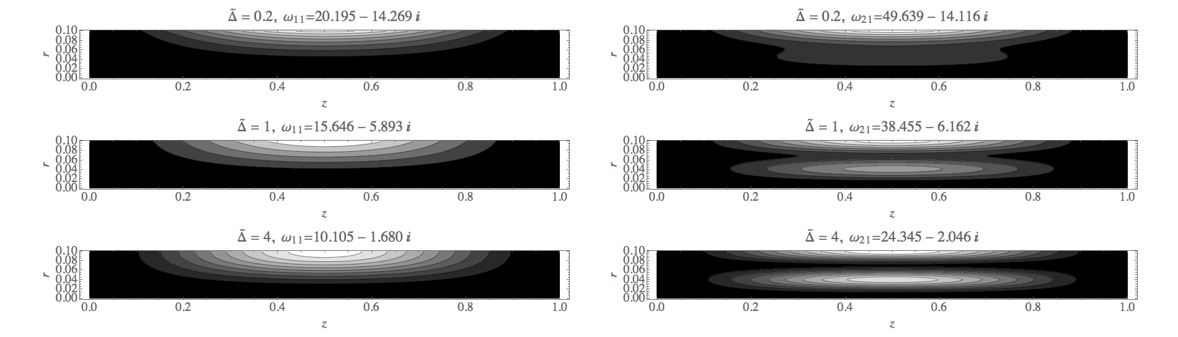
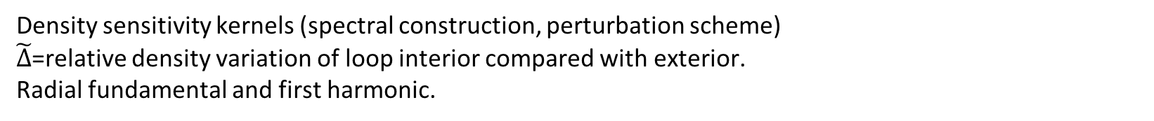
Paul Cally & Ming Xiong: ongoing
Sausage mode seismology
Density sensitivity kernels (spectral construction, perturbation scheme)
$\tilde{Δ}$=relative density variation of loop interior compared with exterior.
Radial fundamental and first harmonic.
Kernels very concentrated at loop edge.

