Slide 1
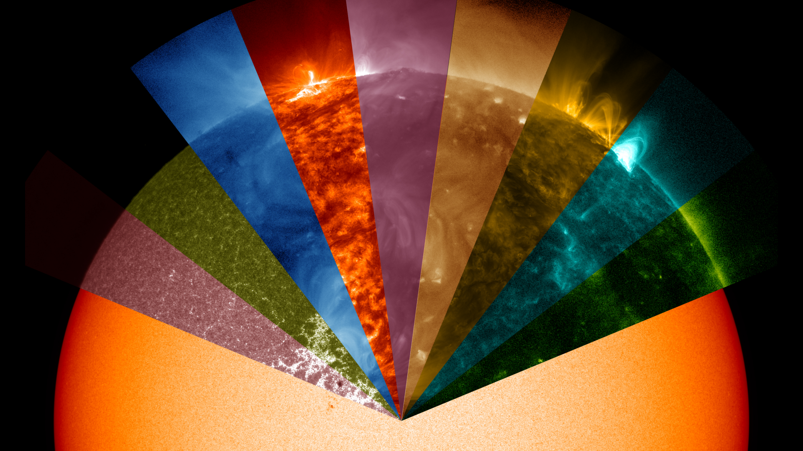


Kink oscillations of coronal loops - a statistical study
C. R. Goddard
V. M Nakariakov, G. Nistico, I. V. Zimovets, D. J. Pascoe, S. Anfinogentov
Centre for Fusion, Space and Astrophysics
University of Warwick

Slide 2
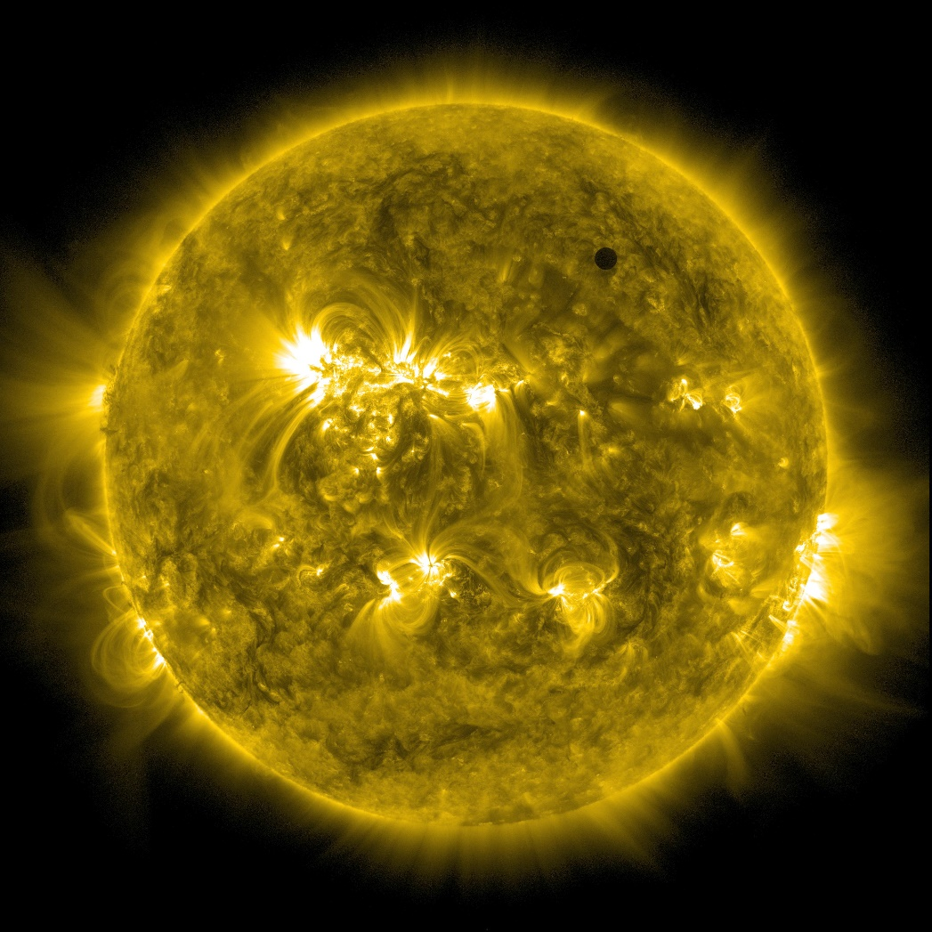
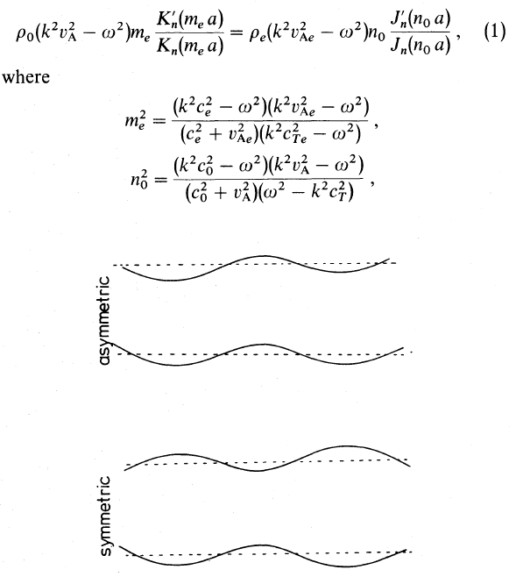
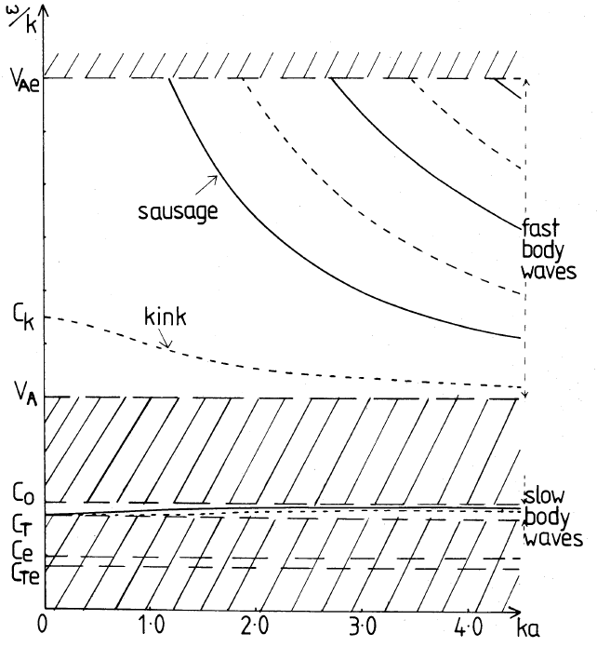
MHD Modes of a Plasma Cylinder

Slide 3
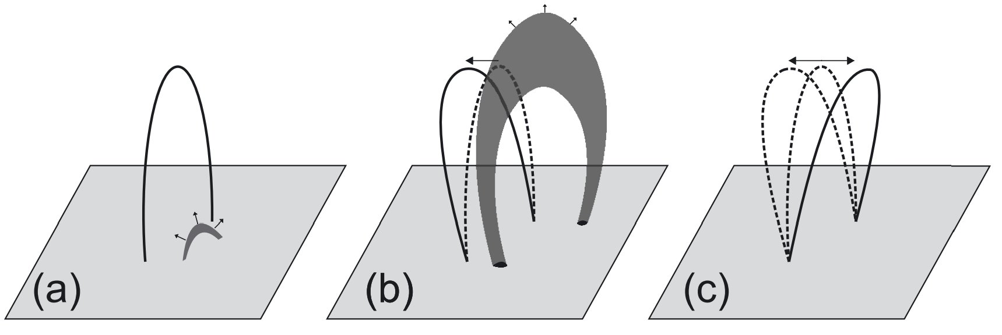
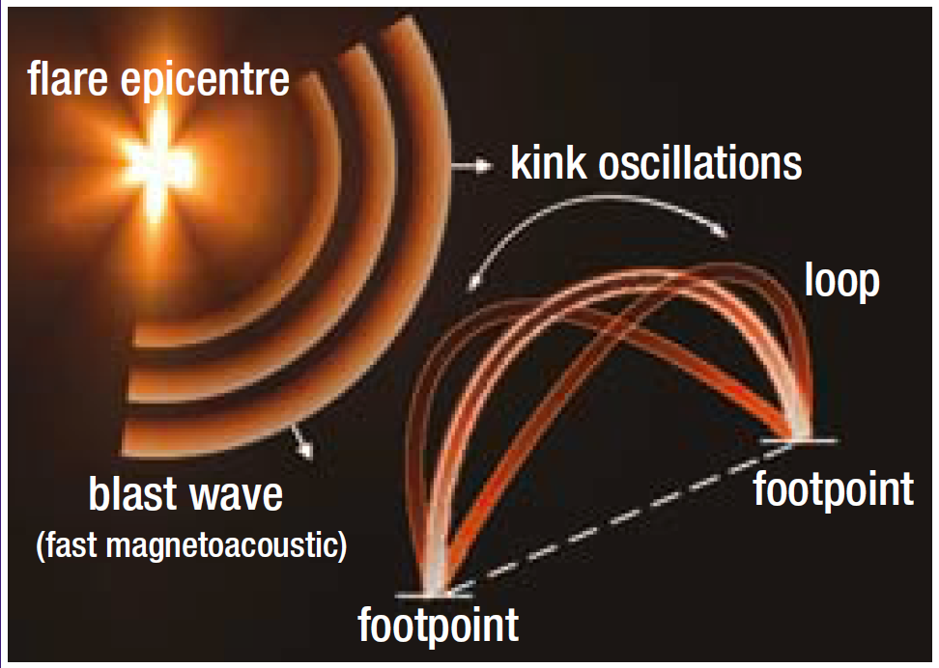
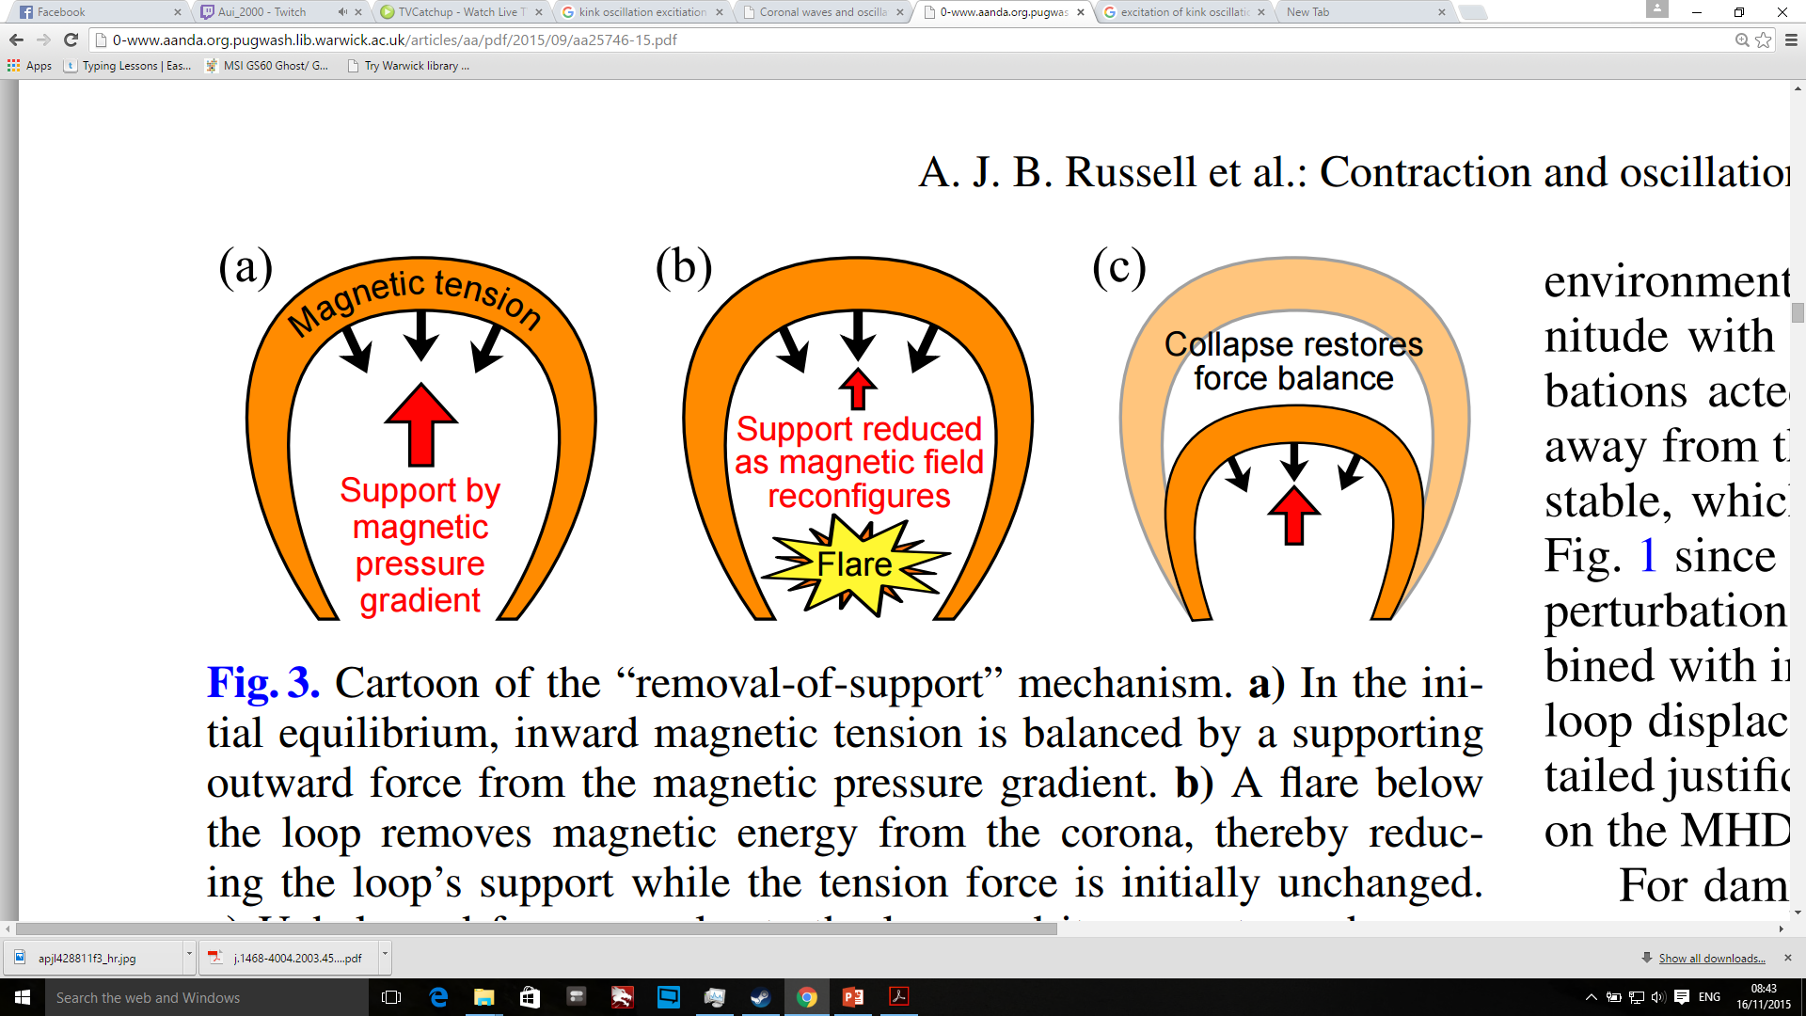
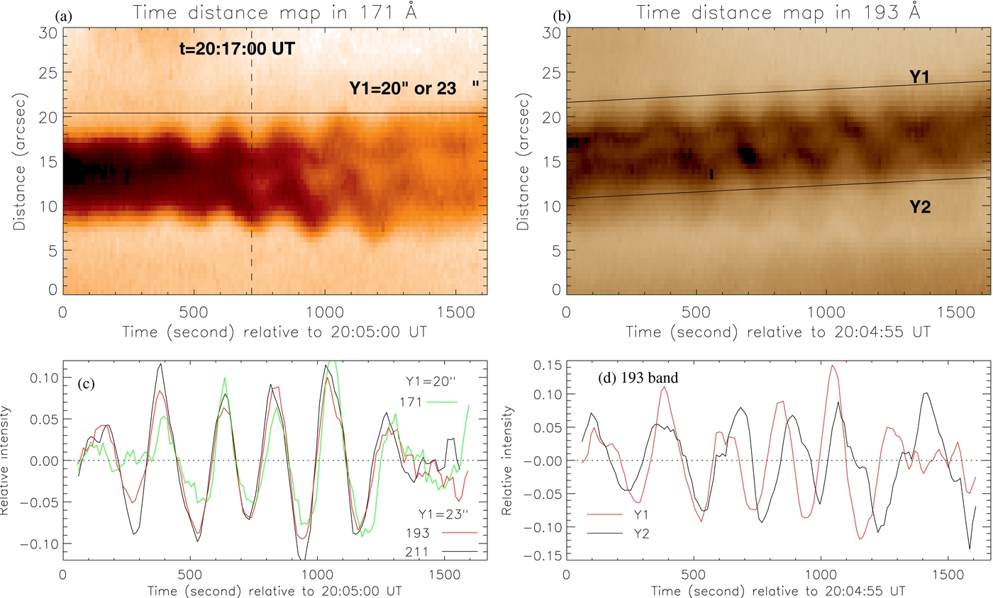
Excitation Mechanism

Slide 4
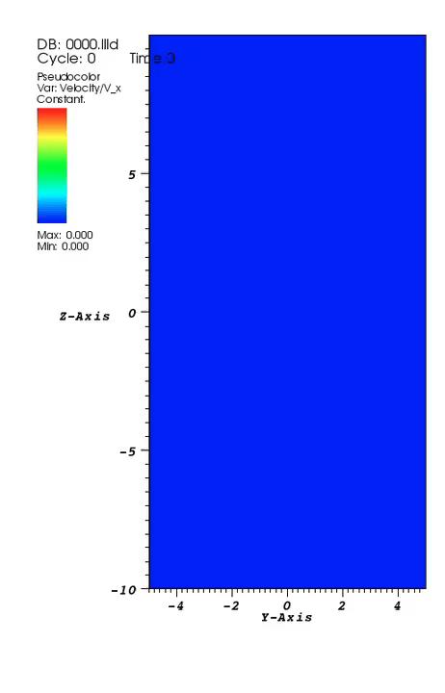
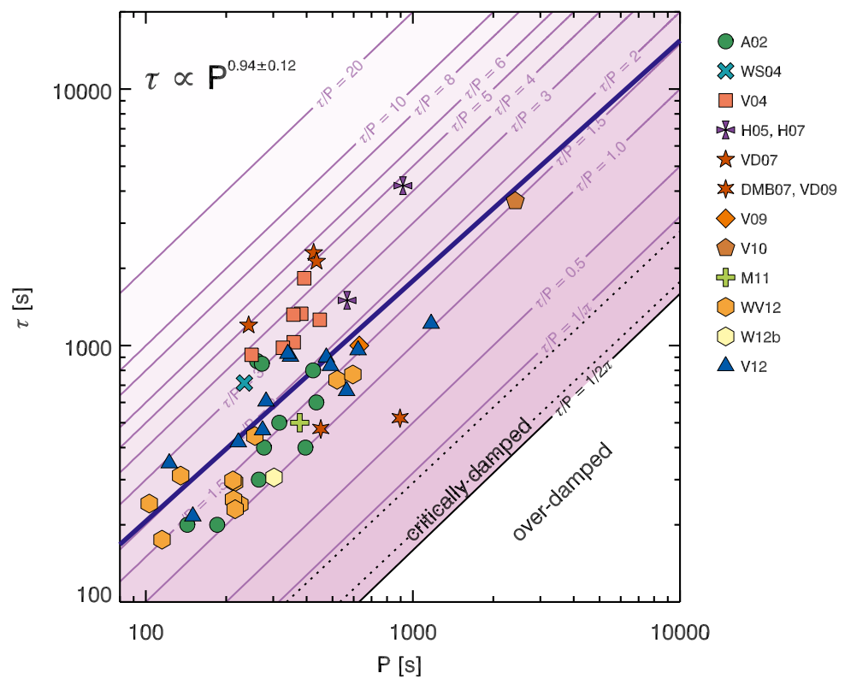
Damping
Dissipative and resistive damping
Phase mixing
Mode Coupling (resonant absorption)

Slide 5
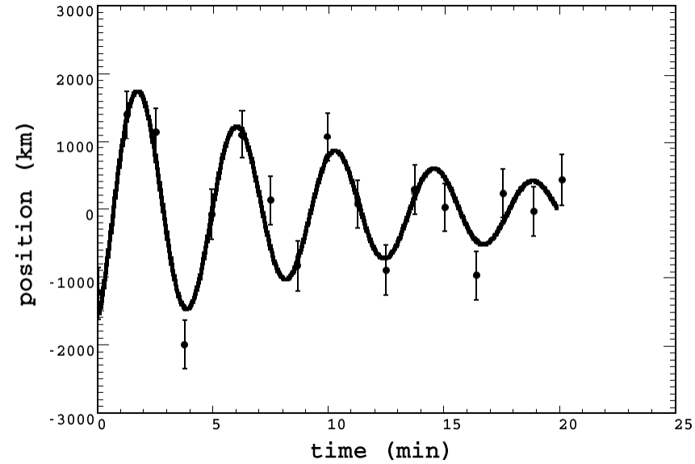
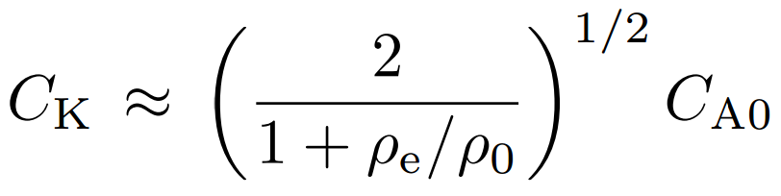
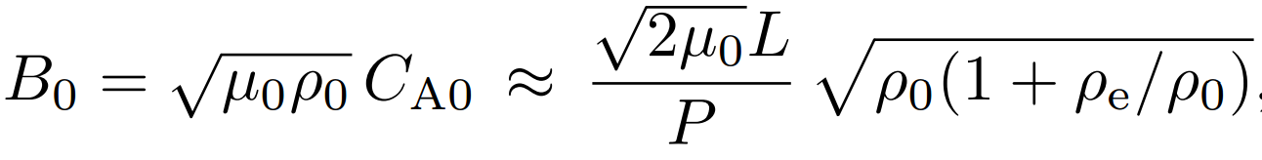
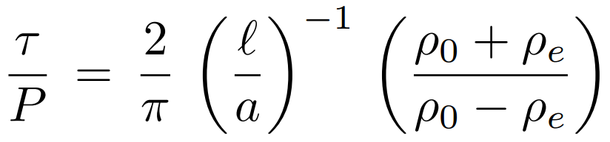
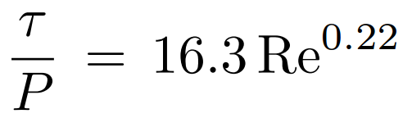
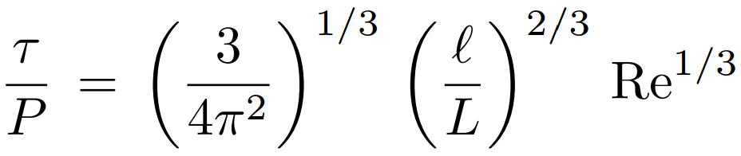
Seismology

Slide 6
Aims
Use the existing catalogue of oscillation events to perform a statistical study of decaying kink oscillation parameters.
Analyse the distributions and dependencies of the parameters.
Provide a detailed catalogue to allow targeted follow up studies.

Slide 7
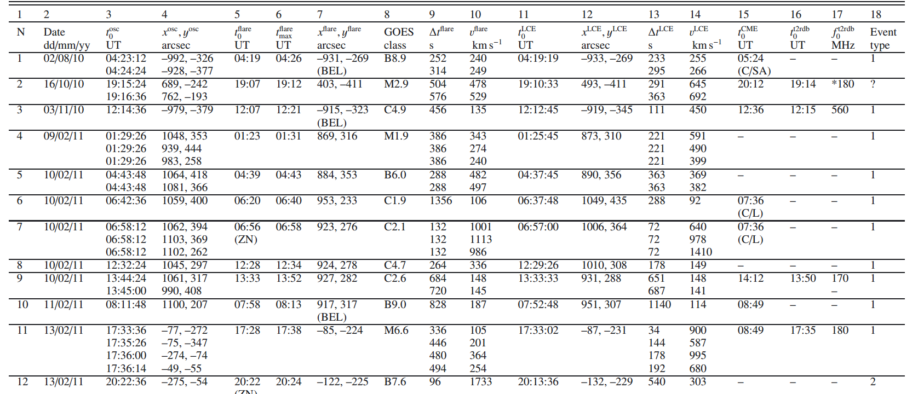
Initial Catalogue
Table 1. : Zimovets, I. V. & Nakariakov, V. M., 2015, A&A, 577, A4

Slide 8
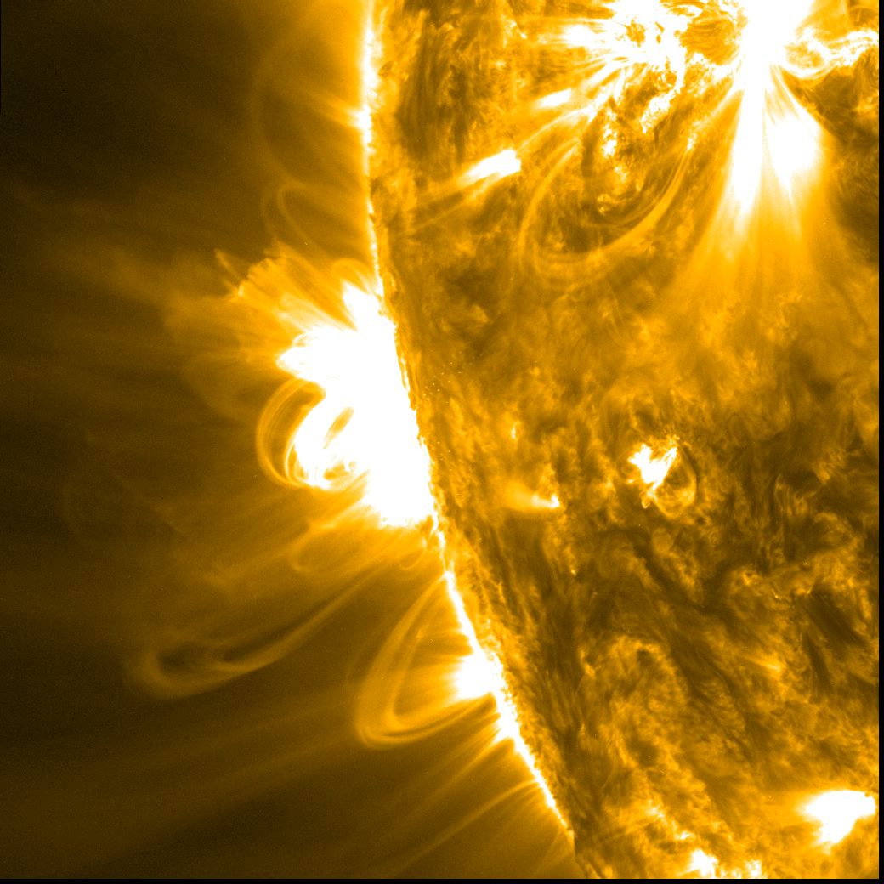
Locating suitable oscillations

Slide 9
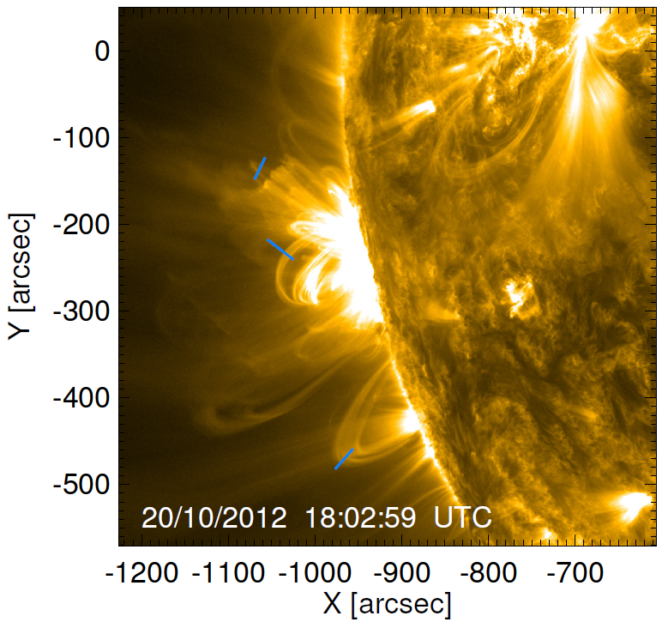
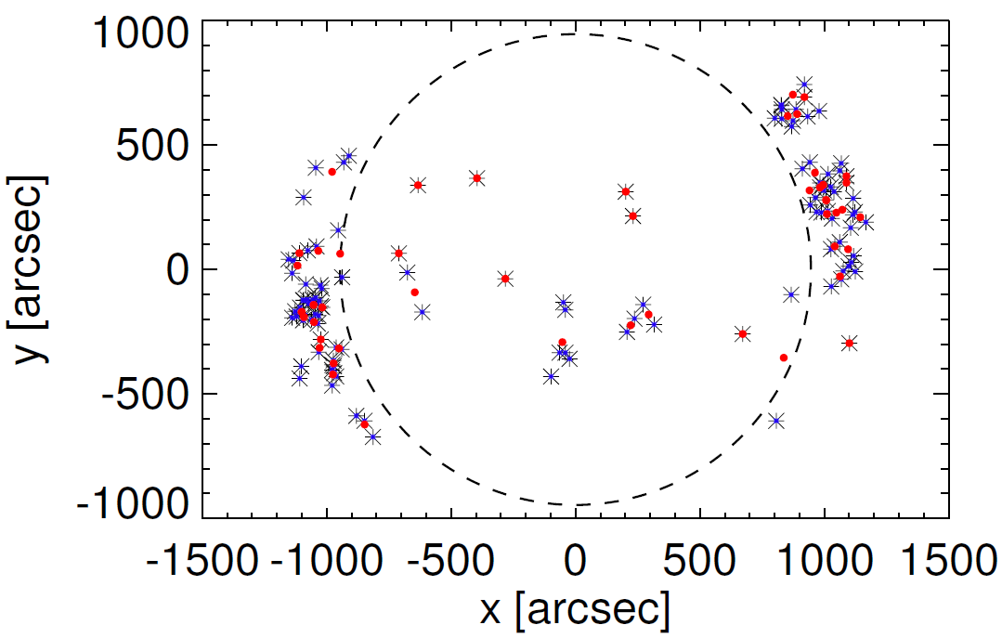
Final sample
56 events analysed
120 individual kink oscillations recorded
TD maps analysed for each loop

Slide 10
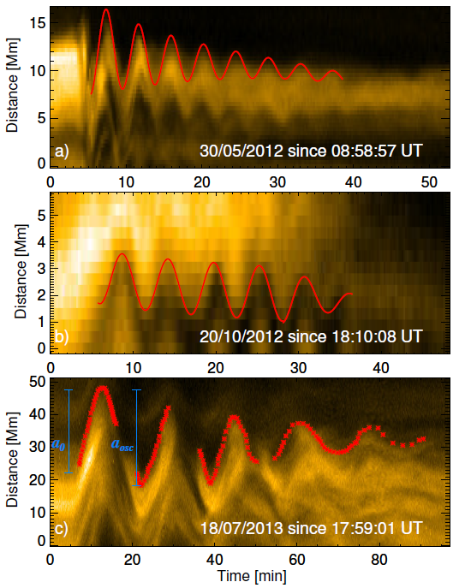
Time-Distance maps
TD maps zoomed to region of interest
Initial displacement and amplitude of oscillation measured
Points taken to map out the oscillations by hand
Points fit to obtain a period and damping time

Slide 11
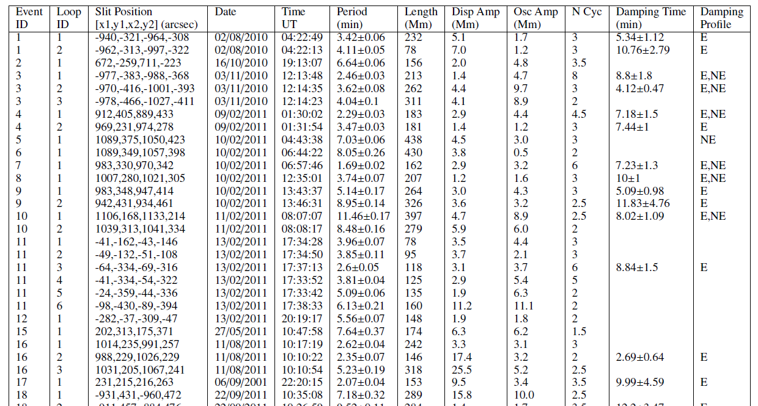

Slide 12
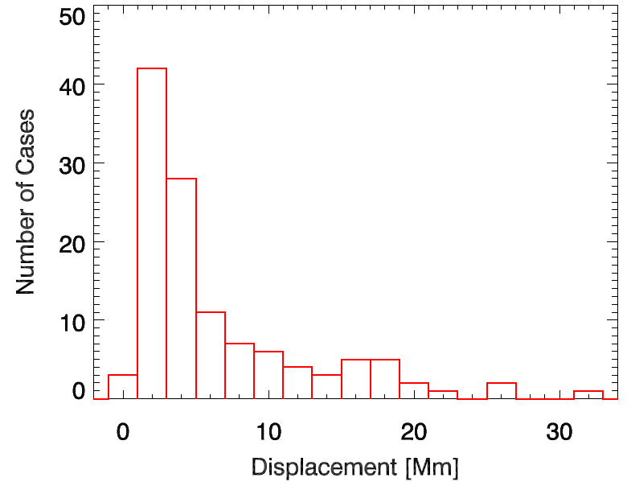
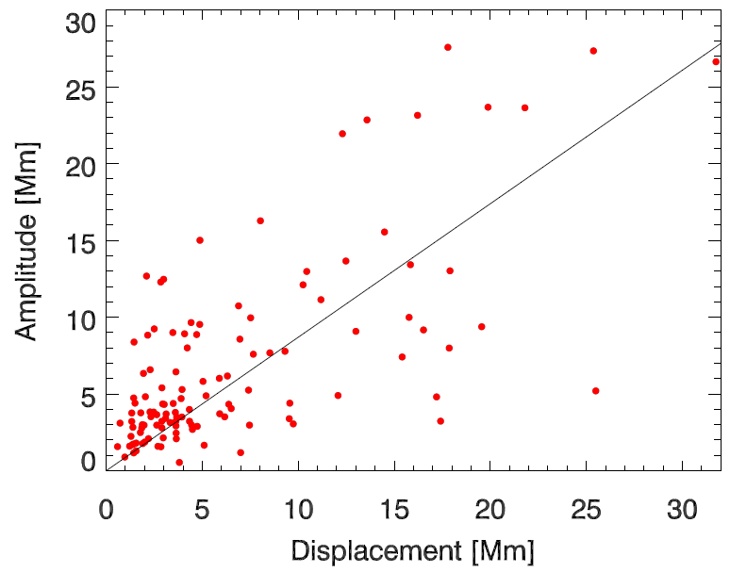
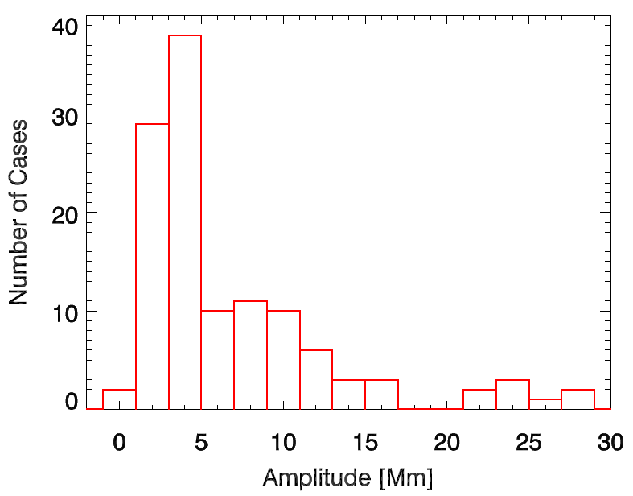
Initial displacement and oscillation amplitude

Slide 13
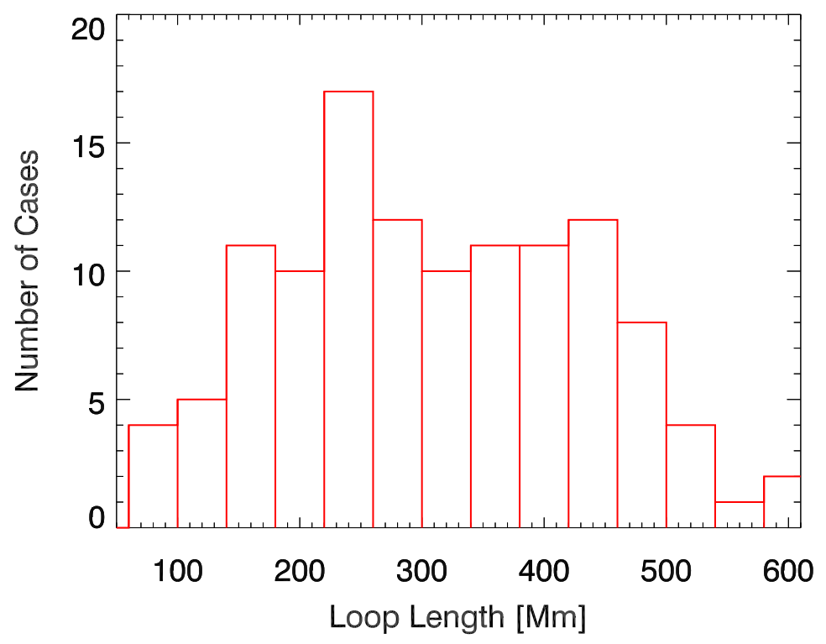
Loop length and period distributions

Slide 14
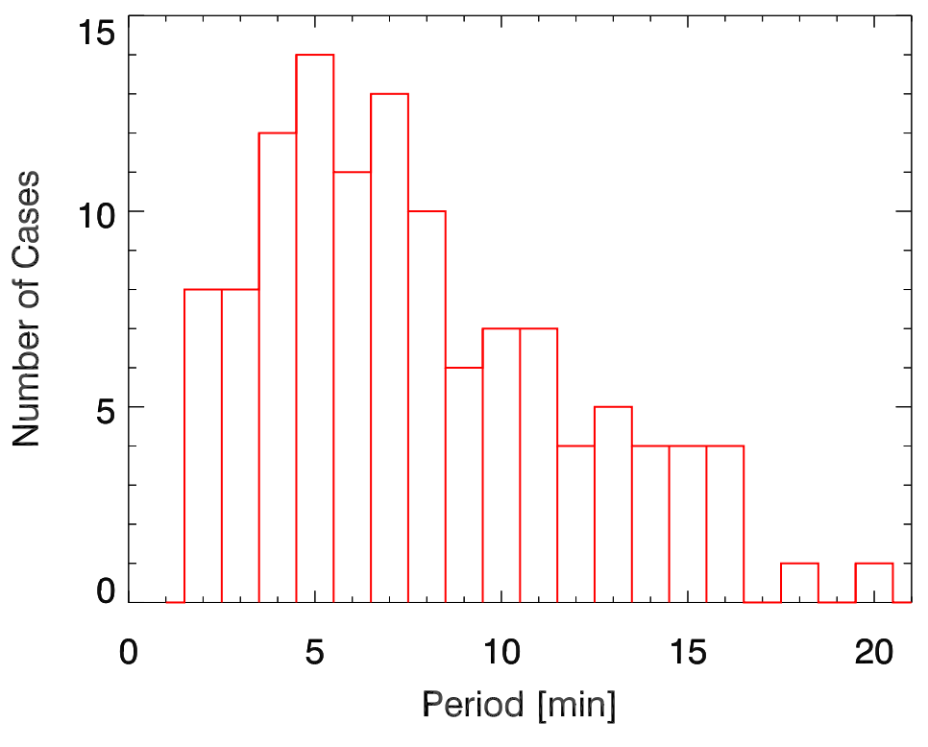
Loop length and period distributions

Slide 15
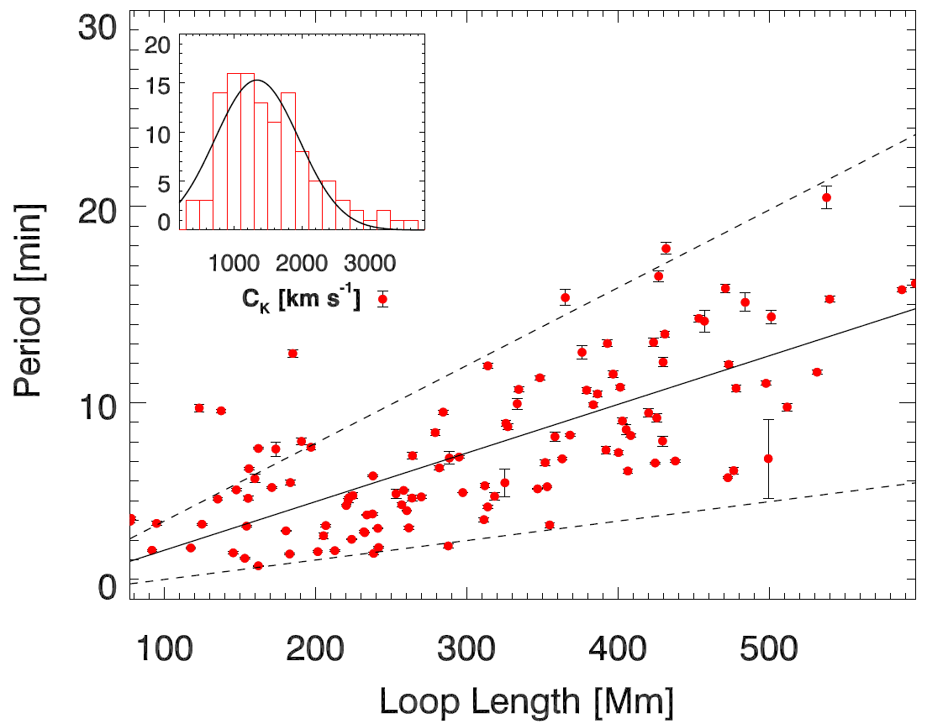
Period against loop length
P = 2L/Ck
Ck=(1330±50) km s⁻¹
^{Range = 800-3300}

Slide 16
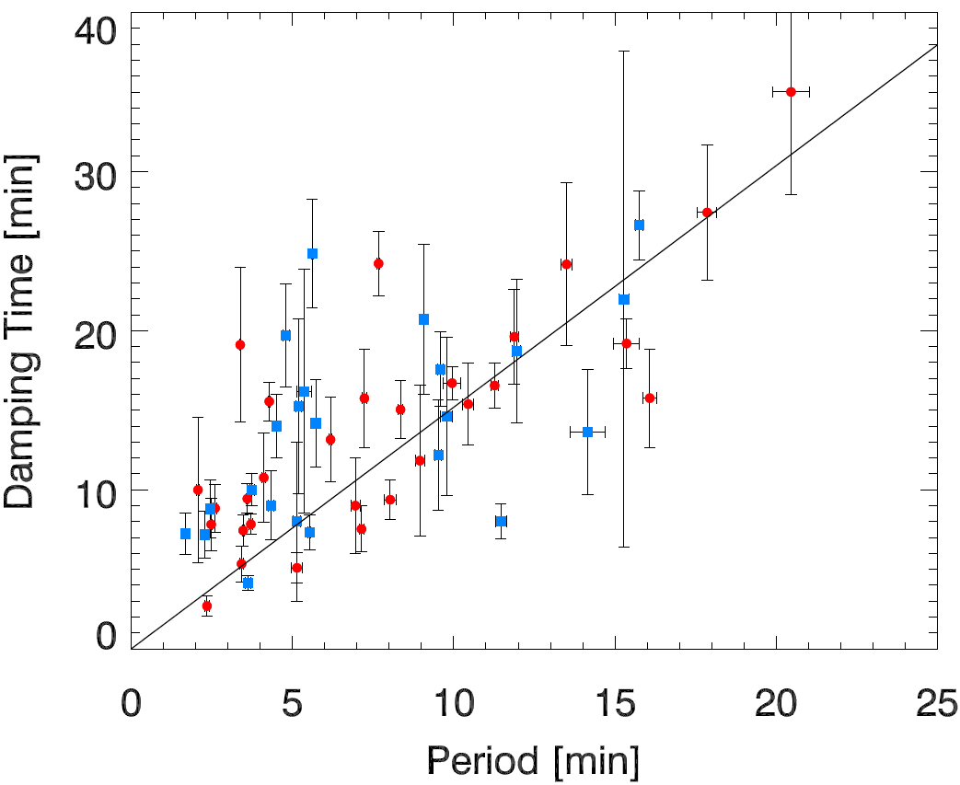
Damping time against period
22 of the 52 profiles measured may include ‘non-exponential’ sections in the damping profile.
τ=(1.53±0.3)P

Slide 17
Conclusions
The initial loop displacement prescribes the initial oscillation amplitude in the majority of cases.
The period scales linearly with the loop length and a kink speed of C_{k}=(1330±50) km s⁻¹ is obtained; the majority of the data points are in the range (800–3300) km s⁻¹, following a Gaussian distribution.
A linear scaling of the damping time with period is observed
and non-exponential damping profiles have been detected.

Slide 18
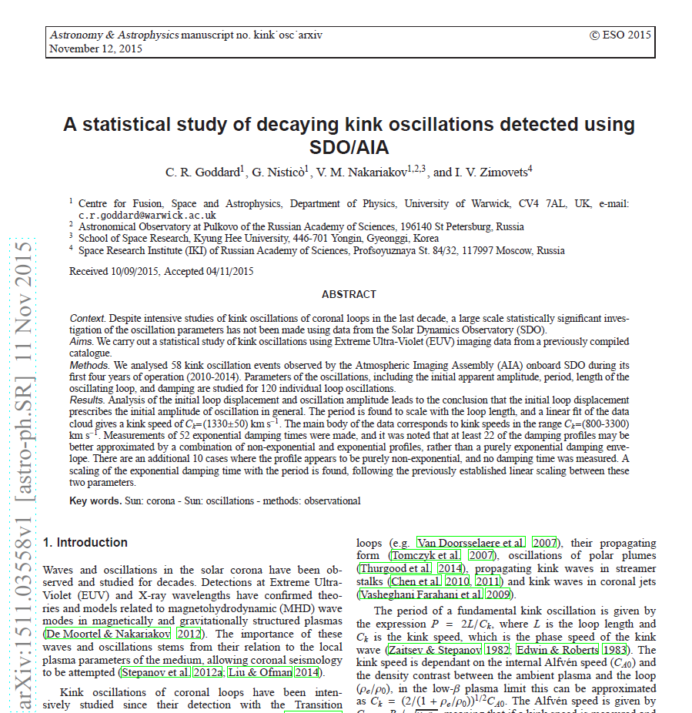
Goddard, C. R.; Nistic'o, G.; Nakariakov, V. M.; Zimovets, I. V. arXiv:1511.03558, 2015 , in press (A&A)

Slide 19
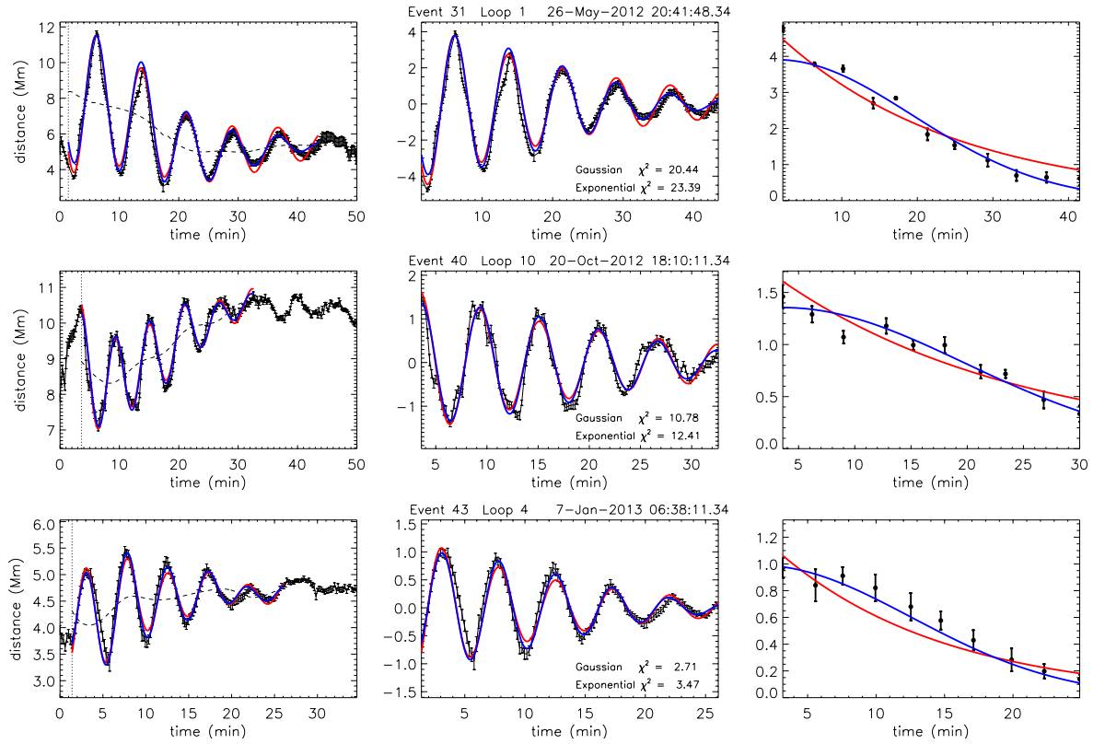
Damping envelopes

Slide 20
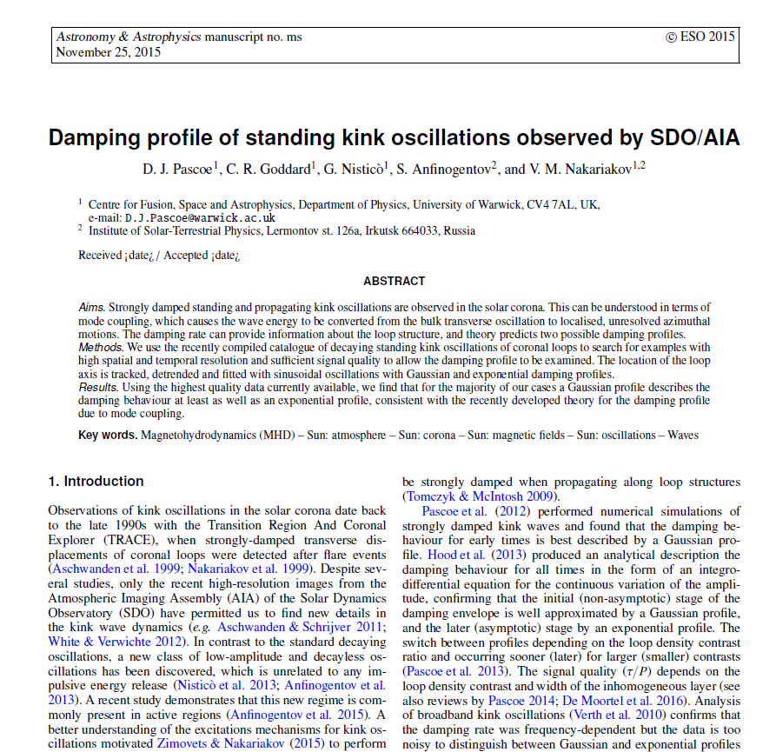
Pascoe, D. J; Goddard, C. R.; Nistic'o, G.; Anfinogentov, S.; Nakariakov, V. M., 2015 , submitted (A&A)

Slide 21
Further follow up work
Detailed analysis of individual damping profiles to make unique seismological inversions
Normalise distributions where required, and use parameters for ‘large scale’ seismology and inferences
Measure and parameterise examples with multiple harmonics
Other interesting examples
Questions?

