Slide 1

Spectral and Imaging observations of quasi-periodic pulsations in solar flares
Dong Li
lidong@pmo.ac.cn
Purple Mountain Observatory, CAS

Slide 2
Outlines
4-minute QPPs detected from spectra and images (Li et al., 2015, ApJ)
1-minute QPPs seen in a Solar Flare (Ning 2017, Solar physics)
QPPs with changing periods depending on the thermal or nonthermal components in a flare (Li et al., 2017, A&A)
QPPs in a circular-ribbon flare (Zhang et al., 2016, ApJ)
QPPs with increasing periods with HXR energies

Slide 3
4-minute QPPs
See detailed in Li et al., 2015
2015ApJ...807...72L

Slide 4
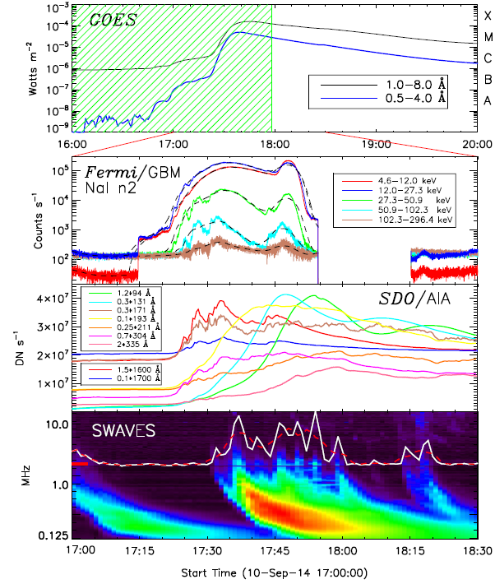
2014-9-10
X1.6

Slide 5
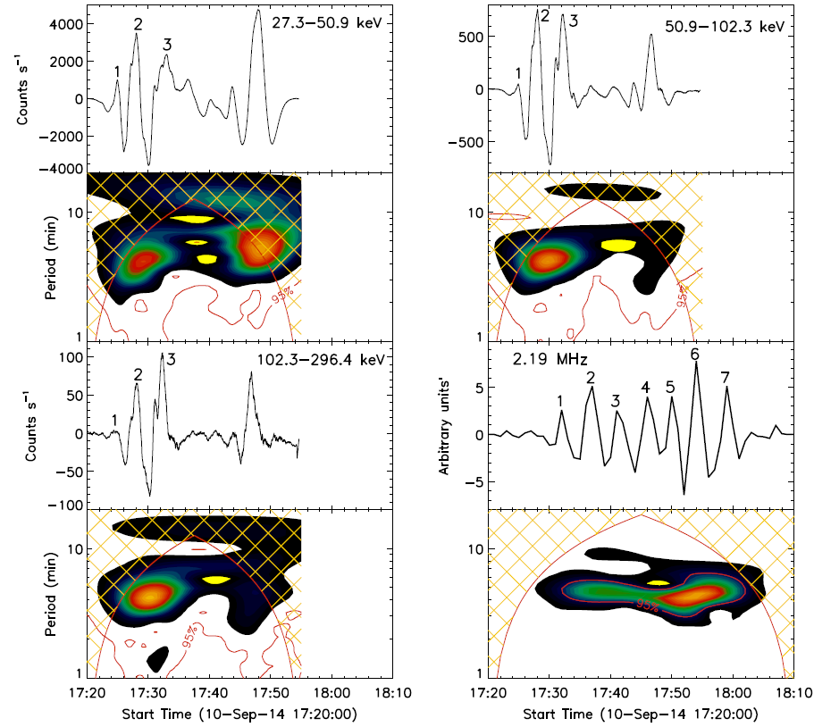
QPPs in HXR and radio channels
Periods
  ~4 minutes
Time delay:
  ~8 minutes

Slide 6
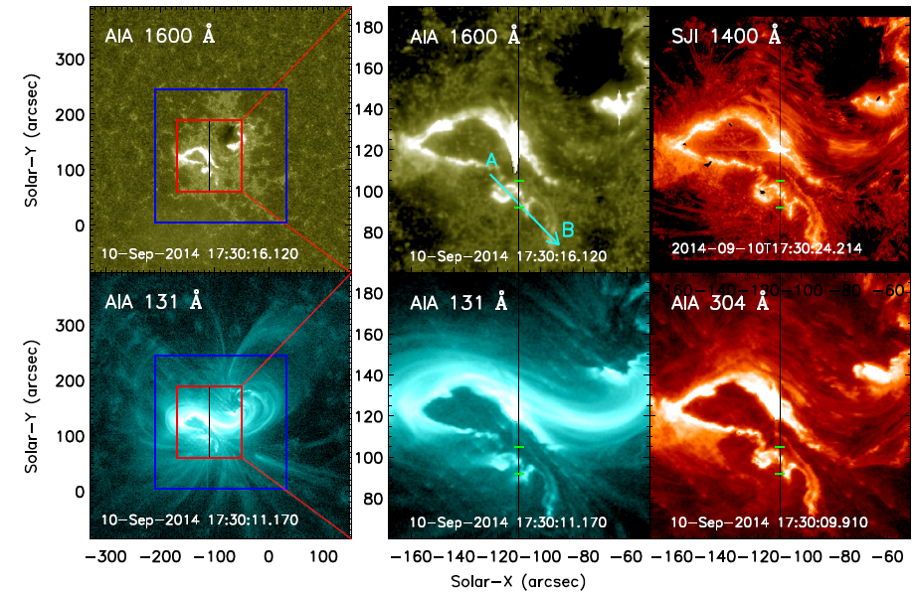
IRIS slit position
Fixed
flare ribbon front

Slide 7
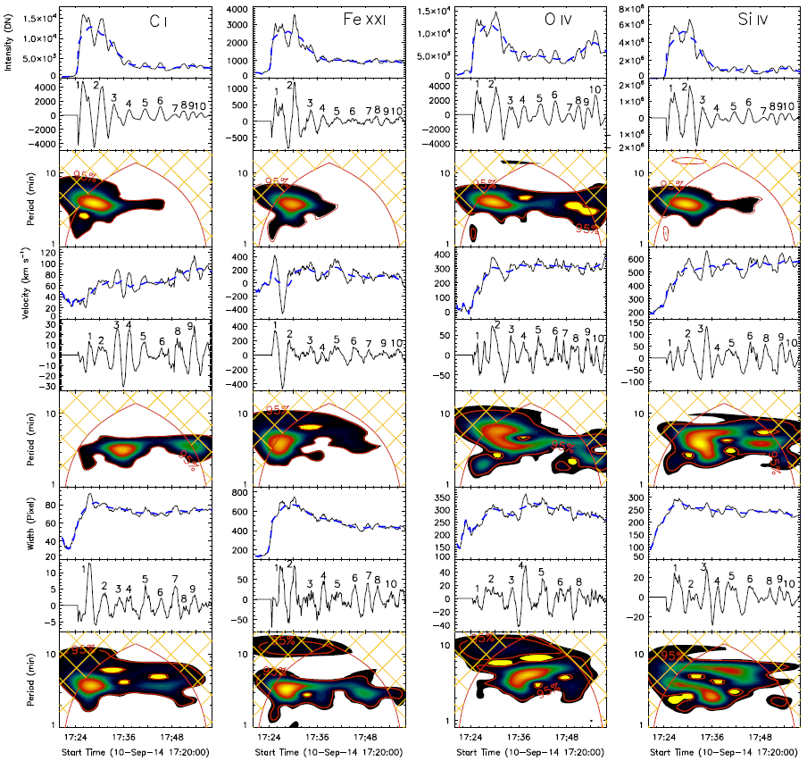
QPPs in spectra
Periods
  ~4 minutes
QPP peaks
broad line width
red shift

Slide 8
QPPs in EUV/UV bands
Periods
  ~4 minutes

Slide 9
Summary
The 4-minute QPPs are found in a broad wavelength from HXR through EUV to the radio, indicating that the QPPs are produced by the non-thermal electrons that are accelerated by the quasi-periodic magnetic reconnections.
Imaging observations of SDO/AIA show that the QPPs originate from the flare ribbon front.
Spectral observations of IRIS present that the QPP peaks tend to a broad line width and a redshift velocity.

Slide 10
1-minute QPPs
See detailed in Ning, 2017
2017SoPh..292...11N

Slide 11
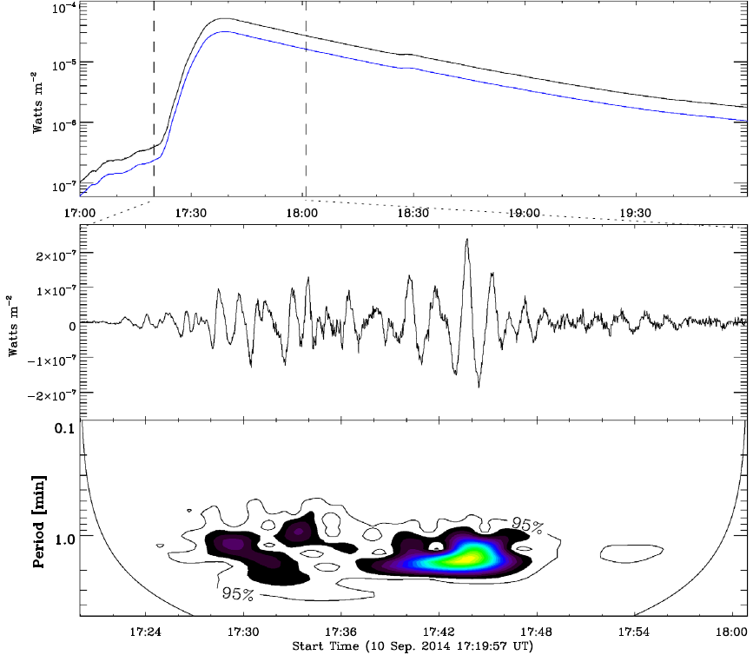
QPPs in SXR band
2014-9-10
X1.6
1 – 8 Å

Slide 12
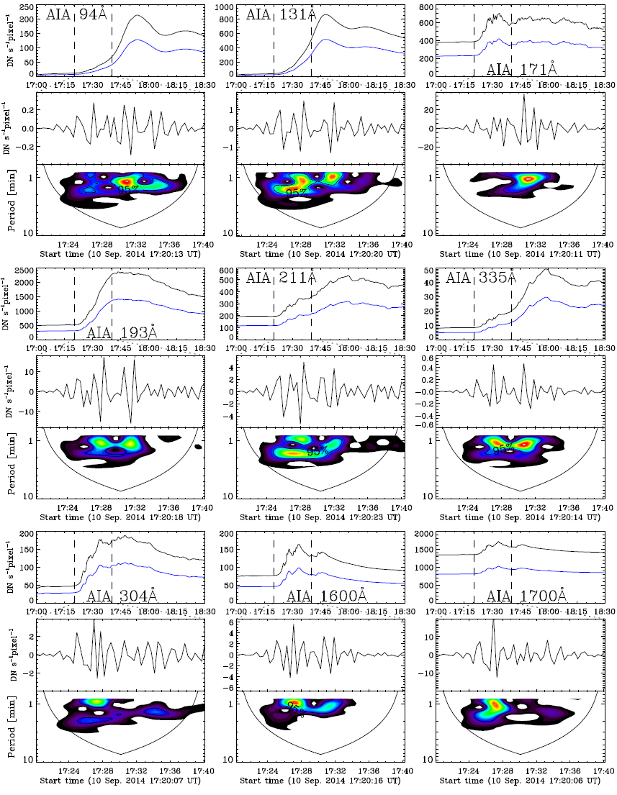
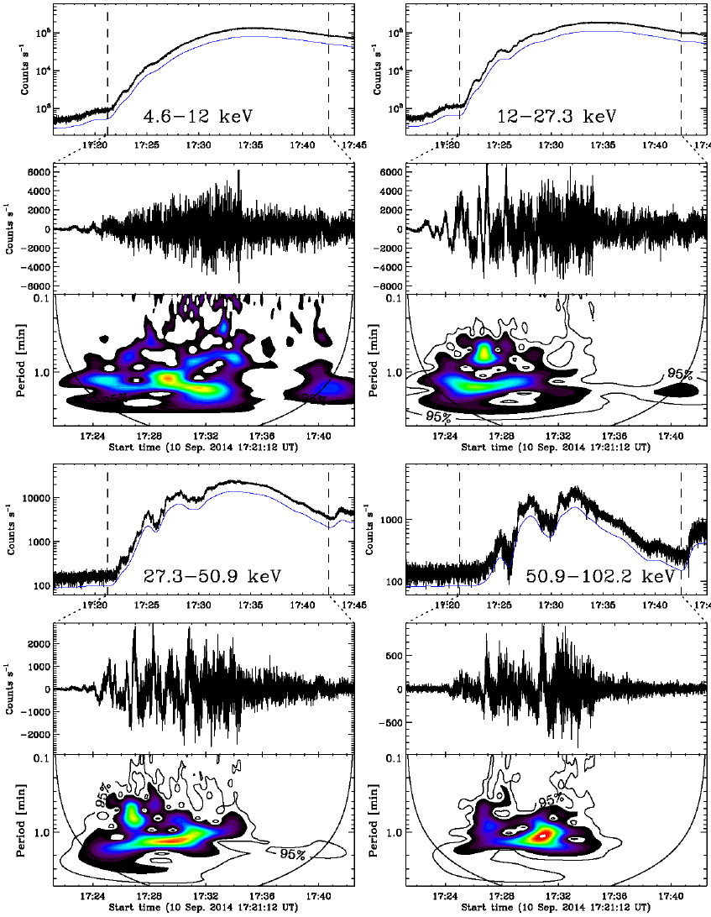
QPPs in EUV/UV and X-ray bands

Slide 13
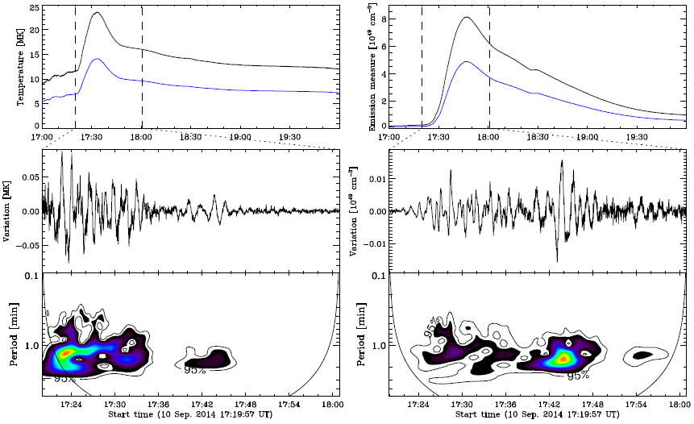
QPPs in from GOES temperature and emission measure

Slide 14
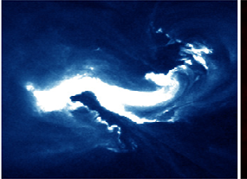
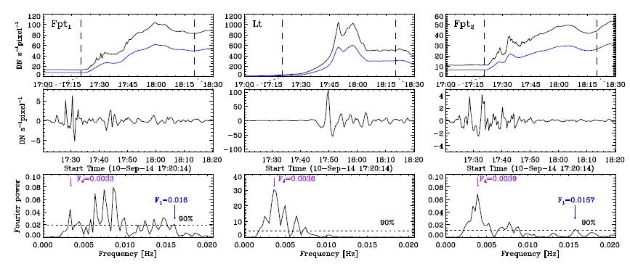
1-minute QPPs positions
AIA 335
Fpt1
Lt
Fpt2

Slide 15
Summary
1-minute QPPs are simultaneously found in SXR, EUV/UV, HXR emissions, and it varies in a broad range of ≈30 – 120 s.
The 1-minute QPPs tend to originate from the flare loop footpoints.

Slide 16
QPPs with changing periods
See detailed in Li et al., 2017
2017A&A...597L...4L

Slide 17
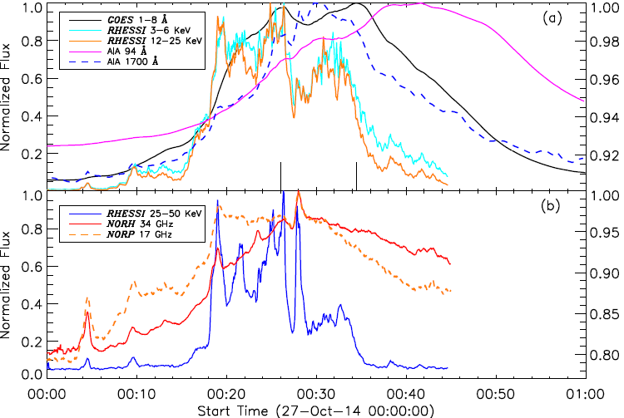
2014-10-27 M7.1 flare

Slide 18
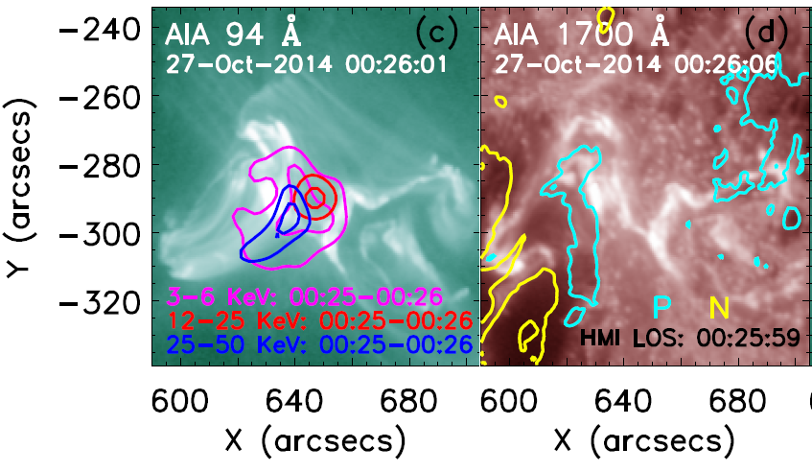
Flare position
NOAA AR12192

Slide 19
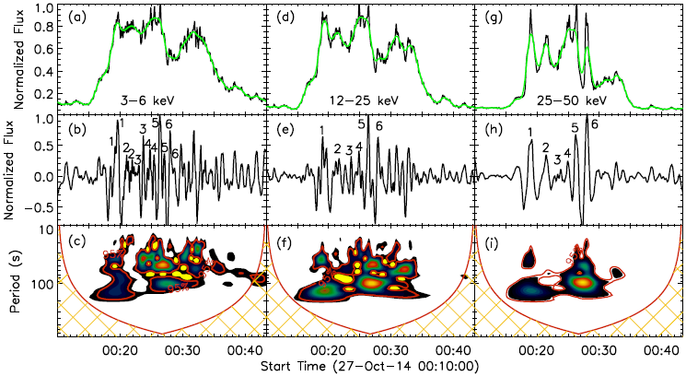
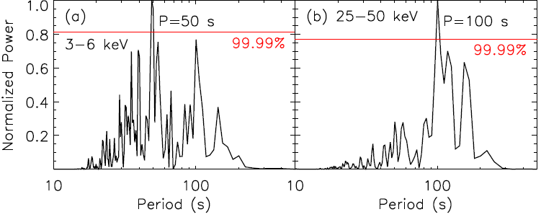
QPPs in X-ray emissions
HXR
SXR

Slide 20
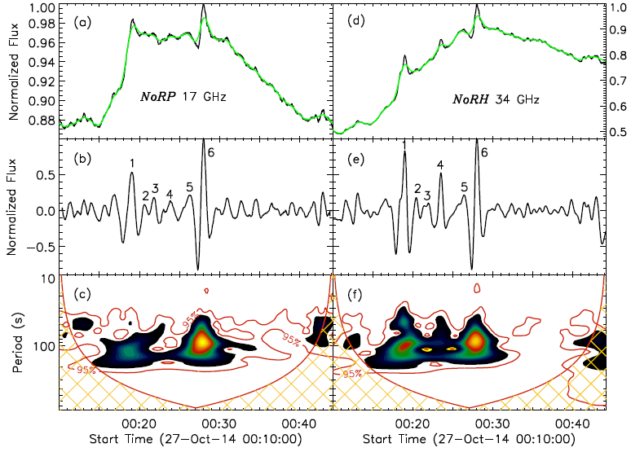
QPPs in Microwave emissions

Slide 21
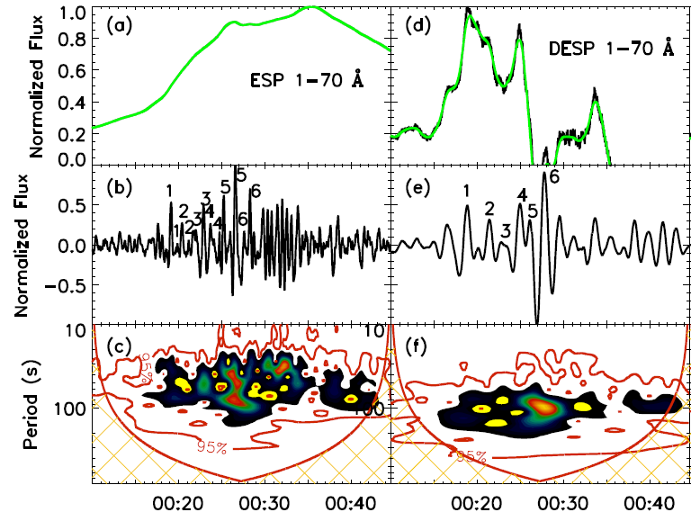
QPPs from EVE observation
Derivatives
SXR

Slide 22
Summary
The QPPs period changes from thermal (SXR) to nonthermal (HXR, microwave) components in a single flare that occur at almost the same time.
The period ratio is exactly 2.0, which might be due to the modulations of the magnetic reconnection rate by the fundamental and harmonic modes of MHD waves.

Slide 23
QPPs in a circular-ribbon flare
See detailed in Zhang et al., 2016
2016ApJ...832...65Z

Slide 24
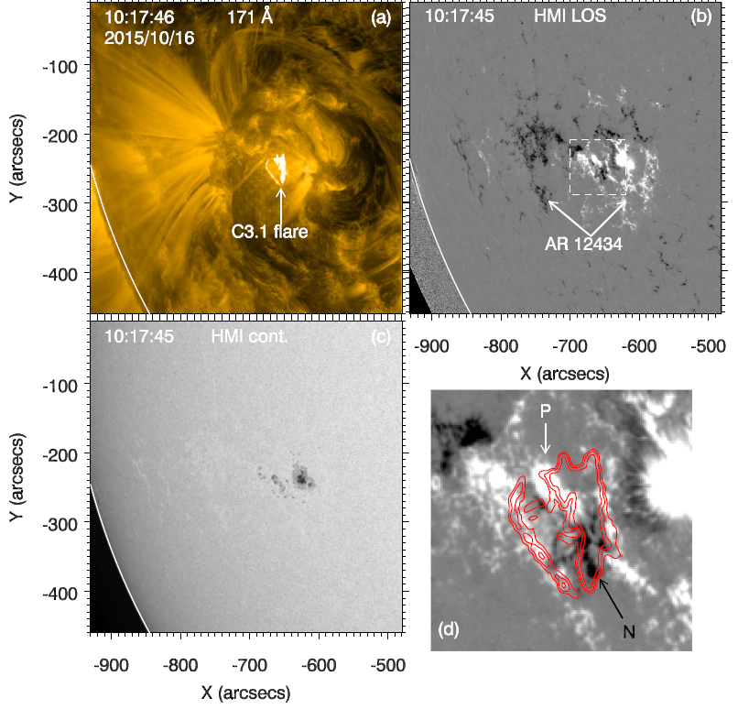
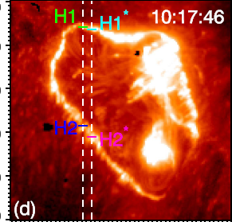
circular-ribbon flare
2015-10-16
C3.1

Slide 25
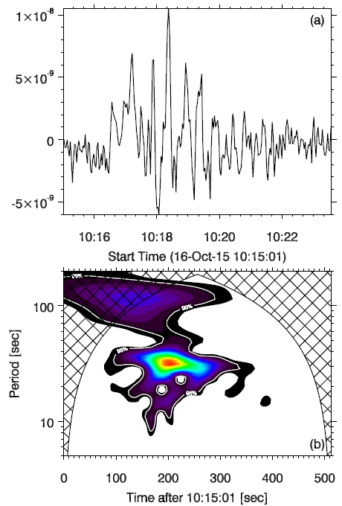
Time derivative
of SXR flux
1–8 Å
P=32 s

Slide 26
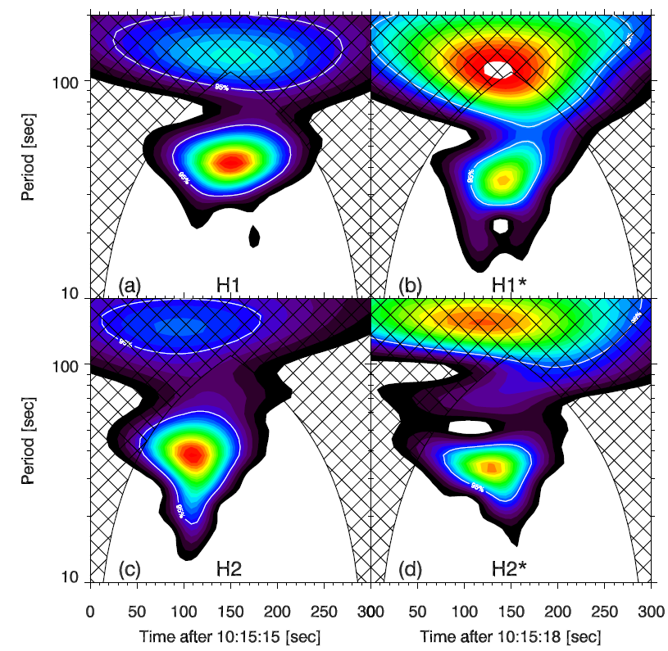
Si IV intensity
P=33-42 s

Slide 27
Summary
During the impulsive phase of flare, the Si IV line intensities and SXR derivative show QPPs with periods of 32–42 s.
The QPPs were most probably caused by intermittent null-point magnetic reconnections modulated by the fast wave.

Slide 28
QPPs with increasing periods

Slide 29
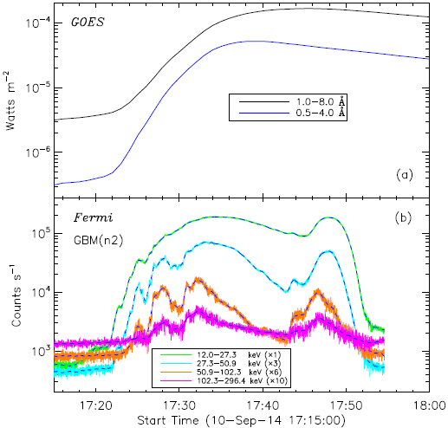
2014-9-10
X1.6

Slide 30
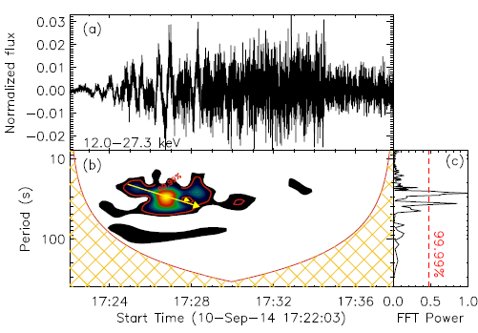
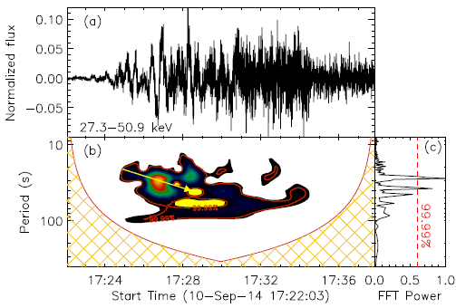
QPPs in lower energy
P=25-35 s
Mean: 30 s

Slide 31
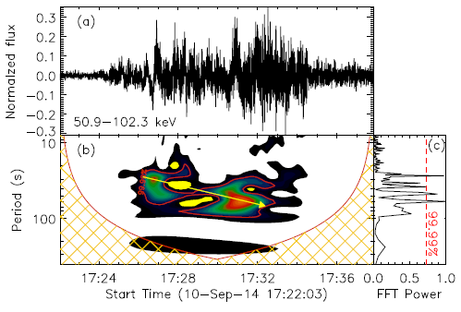
QPPs in medium-energy
P=30-60 s

Slide 32
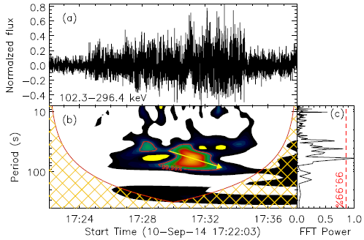
QPPs in higher energy
P=50-70 s
Mean: 60 s

Slide 33
Summary
The QPPs show increasing periods with energies at HXR channels.
The QPPs show increasing periods with time from HXR emissions.
The QPPs with double periods (~30 s and ~60 s) at HXR channels could be due to the modulations of the magnetic reconnection rate by the higher order harmonic modes of MHD wave.

Slide 34
Type II burst
P=25-35 s
Mean: 30 s
?

Slide 35
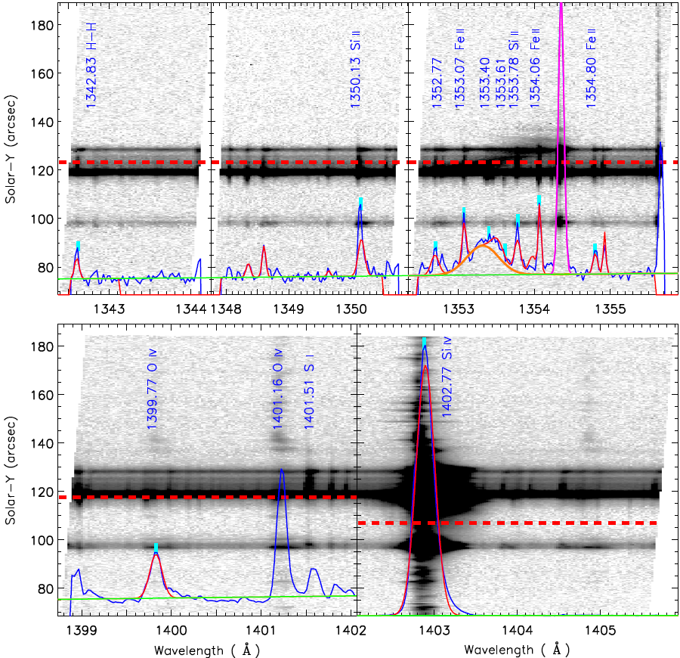
IRIS Fitting

Slide 36
THANK YOU!

