Slide 1
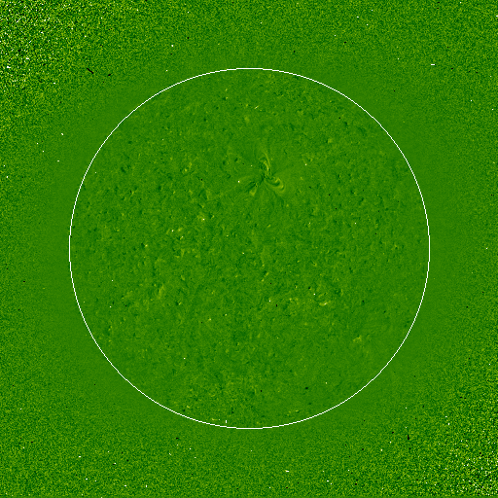

Coronal Seismology Based on EUV Waves
P. F. Chen
，China
Notes:
4 aspects of observations which can help us better understand the standard model

Slide 2
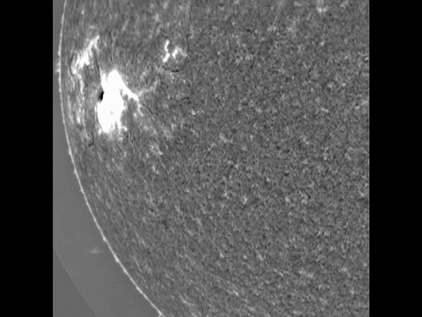
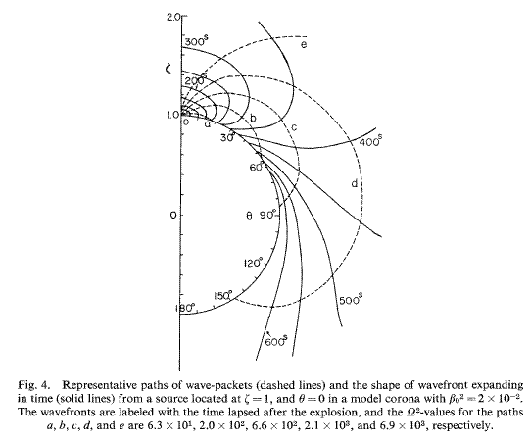

Moreton wave
Hα
Hα Observation
Moreton et al. (1961)
Moreton waves are associated with big flares
Propagation velocity: ~1000 km/s
Propagation distance: 5×10⁵ km
Credit: ISOON
Theoretical Explanation
Uchida (1968; 1974):
Fast-mode wave in the corona
P. F. Chen @ISSI-Beijing

Slide 3
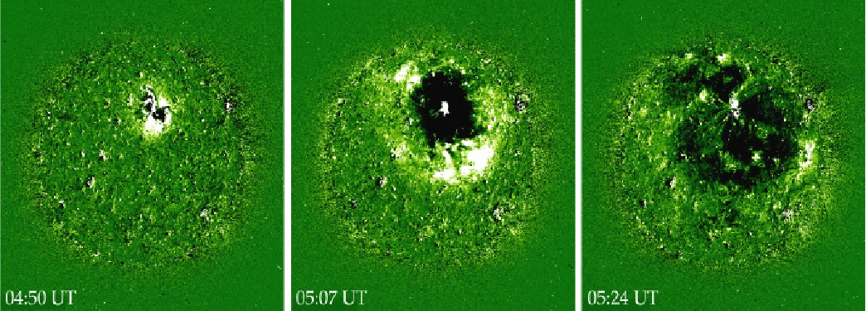
Discovery of EIT Wave
SOHO/EIT 195 Å
EIT Wave
Thompson et al. (1998)
Large-scale coronal wave Veronig+(2010)
Coronal Bright Fronts (CBP) Gallagher+(2010)
Coronal Propagating Fronts (CPF) Schrijver+(2011)

Slide 4
Debates
Flare pulse
CMEs
Wu et al. (2001), Warmuth et al. (2004), Vrsnak et al. (2002), Vrsnak et al. (2006) ……
source
Thompson et al. (2000), Biesecker et al. (2002), Kay et al. (2003), Cliver et al. (2005), Chen et al. (2002, 2005, 2006, 2009), Attrill + (2014)
Wang (2000), Wu et al. (2001), Ofman et al. (2003), Warmuth etl. (2004), Vrsnak et al. (2002), Ballai et al. (2005), ……
Fast wave
Non-wave
nature
Delannee + (1999, 2000, 2008), Chen et al. (2002, 2005, 2006, 2011), Harra & Sterling (2003), Zhukov + (2010), Schrijver +(2011)
P. F. Chen @ISSI-Beijing

Slide 5
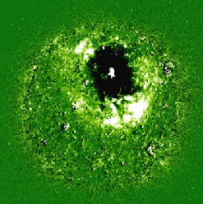
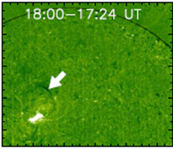
What is the Driving Source?
CME
Half EIT wave events are associated with B-class flares
Cliver et al. (2005)
Without CME, even an X-class flare is not associated with EIT wave
Chen (2006)

Slide 6
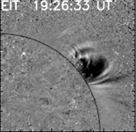
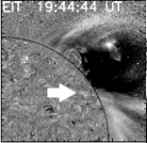
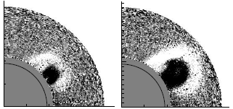
CME-EIT wave relation
P. F. Chen (2009, ApJ, 698, L112)
Dai et al. (2010, ApJ, 708, 913)
EIT images
Mauna Loa
Coronagraph
P. F. Chen @ISSI-Beijing

Slide 7
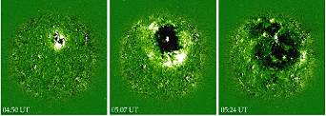
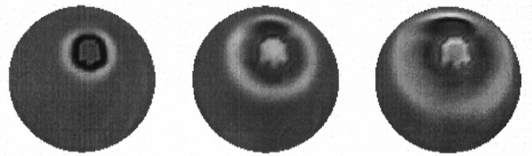
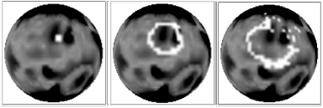
What Is the Nature?
?
Fast-mode wave
coronal Moreton wave
Thompson et al. (1998)
Y.-M. Wang (2000)
Wu et al. （2001）Zheng et al. (2002)
Ofman （2003） Warmuth & Mann (2005), Grechnev et al. 2008; Pomoell et al. (2008), Veronig et al., (2008), Gopalswamy et al. (2009), Long et al. (2009), Patsourakos et al., 2009; Kienreich et al. (2009), Temmer et al. (2011), Zheng et al. (2014)
P. F. Chen @ISSI-Beijing

Slide 8
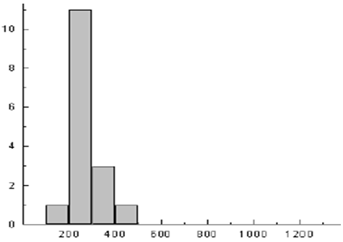
Drawback 1 of Fast-mode Wave Model
Klassen et al. (2000)
Muhr + (2014)
V_{EIT} ~1/3 V_{f}
Moreton + (1961)
Eto et al. (2002)
Zhang + (2011)
Gunawan + (2014)
#
Moreton waves
Velocity (km/s)
P. F. Chen @ISSI-Beijing

Slide 9
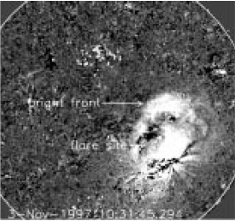
Drawback 2 of Fast-mode Wave Model
Stationary front
Delannee & Aulanier (1999)
Delannee (2000)
P. F. Chen @ISSI-Beijing

Slide 10
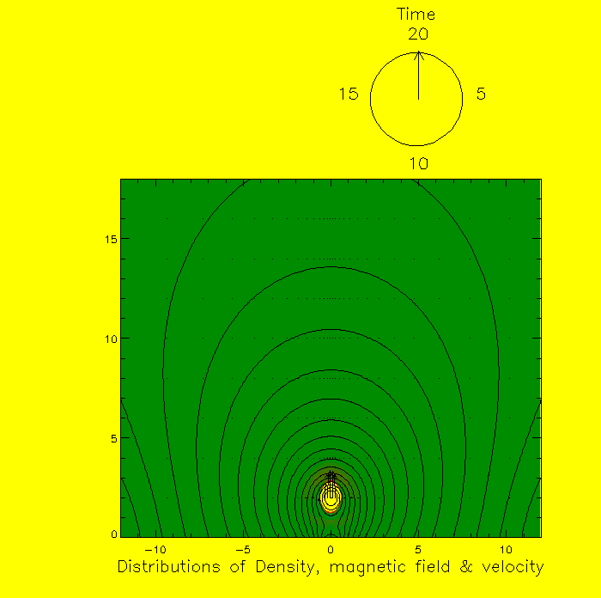
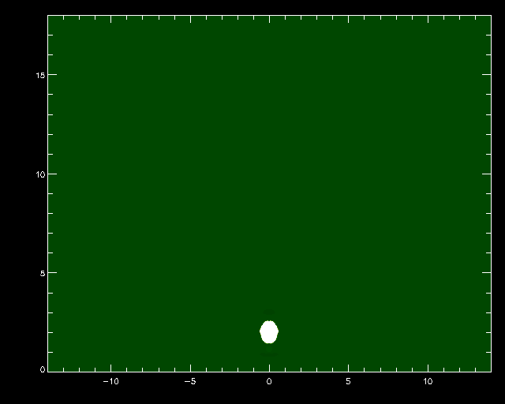
Our Field-line Stretching Model
Chen, Wu, Shibata, & Fang (2002); Chen, Fang, & Shibata (2005)
Coronal Moreton wave 775 km/s
EIT wave 250 km/s
195 Å
P. F. Chen @ISSI-Beijing

Slide 11
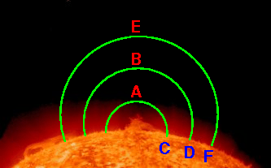
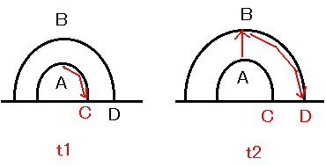
Our Field-line Stretching Model
P. F. Chen @ISSI-Beijing

Slide 12
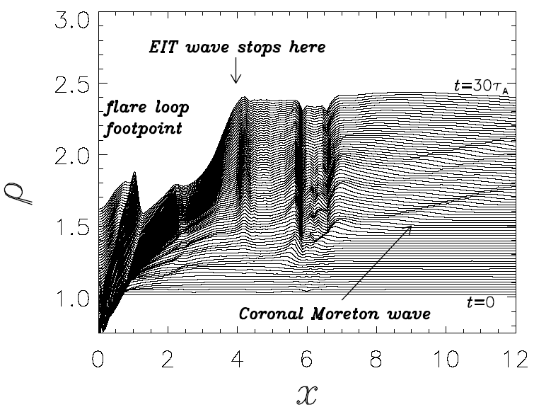
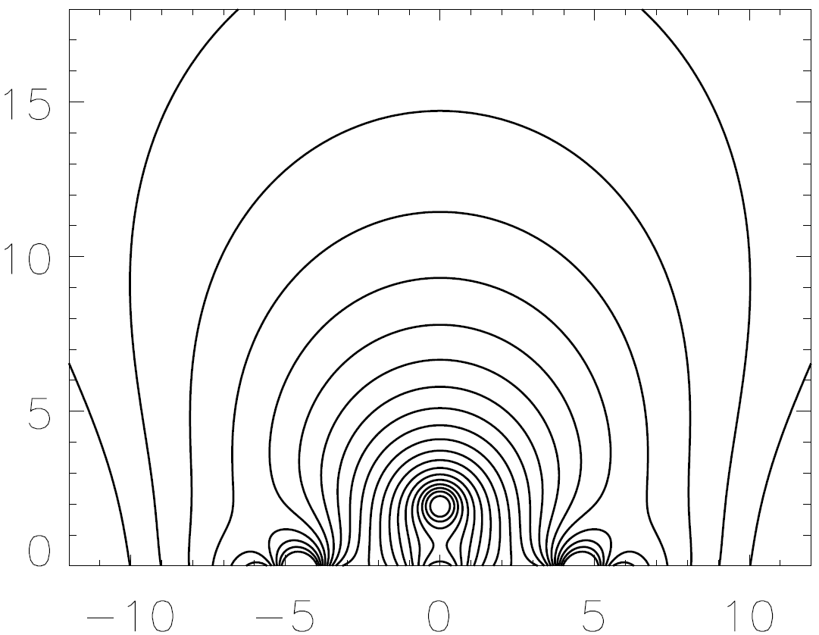
Why EIT Wave Stops near Magnetic Separatrix
Chen, Fang, & Shibata (2005)
P. F. Chen @ISSI-Beijing

Slide 13
A Full View of EIT Waves
Chen et al. (2002, 2005)
1. Coronal Moreton waves
due to piston-driven shock
2. “EIT waves”
Diffuse, due to successive
stretching of closed field lines.
EIT telescope missed the faster one because of low time cadence, 15 min
Later , STEREO/EUVI (2.5 min)
could not detect two waves either.
P. F. Chen @ISSI-Beijing

Slide 14
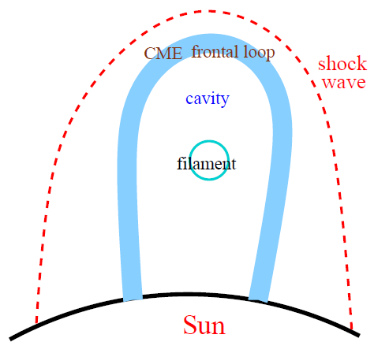
Chen (2009, ApJ); Chen (2011, LRSP)
EIT telescope missed the faster one

Slide 15
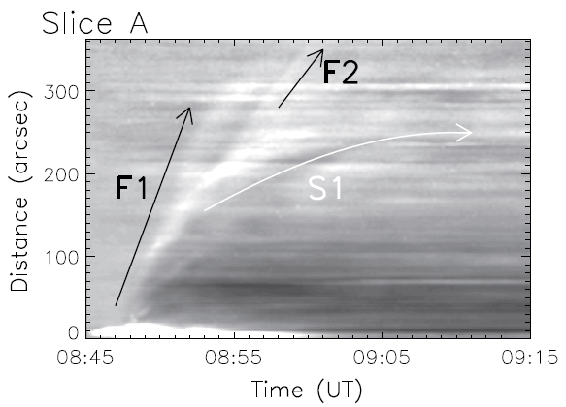
SDO/AIA Era
Chen, P. F. & Wu, Y. (2011, ApJ, 732, L20)
570 km/s
190 km/s
P. F. Chen @ISSI-Beijing

Slide 16
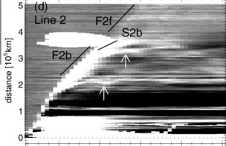

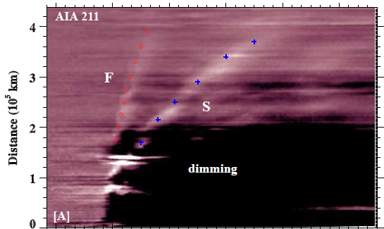
SDO/AIA Era
Asai et al. (2012)
Schrijver et al. (2011)
Cheng et al. (2012)
Shen et al. (2012, 2013)
Kumar et al. (2013)
1080 km/s
280 km/s
P. F. Chen @ISSI-Beijing

Slide 17
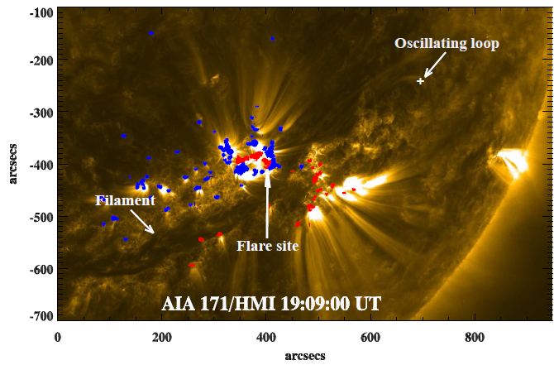
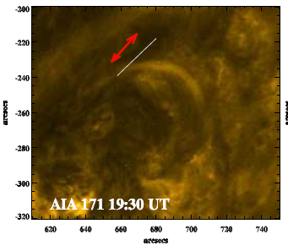
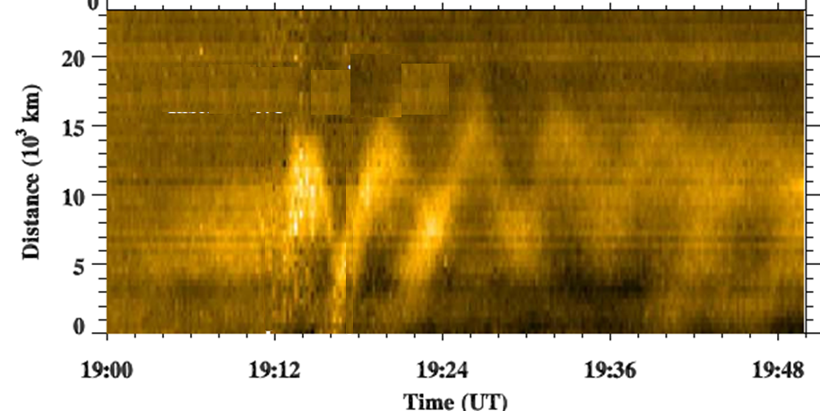
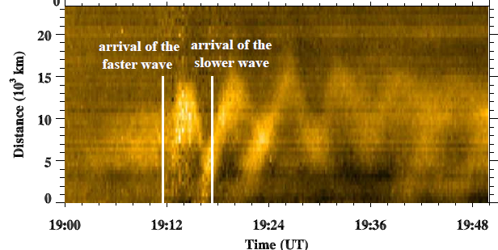
Two EUV Waves
Kumar, … Chen et al. (2013)
16 October 2010.
1080 km/s
280 km/s

Slide 18
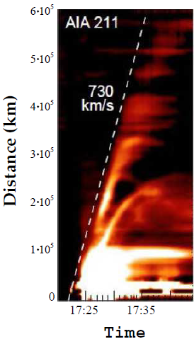
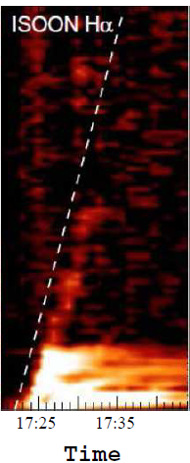
White et al. (2013)

Slide 19
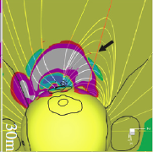
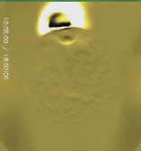
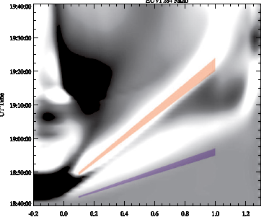
3D MHD Simulations
Downs, Roussev et al. (2011, 2012)
P. F. Chen @ISSI-Beijing

Slide 20
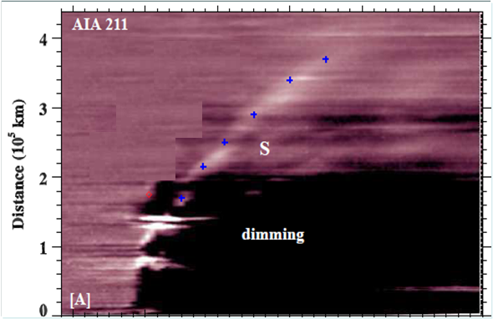
Coronal Seismology (Nakariakov & Verwichte 2005)
900 km/s
300 km/s
Time
Ballai et al. (2004)
Warmuth & Mann (2005)
West et al. (2011)
B=1 G
±1

Slide 21
Long et al. (2013, SP)
B=8 G
P. F. Chen @ISSI-Beijing

Slide 22
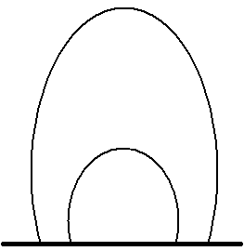
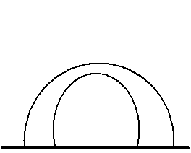
low speed
high speed

Slide 23
Solar
surface
helioseismology

Slide 24
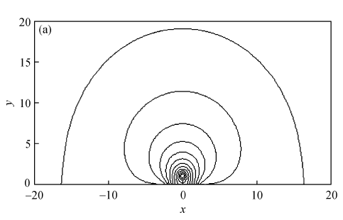
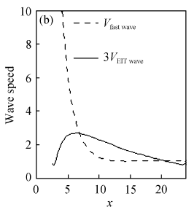
Chen (2009, Science China (G), 52, 1785)
P. F. Chen @ISSI-Beijing

Slide 25
Summary
There are two types of EUV waves;
2. The faster one can be used to coronal seismology directly; The slower one can as well, and even may provide 3D magnetic distribution (in principle).

