Slide 1

Detection of Quasi-periodic rapidly propagating Euv intensity perturbations using sdo/aia
BUKS 2015
C.R. Goddard, G. Nisticò, V. M. Nakariakov

Slide 2
Overview
Fast dispersive wave trains introduction
Brief Theory overview
Review current state of the field
Current research – recent detections
Summary

Slide 3
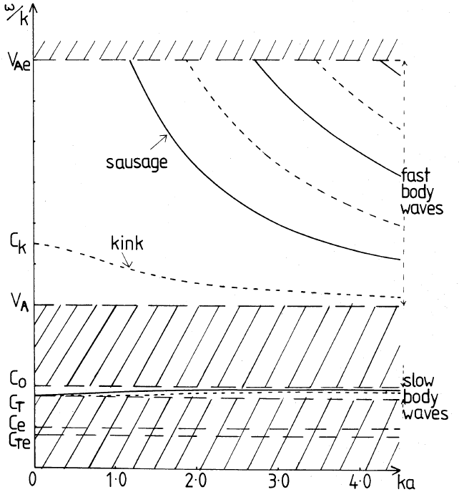
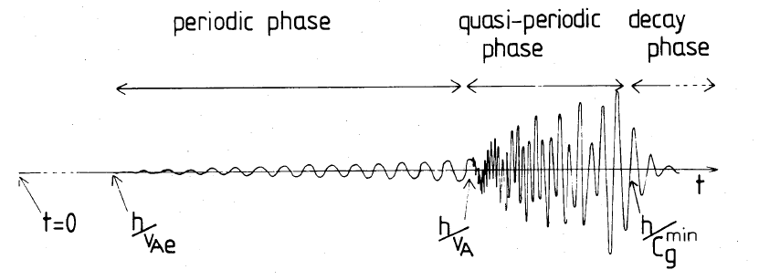
Fast Dispersive Wave Trains
First proposed by Roberts et al (1984) ^{[1]}. Dispersion relations and behaviour in magnetic cylinders are considered.
Dispersive evolution of fast magneto-acoustic waves guided by coronal structures creates quasi-periodic fast wave trains.
Wave train forms a certain distance from the source, dependant on wave guide width and the wavelength.
Figure 1 & 2 : Roberts, B., Edwin, P. M., & Benz, A. O. 1984, ApJ, 279, 857
[1] Roberts, B., Edwin, P. M., & Benz, A. O. 1984, ApJ, 279, 857
Notes:
Mention role of waves

Slide 4
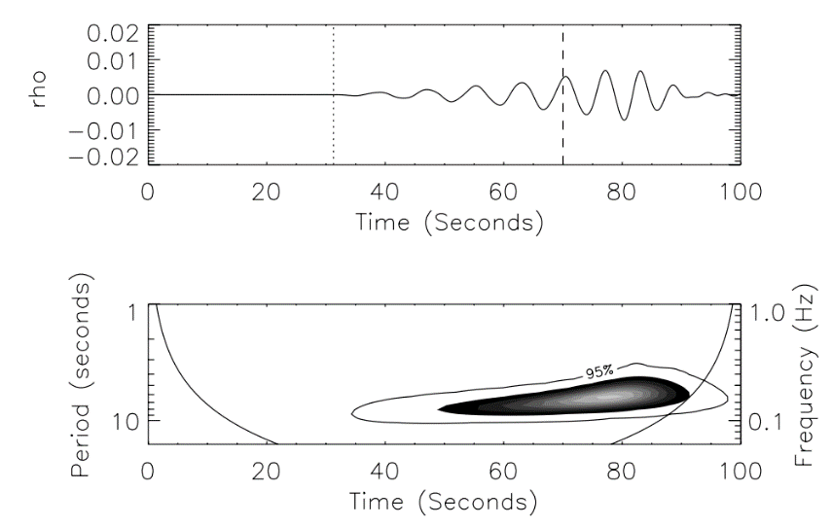
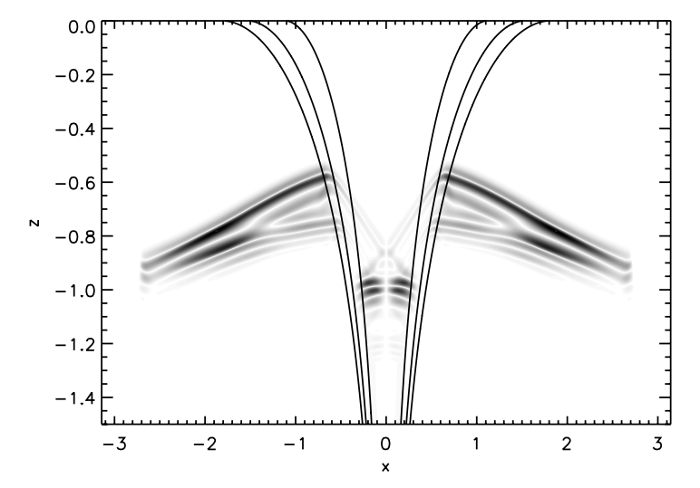
Fast Dispersive Wave Trains
Dispersive wave trains can have ‘crazy tadpole’ wavelet spectra [2], depending on duration and spectrum of the initial perturbation.
SDO/AIA has produced several clearly imaged events, encouraging further modelling work.
Why? - Diagnostic tool potential.
- Unanswered questions.
Figure 1 : V. M. Nakariakov et al, Mon. Not. R. Astron. Soc. 349, 705-709 (2004)
Figure 2 : D. J. Pascoe et al, A&A 560, A97 (2013)
[2] V. M. Nakariakov et al, Mon. Not. R. Astron. Soc. 349, 705-709 (2004
Notes:
Include link to module – type of disturbance, cylinder modes, dispersion curves

Slide 5
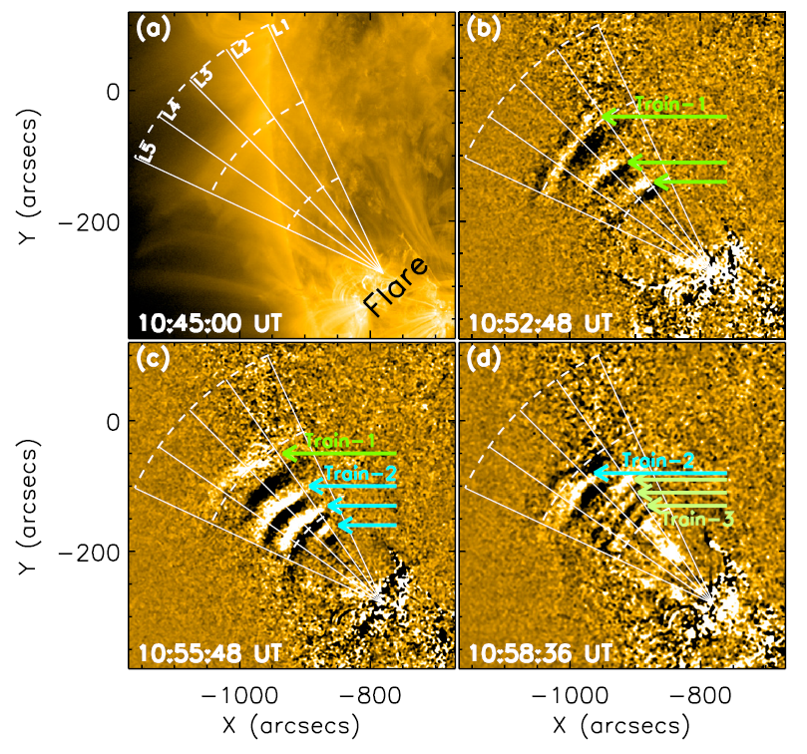
EXAMPLE DETECTIONS
Figure 1 : Katsiyannis, et al. 2003, A&A, 406,709
Figure 2 : Yuan, D., Shen, Y., Liu, Y., et al. 2013, A&A, 554, A144
Notes:
Include link to module

Slide 6
Current State of the Field
Prior to AIA detections were limited primarily to X-ray and radio bands.
The high spatial and temporal resolution of the SDO/AIA instrument has allowed the discovery of fast propagating wave trains at EUV wavelengths.
The first EUV detections were reported by Liu et al [3], [4].
Detections show typical speeds of 500 –2000 kms ⁻¹ and periods of 30 –200 s.
These detections have confirmed theories and allowed limited diagnostics to be performed.
[3] Liu, W., Title, A. M., Zhao, J., et al. 2011, ApJ, 736, L13
[4] Liu, W., Ofman, L., Nitta, N. V., et al. 2012, ApJ, 753, 52
Notes:
Include link to module

Slide 7
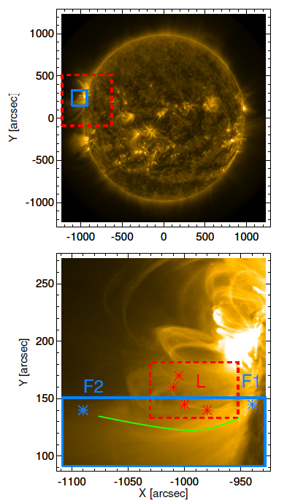
Potential New Detection
M6.5 class flaring event, 03/11/14.
Rapidly propagating intensity fluctuations visible at 171 Å.
Decaying oscillations and dynamics visible in surrounding loop structures.
CME interaction with the background structures observed at 131 Å.
Correlation of start times of guided enhancements and loop oscillation with CME impact.

Slide 8
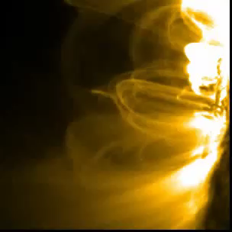
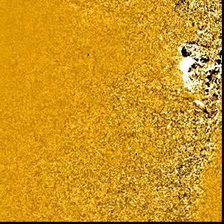
Potential New Detection

Slide 9
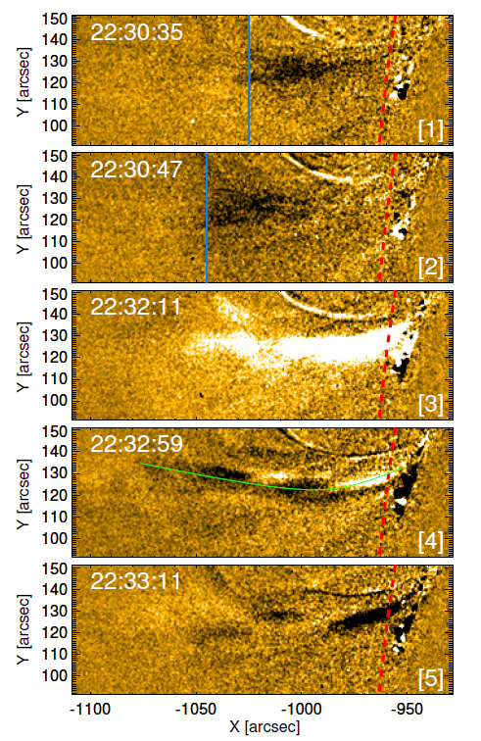
Potential New Detection
Intensity perturbations propagate along a funnel structure away from the active region.
RDIs reveal some propagating features with phase speeds of ~1200 km s^{-1.}
Propagation of some enhancements is not observed.
Contribution of several different propagations/oscillations?
Nearby loop undergoes dynamics simultaneously.

Slide 10
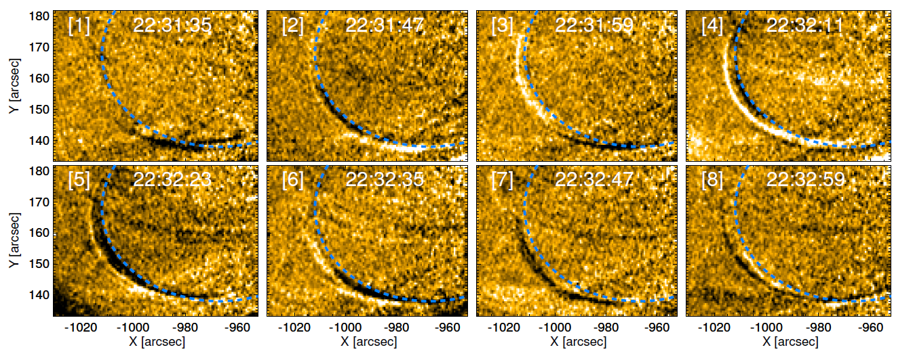
Potential New Detection

Slide 11
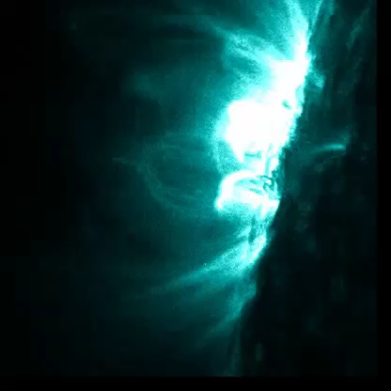
Potential New Detection

Slide 12
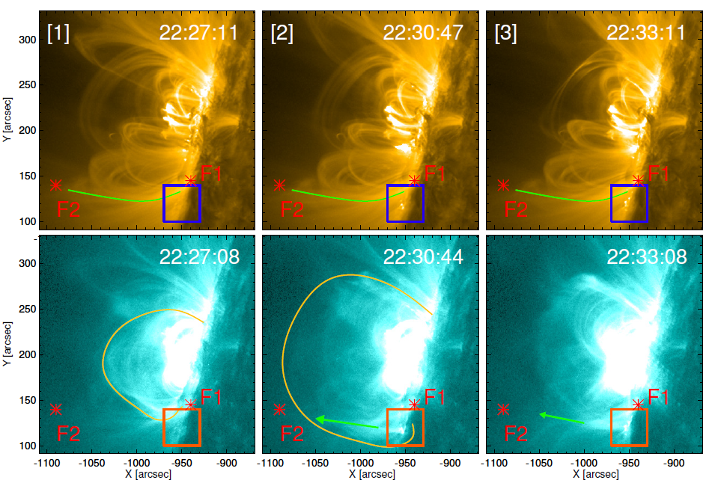
Potential New Detection

Slide 13
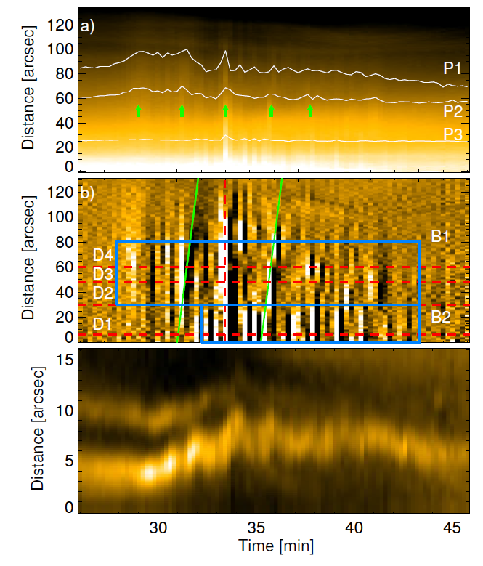
Potential New Detection
Time-distance (TD) maps shows series of intensity enhancements.
Period of 1.8 min measured, in addition to a shorter period.
Propagating features yield a phase speed of ~1200 km s⁻¹.
Some features propagate the entire distance between frames, or do not propagate at all.
TD map across the loop shows radial displacement of the loop and some additional features.

Slide 14
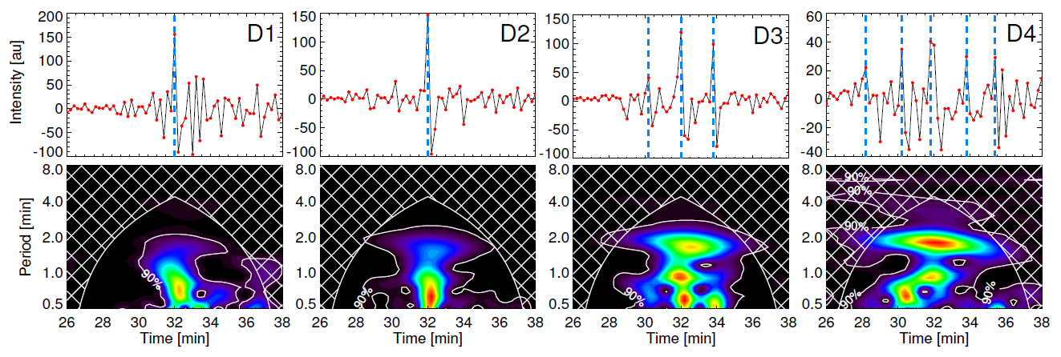
Potential New Detection

Slide 15
summary
Quasi-periodic EUV enhancements detected with a period (1.8 min) and phase speed (~1200 km s⁻¹) within the range set by previous wave train detections.
Some features appear and disappear between neighbouring frames, indicating propagation at unrealistic speeds.
Potential dispersion of the initial intensity enhancement is seen along its path, producing a series of wave fronts preceding and following it.
Oscillation of the nearby loop is time coincident with the guided enhancements, suggesting a shared driver?
CME interaction is time coincident with observed phenomena, potentially indicating this excites a series of FMWs corresponding to the enhancements.
Our findings indicate the presence of interesting short period oscillatory phenomena in the corona, that can be better resolved with future instruments.

Slide 16
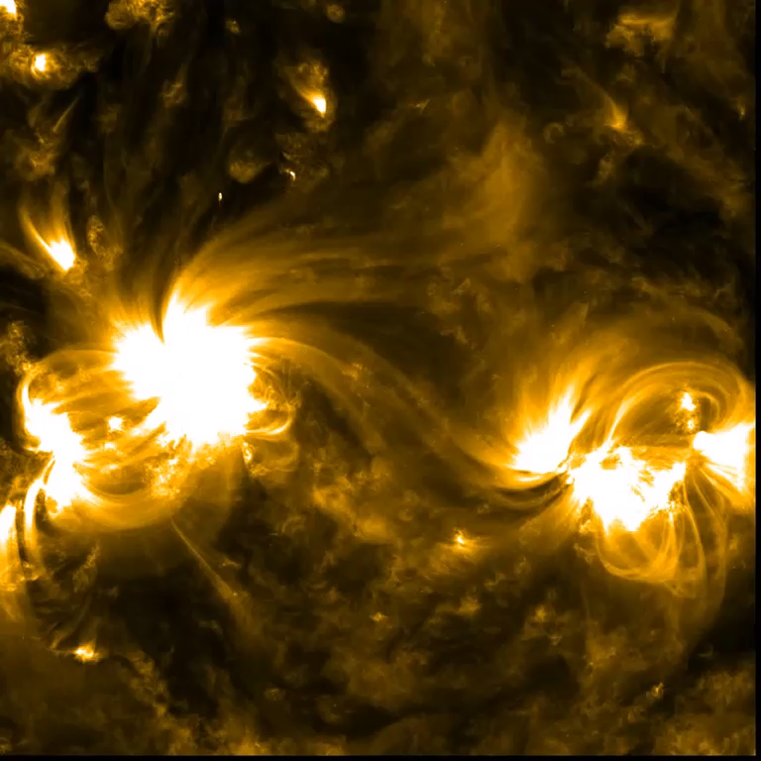
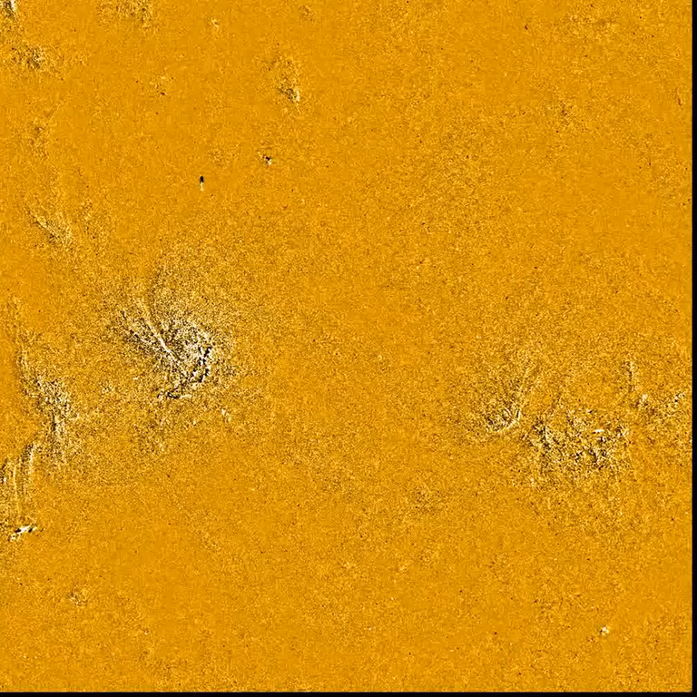
Next event for analysis

Slide 17
Questions?

