Slide 1
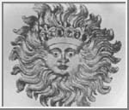
Физика Солнца-2
Lecturer: Professor Valery Nakariakov
Накаряков Валерий Михайлович
Web-page: …

Slide 2
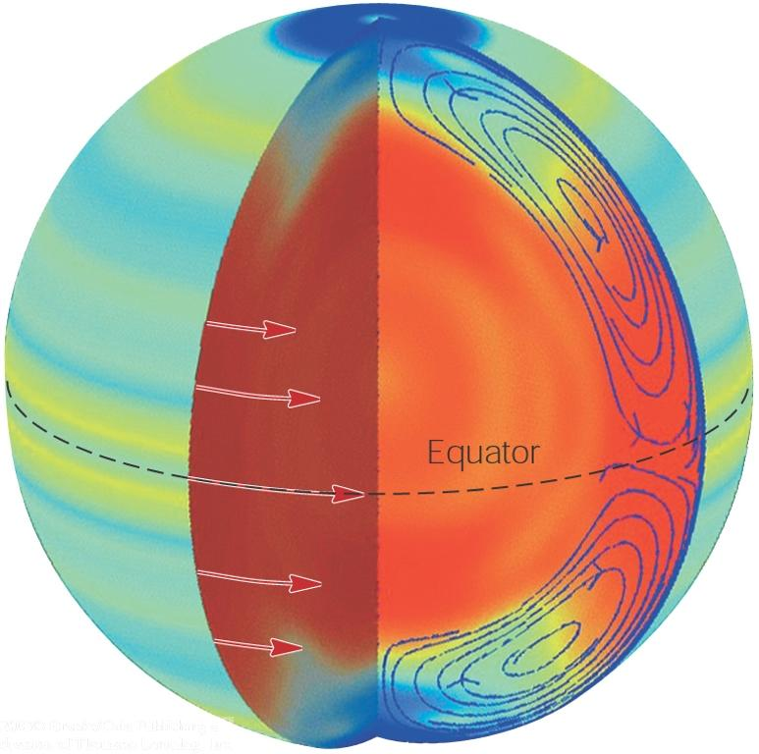
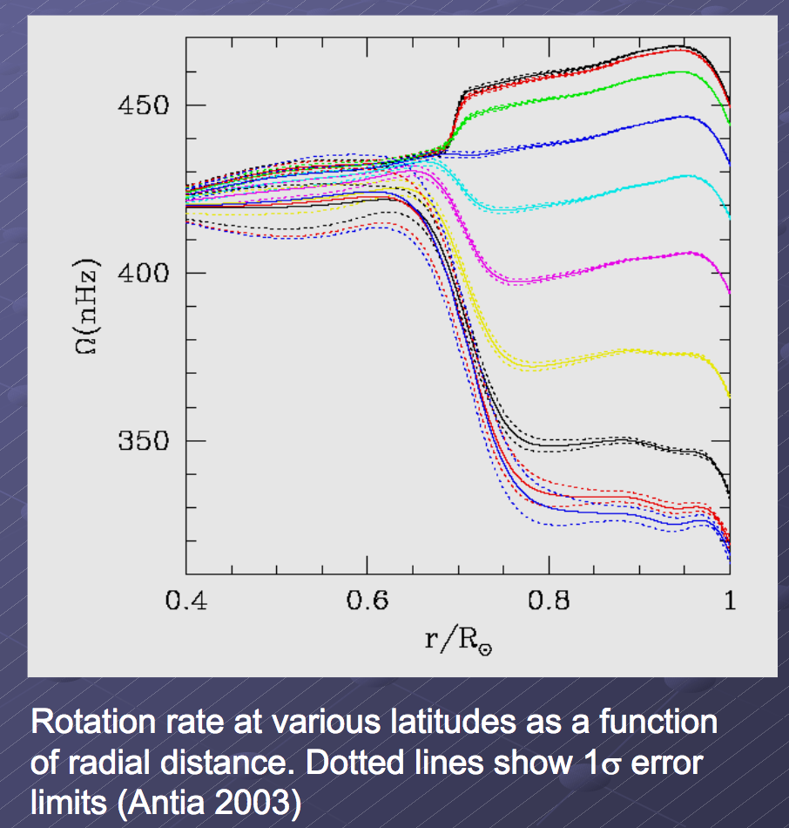
Solar dynamo:
Differential rotation

Slide 3
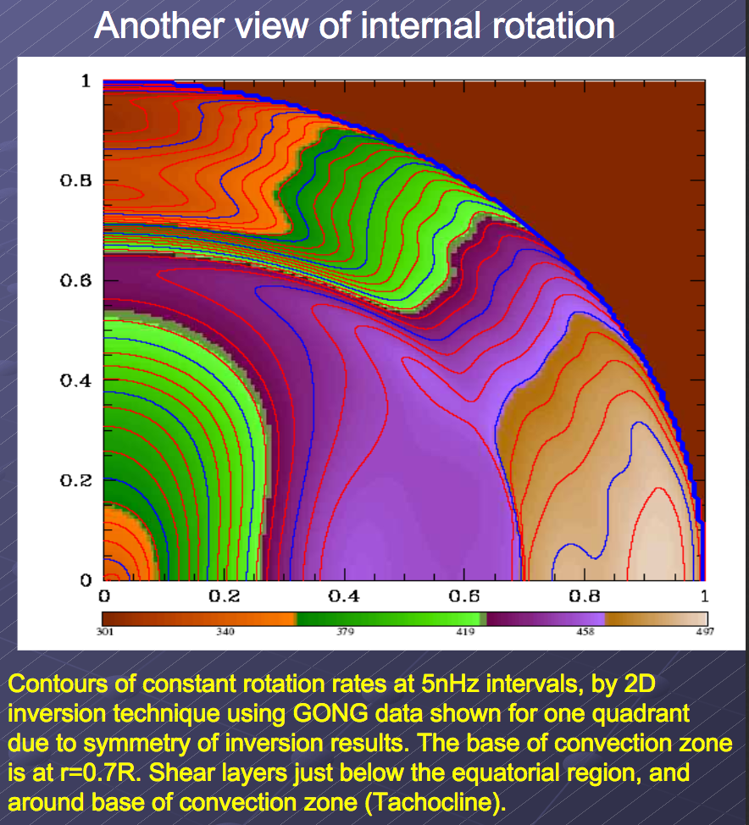

Slide 4
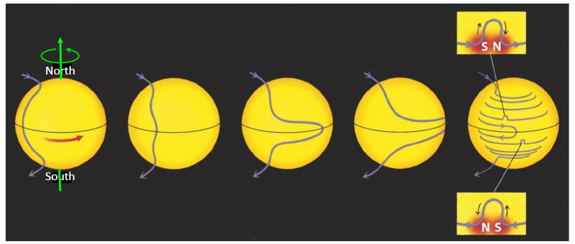

Slide 5
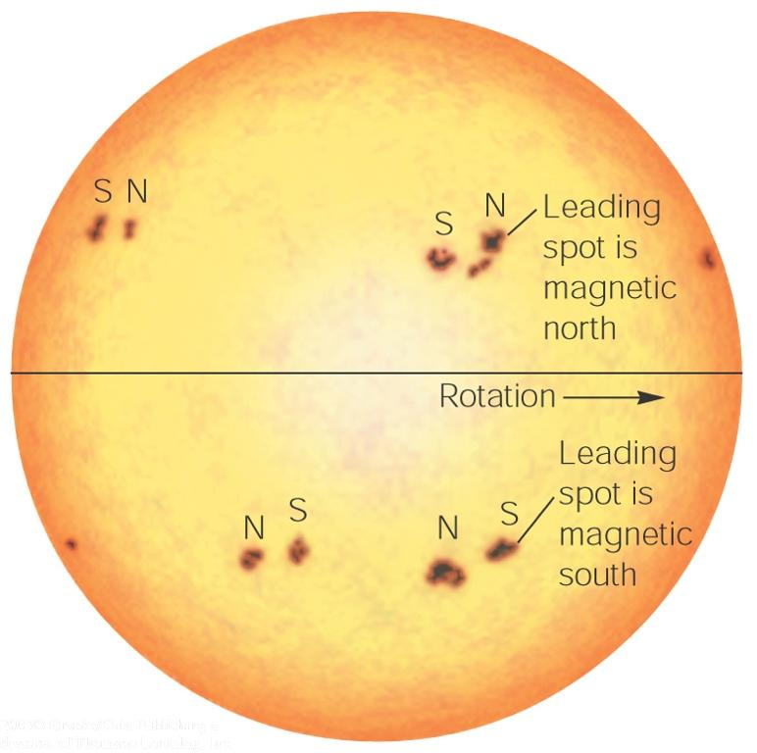

Slide 6
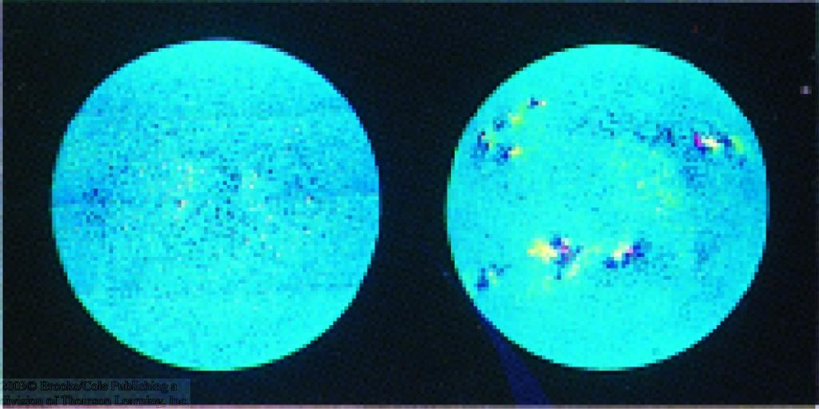
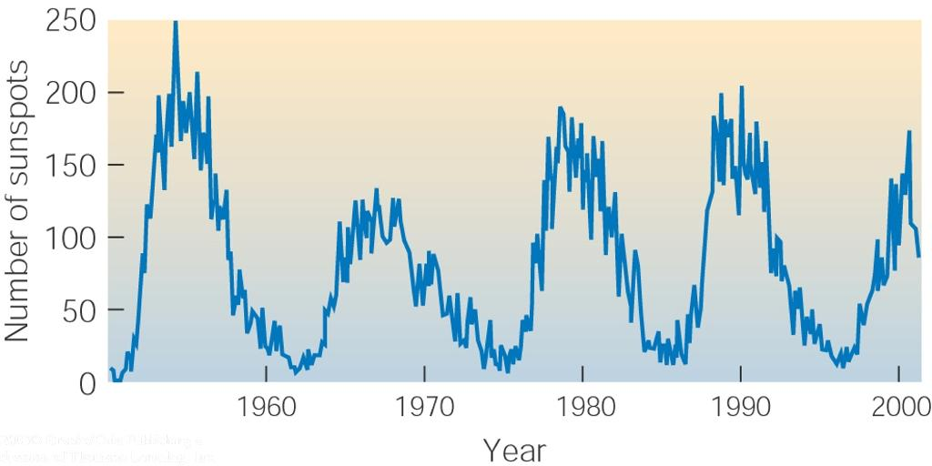
The Solar Cycle
After 11 years, North/South order of leading/trailing sun spots is reversed
11-year cycle
=> Total solar cycle = 22 years
Reversal of magnetic polarity

Slide 7
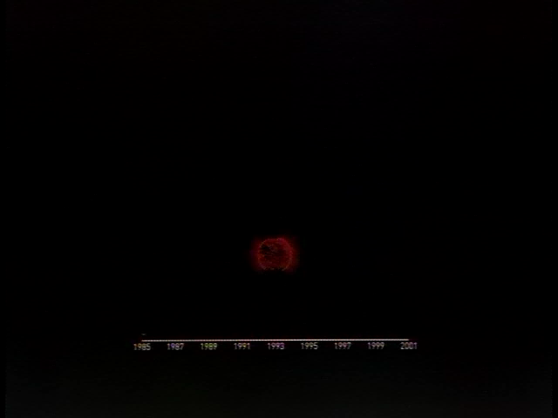

Slide 8
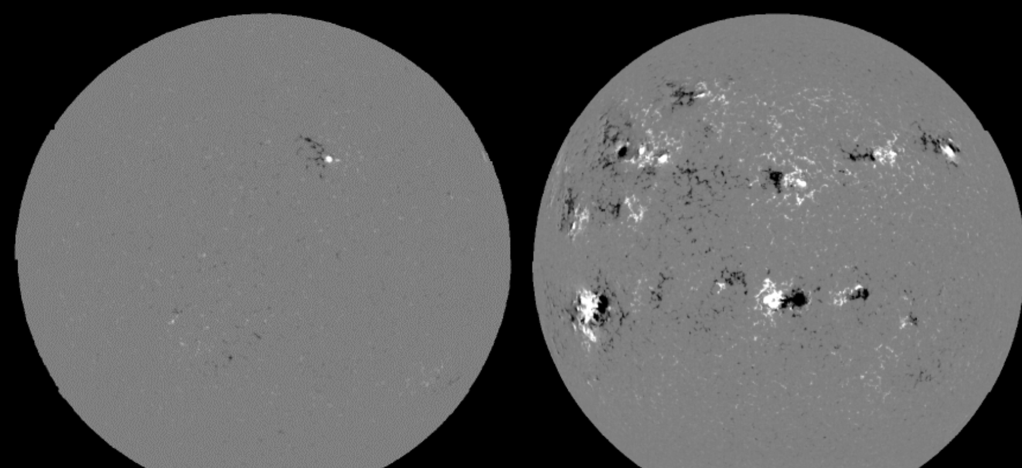
Solar minimum Solar maximum

Slide 9
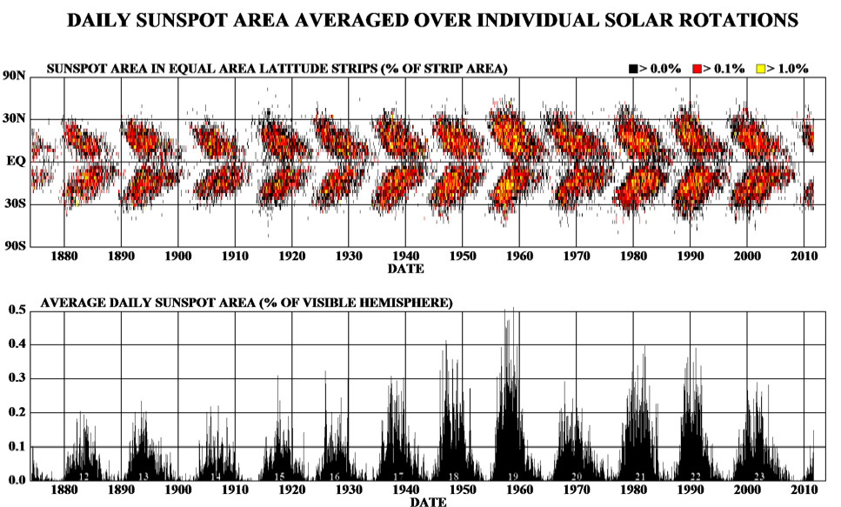
The Maunder Butterfly Diagram

Slide 10
Sunspot cycle starts out with spots at higher latitudes on the Sun;
Evolve to lower latitudes (towards the equator) throughout the cycle.

Slide 11
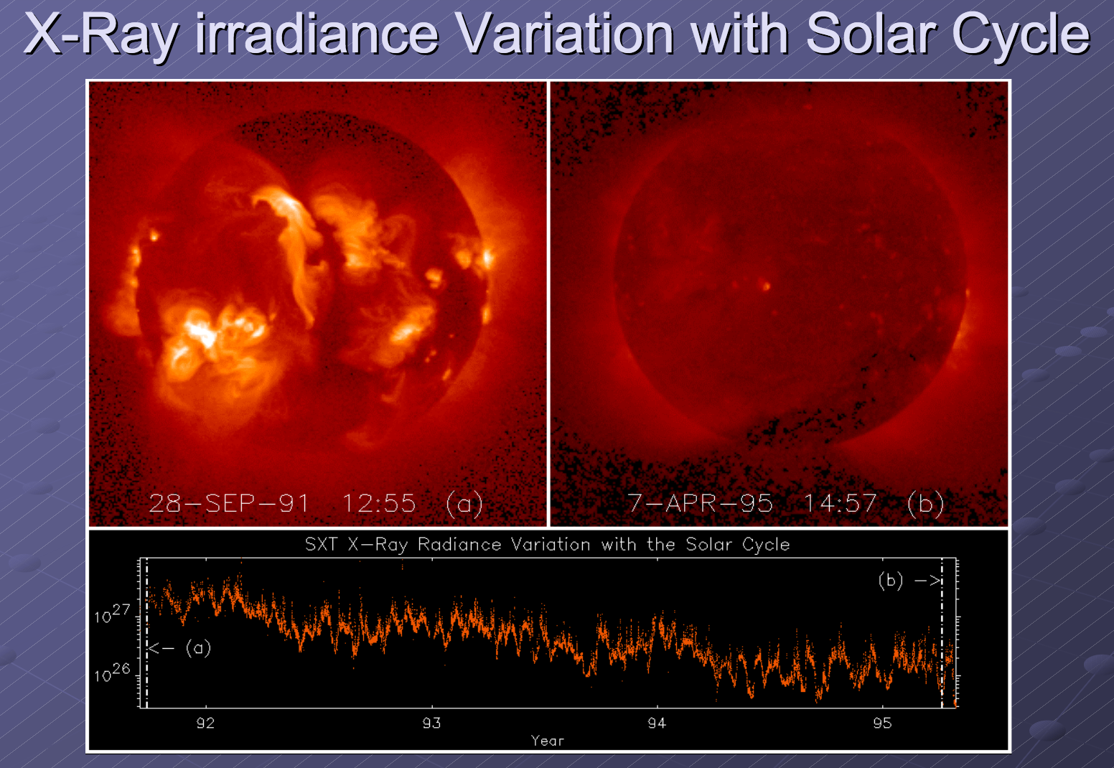

Slide 12
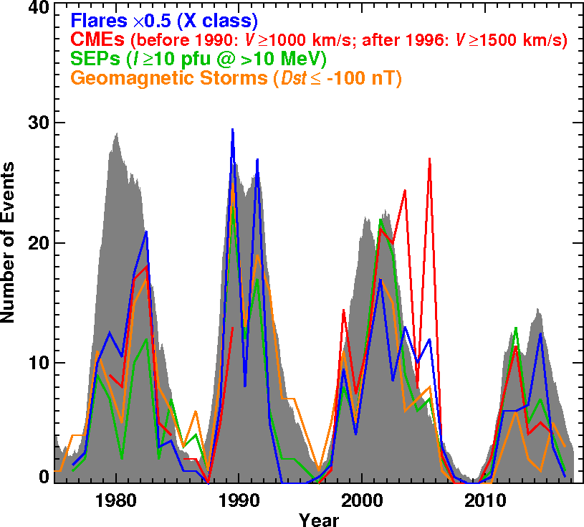
Cycle 24 Compared to Previous Cycles
Solar Weather in Cycle 24 is clearly very mild;
CME and sunspot activity have discordant behavior between the two sunspot number peaks;
More fast CMEs during first peak, but a smaller SSN;
X-class flares are more during the second peak;
# of SEP events, magnetic storms similar to CMEs.
21
22
23
24

Slide 13
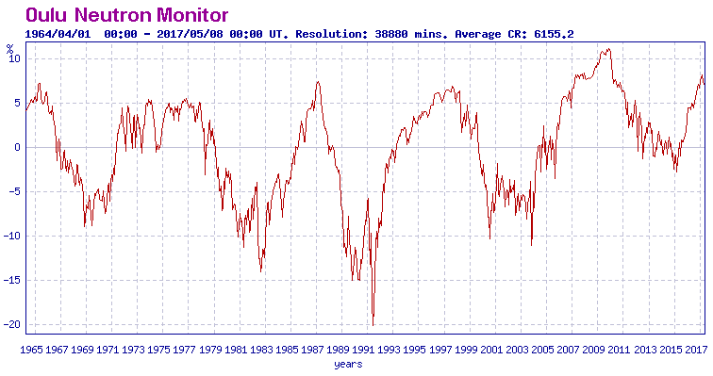
Cosmic Rays Arrivals:

Slide 14
Geoeffectiveness of the solar variability:
Space Weather refers to changes in the space environment near Earth
Radiation Storms
1-4 per month at max
Geomagnetic Storms
3-5 per month at max
Radio Blackouts
50-100 per month at max
Sunspot Number
11-year cycle

Slide 15
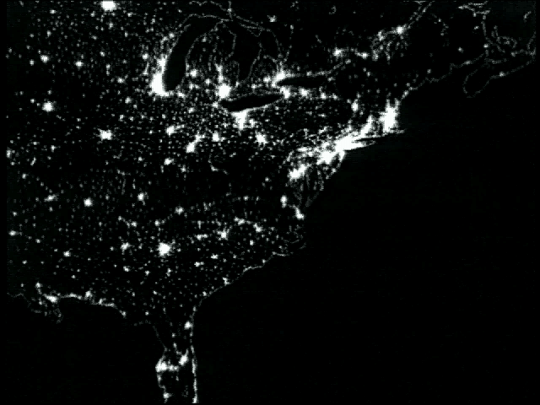
Example of power blackout:

Slide 16
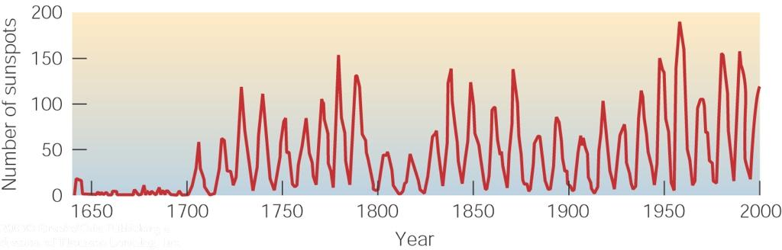
The Maunder Minimum
The sun spot number also fluctuates on much longer time scales:
Historical data indicate a very quiet phase of the sun, ~ 1650 – 1700: The Maunder Minimum

Slide 17
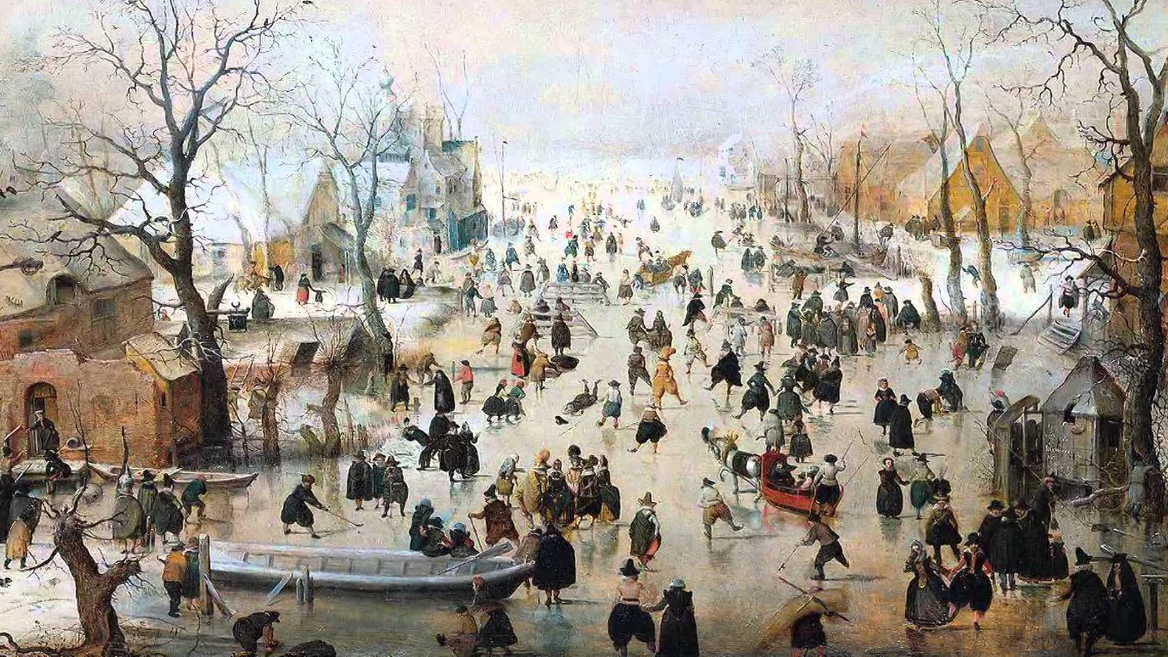
The Little Ice age in Europe

Slide 18
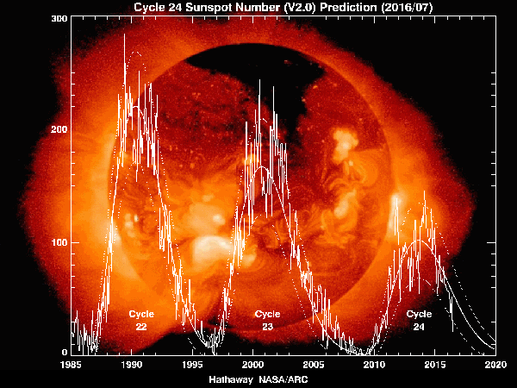
“Prediction is very hard - especially when it’s about the future”
Niels Bohr

Slide 19
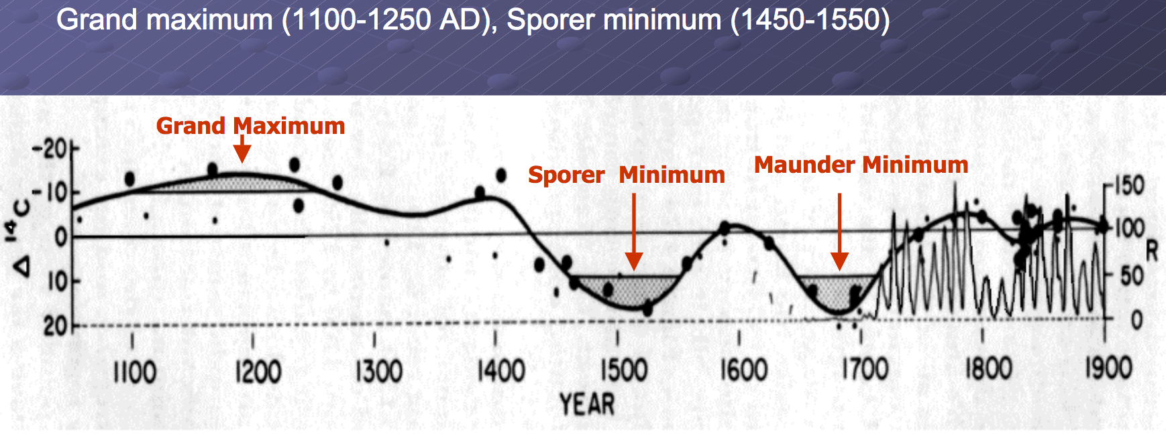

Slide 20
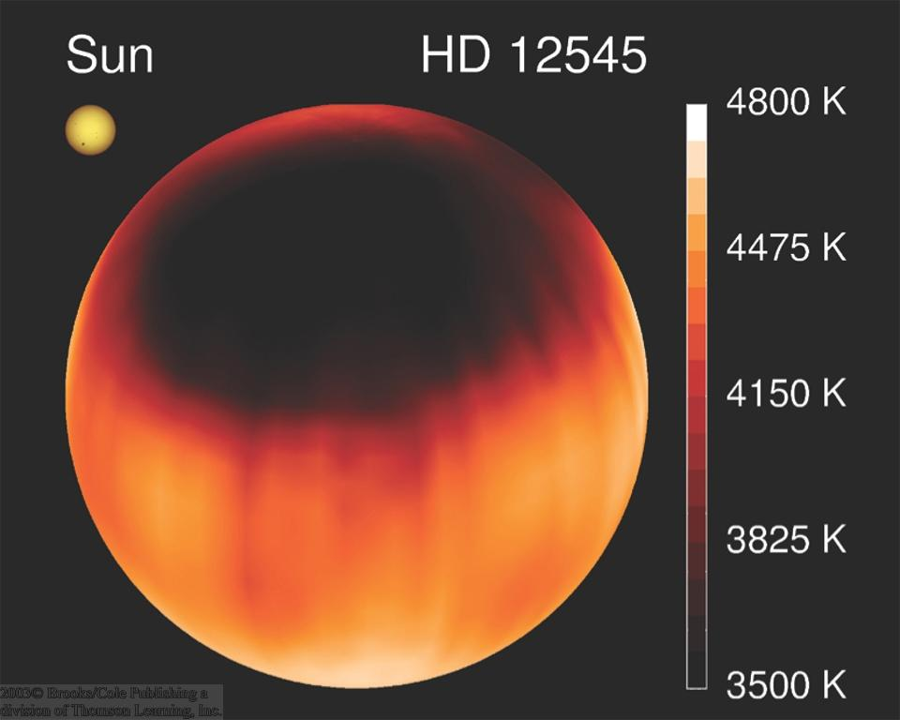
Other stars might also have spots:

Slide 21
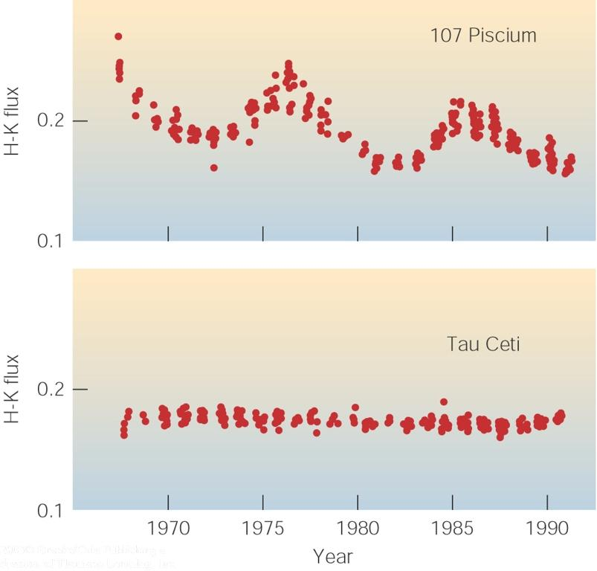
Magnetic cycles on other stars
H and K line emission of ionized Calcium indicate magnetic activity also on other stars.

Slide 22
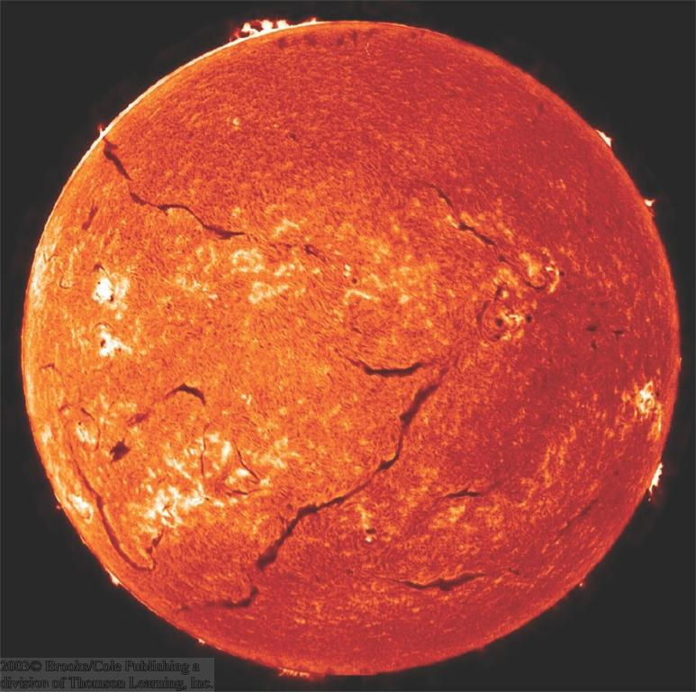
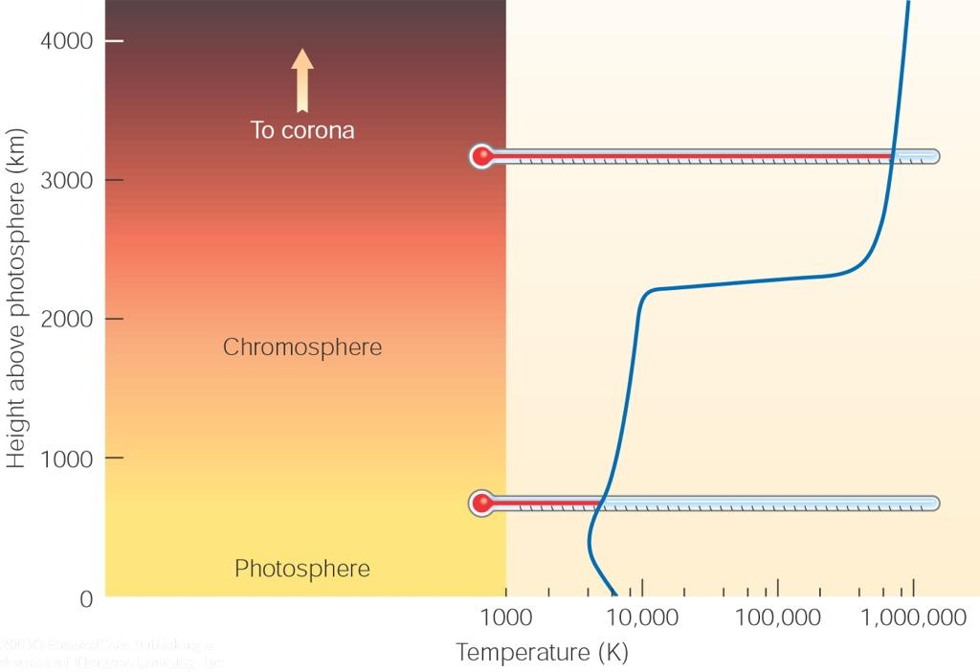
The Chromosphere
Region of Sun’s atmosphere just above the photosphere.
Visible, UV, and X-ray lines from highly ionized gases;
Temperature increases gradually from ≈ 4500 ºK to ≈ 10,000 ºK, then jumps to ≈ 1 million ºK
Filaments
Transition region
Chromospheric structures visible in Hα emission (filtergram)

Slide 23
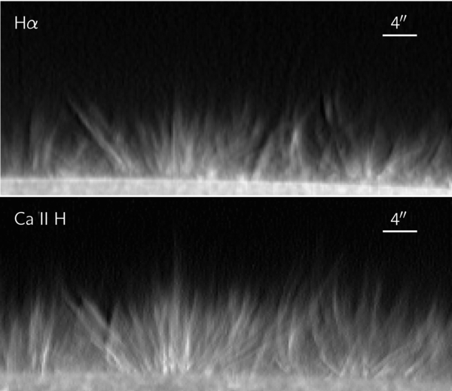
Chromospheric spicules
Filaments of cooler gas from the photosphere, rising up into the chromosphere.
Visible in Ha emission.
Diameter about 1 Mm, lengths 6-10 Mm.
Speeds up to 20-30 km s⁻¹.
Each one lasting about 5 – 15 min.
More than a million spicules are seen on the Sun at any time.

Slide 24
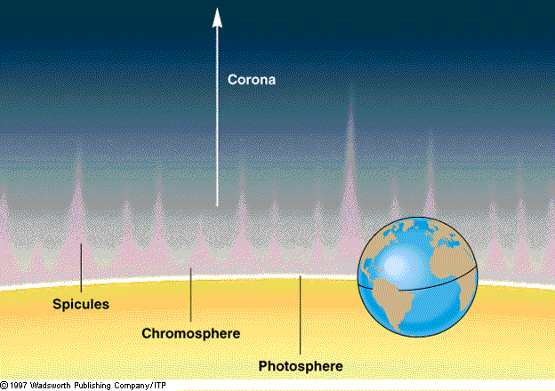

Slide 25
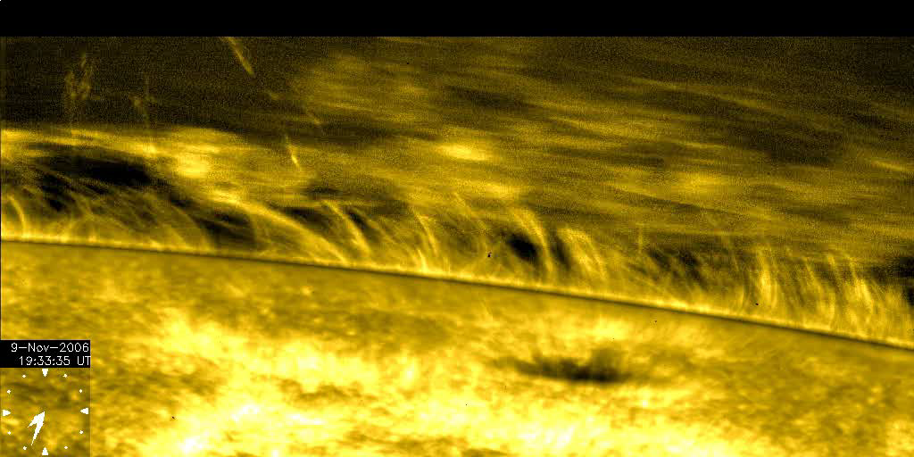

Slide 26
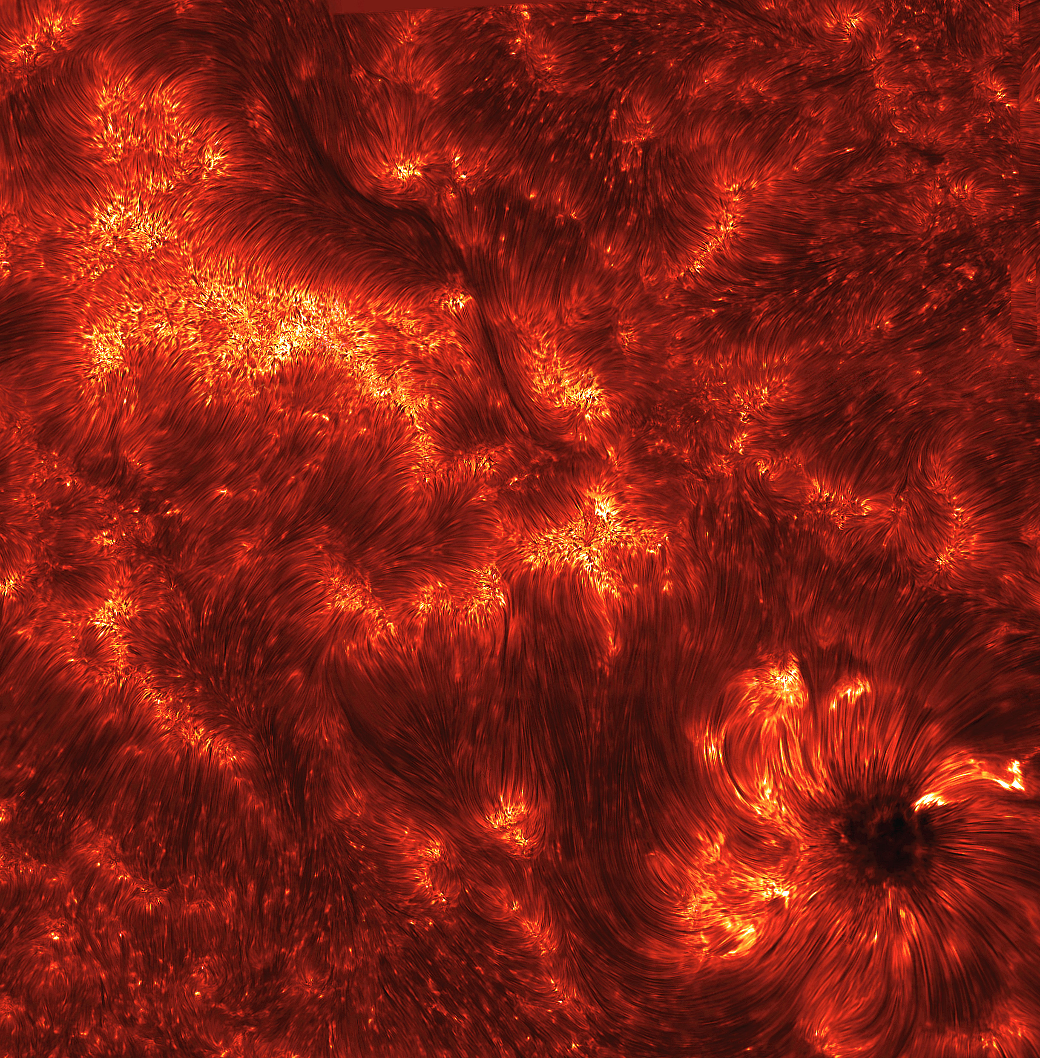

Slide 27
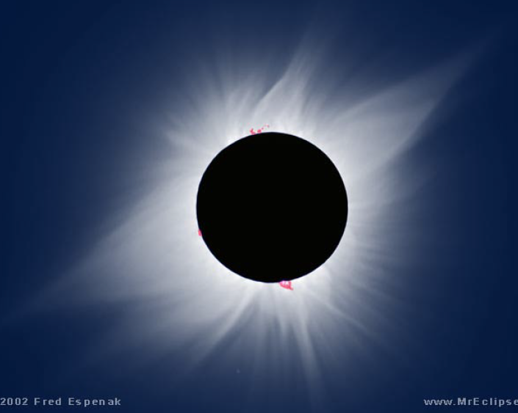
The corona
Almost fully-ionised outer part of the solar atmosphere.
Temperature higher than 10⁶ MK.
A magnetically dominated plasma.
Highly structured.

Slide 28
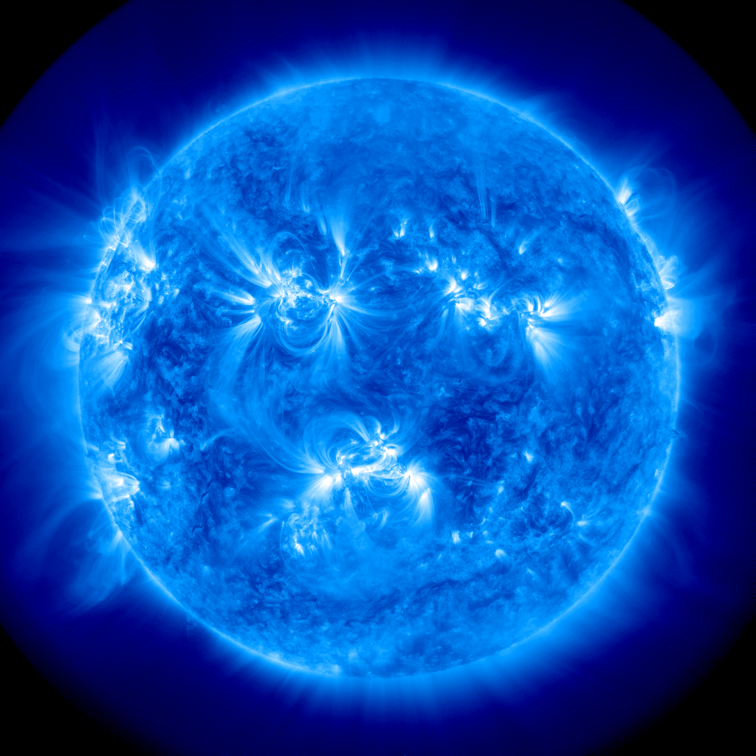
Inner corona

Slide 29
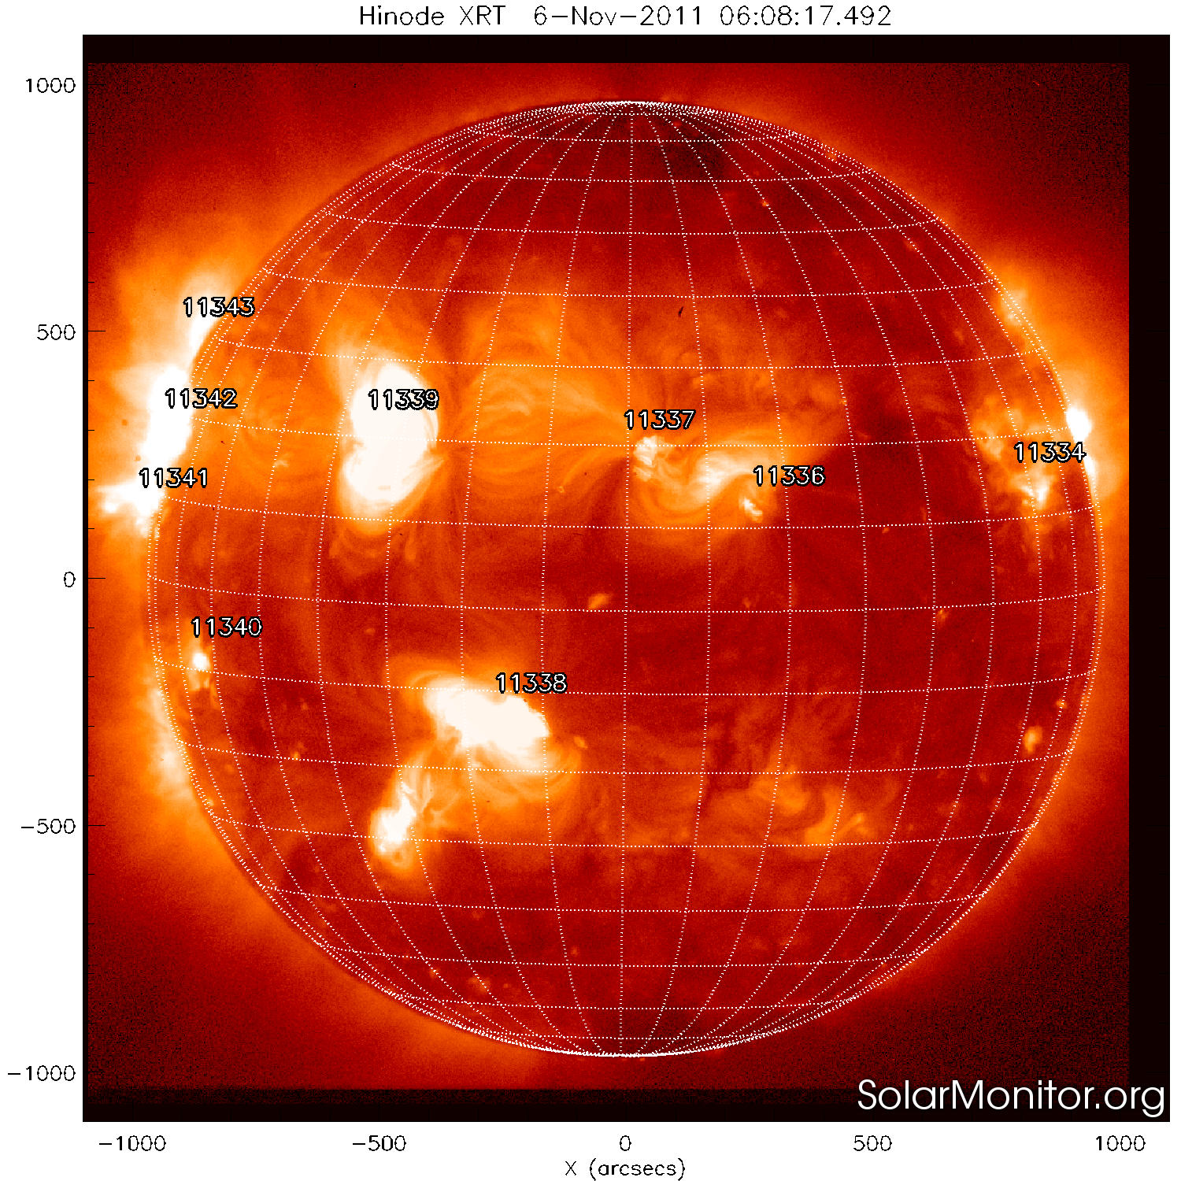
Inner corona:
Soft X-rays

Slide 30
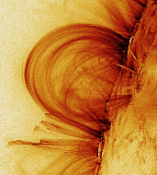
Steady coronal loops:
“If the Sun did not have a magnetic field, it would be as uninteresting a star as most astronomers believe it to be.''
attributed to R. Leighton

Slide 31
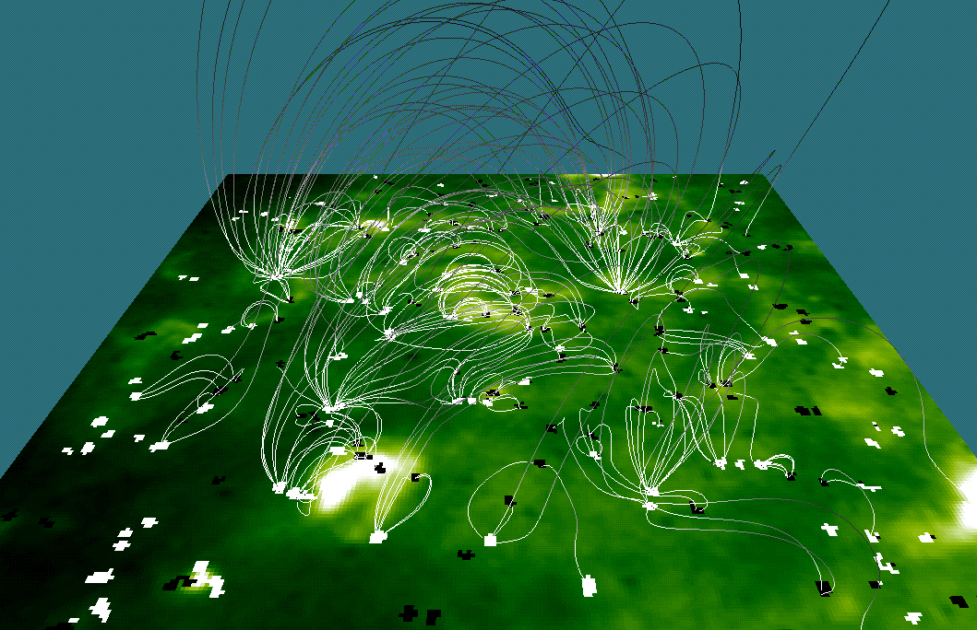
The Magnetic Carpet of the Corona
Corona contains very low-density, very hot (1 million ºK) gas
Coronal gas is heated through motions of magnetic fields anchored in the photosphere below (“magnetic carpet”)
Computer model of the magnetic carpet

Slide 32
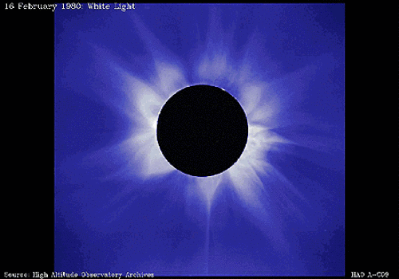
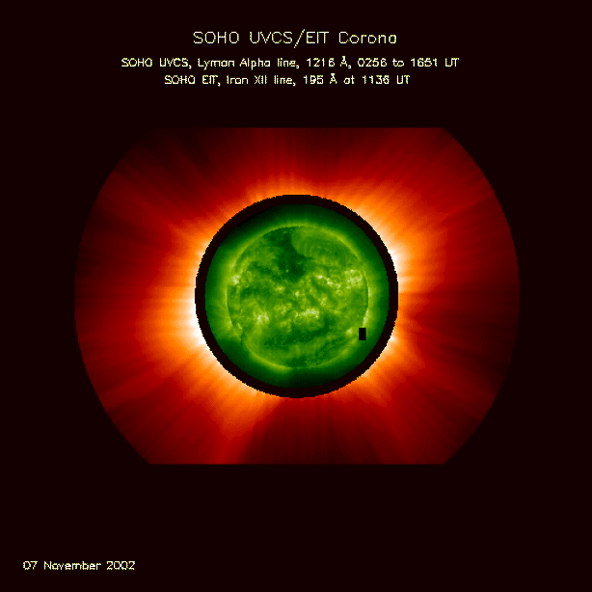
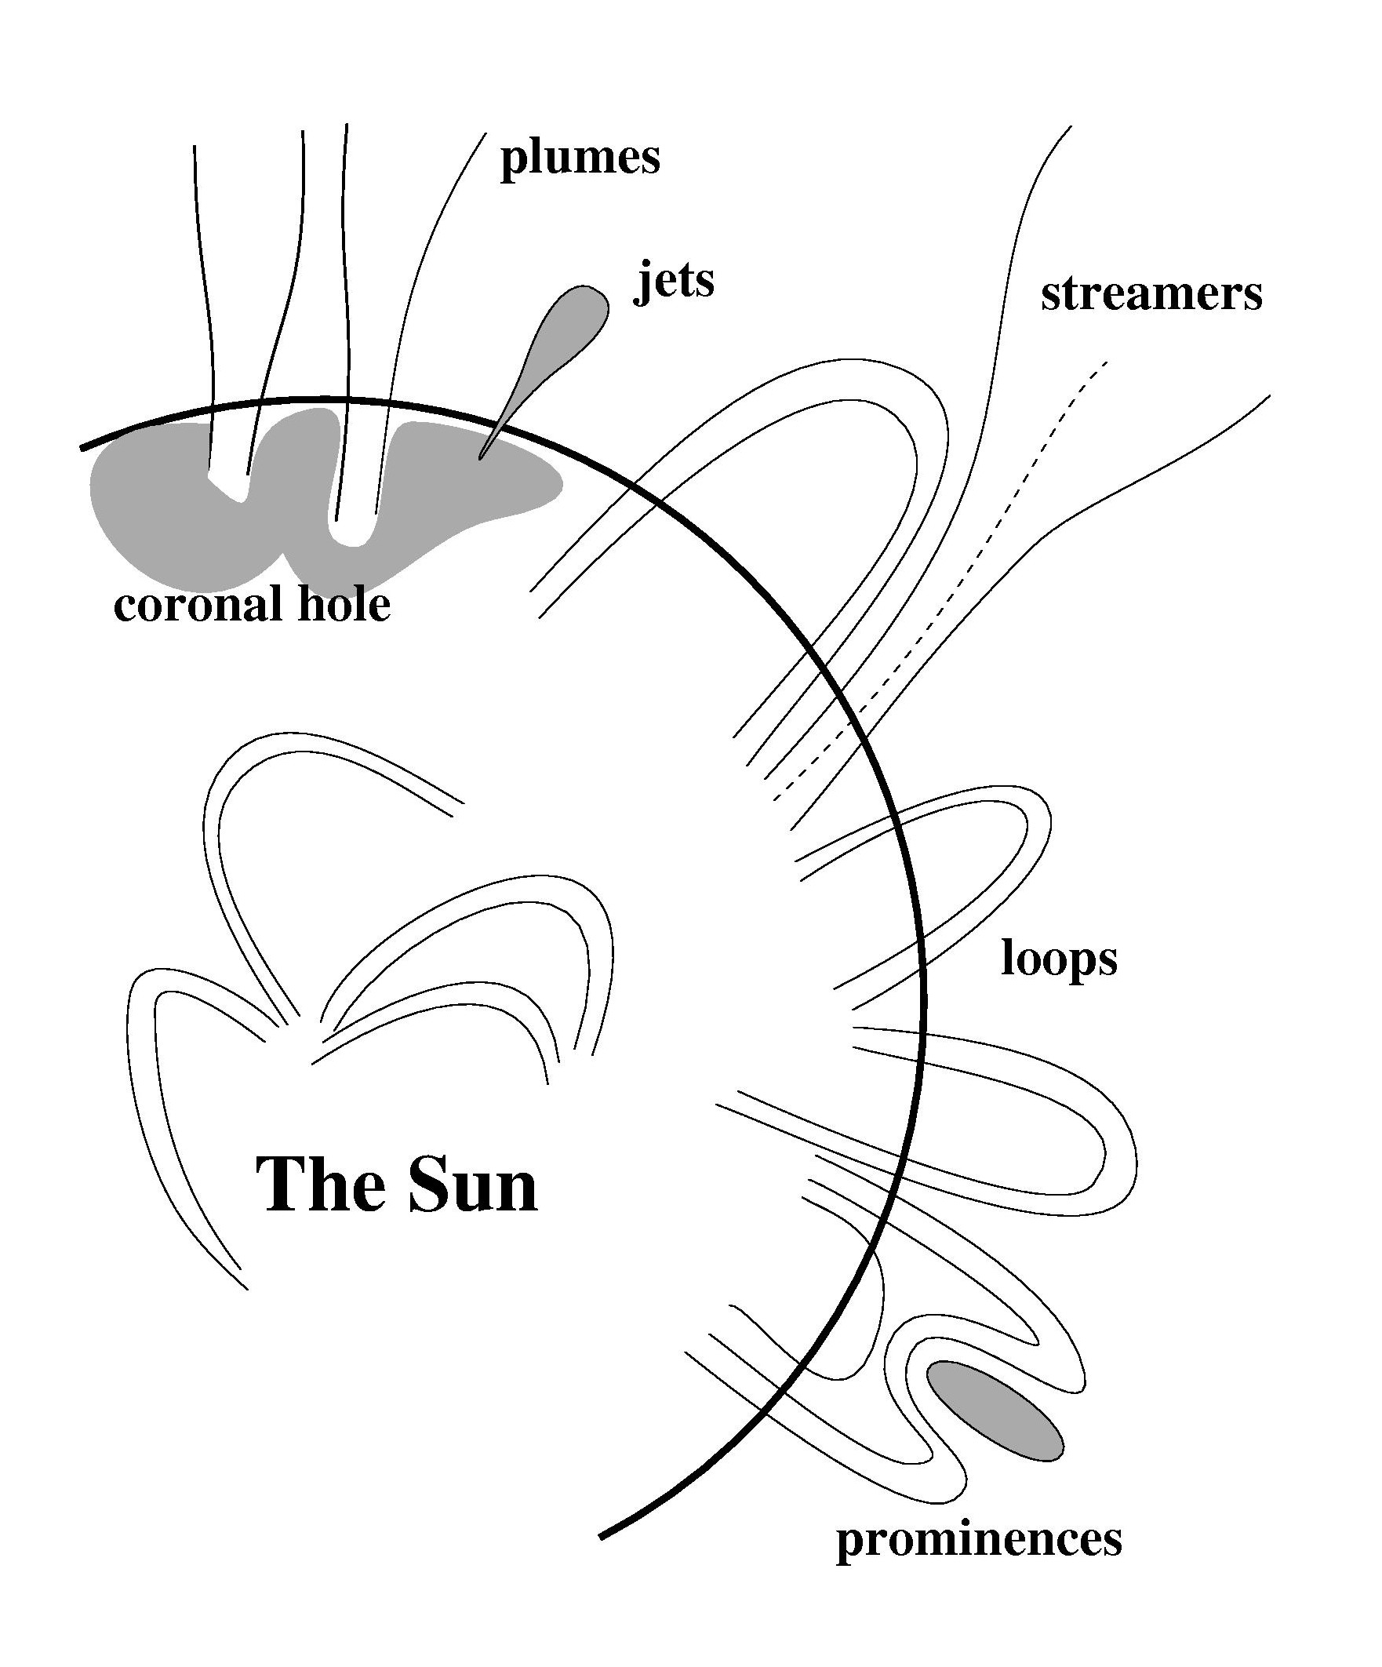
Structures in the solar corona:

Slide 33
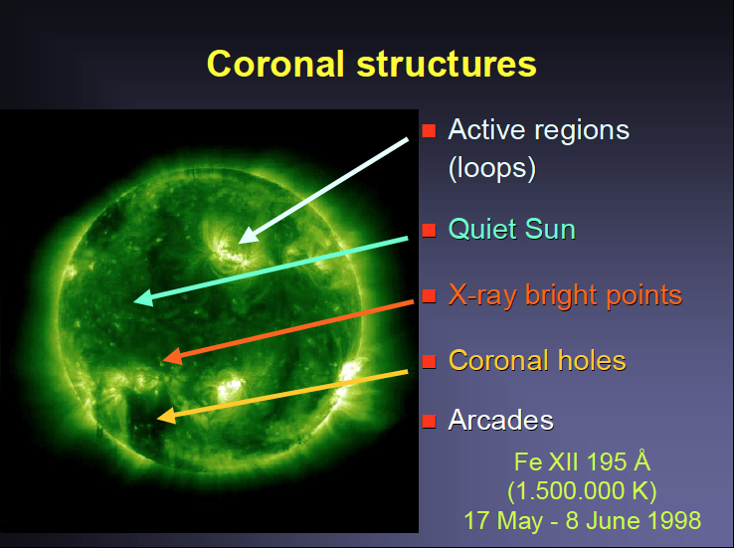

Slide 34
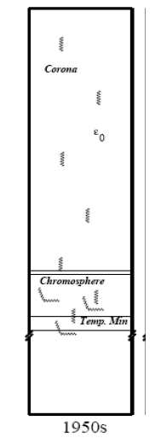
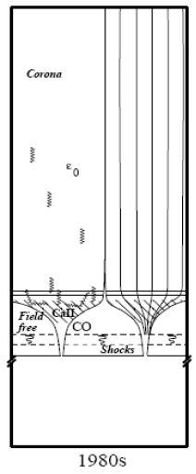
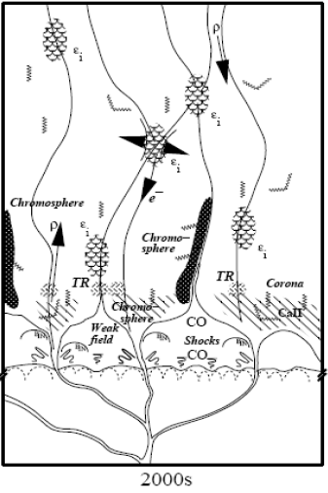
Evolution of the Sun’s atmospheric models:

Slide 35
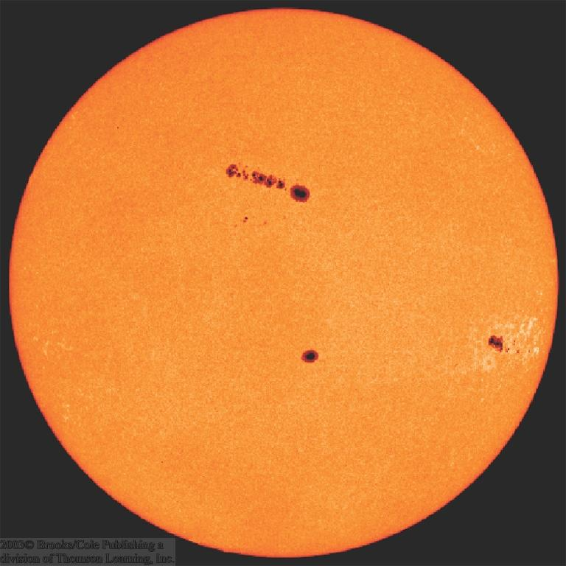
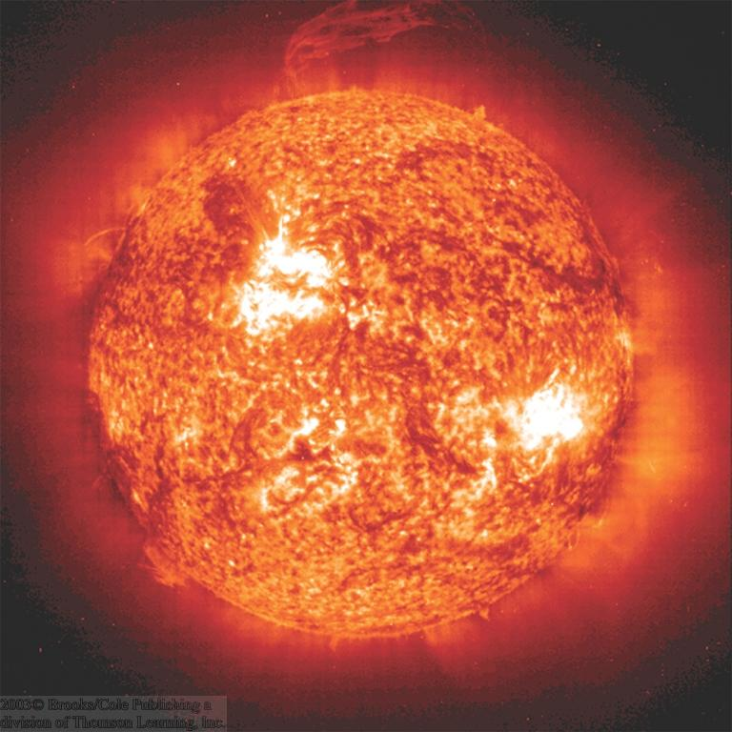
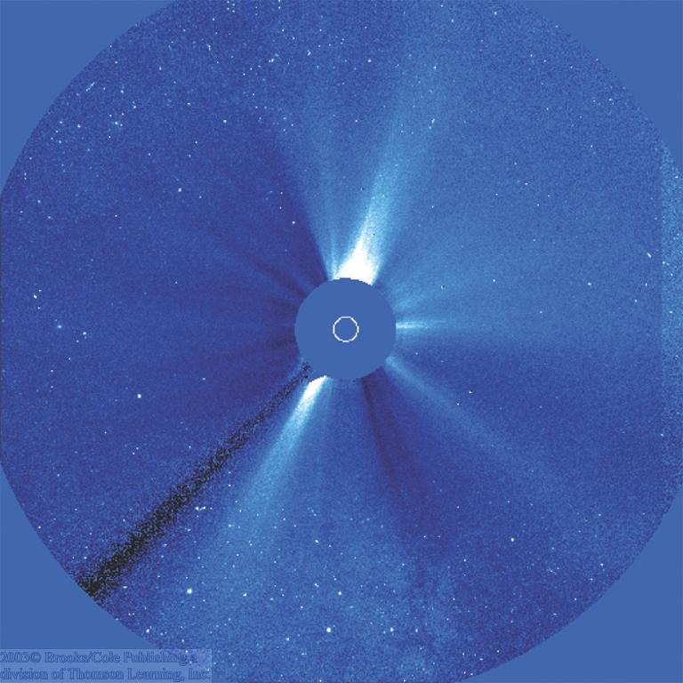
The Layers of the Solar Atmosphere
Visible
Sun Spot Regions
Ultraviolet
Photosphere
Corona
Chromosphere
Coronal activity, seen in visible light

Slide 36
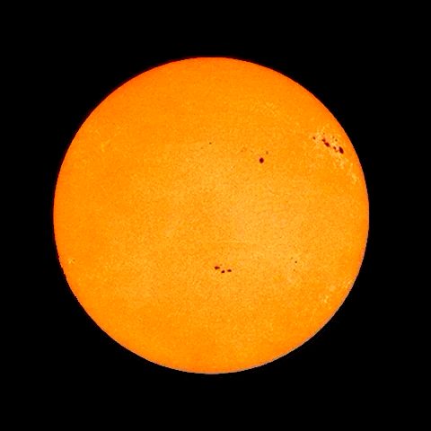

Slide 37
The Solar Wind
Constant flow of particles from the Sun.
Speed ≈ 300 – 800 km/s
Density ≈1 to 100 particles per cm³
Sun is constantly losing mass:
10⁷ tons/year
(≈ 10⁻¹⁴ of its mass per year)

Slide 38
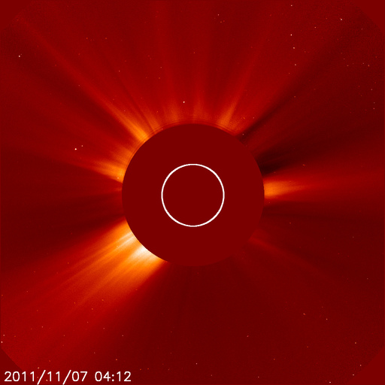
Outer corona = the birthplace of the solar wind

Slide 39
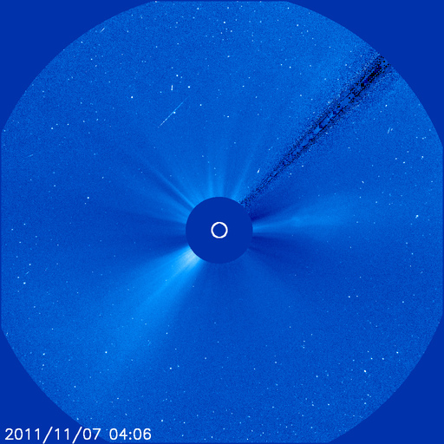

Slide 40
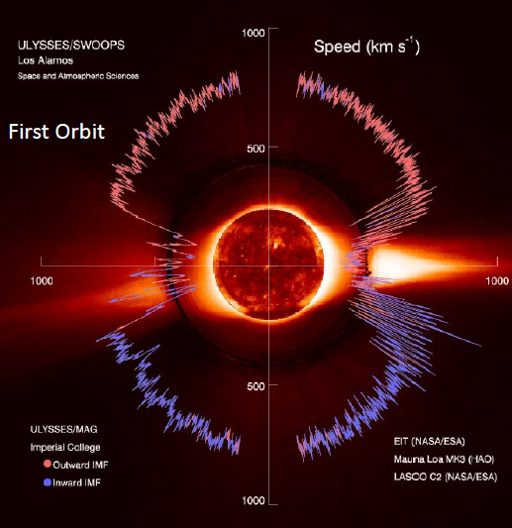
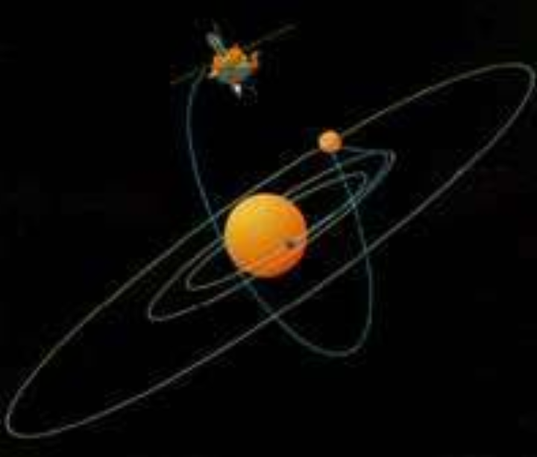
The solar wind structure off the ecliptic plane:

Slide 41
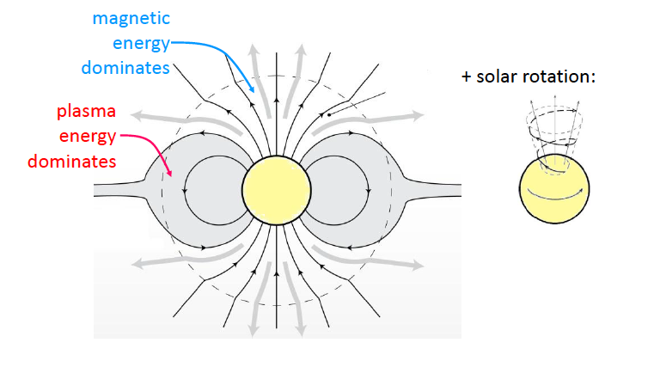

Slide 42
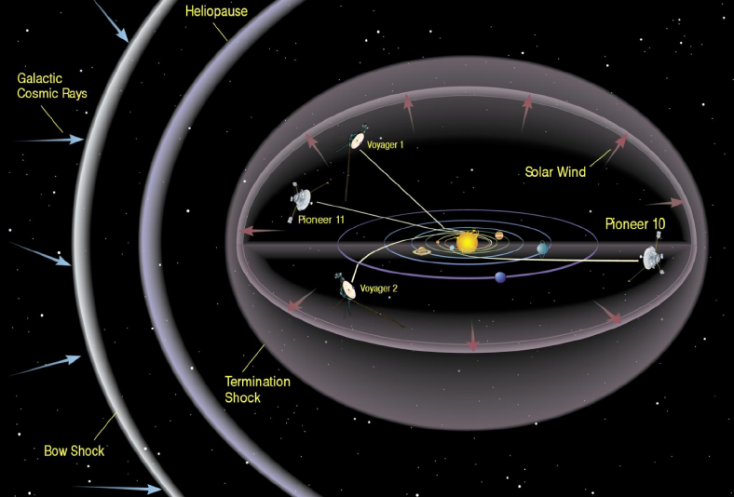

Slide 43
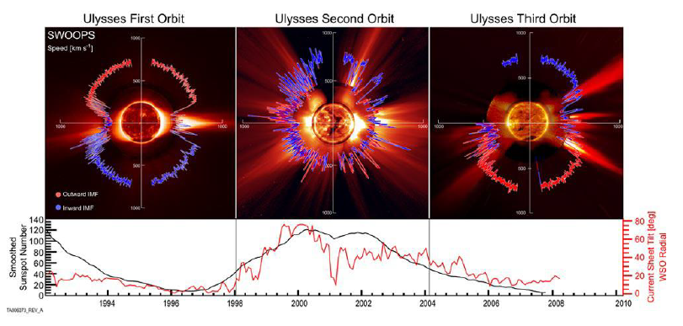
Variation of the solar wind with the solar cycle:

