Slide 1
RIAAM, 28/02/2019
Several examples of analytical work
Valery M. Nakariakov
University of Warwick
UK

Slide 2
1. Progression of flare kernels along the neutral line

Slide 3
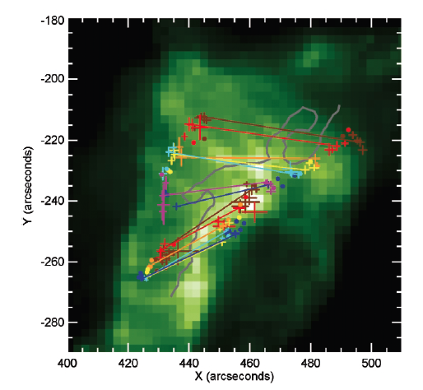
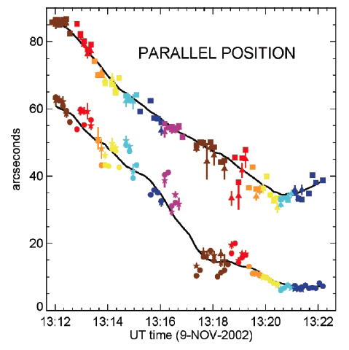
Evolution of a typical two-ribbon flare
Grigis & Benz, ApJ 625, L143, 2005

Slide 4
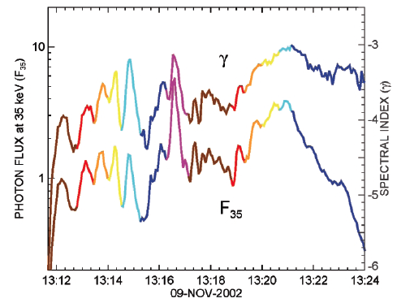
Such a behavior was found in 35% of the flares observed with Yohkoh/HXT, analysed by Bogachev et al. (2005)

Slide 5
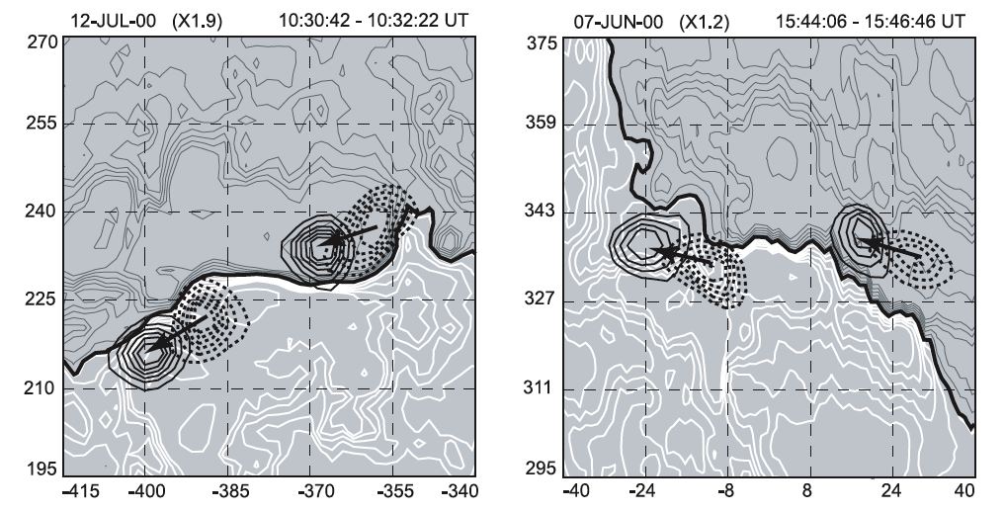
Bogachev et al. 2005

Slide 6
Reznikova et al. 2010: V = 8 km/s
Tripathy et al. 2006: V = 3-39 km/s
Krucker et al. 2003: V = 50 km/s
Krucker et al. 2005: V = 20-100 km/s
Li & Zhang 2009: V = 3-39 km/s
(by 124 two-ribbon flares)
Grigis & Benz 2005: V = 50-60 km/s
Bogachev et al. 2005: 35% of 72 flares
Zimovets & Struminsky 2009: 60-90 km/s
QPP:
Grigis & Benz 2005: P = 8-30 s
Zimovets & Struminsky 2009: P = 1-3 min

Slide 7
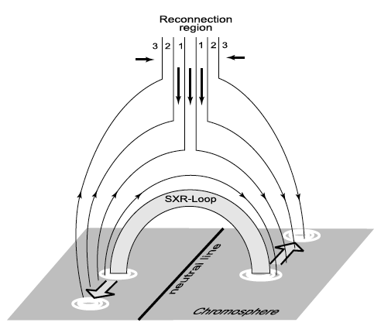
Bogachev, Somov et al. 2005

Slide 8
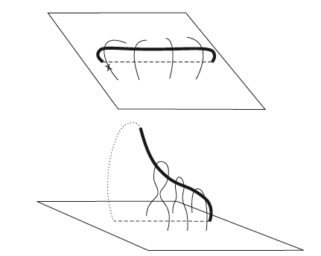
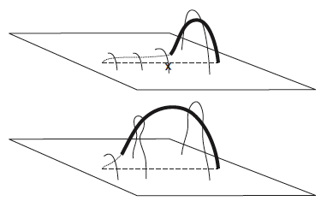
Liu et al. 2009
“Whipping-like” and “zipping-like” asymmetric filament eruption.

Slide 9
But, why are the observed speeds always essentially subsonic?
What is the cause of the quasi-periodicity?

Slide 10

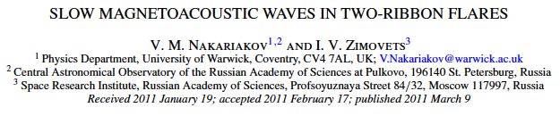
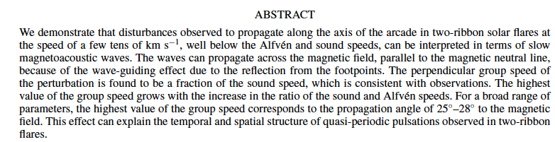

Slide 11
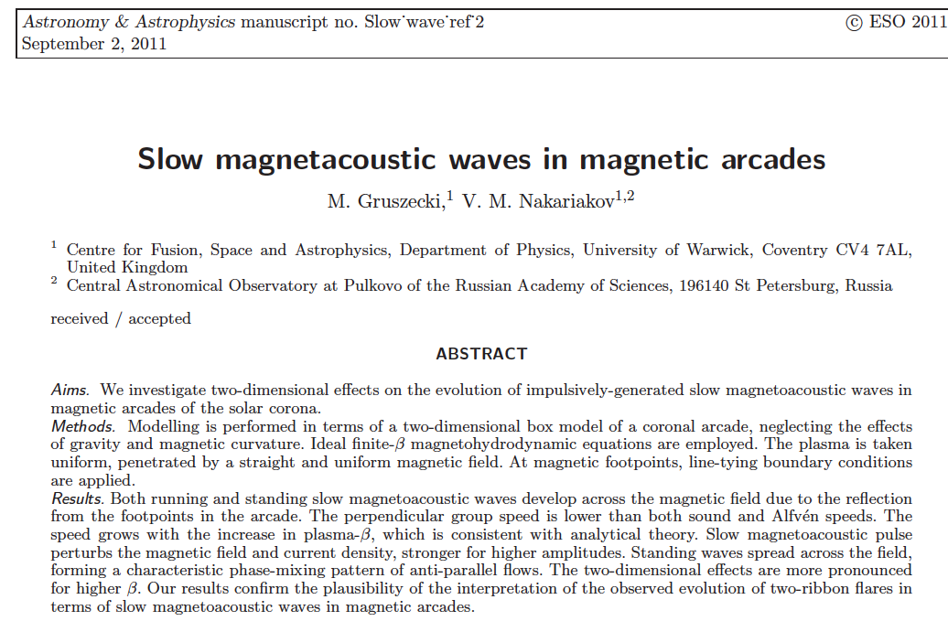

Slide 12
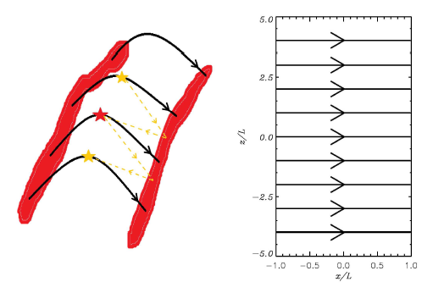
Our model:

Slide 13
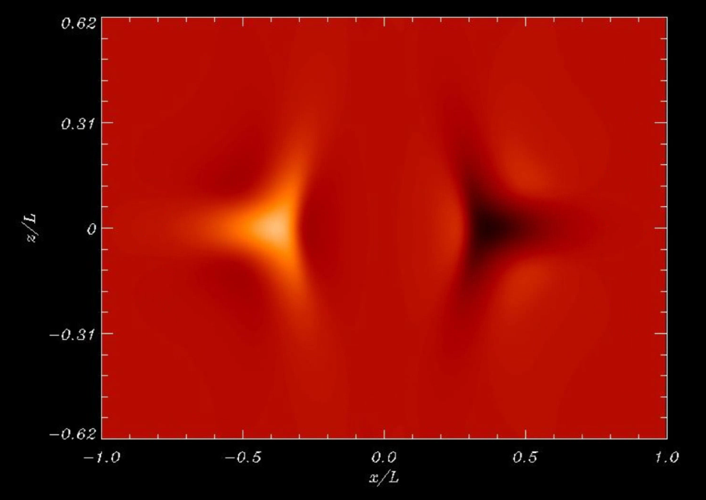
Movies:
V_||
Rho
B_||
J_perp

Slide 14
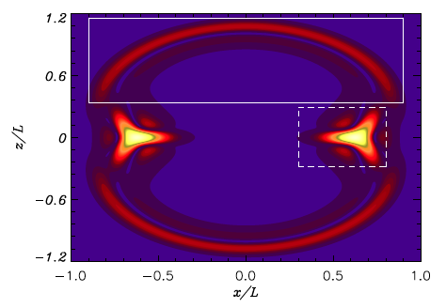

Slide 15
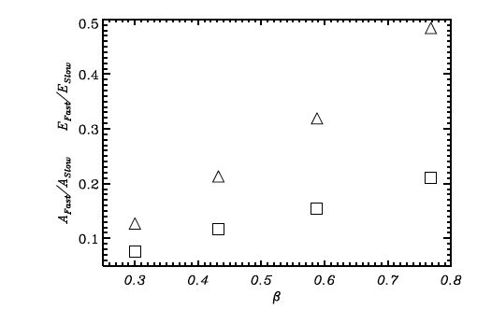

Slide 16
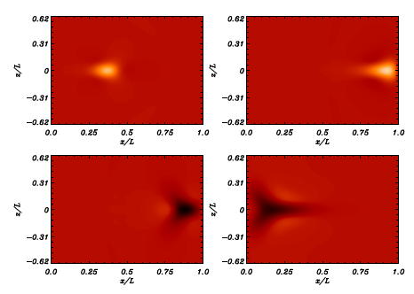

Slide 17
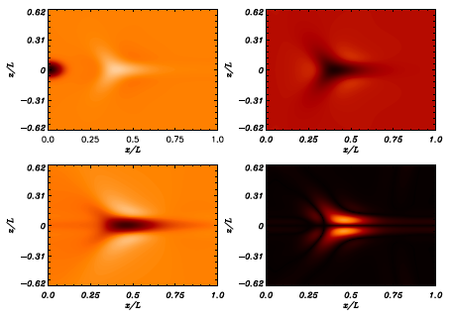

Slide 18



Slide 19
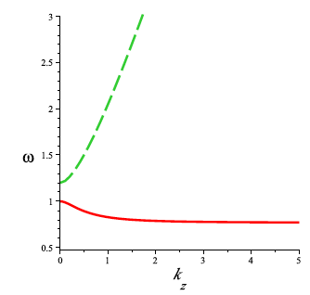
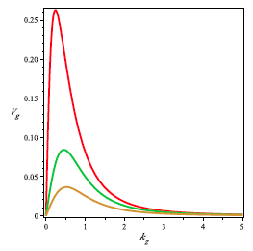
25-28° to B

Slide 20
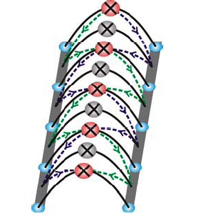
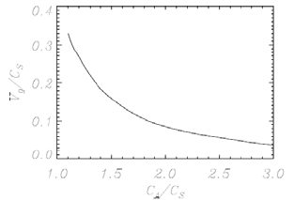

Slide 21
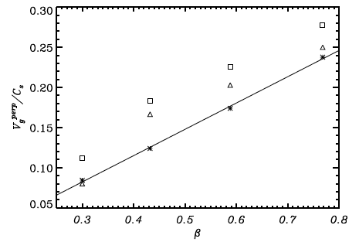
Group speed across the field:

Slide 22
2. Accounting for the effect of thermal misbalance on compressive MHD waves

Slide 23
We have to consider the perturbations of
Mechanical equilibrium,
But, also, the thermal equilibrium,
e.g.
Here

Slide 24
For small perturbations,
we can Taylor-expand the heating/cooling function
in the vicinity of the thermal equilibrium,

Slide 25
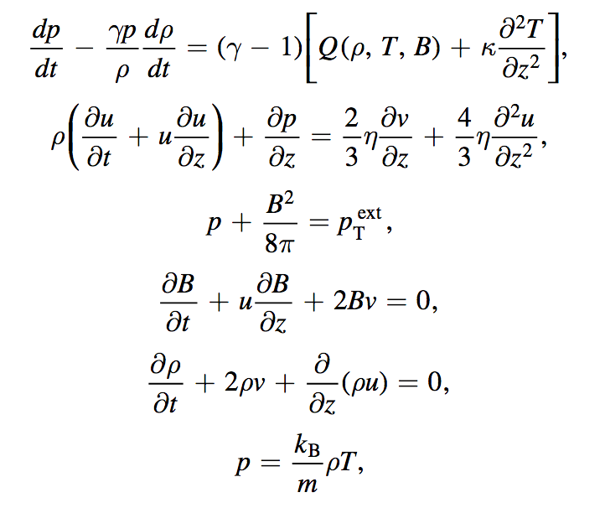
Thin flux tube approximation (accounting for the finite-β effects)
$λ_{∥}≫$ $λ_{⊥}$

Slide 26
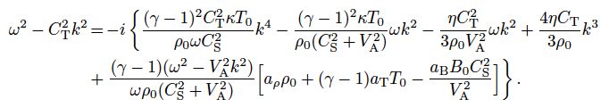

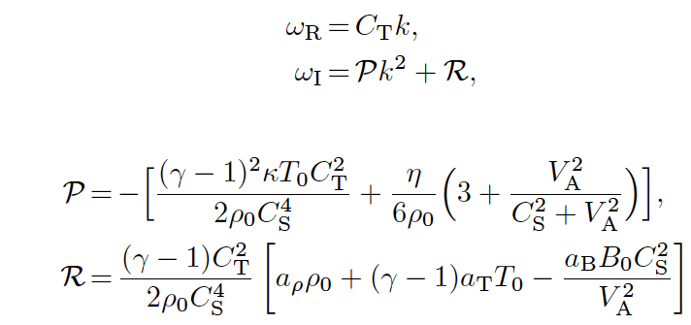
e.g., for long-wavelength slow magnetoacoustic waves in a plasma cylinder with weak dissipation:

Slide 27

Threshold of the over-stability: for R > R_{crit} the plasma is an active medium

Slide 28
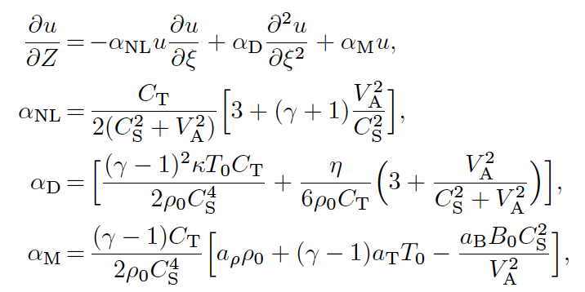
Burgers equation with the linear “reaction” term

Slide 29
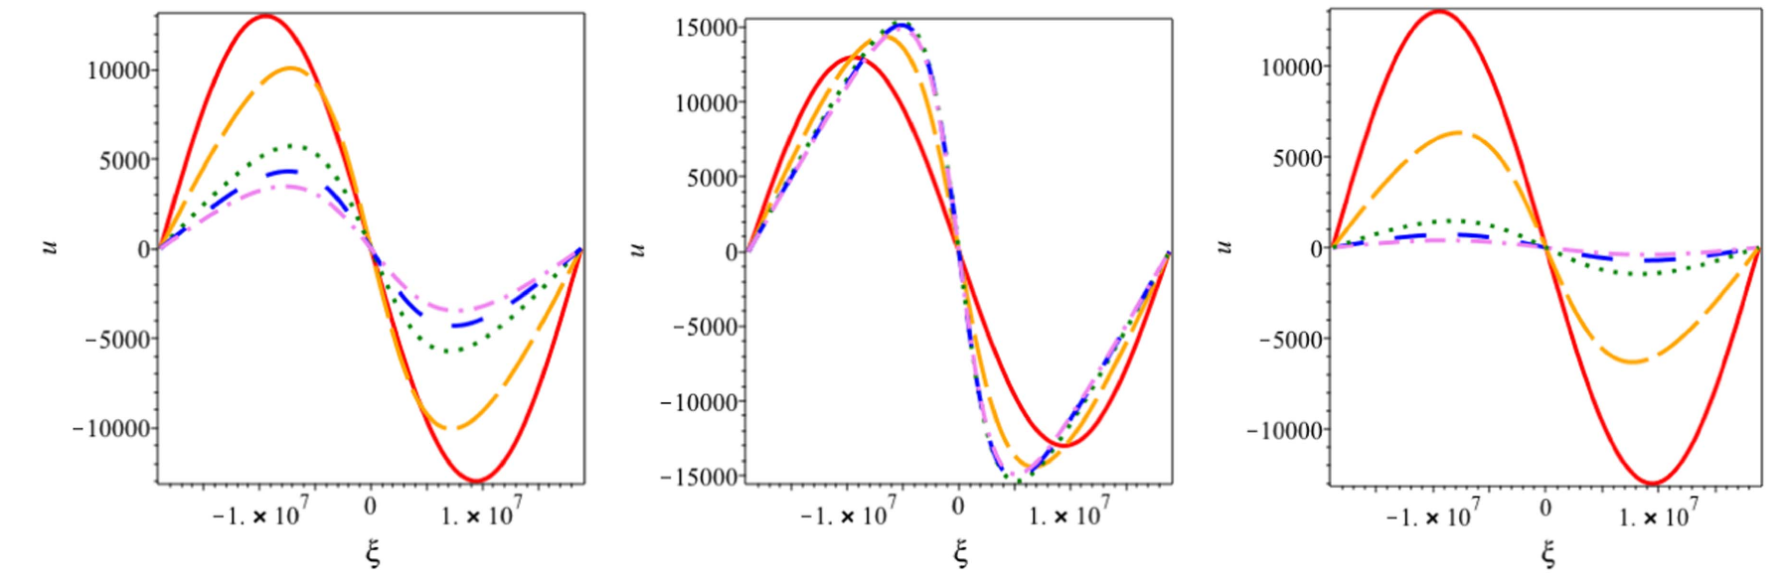
Only thermal conduction
Over-stable case
Enhanced damping case
The cooling/thermal misbalance can strongly affect coronal compressive waves.
Nakariakov et al. 2017ApJ...849...62N

Slide 30
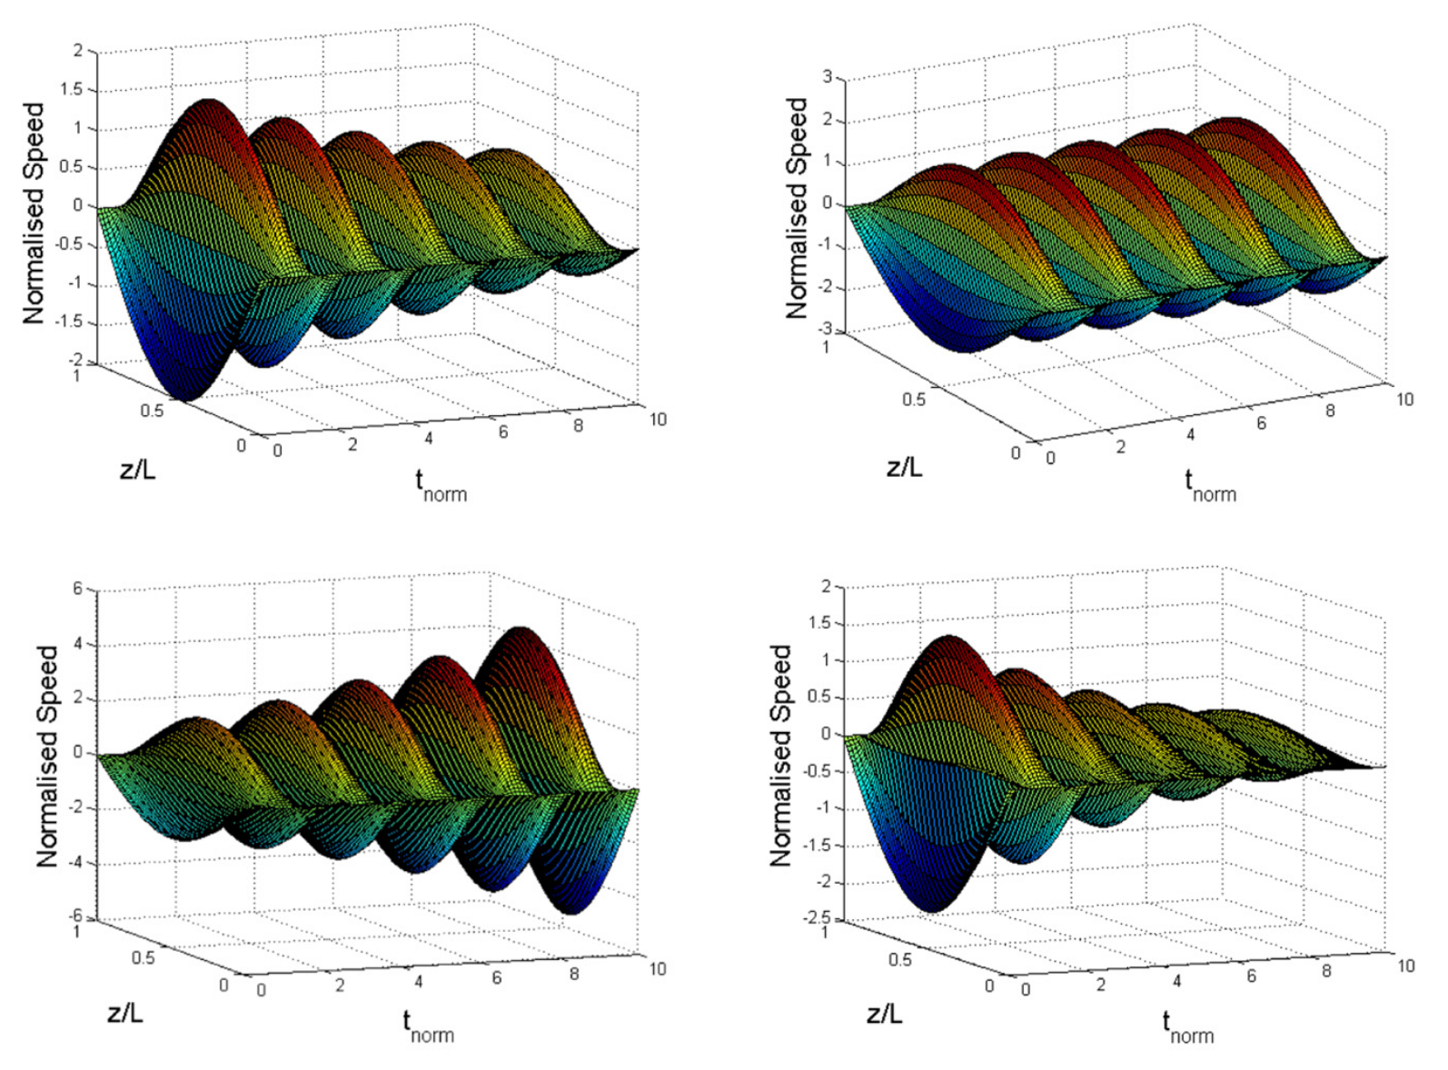

Slide 31
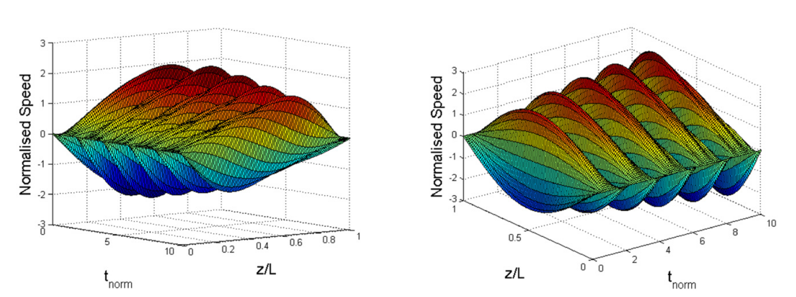
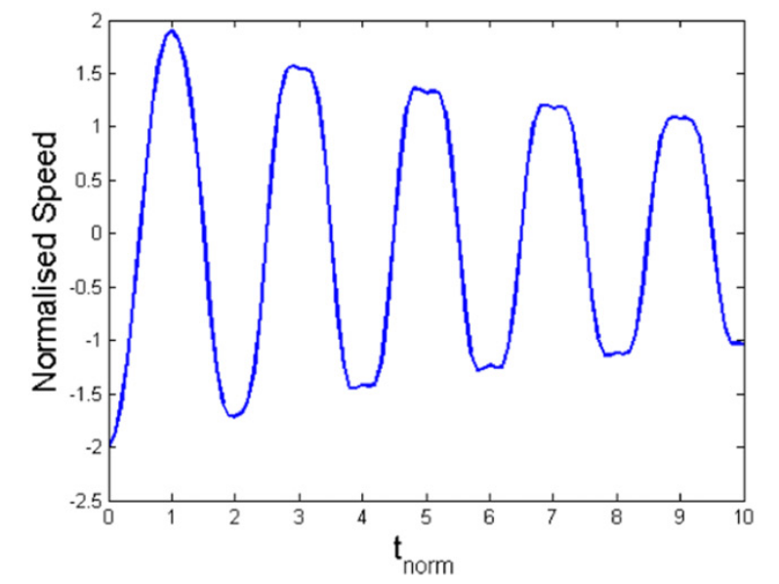
Sloshing?

Slide 32
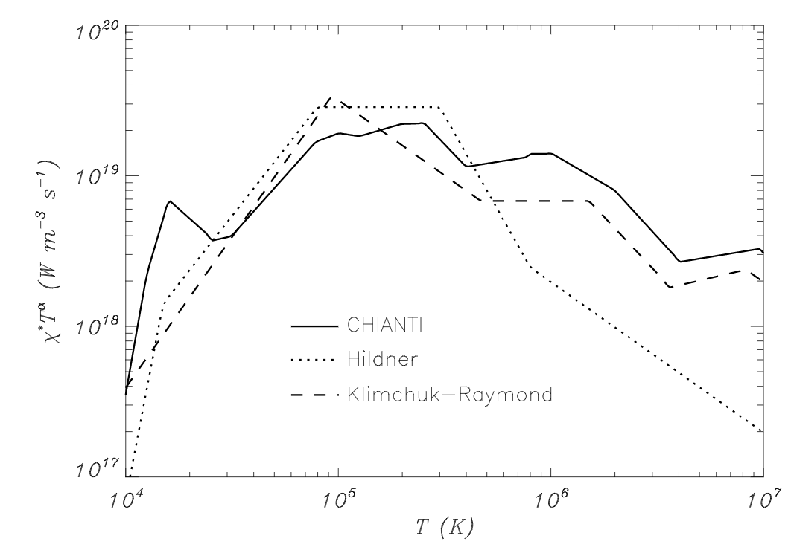
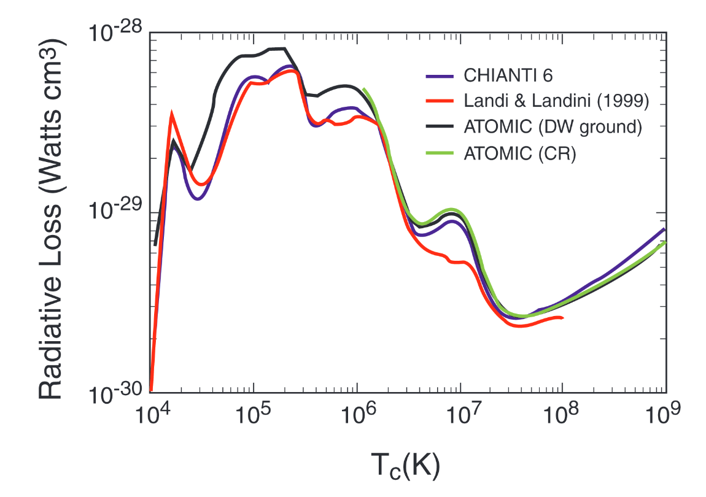
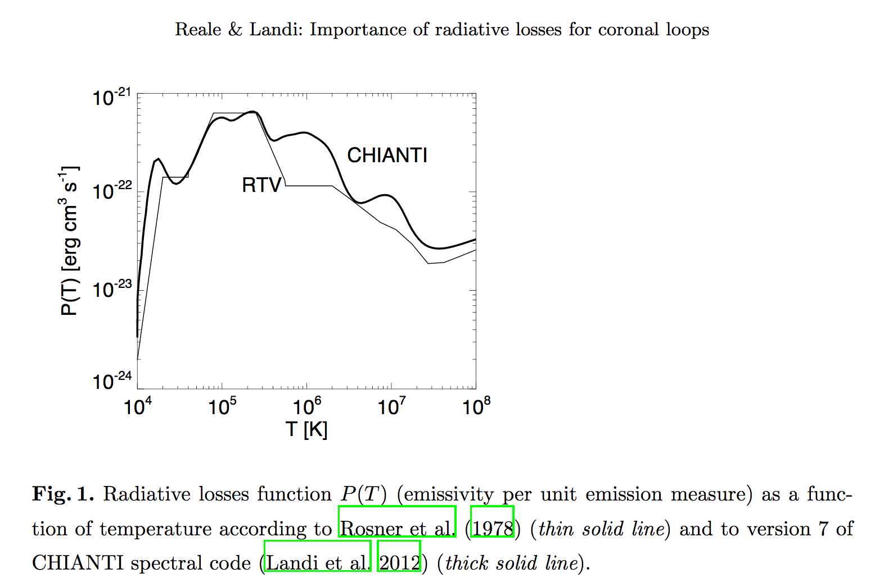
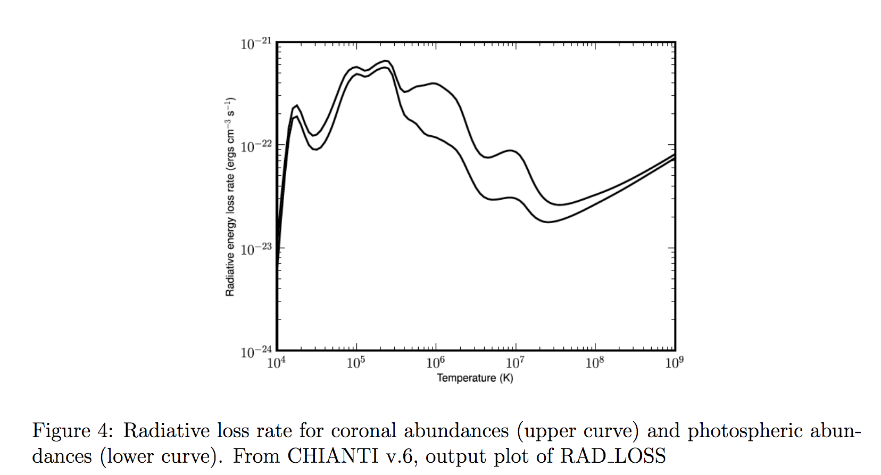
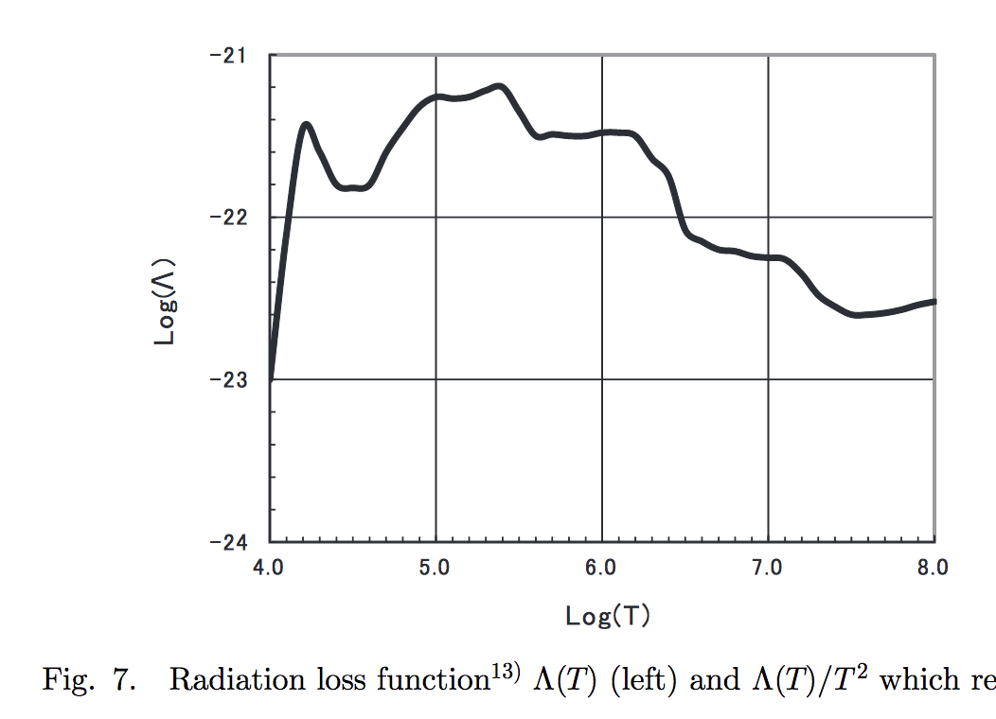
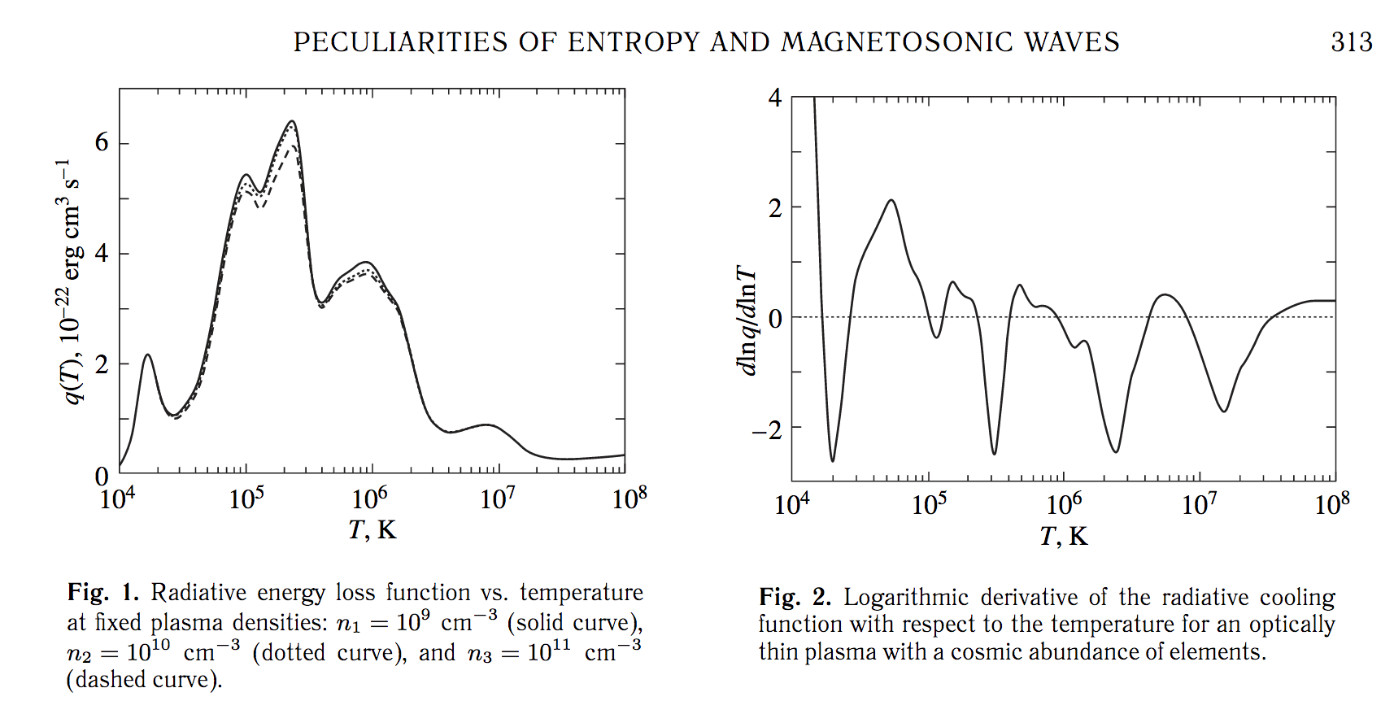
The problem...: the heating function H is unknown...
Moreover, the radiative loss function is, hm... too...

Slide 33
Thus, we should treat
as unknown.
Can seismology help us to constrain it?
i.e. (properties of waves) → A_{p}, A_{ρ}, and A_{B}
→ Seismological constraints on the coronal heating function

Slide 34
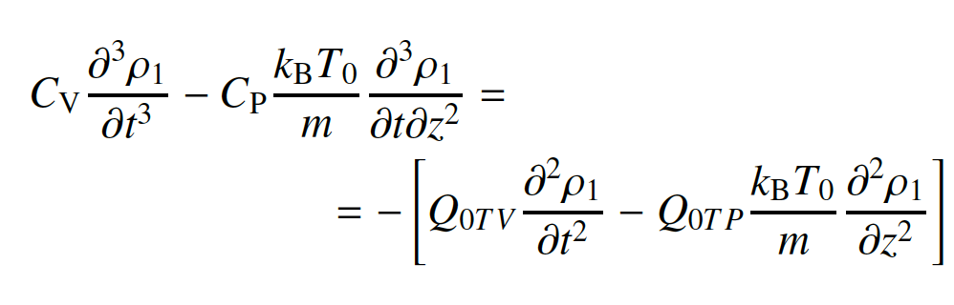
Effects of $ω_{R}≈ω_{I}$: (infinite B case)
$$Q_{0TV}={ (\frac{∂Q}{∂T})}_{ρ=const},$$
$$Q_{0Tp}={ (\frac{∂Q}{∂p})}_{T=const}$$
There is no thermal conduction of viscosity, to emphasise the effect of the cooling/heating misbalance

Slide 35
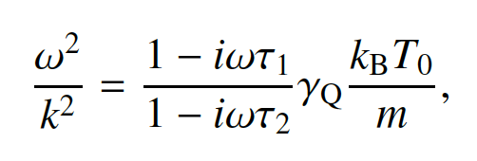
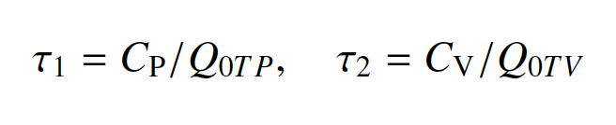
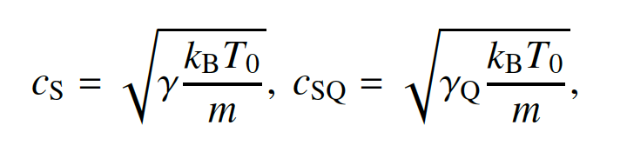
Full dispersion relation:
Characteristic times:
We can introduce two sound speeds:

Slide 36
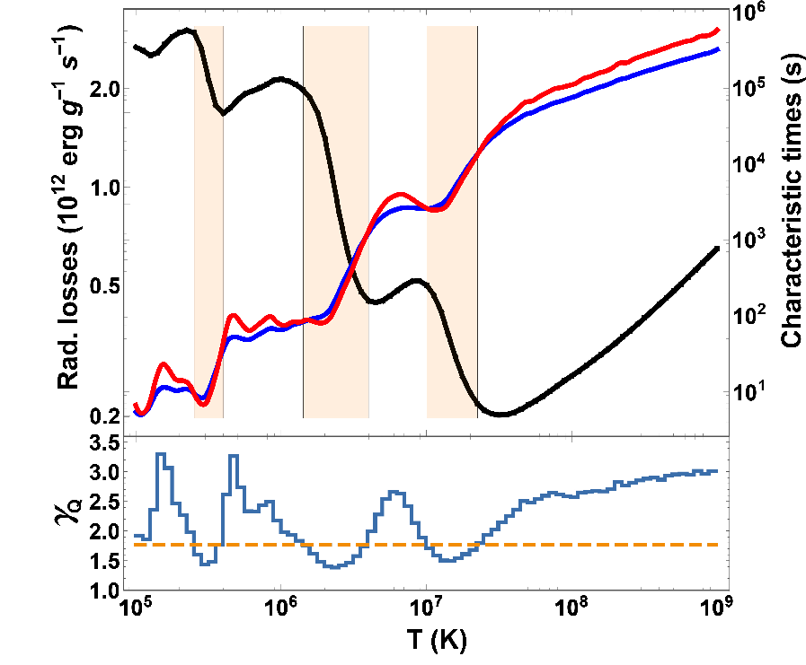

$$τ_{2}$$
$$τ_{1}$$
Using CHIANTI v. 8.0.7
$$γ=5/3$$

Slide 37
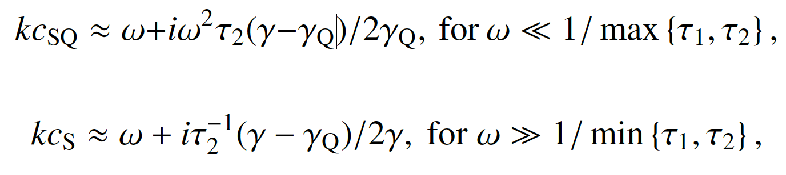
Limiting cases:
The previously considered case of the wavelength-independent enhanced damping or over-stability

Slide 38
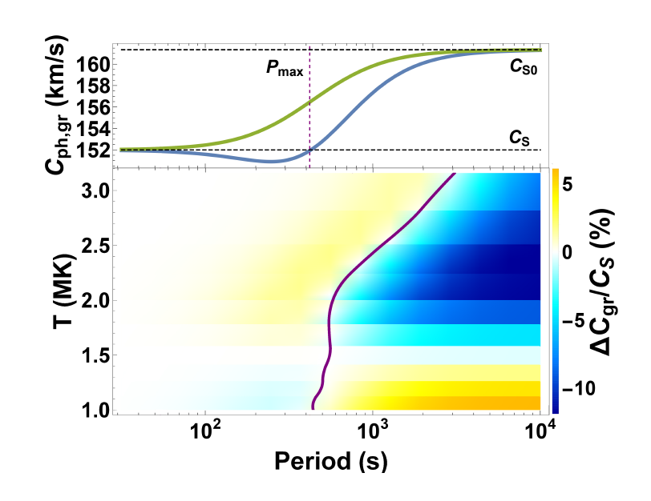
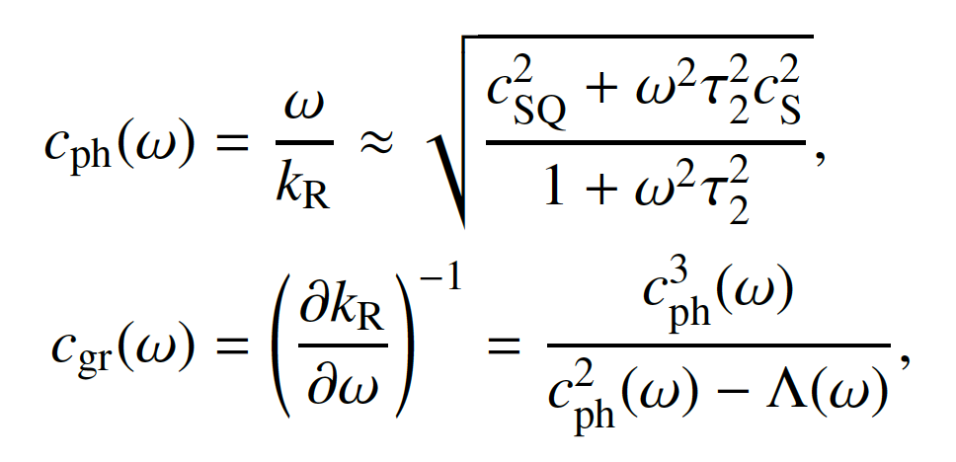
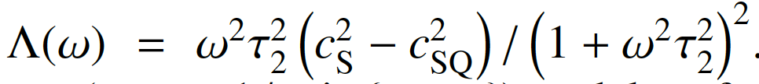
Wave dispersion
(different from Roberts’ geometric dispersion)
Phase and group speeds:
phase
group

Slide 39
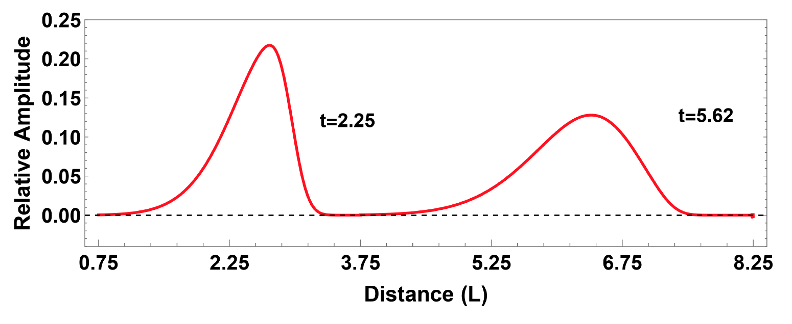
Evolution of a slow pulse:
Enhanced damping regime

Slide 40
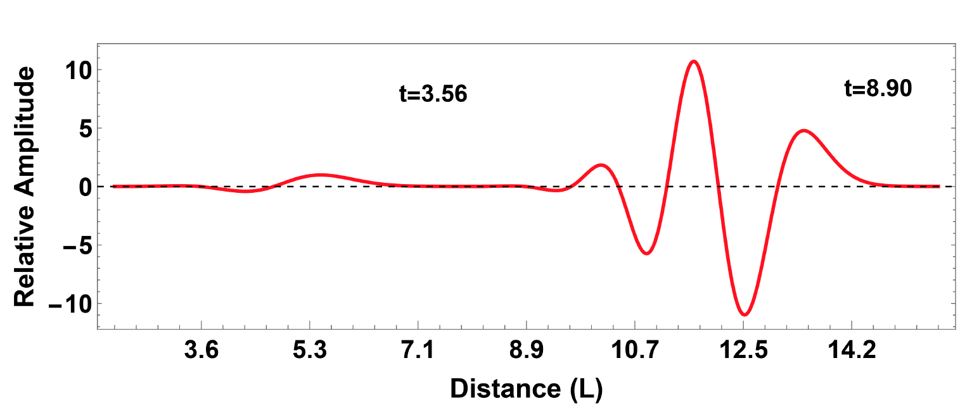
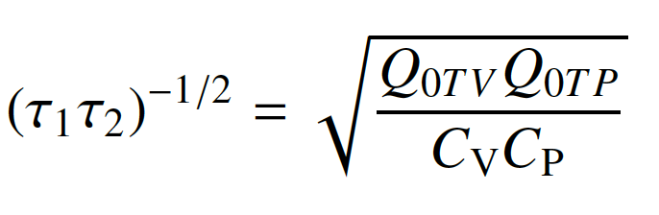
Over-stable regime:
$$P_{char}≈$$

Slide 41
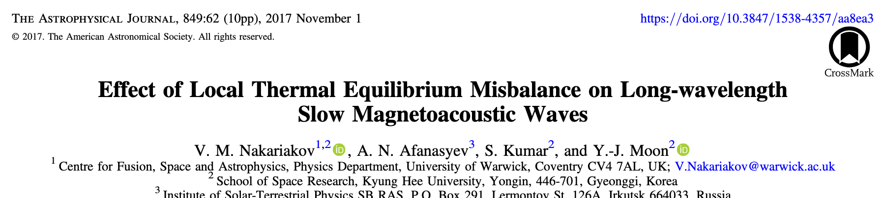
3. Derivation of Evolutionary Equations
(Weakly-dissipative, weakly-nonlinear, …
Weakly-dispersive…)

Slide 42
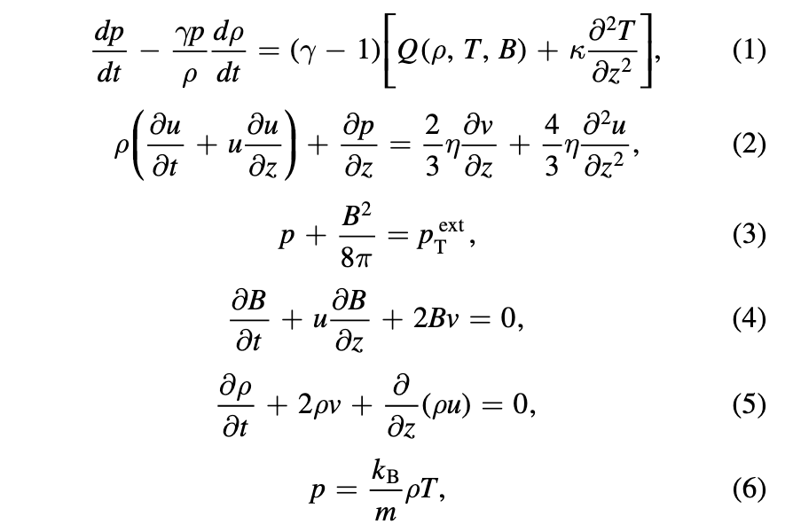
Governing Eqs.:

Slide 43
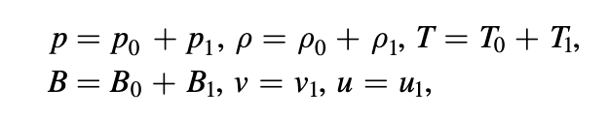
Identify the equilibrium, and perturb it:
(assume that perturbations as small, but finite)

Slide 44


Slide 45

From the linear equations obtain the linear relationship between different quantities perturbed by the wave:
Use it to exclude all variables except one, e.g., u:

Slide 46

“Wave” equation

Slide 47

All nonlinear terms are expressed through u too:

Slide 48


Have a look at the dispersion relation:
And neglecting all nonlinear terms obtain:

Slide 49

Assume that the dissipative and dispersive terms are small,
and consider a wave propagating, e.g., to the right:

Slide 50



The “propagating wave” part of the wave Eq.:
$$\left(\frac{∂^{2}}{{∂t}^{2}}−C_{T}^{2}\frac{∂^{2}}{{∂z}^{2}}\right)u=\left(\frac{∂}{∂t}−C_{T}\frac{∂}{∂z}\right)\left(\frac{∂}{∂t}+C_{T}\frac{∂}{∂z}\right)u=RHS$$
If RHS=0, the wave does not evolve, the solution is some $u=f\left(z∓C_{T}\right).$
To study weakly dissipative/dispersive/nonlinear modification of the wave – the evolutions - come back to the wave equation and change the variables:

Slide 51

Generalised Burgers equation

Slide 52
Evolutionary equations could be either solved analytically (if there are known exact solutions),
Or numerically, e.g. with Maple, Matlab, Mathematica…

Slide 53
4. Using evolutionary equations to get new knowledge
(e.g., the nonlinear effects associated with torsional Alfvén waves)

Slide 54




Spherical Cohen-Kulsrud-Burgers Eq.
Evolution of the Alfven wave shape:
Evolution of the wave amplitude with height

Slide 55


Compressive flows induced by by the centrifugal, magnetic tension and ponderomotive forces:
Ω = V_{ϕ}/r
- vorticity
J = B_{ϕ}/r
– twist.
In a propagating torsional wave:
The effects of nonlinear magnetic twist and plasma rotation in the travelling wave cancel out each other, and do not add new effects.

Slide 56


Fundamental nonlinear effect: induced density perturbations in a plane Alfvén wave:
Induced density perturbations in a long-wavelength torsional Alfvén wave:
Hence, the parallel nonlinear cascades in torsional waves and in shear Alfvén waves are different!
Thin flux tube formalism:
Vasheghani Farahani et al., A&A 526, A80, 2011

Slide 57


In a plane (shear) Alfvén wave, the induced density perturbation propagates at the sound speed.
In a torsional Alfven wave, they propagate at the tube speed
Alfvén speed
sound speed
tube speed

Slide 58


The Cohen-Kulsrud Equation for long-wavelength torsional Alfvén waves:
c.f. with the Cohen-Kulsrud Equation for plane shear Alfvén waves:

Slide 59


By the way, both Eqs. have analytical implicit solutions:
where $f\left(ξ\right)$ $is the initial profile of the perturbation$

Slide 60


Blue – shear wave; Red - torsional wave

Slide 61


Blue – shear wave; Red – long-wavelength torsional wave
|| cascade

Slide 62



What about the effect of finite parallel wavelength?

Slide 63

Density perturbations propagate at Alfvén speed

Slide 64


The amplitudes of different components of the velocity have different normalisations!

Slide 65

Role of the perpendicular nonuniformity of the wave front
(intrinsic for torsional waves):
β = 0

Slide 66


Slide 67


What are the perturbations of V_{r}?
Sausage mode:
Leaky regime
Trapped regime:
m=0 mode

Slide 68


Why is the excitation of the sausage perturbations (fast magnetoacoustic modes) by Alfvén wave phase mixing much less effective than of the parallel flows (slow magnetoacoustic)?
Nakariakov et al. Solar Phys. 175, 93, 1997
On one hand:
On the other hand:
But, induced fast waves could spread the energy (heat the plasma!) across the field…
Botha et al. A&A 363, 1186, 2000

