Slide 1
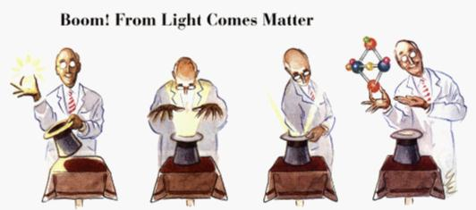
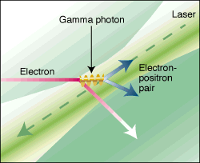
How hard can light punch?
Reaching for the brightest light and the physics that can be done with it
Gil Eisner, Photonics Spectra, Nov . 1997
D. Pugh, Science 277, 1202 (1997)
Thomas Koffas
Many thanks to:
Phil Bucksbaum, Christoph Keitel,
Sebastian Meuren, Kirk McDonald,
David Reis

Slide 2
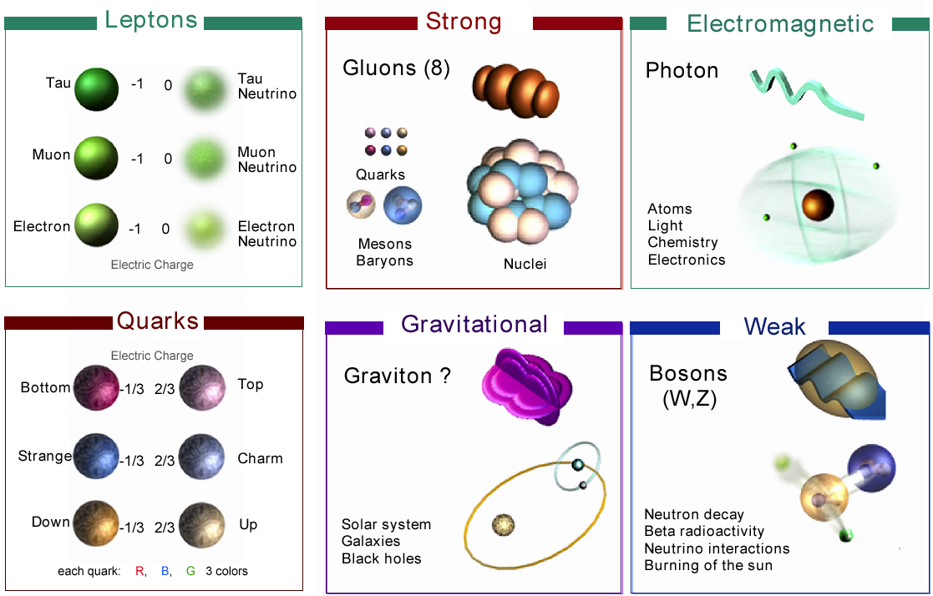
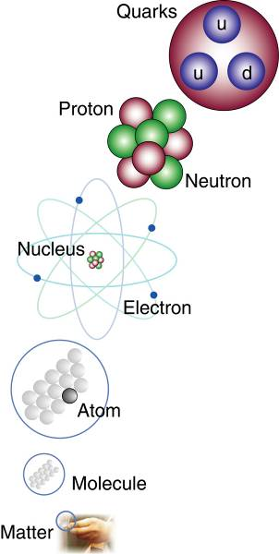
Known Particles and Forces

Slide 3
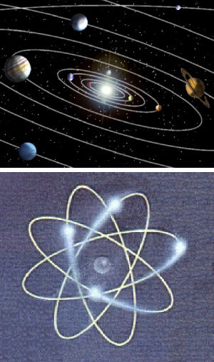
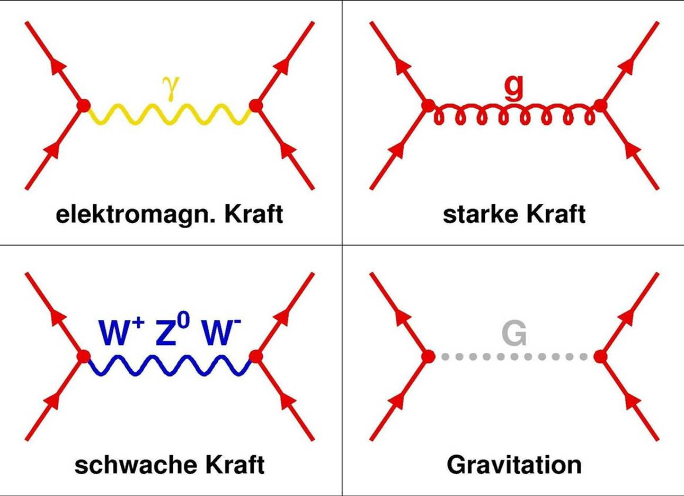
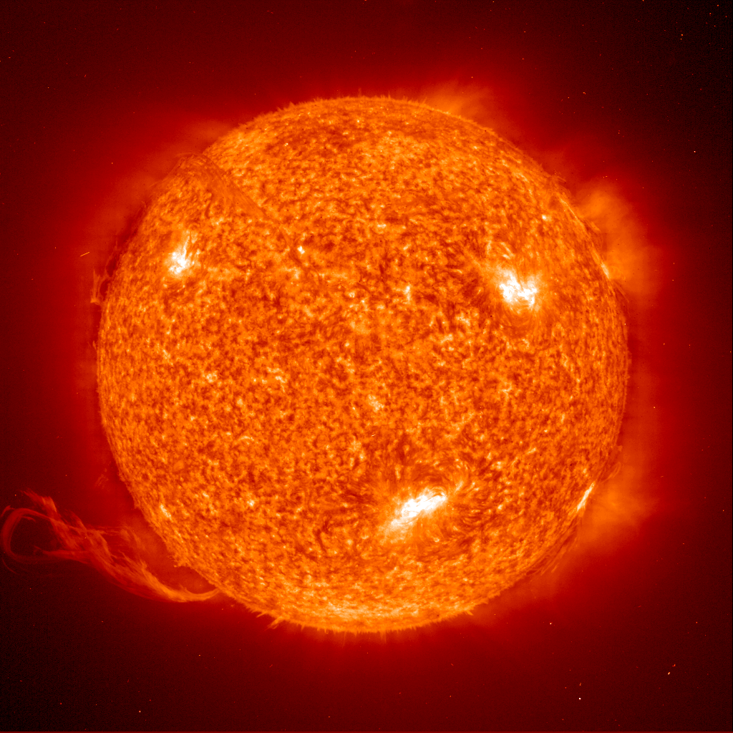
The Standard Model
p
n
n
p
n
p
n
n
n
p
n
n
p
p
p
p
p
p
p
n
Electromagnetic force
Strong force
Weak force
Gravitation

Slide 4
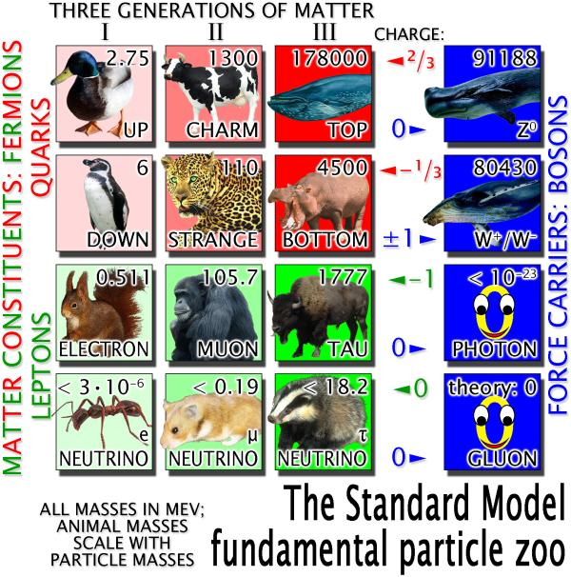
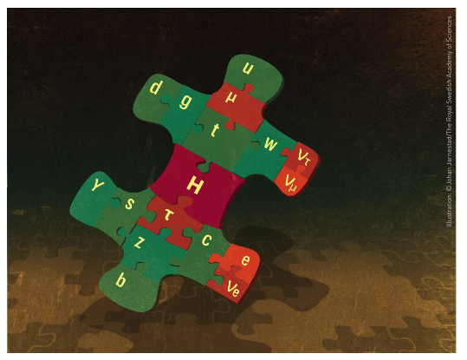
The Standard Model fundamental particle zoo – a summary
Different animals indicate
the measured ratio of
the masses of the
different particles…
+
Higgs!
Joined!

Slide 5
The Crisis of Modern High-Energy Physics
Many open questions to answer!

Slide 6
The Crisis of Modern High-Energy Physics
Many open questions to answer!
1) How to combine gravity with the SM?

Slide 7
The Crisis of Modern High-Energy Physics
Many open questions to answer!
1) How to combine gravity with the SM?
2) Mass of the particles?

Slide 8
The Crisis of Modern High-Energy Physics
Many open questions to answer!
1) How to combine gravity with the SM?
2) Mass of the particles?
3) Why is there more matter than antimatter?

Slide 9

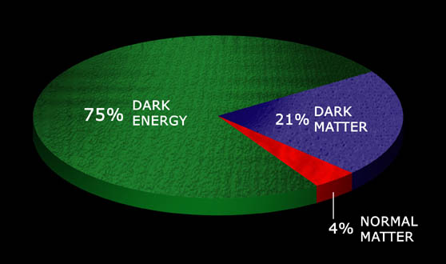

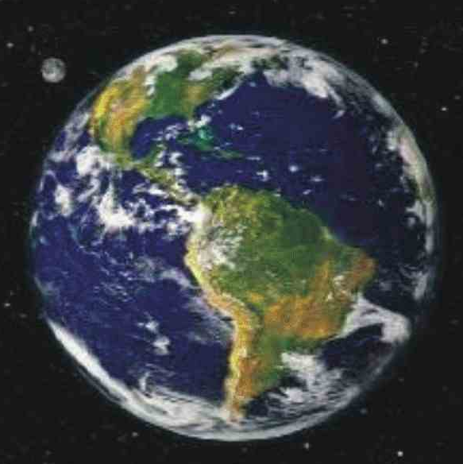
The Crisis of Modern High-Energy Physics
Many open questions to answer!
1) How to combine gravity with the SM?
Darth Vader
2) Mass of the particles?
3) Why is there more matter than antimatter?
In our universe there must be about 5 times more Dark Matter than known matter!!!
4) Explanation for dark matter/energy?
© Rocky Kolb
Composition of the universe
Dark Matter
matter

Slide 10
The Crisis of Modern High-Energy Physics
Many open questions to answer!
1) How to combine gravity with the SM?
Darth Vader
2) Mass of the particles?
3) Why is there more matter than antimatter?
In our universe there must be about 5 times more Dark Matter than known matter!!!
4) Explanation for dark matter/energy?
© Rocky Kolb
5) Extra dimensions? Quantum gravity?
Composition of the universe
Dark Matter
matter

Slide 11
The Crisis of Modern High-Energy Physics
Many open questions to answer!
1) How to combine gravity with the SM?
Darth Vader
2) Mass of the particles?
3) Why is there more matter than antimatter?
In our universe there must be about 5 times more Dark Matter than known matter!!!
4) Explanation for dark matter/energy?
© Rocky Kolb
5) Extra dimensions? Quantum gravity?
Composition of the universe
⋮
Dark Matter
matter

Slide 12
The Crisis of Modern High-Energy Physics
Many open questions to answer!
1) How to combine gravity with the SM?
Darth Vader
2) Mass of the particles?
Experiments at the energy frontier face a hard limit
Conventional accelerator technology will not reach above 100 TeV
Planck scale (quantum gravity) is at 10¹⁶ TeV → far away
3) Why is there more matter than antimatter?
In our universe there must be about 5 times more Dark Matter than known matter!!!
4) Explanation for dark matter/energy?
© Rocky Kolb
5) Extra dimensions? Quantum gravity?
Composition of the universe
⋮
Dark Matter
matter

Slide 13
The Crisis of Modern High-Energy Physics
Many open questions to answer!
1) How to combine gravity with the SM?
Darth Vader
2) Mass of the particles?
Experiments at the energy frontier face a hard limit
Conventional accelerator technology will not reach above 100 TeV
Planck scale (quantum gravity) is at 10¹⁶ TeV → far away
Look for new physics beyond the energy frontier!
3) Why is there more matter than antimatter?
In our universe there must be about 5 times more Dark Matter than known matter!!!
4) Explanation for dark matter/energy?
© Rocky Kolb
5) Extra dimensions? Quantum gravity?
Composition of the universe
⋮
Dark Matter
matter

Slide 14
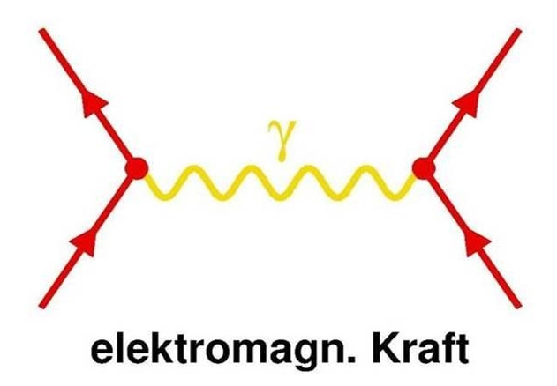

A new test of the Standard Model
photon = “messenger”
e
Electromagnetic Interaction
matter particle
matter particle
Quantum Electrodynamics (QED)
Describes the electromagnetic interaction
The most successful quantum field theory we have
  e.g. explains how one’s cell phone operates
Works because messenger-particle interaction conditioned by a small parameter
fine structure constant α=1/137

Slide 15
A new test of the Standard Model
photon = “messenger”
e
Electromagnetic Interaction
matter particle
matter particle
Quantum Electrodynamics (QED)
Describes the electromagnetic interaction
The most successful quantum field theory we have
  e.g. explains how one’s cell phone operates
Works because messenger-particle interaction conditioned by a small parameter
fine structure constant α=1/137

Slide 16
A new test of the Standard Model
photon = “messenger”
e
matter particle
matter particle
Not true any longer when electric/magnetic fields are ultra-strong
How ultra-strong?
Electromagnetic Interaction
Quantum Electrodynamics (QED)
Describes the electromagnetic interaction
The most successful quantum field theory we have
  e.g. explains how one’s cell phone operates
Works because messenger-particle interaction conditioned by a small parameter
fine structure constant α=1/137

Slide 17
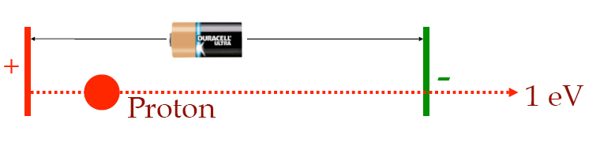
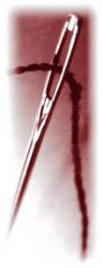

A game of scales
1) Energy Scales
52 GeV (Giga eV) mass of the iron atom
1 GeV mass of the proton
0.5 MeV (Mega eV) mass of the electron
0.025 eV temperature in this room
2.3 x 10⁻¹³ eV temperature in the universe today
At 1 MeV effects become relativistic…
2) Length Scales
An atom is 1,000,000 smaller…
Think even smaller!
Another 1000 times smaller…
This gets us down to the electron’s
Compton wavelength $λ_{c}$≈10⁻¹¹cm
Needle head: diameter 0.3 mm

Slide 18
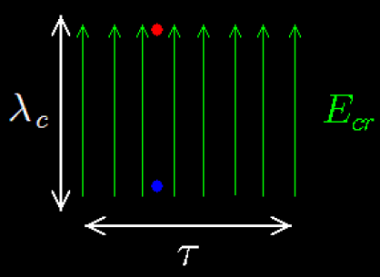
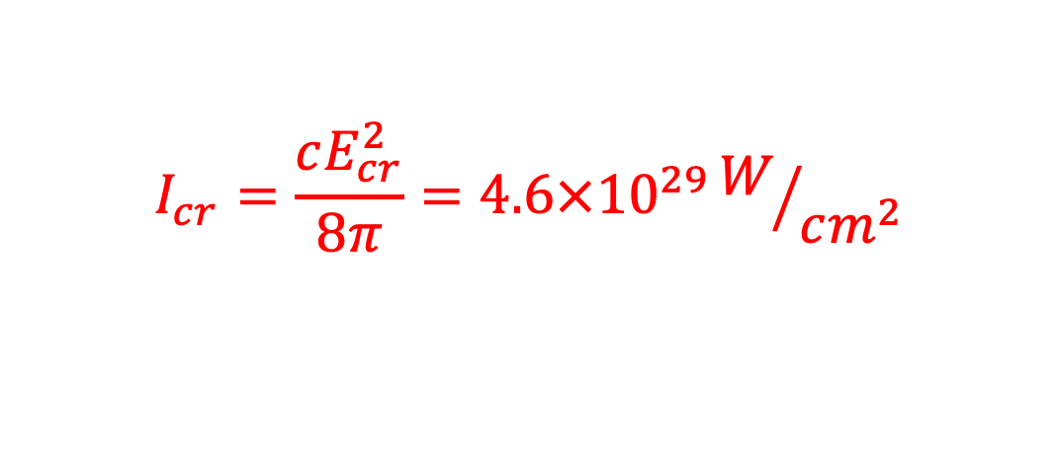
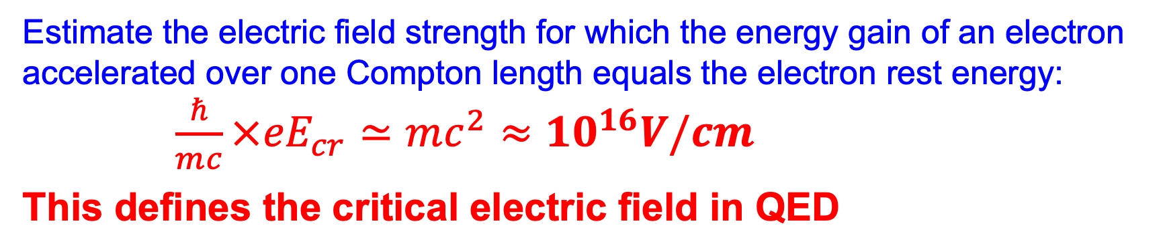

Fundamental Physics During Violent Accelerations
Estimate the electric field strength for which the energy gain of an electron accelerated over one Compton length equals the electron rest energy:
$\frac{ℏ}{mc}×{eE}_{cr}≃mc^{2}≈{10}^{16}V/cm$
This defines the critical electric field in QED
$$I_{cr}=\frac{cE_{cr}^{2}}{8π}=4.6×10^{29}W/{cm^{2}}$$
The acceleration of a free electron in this case is so
violent that the interaction is nonlinear.
Probing $E_{cr}$ tests QED in a completely different non-perturbative regime
A regime not covered by Standard Model
The strong-field QED regime is largely unexplored

Slide 19
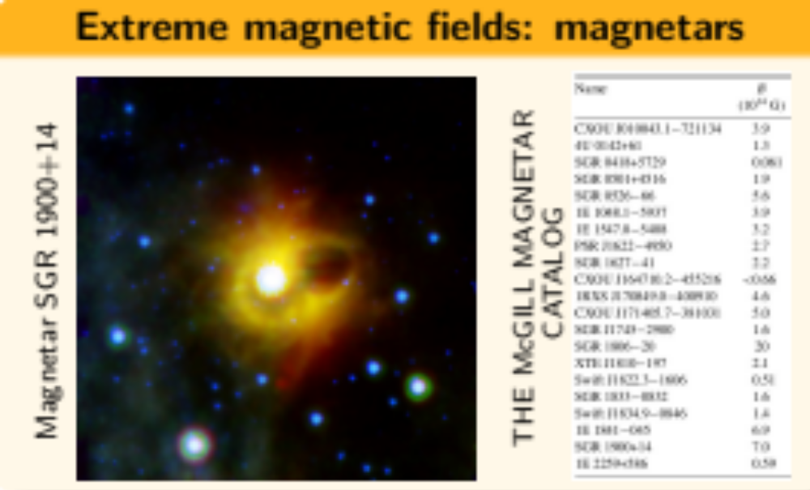
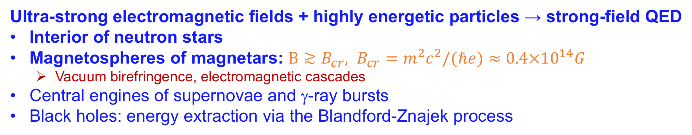
Strong Fields in Astrophysics
Ultra-strong electromagnetic fields + highly energetic particles → strong-field QED
Interior of neutron stars
Magnetospheres of magnetars: $B≳B_{cr}, B_{cr}=m^{2}c^{2}/(ℏe)≈0.4×{10}^{14}G$
  Vacuum birefringence, electromagnetic cascades
Central engines of supernovae and γ-ray bursts
Black holes: energy extraction via the Blandford-Znajek process

Slide 20
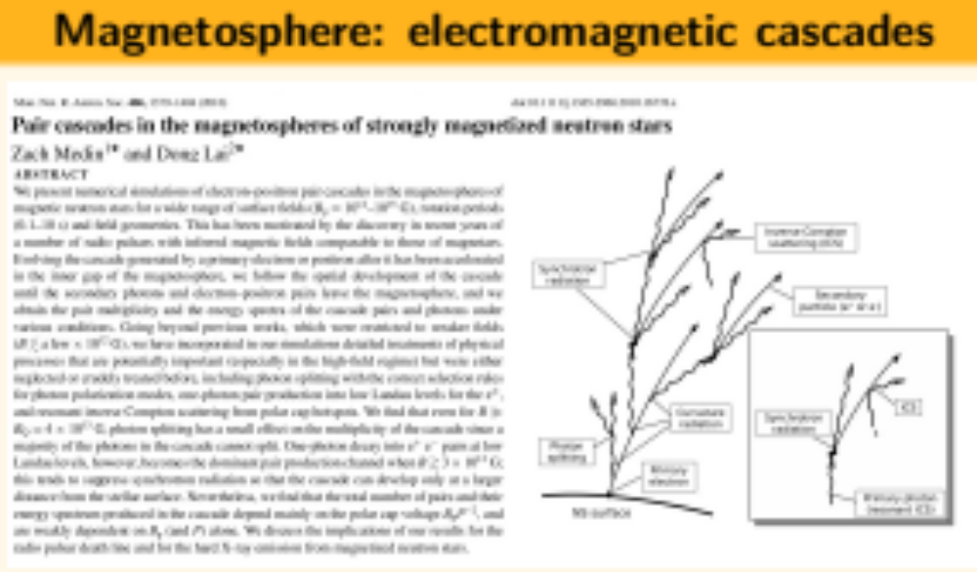
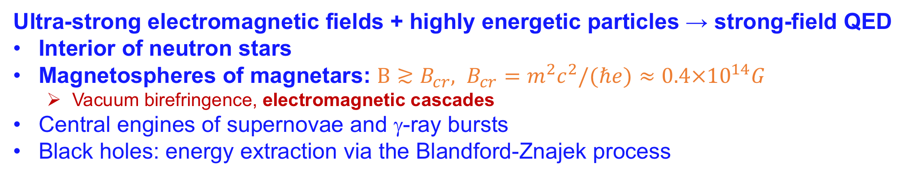
Strong Fields in Astrophysics
Ultra-strong electromagnetic fields + highly energetic particles → strong-field QED
Interior of neutron stars
Magnetospheres of magnetars: $B≳B_{cr}, B_{cr}=m^{2}c^{2}/(ℏe)≈0.4×{10}^{14}G$
  Vacuum birefringence, electromagnetic cascades
Central engines of supernovae and γ-ray bursts
Black holes: energy extraction via the Blandford-Znajek process

Slide 21
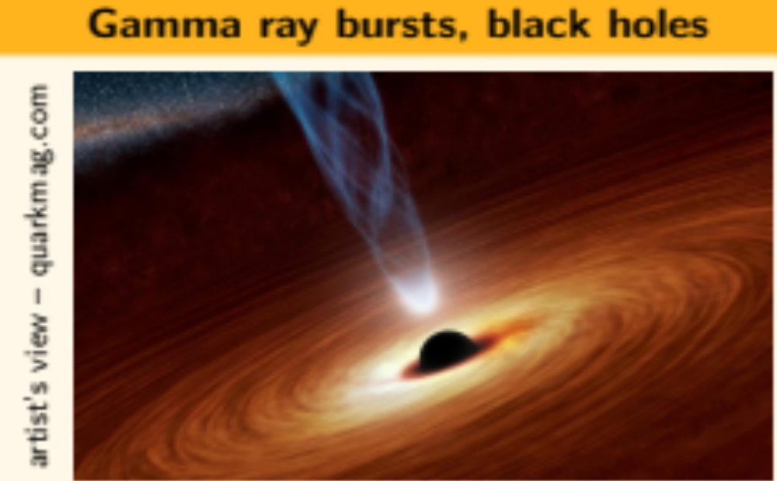
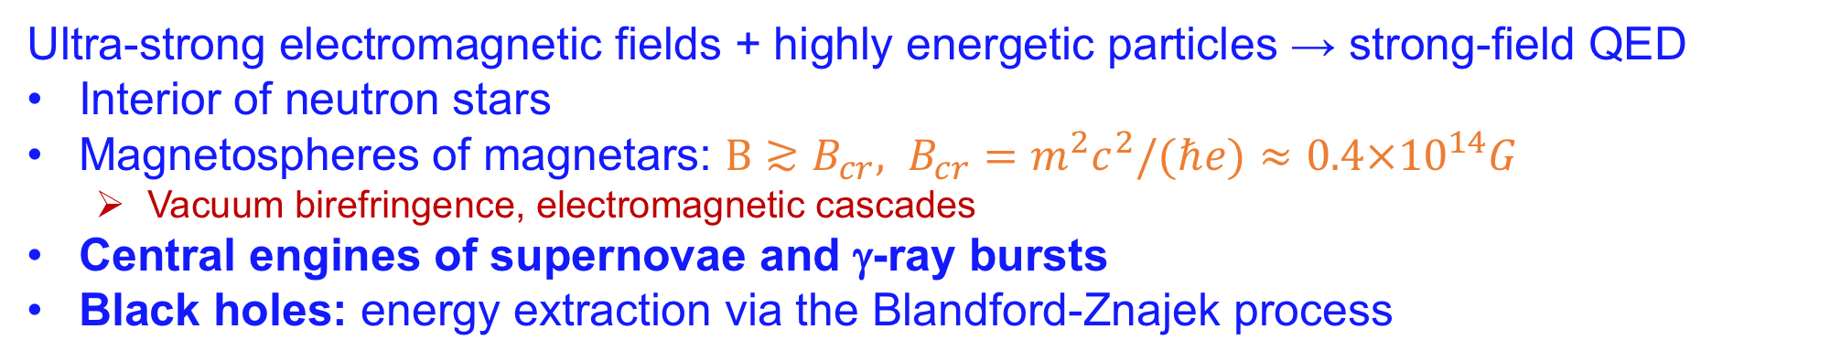
Strong Fields in Astrophysics
Ultra-strong electromagnetic fields + highly energetic particles → strong-field QED
Interior of neutron stars
Magnetospheres of magnetars: $B≳B_{cr}, B_{cr}=m^{2}c^{2}/(ℏe)≈0.4×{10}^{14}G$
  Vacuum birefringence, electromagnetic cascades
Central engines of supernovae and γ-ray bursts
Black holes: energy extraction via the Blandford-Znajek process

Slide 22
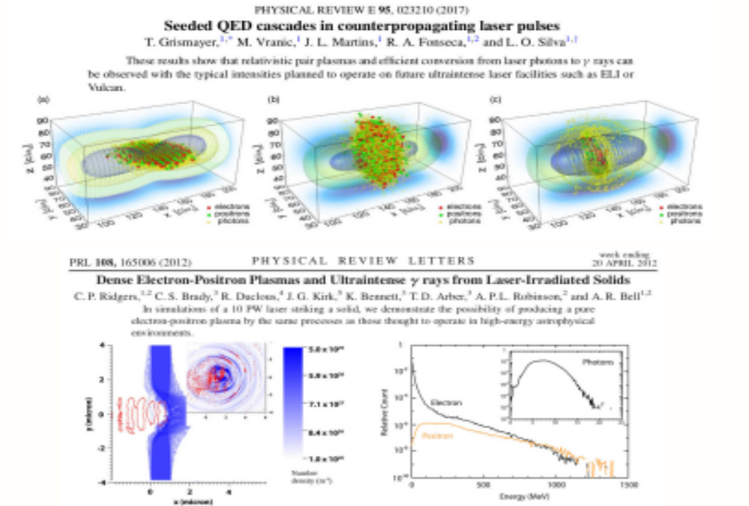
Strong Fields and Plasma Physics

Slide 23
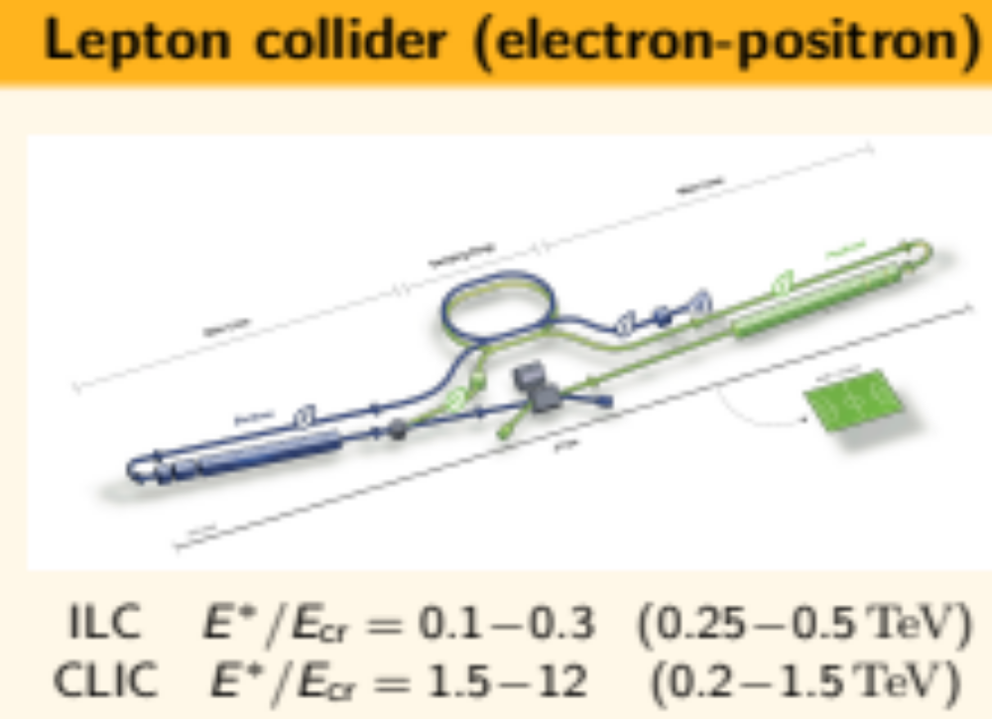
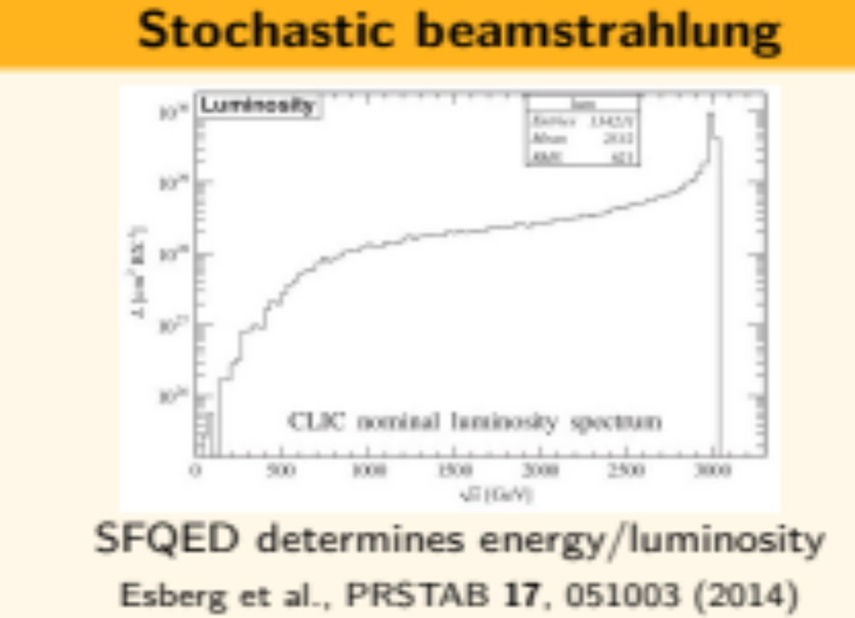
Strong Fields in Future Colliders
Problems of future Linear Electron-Positron Collider: → strong-field QED
High luminosity → high charge density → strong fields → beamstrahlung
Stochastic photon emission + large recoil: non-trivial energy distribution,
modified transverse beam structure (beam broadening → focusing quality)

Slide 24
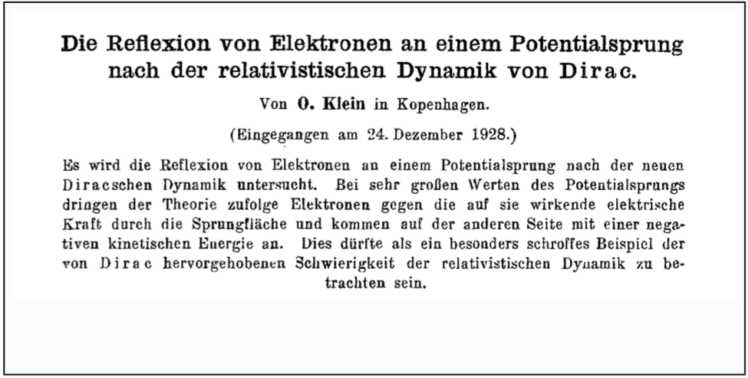
Brief History of Strong Field QED
1929: Klein discovers “paradoxical” predictions
By calculating the scattering of electrons from a potential barrier
The electrons “tunnel” with high probability through a strong potential
The electrons appear on the other side with “negative energy”
O. Klein, Z. Phys. 53, 157-165 (1929)

Slide 25
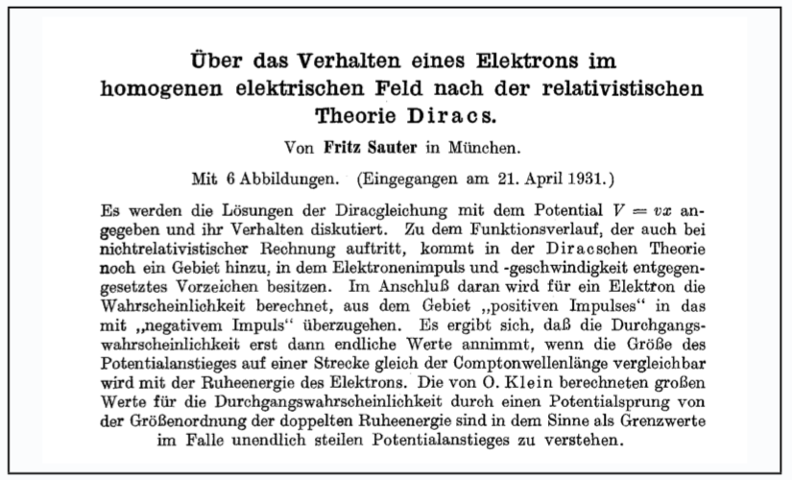
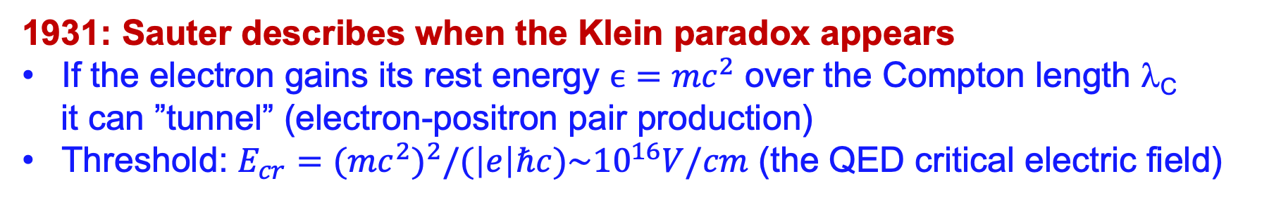
Brief History of Strong Field QED
1931: Sauter describes when the Klein paradox appears
If the electron gains its rest energy $ϵ={mc}^{2}$ over the Compton length λ_{C}
it can ”tunnel” (electron-positron pair production)
Threshold: $E_{cr}=(mc^{2})^{2}/(\left|e\right|ℏc)\sim {10}^{16}V/cm$ (the QED critical electric field)
F. Sauter, Z. Phys. 69, 742-764 (1931)

Slide 26
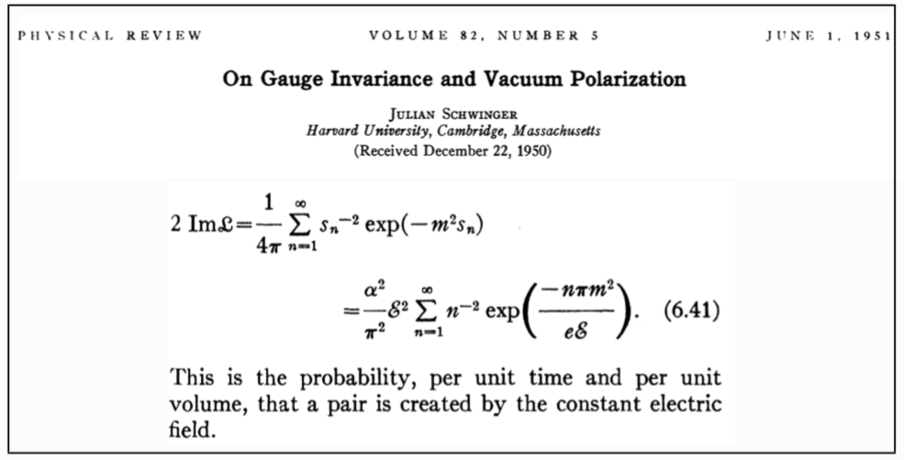
Brief History of Strong Field QED
1951: Schwinger presents the first modern derivation
Introduces quantum field theory with background fields
All previous results are derived within a consistent formalism
Particle production from vacuum is often attributed to him
J. Schwinger, Phys. Rev. 82, 664-679 (1951)

Slide 27
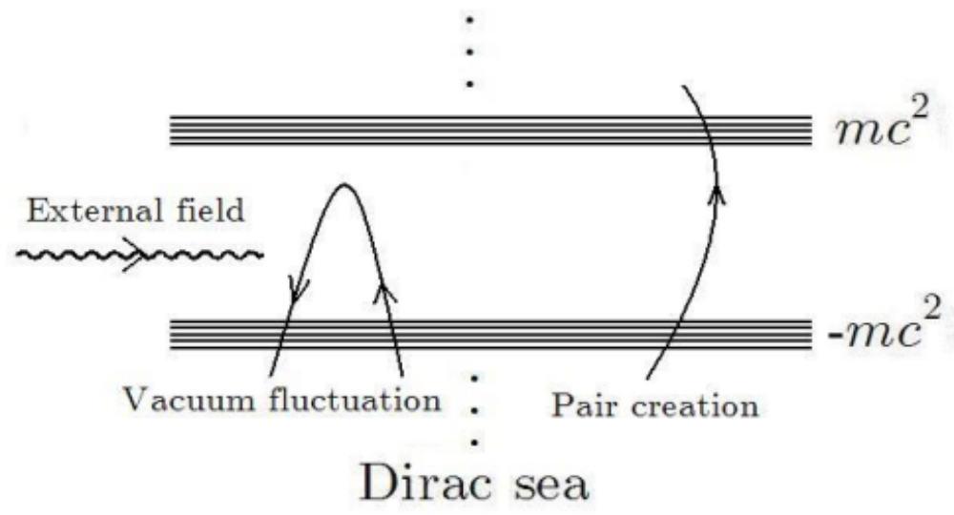
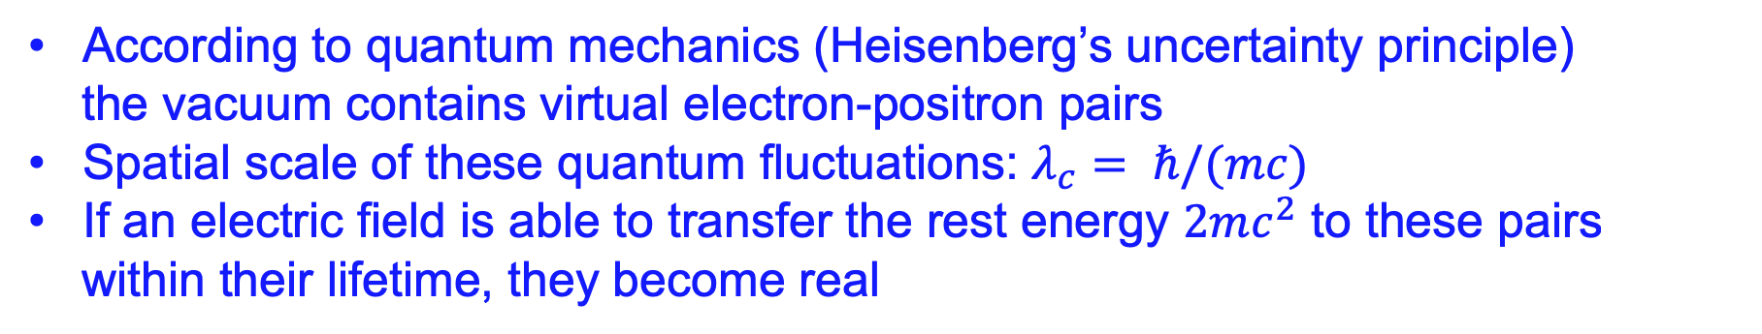
Intuitive Explanation of Spontaneous Pair Production
According to quantum mechanics (Heisenberg’s uncertainty principle)
the vacuum contains virtual electron-positron pairs
Spatial scale of these quantum fluctuations: $λ_{c}= ℏ/(mc)$
If an electric field is able to transfer the rest energy $2mc^{2}$ to these pairs
within their lifetime, they become real
Spontaneous pair production:
Predicted in 1931 – challenging to observe

Slide 28

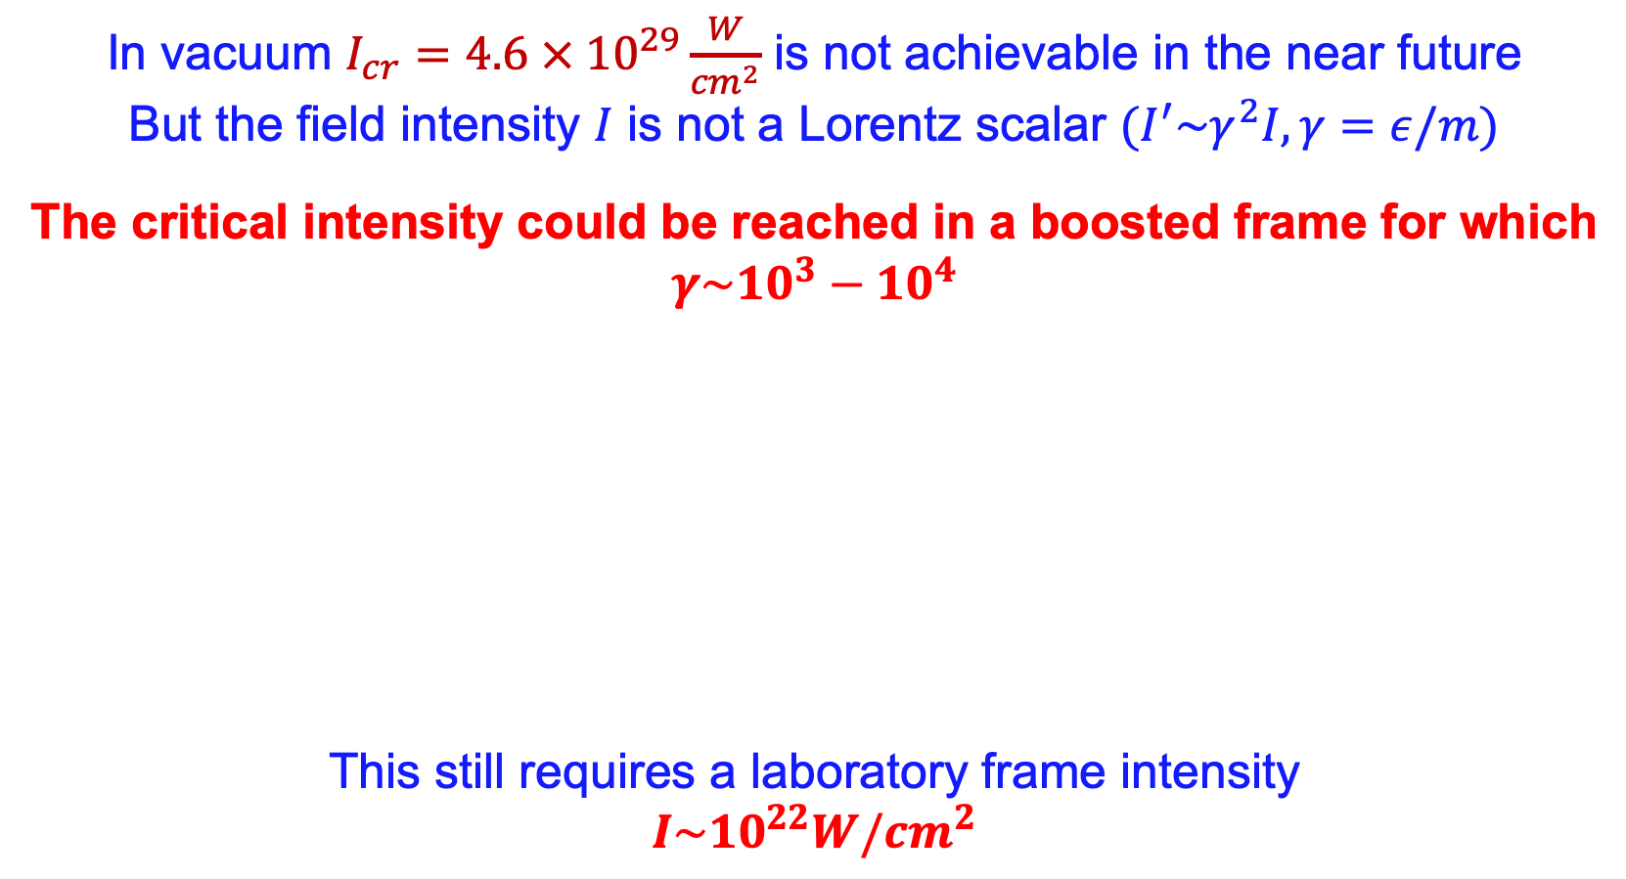
Can this be done?
In vacuum $I_{cr}=4.6 × {10}^{29}\frac{W}{{cm}^{2}}$ is not achievable in the near future
But the field intensity $I$ is not a Lorentz scalar ${(I}^{′}\sim γ^{2}I, γ=ε/m)$
The critical intensity could be reached in a boosted frame for which
$$γ\sim {10}^{3}−{10}^{4}$$
This still requires a laboratory frame intensity
$$I\sim {10}^{22}W/{cm}^{2}$$
An optical Petawatt system!

Slide 29
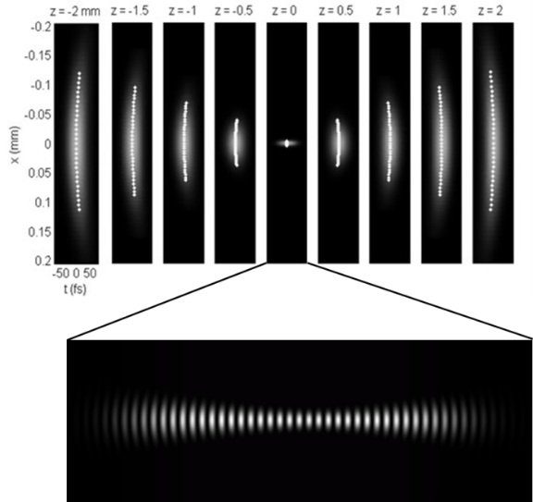
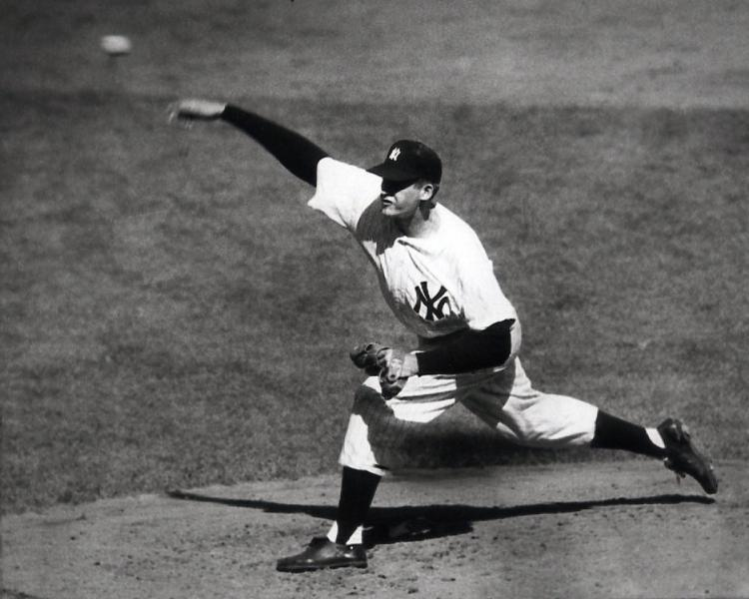
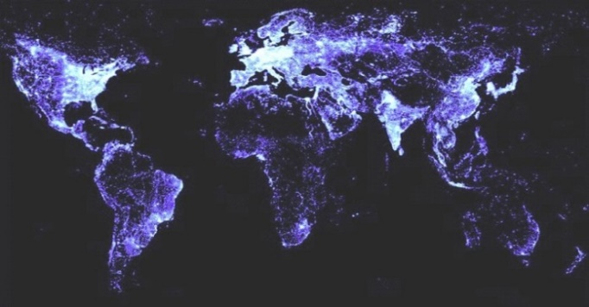
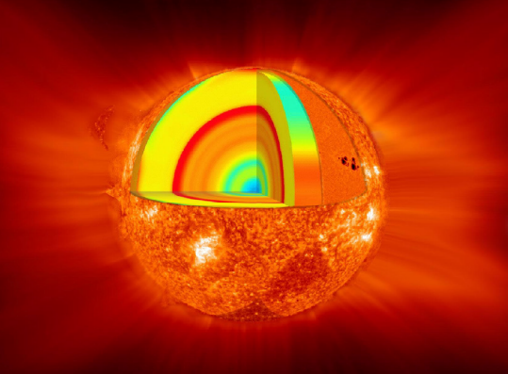
What's one Petawatt, after all?
100 J in 100 fs, at λ=800 nm, focused to 10µm
The total energy, 100 Joules, is about the kinetic energy of a pitched baseball, or a kicked soccer football.
The peak power is nearly 100x the world’s power consumption rate.
The focused intensity is ten trillion trillion W/m², greater than the center of the sun. The rms electric field is 100 trillion V/m.
What is a petawatt laser pulse?
ENERGY
POWER
INTENSITY
Notes:
At the center of the sun, T is 15 million degrees. Intensity is sigma*T^4/pi and Stefan Boltzman sigma is 5.7e-8 in SI, so that's about 1e21/W/m^2.
1e-9C / (1.6e-19 C/e) x (1.5e10 eV) x (1.6e-19 J/eV) = 1e-9C x 1.5e10 eV = 15J

Slide 30
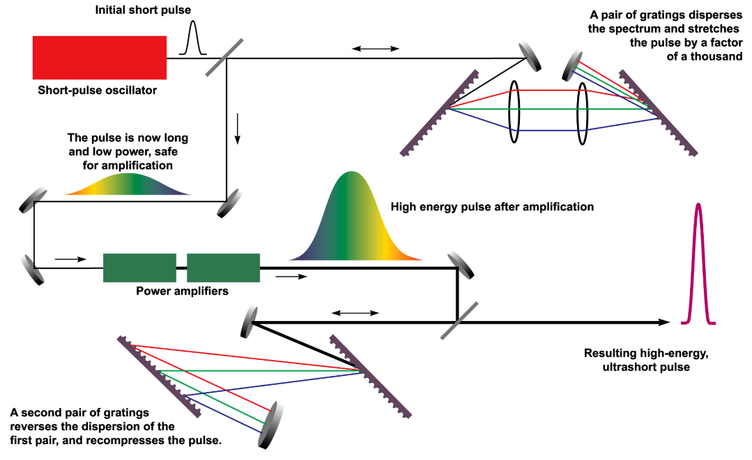
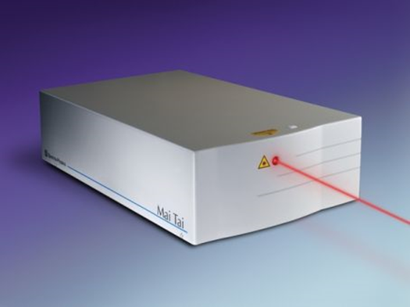
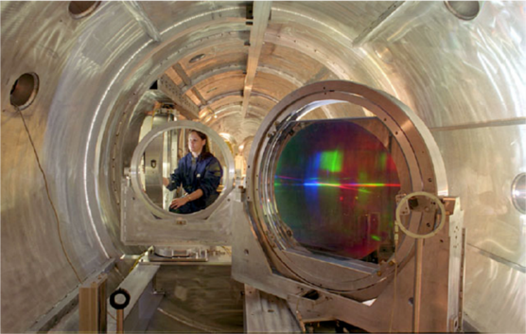
Chirped-pulse amplification - key enabling technology
Need large gratings!
D. Strickland and G. Mourou,
“Compression of amplified chirped optical pulses”,
Opt. Commun. 56, 219 (1985)

Slide 31
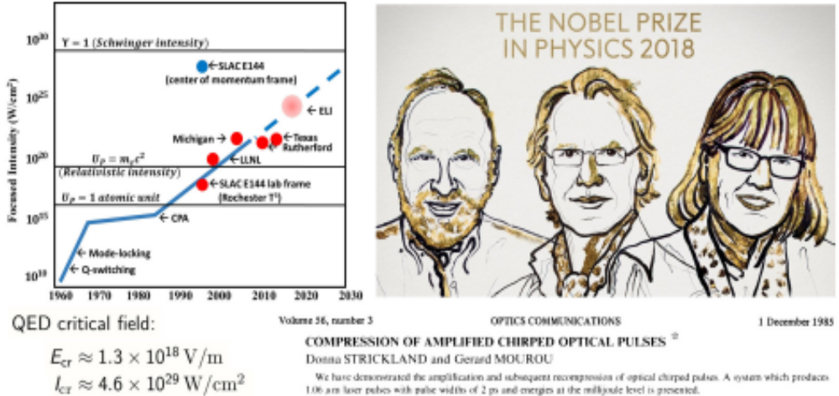
A Nobel Prize Effort!

Slide 32
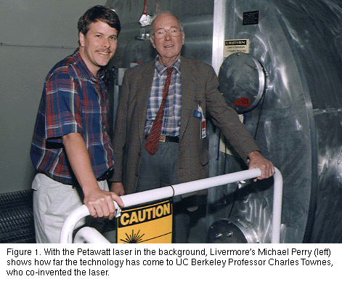
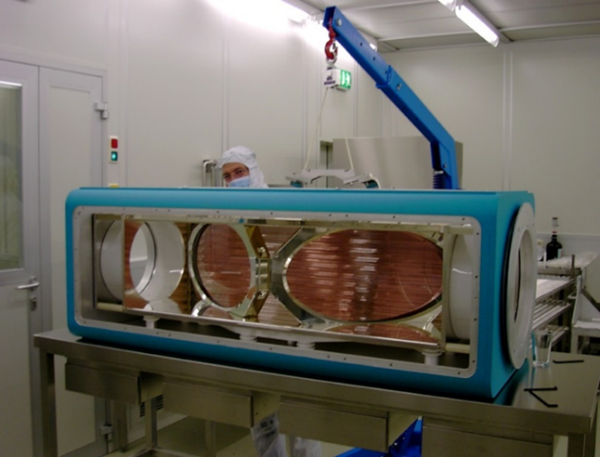
First PW laser at LLNL used Nd:glass, large gratings
1.5 PW (1998)
660 J in 440 ps
  M. D. Perry, D. Pennington, B. C. Stuart,
  G. Tietbohl, J. A. Britten, C. Brown, S. Herman, B. Golick, M. Kartz, J. Miller, H. T. Powell, M. Vergino, and V. Yanovsky, “Petawatt laser pulses,” Opt. Lett. 24, 160 (1999).

Slide 33
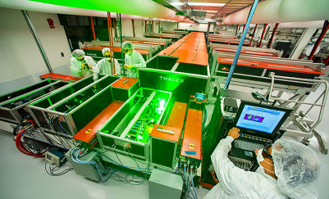
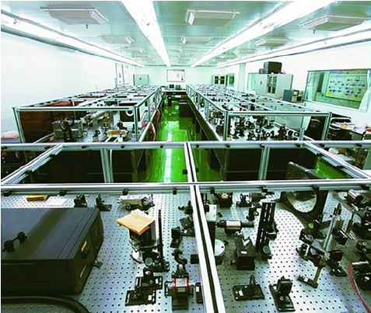
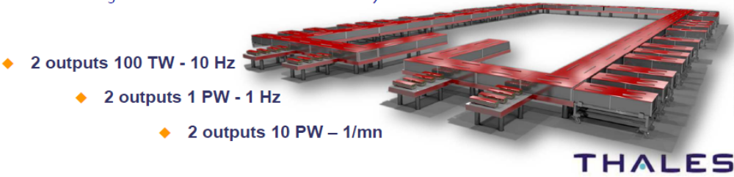
New technologies have enabled shorter pulses
Ti:sapphire
  Pumped by another laser, typically with 10-20-ns pulses
  Large gain bandwidth allows amplification of 20-30-fs pulses
  Much better thermal properties than Nd:glass allows higher pulse rates
  Can combine energy from multiple pump lasers for scaling
OPCPA (Optical Chirped Pulse Parametric Amplifier)
  Not a laser, a nonlinear optical device
  Pumped by another laser, typically with ns-duration pulses and good beam quality
  To date, 30-70 fs pulses for PW-class sources, lower conversion than Ti:sapphire

Slide 34
The possible future
Higher-pulse rate, PW-class, conventional sources
  Flashlamps replaced by diode lasers
  Allow optimized focusing from active feedback, improved productivity and statistics in experimental work
Directly diode-pumped amplifiers, for higher pulse rates, efficiency
  Yb-doped, broad-bandwidth media, optimized for efficiency
  Green-diode-pumped Ti:sapphire
Beam-combined fiber lasers
  Substantial challenges in scaling to PW class
Shorter-pulse OPCPA systems
  Spectral combination to produce 1-fs-duration pulses
X-ray Free-Electron Lasers (FELs)
  Present cost an obstacle

Slide 35
Active international competition; greatest concentration in Europe; rapid growth in China

Slide 36
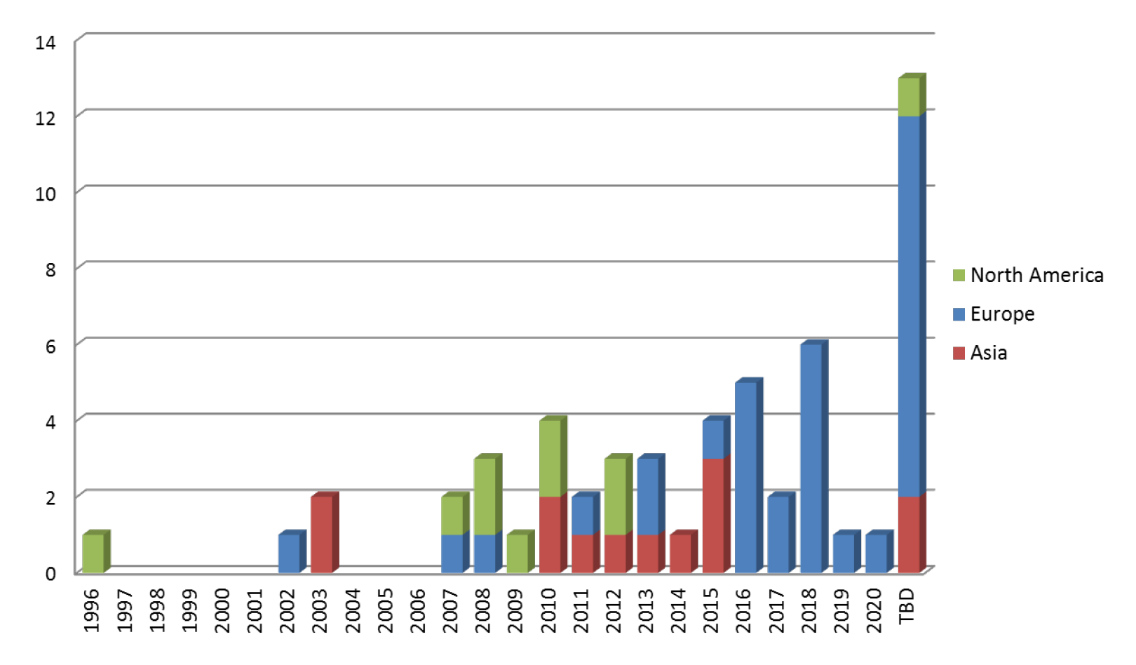
Dates PW systems come on line: Europe & Asia will dominate

Slide 37
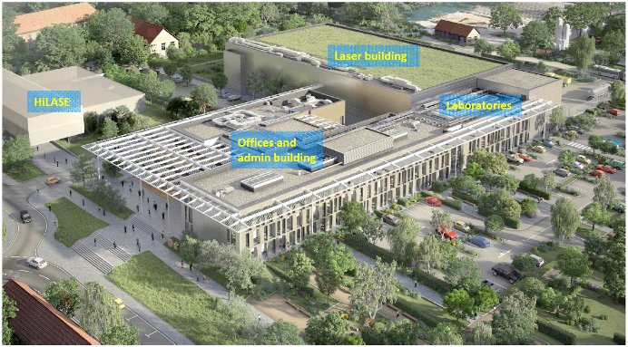





ELI Facilities built or under construction
2 key lasers from US,
Ti:sapphire (LLNL)
and
Nd:glass (National Energetics)
Two 10-PW Ti:sapphire lasers from Thales
Assorted lasers from EU

Slide 38
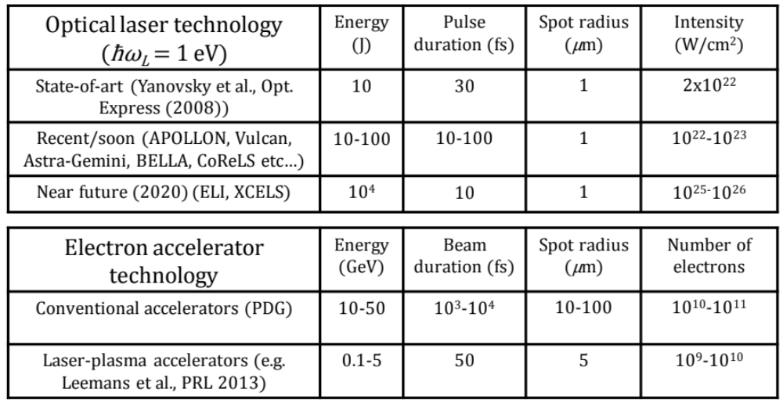
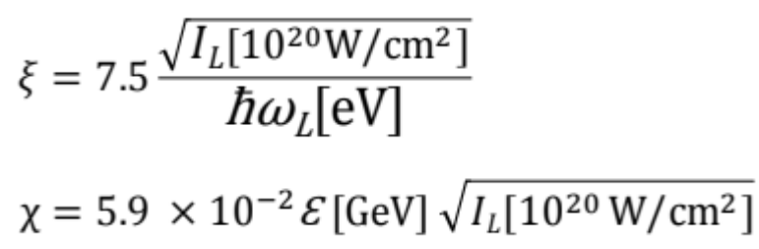

Present Electron and Laser Technology
Current technology allows in principle the
experimental investigation of strong-field QED
NOTE: modern notation is η ≡ ξ and ≡ χ

Slide 39








Strong-Field QED
Nonperturbative, strong-field QED is described by two dimensionless measures, and ,
of the strength of a plane wave with angular frequency and 4-potential
1. $η=\frac{eE_{rms}}{mω_{0}c}$
governs the importance of multiple photons in the initial state, and characterizes the “mass shift”,
of a (quasi)electron in a “background “ electromagnetic wave (laser beam).
D.M. Volkov, Z. Phys. 94, 250 (1935), T.W.B. Kibble, Phys. Rev. 150, 1060 (1966)
[For electrons in metals, R. Peierls, Z. Phys. 80, 762 (1933),]
2. $Υ=\frac{2p_{0}}{mc^{2}}\frac{E_{rms}}{E_{crit}}=\frac{2p_{0}}{mc^{2}}\frac{λ_{c}}{λ_{0}}η$
governs the rate of “spontaneous” e⁺e⁻ pair creation (“sparking the vacuum”) in a wave probed by an electron with 4-momentum
NOTE: modern notation is η ≡ ξ and ≡ χ
The electric field of a focused TeraWatt laser appears critical to a
counterpropagating 50 GeV electron ⇒ SLAC Experiment E-144

Slide 40




SLAC Experiment E-144
Performed in the Final Focus Test Beam, SLAC (1996-1997)
FFTB: V. Balakin et al., Phys. Rev. Lett. 74, 2479 (1995)
Terawatt laser system: Chirped-Pulse Amplification (CPA)
in a “slab” amplifier. (Special thanks to D. Meyerhofer.)
E144 laser system: C. Bamber et al., Laser Phys. 7, 135 (1997)
This is the same laser system
(T³) for which the Nobel Prize
was awarded this year

Slide 41


Nonlinear Compton Scattering
C. Bula et al. Phys. Rev. Lett. 76, 3116 (1996)
Rate (@ order n) ∝ I ^{n-1},
when normalized to
total scattered photon rate.
Rate
I
I
Theory based on Volkov states of a (dressed) Dirac electron in a plane wave.
A.I. Nikishov & V.I. Ritus, Sov. Phys. JETP 19, 529 (1964)
N.B. Narozhny, A.I. Nikishov & V.I. Ritus, Sov. Phys. JETP 20, 22 (1965)

Slide 42







Physics at High U: Pair Creation by Light
Two-step process: then → 106 ± 14 signal positrons.
D. Burke et al., Phys. Rev. Lett. 79, 1626 (1997), C. Bamber et al., Phys. Rev. D 60, 092004 (1999)
Rate ∝ η^{2n}, where
n = 5:1 ± 0.2 (stat.) ± 0.7 (syst.)
5 laser photons
(process is below threshold for 1 photon).
trident =
C. Bula & KMcDonald, trident.pdf (1998)
Nonlinear Breit-Wheeler scattering,
G. Breit and J.A. Wheeler, Phys. Rev. 47, 1087 (1934)

Slide 43






Strong-Field Pair Creation as Barrier Penetration
For a virtual e⁺e⁻ pair to materialize in a field E, the electron and positron
must separate by distance d sufficient to extract energy 2mc² from the field:
$eEd≥2mc^{2}$
The probability P of a separation d arising as a quantum fluctuation
is related to penetration through a barrier of thickness d:
$P∝\exp\left(−\frac{d}{λ_{c}}\right)=exp⁡(−\frac{2}{Υ})$
F. Sauter, Z. Phys. 69, 742 (1931)
W. Heisenberg and H. Euler, Z. Phys. 98, 714 (1936)
J. Schwinger, Phys. Rev. 82, 664 (1951)
Rate e⁺∝ exp{[-1.8 ± 0.2 (stat.) ± 0.2 (syst.)]/$Υ$}.

Slide 44

New Science Opportunities beyond the Schwinger Threshold
E144 was ahead of its time…
Leptonic plasmas from the quantum vacuum
  QED cascades
  Standing wave enhancement of pair creation (Bell and Kirk)
  Quantum Radiation reaction (shorting out the vacuum)
Bosonic plasmas from the vacuum
  Bosonic enhancement of pair production
  Boson avalanche
Multi-particle correlations: Charge, angle, energy.
1PW/15GeV
(lab frame)
Reaching for the Brightest Light (2018)
US Natl. Acad. Sci., p. 15

Slide 45


Photon-Photon Scattering
Electron-positron fluctuations can mediate a pure quantum
interaction among laser beams in the vacuum in many ways
Multi-PW laser systems may open the possibility of observing
for the first time direct photon-photon scattering in vacuum
  Three colliding laser pulses stimulate emission in a fourth direction with a new frequency
Lundstroem et al., Phys. Rev. Lett. 2006
A matterless double-slit setup has been put forward
Photons are created by virtual pair annihilation
  After head-on collision of a probe laser field and two
  ultra-intense laser beams
Form double-slit interference pattern
Predicted to induce material-like behavior in vacuum
  Support elastic scattering between photons
Ben King et al., Nature Photonics 2010

Slide 46







Induced Light-by-Light Scattering
ω₁ , ω₂
ω₃
ω₄
where final-state
photon ω₃ goes into an intense laser beam ⇒ amplitude gets boson enhancement.
Vacuum should have less than
1 atom in the laser focal volume,
Separation of atoms
> 10 μm ⇒ < 10⁻⁹ mm.
[1] A. Varfolomeev, Sov. Phys. JETP 23, 681 (1966)
[2] N. Kroll, Phys. Rev. 127, 1207 (1962), footnote 9
Rate $≈{10}^{−6}\frac{ {(ℰ\left[Joules\right])}^{3}}{{(τ\left[psec\right])}^{2}}$
Extremely small, can reach
1 scatter per pulse if $ℰ$=10J, τ=30fs

Slide 47

Laser-Driven Seeded QED Cascades
Seed electrons are violently accelerated by the laser
fields, emit large numbers of hard (high-energy)
photons, which in turn convert in e⁺e⁻ pairs
The generated e⁺e⁻ pairs are then accelerated by
the laser fields and initiate a new generation of
particles
QED cascades are predicted to be developed in
collisions of two laser pulses each with an intensity
10²⁴ W/cm² (Bell PRL 2008, Kirk PPCF 2009,
Bulanov PRL 2010, Nerush PRL 2011).
Exponential increase of particles
  At a certain point, electron-positron plasma is produced
Current theoretical understanding is rather flimsy:
  Its validity has not been verified
    Exponential increase of particles?
    How is the laser field depleted?
Semi-Classical Approach

Slide 48




Recollisions of Laser-Generated e⁺e⁻ Pairs
The laser-induced field becomes so heavy
that behaves like an atom…
Semi-classical three-step process
1) Pair creation, 2) Acceleration by laser field, 3) Recollision
(S. Meuren et al., PRL 114, 143201 (2015)

Slide 49




Vacuum Birefrigence
A strong laser field behaves like a birefringent medium:
The polarization of a probe photon changes inside the strong field
Probe photon can be from an x-ray photon beam
The laser pulse induces the phase shift $δΦ\sim αΥηN$ if $Υ≪1$
Limit in the range of $Υ≲0.1$ to avoid real pair production
Using very long laser pulses a significant phase shift could be induced
  Diffraction may decrease the overall effect
  Heinzl et al., Opt. Commun. (2006)
  S. Meuren et al., PRD 91, 013009 (2015)
These have been very old speculations, for example:
J.S. Toll, Princeton PhD thesis (1952)
Birefringence of the vacuum. Adviser: J.A. Wheeler

Slide 50

Cosmology & Astrophysics
Hints of vacuum birefringence in optical polarimetry of neutron stars
R. P. Mignani et al. MNRAS, 465, 2017.
Emission of coherent radio waves in pulsars/ x rays in magnetars, gamma ray bursts…
Electron-photon decoupling primordial nucleosynthesis
Schwinger fields existed 100s after the Big Bang, when T~10¹⁰K

Slide 51

Laboratory Astrophysics:
Generation of Electron-Positron Pair Plasmas
30fs positron jets recorded
Scaling with charge number Z
Consistent with two-step process
  Brem + Bethe-Heitler
Emitted as collimated jets by energetic objects in the Universe
  Black holes, pulsars, quasars
These plasmas play a fundamental role in the dynamics of ultra-massive astrophysical objects
  Strongly believed to be associated with the emission of ultra-bright gamma-ray bursts
Poorly understood despite extensive theoretical modelling
  Primarily due to difficulty in creating matter-antimatter plasmas in the laboratory
Non-linear processes present in strong-field environments could allow for table-top experiments

Slide 52



Laboratory Astrophysics
Parameters not as in astrophysical jets but
with scaling results may become relevant
Follow-up experiment in Astra-Gemini produced neutral
electron-positron beam, G. Sarri et al., Nat. Comm. (2015)
Generation of electron-positron jets with variable %
of positrons from 0-50%
Plasma dynamics much more
appropriate and comparable to that observed
in astrophysical jets

Slide 53





PetaWatt Laser-driven Acccelerators
LPA concept
Livingston plot (Moore's Law for accelerators)
Leemans, LBNL
BELLA 9cm plasma accelerator channel
At $I≈{10}^{22}W/m^{2}$ laser pulses propagate through a plasma
Generate longitudinal plasma wave which trails the laser pulse
  Similar to a wake that follows a boat travelling across water.
In a plasma wave $ℇ≈100 kV/μm$
  ×1000 the accelerating fields used in the LHC at CERN.
Could result in first table-top particle collider!
Magnetic spectrometer data showing the production of high quality electron beam at 1 GeV from a 3 cm plasma structure
Notes:
FIGURE 5.5 Effective constituent collisions energy of hadron colliders (top curve) and electron-positron colliders (bottom curve). The Livingston plot shows that the CME increased by a factor of 100 every 25 years but this has dramatically decreased entering the new millennia. This saturation has many contributions including technical and economics. SOURCE: M. Tigner, 2001, Does accelerator-based particle physics have a future? Phys. Today 54(1): 36.
Laser-plasma accelerators (LPAs) can produce ultrahigh fields of 10-100 GV/m, resulting in an accelerating gradient some three orders of magnitude beyond that produced by convention radio-frequency accelerators. Therefore LPAs may provide a technology for more-compact high-energy colliders.
As shown in the schematic, a vision for a LPA-based collider consists of coupling many individual LPA stages together, each LPA stage boosting the particle beam energy by 10 GeV, and each stage driven by laser with a pulse energy on the order of tens of joules, which is similar to the pulse energy of the BELLA laser system. A collider will require a very high repetition rate, on the order of 10 kHz, well beyond the capability of the BELLA laser, which points to the need to develop high repetition rate lasers for high energy physics applications.
A major focus of the BELLA Center is to explore and develop LPAs for high energy physics applications. One primary goal is to demonstrate the production of electron beams at the 10 GeV level using the BELLA laser and a meter-scale plasma. Another goal is to demonstrate the coupling of two LPA stages, each powered by separate laser pulses. The first stage will produce a relativistic electron beam, which is then coupled to the second LPA stage for acceleration to the 1 GeV level.

Slide 54

A TeV collider would use a lot of lasers…
Leemans, LBNL

Slide 55


Intense Beam Therapies
Target Normal Sheath Acceleration
Petawatt lasers can produce intense 10-100 MeV proton beams for tumor therapy
Target Normal Sheath Acceleration is a mechanism for high intensity pulsed beams.

Slide 56





High-Intensity/Strong-Field Science opportunities have been recognized in previous reports
Developed largely in the US in the 20th century
Emerging European and Asian dominance in the
21st century
Continuing need for laser technology
Commercial involvement
Workforce development
ENERGY

Slide 57


Opportunities in Intense Ultrafast Lasers;
Reaching for the Brightest Light
U.S. National Academy of Sciences, December 2017
http://nap.edu/24939
The study was supported by funding from the DOE Office of Science, NNSA, ONR, and AFOSR.

Slide 58




1st International Strong-Field QED Workshop
Link: https://indico.desy.de/indico/event/19493/overview
A report is in preparation to provide input for the European Strategy deliberations

Slide 59






The E-144 Collaboration
Dave Meyerhofer Bill Bugg Achim Weidemann Dave Burke Christian Bula Adrian Melissinos
Kostya Shmakov Charles Bamber Uli Haug Dieter Walz Jim Spencer KTMcDonald
Glenn Horton-Smith Wolfram Ragg Steve Boege
Theo Kotseroglou
Steve Clive Thomas Eric David
Berridge Field Koffas Prebys Reis

