Slide 1
The ‘Multipliciy Jump!’ – finding B’s in multi-TeV jets w/o tracks
Todd Huffman, Oxford University
Thomas Russell, currently @ Bloomberg L.P.
Jeff Tseng, Oxford University
Arxiv:1701.06832
Also: 2016 J.Phys. G: Nucl. Part. Phys. 43 085001

Slide 2
Outline
Why do we want to tag b-jets?
Explain the “multiplicity jump” technique
(aka – Todd’s crazy idea)
The “invented” parameter F_{i}
Pile-up and luminous region
Using an Artificial Neural Net (ANN)
  (It’s not “deep” enough to be a DNN)
  Learning a little from “deep learning”
Future prospects @ ATLAS

Slide 3
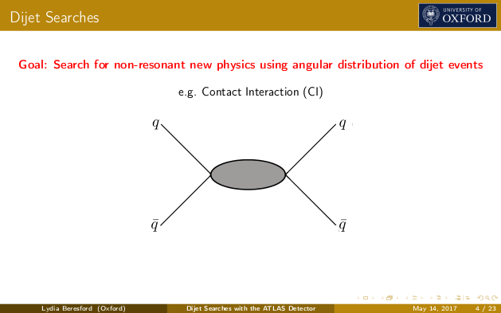
B hadron’s in jets?
Why bother -
b
b

Slide 4
Another example -- boosted 2h → WW bb analysis
1-lepton final state
hh ➝ bb + WW* ➝ bb + lvqq
large-R-jet
Boosted analysis
h ➝ bb reconstruction with large-R jet.

Slide 5
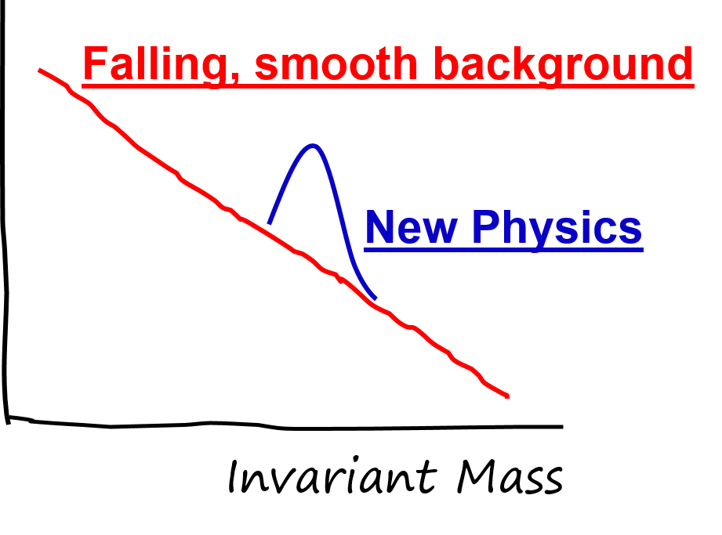
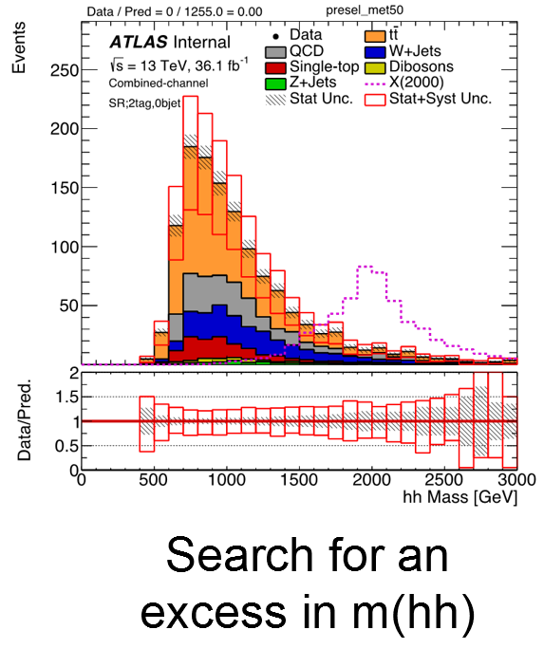
Basic point of searches

Slide 6
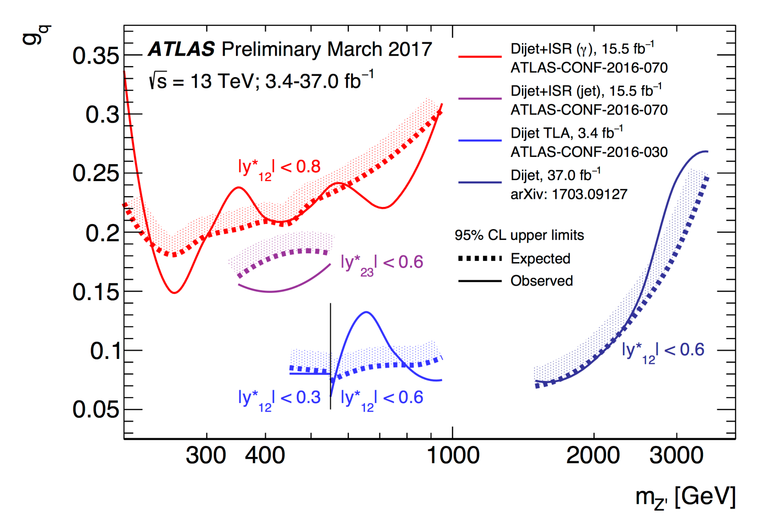
Dijets
ATLAS Search - 2016
want to b-tag these jets

Slide 7
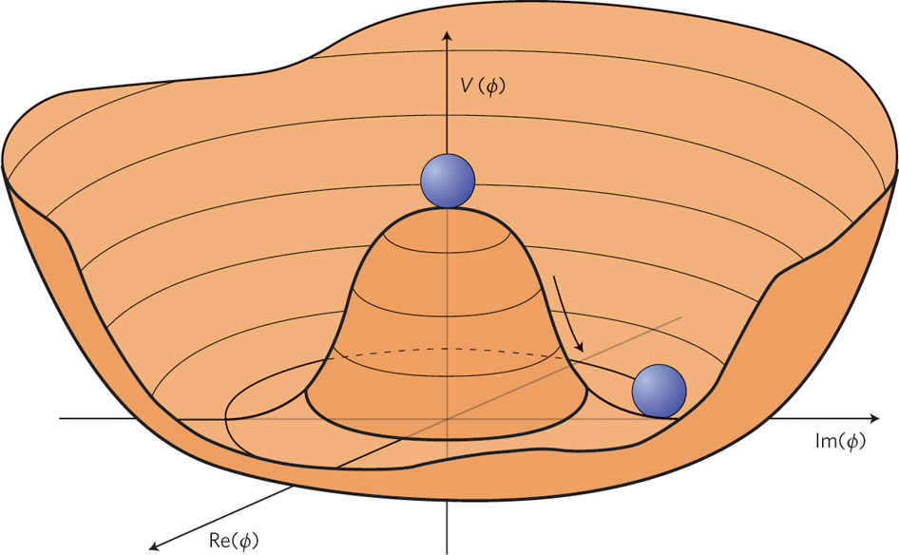
Taken from Nature Physics 7, 2–3 (2011);

Slide 8
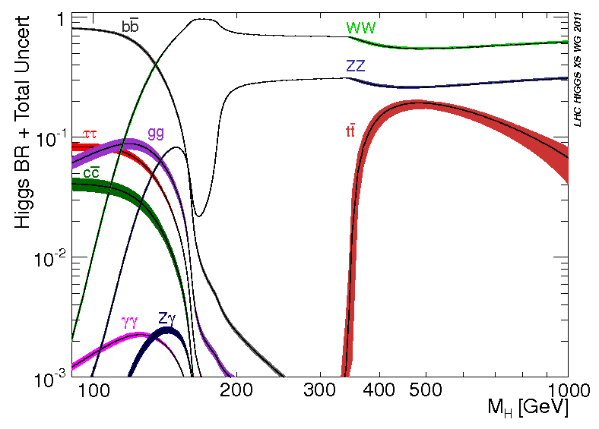
H→bb
80% Branching ratio

Slide 9
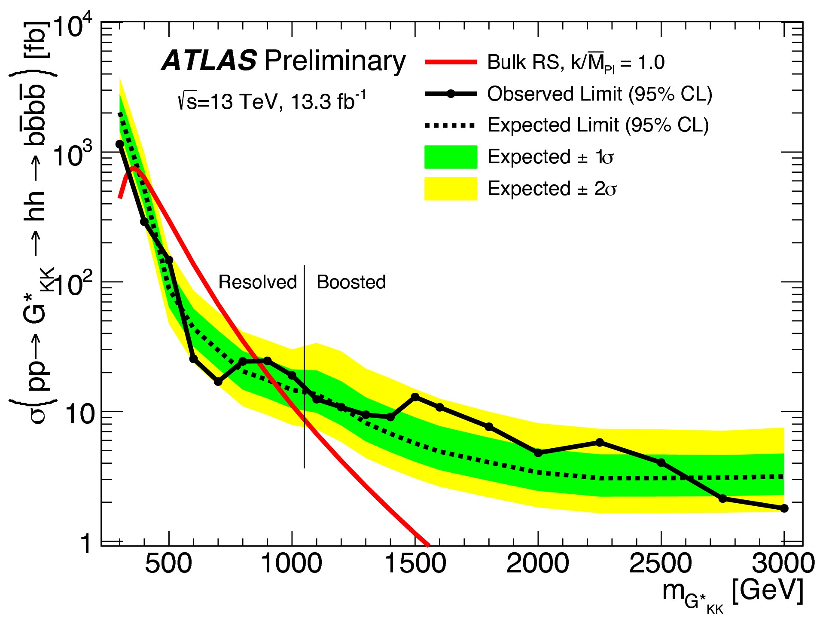
Higgs Hunting example
HH → 4b’s
ATLAS-CONF-2016-049

Slide 10
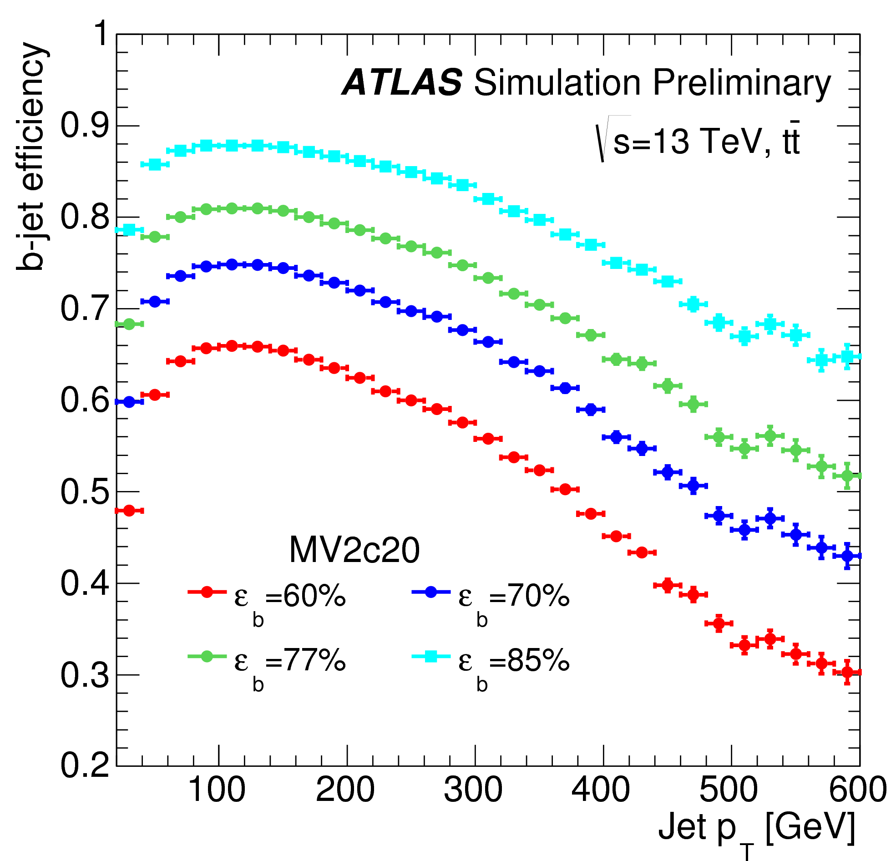
Problem: Tag high P_{T} B-jet
Aux. Fig. 4a → Pub. Note
ATL-PHYS-PUB-2015-022
Next: Why it happens
Notes:
Difference between the curves is the rejection against light quark jets.

Slide 11
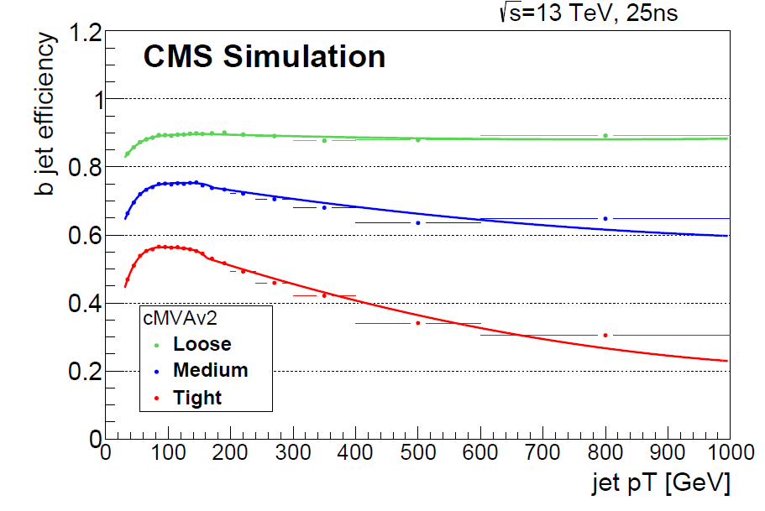
Problem: Tag high P_{T} B-jet
Much great work happening
From CMS btag note
CMS PAS BTV-15-001
Why it happens
Notes:
Difference between the curves is the rejection against light quark jets.

Slide 12
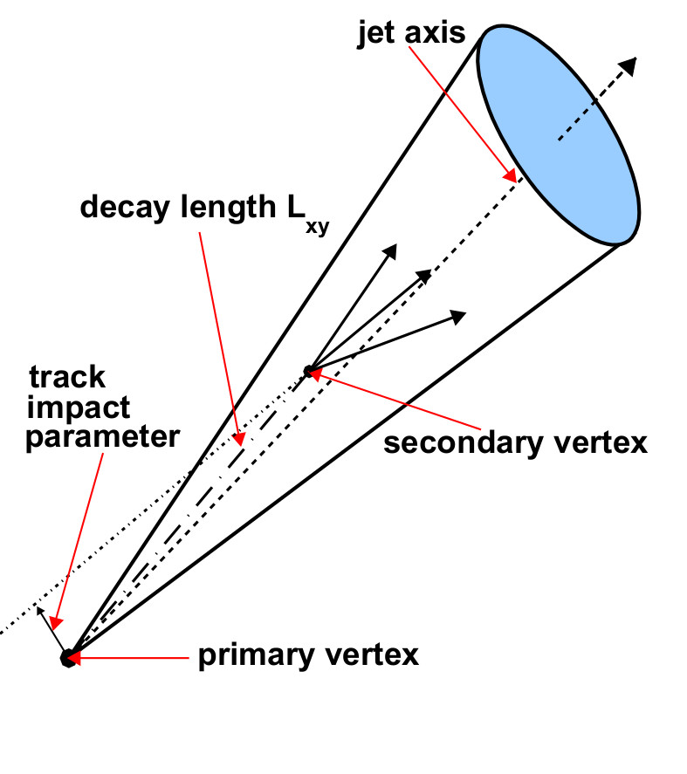
B-taggers
Fight RElativity
Small cone sizes are prevalent.
ΔR≈0.04 for a B in a 500+ GeV Jet.
1 TeV B hadron
γ = 200
γcτ = 90 mm
Radius 1st layer = 25 mm
200 GeV B hadron
γ = 40
γcτ = 18 mm

Slide 13
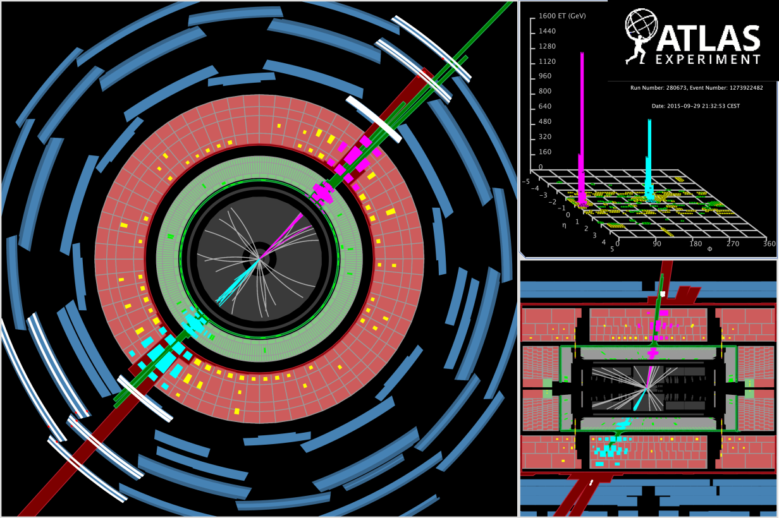
>2.5 TeV Jets seen!

Slide 14
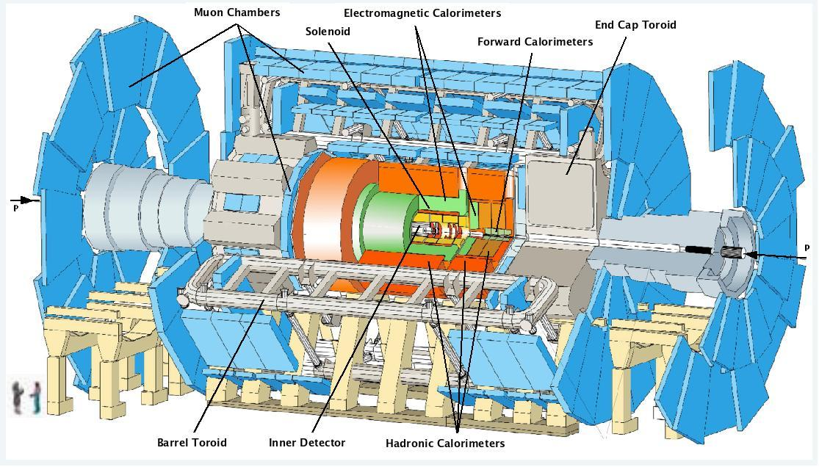
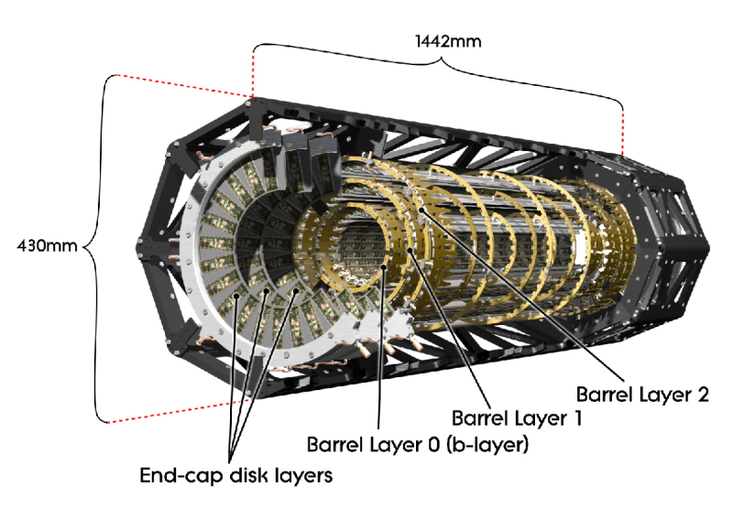
Deep in the heart of ATLAS

Slide 15
Silicon Vertex Detector
Silicon Detectors
  Reversed biased diodes
  Crank the reverse voltage up until they are fully depleted
Charged Particle liberates electron-hole pairs
  Small pulse of current
  Amplify it and record the hit.
p
n
Depletion Region

Slide 16
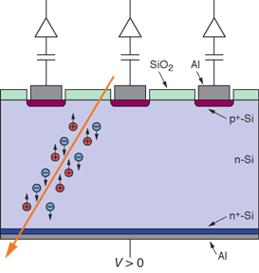
Pixel detector
~ 150 μm
Many thousands
of tiny sensors
50 μm x 250 μm
and 300 μm thick

Slide 17
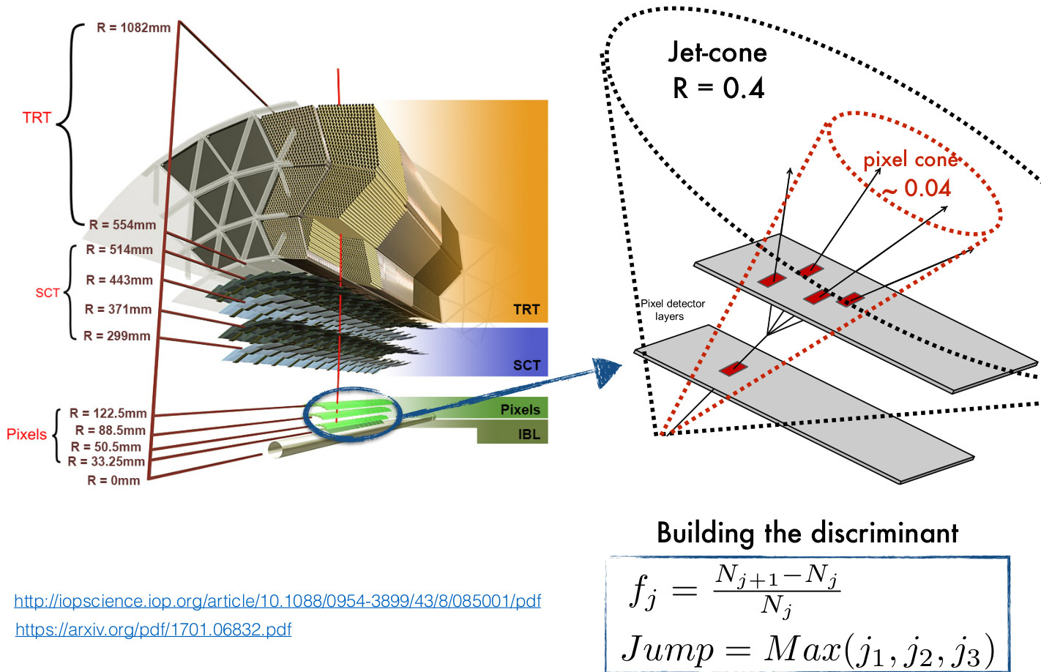

Slide 18
Energy-fraction of B hadrons?
Does it depend on Jet energy?
Energy fraction of B hadrons as Jet energy increases
  x_{B} Logarithmic?
  x_{B} Non-linear?
  x_{B} Constant?
  If Jet energy → more tracks
    Helps taggers
Does x_{B} get worse
Larger E-jet??
All jet energies?
x_{B}
1.0
Let’s at least find out what simulations say!

Slide 19
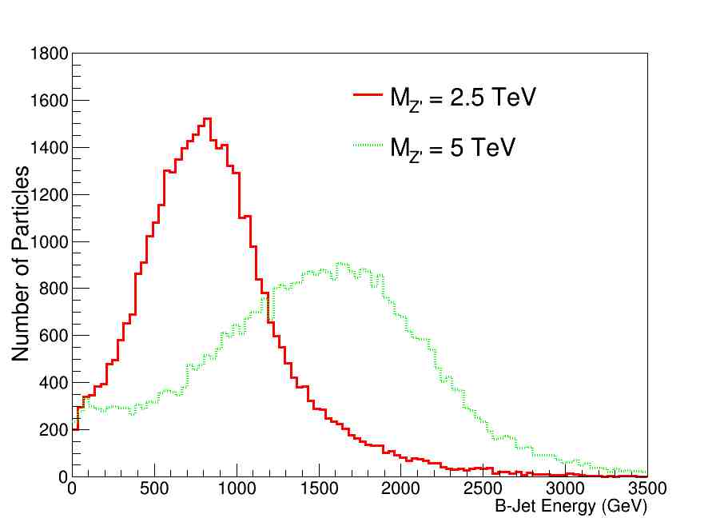
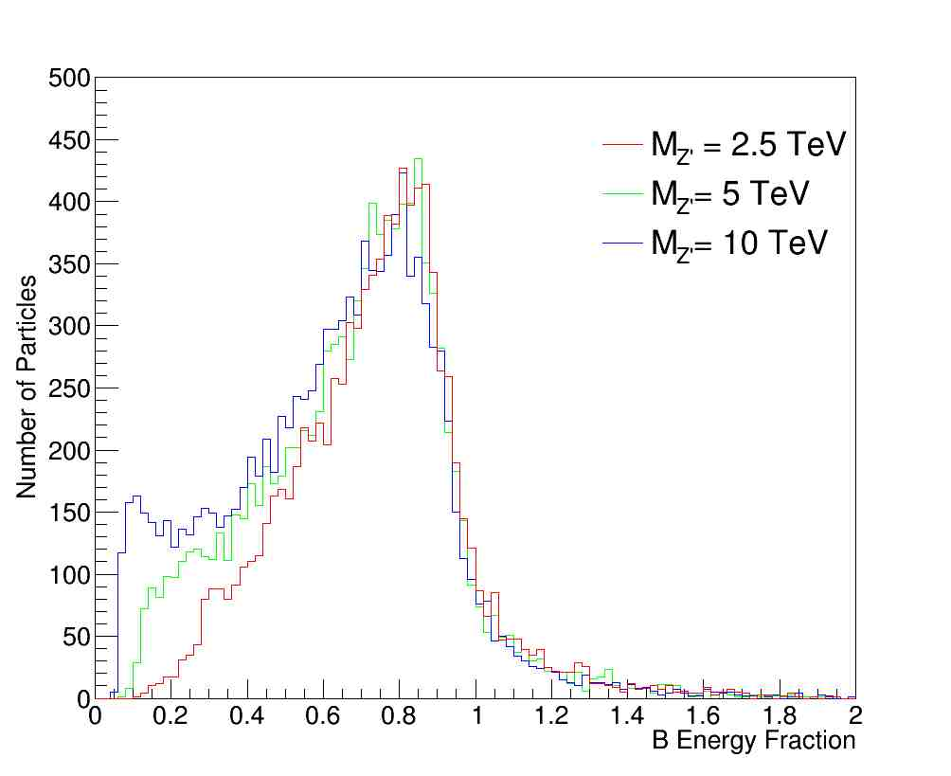
B hadron
Energy fraction (pythia+Fastjet)
However; Fraction of Jet energy each B hadron has does not strongly depend on energy of the jet.
The energy of B hadrons
in our simulation
So as Jet energy increases,
the problems of B-taggers will get worse.
And more B hadrons will decay inside the detector volume.

Slide 20
Simulation Details
Generator level simulation → Pythia 8
  pp collider with √s = 13 TeV
  Generate hard QCD; P_{T} > 700 GeV
  Use EvtGen to get B hadron decays correct
Jet simulation → FastJet 3
  Anti-k_{T} algorithm for forming jets
  Can set jet cone size
    We’ve used R = 0.2
Semi-Toy Detector simulation → GEANT4
  Volume → Cylinder 1.4 m radius filled with air, 2T mag. Field
  Silicon layers
    Active at radii 25, 50, 88, and 122 mm
      “Pixels” 50 x 400 x 300 μm (φ x z x r)
      inner layer 50 x 250 x 300 μm → IBL-like
    Passive cylinders 2.5 mm thick → X₀=2.5% per layer

Slide 21
Δhit fraction → f_{i}
We define a quantity we call “Hit-difference Ratio” or “Hit-ratio” for short → “f_{i}”.
  Use cone ΔR < 0.04 around jet axis.
  from i^{th} layer: f_{i} = (#hits_{i+1} - #hits_{i})/#hits_{i}
    Can only have positive or zero hits, so:
    f_{i} is bounded from below by -1. & unbounded from above.
  Have a look at the f_{i} distribution.
    Note: This sample → 0.5 to 2.5 TeV jets.

Slide 22
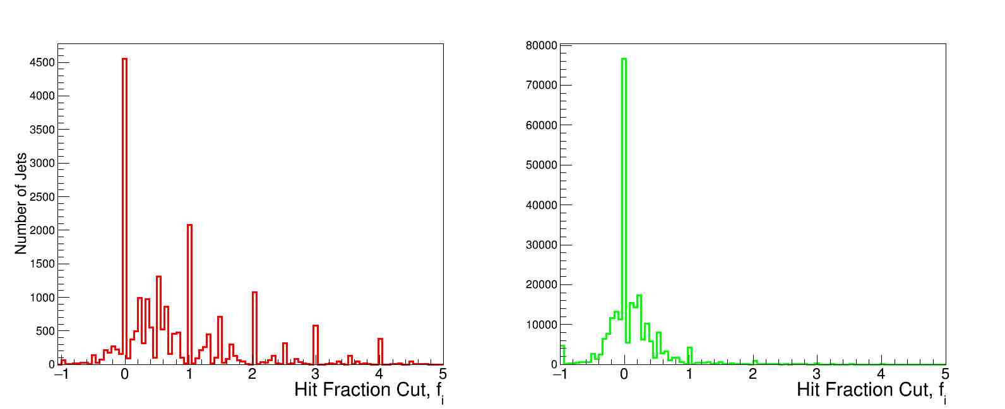
Δhit fraction = f_{i}
Jets with a B hadron
All gaps containing a decay
uds Jets
Simulation Z’→u,d,s,c, and b quarks only.
This looked promising → next use it as a cut variable

Slide 23
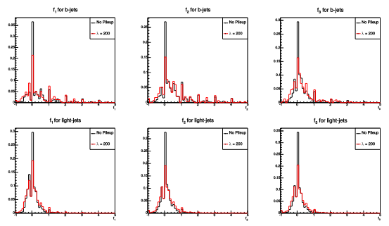
Pileup - f_{i}
How does pileup affect our f_{i}?

Slide 24
Pileup - Conclusion
Tagger insensitive to increased pileup (tested to pileup with λ = 200),
  little change in f_{i} > 0
Makes sense - most pileup does not result in hits in R<0.04 between layers.
NOTE: All plots now have pileup with λ = 45.

Slide 25
Applying Δhit_{f} cut
Start at f_{i}= -1.0 (i.e. no cut at all)
  And Start increasing the cut.
At each cut value, Plot (Number of Events passing cut)/(number of starting events)
NOTE! Only count B hadron jets where B decayed inside the layers!
“ALL Layers” plot is logical OR of individual layers
  if any one of the ΔHit_{f} between any pair of layers passes the cut, the event passes.

Slide 26
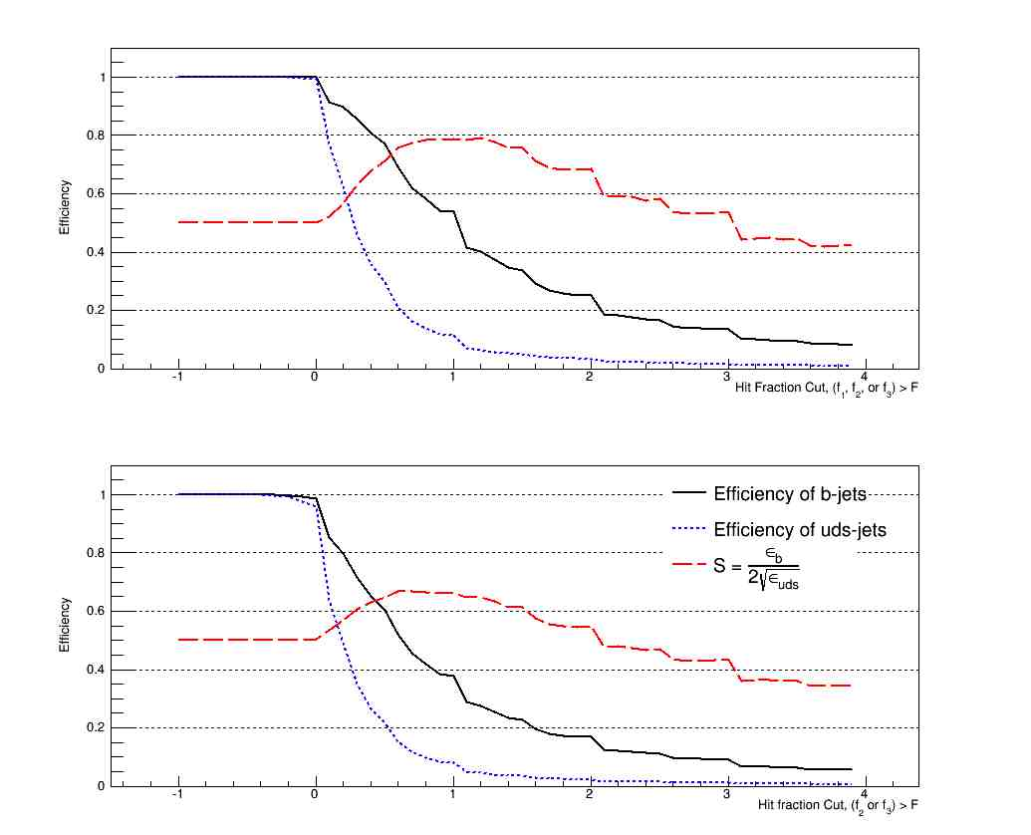
f_{i} efficiency and purity - layers 1234
M_{z’} = 2.5 TeV
f_{i} ≥ F=1
Layers:
1-2 or
2-3 or
3-4
Layers:
2-3 or
3-4
0
1
2
Cut (f₁, f₂, or f₃) ≥ F
Choose this one!!
Fiducial region → Whole volume,
So can compare.
0
1
2
Cut (f₂, or f₃) ≥ F

Slide 27
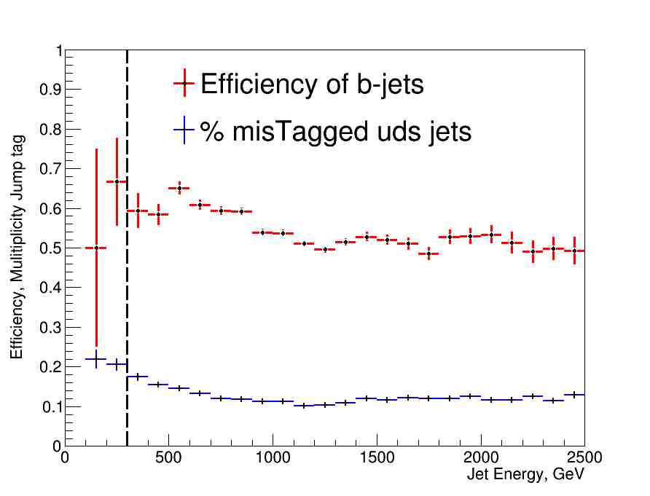
Efficiency vs. Jet energy
Some uds separation – efficient for high Pt jets

Slide 28
Artificial Neural Network

Slide 29
Building the ANN
ROC analysis showed that 8-layer ANN was as effective as a 2-layer ANN → not really a “deep learning” problem,
Reducible, small feature set.
Fewer node layers means less chance of overfitting.
Used TMVA for a “standard HEP” packaged ANN.
Activation function was tanh(x).
2 Hidden layers:
16 and 5 neurons wide.
(Smaller second hidden layer helps prevent overfitting).
Architecture → educated guessing.
Too many combinations to evaluate
Input Layer:
- Raw hits in each layer
- Multiplicites f₁, f₂, f₃
- max(f₁, f₂, f₃)
- Jet Energy, p_{T} and mass

Slide 30
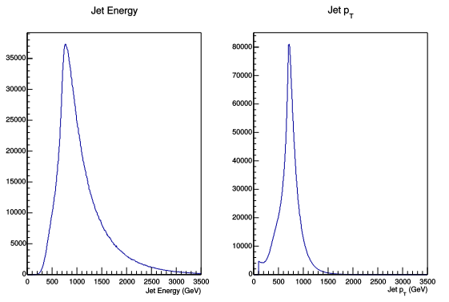
Training Sample
Training sample had min p_{T} of interaction at 700GeV.
1 million general hard QCD events (anything goes), 300,000 hard QCD events resulting in B-hadron production.
Testing is then done on an independent hard QCD sample.

Slide 31
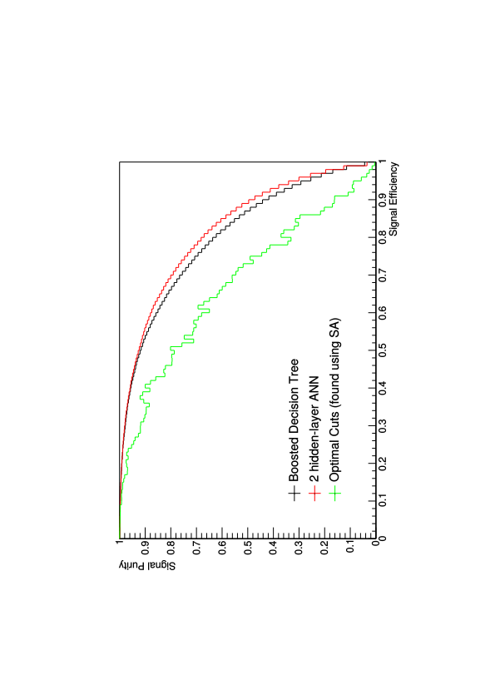
Choosing a ML technique
Each ML technique has a distinct set of advantages/disadvantages.
ROC curve (Signal Purity vs. Signal Efficiency)
(SA → simulated annealing)

Slide 32
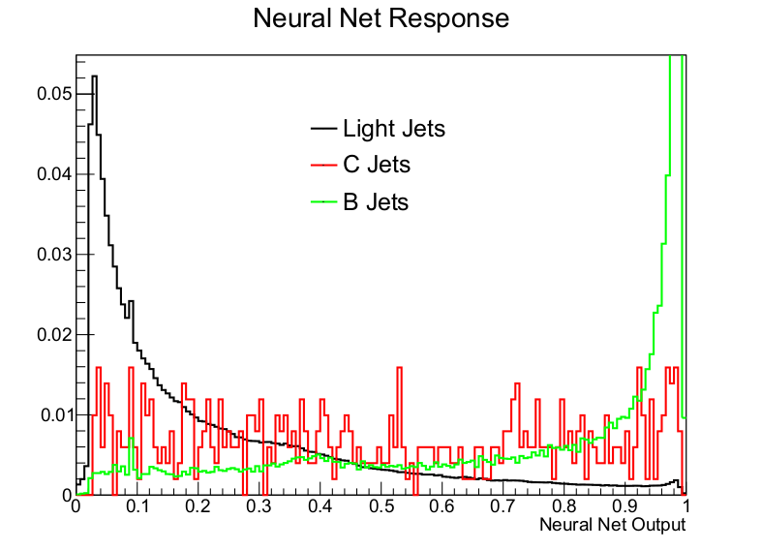
ANN test MC results
Significance = ε_{b}/√ ε_{uds}

Slide 33
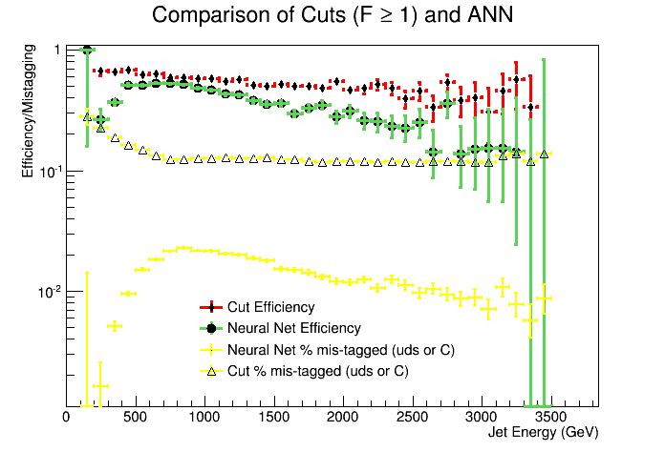
With → ANN output>0.9

Slide 34
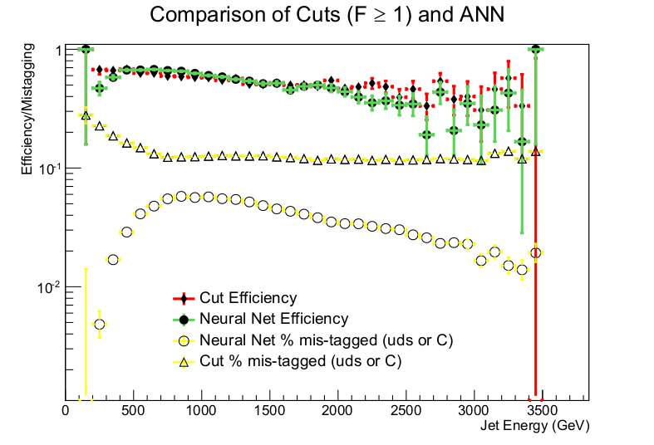
With → ANN output>0.75

Slide 35
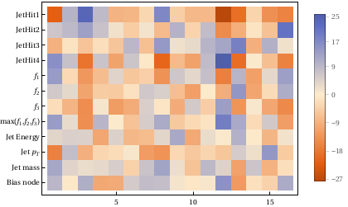
Heat Map
Neural Net seems to find
Nhit4 – Nhit1 → good discriminator

Slide 36
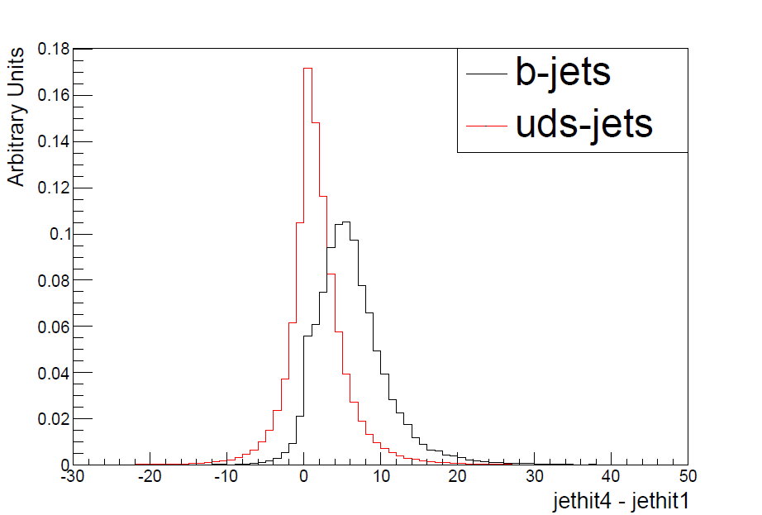
ANN inspired
Straight hit difference between layer 4 and layer 1.
Definite advantage can be seen.

Slide 37
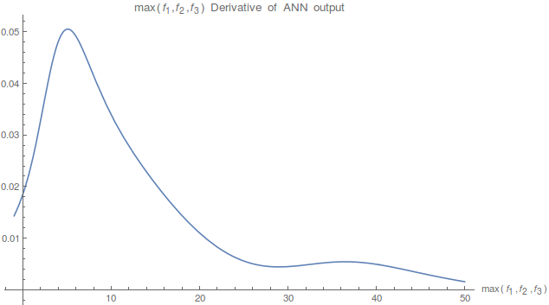
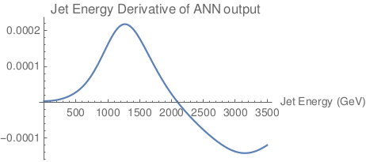
ANN output dependence
(examples)
NN is just a complicated function h(x_{j}) – Look at Δh/Δx_{j}
Max(F)
Jet Energy
Trained NN output is ~100 times more sensitive to Max(F) than to Jet Energy
Conclude: The Machine is focused on the “right” types of quantities.

Slide 38
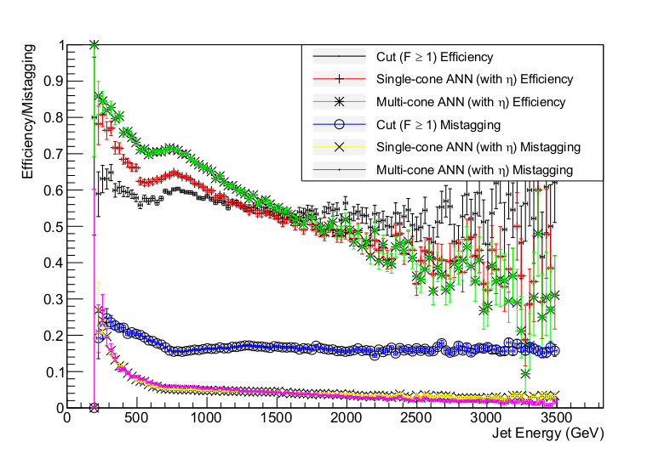
Last thing –
Multiple Cone sizes
Include more B hadron decay products @ lower Energy
ΔR<0.04, ΔR<0.1 and ΔR<0.2 added
Each with own set of inputs
Training sample
Shape dependence?

Slide 39
Conclusions
Using Mulitvariate techniques significantly improves rejection of uds jets.
Results robust to pile-up
Multiplicity Jump technique more immune to searchlight effect and highly boosted B hadrons.
If continues to show promise, could be added to existing taggers to enhance efficiency at TeV scale jet energies.
Experiments (ATLAS, CMS) are looking into the technique with full simulations → Clear next step.

Slide 40
Hand off to ATLAS & CMS!!
Thank you! (Backup slides)

Slide 41
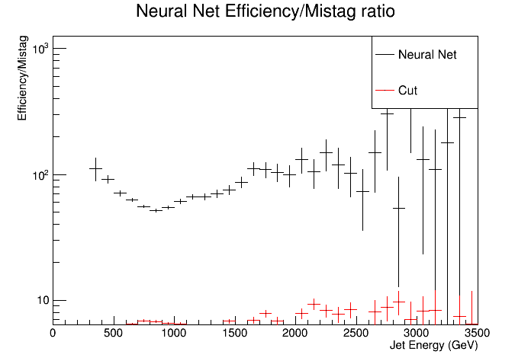
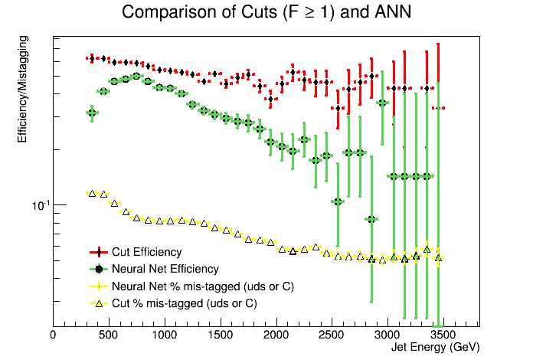
Dead material removed – no early showers

Slide 42
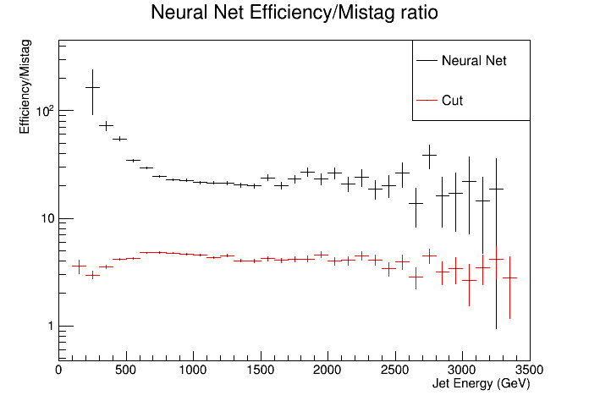
ANN - Straight cut comparison

Slide 43
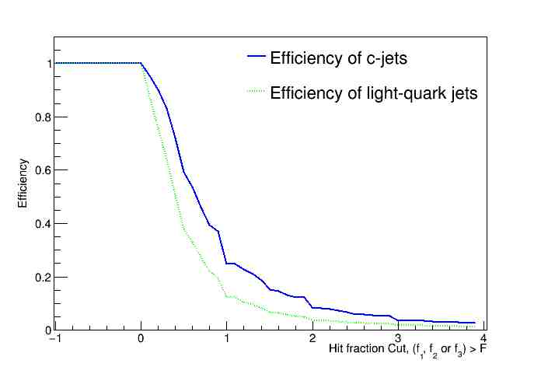
Max(f_{1,}f₂,f₃) > Δhit
Completeness
Charm jets
2.5 TeV
Same set of conditions

Slide 44
Upgrading the simulation
Making sure it works in a more realistic scenario

Slide 45
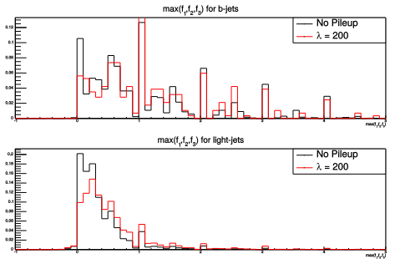
Pileup – max(f₁,f₂,f₃)

Slide 46
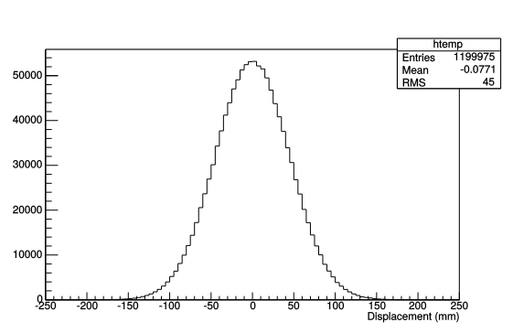
Luminous Region
Events do not always occur at (0,0,0) – modify GEANT4 sim to account for this.
ATLAS has σ_{z}= 45mm
Vertex Z Displacement
New Problem – Jet vectors no longer from (0,0,0), have to be careful when selecting pixels.
Easily resolved by finding the event primary vertex. Once this is done, luminous region vs origin makes no difference to the quality of the tagger.

Slide 47
Upgrading the Tagger
We know it works… Let’s make it work better!

Slide 48
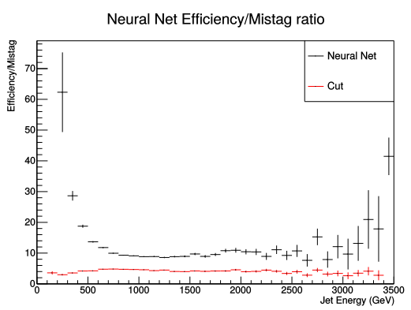
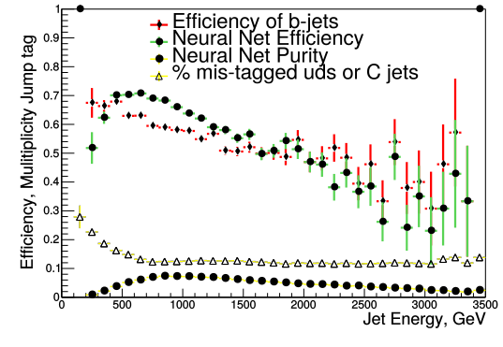
How does it do?
Neural Net Wins!!

Slide 49
Extra Slides

Slide 50
