Slide 1
LHCb
Mapping the VELO Detector
By Abraham Jacob
Supervisors: Tom Latham and Tim Gershon

Slide 2
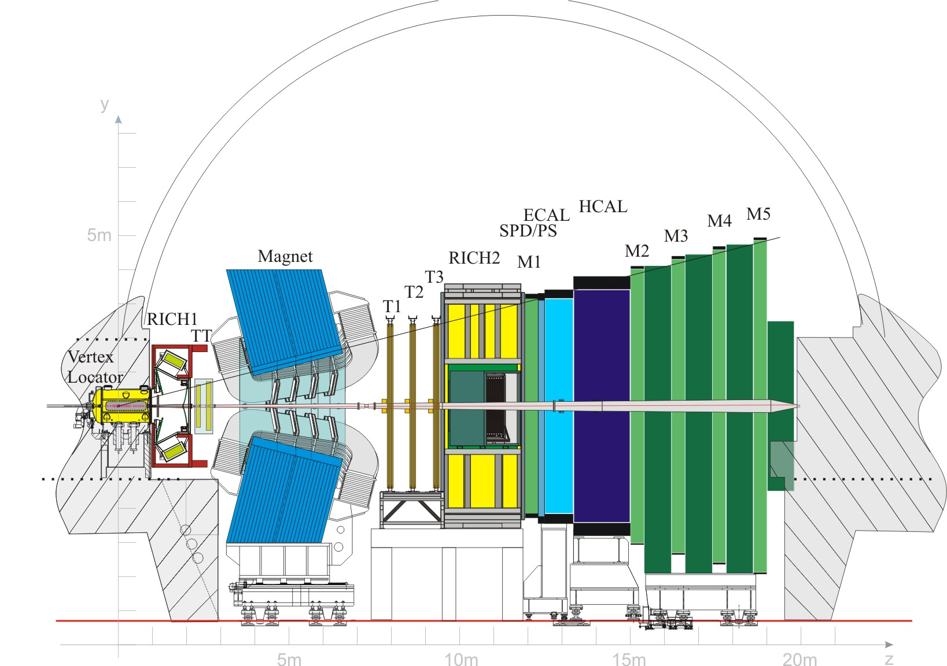
Introduction

Slide 3
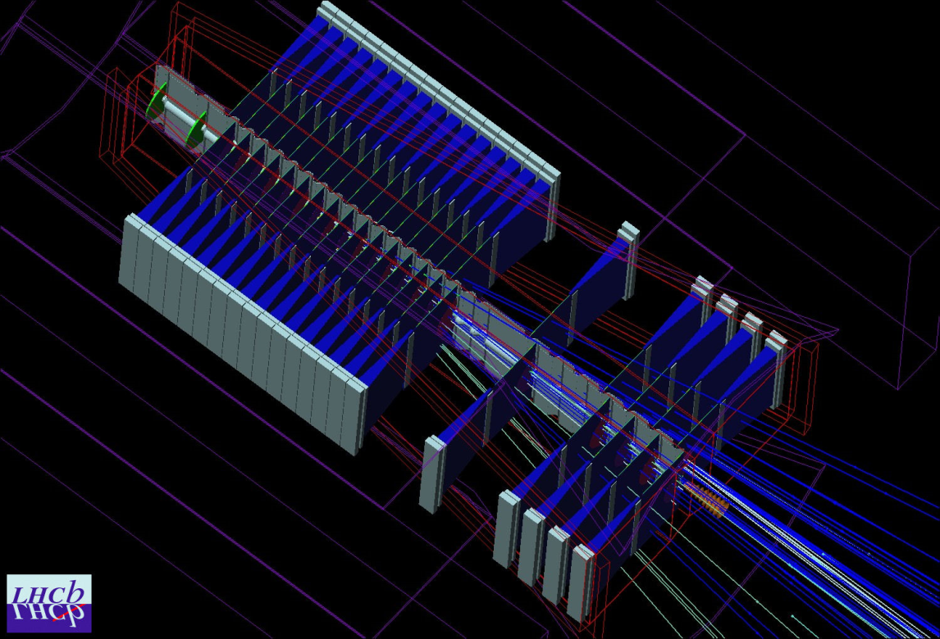
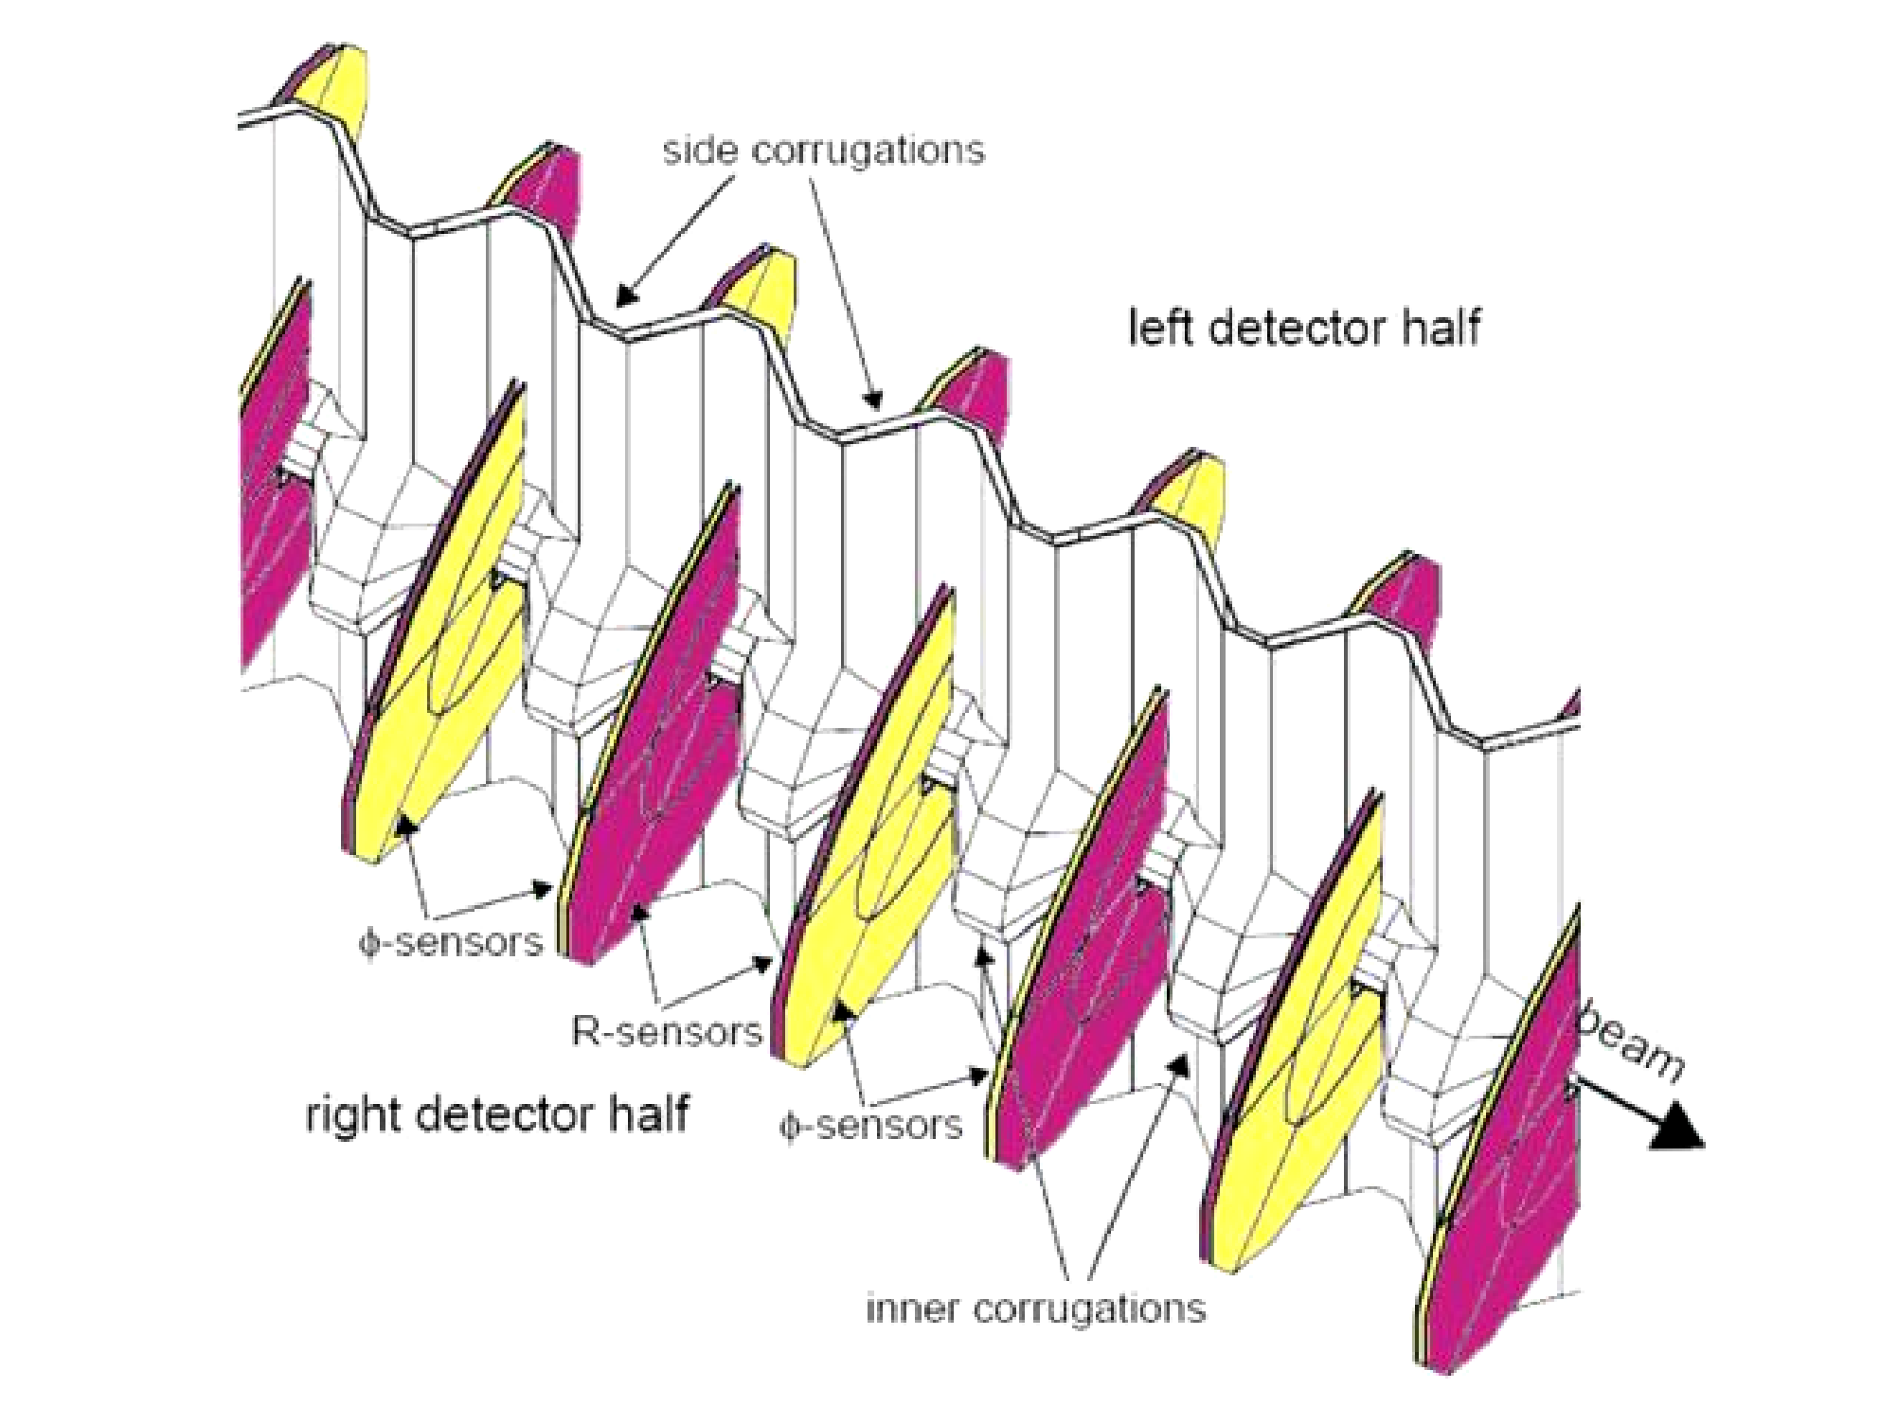
The Vertex Locator (VELO)
Notes:
The VELO’s purpose is to detect the tracks of charged particles specifically B mesons which are of importance to the LHCb experiment with high precision close to the region where the proton beams collide (known as luminous region). As B mesons are relatively long lived and they can move a few mm from the primary vertex so their track must be detected by the VELO , hence it is within millimetres of the proton beams. It has a precise design (which even now there proposed upgrades) to ensure an effective job can be done.
The diagrams here show the layout for the VELO and a more specific view of the components.

Slide 4
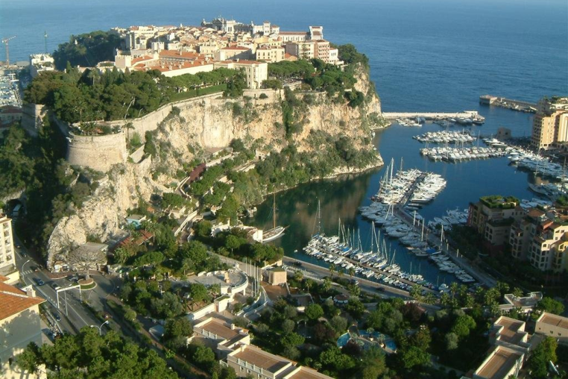
Monte Carlo (MC) and Real Data
Unfortunately not this Monte Carlo.
Monte Carlo algorithms can produce simulated data
Can “reconstruct” the vertex in same way as real data
Also MC truth data where vertex locations are known
Want to compare the simulated data to real data to make sure simulation algorithms are as good as possible
Notes:
As well as using real data the events can be simulated by Monte Carlo algorithms which pass through a simulated “detector” which accounts for the physics we expect to see (based on things such as known probabilities of possible interactions). The product particles can be detected and a vertex can be found by reconstructing back in the same way as would be used for real data. Alternatively since the interactions are artificially created the computer knows exactly where the vertices should be and this constitutes MC truth data. Ideally we want the simulation to be as fully representative of the real data as possible and hence I have used both types of data so there can be comparison.

Slide 5
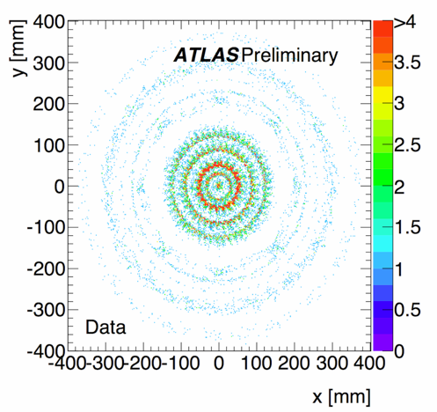
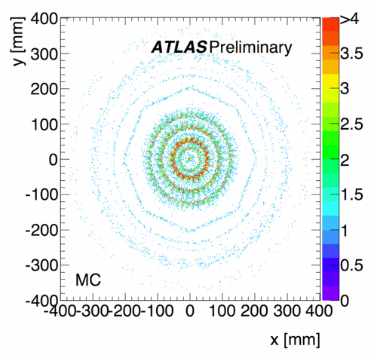
Mapping ATLAS detector
Images from ATLAS collaboration presented at ICHEP, Paris, July 22nd 2010.

Slide 6
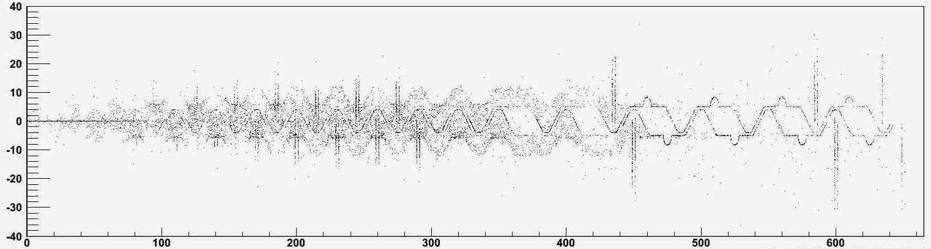
MC Truth Data
x (mm)
z (mm)

Slide 7
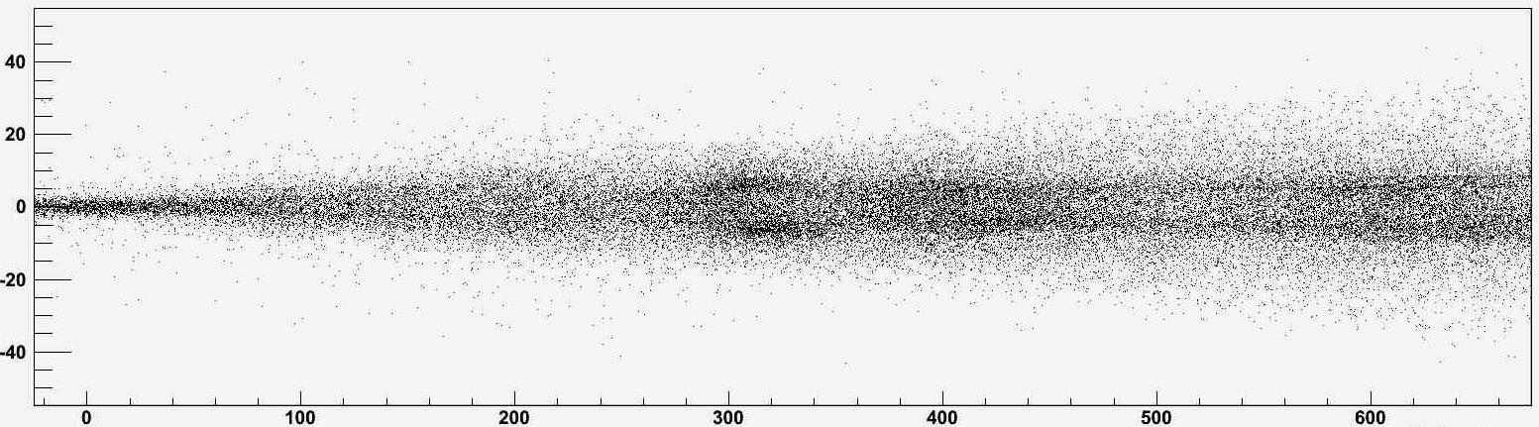
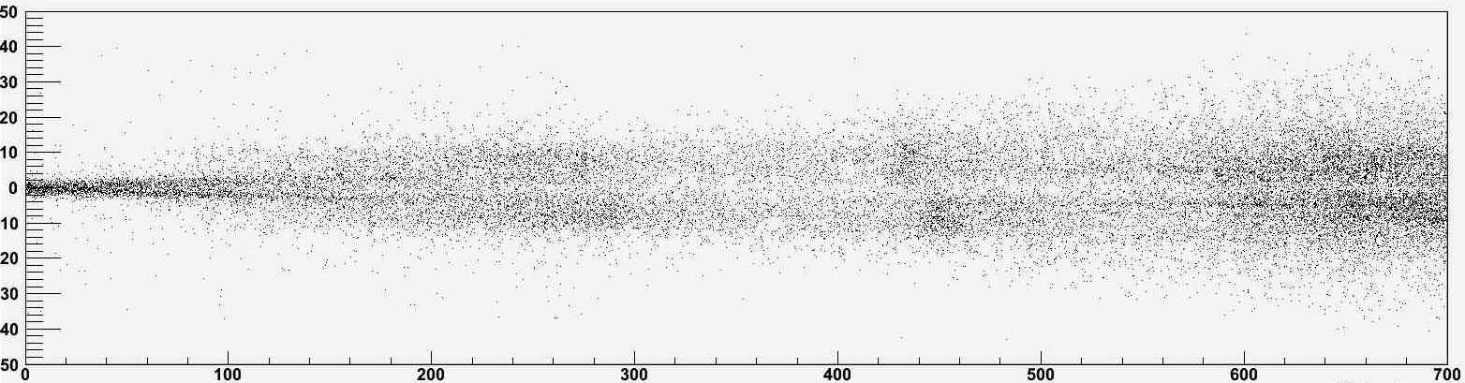
MC data
x (mm)
z (mm)
Real Data
x (mm)
z (mm)

Slide 8
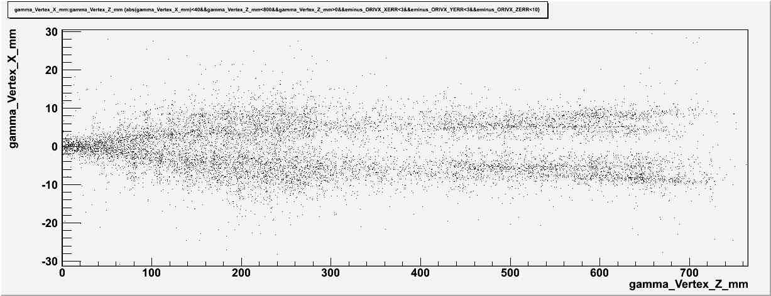
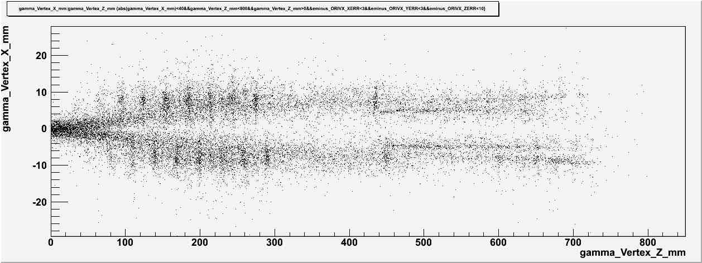
MC data
Real Data

Slide 9
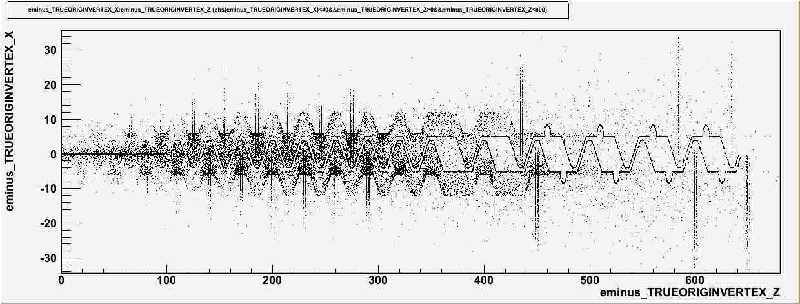
MC Truth Data

Slide 10
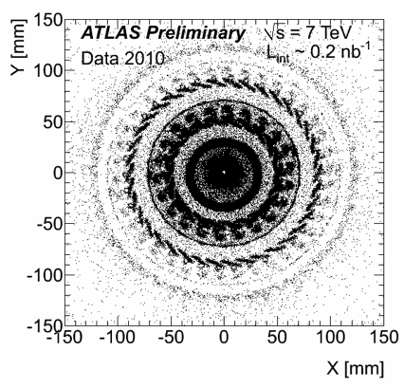
Hadronic interactions in ATLAS
Images from ATLAS collaboration presented at ICHEP, Paris, July 22nd 2010.

Slide 11
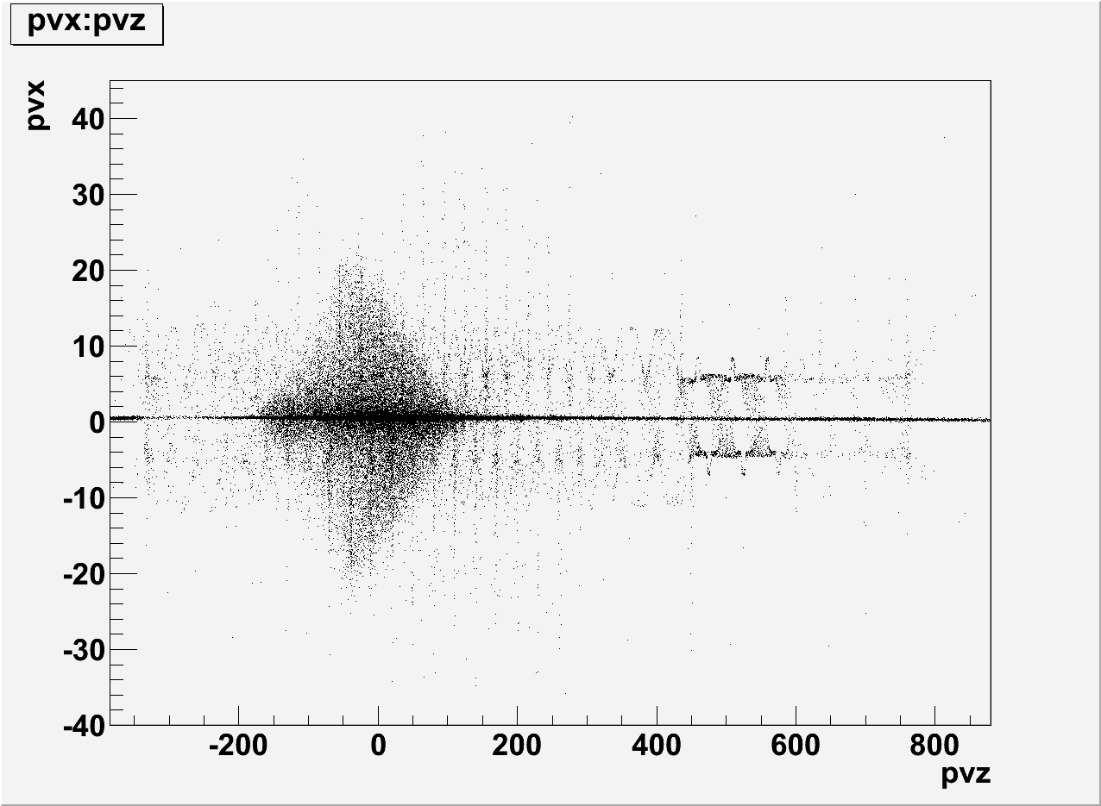
Vertices with at least 3 output tracks

Slide 12
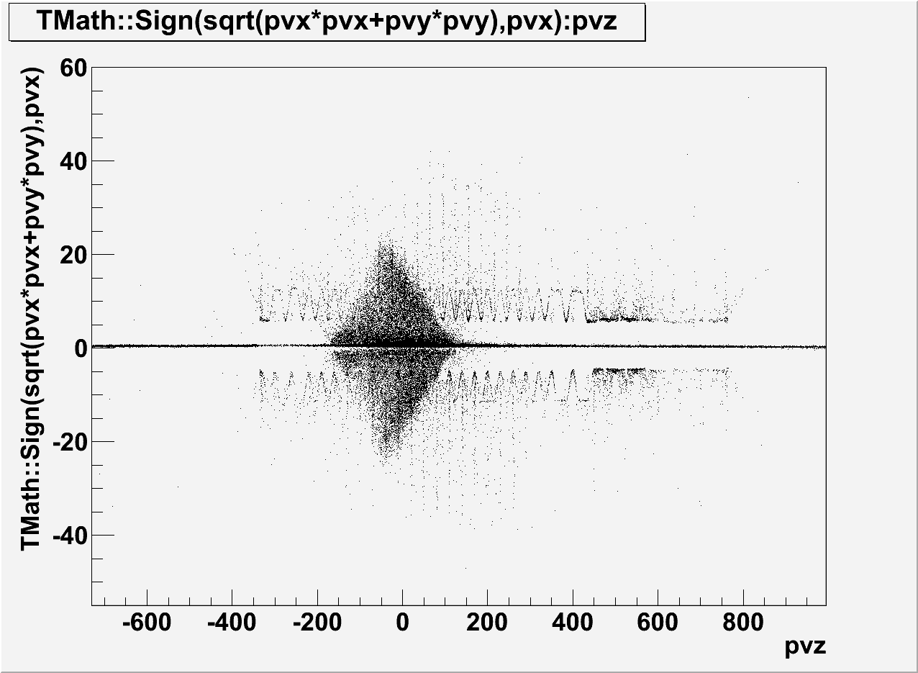
Radius against Z axis

Slide 13
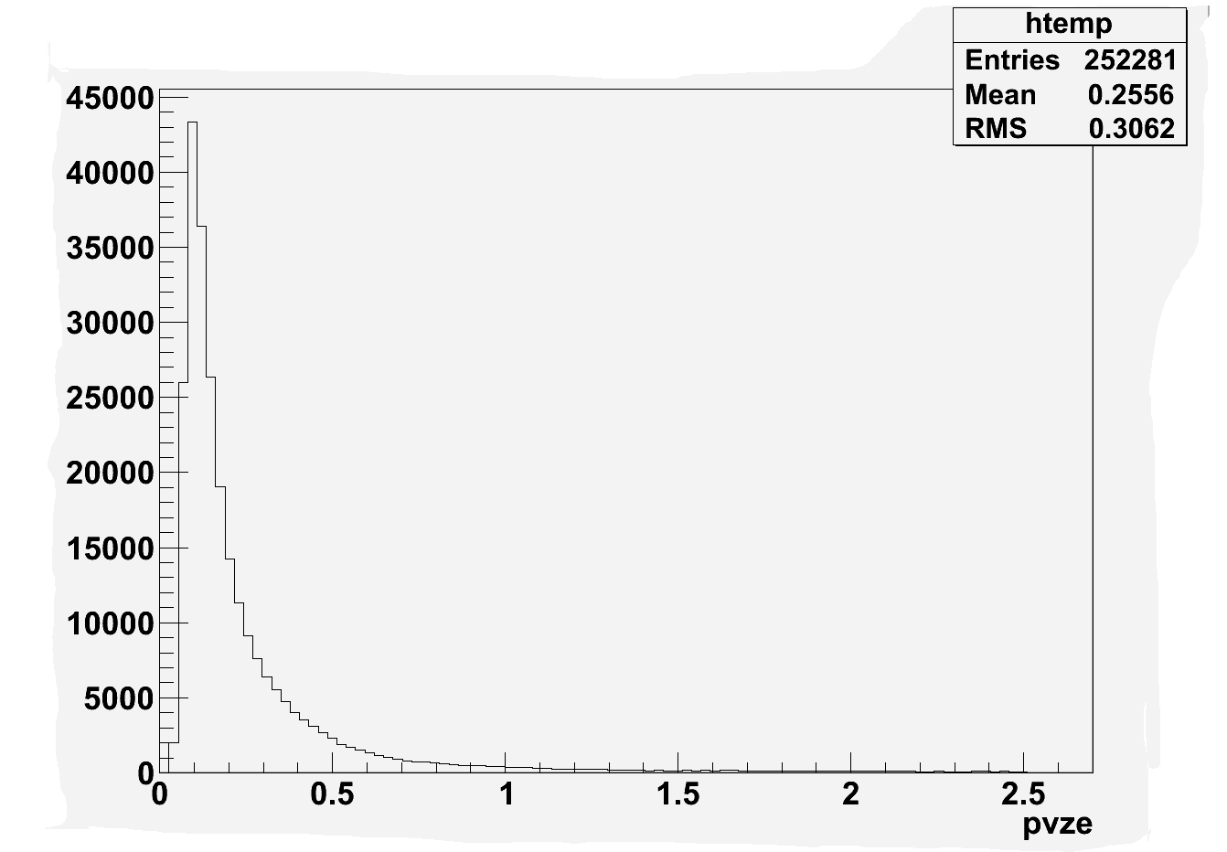
Error in z position in mm

