Slide 1

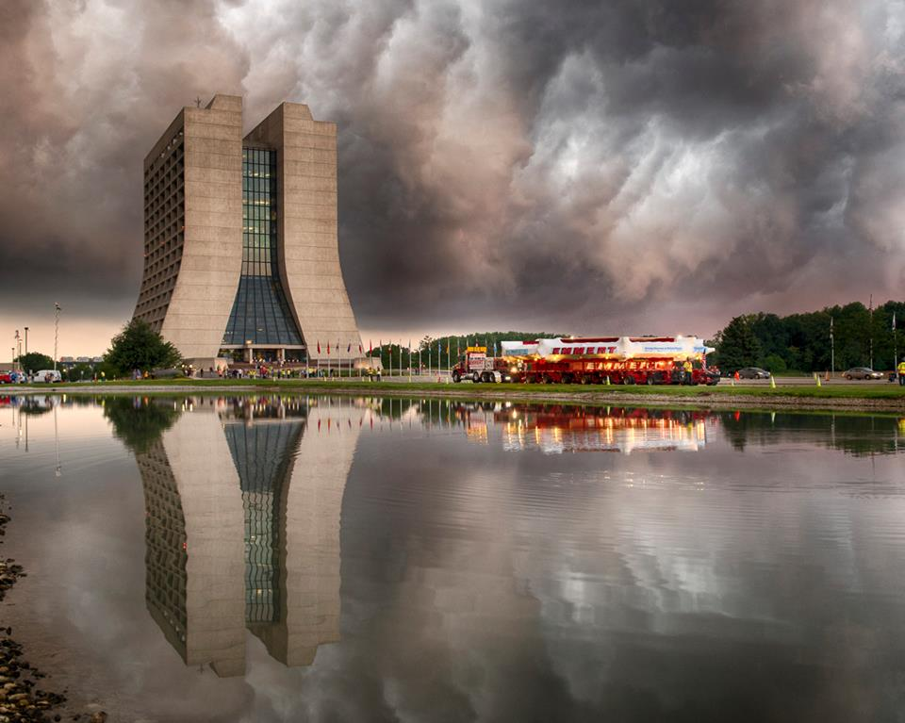
The g-2 experiment at Fermilab
Becky Chislett
University of Warwick
15th March 2018

Slide 2
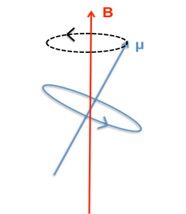


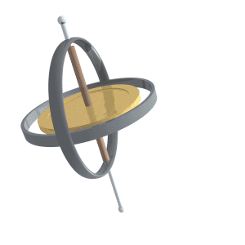


Magnetic moments
The magnetic moment determines how something interacts with a magnetic field
A magnetic moment placed in a magnetic field will experience a force :
Classically the magnetic moment is :
The torque from the magnetic field causes the angular momentum and magnetic moment to precess
Analagous to a gyroscope
For particles with quantum mechanical spin (e.g. electrons) :
Notes:
The magnetic moment for particles is caused by spin and so also precesses in a magnetic field

Slide 3
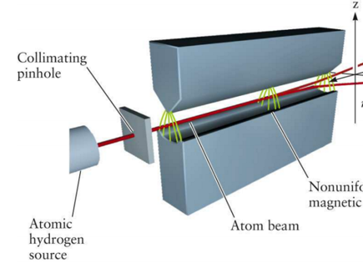

A brief history – Stern-Gerlach
1922
Stern fired silver atoms through a non-uniform magnetic field
Observed a quantised result (up or down) due to the magnetic moment of the silver atom
Collimator
Non uniform magnetic field
Source
Beam
The magnetic moment of a silver atom comes from the lone electron in the outer shell
Demonstrated quantisation of spin
Showed electrons have spin ½
Showed that for electrons g = 2
Notes:
The inhomogeneous magnetic field means that the torque on one end of the dipole is larger than the other causing the particles to move either up or down depending on the direction of the spin.
The circle comes from the fact that the atoms start in a band and only the ones in the centre experience a large enough field to split the atoms
Stern was Einsteins first post doc

Slide 4
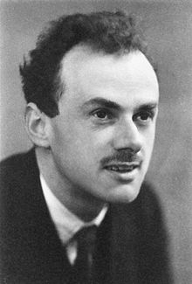

A brief history – The Dirac equation
1928
The Dirac equation is a marriage of quantum mechanics and special relativity with two remarkable children – intrinsic spin and anti matter
The Dirac equation describes all spin ½ massive particles
If a magnetic field is introduced the equation predicts an intrinsic magnetic moment for the Dirac particle with g = 2

Slide 5
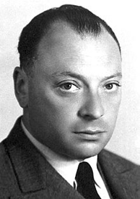
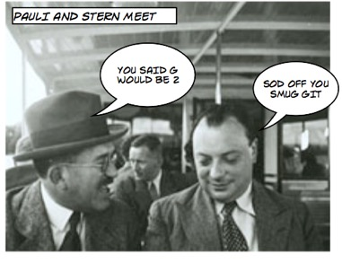
A brief history – proton magnetic moment
1933
It was assumed that the magnetic moment of the proton would be 2 like the electron
Pauli : “If you enjoy doing
difficult experiments, you can do them, but it is a waste of time and effort because the result is already known”
Gerlach : “No experiment is so dumb, that it should not be tried”
Stern measured the magnetic moment of the proton using hydrogen to be between 4 and 6
Confirmed by Rabi using atomic hydrogen.
Also measured deuteron to find a non zero magnetic moment of the neutron
First evidence for substructure of the proton - quarks
Notes:
Magnetic moment of the proton is about 2000 times smaller than that of the electron due to its mass mu = gqh/4mc. So it contributes to the magnetic moment of hydrogen much less but using a longer time they managed to detect it
Rabi used NMR techniques – atoms absorb and reemit EM radiation at a certain frequency in a magnetic field due to their magnetic properties
Using deuteron (p+n with spins aligned) can calculate the magnetic moment of a neutron if you know the value for the proton

Slide 6
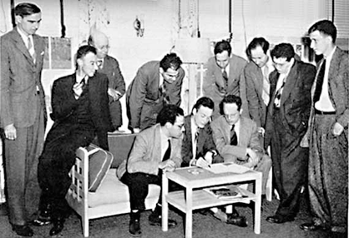
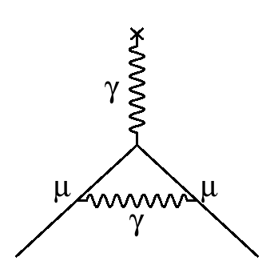
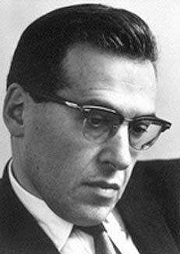

A brief history – Shelter Island
1947
Three measurements caused problems :
  Hyperfine structure of hydrogen
  The Lamb shift
  The magnetic moment of the electron
These results can be explained by a value of g slightly greater than the 2 predicted by Dirac
Schwinger’s theory of renormalisable QED
B-field is simply a photon
e
e
Notes:
Shelter Island : first conference on the foundations of quantum mechanics
Hyperfine structure of hydrogen : Rabi : the difference in energy between the energy levels with spin up and spin down electrons is determined by the interaction between the nuclear magnetic moment and the electron spin -> shows that either alpha is wrong or g != 2
Lamb shift : Lamb : the energies of the 2S1/2 and 2P1/2 orbitals are not the same as Dirac would predict – shows the need for HO QED and that g != 2
Magnetic moment of the electron : Kusch and Foley : done comparing energies of different orbitals in Na and Ga – g != 2
Kusch and Lamb shared Nobel Prize in 1955 and Rabi already got it in 1944.
Present at Shelter Island:
I.I. Rabi, Linus Pauling, John Van Vleck, Willis Lamb, Gregory Breit, Duncan MacInnes, Karl Darrow, George Uhlenbeck, Julian Schwinger, Edward Teller, Bruno Rossi, Arnold Nordsieck, John von Neumann, John Wheeler, Hans Bethe, Robert Serber, Robert Marshak, Abraham Pais, J. Robert Oppenheimer, David Bohm, Richard Feynman, Victor Weisskopf, Herman Feshbach.

Slide 7
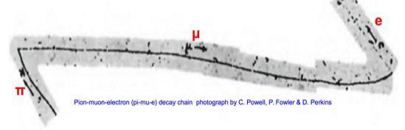
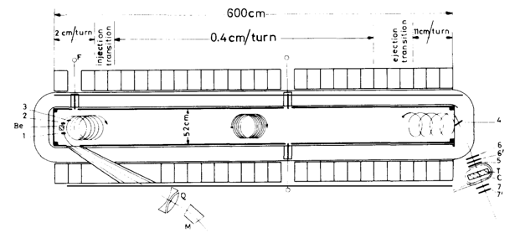
A brief history – Muons
The muon was first observed in a cloud chamber in 1933
It was uncertain what the muon was – a heavy unstable electron?
1956 : Observed
  Parity violation in muon decays
  Muon magnetic moment about 2
1963 : CERN
Measured g-2 of the muon to 4300 ppm - showed that QED was correct
There is no muon substructure
(above 0.2 fm)
Notes:
1933 : first seen in a cloud chamber – “a particle of uncertain nature”
1936 : Anderson and Neddermeyer observed “particles less massive than protons but more penetrating that electrons in cosmic rays”
- confirmed by others the next year
- interacts too weakly with matter to be a carrier of the strong force
Questions :
- Does it have substructure?
- Is it a heavy unstable electron?
- is the electron : muon mass ratio special?
1956 : observed large anisotropy of decay electrons in pi -> mu -> e decays - first evidence of the handedness of weak interactions (parity violation)
1963 : inject muons in one ended and detect their spins at the other after they’ve spent time in the magnetic field using a polarization analyzer

Slide 8
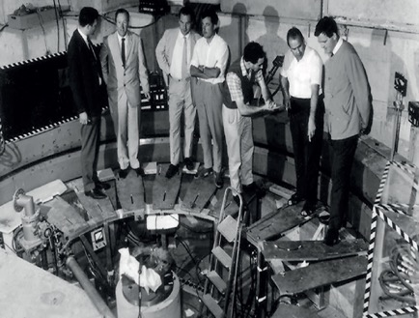
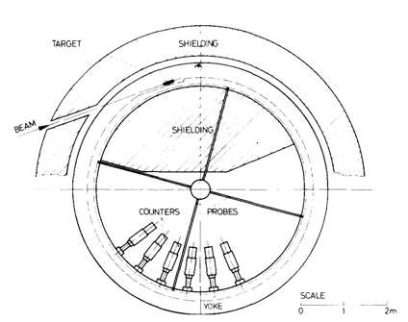
A brief history – CERN II
1968
The CERN II g-2 experiment was the first storage ring experiment
Head of CERN Theory : “The Muon obeys QED. g-2 is correct to 0.5%. In my opinion, it will be right to any accuracy. So it’s not worth doing the experiment”
F. Farley : “Would you like to predict the result?”
Measured g-2 of the muon to 265ppm
        Showed that QED alone wasn’t enough to predict the value theoretically
Notes:
More similar to the technique being used at Fermilab today with a storage ring and detectors on the inside to detect the decaying positron
There were problems :
- range of momenta and polarisation of muons
- trouble constraining the beam and knowing the B field well enough
- low rates
- lots of junk in the detectors from the target which was in the ring

Slide 9
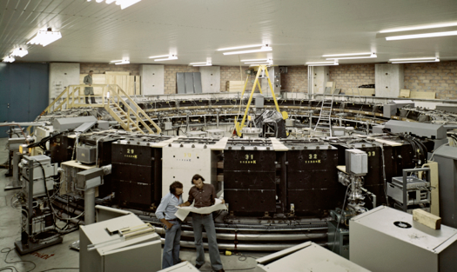
A brief history – CERN III
1976
The third experiment learnt from the lessons of the previous two
  Inject pions into the ring with fixed momentum and polarisation
  Use a constant magnetic field
  Use electric focussing
  Run at the magic momentum (3.094 GeV)
The muon g-2 was measured to 7ppm
Rules out muon substructure down to 0.005 fm
Confirms QED to third order
Notes:
Very similar to the technique used today – especially the magic momentum
Only difference is today we go one step further and inject muons rather than pions into the ring

Slide 10
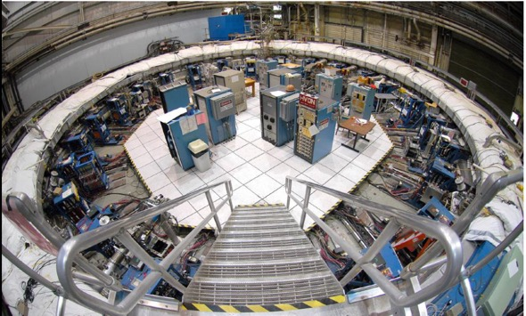
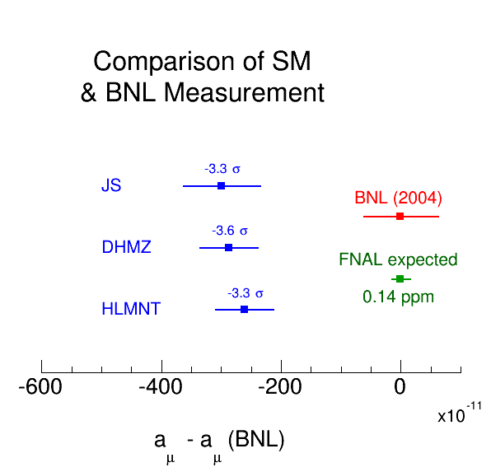
A brief history - BNL
The most recent g-2 experiment was done at Brookhaven using the same experimental technique as is being used at the new experiment at Fermilab
The BNL experiment measured g-2 to 0.54 ppm :
The measurement differs from the theoretical prediction by ~3.5σ.
Is this :
  A mistake in the theory
  A sign of new physics
  A mistake / statistical fluctuation in the experiment
Notes:
I won’t go into detail about the experimental setup as I’ll explain later but the main difference from the CERN experiment was that muons were injected into the ring

Slide 11
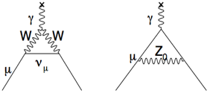

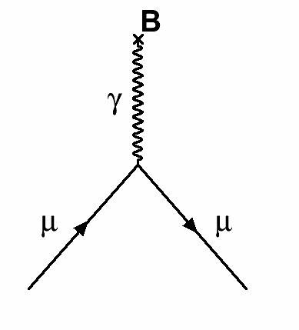

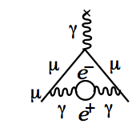
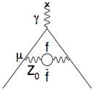

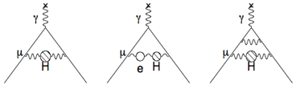

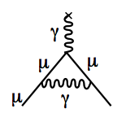

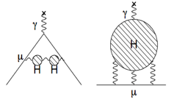
The Standard Model contributions
Dirac
Charged,
spin ½ particle
12672 diagrams
Electroweak
Up to 10th Order QED
Kinoshita
Hadronic
Schwinger
?
Dominant uncertainty in calculation
1st Order QED
Notes:
I won’t go into detail about the experimental setup as I’ll explain later but the main difference from the CERN experiment was that muons were injected into the ring

Slide 12
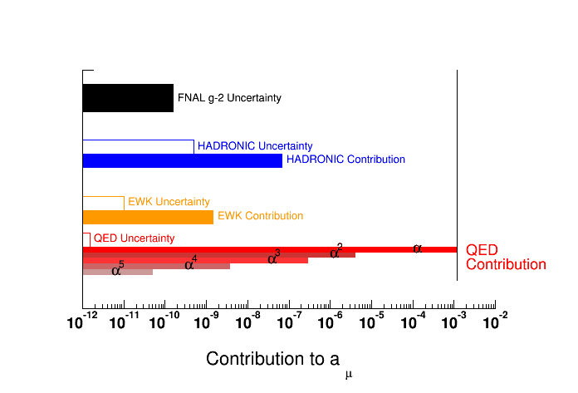
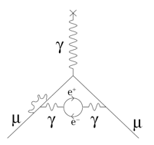
The theoretical prediction
The theoretical calculation has to include QED, electroweak and hadronic contributions
Notes:
Experimental uncertainty inline with the theoretical uncertainty
QED contribution is the largest and the error is the smallest
Hadronic contribution is the hardest to calculate theoretically due to the fact that it is non perturbative

Slide 13
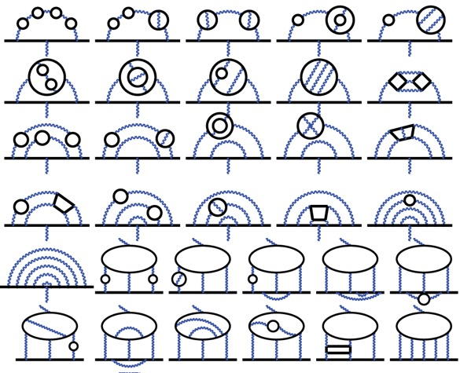
QED
The QED contribution has been calculated exactly up to 5 orders
The calculation includes 12,672 Feynman Diagrams
Theory :
2.00231930436356 ± 0.00000000000154
Experiment :
2.00231930436146 +- 0.00000000000056

Slide 14
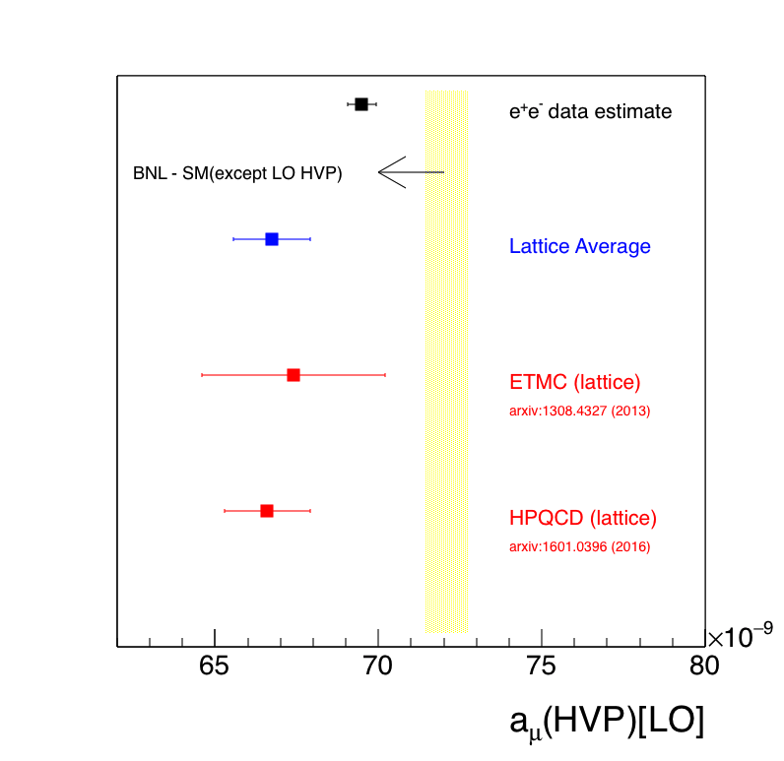
Hadronic Contribution
The hadronic contribution to g-2 cannot be calculated exactly and instead uses experimental e⁺e⁻ cross section data
The largest contribution to the theoretical uncertainty comes from the uncertainties in the low energy cross section data
Contribution to hadronic uncertainty
75%
~ 0%
25%
The result is also backed up by lattice calculations
Expect a factor 2 improvement in the theoretical value due to more precise data
Notes:
Hadronic vacuum polarisation relies on data from e+e- -> hadrons data which is the main source of uncertainty
Expect more data from BESIII and VEPP-2000 which should cover a larger energy range and give greater precision. Currently limited by the small disagreements in the experimental measurements
more precise data with more channels and ISR vs direct-scan from BES-3, SND, CMD-3, KLOE-2, final BaBar and then Belle-2
Hadronic light by light cannot be calculated using experiments so has to use hadronic models that reproduce QCD
Lattice calculations are now catching up – allows for a comparison to a different calculation method. The errors are still larger currently but are getting smaller.
The lattice calculation is in rough agreement with the e+e- calculation – same side of the data, about 3.5 sigma away

Slide 15
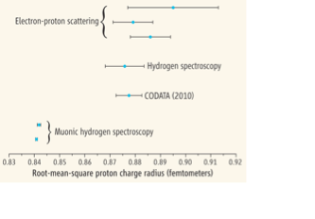
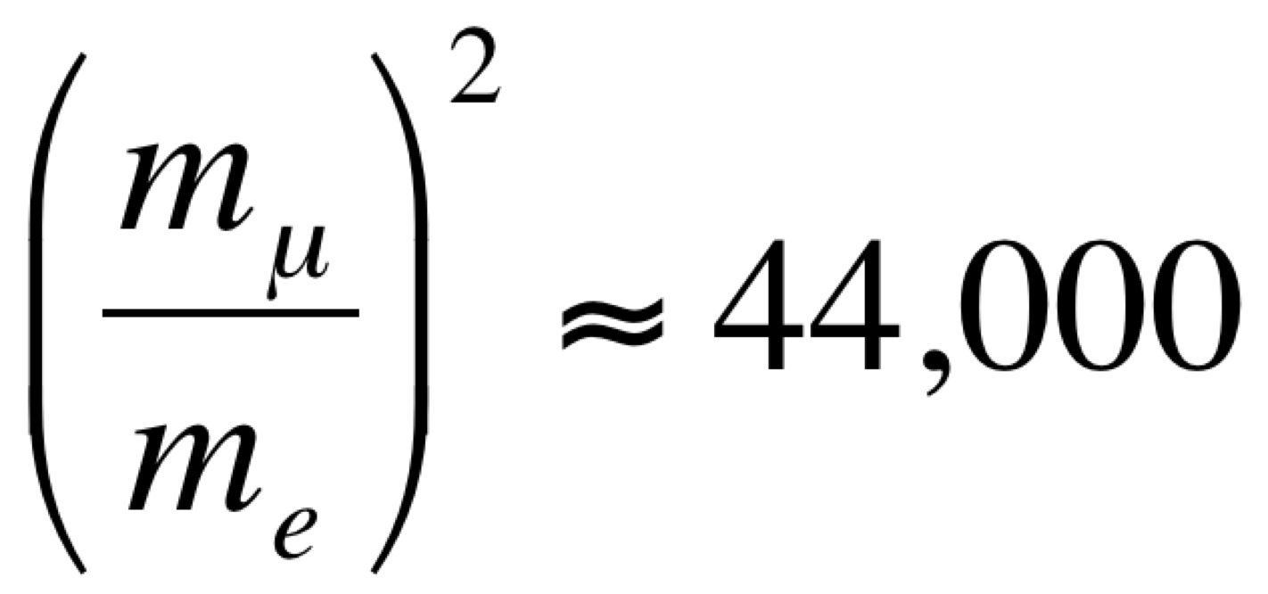
New Physics?
New physics can contribute in the loops and adjust the value of g-2
New physics would contribute as
The electron g-2 is measured 2000 times better than the muon g-2, but
Muon g-2 is sensitive to new physics from MeV to Tev scales
Electron g-2 is limited to new physics below 100 MeV
????
The only measurements for which the SM has no compelling explanation are in the lepton sector :
    Neutrino oscillations
    Proton radius of muon hydrogen : 7.9σ
      arxiv: 1502.05314

Slide 16
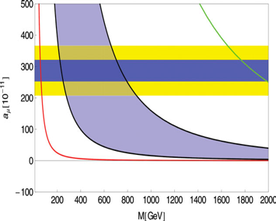
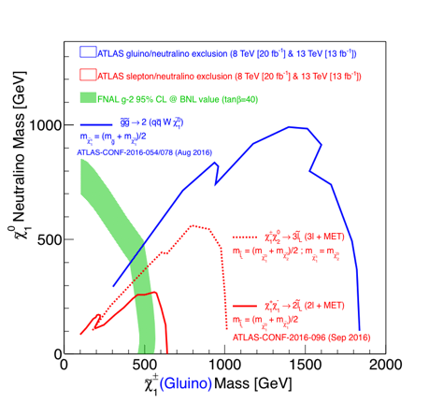
New Physics?
The muon g-2 can probe new physics at TeV scales – complementary to the LHC
Radiative muon mass / technicolor
The value of the muon g-2 can help set limits on models of new physics
The g-2 interactions flip the chirality of the muon but conserve flavour and CP
a_{μ} [10⁻¹¹]
SUSY, RS-EDs
Z’, UED, Littlest Higgs
The LHC has good sensitivity to strongly interacting new physics (SUSY)
But is less sensitive to weakly interacting new physics
Muon g-2 is probing similar phase space as the LHC with more sensitivity in some areas
Notes:
Top right plot : the value of g-2 cuts out some BSM models – provides a different probe for the same models as the LHC is measuring
Bottom left plot : g-2 is a good probe for weakly interacting physics where the LHC is less sensitive
G-2 is complementary to the LHC data – if something is observed at the LHC the value of g-2 will help to work out what it is or vice versa.

Slide 17
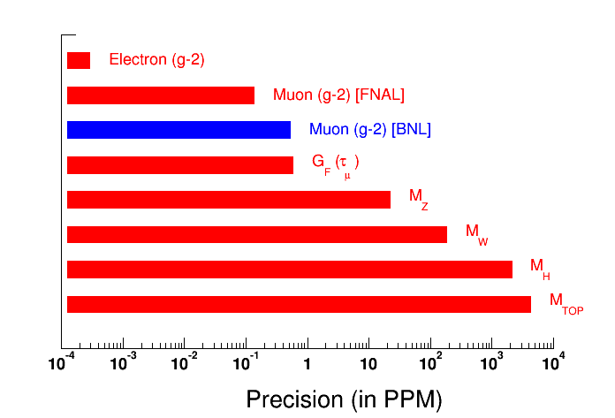
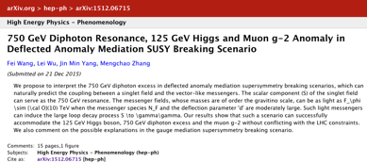
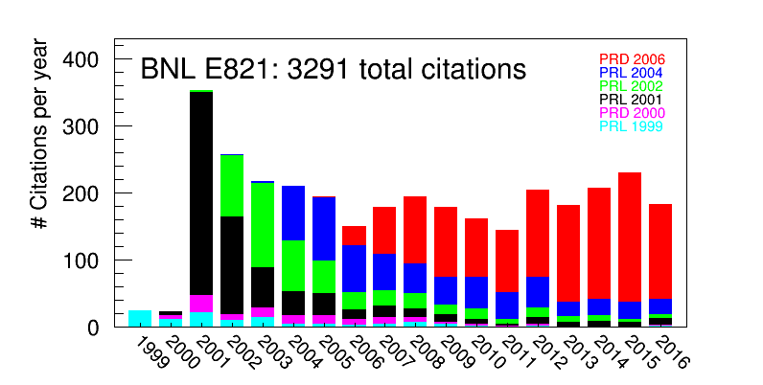
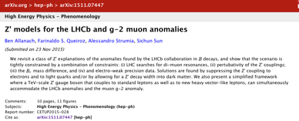
Redo the measurement…
In order to find out if there really is a discrepancy between the theory and experiment we need a higher precision measurement
0.14 ppm
0.54 ppm
Enough to establish 5-10 σ
Notes:
One of the most precisely measured quantities in particle physics
Need precision in order to determine if there is some new physics or if it is just a measurement error/fluctuation
5-10 sigma depending on the advances in the theory predictions (5 with no improvements)

Slide 18


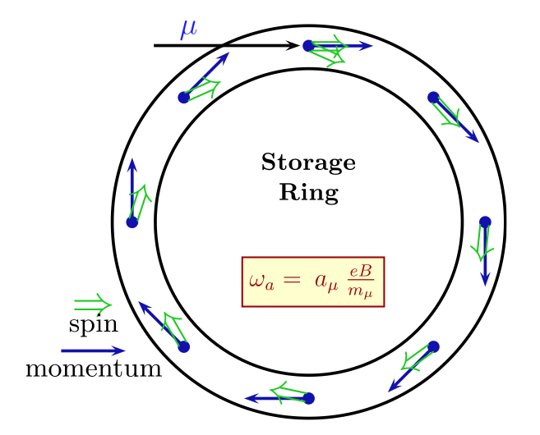


Experimental setup
The anomalous magnetic moment causes the spin to precess faster than the momentum vector as the muon moves around the ring
In a 1.5 T magnetic field the spin rotates in 144ns and the momentum in 149ns
Measure the spin precession from the positron decays
Measure the magnetic field in the ring
Notes:
Inject a beam of polarised muon into the ring and wait for them to decay (2.2us)
Both spin and momentum vectors precess but the spin precesses faster -> spin precesses around the momentum vector due to the anomalous part of the magnetic moment
If g=2 then they would both go at the same speed
Measure the difference in the spin and momentum precession and the magnetic field and extract the value of the anomalous magnetic moment

Slide 19
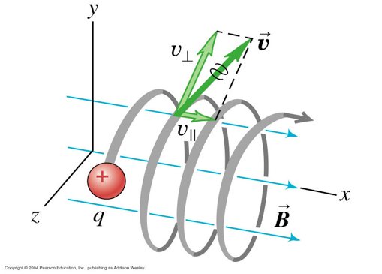
Vertical Focussing
The magnetic field that keeps the muon in orbit causes the beam to diverge vertically so we need a vertical constraining force – an electric quadropole
The electric field looks like an addition magnetic field to a moving particle and so adds a term to the precession frequency :
By choosing γ = 29.3 we can cancel out this term
Run at the magic momentum, p = 3.094 GeV – the CERN-III miracle!
Even so there are small effects :
  The muons aren’t exactly at the magic momentum
  There is a small degree of vertical motion of the muons
These small corrections can be calculated using the tracker and beam dynamics models
Notes:
The CERN II experiment had problems with keeping the beam constrained vertically. Any vertical momentum means the particles spread outwards
They didn’t want to use an electric field because it changes the precession frequency – an electric field looks like a magnetic field to a moving particle
But at CERN-III they realised that they could cancel this term out by choosing the momentum wisely

Slide 20
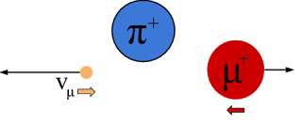
Muon production
A proton beam is hit into a pion production target and the muons from the pion decays are collected
Protons hit a pion target to produce pions which subsequently decay :
The muons and protons separate as they go around the delivery ring
Delivery Ring
Target
p
26 ns
3.11 GeV pions selected using a lithium lens
In the pion decay the neutrino must have spin opposite to the momentum
    To conserve spin the muon spin must also be opposite to the momentum
We get a naturally polarised muon beam from the physics of the pion decays
Notes:
Pion target : 8 GeV protons into heavy material (Inconel – Ni with Cr and Fe), focussed with a lithium lens, put through a 3 degree turn in a B field to select pions with 3.11 GeV (slightly higher than the magic momentum) wrong sign and other energies get dumped.
Pion decay : pi -> mu + nu, neutrino has to be LH, pion spin is 0 so muon has to have spin opposite to neutrino. Rest frame emitted in opposite direction so has to be RH – i.e. the spin is in the opposite direction to the momentum producing a polarised beam.
Get > 90% polarisation by selecting highest energy muons

Slide 21
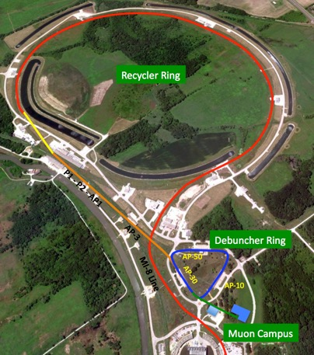
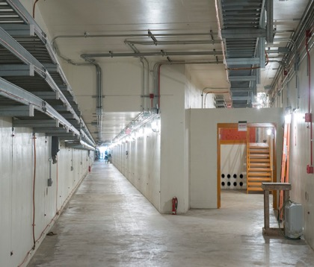
Accelerator Modifications
The Fermilab accelerator complex has been adjusted to provide 20 times more muons at lower instantaneous rate with reduced pion contamination compared to BNL
Modifications to the proton accelerator to allow for the pulsed beam
The old antiproton complex is reconfigured to provide muons
Recycler Ring
Delivery Ring
Mu2e
g - 2
Notes:
The accelerator has been repurposed to provide a Fermilab muon facility (g-2 and mu2e)
Accelerator mod allow 15Hz rate of protons
Antiproton complex becomes the delivery ring – goes around this for a few turns to allow for all the pions to decay before going into the g-2 ring

Slide 22
Improvements since BNL
Unique capabilities
of FNAL accelerators
More μ per proton
Lower inst. rate
Fewer pions
ENERGY
FRONTIER
Improved detectors
Improved stored muon
beam dynamics
New / improved technologies
Additional collaborators
Building on wealth of experience
from BNL E821 & other expts
Improved field uniformity, field
measurement & calibration
Improved modeling of beam
& detectors
Notes:
How do we plan to improve the sensitivity at the new experiment from 0.54 to 0.14 ppm?
Move to Fermilab -> the accelerator system there is better equipped to provide a pure muon beam
- longer decay time for the pions before entering the storage ring so the beam is more pure
- lower instantaneous rate -> less pile up, but more muons – bunched beam
Also use the same ring but replace pretty much everything else
- better detectors including new trackers (UK)
- better beam modelling with improvements to the computing abilities and increased understanding
- more uniform field – computer simulations allow for very small adjustments
- choose a better running point for the electrostatic quadrupole so the beam motion is minimised
Larger set of collaborators with the expertise from people on the previous experiment. Better technology.

Slide 23
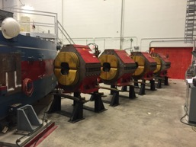
Injection into the ring
The muon beam enters through the inflector magnet on the wrong orbit and needs a kick to get onto the correct orbit
Inflector
The inflector magnet is a field free region allowing the muons to enter tangentially to the orbit
B = 1.45 T
Injection orbit
The kicker magnets provide a vertical magnetic field to put the muons on the correct orbit
Central orbit
Kicker
magnets
R
R
The muons need a ~11mrad kick
Notes:
Inject through a field free region so the beam is not bent as it enters. On a tangential orbit but at the wrong position.
Kickers provide a vertical magnetic field to kick the muons sideways by about 11 mrad on the first turn.

Slide 24
New Kicker Magnet
A new kicker magnet is being designed for the Fermilab experiment which should provide a shorter pulse
The ideal kicker pulse is a constant field across one orbit of the beam
The BNL kicker pulse went across 3 beam cycles
A new kicker has been designed at Cornell with 200ns width
Notes:
Ideally the kicker pulse should be the same for all muons whether they’re at early or late injection times.
Red : muons passing the kickers
Blue : idealised kicker pulse
Reality : takes time to turn the field on and off so can’t get the sharp peak.
Cornell – pulse dies odd by 200ns – one muon turn

Slide 25
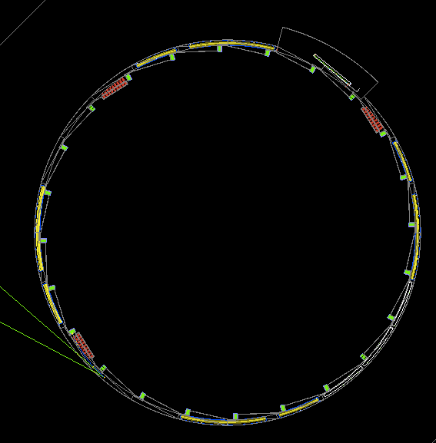
Final Ring Design
μ⁺
Inflector Magnet
The storage ring for the Fermilab experiment is the same as the one used at BNL
7 cm
Q1
Q4
Kicker magnets
7.1 m
In GEANT4
Tracker
Q3
Focussing quads
Q2
Fiber harps
Tracker
Collimators
24 calorimeters
The detectors lie on the inside of the ring for beam monitoring and measuring the precession frequency from positron decays
Tracker
Notes:
Focussing quads – veritcal focussing
Kickers to get the right orbit
Collimators to scrape muons which are not at the right momentum or position
Detectors in the centre :
- calorimeters to detect the hit time and energy of positrons
- trackers at 3 locations to get more precise positron trajectories to model the beam
- fibre harps – obstructive so can’t be used for real data taking but in dedicated runs they are moved out to map the beam profile. Trackers allow this to be done to an extent while we are data taking.

Slide 26
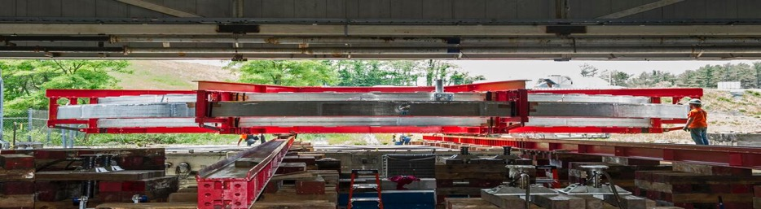

The Big Move
ENERGY
FRONTIER
Notes:
The ring had to be moved from BNL to Fermilab – needed to maintain high tolerances so minimal movement of the parts during transfer – best to go by sea.

Slide 27
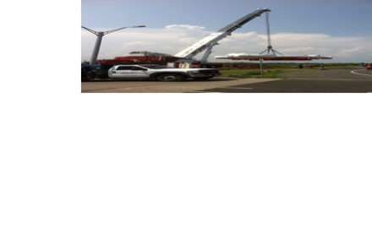
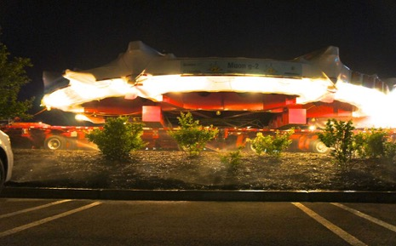

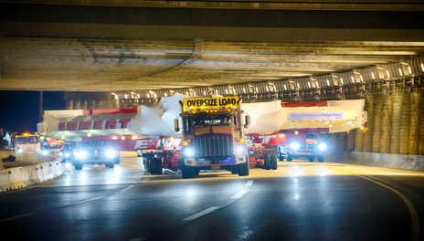
The Big Move
ENERGY
FRONTIER

Slide 28
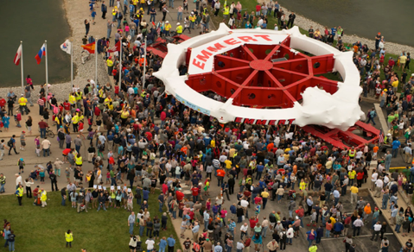
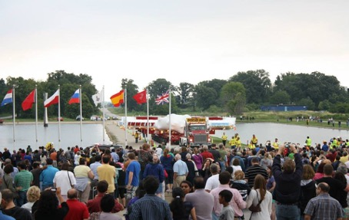
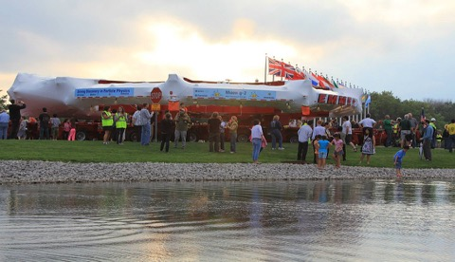

Arrival at Fermilab
ENERGY
FRONTIER

Slide 29

Arrival at Fermilab…

Slide 30




Installation
Bottom yoke pieces
SC coils installed
ENERGY
FRONTIER
Top yoke pieces

Slide 31

Installation
RECYCLER
TARGET
DELIVERY
RING
g-2
Mu2e
MUONS
BOOSTER

Slide 32



The magnetic field
The measurement of g-2 requires a very uniform and precisely measured magnetic field in the storage region
The magnetic field has been on for the past year and is in the process of shimming the magnet to achieve ±25ppm uniformity
Shimming involved using shims that are thinner than a human hair!
Notes:
Pole pieces can be adjusted
Top hats and wedges are adjusted
Surface shims are put in (as thin as a human hair)
Need ±25ppm uniformity azimuthally.

Slide 33


Measuring the Magnetic Field
The magnetic field is measured using 375 fixed probes and 17 probes on a trolley that is driven around the ring every 2 hours
Field measurement as the trolley moves around the ring during the early stages of shimming
Improvements since BNL :
  Better probes
  Improved temperature control
  More frequent measurements
Notes:
Fixed probes on the edge of the storage region (outside the beam). Trolley measures the magnetic field where the beam is between runs.
BNL : measured every 2 days, Fermilab measure every 2 hours. More probes.
Plot shows the probes on the trolley making their measurement as it goes around the ring when the field was first turned on last November.
Started with 1400 ppm uniformity

Slide 34


Measuring the magnetic field
The muon distribution must be convoluted with the magnetic field in order to calculate the final result
The muon distribution in the storage region
We need to know the magnetic field that a muon has experienced at the point of decay.
As the magnetic field is not perfectly uniform over the storage region we convolve the two
Notes:
Muons are not distributed evenly in the storage region – more muons in the centre.
Magnetic field is pretty uniform across the radial direction but varies more aimuthally – left plot shows azimuthal variation, right plot shows radial variation.
Need to know what magnetic field the muon has experience as it goes around the ring so need to convolve the two to get the final result

Slide 35






Shimming progress
The magnet uniformity is now 4 times better than it was at BNL
+
Poles
Top hats & wedges
Surface foils
50
ppm
~1400 ppm
Oct 2015 → Sep 2016
Notes:
Shows the shimming progress in the past year.
BNL magnet is shown in blue.
Start adjusting the poles
Then in may/june top hats and wedges
August : surface foils
End see that we’re at ±25ppm, 4x better than BNL

Slide 36


Measuring the spin precession
The spin precession is measured by detecting the positrons from the muon decays using detectors in the centre of the ring
High E kinematics
A consequence of the weak decay is that the highest energy positrons are emitted along the direction of the muon spin
RH
s
p
RH
LH
Measure the number of the highest energy positrons decaying at a fixed location as a function of time
The number varies at the frequency determined by the spin precession (g-2)
Complicated by the fact that the muon is not decaying at rest, but this is precisely predicted
Notes:
How do we measure the spin precession?
Highest E configuration : positron emitted in the direction opposite to the neutrinos
- neutrino must be LH, anti neutrino must be RH so their spins cancel
- positron must carry the muon spin and is preferentially RH so is emitted along the muon spin direction
Conversely in the lowest E configuration : positron emitted in the same direction as one of the neutrinos
- neutrino LH, anti neutrino RH -> opposite directions so their spins add
- positron wants to be RH so is preferentially emitted to cancel the neutrino spin in the opposite direction of the muon spin direction
Not decaying at rest : gets a boost
When muon decays the positron spins into the ring because of the magnetic field so place calorimeters in the centre of the ring to detect the decaying positron
Only select those with the highest energy so we know they’re most likely to be in the same direction as the muon spin
Number detected at a point should vary in time with the spin precession

Slide 37


Wiggle plot
Plot the number of positrons arriving in the calorimeters with an energy larger than 1.2 GeV as a function of time
The data is from the BNL g-2 experiment :
  The number oscillates due to the spin oscillation
  The total number decreases exponentially as the number of stored muons decreases
In order to extract the precession frequency the data is fitted :
Notes:
Also the ratio method which tried to cancel out the exponential component to make for an easier fit.

Slide 38



Calorimeters
The calorimeters need to accurately measure the energy and time of the positrons from the muon decays
Requirements :
  Better than 5% energy resolution
  Time accurate to 100ps
  Resolve all showers separated by more than 5ns, and most below that
  Stable gain during a fill
Improvements :
  Segmented calorimeter
  Faster sampling rate
  Quicker response
  Improved energy resolution and gain
  Laser calibration system
Notes:
Segmented calorimeter – have some spatial information which makes it easier to separate pileup events
Faster sampling rate – how often you read out the PMT information, gives you better timing information and pulse shape
Improved technology means a quicker response
Laser calibration system to be run between fills means a good knowledge of the gain at all times.

Slide 39



Commissioning Run (Summer 2017)
The commissioning run last summer was the first test of the full experiment with a beam highly contaminated by protons
decay e⁺
p/μ⁺
(MIPs)
Spatial Reconstruction
3 GeV e⁺ in few crystals
μ⁺
Majority of particles hit crystals closest to beam
Notes:
Also the ratio method which tried to cancel out the exponential component to make for an easier fit.

Slide 40

Commissioning Run (Summer 2017)
The commissioning run last summer was the first test of the full experiment with a beam highly contaminated by protons
Proton flash
The arrival time of hits in the calorimeters shows a lot about the beam
  Positron decays
  Proton contamination
e⁺ from stored muons
Beam loss as quads turn off
Time [μs] : One bin = One turn
The wiggle plot could be extracted from the data
This data will be collected in ~1 minute when running at full intensity
Notes:
Also the ratio method which tried to cancel out the exponential component to make for an easier fit.

Slide 41





Straw Trackers (UK)
The straw trackers allow for the reconstruction of the positron tracks and traceback to the storage region
Aims :
  Measure the beam profile in multiple locations around the ring as a function of time
  Calibration and acceptance of the calorimeters
    Pile up, gain, lost muons
  Measure or set a limit on
  a muon EDM
Storage Region

Slide 42



Commissioning run – first tracks!
The commissioning run was the first test of the tracker and tracking algorithms with real data
Non-stored protons
e⁺ & p
Nice long tracks (hitting many modules) from the protons
Uniform illumination of the tracker with more hits closest to the storage ring
Momentum distribution consistent with a proton dominated beam
Notes:
Plot known DCA from the silicon auxilliary detector against the measured DCA from the straws data to get resolution.

Slide 43


Commissioning run – first tracks!
Due to the composition of the beam the observed momentum distributions differ between the commissioning run and the latest data
In the tracker we cannot distinguish protons, positions and muons so they all show up in the momentum distributions :
Non-stored protons
e⁺
Non-stored muons
e⁺ & p
Commissioning Run: Summer 2017
Tuning Runs: December 2017
Notes:
Plot known DCA from the silicon auxilliary detector against the measured DCA from the straws data to get resolution.

Slide 44




Beam tuning data
The more recent beam is not proton dominated
The momentum distribution is mostly from positron decays
The g-2 wiggle also appears in the trackers after a momentum cut
The FFT shows up the g-2 frequency and the beam oscillation frequency
e⁺
Non-stored muons
p > 1.8 GeV
g-2
FFT
Beam Oscillation
Notes:
Plot known DCA from the silicon auxilliary detector against the measured DCA from the straws data to get resolution.

Slide 45








Beam distribution from the trackers
The tracks can be extrapolated back from the point of tangency to get the beam distribution
Decay Vertices
Radial & Vertical Position
Radial Position within Fill
Mean & RMS of Radial Position
Notes:
Plot known DCA from the silicon auxilliary detector against the measured DCA from the straws data to get resolution.

Slide 46


Tracker – Calo Cross Checks
The trackers are located in front of 2 of the calorimeters so can be used for systematic checks in terms of gain and pile up
Engineering Run
Comparison between calorimeter energy and tracker momentum
See correlation as expected for the decay positrons
Calo Energy [MeV]
e⁺
p
Track Momentum [MeV]
Can check the pileup in the calorimeter – for example here there are 2 tracks but only one calorimeter cluster
Notes:
Plot known DCA from the silicon auxilliary detector against the measured DCA from the straws data to get resolution.

Slide 47




EDM
The g-2 experiment at Fermilab can also look for a potential muon EDM
Fundamental particles can also have an EDM
defined by an equation similar to the MDM:
Defined by the Hamiltonian:
Provides an additional source of CP violation
 | E | B | μ or d
P | - | + | +
C | - | - | -
T | + | - | -
Standard scaling :
d_{e} limits imply d_{μ} scale of 10⁻²⁵ e•cm
But some BSM models predict non-standard scalings
(quadratic or even cubic)
The muon is a unique opportunity to search for an EDM in the 2nd generation

Slide 48



EDM
If an EDM is present the spin equation is modified to:
MDM
EDM
Dominant term
An EDM tilts the precession plane towards the centre of the ring
Vertical oscillation
(π/2 out of phase)
Expect tilt of ~mrad for d_{μ} ~10⁻¹⁹
An EDM also increases the precession frequency
Should reach BNL sensitivity in a few weeks (~1 million tracks)
Expect to reach 10⁻²¹ by the end of the experiment (several billion tracks)

Slide 49

Systematics
To put the precision into context consider this 1000 piece jigsaw with 1 missing piece…
1,000 ppm

Slide 50

Systematics
Consider 100 jigsaw puzzles with only one missing piece
CERN result was ~7ppm
10 ppm

Slide 51


Systematics
7143 jigsaw puzzles with one missing piece
140 ppb
Lose one piece 140ppb (Fermilab aim)
Every detail counts!

Slide 52
Summary
The new g-2 experiment at Fermilab is getting ready to start physics data taking
  Expecting to start taking physics quality data within the next few weeks
  The new experiment aims to reduce the experimental uncertainty by a factor to investigate the current discrepency between experiment and theory of ~3.5
  Expect to publish an early result with comparable to BNL precision by early 2019 (based on the data taken between now and the summer)
  An internediate result will be published in 2020 and then the final full precision result in 2021

Slide 53










Thank you
ENERGY
FRONTIER

Slide 54
Back up

Slide 55

Magnetic Field Systematics

Slide 56

Spin Precession Systematics

Slide 57
Beam distribution
In reality we need to accurately model the beam for vertical polarisation components and momentum distribution
The pions and daughter muons enter the delivery ring for several turns before injection into the muon storage ring
BMAD simulation of the beamline
Notes:
Beam is not perfectly polarised or of exactly the right momentum. Beam modelling allows us to have a good understanding of the beam distribution.
Also have scraping in the ring to get rid of muons with the wrong momentum on entering the storage ring
Top plot shows how the number of muons evolves with distance from the pion target – from 10^9 protons we expect to get about 500 muons
Bottom right : shows that the radial position of the muons is highly correlated with the difference of the momentum from the magic momentum – those in the centre are perfect.

Slide 58



Back up
    HVP
    σ (600-900 MeV)
    σ (e⁺e⁻→π⁺π⁻) [nb]
    e⁺ e⁻ → hadrons
    m(π⁺π⁻) [GeV]
B. Kloss, CIPANP 2015

