Slide 1


Ultra-sensitive Charge Spectroscopy from Electrostatic Force Measurements.
A possible new method for Neutrino mass measurement.

Slide 2
Introduction
We have already built a working, in air, prototype.
Capable of very accurate voltage, charge and force measurement.
Our aim was to complete construction on a vacuumed version.
Test Vacuum stability.
Use new setup to study β⁻ Decay in the ⁶³Ni sample.

Slide 3
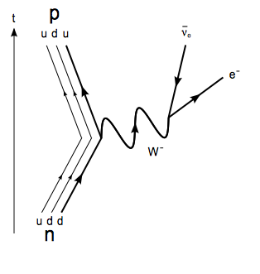
β⁻ Decay Theory
Main feature of β⁻ Decay is the electron and electron anti-neutrino production:
The chosen β⁻ Decay candidate was ⁶³Ni:
Fig 1. Quark level Feynman diagram of a β – decay.

Slide 4
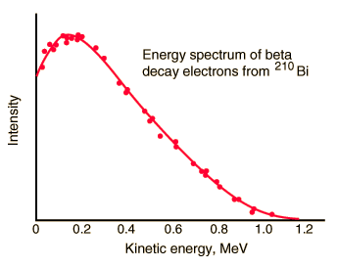
β⁻ Decay Energy Spectrum
Energy distribution for the electron emissions.
Described by the “Fermi Function”.
Important to notice there is a cut off energy.
Fig 2. Example of a β⁻ Decay electron energy spectrum

Slide 5
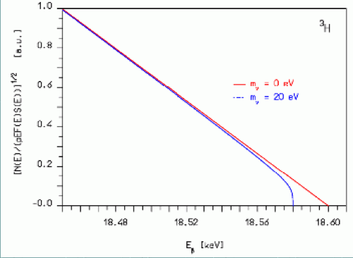
The Kurie Plot
Plot of linearized version of β⁻ Decay energy spectrum.
With non-zero neutrino mass the plot becomes non-linear.
Occurs at high electron energy values.
Fig 3. Kurie plot demonstrating effect of non-zero neutrino mass.

Slide 6
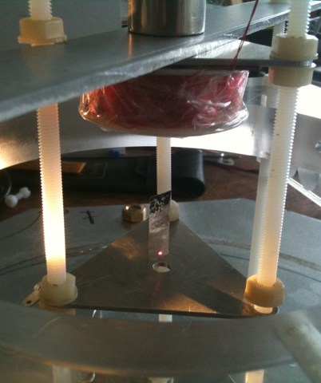
Basic Principle
Vane setup in Vacuum.
Vane undergoes β⁻ Decay.
Electrons are emitted.
Vane becomes positively charged.
Reaches an equilibrium comparable to the upper electron energy bound.
Fig 4. Photograph of floating dummy Nickel sample in the current experiment.

Slide 7
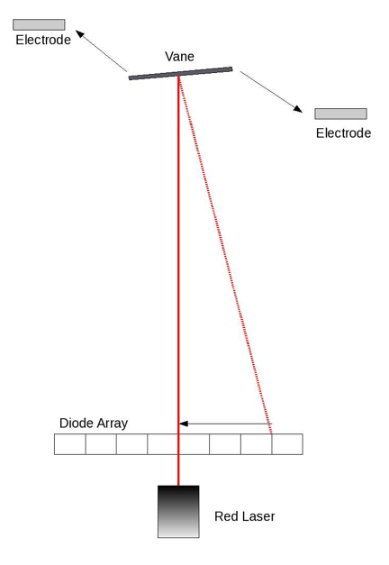
Measuring the Vane Voltage
Vane is kept in place by a red laser and the diode array.
Electrostatic correction force is controlled by the diodes
Vane held stationary by steadily increasing supply voltage.
Fig 5. Schematic diagram of the rotation control system.

Slide 8
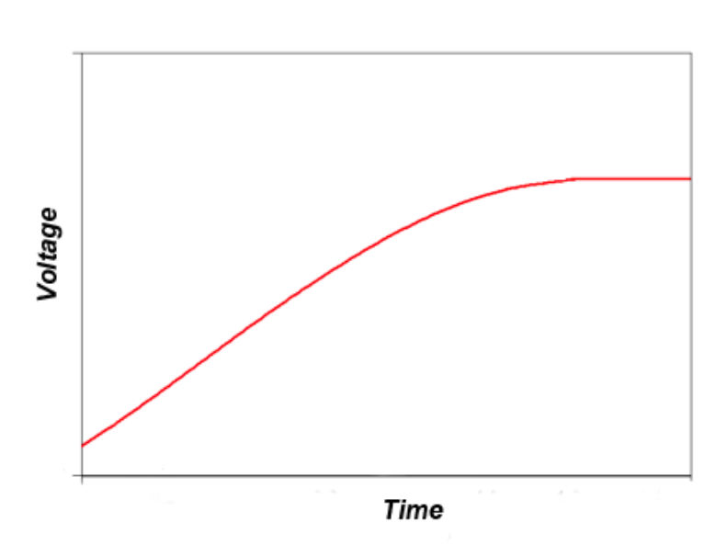
Vane Voltage Ramp
Electrons emitted ramp charge on vane.
Vane becomes highly charged and fewer electrons are emitted
Eventually only high energy electrons are able to escape.
Fig 6. Graph modelling the proposed negated voltage ramp on the vane due to electron emission.

Slide 9
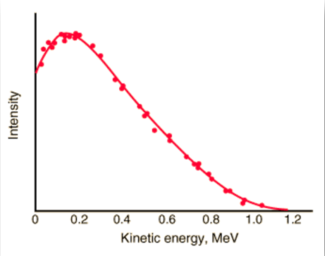
Data Analysis
Output data from the experiment
β⁻ Decay spectrum
Kurie Plot
Differential of the output data produces the energy spectrum
Linearized version of the energy spectrum should produce a kurie plot

Slide 10
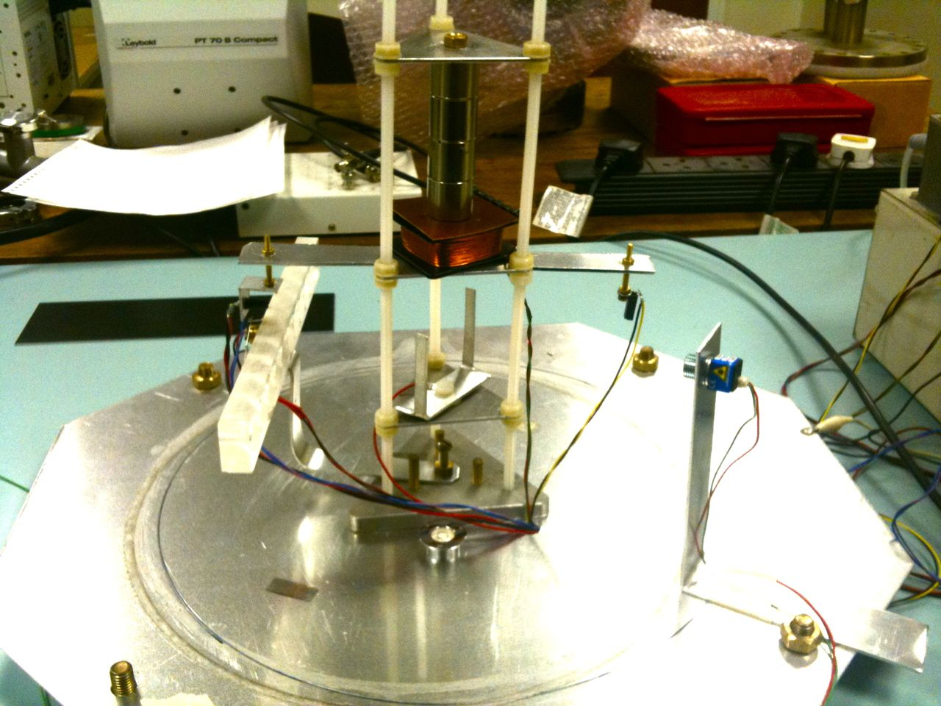
The Current Experimental Set Up
Neodymium magnetic suspension system .
Infrared Laser control system.
  Height and Rotation.
Levitation Control System
Levitation Zone
Rotation Control
Diodes and Laser
Rotation control electrode
Fig 7. Photographs taken of the current set up.

Slide 11
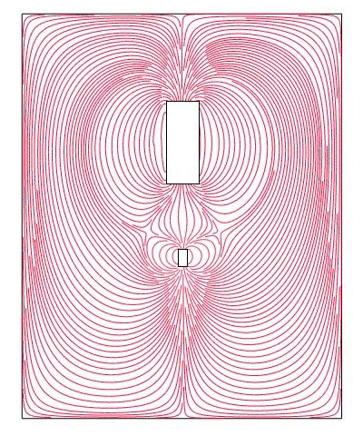
Levitation System
Infrared laser strikes top edge of the plate.
A feedback system is set up with the control coil.
Magnetic field strength is continuously adjusted.
Vane levitated due to ferromagnetic properties.
Vane is balanced in an unstable fixed point.
Fig 8. Simulation of magnetic field lines supporting the ferromagnetic Vane.

Slide 12
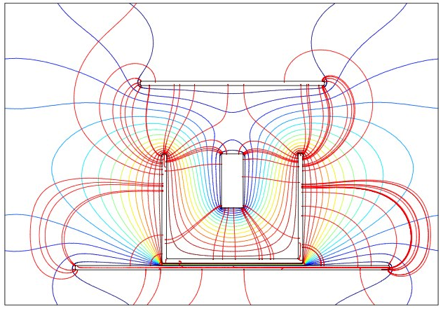
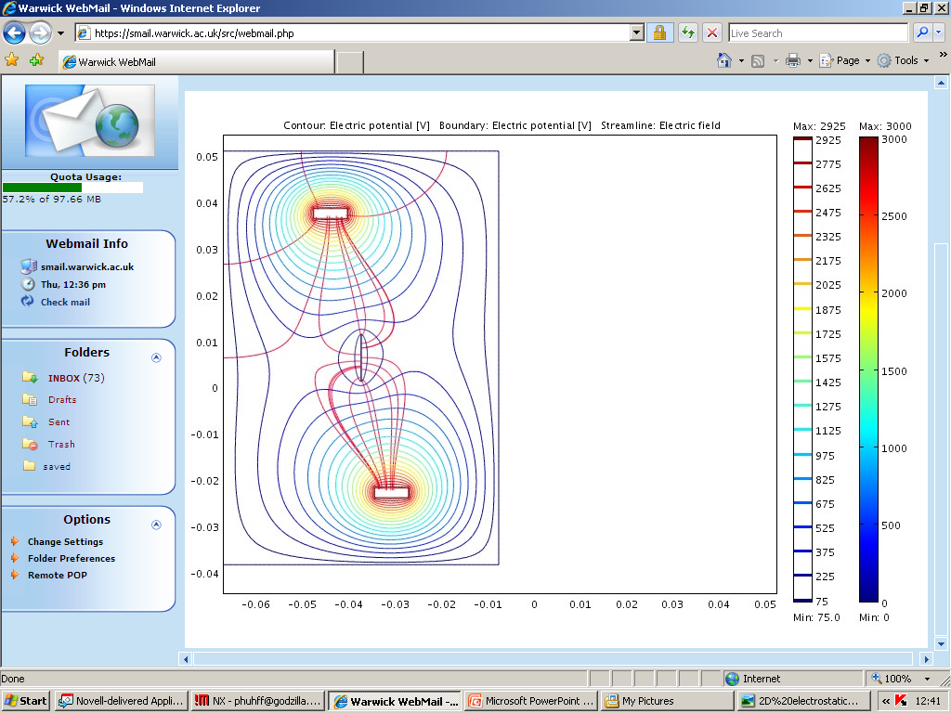
Current Rotation Control
Electrostatic rotation control.
HT D.C. voltage applied to electrode.
Fig 9. Top view of the electrostatic field .
Fig 8. Front view of the electrostatic field.
The Nickel vane aligns with electrode.
Nickel is still levitated by magnetic field only.

Slide 13
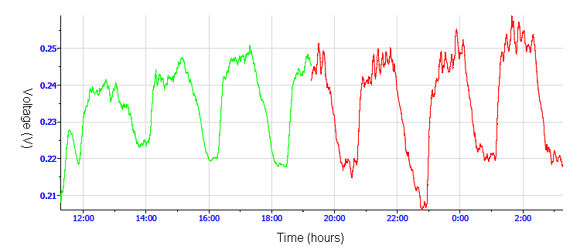
Calibration
Fig 10. output data from a laser calibration run.
External Laser applied to vane using a square wave form.
A voltage change is displayed, the amplitude linearly corresponds to the Laser’s photon force.
Order of magnitude of 5 x 10 ⁻¹² N.
Pico Newton force measurement.

Slide 14
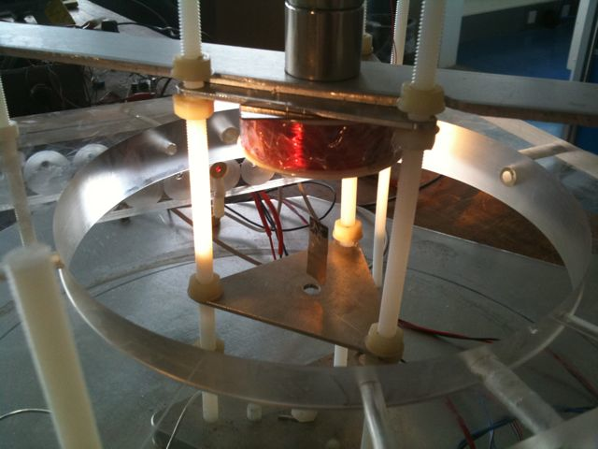
The New Set Up
Two height control lasers
Allows free rotation through 360 degrees
Allows us to see preferred positions
Vacuum system.
Fig 11. Photograph of new height control system to be placed into the vacuum system.

Slide 15
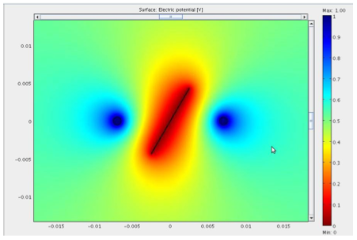
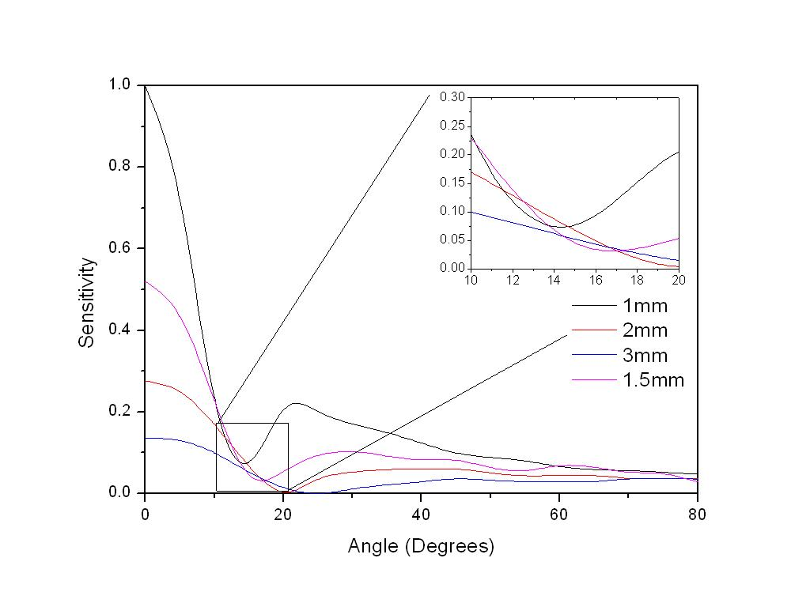
New Rotation Control Sensitivity
Fig 12. Simulation cross section of new rotation control setup with contours depicting the electric field values.
Fig 13. Sensitivity plotted against angle of vane at varying electrode distances.

Slide 16
…Finally.
Current progress:
  Prototype built and tested.
  Calibrated.
  Vacuum system is built undergoing vacuum testing.
Future applications:
  Detailed conduction studies of various gases.
  Precise capacitance measurement.
  Large range of experiments requiring sensitive force measurement.

Slide 17
Thanks to Yorck and the Electronics Workshop.
Any further questions?

