Slide 1


Neutrino Oscillations in
Susan Cartwright

Slide 2
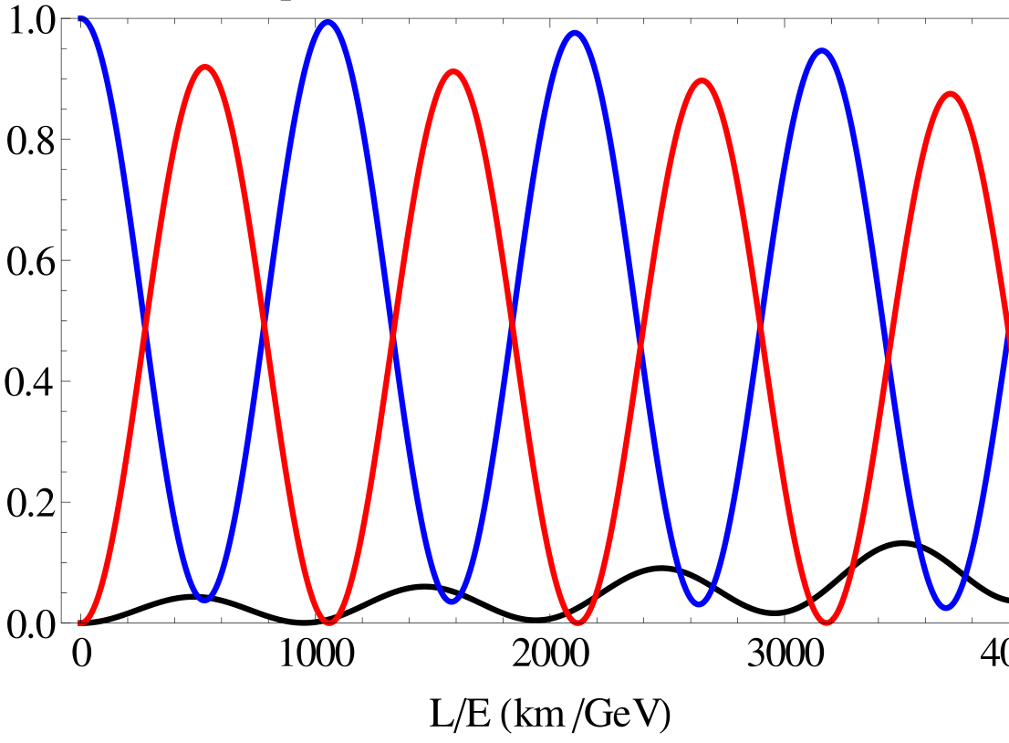
Neutrino Oscillations
Principles
Experimental techniques

Slide 3
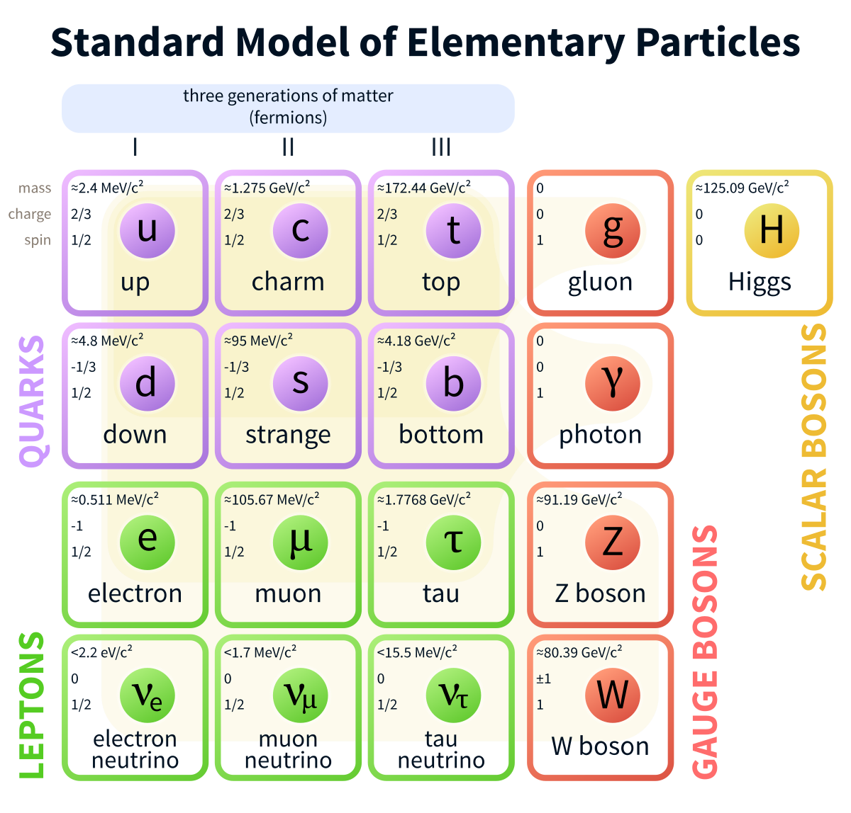
Neutrino oscillations: Principles
The Standard Model contains three neutrinos
These can be labelled by flavour as ν_{e}, ν_{μ}, ν_{τ}
They can also be labelled by mass as ν₁, ν₂, ν₃
These two bases are not aligned, so there is a mixing matrix U

Slide 4
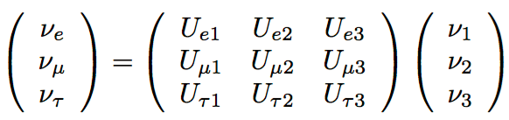
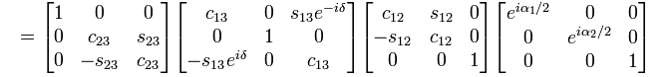
Neutrino oscillations: Principles
We therefore have where
U
atmospheric neutrinos
accelerator/ reactor neutrinos
solar neutrinos
Majorana phases

Slide 5
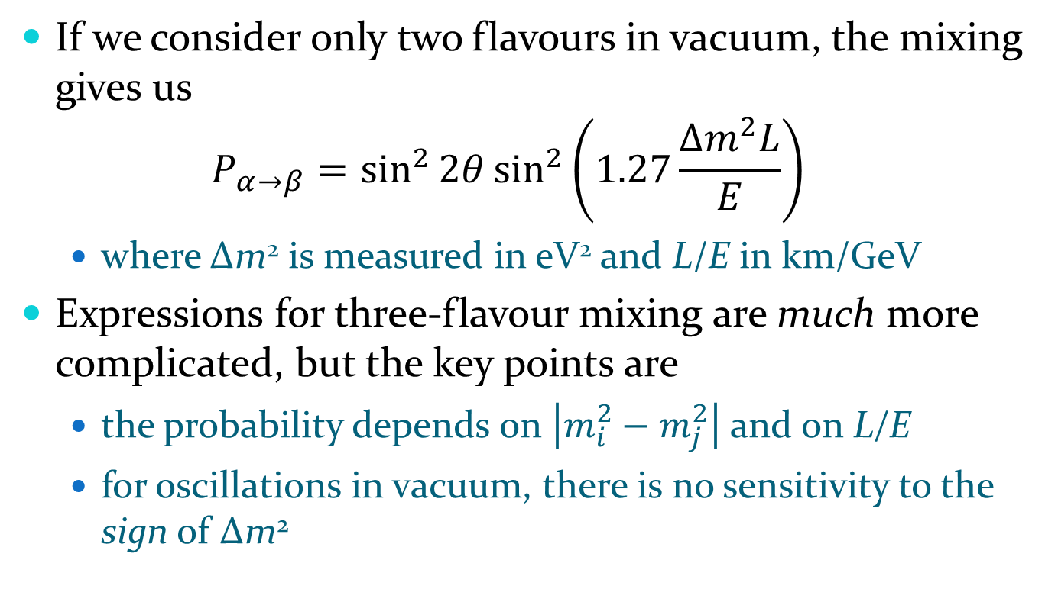
Two-flavour approximation
If we consider only two flavours in vacuum, the mixing gives us $P_{α→β}=\sin^{2}{2θ}\sin^{2}\left(1.27\frac{Δm^{2}L}{E}\right)$
where Δm² is measured in eV² and L/E in km/GeV
Expressions for three-flavour mixing are much more complicated, but the key points are
the probability depends on $\left|m_{i}^{2}−m_{j}^{2}\right|$ and on L/E
for oscillations in vacuum, there is no sensitivity to the sign of Δm²

Slide 6
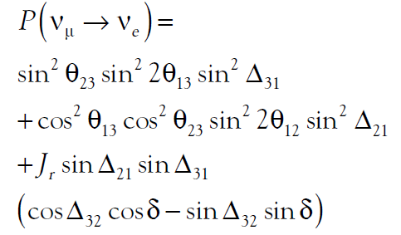

Three-flavour mixing
An expression for three-flavour mixing:
where
Note that this expression includes the phase δ, which is CP violating—i.e. distinguishes neutrinos and antineutrinos

Slide 7
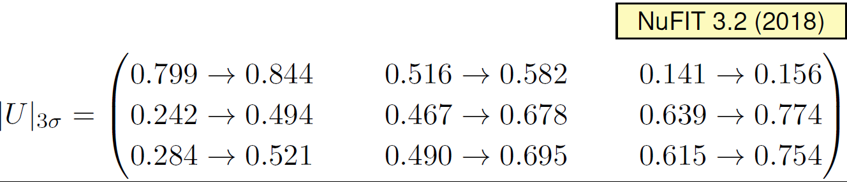
Neutrino oscillations: key points
The current best estimate of U is
This is very unlike the quark CKM matrix: the misalignment between mass eigenstates and flavour eigenstates is not small
We know that m₁ < m₂, but do not know whether m₃ is greater than m₂ (normal hierarchy) or less than m₁ (inverted hierarchy)

Slide 8
Experimental techniques
Basic aim of an oscillation experiment: measure the level of flavour change, i.e. the probability that a neutrino produced as ν_{α} is detected as ν_{β}, where α ≠ β
Two approaches:
disappearance experiment: observe that the flux of ν_{α} is less than expected
solar and reactor neutrino experiments must work this way, because their neutrinos have energies too low to permit the production of any charged lepton other than the electron
appearance experiment: observe ν_{β} in a beam that was produced as ν_{α}
this requires careful control of the original beam composition

Slide 9
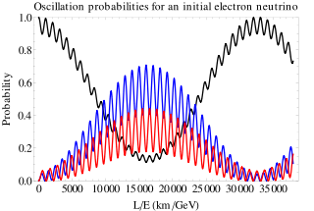
Tuning L/E
We know that Δm²₃₂ ≫ Δm²₂₁
they are respectively 2.5×10⁻³ and 7.4×10⁻⁵ eV² (normal ordering, NuFIT 3.2)
Therefore, if you start with ν_{e} (relevant mixing angles θ₁₂ and θ₁₃) it is possible to “tune” your L/E so that only one mixing angle is significant
hence KamLAND (reactor neutrinos, L ~ 180 km) saw θ₁₂ whereas Daya Bay (L ~ 1.6 km) sees θ₁₃
This doesn’t work for ν_{μ} beam

Slide 10
Characterising the beam
If you are conducting a disappearance experiment you need to know the initial flux as precisely as possible
otherwise you introduce a systematic error
If you are conducting an appearance experiment you need to know the initial flavour composition
otherwise you may mistake contamination of the beam for an oscillation signal
Both of these requirements are best met by building a near detector
close enough to the beam source for oscillation effects to be negligible

Slide 11
Neutrino oscillation measurement
Find or make a source of neutrinos
Build a near detector to characterise your beam
flux and energy spectrum for disappearance experiment, flux, energy spectrum and flavour content for appearance experiment
Build a far detector to make your measurement
neutrino energy for disappearance experiment, energy and flavour for appearance experiment
Make measurement, publish paper, bask in admiration of colleagues/win Nobel Prize
(It is, of course, not quite as easy as that…)

Slide 12
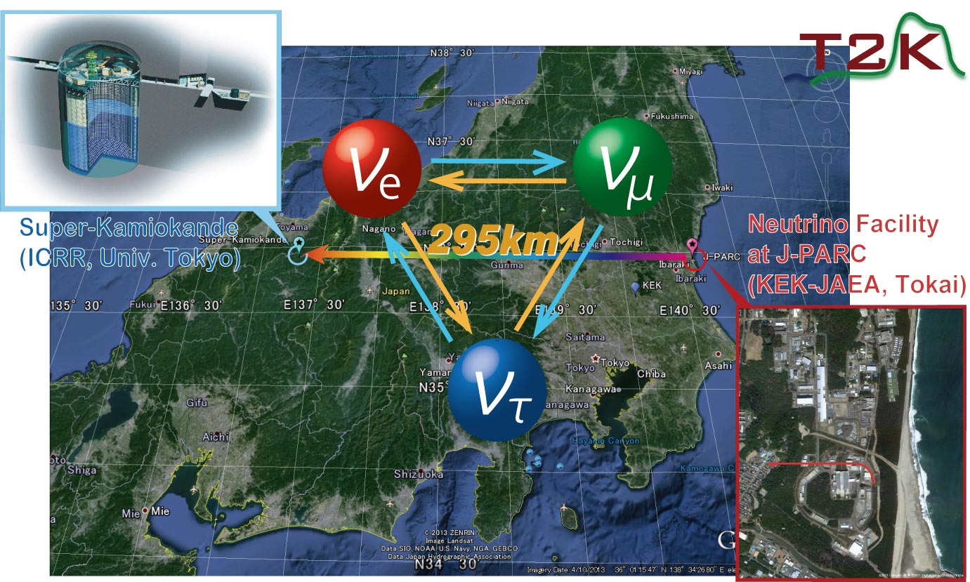
The T2K Experiment
Experiment
Oscillation measurement

Slide 13
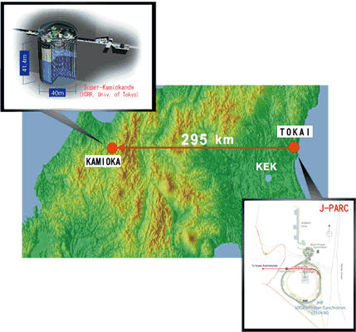
The T2K Experiment
Basic idea:
use 30 GeV proton synchrotron at J-PARC nuclear physics facility to make a ν_{μ}/ν̄_{μ} beam
characterise with ND280 detector 280 m from beam target
measure oscillations at Super-Kamiokande, 295 km from target

Slide 14
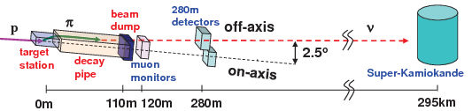
Make the beam…
Direct proton beam on to graphite target
proton interactions produce numerous charged pions
Focus pions of desired charge with magnetic horns
let them decay: π⁺ → μ⁺ ν_{μ}, π⁻ → μ⁻ ν̄_{μ}
Momentum conservation ensures that your neutrinos are all going in roughly the same direction

Slide 15
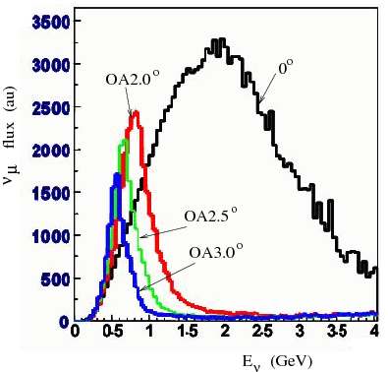
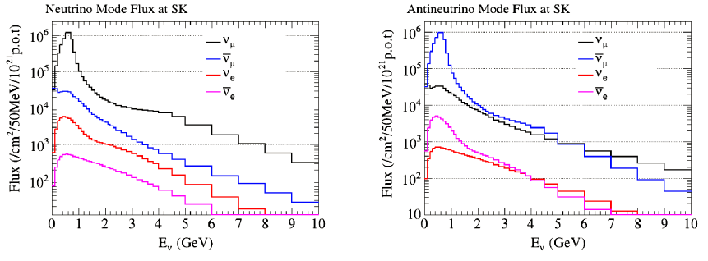
More about the beam
Beam is directed slightly off-axis, to tune L/E
It’s almost but not quite a pure ν_{μ}/ν̄_{μ} beam

Slide 16
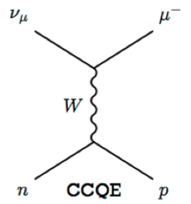
Measuring the neutrino energy
Because oscillation probability depends on L/E, you want to measure E_{ν}
The best tool for this is charged-current quasi-elastic (CCQE) events
Two-body kinematics allows us to reconstruct E_{ν} from just the energy and direction of the produced lepton
(This is not quite so simple in practice, because other interactions can leave CCQE-like signatures in the detector)

Slide 17
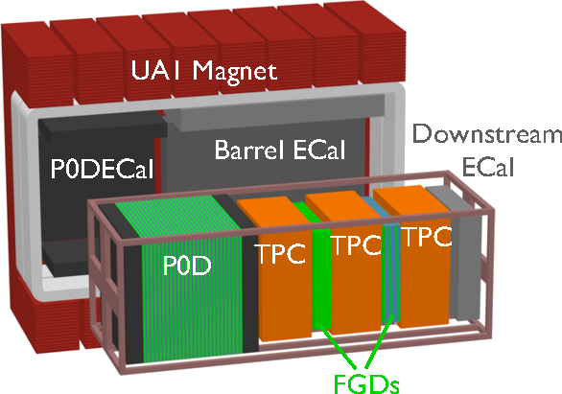
Characterising the beam
The off-axis near detector, ND280, is designed to measure the flavour content of the unoscillated beam and to study neutrino interaction cross-sections

Slide 18
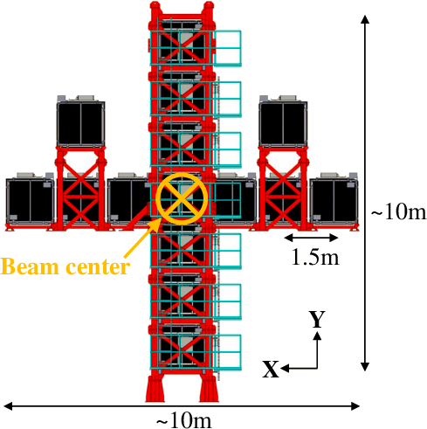
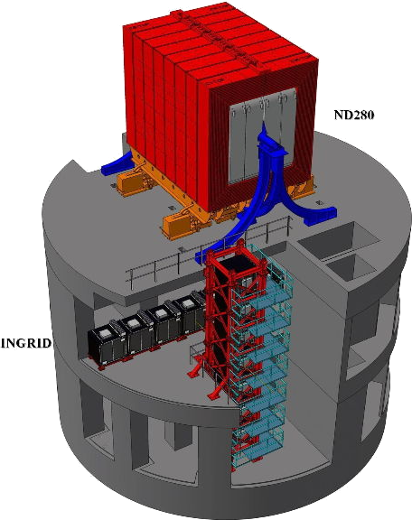
Characterising the beam
The on-axis near detector INGRID measures the beam profile and the delivered luminosity (protons on target)

Slide 19
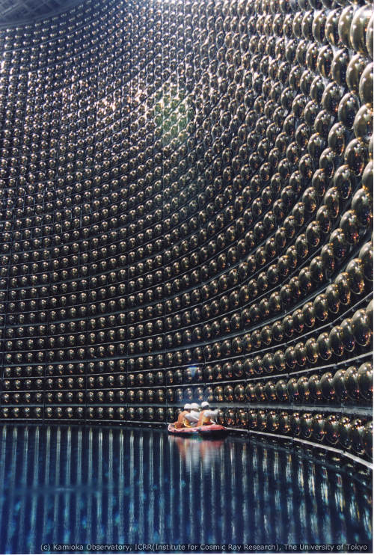
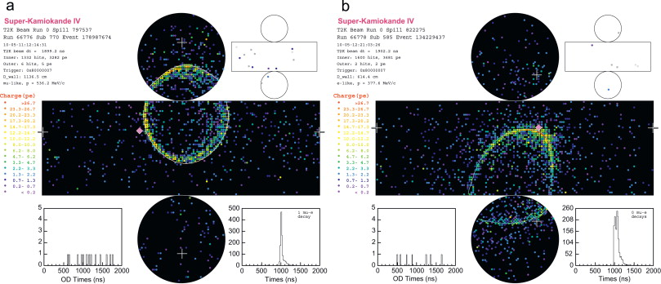
The far detector
Super-Kamiokande: 50 kton water Cherenkov detector
e/μ separation by ring morphology; no charge separation

Slide 20
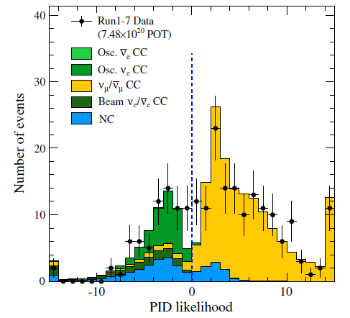
The Oscillation Measurement
The measurement
The results

Slide 21
Neutrino oscillations in T2K
Data (runs 1–7, up to May 2016):
7.482 × 10²⁰ protons on target ν-mode
7.471 × 10²⁰ protons on target ν̄-mode
Possible oscillation measurements:
ν_{μ}/ν̄_{μ} disappearance
ν_{e}/ν̄_{e} appearance
Relevant observables: θ₁₃, θ₂₃, Δm²₃₂, δ_{CP}
Important tools:
the beam simulation
the neutrino interaction model

Slide 22
The neutrino interaction model
Neutrino interactions with nuclei more complex than deuterium turn out to be non-trivial
nucleons are bound in a nucleus
need a momentum distribution
there are nucleon-nucleon correlations
multinucleon (2p2h) interactions
screening effects
particles produced in the initial interaction may re-interact within the nucleus
visible products may not be the same as initially produced

Slide 23
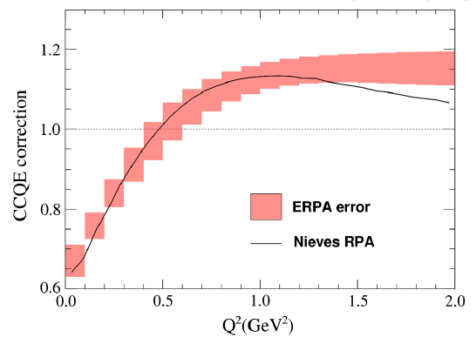
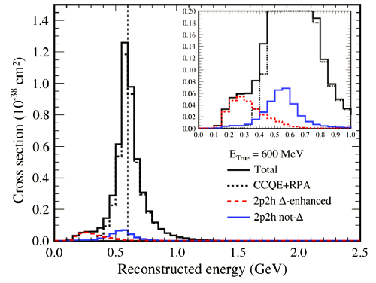
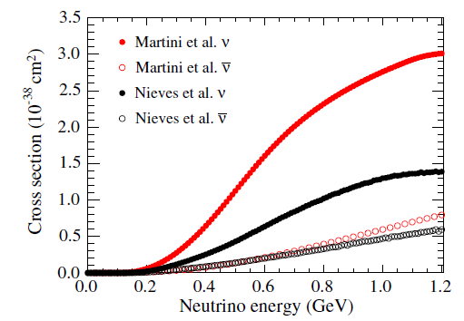

The neutrino interaction model
2p2h
(This still needs work: models do not describe data from all experiments well)

Slide 24
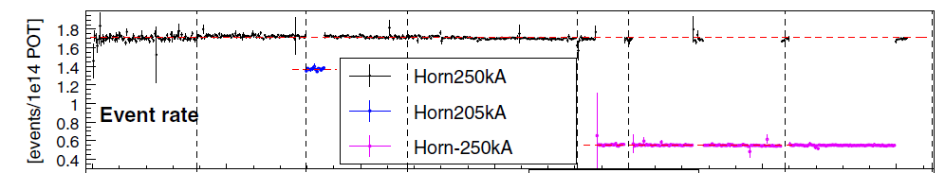
Near detector analyses
INGRID is used to monitor event rate, beam profile, and location of beam centre
Note that the event rate drops considerably in ν̄ mode: p-¹²C interactions produce more π⁺ than π⁻, and ν̄-N CC cross-section is only about half that of ν-N

Slide 25
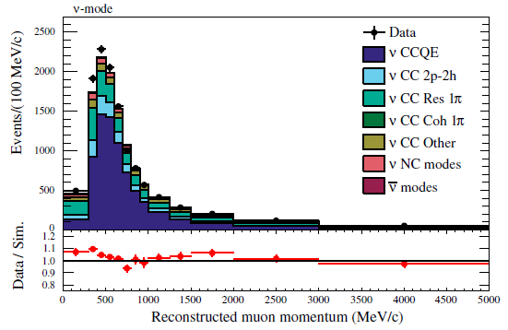
Near detector analyses
ND280 measures neutrino energy spectrum, flavour content and interaction rates
three different event categories are used in ν-mode
CC-0π
CC-1π⁺
CC-other
in ν̄-mode use
CC-1-track
CC-N-tracks
much lower statistics in ν̄-mode
CC-0π

Slide 26
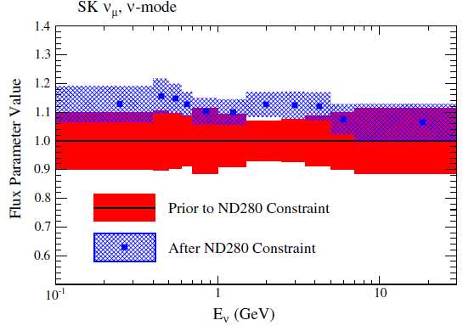
Effect of the near detector
Near detector data are fitted to constrain parameters for Super-K
The effects can be quite sizable, e.g. 10-15% increase in estimated flux
Cross-section model parameters are also constrained by ND280 fit

Slide 27
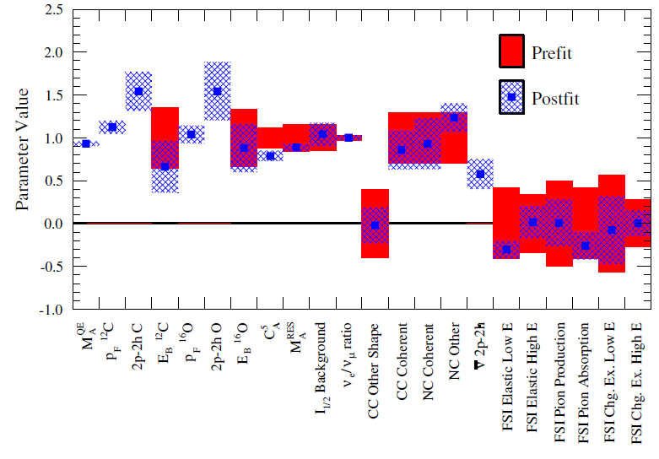

Slide 28
Result of near detector fits
The principal effect of the near detector fits is to reduce the systematic error, because parameters that would otherwise have to be taken from simulations are constrained by real data
Systematic error on predicted CCQE-like event rates:
without ND280 constraints: ν-mode 12.7%, ν̄ 14.5%
with ND280 constraints: ν-mode 5.5%, ν̄ 6.5%
This illustrates the importance of having a near detector!

Slide 29
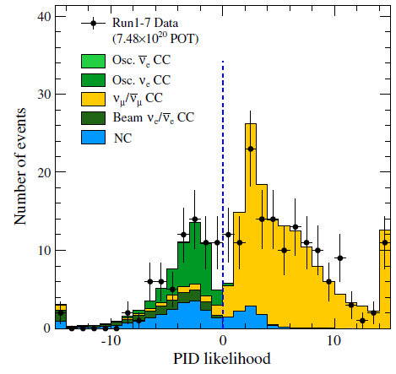
Oscillation measurements
Super-K data sample
CCQE-like
fully contained in fiducial volume
single ring (proton is below Cherenkov threshold)
muon-like or electron- like by ring morphology
for muon-like: p > 200 MeV/c, ≤ 1 Michel electron
for electron-like: 100 MeV < E < 1250 MeV, no Michel electron, event not consistent with π⁰ hypothesis

Slide 30
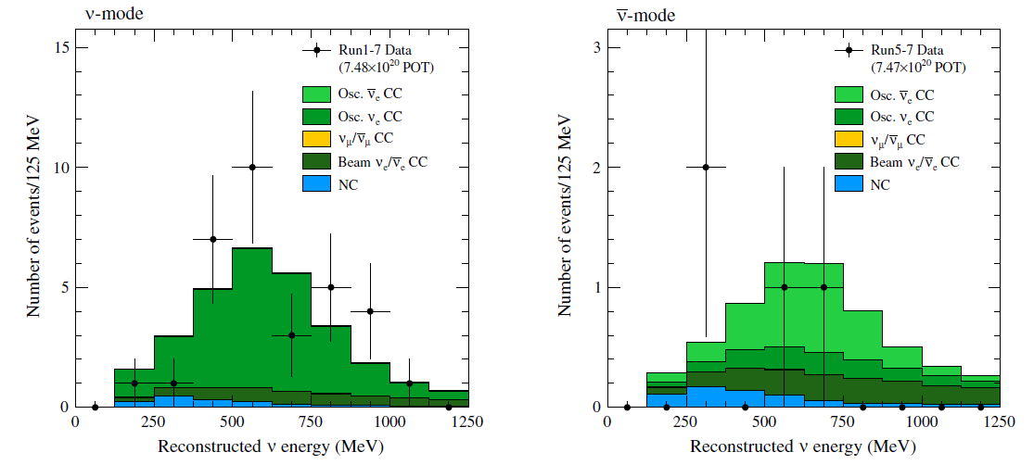
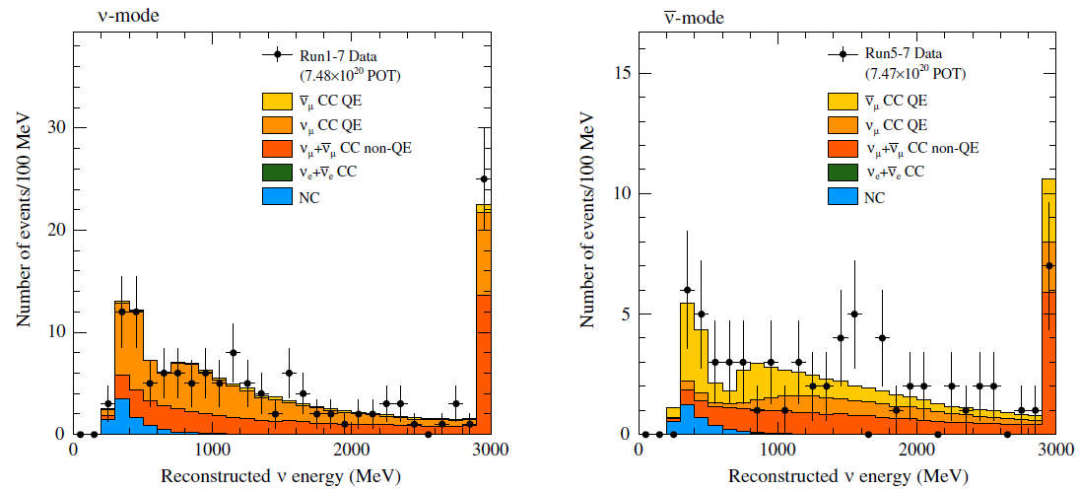
32 ν_{e} candidates observed in ν-mode; 4 ν̄_{e} in ν̄-mode
135 ν_{μ} candidates observed in ν-mode; 66 ν̄_{μ} in ν̄-mode

Slide 31
Oscillation results
We have three parallel oscillation analyses, two frequentist and one Bayesian
one frequentist analysis is binned in (E_{ν, rec}, θ_{lep}) and the other in (p_{lep}, θ_{lep}); Bayesian analysis uses (E_{ν, rec}, θ_{lep})
Bayesian analysis fits ND280 and SK simultaneously; frequentist analyses use ND280 fit to determine flux and cross-section parameters for SK fit
all analyses show good agreement in both ND280 tuning and final oscillation results

Slide 32
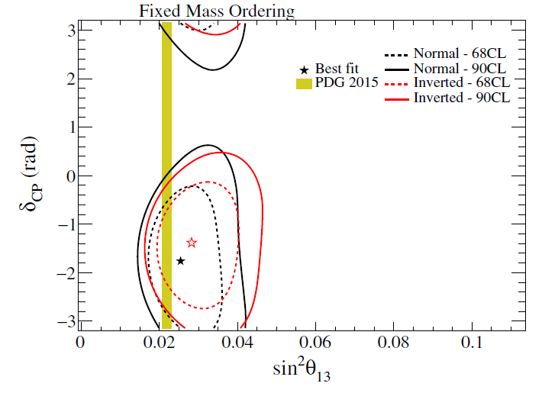
Oscillation results
Joint fit to appearance and disappearance, using T2K data only

Slide 33
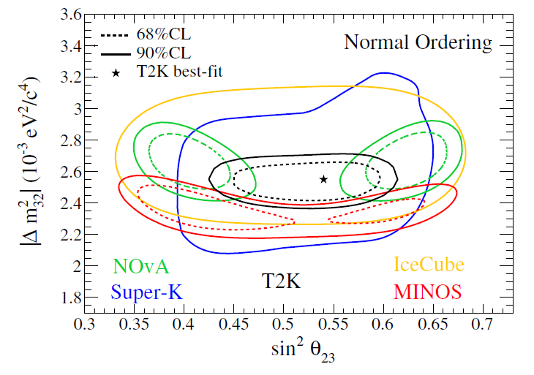
Oscillation results
Joint fit to appearance and disappearance, using reactor constraint sin² 2θ₁₃ = 0.085 ± 0.005 and assuming normal ordering

Slide 34
Oscillation results
±1σ ranges, frequentist analysis, with reactor constraint
This provides a hint that δ_{CP} is non-zero, but the evidence is not strong
Normal ordering gives better χ² than inverted
Parameter | Normal | Inverted
δ_{CP} | [−2.538; −0.877] | [−2.170; −0.768]
sin² θ₂₃ | [0.465; 0.601] | [0.470; 0.601]
|Δm²₃₂| (10⁻³ eV²) | [2.460; 2.621] | [2.429; 2.588]

Slide 35
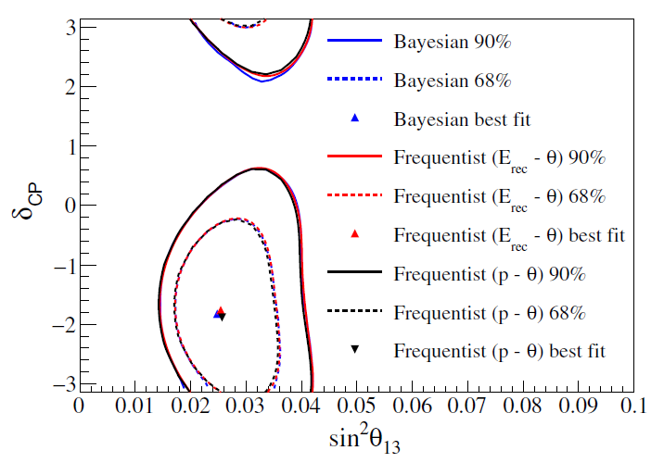
Consistency check

Slide 36
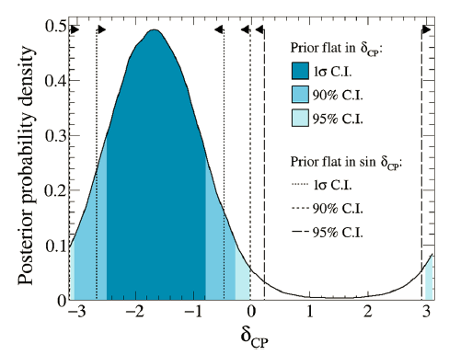
Conclusions
T2K has observed ν_{μ} disappearance and ν_{e} appearance in both neutrino and antineutrino modes
There is a preference for non-zero δ_{CP}, but it is nowhere near discovery level yet
Results from different experiments show some tension
(underestimated systematics?)
Still need more statistics, especially in ν̄ mode

Slide 37
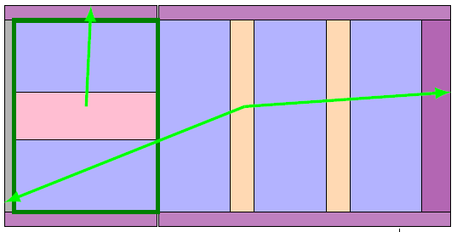
Future plans
Gd-loading in Super-K
possible ν/ν̄ separation by neutron tagging
CCQE: ν + p → ℓ⁻ + n whereas ν̄ + n → ℓ⁺ + p
Upgrade to ND280
replace P0D (scintillator) with horizontal target plus TPCs and ToF
measure large-angle tracks
This does assume continued/improved beam time

