Slide 1

Extracting Cone Beam CT (CBCT) Dose Volume Statistics and Radiomics Features to Predict Optimum Adaptation Point in Thoracic Radiotherapy
Claire Lesley Fletcher UHCW (Claire.fletcher@uhcw.nhs.uk)
Jane Rogers UHB, Jon Duffy UoW

Slide 2
Background
Radical lung RT in UK is usually 55Gy in 20#
Daily CBCT indicates changes during treatment, but not routinely used for oART
Identifying a suitable point for offline adaptation might provide a pragmatic alternative to oART
Similar work exists for longer fractionation schemes (e.g. 66Gy/33#)

Slide 3
Patient Statistics
162 patients treated with 55Gy in 20# radical radiotherapy between 2018-2023 at UHCW
154 lung
8 Oesophagus

Slide 4
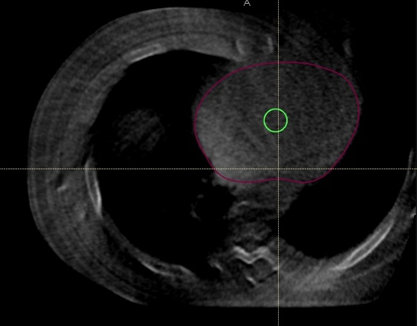
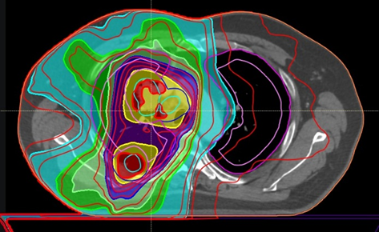
Method
Daily CBCTs collected
Imported to RayStation
Adjusted for Intensity fluctuations
Normalise to signal in a 5cc volume at centre of heart
Correct for daily value of region receiving 0-5Gy planned dose

Slide 5
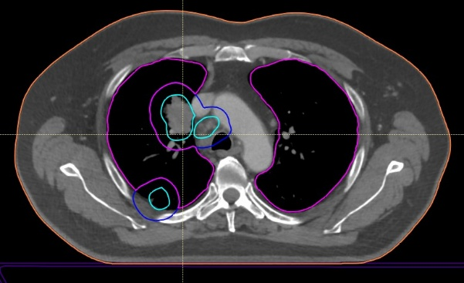
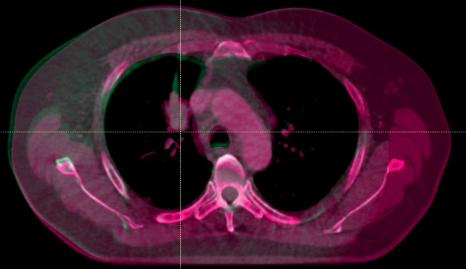
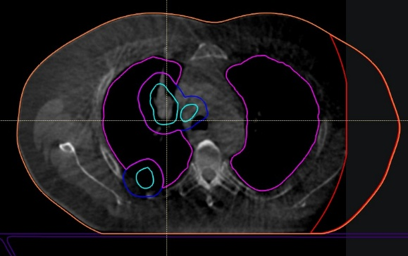
Corrected CBCTs deformably registered to plCT
OARs and GTV mapped to the CBCTs
OARs outlined on plCT
Fusion between plCT and CBCT #20
CBCT #20 and OARs mapped onto CBCT #20

Slide 6
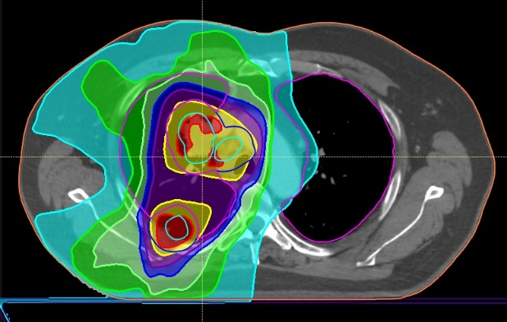
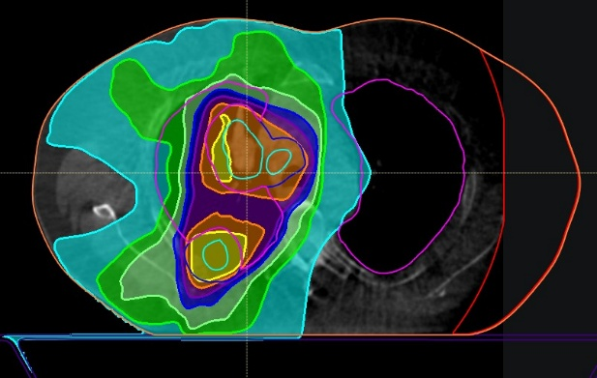
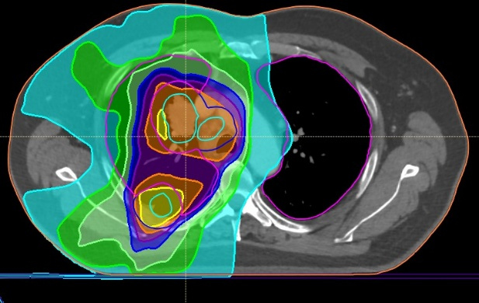
Planned dose distribution recalculated on daily CBCTs
Deformed to the planning CT
Planned dose on PlCT
Dose calculated on CBCT #20
Dose from CBCT #20 deformed back onto plCT

Slide 7
Several statistics were extracted to investigate:
Change throughout the treatment course
A point at which final changes could be predicted
Effect of adapting treatment
Statistics extracted for each treatment fraction:
GTV
Density (pixel intensity) change
V5 and V20 (volume of lung receiving 5Gy / 20Gy)
MLD (mean lung dose)
EUD (Equivalent Uniform Dose) to lung
Radiomics features

Slide 8
Predicting Final Changes
Data gathered for:
1 week, 2 weeks, 3 weeks, 1/3 treatment, 2/3 treatment
For DVH statistics fitted exponential / linear models
Compared predicted final values at each stage to predicted value found using all data

Slide 9
Finding Optimum Adaptation Point
Adapted method from Berkovic 2015
Calculated % change in DVH values (V5, V20, MLD, EUD) at different points
Assumed replanned at this point and % change reset to zero
Summed change for each fraction
Final summed change for adaptation was compared to original change

Slide 10
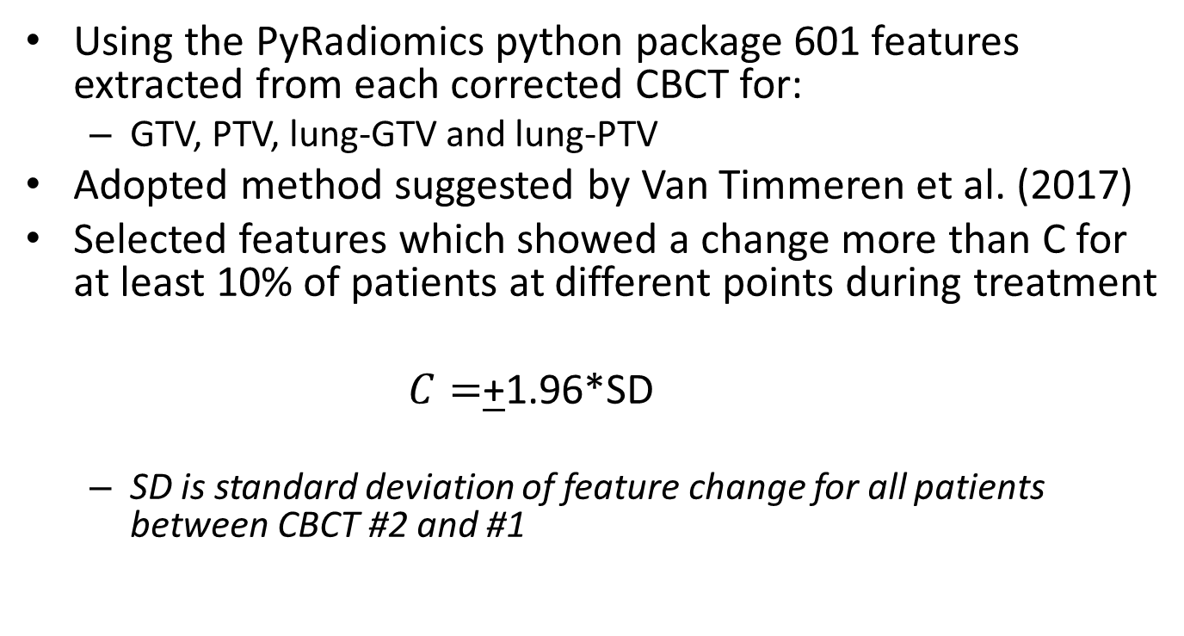
Radiomics Feature Analysis
Using the PyRadiomics python package 601 features extracted from each corrected CBCT for:
GTV, PTV, lung-GTV and lung-PTV
Adopted method suggested by Van Timmeren et al. (2017)
Selected features which showed a change more than C for at least 10% of patients at different points during treatment
$C=$+1.96*SD
SD is standard deviation of feature change for all patients between CBCT #2 and #1

Slide 11
Results
80% of patients showed a reduction in GTV
Average -10% at end of treatment , Projected -18% at 50 days
Lower than: Berkovic 2015, Elsayad 2018, Jabbour 2015 -~40% reduction at 40-45d
Similar to: Brink 2013 -20% at 50 days, Kwint 2020 -18.5% 24#
Average EUD change:
lung-GTV 2% increase
lung-PTV 2.6% increase
Average Pixel intensity change:
GTV 17% increase
lung-PTV, lung-GTV 0.1% decrease
No real detectable change during treatment

Slide 12
Optimum Point to Predict Final Changes
Point at which final values of EUD, GTV and GTV pixel intensity change could be predicted was 2 weeks
P=0.890
P=0.239
P=0.777

Slide 13
Optimum Adaptation Point
To minimise increases to MLD, EUD, V5 and V20 the optimum adaptation point was 2 weeks
Berkovic 2015 found optimal adaptation point at #15/25

Slide 14
Radiomics Feature Analysis
Stable number of radiomics features showing a detectable change for >10% patients at week 2
Van Timmeren 2017 Found week 2 too early to find stable detectable feature changes for GTV for >10 patients

Slide 15
Conclusion
An optimal point for data analysis and prediction for DVH statistics and radiomics feature extraction was found to be week 2 of the UK regime
Previous work that found week 3 optimal in longer treatment regimes (Berkovic 2015 for DVH statistics, Van Timmeren 2017 for extracting radiomics)
This information could be used for adaptation strategies when combined with treatment outcome data

Slide 16
Thanks for Listening

Slide 17
References
Van Timmeren J et al., Feature selection methodology for longitudinal cone-beam CT radiomics, Acta Oncologica, 2017, 56(11): p. 1537-1543
Berkovic, P., et al., Adaptive radiotherapy for locally advanced non-small cell lung cancer, can we predict when and for whom? Acta Oncol, 2015. 54(9): p. 1438-44.
Brink, C., et al., Locoregional control of non-small cell lung cancer in relation to automated early assessment of tumor regression on cone beam computed tomography. Int J Radiat Oncol Biol Phys, 2014. 89(4): p. 916-23.
Jabbour, S.K., et al., Reduction in Tumor Volume by Cone Beam Computed Tomography Predicts Overall Survival in Non-Small Cell Lung Cancer Treated With Chemoradiation Therapy. Int J Radiat Oncol Biol Phys, 2015. 92(3): p. 627–33.
Elsayad, K., et al., Is tumor volume reduction during radiotherapy prognostic relevant in patients with stage III non-small cell lung cancer? Journal of Cancer Research and Clinical Oncology, 2018. 144(6): p. 1165–1171.
Kwint, M., et al., The prognostic value of volumetric changes of the primary tumor measured on Cone Beam-CT during radiotherapy for concurrent chemoradiation in NSCLC patients. Radiotherapy and Oncology, 2020. 146: p. 44–51.

