Slide 1
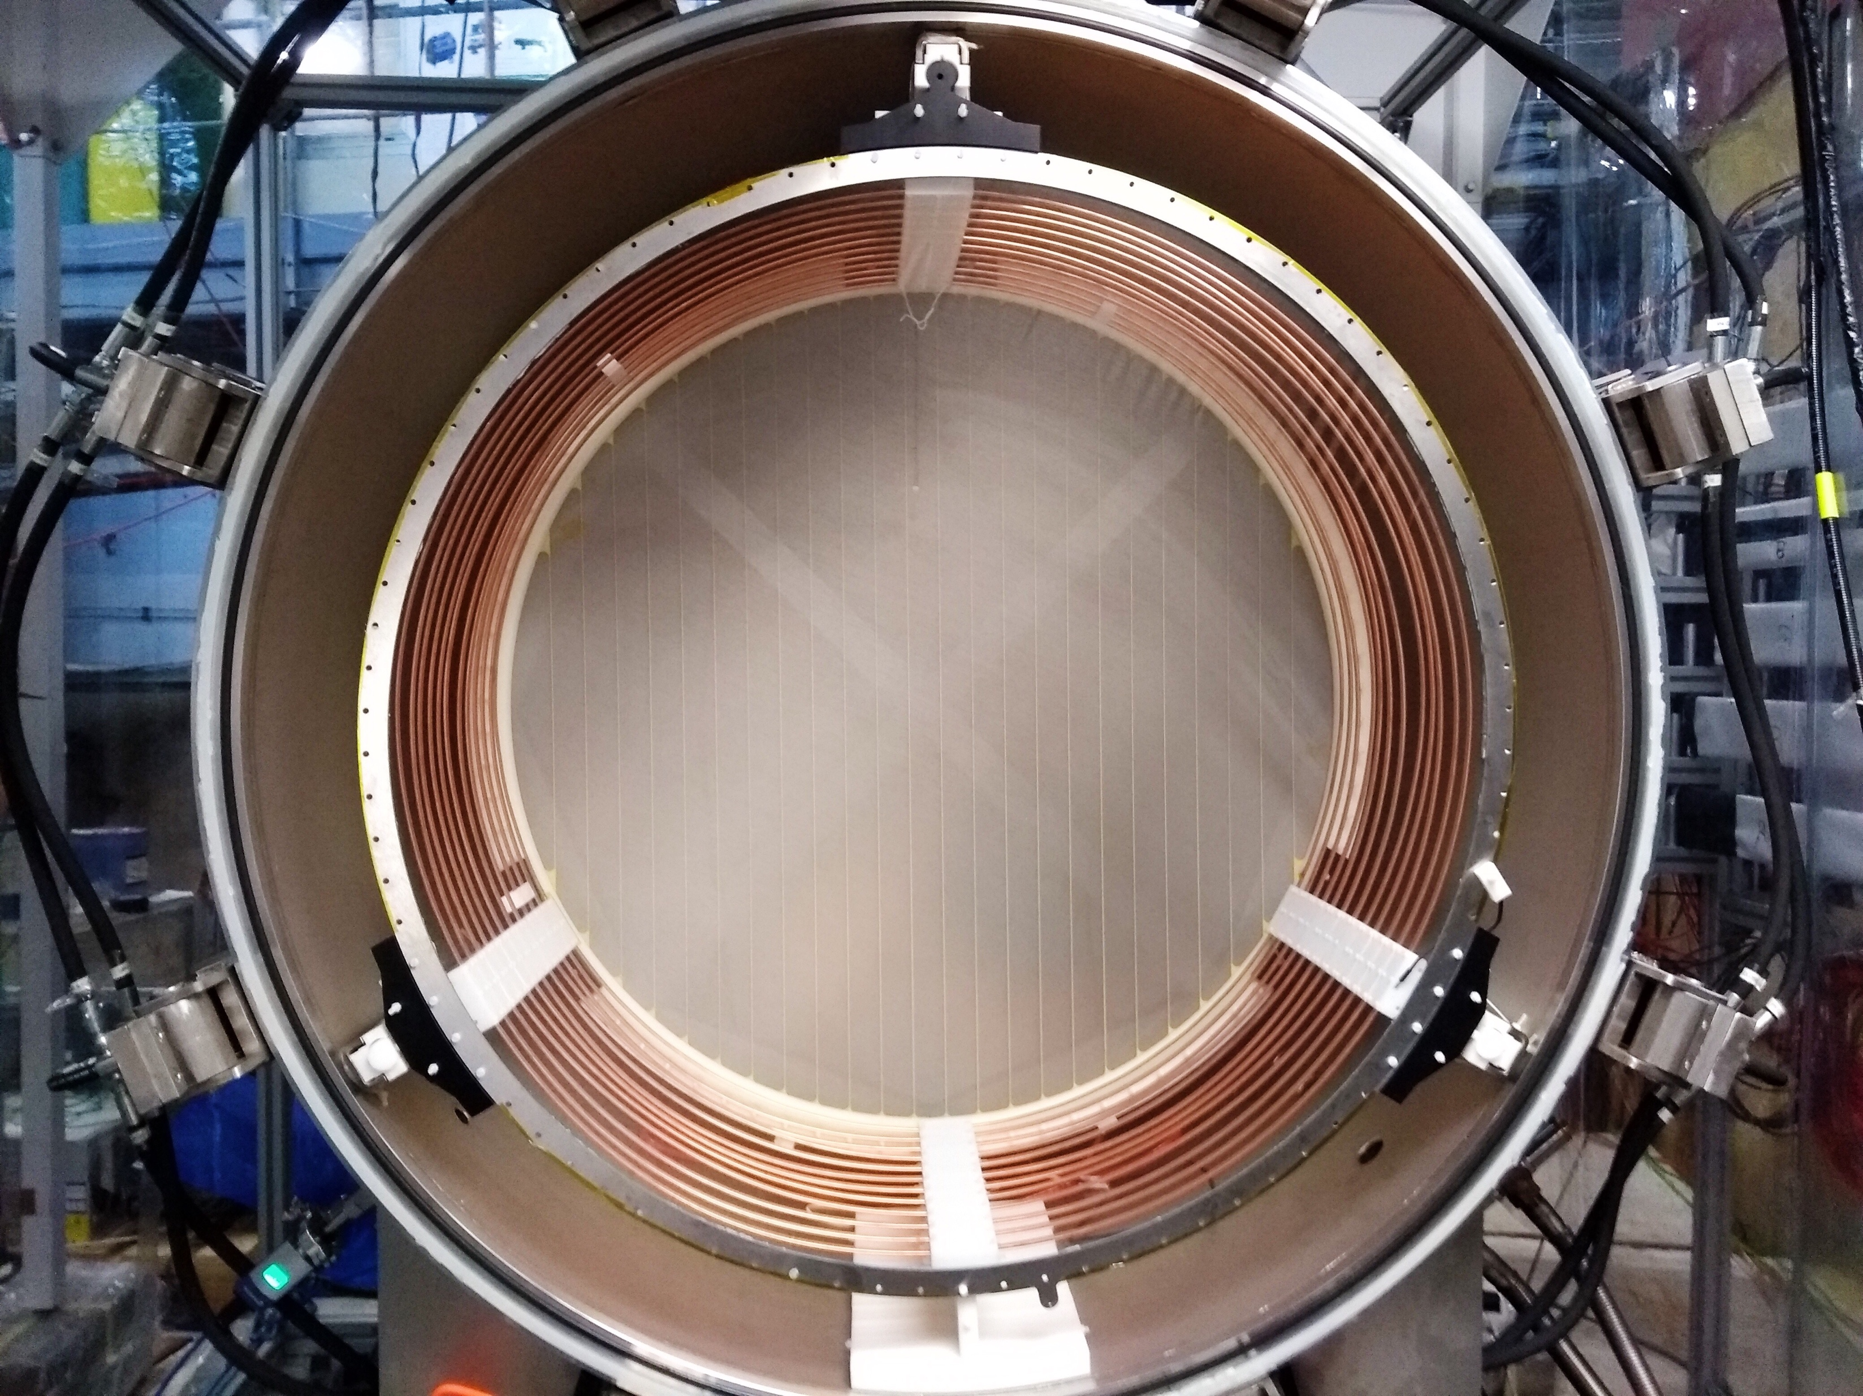
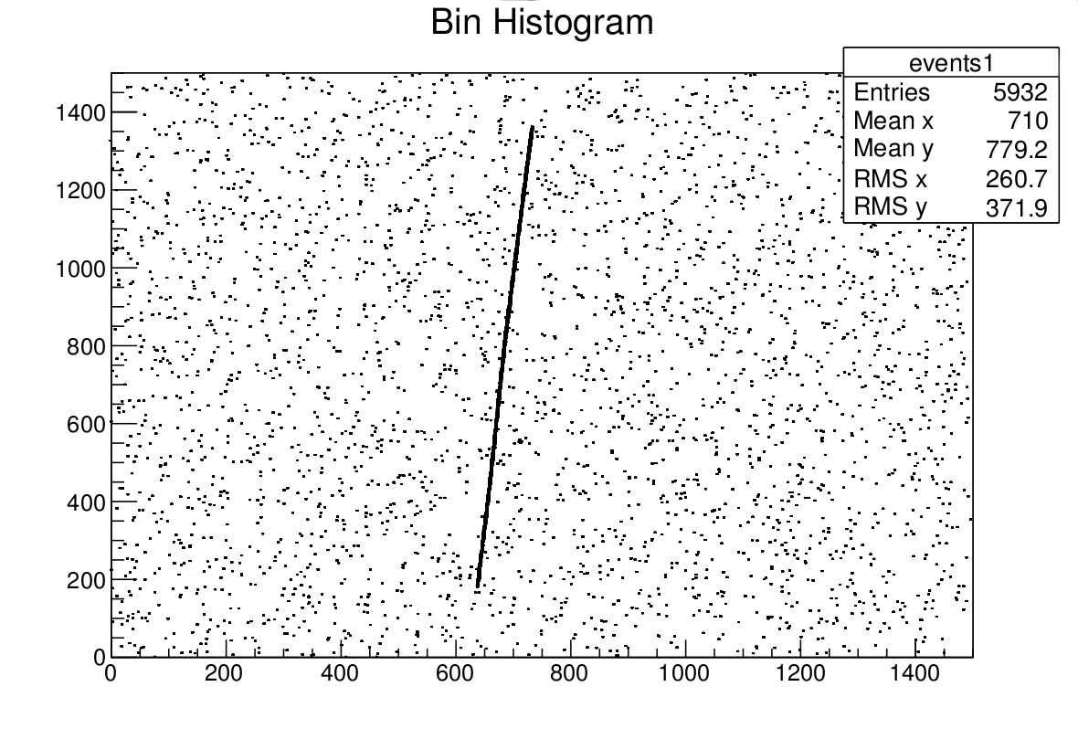
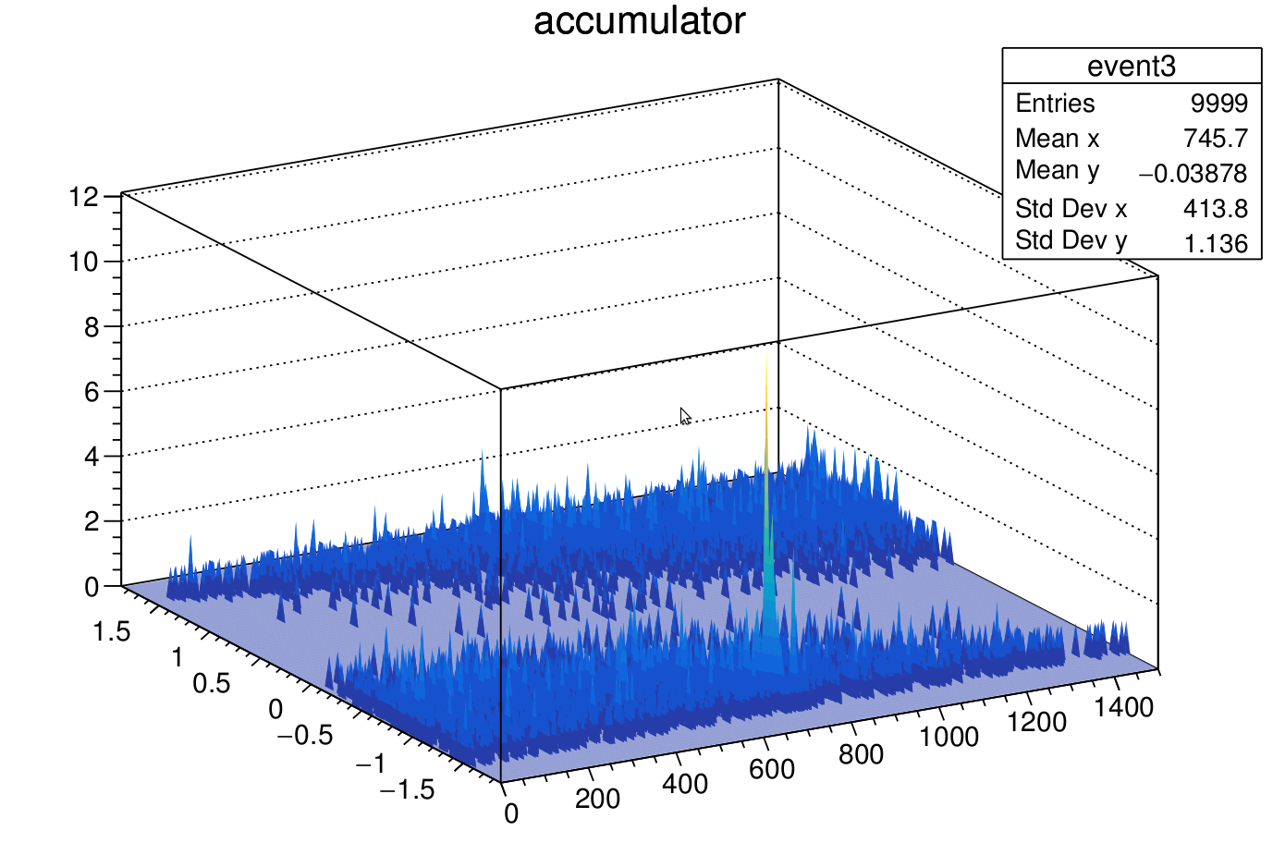
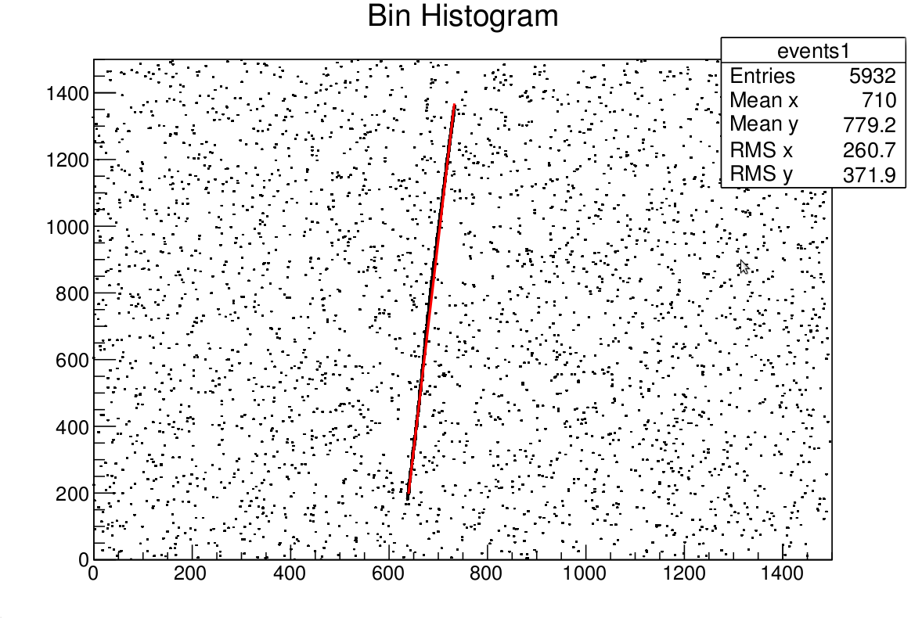
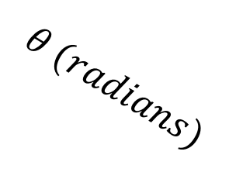
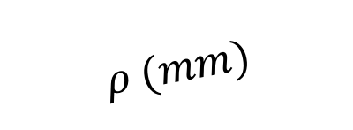
Using Hough Transform to Reconstruct Particle Tracks in HPTPC
Veera Mikola, Department of Physics
Introduction
A high pressure time project chamber (HPTPC) was built to measure proton and pion scattering in highly pressurised argon and tested at CERN (figure 1).
Particle tracks (figure 2) were reconstructed using a randomised Hough transform method [1].
An HPTPC may be used in future studies of low energy neutrino-nucleus scattering [2].
Figure 1: HPTPC detector seen from the inside
Methodology
Two randomly chosen data points were used to define a line. The polar coordinates of all lines were accumulated in a histogram - a peak appearing at the coordinates of the physical line (figure 3).
The peak information was used to collect hits belonging to the track, from which start and end points were defined, finally reconstructing the track.
Results
Figure 2: A simulated CCD image of a single proton track
Used in the analysis
The algorithm finds at least one track in most events but generates, in some cases, more tracks than is expected.
These comprise low hit density fake tracks made from the noise, or from multiple tracks caused by two or more close peaks. These were remove by setting a lower limit to the the hit density, and by comparing the y-intercept and slope values of the reconstructed tracks.
The programme successfully finds and reconstructs particle tracks in simulated single particle events containing both protons or pions (figure 4).
$$θ (radians)$$
$$ρ (mm)$$
Figure 3: The Hough transform space of a simulated one tracks proton event
Figure 4: A simulated one track proton event after reconstruction.
References:
[1] C. Galambos, J.Matas and J.Kittler, IEEE Computer Society Conference on Computer Vision and Pattern Recognition, 1999
[2] P. Hamilton et al, Neutrino Scattering R&D for CP Violation Searches, STFC PRD Grant Proposal, Council Reference ST/N003217/1, July 2015

