Slide 1

Using Hough Transform to reconstruct particle tracks in hptpc
Veera Mikola

Slide 2

Reminder of randomised Hough Transform
Voxelize files using trex
Run through event(s) wanted
Create a dictionary consisting of all the coordinates and energy deposits in the event
Choose two points randomly from this dictionary and draw a line between them
From the line define $ρ$ and $θ$, and draw a 2-D histogram of the accumulator
Find peaks from the histogram using TSpectrum
Collect hits using the peak information
Find a start and an end point of the track

Slide 3
Progress
Program finds the peaks
Program collects the hits, and from that defines the start and end points of the tracks
For events with multiple peaks found, have found two ways to exclude the tracks caused by “ghost peaks” (incorrect peaks usually found around the main peaks, mostly in short track/high noise events)
Fake tracks, i.e. tracks that have a very low hit density (number of hits/distance of the track)
Duplicate tracks, caused by peaks very close to each other. Look at the values of b and m for the tracks to cut these out

Slide 4
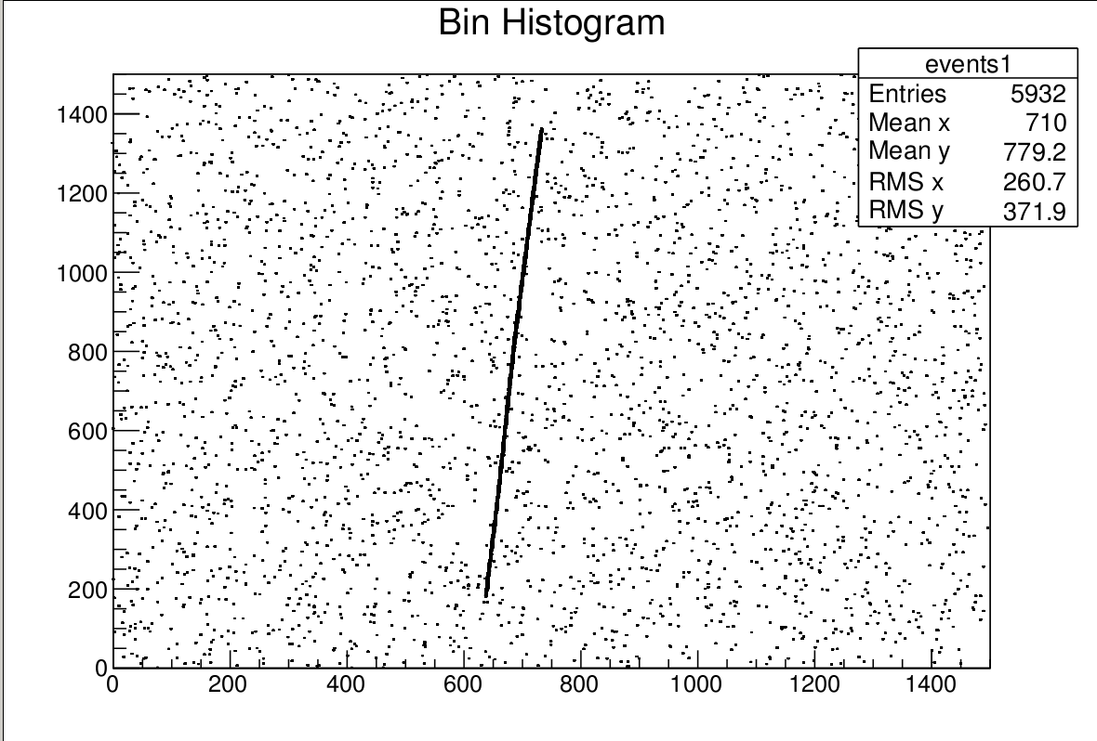
Protons tracks

Slide 5
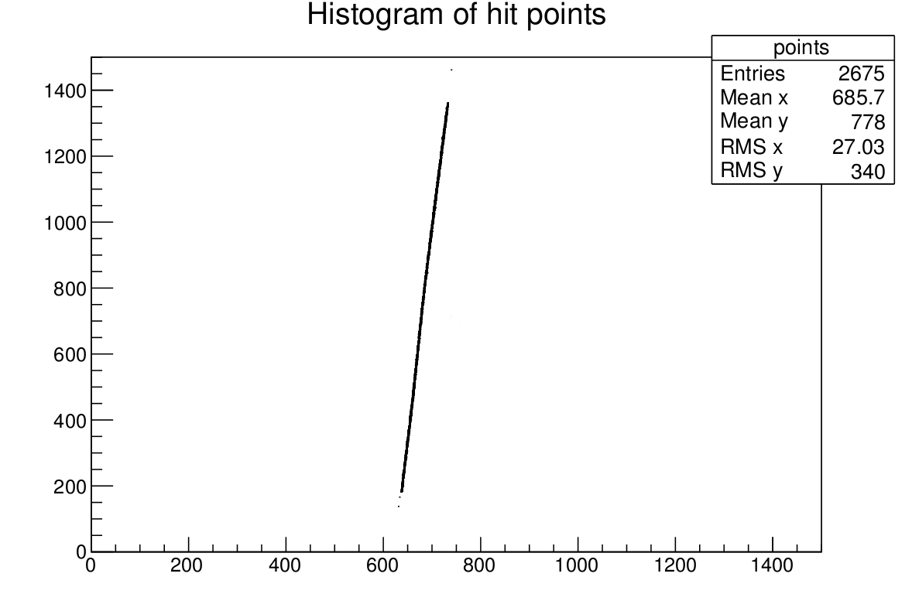
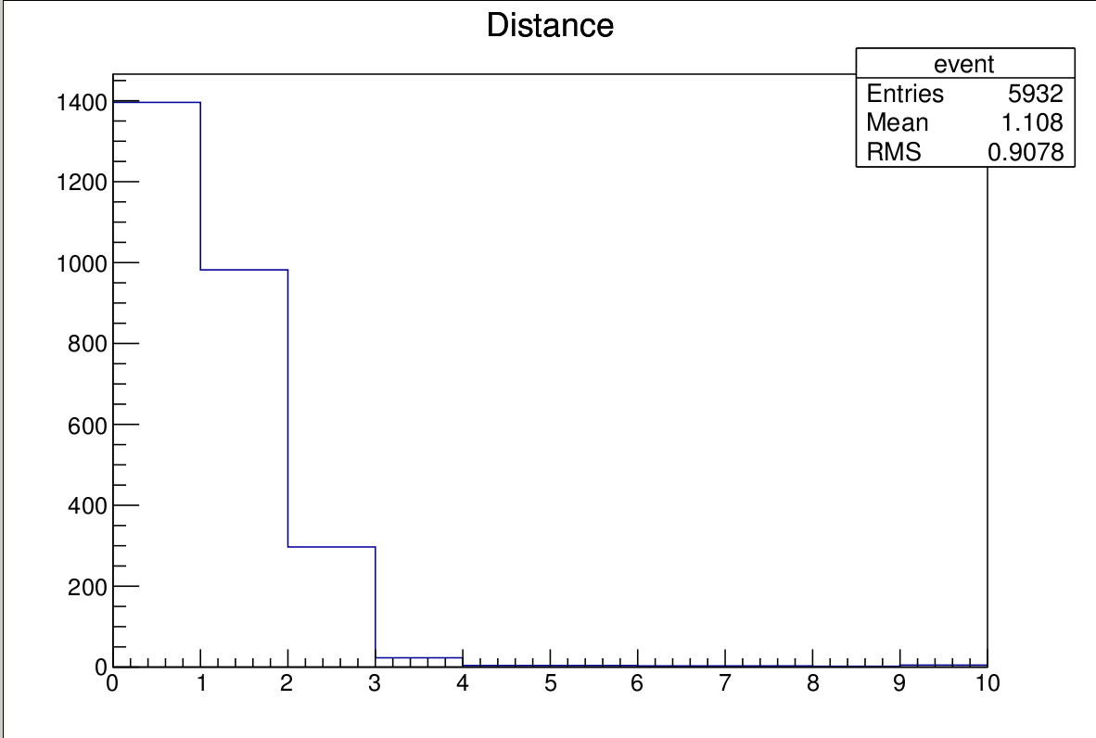
Proton tracks

Slide 6
The algorithm of finding the start and end point
Calculate the length of the line formed by the hits collected
Divide the line into 100 equal segments
Calculate the number of hits in each length segment and put it into a histogram
Define start and end points as being 10% of maximum in the histogram

Slide 7
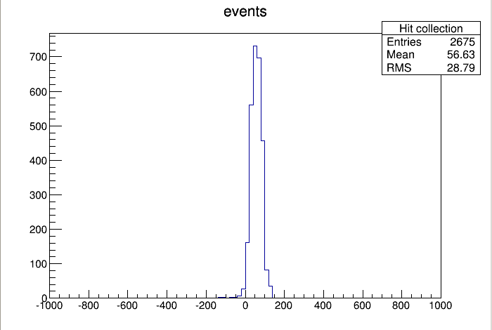
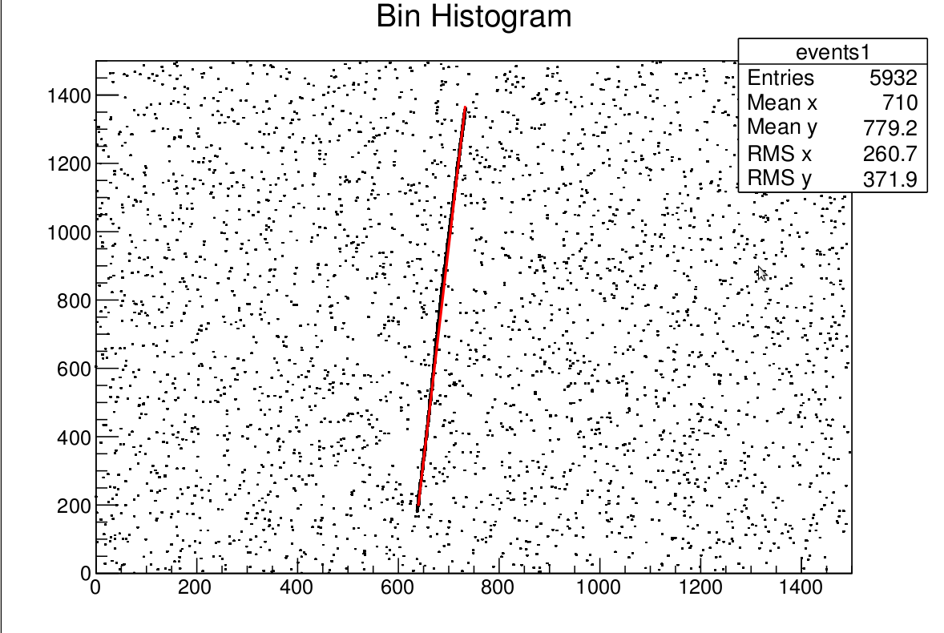
Proton tracks

Slide 8
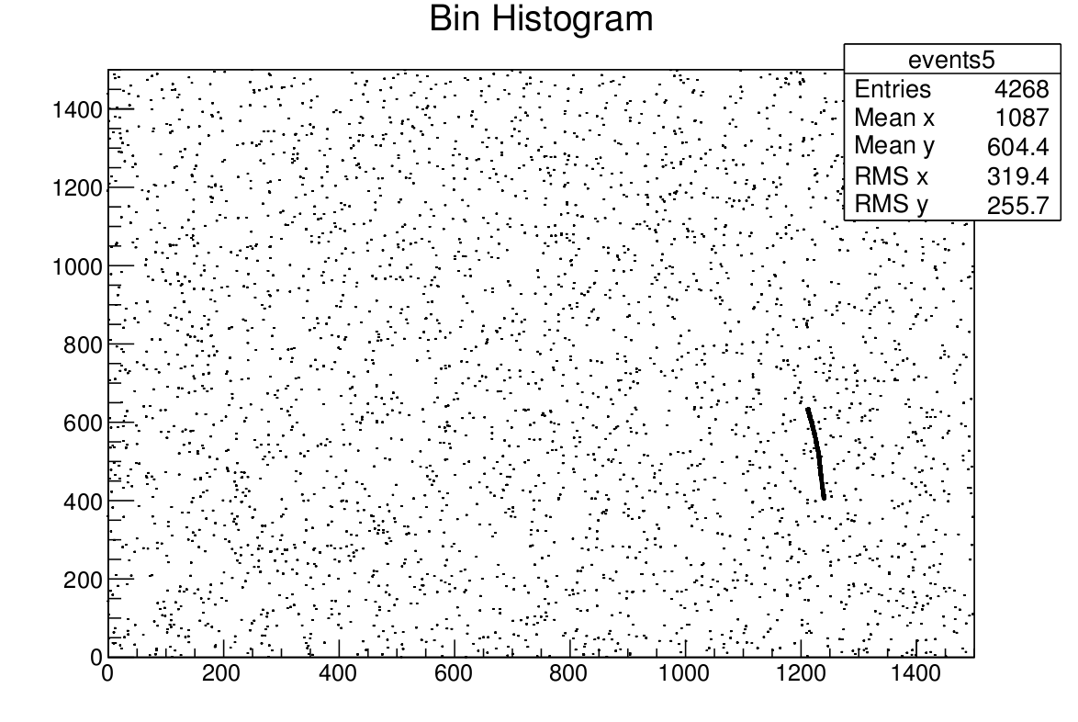
Proton tracks

Slide 9
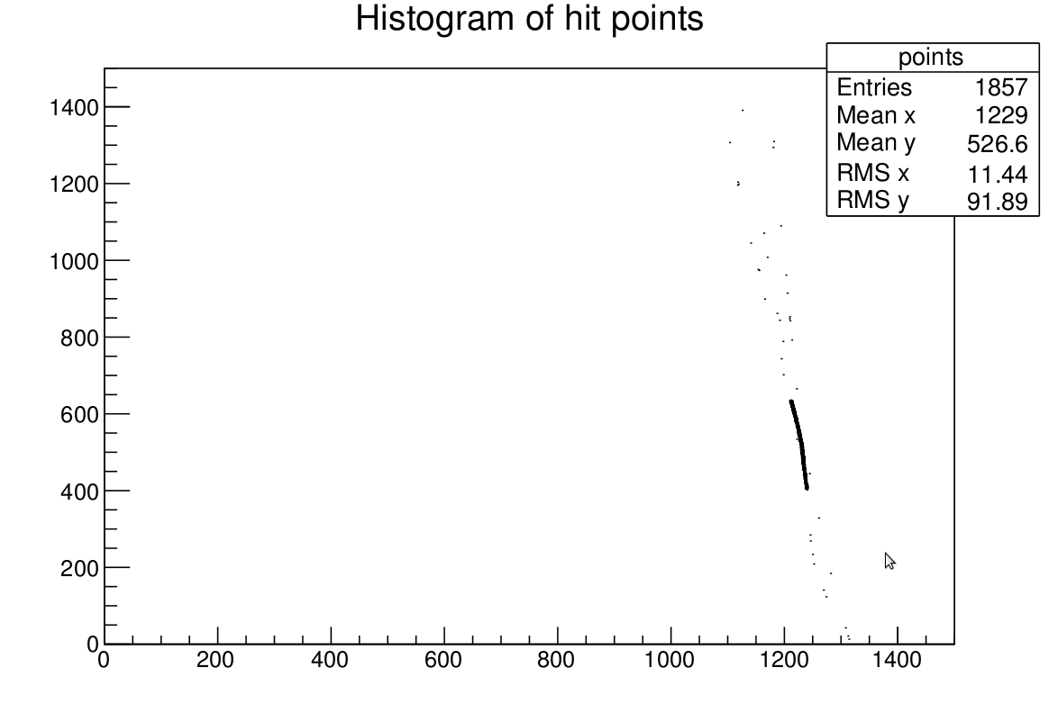
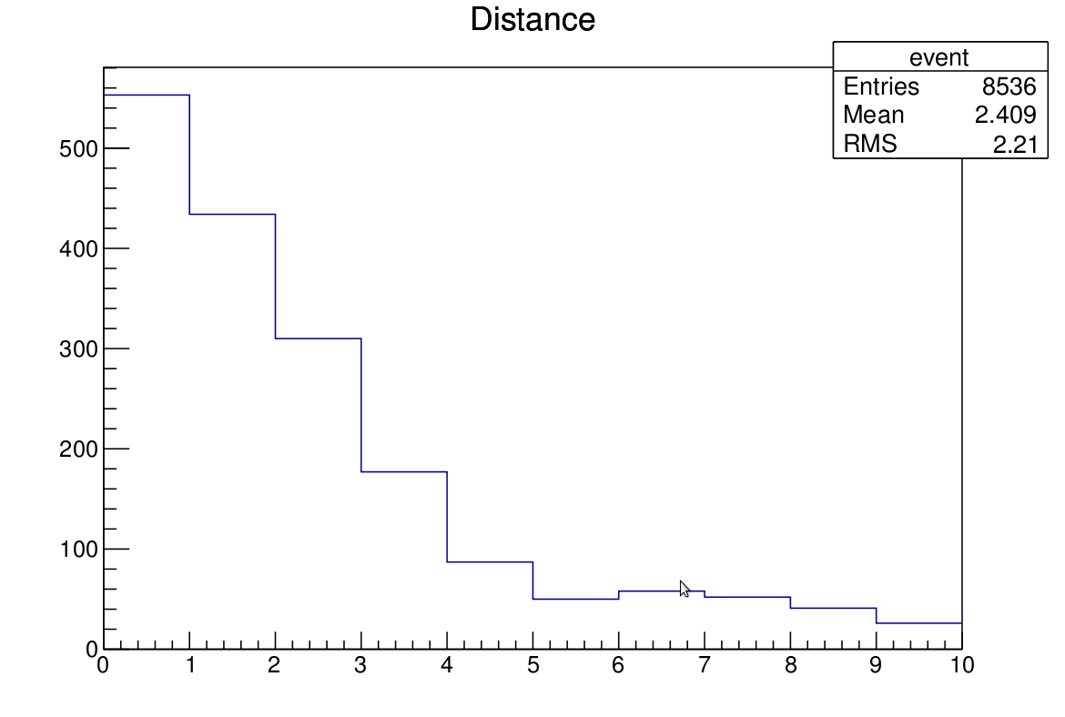
Proton tracks
Event5

Slide 10
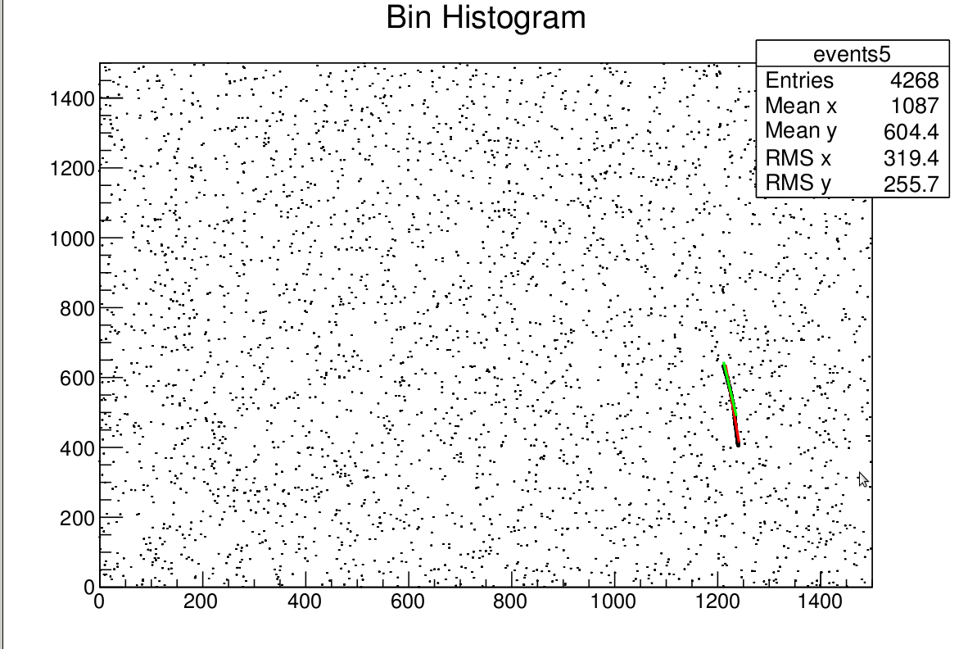
Proton tracks

Slide 11
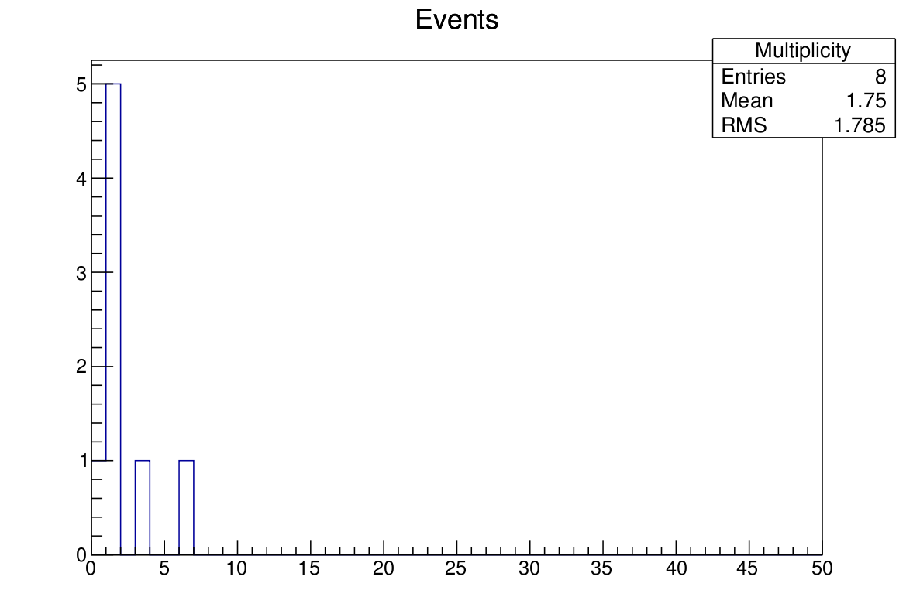
Multiplicity (number of tracks found)

Slide 12
Fake tracks and duplicate tracks
Fake tracks
Find the hit density of all tracks
For tracks that have density less than 0.02 (found the limit looking at hit densities of events where more than 1 peak found) set the start and end point to 0
Duplicate tracks
Look for the values for b and m (y-intercept and gradient) of the track
If they are close to each other (limits found looking at events with more than 1 peaks) set start point and end point to 0
Currently for some rare tracks all tracks are cut off, but this is a work in progress

Slide 13
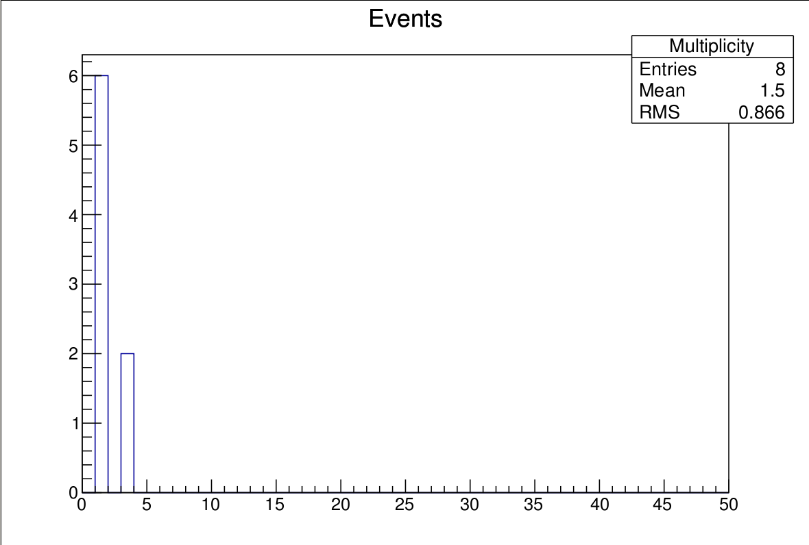
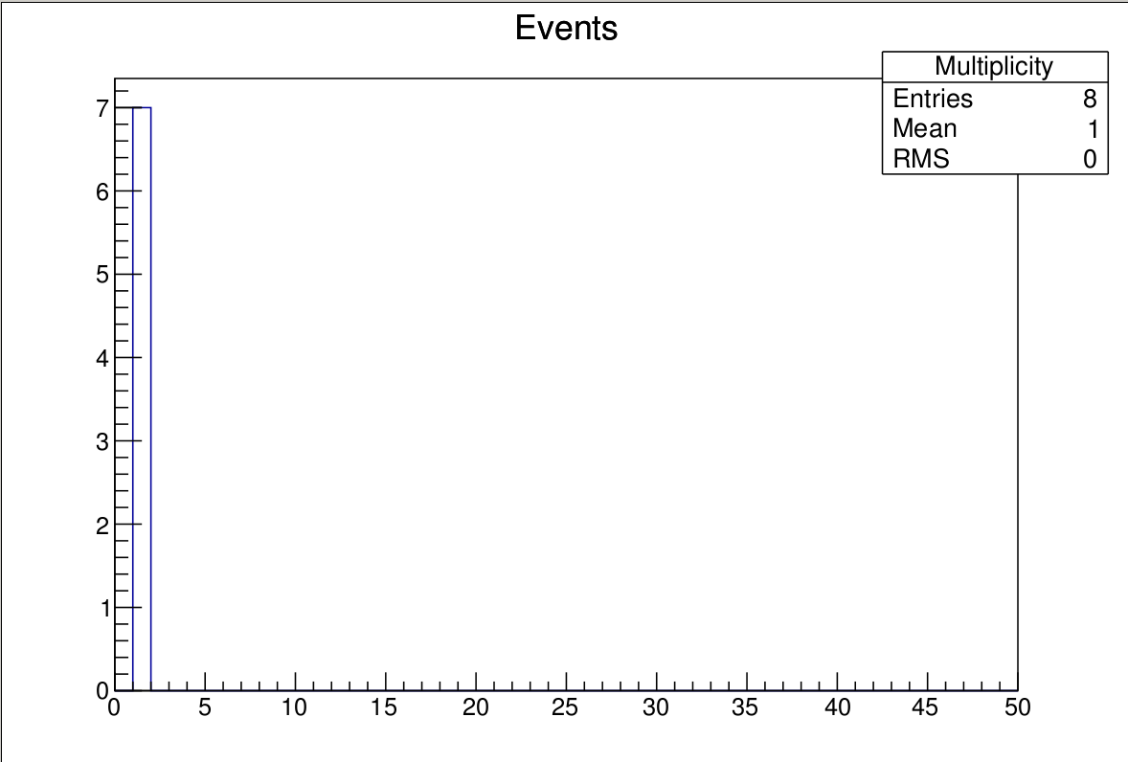
Multiplicity after removing tracks (protons)
Fake track
Duplicate tracks

Slide 14
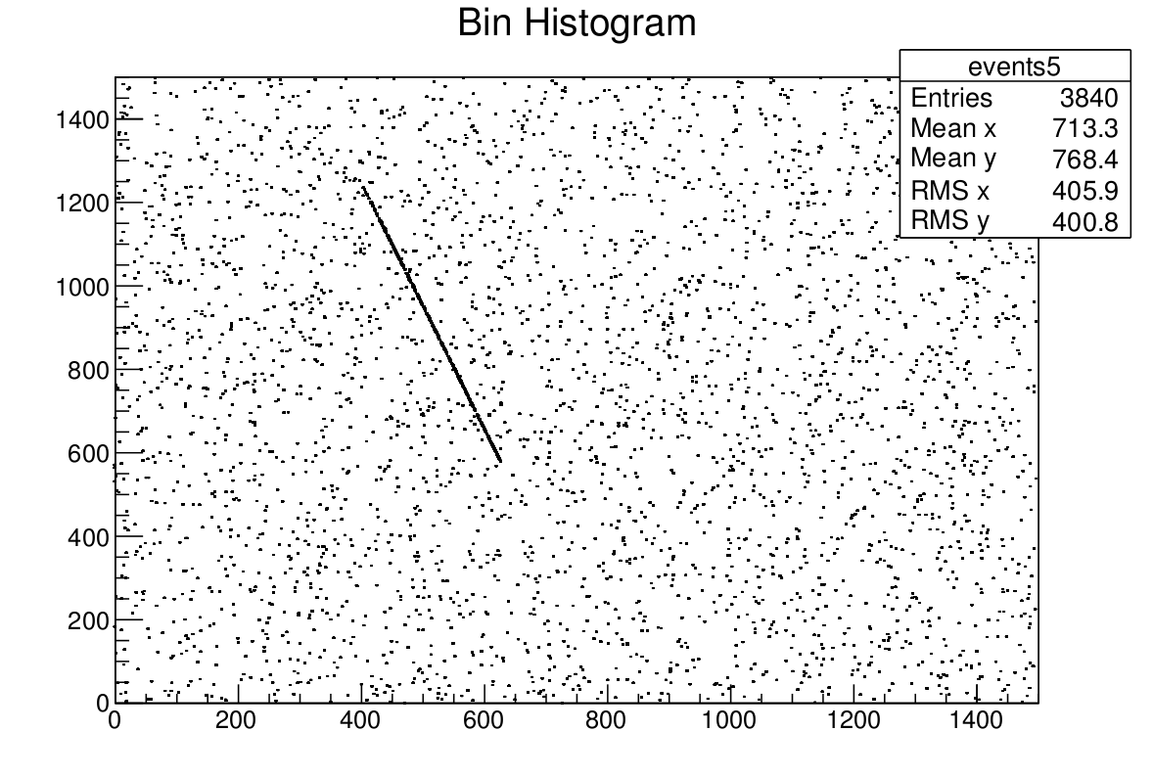
Pion tracks

Slide 15
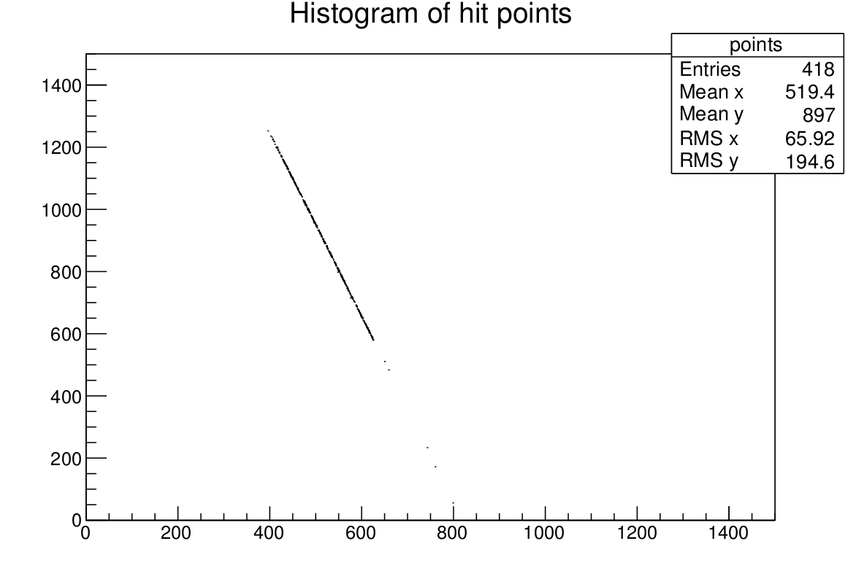
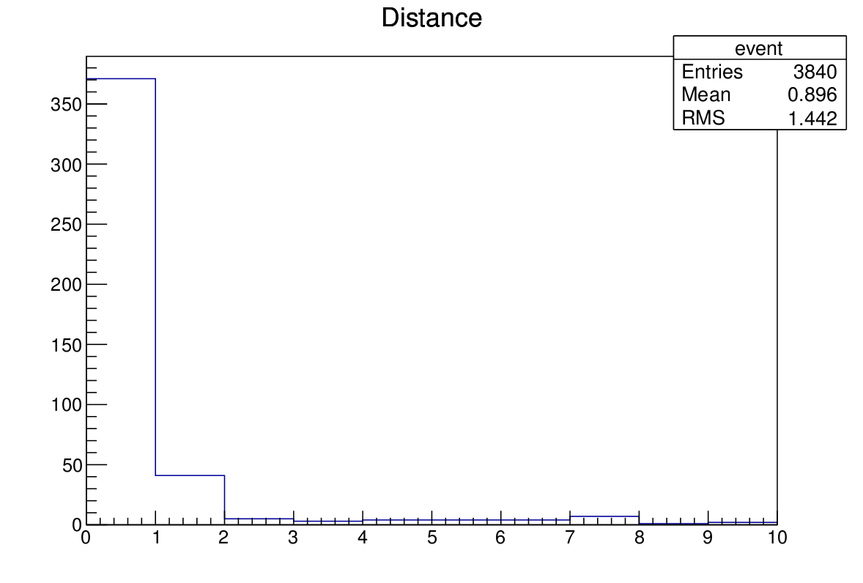
Pion tracks

Slide 16
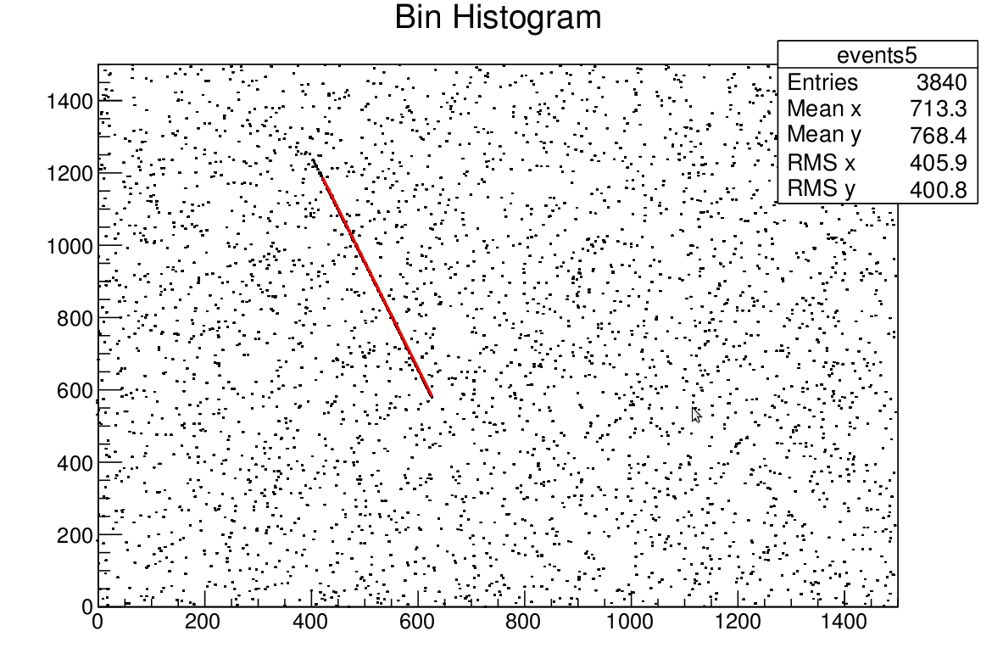
Pion tracks

Slide 17
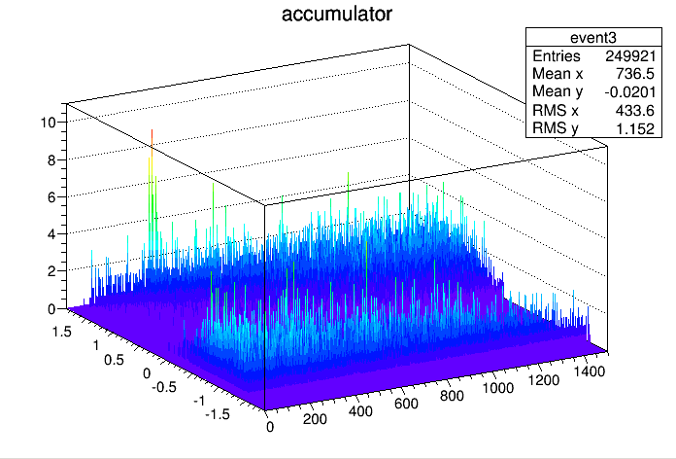
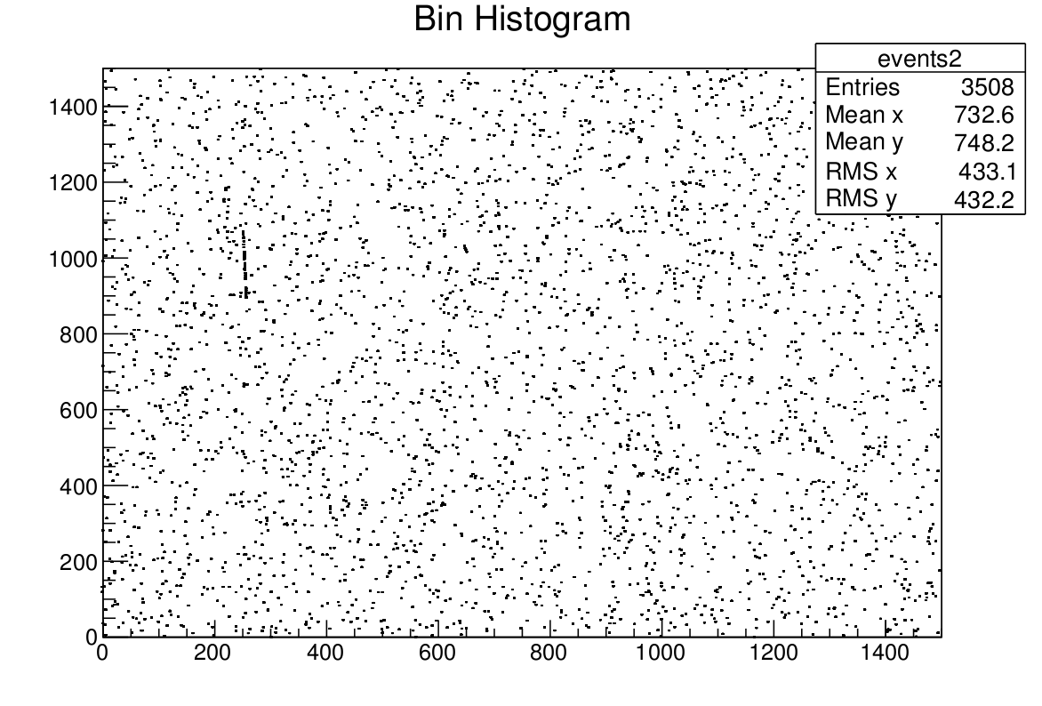
Pion tracks

Slide 18
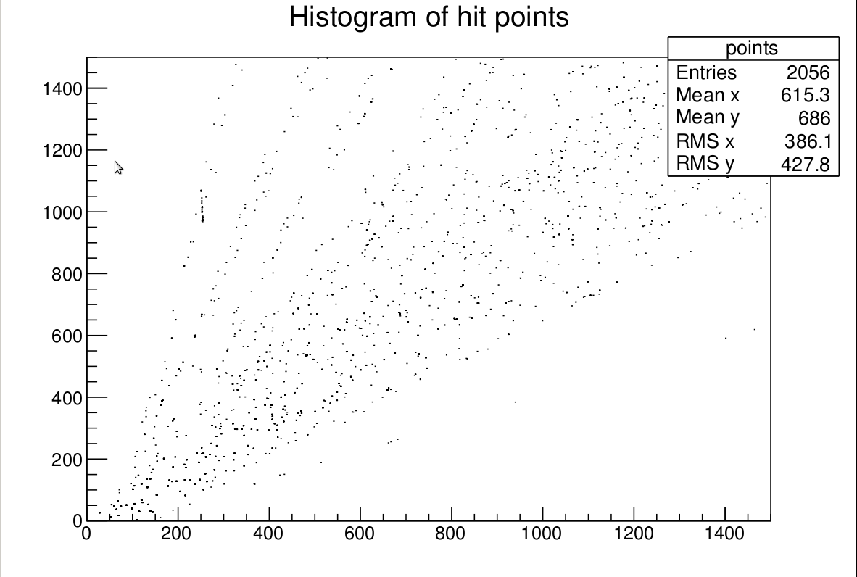
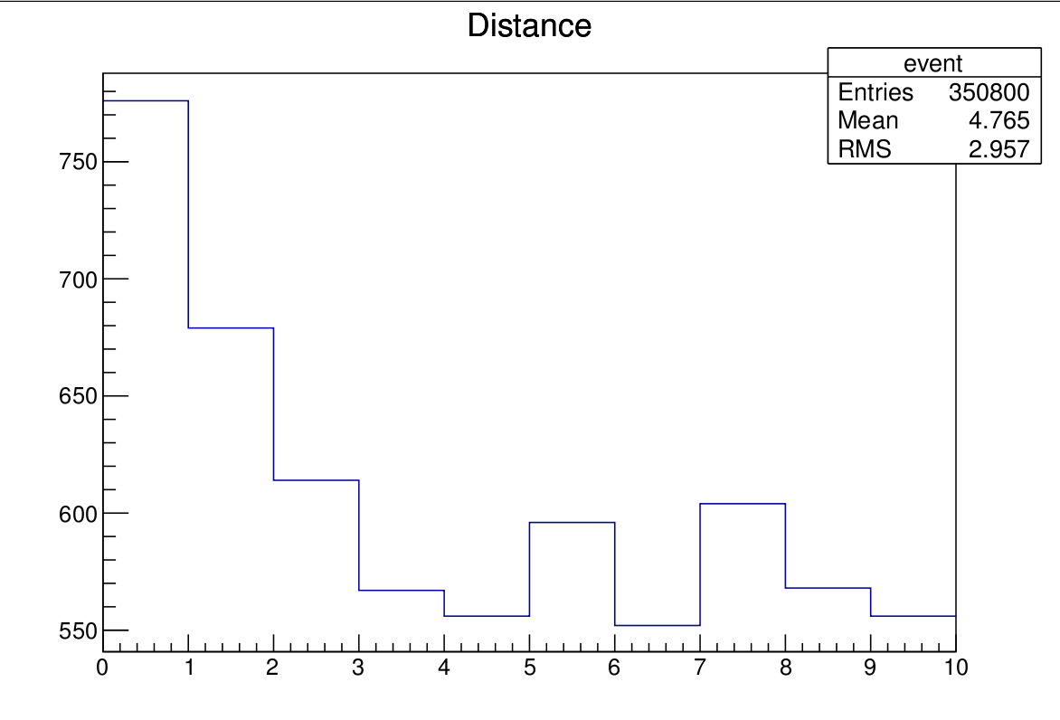
Pion tracks
Event2

Slide 19
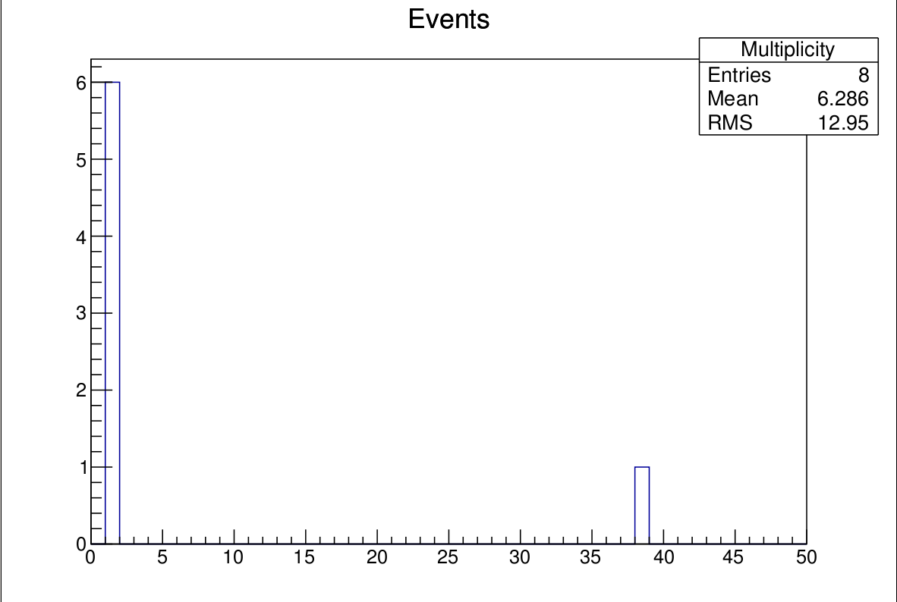
Multiplicity (pions, 8 events)

Slide 20
Multiplicity after removing tracks (pions)
Fake tracks
Duplicate trakcs

Slide 21
Next…
Improve the detection of fake tracks and duplicate tracks
Try a different approach to finding the peaks (maybe try something else than TSpecturm?)
Test the programme using actual data from hptpc when possible

