Slide 1

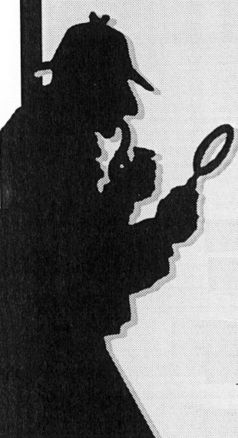
Neutrinos and the Case
of the Missing Antimatter
Steve Boyd, University of Warwick

Slide 2
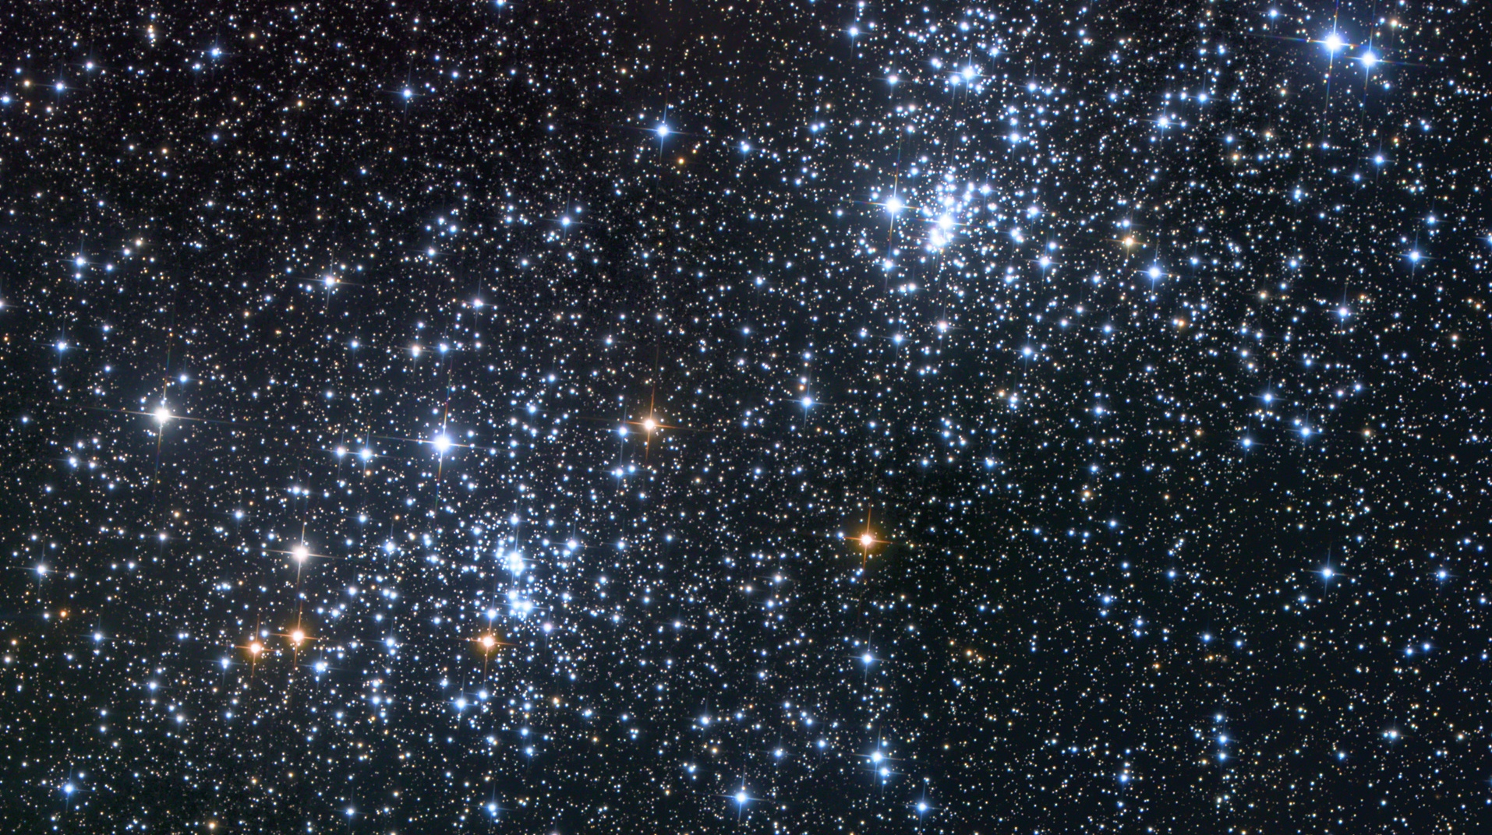
Where is all the antimatter?

Slide 3
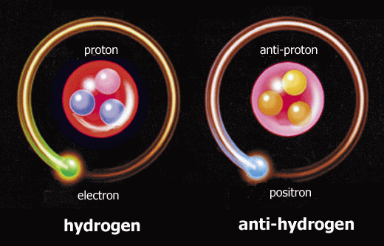
Matter
Anti-Matter
anti-quark
quark
Negative
electric charge
Positive
electric charge
Predicted by Dirac in 1928
Discovered by Anderson in 1932

Slide 4
Matter
Anti-Matter
anti-quark
quark
Negative
electric charge
Positive
electric charge
Predicted by Dirac in 1928
Discovered by Anderson in 1932

Slide 5
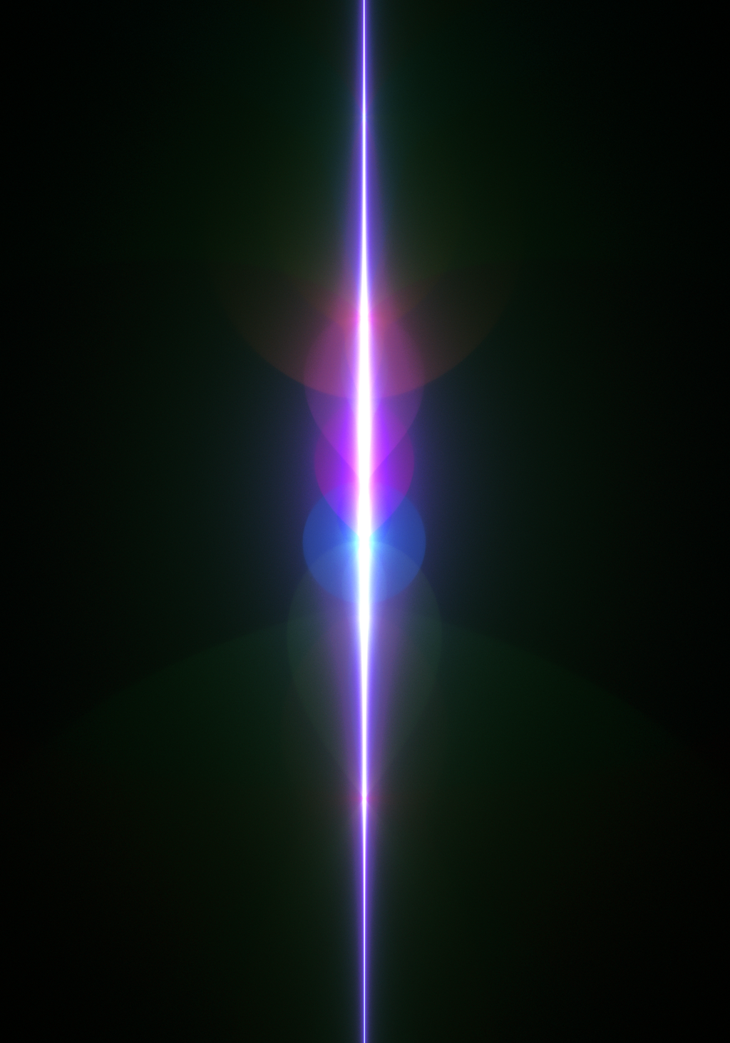

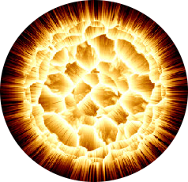

Matter
light
Anti-Matter
E = mc2

Slide 6
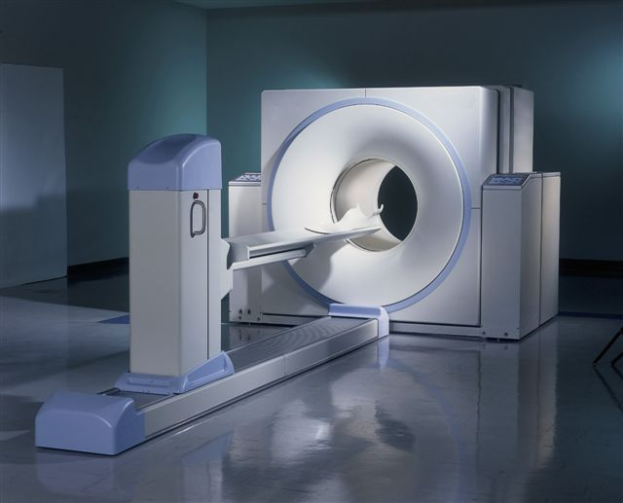
Positron Emission Tomography (PET)

Slide 7
Matter
light
Anti-Matter
The reverse reaction should also happen
with the same probability

Slide 8
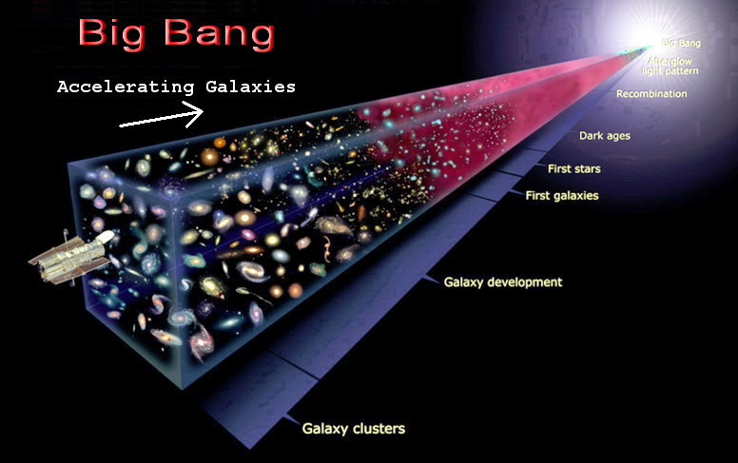
Equal amounts of
matter and antimatter
1 atom of matter to
0.0000000001 atoms
of antimatter

Slide 9
Neutrinos
The smallest, most insignificant (yet most
common) particle in the cosmos may just
hold the reason!
This particle is called the neutrino

Slide 10
So what is a neutrino?
Neutrinos are the second most common
particle in the universe. They are produced
whenever something radioactively decays
Electron, e
Electron Neutrino, ne
Negative
Charge
Neutral
Tiny mass ( 1 )
Very tiny mass
(<0.0000001)

Slide 11
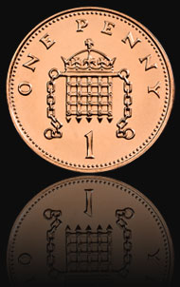

Slide 12
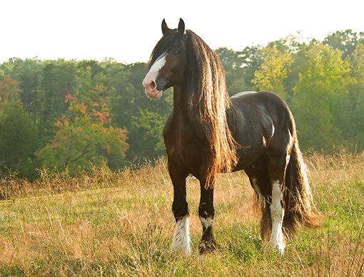

Slide 13
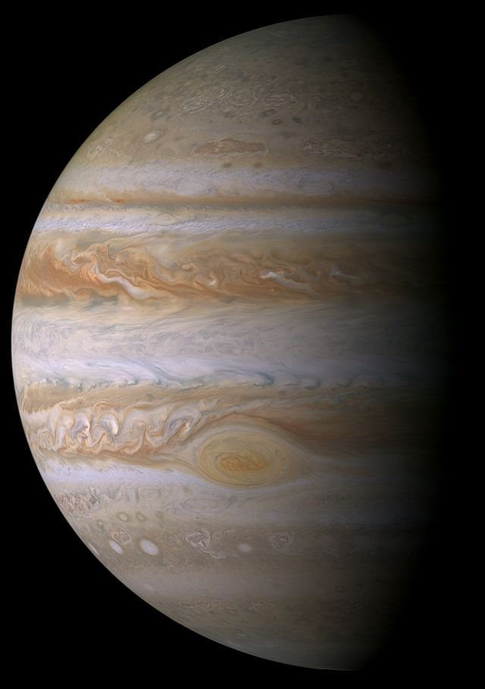

Slide 14
x 150

Slide 15
Electron
Neutrino, ne
Electron
Antineutrino, ne
Muon
Neutrino, nm
Muon
Antineutrino, nm
Tau
Neutrino, nt
Tau
Antineutrino, nm
3 neutrino Flavours

Slide 16
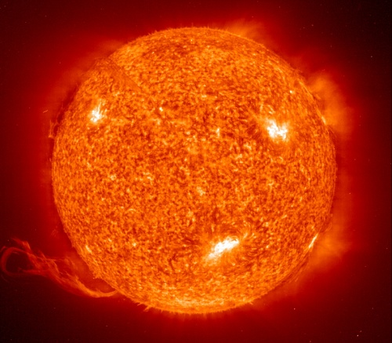
The sun generates about 2x1038 neutrinos/s as
byproducts of the fusion processes that make
the star shine.

Slide 17
So why don't we notice?
n are almost ghosts. They interact extremely
weakly with matter.
To a neutrino a planet is mostly empty space.

Slide 18
500,000,000,000,000 neutrinos
from the sun just went through
each and every one of you

Slide 19
"The chances of a neutrino actually hitting something as it travels through all this howling emptiness are roughly comparable to that of dropping a ball bearing at random from a cruising 747 and hitting, say, an egg sandwich."
Douglas Adams - Mostly Harmless

Slide 20

Probability  1 x 10-13
Egg Sandwich

Slide 21
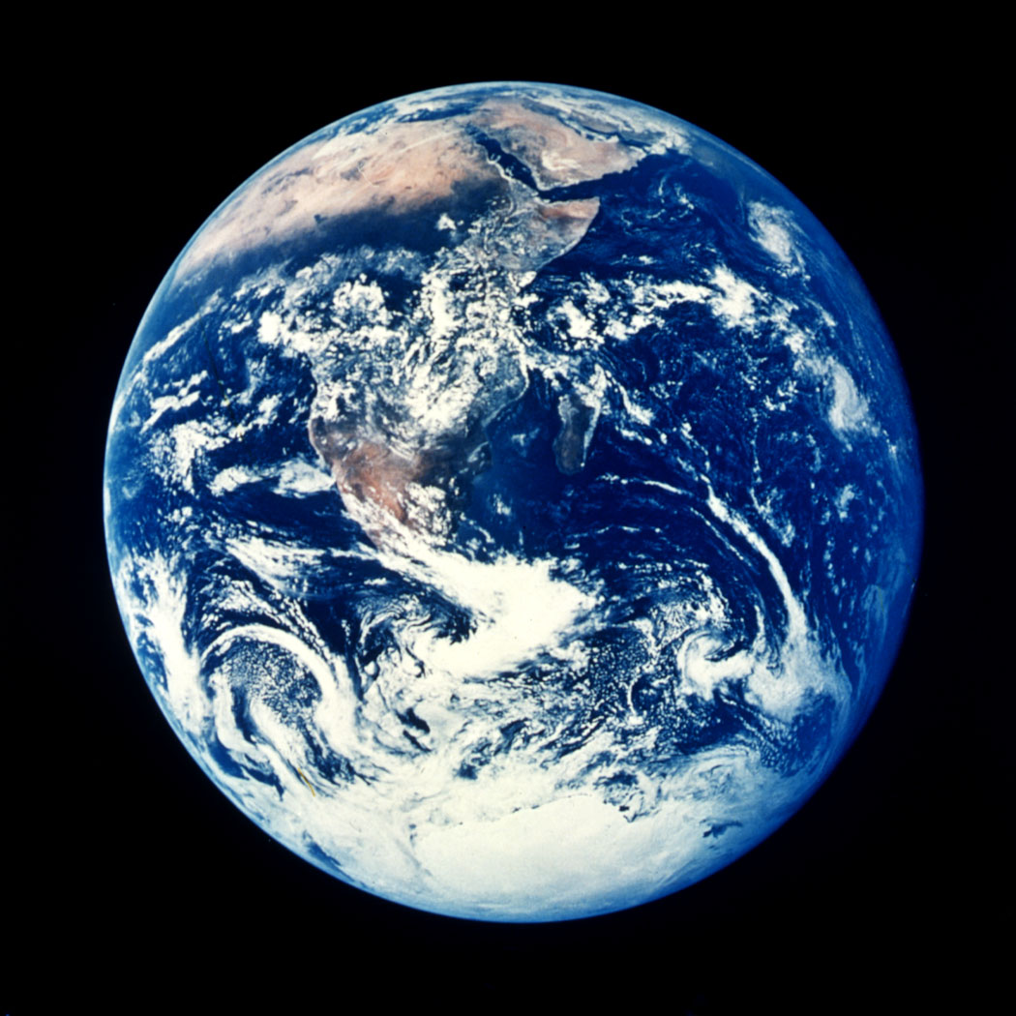
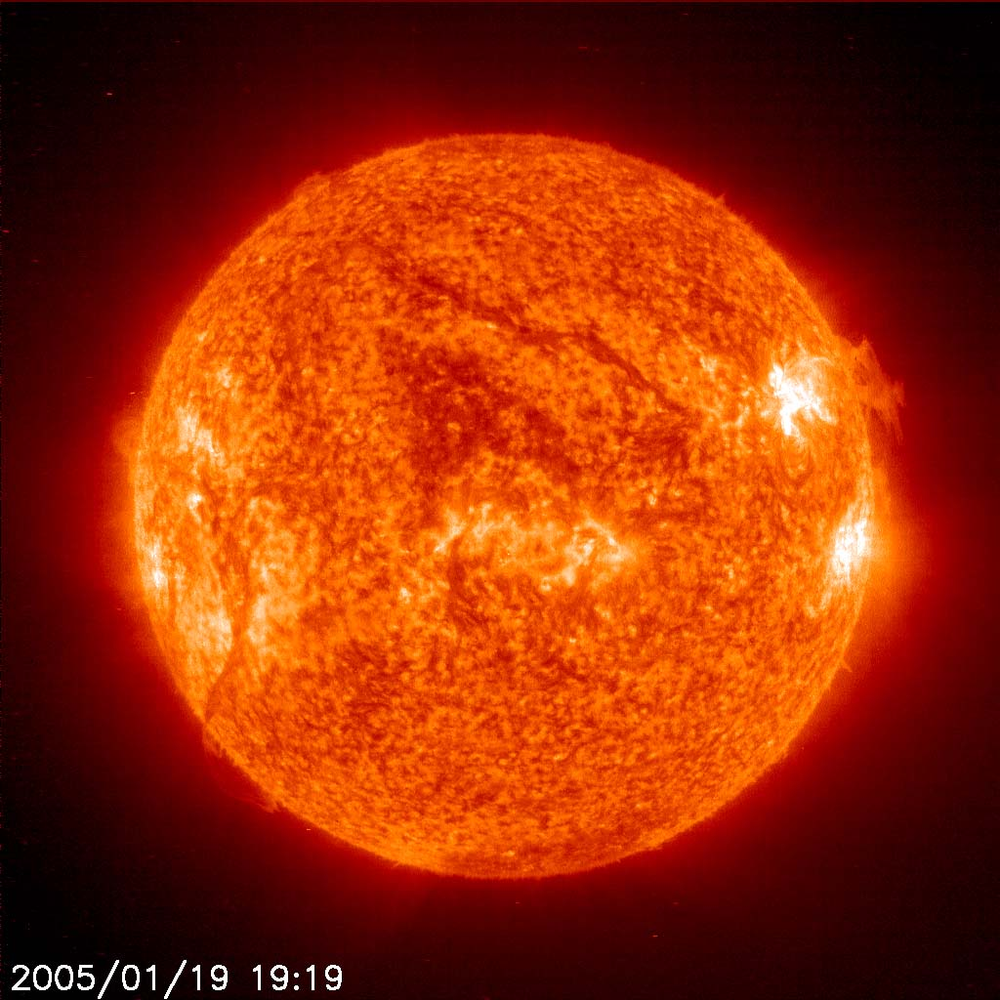
ne

Slide 22
Probability  5 x 10-13
ne

Slide 23
How do we use neutrinos to study the matter/anti-matter asymmetry?

Slide 24
Electron
Neutrino, ne
Electron
Antineutrino, ne
Muon
Neutrino, nm
Muon
Antineutrino, nm
Tau
Neutrino, nt
Tau
Antineutrino, nm
3 neutrino Flavours

Slide 25
Neutrino Flavour Oscillations
l
l
nl
nl
A typical neutrino experiment

Slide 26
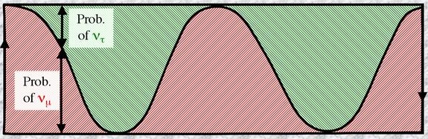
m
e
nm
ne
distance
1
Prob. It is nm
0
Distance Travelled

Slide 27

How do we use this?
Then neutrinos behave differently from
anti-neutrinos
An idea floating around suggests that,
if this happens, then the same thing will
happen to matter and anti-matter

Slide 28
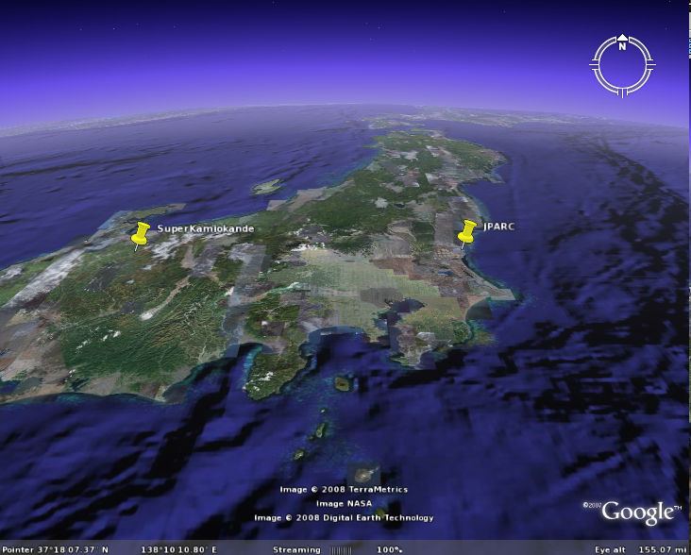
T2K Experiment
90% nm
10% ne
295 km
100% nm

Slide 29
The case of the missing antimatter
For some reason the laws of physics behave differently when applied to matter than when applied to antimatter. This is the reason why there is stuff around at all.
We don't know why (yet)
The neutrino – the lightest and most numerous (but hardest to study) particle in the universe may just hold the key to understanding why we are here at all.

Slide 30

The case of the missing antimatter
For some reason the laws of physics behave differently when applied to matter than when applied to antimatter. This is the reason why there is stuff around at all.
We don't know why (yet)
The neutrino – the lightest and most numerous (but hardest to study) particle in the universe may just hold the key to understanding why we are here at all.
So far.........

Slide 31
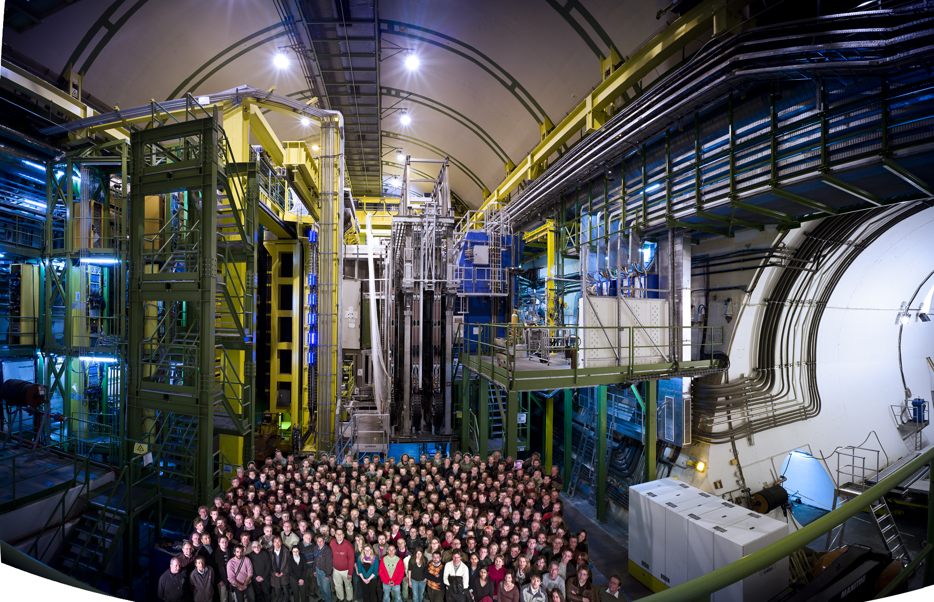
There is a difference between the physics
of matter and antimatter. It's name is CP Violation
LHCb
The LHC will study this by looking differences
between particles called B0 and B0 mesons

Slide 32
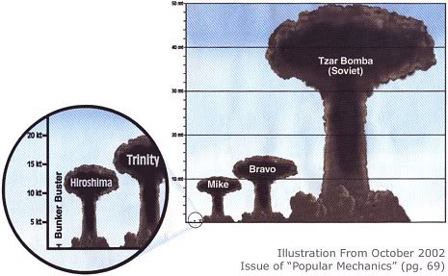
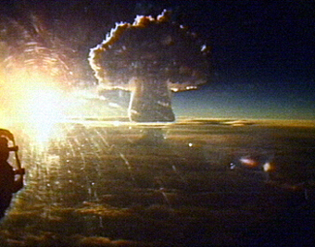
1 kilogram of matter
+
1 kilogram of antimatter
x2

Slide 33
Neutrino Oscillations
THE most important discovery about neutrinos in the
last 20 years
l
l
A typical neutrino experiment

Slide 34
Neutrino Oscillations
lepton
another type of
lepton
A typical neutrino experiment

Slide 35
Neutrino Oscillations
lepton
another type of
lepton
A typical neutrino experiment

Slide 36

It's Quantum.....
where Uαi is a unitary matrix

