Slide 1
Particle Identification Warwick Week
Antonis Papanestis
RAL – STFC
(with borrowed material from S. Easo)

Slide 2
Outline
Introduction
Particle ID techniques:
Time of flight
Transition radiation
Cherenkov radiation
RICH detectors
DIRC detectors
dE/dx
Give examples of experiments and detectors

Slide 3
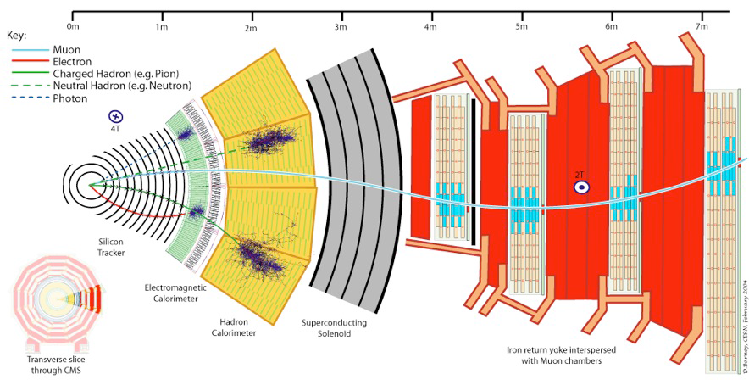
Introduction (i)
A “generic” particle physics experiment has “built-in” a lot of particle ID for:
Electrons, photons, neutrons and muons

Slide 4
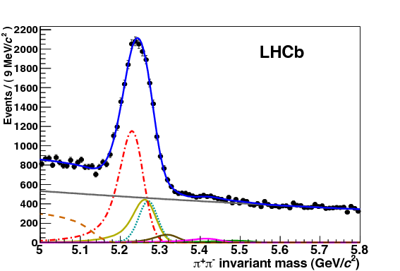
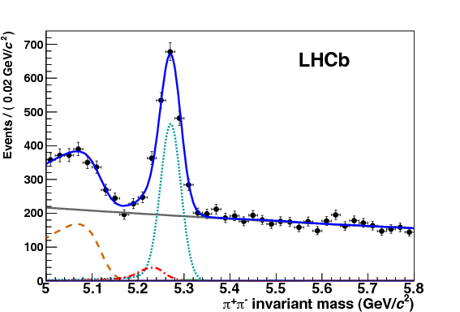

Introduction (ii)
Particle ID for hadrons
Distinguish between kaons, pions, protons, deuterons
Required for flavour physics
Specific experiment requirements
Distinguish between electrons and charged pions
Distinguish between electrons and muons
For neutrino experiments
For rare decay searches
$$B→π^{+}π^{−} (h^{+}h^{−})$$
before and after RICH PID

Slide 5

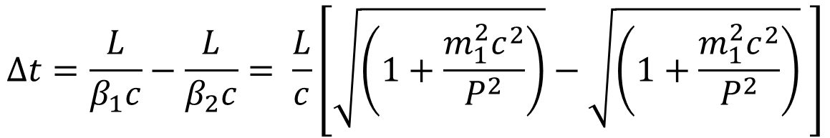
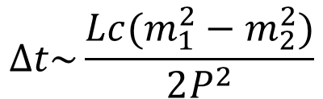
Time of flight
Time difference for two particles with masses m₁ and m₂ for length L
$$∆t=\frac{L}{β_{1}c}−\frac{L}{β_{2}c}= \frac{L}{c}\left[\sqrt{\left(1+\frac{m_{1}^{2}c^{2}}{P^{2}}\right)}−\sqrt{\left(1+\frac{m_{1}^{2}c^{2}}{P^{2}}\right)} \right]$$
$$P^{2}≫m^{2}c^{2}$$
$$∆t\sim \frac{Lc(m_{1}^{2}−m_{2}^{2})}{2P^{2}}$$
Mass resolution depends on time resolution of detectors and distance L
Typical values: L=3.5 m, Δt=100 ps, for 3 σ separation, P_{max}=2.1 GeV/c
Requires fast detectors: scintillation, Cherenkov, fast collection of ionisation

Slide 6
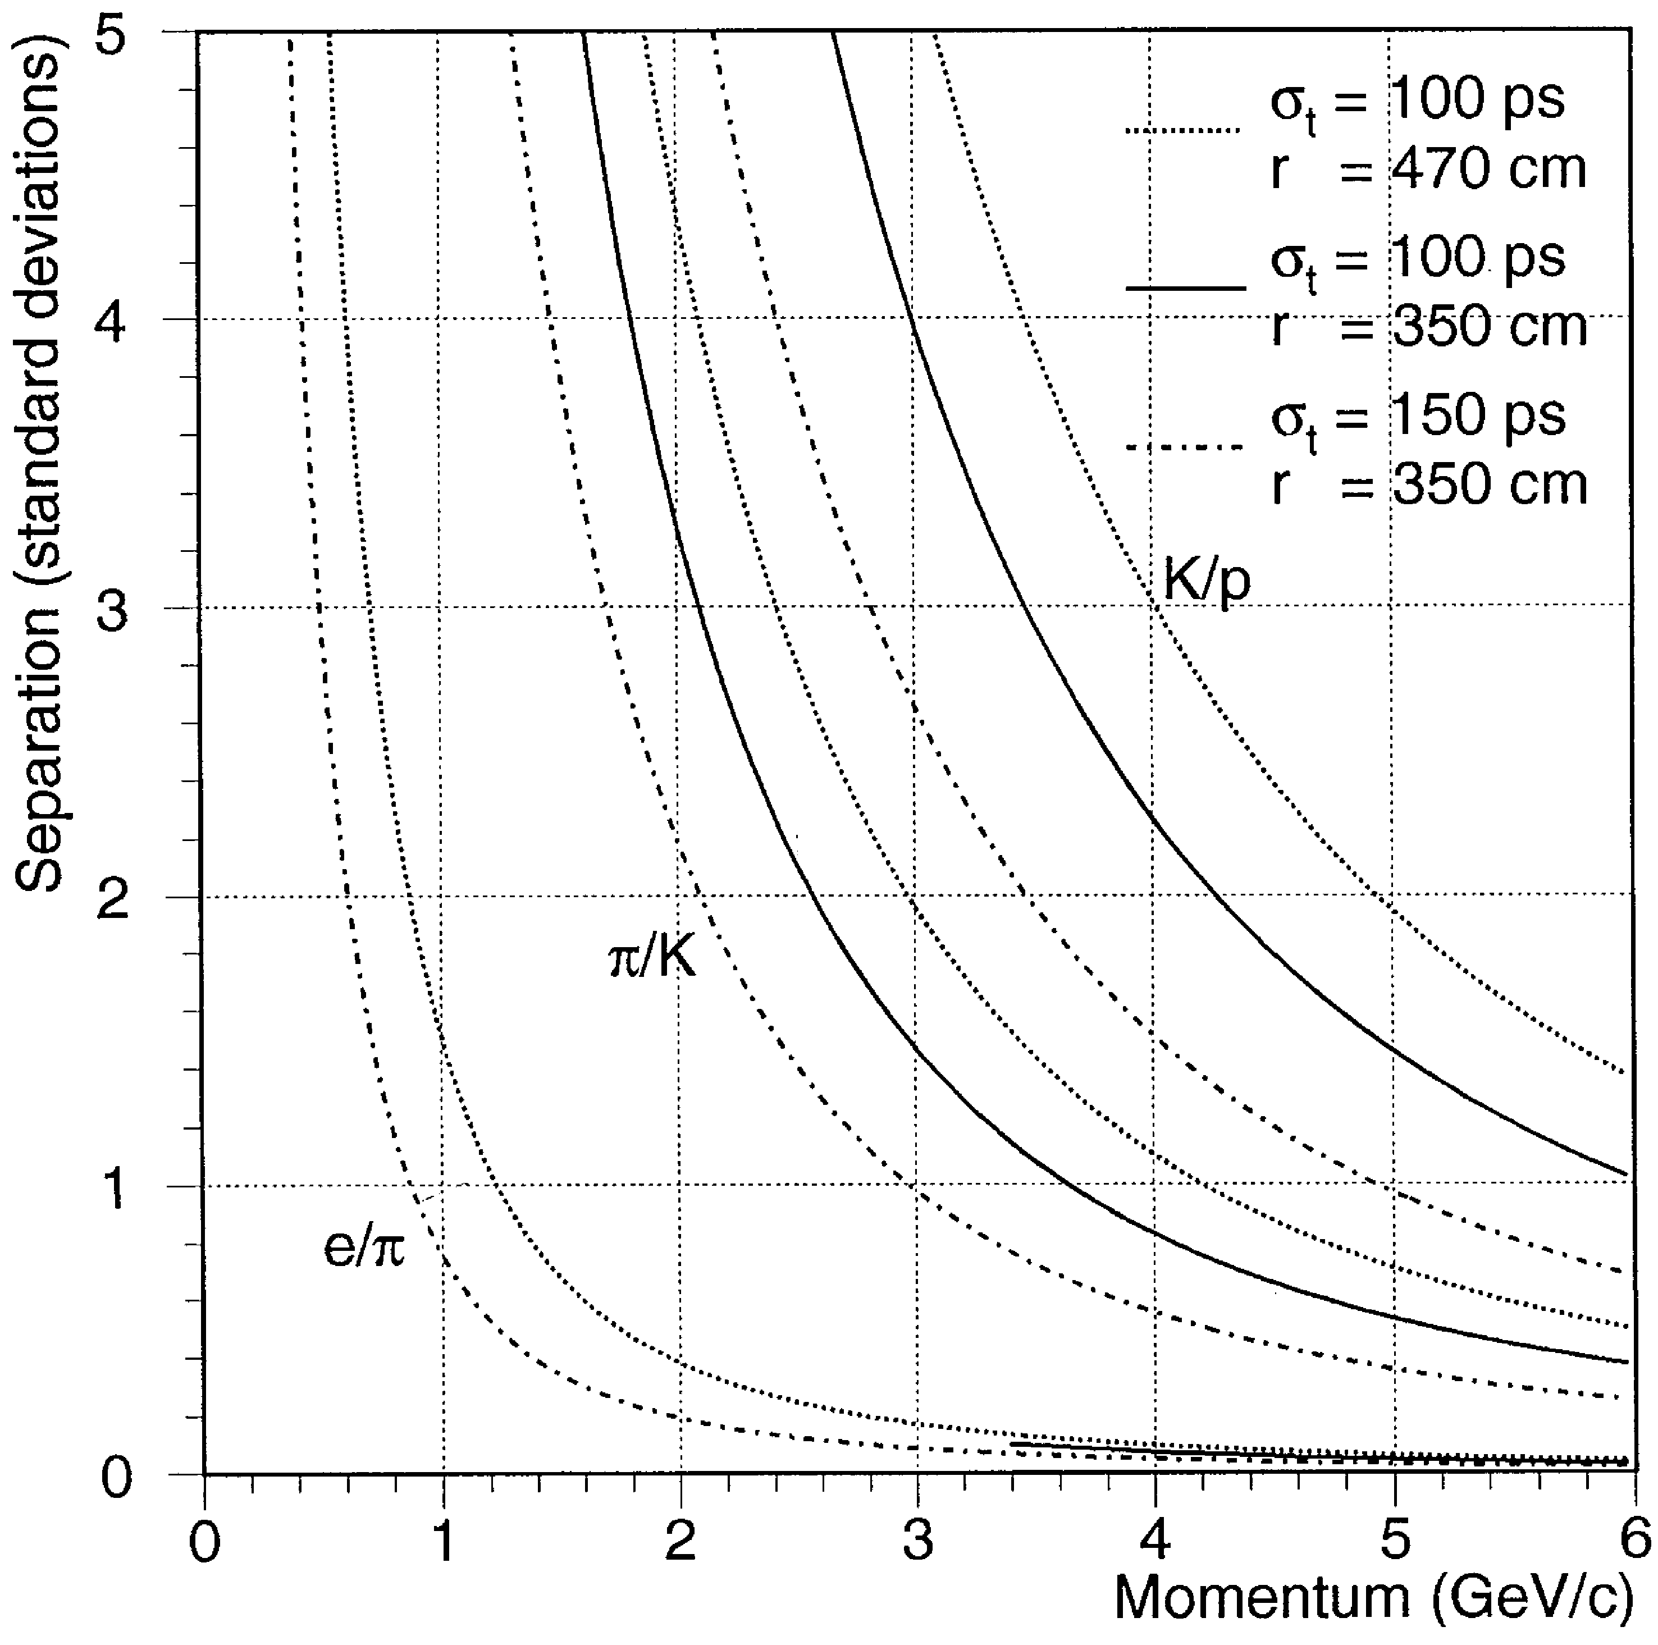
PID with TOF
Expected PID performance for various path lengths and time resolutions
TORCH, a proposed future detector, can push π/K separation to 9 GeV/c with L~10 m and time resolution per track ~ 20 ps

Slide 7
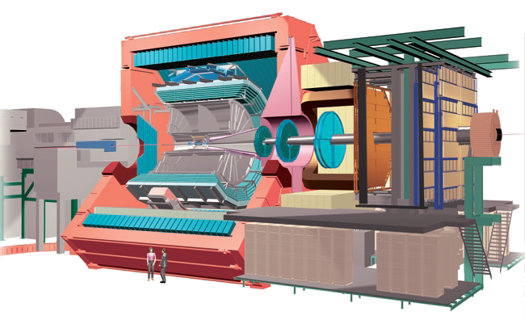
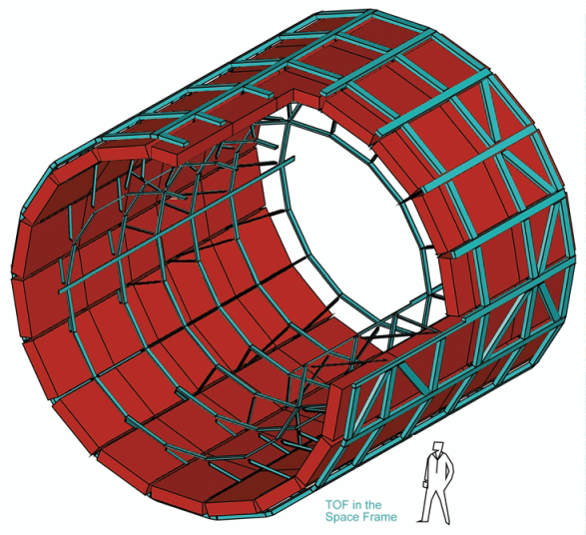
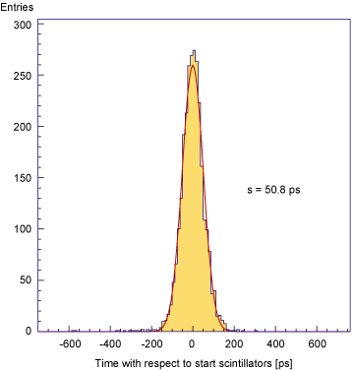
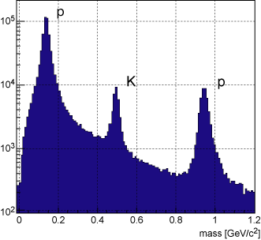
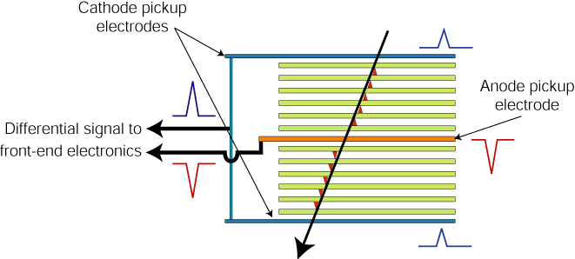
TOF: ALICE experiment
http://aliceinfo.cern.ch/Public/en/Chapter2/Chap2_TOF.html
Resistive plates made of glass.
2 X5 gaps : 250 mm
Readout by HPTDC chip (High Performance Time to Digital Converter)
σ=50.8ps
3σ π/K separation up to 2.2 GeV/c and K/p separation up to 4 GeV/c.

Slide 8

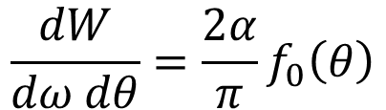
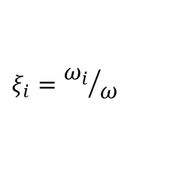
Transition Radiation (TR)
Transition Radiation: Radiation in the x-ray region when ultra
relativistic particles cross the boundary
between 2 media with different dielectric constants.
Mainly for e-π separation in 0.5 GeV/c → 200 GeV/c.
Full explanations and the derivations from Maxwell’s equations:
NIMA 326 (1993) 434-469 and references there in.
f
θ
The radiation is peaked at a small angle:
θ = 1/γ
g
$$\frac{dW}{dω dθ}=\frac{2α}{π}f_{0}\left(θ\right)$$
$$f_{0}\left(θ\right)=θ^{3}\left(\frac{1}{γ^{−2}+θ^{2}+ξ_{g}^{2}}−\frac{1}{γ^{−2}+θ^{2}+ξ_{f}^{2}}\right)$$
$$ξ_{i}={ω_{i}}/ω$$
ω_{i} =plasma freq of medium i

Slide 9
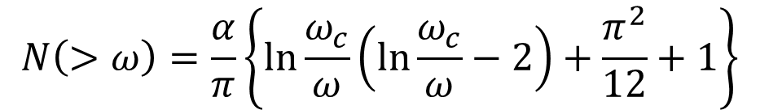

TR Detection
Integrating the previous equation, one can get , for ξ_{g}=0,
γ = E/m of the particle. This makes PID possible by measuring W.
Lighter particle give larger signal
ω_{f} = plasma frequency = 28.8 (ρ Z/A)^{0.5} eV
ρ=density, Z=atomic weight, A=atomic number
$$W_{TR}=2.43×{10}^{−3}ω_{f}γ$$
For example, for ω_{f} = 0.02 keV and γ = 5000, most of the photon energy is
in the range 10 keV< ω <100 keV (ie. 0.1 ω_{c}< ω < ω_{c}
where ω _{c} = cut-off frequency ).
$$N\left(>ω\right)=\frac{α}{π}\left\{\ln{\frac{ω_{c}}{ω}\left(\ln{\frac{ω_{c}}{ω}−2}\right)+\frac{π^{2}}{12}+1}\right\}$$
Number of photons produced =
For ω_{c}=100 keV and ω=1 keV, N= 0.03 for a single surface.
Hence to get sufficient number of photons , large number of interfaces are used:
a stack of many foils with gaps in between.

Slide 10
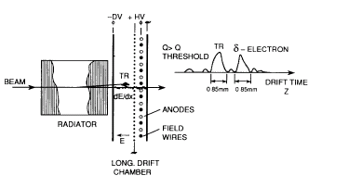
TRD Example 1: HELIOS experiment (NA34)
The minimum thickness of the foils and air gaps are determined by the size of the
‘formation zone’ and the interference effects.
( typically foils can be 10-20 μm thick and are made of polypropelene)
Behind a TRD foil stack there is a MWPC or drift chamber where the
TRD signal is detected along with the signal from the charged track.
Drift space = 10 mm,
Anode space = 6 mm
Drift time=0.5→1 μs
May use FADC or discriminators

Slide 11
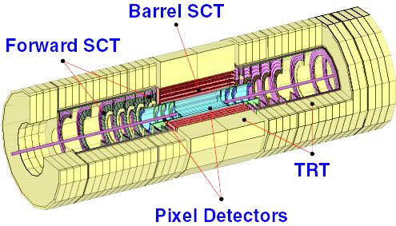
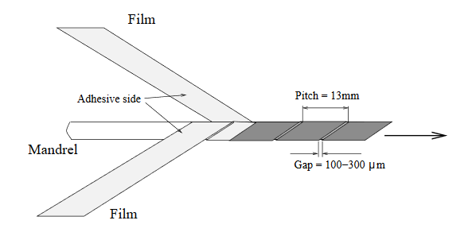
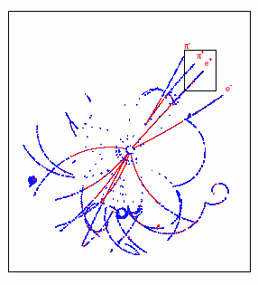
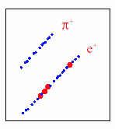
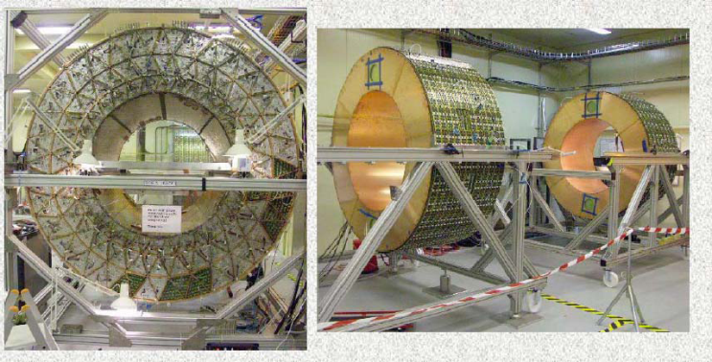
TRD Example 2: ATLAS TRT
TRT straw wall design
Barrel and endcap TRT
B_{d}→J/ψ K_{s}
Blue dots: ionizing hits
Red dots : TR hits
In an average event, energy deposit from:
Ionization loss of charged particles ~ 2.5 keV
TR photon > 5 keV.
(Photon emission spectrum peaks at 10-30keV)

Slide 12

Cherenkov radiation

Slide 13
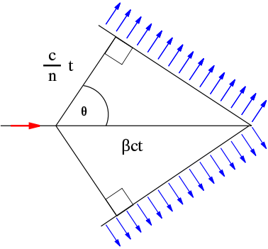

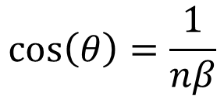
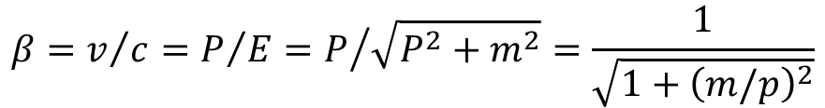
Basics of Cherenkov radiation
photon
θ
Charged particle
$$\cos\left(θ\right)=\frac{1}{nβ}$$
$$n\left(E_{ph}\right)=c/c_{M}$$
Refractive index
$$β=v/c=P/E=P/{\sqrt{P^{2}+m^{2}}=\frac{1}{\sqrt{1+{\left(m/p\right)}^{2}}}}$$
β= velocity of the charged particle in units of speed of light (c) vacuum
P, E ,m = momentum, energy, mass of the charged particle.
C_{M} = speed of light in the medium (phase velocity) ,
E_{ph} = photon energy, λ=Photon wavelength.
Theory of Cherenkov Radiation: Classical Electrodynamics by J. D. Jackson (Section 13.5)

Slide 14
History of Cherenkov radiation
The formula cos (θ ) =1/(nβ) was already predicted by Heaviside in 1888
~1900: ‘Blue glow’ seen in fluids containing concentrated Radium (Marie & Pierre Curie)
Pavel Alexeevich Cherenkov (1904-1990): Lebedev Physical Institute of the Russian Academy of Sciences.
Discovery and Validation of Cherenkov Effect : 1934-37
Full Explanation using Maxwell’s equations: I.M. Frank and I.E. Tamm in 1937
Nobel Prize in 1958: Cherenkov, Frank and Tamm.

Slide 15
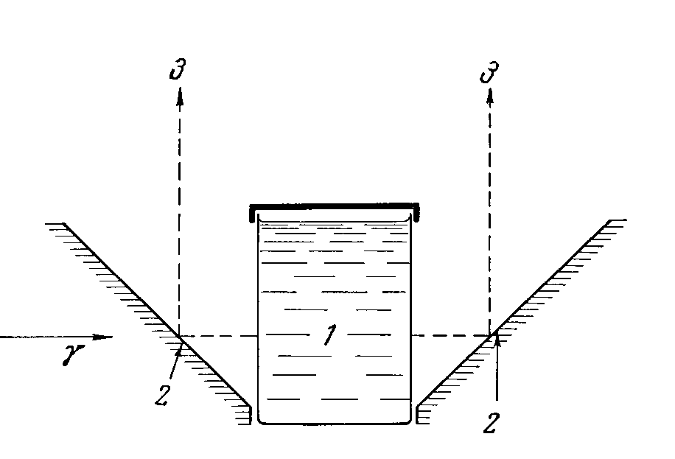
First experiments
1: vessel with liquid
2: mirror
3: Cherenkov photons towards the photographic plate
Typical Apparatus used by Cherenkov to study the angular distribution of Cherenkov photons.
(Incident γ ray produces electrons by Compton scattering in the liquid).
P. Cherenkov established that:
Light Intensity is proportional to the electron path length in the medium.
Light comes only from the ‘fast’ electrons above a velocity threshold, in his Apparatus.
Light emission is prompt and the light is polarized.
The wavelength spectrum of the light produced is continuous. No special spectral lines.
The angular distribution of the radiation, its intensity, wavelength spectrum and its dependence on the refractive index agree with the theory proposed by his colleagues Frank and Tamm.

Slide 16
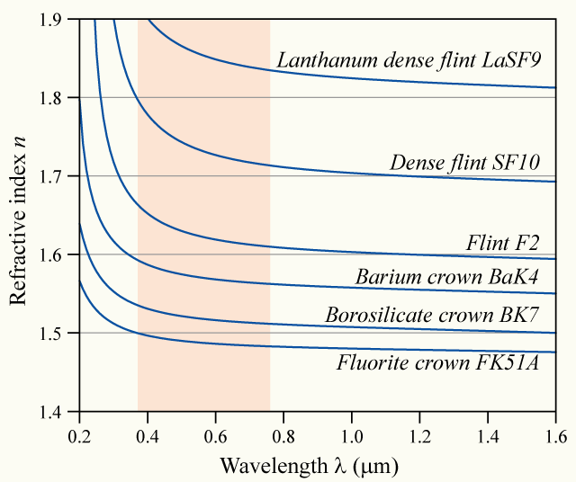
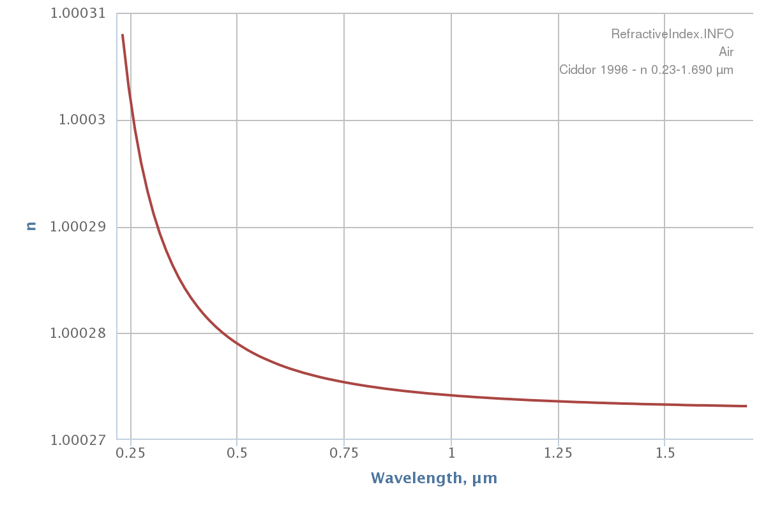
Refractive index
Glass
Air
Dependence of the refractive index on photon frequency means the Cherenkov angle is not constant
The spread of angles is referred to as Chromatic Error

Slide 17
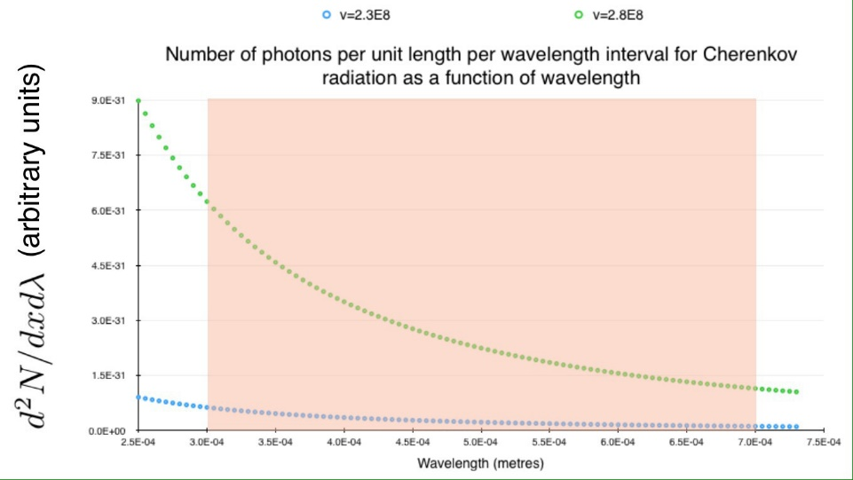



Number of photons
Number of emitted photons:
$$\frac{∂^{2}N}{∂x∂λ}=2πa\left(1−\frac{1}{β^{2}n^{2}}\right)\frac{1}{λ^{2}}$$
Between two wavelengths:
$$\frac{∂N}{∂x}=2πa\left(1−\frac{1}{β^{2}n^{2}}\right)\left(\frac{1}{λ_{L}}−\frac{1}{λ_{H}}\right)$$
The number of photons increases with energy
Using frequency instead of wavelength
$$\frac{dE}{dx}=\frac{q^{2}}{4π}\int_{v>\frac{c}{n\left(ω\right)}}{μ\left(ω\right)ω\left(1−\frac{c^{2}}{v^{2}n^{2}\left(ω\right)}\right)dω}$$
Typical example: Charged particle with momentum of few GeV/c or more emitting Cherenkov photons with few eV of energy

Slide 18





Detected photons
$$\frac{∂N}{∂x}=2πa\left(1−\frac{1}{β^{2}n^{2}}\right)\left(\frac{1}{λ_{L}}−\frac{1}{λ_{H}}\right)$$
For λ_{L}=400 nm and λ_{H}=700 nm
$$\frac{N}{L}=490\sin^{2}{θ}$$
If the photons are reflected by a mirror with reflectivity R(λ), and detected by a photon detector with quantum efficiency QE(λ) through a window with transmission T(λ)
$$N=490 L R Q T\sin^{2}{θ}$$
$$=N_{0}L\sin^{2}{θ}$$
And if we assume the mean angle θ_{c}
$$N=N_{0}L\sin^{2}{θ_{c}}$$
Ν₀ is a figure of merit for a Cherenkov detector; e.g. Ν₀=200/cm is a good value

Slide 19
A variety of Cherenkov detectors
Detector design:
Threshold Counters
Imaging detectors
Differential Cherenkov detectors
Ring Imaging Cherenkov detectors (RICH)
Detector for Internally Reflected light (DIRC)
Types of photon detectors:
Gas based
Vacuum
Solid state
Applications:
Accelerator HEP detectors
Astroparticle Physics detectors
Neutrino detectors

Slide 20
Threhold Cherenkov Counters
Signal produced from only those particles which are above Cherenkov Threshold.
Basic version: Yes/No decision on the existence of the particle type.
One counts the number of photoelectrons detected.
Improved version: Use the number of observed photoelectrons or a calibrated pulse height
to discriminate between particle types.
For typical detectors: N_{o} = 90 cm^{-1,}
N_{ph} per unit length of the radiator = N_{o} * (m₁² – m₂²)/(p²+m₁²)
At p= 1 GeV/c, N_{ph} per unit length = 16 /cm for Pions and 0 for Kaons.
At p= 5 GeV/c, N_{ph} per unit length= 0.8 /cm for Pions and 0 for Kaons.
Δ β / β = tan² θ / (2 * sqrt (N_{ph}) )

Slide 21
Differential Cherenkov Detectors
With Solid (quartz) radiator
Very small acceptance in β and direction of the charged particle. (Narrow range in velocity and direction intervals ).
Mostly used for identifying particles in the beam lines.
Δ β/ β = (m₁² – m₂²) /2 p ² = tan θ Δθ
m₁,m₂ (particle masses )<< p ( momentum)
Δβ/ β from 0.011 to 4* 10 ⁻⁶ achieved.
Discovery of anti-proton
in 1955 by Chamberlain,
Segre et. al. at Berkeley.
Nobel Prize in 1959

Slide 22
Threshold Counters
BELLE: Threshold Cherenkov Detector
Five aerogel tiles
inside an aluminum box
lined with a white
reflector(Goretex reflector)
Performance from test- beam
Approx .
20 photoelectrons
per Pion detected
at 3.5 GeV/c
More than 3σ
separation
p below and π above Threshold

Slide 23
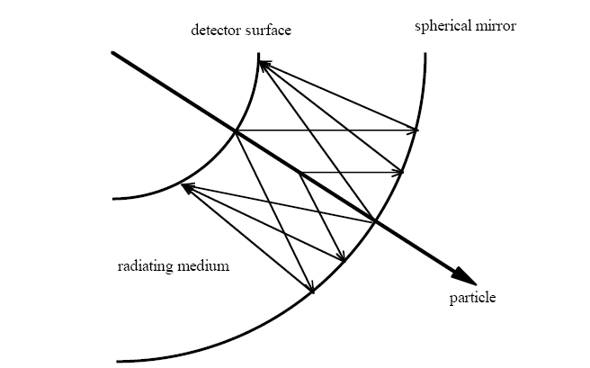
RICH Detectors
Measures both the Cherenkov angle and the number of photoelectrons detected.
Can be used over particle identification over large surfaces.
Requires photodetectors with single photon identification capability.

Slide 24
RICH detectors
Δ β / β = tan(θ) * Δθ_{c} = K where Δθ _{c} = < Δθ > / sqrt(N _{ph} ) + C
where <Δθ> is the mean resolution per single photon in a ring and C is the
error contribution from the tracking , alignment etc.
For example , for 1.4 m long CF₄ gas radiator at STP and a detector with N₀ = 75 cm⁻¹
K = 1.6 * 10 ⁻⁶ . ( E=6.5 eV, ΔE = 1 eV)
This is better than similar Threshold counters by a factor 125.
This is also better than similar Differential counters by a factor 2.
Reason: RICH measures both θ and N_{ph} directly.
RICH detectors have better resolution than equivalent Differential and Threshold counters.
Let u= sin² (θ) = 1- (1/n²⁾ - (m/p*n) ²
Number of standard deviations to discriminate between mass m₁ an m₂
= N _{σ} = (u₂-u₁) / ( σ _{u} * sqrt( N)) where σ _{u} : Δ θ converted into the parameter u.
( Δ θ = error in single photon θ measurement)
At momentum p (=β E), p= sqrt((m₂²-m₁²)/(2* K * N_{σ} )) , for β ∼1
This equation can be used in the design of the RICH detectors.
One the first large size RICH detector: in DELPHI at LEP.

Slide 25
Detection of Photoelectrons
Principle:
Convert Photons → Photoelectrons using a photocathode
Detect these photoelectrons using ‘charged track detectors’.
Measure the position and (/or ) time of photoelectrons in the tracking detector.
General introduction to tracking detectors and silicon detectors is not covered in this lecture.
In this lecture, we focus on some of the aspects related to the detection of photoelectrons in Cherenkov Detectors.
Gas based detectors:
MWPC (Multi Wire Proportional Chambers)
GEM (Gas Electron Multiplier )
Vacuum based detectors: PMT (Photomultiplier tubes)
HPD (Hybrid Photodiodes)
Solid state detectors: Silicon photomultipliers

Slide 26
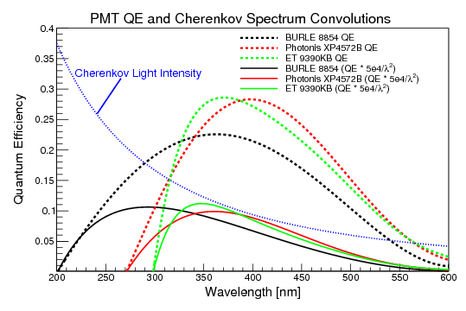
Photodetectors
Photon Conversion:
Photoelectric Effect : Photon energy to be above the ‘work function’
(Einstein : Nobel Prize in 1921).
Commercial alkaline Photocathodes: Bialkali , Trialkali (S20) , CsI etc.
Alkali metals have relatively low ‘work function’.
There are also gases where the photon conversion takes place.
Different photocathodes are efficient at different wavelength ranges.
Quantum Efficiency (QE) : Fraction of photons converted to electrons

Slide 27
Photodetector with CsI photocathode
Used in ALICE experiment at CERN
Thickness of :
radiator = 10mm
quartz window= 5mm
MWPC gaps= 2 mm
Wire cathode pitch=2 mm
Anode pitch= 4 mm
anode diameter= 20 micron
pad size = 8*8 mm²
Total detector area: 12 m²
Open geometry: using MWPC
Proximity focussing
photon
Backscatterd electron
Electron transport region (diffusion)
Typical gain: 10 ⁴
photon
cause feedback: leading to loss of original signal info.

Slide 28
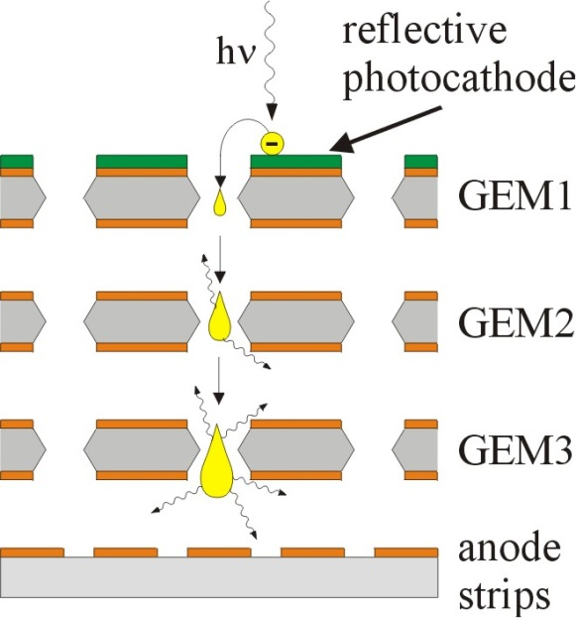
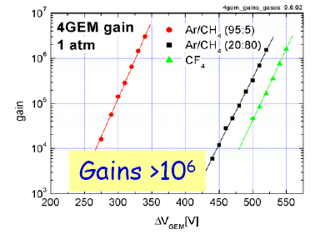
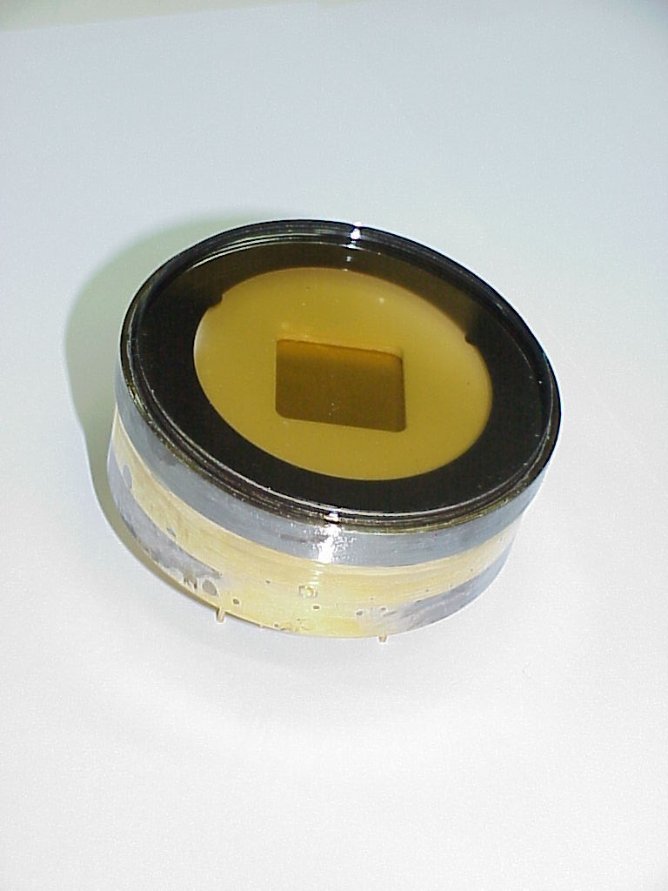
Recent Developments: Gas Based Photodetectors
GEM: Gas Electron Multiplier
GEM with semi-transparent Photocathode
(K-Cs-Sb)
Photon and ion feed back reduced.
Gated operation to reduce noise.
(no readout outside a ‘time window of signal’)
For now only closed geometry ( in sealed tubes):
Reduced fraction of useful area for photon
detection (Active Area Fraction) compared to open
geometry.

Slide 29
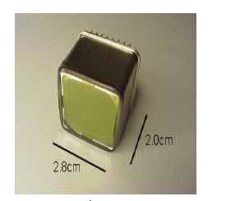
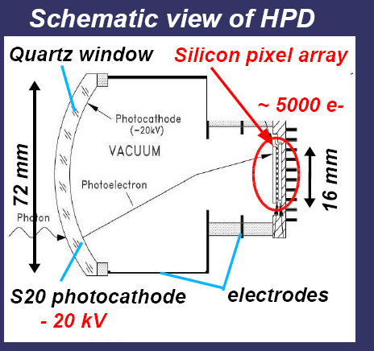
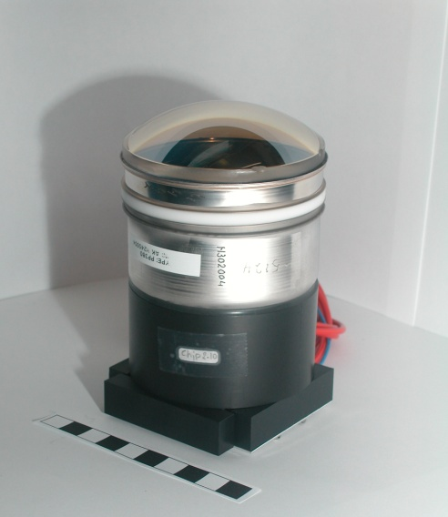
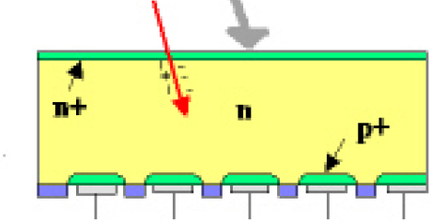
Vacuum Based Photodetectors
PMTs
MAPMT
PMTs Commercially produced: more info in
www.sales.hamamatsu.com
Silicon detector of HPD
HPD

Slide 30
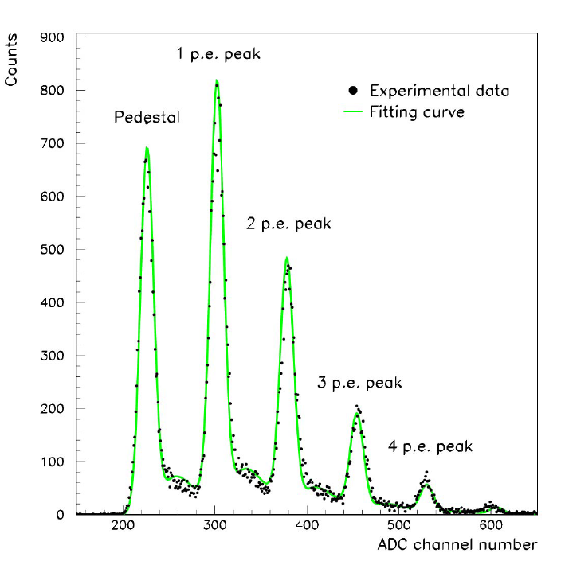
Features of HPD
Signal pulse height spectrum of a 61-pixel HPD
Illuminated with Cherenkov photons
Band gap in Silicon = 3.16eV; Typical Max Gain = 20 keV / 3.16 eV = 5000 (approx)

Slide 31
Features of the PMTs and HPDs
PMT:
Typical Gain of MAPMT 300 K.
Excellent time resolution: 125 ps for example
(Ex: used in underwater Cherenkov detectors).
Active area fraction: 40 % : Fraction of effective detection area.
This can be Improved with a lens, but then one may loose some
photons at the lens surface.
Recent developments: Flat panel pmts with 89 % active area fraction.
New photocathodes with >45% QE at 400 nm
HPD:
Typical gain 5K, but quite uniform across different channels.
Excellent Single photon identification capability.
Active area fraction: 35→ 76 %

Slide 32
Comparison of photodetectors
Choice of photodetector depends on the design of the Cherenkov detectors
and constraints on cost etc.
Gaseous:
Issues:
Related to photon and ion feed back and high gains at high rate.
Detection in visible wavelength range (for better resolution)
Advantages:
Can operate in high magnetic field
Lower cost for large size detectors compared to vacuum based
Vacuum based:
Issues:
Sensitivity to magnetic field
Active Area Fraction
Advantages:
Can easily operate at high rate (eg. LHC rates and higher).
Operates also in visible wavelengths.
Ease of operation at remote locations: underwater, in space etc.
HPD: uniform gain over large number of tubes and small noise.
Other Types and new developments:
APD, Silicon photomultiplier, HAPD , MCP etc.

Slide 33
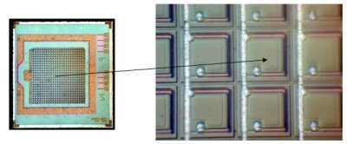
Recent Developments:Silicon Photomultipliers
Array of APDs
Photon Detection Efficiency (PDE)
for SiPM is better that of ordinary PMT.
Time resolution= ~ 100 ps.
Works in magnetic field
gain = ~ 10 ⁶
Reducing noise levels for single photon
detection is still an issue and is being worked upon.

Slide 34
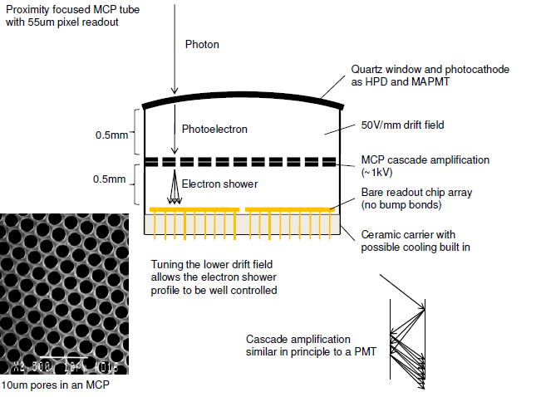
New Developments: Micro Channel Plate (MCP) Photon Detectors

Slide 35
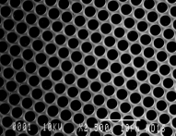
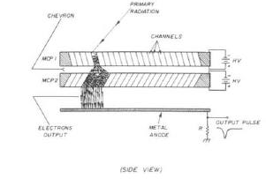
New Developments: Micro Channel Plates (MCP )
Typical Size:
2 mm thickness,
51 mm X 51 mm active area.
10 micron pores separated by 15 microns
Chevron: 8 degree tilt : To increase
th gain and reduce ion-feed back
Gain: ~ 5 * 10 ⁵
Typically ~ 1000 channels per MCP.
Measure Space and time of the hits.
Manufactured by industry ( Photonics for example).
Resolutions: Space: ~100 microns, Time: ~ 50 - 100 psec.
Short flight path of photoelectrons: Resistant to magnetic fields up to 0.8 Tesla.
Can work at 40 MHz readout rate.
Can detect single photons ( No noise from ‘first dynode’ as in MAPMT).
Fast ‘ageing’ at large luminosity (eg: LHC) is an issue, but there are some solutions.

Slide 36
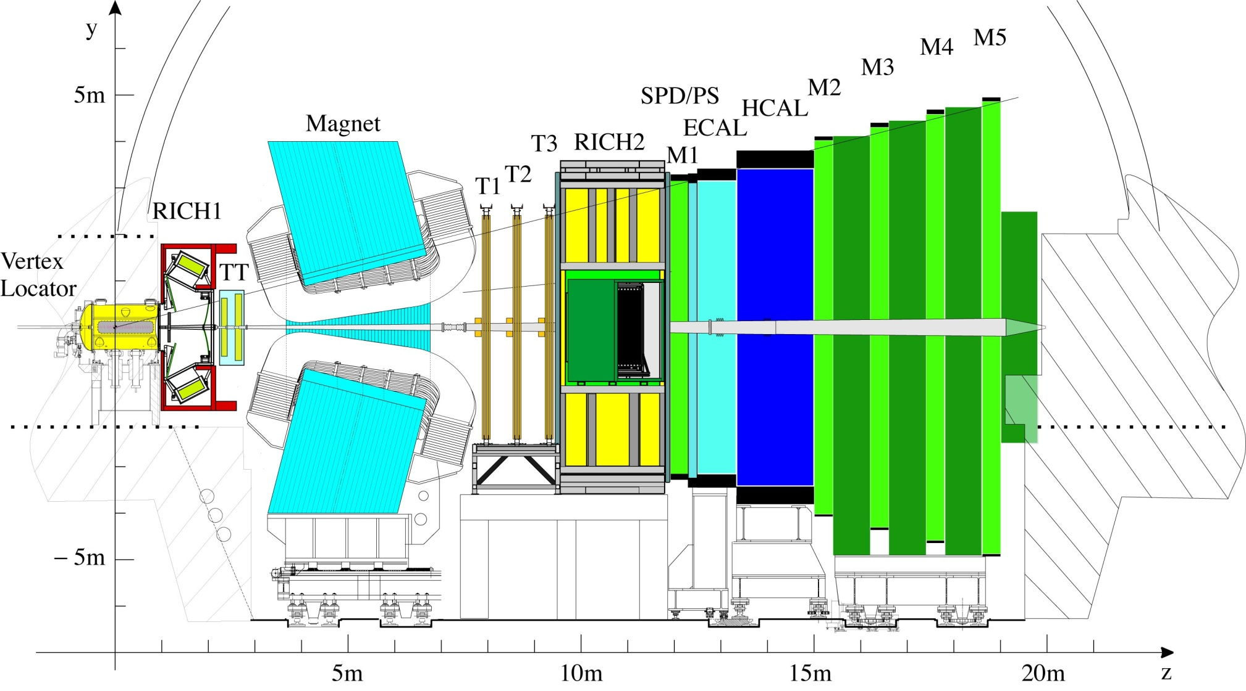
LHCb Experiment
Precision measurement of B-Decays and search for signals beyond standard model.
Two RICH detectors covering the particle momentum range 1→100 GeV/c using
aerogel, C₄F₁₀ and CF₄ gas radiators.

Slide 37
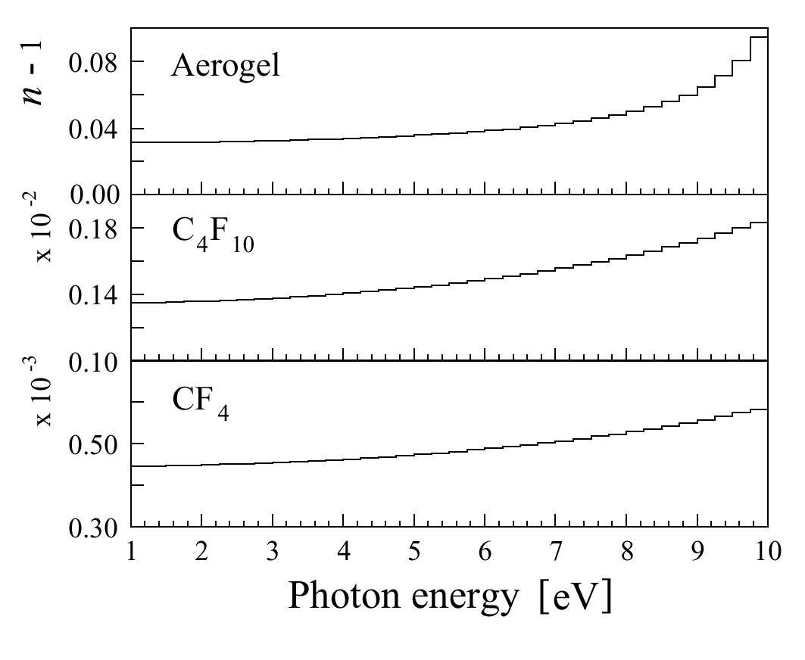
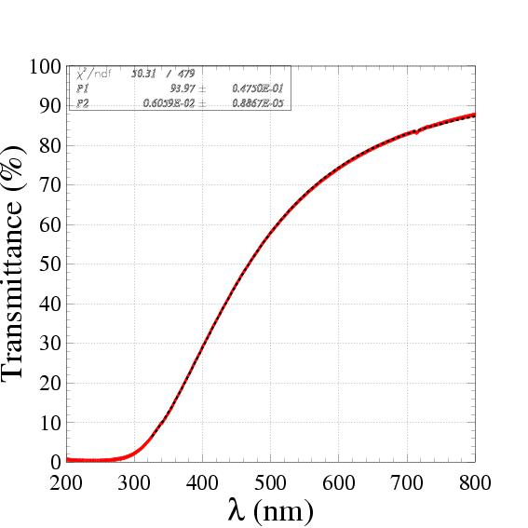
LHCb-RICH Specifications
(Refractive Index-1) vs. Photon Energy
RICH1: Aerogel 2→10 GeV/c
C₄F₁₀ < 70 GeV/c
RICH2: CF₄ <100 GeV/c.
n=1.03
n=1.0014
Aerogel C₄F₁₀ CF₄
L 5 86 196 cm
θ_{c}^{max} 242 53 32 mrad
π _{Th} 0.6 2.6 4.4 GeV/c
K_{Th} 2.0 9.3 15.6 GeV/c
n=1.0005
Aerogel Transmission
Aerogel: Rayleigh Scattering
Not used from 2015 onwards
T = A e ^{(-C t / λ4)}
Typically: Α= 0.94, C =0.0059 μm⁴ /cm

Slide 38
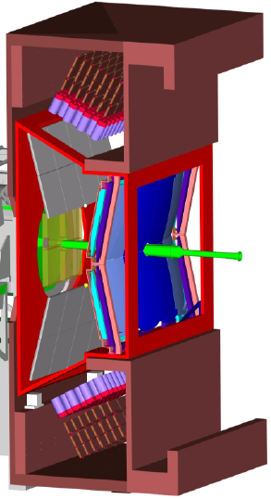
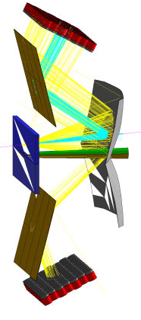
LHCb- RICH1 SCHEMATIC
RICH1 OPTICS
Magnetic Shield
Gas Enclosure
Beam Pipe
Spherical Mirror
Flat Mirror
Photodetectors
Readout Electronics
Spherical Mirror tilted
to keep photodetectors outside acceptance
(tilt ~ 0.3 rad)

Slide 39
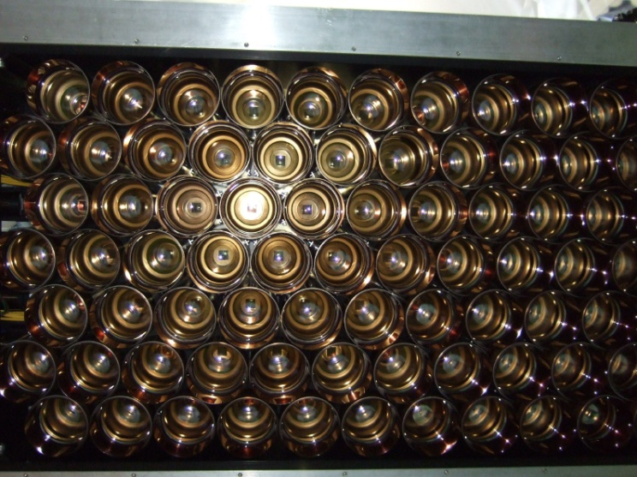
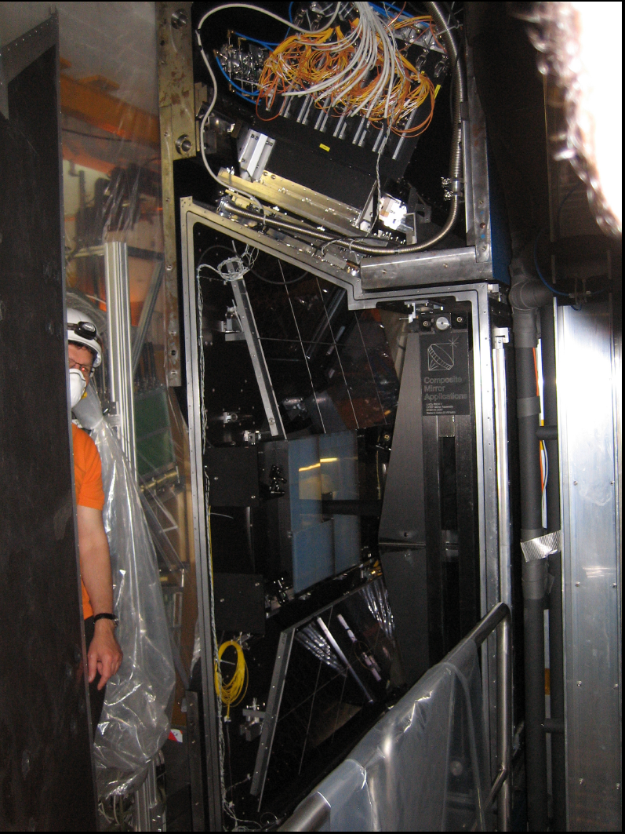
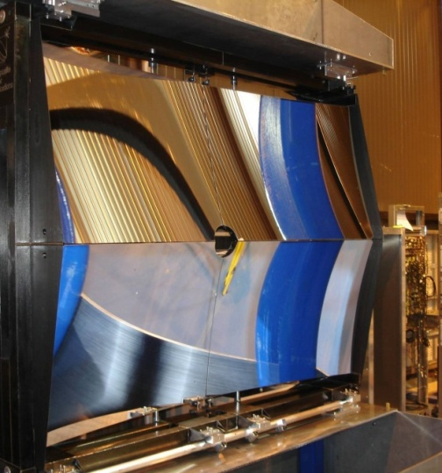
RICH1 Photos
RICH1-HPDs
RICH1 mirrors

Slide 40
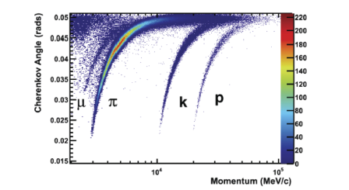
Performance of LHCb RICH
From isolated Cherenkov rings from RICH1 in Real Data
Compare with the expectations plotted in page 9.

Slide 41

LHCb-RICH resolution
Single photon resolutions
Real Data 2011:
C₄F₁₀
CF₄
From simulation in 2011:
σ_{Δθ} = 1.53 mrad
From simulation in 2011:
σ_{Δθ} = 0.68 mrad
Resolution components: Chromatic : ref. index variation
Emission Point: tilt of the mirror
Pixel size: granularity of the pixel
PSF: spread of photo electron direction inside HPD

Slide 42

LHCb: Hits on the RICH from Simulation
Red: From particles from Primary and Secondary Vertex
Blue: From secondaries and background processes (sometimes with
no reconstructed track)

Slide 43
Pattern Recognition in Accelerator based Cherenkov Detector
Events with large number of charged tracks giving rise to several
overlapping Cherenkov Rings on the Photo detector plane.
Problem: To identify which tracks correspond to which hits and then identify
the type (e, π, p etc.) of the particle which created the tracks.
Hough Transform:
(used by ALICE
at CERN)
Project the particle direction on to the detector plane
Accumulate the distance of each hit from these projection points
in case of circular rings.
Collect the peaks in the accumulated set and associate the
corresponding hits to the tracks.
Likelihood Method:
For each of the track in the event, for a given mass hypothesis,
create photons and project them to the detector plane using the
knowledge of the geometry of the detector and its optical properties.
Repeat this for all the other tracks.
From this calculate the probability that a signal would be seen in each
pixel of the detector from all tracks.
Compare this with the observed set of photoelectron signal on the pixels,
by creating a likelihood.
Repeat all the above after changing the set of mass hypothesis of the tracks.
Find the set of mass hypothesis, which maximize the likelihood.
(used by LHCb
at CERN)
(Ref: R.Forty: Nucl. Inst. Mech. A 433 (1999) 257-261)

Slide 44


LHCb-RICH PID performance
Real data
Simulation
Red: Kaon identification efficiency
Black: Pion mis-identification probability
PID performance in D* events (calibration channel)
General agreement between real data and simulation

Slide 45



RICH Detectors in LHCb
Real data from 2011
Before RICH PID
After RICH PID
Without RICH PID, the is completely dominated by
RICH PID useful for physics analysis

Slide 46
How to make a better RICH detector
Increase the number of photons
Better photon detectors (photo-cathodes)
Better area coverage by photon detectors
Better optical coupling of components
Improve Cherenkov angle resolution
Smaller pixels
Lower chromatic error
Detectors sensitive to green rather than blue
Improve aberrations
Light weight mirrors in the acceptance

Slide 47


DIRC
Direct Internally Reflected Cherenkov light
Detectors outside the “acceptance”
Can fit in a narrow space
The standoff region is designed to maximize the transfer efficiency between the radiator and the detector.
If this region has the same index of refraction as the radiator, n₁≅n₂, the transfer efficiency is maximized and the image will emerge without reflection or refraction at the end surface.

Slide 48



Babar DIRC
± 8 ns Δt window for background rejection

Slide 49

TORCH (i)
A time of flight detector based on Cherenkov radiation

Slide 50


TORCH (ii)
The focusing unit converts angles to positions allowing the measurement of propagation time
Multiple photons from the same track can improve the time accuracy

Slide 51

Energy loss by muons dE/dx : Bethe-Block Formula
Ionisation Constant for material
Density correction
Max energy in single
Collision.
K=4 π N r_{e}² m_{e} c²

Slide 52



dE/dx detectors: Silicon based
Bethe-Block formula ( for 2 γ m/M << 1 )
For 0.2< β <0.9, dE/dx ~ (M/p)²
M,p= mass, momentum of the traversing particle
FWHM= 30-35 %
Ref: NIMA 469(2001) 311-315

Slide 53



dE/dx Detectors : Silicon based
Each Silicon sensor gives a dE/dX measurement.
Estimate the Most Probable Value from several (10-25)
measurements (Truncated Mean: Ignore upper 40%)
CMS Silicon tracker:
CMS Silicon strip wafer

Slide 54






dE/dx Detectors: Drift Chambers
Larger Landau fluctuations compared to those from Silicon detectors.
So many measurements needed to get the average.
BABAR Drfit Chamber:
Ref: IEEE-TNS VOL:47 , NO:6, Dec2000.

Slide 55


Time of Flight (TOF) Detectors
Measurement of time: Using scintillators
Energy loss (dE/dx) from the charged particle= 2MeV/cm
This energy is re-emitted as optical photons in UV. (Approx 1 photon/100 eV)
Too small attenuation length and low yield.
Fluorescent material added to scintillator so that the photon re-emitted at
longer wavelengths (ex: 400 nm) longer attenuation length ( ex: 1 meter) and
high yield . These photons collected by a PMT. (0.002 pe per emitted photon)
NA 49: Heavy ion expt, Scintillator thickness=2.3 cm, time resolutions= 59ps, 95 ps
Had a TPC to measure dE/dx.

Slide 56
Summary
The field of Particle Identification Detectors is an evolving field.
They have contributed to some of the important discoveries in High Energy Physics in the last 50 years and they continue to be a crucial part of some of the recent experiments.
The RICH detectors offer excellent Particle Identification capability for the hadrons since they can be designed to have very good single photon Cherenkov Angle resolution and large Photoelectron yield. Recent advances in photodetectors enhance the capability of these detectors.
The particle ID using dE/dx, time-of-flight and Transition Radiation detectors continue to provide Particle Identification in different experiments.
Particle identification is a crucial part of some of the Astroparticle physics experiments and long base line neutrino experiments

Slide 57
The end
Thank you for
your attention
Any (more) questions?

Slide 58



Photonic Crystals
Optical micrograph of blue feather barbs
www.pnas.org/cgi/doi/10.1073/pnas.1204383109
Parrot (scarlet macaw) in a tropical forest
CERN Courier Aug23, 2005
Phys. Rev. E 72, 010902 (2005)

Slide 59
Photonic Crystals
Periodic arrangement of objects with two different refractive indices.
Lattice constants comparable to the
wavelength of light in the material
electrons in pure semi-conductor : similar features to photons in photonic crystal
Cherenkov radiation:
Physical origin is a mixture of conventional Cherenkov radiation
and Transition radiation
Photon propagation in the crystal in the form of Bloch waves
All the properties can be derived from solving Maxwell’s arXiV:0808:3519
equations for periodic lattice
There is no Cherenkov Threshold
Cherenkov cone can be forward or backward
r=cylinder radius
a= lattice constant
Starting from two media with refractive indices n₁ and n₂,
create a new effective refractive index n₃.

Slide 60
Possibility of particle identification with periodic media
PRL 113, 167402 (2014)
Sensitivity= θ _{eletron} – θ _{proton}
Transformation optics:
Longitudinal stretching=F=1.005 : Shift curves to right
Transverse stretching = G=10 : Increase θ

Slide 61




Cherenkov Detectors in Astro Particle Physics
Goal: Contribute to the understanding of our Universe.
Understanding production mechanism
(‘cosmic accelerators’) of HE cosmic rays ;
Study very energetic galactic / extragalactic objects :
SN remnants, microquasars, GRB, AGN,…;
Search for Dark matter (wimps)
. . .
SNR
AGN
Binary systems
GRB
Micro-quasars

Slide 62

Astro Particle Physics
Search for :
Neutrinos → muons
High energy Gamma and other Cosmic rays → Air showers
Ultra high energy Gamma ( > 10 ¹⁹ eV ) → Air showers
Neutrinos: Advantages:
Neutral : Hence Weak interaction only
Neutrinos point back to the astrophysical production source
Unlike photons which interact with CMB and matter…
or protons: which also undergo deflection by magnetic fields
Disadvantages:
Rate of arrival very low. Hence need very large detectors.
Using the Ocean , ice in Antartica etc.

Slide 63
Typically 1γ / PMT
40 m from μ axis
o
Measure position
and time of the hits.
Angle between the μ and ν direction=
Importance of Timing Resolution
c in water ~ 20 cm/ns
Chromatic dispersion ~ 2 ns (40 m typ. Path)
(PMT TTS s ~1.3ns) so detector not dominant source of error

Slide 64




ANTARES Experiment in the sea.
Optical Module
Hamamatsu PMT :
Size :10 inch
Glass pressure Sphere.

Slide 65


IceCube Experiment in Antartica
Design Specifications
Fully digital detector concept.
Number of strings – 75
Number of surface tanks – 160
Number of DOMs – 4820
Instrumented volume – 1 km³
Angular resolution of in-ice array < 1.0°
Fast timing: resolution < 5 ns DOM-to-DOM
Pulse resolution < 10 ns
Optical sens. 330 nm to 500 nm
Dynamic range - 1000 pe / 10 ns - 10,000 pe / 1 us.
Low noise: < 500 Hz background
High gain: O(10⁷) PMT
Charge resolution: P/V > 2
Low power: 3.75 W
Ability to self-calibrate
Field-programmable HV generated internal to unit.
10000 psi external

Slide 66


Ice Cube/AMANDA Event signatures
E_{µ}=10 TeV
ν_{μ} from CC
interactions
All signals from Cherenkov
Radiation.
ν_{τ} → τ → μ
ν _{e} from CC or ν _{x} from NC interactions
~300m for
>PeV ν_{τ}

Slide 67

High Energy Cosmic Ray Spectrum.
Measure the Energy
Spectrum
Determine the Arrival
Direction distribution
etc.
Composed of
Baryons, photons,
neutrinos etc.
Knee
>10¹⁹ eV
1 km⁻² year⁻¹ sr⁻¹

Slide 68

Principle of Auger Project
Fluorescence →
Array of water → Cherenkov detectors

Slide 69
1600 surface stations
1.5 km spacing
over 3000 square kilometers
Fluorescence Detectors:
4 Telescope enclosures,
each with 6 telescopes.

Slide 70



AUGER Project: Water Cherenkov Detector
Communications
antenna
GPS antenna
Time difference between test signals from nearby detectors ( Carmen-Miranda)
Electronics
enclosure
Solar panels
Battery box
3 – nine inch
photomultiplier
tubes
Plastic tank with 12 tons of water
Installation of the Cherenkov detectors are continuing and data taking started.
First set of results are published

Slide 71

Long Base Line Experients: T2K
Neutrino production: Protons incident on graphite target to create pions,
which decay into μ and ν_{μ.} The muons and and any
remaining protons and pions are stopped by a second layer
of graphite; but the ν_{μ} pass through towards SuperK.
Beam energy: Centered around 600 MeV (to maximize the oscillation
probability into ν_{ε} ).
Far-detector: underground to reduce cosmic rays.

Slide 72




Super-K water cherenkov detector
40 m high, 17 m radius.
PMT-schematic

Slide 73




Super-K Cherenkov signals
The leptons create Cherenkov light in the water.
(muon)
(in water)
β ∼ 1

Slide 74

Super-K signals
Measure the charge and time of
each pulse. From this estimate :
(a) energy of the charged particle.
( Charge α number photons
α energy loss )
(b) position (vertex ) of the interaction.
(c ) direction of the charged particle.
Muons create sharp rings,
Electrons scatter and shower and hence create ‘fuzzy’ rings.

Slide 75


DIRC PRINCIPLE
If n>√2 some photons are always totally internally reflected for β≈1 tracks.
Radiator and light guide: Long, rectangular Synthetic Fused Silica (“Quartz”) bars (Spectrosil: average <n(λ)> ≈ 1.473, radiation hard, homogenous, low chromatic dispersion)
Photons exit via wedge into expansion region
(filled with 6m³ pure, de-ionized water).
Pinhole imaging on PMT array (bar dimension small compared to standoff distance). (10,752 traditional PMTs ETL 9125, immersed in water, surrounded by hexagonal “light-catcher”, transit time spread ~1.5nsec, ~30mm diameter)
DIRC is a 3-D device, measuring: x, y and time of Cherenkov photons, defining θ_{c}, φ_{c}, t_{propagation} of photon.

Slide 76


DIRC PERFORMANCE
Number of Cherenkov photons
per track (di-muons) vs. polar angle:
Resolution of Cherenkov angle fit
per track (di-muons):
Between 20 and 60 signal photons per track.
σ(Δθ_{c}) = 2.4 mrad
Track Cherenkov angle resolution is within ~10% of design

Slide 77




DIRC PERFORMANCE
Kaon selection efficiency typically above 95%
with mis-ID of 2-10%
between 0.8-3GeV/c.
D∗– → D⁰ π –
K– π ⁺
(6% comb. background)
Kaon selection efficiency for L ^{K} > L ^{π}
(track in DIRC fiducial, comb. background corrected)
π mis-id as K

Slide 78

New Development: Focussing DIRC
Red photons arrive before blue photons
Time of Propagation= PathLength/ v _{group}
Correct for Chromatic error from the
mesurement of time of propagation.
Ref: NIMA 595(2008)104-107

Slide 79
Gas Based Photon Detectors
QE: 33% at 150 nm
Spectral Range: 135-165 nm
TEA: Triethylamine
Photon Detector of the CLEO-III Cherenkov detector
photon passes through the CaF₂ and converts to photoelectron by ionizing a TEA molecule.
The photoelectron drifts towards and avalanches near the anode wires,
theirby inducing a charge signal on the cathode pads.

Slide 80

Balloon Experiment:
RICH detector
CAPRICE Experiment
TMAE:
(tetrakis(dimethylamino)
ethylene)

Slide 81


Components of a Cherenkov Detector
Main Components:
Radiator : To produce photons
Mirror/lens etc. : To help with the transport of photons
Photodetector : To detect the photons
Radiator: Any medium with a Refractive Index.
Aerogel: network of
SiO₂ nano-crystals
γ = 1/sqrt(1-β²)
The atmosphere, ocean are the radiators in some Astro Particle Cherenkov Detectors

Slide 82

LHCb-RICH Design
RICH1: Aerogel L=5cm p:2→10 GeV/c
n=1.03 (nominal at 540 nm)
C₄F₁₀ L=85 cm p: < 70 GeV/c
n=1.0014 (nominal at 400 nm)
Upstream of LHCb Magnet
Acceptance: 25→250 mrad (vertical)
300 mrad (horizontal)
Gas vessel: 2 X 3 X 1 m³
RICH2: CF₄ L=196 cm p: < 100 GeV/c
n =1.0005 (nominal at 400 nm)
Downstream of LHCb Magnet
Acceptance: 15→100 mrad (vertical)
120 mrad (horizontal)
Gas vessel : 100 m³

Slide 83


LHCb RICH Data in Physics Analysis
φ → K ⁺ K ⁻
Status in 2011
using RICH data
RICH data has been used in Physics analysis

Slide 84
Example of LHCb-RICH PERFORMANCE
Performance as seen in Simulated Data in 2010
Yield: Mean Number of hits per isolated
saturated track ( β ~1).
Aerogel | C4F10 | CF4
4.6 | 34.0 | 24
Single Photon Cherenkov Angle Resolutions in mrad.
Components and Overall (mrad) | Aerogel | C₄F₁₀ | CF₄
Chromatic | 2.65 | 0.84 | 0.48
Emission Point | 0.34 | 0.61 | 0.27
Pixel Size | 0.59 | 0.6 | 0.19
PSF | 0.78 | 0.79 | 0.29
Overall RICH | 2.84 | 1.45 | 0.65
Overall RICH+Tracks | 2.86 | 1.50 | 0.76
Chromatic: From the variation in
refractive index.
Emission Point: Essentially from the
tilt of the mirrors.
Pixel Size: From the granularity of the
Silicon detector pixels in HPD
PSF ( Point Spread Function):
From the spread of the Photoelectron direction
as it travells inside the HPD,
(from the cross focussing in the electron optics)

Slide 85
Differential Cherenkov Detectors
Very small acceptance in β and direction of the charged particle.
(Narrow range in velocity and direction intervals ).
From the Cherenkov angle (θ ) determine β.
Mostly used for identifying particles in the beam lines.
Resolution that can be achieved = Δ β/ β = (m₁² – m₂²) /2 p ² = tan θ Δθ
m₁,m₂ (particle masses )<< p ( momentum)
At high momentum, to get better resolution, use gas radiators which have smaller
refractive index than solid radiators. Have long enough
radiators to get sufficient signal photons in the detector.
To compensate for Chromatic dispersion (n (E_{ph}) ) , lens used in the path of the photons.
(DISC: Differential Isochronous self- collimating Cherenkov Counter).
Δβ/ β from 0.011 to 4* 10 ⁻⁶ achieved.

Slide 86
Differential Cherenkov Detectors
With a Gas radiator

Slide 87
Threshold Cherenkov Detectors
Can be used over a large area, for Example : For secondary particles in a fixed target or
Collider experiment.
E691 at Fermilab: To study decays of charm particles in the 1980’s
Δβ/β = 2.3 * 10⁻⁵ using gas radiator.
BELLE Experiment: To observe CP ciolation in B-meson decays at an electron-positron
collider.
BELLE: Continues to take
Data.

Slide 88


LHCb-RICH2 SCHEMATIC
Mirror Support Panel
RICH2 Optics Top View
Spherical Mirror
Support Structure
Y
X
X
Z
Beam Axis-→
Z
Flat Mirror
Plane Mirrors to reduce the length of RICH2
Spherical mirror tilted to keep photodetectors
outside acceptance.(tilt=0.39 rad)
Central Tube
Photon funnel+Shielding

Slide 89


LHCb- RICH2 STRUCTURE
Entrance Window
(PMI foam between two
carbon fibre epoxy Skins)
RICH2

