Slide 1

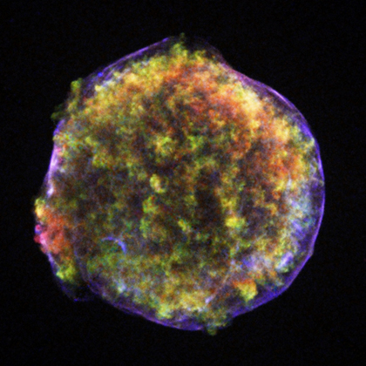
ASTROPARTICLE PHYSICS LECTURE 1
Susan Cartwright
University of Sheffield

Slide 2
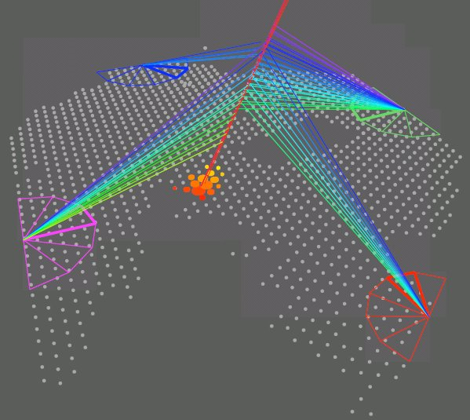
Overview
What is Astroparticle Physics?

Slide 3
What is Astroparticle Physics?
Various definitions! Mine is
the use of particle physics technology to study astrophysical phenomena
Included:
  neutrino astrophysics
  gamma-ray astronomy
  cosmic rays
  dark matter
  early-universe cosmology
Sometimes also included:
  cosmic microwave background
  gravitational waves
  neutrino masses (especially 0νββ)
coherent field with a lot of common factors
High Energy Astroparticle Physics
someone else’s problem!
not very particulate
not very astrophysical

Slide 4
Common Issues
Low rates
  fluxes of high-energy particles are small
  neutrinos and dark matter have weak interactions
Need for large detectors
No control over “beam”
  harder to control backgrounds
  harder to calibrate, e.g., energy resolution
Signals can be difficult to establish and/or characterise
  cf. solar and atmospheric neutrino oscillation

Slide 5
Related Fields
Neutrino physics
  atmospheric neutrinos are “astroparticle physics” but have contributed more to understanding of neutrinos than to astrophysics
  similar situation for solar neutrinos
  long-baseline neutrino experiments can do low-energy neutrino astrophysics “for free” (and vice versa)
Nucleon decay
  many detector technologies useful for both
    original purpose of Kamiokande (NDE = Nucleon Decay Experiment not Neutrino Detection Experiment!)
    planned noble-liquid detectors may be able to do both nucleon decay experiments and dark matter searches

Slide 6
Topics to be Covered
High energy astroparticle physics
(cosmic rays, gammas, high-energy neutrinos)
  sources
  detection
  results
  prospects
Dark matter
  evidence
  candidates
  search techniques
Not Covering:
solar neutrinos (SB)
neutrino masses (SB)
supernova neutrinos (no time)

Slide 7
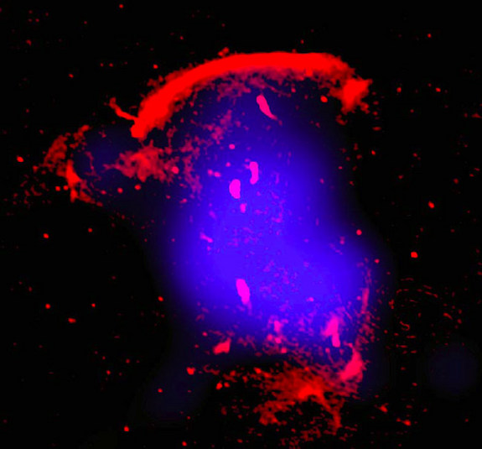
High Energy Astroparticle Physics
Acceleration Mechanisms
Sources
Detection

Slide 8
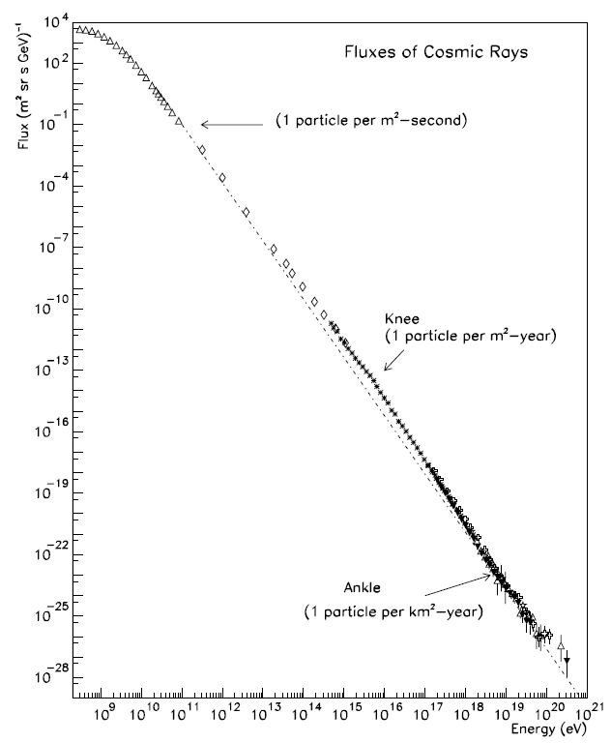
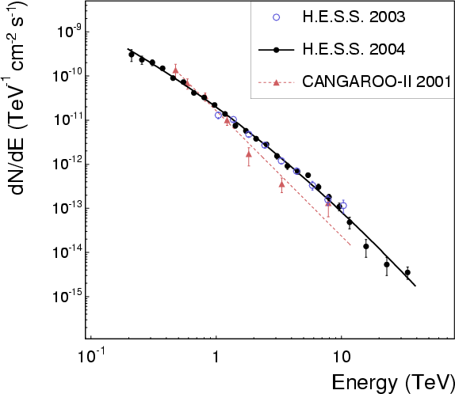
Cosmic Accelerators
Cosmic rays and gamma rays
are observed up to extremely
high energies
something must therefore
accelerate them
10⁹ eV 10²¹
Note the power-law spectrum

Slide 9
Acceleration Mechanisms
Fermi Mechanism
  energetic charged particles can gain energy by scattering off local magnetic turbulence (Fermi 1949)
    Assume particle scatters off much more massive object moving with speed u. Then in the com frame (= frame of massive object) its energy and momentum before the scatter are
    The particle scatters elastically: its energy is conserved and its x-momentum reversed. In original (lab) frame

Slide 10
Acceleration Mechanisms
Fermi Mechanism
  energetic charged particles can gain energy by scattering off local magnetic turbulence (Fermi 1949)
    We need to average over angle. Head-on collisions are slightly more likely than overtaking collisions, so middle term doesn’t just go away. In relativistic limit we find
    Hence this process is known as second-order Fermi acceleration.
  The good news
    this produces a power law energy spectrum: N(E) ∝ E^{−x} where
    x = 1 + 1/ατ, α is the rate of energy increase and τ is the residence time of the particle
  The bad news
    since u << c, it’s slow and inefficient

Slide 11
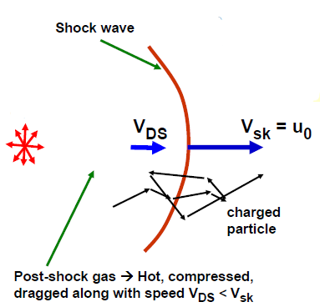
Acceleration Mechanisms
Don Ellison, NCSU
First-order Fermi Mechanism
(Diffusive Shock Acceleration)
  O(u/c) term gets lost in integral over
  angles—we could retrieve this if we
  could arrange to have only head-on scatters
  Consider shock wave as sketched above
    high-energy particles will scatter so that their distribution is isotropic in the rest frame of the gas
    crossing shock in either direction produces head-on collision on average
Rest frame of upstream gas
Rest frame of downstream gas
Rest frame of shock
V_{DS}
V_{DS}
u₀
u₀ − V_{DS}

Slide 12
Acceleration Mechanisms
Rest frame of shock
DSA, continued
  shock compresses gas, so
  density behind shock ρ₂ > ρ₁
  in rest frame of shock, ρ₁u₀ = ρ₂u₂ where u₂ = u₀ − V_{DS}
    for strong shock ρ₂/ρ₁ = (γ + 1)/(γ − 1) where γ is ratio of specific heats (= ⁵/₃ for hydrogen plasma)
    therefore expect u₂/u₀ ≈ ¼
    gas approaches shock-crossing particle at speed V = ¾ u₀
    if high-energy particles move randomly, probability of particle crossing shock at angle θ is P(θ) = 2 sin θ cos θ dθ, and its energy after crossing shock is E’ ≈ E(1 + pV cos θ) (if V << c)
    therefore average energy gain per crossing is
u₀ − V_{DS}
u₀

Slide 13
Acceleration Mechanisms
DSA spectrum
  if average energy of particle after one collision is E₁ = fE₀, and if P is probability that particle remains in acceleration region, then after k collisions there are N_{k} = N₀P^{k} particles with average energy E_{k} = f^{k}E₀.
  Hence , or
  This is the number of particles with E ≥ E_{k} (since some of these particles will go on to further collisions), so differential spectrum is
  for DSA this comes to N(E) dE ∝ E^{−(r + 2)/(r − 1)} dE, where r = ρ₂/ρ₁.
    “universal” power law, independent of details of shock

Slide 14
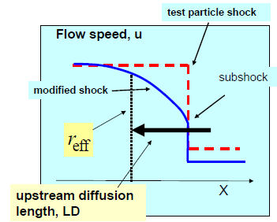
Additional Complications
Above was a “test particle” approach, in which we assume most of the gas is unaffected
  If acceleration is efficient, high momentum particles will modify the shock
  Need a consistent treatment
  which takes proper account
  of this
    mathematically challenging
    but valid across very large
    range of particle energies
  Also need to allow for
  possibility of relativistic shocks
_{D}
Don Ellison, NCSU

Slide 15
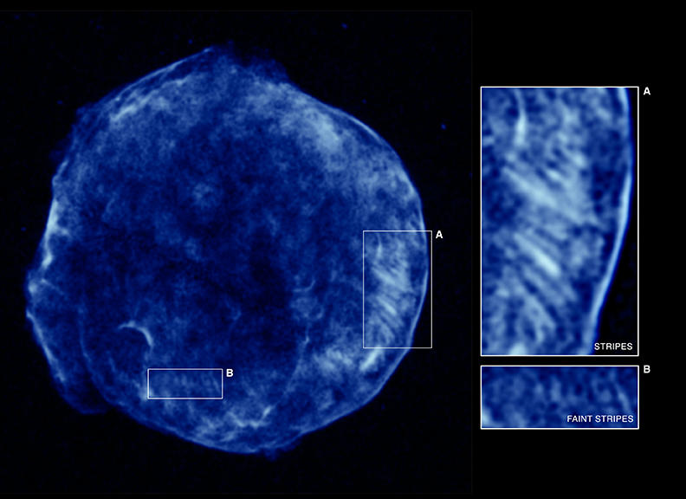
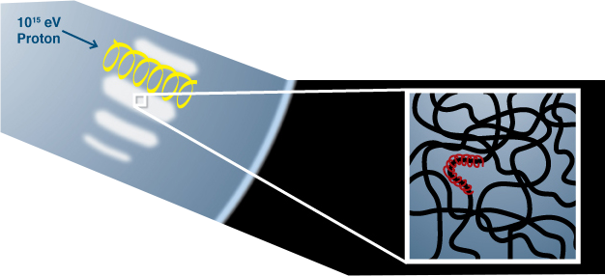
Tycho’s Supernova (SN 1572)
Shock front seen in high-energy electrons
“Stripes” may signal presence of high-energy protons
Chandra

Slide 16
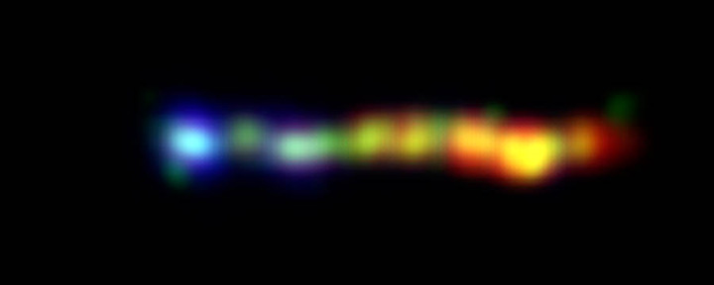
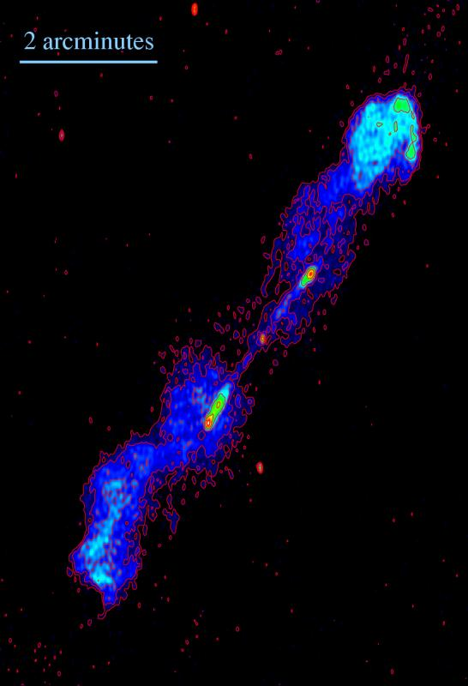
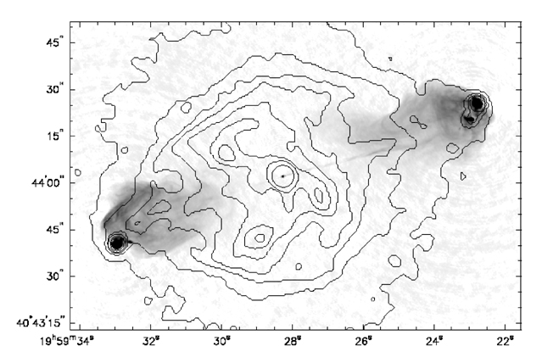
Radio Galaxies
3C 273 jet
Chandra, HST, Spitzer
B1545-321
13 cm wavelength ATCA image by L. Saripalli, R. Subrahmanyan and Udaya Shankar
Cygnus A in X-ray (Chandra) and radio (VLA)

Slide 17
Acceleration Mechanisms
Resonant Cyclotron Absorption (RCA)
  acceleration of e⁺e⁻ in relativistic shock with magnetic field perpendicular to particle flow (so DSA doesn’t work)
    relevant to pulsar wind nebulae, e.g. Crab
  principle: consider relativistic plasma whose mass is dominated by ions (m_{i}/m_{e±} >> 1)
    ions gyrate coherently in magnetic field
    they therefore radiate ion cyclotron waves (Alfven waves) at shock front
    positrons and electrons absorb these resonantly and are accelerated to high Lorentz factors with fairly high efficiency (few % of upstream energy density converted to non-thermal e±)
  mechanism seems to account well for high-energy emission; not so clear that it deals with radio−IR emission
    two different electron populations?
    but consistency of spectra suggest otherwise

Slide 18
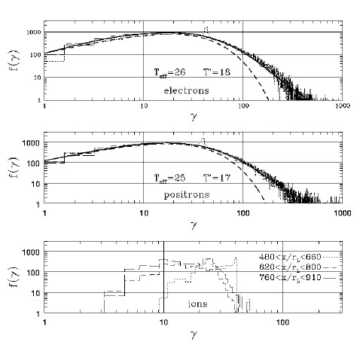
RSA Simulations
Simulation by Amato & Arons (ApJ 653 (2006) 325)
Input parameters:
  N_{i}/N_{e±} = 0.1
  m_{i}/m_{e±} = 100
  72% of upstream energy density carried by ions
Result:
  5% of upstream energy density winds up in accelerated e±
Less extreme ion loading, e.g. m_{i}/m_{e±} = 20, preferentially accelerates positrons

Slide 19
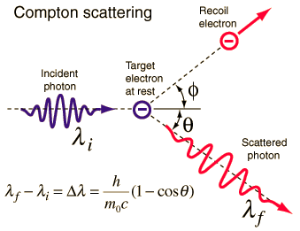
Photons and Neutrinos
High-energy photons and neutrinos are secondary particles produced by interactions of high-energy primaries.
  production mechanisms:
  inverse Compton scattering (photons only)
    Low-energy photon backscatters off high-energy electron.
    In electron rest frame we have
    Δλ = h(1−cos θ)/mc².
    In lab frame, maximum energy gain
    occurs in head-on collision:
    ν ≈ 4γ²ν₀
    Because of relativistic
    aberration, spectrum is
    sharply peaked near maximum

Slide 20
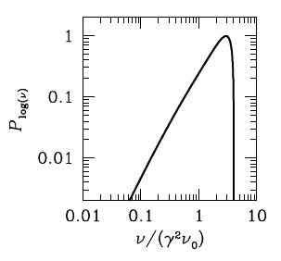
Photons and Neutrinos
  inverse Compton scattering (continued)
    Plot shows calculated spectrum for
    monoenergetic photons and electrons.
    Plenty of potential sources of low-energy
    photons to be upscattered:
      synchrotron radiation produced by the
      same population of fast electrons
      (synchrotron-self-Compton, SSC)
      cosmic microwave background
      optical photons from source
    For real objects, need to integrate over power-law spectrum of electrons and spectrum of photon source

Slide 21
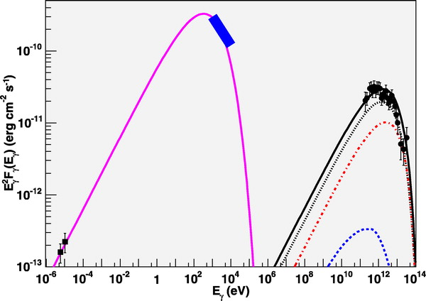
Spectrum of RXJ 1713.7−3946
Assumed distance 1 kpc, electron luminosity
1.5×10³⁰ W,
B = 12 μG
Source photons include optical, IR, CMB
Porter, Moskalenko & Strong, ApJ 648 (2006) L29-L32

Slide 22
Photons and Neutrinos
High-energy photons and neutrinos are secondary particles produced by interactions of high-energy primaries.
  production mechanisms:
  pion decay (photons and neutrinos)
    pions produced by high-energy proton colliding with either matter or photons (pion photoproduction)
    neutral pions decay to γγ, charged to μν_{μ}
      mechanism produces both high-energy γ-rays and neutrinos
Both mechanisms need population of relativistic charged particles
  electrons for IC, protons for pion decay
Unclear which dominates for observed TeV γ-ray sources

Slide 23
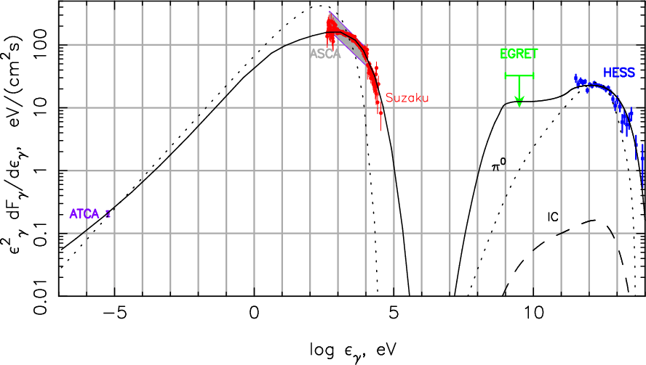
Spectrum of RXJ 1713.7−3946, take 2
Uses DSA to accelerate protons.
B = 142 μG downstream of shock.
High B-field enhances synchrotron relative to inverse Compton
Berezhko & Völk, A&A 511 (2010) A34

Slide 24
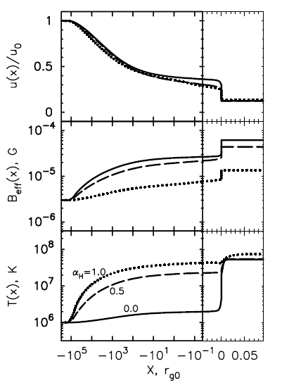
Are high magnetic fields plausible?
Hadronic model fit to RXJ 1713 needs B > 100 μG
  much larger than ambient Galactic B-fields
  amplification required to make DSA fits self-consistent
  fortunately modelling indicates that the interaction of the accelerated CRs with the magnetic field induces turbulence, resulting in amplification
Direct observational evidence of high B-fields in some SNRs
  e.g. Cas A, B > 500 μG from comparing synchrotron & IC/ bremsstrahlung contributions
  (Vink & Laming, ApJ 584 (2003) 758)
Vladimirov, Bykov, Ellison, ApJ 688 (2008) 1084

Slide 25
Acceleration: Summary
Observations made in high-energy astroparticle physics require that charged particles be accelerated to very high energies (~10²⁰ eV)
Likely candidate is diffusive shock acceleration
  requirement of shocks associated with magnetic fields found in many astrophysical objects, especially supernova remnants and AGN
  synchrotron radiation from these objects direct evidence for population of fast electrons
  much less evidence for presence of relativistic hadrons, but there must be some somewhere since we observe them in cosmic rays!
TeV γ-rays can be produced by fast electrons using inverse Compton scattering, or by fast protons from π⁰ decay
  latter will also make TeV neutrinos, not yet observed

Slide 26
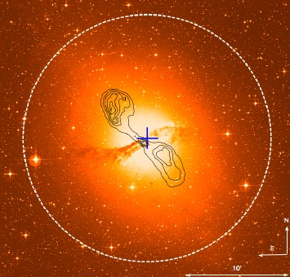
High Energy Astroparticle Physics
Acceleration Mechanisms
Sources
Detection

Slide 27
Gamma-Ray Astronomy
Well-established branch of high-energy astrophysics
  most work done at modest energies (few 10s of MeV)
    some, e.g. EGRET, out to few 10s of GeV
  this is not usually regarded as astroparticle physics
    though EGRET catalogue sometimes used as list of candidates for, e.g., neutrino point source searches
Atmosphere is not transparent to gamma rays
  low and medium energy γ-ray astronomy is space-based
    CGRO, SWIFT, GLAST, INTEGRAL, etc.
  space platforms not suitable for TeV γ-ray astronomy
    too small!
  therefore very high energy γ-ray astronomy is a ground-based activity
    detect shower produced as γ-ray enters atmosphere

Slide 28
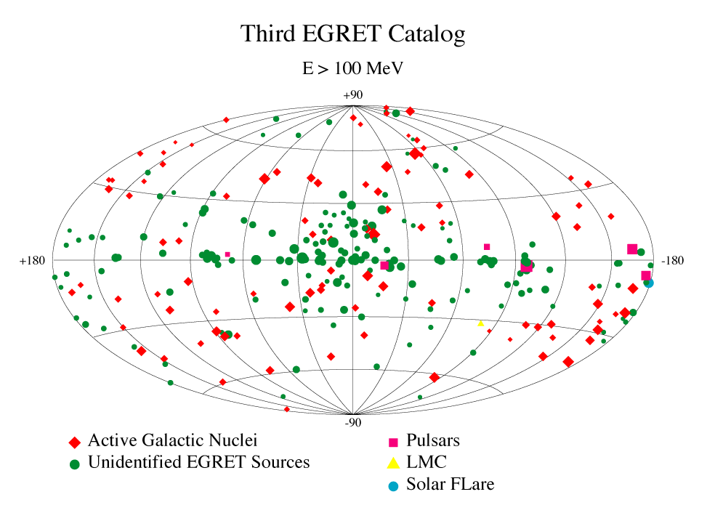
EGRET Point Sources

Slide 29
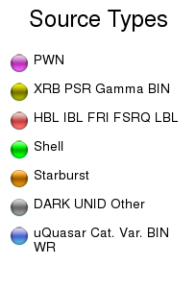
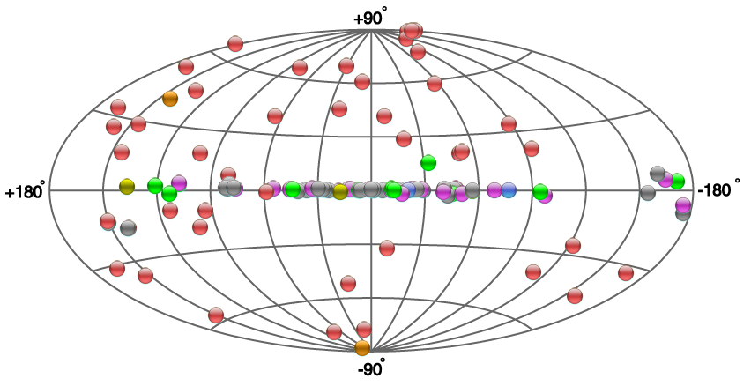
TeV Gamma-Ray Sky
from TeVCat, http://tevcat.uchicago.edu/

Slide 30
Gamma-Ray Sources
From maps, clearly mixed Galactic and extragalactic
  extragalactic sources of TeV γs are mostly blazars (a class of AGN where we are looking down the jet)
  identified Galactic sources are SN-related (supernova remnants and pulsar wind nebulae), plus a few binary compact objects
  dark/unidentified objects associated with Galactic plane, therefore presumably Galactic
SNRs and AGN are suitable environments for particle acceleration
  shocks, magnetic fields, synchrotron emission

Slide 31
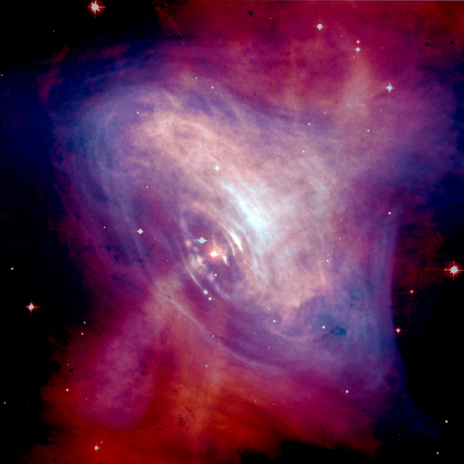
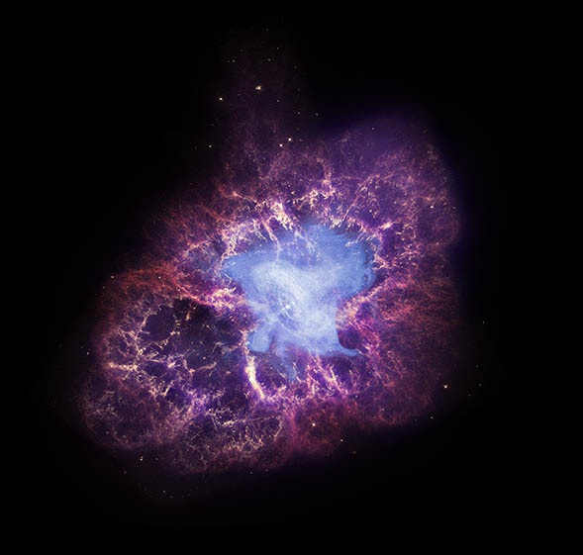
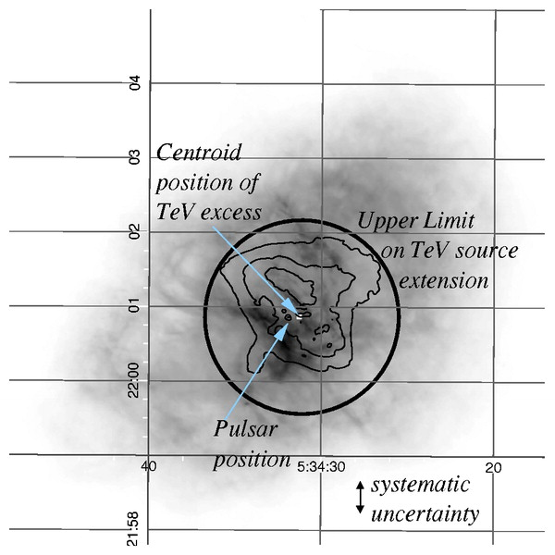
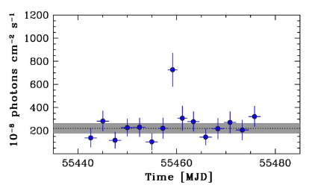
Pulsar Wind Nebula: The Crab
TeV gamma-ray signal as observed by HEGRA (Aharonian et al. 2004)
Medium-energy γ-ray flare observed by AGILE (Tavani et al. 2011)

Slide 32
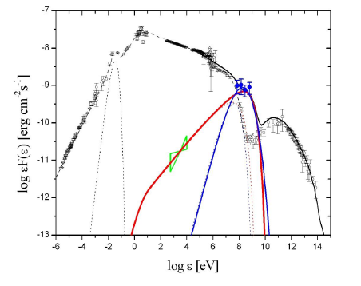
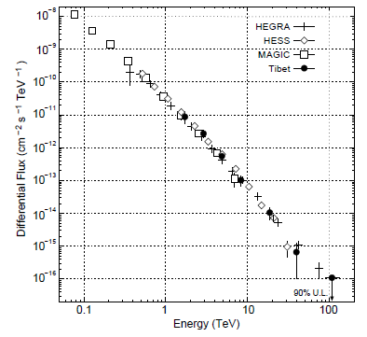
Pulsar Wind Nebula: The Crab
Crab spectral energy distribution showing September 2010 flare
TeV energy spectrum

Slide 33
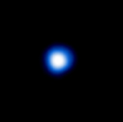
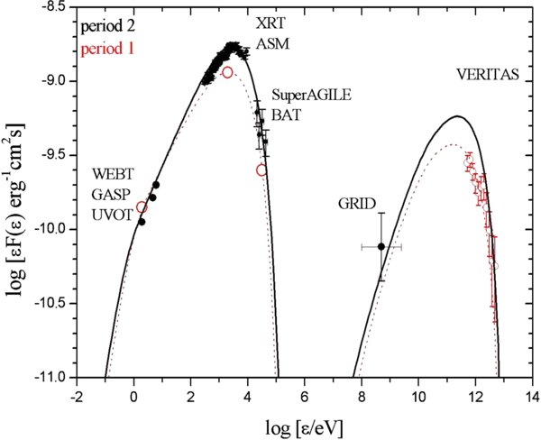
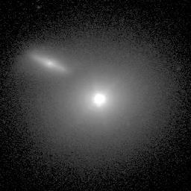
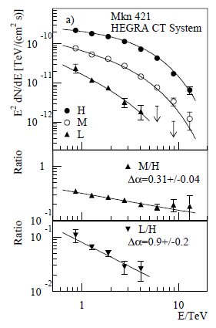
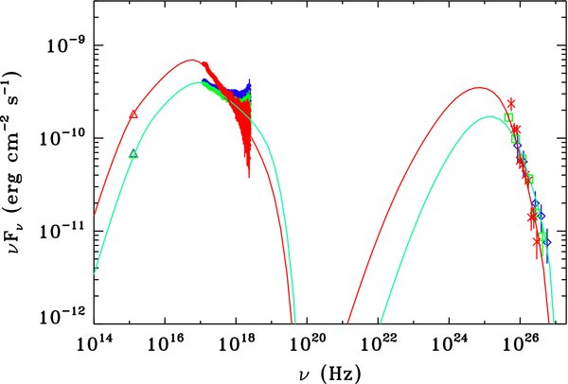
Blazar: Mkn 421
Mkn 421 and companion galaxy.
Aimo Sillanpaa, Nordic Optical Telescope.
(Above: very boring X-ray image by Chandra)
Highly variable (typical of blazars)
Spectrum varies according to state

Slide 34
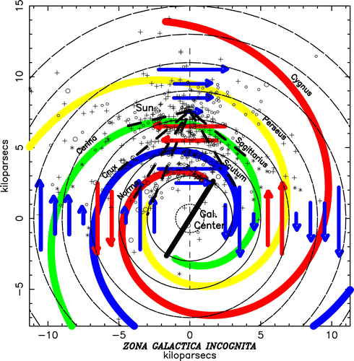
Cosmic Ray Sources
Observations of cosmic rays now span about 100 years
However, sources are not definitively established
  Galaxy has a complex magnetic
  field which effectively
  scrambles direction of
  charged particles
  Gamma ray luminosity
  requires fast particles,
  but maybe only electrons
    therefore, observation of
    γ-rays does not definitively
    establish source as a cosmic
    ray factory
  Neutrino luminosity does
  require fast hadrons
    but no neutrino point sources
    yet
Vallée, ApJ 681 (208) 303

Slide 35
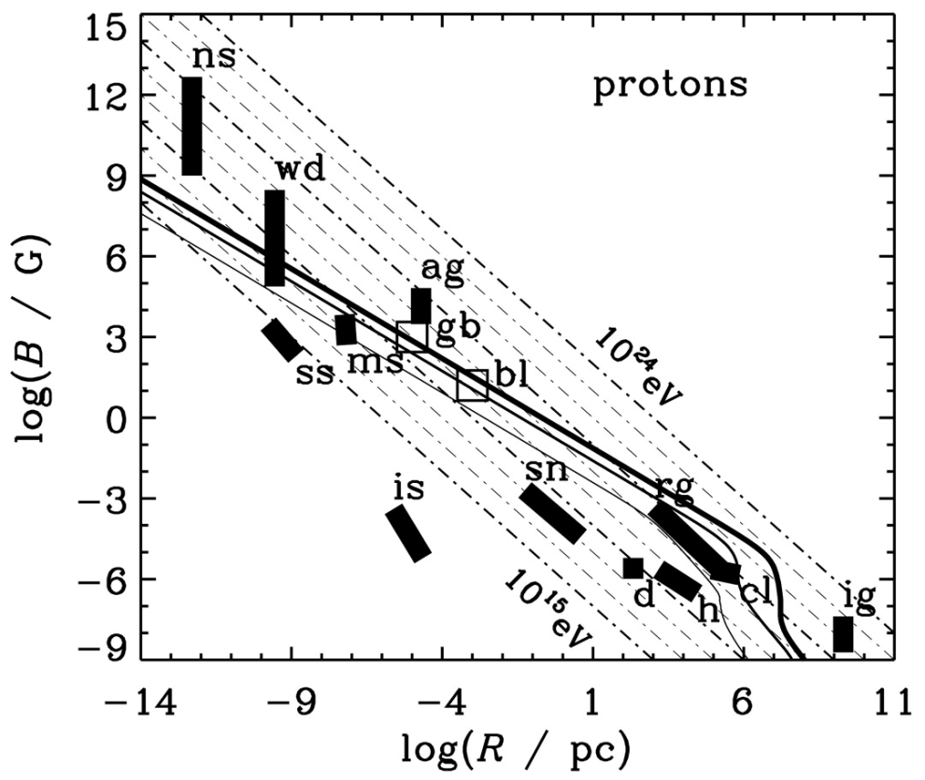
Cosmic Ray Sources
General dimensional analysis suggests
E_{max} [GeV] ≈ 0.03 η Z R[km] B[G] (Hillas condition)
  basically requires particles to remain confined in accelerating region
  quite difficult to satisfy for highest-energy CRs
    plot shows
    neutron stars
    white dwarfs
    sunspots
    magnetic stars
    active galactic nuclei
    interstellar space
    supernova remnants
    radio galaxy lobes
    disc and halo of Galaxy
    galaxy clusters
    intergalactic medium
    gamma-ray bursts
    blazars
    shock-wave velocities
Torres & Anchordoqui, astro-ph/0402371

Slide 36
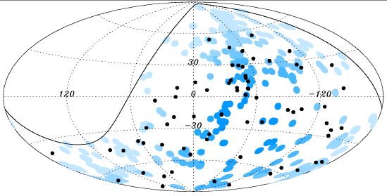
Cosmic Ray Sources
Amount of magnetic deflection decreases with increasing energy
  highest energy events might remember where they came from...
    Pierre Auger Observatory
    observes significant
    correlation between
    arrival directions of
    CRs above 55 EeV
    and a catalogue
    of AGN
    38±7% of events
    within 3.1° of a catalogued
    nearby AGN, cf. 21% expected for
    intrinsically isotropic distribution
    similar results found for SWIFT catalogue—data do however require significant isotropic component (40−80%)

Slide 37
Cosmic Ray Sources: Summary
CRs up to about 10¹⁵ eV or so assumed to come from SNRs
  but they don’t provide good directional information, so this remains to be confirmed
    neutrino observations, or definitive proof that some SNR γ-rays originate from π⁰ decay
Ultra-high energy CRs may come from local AGN
  statistically significant (but partial) correlation
  note that intergalactic space is not completely transparent to UHECRs—see later—so distant AGN (beyond ~100 Mpc) are assumed not to contribute

Slide 38
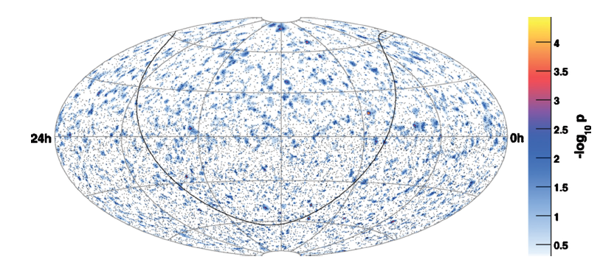
Neutrino Sources
Known sources of low-energy (0.1−100 MeV) neutrinos:
  Sun
  SN 1987A
Known sources of high-energy neutrinos:
  none
    to be fair, this is as expected for current exposure times
IceCube search for point sources.
No significant excess found.
(Halzen & Klein 2010)

Slide 39
Sources: Summary
TeV gamma rays are observed from a variety of sources, primarily SNRs within the Galaxy and blazars outside
  clear evidence of charged particles accelerated to very high energies, but whether electrons or hadrons is unclear
Cosmic ray sources are difficult to pinpoint because CRs are strongly deflected by the Galactic magnetic field
  SNRs suspected to be source of CRs at <10¹⁵ eV
  some hints that local AGN may be responsible for highest energy CRs
Observations of high energy neutrinos would solve the mystery, but are not yet available
  situation should improve after a few years of IceCube running

