Slide 1
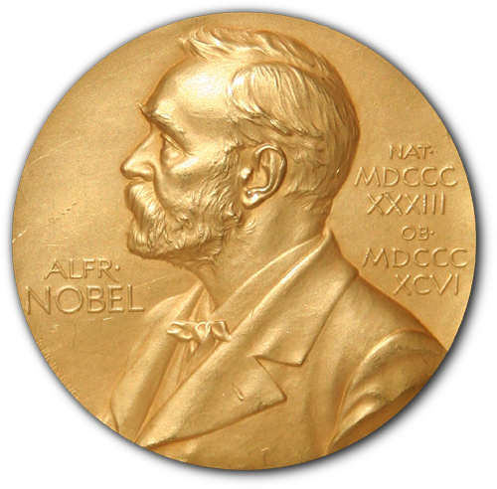
Intense laser beams
Physics Nobel Prize 2018 awarded to Arthur Ashkin, Gérard Mourou and Donna Strickland
Today’s speakers:
Dr James Lloyd-Hughes and Dr Gavin Morley Warwick Physics

Slide 2
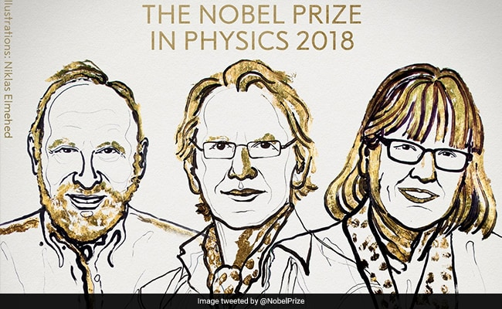
Arthur Ashkin Gérard Mourou Donna Strickland

Slide 3
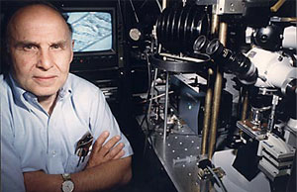
Arthur Ashkin: inventor of optical tweezers

Slide 4
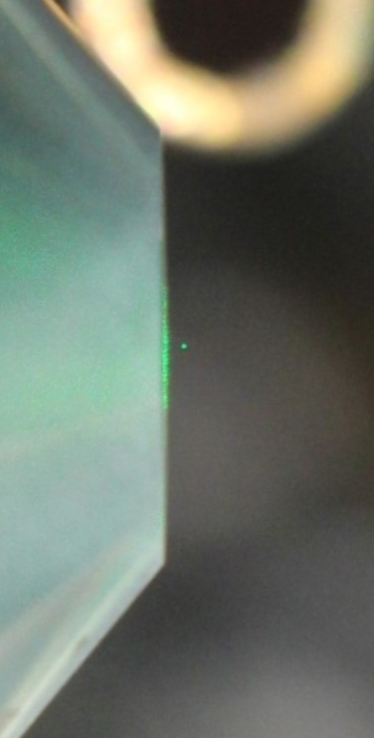
Optical tweezers

Slide 5
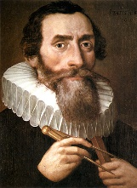
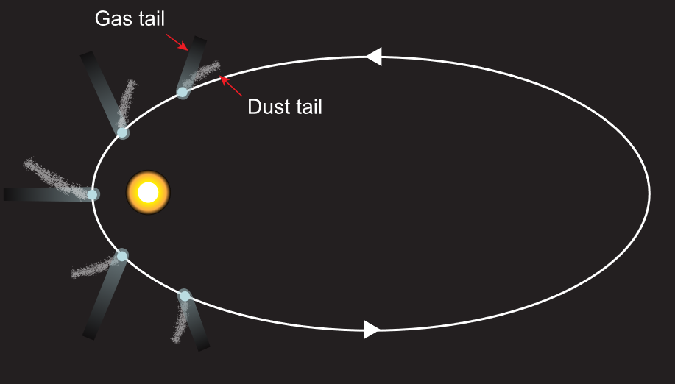
History of radiation pressure
Johannes Kepler (1571 –1630)
By Юкатан - Own work, CC BY-SA 4.0, https://commons.wikimedia.org/w/index.php?curid=49018539

Slide 6
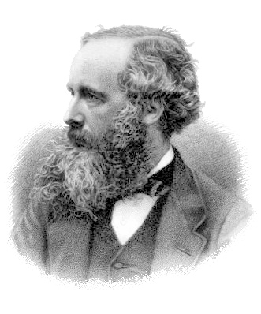
History of radiation pressure
James Clerk Maxwell (1831 – 1879)

Slide 7
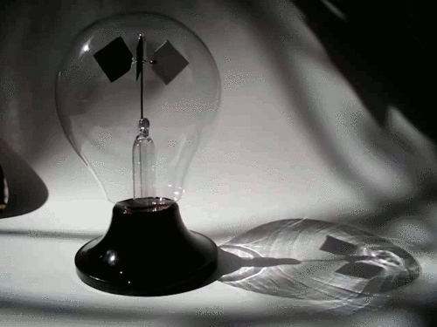
Not radiation pressure: Crookes radiometer

Slide 8
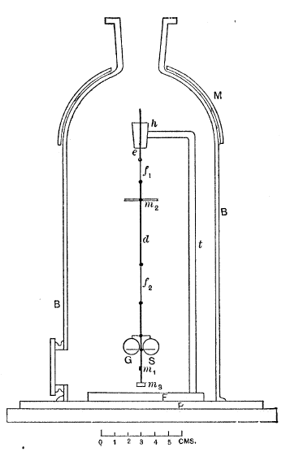
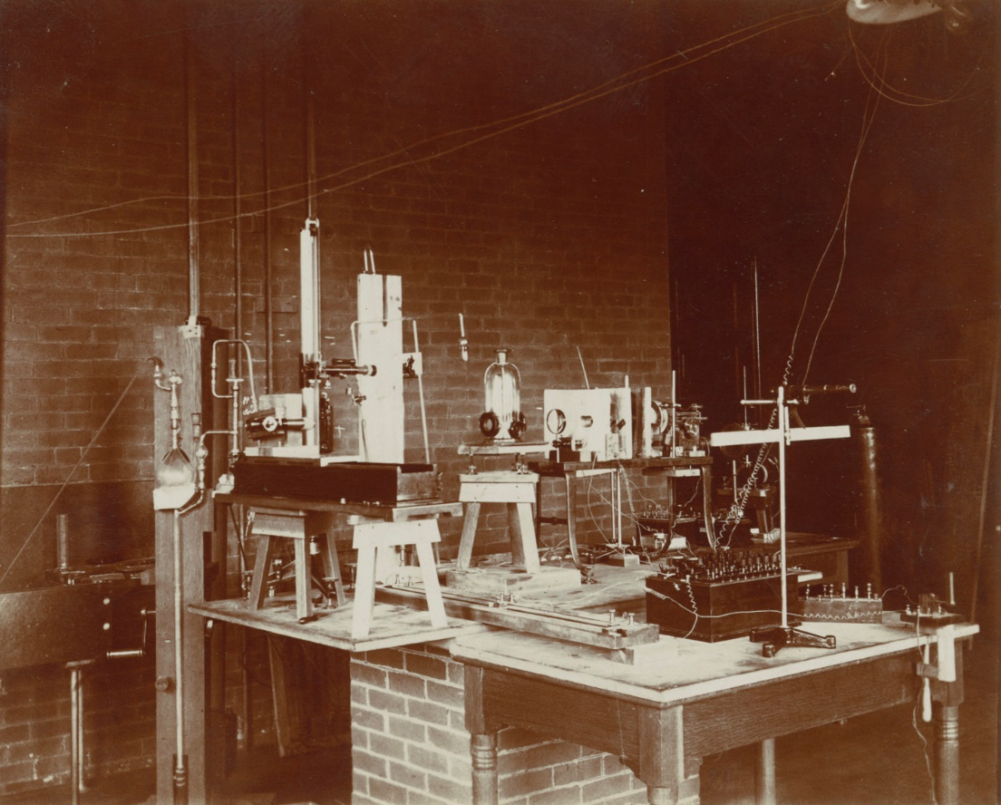
History of radiation pressure
EF Nichols & GF Hull, A Preliminary communication on the pressure of heat and light radiation, Phys Rev 13, 307 (1901)
P Lebedev, Untersuchungen über die Druckkräfte des Lichtes, Annalen der Physik 311, 433 (1901)

Slide 9
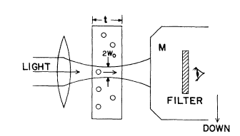
Radiation pressure
A Ashkin, Physical Review Letters 24, 156 (1970)
“I thank JM Dziedzic for making his equipment and skill available.”
Joseph Dziedzic and Arthur Ashkin were co-authors on 27 papers 1971-1990

Slide 10
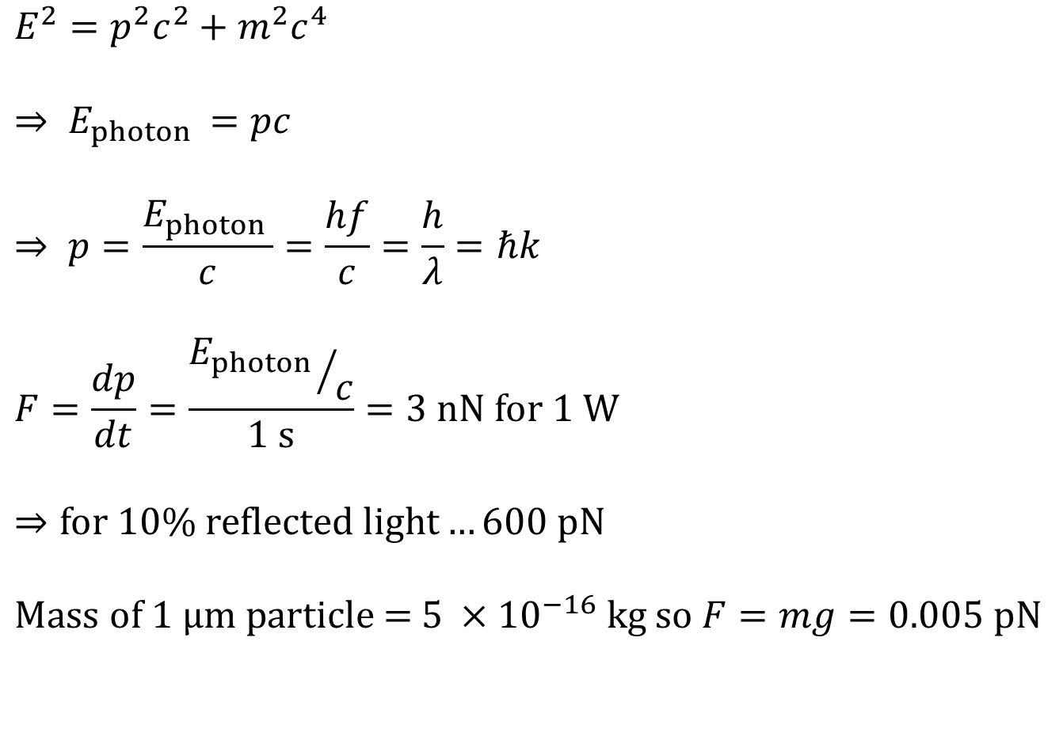
Radiation pressure
$$E^{2}=p^{2}c^{2}+m^{2}c^{4}$$
$$⇒ E_{photon }=pc$$
$$⇒ p=\frac{E_{photon }}{c}=\frac{hf}{c}=\frac{h}{λ}=ℏk$$
$$F=\frac{dp}{dt}=\frac{{E_{photon }}/c}{1 \text{s}}=3 \text{nN} \text{for}\text{ 1 }\text{W}$$
$$⇒\text{for}\text{ 10\% }\text{reflected} \text{light}…\text{600 }\text{pN}$$
$$\text{Mass} \text{of}\text{ 1 }μ\text{m} \text{particle}\text{ = 5 }×{10}^{−16} \text{kg} \text{so} F=mg=0.005 \text{pN}$$

Slide 11
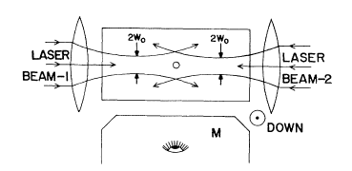
Optical trapping
Only 50 mW green laser light
A Ashkin, Physical Review Letters 24, 156 (1970)
“I thank JM Dziedzic for making his equipment and skill available.”

Slide 12
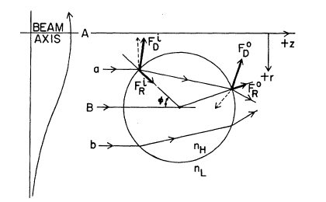
Optical trapping: larger particles
A Ashkin, Physical Review Letters 24, 156 (1970)
“I thank JM Dziedzic for making his equipment and skill available.”

Slide 13
Optical trapping: smaller particles
+
e-
e-
+
A Ashkin, Physical Review Letters 24, 156 (1970)
“I thank JM Dziedzic for making his equipment and skill available.”

Slide 14
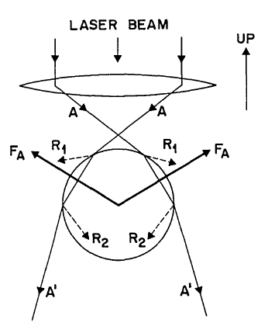
Optical trapping: single beam
A Ashkin, Physical Review Letters 40, 729 (1978)
A Ashkin, JM Dziedzic, JE Bjorkholm & Steven Chu, Optics Letters 11, 288 (1986)

Slide 15
Atom trapping
1997 Nobel Prize in Physics:
Steven Chu
William Phillips
Claude Cohen-Tannoudji
for the development of methods to cool and trap atoms with laser light
Steven Chu, JE Bjorkholm, A Ashkin & A Cable,
Physical Review Letters 57, 314 (1986)

Slide 16

2018 Arthur Ashkin: Optical tweezers
2009 Willard S Boyle & George E Smith: Invention of the charge-coupled device (CCD)
1998 Horst Störmer, Daniel Tsui & Robert Laughlin: Fractional Quantum Hall Effect
1997 Steven Chu: Methods to cool and trap atoms
1978 Arno A Penzias & Robert W Wilson: Cosmic microwave background radiation
1977 Philip W Anderson: Electronic structure of magnetic and disordered systems
1956 John Bardeen, Walter H Brattain & William Shockley: Invention of the transistor
1937 Clinton J Davisson: Diffraction of electrons by crystals

Slide 17
Optical trapping: single beam
A Ashkin, Physical Review Letters 40, 729 (1978)
A Ashkin, JM Dziedzic, JE Bjorkholm & Steven Chu, Optics Letters 11, 288 (1986)

Slide 18
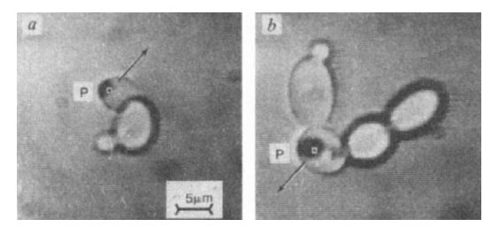
Optical Tweezers with 1 µm light
Division of yeast cells → E. Coli, red blood cells, green plant cells, algae
A Ashkin & JM Dziedzic, Science 235, 1517 (1987)
A Ashkin, JM Dziedzic, & T Yamane, Nature 330, 769 (1987)

Slide 19
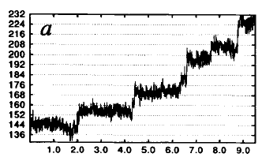
Optical Tweezers for molecular motors
Motor protein kinesin moves in 8 nm steps on microtubules
K Svoboda, CF Schmidt, BJ Schnapp & SM Block Nature
365, 721 (1993)

Slide 20
Optical Tweezers for biophysics
David Grier (exotic holographic traps)
Steve Block (single molecule force measurements)
Kishan Dholakia
Miles Padgett
Halina Rubinsztein-Dunlop
Roberto di Leonardo
Rob Cross (Warwick, Centre for Mechanochemical Cell Biology)
Carlos Bustamante
Marco Polin (Warwick Physics)

Slide 21
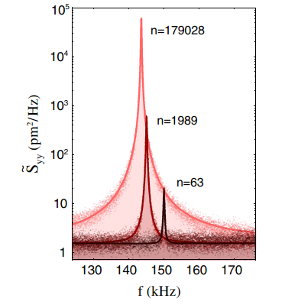
Optical Tweezers for physics
Towards ground-state cooling in vacuum
J Millen, PZG Fonseca, T Mavrogordatos, TS Monteiro & PF Barker, Physical Review Letters 114, 123602 (2015)
V Jain, J Gieseler, C Moritz, C Dellago, R Quidant & L Novotny, Physical Review Letters 116, 243601 (2016)
J Vovrosh, M Rashid, D Hempston, J Bateman, M Paternostro & H Ulbricht, Journal of the Optical Society of America B 34, 1421 (2017)

Slide 22
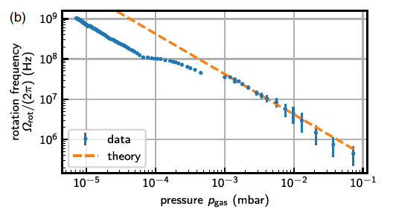
Optical Tweezers for physics
GHz rotation
R Reimann, M Doderer, E Hebestreit, R Diehl, M Frimmer, D Windey, F Tebbenjohanns & L Novotny, Physical Review Letters 121, 033602 (2018)
J Ahn, Z Xu, J Bang, Y-H Deng, TM Hoang, Q Han, R-M Ma & T Li,
Physical Review Letters 121, 033603 (2018)

Slide 23
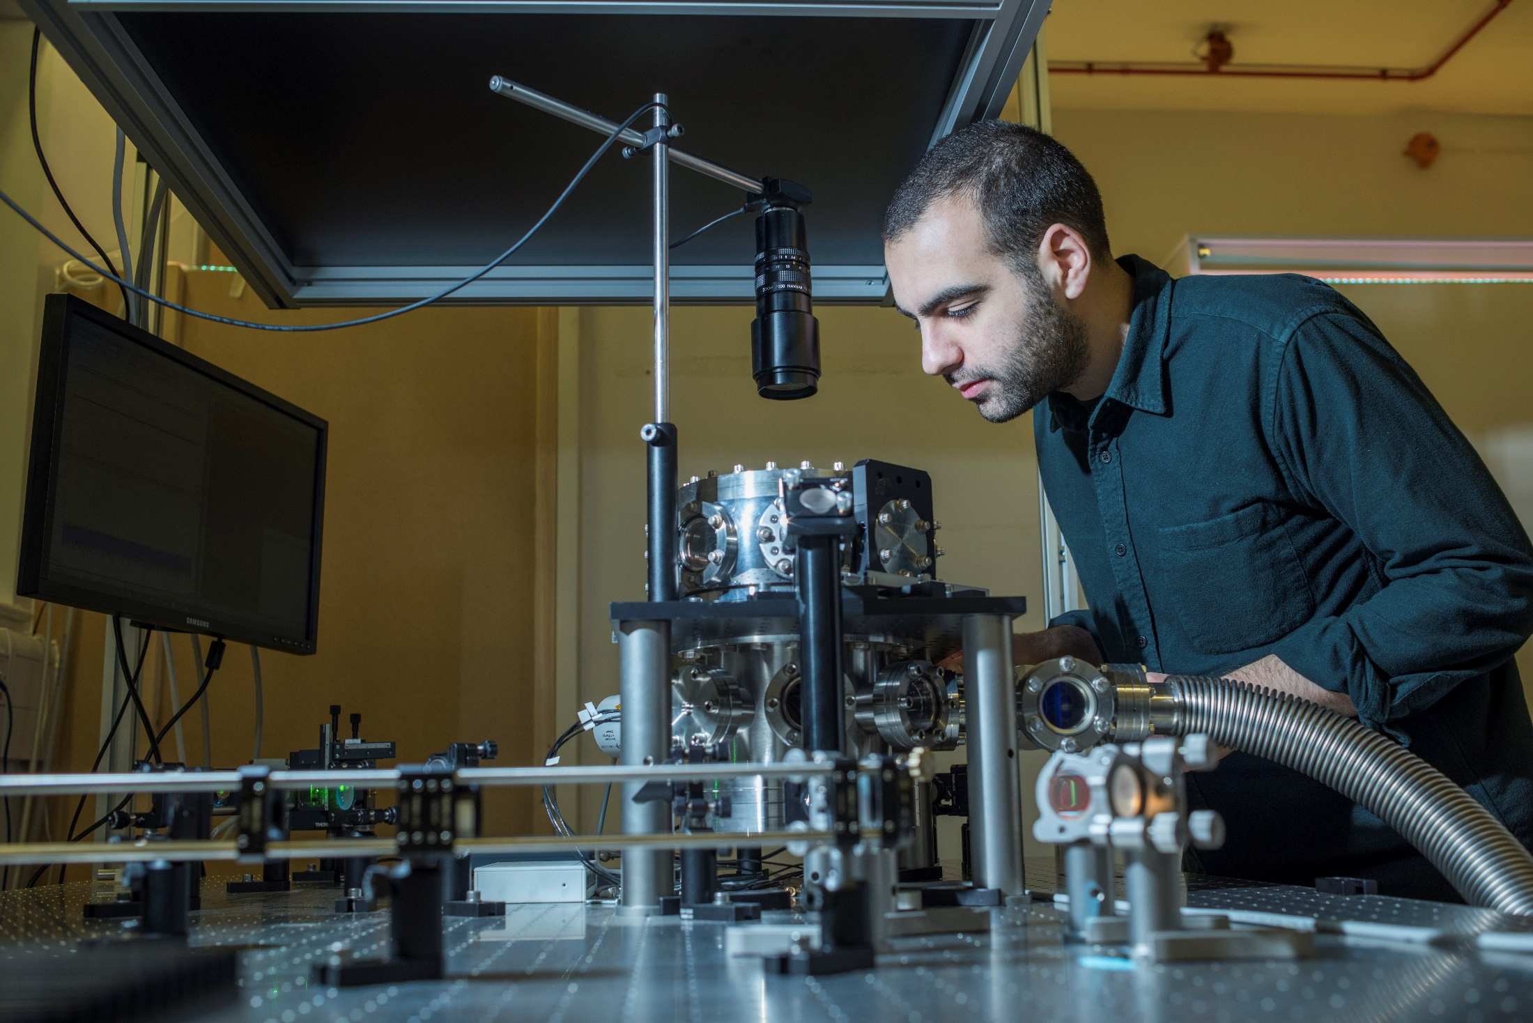

Our experiment: optically levitated nanodiamond

Slide 24
Our proposal:
drop a nanodiamond containing a spin
Proposals from our collaboration:
- M Scala… & S Bose, PRL 111, 180403 (2013)
- C Wan…& MS Kim, PRA 93, 043852 (2016)
- C Wan… & MS Kim, PRL 117, 143003 (2016)
- S Bose… & G Milburn, PRL 119, 240401 (2017)
- RJ Marshman… S Bose, arXiv:1807.10830 (2018)
- S Bose & GW Morley, arXiv:1810.07045 (2018)
Our experiments:
- ATMA Rahman… & PF Barker, Sci Rep 6, 21633 (2016)
- ATMA Rahman… & GW Morley, Rev Sci Instrum 89, 023109 (2018)
- AC Frangeskou… & GW Morley, NJP 20, 043016 (2018)

Slide 25
Arthur Ashkin Gérard Mourou Donna Strickland

Slide 26
Extra slides…

Slide 27
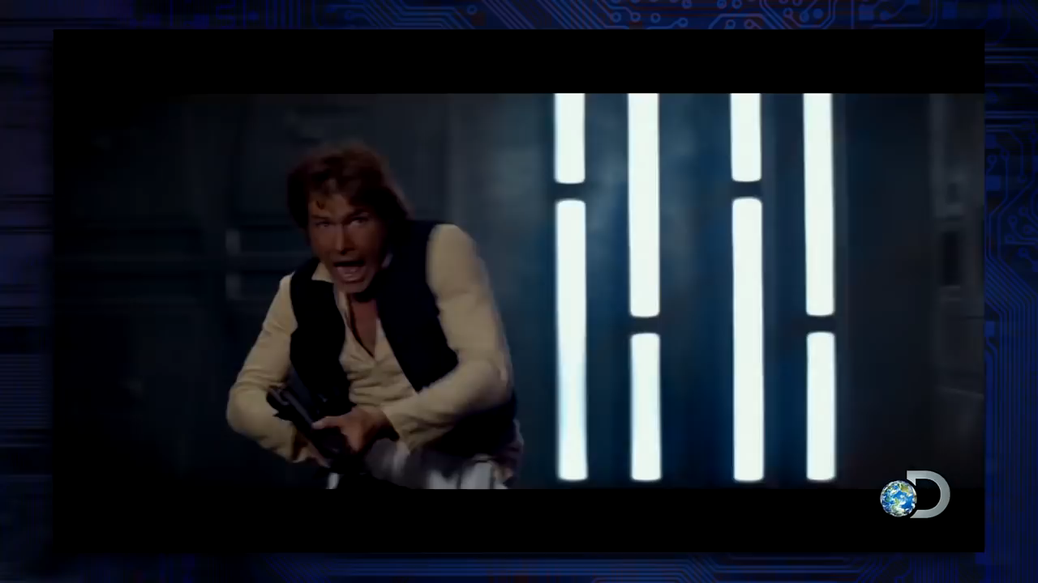

Slide 28
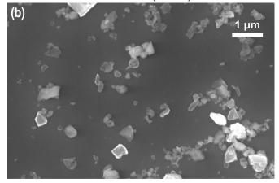

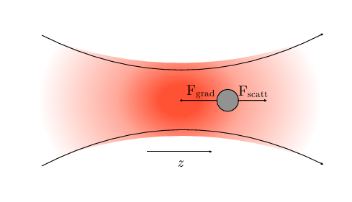
Optical tweezers
Objective Lens
Laser

Slide 29




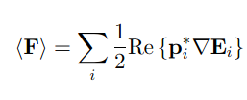
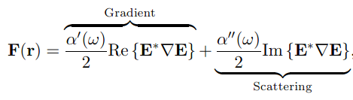
Optical tweezers
Time averaged gradient force:

Slide 30
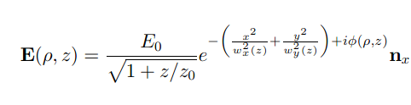



Optical tweezers

Slide 31
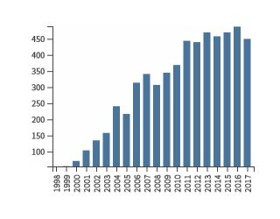
Papers on Optical Tweezers

