Slide 1
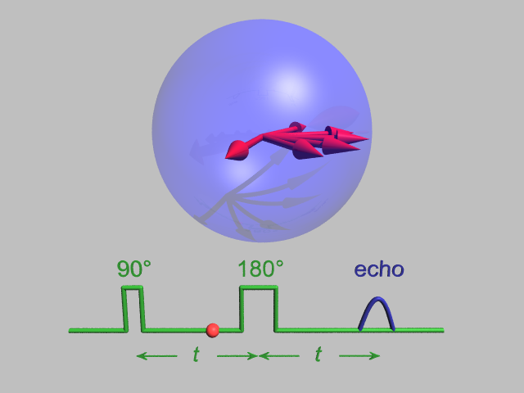
Electron Paramagnetic Resonance and Dynamic Nuclear Polarisation CH916
Gavin W Morley,
Department of Physics,
University of Warwick

Slide 2
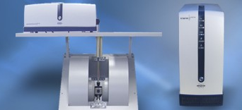
Overview
Electron paramagnetic resonance
What it is
Why it’s useful
Dynamic nuclear polarization
Why it’s useful
What it is

Slide 3
Overview
Electron paramagnetic resonance
What it is
Why it’s useful
Dynamic nuclear polarization
Why it’s useful
What it is
What does an EPR spectrum look like?
What is the resonant frequency for EPR?
Which things have an EPR signal?

Slide 4
Overview
Electron paramagnetic resonance
What it is
…NMR for electrons

Slide 5

Electron paramagnetic resonance (EPR)
… or electron spin resonance (ESR)
… or electron magnetic resonance (EMR)
… or ferromagnetic resonance (FMR)

Slide 6
Magnetism
Electron spins tend to:
Paramagnetism: follow
Diamagnetism: oppose
Ferromagnetism: ignore
…an applied magnetic field

Slide 7
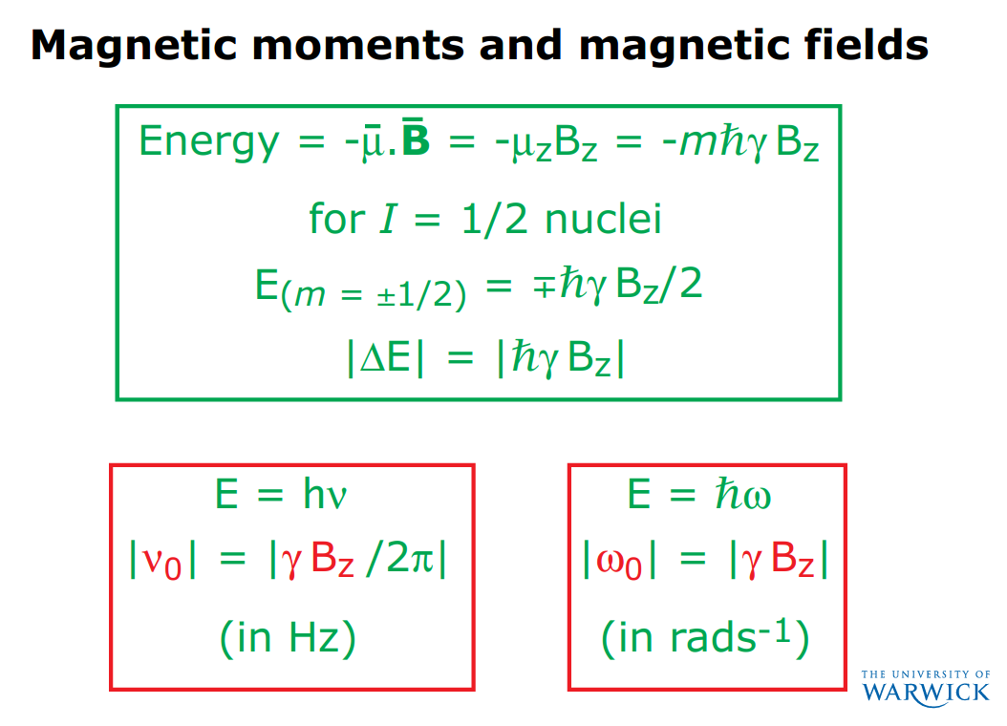
From Steven Brown’s NMR lecture:

Slide 8
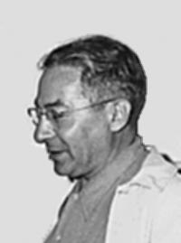
Magnetic resonance
An isolated spin I = ½ has m = ±½
Isidor Isaac Rabi (1898 – 1988)
Energy of a spin ½
m = -½
Photon energy
m = +½
Magnetic field

Slide 9
Magnetic resonance
Isidor Isaac Rabi (1898 – 1988)
Energy of a spin ½
m = -½
Photon energy
m = +½
Magnetic field

Slide 10
Magnetic resonance
Photons reflected
Magnetic field
Isidor Isaac Rabi (1898 – 1988)
Energy of a spin ½
m = -½
Photon energy
m = +½
Magnetic field

Slide 11
Magnetic resonance
Photons reflected
Magnetic field
Isidor Isaac Rabi (1898 – 1988)
Energy of a spin ½
m = -½
Photon energy
m = +½
Magnetic field

Slide 12
Magnetic resonance
Photons reflected
Magnetic field
Isidor Isaac Rabi (1898 – 1988)
Energy of a spin ½
m = -½
Photon energy
m = +½
Magnetic field

Slide 13
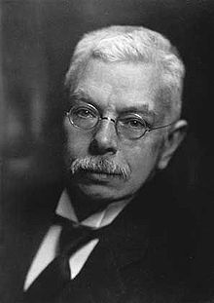
Magnetic resonance
Photons reflected
Magnetic field, B_{z}
Pieter Zeeman (1865 - 1943)
Energy of a spin S = ½
Energy gap |ΔE| = g μ_{B} B_{z}
g is the EPR equivalent of chemical shielding in NMR,
µ_{B} is the Bohr magneton
Magnetic field, B_{z}
Notes:
Zeeman effect

Slide 14
Magnetic resonance condition
Photons reflected
Magnetic field, B_{z}
Energy of a spin S = ½
Energy gap |ΔE| = g μ_{B} B_{z} = hv_{res}
= ħω_{res}
Magnetic field, B_{z}
Notes:
Zeeman effect

Slide 15
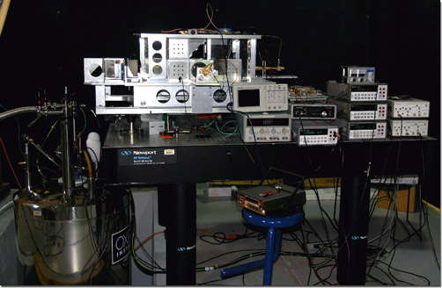
Electron paramagnetic resonance
Photons reflected
Magnetic field, B_{z}
Bruker
J van Tol, L-C Brunel & RJ Wylde, Rev Sci Instrum 76, 076101 (2005)
f_{res} = 10 GHz
f_{res} = 240 GHz

Slide 16
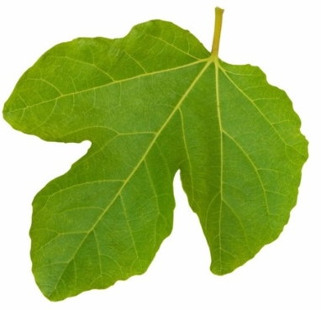
Electron paramagnetic resonance
S = ½
m_{s} = ±½
I = ½
m_{I} = ±½ (= m)
Photons reflected
Magnetic field, B_{z}
Energy of a spin system
Energy gap |ΔE| = g μ_{B} B_{z}
Magnetic field, B_{z}
Notes:
mu_N is the nuclear magneton and it is ~1000 times smaller than mu_B

Slide 17
Electron paramagnetic resonance
S = ½
m_{s} = ±½
I = ½
m_{I} = ±½ (= m)
Photons reflected
Magnetic field, B_{z}
Energy of a spin system
Energy gap |ΔE| = g μ_{B} B_{z}
Magnetic field, B_{z}

Slide 18

Electron paramagnetic resonance
m_{I} = ½ m_{I} = -½
S = ½
m_{s} = ±½
I = ½
m_{I} = ±½ (= m)
Photons reflected
A
Magnetic field, B_{z}
Energy of a spin system
Energy gap |ΔE| = g μ_{B} B_{z} ± A/2
A is the HYPERFINE COUPLING
Magnetic field, B_{z}

Slide 19
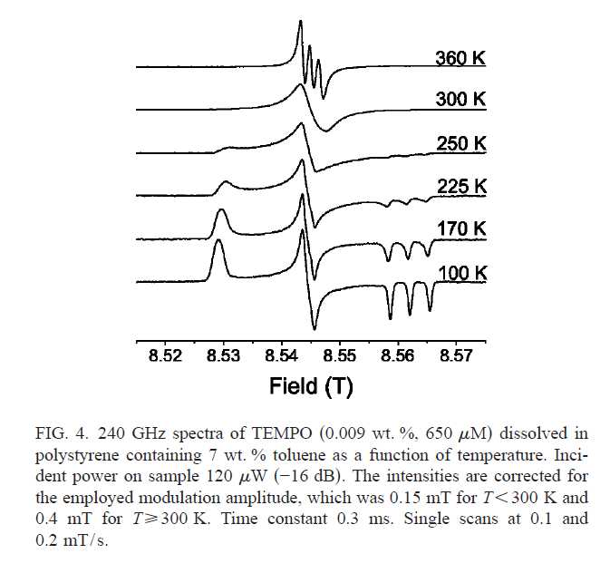
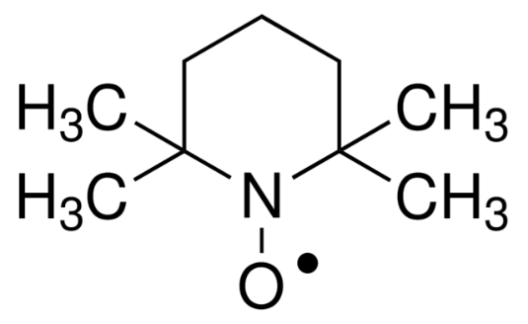
Electron paramagnetic resonance
m_{I} = ½ m_{I} = -½
Photons reflected
A
Stable free radicals:
BDPA
Nitroxides
DPPH
Magnetic field, B_{z}
TEMPO
£20/g from Aldrich
J van Tol, L-C Brunel & RJ Wylde, Rev Sci Instrum 76, 076101 (2005)

Slide 20
Electron paramagnetic resonance
m_{I} = ½ m_{I} = -½
Photons absorbed
A
Magnetic field, B_{z}
TEMPO
£20/g from Aldrich
J van Tol, L-C Brunel & RJ Wylde, Rev Sci Instrum 76, 076101 (2005)

Slide 21
Electron paramagnetic resonance
m_{I} = 1 m_{I} = 0 m_{I} = -1
Photons absorbed
A
Magnetic field, B_{z}
TEMPO
£20/g from Aldrich
J van Tol, L-C Brunel & RJ Wylde, Rev Sci Instrum 76, 076101 (2005)

Slide 22
Electron paramagnetic resonance
m_{I} = 1 m_{I} = 0 m_{I} = -1
Photons absorbed
Differential
absorption
Magnetic field modulation
(~10 to 100 kHz)
Advantage: noise only at
modulation frequency
Magnetic field, B

Slide 23
Electron paramagnetic resonance
m_{I} = 1 m_{I} = 0 m_{I} = -1
Differentialabsorption
A
Magnetic field, B
TEMPO
£20/g from Aldrich
J van Tol, L-C Brunel & RJ Wylde, Rev Sci Instrum 76, 076101 (2005)

Slide 24
Electron paramagnetic resonance
m_{I} = 1 m_{I} = 0 m_{I} = -1
Differentialabsorption
Magnetic field, B
TEMPO
£20/g from Aldrich
J van Tol, L-C Brunel & RJ Wylde, Rev Sci Instrum 76, 076101 (2005)

Slide 25
Electron paramagnetic resonance
spectrometer
Microwave bridge
Console
Computer
S
Electromagnet (up to 1.5 T) or superconducting magnet for higher field

Slide 26
Electron paramagnetic resonance
spectrometer
Bridge
source
detector
Modulation coils
S
Microwave resonator

Slide 27
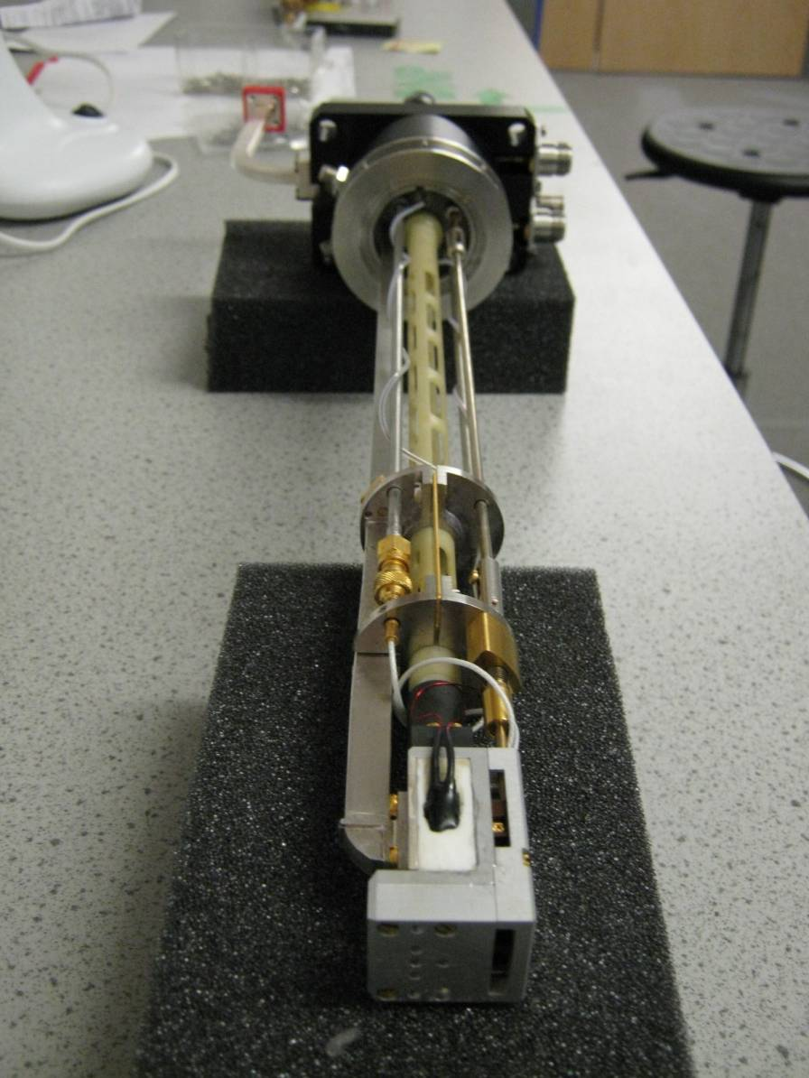
Electron paramagnetic resonance
spectrometer
Bridge
source
detector
Modulation coils
S
Microwave resonator

Slide 28
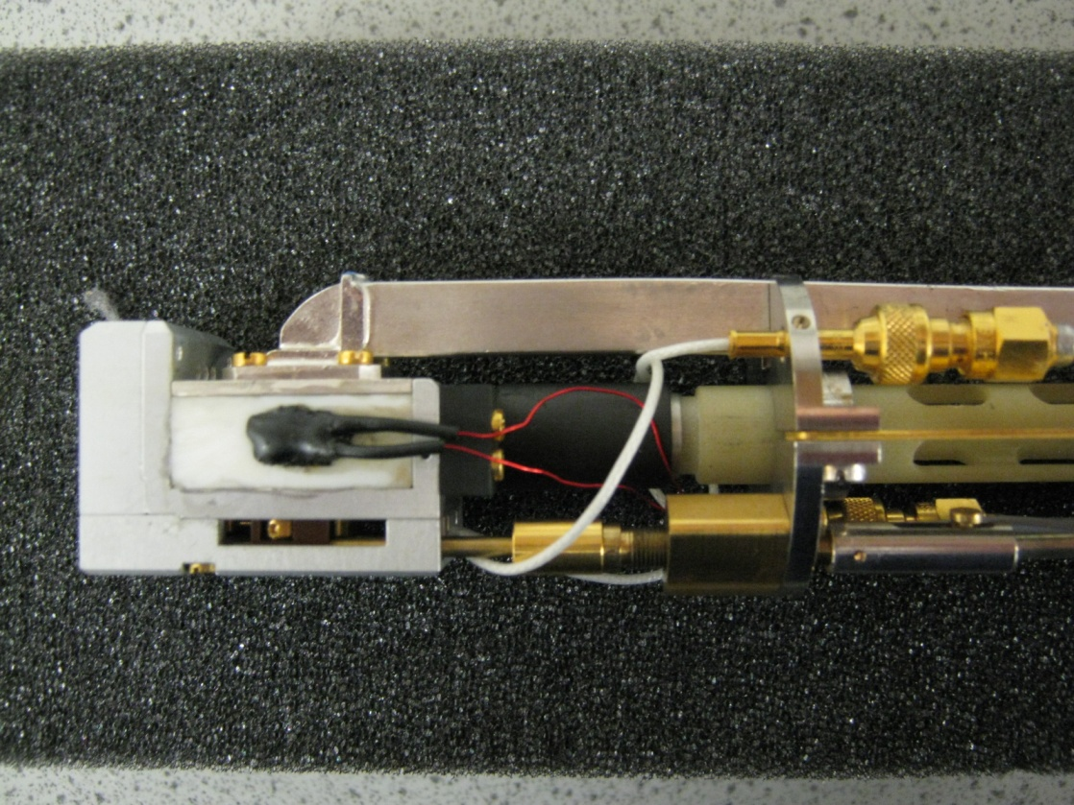
Electron paramagnetic resonance
spectrometer
Bridge
source
detector
Modulation coils
S
Microwave resonator

Slide 29
Electron paramagnetic resonance
spectrometer
CW EPR so far…
Pulsed EPR next

Slide 30
Pulsed electron paramagnetic resonance spectrometer
Bridge
High power pulsed source
Protected detector
Modulation coils off
S
Microwave resonator

Slide 31
Pulsed electron paramagnetic resonance

Slide 32
Pulsed electron paramagnetic resonance
resonance condition g μ_{B} B_{res} = h f
B_{res}
Polarize (thermalize) on timescale T₁
f
^{π}/₂
Free induction decay (FID) on timescale T₂*

Slide 33
Pulsed EPR
J van Tol, L-C Brunel & RJ Wylde, Rev Sci Instrum 76, 076101 (2005)
~100 MHz width
Pulse width < 500 MHz
Resonator ringing → deadtime
Short T₂ and T₂* compared to NMR
Homogeneous (T₂) can be much longer than inhomogeneous (T₂*) so most pulsed EPR uses spin echo
f
^{π}/₂

Slide 34
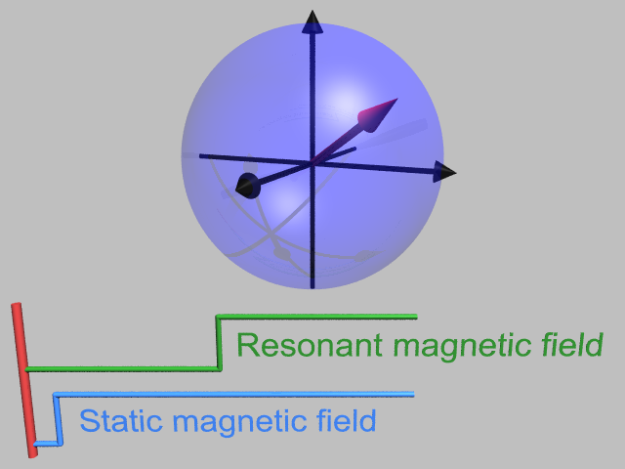
The rotating frame of reference
Larmor precession

Slide 35

The rotating frame of reference
Larmor precession

Slide 36
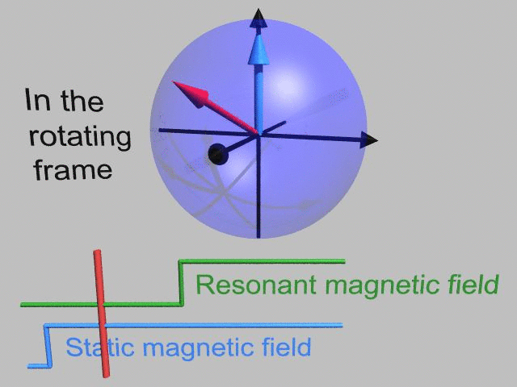
The rotating frame of reference
Larmor precession

Slide 37
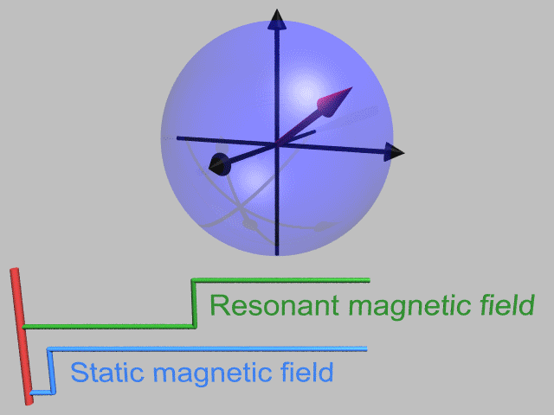
Rotating frame

Slide 38
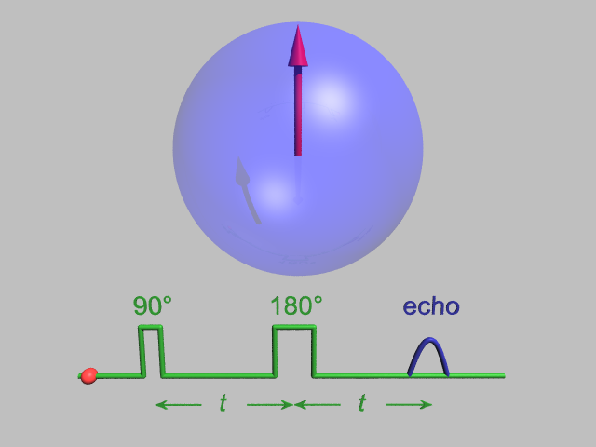
Spin echo
In rotating frame

Slide 39
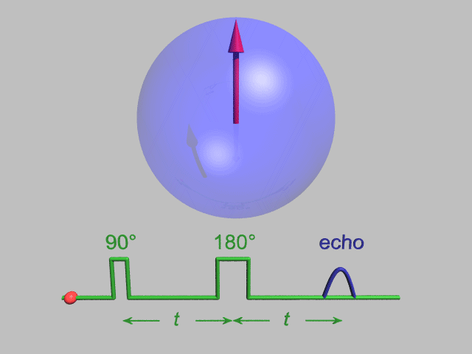
Spin echo
In rotating frame

Slide 40
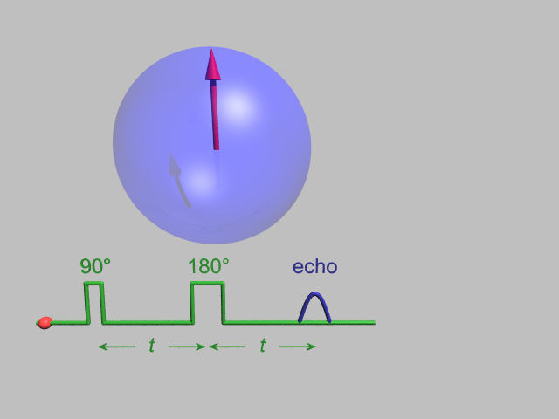
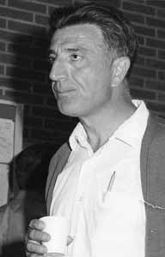
Spin echo decay
Erwin L Hahn (born 1921) Photo: AIP Emilio Segre Visual Archives, Stephen Jacobs Collection

Slide 41

Spin echo decay
Erwin L Hahn (1921-2016) Photo: AIP Emilio Segre Visual Archives, Stephen Jacobs Collection
Notes:
Hahn echo

Slide 42
Pulsed EPR
Double electron-electron resonance (DEER) allows distances between two electron spins in the range 2 to 6 nm to be measured (cf < 1 nm by NMR for two nuclear spins)
Dipolar coupling α 1/r³
Site directed spin labelling with
one or more TEMPO

Slide 43
Electron nuclear double resonance (ENDOR)
m_{I} = ½ m_{I} = -½
S = ½
m_{s} = ±½
I = ½
m_{I} = ±½ (= m)
Photons reflected
A
Magnetic field, B_{z}
Energy of a spin system
Energy gap |ΔE| = g μ_{B} B_{z} ± A/2
Magnetic field, B_{z}

Slide 44
Electron nuclear double resonance (ENDOR)
Why do ENDOR instead of NMR?
only need ~10¹⁰ spins instead of ~10¹⁵
NMR may be difficult near the electron spin
Energy of a spin system
Energy gap |ΔE| = g μ_{B} B_{z} ± A/2
Magnetic field, B_{z}

Slide 45
Electron nuclear double resonance (ENDOR)
B₀ is static magnetic field
B₁ is EPR magnetic field
B₂ is NMR magnetic field
Energy of a spin system
Energy gap |ΔE| = g μ_{B} B₀ ± A/2
Magnetic field, B₀

Slide 46
ENDOR for quantum computing
Classical Quantum
computer computer
Bits Qubits
0 or 1 α |0⟩ + β |1⟩
Notes:
A normal computer stores information as bits that can be 1 or 0. A quantum computer uses qubits: two level quantum systems such as spins 1/2

Slide 47
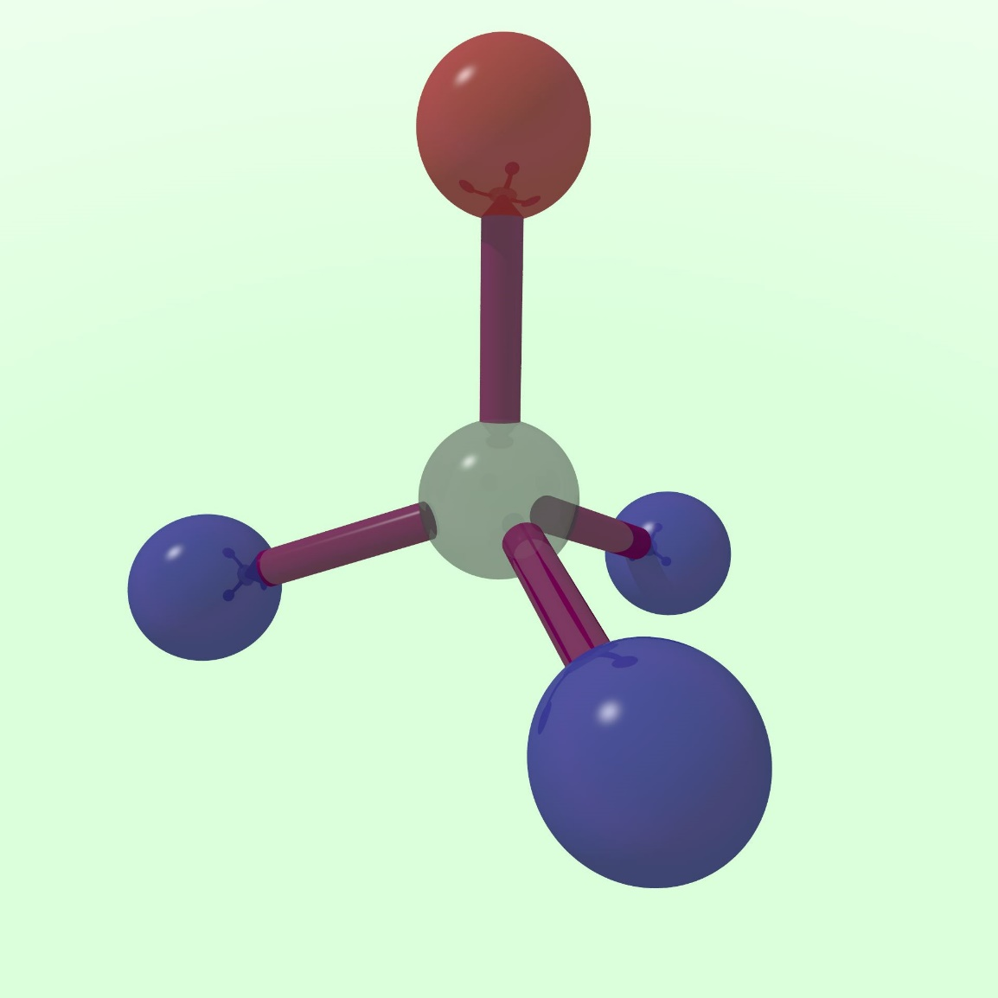

Spin qubits in diamond

Slide 48
EPR applications
Studying biomolecules
Quality control in beer, wine etc
Radiation dose received by teeth
What does an EPR spectrum look like?
What is the resonant frequency for EPR?
Which things have an EPR signal?

Slide 49
Overview
Electron paramagnetic resonance
What it is
Why it’s useful
Dynamic nuclear polarization
Why it’s useful
What it is

Slide 50
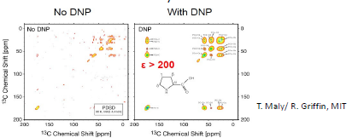
Dynamic nuclear polarization (DNP)
Dynamic nuclear polarization
More signal

Slide 51


Dynamic nuclear polarization (DNP)
Thermal (Boltzmann) equilibrium:
Define polarization as:
$${\frac{n_{2}}{n_{1}}=e}^{−\frac{∆E}{k_{B}T}}$$
$$P=\frac{n_{1}−n_{2}}{n_{1}+n_{2}}$$
n₂
ΔE
n₁

Slide 52

Dynamic nuclear polarization (DNP)
Boltzmann polarization:
So transfer electronic
polarization to nuclei
$${\frac{n_{2}}{n_{1}}=e}^{−\frac{∆E}{k_{B}T}}$$

Slide 53
Electron paramagnetic resonance
S = ½
m_{s} = ±½
I = ½
m_{I} = ±½ (= m)
Photons reflected
Magnetic field, B_{z}
Energy of a spin system
Energy gap |ΔE| = g μ_{B} B_{z}
Magnetic field, B_{z}
Notes:
Show these energy levels again

Slide 54
Electron paramagnetic resonance
m_{I} = ½ m_{I} = -½
S = ½
m_{s} = ±½
I = ½
m_{I} = ±½ (= m)
Photons reflected
A
Magnetic field, B_{z}
Energy of a spin system
Energy gap |ΔE| = g μ_{B} B_{z} ± A/2
Magnetic field, B_{z}
Notes:
…including the hyperfine term, and then redraw the energy levels at some fixed magnetic field

Slide 55
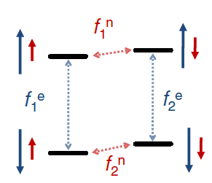
Dynamic nuclear polarization (DNP)
Initial polarizations:
Electrons > 95%
Nuclei < 0.1%
For 8.6 T and 3 K
Notes:
At 8.6T and 3K, electronic polarization is 95% and nuclear polarization is 0.06%.

Slide 56
Dynamic nuclear polarization (DNP)
Nuclear magnetic resonance (NMR)

Slide 57
Dynamic nuclear polarization (DNP)
Electron paramagnetic resonance (EPR)

Slide 58
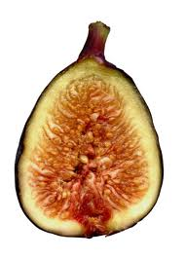
Dynamic nuclear polarization (DNP)
Forbidden transition
→ Overhauser Effect
Electron paramagnetic resonance (EPR)

Slide 59
Magnetic resonance
S = ½
m_{s} = ±½
I = ½
m_{I} = ±½ (= m)
Photons reflected
Magnetic field, B_{z}
Energy of a spin system
Energy gap |ΔE| = g μ_{B} B_{z}
Magnetic field, B_{z}

Slide 60
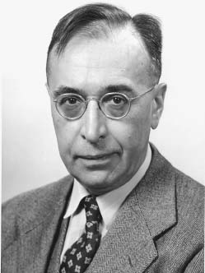
Breit-Rabi diagram
m_{I} = ½ m_{I} = -½
Photons reflected
A
Gregory Breit (1899-1981)
Magnetic field, B_{z}
Energy of a spin system
Energy gap |ΔE| ≈ g μ_{B} B_{z} ± A/2
...in high enough magnetic fields
Magnetic field, B_{z}
Notes:
Breit-Rabi diagram

Slide 61
Breit-Rabi diagram
For a coupled two-spin system at low magnetic field, the spin states of the two spins are not good quantum numbers. Instead:
Energy of a spin system
A
Triplet, F = 1: ↑↑
(↑↓ + ↓↑)/√2
↓↓
Singlet, F = 0: (↑↓ - ↓↑)/√2
Magnetic field, B_{z}
Energy gap |ΔE| = A
...at zero magnetic field

Slide 62
Dynamic nuclear polarization (DNP)
Electron paramagnetic resonance (EPR)
more Forbidden
at high magnetic fields

Slide 63
Dynamic nuclear polarization (DNP)
Solid effect DNP
also gets weaker at high magnetic fields

Slide 64
Dynamic nuclear polarization (DNP)
Solid effect DNP
also gets weaker at high magnetic fields

Slide 65
Dynamic nuclear polarization (DNP)
Cross effect Thermal Mixing
also get weaker at high magnetic fields
e-
e-
e-
n
n
n
e-
e-
e-
n

Slide 66
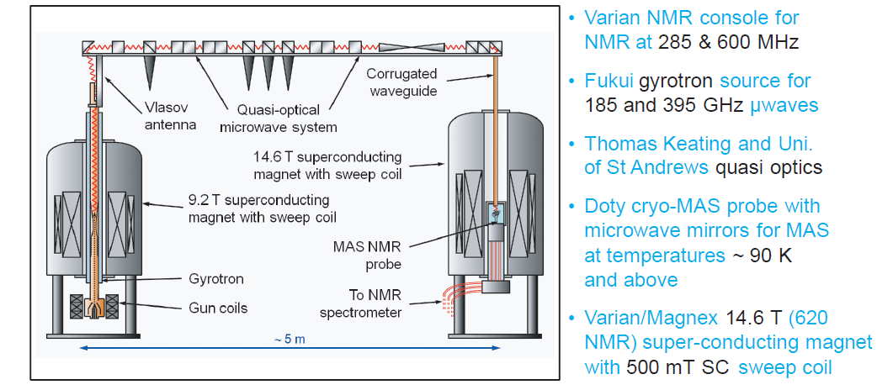
Dynamic nuclear polarization (DNP)
Ray Dupree, Steven Brown, Mark Newton, Kevin Pike, Andrew Howes, Tom Kemp, Mark Smith at Warwick,
see KJ Pike et al, J Mag Res 215, 1 (2012), also Griffin Group (MIT)

Slide 67
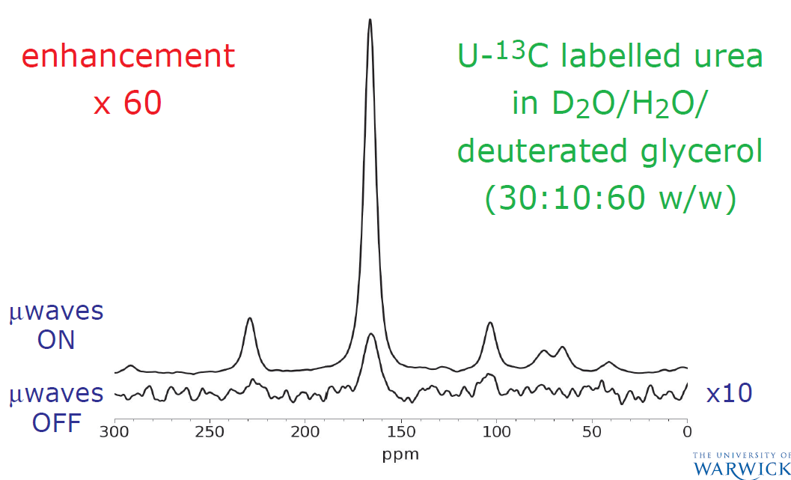
Dynamic nuclear polarization (DNP)
Ray Dupree, Steven Brown, Mark Newton, Kevin Pike, Andrew Howes, Tom Kemp, Mark Smith at Warwick,
see KJ Pike et al, J Mag Res 215, 1 (2012)

Slide 68
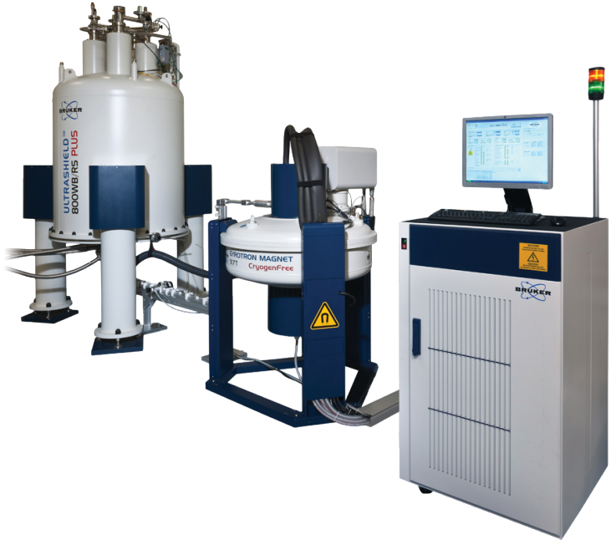
Solid-state DNP
Commercial solid-state DNP-NMR:
400-900 MHz NMR
200x signal enhancement -> 200² quicker scans

Slide 69
Liquid-state DNP
Temperature jump
plus
gain x50 from DNP
and x200 from temp
x10,000 total
See Ardenkjaer-Larsen et al, PNAS 100, 10158 (2003)

Slide 70
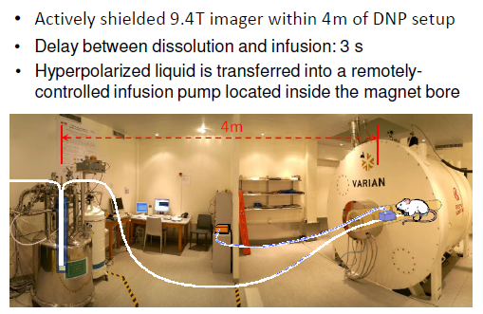
Liquid-state DNP
Temperature jump with dissolution
plus
Arnaud Comment and Rolf Gruetter, Lausanne

Slide 71
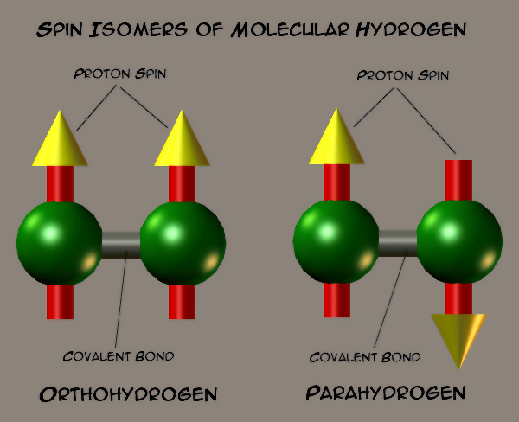
Parahydrogen-induced polarization (PHIP) for liquid-state NMR
Hydrogen at low temperatures becomes almost pure parahydrogen
Image by Xaa (Jim Farris)

Slide 72
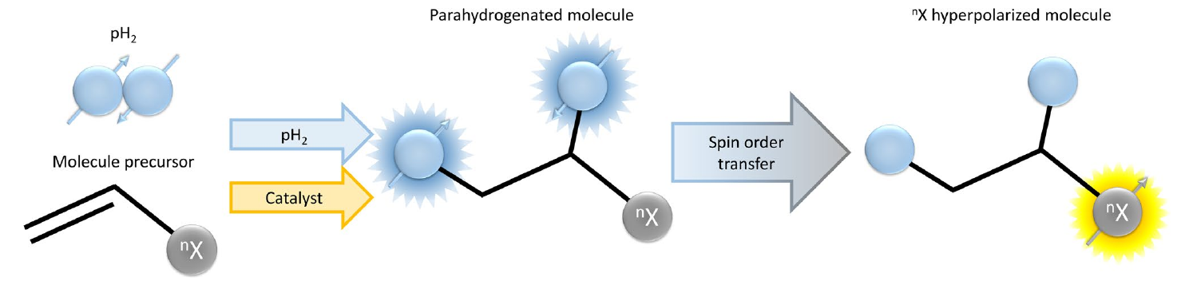
Parahydrogen-induced polarization (PHIP) for liquid-state NMR
Review: F. Reineri, E. Cavallari, C. Carrera & S. Aime, Magn. Reson. Mater. Phys., Biol. Med. 34, 25 (2021).

Slide 73
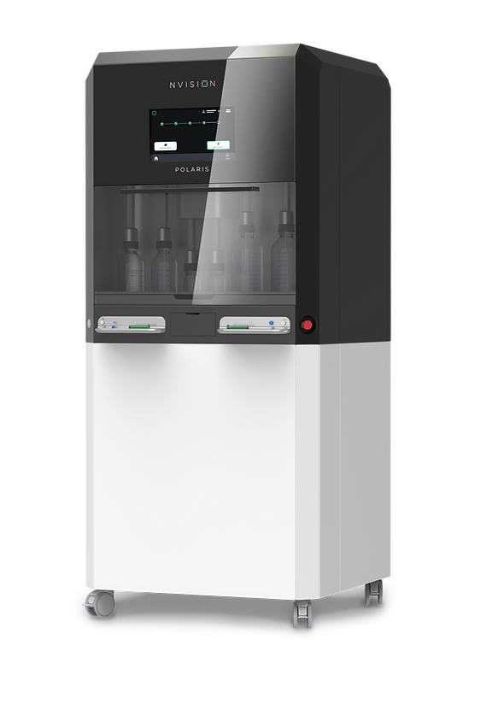
Parahydrogen-induced polarization (PHIP) for liquid-state NMR
A company (eg NVision) creates parahydrogen and ships it to users. It stays stable for months.
Polarization is transferred to a natural metabolite by catalytically adding parahydrogen to a precursor.
After purification, the hyperpolarized metabolite (eg pyruvate) is ready to be injected.
Do MRI to image the metabolism.

Slide 74
Conclusion
Electron paramagnetic resonance
What it is
Why it’s useful
Dynamic nuclear polarization
Why it’s useful
What it is

