Slide 1
Magnetic resonance animation set
Made by Gavin W Morley
CC-by-SA:
https://creativecommons.org/licenses/by-sa/3.0/deed.en
You are free to:
Share — copy and redistribute the material in any medium or format
Adapt — remix, transform, and build upon the material for any purpose, even commercially.
The licensor cannot revoke these freedoms as long as you follow the license terms.
Under the following terms:
Attribution — You must give appropriate credit, provide a link to the license, and indicate if changes were made. You may do so in any reasonable manner, but not in any way that suggests the licensor endorses you or your use.
ShareAlike — If you remix, transform, or build upon the material, you must distribute your contributions under the same license as the original.
No additional restrictions — You may not apply legal terms or technological measures that legally restrict others from doing anything the license permits.

Slide 2
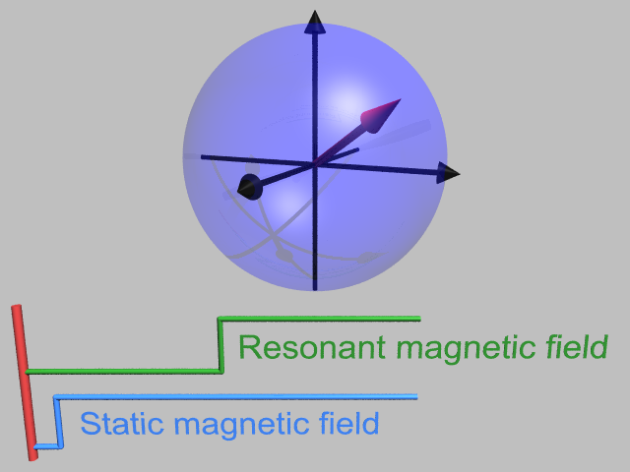
The Rotating Frame (full fast version)
Animation by Gavin W Morley

Slide 3
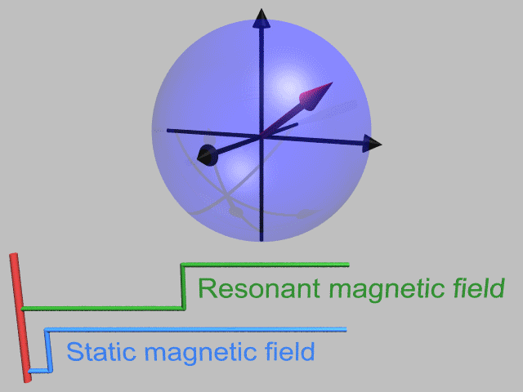
The Rotating Frame (full fast version)
Animation by Gavin W Morley

Slide 5
Put a magnetic moment into a vertical magnetic field
The Rotating Frame (slow version)
Larmor precession at angular frequency ω_{S}
Animation by Gavin W Morley

Slide 6

Put a magnetic moment into a vertical magnetic field
The Rotating Frame (slow version)
Larmor precession at angular frequency ω_{S}
Animation by Gavin W Morley

Slide 7
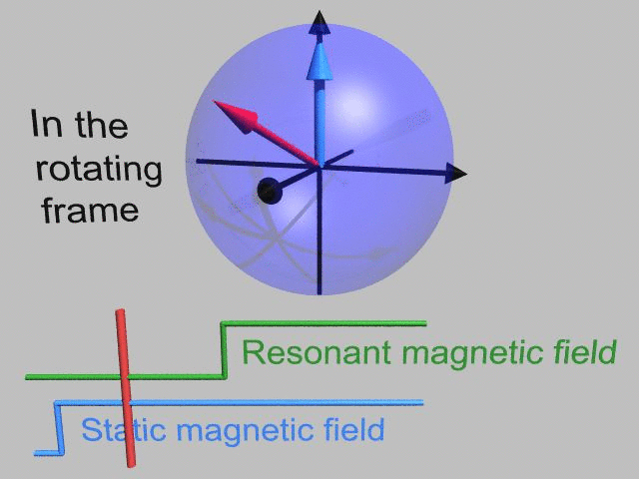
Put a magnetic moment into a vertical magnetic field
The Rotating Frame (slow version)
Larmor precession at angular frequency ω_{S}
Animation by Gavin W Morley

Slide 9
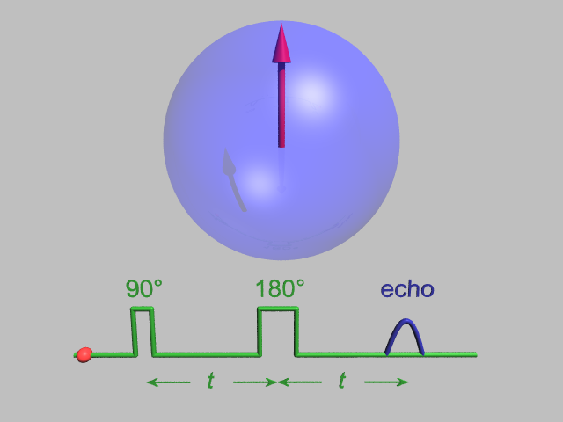
Spin Echo
In rotating frame
Animation by Gavin W Morley
Notes:
Hahn echo

Slide 10
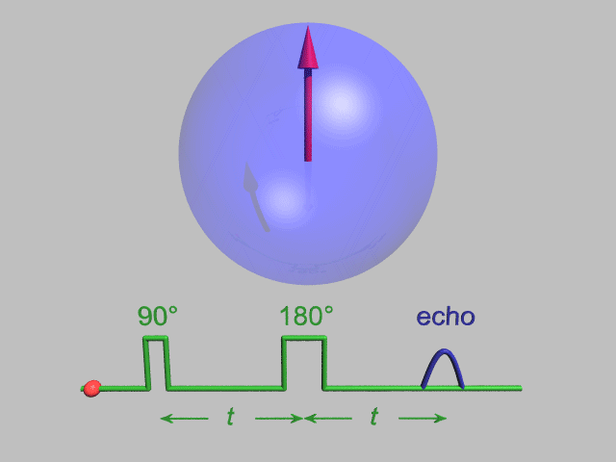
Spin Echo
In rotating frame
Animation by Gavin W Morley
Notes:
Hahn echo

Slide 12
Spin Echo With More Decay
In rotating frame
Animation by Gavin W Morley
Notes:
Hahn echo

Slide 13

Spin Echo With More Decay
In rotating frame
Animation by Gavin W Morley
Notes:
Hahn echo

Slide 15
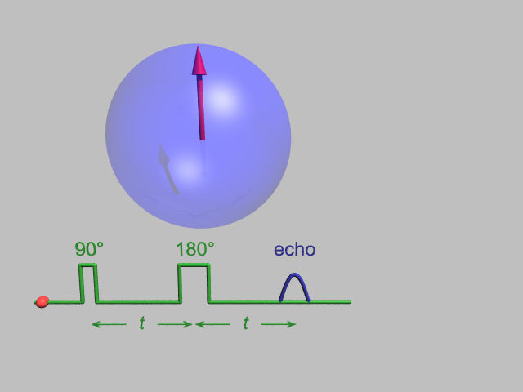
Spin Echo Decay
Animation by Gavin W Morley

Slide 16

Spin Echo Decay
Animation by Gavin W Morley

