Slide 1



Emergence in Quantitative Systems – towards a measurable definition
R C Ball, RS MacKay,
M Diakonova
Centre for Complexity Science,
University of Warwick

Slide 2
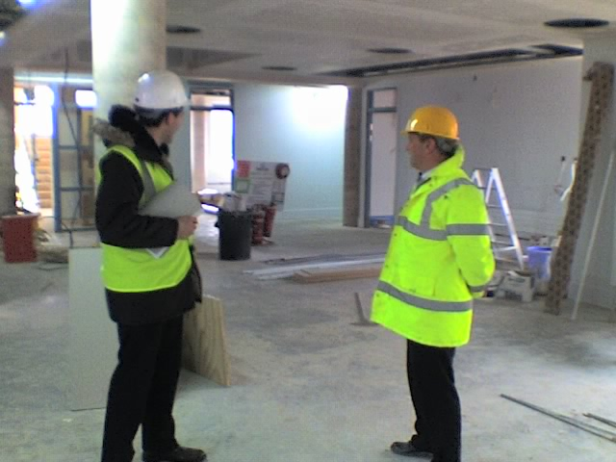
Complexity Science
Key themes
Systems of many inter-linked variables/components
Emergent behaviour: not just an obvious scale up of individuals
Robustness (under perturbation, damage)
Fluctuations and Noise
Common issues
Understanding system response
Forecasting behaviour
Optimising design (cost, performance, robustness ..)
Other angles
Large datasets, hidden info (secondary analysis)
The cost-benefit of [high degrees of] choice
Boundaries
Complicated is not necessarily complex!
Problems need inspiration from outside their field, with prospect to return it.

Slide 3
Emergent Behaviour
System + Dynamics
Many internal d.o.f. and/or observe over long times
Properties: averages, correlation functions
Multiple realisations (conceptually)
time
Statistical
properties
realisations
anticipation
forecast
Emergent properties
behaviour which
can be forecast (from preceding history) but
cannnot be anticipated (from independent realisations).

Slide 4
Strong emergence: different realisations (can) differ for ever
MacKay: non-unique Gibbs phase (distribution over configurations for a dynamical system)
Physics example: spontaneous symmetry breaking
system makes/inherits one of many equivalent choices of how to order (or statically disorder)
fine after you have achieved the insight that there is ordering (maybe heat capacity anomaly?) and what ordering to look for (no general technique).

Slide 5
Emergence in Quantitative Systems – towards a measurable definition
Input ideas:
Shannon: Information -> Entropy
transmission -> Mutual Information
Crutchfield: Complexity <-> Information
MacKay: Emergence = system evolves to non-unique state
Emergence measure: Persistent Mutual Information across time.

Slide 6
Entropy & Mutual Information Shannon 1948
B
B
B
A
A
A

Slide 7
MI-based Measures of Complexity
time
A=past
B=future
Entropy density (rate) Shannon 1948
Excess Entropy Crutchfield & Packard 1982
space
Statistical Complexity Shalizi et al PRL 2004
Persistent Mutual Information
- candidate measure of Emergence

Slide 8

Measurement of Persistent MI
Measurement of I itself requires some rounding or discretising of continuous valued data
above seems the safer order of limits, and computationally practical
The outer limit may need more careful definition

Slide 9
Examples with PMI
Oscillation (persistent phase)
Spontaneous ordering of spins (magnets)
Ergodicity breaking (glasses) – pattern of atoms/spins is random but becomes frozen in over time
Cases without PMI
Reproducible steady state with (decaying) autocorrelation functions
Chaotic dynamics

Slide 10
Discrete vs continuous emergent order parameters
This suggests some need to anticipate “information dimensionalities”

Slide 11
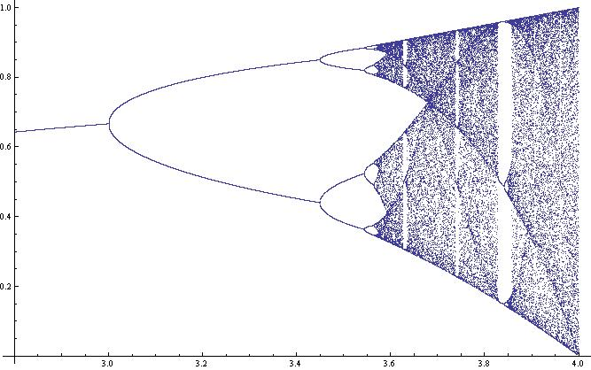
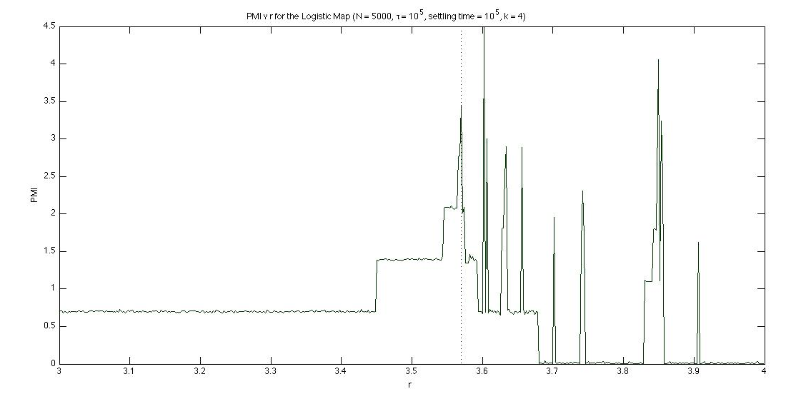
Logistic map
0
log 8
log 4
log 3
PMI = 0
log 2
log 4
log 2
M Diakonova
Measured PMI
log 4
log 2

Slide 12
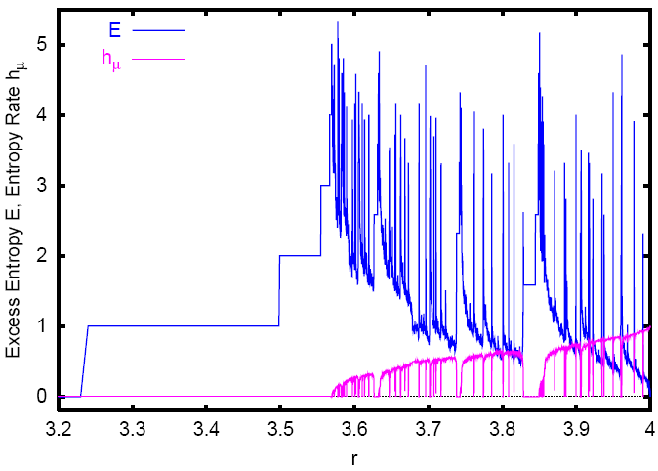
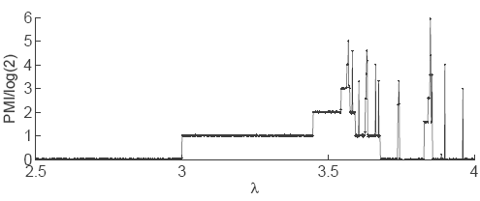
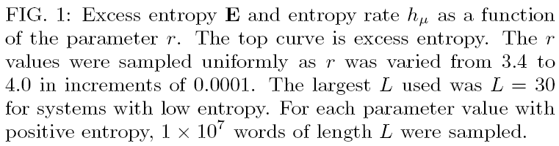
Excess Entropy and Entropy Rate vs
PMI
Feldman,McTague and Crutchfield, arXiv:0806.4789v1

Slide 13
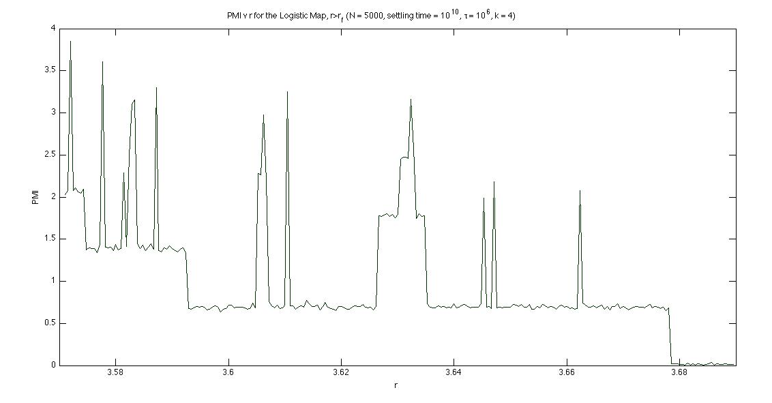
PMI of Banded Chaos
A
B
D
C
PMI
M Diakonova 2009, MI by k-neighbours method (Grassberger )

Slide 14
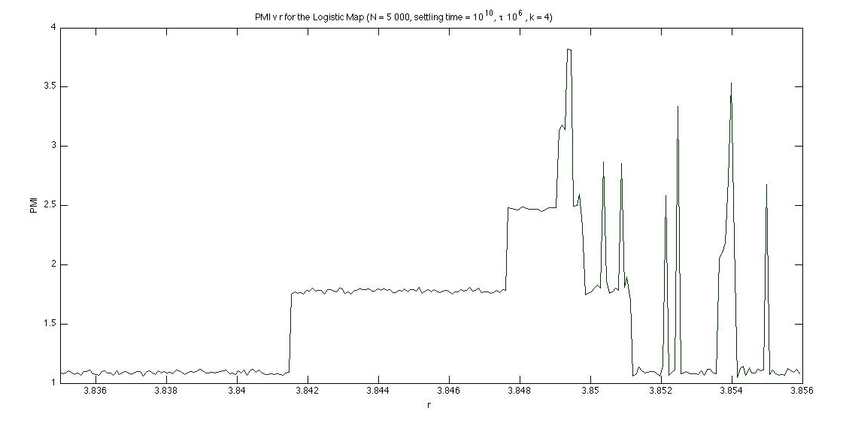
Period 3 region
Log(12)
Log(6)
Log(3)
M Diakonova 2009, MI by k-neighbours method (Grassberger ),
R ranges from 3.835 to 3.856in 250 increments

Slide 15
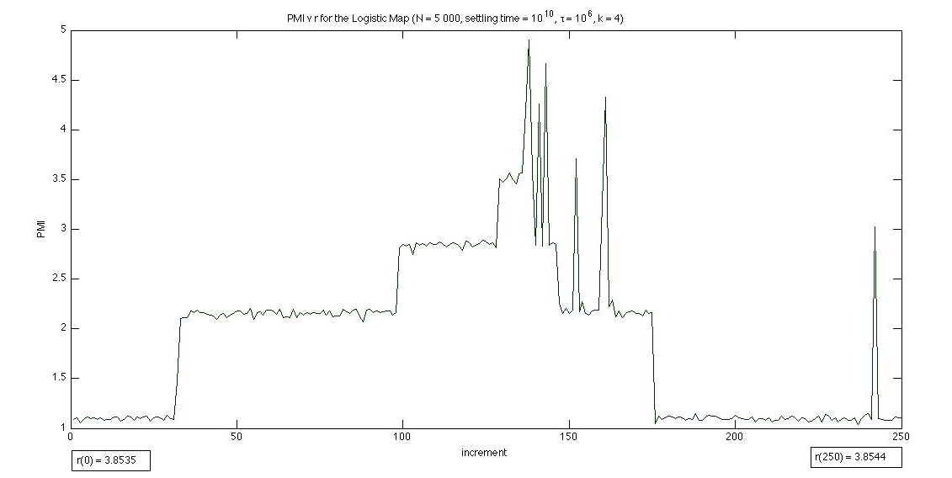
P tripling followed by doubling
(Zoom in on structure visible after P3 doubling)
Log(36)
Log(18)
Log(9)
Log(3)
R ranges from 3.8535 to 3.8544 in 250 increments

Slide 16
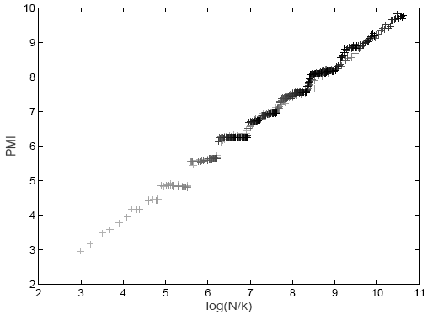

Resolution dependent PMI at the Feigenbaum point
Log (longest period resolvable)

Slide 17
Practical Measurement of Entropy & hence MI

Slide 18
Measured MI in case of Fractal scaling
Relative Information
Co-dimension

Slide 19
Fractal PMI at the Feigenbaum point
Log (longest period resolvable)

Slide 20
Example 2: the Standard Map

Slide 21
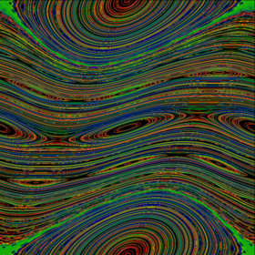
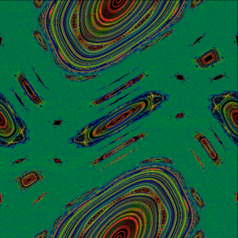
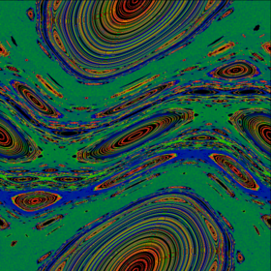
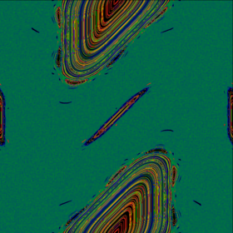
K=0.6
K=1.2
K=0.9716 ~ Kc
K=2.0
p
x
Wikipedia “standard map” (Linas)

Slide 22
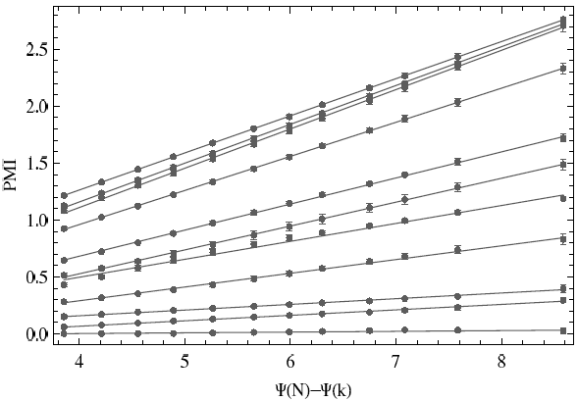
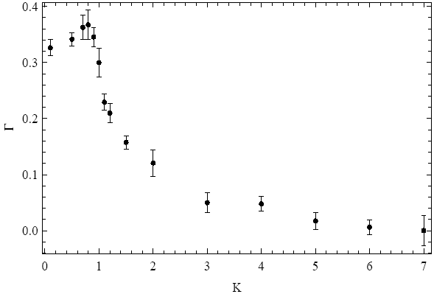
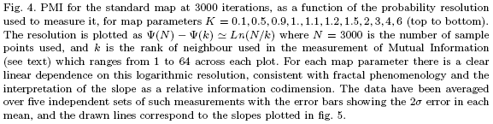
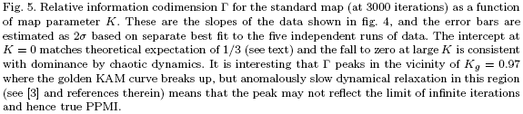
Fractal MI in Standard Map

Slide 23
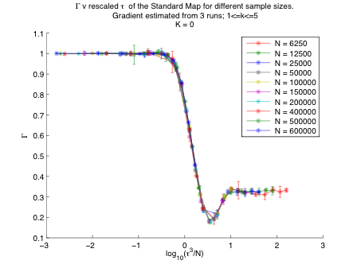

Slide 24
Cross-over scaling

Slide 25
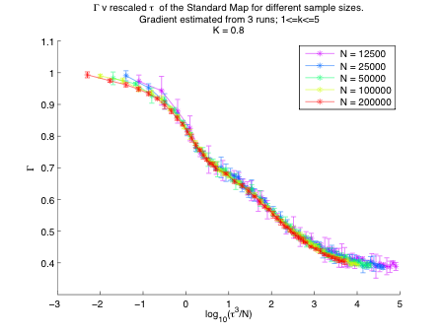
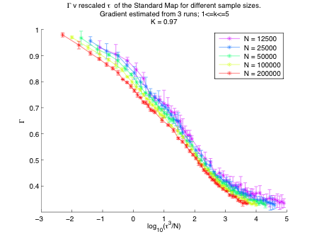
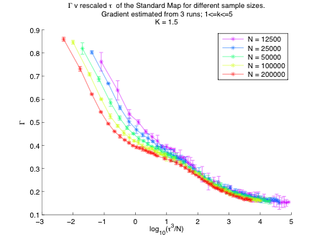
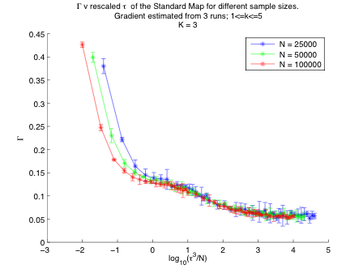

Slide 26
Interpretation

Slide 27
A definition of Emergence
System self-organises into a non-trivial behaviour;
  different possible instances of that behaviour;
  choice unpredictable but
  persists over time (or other extensive coordinate).
Quantified by PMI = entropy of choice
Shortcomings
Assumes system/experiment conceptually repeatable
Measuring MI requires deep sampling
Appropriate mathematical limits need careful construction
Generalisations
PMI as function of resolution → fractal information
PMI as function of timescale probed
Other extensive coordinates could play the role of time
Ref: RCB, M Diakonova, RS MacKay, Adv. in Complex Systems 13, 327-338 (2010)
Ack’t: EPSRC funding of Warwick Complexity Science Doctoral Training Centre

Slide 31
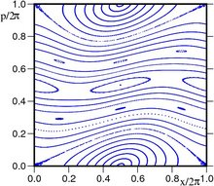
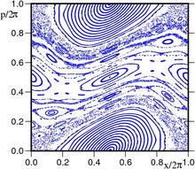
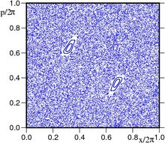
K=0.5 | K=0.971635 | K=5

Slide 32
Logistic map
0
PMI = 0
log 2
log 4
log 2
log 8
log 4
log 3

Slide 33
Graph III – general PMI v r
(500 values of r between 3 and 4. r = 3 not included, because convergence is very very slow)

Slide 34
First direct measurements
PMI / ln2
r
r

Slide 35
Issue of time windows and limits
PMI / log2
Long strings under- sampled
Short time correl’n
Length of past, future
Length of “present”
r=3.58, PMI / log2 = 2

