Slide 1




Accelerator and Atmospheric Neutrinos
Part 1: The Interesting Part
LU Xianguo 卢显国
University of Warwick
2nd JUNO Neutrino Summer School
2025 August 22, Hangzhou

Slide 2
Outline
Neutrino Oscillations
  Visualisation
Accelerator Neutrinos
  Techniques
  Key results
  Future vision
Atmospheric Neutrinos
  MSW matter effect
  Flux
  Key results
There are Quizzes and Homework!

Slide 3
Great lectures on neutrinos if you want to dive into the subject
Steve Boyd, University of Warwick, Neutrino Physics Lectures, Warwick Week, 2025
Great text on nuclear, particle, and neutrino physics
Mohapatra, R. N., Pal, P. B. (2004). Massive Neutrinos in Physics and Astrophysics. India: World Scientific.
Giunti, C., Kim, C. W. (2007). Fundamentals of Neutrino Physics and Astrophysics. United Kingdom: OUP Oxford.
Povh, B., Rith, K., Scholz, C., Zetsche, F., Rodejohann, W. (2015). Particles and Nuclei: An Introduction to the Physical Concepts. Germany: Springer Berlin Heidelberg. 7th Ed.
Donnelly, T. W., Formaggio, J. A., Holstein, B. R., Milner, R. G., Surrow, B. (2017). Foundations of Nuclear and Particle Physics. United Kingdom: Cambridge University Press.
Zuber, K. (2020). Neutrino Physics. United Kingdom: CRC Press. 3rd Ed.
Rubbia, A. (2022). Phenomenology of Particle Physics. United Kingdom: Cambridge University Press.

Slide 4
Part 1: Neutrino Oscillations

Slide 5
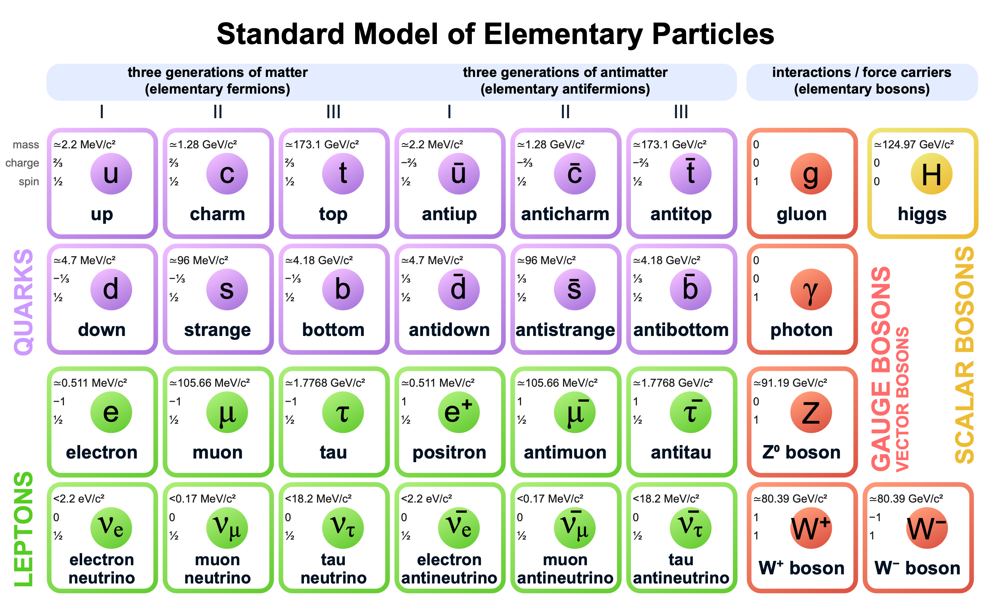
Fundamental matter in our current world view:
Standard Model
3 generations?!
Symmetric antimatter?
0
0
0
0
0
0
ν
ν
ν
ν
ν
ν

Slide 6
Neutrinos and antineutrinos in Standard Model
Charge neutral
Massless
How can we tell all 6 of them apart?
0
0
0
0
0
0
ν
ν
ν
ν
ν
ν

Slide 7
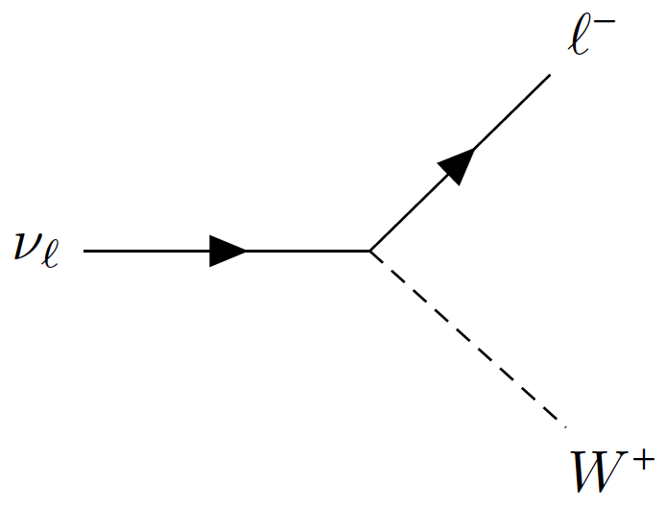

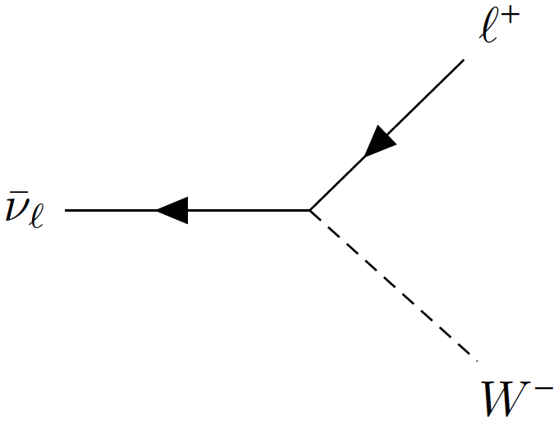
Neutrinos and antineutrinos in Standard Model
Charge neutral
Massless
How can we tell all 6 of them apart?
Flavour, defined by charged-current interactions
0
0
0
0
0
0

Slide 8
Neutrinos and antineutrinos in Nature
Charge neutral
Massless turns out to be tiny but not zero!
How can we tell all 6 of them apart? One more way (too many) to tell the neutrinos apart!
Flavour, defined by charged-current interactions

Slide 9
Neutrino Mass and Mixing
Standard Model
Beyond Standard Model
Mass “levels”
Pontecorvo–Maki–Nakagawa–Sakata
PMNS matrix
A problem only when there are more than 2 masses!
Normal / Inverted Mass Ordering (MO, Hierarchy)
Mass gap (Δm²) and mixing lead to neutrino flavour oscillations
Mark Thomson, Particle Physics lecture notes

Slide 10
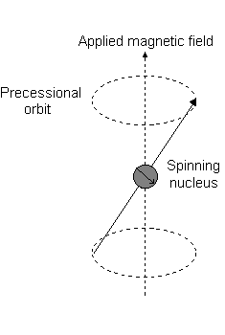

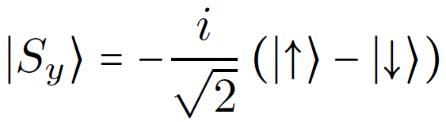
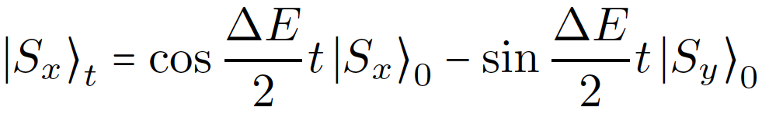
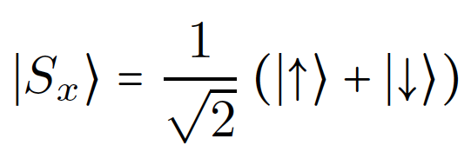
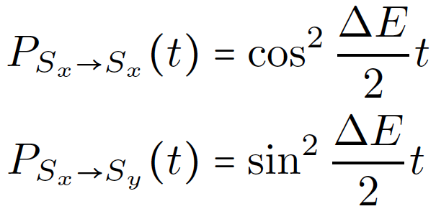
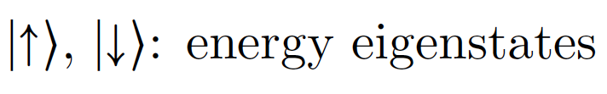
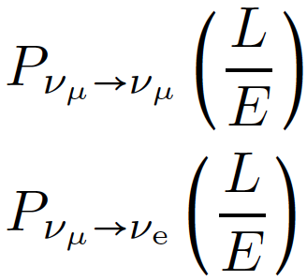
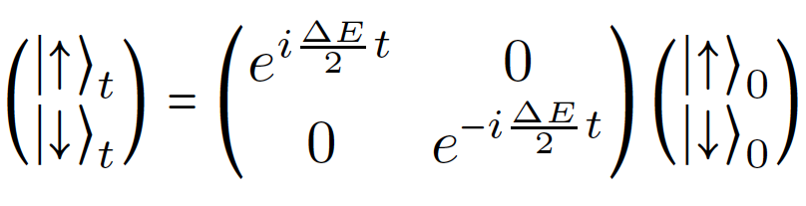
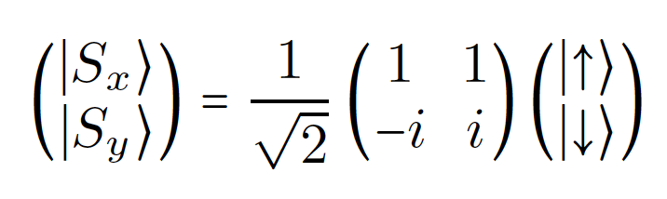
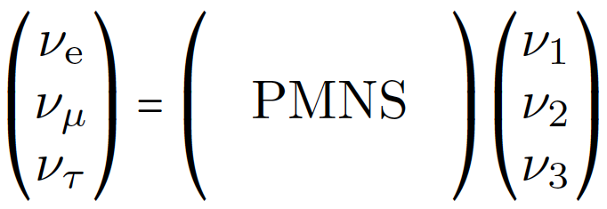

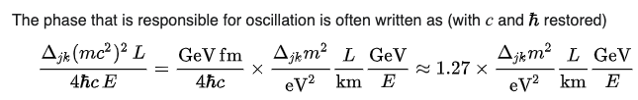

Analogy: spin rotation in a magnetic field
B$≠$0
Homework: Show that
B=0
y
ΔE
Oscillation probability
x
Image source: https://teaching.shu.ac.uk/hwb/chemistry/tutorials/molspec/nmr1.htm
Energy gap
Mixing
Survival
Appearance
Oscillation Phase: [E⁰]
  Δm²: [E²]
  L: propagation distance [E⁻¹]
  E: energy [E]
Phase ~ Δm²L/E
Wiki: https://en.wikipedia.org/wiki/Neutrino_oscillation

Slide 11
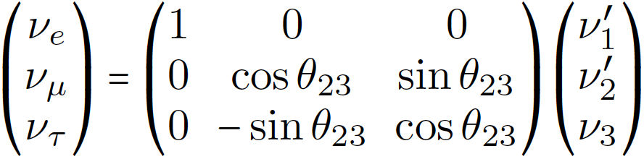
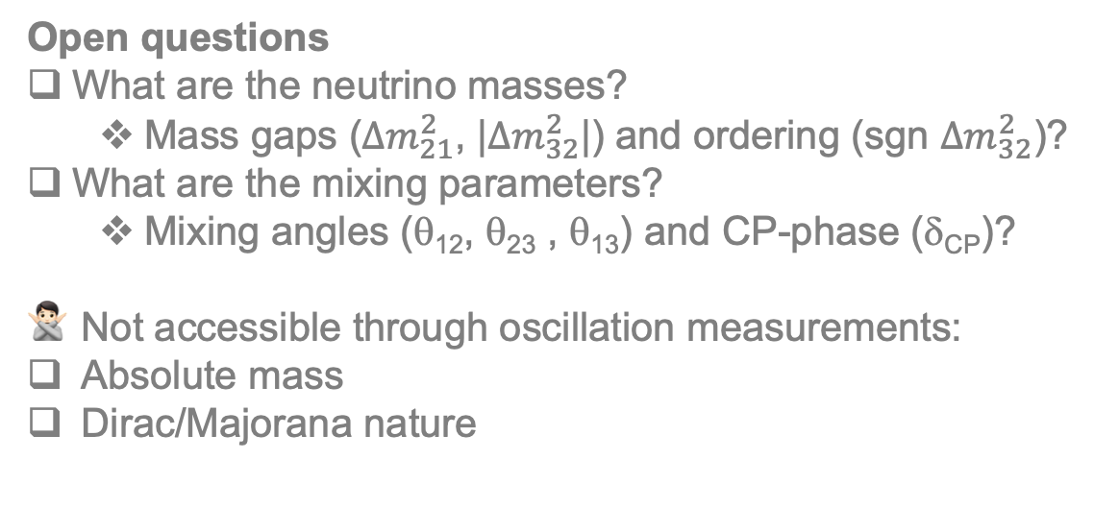
PMNS matrix
θ₁₃ ≠ 0 → δ_{CP} can be observed
Open questions
What are the neutrino masses?
  Mass gaps (${∆m}_{21}^{2}$, |${∆m}_{32}^{2}$|) and ordering (sgn ${∆m}_{32}^{2}$)?
What are the mixing parameters?
  Mixing angles (θ₁₂, θ₂₃ , θ₁₃) and CP-phase (δ_{CP})?
Not accessible through oscillation measurements:
Absolute mass
Dirac/Majorana nature
θ₁₂: mixing between ν₁ and ν₂
θ₂₃: mixing between ν_{μ} and ν_{τ}
θ₁₃: if 0, effective 2 flavour mixing

Slide 12






θ₁₃ = 0
Antineutrinos
2-flavor oscillation
$$νβ$$
$$\overline{ν}β$$
$$P(να)+P(νβ)=1$$
$$P(\overline{ν}α)+P(\overline{ν}β)=1$$
v_{μ}
$$να$$
$$\overline{ν}α$$
Oscillation as a function of time
line-in-line → same trivia

Slide 13








θ₁₃ ≠ 0
Antineutrinos
3-flavor oscillation
$$ντ$$
$$\overline{ν}τ$$
$$P(νe)+P(νμ)+P(ντ)=1$$
$$P(\overline{ν}e)+P(\overline{ν}μ)+P(\overline{ν}τ)=1$$
v_{μ}
$$νμ$$
$$\overline{ν}μ$$
$$νe$$
$$\overline{ν}e$$
Oscillation as a function of time
line-in-plane → CP-violation possible

Slide 14
PMNS
Trimaximal mixing
— maximally CP-violating

Slide 15
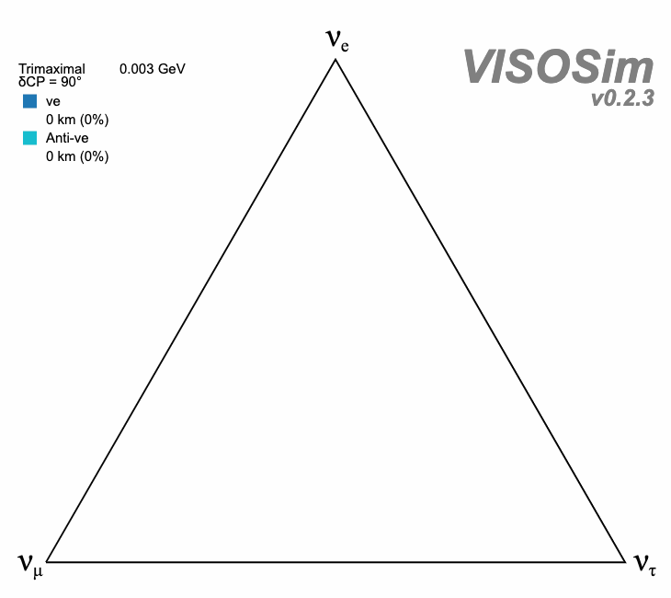
PMNS
Trimaximal mixing
— maximally CP-violating
☛ VISOS
Beautiful but not how Nature works ¯\_(ツ)_/¯

Slide 16
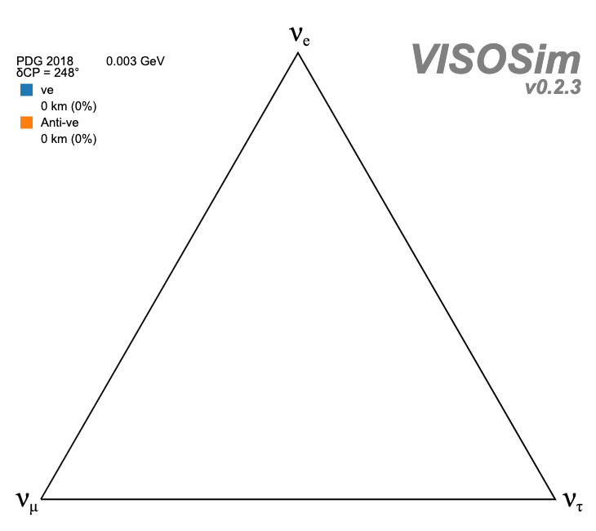
How Nature might work:
Quiz: Which experiment has a 50 km baseline observing few-MeV neutrinos?
☛ VISOS

Slide 17
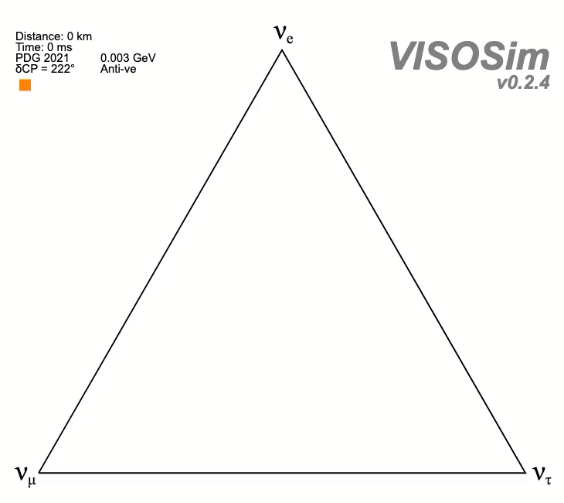
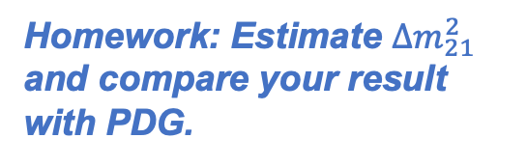
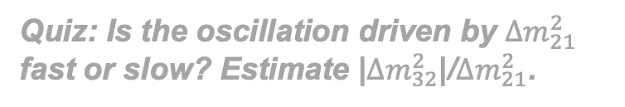
How Nature might work:
Quiz: Which experiment has a 50 km baseline observing few-MeV neutrinos?
Quiz: Is the oscillation driven by ${∆m}_{21}^{2}$ fast or slow? Estimate |${∆m}_{32}^{2}$|/${∆m}_{21}^{2}$.
3
2
1
Homework: Estimate ${∆m}_{21}^{2}$ and compare your result with PDG.
2
☛ VISOS
1
3
Normal / Inverted MO

Slide 18
…will come back to IceCube later
Summer Blot, Neutrino 2020
Oscillation Phase ~ Δm²L/E
Small Δm²
Only two Δm²
Normal
Inverted
Large Δm²
“Wasteland”
Quiz: Name a few experiments in the “wasteland”? What are they for?

Slide 19
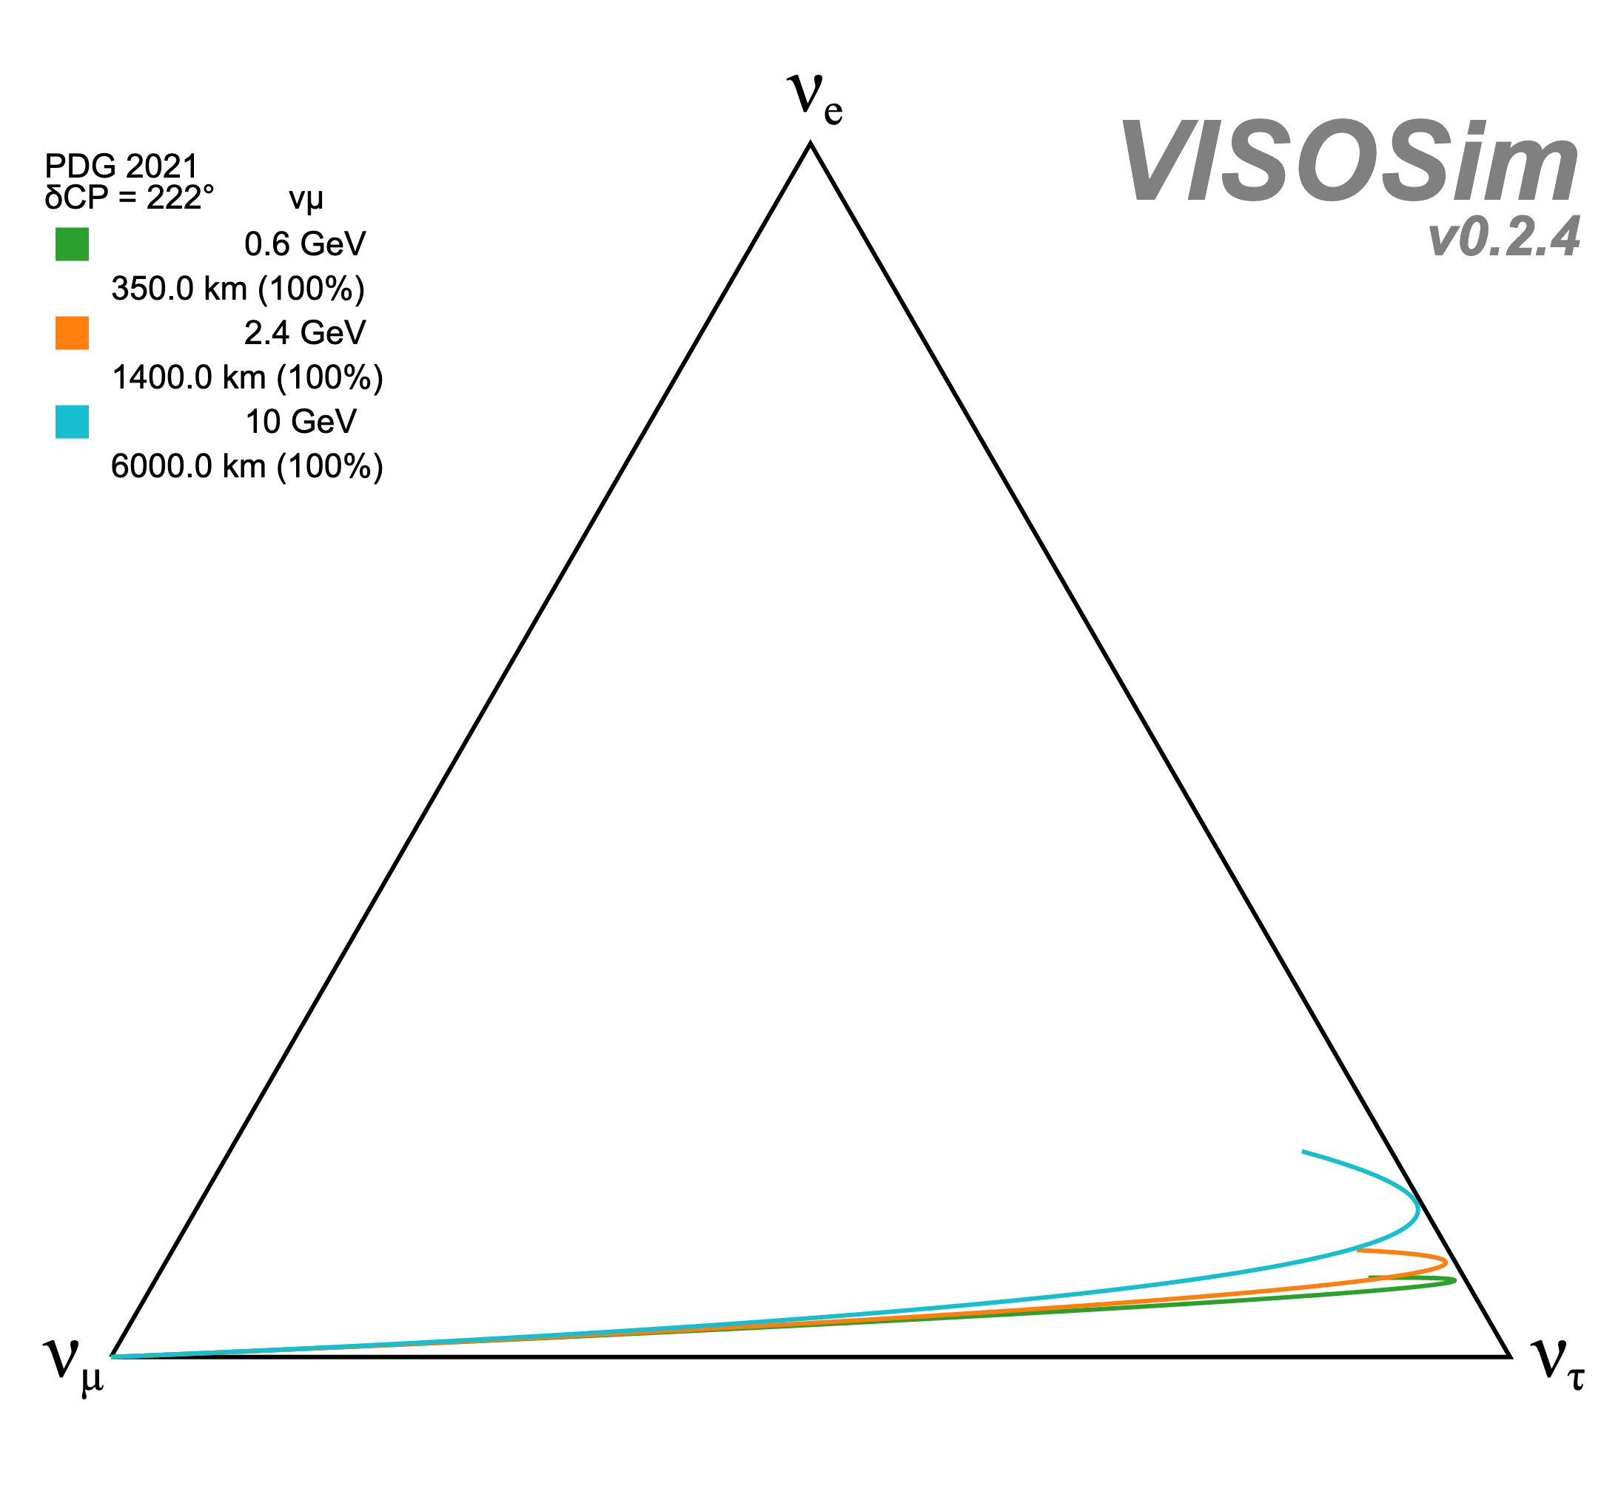
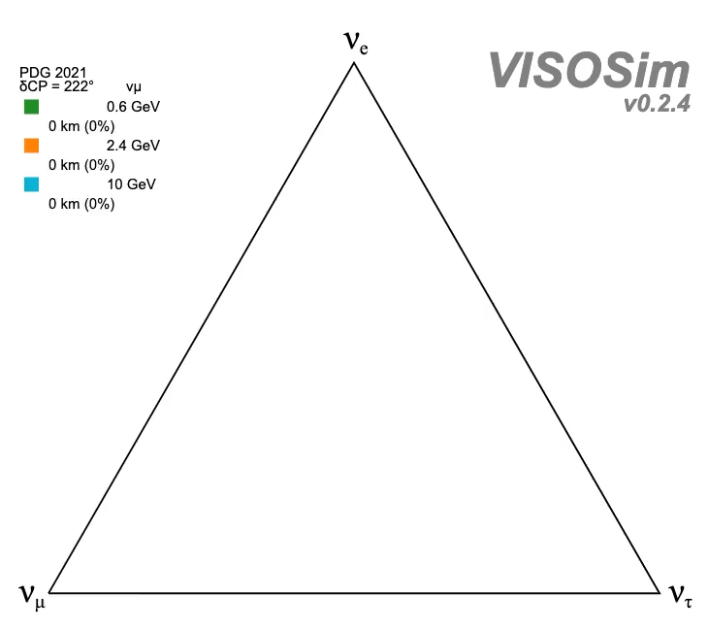

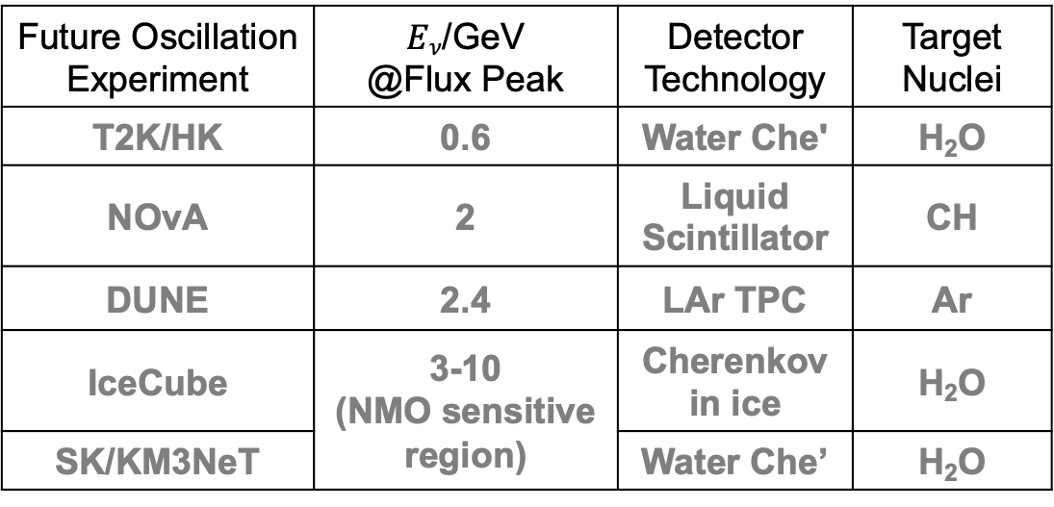


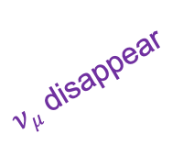
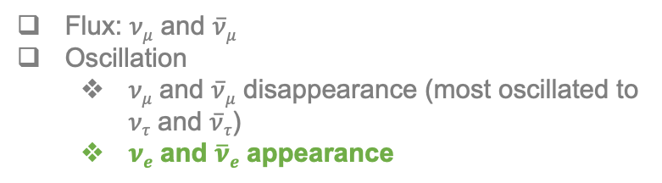
Oscillation experiments
Flux: $νμ$ and $\overline{ν}μ$
Oscillation
  $νμ$ and $\overline{ν}μ$ disappearance (most oscillated to $ντ$ and $\overline{ν}τ$)
  $νe$ and $\overline{ν}e$ appearance
Future Oscillation Experiment | $Eν$/GeV @Flux Peak | Detector Technology | Target Nuclei
T2K/HK | 0.6 | Water Che' | H₂O
NOvA | 2 | Liquid Scintillator | CH
DUNE | 2.4 | LAr TPC | Ar
IceCube | 3-10 (NMO sensitive region) | Cherenkov in ice | H₂O
SK/KM3NeT |  | Water Che’ | H₂O
Signal = (Flux $∙$ Oscillation probability $∙$ Cross section) $⨁$ Detector effects
… to discuss tomorrow
$νμ$ disappear
$νe$ appear
Quiz: Is it driven by ${∆m}_{21}^{2}$ or ${∆m}_{32}^{2}$?
$νμ$ flux
☛ VISOS

Slide 20
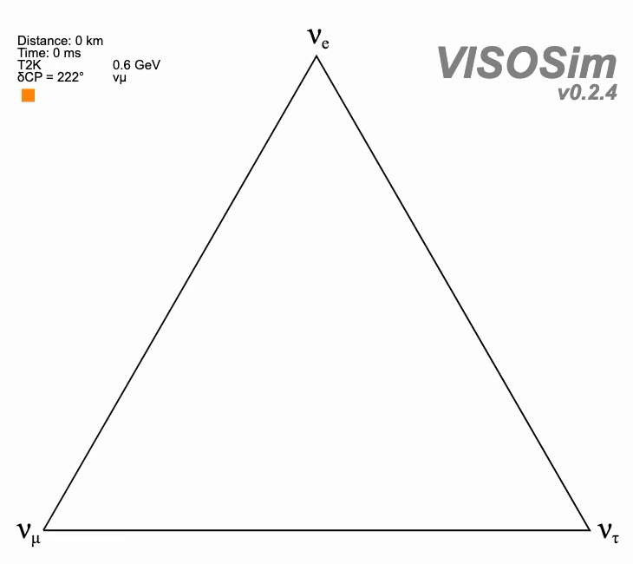
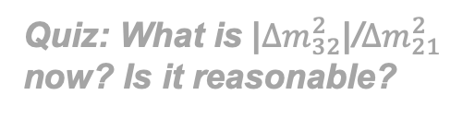
Oscillation experiments
Quiz: What is |${∆m}_{32}^{2}$|/${∆m}_{21}^{2}$ now? Is it reasonable?

Slide 21
Part 2: Accelerator Neutrinos

Slide 22
Accelerator Neutrinos
How to obtain a controlled sample of neutrinos?
Let’s start from π decays

Slide 23
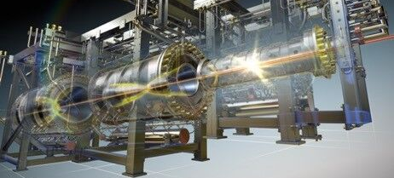
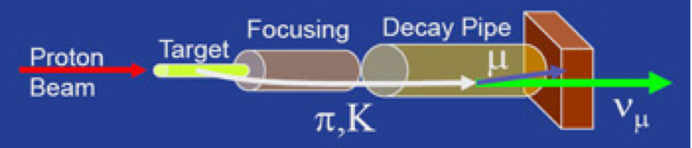
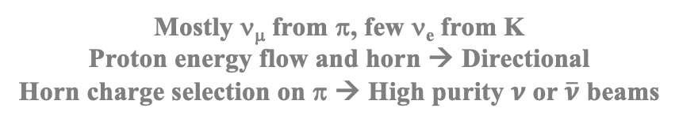
Accelerator Neutrinos
Magnetic “Horn"
https://j-parc.jp/c/en/press-release/2024/01/17001274.html
LBNF
Mostly ν_{μ} from π, few ν_{e} from K
Proton energy flow and horn → Directional
Horn charge selection on π → High purity $ν$ or $\overline{ν}$ beams

Slide 24

Accelerator Neutrinos
Detector (on axis)
LBNF
Mostly ν_{μ} from π, few ν_{e} from K
Proton energy flow and horn → Directional
Horn charge selection on π → High purity $ν$ or $\overline{ν}$ beams

Slide 25
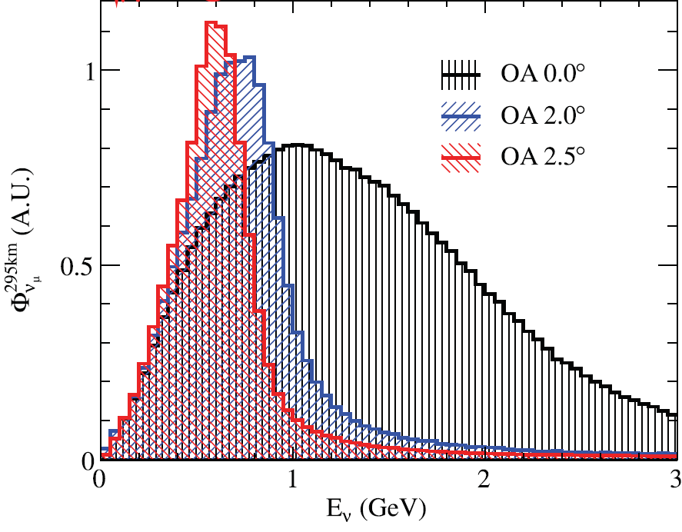
Accelerator Neutrinos
→ Narrow-band beams
Off-axis (OA) technique
D. Beavis, et al., P889: long baseline neutrino oscillation experiment at the AGS, Report No. BNL-52459, April, 1995
Proton beam axis
Off-axis angle
LBNF
Mostly ν_{μ} from π, few ν_{e} from K
Proton energy flow and horn → Directional
Horn charge selection on π → High purity $ν$ or $\overline{ν}$ beams
Detector (off axis)
T2K, Phys. Rev. D 87, 012001 (2013)
“Flux”

Slide 26
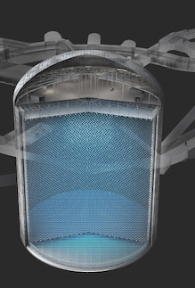
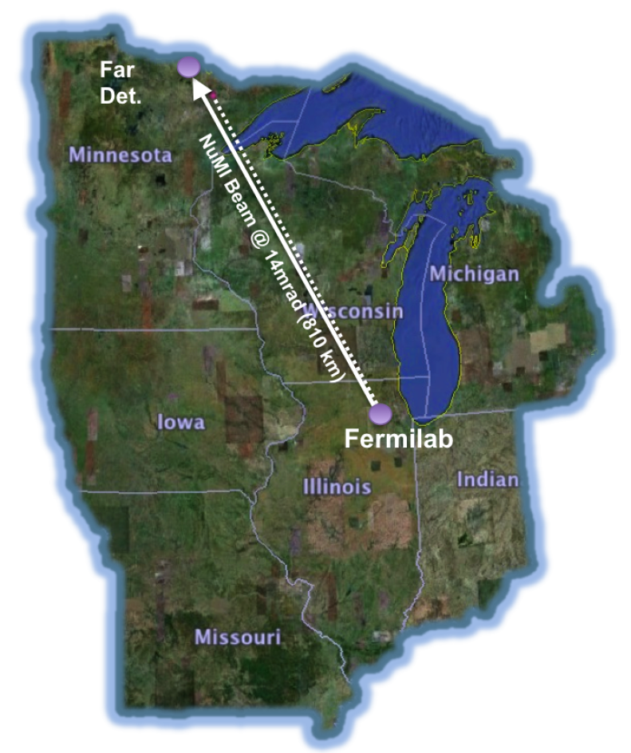
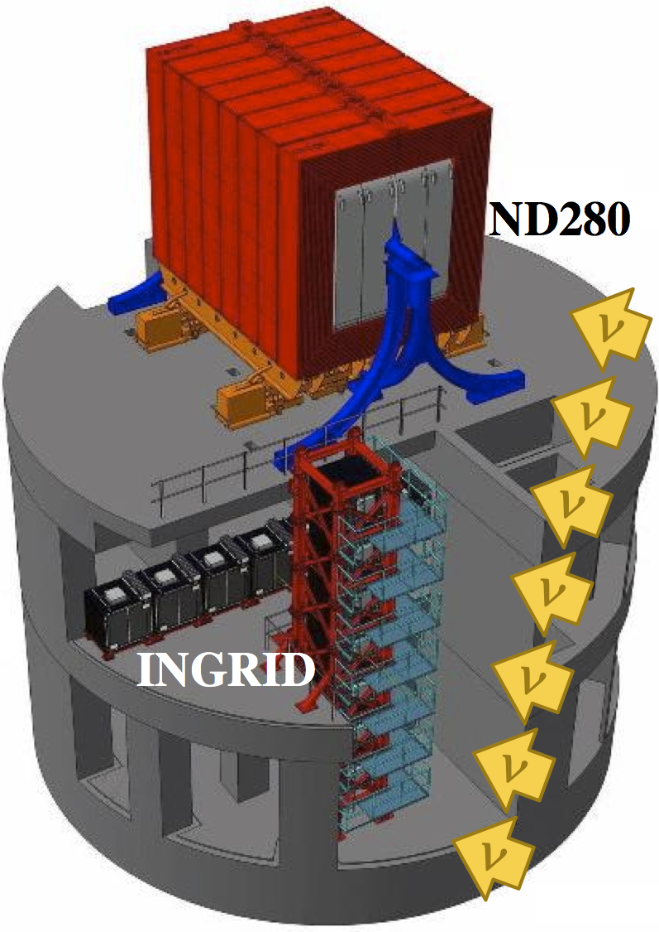
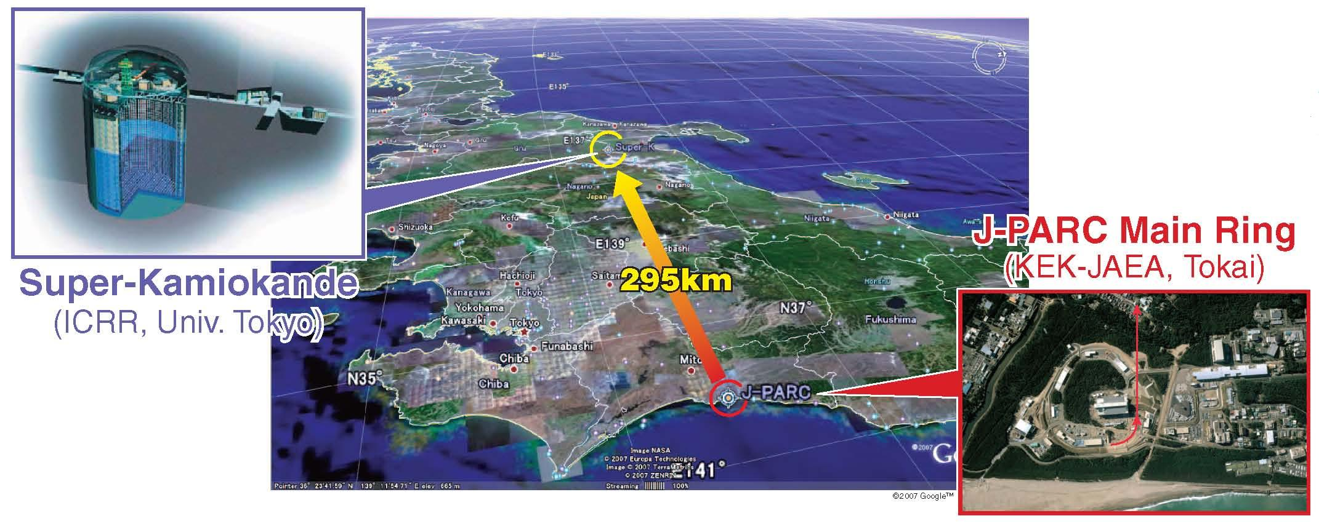
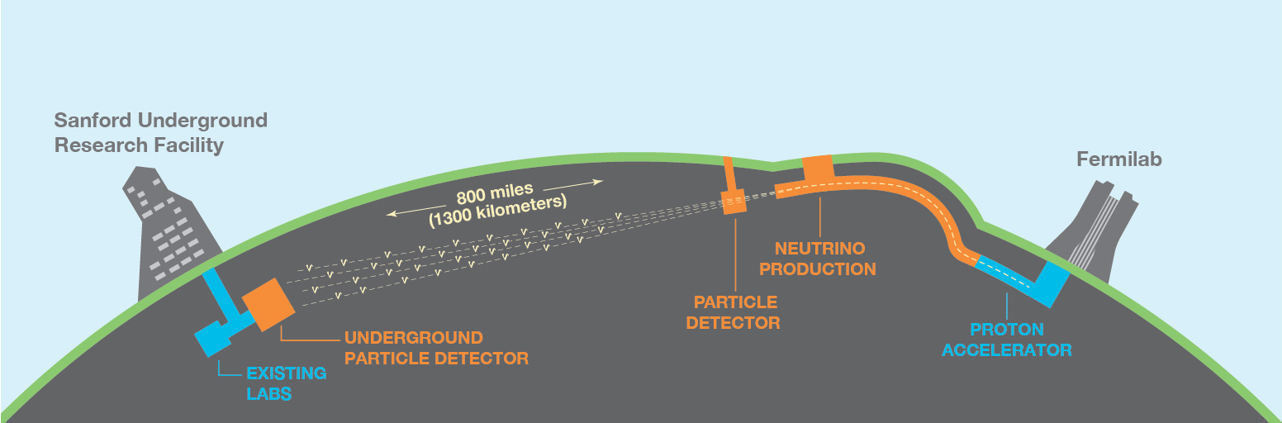
Accelerator Neutrino Experiments
https://www-sk.icrr.u-tokyo.ac.jp/en/hk/about/outline/
T2K
/ Hyper-K
NOvA
T2K
NOvA
ν beams via hadron decay
DUNE
DUNE

Slide 27
Accelerator Neutrino Experiments
https://www-sk.icrr.u-tokyo.ac.jp/en/hk/about/outline/
T2K
/ Hyper-K
NOvA
T2K
NOvA
Near Detectors (NDs) to constrain ν flux and cross section together (no oscillation)
DUNE
DUNE

Slide 28
Accelerator Neutrino Experiments
https://www-sk.icrr.u-tokyo.ac.jp/en/hk/about/outline/
T2K
/ Hyper-K
NOvA
T2K
NOvA
Far Detectors to measure ν oscillation
DUNE
DUNE

Slide 29
Accelerator Neutrino Experiments
T2K
Far Detector
T2K
Will check the detectors tomorrow…
… flux and oscillation measurements today
Near Detector

Slide 30
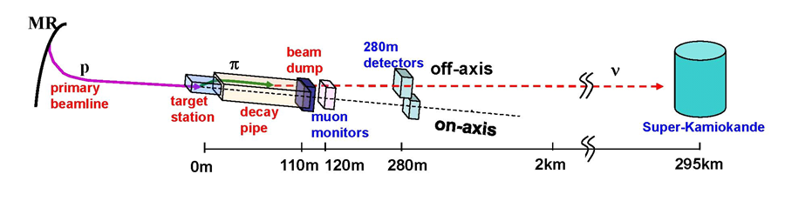
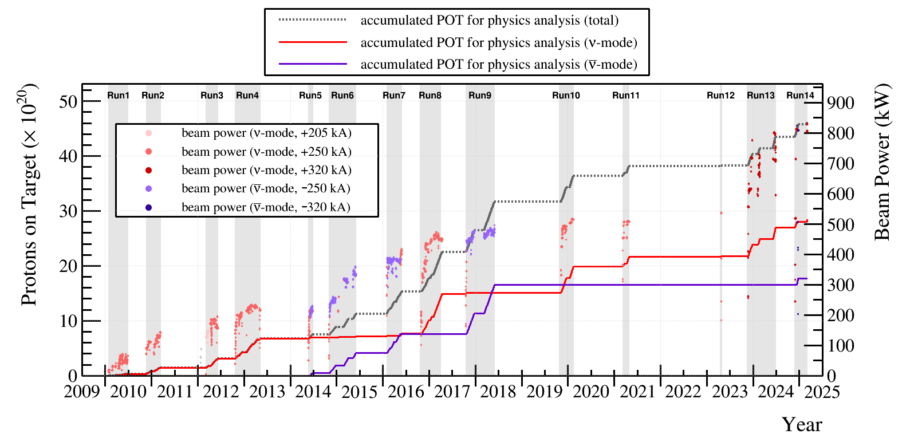
T2K Beams
30 GeV
(OA)
1.3 MW power near the beginning of the Hyper-Kamiokande data taking [HK, 2505.15019]
T2K, 21st Rencontres du Vietnam, Neutrino Physics, 07/2025
T2K, Eur.Phys.J.C 83, 9, 782 (2023)
Latest analysis (07/25)

Slide 31
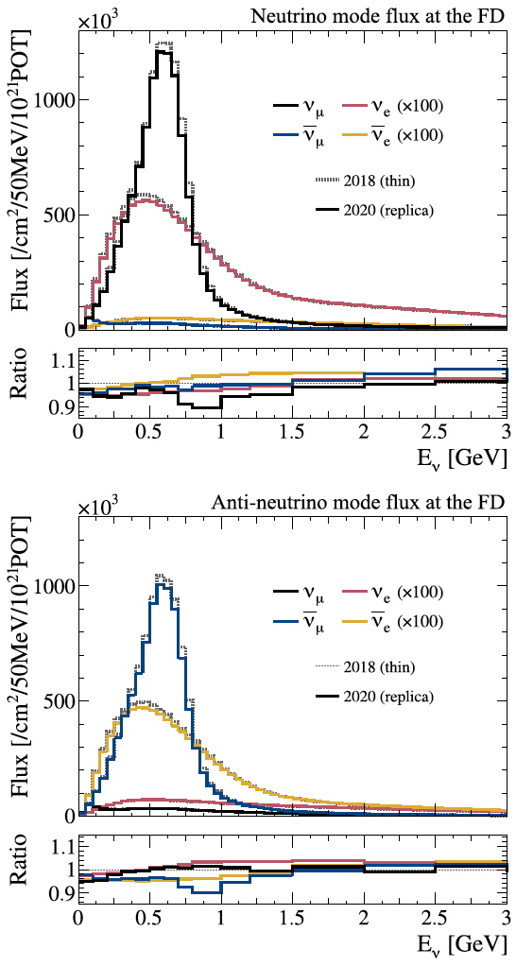
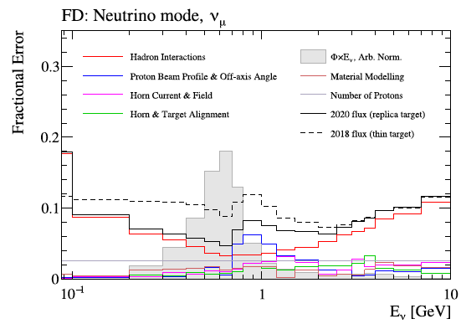


T2K Beams
T2K, Eur.Phys.J.C 83, 9, 782 (2023)
For $ν$ oscillations
Flux model error 5%+
Extremely hard to get it further down
Bkg from 3 other types
… more on this later
For $\overline{ν}$ oscillations
LBNF
No control over neutrino parents (π, K) after focusing. Everything relies on the horn.
… more on this later

Slide 32
Accelerator Neutrino Experiments
T2K
Far Detector
T2K
Near Detector

Slide 33
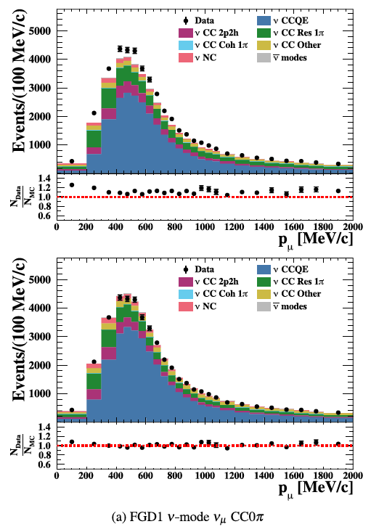
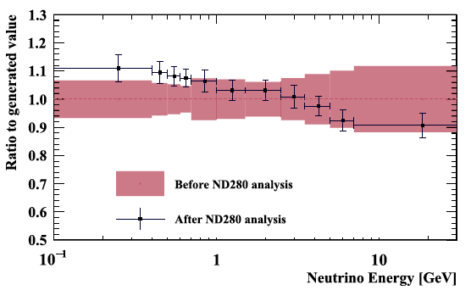
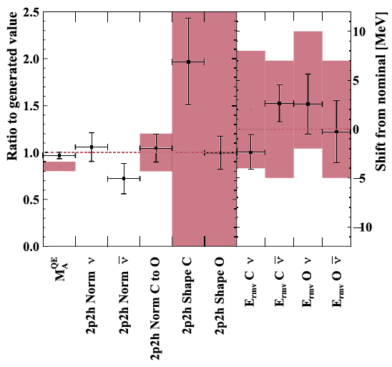
T2K Near Detector (ND) Fits
T2K, Eur.Phys.J.C 83, 9, 782 (2023)
Signal = (Flux $∙$ Oscillation probability $∙$ Cross section) $⨁$ Detector effects
Before ND fits
Flux prediction (mean and spread) improved after ND fits
Cross section models now have constraints or are better constrained after ND fits
After ND fits

Slide 34
Accelerator Neutrino Experiments
T2K
Far Detector
T2K
Near Detector

Slide 35
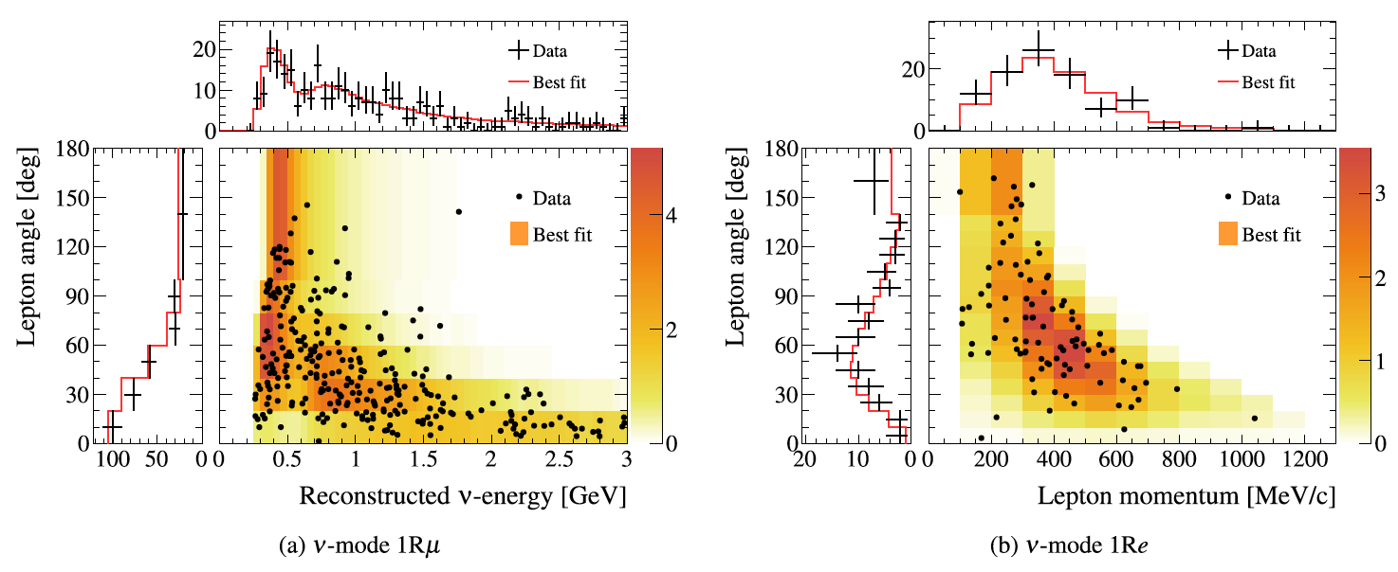
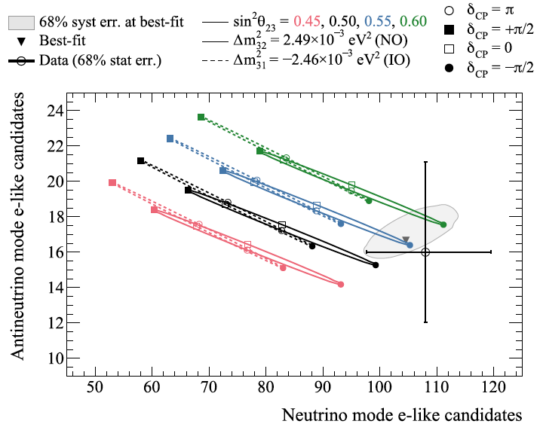
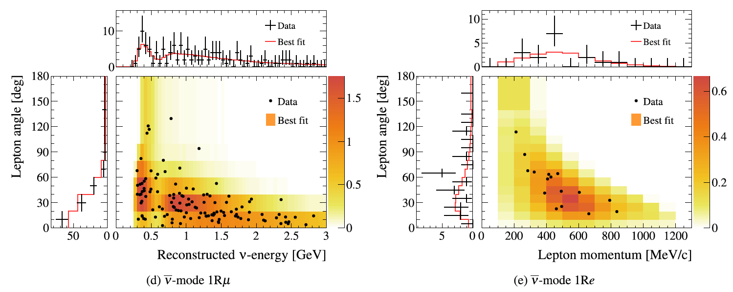
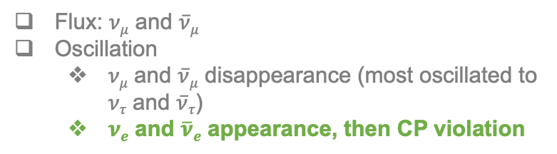
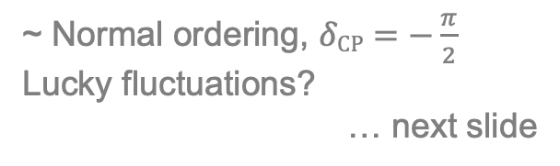
T2K Far Detector Events
T2K, Eur.Phys.J.C 83, 9, 782 (2023)
Flux: $νμ$ and $\overline{ν}μ$
Oscillation
  $νμ$ and $\overline{ν}μ$ disappearance (most oscillated to $ντ$ and $\overline{ν}τ$)
  $νe$ and $\overline{ν}e$ appearance, then CP violation
~ Normal ordering, $δCP=−\frac{π}{2}$
Lucky fluctuations?
… next slide

Slide 36
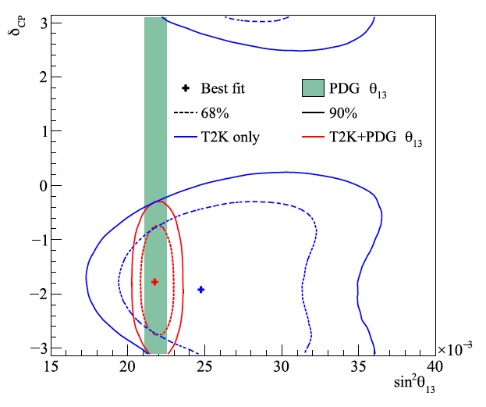


T2K Oscillation Parameter Results
T2K, Eur.Phys.J.C 83, 9, 782 (2023)
$θ_{13}$ relies on $ν_{e}$ appearance, statistically very limited
Need reactor constraints
Similar $δCP$ intervals for both MO
What happens if Nature gives us different event rates here
Need external constraints on MO
… will come to this later

Slide 37




One slide about NOvA
NOvA, 21st Rencontres du Vietnam, Neutrino Physics, 07/2025
NOvA, Phys.Rev.D 106, 032004 (2022)
Not knowing NMO makes it very difficult to determine $δCP$
Already difficult even if NMO known

Slide 38


Coming back to the flux background…
T2K flux
T2K, Phys.Rev.Lett. 116, 181801 (2016)
Maximise $νμ$ and $\overline{ν}μ$ flux

Slide 39

Coming back to the flux background…
T2K flux
T2K, Phys.Rev.Lett. 116, 181801 (2016)
Maximise $νμ$ and $\overline{ν}μ$ flux
Minimise $νe$ and $\overline{ν}e$ to observe appearance
  $νe$ and $\overline{ν}e$ flux are background

Slide 40





Call for a GeV $ν$_{e} and $\overline{ν}$_{e} Machine
$νe$ ($\overline{ν}e$) cross sections: major $δCP$ systematics
Very few $νe$ scattering data
$δCP$ ~ $νe$ appearance ~ no $νe$ in beams
  No in situ $νe$ measurements
$νμ$ for $νe$ via lepton universality, but higher precision needed for $δCP$
Hyper-K example
Improving error of $νe$/$\overline{ν}e$ xsec ratio 4.9% → 2.7%
Improve $δCP$ sensitivity by ~ 1 σ for 6 year
Significantly shorten running time to reach 5σ
HK, 2505.15019
Wishlist
  $νe$ and $\overline{ν}e$ beams with the relevant energy for appearance
  Well-understood fluxes
  High statistics
  Low $νμ$ background

Slide 41




$ν$ from STORed Muons (nuSTORM)
Coming back to the beam control…
LBNF
nuSTORM, arXiv:2203.07545
π captured by storage ring → μ → ν, instead of decay pipe → ν
$\overline{ν}μ\text{+}νe$and $νμ$+$\overline{ν}e$ fluxes from $μ^{±}$ decays
  Storage ring: tunable fluxes
  μ decay: perfect understanding of flux shape and normalisation

Slide 42
Part 3: Atmospheric Neutrinos

Slide 43





More on Neutrino Mass: MSW Matter Effect
Before getting into atmospheric ν …
Bethe, Phys.Rev.Lett. 56, 1305 (1986)
Level crossing
Homework: Write down the Feynman diagrams of $ν_{e}$ and ${\overline{ν}}_{e}$ CC interactions with electrons.

Slide 44



More on Neutrino Mass: MSW Matter Effect
Bethe, Phys.Rev.Lett. 56, 1305 (1986)
Quiz: Is there oscillation when the mixing angle is π/2?

Slide 45

More on Neutrino Mass: MSW Matter Effect
e.g. Giunti & Kim (2007)
… will come back to this later
Homework: Recover the previous no-mixing and small gap cases with the general effective mass gap and mixing angle.

Slide 46
Oscillation experiments
Flux: $νμ$ and $\overline{ν}μ$
Oscillation
  $νμ$ and $\overline{ν}μ$ disappearance (most oscillated to $ντ$ and $\overline{ν}τ$)
  $νe$ and $\overline{ν}e$ appearance
Future Oscillation Experiment | $Eν$/GeV @Flux Peak | Detector Technology | Target Nuclei
T2K/HK | 0.6 | Water Che' | H₂O
NOvA | 2 | Liquid Scintillator | CH
DUNE | 2.4 | LAr TPC | Ar
IceCube | 3-10 (NMO sensitive region) | Cherenkov in ice | H₂O
SK/KM3NeT |  | Water Che’ | H₂O
Signal = (Flux $∙$ Oscillation probability $∙$ Cross section) $⨁$ Detector effects
… to discuss tomorrow
$νμ$ disappear
$νe$ appear
$νμ$ flux
☛ VISOS

Slide 47
Atmospheric Neutrinos
Flux: $νμ$ and $\overline{ν}μ$
Oscillation
  $νμ$ and $\overline{ν}μ$ disappearance (most oscillated to $ντ$ and $\overline{ν}τ$)
  $νe$ and $\overline{ν}e$ appearance
Smaller contributor: smaller flux, smaller disappearance prob.
$νμ$ disappear
$νe$ appear
Kajita, Nobel Lecture
☛ VISOS

Slide 48




Atmospheric Neutrinos
Flux: $νμ$ and $\overline{ν}μ$
Oscillation
  $νμ$ and $\overline{ν}μ$ disappearance (most oscillated to $ντ$ and $\overline{ν}τ$)
  $νe$ and $\overline{ν}e$ appearance
Smaller contributor: smaller flux, smaller disappearance prob.
Figure courtesy: Z.-O. He, Warwick
Naïve expectation
Quiz: What causes
to fail?
Kajita, Nobel Lecture

Slide 49
Atmospheric Neutrinos
Fully uncontrolled
Flux: $νμ$ and $\overline{ν}μ$
Oscillation
  $νμ$ and $\overline{ν}μ$ disappearance (most oscillated to $ντ$ and $\overline{ν}τ$)
  $νe$ and $\overline{ν}e$ appearance
p
π⁺
ν_{μ}
Kajita, Nobel Lecture

Slide 50




p
Atmospheric Neutrinos
Fully uncontrolled
Flux: $νμ$ and $\overline{ν}μ$
Oscillation
  $νμ$ and $\overline{ν}μ$ disappearance (most oscillated to $ντ$ and $\overline{ν}τ$)
  $νe$ and $\overline{ν}e$ appearance
π⁺
LBNF
ν_{μ}
T2K p-beam 30 GeV
Gaisser and Stanev, Nucl.Phys.A 777, 98 (2006)
Gaisser, astro-ph/0501195
Favier et al., Phys.Rev.D 68, 093006 (2003)
Cosmic rays: p + others
Not monoenergetic
inhomogeneous target, non-localised production

Slide 51

Slide by Kajita, NPB 2024

Slide 52

Atmospheric Neutrinos
Kajita, Nobel Lecture
SK, Phys.Rev.Lett. 81, 1562 (1998)
No oscillations
Oscillations
L-dependence: zenith angle variation
Many systematics cancelled in up-down asymmetry

Slide 53




Geomagnetic effect
Honda et al., Phys.Rev.D 92, 023004 (2015)
JUNO
Remember the “Horn”?
No geomagnetic field
Geomagnetic field
Cook, PhD thesis, Oxford, 2022
B (G) | Down (local sky) | Up (over much larger sky region)
SK | 0.30 | -
JUNO | 0.38 | -
Intrinsic up-down flux asymmetry can mimic oscillation
  Local B in flux calculation is crucial
  Worse at low energy
Figure courtesy:
Z.-O. He, Warwick

Slide 54

SK, PTEP 053F01 (2019)
SK flux error in a typical oscillation analysis

Slide 55

SK Measurement of Atmospheric Neutrino Fluxes
SK, Phys.Rev.D 94, 052001 (2016)
Coming back to IceCube…
SK: low energy
IceCube (DeepCore): high energy

Slide 56

Introducing IceCube
Slide courtesy: Donglian Xu

Slide 57







SK NMO Measurement with Atmospheric Neutrinos
Coming back to the MSW resonance…
θ
Vacuum
ν
Figure courtesy:
Z.-O. He, Warwick
Matter effect seen as probability distortion
Effective mixing and mass gap in matter
3
2
e.g. SK, PTEP 053F01 (2019)
1
Small θ₁₃, MSW resonance at
A_{CC} $≈$ Δm²₃₂
NO: A_{CC} >0, resonance with $ν$
IO: A_{CC} <0, resonance with $\overline{ν}$
2
1
3
Normal / Inverted MO
SK, Phys.Rev.D 109, 072014 (2024)

Slide 58





SK NMO Measurement with Atmospheric Neutrinos
SK, Phys.Rev.D 109, 072014 (2024)
with sin²θ₁₃ constrained
with sin²θ₁₃ constrained
= 0.077, rejecting IO at 92.3% (~ 1.4σ)
Posiadala-Zezula, NEUTRINO 2024
with sin²θ₁₃ constrained

Slide 59


T2K+SK Joint Analysis
T2K, Eur.Phys.J.C 83, 9, 782 (2023)
Coming back to NMO constraints…
SK & T2K, Phys.Rev.Lett. 134, 011801 (2025)
Sensitivity
Data results

Slide 60



IceCube DeepCore Atmospheric Oscillation Measurement
IceCube, Phys.Rev.Lett. 134, 091801 (2025)
Quiz: What are cascade-like events?
Cascade-like
IceCube, Phys.Rev.Lett. 134, 091801 (2025)
Track- and
cascade-like
Competitive with other experiments!
Huge statistics: km³-scale detector → far more multi-GeV
Best L/E coverage: optimised for 5–50 GeV range
Lower flux uncertainty: multi-GeV flux is better modelled
Cross section uncertainty: multi-GeV xsec dominated by DIS
In-situ flux calibration: high-energy unoscillated sample
Track-like
But not for NMO:
Miss the MSW resonance at lower energy
PINGU (or ORCA) will lower the energy threshold
  But then all the low-energy systematics (flux, xsec) are like SK—no way around for NMO
  One can play with stat. and detector technology.
42-72 m horizontal spacing
IceCube, Phys.Rev.D 108, 012014 (2023)
Larger E
Larger L
10k km/10 GeV

Slide 61



$ν_{τ}$ Appearance with Atmospheric Neutrinos
Completing the 3-flavour oscillation picture
Negligible $ν_{τ}$ at production
Quiz: Is there matter effect in $ν_{μ}→ν_{τ}$?
$ν_{τ}$ appear
$νμ$ disappear
$νe$ appear
☛ VISOS

Slide 62










Measurements of $ν_{τ}$ Appearance
IceCube, Phys.Rev.D 99 (2019) 3, 032007
SK, Phys.Rev.D 98, 052006 (2018)
SK 4.6σ
$$ν_{τ}$$
IceCube-DeepCore 3.2σ
$$ν_{τ}$$
SK, Phys.Rev.D 98, 052006 (2018)
Expected appearance from both $νμ$ and $νe$ fluxes

Slide 63

Accelerator and Atmospheric Neutrinos
Neutrino mass gap and mixing → oscillation
Three masses → NMO
Three-flavor mixing → δ_{CP}
Neutrino Oscillations
  Visualisation: spin rotation analogy, VISOSim
Accelerator Neutrinos
  Techniques: hadron decay beams, near-far measurements
  Key results: T2K and NOvA → δ_{CP} precision needs NMO constraints
  Future vision: nuSTORM (maybe!)—futuristic, unique $ν_{e}$ and ${\overline{υ}}_{e}$ machine
Atmospheric Neutrinos
  MSW matter effect: start with no mixing / no gap cases
  Flux: systematics
  Key results: SK and IceCube → NMO determination still pending

Slide 64

A Short Demo for VISOSim

Slide 65

Quiz
Which experiment has a 50 km baseline observing few-MeV neutrinos?
Is the oscillation driven by ${∆m}_{21}^{2}$ fast or slow? Estimate |${∆m}_{32}^{2}$|/${∆m}_{21}^{2}$.
Name a few experiments in the “wasteland”? What are they for?
Is it driven by ${∆m}_{21}^{2}$ or ${∆m}_{32}^{2}$? (What is |${∆m}_{32}^{2}$|/${∆m}_{21}^{2}$ now? Is it reasonable?)
Is there oscillation when the mixing angle is π/2?
What causes to fail?
What are cascade-like events?
Is there matter effect in $ν_{μ}→ν_{τ}$?

Slide 66

Homework
Show that
Estimate ${∆m}_{21}^{2}$ and compare your result with PDG.
Write down the Feynman diagrams of $ν_{e}$ and ${\overline{ν}}_{e}$ CC interactions with electrons.
Recover the previous no-mixing and small gap cases with the general effective mass gap and mixing angle.

Slide 67
BACKUP

Slide 68


e.g. Boyd, Warwick Week 2025 lecture

Slide 69


$ν$ from STORed Muons (nuSTORM)
1st ν beam facility & highest ever beam power based on stored muons
Fine tune neutrino fluxes via $μ$ acceptance

Slide 70
$ν$ from STORed Muons (nuSTORM)
Production Straight
Return
Arc
Return
Arc
Return Straight
1st ν beam facility & highest ever beam power based on stored muons
Fine tune neutrino fluxes via $μ$ acceptance

Slide 71


$ν$ from STORed Muons (nuSTORM)
Fixed Field Alternating gradient (FFA) lattice
Improve acceptance of muon
FODO lattice
Minimise dispersion
J. Pasternak, J.B.Lagrange
Production Straight
Return
Arc
Return
Arc
Return Straight
1st ν beam facility & highest ever beam power based on stored muons
Fine tune neutrino fluxes via $μ$ acceptance
Production Straight (example w/ $π^{+}$ injection)
  $ν_{μ}$ flux from $π^{+}→{μ^{+}ν}_{μ}$ (“pion flash”)
  $ν_{e}$+ ${\overline{ν}}_{μ}$ flux from $μ^{+}→e^{+}ν_{e}{\overline{ν}}_{μ}$
  Maximise $μ$ capture efficiency
Return Arcs and Straight
  p_{μ} tunable between 1 and 6 GeV/c, spread ±16%

Slide 72


A Brief History of nuSTORM
CERN-PBC-REPORT-2019-003
DOI:10.17181/CERN.FQTB.O8QN
2012-13 LoI and Proposal to FNAL PAC [arXiv:1206.0294, arXiv:1308.6822], EoI to CERN [arXiv:1305.1419]
      Sterile neutrinos
      Neutrino-nucleus scattering
      Technology test bed for muon accelerators
2014 Steriles sensitivity [Phys.Rev.D 89, 071301 (2014)]
      nuSTORM at FNAL
2019 Feasibility of nuSTORM at CERN [CERN-PBC-REPORT-2019-003]
      SPS 100 GeV proton beam
      Optimised for neutrino-nucleus scattering, maintaining sensitivity to BSM (steriles + non-unitarity, NSI, Lorentz-invariance/CPT violation)
2022 Snowmass 2021 [arXiv:2203.07545]
      Advocating synergy with ENUBET and Muon Collider Demonstrator
        Muon Collider demonstrator
          6-D cooling
        nuSTORM as test bed for muon storage ring
          Complete implementation for large acceptance
          R&D for very precise determination of stored-muon energy and spread
2025 On-going: European Strategy Update for Particle Physics
      Submission: https://indico.cern.ch/event/1439855/abstracts/191113/
Why do we need nuSTORM?
What other physics can we do with it?

