Slide 1


TKI, TKI+, and TKI-
– 10 Years of Transverse Kinematic Imbalance with Personal Recollections
LU Xianguo 卢显国
University of Warwick
NuWro Workshop
2026 September 16, Wrocław

Slide 2
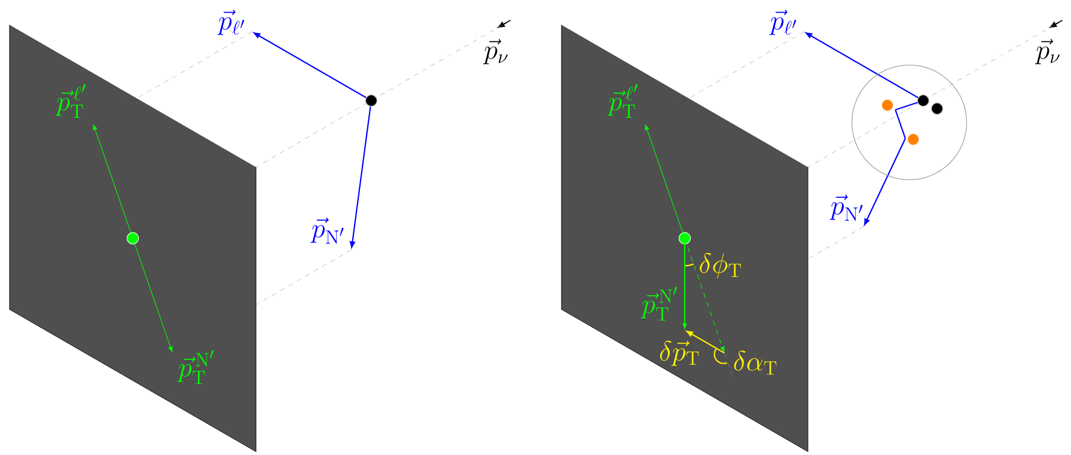
Transverse Kinematic Imbalance (TKI)
No nuclear effect
Complicated nuclear effects

Slide 3
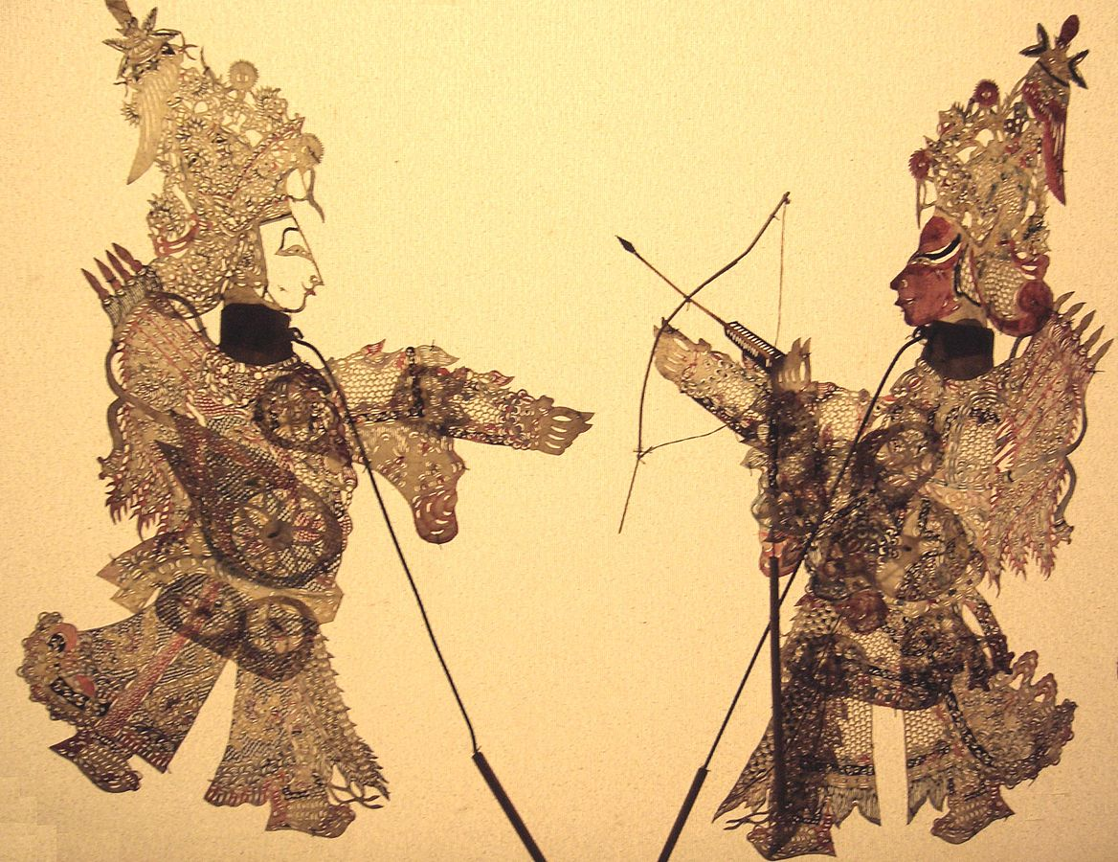
Wiki 皮影戏 (Shadow Play)

Slide 4
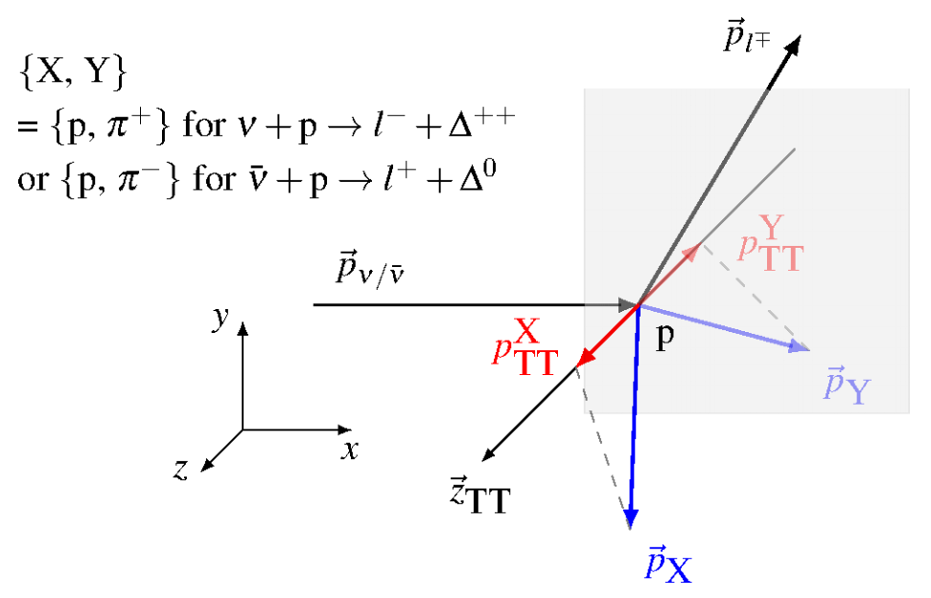
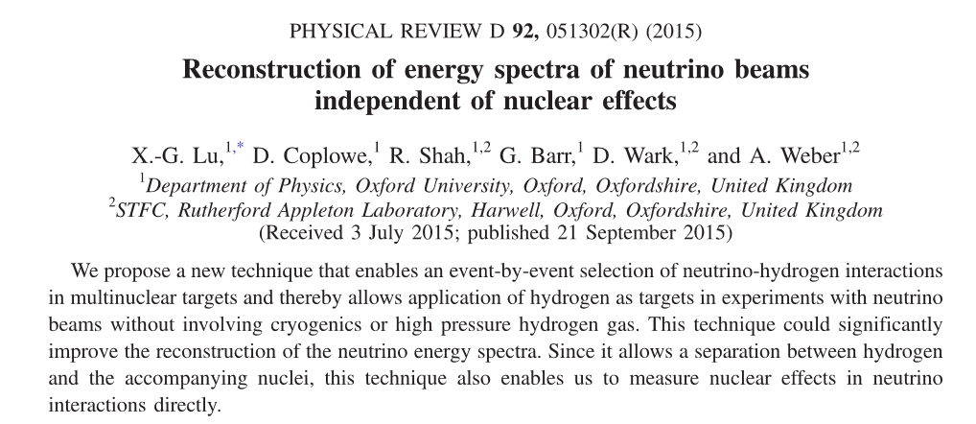

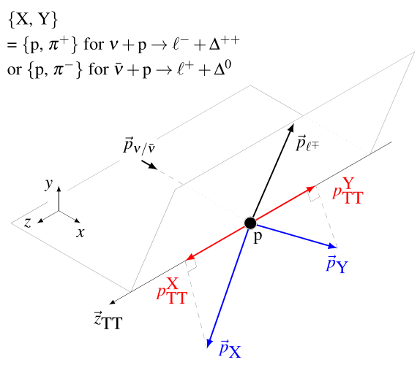
Double-TKI
XL, JPS Conf.Proc. 12, 010034 (2016)

Slide 5
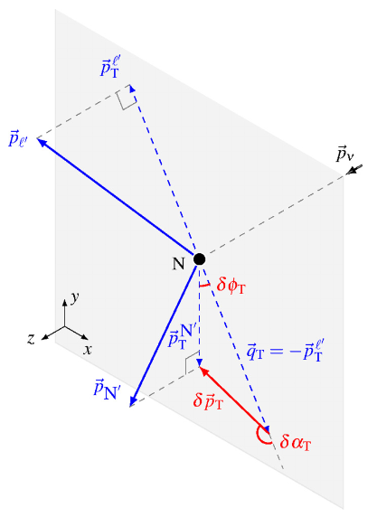
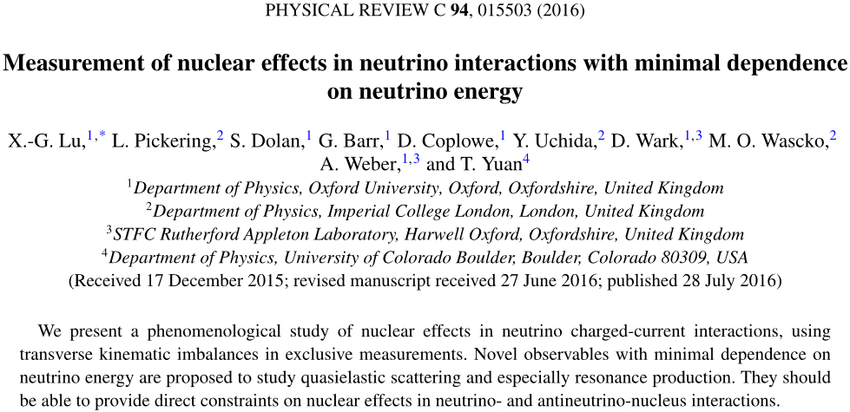
Single-TKI

Slide 6
Every good story has its twists and turns.
So, how did it start?
A huge thanks to Gmail (not Outlook!) which makes this archology possible.

Slide 7
Single-TKI: δp_{T} and δφ_{T}
Sun, Jan 18, 2015
first study of pT imbalance in ND280 as a measure for FSI and bound state effects
[…]
during the discussion in our group meeting last Wednesday, I remembered something old from my previous
experiments. Now the idea becomes more clear to me. That is, pT is very interesting in ND280.
Suppose we consider the interaction
nu + n -> mu + p
If the neutron were static and free, the pT of the muon and proton would be balanced. It is however not the case due
to Fermi motion, FSI, and some exotic quasi-bound-state effect, which currently limit our E_nu reconstruction
precision. It means that the pT difference is a characteristic of all these effects. By measuring it, we can constrain the
theoretical models right at the point where we need them to be improve for the very goal of our experiment. The
concept resembles largely what we call "pT broadening" at HERMES and "jet quenching" at ALICE.
In the attachment is a first study of the pT imbalance between muon and proton in CCQE using MC.
The left plot shows the pT modification of the proton and the right plot the angular (defined in the perpendicular plane
w.r.t. the neutrino beam) modification. The simulation quantities are compared to the reconstructed ones (default
setting, no QA cuts).
[…]
These two variables had been measured and used in various ways in e.g. NOMAD and T2K, see discussions in the PRC paper.

Slide 8
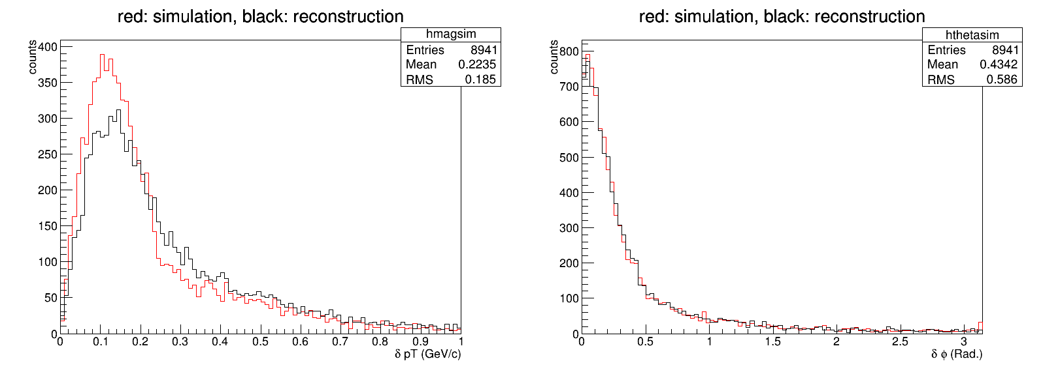
Single-TKI: δp_{T} and δφ_{T}
Sun, Jan 18, 2015

Slide 9
Single-TKI: δp_{T}, δφ_{T}, and δα_{T}
Wed, Jan 21, 2015
talk on pT spectrum in x-sec pre-meeting
[…]
in fact my idea here was coming from my HERMES experience. Here is a paper about pt broadening
http://inspirehep.net/record/823107?ln=en
The physics is very similar indeed.
However, there the pt is defined w.r.t. the virtual phone direction. Since we don't know about the neutrino energy,
we don't know the W-boson direction.
Actually the technical picture I present is more similar to jet quenching from ALICE ...
While you walked down the street, I got another interesting variable -- the force angle. See page 5-6 in the
attachment.
[…]

Slide 10
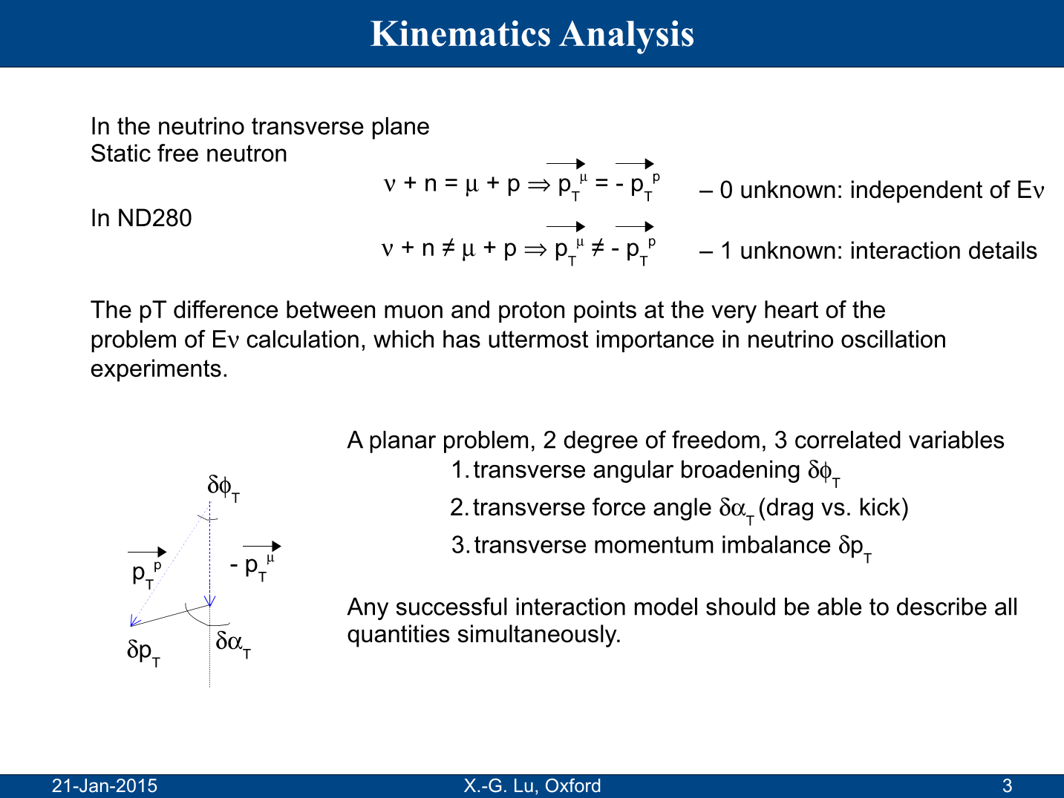
Single-TKI: δp_{T}, δφ_{T}, and δα_{T}
Jan also commented on this early on:
the many variables are over-constraining.
New variable

Slide 11
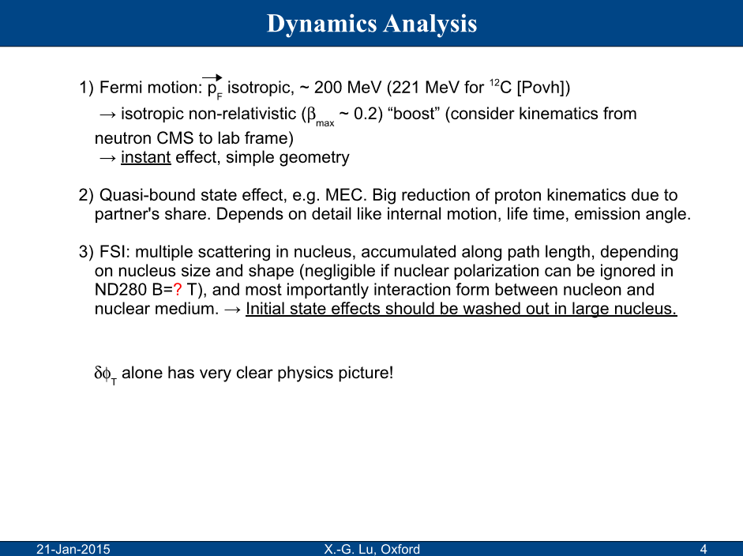
Single-TKI: δp_{T}, δφ_{T}, and δα_{T}
… but most susceptible to flux uncertainty, see discussions in the PRC paper

Slide 12
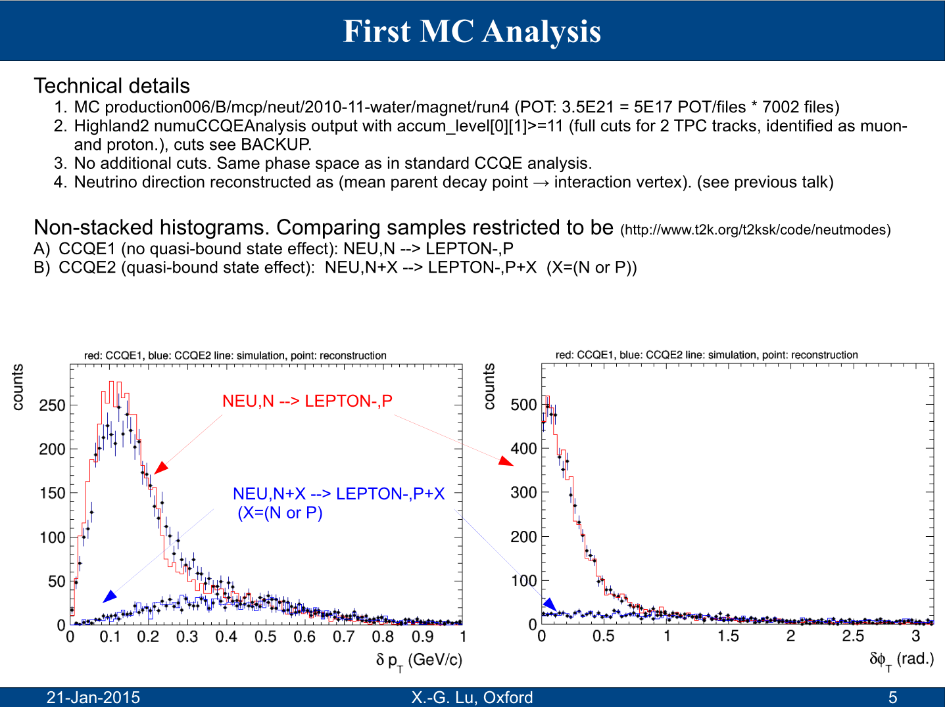
Single-TKI: δp_{T}, δφ_{T}, and δα_{T}

Slide 13
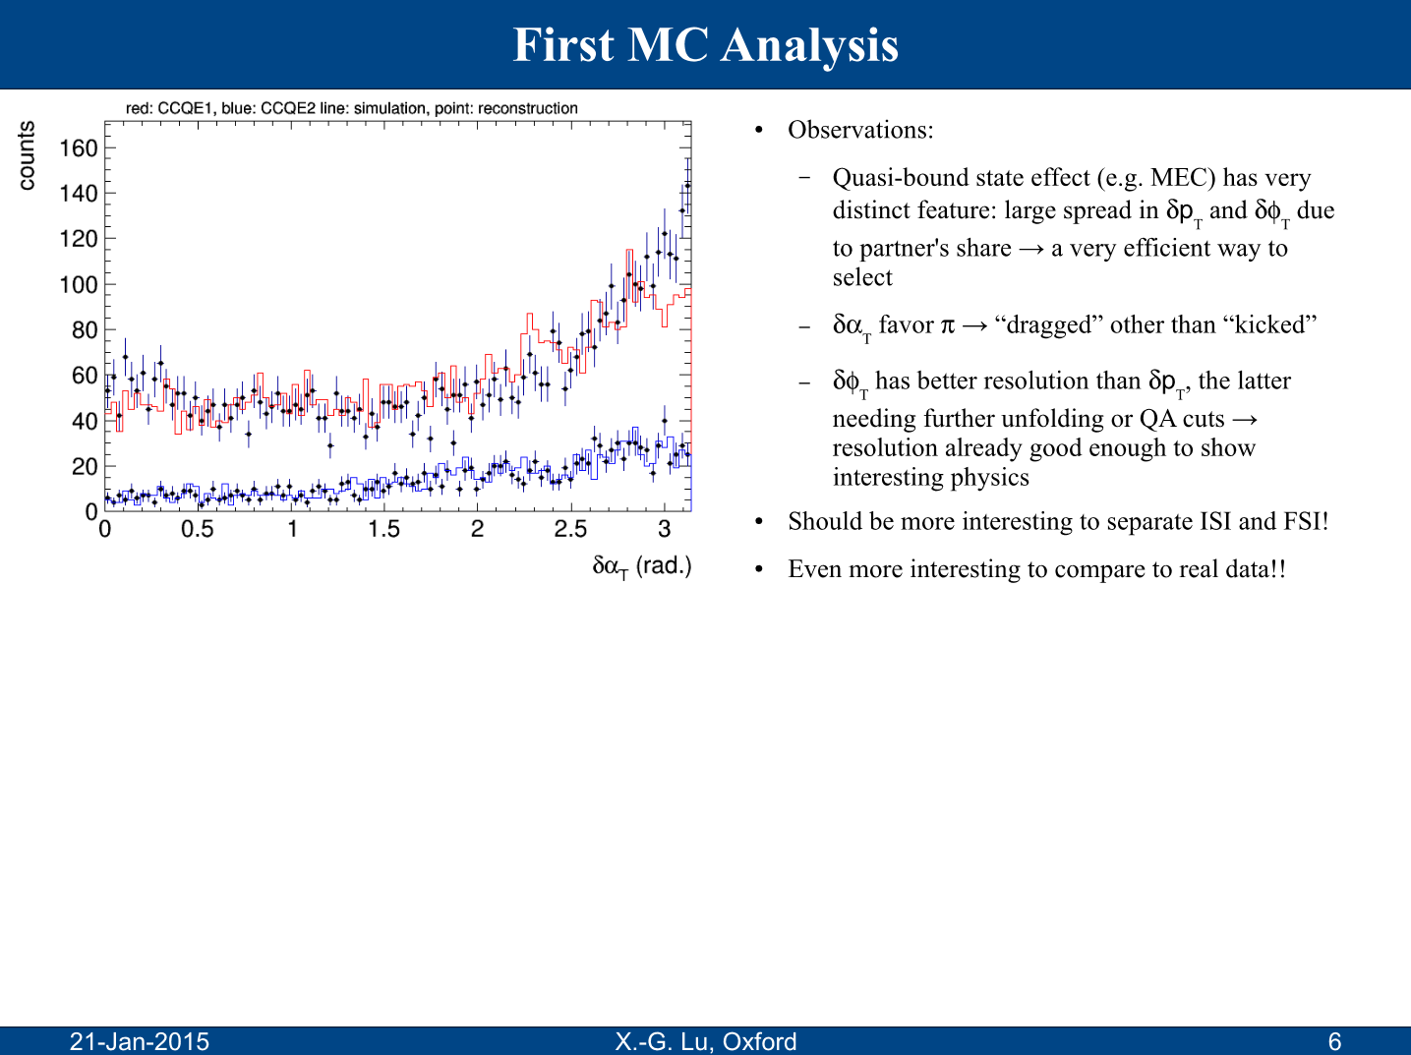
Single-TKI: δp_{T}, δφ_{T}, and δα_{T}

Slide 14
Tagged Single-TKI → Double-TKI: δp_{TT}
Fri, Feb 6, 2015
No. x-th idea
[…]
[…] In the mean time (this afternoon out of no reason, I don't know how it happened...),
another potentially influential measurement came up.
What we discussed today was, in neutrino-scattering, if we measure transverse angular broadening of proton, in
addition requiring exactly 1 pi+ in the event, we can probe Delta^{++}-medium effect.
A more general idea is, we can measure transverse angular broadening of proton, in addition requiring certain other
particle(s) in the final state. For example, if we require at least one electron/position track in TPC or
gamma/electron/position clusters in ECal in the final state, we can probe Delta^{+}-medium effect. This is in fact very
powerful because we don't need to reconstruct pi0 at all and even don't need 4 legs. 1 is enough. The logic can
certainly be carried on.
[…]
Sat, Feb 7, 2015
recent development
[…]
here is the recent development. Please have a look at the attachment. Sorry for the late briefing. The ideas are really
fresh and now seems stable […]
[…]

Slide 15
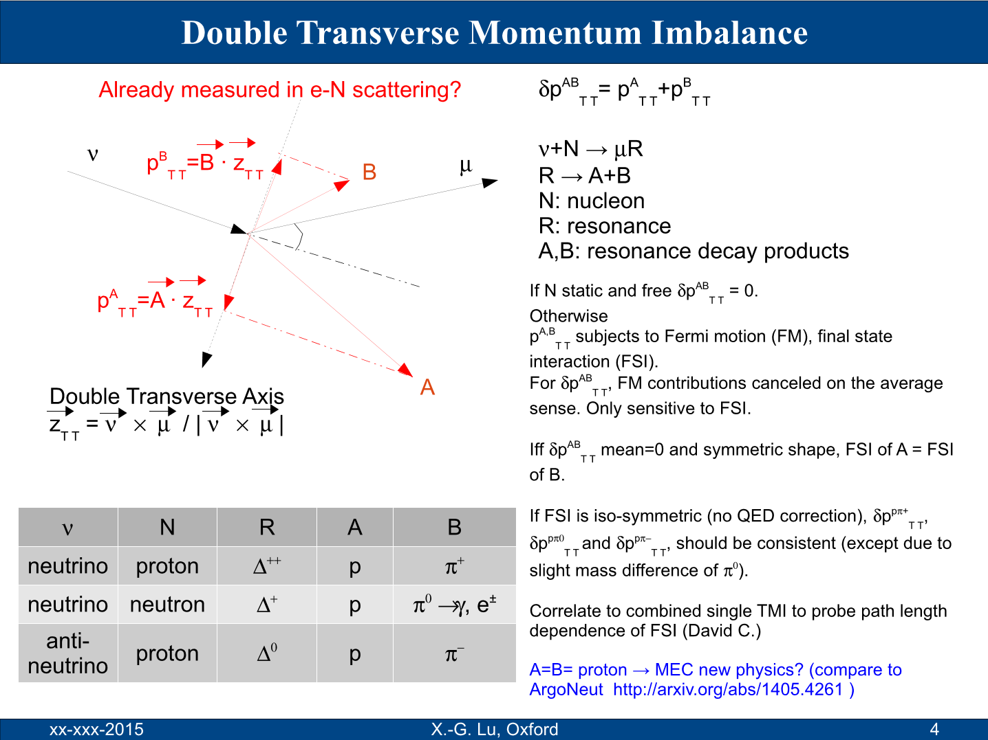
Double-TKI: δp_{TT}
Sat, Feb 7, 2015

Slide 16
Double-TKI: δp_{TT}
Tue, Apr 7, 2015
nuclear free neutrino energy measurement
[…]
I am sure you still remember the delta function in the distribution of dpTT in s17 of the attachment, which I also
showed last week. I though there is something wrong with the MC. But today Giles pointed it out to me that, in case of
interaction on Hydrogen target, there won't be nuclear effects and after a check in the analysis, this is indeed the
case. So the delta function is indeed physics. In s28 you can see the reconstructed distribution and the distinct peak is
seen.
I just realize that we have some potentially very important application from it:
1) nu on H target Delta++ xsec and anti-nu on H target Delta0 xsec
2) nuclear-free neutrino energy reconstruction using nu on H target.
Currently 2) still suffer from detector resolution, but the results will be of potential impact in the neutrino community
because
a) we know how to improve transverse kinematic detector resolution very well
b) we can use H-enriched material as target material
so if we are considering future experiment, then as long as we have a decent magnetic field, we will be able to measure
neutrino energy precisely. The transverse kinematic enables us to select the signal unambiguously. The cross section
calculation may be still an issue, but nuclear free nu p -> mu Delta++ doesn't seem very challenging in my impression.
I need to sit down quietly to think about how to update my talk...
[…]

Slide 17
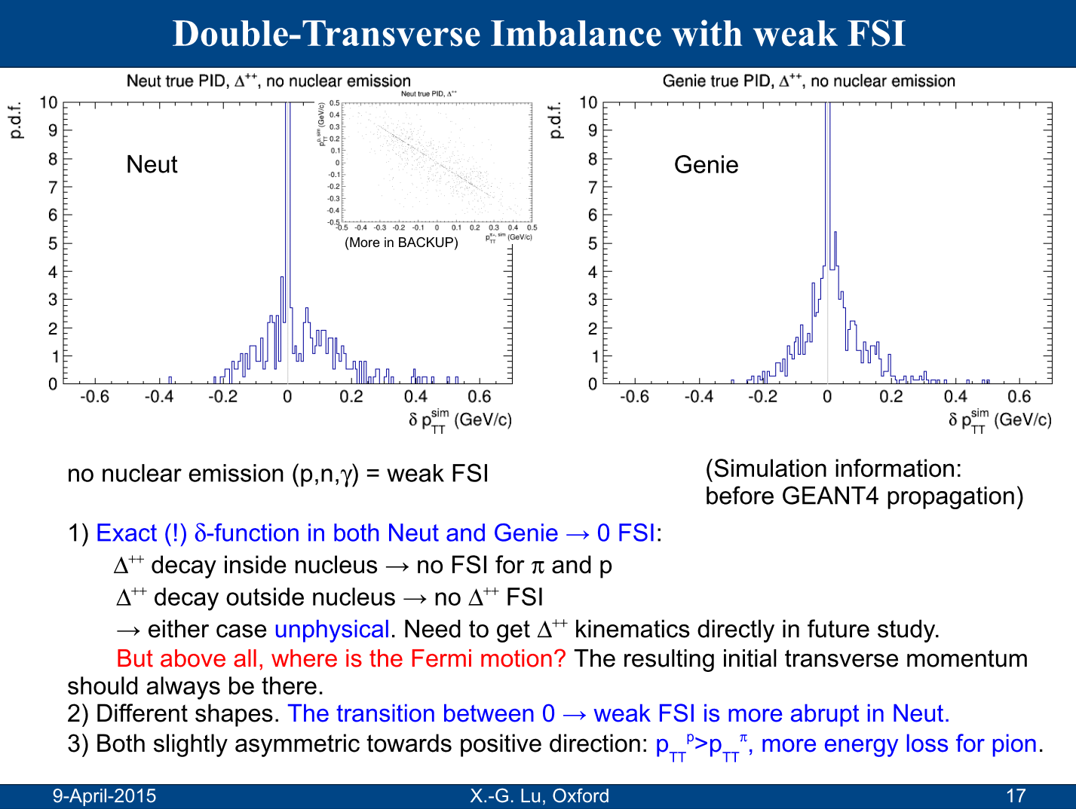
Double-TKI: δp_{TT}
7-April-2025 draft

Slide 18
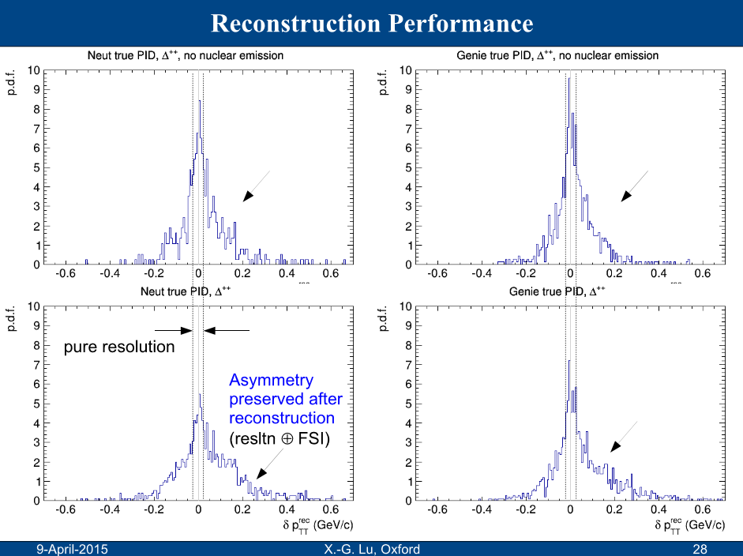
Double-TKI: δp_{TT}
7-April-2025 draft

Slide 19
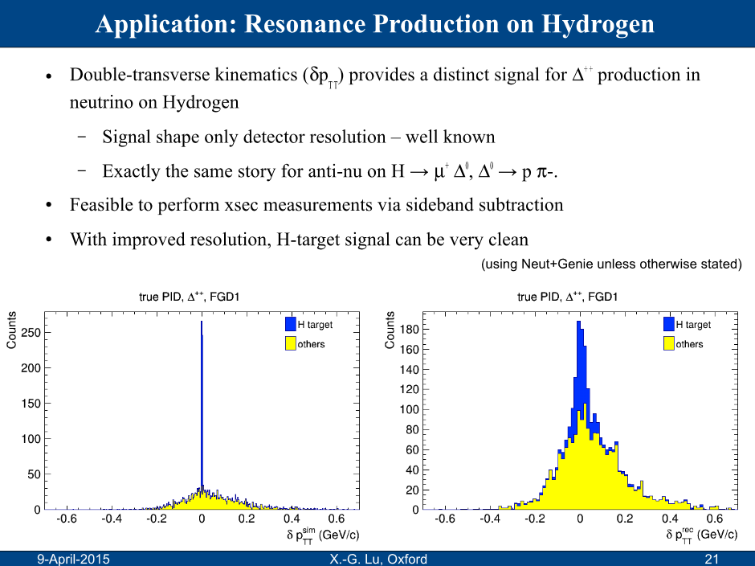
Double-TKI: δp_{TT}
T2KUK presentation

Slide 20
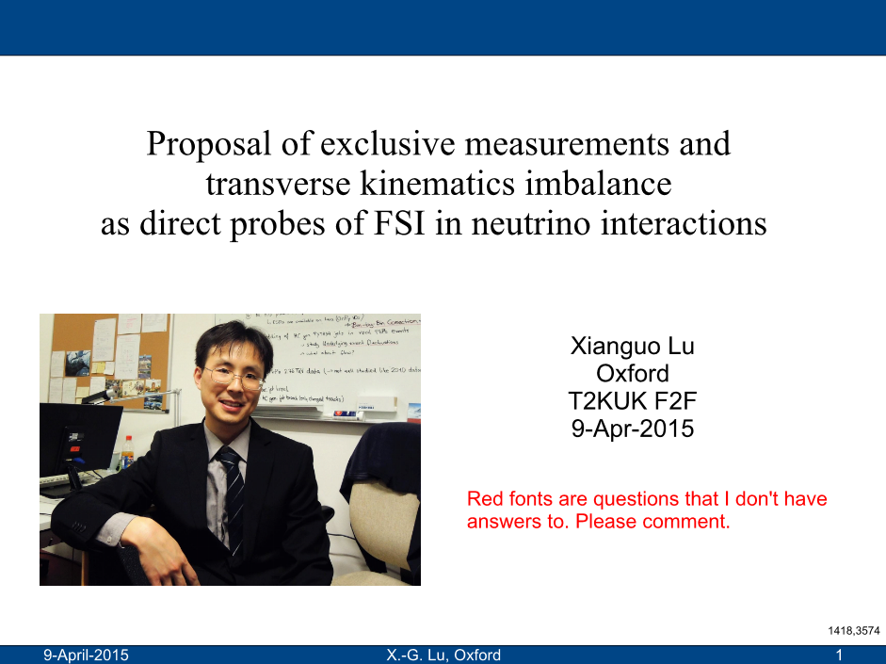
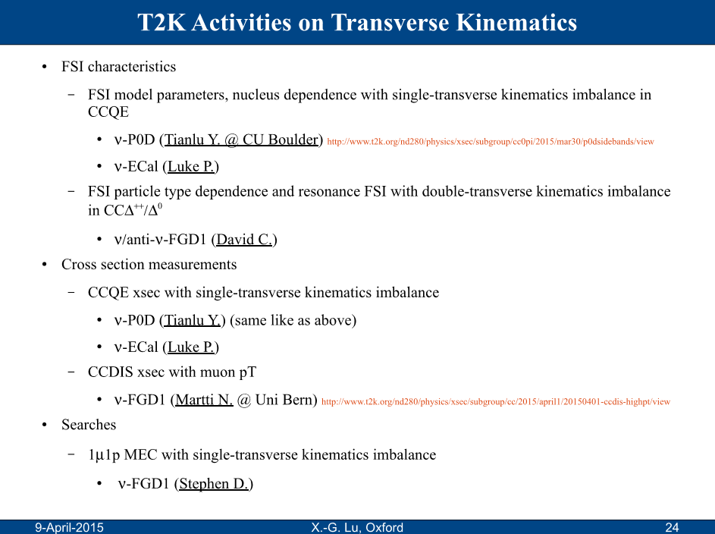
Proposed TKI Effort in T2K

Slide 21
TKI Effort in MINERvA
Soon after, informal invitation came on 22 May 2015 to join MINERvA for contributing to this equivalent analysis.
Oxford was accepted by MINERvA IB on Feb 6, 2016.
Since then, the first generation of TKI analyses had been carried out in T2K and MINERvA simultaneously.

Slide 22
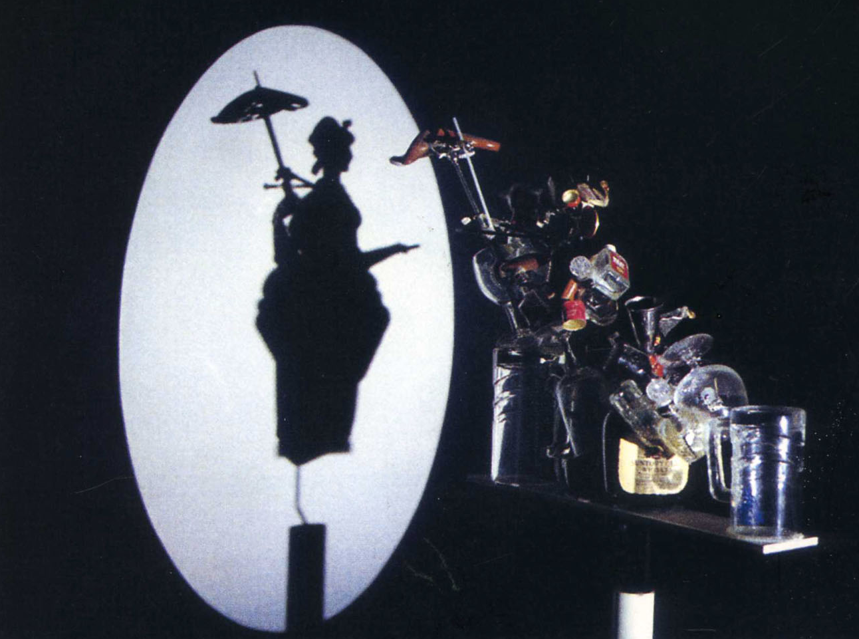
©Shigeo Fukuda

Slide 23

Transverse Boosting Angle δα_{T}
δα_{T} is Fermi motion direction → isotropic
—total transverse momentum
—transverse momentum imbalance
—missing pT
—...
In full
FSI and missing particles

Slide 24
Transverse Boosting Angle δα_{T}
FSI and momentum sharing with extra particles
pion absorption
2p2h

Slide 25

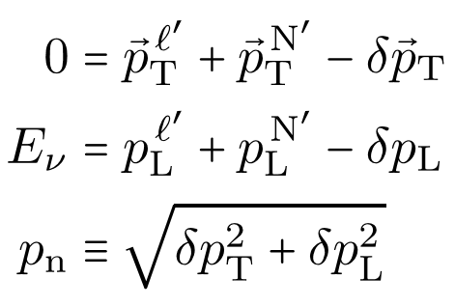
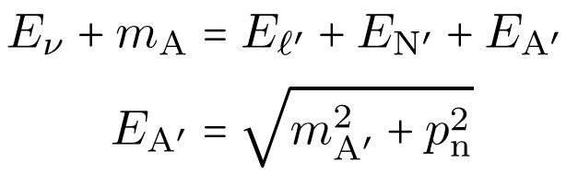




Generalisation #1: δp_{T}→ p_{n} (TKI+)
[Furmanski & Sobczyk, Phys.Rev.C 95, 065501 (2017)]
A general analysis of kinematic imbalance
Transverse:
Longitudinal:
New variable:
Neutrino energy is unknown (in the first place), equations are not closed.
Assuming exclusive final states
Use energy conservation to close the equations
Final-state interpretation
: recoil momentum of nuclear remnant
Dual interpretation
Initial-state interpretation
For CCQE,
No more unknows
: neutron Fermi motion
recoil
Fermi motion

Slide 26
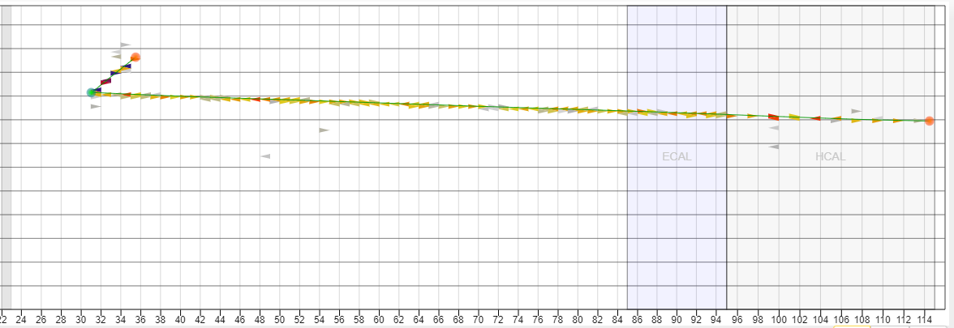



Generalisation #2: p→ pπ in (Single-)TKI(+)
[XL & Sobczyk, PRC 99, 055504 (2019)]
MINERvA
p
MINERvA
$$μ^{−}$$
$$N′=p$$
$$N′=pπ$$

Slide 27
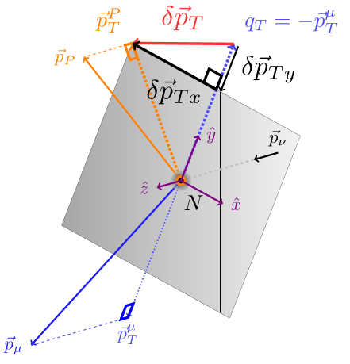

Generalisation #3: pπ→ p in Double-TKI
[MINERvA, Phys.Rev.D 101, 092001 (2020)]
when there is no pion in the final state

Slide 28
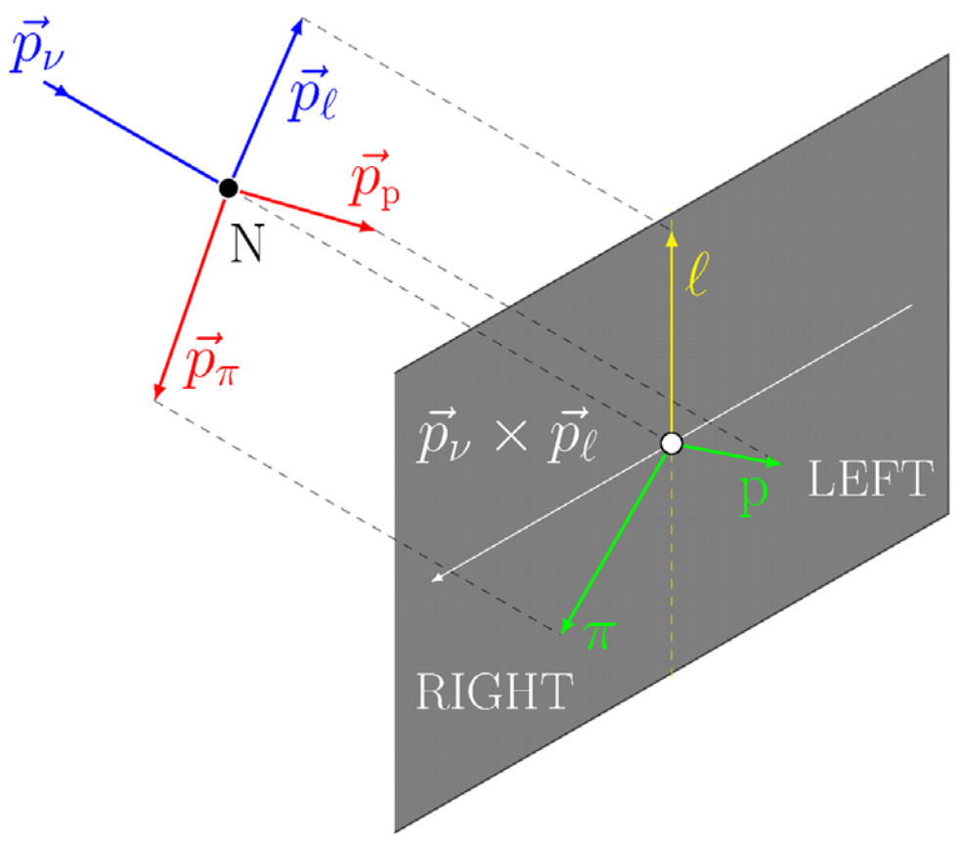

Generalisation #4: Double-TKI → L-R Asymmetry (TKI-)
[Cai, XL, and Ruterbories, Phys.Rev.D 100 (2019) 073010]

Slide 29
Generalisation #4: Double-TKI → L-R Asymmetry (TKI-)
[Cai, XL, and Ruterbories, Phys.Rev.D 100 (2019) 073010]
0π production contains
QE
pion absorption (RES)
2p2h
L-R asymmetry of 0π come from that of each component.
RES could have L-R asymmetry; QE and 2p2h not.
Dilution of RES L-R asymmetry tells us how much QE and 2p2h there are, together with TKI separating QE and 2p2h+RES, so we have a way to isolate 2p2h from RES in 0π!
(Detailed analysis in later slides…)
Bird's-eye view—Muon pointing up
L
ν
μ
p
R

Slide 30
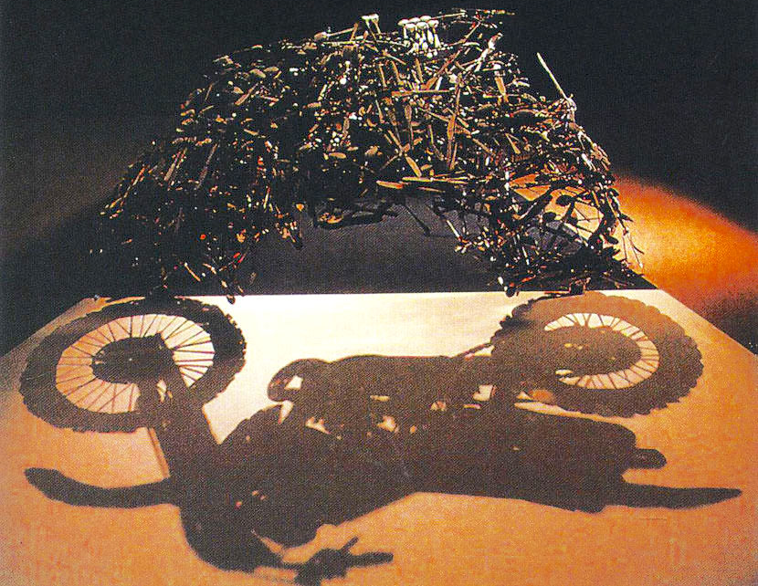
©Shigeo Fukuda

Slide 31
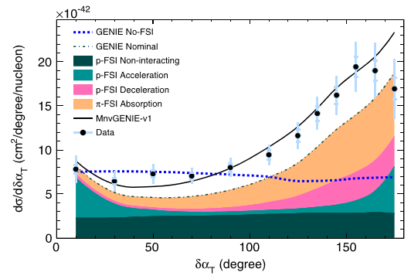
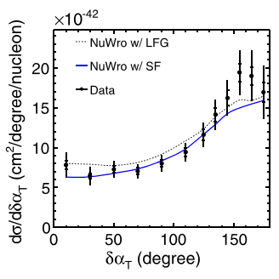
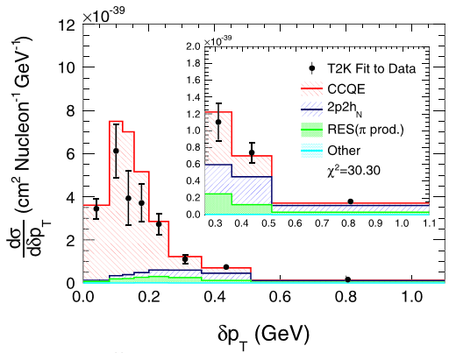
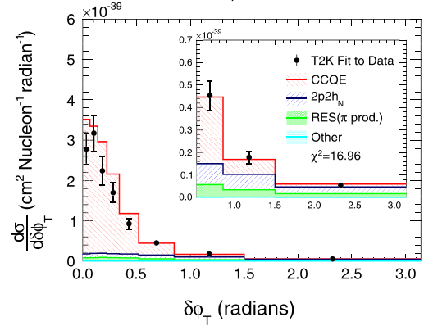
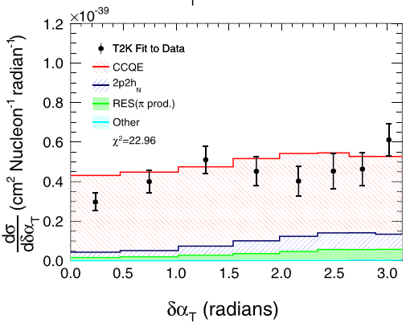
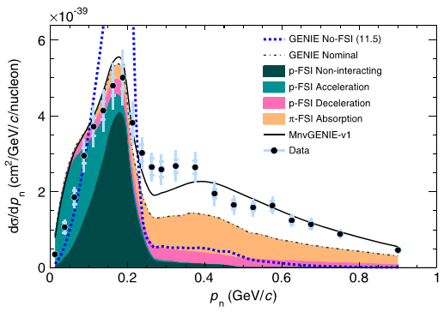
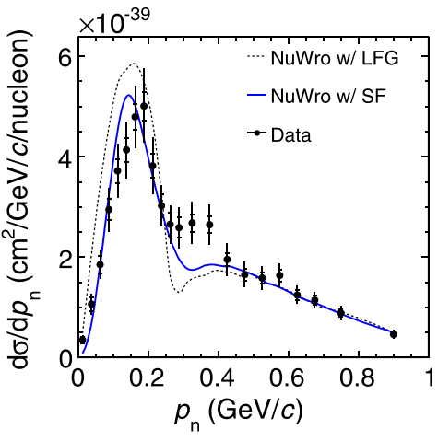
MINERvA/T2K Results: (1) carbon, 0π
TKI
MINERvA, Phys.Rev.Lett. 121, 022504 (2018)
T2K, Phys.Rev.D 98, 032003 (2018)
TKI+

Slide 32
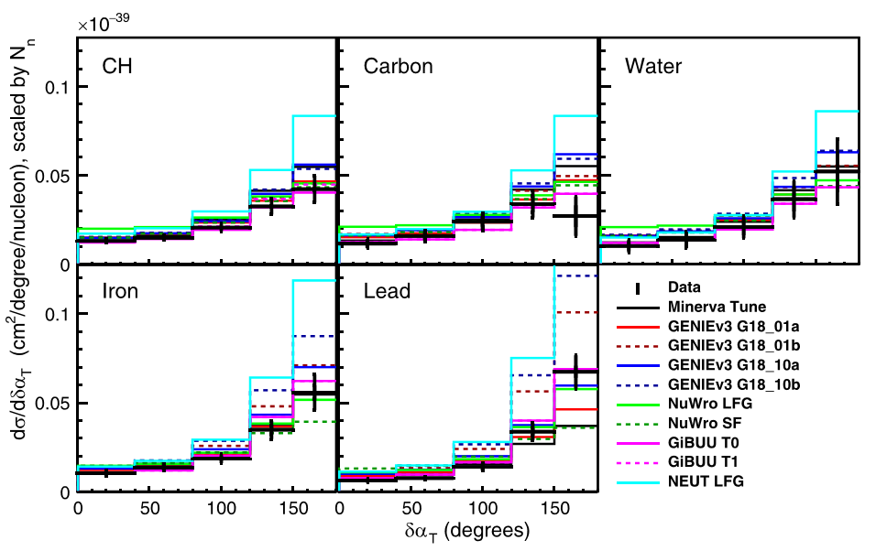
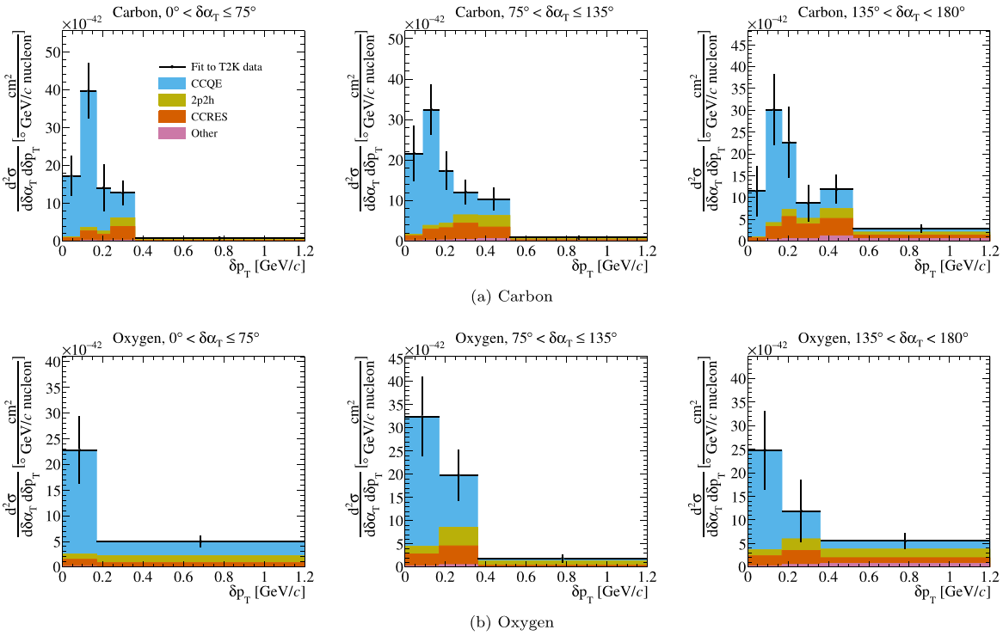
MINERvA/T2K Results: (2a) nuclei, 0π
TKI
MINERvA, Phys.Rev.D 112, 052005 (2025)
T2K, 2607.10638, 2607.10644

Slide 33
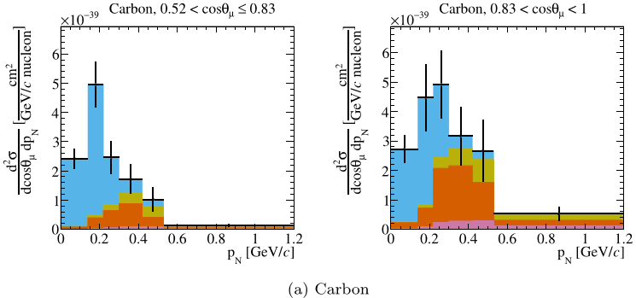
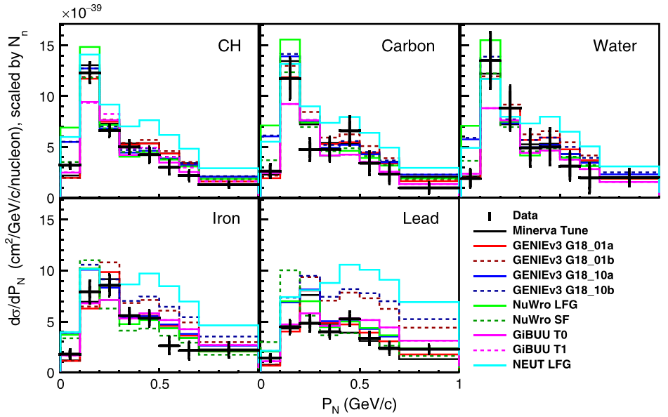
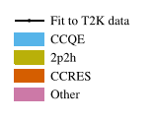
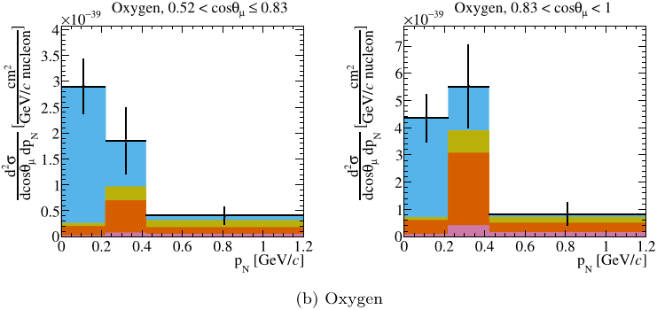
MINERvA/T2K Results: (2b) nuclei, 0π
TKI+
MINERvA, Phys.Rev.D 112, 052005 (2025)
T2K, 2607.10638, 2607.10644

Slide 34
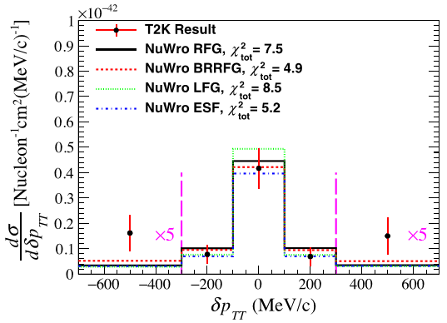
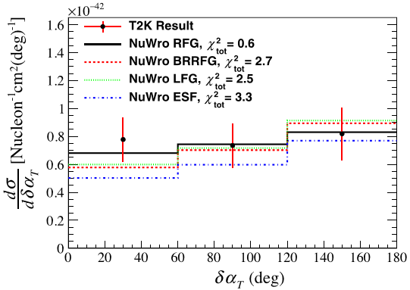
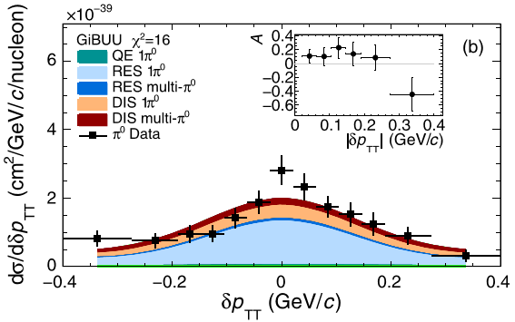
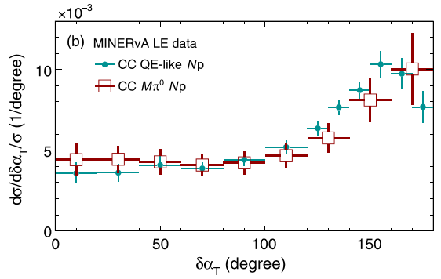
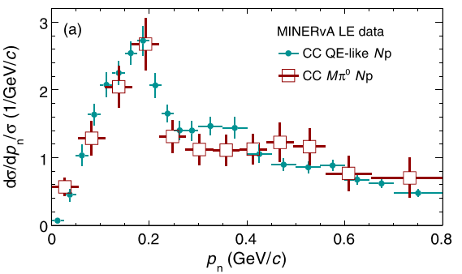
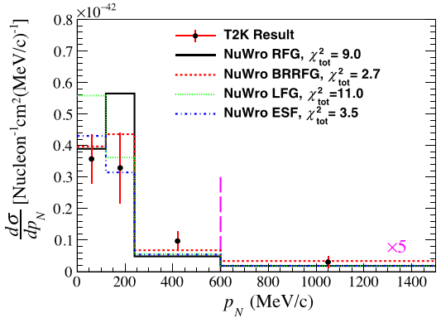
MINERvA/T2K Results: (3) pion production
π⁰
π⁺
MINERvA, Phys. Rev. D 102, 072007 (2020)
T2K, Phys.Rev.D 103, 112009 (2021)
TKI
TKI+

Slide 35
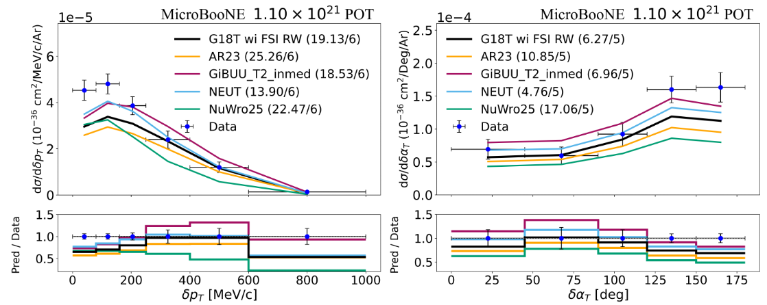
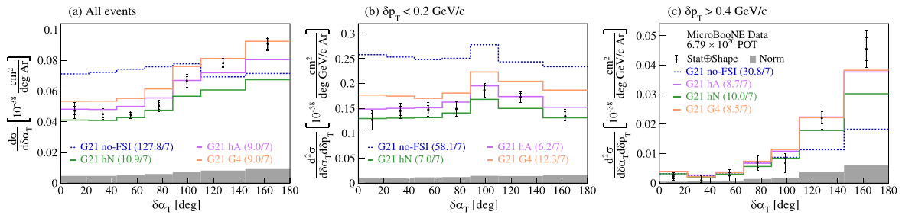
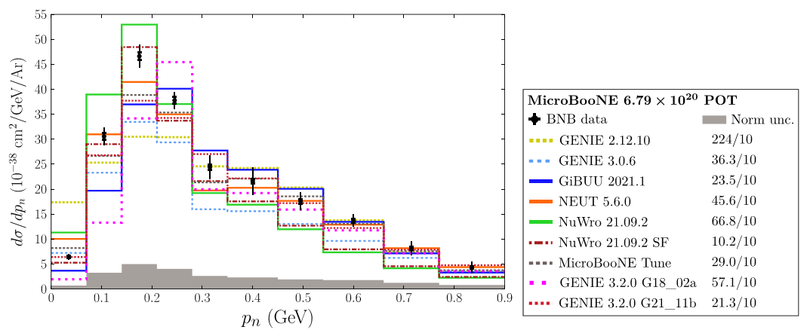
MicroBooNE Results
0π
π⁰
TKI
MicroBooNE TKI [Phys.Rev.Lett. 131, 101802 (2023), Phys.Rev.D 108, 053002 (2023), Phys.Rev.D 112, 112004 (2025)]
TKI+
MicroBooNE π⁰ TKI [arXiv:2606.23559]
MicroBooNE TKI+ [Phys.Rev.D 112, 112004 (2025)]

Slide 36
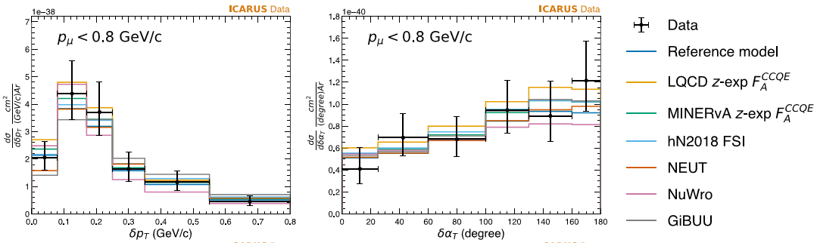
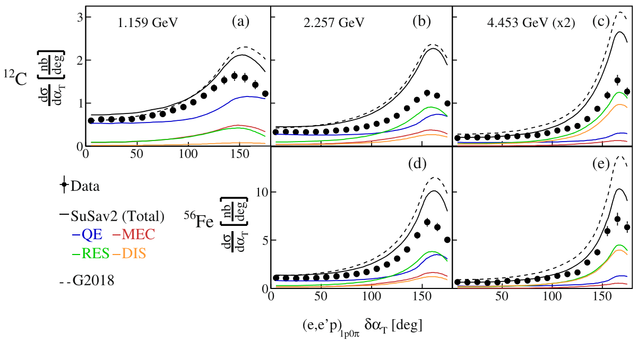
Other TKI Measurements
Also a dip at 180º?
ICARUS TKI [Phys.Rev.D 114, 052002 (2026)]
CLAS & e4v TKI [Nature 599 (2021) 7886, 565]

Slide 37
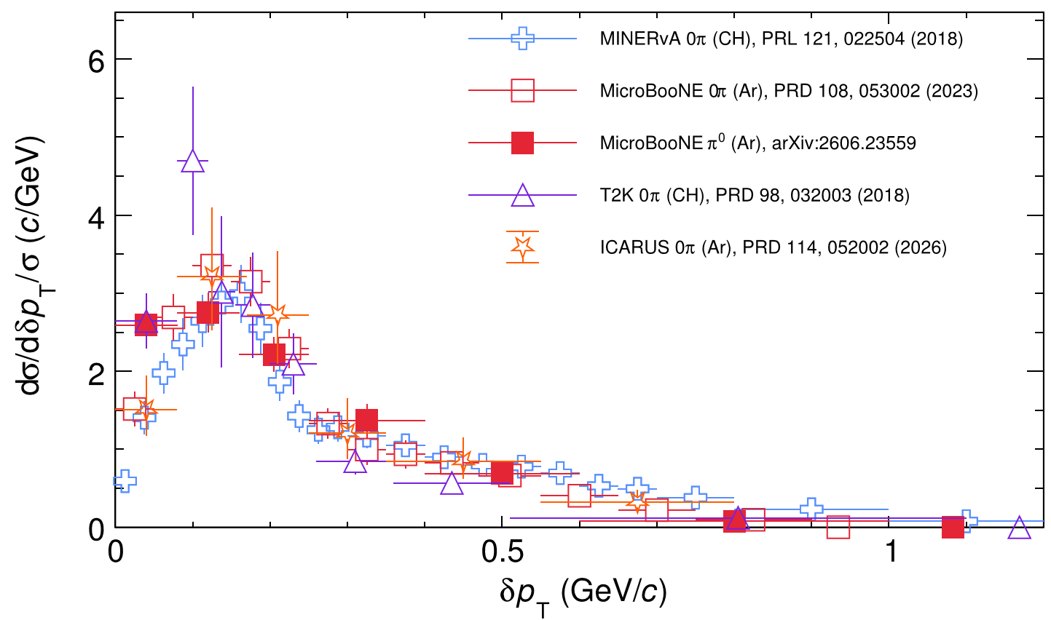
A Big Picture
Figure courtesy: Q. Yan
Figure courtesy: Q. Yan

Slide 38








A Big Picture
TKI(+):
Same observable for different beam energy, target, topology.
Physical insight without referring to any model
Figure courtesy: Q. Yan
Figure courtesy: Q. Yan
ChatGPT’s impression of apple-to-apple comparisons

Slide 39

Cave of Pettakere, Bantimurung district (kecamatan), South Sulawesi, Indonesia. Hand stencils estimated between 35,000-40,000 BP.
Wiki Cave Painting

Slide 40
L-R Asymmetry (TKI-)
[Cai, XL, and Ruterbories, Phys.Rev.D 100 (2019) 073010]
0π production contains
QE
pion absorption (RES)
2p2h
L-R asymmetry of 0π come from that of each component.
RES could have L-R asymmetry; QE and 2p2h not.
Dilution of RES L-R asymmetry tells us how much QE and 2p2h there are, together with TKI separating QE and 2p2h+RES, so we have a way to isolate 2p2h from RES in 0π!
Bird's-eye view—Muon pointing up
L
ν
μ
p
R

Slide 41
L-R Asymmetry (TKI-)
Pion prefers one side: L-R asymmetry
Resonant and nonresonant interference
Predicted by Adler and more recent models
Difficult measurements by ANL, MINERvA, T2K, consistent with 0 within error
So the first step is to establish the amount of L-R asymmetry experimentally.
R
L
Y
Up
ANL data and Adler model [Radecky et al., Phys. Rev. D 25, 1161 (1982)]

Slide 42


L-R Asymmetry (TKI-)
Increase with energy?!
of π
Exp. | π | Target | E_{ν} (GeV) | A_{LR}
ANL | π⁺ | D | 0.9 | 0.053 ± 0.035
MINERvA | π⁰ | CH | 3 | 0.15 ± 0.10
T2K | π⁺ | CH | 0.6 | 0.038 ± 0.046
[ANL, Phys. Rev. D 25, 1161 (1982); 26, 3297(E) (1982).
MINERvA, Phys. Rev. D 96, 072003 (2017).
T2K, Phys.Rev.D 101, 012007 (2020)]

Slide 43


L-R Asymmetry (TKI-)
MINERvA π⁰ Double-TKI [Phys. Rev. D 102, 072007 (2020)]
δp_{TT}=0 : symmetric FSI for p and π⁰
Otherwise: L-R asymmetry$\&\&$FSI asymmetry
T2K Double-TKI: Such an asymmetry is not observed within errors in this study.
[T2K, Phys.Rev.D 103, 112009 (2021)]

Slide 44





L-R Asymmetry (TKI-)
when there is no pion in the final state
MINERvA 0π TKI Measurement
[Phys.Rev.D 101, 092001 (2020)]
Dynamic!

Slide 45
L-R Asymmetry (TKI-)
Bird's-eye view—Muon pointing up
Pion absorption
L
L
π
p/n
ν
μ
ν
π
μ
p
p
R
R

Slide 46
L-R Asymmetry (TKI-)
Bird's-eye view—Muon pointing up
Pion absorption
L
L
π
p
ν
μ
ν
π
μ
p
p
R
R
So, pion is indeed absorbed!
  — Or, how do we actually know pions are absorbed in ν interactions?

Slide 47
Summary & Outlook (a)
 | MINERvA | T2K | MicroBooNE | ICARUS
0π
TKI+ | ✓✓ | ✓✓ | ✓ | ✓
TKI+ | ✓✓ | ✓ | ✓
TKI- | ✓
π
TKI+ | ✓ | ✓ | ✓
TKI+ | ✓ | ✓
TKI- | ✓ | ✓

Slide 48
Summary & Outlook (b)
Neutrino interaction measurements are entering precision era.
More information does not necessarily mean better knowledge; organisation matters.
Neutrino energy is unknown; transverse plane factors out this uncertainty, allowing useful correlations.
Full problem = muon flavour + electron flavour
= neutrino + antineutrino
= low E_{ν} + high E_{ν}
= carbon + oxygen + argon + …
= 0π + Nπ
= charged final states + neutral final states
= above tracking threshold + below tracking threshold (calorimetry)
= transverse + longitudinal
= …
How do you eat an elephant?
One bite at a time…
…and start with an easy bite!

Slide 49

Cueva de las Manos located Perito Moreno, Argentina. The art in the cave dates between 13,000-9,000 BP
Wiki Cave Painting

Slide 50
BACKUP

