Slide 1
Supporting Black Asian Minority Ethnic students (“BAME”) learning and student experience
Investigator(s): Principal Investigator: Dr Jagjeet Jutley-Neilson, Dr Amy Cook, Paige Clarke-Jeffers, Professor Sotaro Kita, Dr Adrian von Muhlenen, Professor Derrick Watson, Noorin Rodenhurst& Inchara Athreya.
Notes:
BAME stands for Black, Asian, and Minority Ethnic communities. We have used the term BAME throughout this survey. While these terms are often used to talk about the experiences of those students who identify as BAME, these are not homogenous communities, and we recognise that most people don’t use those terms to describe themselves.
You will be asked questions about the content of your psychology degree and in particular the representation of Black, Asian, and Minority Ethnic (BAME) communities in your curriculum content.

Slide 2
Format of today’s masterclass
Aims of today’s masterclass and participation agreement
Padlet activity
Presentation of findings from the mixed-method project
Introduction to the decolonising psychology curriculum pedagogies toolkit.
Next steps

Slide 3

Padlet Activity
What does decolonising the psychology curriculum and your pedagogies mean to you?
You can also comment on your experiences and approaches.
Notes:
We will spend 5-10 minutes in breakout rooms

Slide 4
Supporting Black Asian Minority Ethnic students (“BAME”) learning and student experience
Investigator(s): Principal Investigator: Dr Jagjeet Jutley-Neilson, Dr Amy Cook, Paige Clarke-Jeffers, Professor Sotaro Kita, Dr Adrian von Muhlenen, Professor Derrick Watson, Noorin Rodenhurst& Inchara Athreya.

Slide 5
Project Aims
The project was exploratory in nature and aimed to look at:
“BAME” students’ academic learning experiences (survey and interviews)
Creation of an “inclusive good practice pedagogical toolkit”
This toolkit would include pedagogical exemplars for staff to use
These exemplars are supported by capturing students learning and student experience voices in pen portraits and infographics

Slide 6

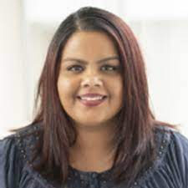
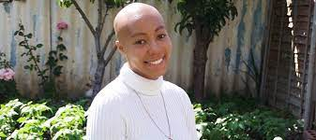
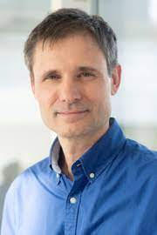


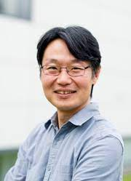


The research team

Slide 7
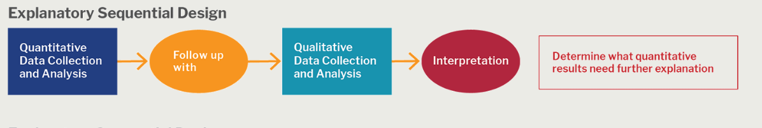
Project Design: Mixed methods approach

Slide 8
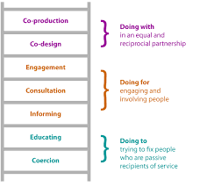
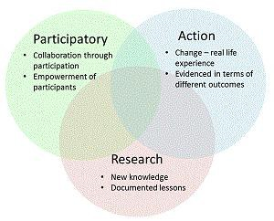
Project Design: Partnership
Co-production of survey and focus group interviews
  students researchers designed
  academics and students worked together to review, etc.
Participatory Action Research
  Recruitment
  Survey design
  Terminology of “BAME”

Slide 9
Quantitative Survey design
The Psychology Curriculum
Psychology curriculum - It is important to me that my psychology curriculum covers topics about the experiences of BAME communities and / or individuals
Psychology curriculum - My psychology curriculum / modules reflect topics which represent people from BAME backgrounds
Psychology curriculum - It is important to me that my psychology curriculum explores the experiences of BAME communities and / or individuals
Psychology curriculum - I have heard of decolonising the psychology curriculum
Representation
It is important to me that academics from BAME backgrounds are appropriately represented within my department
Approaches to Learning (6)
Personal Tutoring (3)
Resources (5)
Student Engagement outside of the curriculum (4)
Student Voice (5)
Peers (4)
My peers make me feel welcome in my department
I've made meaningful friends with my psychology peers
When in lectures / seminars, I tend to sit with people of the same ethnicity as me
What percentage of your friends at university are the same ethnicity as you?

Slide 10
Quantitative Survey design
1. Would you identify yourself using the terminology ‘BAME’? Alternatives?
1. I believe psychology staff have been / will be supportive and helpful when / if I have approached them with concerns about BAME related barriers I have experienced (1)
2. I would feel comfortable talking about race and racism within my department (friends, in lessons, to staff) (2)
3. University staff (lecturers, seminar tutors, personal tutors etc.) are aware of the impact that ethnicity can have on the student learning experience (3)
4. My non-BAME peers have accurate perceptions of the issues which BAME students face (4)
1. Coming from a BAME background has negatively affected how I engage with my Psychology course (1)
2. Coming from a BAME background, I have felt out of place / lack a sense of belonging while studying Psychology (2)
3. Coming from a BAME background, I have had to adjust my cultural values or beliefs to fit in (3)
4. Coming from a BAME background has negatively affected how I engage in the non-academic side of being at university e.g., extracurricular activities (nightlife, catering, living in halls, getting a part-time job etc.) (4)

Slide 11

Participants
195 students – 106 BAME and 89 White
5 Arab, 24 Black, 11 east Asian, 16 mixed, 50 south Asian
24 students international
48 students disclosed a disability
24 students mature (over 24 yrs of age)
123 BCU and 72 UoW
101 away from home, 92 home, 3 did not say
41 WP background, 25 not sure, 129 not WP

Slide 12
Results: Means
Notes:
Psychology curriculum - It is important to me that my psychology curriculum covers topics about the experiences of BAME communities and / or individuals Psychology curriculum - My psychology curriculum / modules reflect topics which represent people from BAME backgrounds Psychology curriculum - It is important to me that my psychology curriculum explores the experiences of BAME communities and / or individuals Psychology curriculum - I have heard of decolonising the psychology curriculum On a scale of 1-10, (1 being the least inclusive and 10 the most inclusive) how important is it to you that your curriculum is inclusive of the following: - BAME communities On a scale of 1-10, (1 being the least inclusive and 10 the most inclusive) how important is it to you that your curriculum is inclusive of the following: - Gender On a scale of 1-10, (1 being the least inclusive and 10 the most inclusive) how important is it to you that your curriculum is inclusive of the following: - Social class On a scale of 1-10, (1 being the least inclusive and 10 the most inclusive) how important is it to you that your curriculum is inclusive of the following: - LGBTQUA+ communities

Slide 13
Curriculum – all students
Psychology curriculum - It is important to me that my psychology curriculum covers topics about the experiences of BAME communities and / or individuals – 6% neutral, 3% negative, 91% positive
Psychology curriculum - My psychology curriculum / modules reflect topics which represent people from BAME backgrounds -27% disagree, 25% neutral, 48% agree
Psychology curriculum - It is important to me that my psychology curriculum explores the experiences of BAME communities and / or individuals – 1% disagree, 2% neutral, 97% agree

Slide 14
“BAME” Specific Qs
Identify with term BAME =22% no, 8% N/A and 70%% yes
Coming from a BAME background has negatively affected how I engage with my Psychology course 12% agree, 25% neutral and 58% disagree with statement
Comfortable talking of race and racism – 20% disagree, 18% neutral, 68% agree
Coming from a BAME background, I have felt out of place / lack a sense of belonging while studying Psychology 28% agree, 26% neutral and 46% disagree
My non-BAME peers have accurate perceptions of the issues which BAME students face 30% disagree, 34% Neutral, 36% agree

Slide 15
Free Text Comments
Understanding & Compassion
“I don't think my tutors understand the experience of BAME students, being in a space where we are not represented. I don't doubt they would support any conversation on the topic, but it’s not sympathy that is needed sometimes I need practical advice or just an understanding” (Jenson)
“By promoting discussions about racial difference in class, BAME students can hear what other people think of ethnic minorities and if they can confirm that the room is a safe space, then they are more likely to speak to non-ethnic minorities, knowing that there is no prejudice against them” (Shazia)
Peer Homophily
“I think people group together with those of the same ethnic background because the psychology cohort is vastly segregated… BAME students tend to group together for safety and security. They are most likely going to be able to resonate with each other because they may have grown up in the same urban city, or social class. I don't say this to stereotype but as a Black person myself, this explanation is very probable” (Ama)
“I prefer to be around people with the same ethnicity as we share a common experience in general life and so the ways in which we would handle university would be similar. For example, experiencing academic burnout but also the pressure of being a first generation child of an immigrant and needing to do well to support your family” (Micheal)
The Curriculum:
“More focus on alternative stories, a shift from westernised stories/accounts” (Paulo).
“I would have appreciated the diversity in the curriculum, I have made lemonade with the Lemons I have… Again, if we discuss the elephant in the room (which is that White and Black people have different experiences in life)” (Jasleen)
Representation and authorship:
We don't have enough BAME professors (Ash)
I think if we had more representation in our department, it would make a difference” (Jenna). “Attempt to cover more research authored by ethnic minorities/other minority groups (Olu).

Slide 16
Qualitative – Method Section
Semi structured interview provided flexibility and topics to naturally arise
Topics of the interview schedule included:
  Learning, teaching and student experience (relation to the experiences of being BAME)
Purposive Sampling
  Warwick university → poster e-mailed to psychology students
  BCU → poster e-mailed to psychology students and through the psychology departments research scheme where students can gain points for taking part in research
  Students received a £10 Love2Shop voucher after completion
BCU RA interviewer identified as Black and Warwick RA interviewer identified as White and Asian
  Importance of positionality (insider) → building a rapport, identity similarity and participants feeling comfortable talking to non-teaching staff
Notes:
Learning experience eg:
Assessment, Lectures, Seminars, Tutorials, belonging to the university/department/student accommodation
Teaching experience eg:
Relating to the content such as research, theories and topics
Student experience eg:
Feedback on assignments, research experience, raising concerns, departmental activities involvement

Slide 17
Qualitative – Method Section
Online interviews conducted via Microsoft Teams and transcribed using Otter.ai
Participants
  Warwick university N = 15 BAME students, BCU N= 12; n = 9 BAME students, n = 3 white students
  BAME breakdown across both universities: n=11 Asian, n=9 Black, n=3 Mixed Heritage, n=1 Arab
Analysed using Reflective Thematic Analysis (Braun & Clarke, 2021)

Slide 18
Qualitative – Analysis Section
Themes across both universities
Theme 1: Identifying
  Sub-theme: Sense of Belonging (to the environment and peers)
Theme 2: Representation
  Sub-theme: Staff and Authorship
Theme 3: Understanding and Compassion
  Sub-theme: Support Systems
Theme 4: Learning Approaches
  Sub-theme: Assessments and Feedback
Notes:
The themes that were conceptualised were….

Slide 19
Qualitative – Analysis Section
Theme 1: Identifying
  Sub-theme: Sense of Belonging (to the environment and peers)
“I don’t really feel a part of the university. I guess when I came to uni, I was just reminded that I was a minority, if that makes sense. Because I live in London, which is really diverse. So obviously I was kind of shocked when I would attend to lectures and there’s less than 10 Black people in the whole cohort kind of thing […] sometimes you just feel like the, the odd one out, like, ‘oh, just a minority over here’.” – Warwick University, Black African, Home Student
“To be honest, I don't think like the psychology department has done anything particular to make me feel like I belong. I think a lot of the belonging, feelings. It's kind of stemmed from me having to go, like attend society events going out of like, my circle like going out to meet people at parties and stuff like that, but I feel like the department didn't really have any events.” - Warwick University, Chinese, International Student
Notes:
Ones ethnicity is part of their identity. Being bame within uni is further highlighted when there is a lack of diversity in their env. And social r.ships
Reminded of being a minority, feeling less than and not feeling apart/like they belong as if they are sticking out within the institutions. Then feeling that the psy dep is doing much to celebrate different cultures and groups so venturing out to societies to find people akin to them

Slide 20
Qualitative – Analysis Section
Theme 2: Representation
  Sub-theme: Staff and Authorship
“For me, personally, I feel like it's really important for me to be able to see that kind of representation in what I study, and who is teaching me as well, because it would also inspire me to want to continue going into that profession.” – BCU, Pakistani, Home Student
“I feel like that they could add more content about BAME people, because I know that they already do. But it's like they have like the one lecture about it. And it just feels like they're only teaching us about it just to say that they have, just for the sake of it, but it doesn't actually seem like they care. Like they don't really put any passion into it […] I think it's important to integrate more content about ethnic minorities.” – BCU, Bangladeshi, Home Student
“I think intersectionality comes into this as well. I'm a Black female, and I'm constantly being taught about White men. I think that there is something that can be done about this, you can't tell me that only White people were philosophers that that cannot be true. And I feel like more of an effort to diversify.” – Warwick University, Black African, Home Student
Notes:
When I say authorship I’m referring to the content taught, the researchers and theories that students learn about. There is a lack of diversifying and including content and research by a range of BAME ind.v’s that will help provide representation to all students but will be advantageous to BAME to show how ind.v from a similar background as them has made powerful movements that can inspire them to push further.
If cross-culture research is taught it often lacks passion the student states as if its not important to teach about the diversity.

Slide 21
Qualitative – Analysis Section
Theme 3: Understanding and Compassion
  Sub-theme: Support Systems
“I think it's 50/50. I think some lectures do go the extra mile, which really is supportive and helpful. And that's where I can see my grades are the highest because, you know, they've actually helped. Some lectures don't really, they send a simple word answer, blunt email […] external factors, so like, needing support with living while I was in Birmingham, or sort of support with helping me with my career after finishing my degree, I'd say very poor, just from personal experience.” – BCU, Black African, Student Accommodation
“How they're supposed to indicate that they're more BAME friendly. Because with LGBT stuff they can put like, I don't know pronoun badges or pins like a rainbow to indicate that they're like, LGBT friendly, that you could approach them, but how that you do that for like BAME stuff?” – Warwick University, Filipino, Home Student
“POC staff would be cool, like I email [stated lecturers name] and stuff because [they are] super, like super friendly, […] if there was a race issue in the department, I would look for a POC person before going to a White person.” - Warwick University, Filipino, Home Student
Notes:
Personal Tutors, Lecturers and uni. External services
Students want to feel wanted and listened to my members of staff and there are some staff that go the extra mile to provide that support system. However, it can be difficult for BAME to seek pastoral support that can be in relation to academic or personal issues as it’s not always clear which member of staff is going to be compassionate and understands ones needs. Being a stand-offish lecturer can put up a barrier where BAME don’t want to ask for help and it makes it even harder when everyone does not look like you (bame) so bame students are trying to weigh up if from a white member of staff if going to provide a good level of compassionate care.

Slide 22
Qualitative – Analysis Section
Theme 4: Learning Approaches
  Sub-theme: Assessments and Feedback
“Going online was one of the best things that the department could have done really, I don't know about everyone else. But for me in person exams, it produces a lot of anxiety, the issue around memorising content and then regurgitating it or doing something in a short space of time.” - Warwick University, Black African, Home Student
“I definitely have an issue with feedback […] they give very general sort of feedback. One, tutor it was just awful, I didn't understand. It wasn't very student focused. It was very, very general. There was another lecture, we did a really good feedback session. So a slide was prepared for each student's work, each student's formative piece of work. So that was really good. So I feel that there's no consistency across the, the modules. And I think that needs to change, because then we don't know what we should be expecting.” – BCU, Pakistani, Home Student
Notes:
Blended learning – exams online, reduces anxiety and can help with better performance. Online exams can help students to consolidate and have time to think about what they want to submit. Pressures of restricted time, exam conditions are negative for students capability.
Feedback- mixture of feedback on work. There needs to be consistency in how feedback is given across the whole board of psy so students know what to expect.

Slide 23
Take Home Message
All students regardless of ethnic background want to see the psychology curriculum decolonised.
Buy-in from the top for staff to have time to develop their pedagogies and tools to do so.
Increase the confidence of staff and students to discuss ethnicity, race and culture in the classroom – build inclusive communities.

Slide 24

Toolkit
https://warwick.ac.uk/fac/sci/psych/bame/
This Photo by Unknown Author is licensed under CC BY

Slide 25

Next Steps…
Toolkit development
Survey further development
Sharing findings
Thank you !!!!
This Photo by Unknown Author is licensed under CC BY

