Slide 1

Career Support for you
Siobhan Qadir
s.qadir@warwick.ac.uk
Careers, Employability and Skills
This Photo by Unknown Author is licensed under CC BY-SA

Slide 2
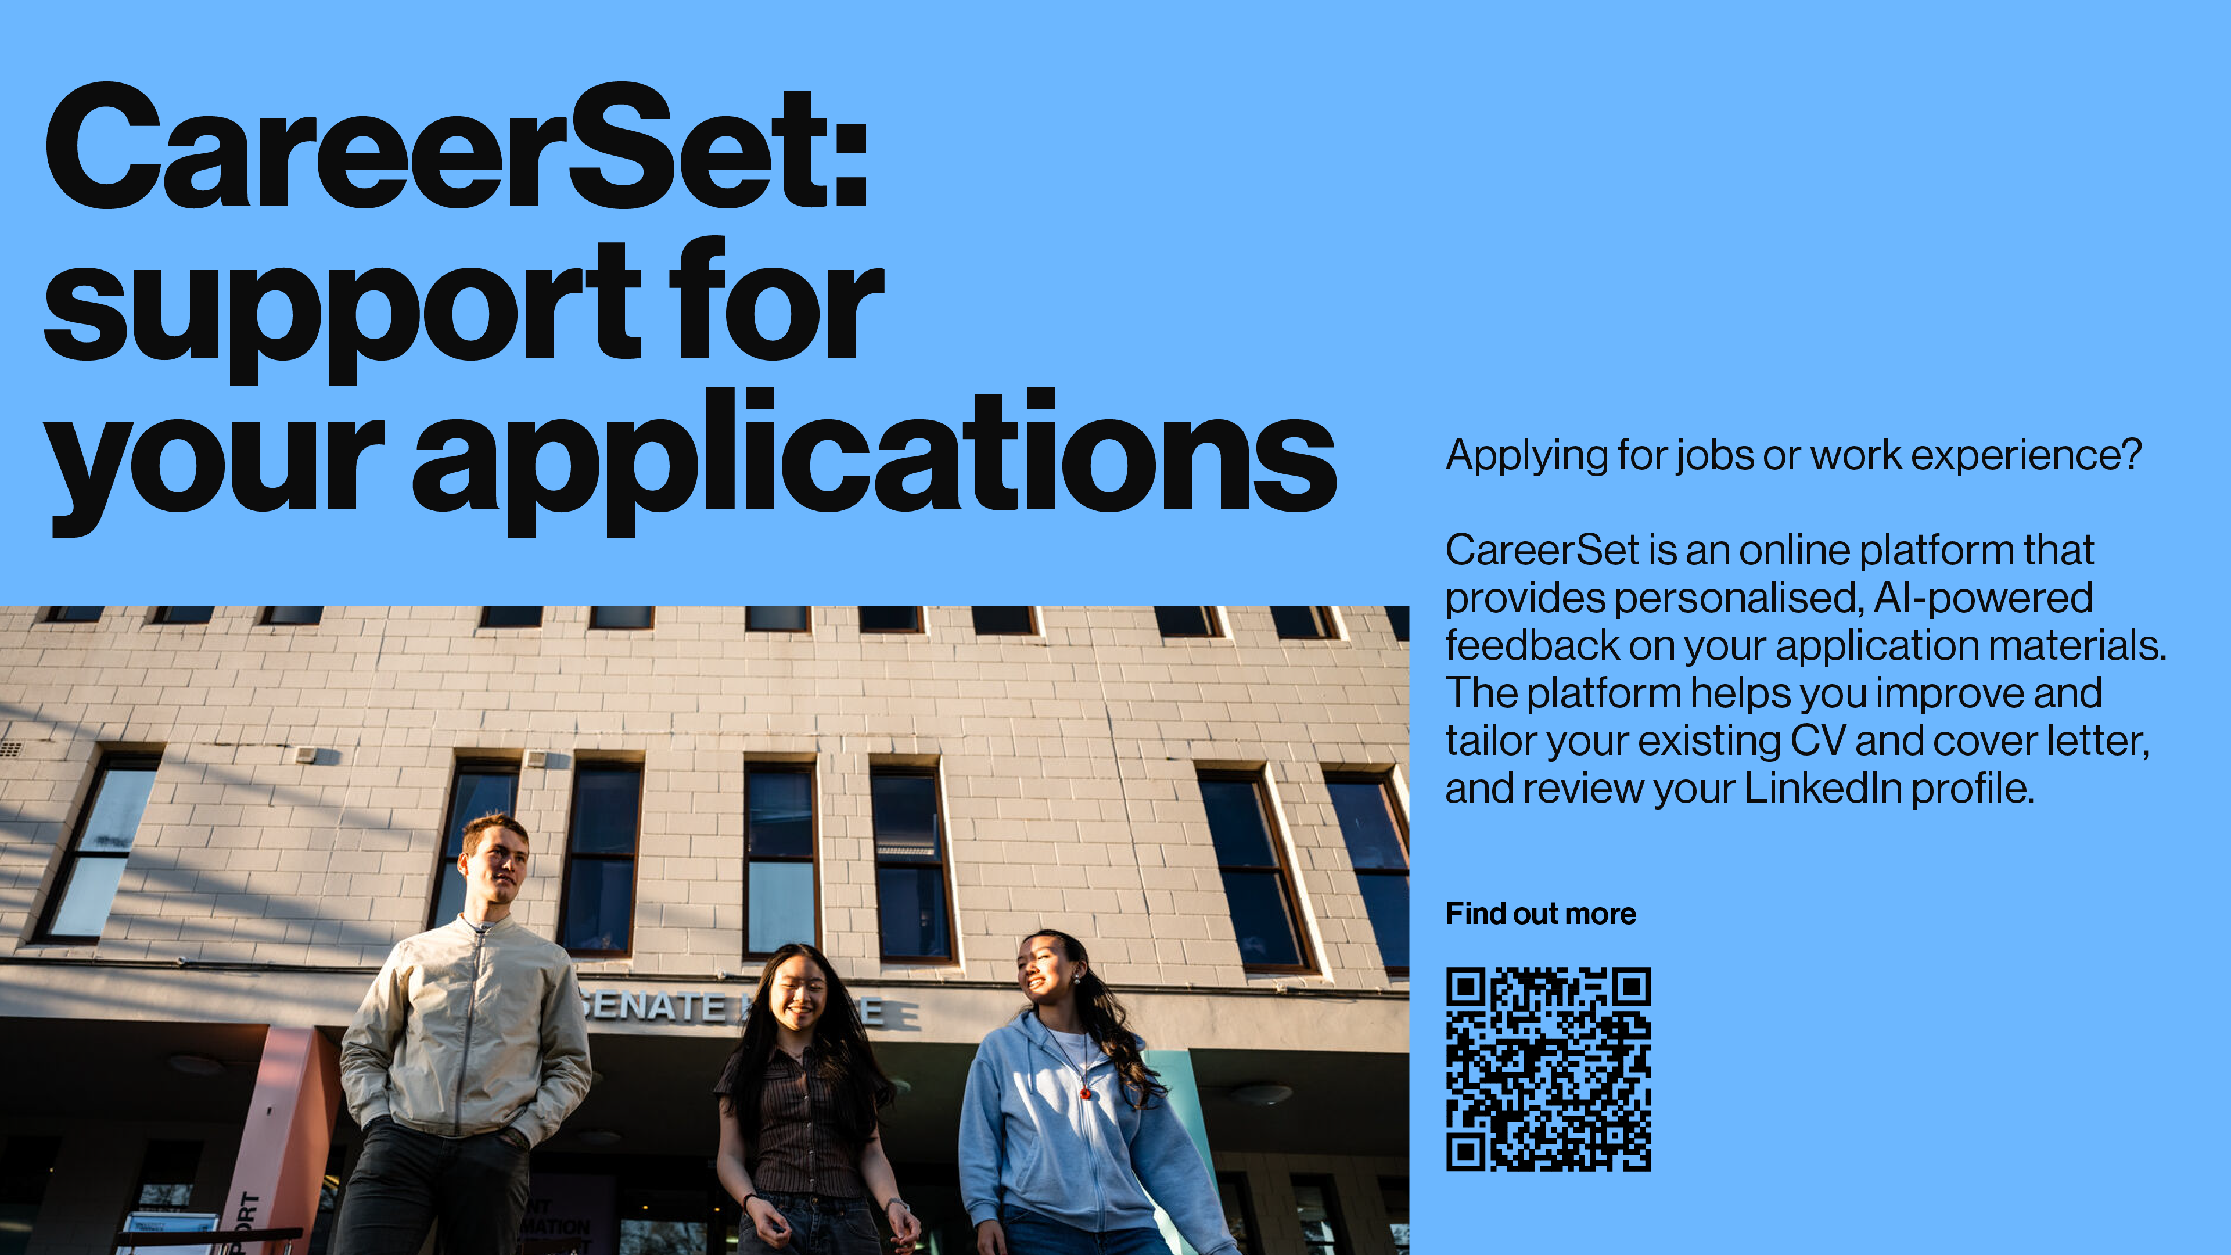

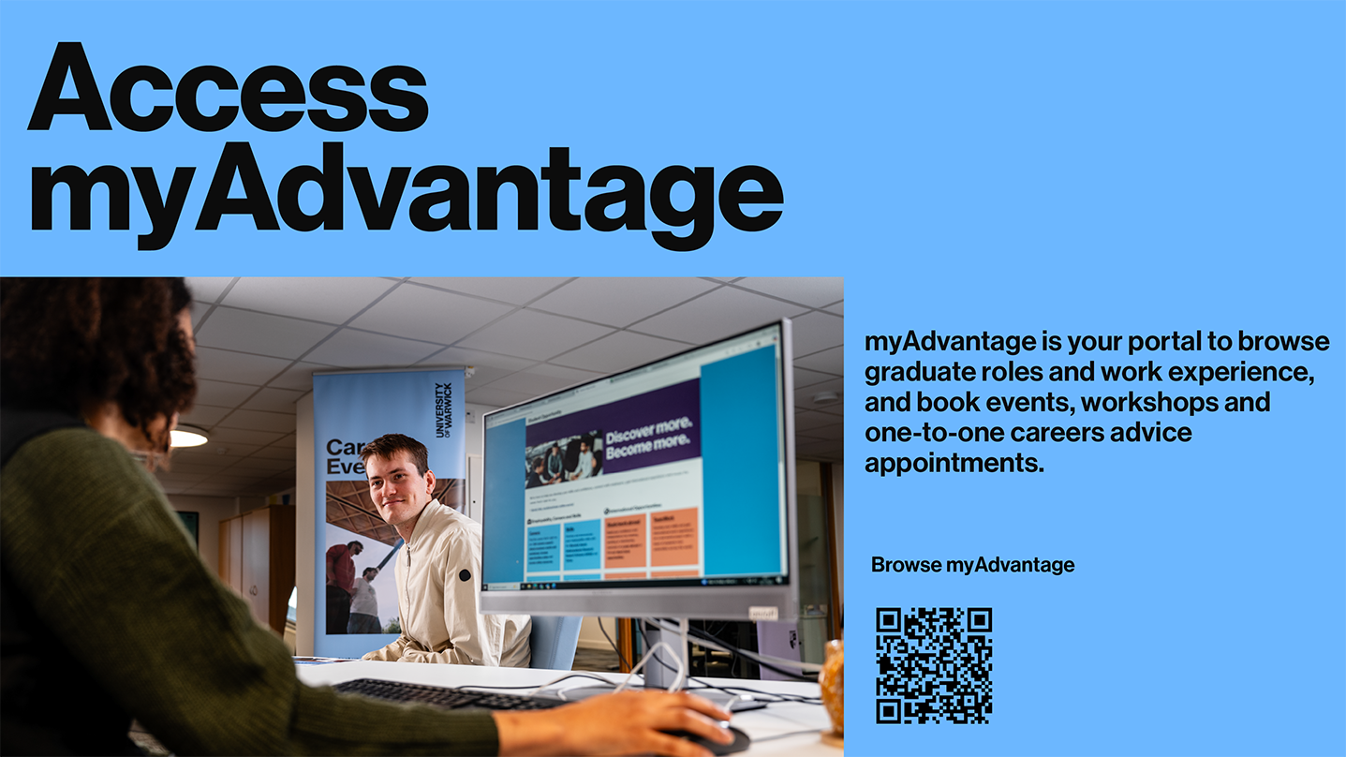
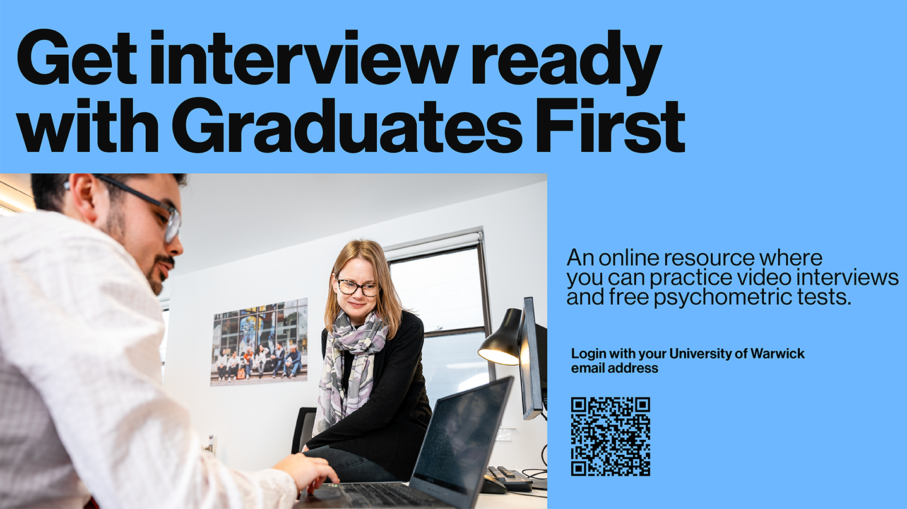
12 Warwick Core Skills
Communication: ability to convey or share ideas and feelings effectively, by speaking, writing, or using some other medium.
Critical Thinking: independently analyse facts, data, information, and opinions to form an evaluation and engage in debate.
Digital Literacy: learn, and work in a society where communication and access to information is through digital technologies like internet platforms, social media, and mobile devices.
Ethical Values: ability to operate in the workplace with high moral standards. To be fair, respectful, compassionate, honest, and responsible. Taking responsibility for your own actions.
Information Literacy: understand the nature, value, use, and management of information.
Intercultural Awareness: work productively with people from different cultural backgrounds. Organisational Awareness: understand how organisations work and act on that knowledge to interact effectively with and within them.
Problem Solving: ability to define a problem or challenge, then find, design, and select a solution to it.
Professionalism: to be reliable, set your own high standards, being industrious and organised.
Self Awareness: Be aware of your own personality, strengths, and emotions, then learn and develop accordingly.
Sustainability: ability to develop capabilities towards balancing the needs of human culture and wider environments for the present and future. Teamwork: Work collaboratively.

Slide 4
12 Warwick Core Skills
Communication: ability to convey or share ideas and feelings effectively, by speaking, writing, or using some other medium.
Critical Thinking: independently analyse facts, data, information, and opinions to form an evaluation and engage in debate.
Digital Literacy: learn, and work in a society where communication and access to information is through digital technologies like internet platforms, social media, and mobile devices.
Ethical Values: ability to operate in the workplace with high moral standards. To be fair, respectful, compassionate, honest, and responsible. Taking responsibility for your own actions.
Information Literacy: understand the nature, value, use, and management of information.
Intercultural Awareness: work productively with people from different cultural backgrounds. Organisational Awareness: understand how organisations work and act on that knowledge to interact effectively with and within them.
Problem Solving: ability to define a problem or challenge, then find, design, and select a solution to it.
Professionalism: to be reliable, set your own high standards, being industrious and organised.
Self Awareness: Be aware of your own personality, strengths, and emotions, then learn and develop accordingly.
Sustainability: ability to develop capabilities towards balancing the needs of human culture and wider environments for the present and future. Teamwork: Work collaboratively.

Slide 5
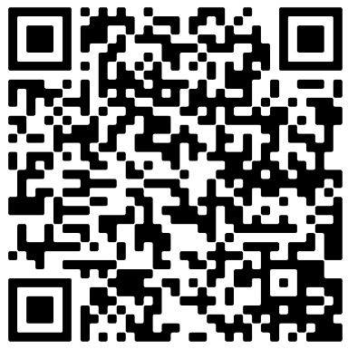
Access Student Circus
Student Circus is a job search platform for international students that brings you filtered visa job listings, internships, and placement opportunities. Student Circus saves you time in your job search by showing you job opportunities with employers who hire and value international students.
If you want to stay and work in the UK, find Skilled Worker Visa opportunities for you in UK-based organisations on the platform.
If you’re looking to return home and work in a high-impact organisation, the platform handpicks top employers who value your global outlook and international experience.
If you’re looking to plan an international career, look at Student Circus’s home country career guides, which exist for 16 countries outside of the UK

Slide 6

Looking at your degree from your first year.
Careers for Psychology
Moodle
Covers career ideas, work experience, podcasts, applications and more

Slide 7

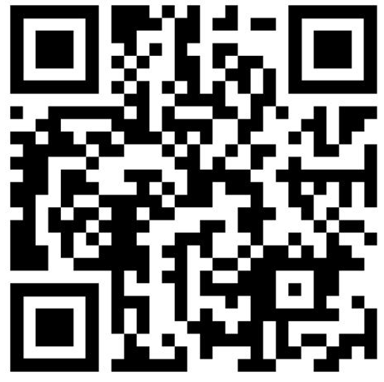
Warwick Volunteers
What is Warwick Volunteers?
Warwick Volunteers supports students at the University of Warwick to volunteer in the communities around campus.
Benefits for you?​
Developing Soft Skills:​
You can communication, leadership, project management skills and more
Boost Employability:
Your volunteering hours count towards the Warwick Award.
Meet New People:
Meet other students from different courses and get to know the local community!
Find your volunteering opportunity here
Notes:
I'm 'xx' and I am here today to give you all a quick introduction to what Warwick Volunteers is and why you should become a volunteer!

Slide 8


Why not look at your modules and the skills they give you!
Info on podcasts, applying for jobs, writing your CV, volunteering, virtual work experience and much, much more
Check out the Psychology Careers Moodle
This Photo by Unknown Author is licensed under CC BY-SA

Slide 9
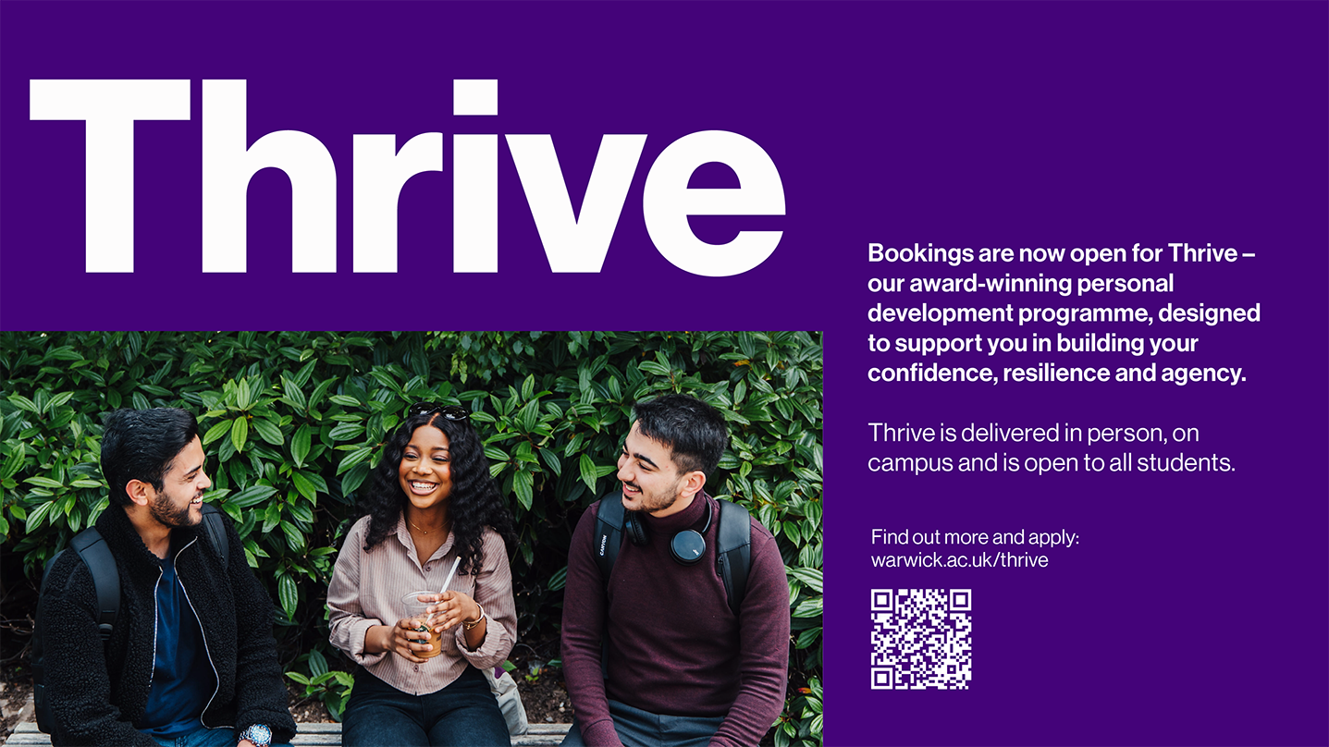
Why not look at your modules and the skills they give you!
Info on podcasts, applying for jobs, writing your CV, volunteering, virtual work experience and much, much more
Check out the Psychology Careers Moodle
This Photo by Unknown Author is licensed under CC BY-SA

Slide 10
Careers Supports:
International Students
Race and Ethnicity
Neuro Diverse
Care leavers
Mental Health
Disabilities
Carers
Mature students
Criminal Convictions
Gender
LGBTQUIA+
Social Mobility
Dyslexia
Religion

