Slide 1
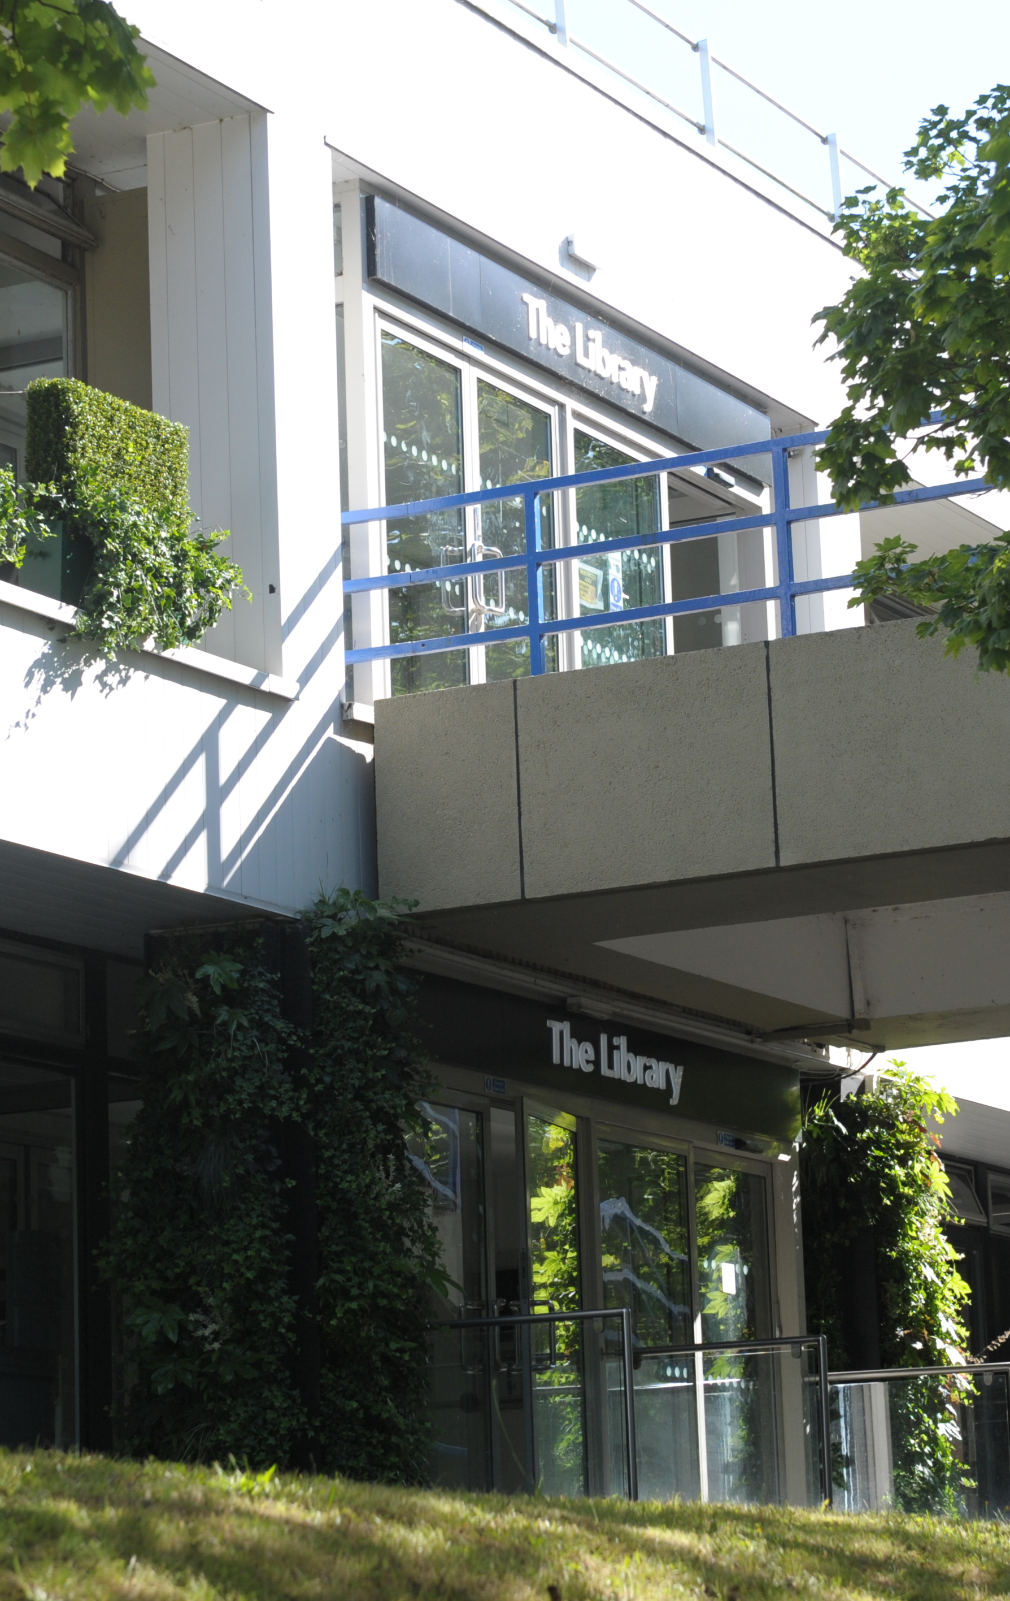
Welcome to the Library
Samantha Johnson & Chris Bark
Research & Academic Support Librarians

Slide 2

How can we help?
There is lots of help available:
finding your way around the building
accessing the Library’s services and resources
accessing our e-books, electronic journals and
databases

Slide 3
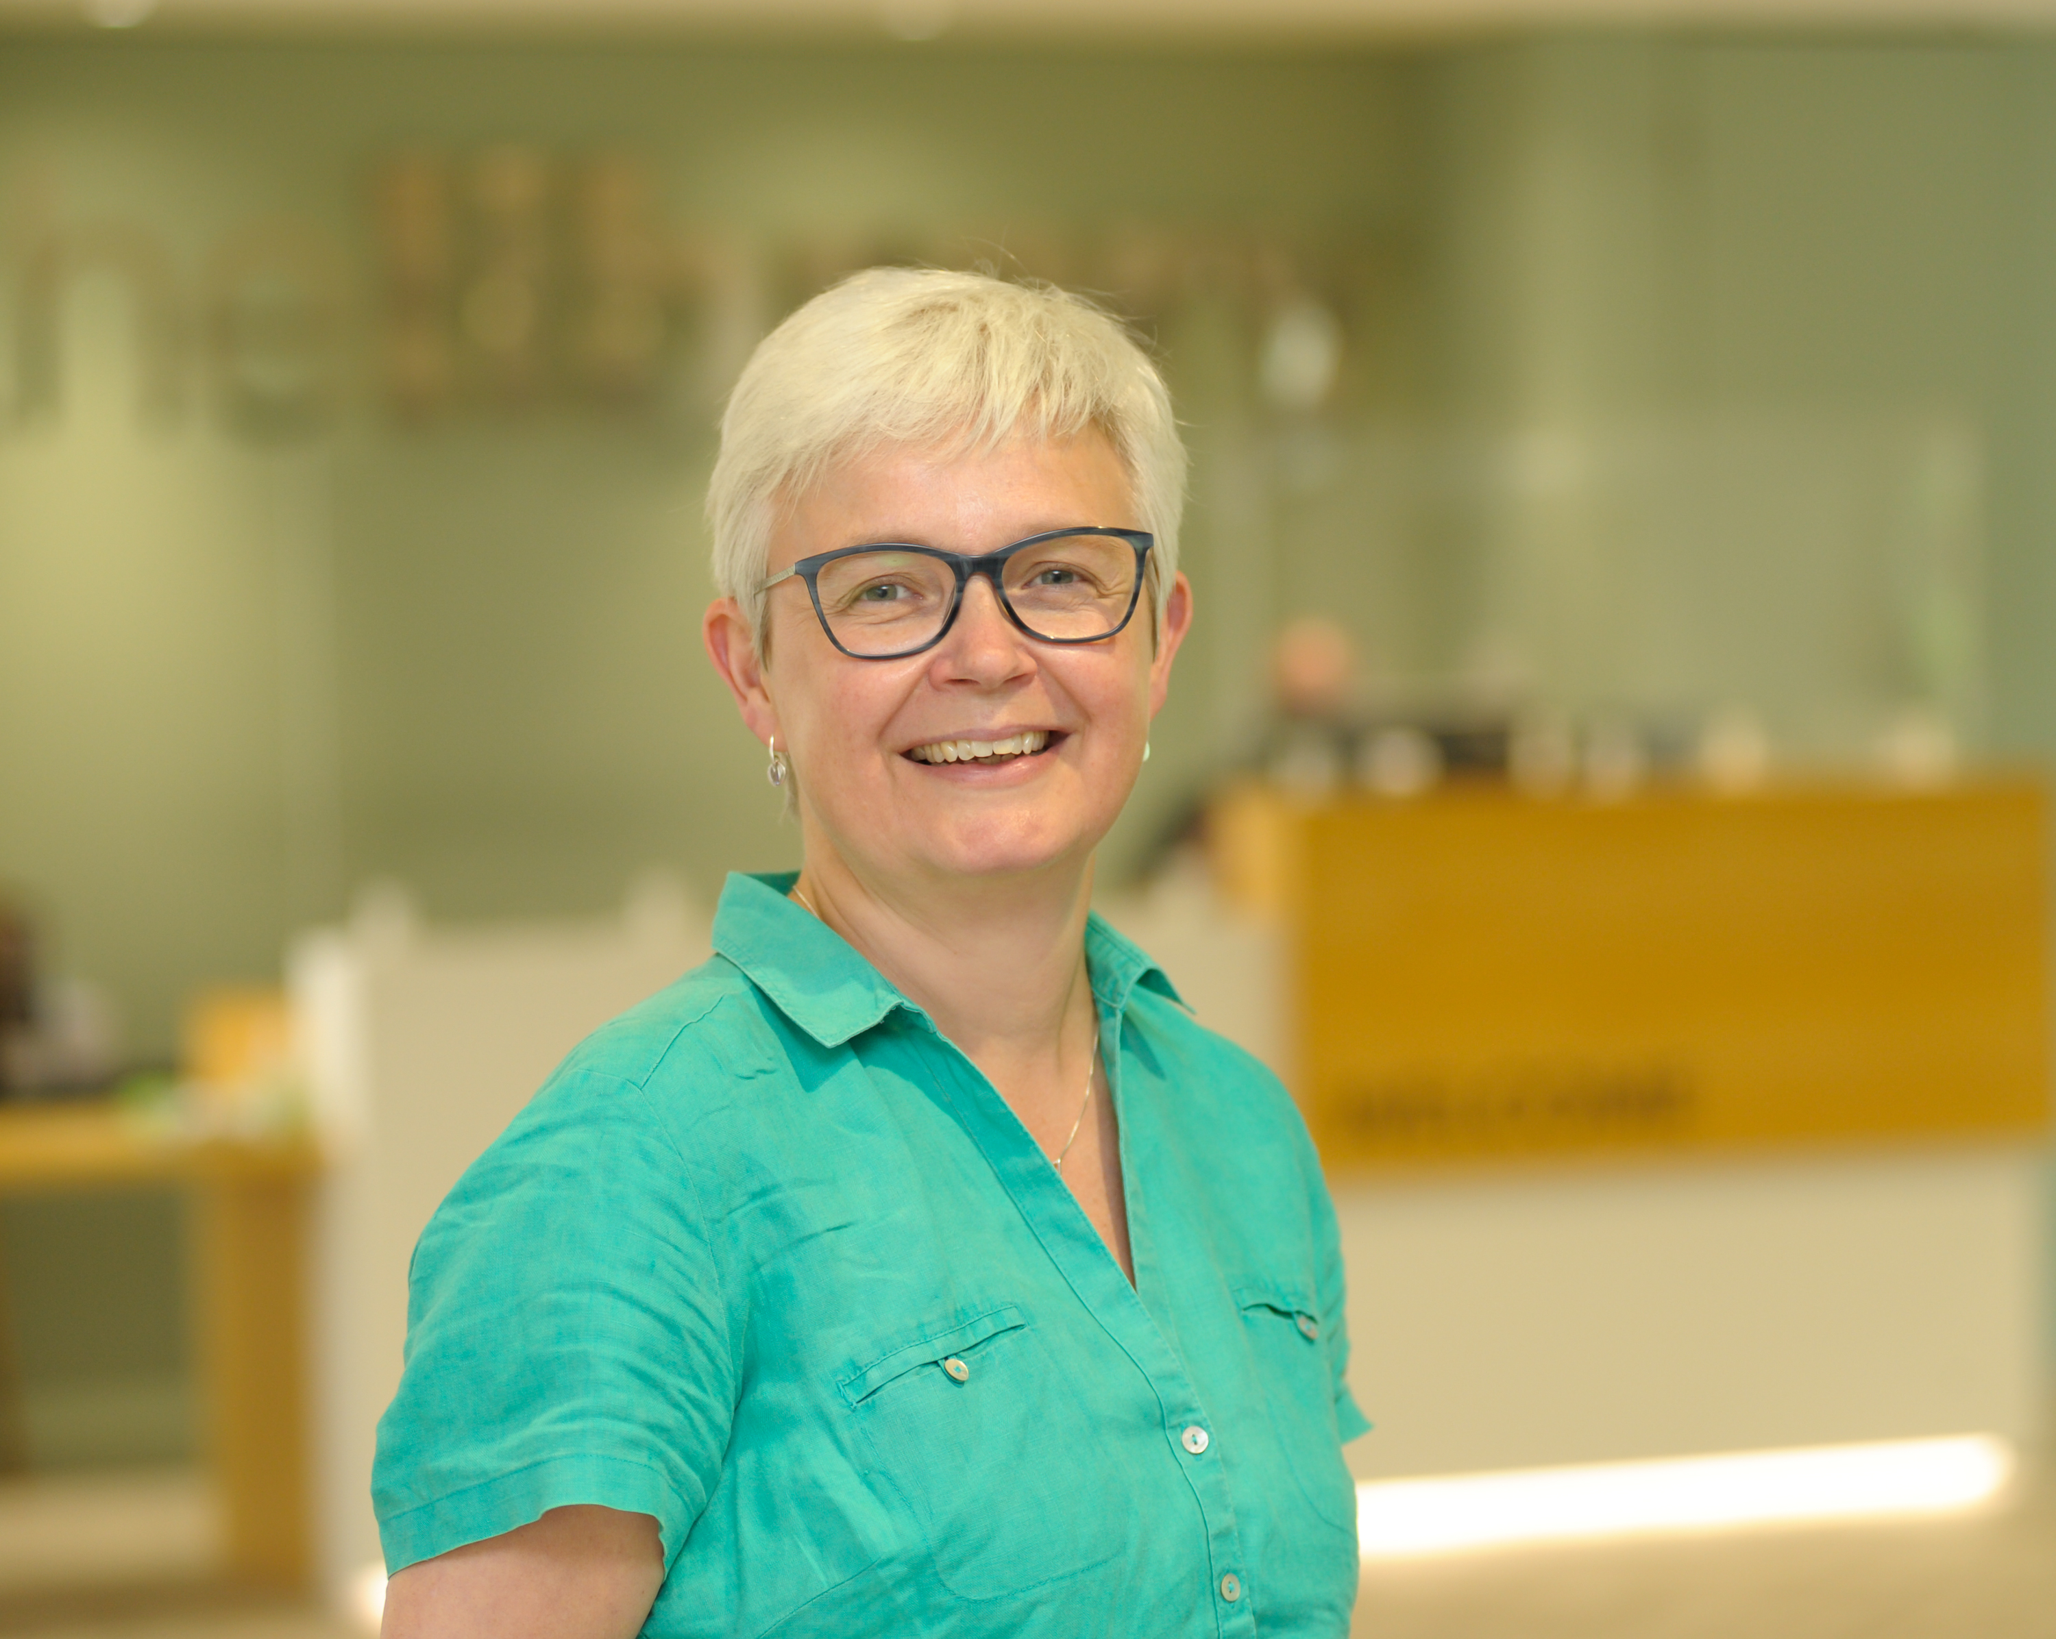
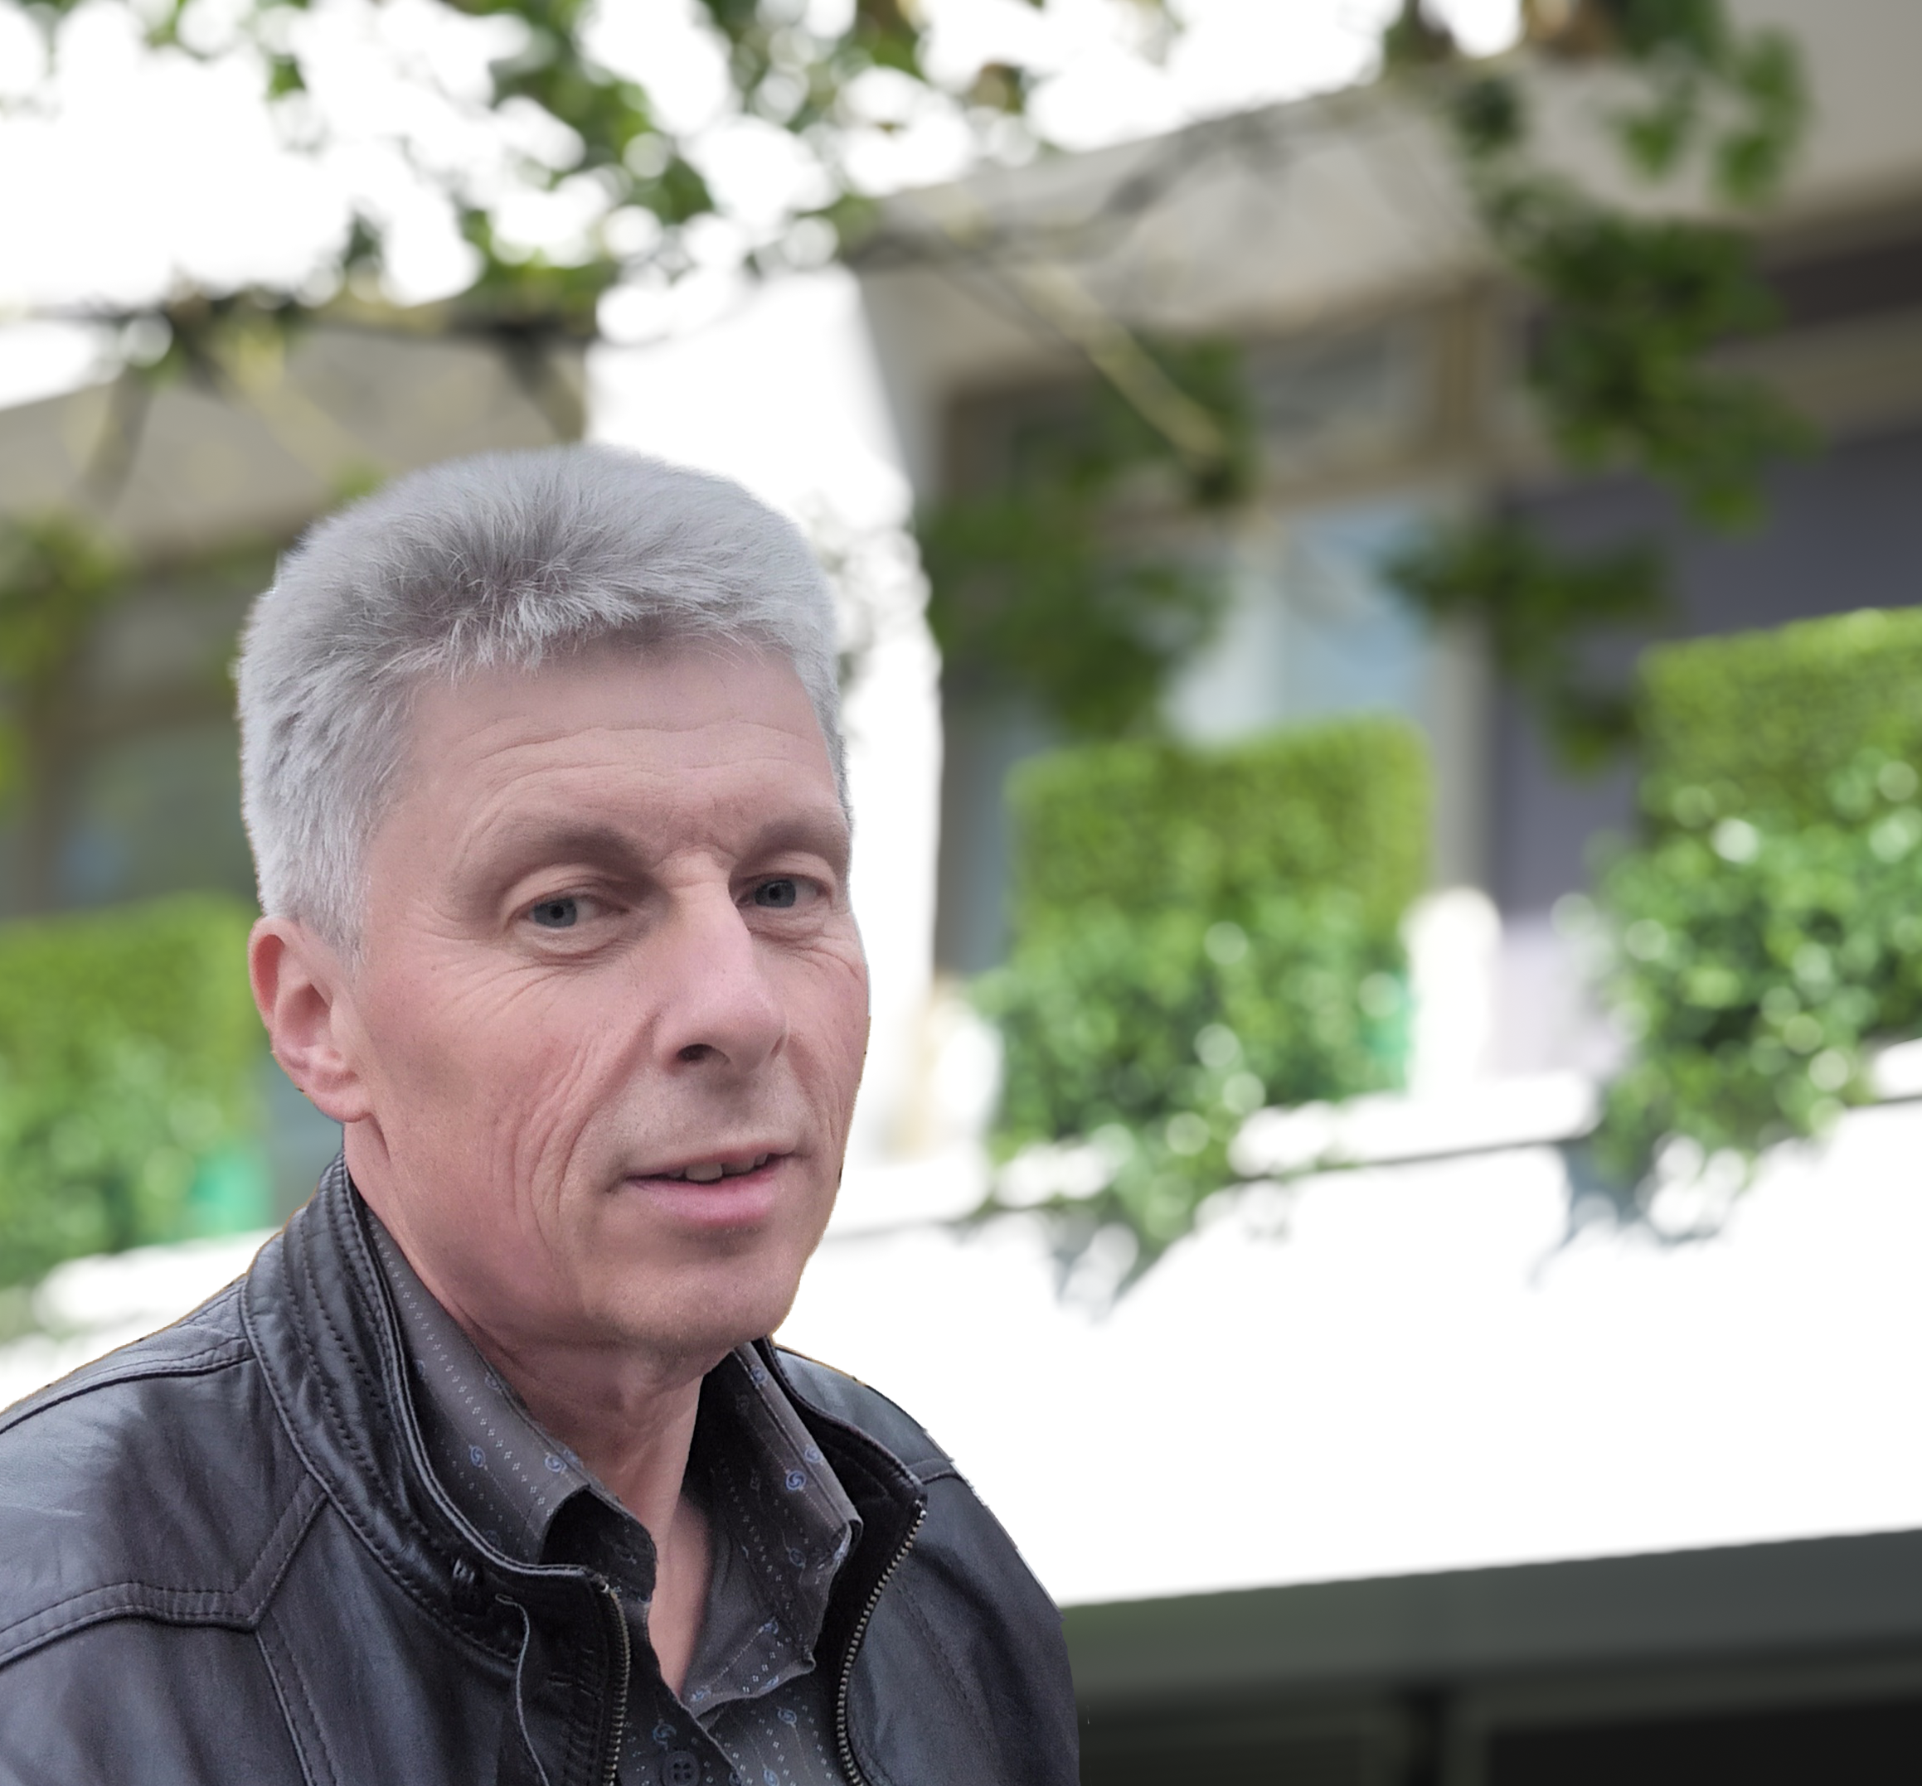
How can we help?
ask Library staff or our Library Student Partners
Email the Library via Library@warwick.ac.uk
Check out our online guides and videos
Contact us direct:
  Happy to meet in person, by email or via Teams
  Samantha.A.Johnson@warwick.ac.uk
  Chris.Bark@warwick.ac.uk

Slide 4

Library Welcome Week Events
Come along to any of these events to find out more about the Library and grab yourself some goodies!
Explore Your Library (Stall and Tours) – Main Library, Floor 1
  Monday 28th September: 11:00 – 15:00
  Tuesday 29th September: 11:00– 15;00
  Wednesday 30th September: 11:00 – 15:00
Study essentials: finding academic resources – Creative Community space, Main Library, Floor 2
  Mon 28th Sep – Fri 2nd October
  10:00-11:00 & 14:00-15:00

Slide 5
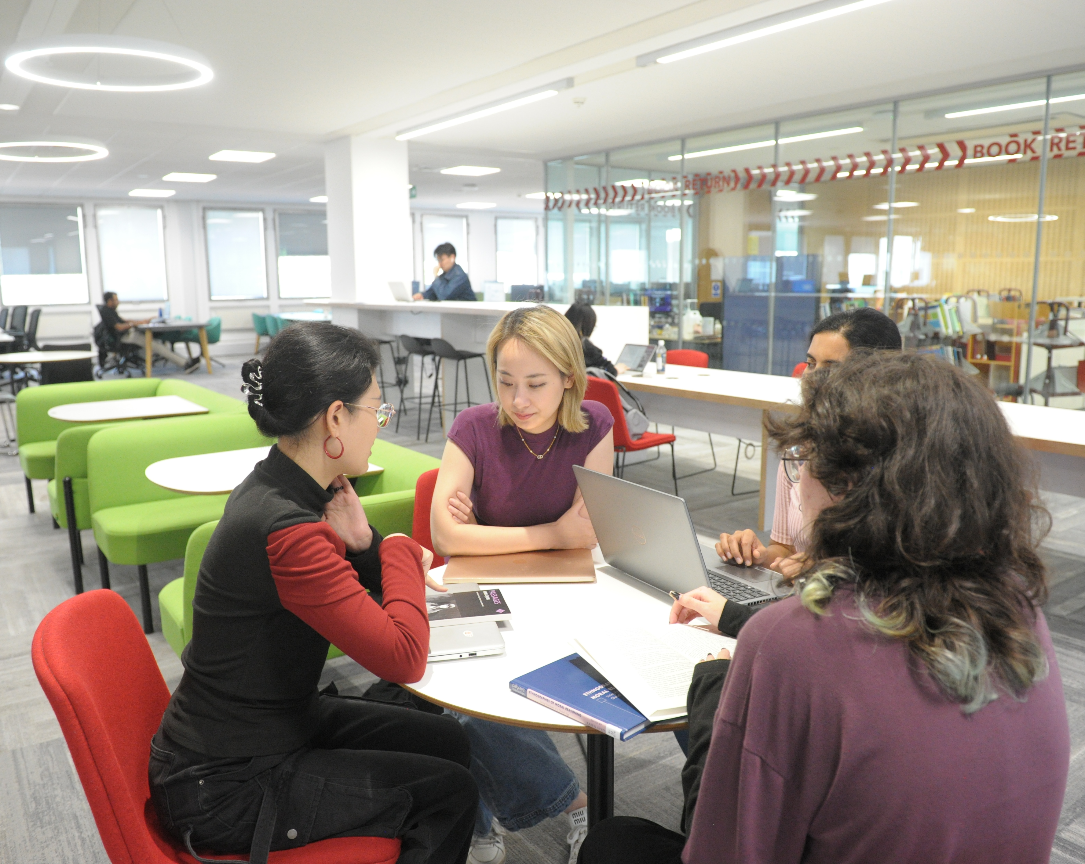
Library Essentials
  Open 24/7 (except summer vacation)
  Library and IT Helpdesks
  Café Library & Library Coffee Bar
  Individual and group study spaces
  Desktop PC’s
  Rootes Grid – study space
  The Breathing Space – relaxation
  area and leisure reading collection
  The Eating Place – relaxation area
  just outside the Library

Slide 6
Usernames and passwords
Your University username and password allows you to access all of our electronic resources
Use the Library pages as your starting point for databases and e-journals as we try to maintain the correct links
Going from another page may mean that you are not recognised as a Warwick person and may be denied access or asked for payment

Slide 7
Borrowing books
Top tip: Lots of books are available electronically
Borrow as many books as you need
Issued for whole academic year
Automatic renewals
No fines
Remember: all print books can be recalled earlier than the original due date.
Failure to return the book will prevent you from borrowing anything else and may result in you being invoiced

Slide 8

Click and Collect
Order up to 10 items for collection from the Library
We will email you when they ready for collection
Pick up time will be approximately 48 hours
For books out on loan to someone else, there will be a longer wait for the books

Slide 9
Where are the books?
Print books
Electronic books
Floors 1 and 2 are study spaces: both individual and group study
Psychology books are on Floor 3
But you will find useful books on other floors as well
Happy to receive book suggestions
Lots of textbooks are available electronically
Check via Library Search
All work slightly differently – some good, some not so good!

Slide 10
Library study spaces
Check website for opening hours and study space availability
Main campus
Main Library
Rootes Grid
PG Hub @Junction

Slide 11

Accessibility https://warwick.ac.uk/services/library/using/accessibility/
Services and facilities to support students with disabilities or learning differences
  Study rooms
  Software
  Loanable equipment
  Adjustable furniture
  Productivity Tools

Slide 12
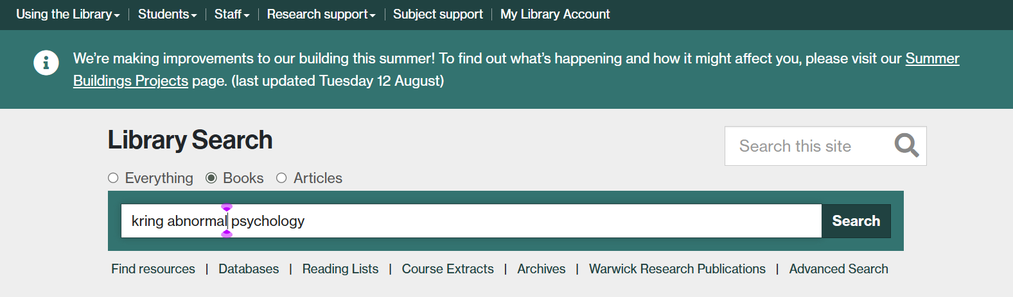
Finding Books

Slide 13
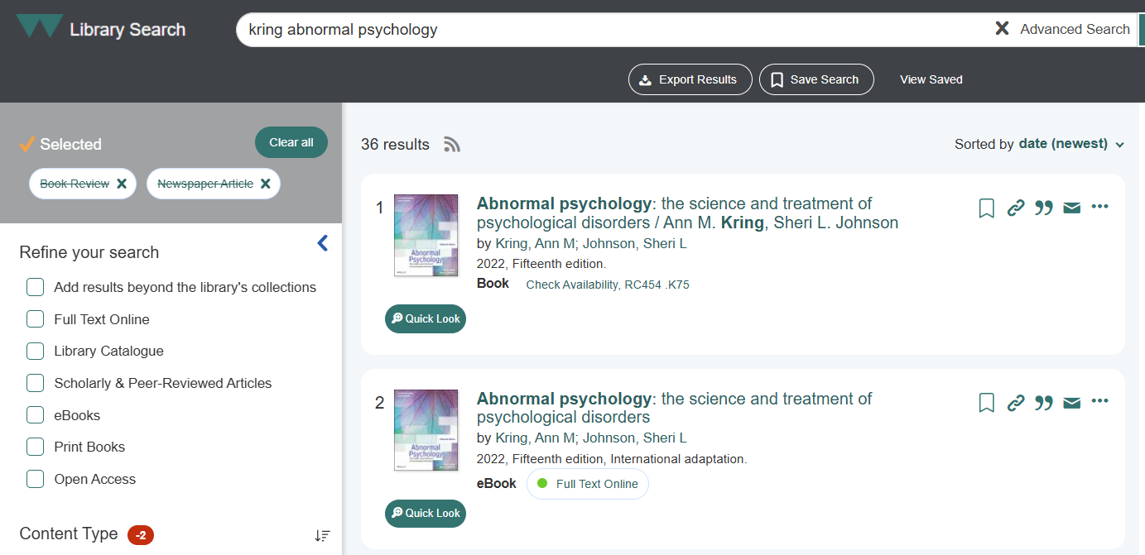
Finding Books

Slide 14
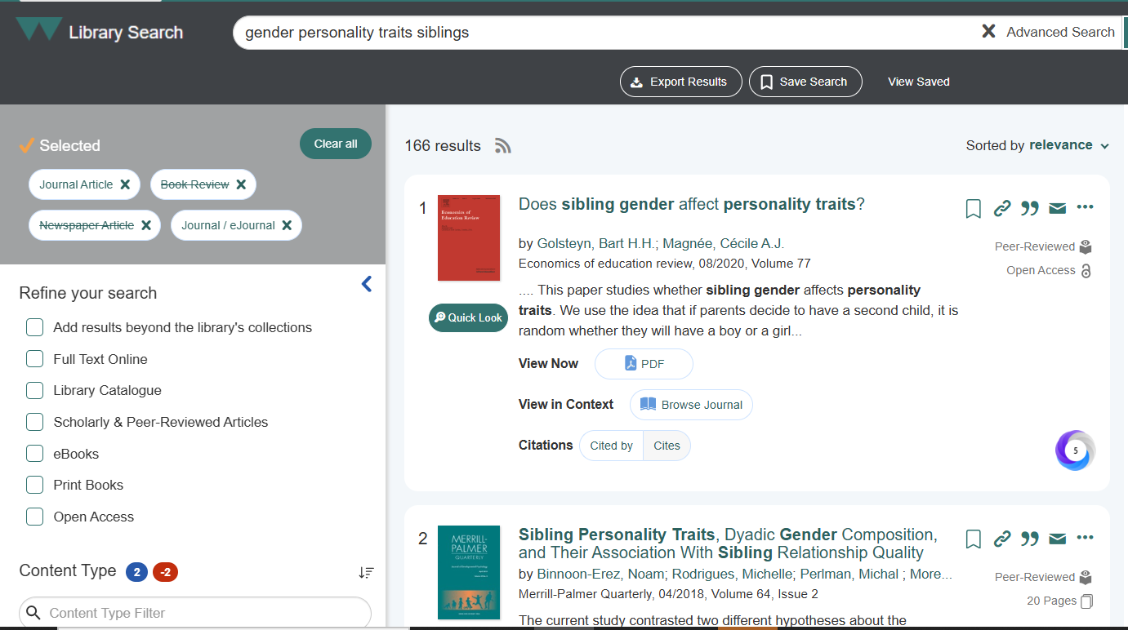
Finding Research

Slide 15
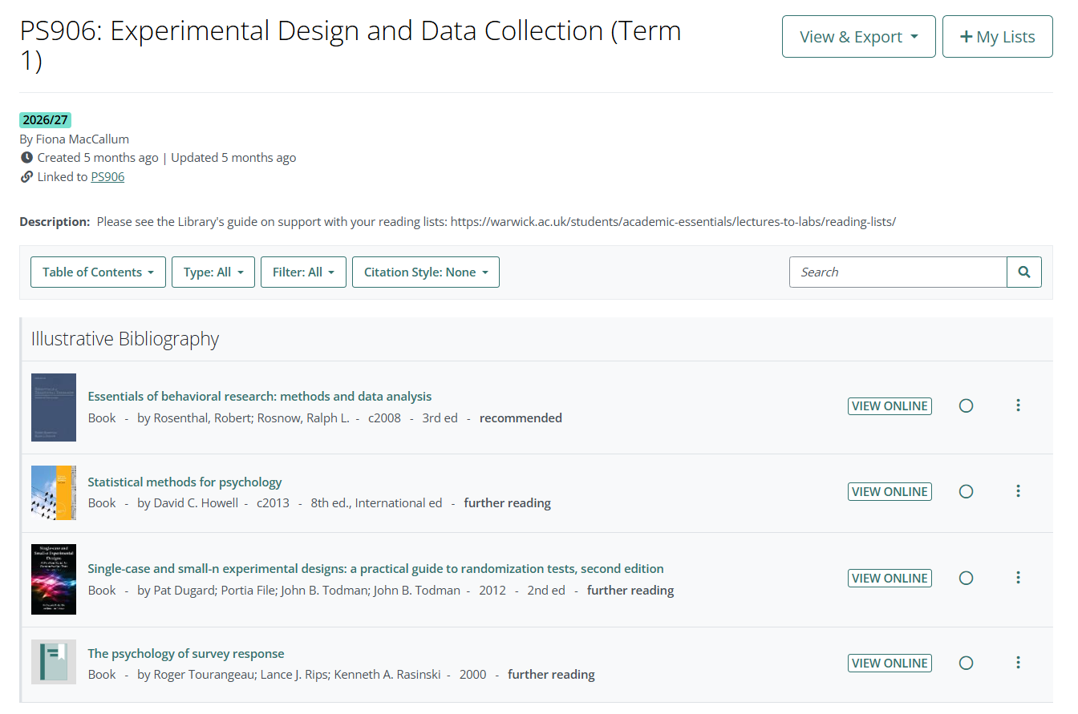
Online reading lists: PS906

Slide 16

  Psychology Guide https://warwick.libguides.com/psychology/home
  Economics, Psychology & Philosophy Guide https://warwick.libguides.com/epp
Advice and guidance about:
  Databases
  Search techniques
  Referencing
  Books and Journals
  Research Support

Slide 17
Help and advice https://warwick.libguides.com/psychology/home
Which database to search?
How to put a search strategy together
Have you found too few or too many references?
Do you think that something is missing from your results?
Would you like your search strategy checking?
Saving and reporting your searches
Finding the full text of articles
Managing your references

Slide 18
Library Online courses
https://warwick.libguides.com/psychology/databases
Medline (covers PsycInfo)
Conducting a systematic literature search
  Search advice and techniques
  Saving searches
  Planning your searches
  Recording and documenting searches
  Managing references
  Starting to sift

Slide 19
Finding the full text
Install LibKey Nomad extension to help find the full text of articles:
https://warwick.ac.uk/services/library/find-resources/e-access/tools/
In Google Scholar, go to Settings > Library Links > Enter Warwick and select Warwick University > Submit
Use the Get it for Me service to request material that is not available:
https://warwick.ac.uk/services/library/using/get-it-for-me/

Slide 20
Referencing
How will you keep track of the articles and books and other sources of information that you use in your assignments?
How will you make sure that your references are in an accepted style?
How will you make sure that your references are consistent?

Slide 21
Endnote
Install Endnote from IT Services
Library runs training sessions and access to recorded webinars
Create a Library of references
Automatically formats references in your preferred referencing style
Alternative software: Mendeley, Zotero
https://warwick.ac.uk/services/library/students/endnote/

Slide 22
Library Online courses
https://warwick.ac.uk/services/library/students/library-online-courses/
Introduction to Referencing
Avoiding Plagiarism
  a good general introduction to referencing
  covers the Harvard and Vancouver styles of referencing
  Passing off someone else’s work as your own
  Can get you into a lot of trouble!

Slide 23

AI is just another tool
Use it appropriately – but don’t trust it
Challenge everything
Be curious
Be critical

Slide 24

Guide to Artificial Intelligence: https://warwick.libguides.com/artificialintelligence
using AI at Warwick
what it is & how it works
common uses & applications
ethics and potential dangers
guidance on properly citing
and referencing AI tools and
resources in your academic
work

Slide 25
Further help and advice
Contact us:
Samantha.A.Johnson@warwick.ac.uk
Chris.Bark@warwick.ac.uk
Book a one to one appointment
Contact the Library:
library@warwick.ac.uk
Check out the Psychology Guide:
https://warwick.libguides.com/psychology/home

Slide 26
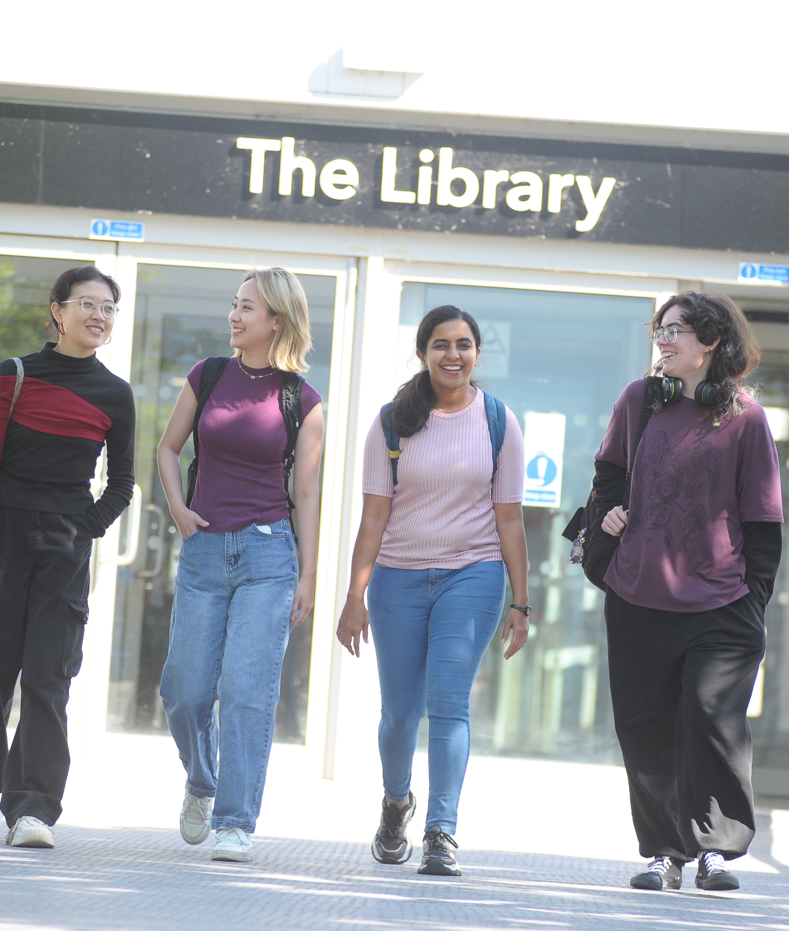
Thank You and Good Luck!

