Slide 1
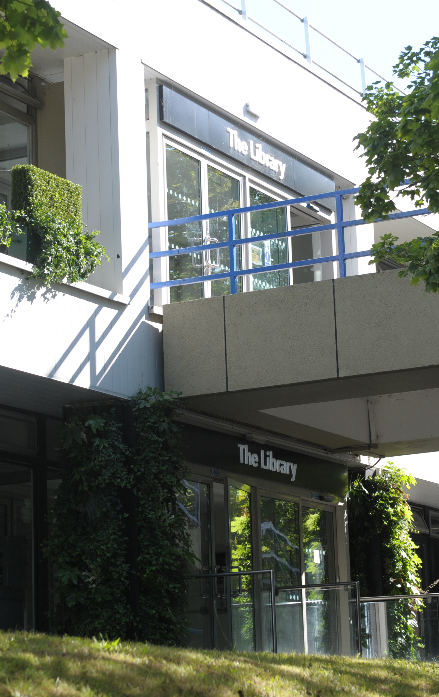
Welcome to the Library Samantha Johnson & Chris Bark Research & Academic Support Librarians

Slide 2
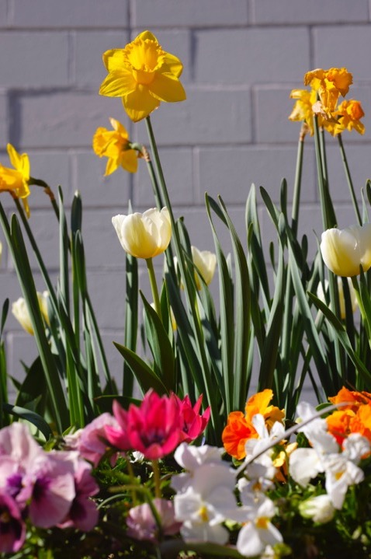
How can we help?
There is lots of help available:
finding your way around the building
accessing the Library’s services and resources
accessing our e-books, electronic journals and databases

Slide 3
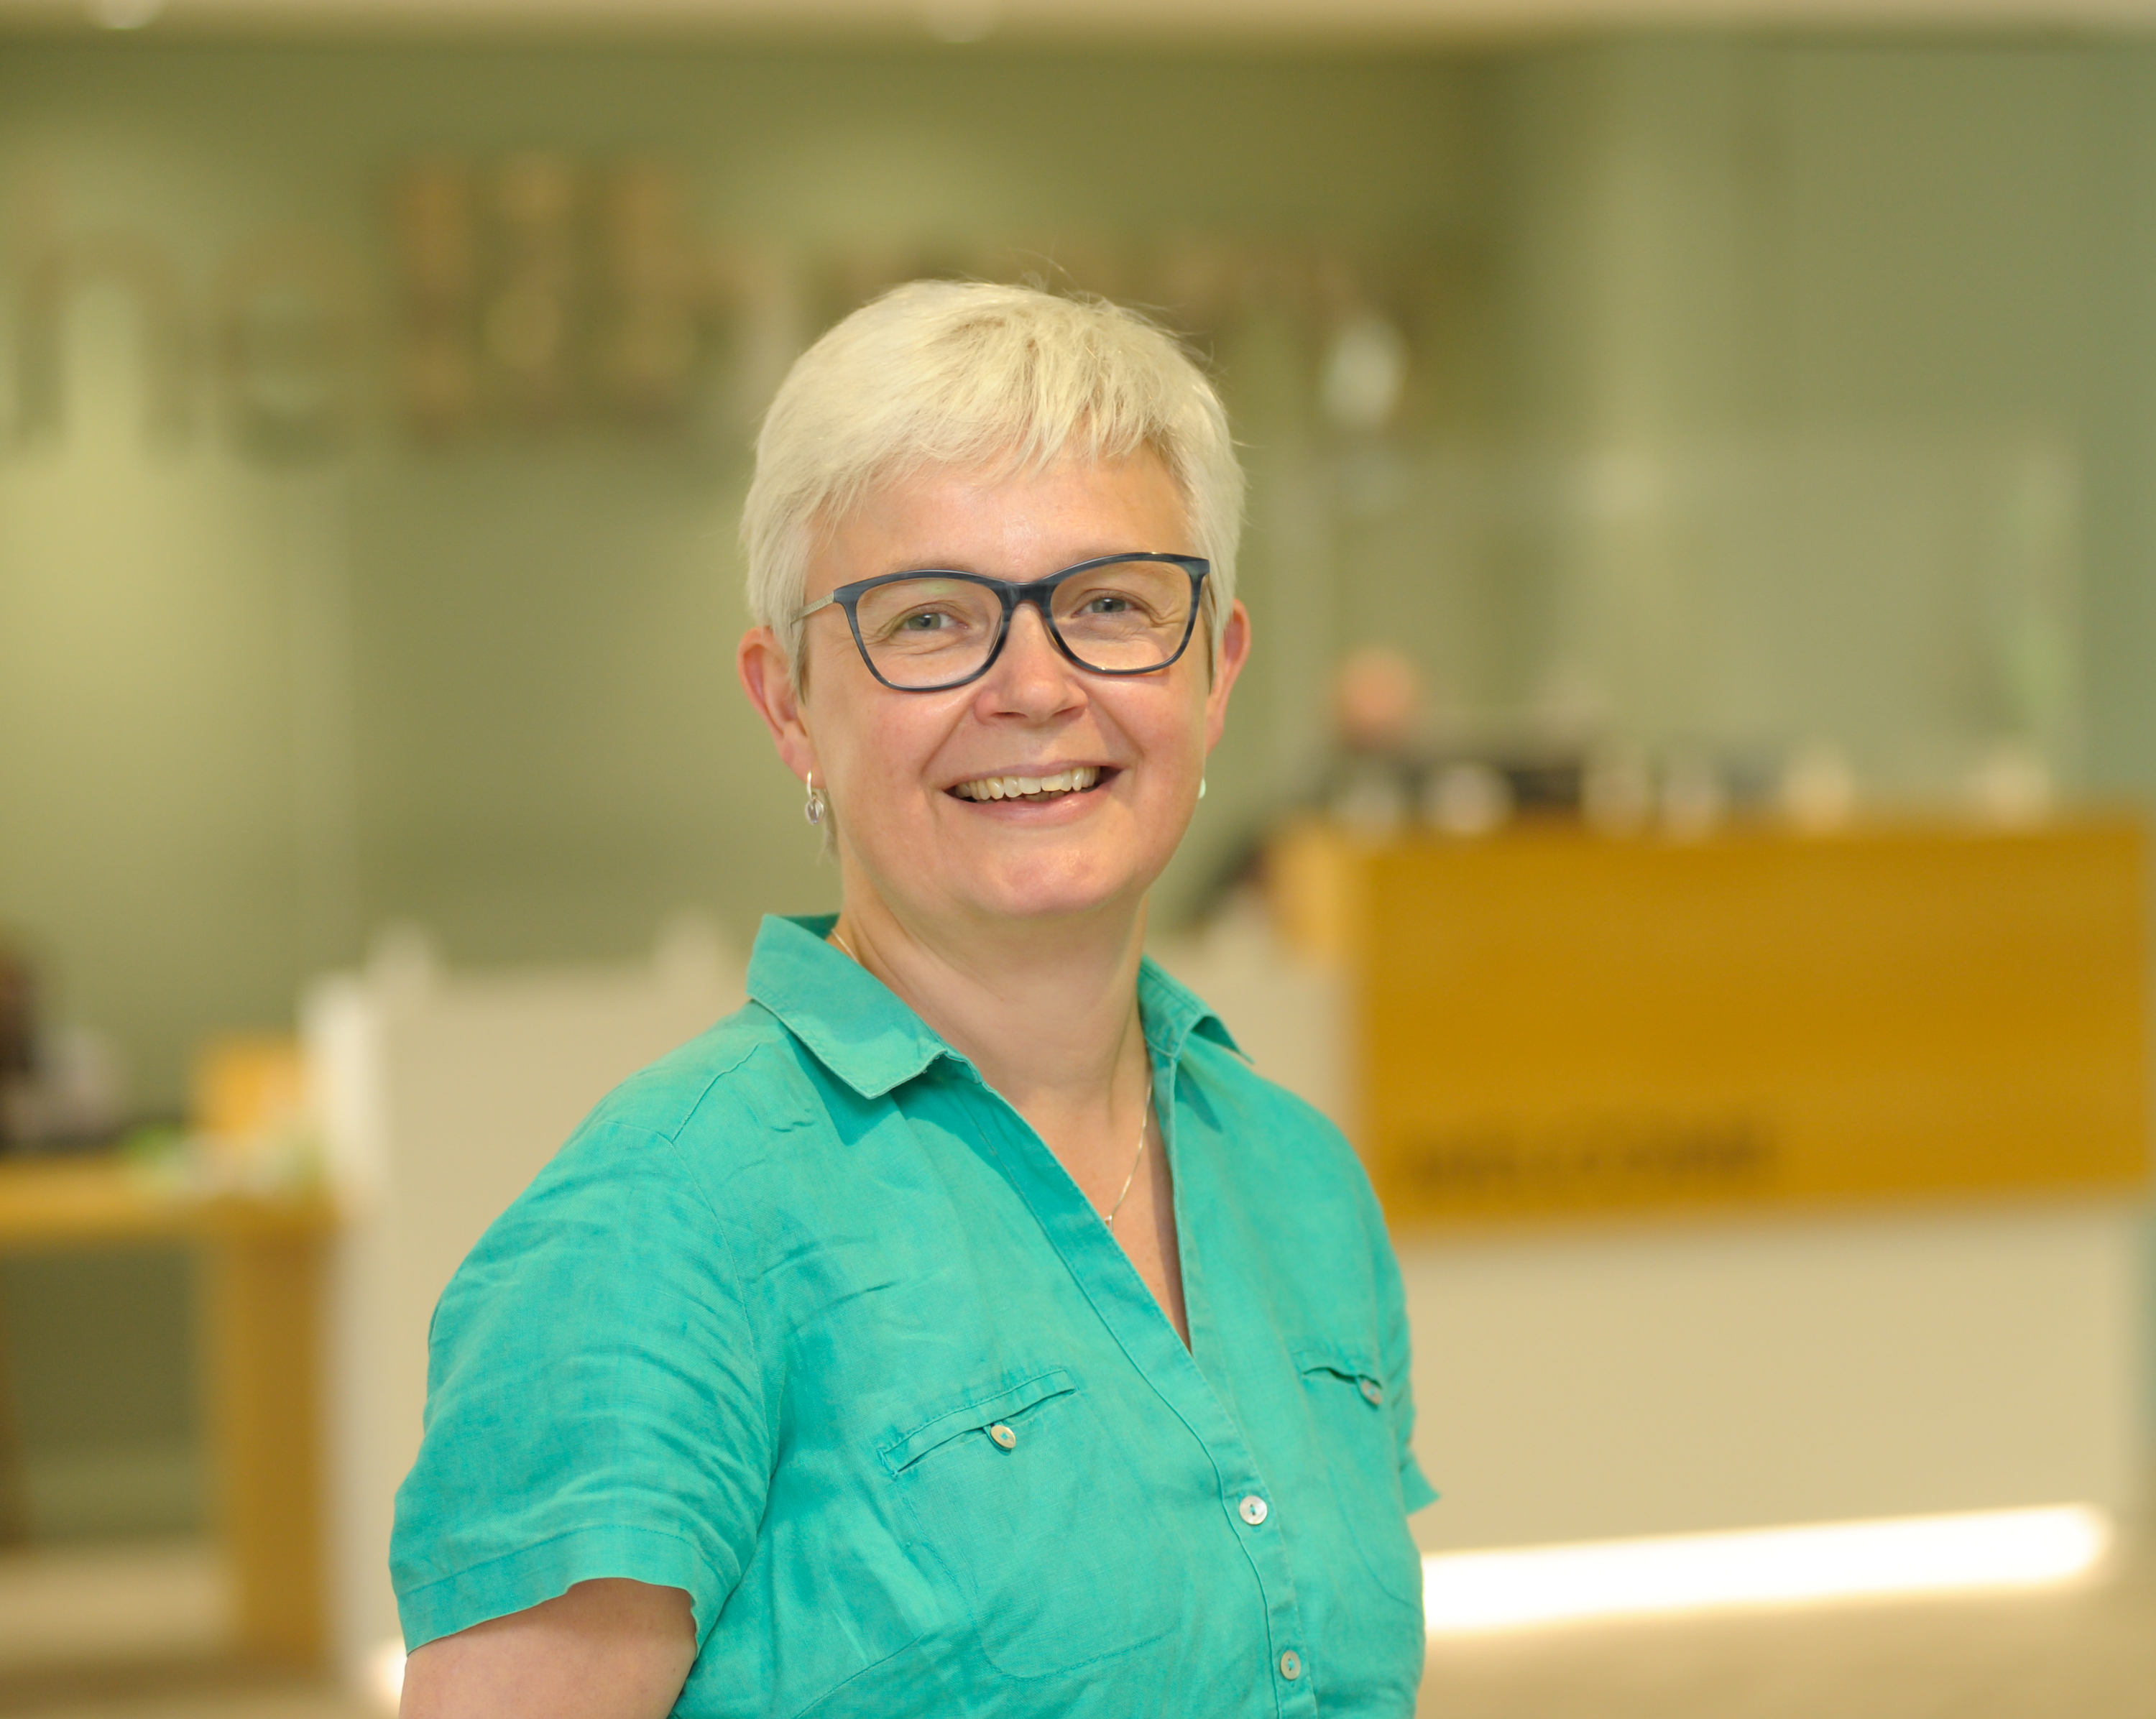
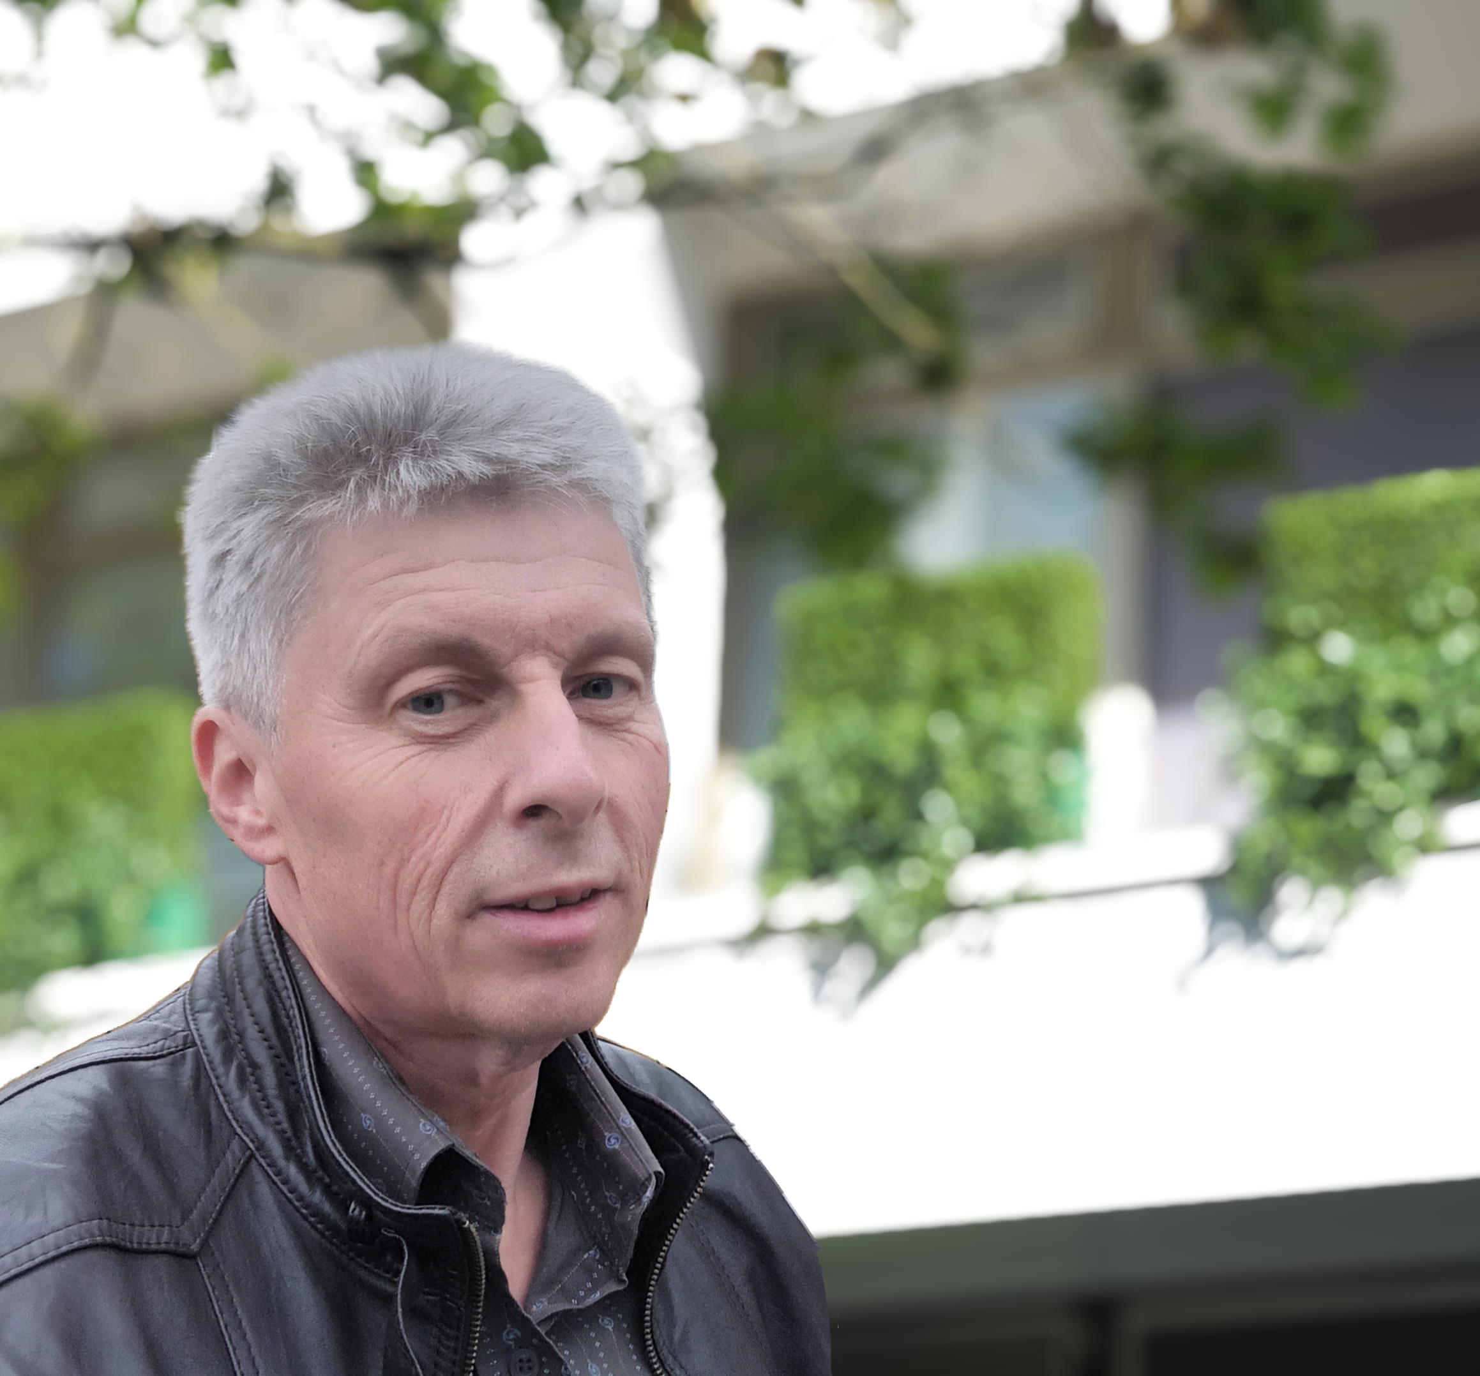
How can we help?
ask Library staff or our Library Student Partners
Email the Library via Library@warwick.ac.uk
Check out our online guides and videos
Contact us direct:
Happy to meet in person, by email or via Teams
Samantha.A.Johnson@warwick.ac.uk
Chris.Bark@warwick.ac.uk

Slide 4


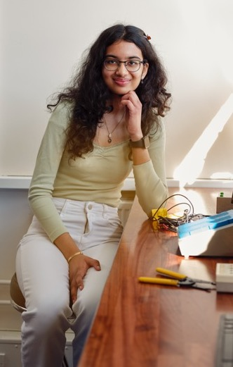
“Come & Explore your Library!
Find out about everything the Library has to offer at our Welcome Stand, or join one of our Library Tours which will run throughout the events
Meet Library staff, our Library Student Partners
Pick up some freebies
When: Welcome Week and Monday-Wednesday in Week 1

Slide 5

Library Essentials
Open 24/7
Library and IT Helpdesks
Café Library & Library Coffee Bar
Individual and group study spaces
Desktop PC’s
The Breathing Space – relaxation
area and leisure reading collection
The Eating Place – relaxation area
just outside the Library

Slide 6
Usernames and passwords
Your University username and password allows you to access all of our electronic resources
Use the Library pages as your starting point for databases and e-journals as we try to maintain the correct links
Going from another page may mean that you are not recognised as a Warwick person and may be denied access or asked for payment

Slide 7
Borrowing books
Top tip: Lots of books are available electronically
Borrow as many books as you need
Issued for whole academic year
Automatic renewals
No fines
Remember: all print books can be recalled earlier than the original due date.
Failure to return the book will prevent you from borrowing anything else and may result in you being invoiced

Slide 8

Click and Collect
Order up to 10 items for collection from the Library
We will email you when they ready for collection
Pick up time will be approximately 48 hours
For books out on loan to someone else, there will be a longer wait for the books

Slide 9
Where are the books?
Print books
Electronic books
Floors 1 and 2 are study spaces: both individual and group study
Psychology books are on Floor 3
But you will find useful books on other floors as well
Happy to receive book suggestions
Lots of textbooks are available electronically
Check via Library Search
All work slightly differently – some good, some not so good!

Slide 10
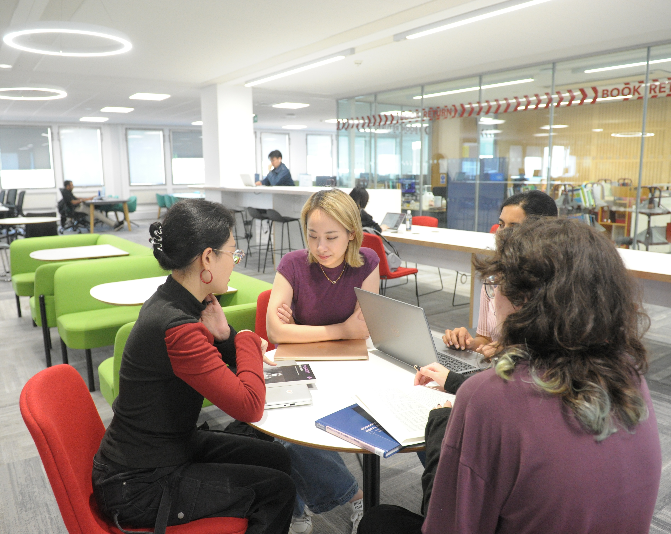
Library study spaces
Check website for opening hours and study space availability
Main campus
Main Library
Rootes Grid
Learning Grid at University House
PG Hub @Junction

Slide 11
Accessibility https://warwick.ac.uk/services/library/using/accessibility/
Services and facilities to support students with disabilities or learning differences
Study rooms
Software
Loanable equipment
Adjustable furniture
Productivity Tools

Slide 12
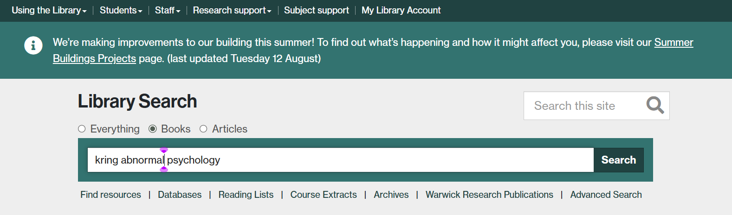
Finding Books

Slide 13
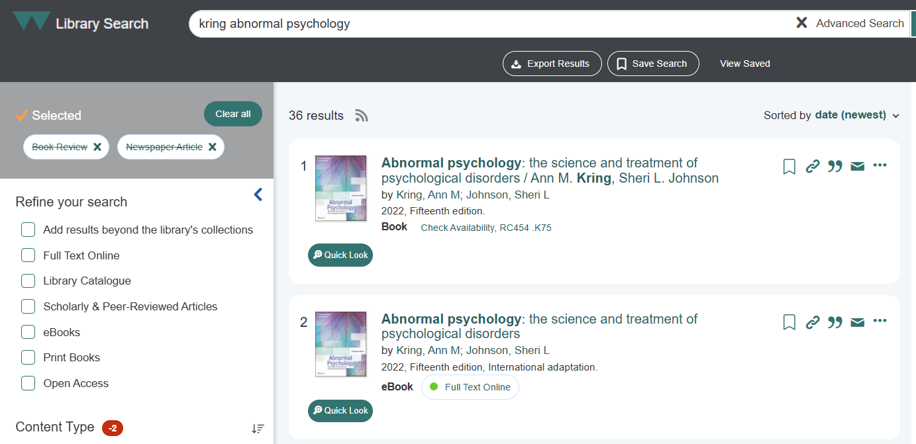
Finding Books

Slide 14
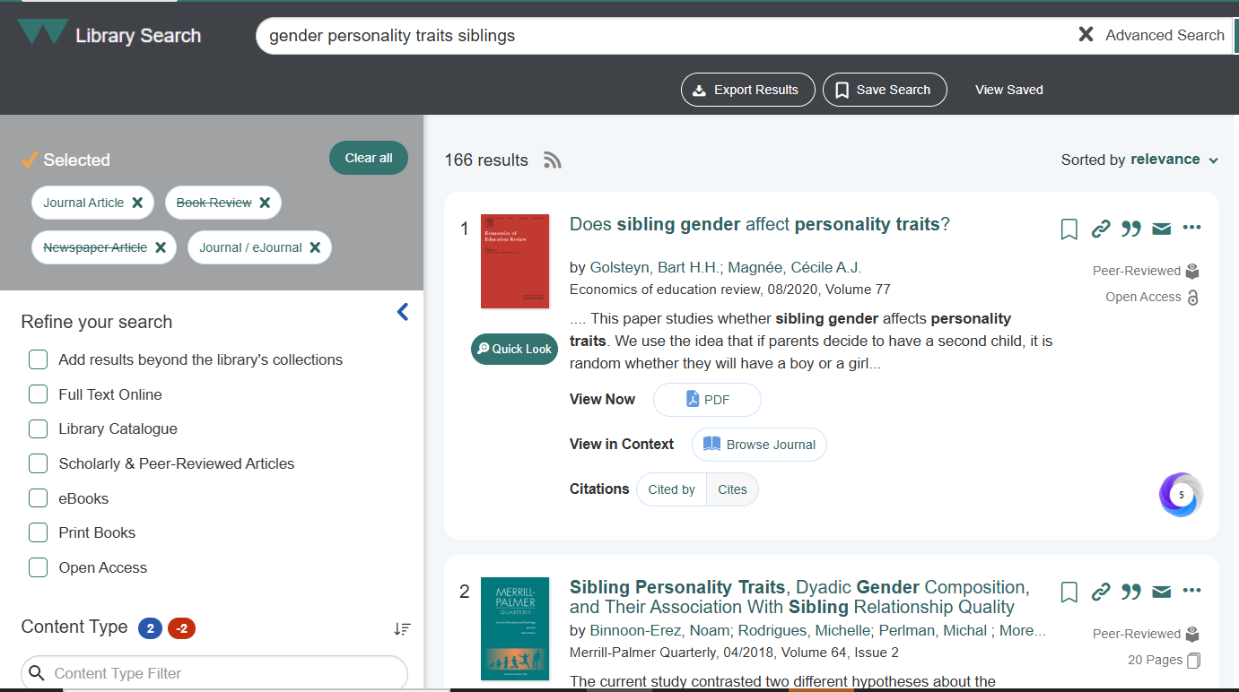
Finding Research

Slide 15
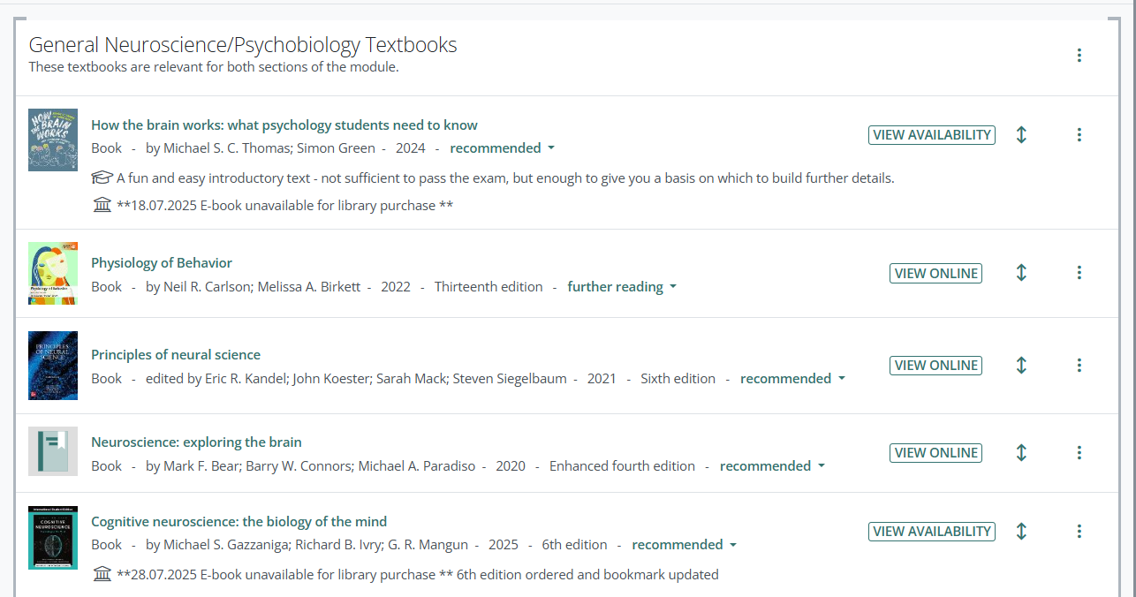
Online reading lists: PS121

Slide 16
Undertaking your own research
Library Search and Google Scholar lend themselves to very simple searches
For more advanced searches, you need to search subject databases:
Collections of research articles
Limit by year, language, population group, etc

Slide 17

Psychology Guide https://warwick.libguides.com/psychology/home Economics, Psychology & Philosophy Guide https://warwick.libguides.com/epp
Advice and guidance about:
Databases
Search techniques
Referencing
Books and Journals
Research Support

Slide 18
Help and advice https://warwick.libguides.com/psychology/home
Which database to search?
How to put a search strategy together
Have you found too few or too many references?
Do you think that something is missing from your results?
Would you like your search strategy checking?
Saving and reporting your searches
Finding the full text of articles
Managing your references

Slide 19
Library Online courses
https://warwick.libguides.com/psychology/databases
Medline (covers PsycInfo)
Conducting a systematic literature search
Search advice and techniques
Saving searches
Planning your searches
Recording and documenting searches
Managing references
Starting to sift

Slide 20
Finding the full text
Install LibKey Nomad extension to help find the full text of articles:
https://warwick.ac.uk/services/library/find-resources/e-access/tools/
In Google Scholar, go to Settings > Library Links > Enter Warwick and select Warwick University > Submit
Use the Get it for Me service to request material that is not available: https://warwick.ac.uk/services/library/using/get-it-for-me/

Slide 21
Referencing
How will you keep track of the articles and books and other sources of information that you use in your assignments?
How will you make sure that your references are in an accepted style?
How will you make sure that your references are consistent?

Slide 22
Endnote
Install Endnote from IT Services
Library runs training sessions and access to recorded webinars
Create a Library of references
Automatically formats references in your preferred referencing style
Alternative software: Mendeley, Zotero
https://warwick.ac.uk/services/library/students/endnote/

Slide 23
Library Online courses
https://warwick.ac.uk/services/library/students/library-online-courses/
Introduction to Referencing
Avoiding Plagiarism
a good general introduction to referencing
covers the Harvard and Vancouver styles of referencing
Passing off someone else’s work as your own
Can get you into a lot of trouble!

Slide 24
Guide to Artificial Intelligence and Academic Integrity
a primer for students and staff who are new to AI within a University setting
what it is, how it works
common uses and
applications
ethics and potential dangers
guidance on properly citing
and referencing AI tools and
resources in your academic
work

Slide 25

Library Welcome Week Events
Come along to any of these events to find out more about the Library and grab yourself some goodies!
Explore Your Library (Stall and Tours) – Main Library, Floor 1
Monday 29th September; 10am – 12pm
Tuesday 30th September; 11am – 1pm
Wednesday 1st October; 10am – 12pm
Thursday 2nd October; 2pm – 4pm
Friday 3rd October; 1pm – 3pm
PG Explore Your Library – PG Hub, Junction
Tuesday 30th September; 2pm – 4pm
Wednesday 1st October; 2pm – 4pm
PGR Explore Your Library – Wolfson Research Exchange, Main Library, Floor 3
Thursday 2nd October; 10.30am – 12pm
Student Toolkit – Gathering Space, Main Library, Floor 2
Friday 3rd October; 11am – 1pm

Slide 26
Further help and advice
Contact us:
Samantha.A.Johnson@warwick.ac.uk
Chris.Bark@warwick.ac.uk
Book a one to one appointment
Check out the Psychology Guide:
https://warwick.libguides.com/psychology/home
Contact the Library:
library@warwick.ac.uk
Follow us on Instagram:
https://warwick.ac.uk/services/library/social-media

Slide 27
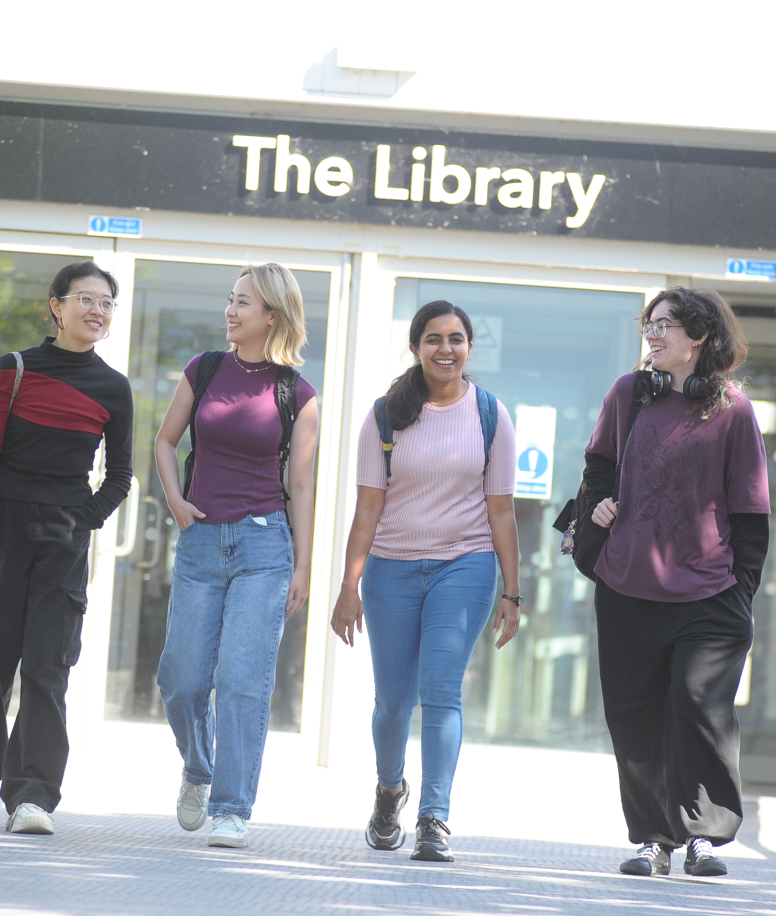
Thank You and Good Luck!

