Slide 1


Welcome to the Library
Samantha Johnson
Academic Support Librarian
Samantha.A.Johnson@warwick.ac.uk

Slide 2
How can we help?
There is lots of help available:
finding your way around the building
accessing the Library’s services and resources
accessing our e-books, electronic journals and
databases
Notes:
So, please do get in touch if you need any questions about the Library, including help with accessing an e-book or the full text of an article, help with a literature search and using our databases such as Psycinfo or Web of Science and questions about referencing.

Slide 3
How can we help?
ask Library staff or our Library Student Partners
Email us via Library@warwick.ac.uk
Check out our online guides and videos
Contact me direct:
  Happy to meet in person, by email or via Teams
  Samantha.A.Johnson@warwick.ac.uk
Notes:
So, please do get in touch if you need any questions about the Library, including help with accessing an e-book or the full text of an article, help with a literature search and using our databases such as Psycinfo or Web of Science and questions about referencing.

Slide 4
Get Started
https://warwick.ac.uk/services/library/using/help/new-users
Come along to our Welcome Stall during Welcome Week and Week 1
Join a guided tour
Try out our new self-guided tour – collect a map from the Welcome Point
Watch our online video guide
Have a look at our Get Started Moodle course and learn how to find books and journal articles

Slide 5
Library Essentials
  Open 24/7
  Library and IT Helpdesks
  Café Library & Library Coffee Bar
  Individual and group study spaces
  Desktop PC’s
  The Breathing Space – relaxation area and leisure reading collection
  The Eating Place – relaxation area just outside the Library

Slide 6

Usernames and passwords
Your University username and password allows you to access all of our electronic resources
Use the Library pages as your starting point for databases and e-journals as we try to maintain the correct links
Going from another page may mean that you are not recognised as a Warwick person and may be denied access or asked for payment
Notes:
The vast majority of our resources are available electronically and you will need to use your University username and passwords to access them.
When you start looking for information, it is a good idea to make the Library your starting point as we try to maintain the correct links and this should make it easier to sign in. If you go directly to a journal homepage, you may not be recognised as a Warwick person and you may be asked for payment. Please don’t pay for anything as we should be able to get most articles for you.

Slide 7
Borrowing books
Borrow as many books as you need
Issued for whole academic year
Automatic renewals
No fines
Remember: all print books can be recalled earlier than the original due date.
Failure to return the book will prevent you from borrowing anything else and you may be invoiced

Slide 8
Click and Collect
Order up to 10 items for collection from the Library
We will email you when they ready for collection
Pick up time will be approximately 48 hours
For books out on loan to someone else, there will be a longer wait for the books
Notes:
You may want to read a little wider than the items on your reading list. The Library Search box from the Library homepage allows you to search for the books held by the Library, including e-books that you can access from home.
Enter some keywords that reflect the area you want to research. If you are looking for a specific book, you can enter the author name and some keywords.
For example, you could look for books on: global public health pandemics
Use the filters on the left hand side to restrict the results to e-books.
When you find a book that looks relevant, click on the title and sign in with your University username and password.
E-books vary in their usability. In some, each chapter is a PDF and you can download the whole book. Other e-books are more restrictive in the number of pages you can download or copy.
Watch the video to see an example of how to search for books

Slide 9

Where are the books?
Floors 1 and 2 are study spaces: both individual and group study
The books start on the Floor 2 Extension
Pure psychology books are on Floor 3
Clinical psychology on Floor 2 Ext
Economics on Floor 5
Data Science on Floor 2 Ext
Happy to receive book suggestions
Notes:
The vast majority of our resources are available electronically and you will need to use your University username and passwords to access them.
When you start looking for information, it is a good idea to make the Library your starting point as we try to maintain the correct links and this should make it easier to sign in. If you go directly to a journal homepage, you may not be recognised as a Warwick person and you may be asked for payment. Please don’t pay for anything as we should be able to get most articles for you.

Slide 10
E-books
Lots of textbooks are available electronically
Check via Library Search
All work slightly differently – some good, some not so good!

Slide 11

Library study spaces
Find the study space that suits you:
  Main Library
  PG Hub @ Junction
  Rootes Grid
  Learning Grid at University House
Check our website for opening hours and study space availability
Notes:
The vast majority of our resources are available electronically and you will need to use your University username and passwords to access them.
When you start looking for information, it is a good idea to make the Library your starting point as we try to maintain the correct links and this should make it easier to sign in. If you go directly to a journal homepage, you may not be recognised as a Warwick person and you may be asked for payment. Please don’t pay for anything as we should be able to get most articles for you.

Slide 12
Accessibility
Services and facilities to support students with disabilities or learning differences
  Study rooms
  Software
  Loanable equipment
  Adjustable furniture
  Productivity Tools

Slide 13
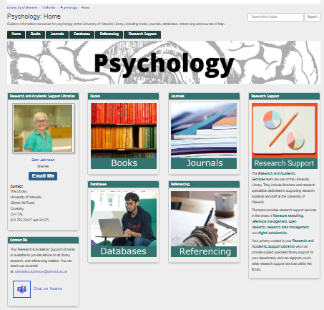
Psychology LibGuide
Find help and support about:
  Books
  Journals
  Databases
  Referencing
  Online courses
  Research Support
  https://warwick.libguides.com/psychology

Slide 14
Getting started
Check if there is an online reading list available
  Links to print and electronic books
  Links to research articles
Explore which books (print and electronic) that you have access to
Start to investigate the published research literature
Have a look at the Library’s Online Courses and the Psychology LibGuide
Notes:
So, where should you start looking for information to support your academic work? There are a number of approaches to take and you will need to do a combination of all of them to get the best results.
The following three, short videos will show you how to check to see if there is an online reading list for your module; see which books are available as ebooks in a particular subject area and how to find the most current research articles to support the arguments you are making in your assignments.

Slide 15
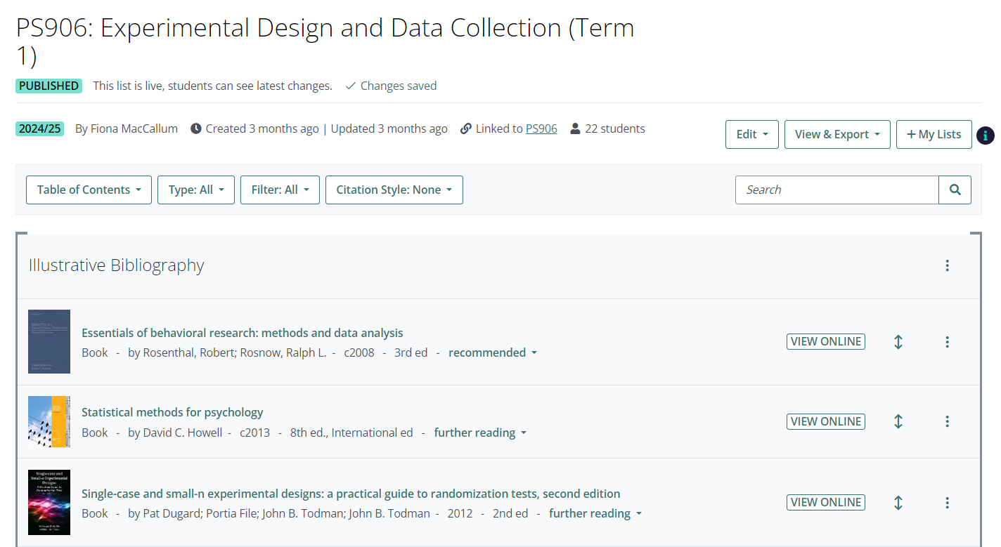
Online reading lists
Access from your module homepage

Slide 16
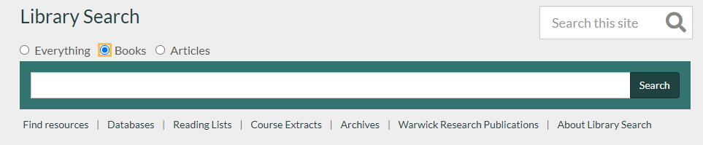
Finding books

Slide 17
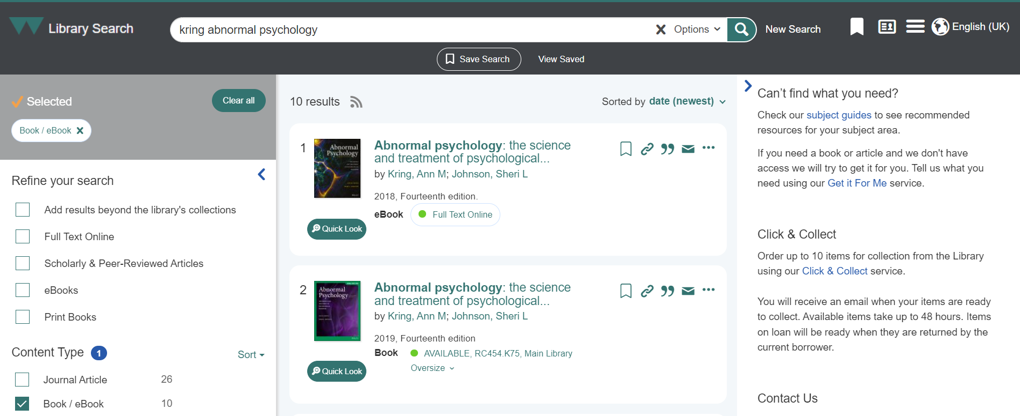
Finding books
E-book
Print book

Slide 18
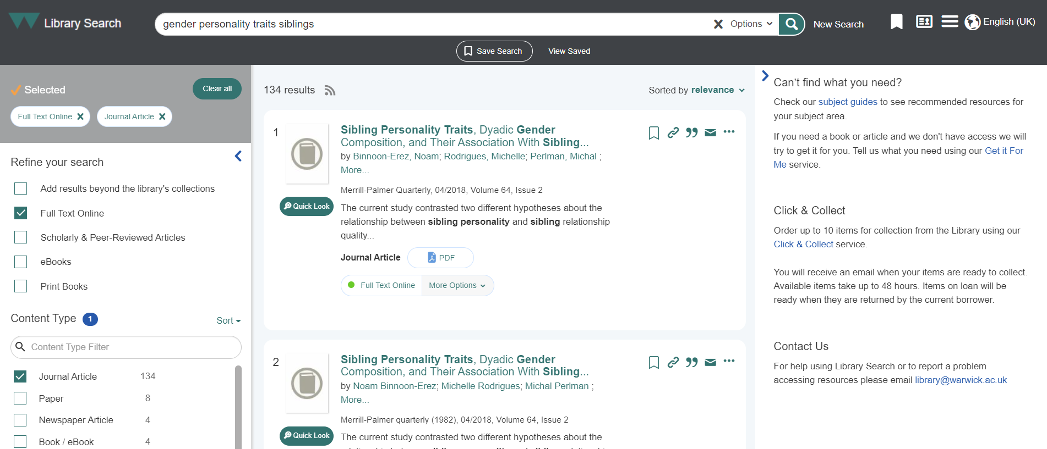
Finding research
Full text options

Slide 19
Databases
Library Search and Google Scholar lend themselves to very simple searches
For more advanced searches, you need to search subject databases:
  Collections of research articles
  Limit by year, language, population group, etc
You have access to: PsycInfo, Web of Science, Scopus, Econlit
Full list at: https://pugwash.lib.warwick.ac.uk/search~S1/v
Notes:
So far, we have seen how to get started with your literature searching. As you progress through your modules you will need to develop more advanced literature searches and this will mean searching different databases, such as PsycInfo, Medline, PubMed, CINAHL and Web of Science. Hopefully, you may be familiar with some of these databases.
Databases are collections of research articles in specific subject areas. The big advantage of using databases is that you can further refine your searches by restricting the search to a particular year range, a specific age group or a publication type, such as clinical trials.
You can sign in to all of these databases using your University username and password.
I would not expect you to start using the databases immediately, but I wanted to make you aware of what is available to you, for when you do need to start searching for information.

Slide 20
Medline tutorial
Main psychology database is PsycInfo
Warwick uses the OVID version – this may be different from the one you are used to using
PsycInfo uses the same search interface as Medline
Further information on developing a search strategy
More detailed information on techniques for searching Medline/PsycInfo
Have a go at the “Searching Medline” activity

Slide 21
Get it for Me
Free and easy access to articles and books that we don’t have full text access to
Articles delivered direct to your Warwick email
https://warwick.ac.uk/services/library/using/get-it-for-me/
Notes:
If, when you click on the WebBridge button, you see a message saying that we do not have online access, you should see a link to our Article Reach service. This allows you to request the article, free of charge. If we are able to get a copy of the article, it will be delivered to your Warwick inbox within a couple of days.

Slide 22
Referencing
How will you keep track of the articles and books and other sources of information that you use in your assignments?
How will you make sure that your references are in the accepted style?
How will you make sure that your references are consistent?
Notes:
The final topics that I want to mention are referencing and plagiarism.
It is never too early to start thinking about how you are going to manage your references. It is very important that you keep a record of everything that you read and subsequently use in your assignments as this prevents you committing plagiarism.
You need to make sure that your references are accurate and consistent.

Slide 23
Endnote
Install Endnote 21 from IT Services
Library runs training sessions and access to recorded webinars
Create a Library of references
Automatically formats references in your preferred referencing style
Alternative software: Mendeley, Zotero
https://warwick.ac.uk/services/library/students/endnote/

Slide 24
Library Online courses
Introduction to Referencing:
  a good general introduction to referencing
  covers the Harvard and Vancouver styles of referencing
Avoiding Plagiarism:
  Passing off someone else’s work as your own
  Can get you into a lot of trouble!
https://warwick.ac.uk/services/library/students/library-online-courses/
Notes:
If, when you click on the WebBridge button, you see a message saying that we do not have online access, you should see a link to our Article Reach service. This allows you to request the article, free of charge. If we are able to get a copy of the article, it will be delivered to your Warwick inbox within a couple of days.

Slide 25

Further help and advice
Email: Samantha.A.Johnson@warwick.ac.uk
Book a one to one appointment
Check out the Psychology LibGuide:
https://warwick.libguides.com/psychology/home
Notes:
So, that is the end of my introduction to Library services and resources. I hope that you have found it useful.
Don’t forget, that if you need any help or advice, do get in touch. Always remember that there is no such thing as a stupid question but there is nearly always an answer or a solution.
Good luck with your studies and enjoy your time at Warwick.

Slide 26




Contact us
library@warwick.ac.uk
@warwicklibrary
@warwicklibrary

