Slide 1
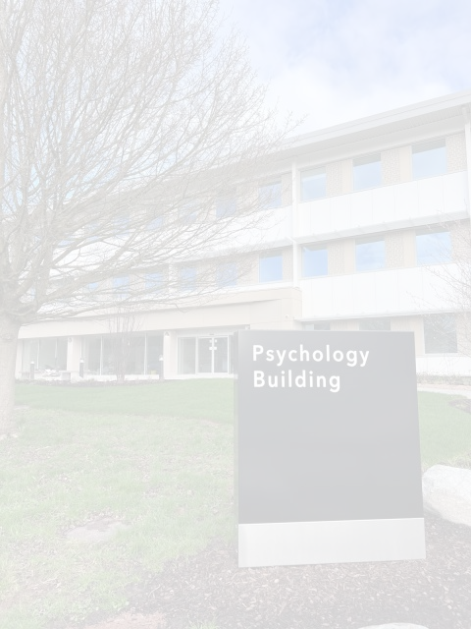


Welcome to Warwick!
PG SSLC Introduction

Slide 2
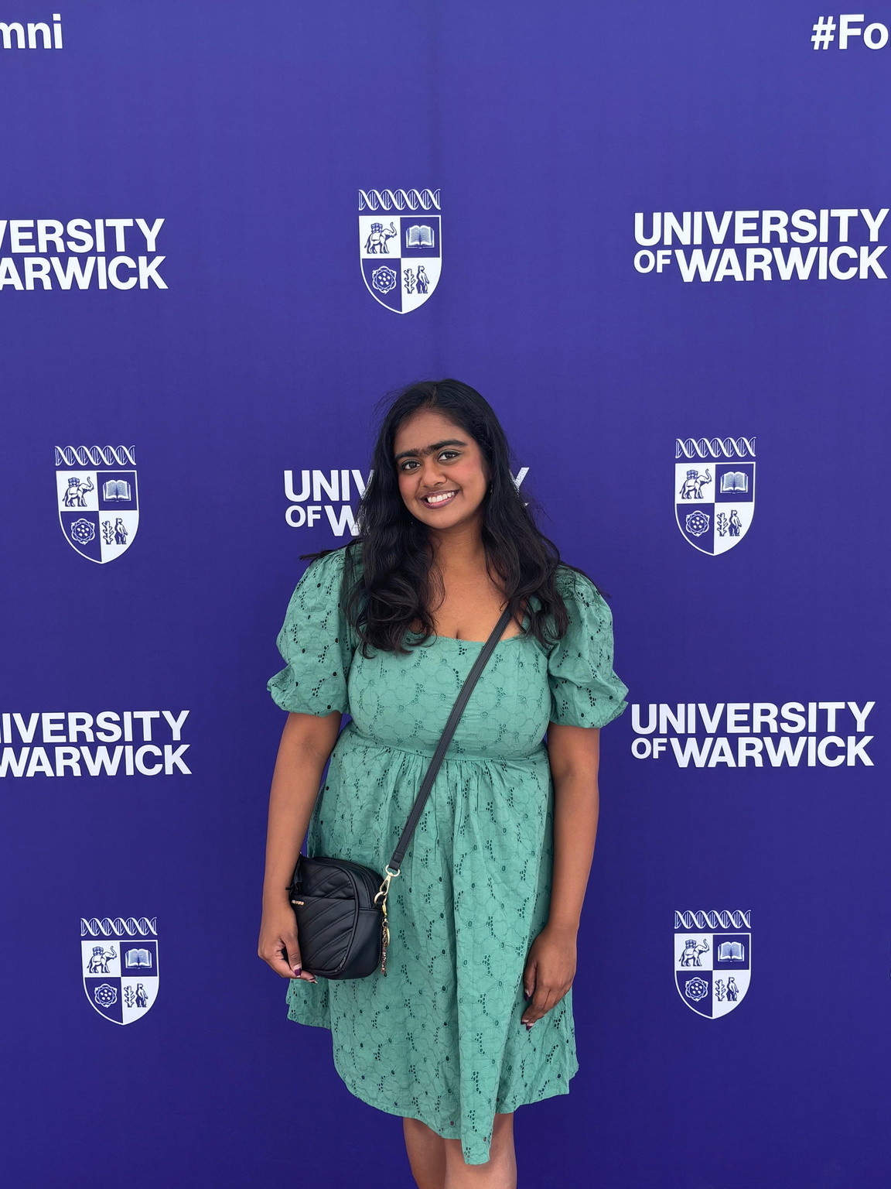
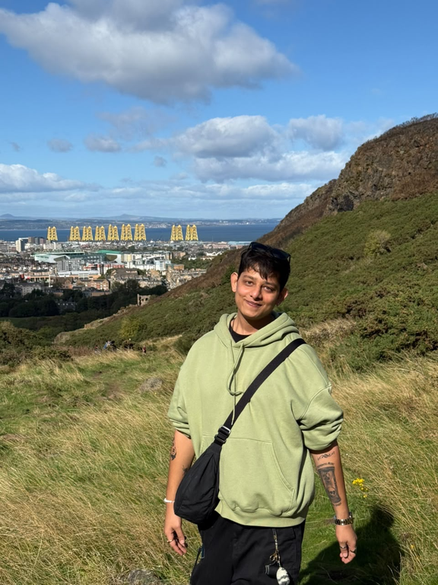
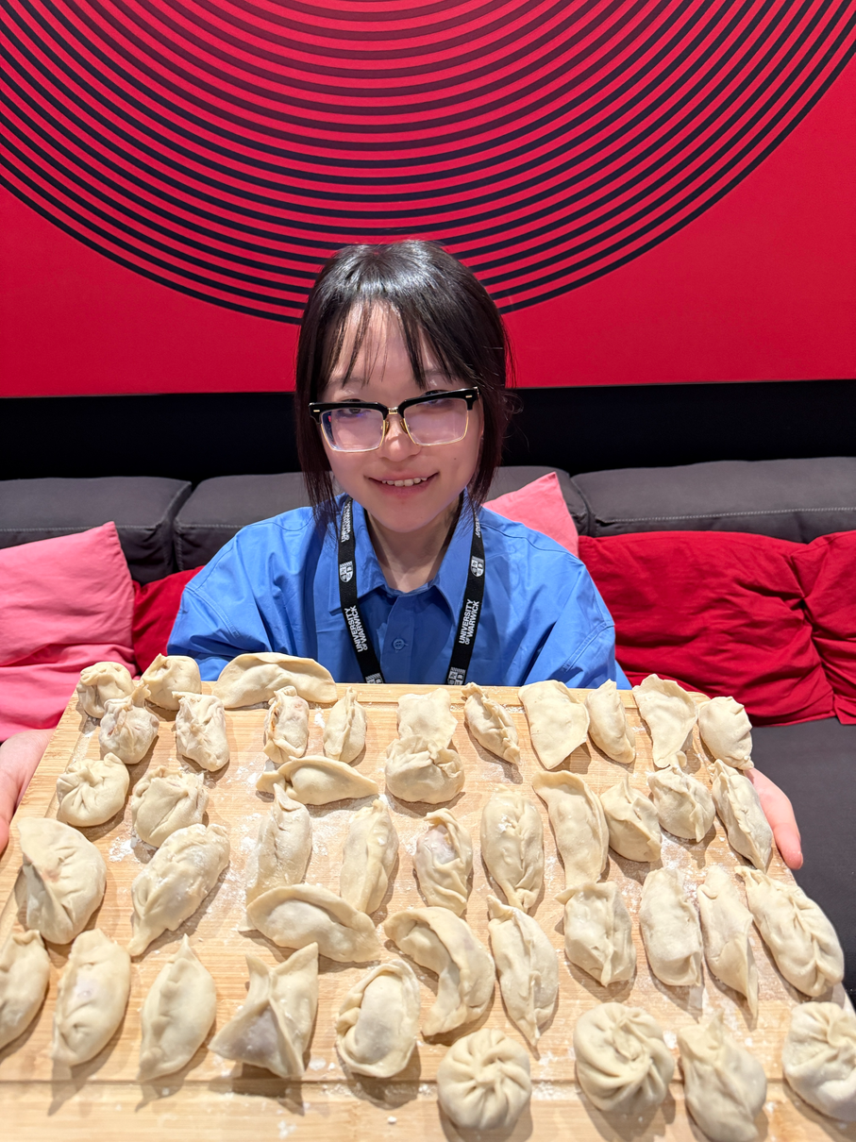
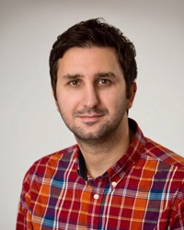
Who Are We...?
Inchara Athreya
Sarwang S Dwivedi
Olivia Wang
Manos Konstantinidis (AP)
Second year PhD student
Second year PhD student
Second year PhD student
Inchara.Athreya@warwick.ac.uk
Sarwang.Dwivedi@warwick.ac.uk
Zimeng.Wang@warwick.ac.uk
Staff Representative
E.Konstantinidis@warwick.ac.uk

Slide 3











What is the SSLC?
1.
1. Student led representatives to act as a bridge between students and staff.
2.
2. Discuss ideas & issues related to teaching, learning & student support
(e.g., Funding, career prospects, internships, scholarships, curriculum design).
3.
3. Attend regular meetings.

Slide 4
What have SSLCs across the universities achieved?
📚
💾
🖥️
Extension of Library opening times
Increased digital resources in the Library
Improvements in IT, e.g. increase in
e-learning and e-submission
🗓️
✉️
🏅
Earlier publication of exam timetables
Quicker feedback from departments on assignments
Greater skills recognition
🤝
⏰
🌍
Setting up mentoring/’buddy’ schemes
Extension of computer lab opening hours
Increased departmental support for Erasmus and year abroad students

Slide 5
Any Questions?

