Slide 1

The Warwick Award
George Haughie
Skills Developer
George.Haughie@warwick.ac.uk

Slide 2

Skills!
How can you best show off the broad range of skills you will develop across your foundation year and beyond?

Slide 3













12 Core Skills

Slide 4

The Warwick Award
Launched in October 2022
Free, optional, and students can join at any time
Runs for the whole time you are registered as a taught student at Warwick
Focuses on the Warwick Core Skills
Recognised on the HEAR
Postgraduate Award
20 Core Skills Points

Slide 5

Introduction to the Warwick Award Pathway
When you signed up to the Warwick Award, you were automatically enrolled on this introductory pathway to help you get started with your Award and direct you to some of the introductory activities that will get your first few points on the board.
The pathway contains:
The 12 Warwick Core Skills: Your Experience survey
JISC Digital Capability Discovery Tool
Introduction to the 12 Core Skills Moodle course
A selection of Moodle course on specific Core Skills
Choosing and Planning Activities Reflection
Find out more on your Warwick Award profile

Slide 6
Why should you get involved?
The chance to recognise, reflect on and articulate skills developed across your experiences
Identify skills for development or improvement, and find activities to develop them in
Find and get involved in opportunities from all over the university
Try new activities and experiences, and get recognition for being involved
Get a certificate and a digital badge to prove you did these things
Have fun, make friends, belong to the Warwick community

Slide 7










Some activity providers working with the Warwick Award
URSS

Slide 8
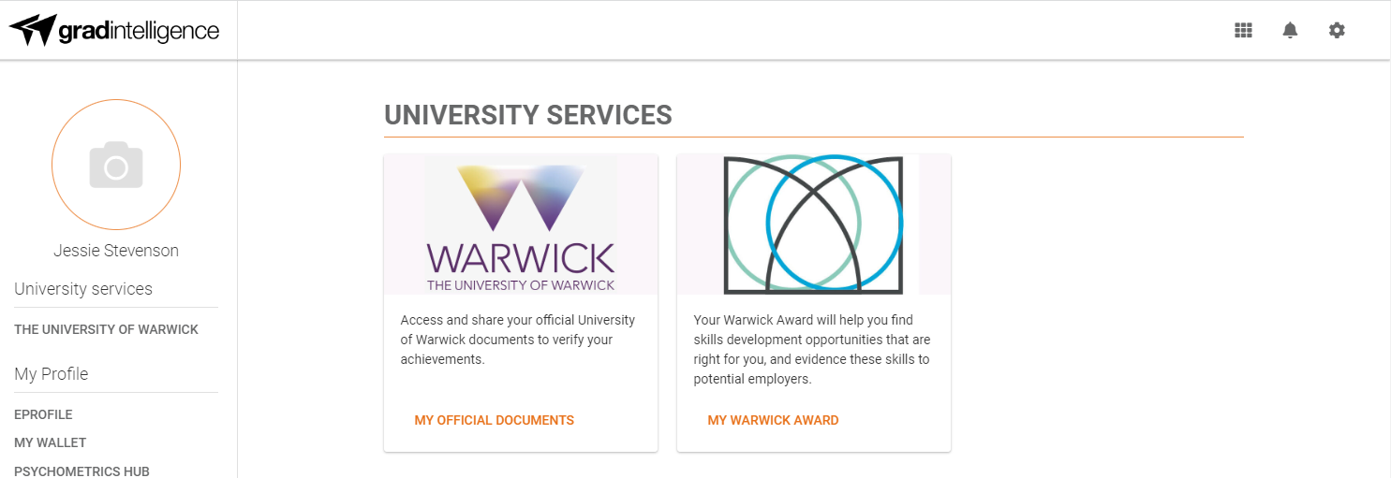

Slide 9

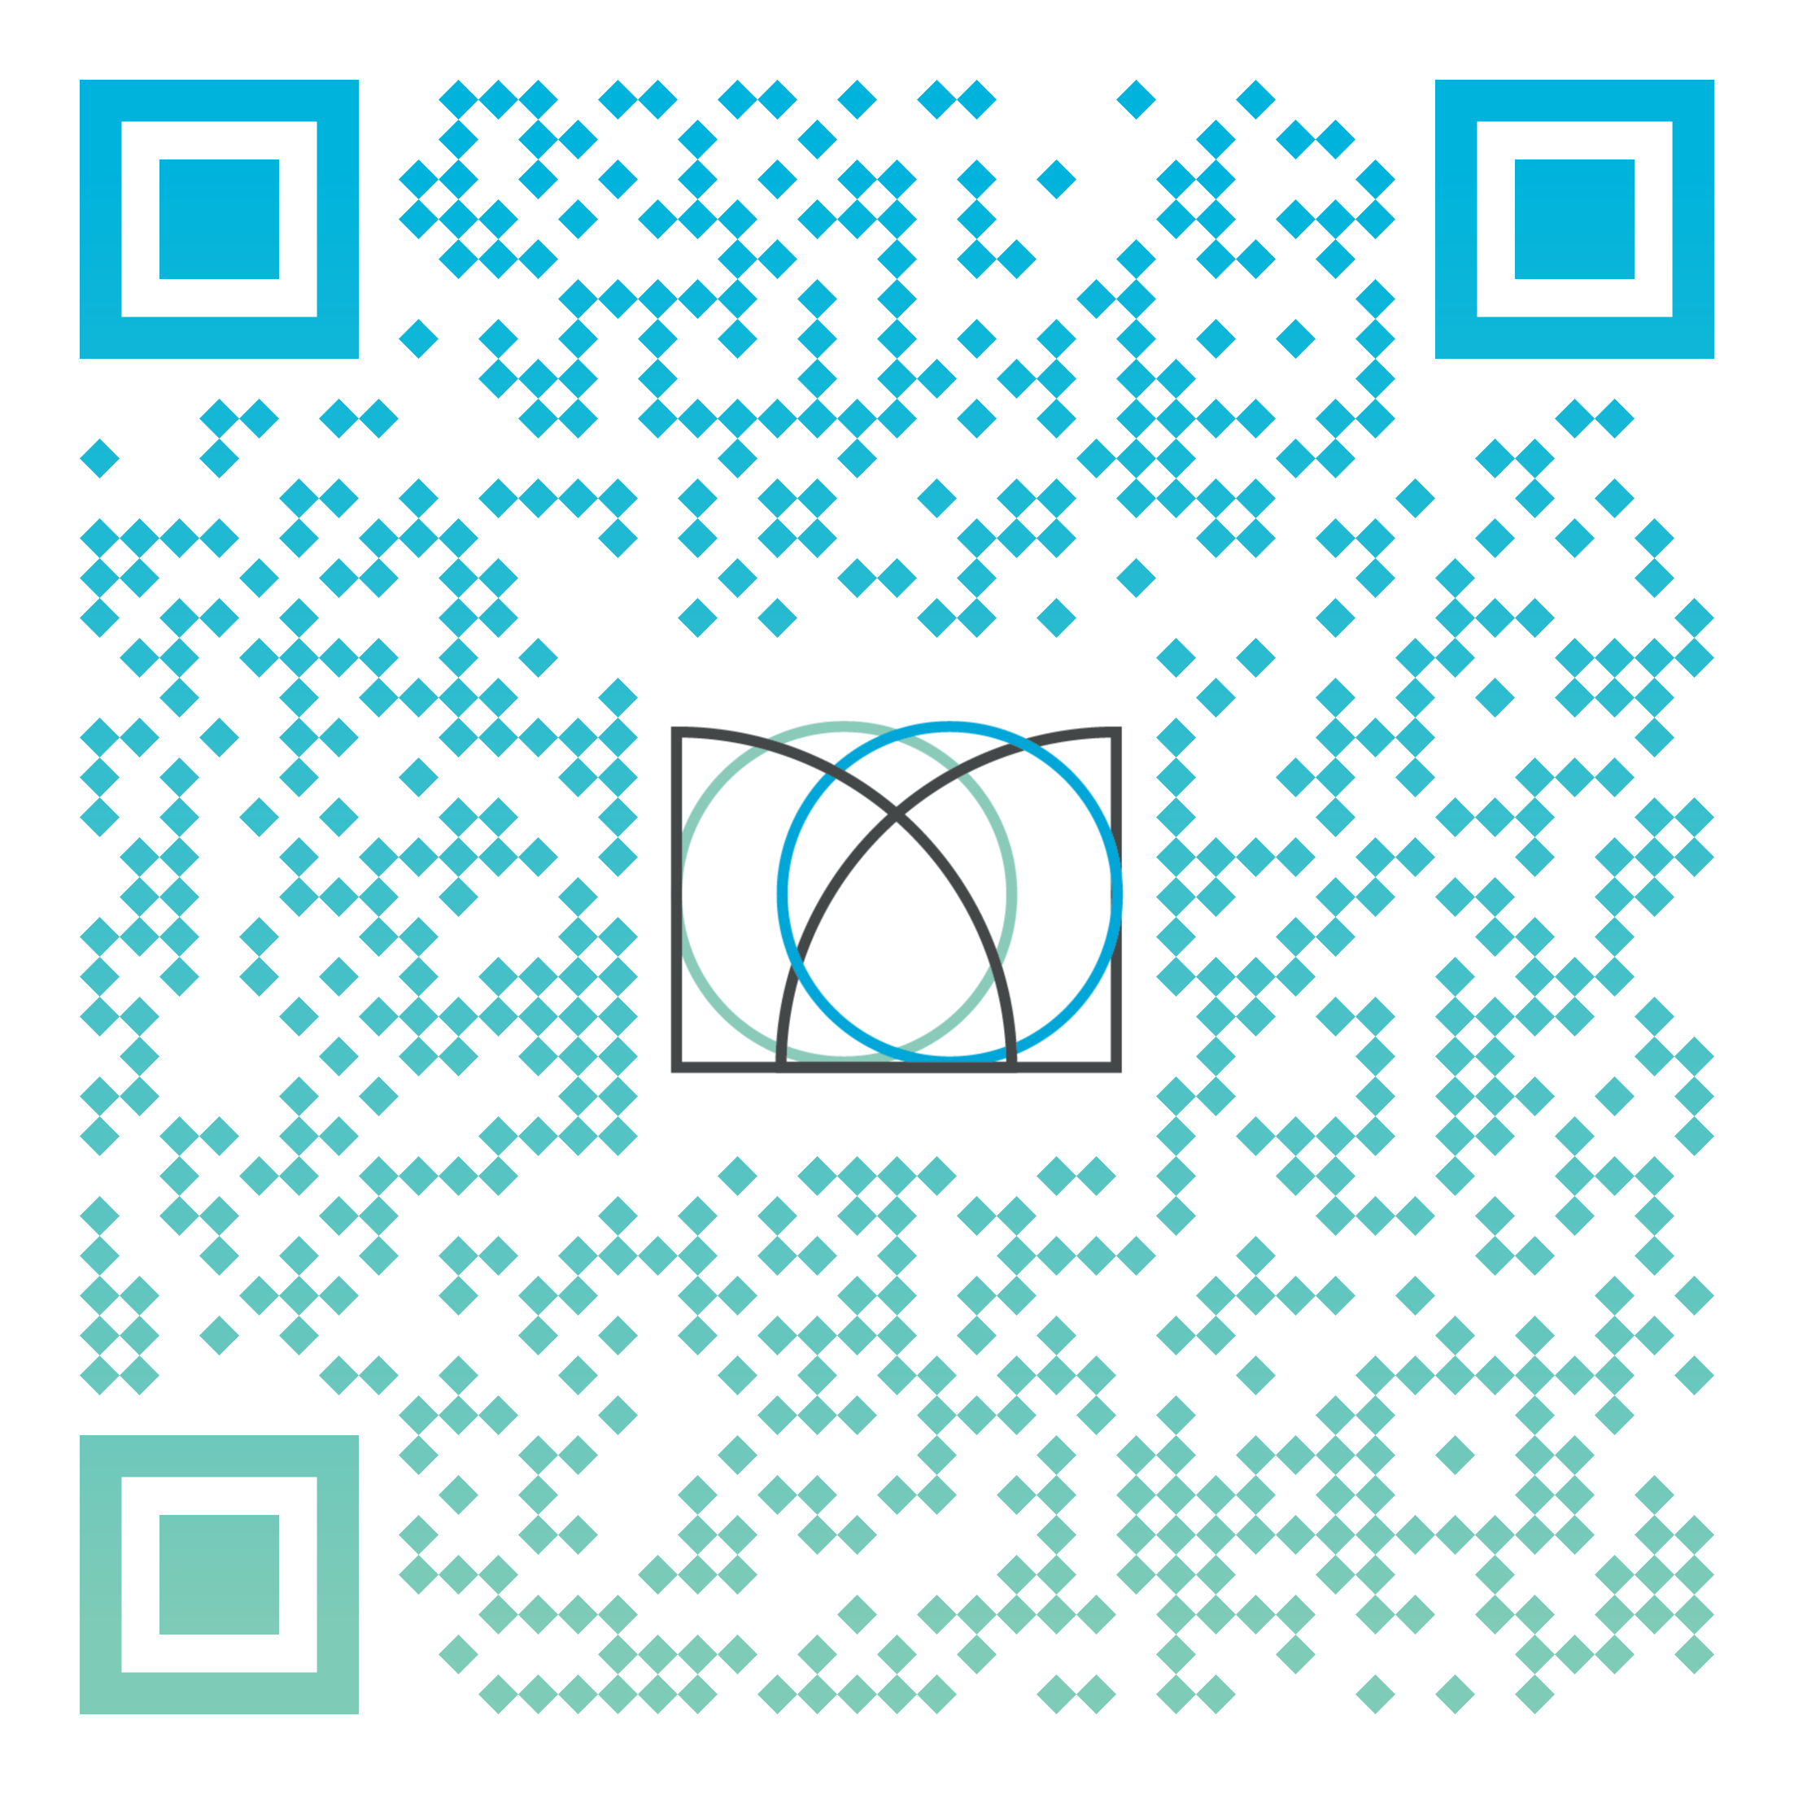
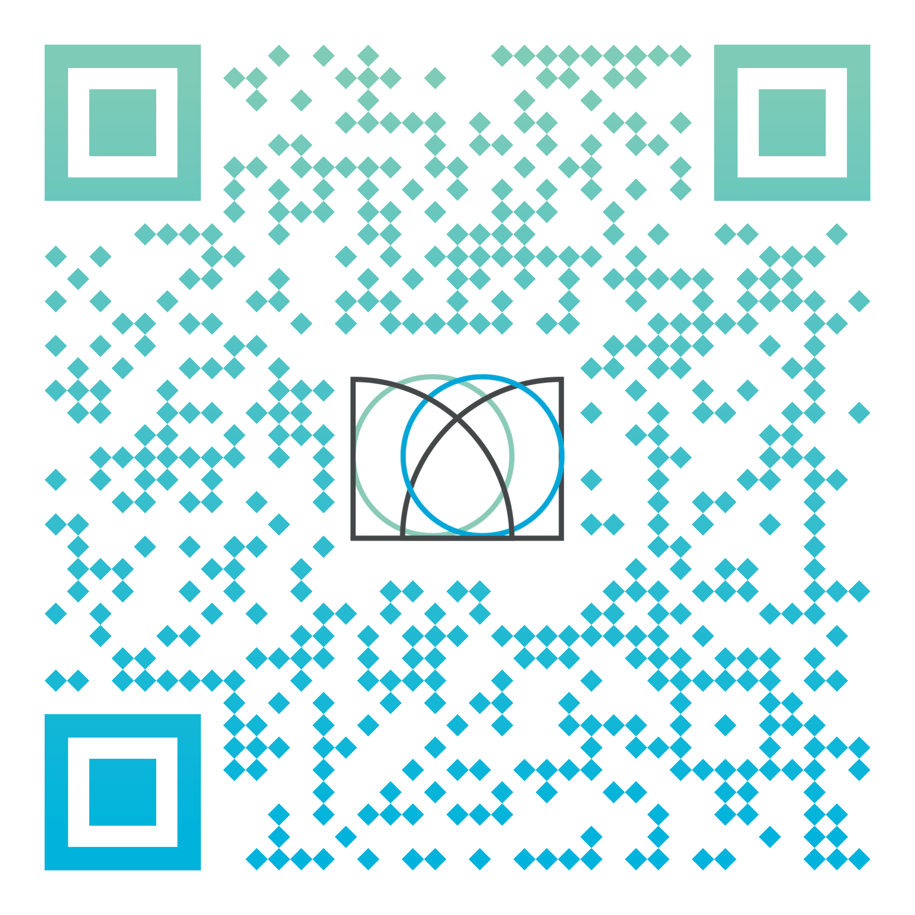
Go to the Warwick Award website to find out more about signing up
Go straight to the Gradintelligence platform to log in
Notes:
QR code takes students straight to GI - *not* our webpage

Slide 10



