Slide 1


Inclusive Participatory Research in Autism Research: Methods and Practice
Webinar
July 2025

Slide 2
🧹 Webinar Housekeeping Guidance
Mute & Audio: We have disabled audio to avoid background noise.
Confidentiality: Do not share personal details or specific information about individuals in the chat.
Chat Function: Feel free to use the chat to ask questions, share reflections, or flag any technical issues. We’ll monitor it throughout.
Recording: This session is being recorded and will be shared with attendees afterwards. We have disabled visuals for this purpose.
Accessibility: Live captions are available -please enable them via the toolbar if needed. Let us know if you require any additional support.
Breaks: We’ll have a short break at the halfway mark built into the session. You’re welcome to step away as needed. But feel free to have a break at any time.
Programme
10:00-10:50: Session 1 Inclusive Participatory Research in Autism Research: a collaboration between academia, the NHS, and community members
10:50-11:00 BREAK
11:00-11:45 Session 2 Introducing an evaluation framework to support researchers in participatory research with the autistic community
Notes:
Jag

Slide 3
Inclusive Participatory Research in Autism Research: a collaboration between academia, the NHS, and community members
Session 1
Dr Jagjeet (Jag) Jutley-Neilson, Gemma Cartwright, Dr Gurnam Singh, John Bernard, Rohan Dasgupta, Misrah Mohamed, Emily Ahmed, Dawn Nicholls, Dr Gitit Kadar-Satat
Notes:
Jag

Slide 4
Participatory Research (PR) in Autism
Historically, research was DONE on autistic individuals and their carers/families.
Participatory research helps autistic individuals and their carers/families become equal partners in research.
PR helps to ensure that the needs and wants of the autistic community and their carers/families are at the centre of research - “nothing about us without us”.
This approach emphasises co-production, shared decision-making, and lived experience.
Builds trust and relevance by centring autistic voices.
Notes:
Jag

Slide 5
Barriers to PR work in the area of autism
PR research is growing in the area of autism, but still not as established in other areas of health.
However,
Researchers in the area of autism have said they lack guidance and skills for PR work, esp. early career researchers (Pellicano et al., 2014).
In addition, even though PR aims to address underrepresentation in research, some communities within autism research are still underrepresented. e.g., ethnic minority autistic people and/or their families (May et al., 2022)
Notes:
Jag

Slide 6
Warwick University Aims
1. Based on barriers to PR work in the area of autism, we aimed to
Develop an autism PR framework for autism research to address (the ELPART, learn about the ELPART in the 2nd part of the webinar)
2. To ensure diverse representation, we aimed to develop further guidance to learn about the 2nd part of the webinar.
Enhance researchers' skills for cultural competence in autism research.
Provide ideas for researchers to help recruit ethnically diverse experts by experience (EbEs) and participants to address ethnic minority underrepresentation in autism research through community collaboration.
Notes:
Jag

Slide 7


Autism and Ethnicity
Gemma Cartwright - Consultant Practitioner in Neurodiversity (C&W) & Clinical Director for Autism (NHS England Midlands)
Dawn Nicholls - Dimensions Project Manager and Community Engagement
Notes:
Gemma

Slide 8

National Autism Data
Research
Ethnicity | Rates in whole school | Rates in autism
Bangladeshi | 1.76 | 1.86
Indian | 3.13 | 1.83
Pakistani | 4.42 | 2.95
Black African | 3.84 | 4.72
Gypsy Roma | 0.32 | 0.15
White British | 66.11 | 69.8
Other White | 6.44 | 4.46
Evidence from across the UK shows that CYP from ethnic minority backgrounds experience lower rates of identification of autism and often have higher support needs (Beger et al, 2009)
There is compelling evidence of underdiagnosis among bilingual CYP and ethnic minority CYP in comparison to White British CYP (PinPoint Cambridgeshire, 2023)
National SEN data (Jan 2023)
Notes:
Gemma
So what is the national data telling us? Well according to SEN national data from 2023, it highlights that black African children are over represented in autistic population basically
3.84% of the whole school population are black African, but 4.72 % of the autistic school population are black African.
3.18 % of the whole school population are Indian but only 1.83 % of the autistic school age population are Indian, Pakistani 4.42% of whole school but only 1.82% of the autistic population
White British are also overrepresented, however this is due to other groups being under represented rather than an ‘over Dx trend’
Gypsy Roma are underrepresented,
‘white other’ under represented in the SEN autistic population
19% of the whole school population have English as an additional language but only 13% of those diagnosed autistic have English as first language

Slide 9
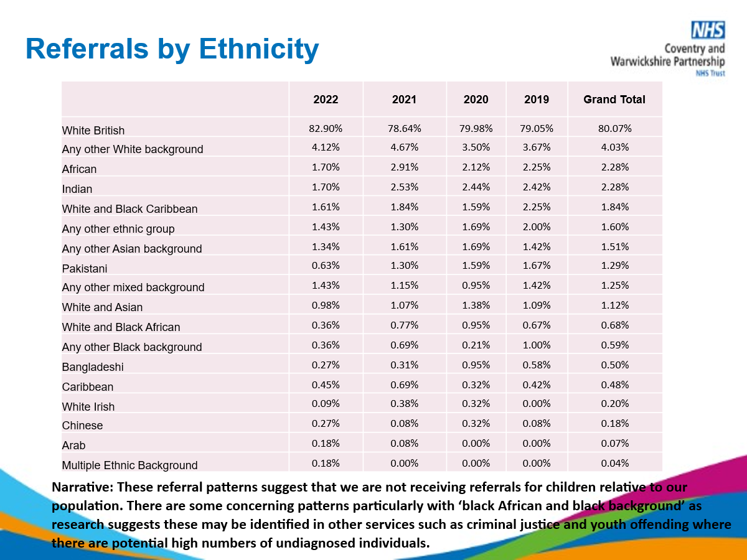
Local autism data- Referrals (CWPT)
Notes:
Gemma
Locally our data for referrals doesn’t reflect the national SEN data- low representation of black African
But does reflect the low numbers for Indian, Chinese and white other
White and black African

Slide 10

Intersections of ethnicity and autism
The intersection of ethnicity and autism involves understanding how cultural, social, and systemic factors influence the identification, diagnosis, and support for autistic individuals across different ethnic groups.
Key points to consider:
Diagnosis disparities- under diagnosis & misdiagnosis, delayed diagnosis
Cultural perception – cultural beliefs and stigma, religion, understanding & awareness
Access to services – healthcare access
Research and representation – lack of inclusive research & cultural incompetency
Community support- engagement, culturally sensitive interventions
Policy & Advocacy – equitable policy and awareness campaigns
Audits
Notes:
Gemma
1. Diagnosis Disparities
Underdiagnosis and Misdiagnosis: Children from ethnic minority backgrounds, are often underdiagnosed or misdiagnosed compared to their White peers. This can be due to various factors, including biases in diagnostic practices, lack of access to healthcare, and cultural differences in recognising and interpreting symptoms. Some suggestion that in the USA black children are more likely to be diagnosed with oppositional defiant disorder or conduct disorder than autism or ADHD
• Delayed Diagnosis: There is often a significant delay in diagnosing autism in children from ethnic minority groups, which can impact the timely provision of early intervention services crucial for developmental support.
2. Cultural Perceptions
• Cultural Beliefs and Stigma: Different cultures have varying beliefs about autism, which can affect whether and how parents seek a diagnosis and support. In some communities, there may be stigma associated with developmental disabilities, leading families to avoid seeking help.
There may be limited knowledge about autism among family members, denial of autism due to religious beliefs that consider acceptance as an endorsement, and school authorities possibly having stereotypical views about behaviours of children from ethnic minority backgrounds
Stigmatisation can impact on self-esteem- may not be something you will be proud of as you may be marginalised within your own community. Behave differently in different spaces due to ethnicity, masking more than one factor, Masking or trying to blend (code switching can be positive, not all masking bad. However, there is a link with masking at a high level which impacts on MH due to poorer self identity, we need to consider self concept and understand how some of the coding can help understand cultural awareness )
Religion
religious leaders play an important part in the cultural lives of many people from ethnic minority backgrounds. While religious beliefs may contribute to reluctance to seek diagnosis, religion could also provide a major source of help for families of autistic people, including emotional support, strength to carry on, accepting the diagnosis and living with the day-to-day challenges (Pitten, 2008).
While Christianity is mainly popular within the African-Caribbean community, most in the South-Asian community are followers of Islam. These belief systems can play a major role in the acceptance of a child’s autism. Faith, arguably, gives autistic parents the strength, hope and feeling of ‘all shall be well’ (Pitten, 2008). However, misconceptions about autism by people of faith could have negative consequences which can impact on the wellbeing of autistic people and their families. An extreme view is that autism is caused by demonic spirits or genies. Alarmingly, exorcism is not unheard of and this has been highlighted as a concern in research focussing on harmful cure focussed interventions. (https://network.autism.org.uk/content/westminster-commission-autism-reports-harmful-interventions). Accepting a diagnosis of autism can be very difficult for families faced with stigmatising views of what this might mean. Some religious leaders warn parents not to accept an autism diagnosis but rather to rely on the power of prayer. Attitudes in some places of worship can limit the inclusion of autistic persons (Haack, 2017; Ault et al, 2013)
: Cultural differences can also influence how autism is understood and described. Some behaviors might be seen as typical within one cultural context but viewed as indicative of autism in another.
3. Access to Services
• Healthcare Access: Ethnic minority families may face barriers to accessing healthcare services, including language barriers, lack of culturally competent providers, and socioeconomic factors. These barriers can limit access to diagnostic services and interventions.
• Slade’s (2014) some communities can experience the pressure of isolation and alienation from their extended family and their community because of other people’s reactions to their child’s autism. Myths about autism are common and unhelpful. Professionals involved in working with families need to be culturally sensitive to these factors.. People who are perceived to ‘deviate from the norm’ in some way are more likely to be stigmatised as a result of subjection to ‘high surveillance levels’ (Papadopoulos, 2016, p.4) in which observers are on the lookout for difference. A major implication is that families who feel watched may decide to hide their autism circumstances from stigmatising community disapproval. Concealment in this way potentially leads to further isolation and loneliness.
Reasons for poorer access to healthcare (Papadopoulos, 2016), including access to autism services (Slade, 2014). range from apparent cultural misunderstanding by service providers, lack of rapport, discrepancies in conceptualization of autism between professionals and parents, and language barriers. Families may experience some behaviours from professionals as culturally insensitive and assume that they are on the receiving end of judgemental attitudes. This in turn may lead them to avoid particular services. The ability to self-advocate can be hampered by lack of knowledge of entitlement and availability of services and disjuncture in communication between families and professional. Language barriers will exacerbate already difficult situations and further limit access. Perceived lack of recognition and acceptance of autistic people in communal spaces increased the level of vulnerability of autistic people and their families, and led to self-imposed ostracism, social isolation and loneliness. This is likely to have a negative effect on autistic people and their families including causing poor mental health
4. Research and Representation
• Inclusive Research: Historically, research on autism has predominantly involved White participants, leading to a lack of data on how autism manifests and is experienced across different ethnic groups. There is a need for more inclusive research that considers the diversity of the autistic population.
• Cultural Competency in Research: Researchers need to be culturally competent and considerate of how ethnicity may influence the presentation and diagnosis of autism.
5. Community Support
• Community Engagement: Engaging with communities to raise awareness about autism and available resources is crucial. Community-based organizations can play a key role in providing support and advocacy for families.
• Culturally Sensitive Interventions: Developing and implementing interventions that are culturally sensitive and tailored to the specific needs of diverse populations can improve outcomes for autistic individuals from different ethnic backgrounds.
6. Policy and Advocacy
• Equitable Policies: Advocating for policies that address the disparities in diagnosis, access to services, and support for autistic individuals from ethnic minority backgrounds is essential. This includes promoting equitable healthcare, education, and social services.
• Awareness Campaigns: Public awareness campaigns that educate about autism in diverse cultural contexts can help reduce stigma and promote early diagnosis and intervention.
Understanding and addressing the complex relationship between ethnicity and autism is crucial for creating equitable and effective support systems that meet the needs of all individuals with autism, regardless of their ethnic background

Slide 11
Cultural Inclusion Network (CIN) Recommendations
Listen, listen, and listen to ethnic minorities’ asks and provide for their needs. Please do not use already existing medical models. One size fits all does not work in mental health care.
Enrol more ethnic minority experts by experience to provide a unique perspective and destigmatise mental health
Help family members and carers understand the condition, treatment, and its consequences so they can devise the best strategy of support. Where possible, co-design this strategy with them.
Encourage and facilitate carers and family members to meet with others in similar situations. This creates awareness of existing religious and cultural dimensions, thereby reducing stress or tension build-up
Audits
Notes:
Gemma
We have linked with our CIN and have been aware of not replicating work already completed
However I didn’t want to make any assumptions regarding autism specifically and wanted to ask the question ‘how is autism talked about within your community?’

Slide 12
Participatory Research in Autism - The process Emily Ahmed
• Collaborative Working
Building trust, sharing knowledge, adapting to capacity
• Participatory Approach
Lived experience shaped every stage
• Inclusive Practice
Diverse team, neuro-affirming, culturally responsive
• Recognition & Remuneration
Valuing contributions, but processes need work
Notes:
Emily

Slide 13
The Role of Experts by Experience in Participatory Research in Autism Dr Gurnam Singh, Misrah Mohamed, John Bernard
Notes:
Gurnam, Misrah and John will speak about their role:
About you (short introduction)
How and why did you become involved as an EbE in the participatory research in autism project
What was your role in this project
What it felt like to be part of the project
Any reflections on working with the NHS, Academics and your community

Slide 14
What Families Told Us
Silence and Stigma
Autism often misread as disobedience, and a fear of judgement kept many from seeking help
“If you get labelled, it’ll be used against you.”
Faith as Both Barriers and Bridges
Sensory overwhelming made worship spaces inaccessible, but faith leaders are trusted!
“The gurdwara led it – and people really listened.”
Broken Path to Diagnosis
Nurseries noticed needs early - often before doctors
Language barriers excluded families from the process
“You get leaflets – but no one explains it in your language.”
Notes:
Rohan/Jag

Slide 15
What Families Said They Need
Peer Networks Rooted in Trust
- Culturally connected parents supporting each other
Faith-Based Autism Awareness
- Community-led events in gurdwaras, mosques, churches, etc.
Simple, Visual, Translated Resources
- No more jargon-heavy leaflets
A Single, Clear Route into Support
- “It’s not about more services – it’s about the right ones.”
Notes:
Rohan/Jag
So what do families actually want? The answer wasn’t ‘more services’ – it was better, more accessible ones.
Peer networks were a recurring suggestion. Parents who shared cultural or faith backgrounds wanted to support each other, especially those just starting the journey. That sense of trust and community was far more powerful than professional referrals.
Faith-based awareness was also critical. Many parents said that if information came from a religious leader or a trusted community figure, others would be more willing to engage.
And materials matter. Families are tired of leaflets packed with jargon. What they want are resources that are visual, translated, and actually useable – not just technically ‘available’.
Finally, families want to avoid getting bounced around between services. A single, clear pathway – one point of contact, one trusted relationship would go a long way.

Slide 16
What This Really Tells Us
It’s not just about autism – it’s about identity, belonging, and trust
Families aren’t passive – they’re active advocates navigating broken systems
Change won’t come from “more forms” – it’ll come from listening differently
“This wasn’t just about autism – it was about being seen.”
Notes:
Rohan/Jag
This research isn’t just about autism – it’s about how systems engage with identity, culture, and trust.
What we saw were not passive families waiting for help, but determined parents – often mothers – navigating fractured systems while advocating for their children.
Their message was clear: don’t give us more paperwork, give us spaces to be heard.
And critically, this isn’t just about fixing access. It’s about recognising lived experience as expertise. These families don’t just need to be included – they need to help shape the solutions. As one participant put it, “This wasn’t just about autism – it was about being seen.”

Slide 17
Collaboration with the NHS: Goals, Gaps & Impact
Collaboration bridges academic research with healthcare practice.
Joint projects with NHS clinicians, researchers, and Experts by Experience (EbEs).
Aims to improve early diagnosis, support pathways, and culturally sensitive care.
Identifies gaps and influences policy through community-informed research.
Expected impact: inclusive services, stronger partnerships, better outcomes.
Notes:
Jag

Slide 18

What will do next….
Present to the Learning Disability and Autism Health Inequalities Steering Group
Share findings with the local autism strategy priority group, focusing on inequalities
Share insights with our parent carer networks & Expert by Experience provide
Work with academia to explore different approaches to engagement with our local communities
Weaning Group
Notes:
Gemma
In Coventry we have a significantly higher percentage of ethnicities other than white in the non-autistic population, others areas have less of a discrepancy. Possibly due to the other layers of intersectionality.

Slide 19
BREAK
Webinar

Slide 20
Introducing an evaluation framework to support researchers in participatory research with the autistic community
Session 2
Ellie Horton, Daniel Tones, Dr. Anita Z. Goldschmied and Laura Brownhill.

Slide 21





Coproducing research with autistic people - introducing the ELPART and PAR group checklist Ellie Horton, Dr Anita Z Goldschmied, Dan Tones and Laura Brownhill
Notes:
Ellie - welcome

Slide 22



Mental Health within an autistic population
Introductions
Daniel Tones
Dr. Anita Z. Goldschmied
Laura Brownhill
Ellie Horton
Notes:
All – short intro – our name, what we do and how we have been involved in this project.

Slide 23
Mental Health within an autistic population
Background to our work
Participatory group established in May 2021 with 5 autistic students to coproduce PhD research into the mental health experiences of autistic university students.
Overall purpose of PAR group - To ensure that research is respectful, accessible and socially relevant for autistic people.
More specific goals;
To be involved in the selection of research approaches and measures used and ensure that they are effective and appropriate.
To coproduce specific research questions to ensure that they are socially relevant and that the language used is autism friendly and respectful.
Since then, our work has developed to also focus on how autistic people can be involved in research. Although some members have left and new members joined, the majority have been with the project since its conception.
Notes:
Ellie

Slide 24
Mental Health within an autistic population
What is Coproduction/Participatory research?
“Participatory research is a research to action approach that emphasizes direct engagement of local priorities and perspectives” (Vaughn and Jacquez, 2020, p.1)
“Coproduction is based on the sharing of information and shared decision making between the service users and providers” (Realpe & Wallace, 2010, p.4)
Notes:
Anita

Slide 25
Mental Health within an autistic population
Introduction
Growing emphasis on the meaningful involvement of autistic people in research, participatory research increasingly recognised as best practice or the gold standard (Le Cunff et al., 2023; Fletcher-Watson et al., 2021).
Historically, autism research dominated by neurotypical perspectives, leading to a disconnect between research outcomes and the lived realities of those directly affected.
Mental health - Research demonstrates the different risk factors for the development of mental health issues in the autistic population and need for bespoke approaches to mental health for autistic students (Cassidy et al., 2018; Purkis et al., 2016).
Working in coproduction with autistic people has the potential to transform services (Rudd & Hwang, 2021).
Notes:
Laura

Slide 26
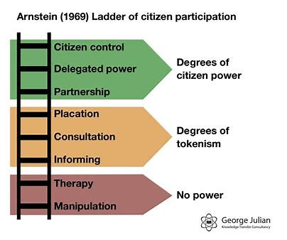
Background into coproduction with autistic
Challenges of coproduction with the autistic community
Perceptual misalignment of what participation is
Lack of Understanding of Meaningful Participation
Mismatch Between Research Priorities
Inconsistencies in Participatory Research Practices
Image above shows Arnstein’s ladder of participation (1969)
Notes:
Dan

Slide 27
Evaluating participation – the ELPART and PAR group checklist
The aim of this project was to develop tools to;
Evaluate the meaningful involvement of autistic people at every stage of the research process (ELPART).
Promote and evaluate inclusive and accessible interactions and redress power imbalances in establishing a Participatory Action Research Group with autistic people (PAR group checklist).
Notes:
Ellie

Slide 28
Evaluating participation – the ELPART and PAR group checklist
These tools will aid researchers adopting participatory approaches and in promoting best practice in autism research by;
Promoting and providing specific guidance around the meaningful inclusion of autistic people throughout the research process, from conception of an idea through to dissemination of results.
Aiding transparency in how and to what extent autistic people are involved throughout the research process and in decision making promoting the fair acknowledgement of autistic people’s views.
Aiding reflection and learning at all stages of the research process.
Address power dynamics inherent in autism research.
Notes:
Dan

Slide 29
Developing the ELPART and PAR group checklist
Drafting tools - Lead researcher created tools. Shared with PAR group and two members of the research team
Group discussion - PAR group reviewed and discussed changes which were implemented.
Securing resources -Spotlight funding for PAR group to lead initial validation activities.
Final review - Final meeting PAR group meeting. Reviewed changes and resolved outstanding points.
Validation meetings - PAR group chaired 2 x 1 hour meetings. Changes reflected researcher feedback.
Literature review - PAR group reviewed the literature and checked alignment with key themes.
Notes:
Laura

Slide 30
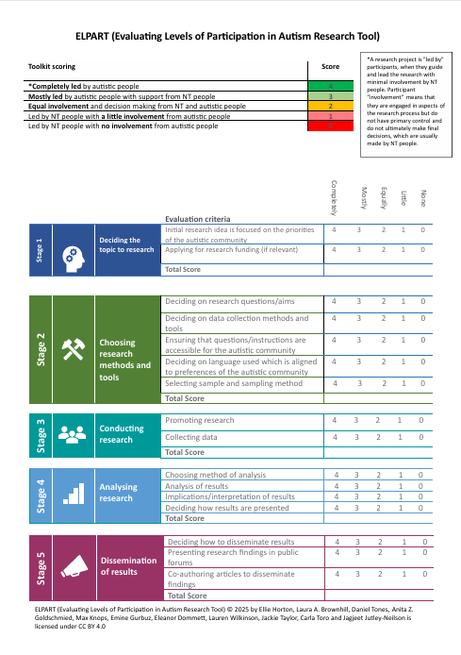
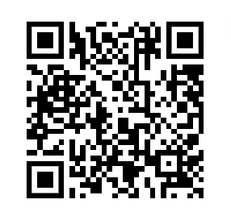
Evaluating participation – the ELPART
ELPART helps measure and address power imbalances in autism research by ensuring autistic individuals have meaningful participation from the earliest stages.
It enhances transparency and accountability in participatory research, reduces tokenism, and can be adapted for various research methods.
It also provides a structured way for funders and institutions to assess the quality of participatory approaches.
Image to the left shows the ELPART
Notes:
Ellie

Slide 31
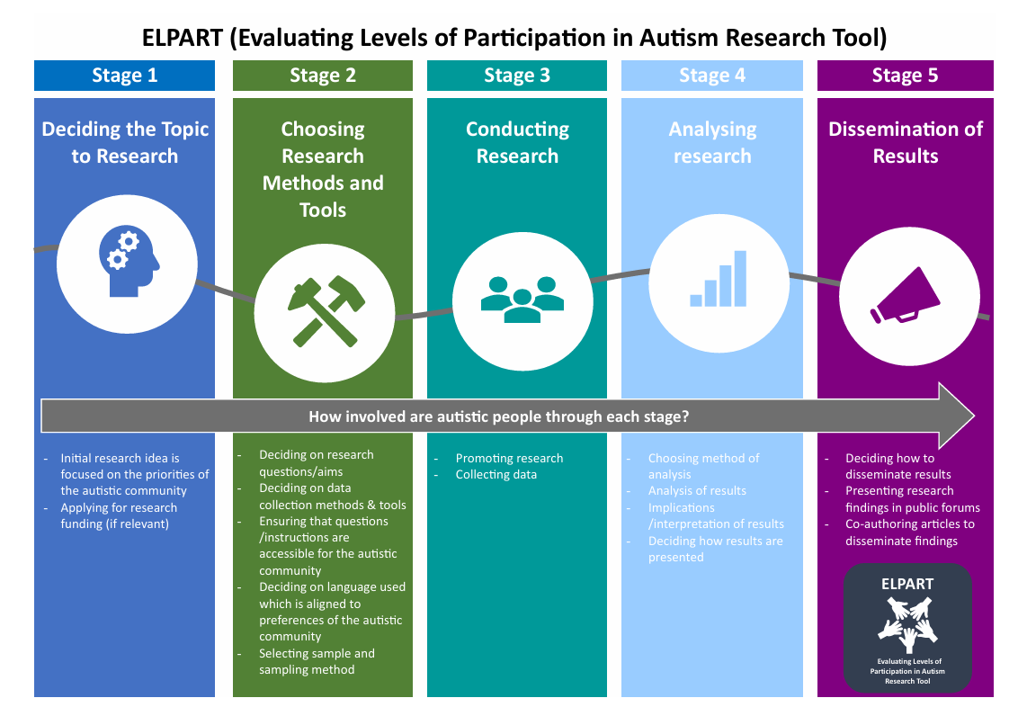
Notes:
Ellie

Slide 32
Evaluating participation – the ELPART guidance
Use ELPART’s five-point scale to assess involvement of autistic people in each stage of the research process (0 = No involvement, 1 = Minimal involvement, 2 = Equal involvement, 3 = Mostly autistic-led, 4 = Completely autistic-led).
The ELPART should not used as a tick box to complete at the end of a research project but should be used from the start to guide good practice.
Autistic community members should be involved in completing the ELPART and PAR group checklist.
Relationships are key to successful collaboration with the autistic community so should be prioritised throughout the research process.
Fostering an environment that is inclusive and encourages open, honest and creative discussions is crucial.
✅
❌
✅
✅
✅
Notes:
Anita

Slide 33
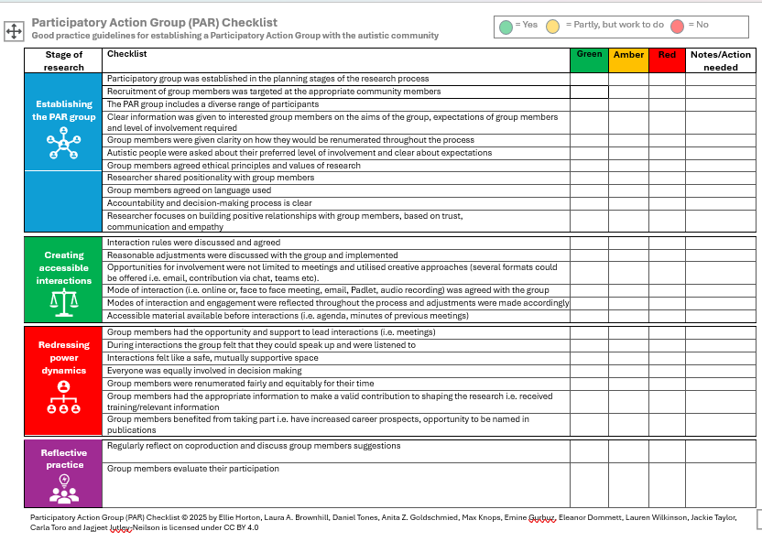
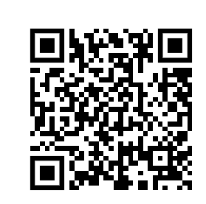
Evaluating participation – the PAR group checklist
The PAR Group Checklist was designed to evaluate best practices for establishing and supporting participatory action research (PAR) groups with autistic individuals.
The PAR group checklist helps remove barriers for autistic co-researchers by ensuring fair pay and accessibility, promotes ongoing improvement through reflection, and supports autistic leadership to challenge traditional research hierarchies.
Image to the left shows the PAR group checklist
Notes:
Ellie

Slide 34
Evaluating participation – the PAR group checklist guidance
✅
✅
✅
✅
✅
The PAR Group Checklist was designed to evaluate best practices for establishing and supporting participatory action research (PAR) groups with autistic individuals. It does not evaluate the extent of participation throughout a project per se, and can be used in conjunction with the ELPART to do this.
Recruit participants with relevant lived experience and ensure diverse representation including underrepresented groups.
Collaborate with organisations and networks to support inclusive recruitment.
Provide clear, accessible information on group aims, roles, expected time commitments, and compensation.
Allow members to choose their preferred level of involvement and be transparent about how their input will influence decisions.
Notes:
Laura

Slide 35
Evaluating participation – the PAR group checklist guidance
✅
✅
✅
❌
✅
✅
Establish shared ethical principles and openly discuss researcher positionality and power dynamics.
Agree on inclusive and respectful language, allowing the group to decide on preferred terminology.
Build relationships based on trust, mutual respect, and open communication through active listening and regular feedback.
Not a tick box exercise
To be used throughout the process rather than at the end
Completed by all members of research team
Notes:
Dan

Slide 36



Points to note
Many barriers to participation are systemic—time, cost, senior staff attitudes, and research culture. These tools help highlight such issues and the need for broader action. Attitudinal and cultural shifts are also essential.
The extent to which power can be shared varies by project context (Pickard et al., 2022; Redman et al., 2021). As Bellingham et al. (2023) note, projects with limited participation or lower PAR checklist scores still have value, offering a starting point for deeper involvement. However, we must remain mindful of their limitations and be transparent about the level of autistic participation—this evaluation framework supports such transparency.
Notes:
Ellie

Slide 37
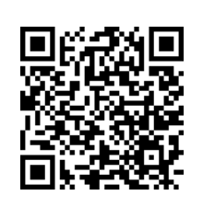
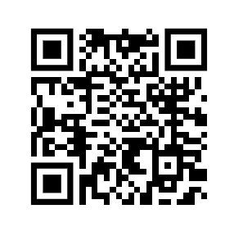
Links to journal and website
Website
Please scan the QR code to access our recent preprint
Both tools available at: https://warwick.ac.uk/fac/sci/psych/research/autism/
Notes:
Ellie

Slide 38

Tips for coproduction
Establish early in the research/service development process and consider how you can coproduce across the stages of research/throughout the service
Be clear on expectations - these may change over time so be flexible
Develop creative and innovative methods
Avoid tokenistic involvement – what can participants get from involvement? i.e. coproduce webinars, journals
Coproduction is about relationships so spend time on developing open, trusting and positive
Reflect continuously and be aware of power
Be ready for challenges and misunderstandings around coproduction
Implement reasonable adjustments – be flexible – everyone’s needs are different!
Pay participants for their time
Ask participants what level of involvement they would like from the start – participants may not want the same level of involvement as you want them to have!
Researchers themselves should be participants to get a rounded view
Notes:
Anita

Slide 39

This Photo by Unknown Author is licensed under CC BY-SA
Contact -
Elizabeth.Horton@warwick.ac.uk
A.Z.Goldschmied@shu.ac.uk

Slide 40
References
References
Arnstein, S. R. (1969). A ladder of citizen participation. Journal of the American Institute of planners, 35(4), 216-224. https://doi.org/10.1080/01944366908977225.
Cassidy, S., Bradley, L., Shaw, R., Baron-Cohen, S. (2018) Risk markers for suicidality in autistic adults. Molecular Autism. 9 (42)
Cassidy, S. A., Bradley, L., Bowen, E., Wigham, S., & Rodgers, J. (2018). Measurement properties of tools used to assess depression in adults with and without autism spectrum conditions: A systematic review. Autism Research, 11(5), 738-754.
Fletcher-Watson, S., Bölte, S., Crompton, C. J., Jones, D., Lai, M. C., Mandy, W., ... & Mandell, D. (2021). Publishing standards for promoting excellence in autism research. Autism, 25(6), 1501-1504.
Horton, E., Brownhill, L., Bycroft, A., Goldschmied, A. Z., Knops, M. J., Lloyd, A., Tones, D., Wiltshire, B., Toro, C. T., & Jutley-Neilson, J. (2025). In our own words: Using participatory dialogue to reflect on the mental health experiences of autistic students in university. Neurodiversity, 3. https://doi.org/10.1177/27546330241310372 (Original work published 2025)
Horton,E., Goldschmied, A. Z., Knops, M. J. J., Brownhill, L. A., Bycroft, A., Lloyd, A., Tones, D., Wiltshire, B., Toro, C. T., & Jutley-Neilson, J. (2024).Empowering voices: fostering reflective dialogue and redefining research dynamics in participatory approaches with the autistic community. Journal of Participatory Research Methods, 5, https://doi.org/10.35844/001c.122455
Le Cunff, A.-L., Ellis Logan, P., Martic, B. L., Mousset, I., Sekibo, J., Dommett. E. & Giampietro, V. (2023). Co-Design for Participatory Neurodiversity Research: Collaborating with a Community Advisory Board to Design a Research Study. Journal of Participatory Research Methods, 4(1). https: //doi.org/10.35844/001c.66184
Purkis, Y., Goodall, E., & Nugent, J. (2016). The guide to good mental health on the autism spectrum. Jessica Kingsley Publishers.
Realpe, A., & Wallace, L. M. (2010). What is co-production. London: The Health Foundation, 1-1.
Vaughn, L. M., & Jacquez, F. (2020). Participatory research methods–choice points in the research process. Journal of Participatory Research Methods, 1(1).

