Slide 1
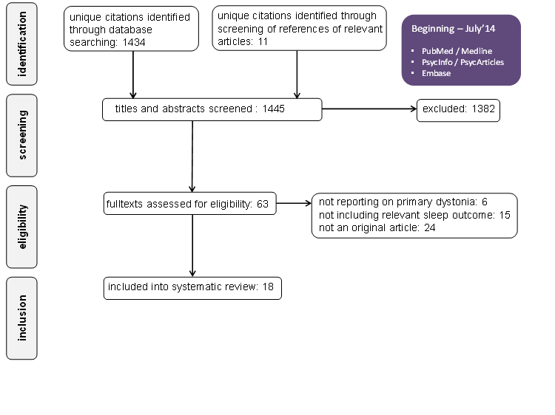

Sleep in Patients with Dystonia: A Systematic Review
Elisabeth Hertenstein¹, Nicole K. Y. Tang², Celia Bernstein², Christoph Nissen¹, Martin Underwood², Harbinder Sandhu²
¹ University of Freiburg Medical Center, Germany, ² University of Warwick, Coventry, UK
Introduction
Primary dystonia is the third most prevalent neurological movement disorder after essential tremor and Parkinson’s disease. It is characterised by involuntary muscle contractions accompanied by repetitive movement, abnormal posture and pain.
Non-motor symptoms of primary dystonia, including sleep disturbance, negatively impact on quality of life¹. Given the increasingly evident link between pain and sleep and the emerging trend of hybrid intervention to tackle both issues simultaneously², we systematically reviewed the state of research on sleep in primary dystonia.
Key results
Prevalence of impaired sleep quality is between 40% and 70% in focal cranial dystonia.
Night time symptoms: Inconsistent findings on sleep continuity and architecture. The presence of abnormal muscle movement is linked to awakenings and sleep disruption, whilst the frequency of which is markedly reduced during deep/REM sleep.
Daytime symptoms: No display of excessive daytime sleepiness.
Clinical correlates of sleep disturbance in cervical dystonia include depressive symptoms, dystonia duration (not severity), restless legs syndrome, bruxism, and medication use.
Treatments: Botulinum toxin treatment is effective in managing motor symptoms but appears to have no positive effect on sleep in cervical dystonia.
Quality of studies identified: Much room for improvement with high risk of bias in multiple areas of research methodology. See Figure 2.
Method
See Figure 1 below. Inclusion criteria: (i) original articles (ii) reporting on patients with primary insomnia and included a quantitative or qualitative sleep measure (iii) published in English, German, French, Spanish, Italian or Chinese.
Figure 1. Search strategy and results
Searched databases
(Beginning – July 2014)
PubMed/Medline
PsycInfo/PsycArticles
Embase
References
Soeder A et al. J Neurol 2009; 256: 996–1001.
Tang NKY et al. Beh Res & Ther, 2012; 50, 814-21.
Proposed research and treatment agenda
Research methodology: Need to be more rigorous in design, utilising large drug-free samples and appropriate controls. Treatment studies should include sleep as an outcome measure.
Topic of investigation: Need to examine the aetiology of sleep disturbance. Pain and psychological distress are potential mediators.
Treatment: Hybrid intervention targeting sleep as well as other motor and non-motor symptoms should be developed and evaluated.
Full text
See Hertenstein et al. 2015 in Sleep Medicine Reviews.
Contact elisabeth.hertenstein@uniklinik-freiburg.de or n.tang@warwick.ac.uk for a copy.
We were supported by the Dystonia Society.

