Slide 1
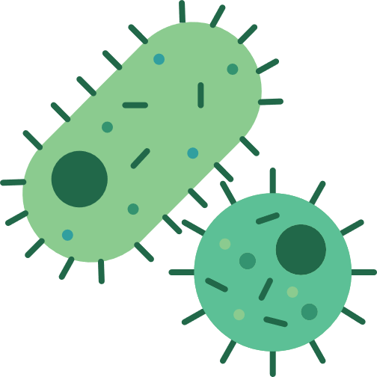
Introduction
IF YOU THINK THAT BACTERIA ONLY CAUSE DISEASE...THINK AGAIN!
iGEM team 2024 University of Warwick

Slide 2
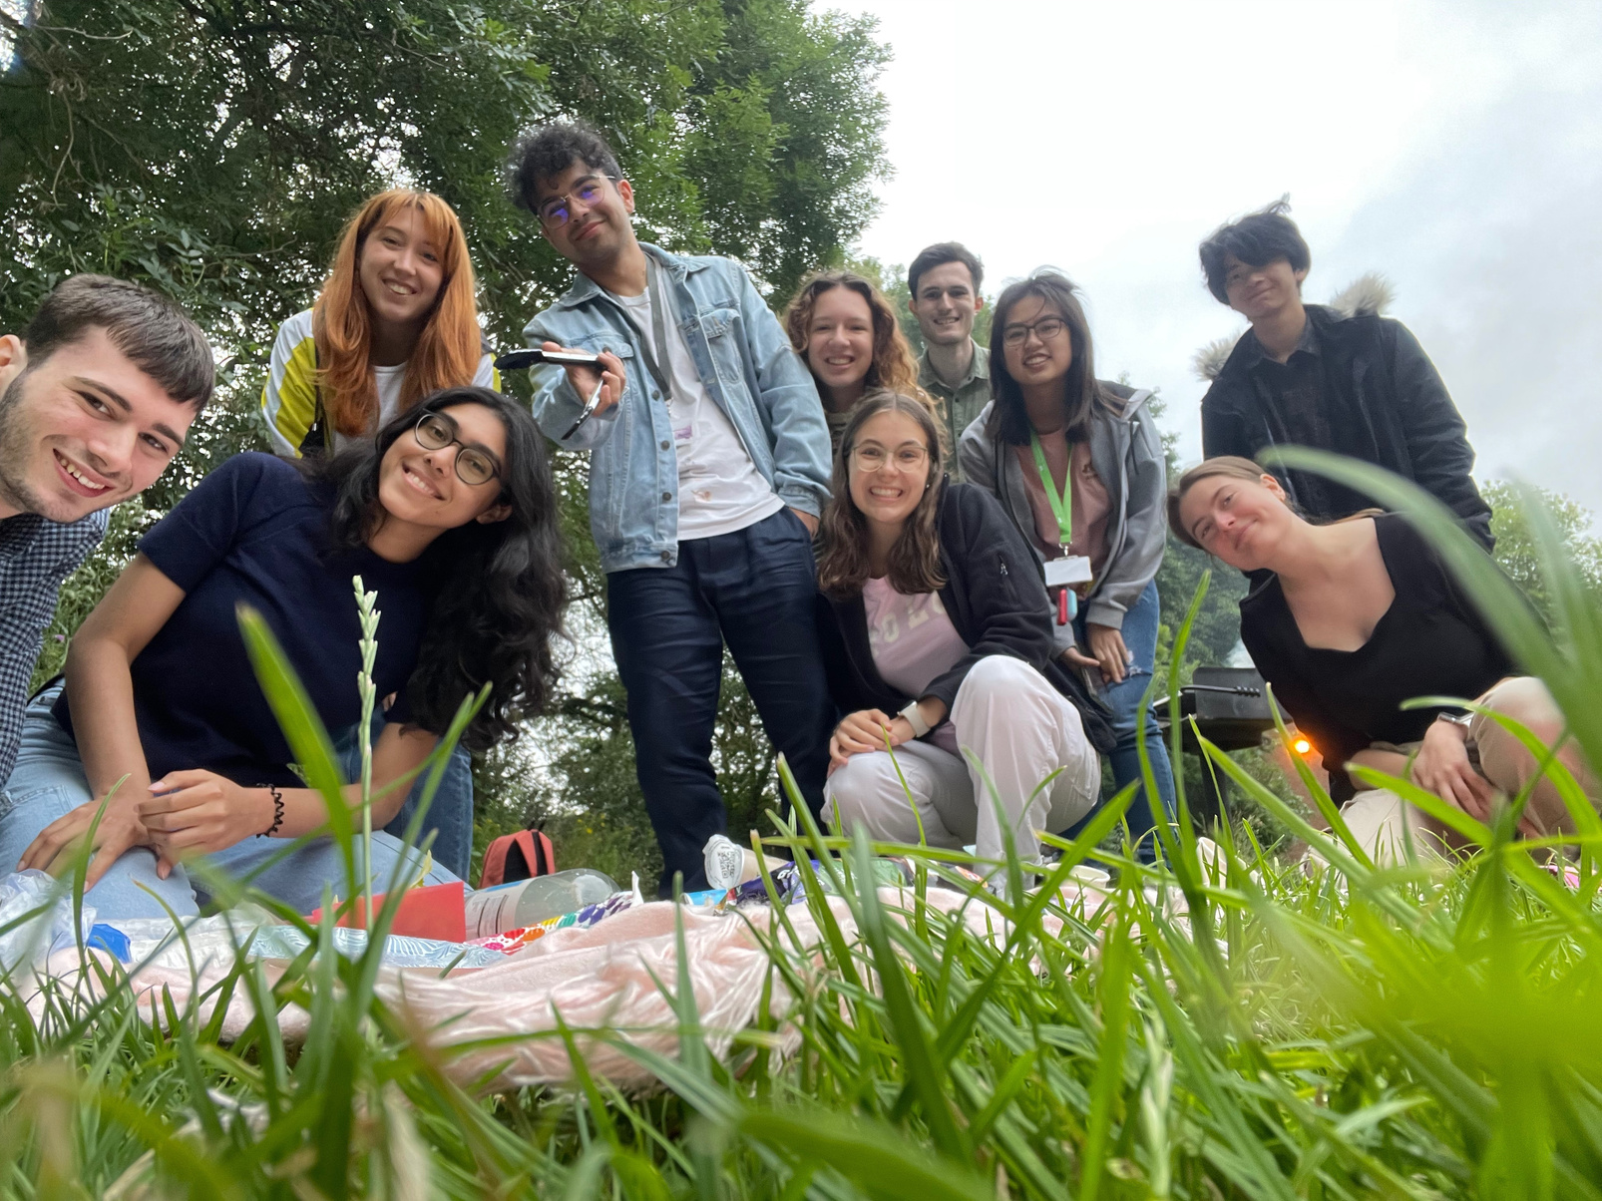

WHO ARE WE?
10 Students from the University of Warwick participating in iGEM
From different courses
  Biochemistry
  Biomedical Sciences
  Chemistry
  Engineering
  Computer Systems Engineering
  Mathematics

Slide 3


WHAT IS IGEM?
iGEM= International Genetically Engineered Machine
Synthetic Biology Competition
Synthetic Biology
  Engineering living organisms to have new abilities
Jamboree in Paris where all teams around the world present their projects

Slide 4
LEARNING OUTCOMES OF THIS LESSON:
  What are bacteria?
  How can bacteria be useful to us?
  Chemotaxis
  Ethics of Genetic Engineering

Slide 5
Lesson
IF YOU THINK THAT BACTERIA ONLY CAUSE DISEASE...THINK AGAIN!
iGEM team 2024 University of Warwick

Slide 6
LEARNING OUTCOMES OF THIS LESSON:
  What are bacteria?
  How can bacteria be useful to us?
  Chemotaxis
  Ethics of Genetic Engineering

Slide 7
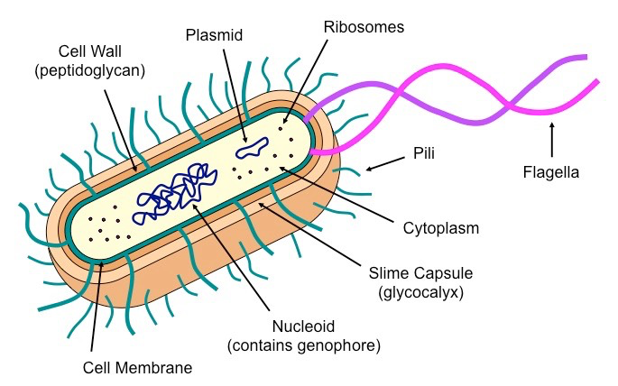
WHAT ARE BACTERIA?
Prokaryotes - what does that mean?
Cause disease - which diseases are caused by bacteria?
How can we treat bacterial infections?
Adapted from Bioninja
1 minute to discuss amongst yourselves...

Slide 8

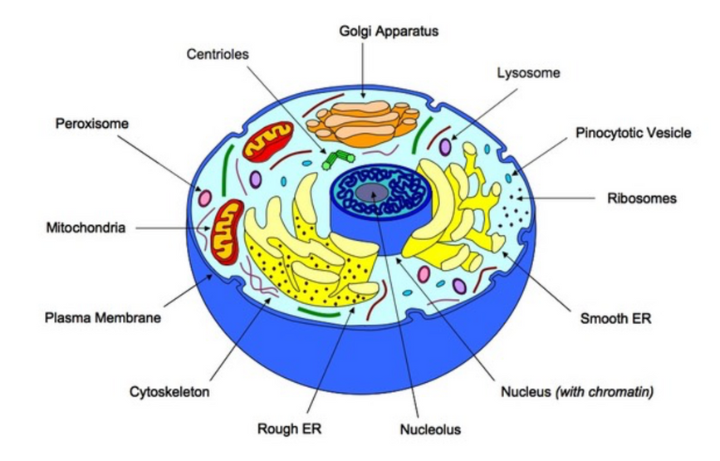
WHAT ARE BACTERIA?
Prokaryotes - no nucleus
Cause disease - Salmonella
Treatment - Antibiotics
ANTIBIOTICS ARE GOOD BUT...
Adapted from Bioninja

Slide 9
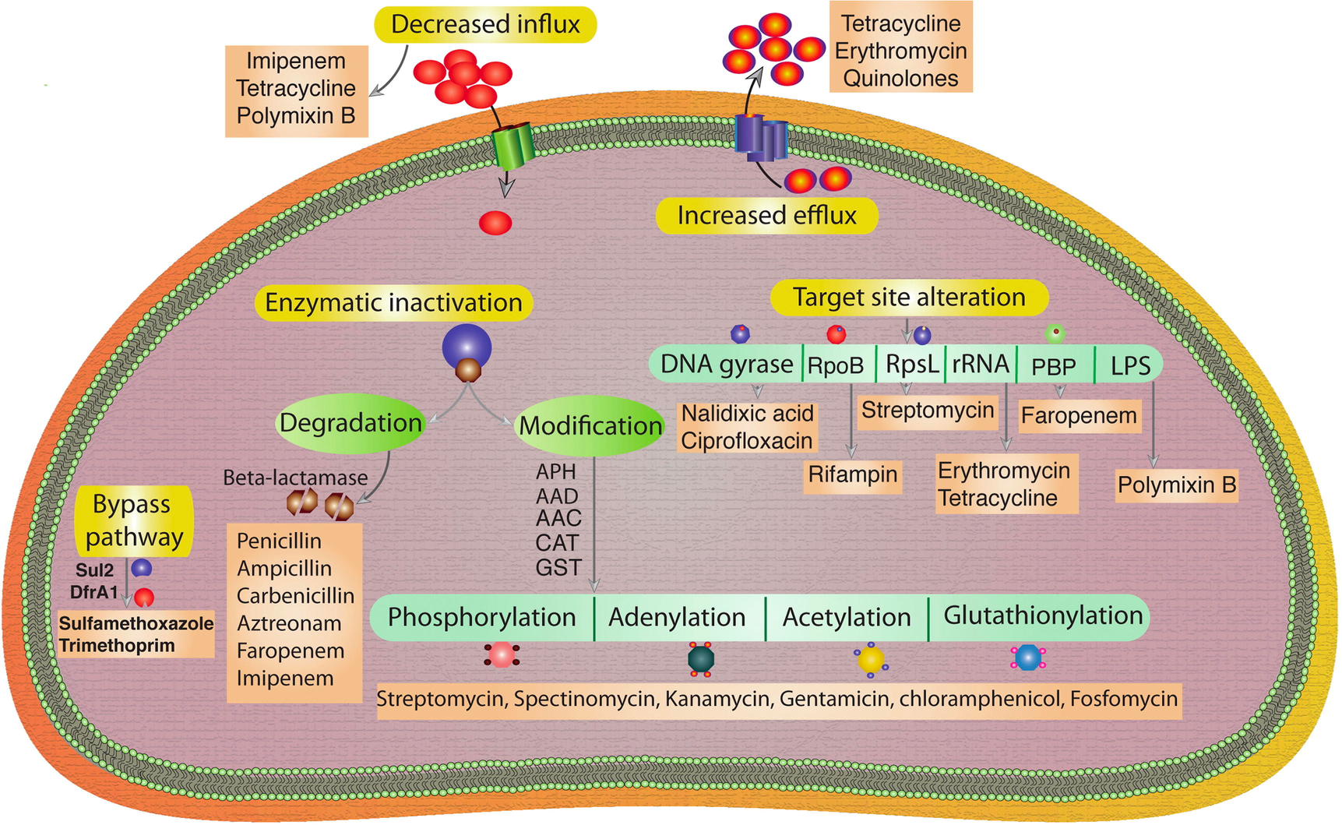
ANTIBIOTIC RESISTANCE
Phage therapy?
Adapted from https://www.sciencedirect.com/science/article/pii/S0264410X19307935

Slide 10
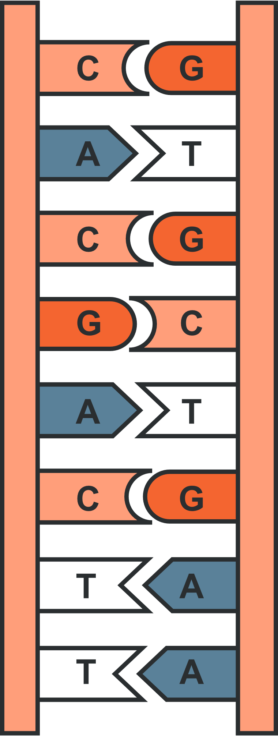
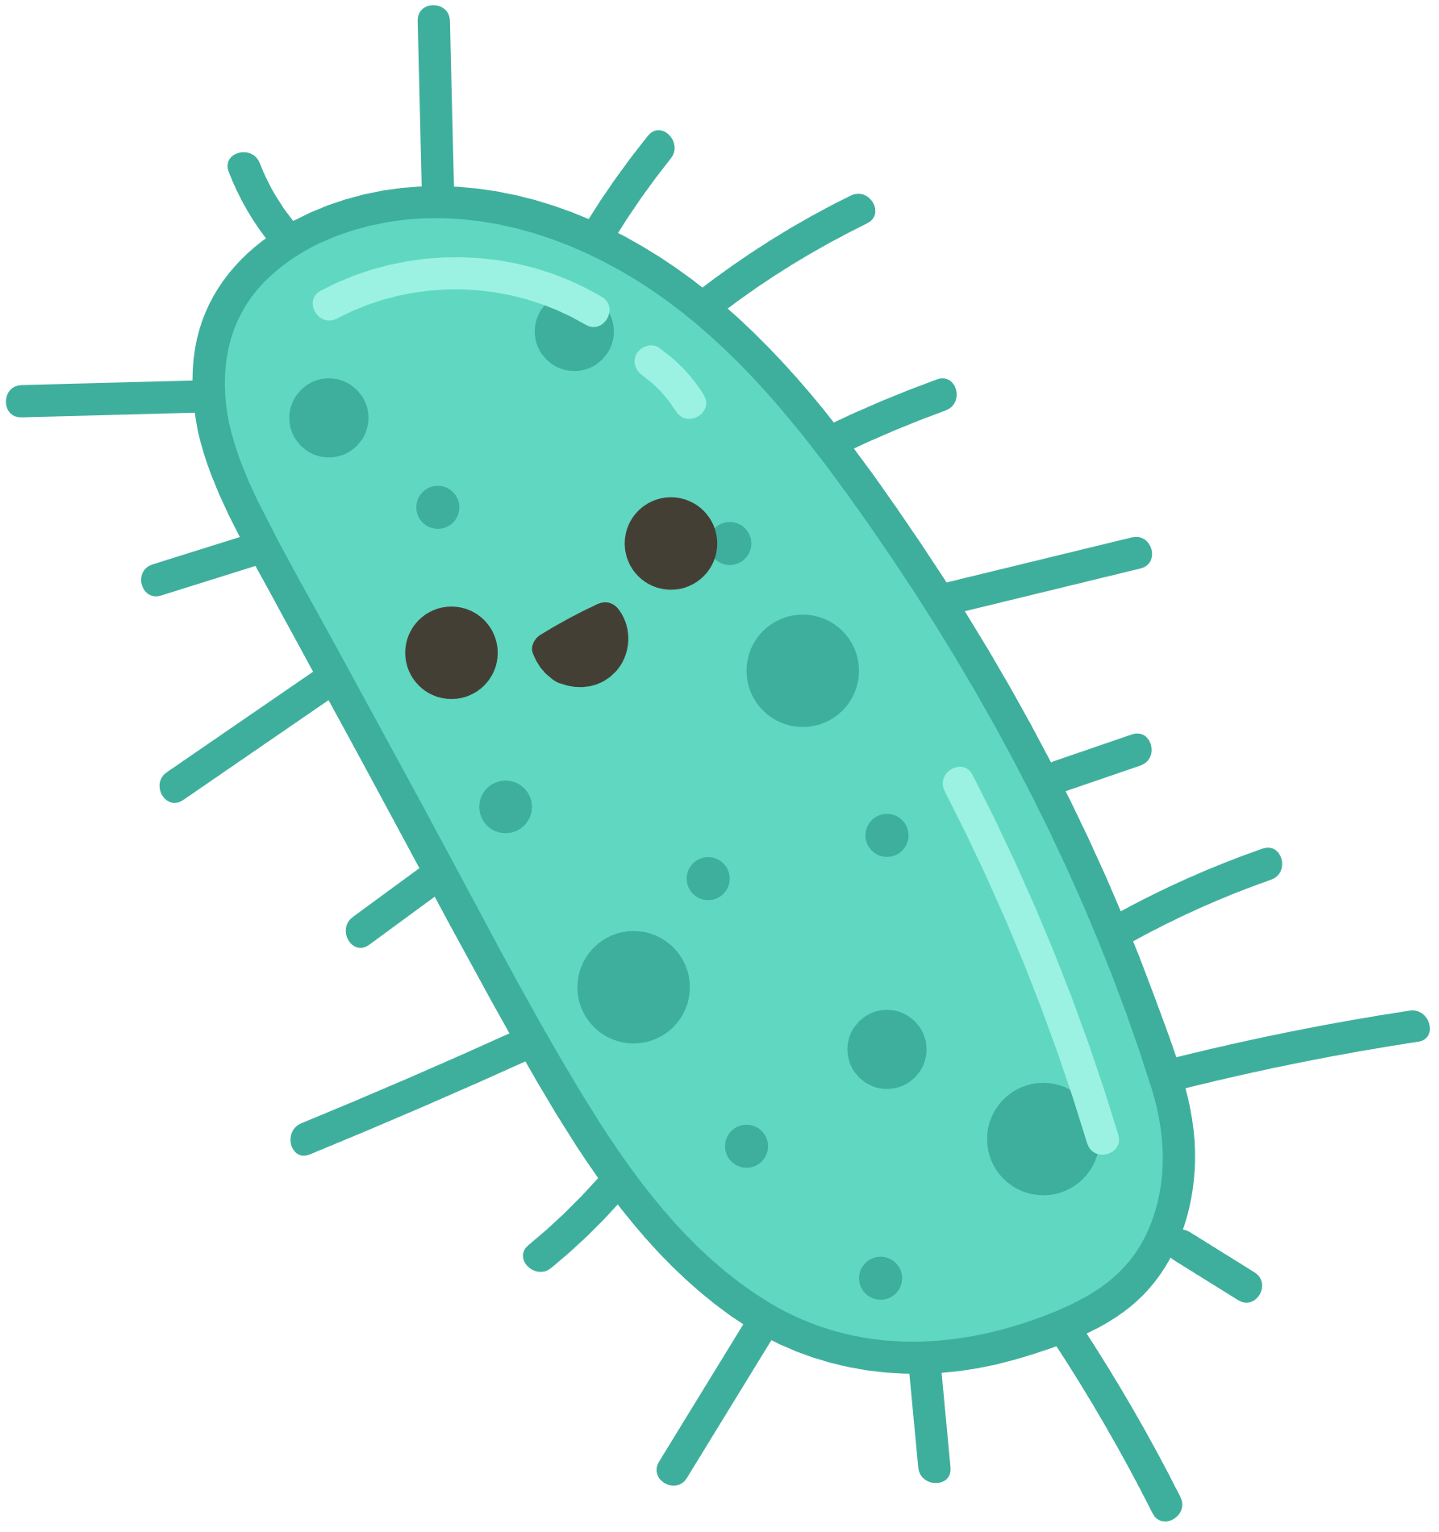

BUT BACTERIA CAN DO MORE THAN JUST CAUSE DISEASE...

Slide 11
  PRODUCE INSULIN
Why is insulin important?
Blood glucose rises
Insulin is released
Cells respond causing a fall in blood glucose
Optimum blood glucose level
Optimum blood glucose level
Cells respond, causing a rise in blood glucose
Glucagon is released
Blood glucose falls

Slide 12
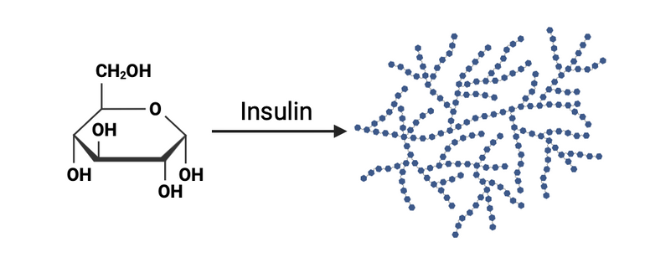

  PRODUCE INSULIN
Type 1 Diabetes
  Cannot produce insulin
Why is this bad?
  If you don’t produce insulin = High blood glucose levels... oh dear...
Treatment
  Inject with insulin
  But where does insulin come from?

Slide 13
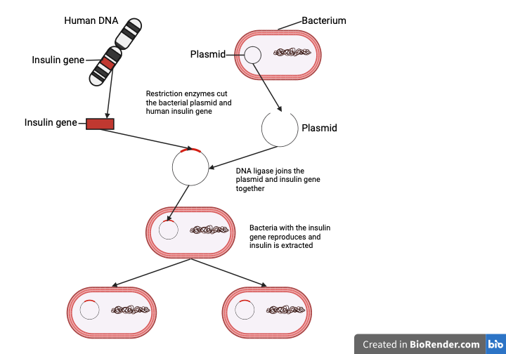
  PRODUCE INSULIN

Slide 14
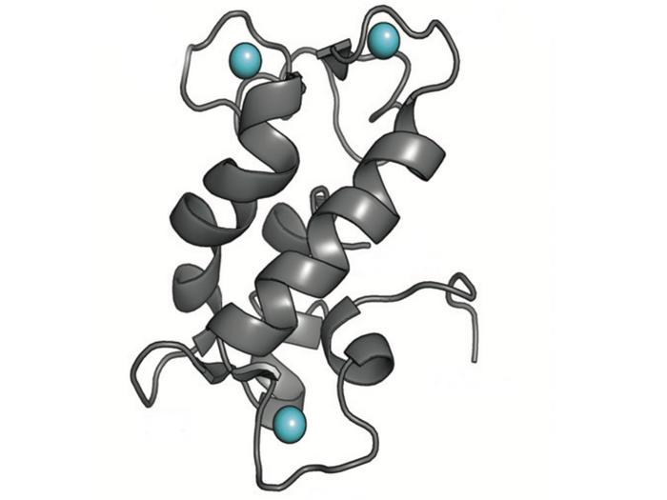


2. RECYCLE METALS
(IGEM PROJECT)
Lanthanide
(metal)
  A bacterium (M. extorquens) has a protein, lanmodulin, which can bind to lanthanides (metals)
  Lanthanides are in electronic devices and batteries
Lanmodulin (protein)
Adapted from COTRUVO LAB/PENN STATE

Slide 15
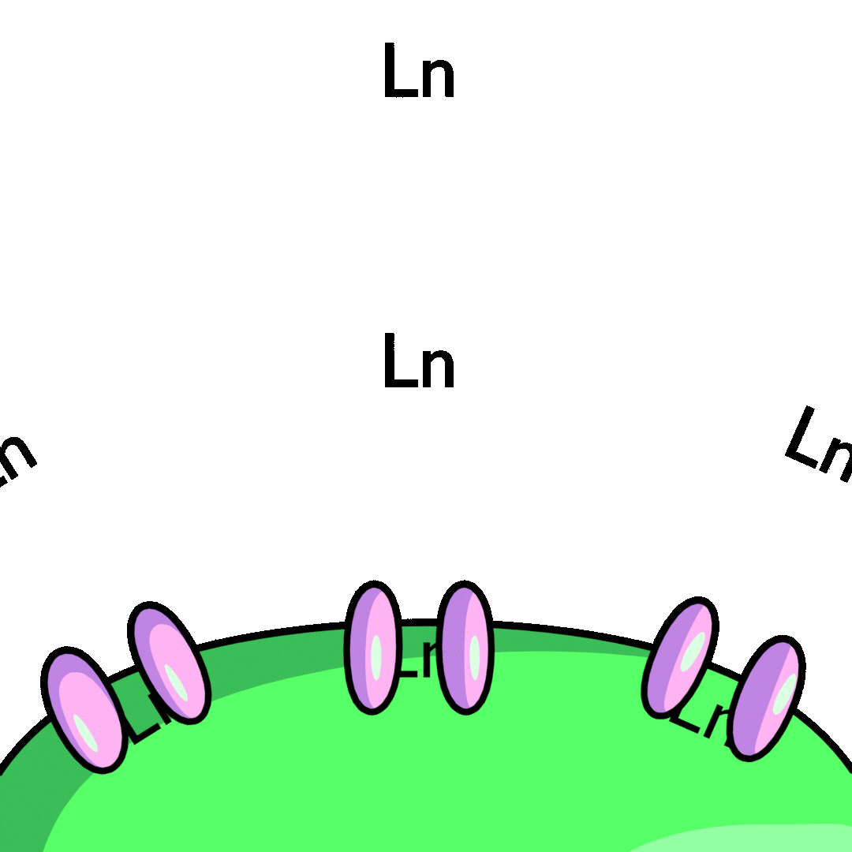
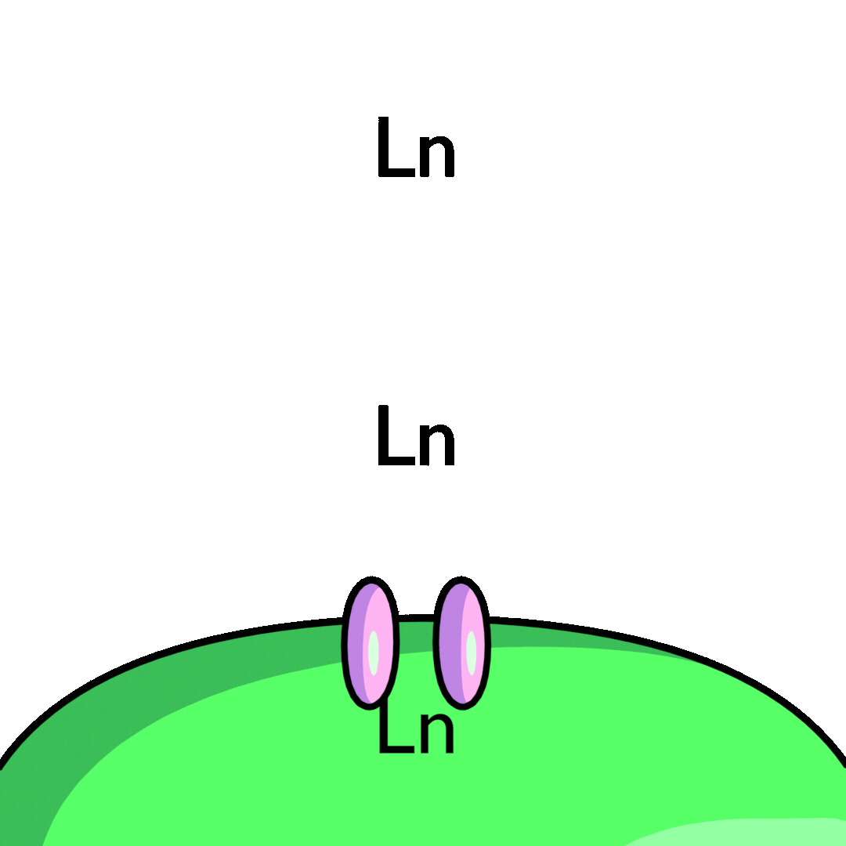
2. RECYCLE METALS
(IGEM PROJECT)
  Bacteria can be genetically engineered to express more pumps on its membrane to pump more metals in

Slide 16
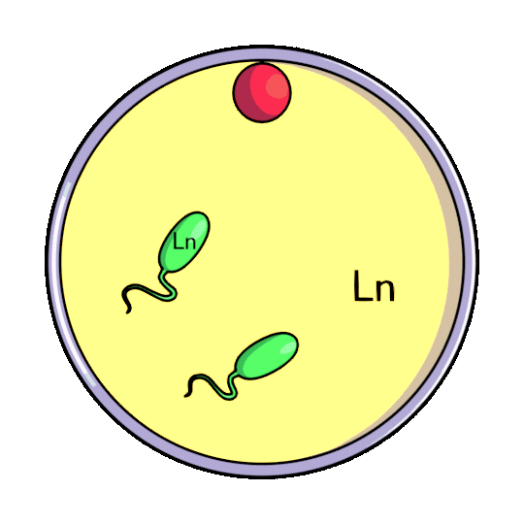
2. RECYCLE METALS
(IGEM PROJECT)
  Bacteria can be genetically engineered to be attracted to a compound (red dot) - this is called chemotaxis
  Bacteria swim to the red dot when it is bound to the metal
  Extract the metal

Slide 17
OTHER EXAMPLES
Genetically modified crops to improve size and quality of food
Sheep have been engineered to produce substances in their milk
Scientists are researching genetic modification treatments for inherited diseases caused by faulty genes

Slide 18
Chemotaxis activity
IF YOU THINK THAT BACTERIA ONLY CAUSE DISEASE...THINK AGAIN!
iGEM team 2024 University of Warwick

Slide 19
WHAT IS CHEMOTAXIS?
  Movement of a motile cell or organism, or part of one, in a direction corresponding to a gradient of increasing or decreasing concentration of a particular substance.
  Bacteria move towards a chemoattractant and away from chemorepellent

Slide 20

CHEMOTAXIS VIDEO
ARE BACTERIA RUNNING IN A STRAIGHT LINE?

Slide 21


CHEMOTAXIS ACTIVITY
RANDOM WALK
Instructions:
  Nominate a person in the class to be the Apple pie (chemoattractant)
  Let the apple pie stand on one side of the classroom and the rest of the students stand randomly distributed on the other side.

Slide 22
CHEMOTAXIS ACTIVITY
Instructions:
3. Start Running: When the teacher says "GO," walk straight for 5 steps.

Slide 23

CHEMOTAXIS ACTIVITY
4. Tumble: Stop and spin on the spot 5 times with your eyes closed.
5. Run Again: After spinning, walk straight for another 5 steps in the new random direction you are facing.

Slide 24
CHEMOTAXIS ACTIVITY
  RANDOM WALK (5 STEPS, 5 SPINS)
  RANDOM BIASED WALK (2/5/10 STEPS, 5 SPINS)

Slide 25
CHEMOTAXIS ACTIVITY
  RANDOM WALK
Instructions:
  Nominate a person in the class to be the Apple pie (chemoattractant)
  Let the apple pie stand on one side of the classroom and the rest of the students stand randomly distributed on the other side.
  Start Running: When the teacher says "GO," walk straight for 5 steps.
  Tumble: Stop and spin on the spot 5 times with your eyes closed.
  Run Again: After spinning, walk straight for another 5 steps in the new random direction.
  Repeat: Continue this pattern (5 steps run, then spin) for a couple of minutes.
  Are you close to the apple pie? How can you be closer to the apple pie when you run and spin? Remember, you cannot just go straight to the apple pie, you have to run and tumble

Slide 26

CHEMOTAXIS ACTIVITY
2. RANDOM BIASED WALK
Now we are going to switch up the rules to make it a random biased walk
Running and Tumbling:
  Facing the Apple Pie: If you're facing the apple pie, run for 10 steps.
  Opposite Direction: If you're facing away from the apple pie, run for 2 steps.
  Perpendicular Direction: If you're facing sideways to the apple pie, run for 5 steps.
  After each run, tumble (spin around).
  Repeat the Process
Are you closer to the apple pie?
10
2
5

Slide 27
CHEMOTAXIS ACTIVITY
CONCLUSION
  Bacteria cannot just run in a straight line to the chemoattractant , they need to tumble in the running process
  Bacteria can make their runs longer when they are facing the chemoattractant to reach the apple pie quicker and their runs shorter when they are facing away from the chemoattractant

Slide 28
ETHICS OF GENETIC ENGINEERING
  Divide the class into two groups
  One group for genetic engineering
  One group against genetic engineering
  Debate!

