Slide 1
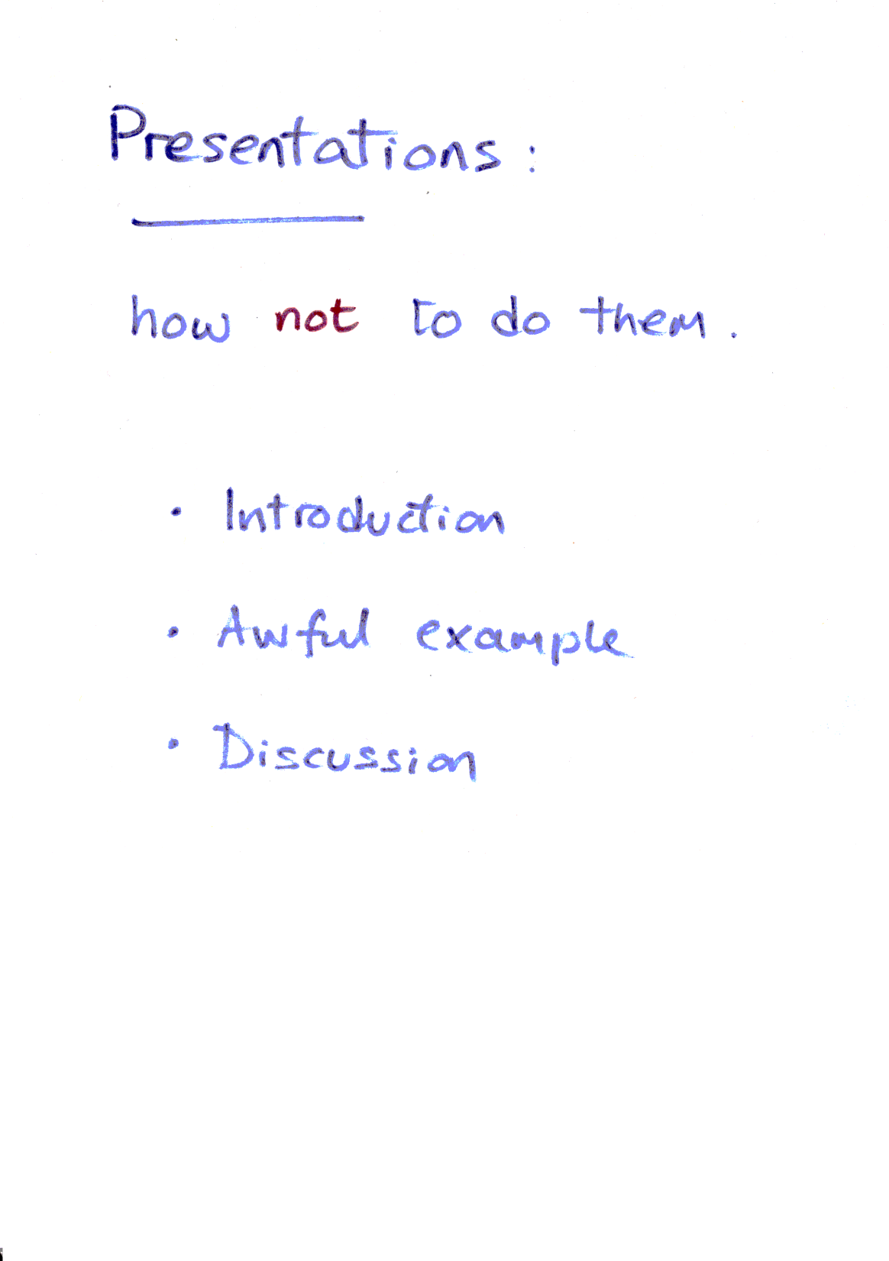
Notes:
Objective: to stimulate thinking about what makes for good presentation skills.

Slide 2
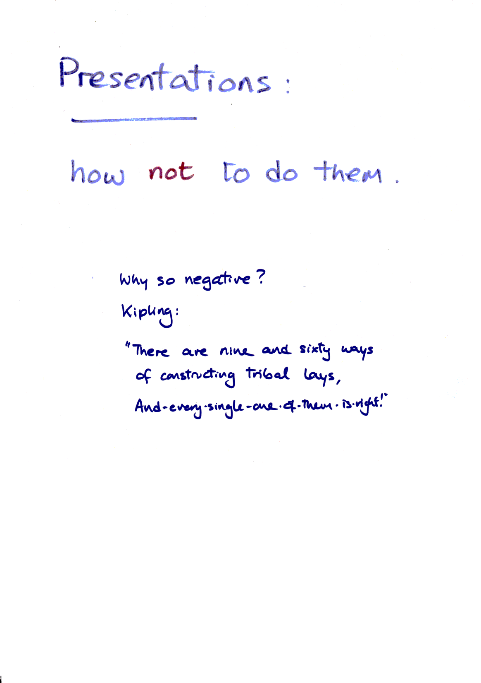
Notes:
Good presentation is a matter of individual style. Bad presentation is a matter of doing silly things.

Slide 3
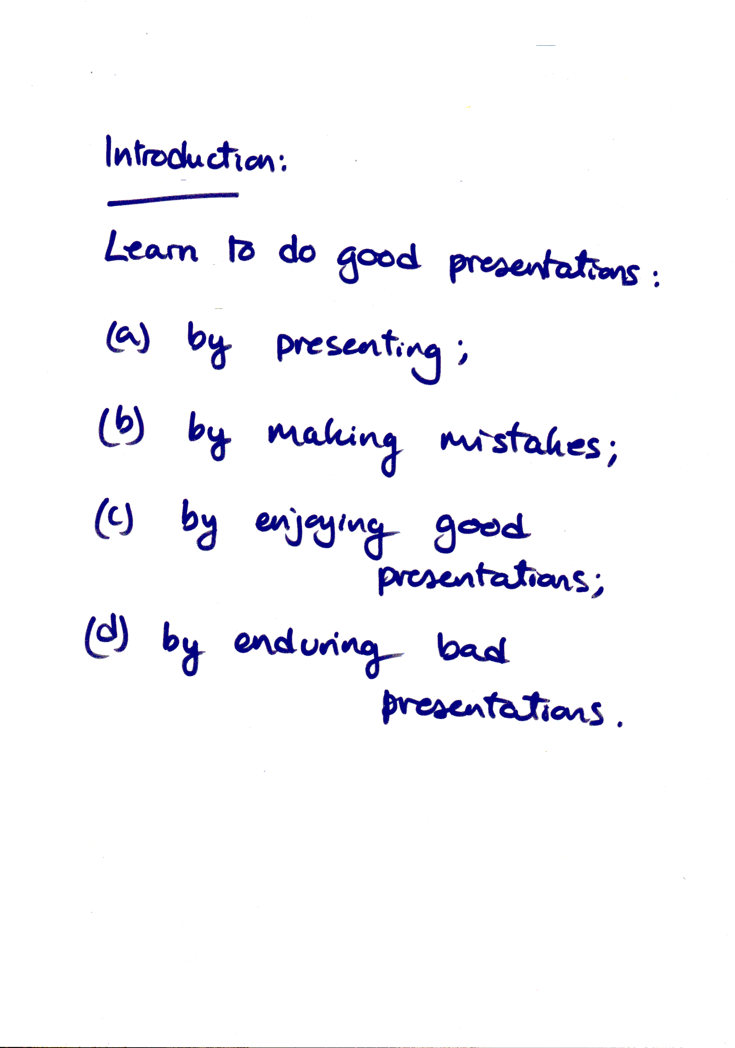
Notes:
APTS provides (we hope!) examples of type (c). Tonight we have a brief example of type (d).

Slide 4
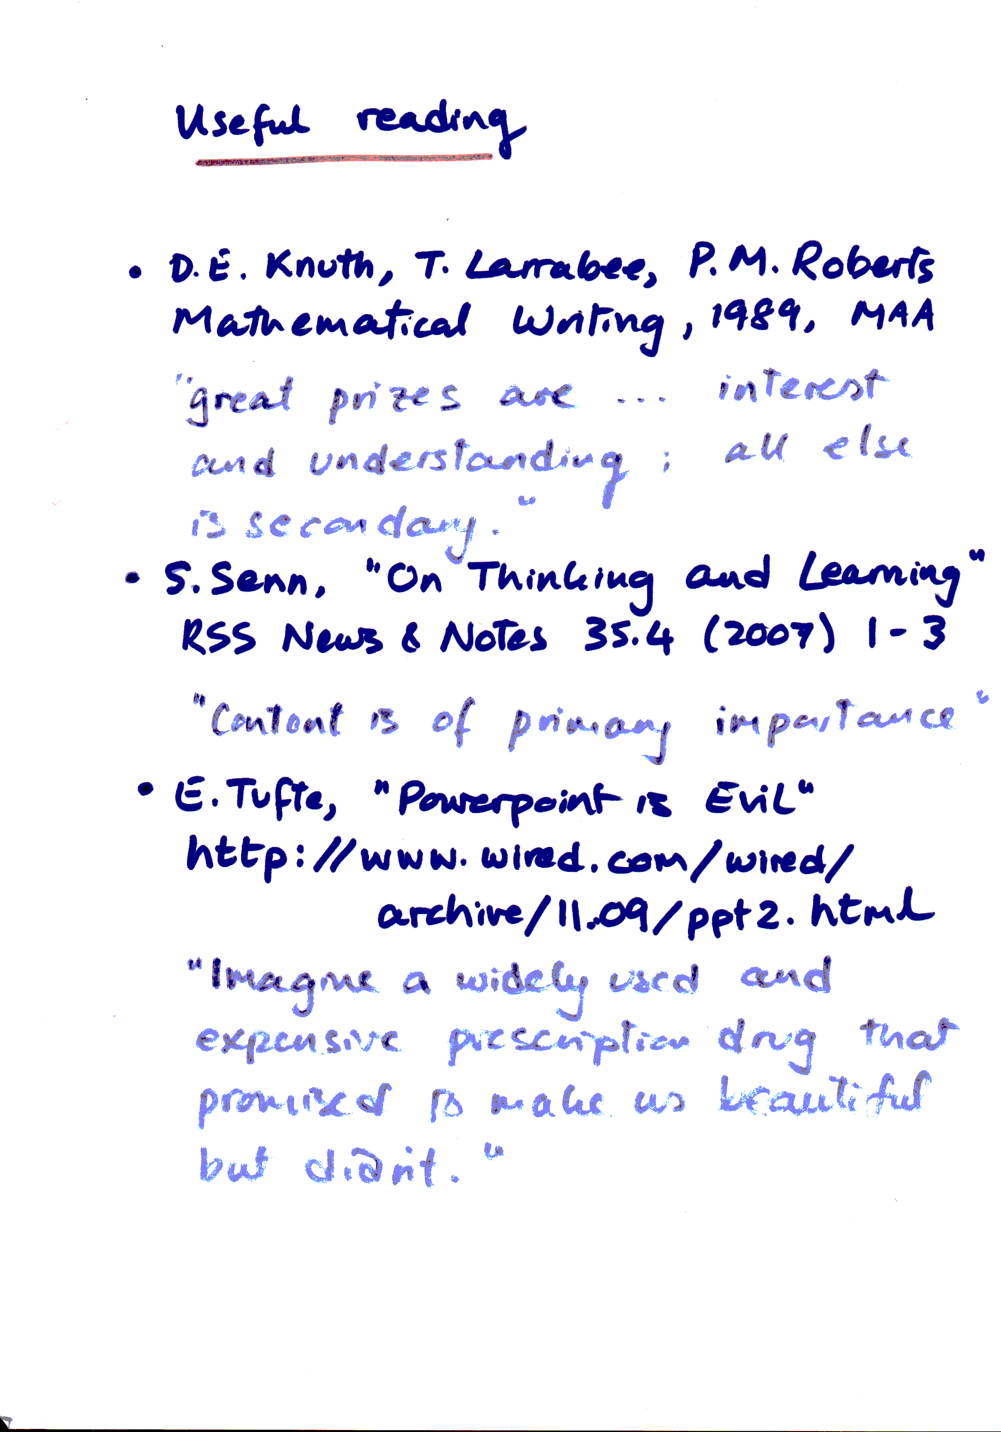
Notes:
Before we turn to the awful example, here are 3 suggestions for possible reading, together with illustrative quotes.

Slide 5
Start of awful
example
Notes:
Select someone to act as chair, to give me XX minutes

Slide 6
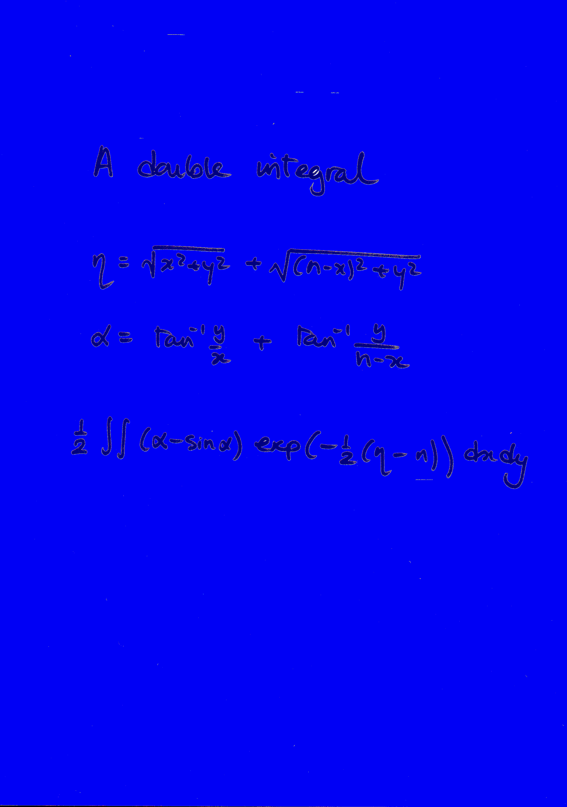
Notes:
Don’t look at audience. Hand in front of mouth. Point to laptop not screen.
Start with apology for not having spent enough time preparing (last week was end-of-term).
No motivation! “This double integral is interesting for people who are interested in that sort of thing.”
Inelegant definition.
No figure.
Bad choice of background colour.

Slide 7
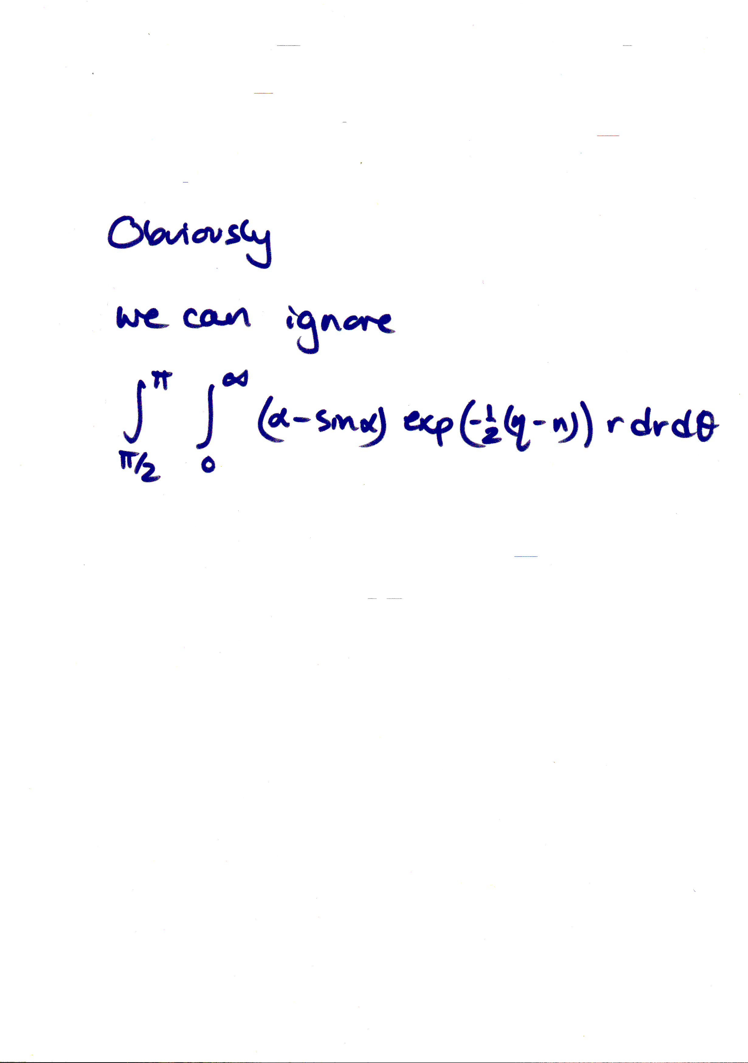
Notes:
The part of the integral for theta between pi/2 and pi can be ignored: it is easy to deal with.
Failing to be clear about new coordinates.
Used “Obviously”.
Could have said more about ignorability without using many more words.
Still haven’t revealed what I am aiming to do, even at this computational level.

Slide 8
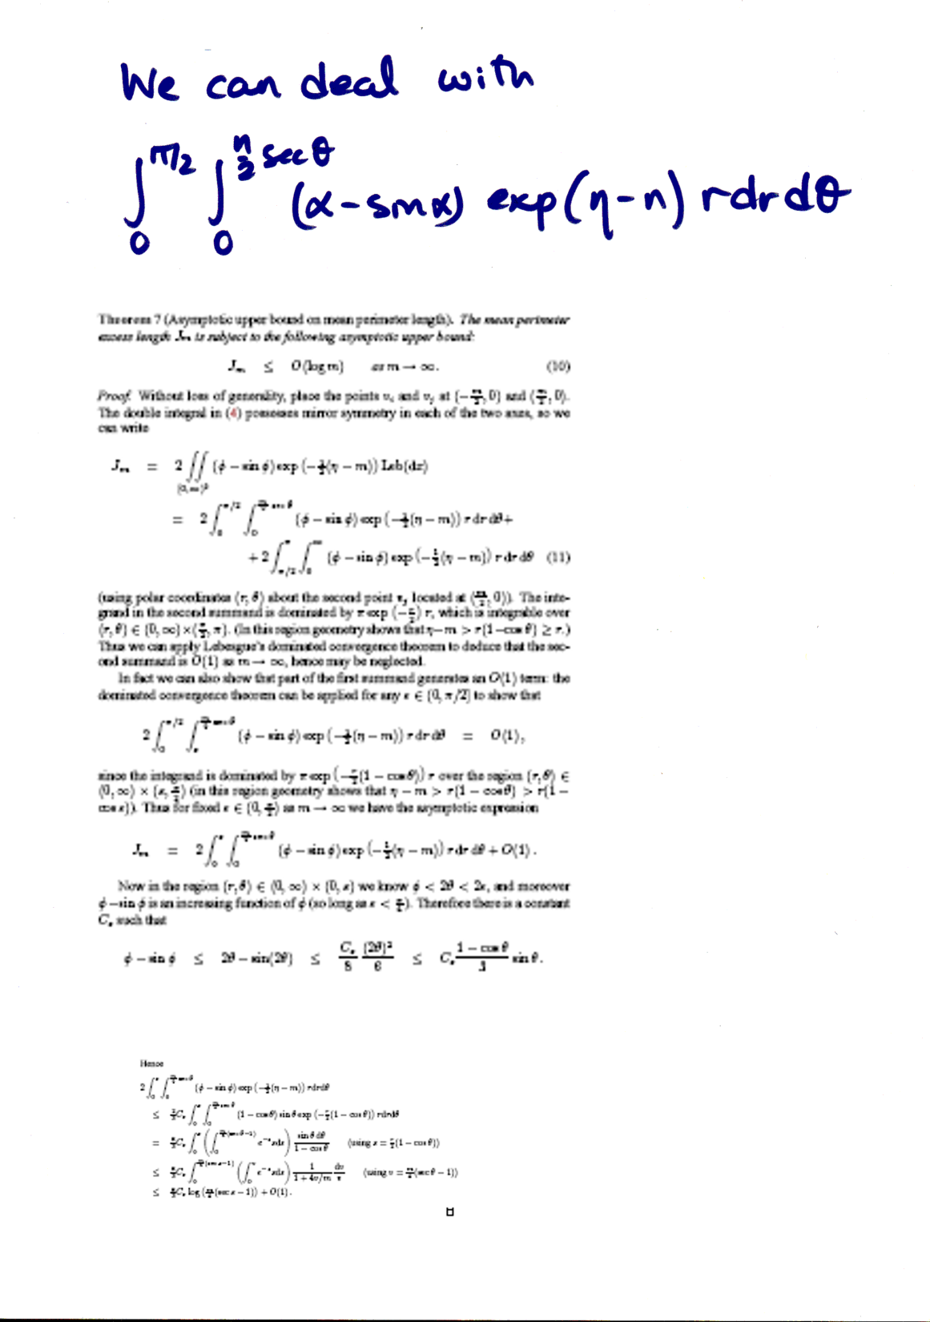
Notes:
The part of the integral for theta between 0 and pi/2 can be controlled by mathematical analysis.
Poor font size.
Taking material directly from printed paper (two different purposes of exposition!).
Both too long for comfort and too short togive an idea of what’s going on.

Slide 9
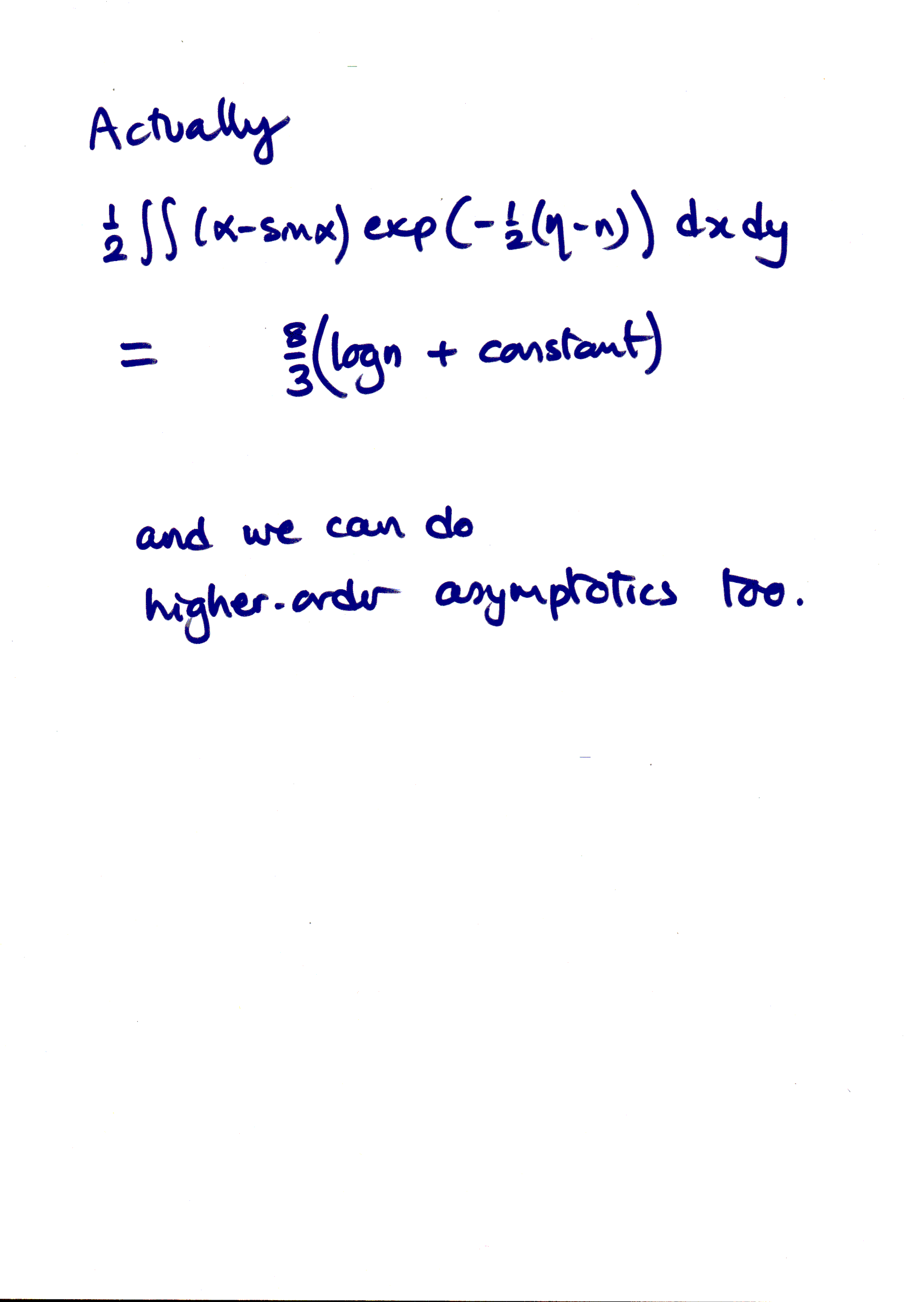
Notes:
Inaccurately phrased statement (actually asymptotic, for large n)

Slide 10
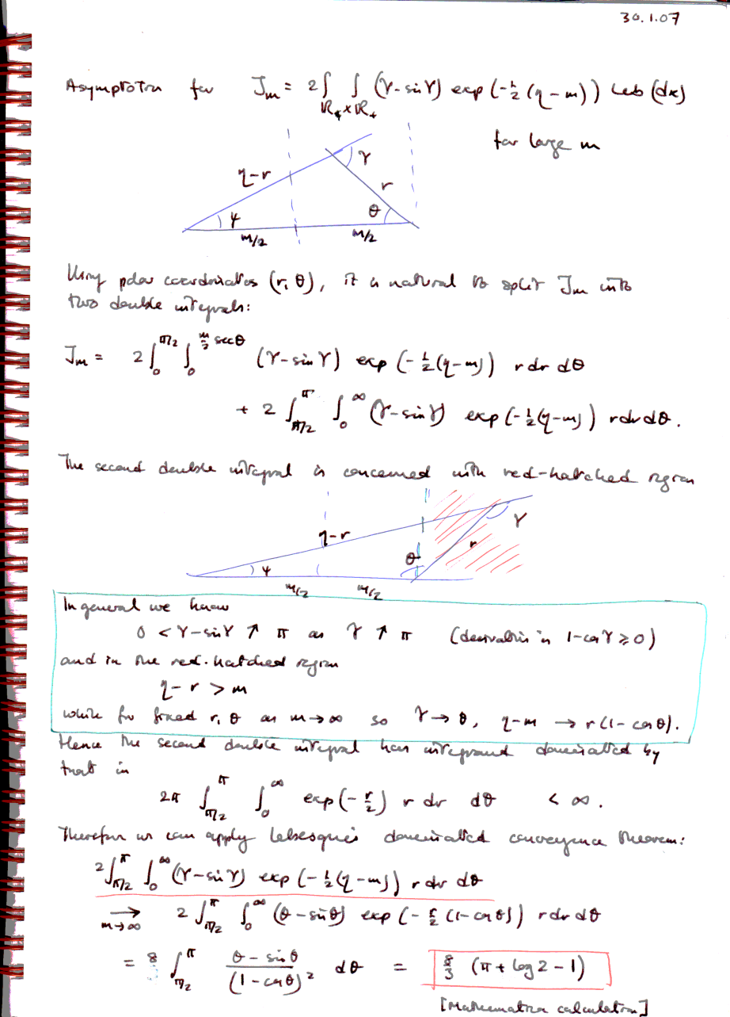
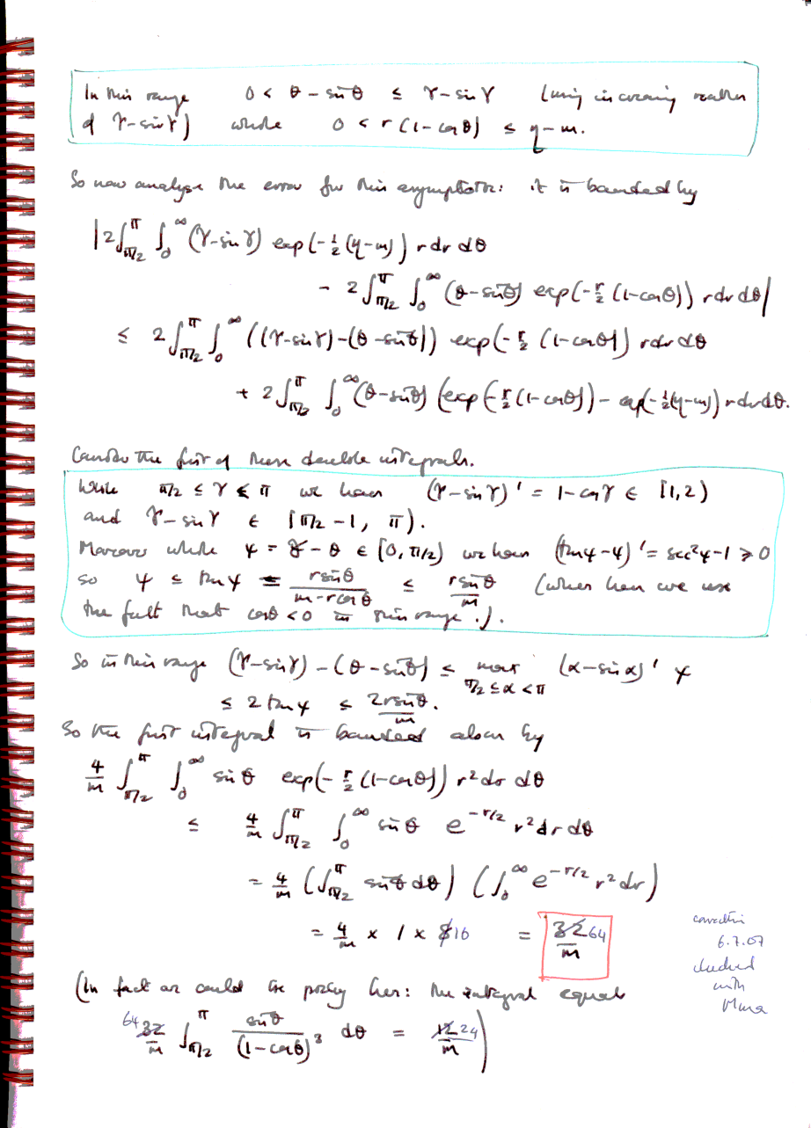
Notes:
Try to have run out of time here.
“We can get better accuracy by going into more details: here are some pages from my notebook to explain how it gets done.
The part of the integral for theta between pi/2 and pi can be controlled using Lebesgue’s dominated convergence theorem.”
Poor choice of scale.
Taking material directly from notebook (two different purposes of exposition!).
Too much information! Poor timing. No attempt to edit and organize argument to show what is really going on.

Slide 11
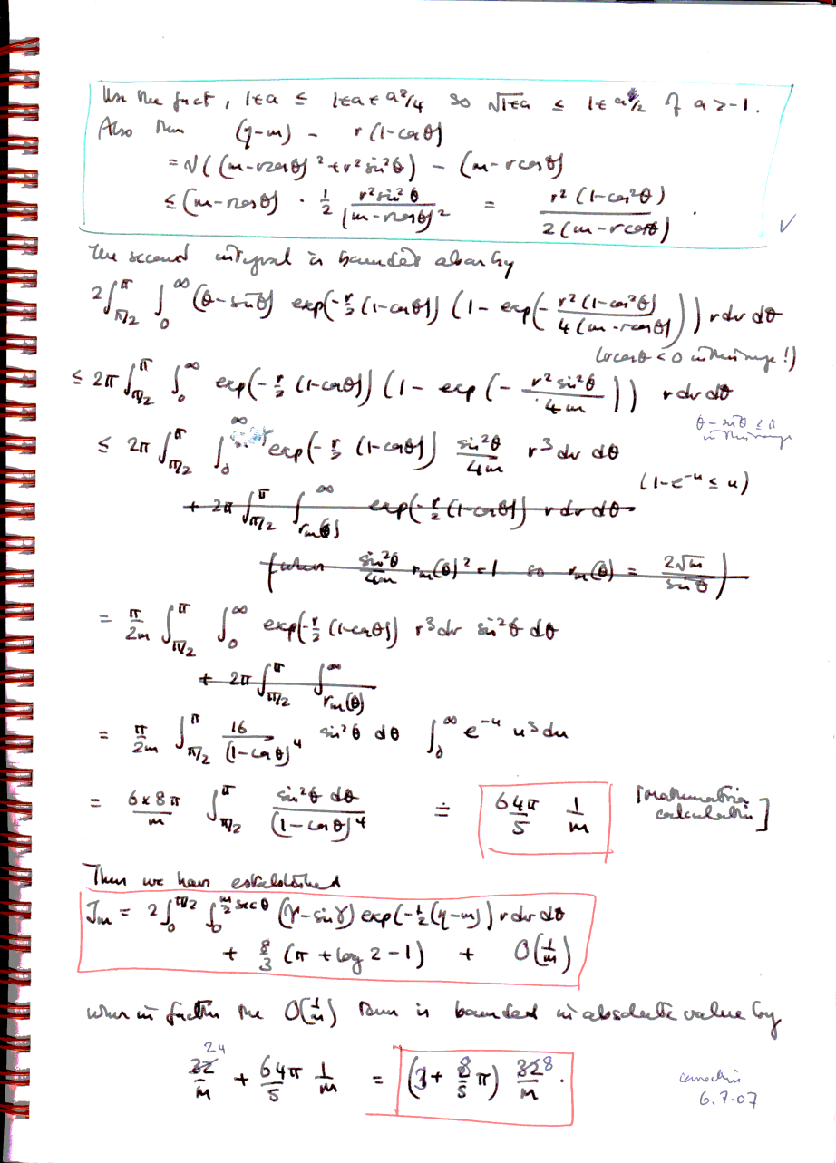
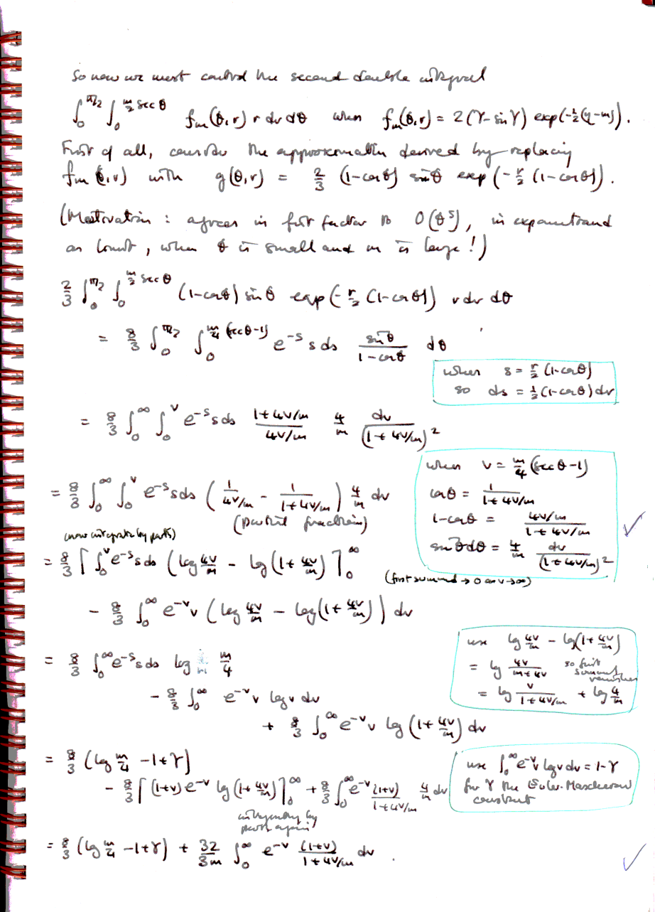
Notes:
The other part is controlled first by carefully transforming coordinates ...

Slide 12
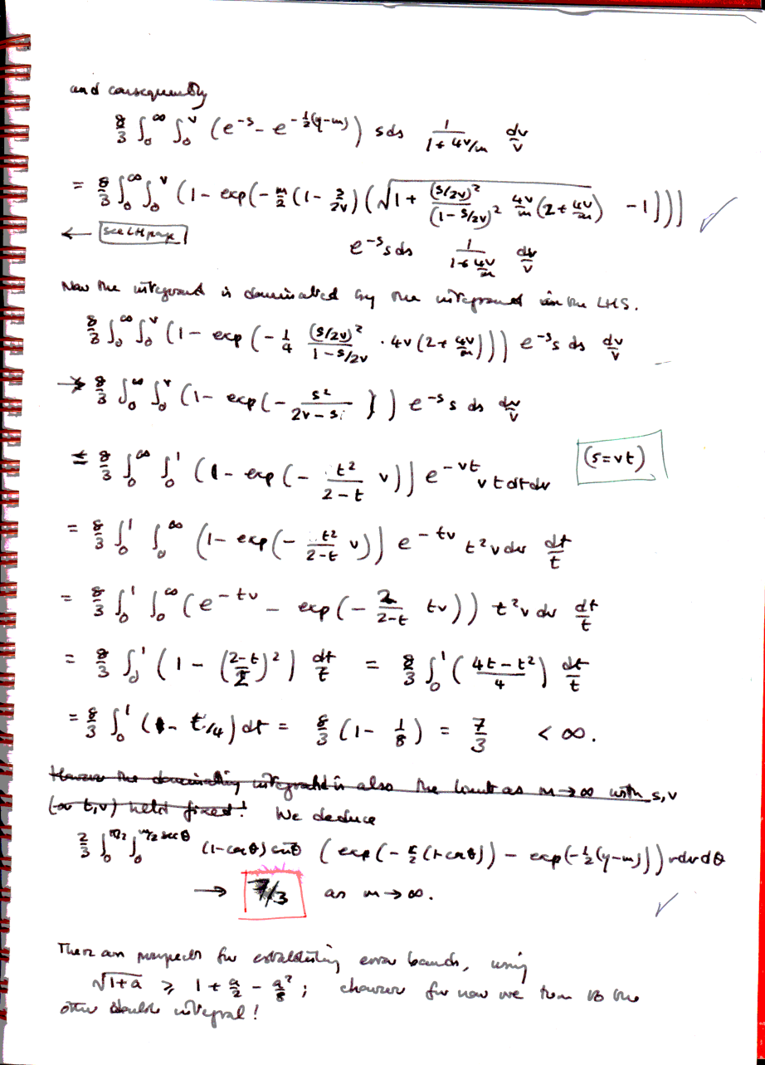
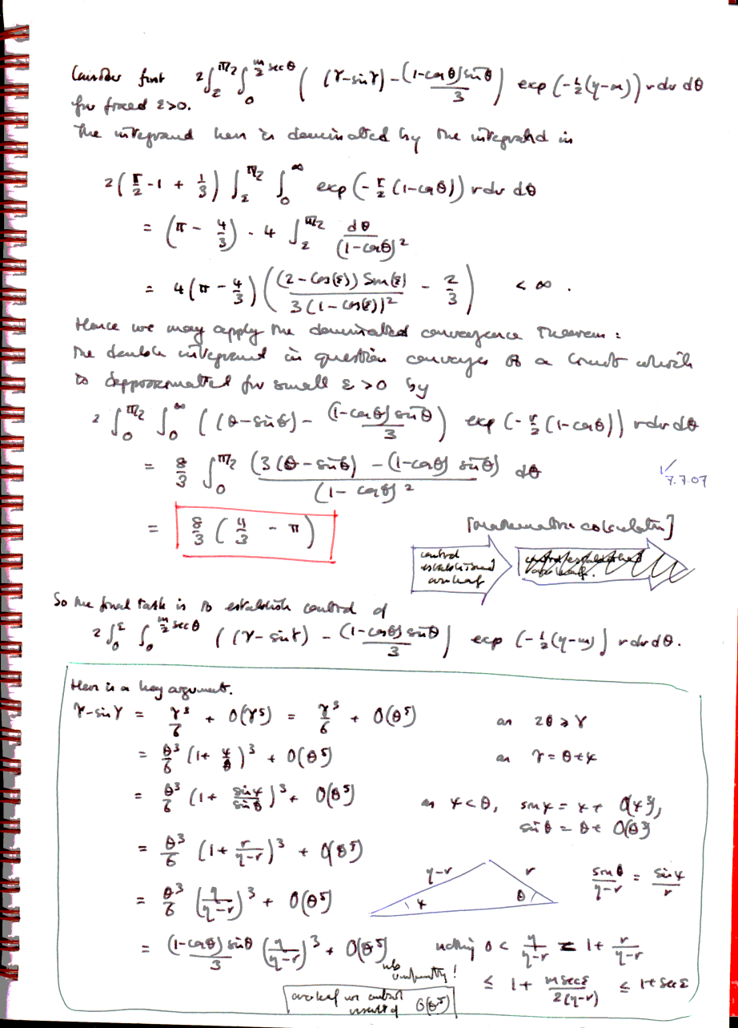
Notes:
... And then by dealing with errors. The substantial contribution comes from theta small but positive.

Slide 13
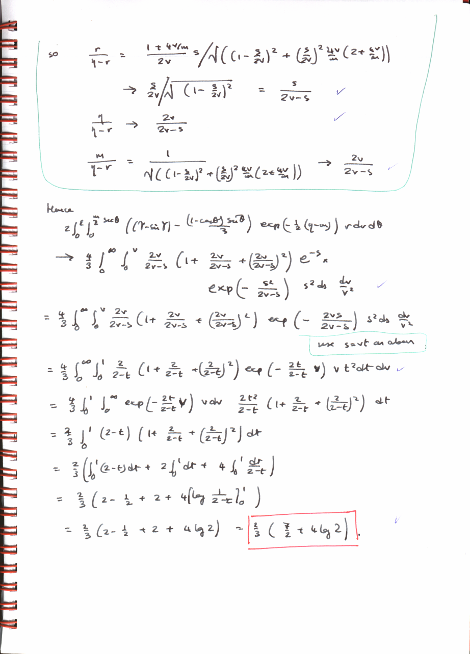
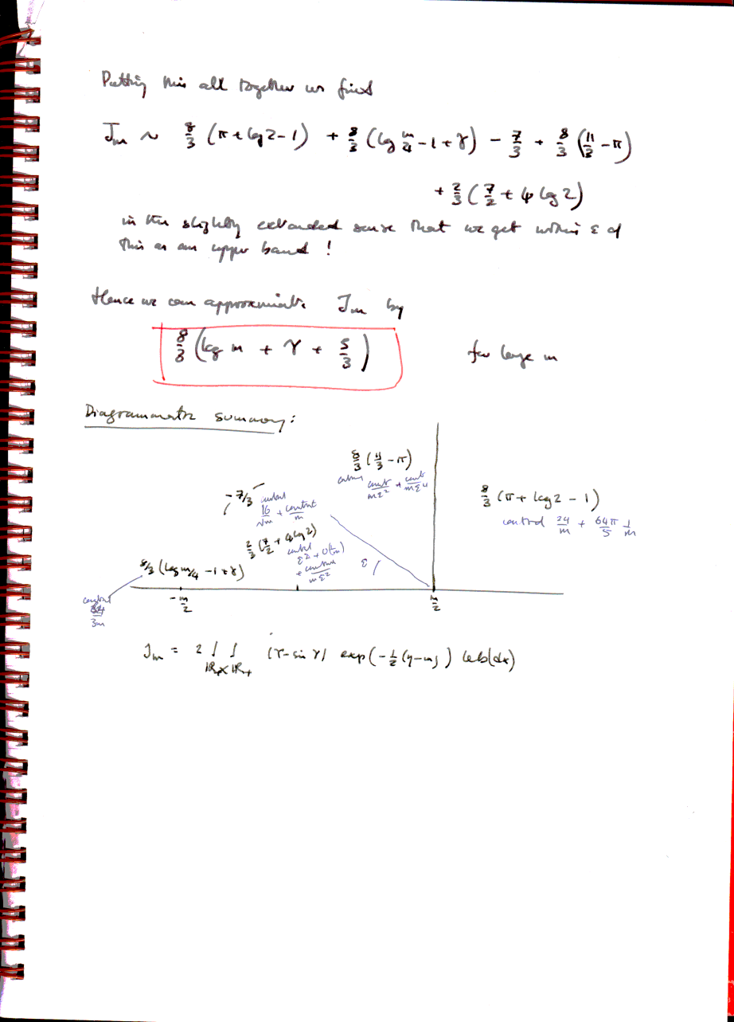
Notes:
Eventually we achieve the constant term in the asymptotic, and actually identify the correction as at most n^(1/3)).

Slide 14
End of awful
example
Notes:
Cease awfulness!

Slide 15
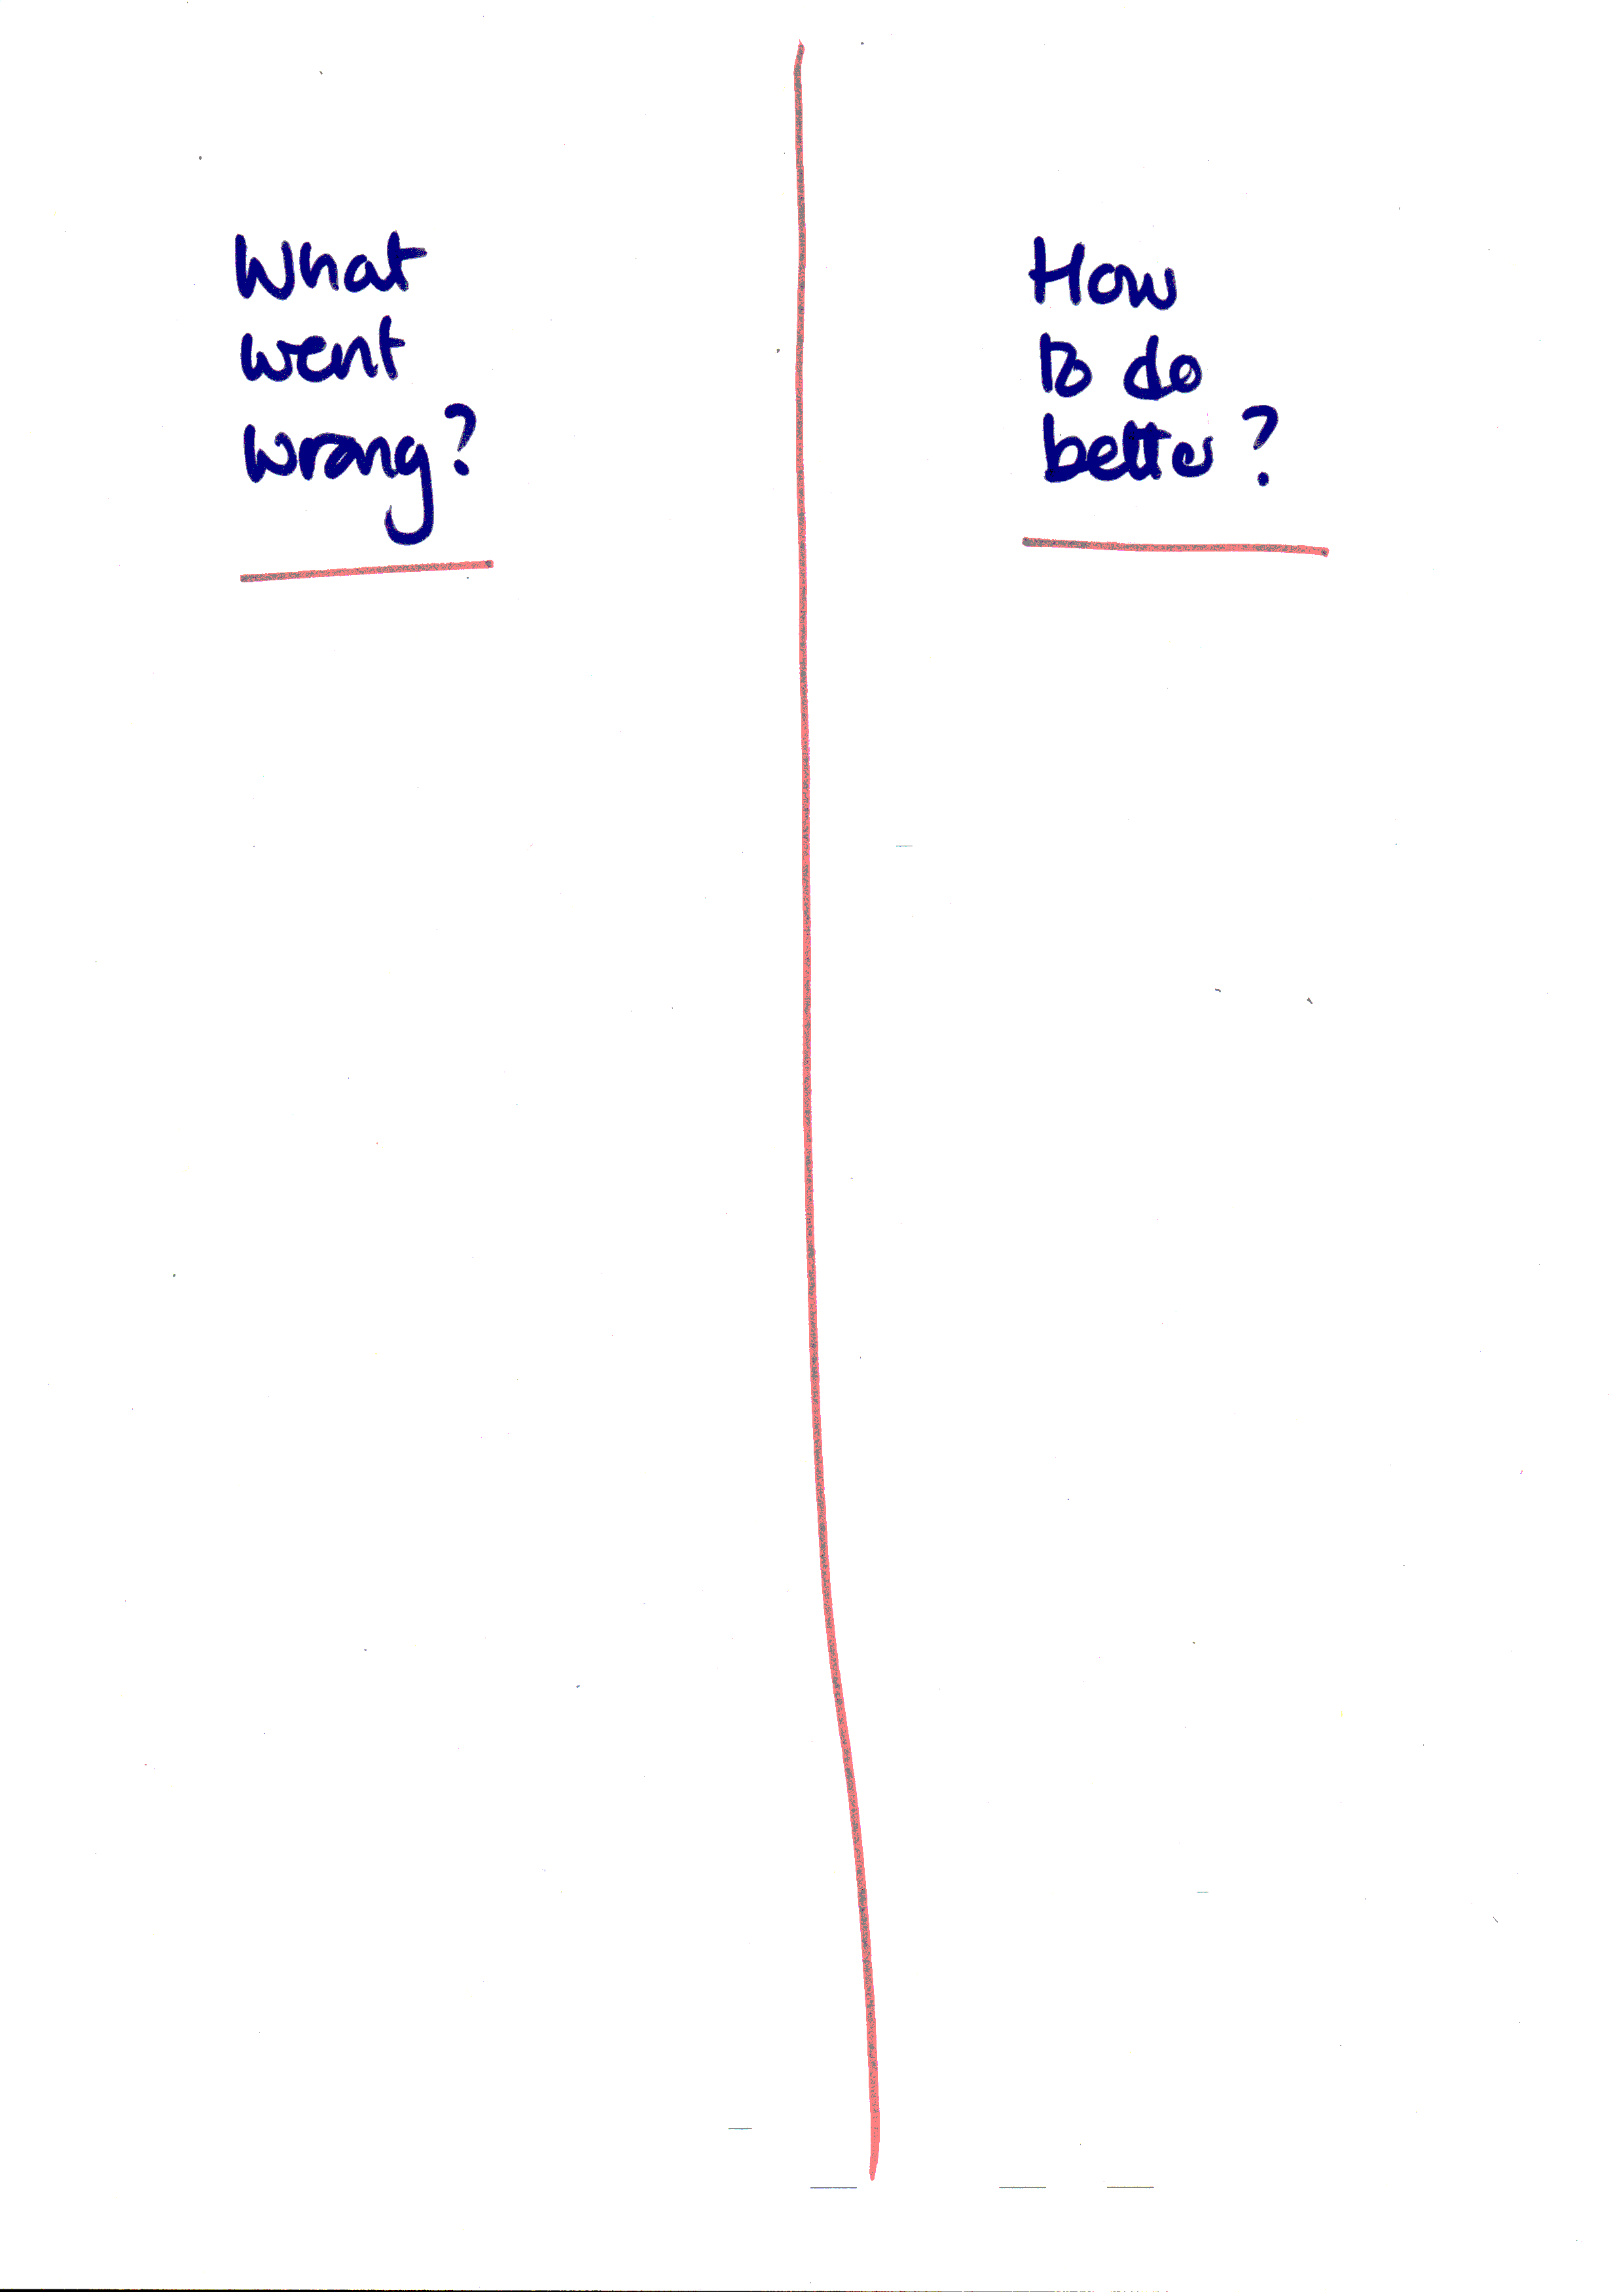
Notes:
Invite comments on both sides of the sheet of paper.

