Slide 1

Model selection/averaging for subjectivists
School of Mathematics
FACULTY OF MATHEMATICS AND PHYSICAL SCIENCES
John Paul Gosling (University of Leeds)

Slide 2
Overview
Setting the scene
Model priors
Parameter priors
Plea for help
Throughout. A number of dead ends…

Slide 3

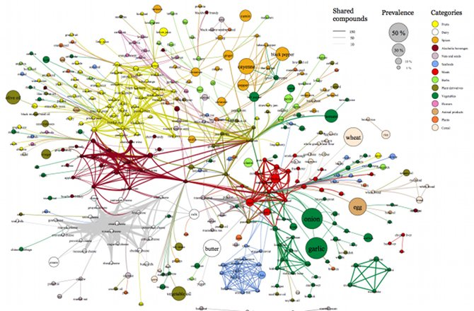
A typical Friday afternoon…
There is this really complicated dataset.
We have spent millions collecting the data and hours talking to experts.
3/152

Slide 4


A typical Friday afternoon…
Our experts tell us that there are several plausible
models. We will denote these:
Each model has some parameter set denoted:
with some parameters being shared across sets.
4/152

Slide 5
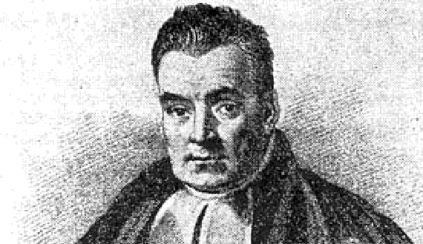
A typical Friday afternoon…
Obviously, Bayesian methods can be used here:
Posterior Prior x Likelihood.
We have lots of data so we will use noninformative priors for our model parameters.
We use Bayes factors to find posterior odds for the plausible models.
5/152

Slide 6
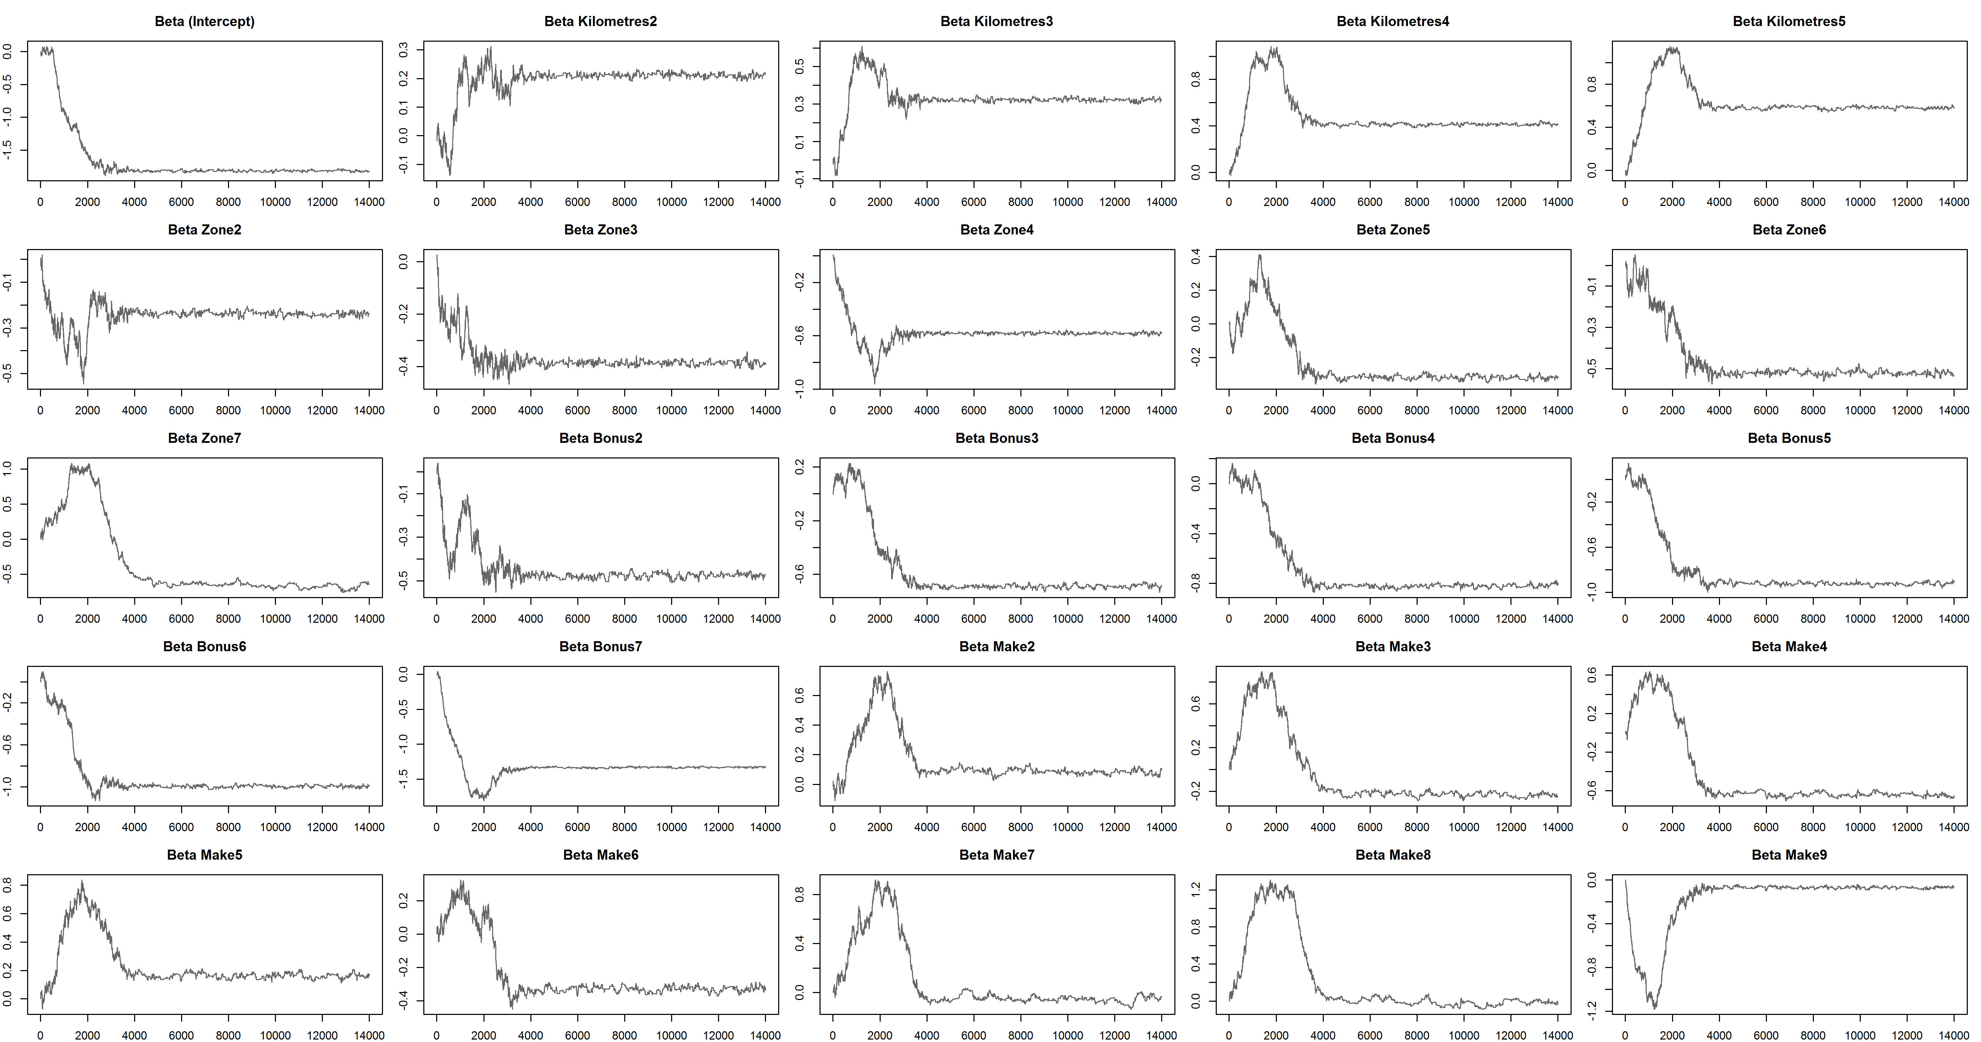
A typical Friday afternoon…
150/152

Slide 7
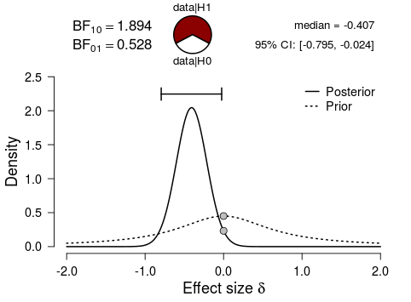
A typical Friday afternoon…
Clearly, model 1 is favoured.
151/152

Slide 8

A typical Friday afternoon…
Conclusions
Solved a big data problem.
MCMC is brilliant.
Model 1 is best.
THANK YOU FOR YOUR ATTENTION.
ANY QUESTIONS?
152/152

Slide 9
A typical Friday afternoon…
Very interesting. May I ask how you went about selecting the prior probabilities for your models?
Conclusions
Solved a big data problem.
MCMC is brilliant.
Model 1 is best.
THANK YOU FOR YOUR ATTENTION.
ANY QUESTIONS?
152/152

Slide 10
A typical Friday afternoon…
Very interesting. May I ask how you went about selecting the prior probabilities for your models?
Conclusions
Solved a big data problem.
MCMC is brilliant.
Model 1 is best.
We felt that we couldn’t allocate tailored probabilities a priori. Given the amount of data and the complexity of model space, it seemed fair and democratic to allocate equal weights.
THANK YOU FOR YOUR ATTENTION.
ANY QUESTIONS?
152/152

Slide 11
A typical Friday afternoon…
Very interesting. May I ask how you went about selecting the prior probabilities for your models?
Conclusions
Solved a big data problem.
MCMC is brilliant.
Model 1 is best.
We felt that we couldn’t allocate tailored probabilities a priori. Given the amount of data and the complexity of model space, it seemed fair and democratic to allocate equal weights.
THANK YOU FOR YOUR ATTENTION.
ANY QUESTIONS?
Who is “we”? And what happened to the aforementioned experts?
152/152

Slide 12

Posterior probability
For model ,

Slide 13
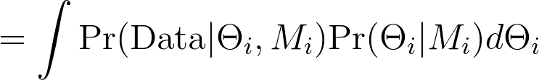
Posterior probability
For model ,
where

Slide 14
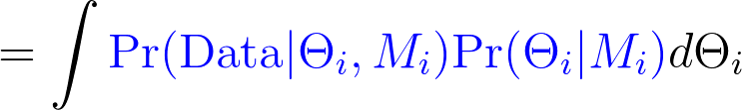
Posterior probability
For model ,
where

Slide 15
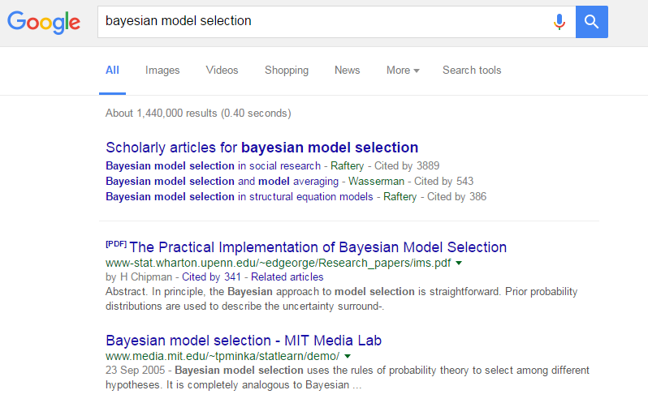
Prior for models

Slide 16
Prior for models
“In principle, the Bayesian approach to model selection is straightforward.”
“However, the practical implementation of this approach often requires carefully tailored priors and novel posterior calculation methods.”
Chipman, George and McCulloch (2001). The Practical Implementation of Bayesian Model Selection.

Slide 17
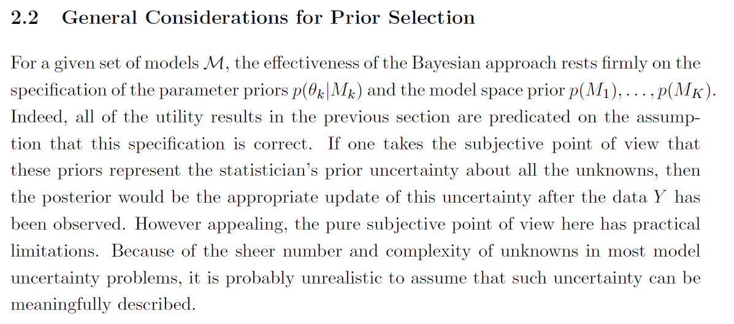
Prior for models
Chipman, George and McCulloch (2001). The Practical Implementation of Bayesian Model Selection.

Slide 18
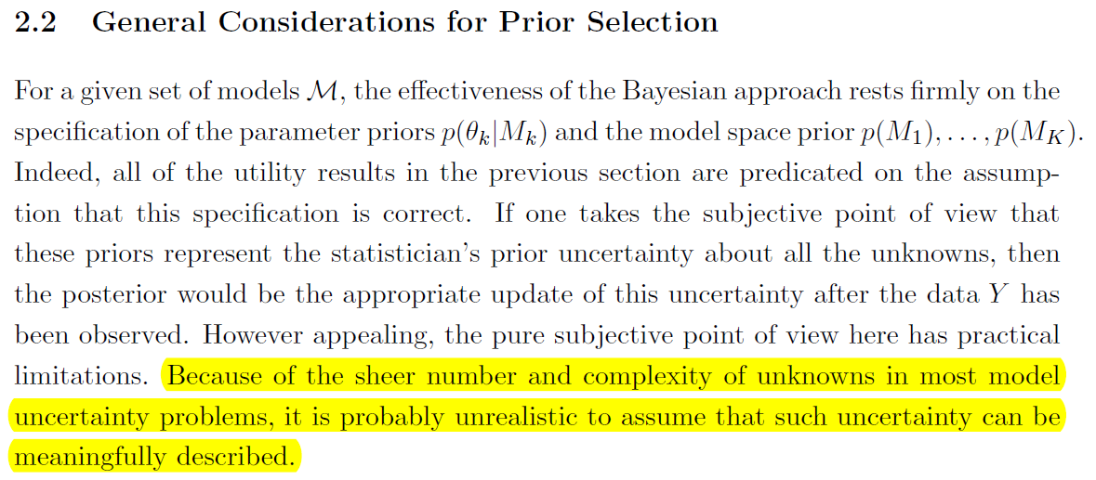
Prior for models
Chipman, George and McCulloch (2001). The Practical Implementation of Bayesian Model Selection.

Slide 19
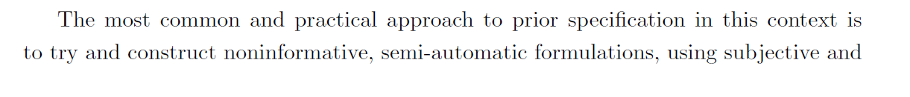
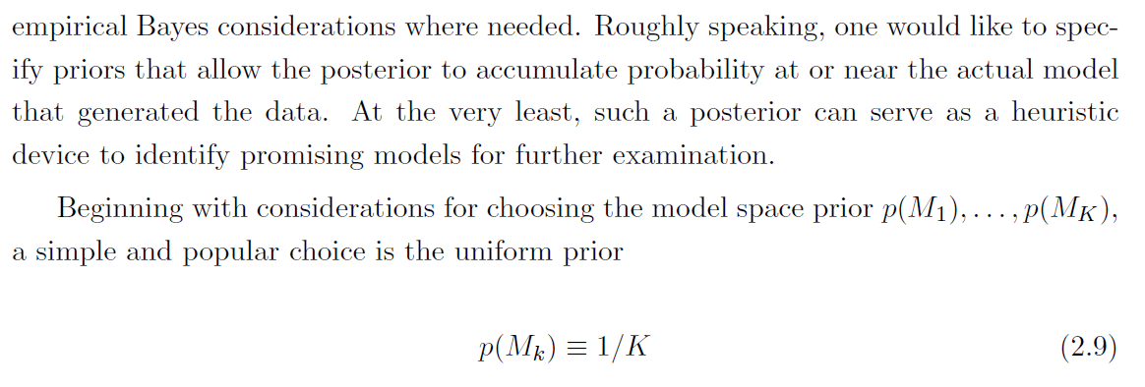
Prior for models
Chipman, George and McCulloch (2001). The Practical Implementation of Bayesian Model Selection.

Slide 20
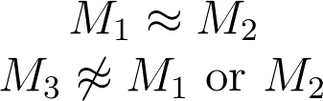
Does it matter?
Equal prior probabilities effectively lead to double weighting one model “type” relative to .
If the likelihoods are such that
then the posterior probabilities are

Slide 21
Does it matter?
Equal prior probabilities over model “types” leads to very different results.
If the likelihoods are such that
then the posterior probabilities are

Slide 22
Priors for models
Another common approach to setting prior model probabilities comes from covariate selection in regression:
where q is the total number of covariates under consideration, q_{i} is the number of covariates included in M_{i} and w is between 0 and 1.

Slide 23
Priors for models
M₁
M₂
M₃
M₄
M₅
M₆
M₇
M₈
M₉

Slide 24
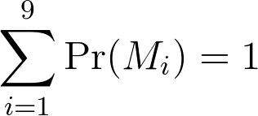
Priors for models
M₁
M₂
M₃
M₄
M₅
M₆
M₇
M₈
M₉
An idealised situation where the “true” model of reality is in our candidate set.

Slide 25
Priors for models
All other possible models M₀
M₁
M₂
M₃
M₄
M₅
M₆
M₇
M₈
M₉

Slide 26
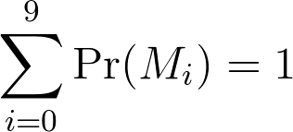

Priors for models
All other possible models M₀
M₁
M₂
M₃
M₄
M₅
M₆
M₇
M₈
M₉
BUT ????

Slide 27
Priors for models
M₁
M₂
M₃
M₄
M₅
M₆
M₇
M₈
M₉
M∞
We could try to capture the link to the real world, M∞.

Slide 28
Priors for models
M₁
M₂
M₃
M₄
M₅
M₆
M₇
M₈
M₉
M*
M∞
Reification can help the modelling/thought process.

Slide 29
Priors for models
If we are happy to operate in the idealised world:
What do we mean by model differences and similarities?
How can we be sure that we are assigning probabilities based on this assumption?

Slide 30
What makes models different?
Physics?
Algorithmic implementation?
Gap to reality?
Statistical assumptions?
Number of parameters?
Predictive capabilities?

Slide 31
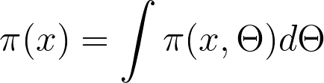
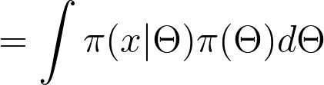

Predictive distributions
Prior-predictive or preposterior distribution:

Slide 32

Predictive distributions
Prior-predictive or preposterior distribution:
Can this tell us about model similarity?
What about the following function?

Slide 33
Example 1
Three competing models:
M₁: X ~ DU({0,1,2});
M₂: X|θ ~ Bin(2, θ), θ ~ Be(1,1);
M₃: p(X=i|φ₁,φ₂) = φ_{i} (for i = 1 or 2) = 1 - φ₁ - φ₂ (for i = 0), (φ₁,φ₂, 1 - φ₁ - φ₂)^{T} ~ Dir((1,1,1)^{T}).

Slide 34
Example 1
Three similar preposteriors:
M₁: Pr(X=i) = 1/3 (for i = 0, 1 or 2) ;
M₂: Pr(X=i) = 1/3 (for i = 0, 1 or 2) ;
M₃: Pr(X=i) = 1/3 (for i = 0, 1 or 2) .

Slide 35

Example 1
Three different .
M₁:
M₂:
M₃:

Slide 36
Example 2
Three competing models:
M₁: X ~ N(0,2);
M₂: X|θ ~ N(θ, 1), θ ~ N(0,1);
M₃: X|φ₁,φ₂ ~ N(φ₁,φ₂), φ₁,φ₂ ~ NIG(0,1,1,1);

Slide 37
Example 2
Three preposteriors:
M₁: X ~ N(0,2);
M₂: X ~ N(0,2);
M₃: X ~ t₁(0,2).

Slide 38
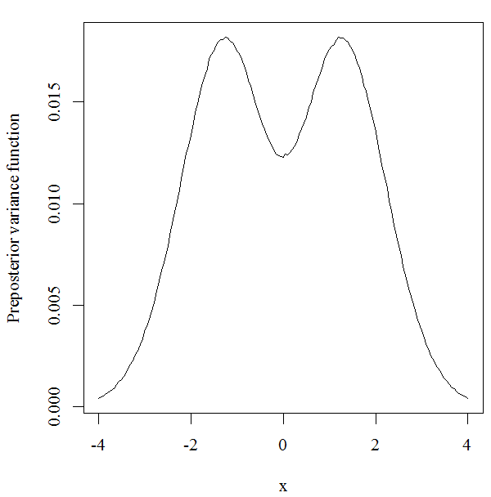
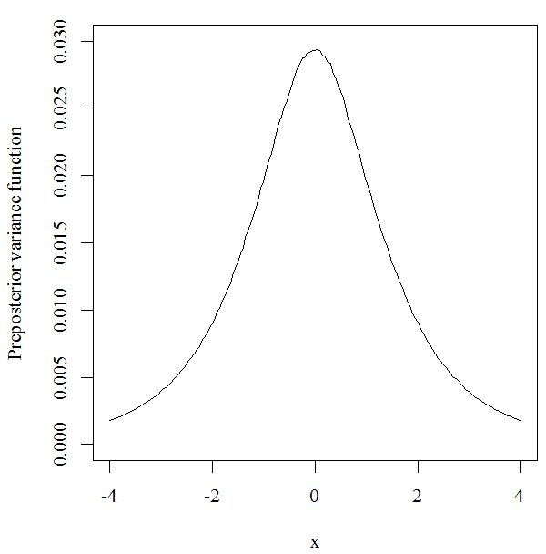
Example 2
Three different .
M₂
M₃

Slide 39
Example 2
Three different .
M₂
M₃

Slide 40
A way forward?
If predictive capabilities are the same in terms of
Expected data distribution
and
(2) Model flexibility,
are the models essentially the same?
Should we prefer more flexible models?
Do nested models give separate challenges?

Slide 41
Parameter prior
For model ,
where

Slide 42
Parameter prior
Expert knowledge elicitation

Slide 43

Parameter prior
Expert knowledge elicitation
BUT
How do we know the expert is conditioning on ?
Do common parameters cause additional problems?
What if some existing data has been used to calibrate the common parameters already?

Slide 44
Parameter prior
We should aim to understand the drivers of parameter uncertainty.
Effort could be made to model the commonality:
We should question the validity of using models that we don’t really believe.
θ₁
θ₀
θ₂
M₁
M₂

Slide 45
Coping strategies
Imagine you know nothing
Uniformity
Pretend to be a frequentist
Read up on intrinsic Bayes factors
Robustness and sensitivity analyses
Cross validation
Use performance-based measures post hoc
Proper scoring rules
Perhaps more principled model ratings
Consider proposed solutions
Specific choices for specific families of models assuming specific levels of uncertainty
Subjectivist
Seek career in philosophy
Realise modelling is challenging

Slide 46
Conclusions
Conclusions
I (probably) have got nowhere.
Actually, I have made it worse.
I am not sure there is an answer yet.
THANK YOU FOR YOUR ATTENTION.
ANY QUESTIONS?
152/152

