Slide 1
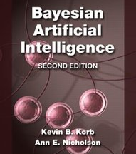
Bayesian decision networks for risk assessment and decision support or
How to combine data, evidence, opinion and guesstimates to make decisions
Information Technology
Professor Ann Nicholson
Faculty of Information Technology
Monash University
(Melbourne, Australia)
Notes:
I’ll start by explaining what “Bayesian” actually means, how we can use these methods to combine data (not necessarily big data – but any data), evidence, opinion and guesstimates to make decision, and describe some of the areas – security, medicine, environmental management, risk assessment – where we have applied them.

Slide 2
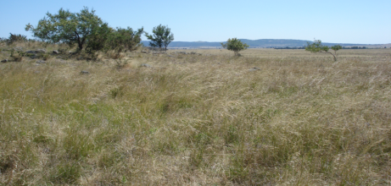
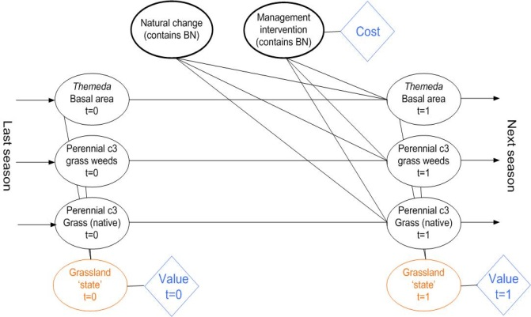
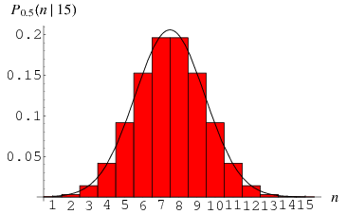
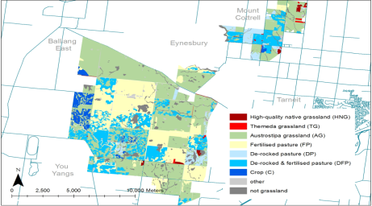
Probabilistic Graphical Models
For a
target system…
… capture the process
structure (not black box)
…and quantify
the uncertainty
Why use models?
Increases understanding
Supports decision making
Use new data and evaluation to improve over time
Notes:
Ok, so Bayesian networks are an example of a wider class of models, called probabilistic graphical models.
Models – to capture, as a useful representation or abstraction, a target system or domain
Graphical – noees and arcs – which represent the process structure (ie are not a black box method, unlike say neural networks)
And of course, the probabilistic part – they quantify the uncertainty – arising from lack of information, complexity, physical randomness.
Why use models?
Building the model increases understanding
Model supports decision making
Ongoing evaluation and refinement against observations improves model and understanding over time

Slide 3
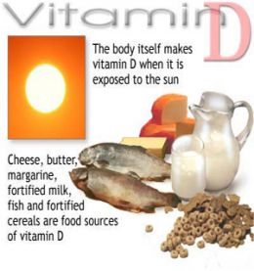
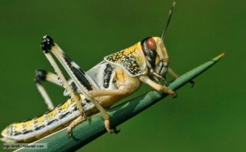
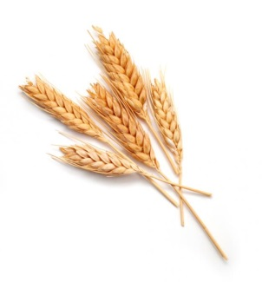

The reasoning process
1. Start with a belief in a proposition
“Beliefs”
Very unlikely
1% chance
Odds of 100 to 1
0.01 probability
From
Gut feeling
Expert opinion
Data
“The proportion of people with insufficient calorie intake is 10-20%”
“There will be a locust plague this summer”
“Wheat prices will fall next year”
“Unemployment is high”
Notes:
Let’s take a step back and think about the reasoning and decision making process that we all apply, every day.
First, we start with a belief in some proposition, whether it is true or not
A biosecurity example – is an imported mango infested with a particular pest
Medical – that a particular patient has lung cancer
Banking – that a loan applicant will pay the loan back
Retail – that the sales of a product will increase
People express these beliefs qualitatively – likely, very unlikely, or as a percentage, or with odds, or with probabilities.
And where do these starting beliefs come from – gut feeling, expert opinion, or be based on data.

Slide 4
The reasoning process
1. Start with a belief in a proposition
2. New information becomes available
“The proportion of people with vitamin deficiencies is 10-20%”
“There will be a locust plague this summer”
“Wheat prices will fall next year”
“Unemployment is high”
“Child mortality rates in region X are double region average ”
“Large egg nests observed”
“Country X is expecting record harvests”
“Food bank numbers are twice average”
But how?
3. Update your beliefs
Notes:
Next, new, relevant, information – or evidence – becomes available.
For example, that the patient is a smoker and has a cough, or that the loan applicant has previously defaulted on a loan.
The rational thing to do is to update your beliefs, in the light of the new evidence. But how should this be done?

Slide 5
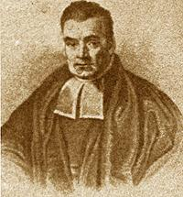
The Bayesian approach
Represent uncertainty by probabilities
Use Bayes’ theorem:
h = hypothesis
e = evidence
P(h|e) = P(e|h) × P(h)
P(e)
Starting belief=‘prior’
New belief
The Rev. Thomas Bayes
1702?-1761
Notes:
We advocate the so-called Bayesian approach.
Some of you may be familiar with so-called “Bayesian statistics”.
The term comes from the Reverend Thomas Bayes, who a couple of hundred years ago, was interested in probabilities and how to calculate them.
The Bayesian approach says that uncertainty should be represented by probabilities, which have a sound mathematical basis
Given some evidence e, how should we update our beliefs about hypothesis h?
Apologies here – a few other speakers included a graph – here is an equation!
Bayes’ theorem tells us – we start off with a belief in a hypothesis H, we get some information (e), we can compute a new conditional probability, which becomes our new belief given that evidence.

Slide 6
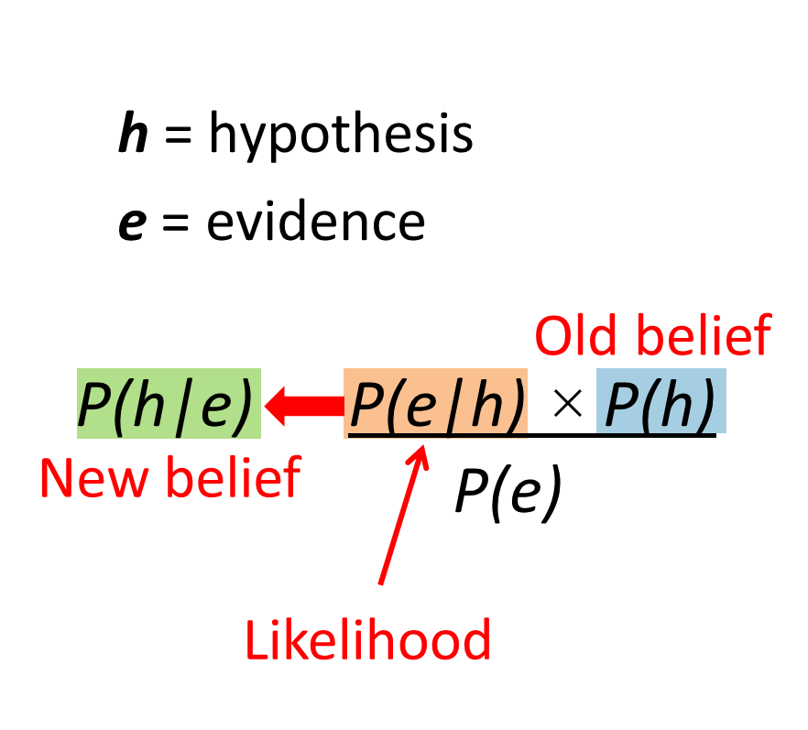
Bayes’ Theorem for Estimating Risk
Suppose:
h = “the athlete is taking steroids”
e = “test result is positive”
And:
P(h) = 0.01 (one in 100 people)
P(e|h) = 0.8 (true positive rate)
P(e|not h) = 0.1 (false positive rate)
What is P(h|e)?
≈ 0.075 (7.5%)
In general, people can’t do Bayes Theorem (well) off hand!
And how do we scale up to X₁, X₂, ….. X₁₀₀, …. X₁₀₀₀ ??
Notes:
To apply Bayes’ theorem, we have to identify the hypothesis, the evidence, know the prior and the likelihoods, then we crank the arithmetic handle and we get
So, in general, people aren’t good at doing Bayes’ theorem calculations off hand or in their head.
And this is the simplest problem of the hypothesis being a single proposition –
How do we scale up to thousands of variables and pieces of evidence??

Slide 7
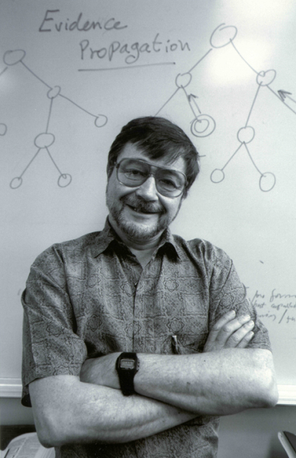
Bayesian Networks
Developed by graphical modeling & AI communities in 1980s for probabilistic reasoning under uncertainty
Many synonyms
  Bayes nets, Bayesian belief networks, directed acyclic graphs, probabilistic networks
Judea Pearl
2012 Turing Award
Notes:
One of the pioneers in Bayesian network technology was Judea Pearl whose work was recognised
In 2012 by the Turing Award, the Computer Science equivalent of a Nobel prize.
Many synonyms
Bayes nets, Bayesian belief networks, Directed acyclic graphs, etc
One of many classes of probabilistic graphical model. So, what are Bayesian networks?

Slide 8
Native Fish Example
A local river with tree-lined banks is known to contain native fish populations, which need to be conserved. Parts of the river pass through croplands, and parts are susceptible to drought conditions. Pesticides are known to be used on the crops. Rainfall helps native fish populations by maintaining water flow, which increases habitat suitability as well as connectivity between different habitat areas. However rain can also wash pesticides that are dangerous to fish from the croplands into the river. There is concern that the trees and native fish will be affected by drought conditions and crop pesticides.
See http://bayesianintelligence.com/publications/TR2010_3_NativeFish.pdf

Slide 9
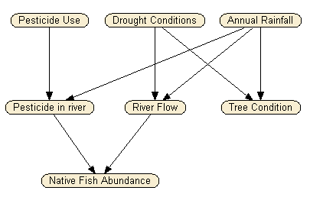
What are Bayesian networks?
A graph in which the following holds:
A set of random variables = nodes in network
A set of directed arcs connects pairs of nodes
It is a directed acyclic graph (DAG), i.e. no directed cycles
Each node has a conditional probability table or distribution (CPT or CPD) that quantifies the effects the parent nodes have on the child node
Node = variable
Arc represents dependencies
Structure represents the causal process (qualitative)
Notes:
This is a ‘toy’ example that we developed for teaching purpose. A tech report giving detailed description of several versions of the network are available at: http://bayesian-intelligence.com/publications/TR2010_3_NativeFish.pdf (with the networks at: http://bayesian-intelligence.com/publications/NativeFish_BNs.zip

Slide 10
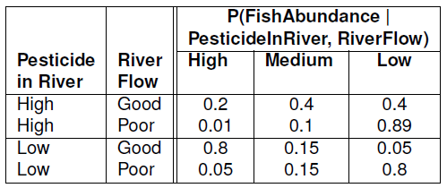
BN parameters (quantative aspect)
A graph in which the following holds:
A set of random variables = nodes in network
A set of directed arcs connects pairs of nodes
It is a directed acyclic graph (DAG), i.e. no directed cycles
Each node has a conditional probability table or distribution (CPT or CPD) that quantifies the effects the parent nodes have on the child node
3 states
CPT
2 states
Each row sums to 1
Notes:
CPTS are the “parameters” of the model

Slide 11
What next?
We now have a model!
Q. How do we use the model to compute new probabilities?
A. we have clever efficient algorithms that do lots of applications of Bayes’ theorem

Slide 12
Reasoning with Bayesian networks
Evidence: observation of specific state
Task: given some evidence, what are the new posterior probabilities for query node(s) ?
Flu
Cause
Cause
Intercausal
reasoning
Effect
Effect
Diagnosis
Prediction
Mixed reasoning

Slide 13
Demo – Native Fish

Slide 14
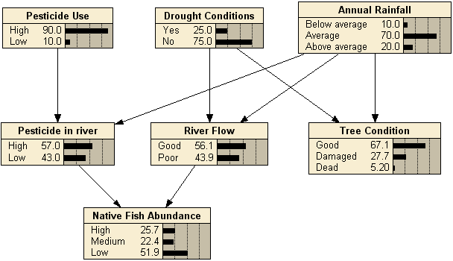
Before you know anything (no evidence)
Notes:
Example screens from Netica demo

Slide 15
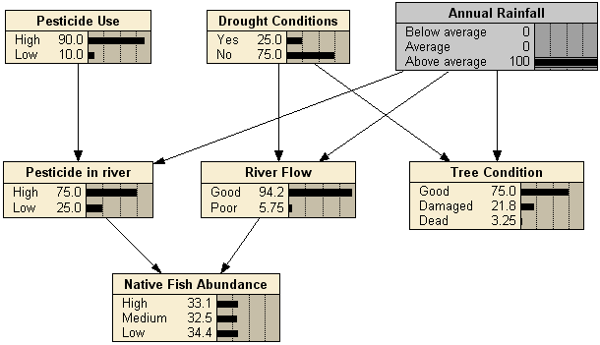
Predictive reasoning (cause to effect): Case 1
“What if?”
Causes
Effects

Slide 16
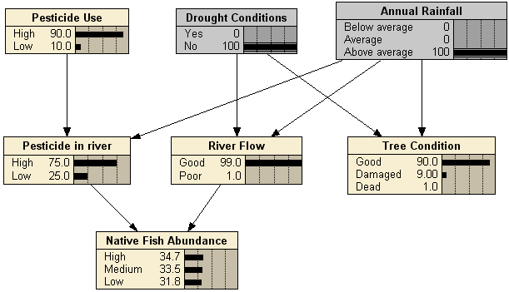
Predictive reasoning (cause to effect): Case 2
Causes
Effects

Slide 17
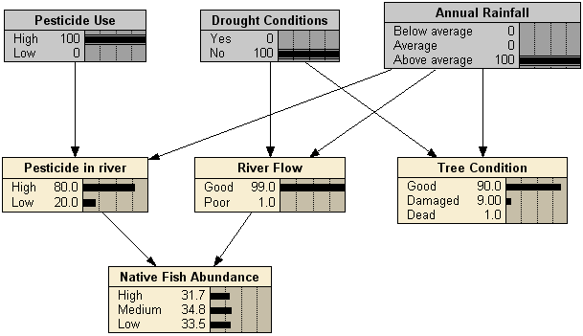
Predictive reasoning (cause to effect): Case 3
Causes
Effects

Slide 18
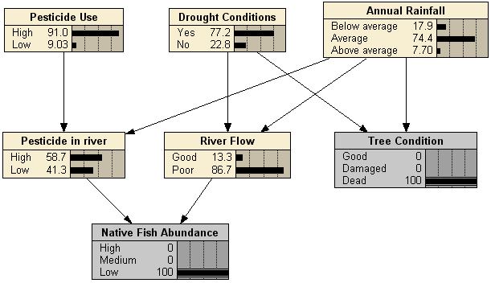
Diagnosis (effect to cause)
Causes
Effects

Slide 19
Prediction – “what if”
Causes
Effects

Slide 20
What next?
Have model
Have estimates of posterior probabilities
Q. How do we use these probabilities to inform decisions (about action or interventions)?

Slide 21
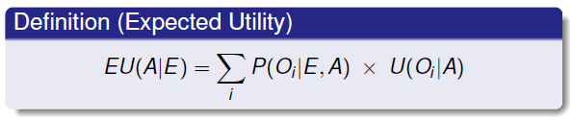
Risk Assessment – the decision-theoretic view
Risk = Likelihood x Consequence
P(Outcome|Action,Evidence)
Utility(Outcome|Action)
Decision making is about reducing risk
or “maximising expected utility”

Slide 22
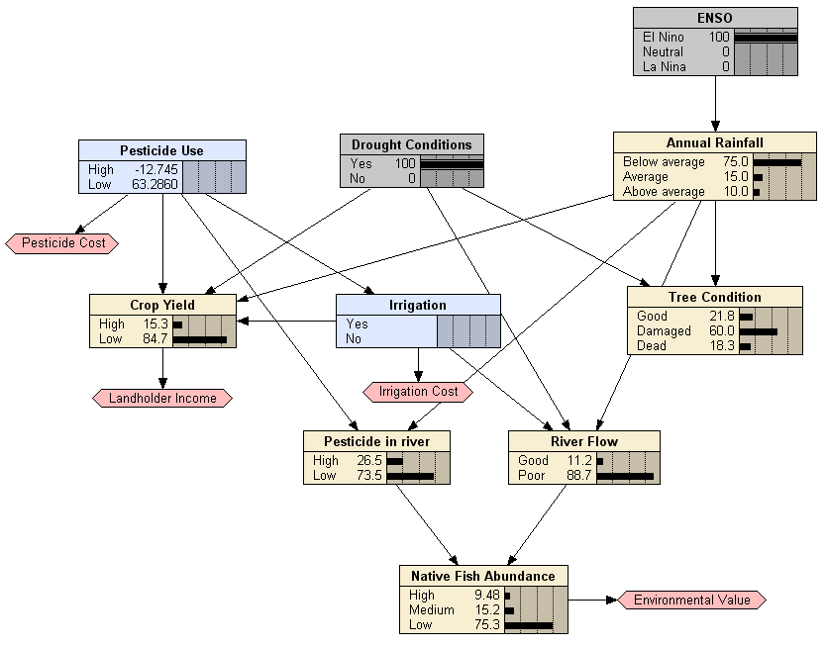
Decision network = BN + decisions + utilities
Decision nodes
Utility nodes
(cost/benefits)

Slide 23
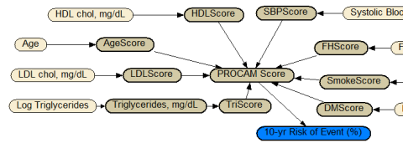

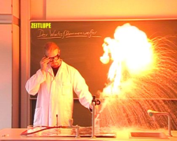
Our methodology
1: Build a model
E.g. Variables: patient’s details, diseases, symptoms, interventions
Costs/benefits: eg. $, QALY
2: Embed model in decision support tool
Diagnosis
Prognosis
Treatment
Risk assessment
Prevention
Design
Structure
Review
Experts
Test
Revise
Build
Literature
Parameters
Review
Data

Slide 24
Advantage of BNs?
Explicit & sound representation of uncertainty
Visualisation of causal process
  not a “black box”
Powerful reasoning engine
Can be built from a combination of:
  Data (observational or simulated)
  Expert opinion
  Equations from the literature
Can be extended with decision and utility nodes (“Bayesian decision networks”)
Many ecological and environmental applications (risk assessment, management, monitoring)

Slide 25
Challenges for BNs?
Some BN software handle only discrete variables
Complex BNs are not easy to build, validate or understand
BNs don’t allow cycles, so can’t model feedback loops?
Winbugs (handles cts variables) or AgenaRisk (dynamic discretization)
“Divide-and-conquer”
  Use sub-networks (GeNIe) or object-oriented BNs (Hugin, AgenaRisk)
Model with dynamic Bayesian networks (DBNs) (Netica, GeNIE, Hugin, etc)

Slide 26
Real-world applications of BN technology
Biosecurity
Ecological and Environmental Management
Bushfire management
Health
Weather
Asset management
[and lots more]
(If any particular application matches your area of interest, come and talk to me!”

Slide 27
Example: Biosecurity Risk Assessment

Slide 28
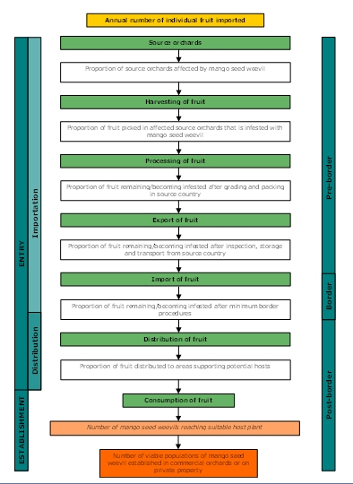
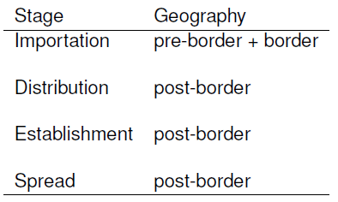
Biosecurity
(Import Risk Assessment)
Exposure pathways based on WTO framework
Each pathway for each pest for each product-source pair assessed separately.
Obvious similarities to food security pathways

Slide 29
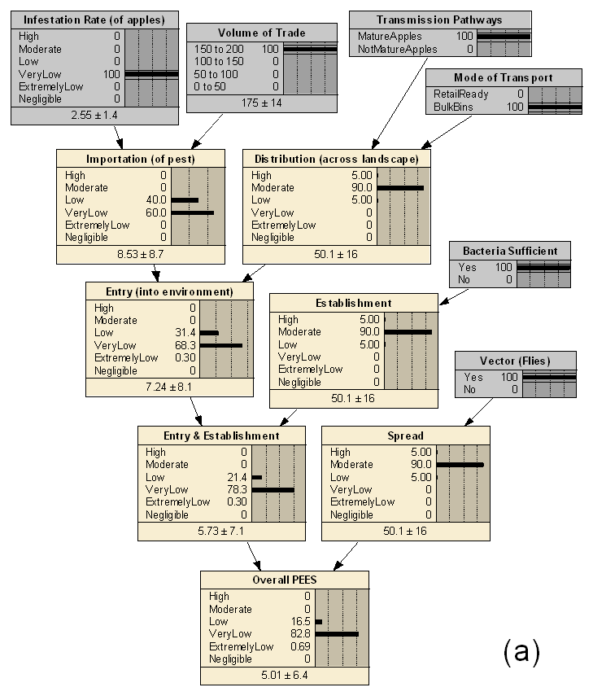
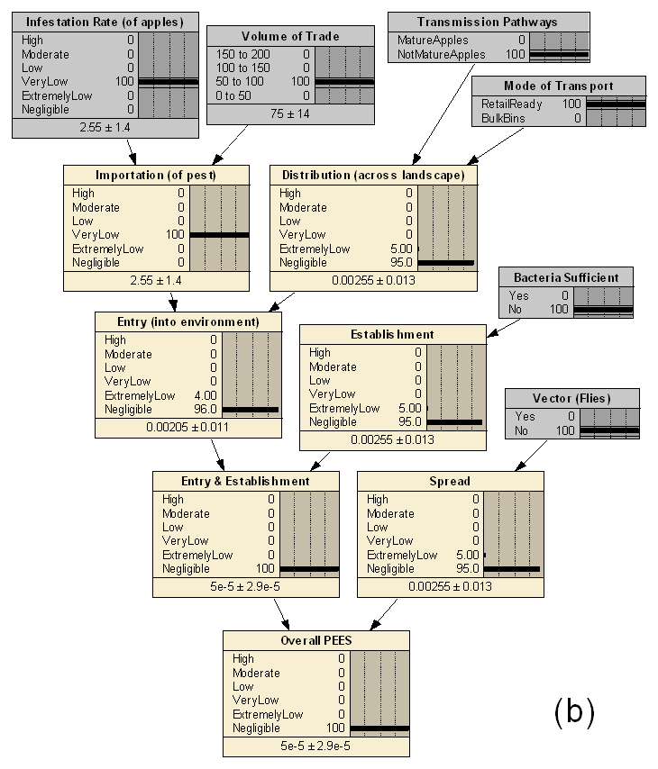
Simple BN model of NZ apples Import Risk Assessment (IRA):
Example of ‘what-if’ reasoning
Australia’s assumptions
NZ assumptions

Slide 30
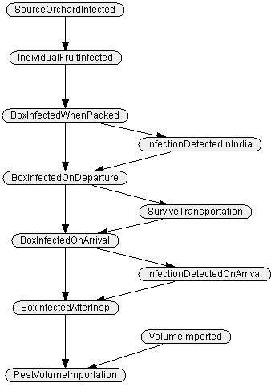
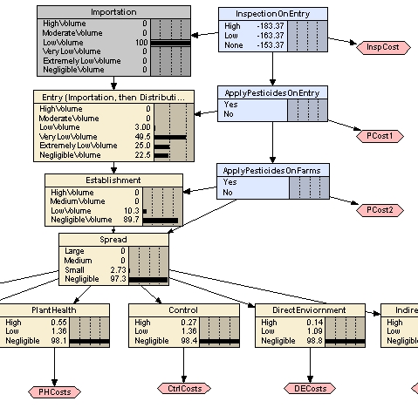
Model of causal process
Model of mitigation actions
More or less complex models for each stage in pathway

Slide 31
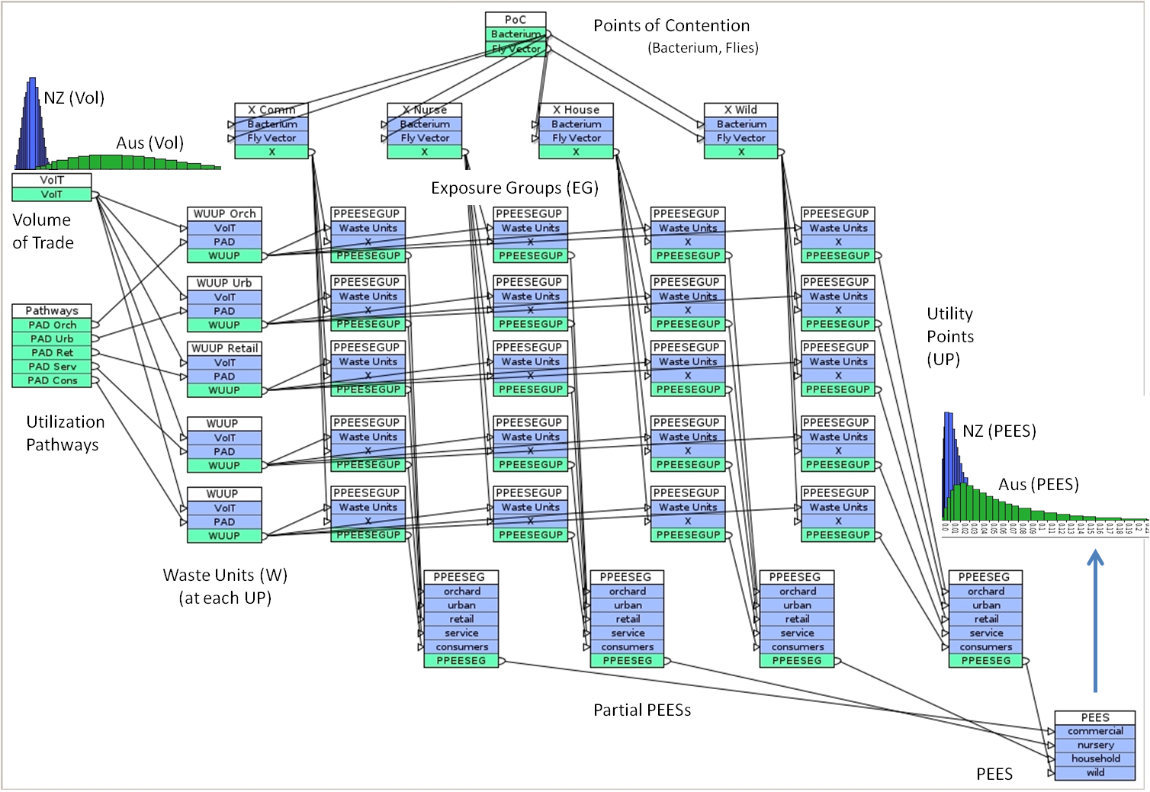
NZ Apples BN (AgenaRisk version)
Explicit handling of quantities (of product)

Slide 32
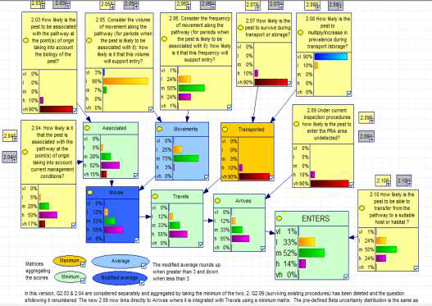
CARPA: example BN (Drosophila suzukii, EPPO 2010)

Slide 33
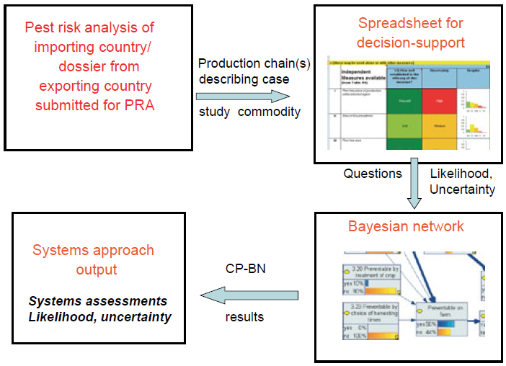
Control Point BNs (CP-BNs)
(Mengersen et al, 2012)
For export pathways, structured, rather than ad hoc use of BNs
Notes:
BNs are generated in a standard template from a spreadsheet of questions and experts’ assessment of uncertainty

Slide 34
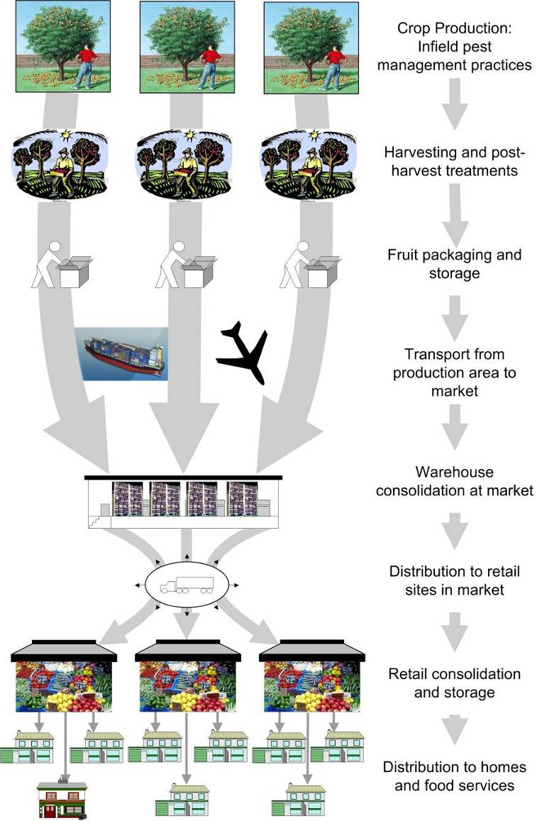
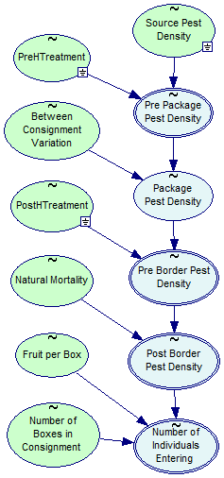
NZ “B3: Better Border Biosecurity
(NZ Inst. for Plant & Food research)
Single pest – multiple pathways
Notes:
PFAs can also be carried out on a single pest that is a hazard on many pathways that can come together at an infection point e.g. Queensland fruit fly on tomatoes, capsicums, zucchini etc.. from Australia to NZ
What about multiple pests and multiple pathways? Complex!

Slide 35
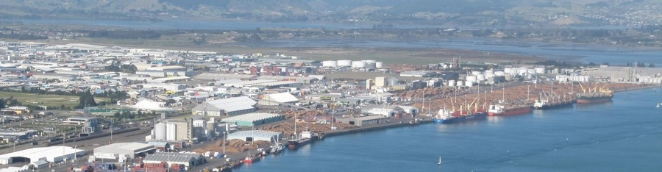
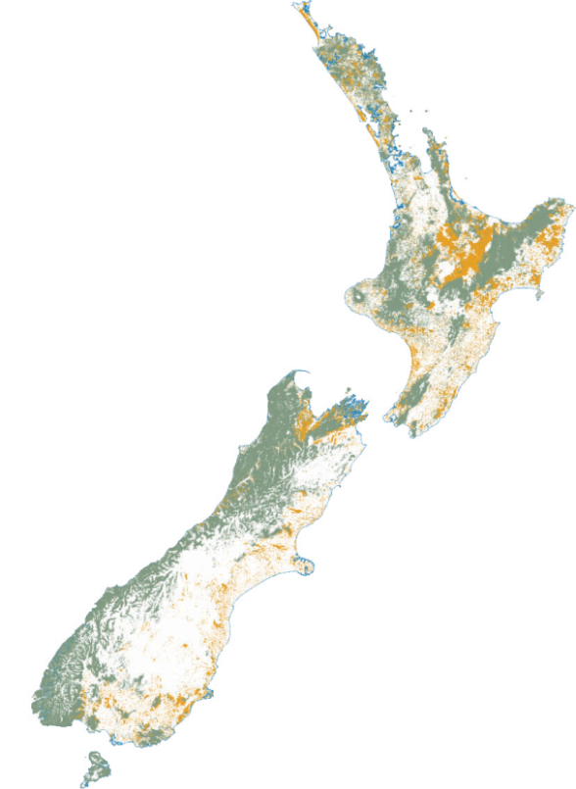
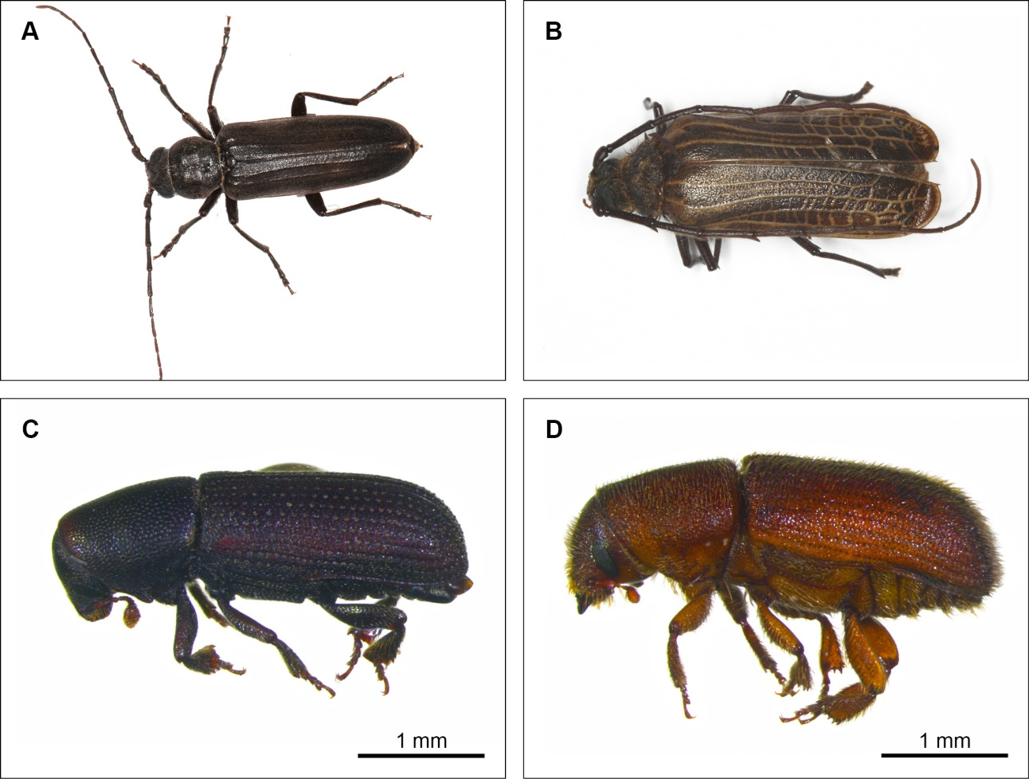
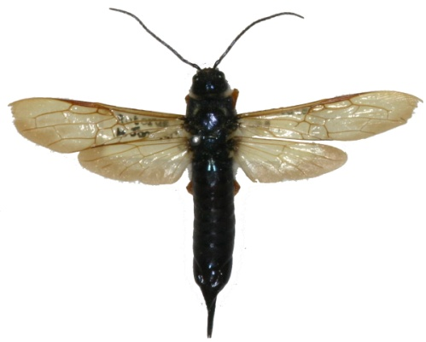
BNs for Risk assessment for Log Exports in NZ
Collaboration with SCION (NZ timber research)
Notes:
And we are using BNs to model the risk from pests in timber exports – to show importing countries that they are not a biosecurity risk – without expensive and environmentally damaging photosanitory treatment – ie lots of nasty chemicals.

Slide 36
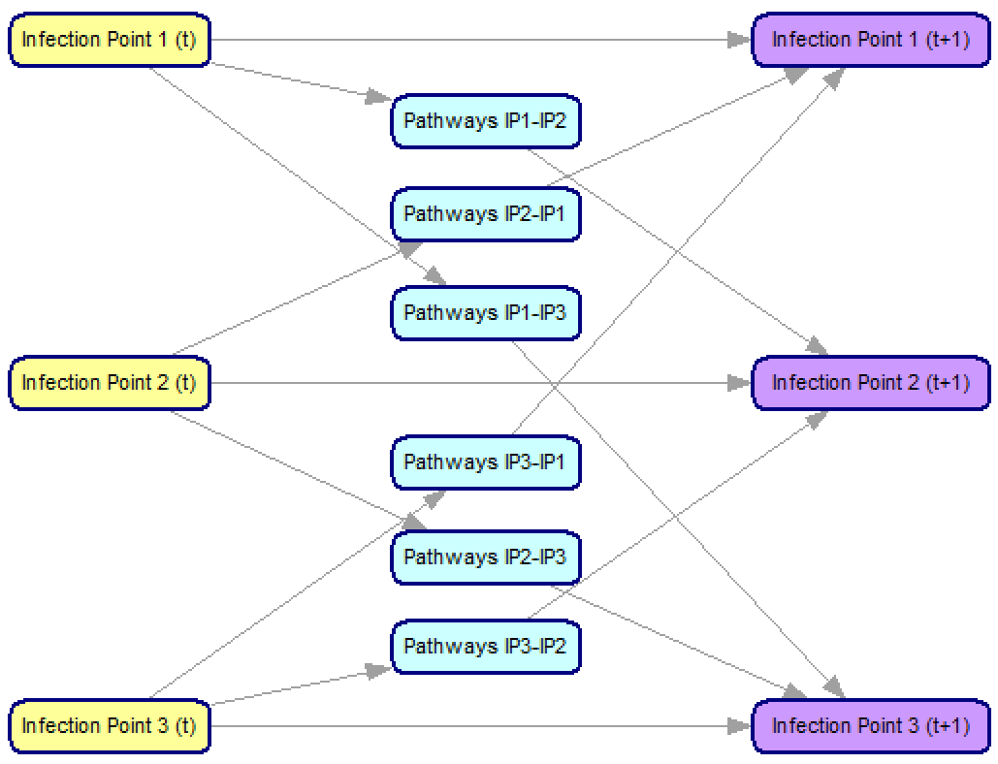
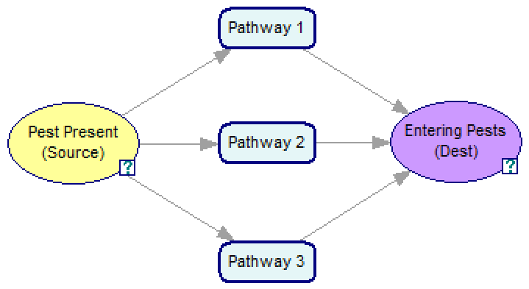
North Australia Biosecurity (NAB)
BN and Support Tool

Slide 37
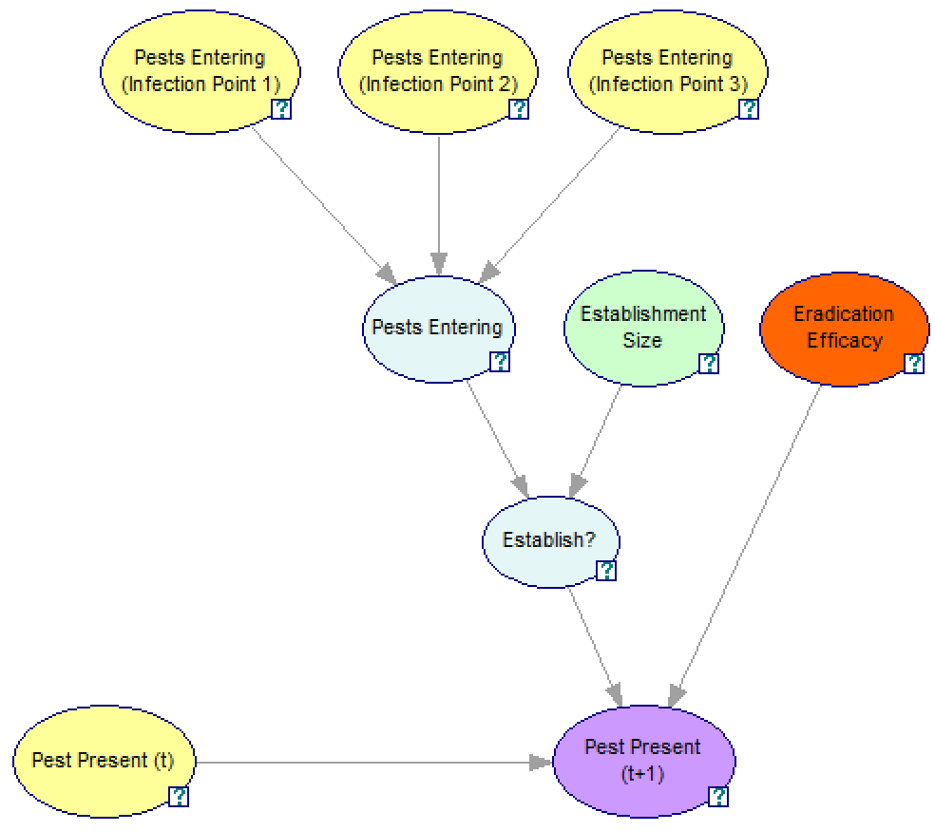
NAB: Infection Point
Outputs from pathways sub-models
How much is enough to establish?
How effective are measures taken to eradicate established population?
Amalgamate all pests entering destination
Is it enough pests to trigger an establishment?
Pest Present (t+1) = (Pest Present (t) or Establish?) and not Bernoulli(Eradication Efficacy)

Slide 38
Examples: Environmental Management

Slide 39
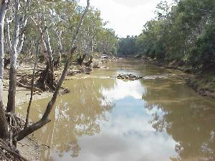
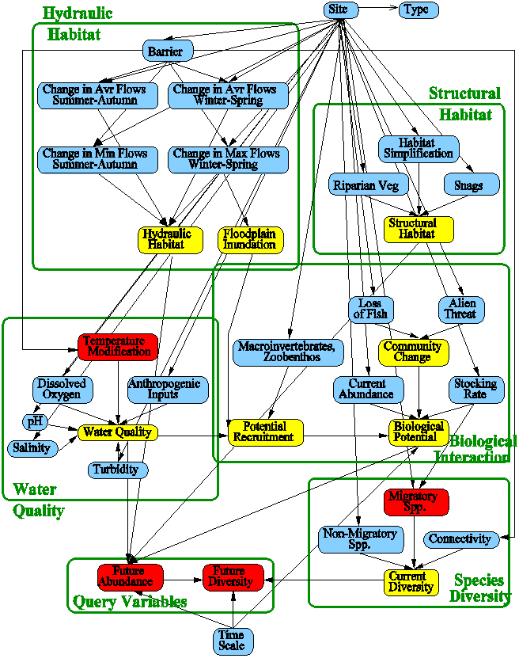
Goulburn catchment native fish model (2004)
5 sub-networks
Water Quality
Flow
        Structural Habitat
        Biological Interactions
2 query nodes
Fish Abundance
Fish Diversity
23 sites 6 reaches
2 temporal scales
1 and 5 year changes
Notes:
So – we’ve modelled impact of water management activities on native fish

Slide 40
Object-oriented BNs
An extension to basic BNs that allow
HieracFor hierarchical decomposition
Single site model
Hydraulic Habitat
Structural
Habitat
Water Quality
Biological
Interactions
Species Diversity
Outcomes

Slide 41
Object-oriented BNs
For spatial modeling (linked to GIS)
Site 1
Site 2
Site 3
Site 4
Site 6
Site 6
Site 7
Site 8
Site 9

Slide 42
Dynamic Bayesian networks (DBN)
For explicitly modeling changes over time (including feedback loops)
T1
T2
T3

Slide 43
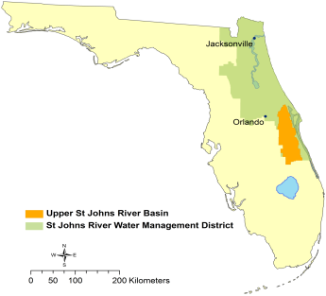
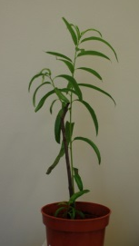
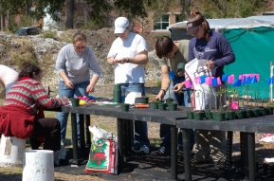
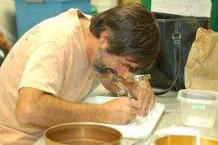
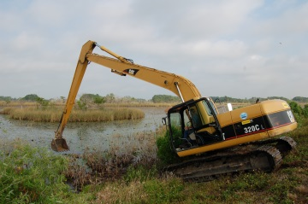
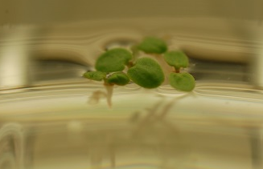
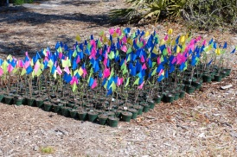
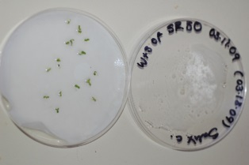















Case Study: Modelling Willows
(in St. John’s River Basin, Florida)
Experimental research program 2009-2011
Plant and seed collection
Evaluating germination
Artificial Islands
Transplanting
Changes in water depth
May 2010
Artificial Ponds
March 2011
Grazing
Greenhouse expts
June 2010
August 2010

Slide 44

DBN Example: Modelling Willows
(in St. John’s River Basin, Florida)
Empty
Yearling
Sapling
Adult
Scenarios
State transitions
Current state
Next state

Slide 45

Architecture of the Integrated Management Tool
cell size = 100m x 100m (1ha)
GIS data
Canals
Cattail
GrassSedgeMarsh
Sawgrass
ST-DBN:
State-Transition
Dynamic Bayesian Network
HerbaceousMarsh
WillowSwamp
MixedShrub
TreeIsland
HardwoodSwamp
OpenWater
Levees
Seed Production & Dispersal Spatial Bayesian Network
Notes:
Our big picture plan, is an integrated management tool that
uses available environmental spatial data from GIS
State-Transition Dynamic Bayesian Networks for modelling the influence of environmental and management actions on the key life stages of willows and
spatial Bayesian Networks for modeling seed production and dispersal dynamics
For each cell, the GIS supplies data on attributes such as soil and vegetation type, current willow cover and landscape position and context.
This data provides inputs to our State-Transition Dynamic Bayesian Network, which models our understanding of how environmental conditions and management actions, interact to influence transitions between willow life stages.
We also have a Spatial Bayesian Network that we use to model seed production and dispersal from neighbouring cells to a target cell.
For each cell, the ST-DBN takes input from the GIS, the spatial seed production and dispersal model and management actions and predicts willow response at future time steps.
Predictions at different time-slices can be mapped for visualisation and also analysed across the study area to produce evaluation metrics for managers. (For instance, to indicate what proportion of the total study area is occupied by willows after 10 years of pursuing a mechanical clearing strategy)
In this way, managers can “test”, visually compare and quantitatively evaluate different candidate management strategies.
In the rest of this talk, we explain how we constructed the ST-DBN and the SBN and how they work.

Slide 46

Managing Complexity: Object-oriented Modeling
Notes:
With 34 nodes and 63 arcs, the graphical model is looking quite complex and a little cluttered.
We used ideas from object-oriented modeling to help manage this complexity by abstracting this model and encapsulating or hiding some of the detail.
And this is what it looks like [click].
Essentially, we converted the regular ST-DBN into an ST-OODBN by using five conceptual categories of nodes from the original network as a guide.
These 5 categories were:
Aspects of willow Stage (in yellow)
Seed germination & survival Process factors (in orange)
Environmental factors (in green)
Management actions (in red) and
Willow StateTransitions (in blue)

Slide 47

Modelling Seed Production
SeedsPerStem = I * F * S
where
I is number of inflorescences
F is the number fruits per inflorescence
S is number of seeds per fruit
SeedsPerHA = SeedsPerStem * NumberOfStemsPerHA
Notes:
[click] The total number of seeds produced per hectare is a product of the number of seeds produced per reproductive stem and the total number of reproductive stems per hectare.
And [click] the number of seeds per stem is the product of
- the number of inflorescences per stem
the number of fruits per inflorescence and
the number of seeds per fruit
We represent this in a subnetwork like this [click]
Cover is the percentage of a 1 ha cell that is occupied by adult willows and
Average Canopy Area is a function of Rooted Basal Stem Diameter.
Together these variables provide an estimate of the number of reproductive stems in a cell.

Slide 48


Application of BNs for complex environmental management: Western Grasslands Reserves
(DSE Project 2012-2013)
10,000 ha to be restored to native grasslands over 10-20 years
Task: build a dynamic Object-Oriented BN to evaluate “what-if” scenarios over 20 years
  a range of management strategies
  for a variety of land types
  explicitly representing costs and environmental values
Notes:
Now I’m going to skim through some applications to give you an idea of the potential for Bayesian modelling methods.
First - environmental management. One common feature – while they have at least some data on different species - abundance and location – from the past, there is pretty much *no data* we can learn from on what would happen under various human intervention scenarios – we haven’t damed the Franklin 1000s of times and collected data each time on how that impacts on different parts of the eco system.

Slide 49






NERP Tropical Ecosystems project 9.4:
Conservation Planning for a Changing Coastal Zone
GIS-BN Tool
Land Use
Scenario (GIS)
Input Layers
(GIS)
Cumulative Impact Model (BN)
Output
(GIS)

Slide 50
Example: Bushfire management

Slide 51




Modelling bushfire prevention & suppression: Dynamic BN
Notes:
And we’ve applied dynamic BN models to bushfire prevention and suppression….

Slide 52

House Risk Assessment Tool which uses a back-end BN reasoning engine:
Importance of the interface
Notes:
We have built an online tool for NSW rural fire service (like the Vic CFA) for household and personal risk assessment – answer questions and show recommendations for the stay and defend, or go.. – hasn’t gone live yet!

Slide 53


BNs for modelling $ consequences of bushfires and costs of fire management treatments: focus on economic aspects (not environmental)
Template
Submodels
(e.g. fire vulnerability)

Slide 54


Medical Risk Assessment: Coronary Heart Disease
Clinical decision support tool showing impact of behaviour modification
Model built from data and based on existing epidemilogical models
Basic interface (research prototype),
never deployed
Notes:
And looked at using epidemiological data to do 10 year risk assessment for heart disease, embedding in a tool for clinical decision support

Slide 55

Power industry asset risk management (Western Power 2012-2013)
“How to build 24 Bayesian models in 9 months” (ABNMS-13)
A BN model for each kind of asset (e.g. ‘poles’)

Slide 56


Bayesian networks for fog forecasting
(Collaboration with Aus. Bur. of Meteorology)
Incremental development, build relationship over 10 years
Example of rare event prediction, used to generate fog alerts
Stage 1: 2005-09
Static model (no explicit time)
In use by weather forecasters in Melbourne and Perth
Stage 2: 2013-15
Explicitly temporal modelling
Predicting time of onset and clearance
Notes:
We’ve worked with the Bur of Met for the past 10 years to build decision support tools for forecasting fog at airports – important for the aviation industry – a fog prediction requires them to carry extra fuel, which is a cost. While a missed fog in the worst case could result in a plane having to divert or land in fog.
In the first stage, an ARC linkage, we kept the model simple – but it added value and has been used for 8 years now in Melbourne.
Stage 2, is to extend the system to incorporate explicit time representaiton and predict a time of onset and clearance

Slide 57
Connections to food security?
BNs are a great modelling tool for any individual component of Food Security (Michael’s Micro Analysis)
BNs allow re-use of model components, tailoring to different regions, populations, food types, etc
Current Research Aim: Scaling up the technical infrastructure to model full(?) system, with multiple interacting components (Michael’s Macro Analysis)
Additional challenge for Food Security:
  Integrating the Social, Physical & Biological Science

Slide 58
Bayesian techniques at Monash
Data Mining
(CaMML,
Chordalysis,
Snob)
Current research
Scaling up to 1000s of variables
Learning models with unobserved variables
Combining data + expert knowledge
Visualisation of probabilistic outputs
Expert Elicitation
Evaluation
BN Models
Existing models
Decision support tools
Advanced modelling
(dynamic/time series, object oriented)
Notes:
My colleagues and I at Monash do research on various aspects of Bayesian networks – data mining (using tools based on our ML methocs), incorporating expert knowledge, etc, and also how to evaluate the models and embed them in decision support tools.
We have an active research program looking at issues including scaling up, learning when important causal variables aren’t observed, combining data with expert knowledge, and better ways to visualise the outputs of our models.
Thank you.

